Slide 1
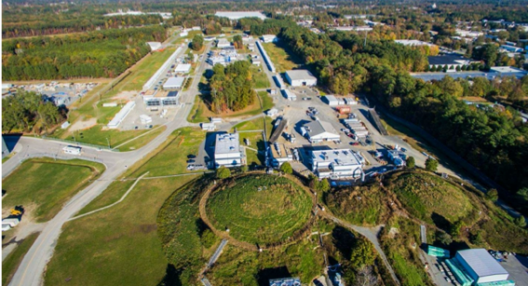
JLAB 20+ Upgrade: Main Goals
Patrizia Rossi
Opportunities with Jlab Energy and Luminosity Upgrade
ECT*- September 26-30, 2022

Slide 2
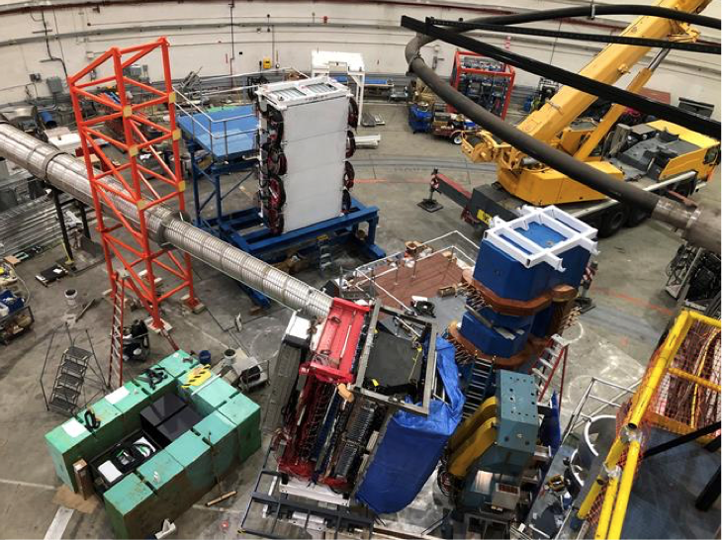
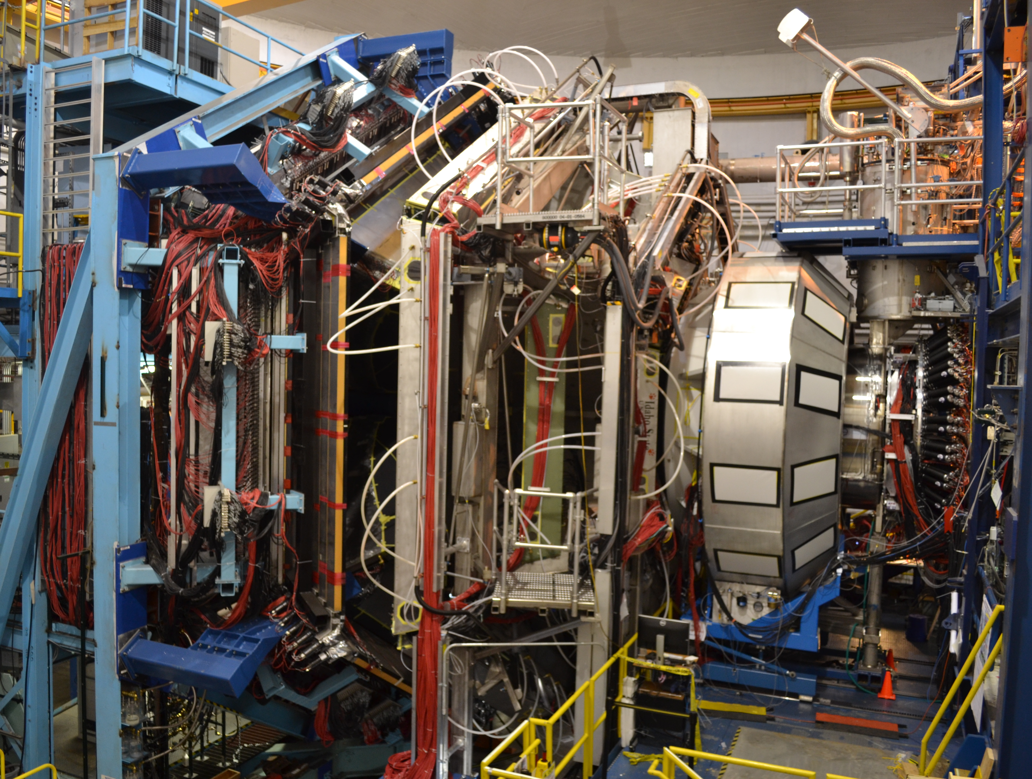
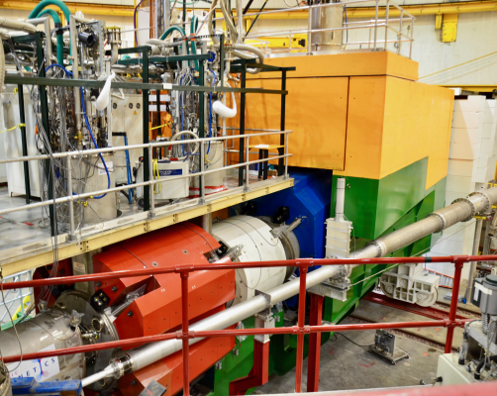
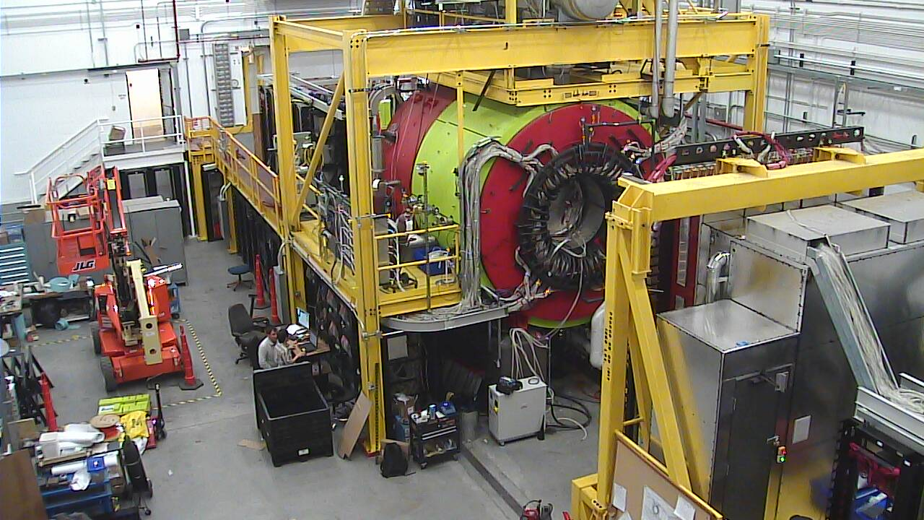
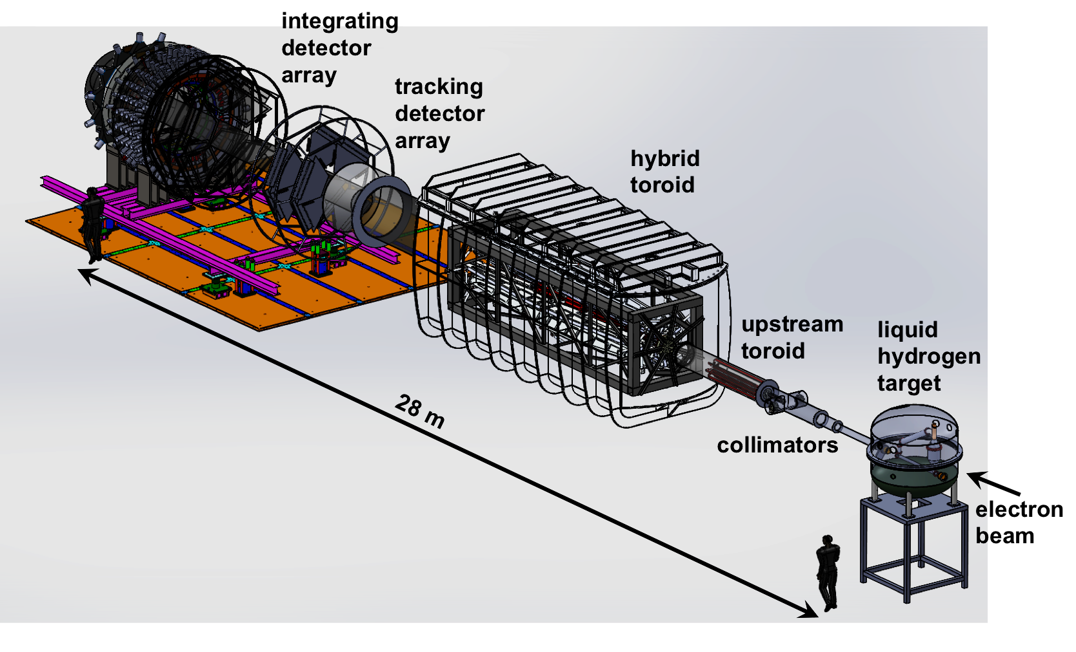
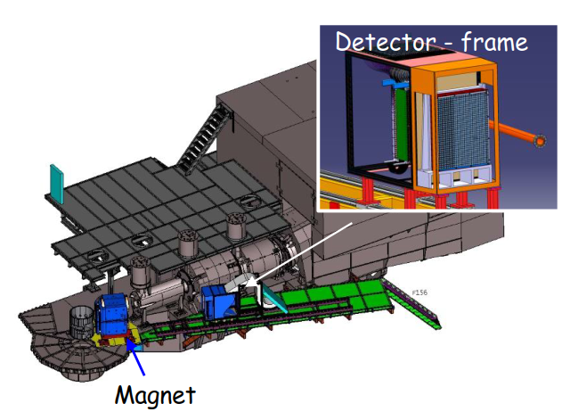
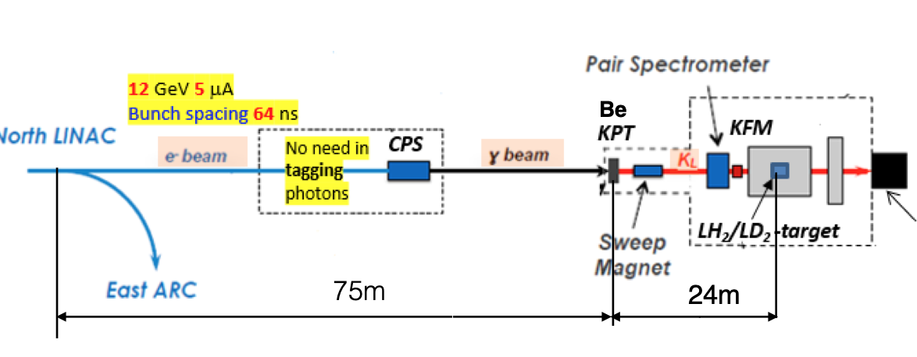
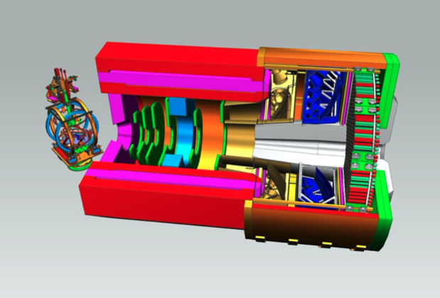
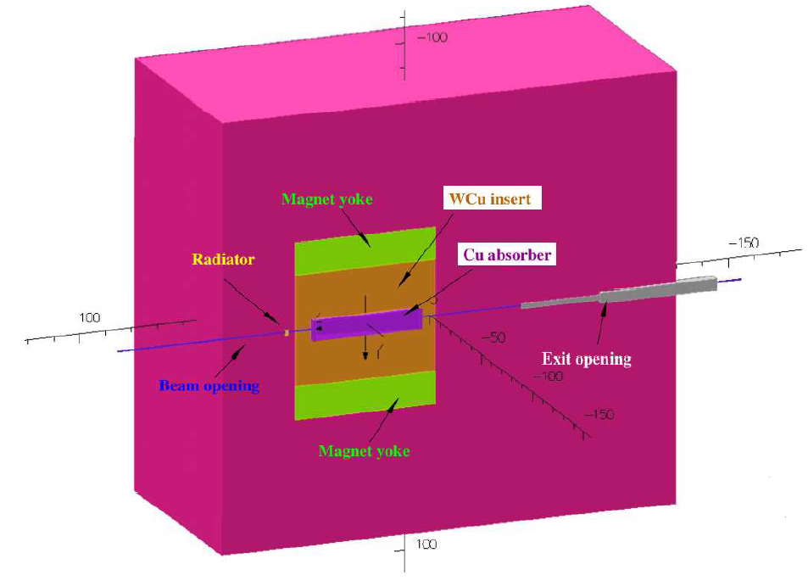
JLab Today and Tomorrow
Hall A: HRSs
Hall A: SBS & BB
Hall B: CLAS12
Hall C: HMS-SHMS
Hall D: GlueX
The 12 GeV Experimental Program is in full swing
33 Experiments completed out of 91 approved
Luminosity Upgrade
KLF
Stage -1: 2x10³⁵cm⁻² s⁻¹
3 years
Stage -2: > 10³⁷cm⁻² s-¹
7-10 years
NPS
MOLLER
CPS
γ
e⁻
SoLID
~8 years at ~30 weeks/year
2
2

Slide 3
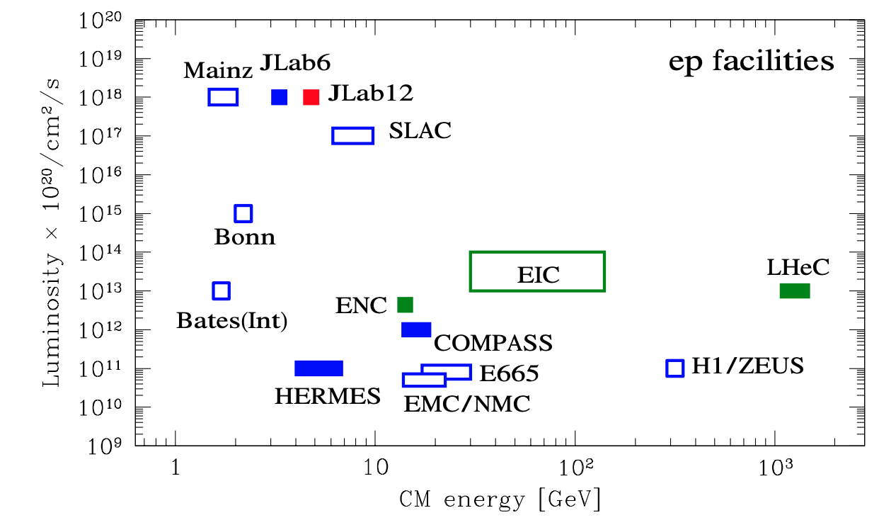
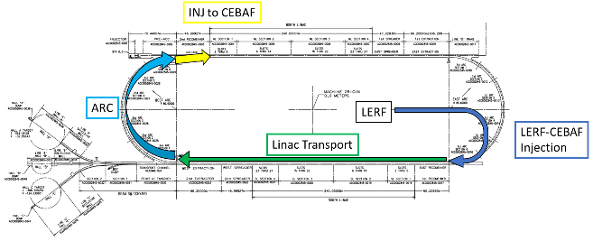
JLab Accelerator Upgrades, the ‘Big Picture’
CEBAF has a unique program with fixed targets at the luminosity frontier
Precision measurements in the valence quark regime requiring high luminosity are the purview of JLab
Developing a Staged Program to take Advantage of Recent Advances in Accelerator Science and Technology
  Positrons (e+) in the LERF (former FEL) with transport to CEBAF
  Energy Upgrade for 650 MeV Electron (e-) Injection in the LERF
3

Slide 4
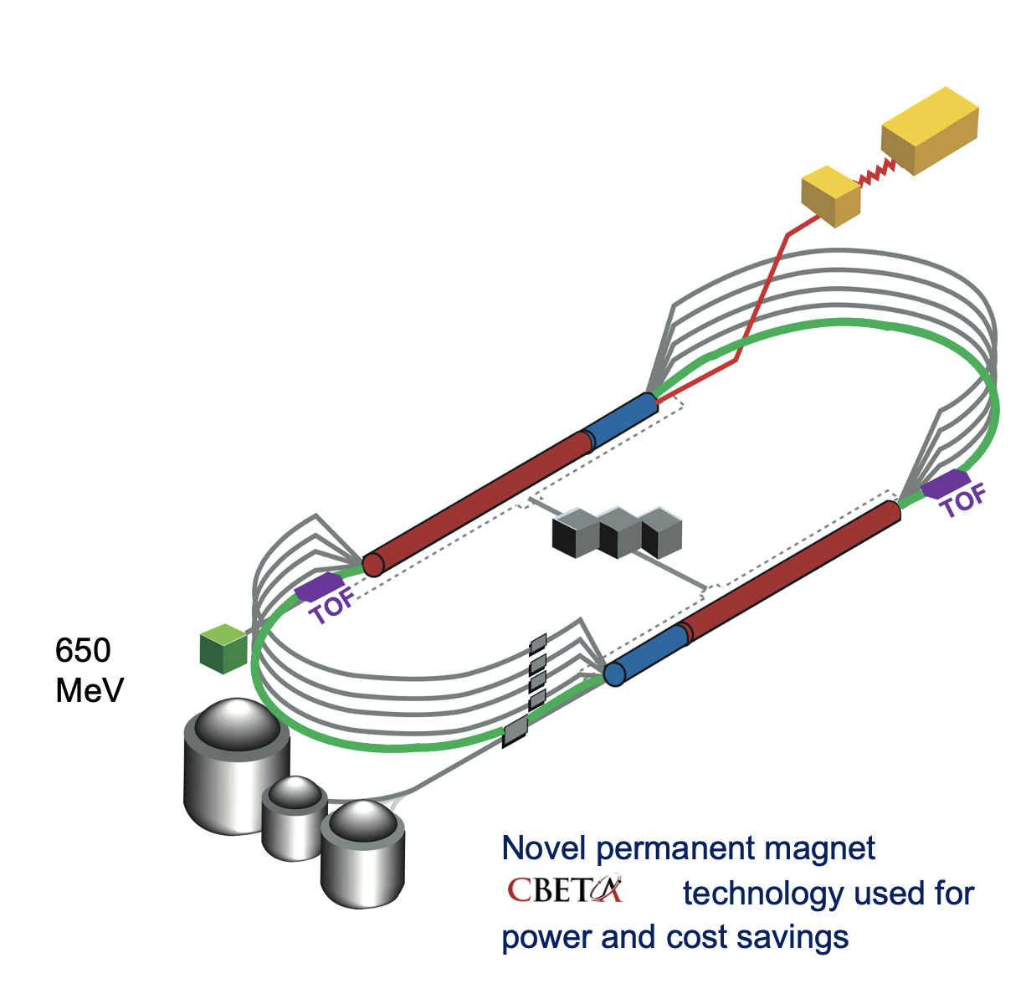
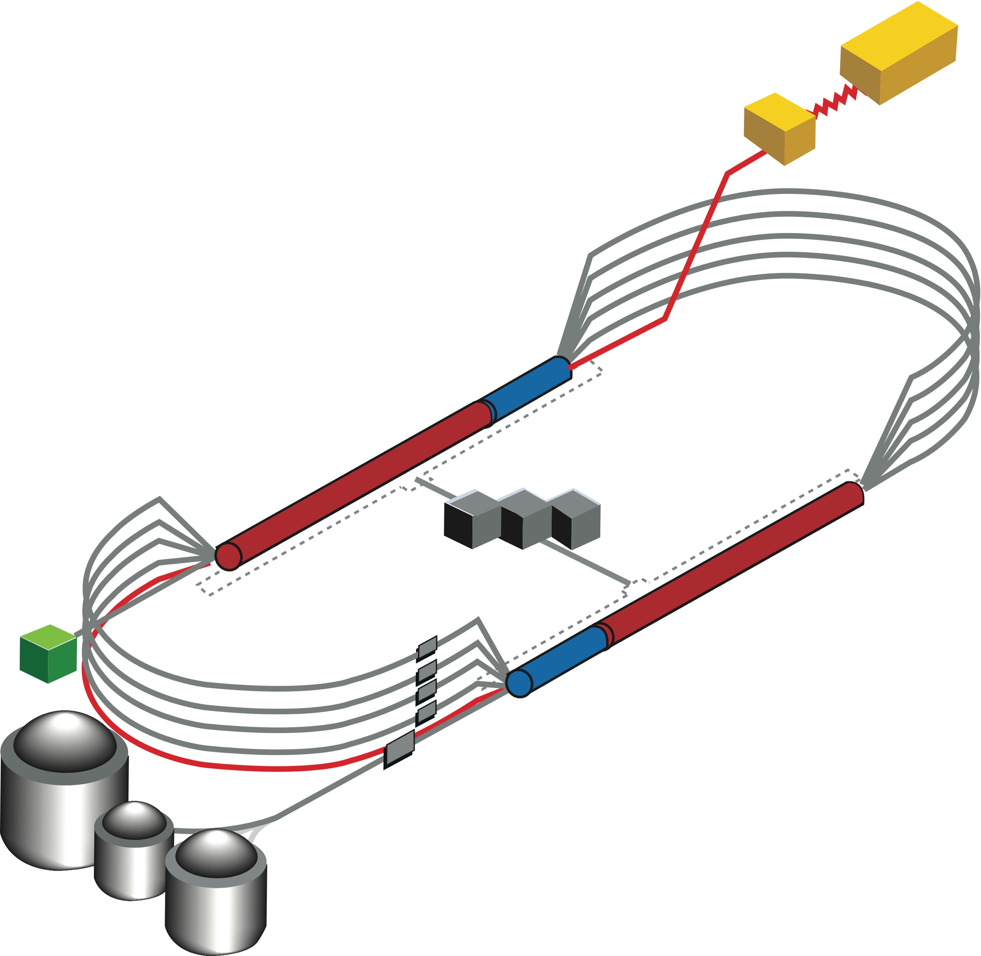

CEBAF FFA Upgrade – ‘Currently under Study’
  Starting with 12 GeV CEBAF as a baseline
  NO new SRF (1.1 GeV per linac)
  New 650 MeV recirculating injector
  Remove the highest recirculation pass (Arc 9 & A) and replace them with two FFA arcs including time-of-flight chicanes
  Recirculate 4+4 times to get to about 18 GeV
TOF
TOF
  Install a secondo pair of FFA arcs ‘on the floor below Arc 9&A
  Recirculate 3 times to get about 24 GeV
TOF
650 MeV
TOF
Pass Arithmetic: 5 -1 + 4 + 3 = 11
Novel permanent magnet technology used for power and cost savings
  Recirculate 4 + 6 times to get to about 22 GeV
Pass Arithmetic: 5 -1 + 6 = 10
Courtesy Alex Bogacz

Slide 5
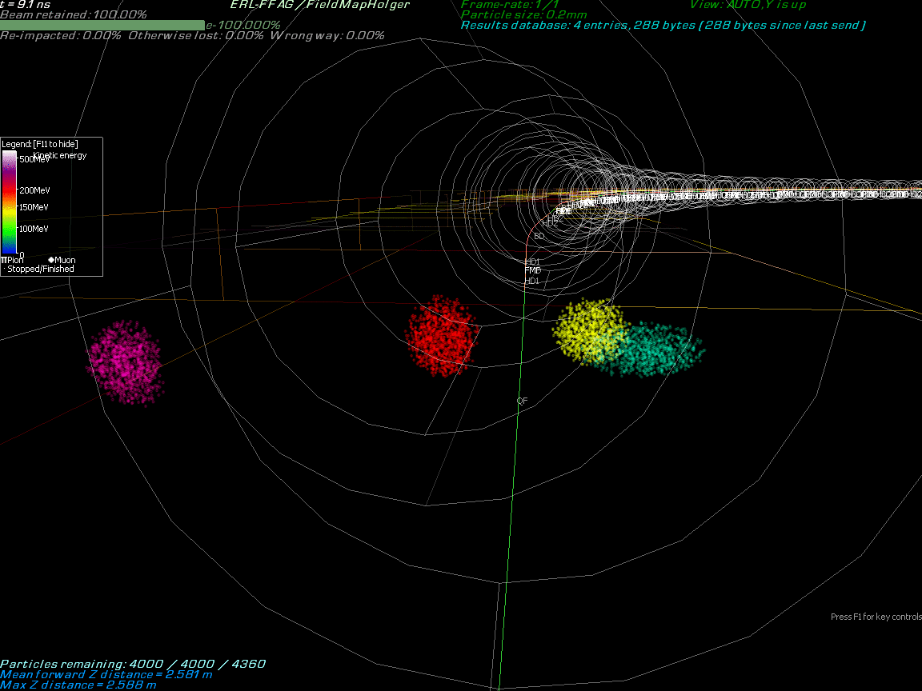
Multi-Energy Beam Dynamics in FFA Arc
January 2022
Stephen Brooks
BNL
5

Slide 6

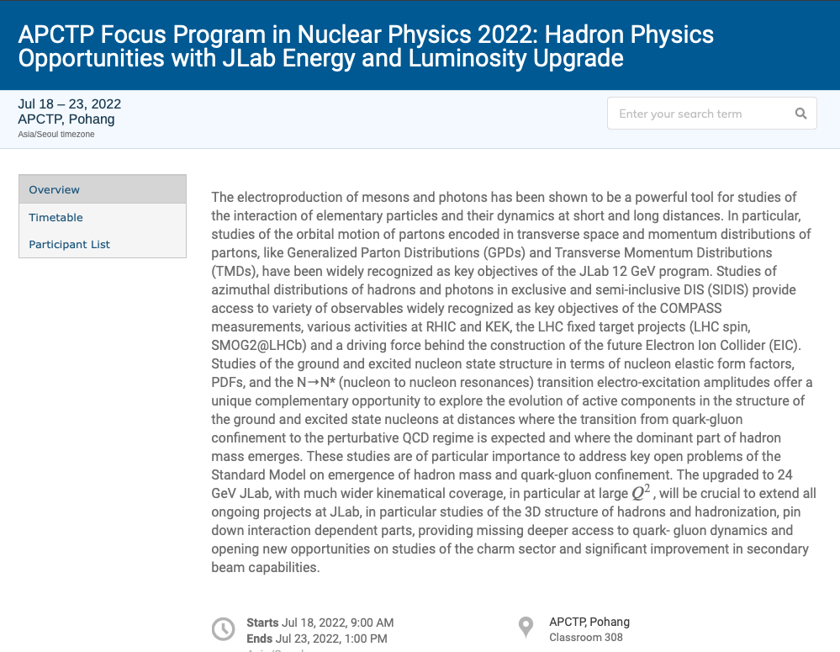

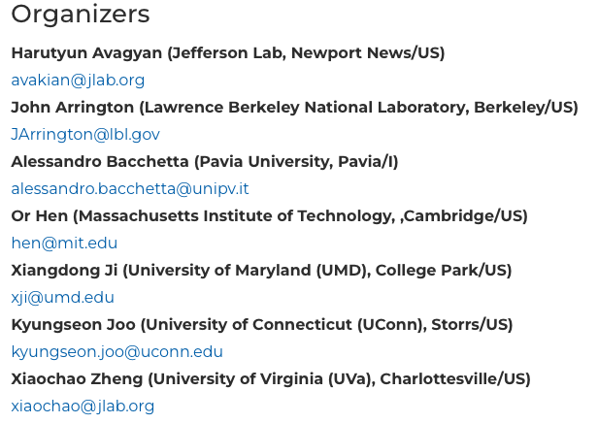
Future Opportunities at CEBAF
Physics with CEBAF at 12 GeV and Future Opportunities
(Nov 30, 2021)
e-Print: 2112.00060 [nucl-ex], Accepted to Progress in
Particle and Nuclear and Physics – In Press
https://indico.jlab.org/event/520/
https://indico.knu.ac.kr/event/566/
https://www.ectstar.eu/workshops/opportunities-with-jlab-energy-and-luminosity-upgrade/
OBJECTIVE:
gather theorists and experimentalists to discuss the physics opportunities and technical options for each of the possible upgrade scenarios: energy, positron, luminosity
6
6

Slide 7
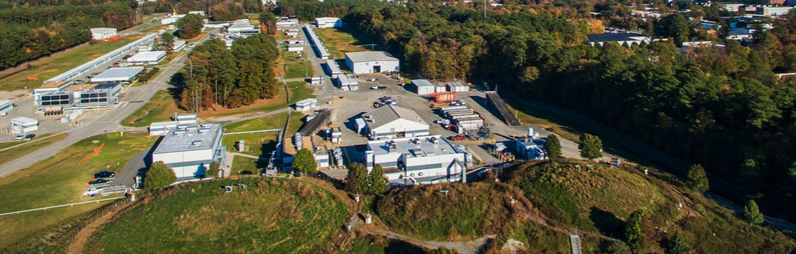
High Energy Workshop Series 2022
https://www.jlab.org/conference/hews22#
We are pleased to announce an upcoming series of summer workshops being organized jointly between the laboratory and the Jefferson Lab Users Organization (JLUO) to probe the science that would be opened up by a higher energy electron beam (~20-24 GeV) at Jefferson Lab. We are particularly interested in identifying key measurements that are not possible to access at 12 GeV, that initially utilize largely existing or already-planned Hall equipment, and that leverage the unique capabilities of luminosity and precision possible at Jefferson Lab in the EIC era.
7

Slide 8
Goals
Identify key measurements that are not possible to access at 12 GeV
initially utilize largely existing or already-planned Hall equipment
leverage the unique capabilities of luminosity and precision possible at JLab in the EIC era
Identify the flagship measurements that can be done only with 20+ GeV and its science impact (uniqueness)
Identify the flagship measurements with 20+ GeV that can extend and improve the 11 GeV measurements, helping the physics interpretation through multidimensional bins in extended kinematics (enrichment)
Identify the measurements with 20+ GeV that can set the bridge between JLab12 and EIC (complementarity)
8

Slide 9
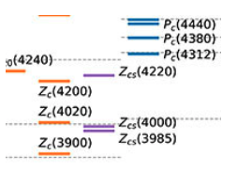
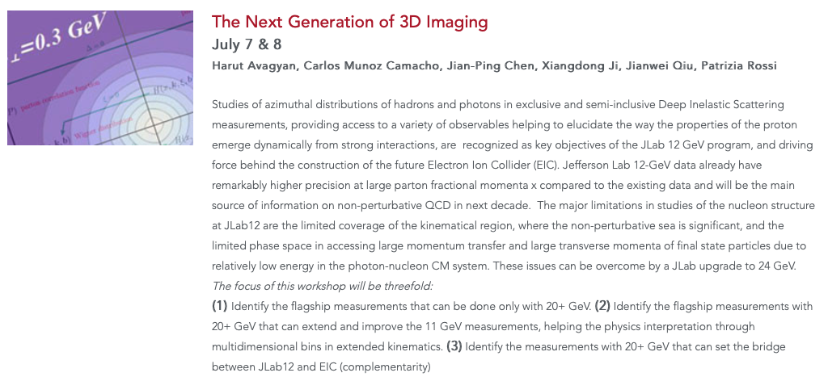
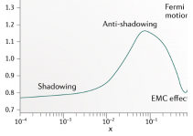
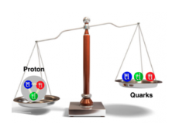
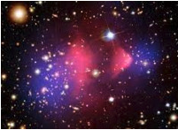
High Energy Workshop Series 2022
Hadron Spectroscopy with a CEBAF Energy Upgrade
The Next Generation of 3D Imaging
Science at Mid x: Anti-shadowing and the Role of the Sea
38 registered p.
8 talks
55 registered p.
13 talks + Summary talk
43 registered p.
14 talks
Physics Beyond the Standard Model
J/Psi and Beyond
Goal to have a first version white paper document ready in a few weeks
To be discussed also at this workshop!
37 registered p.
6 talks
38 registered p.
7 talks + two 1 slide pres.
9
9
9

Slide 10
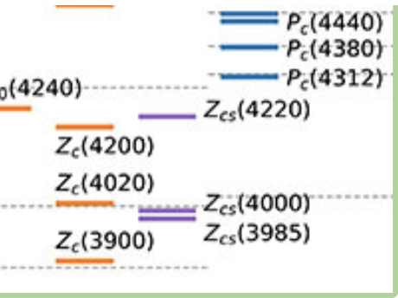
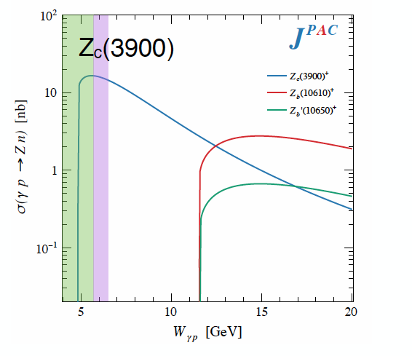
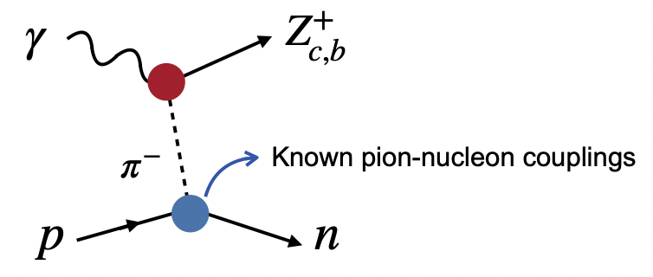
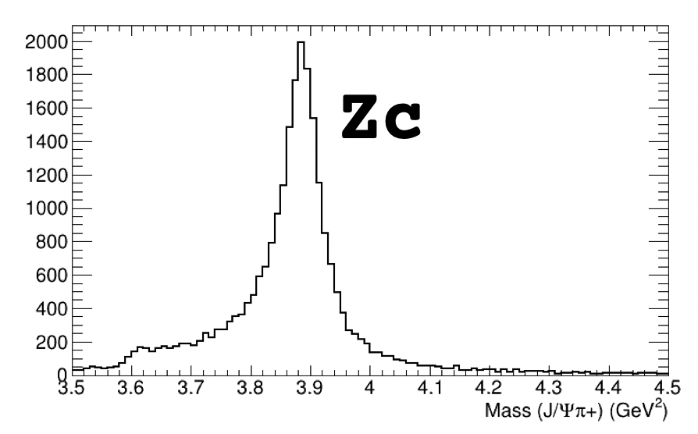
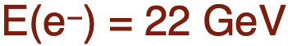

Hadron Spectroscopy
CEBAF @ 20+ GeV : XYZ states & other charmonia can be studied
Tetraquark candidates observed in B decays, e⁺e⁻ colliders
Significant theoretical interest and progress, but internal structure not yet understood
Never direcly produced using photon/lepton beams
$$γp→Jψπ^{+}n$$
Photoproduction provides an alternative mechanisms to study such states
Initial simulations from GlueX and CLAS12 demonstrate the capabilities of the existing detectors to measure these reactions
Full CLAS12 signal MC simulation
10
D. Glazier

Slide 11
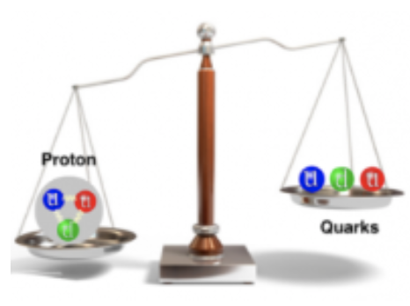
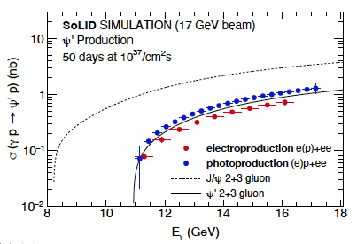
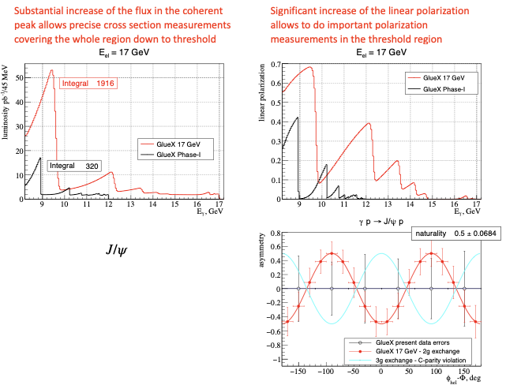
J/ψ and ψ’ photoproduction
Golden processes to pin down:
existence/confirmation of pentaquark resonances
nucleon structure (mass, gluon distribution…)
Initial pentaquark limits
GlueX 20+ Projection
S. Joosten
L. Pentchev
11

Slide 12
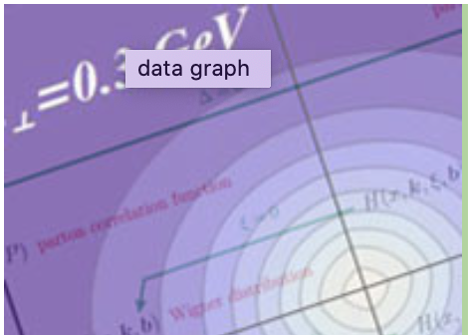
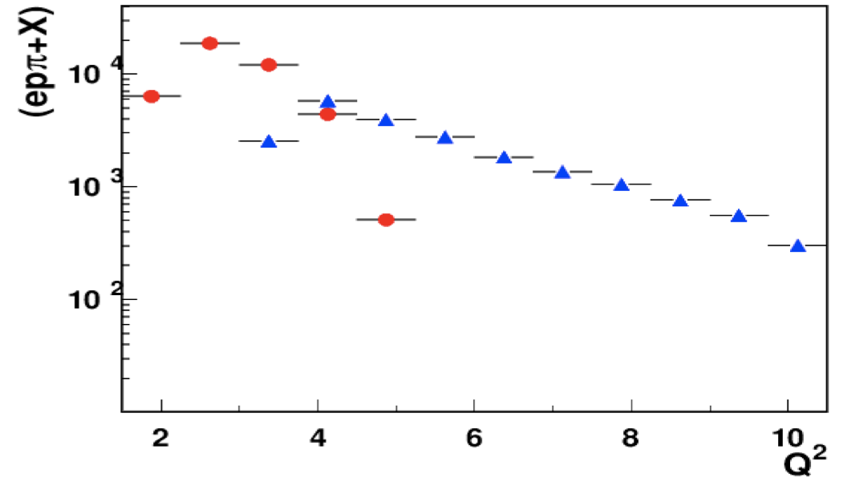
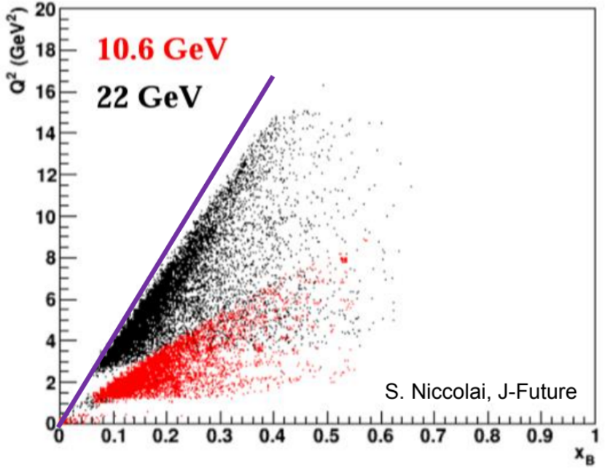
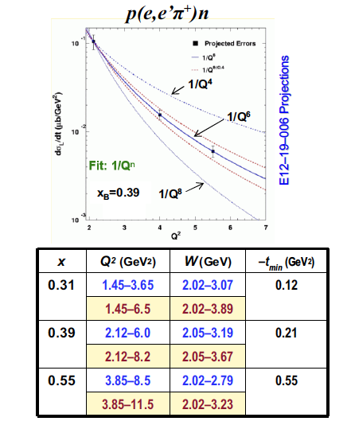
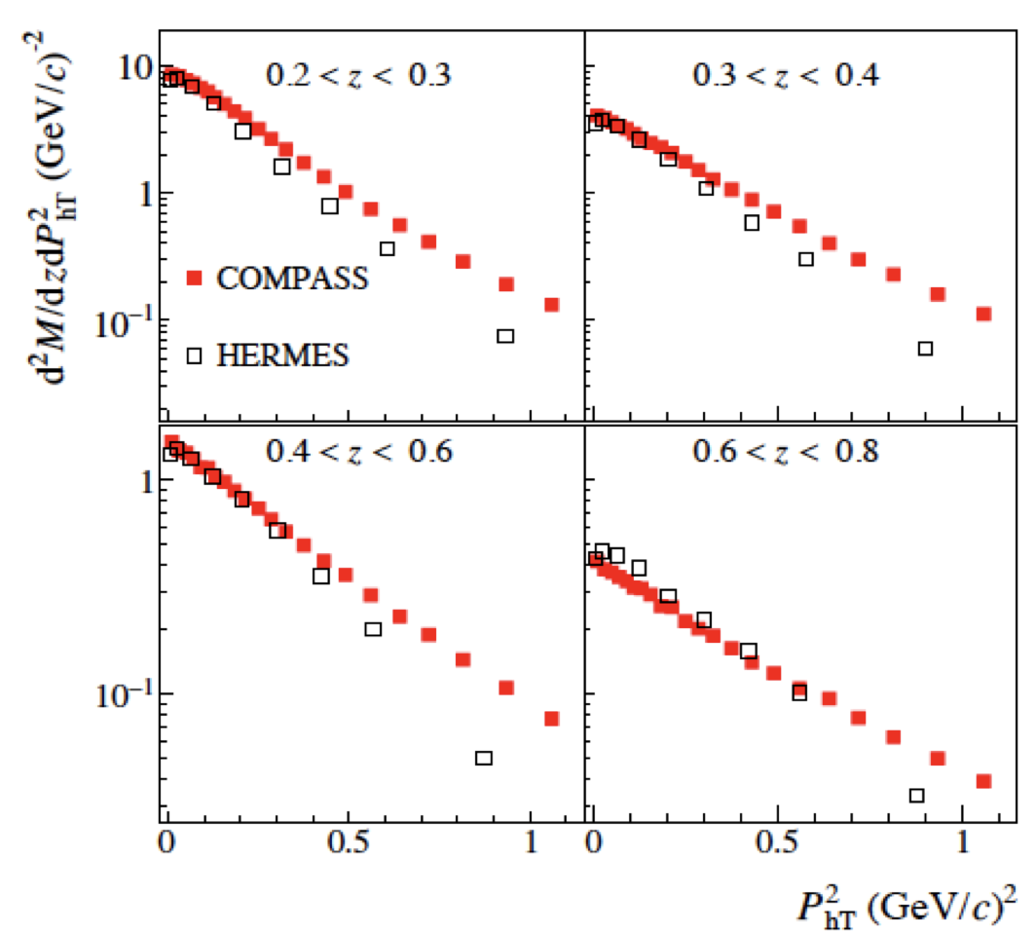
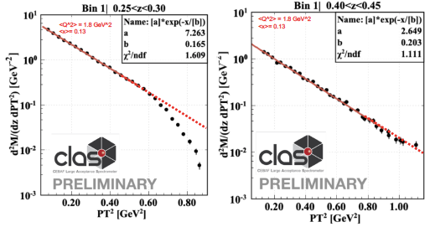
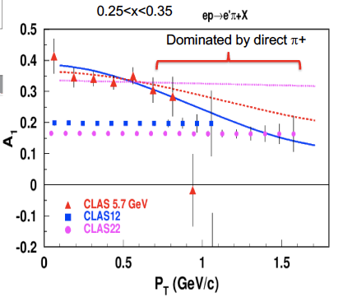
3D Imaging: Enhancement of Q² & P_{T} range
CLAS12
CLAS22
Q² evolution studies possible
More cleanly separate pure twist-2 CFFs
Significantly increase of the relevant Q² range for the Q^{n} scaling test – Not yet proven at 12 GeV
Larger P_{T} range and high luminosity is the key for a better insight into the problem
12

Slide 13

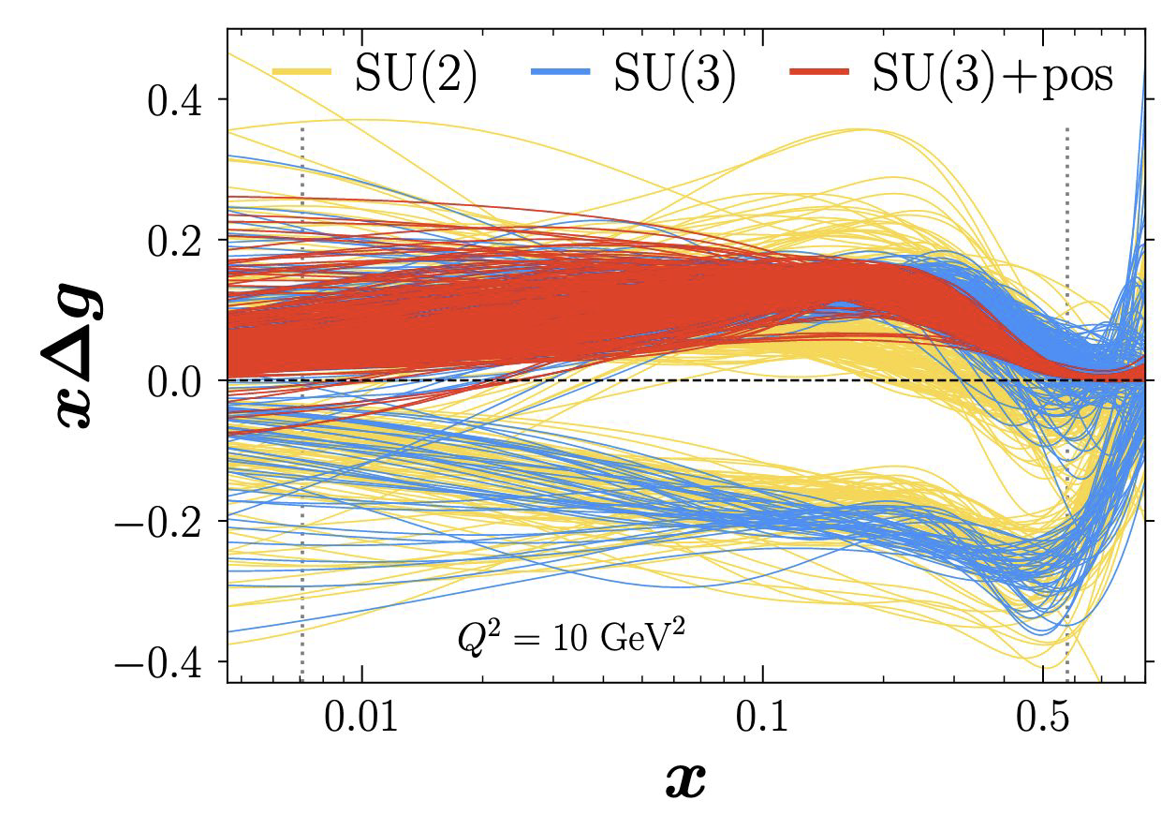
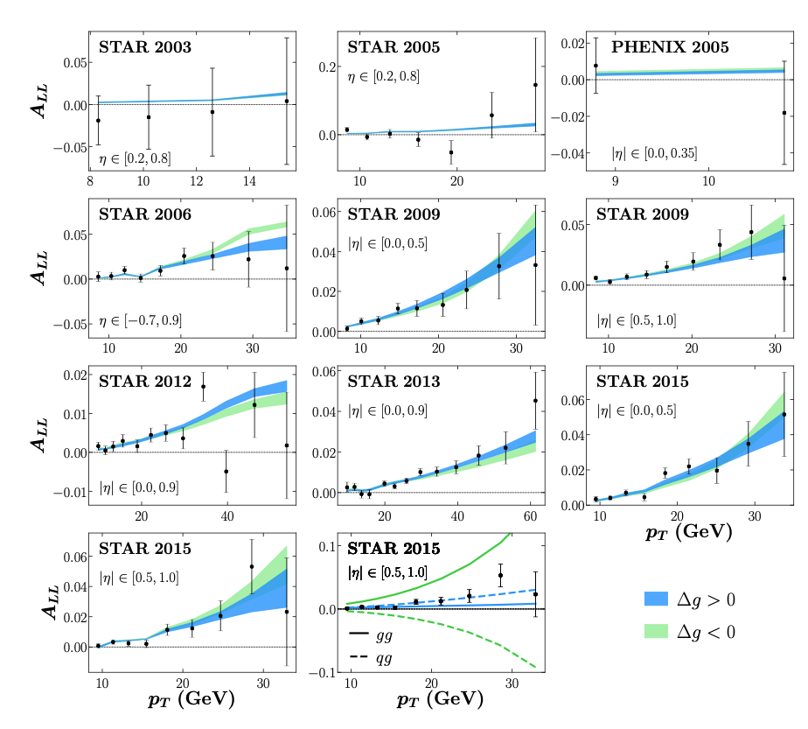
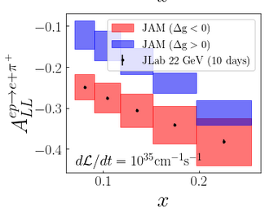
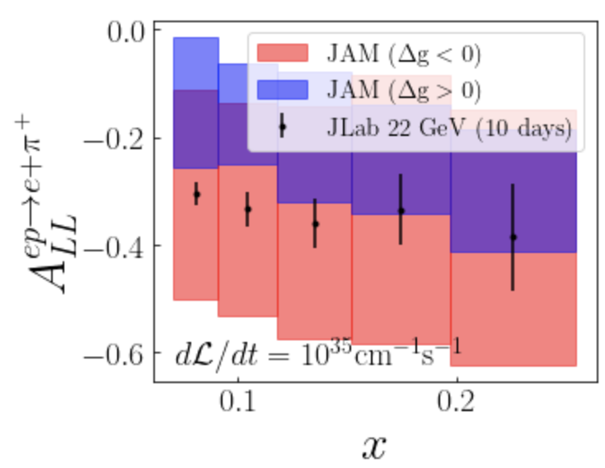
Gluon polarization
Accessing Gluon Polarization
Gluon polarization still elusive in the valence region
First simultaneous global QCD analysis (JAM Coll.), including data from unpolarized and polarized hadron collisions (STAR&PHENIX)
Polarized jet data cannot discriminate between >0 & <0 solutions
In the large P_{T} region: solid theoretical framework based on the collinear factorization (For 0.1<x<0.3 phase space with large P_{T} )
arXiv:2201.02075v2
Z=0.2
Z=0.5
PRELIMINARY
N. Sato, paper in preparation
13

Slide 14
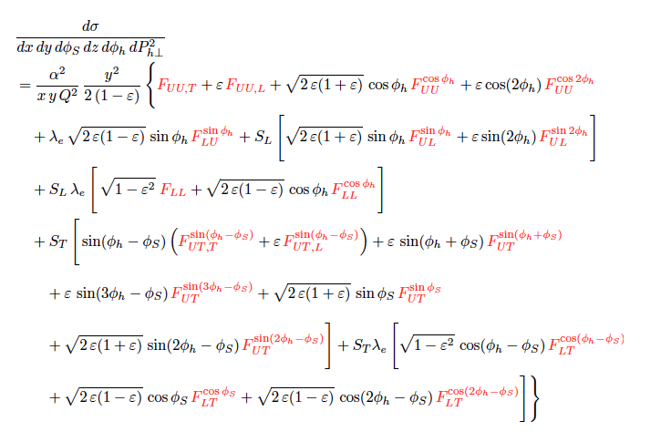
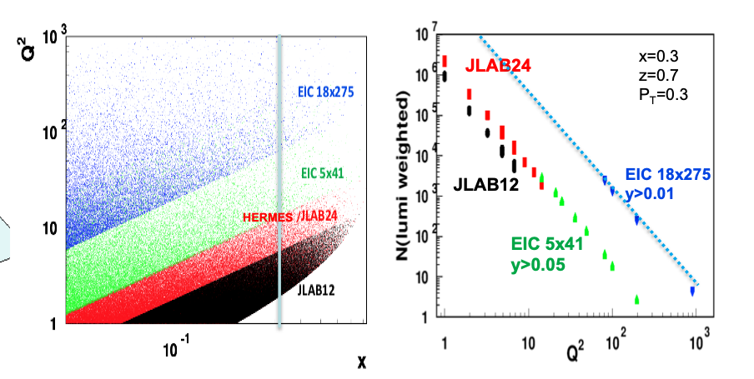
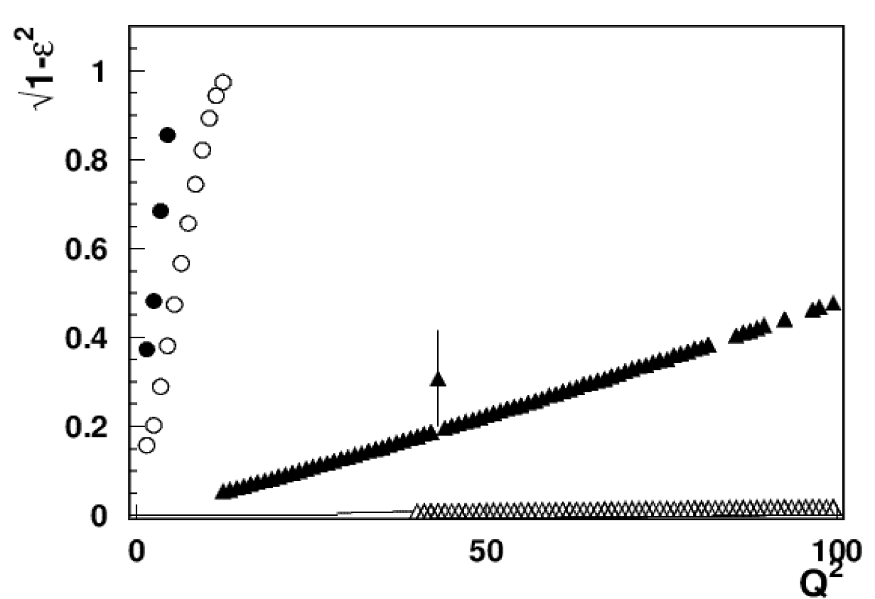
SIDIS at Large x
SIDIS at Large x : JLab domain!
At large x fixed target experiments are sensitive to ALL Structure Functions
For EIC, observables surviving the ε→1 limit (F_{UU}, F_{UL}, Transversely pol. F_{UT})
CLAS12
X=0.3
CLAS24
EIC 5x41
EIC 18x275
x-section from Bacchetta et al, 1703.10157
14
H.Avakian/A. Bacchetta

Slide 15
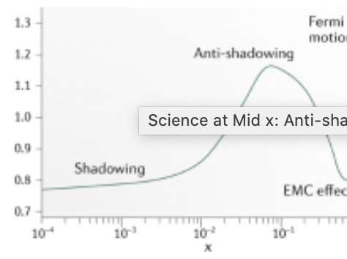
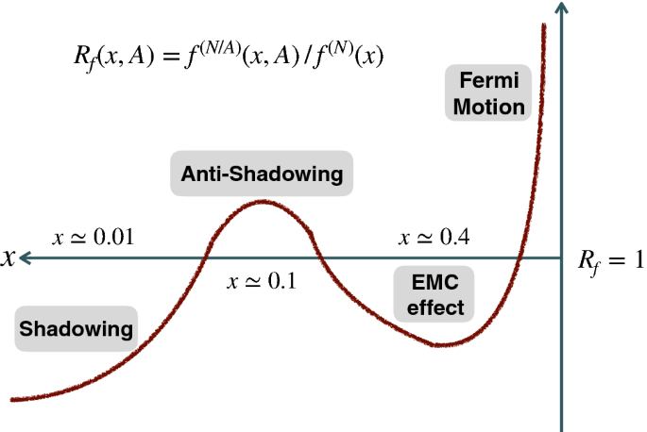
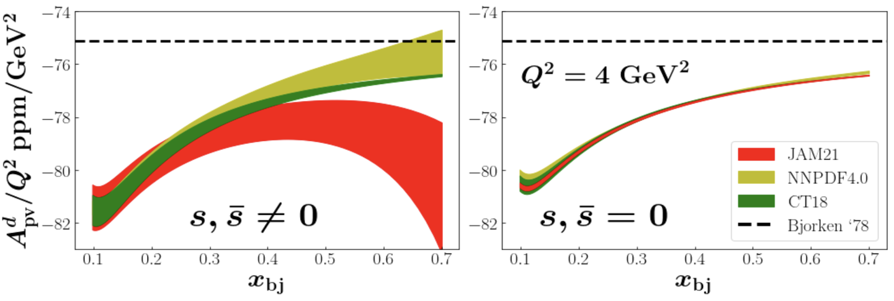
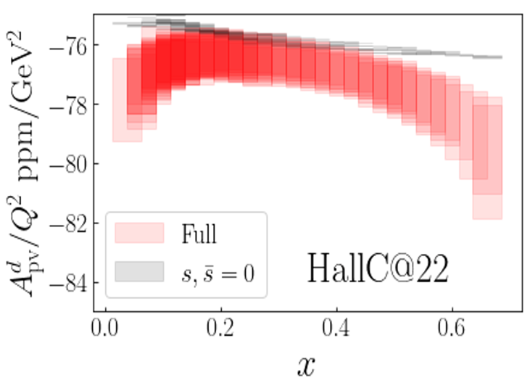
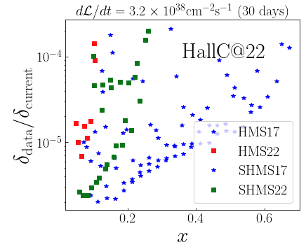

Anti-Shadowing
JLab at ~22 GeV is an anti-shadowing regime machine !
Impact on Strange Quark Puzzle
Parity-violating DIS allows for a large contribution of the strange. $F_{2}^{γZ,p}$ is 5 times more sensitive to the strange
Precision extraction of sin²θ_{W}
~22 GeV
Region extremely interesting, near-equally dominated by valence quarks, sea-quarks, and gluons → many many models!!
Anti-Shadowing is the least studied nuclear structure function effect exp.
  flavor and spin dependence essentially uncharted
  no tagged measurements
Impact on A_{PV} of PVDIS:
What is needed
High precision → high luminosity
e-A (x, Q²) range accessible
Ability to change targets quickly,…
Pol./unpol. mapping across A, N, Z,
Nuclear tagging → links between nuclear dynamic & quark structure
ALL Possible @ Jlab 22 GeV
Projections with SoLID@22 GeV have significant impact as well
15

Slide 16




Physics Beyond the Standard Model
π⁰ Primakoff production off an electron target: eliminate nuclear bkg
L. Gan
16

Slide 17







Long Range Planning
1979
1983
1989
1996
2002
2007
2015
First Long Range Plan came in 1979 ➞ a 40+ year tradition
Fairly consistent cadence: every 5-7 years
They focus on the science, but do indicate budgetary constraints
What do these plans have in common?
  Their input is community driven (➞ involvement of DNP in administering Town Hall Meetings)
  They should articulate the scientific case for the priorities laid out in the plan
  They come with budgetary constraints
  They indicate to DOE/NSF ‘what to do’, but not ‘how to do it’
  There is a closed “Working Group” consisting of scientists and DOE/NSF that actually writes the plan and sets the priorities.
QCD Town Meeting at MIT, 23-25 September 2022 https://indico.mit.edu/event/538/
17

Slide 18

18

Slide 19
QCD Town Hall Meeting
422 participations: 182 In-person, 240 Remote
The meeting consisted of a set of invited plenary and parallel session talks, contributed flash talks (1 - 2 slides, <4 minutes), and open discussion time
Following the meeting discussions on Friday and Saturday, a list of draft recommendations and initiatives was sent to all participants on Saturday evening to conduct an online survey to collect everyone's thoughts.
4 Recommendations and 6 Initiatives
255 responses received. The survey results was shown on Sunday, and served as a starting point for the discussion session.
A 2nd and final survey will be sent on Monday (today) based on the results of the Sunday discussion
The results of the town hall concluding survey will be presented in the QCD white paper and will serve as the basis for the recommendations and the initiatives included in it and that the QCD community will provide to the LRP process.
Expect to present a draft of the white paper to the community, collect comments, and finalize by early February. All members of the QCD community will be able to endorse it and sign on its author list.
19

Slide 20
LRP: Text for a CEBAF Energy Upgrade Initiative Presented
Capitalizing on recent science insights and US-led accelerator science and technology innovations, we strongly recommend the allocation of resources to develop a cost-effective energy upgrade of CEBAF, and its construction in a timeframe compatible with the EIC construction. This will enable a worldwide unique nuclear science program at the luminosity frontier.
The last decade has provided multiple science surprises such as the discovery of exotic states in the charmonium sector at facilities worldwide, the so-called “XYZ” states. Studies of the 3D structure of hadrons and hadronization provided deeper access to quark-gluon dynamics and opened new opportunities to understanding QCD in its full complexity. In addition, mysteries of the visible matter around us remain unsolved, such as a small enhancement of partons found in nuclei at the interface of the quark- and gluon-dominated regions, the so-called “anti-shadowing” region, that to date lacks explanation and can only be further studied at the luminosity frontier.
Capitalizing on recent innovations enabled by accelerator science and technology, a cost-effective energy upgrade of the 12-GeV CEBAF at Jefferson Lab to a 20+ GeV facility has become feasible. Such an upgrade would permit a worldwide unique nuclear science program with fixed targets at the luminosity frontier, roughly five decades above that possible with a collider. Beyond its nuclear science opportunities, this will further steward best-in-class accelerator technology within the US.
20

Slide 21
LRP: Text for a CEBAF Energy Upgrade Initiative Presented
We recommend the allocation of necessary resources to implement high duty-cycle polarized positron beams at CEBAF.
Using the 12 GeV CEBAF and capitalizing on positron source innovations at the Jefferson Lab, high duty cycle polarized electron and positron beams, together with the outstanding capabilities of Jefferson Lab detectors, will enable a unique science program at the luminosity and precision frontier. It will comprise the mapping of two-photon exchange effects as well as essential measurements of the 3D structure of hadrons. It will also offer new opportunities to investigate electroweak physics and the physics beyond the standard model.
21

Slide 22

Results of the two JLab’s Initiatives
22

Slide 23
Some Points from the Follow-up Discussion
A “no answer” (“abstained”) increases for positron and energy upgrade.
Positron and energy upgrade so new initiative and people not aware of costing, timeline, implementation
“No” because no clear efforts that would require to put into the programs.
To first order energy upgrade and EIC running at the same time and a large part of the community objected against that. In the 2015 LRP in the recommendation there is the statement “ in the future the RHIC and JLab community is going to merge into one. No two distinct electron facilities supported by NP at the same time.
Suggestion: request allocation of resources to develop a cost effective implementation of energy upgrade
23

Slide 24
Conclusions
CEBAF 22 GeV upgrade capitalizes on existing investments
  Scientific program with existing Hall equipment
  Re-purpose of idle LERF accelerator
  Leverage new FFA accelerator technology with resistive magnets
Strong science case for JLab energy upgrade in development
  Unique measurements at the luminosity frontier
  Complementary to EIC
  Leverages precision capabilities of Jefferson Lab
CEBAF Energy Upgrade proposed as “Initiative” in the next LRP.
24

Slide 25
Backup Slides
25

Slide 26





Comments…
26

Slide 27



Comments…
27

Slide 28



Positron Beam and its Science Program
Positron source built on the PEPPo exp.
Demonstrated the feasibility of using bremsstrahlung radiation of MeV Polarized Electrons for producing Polarized Positrons
I_{e+} > 100 nA @ P_{e+} = 60%
I_{e+} > 3 μA @ P_{e+} = 0%
Robust program evolved for positron beams at JLab
Eur.Phys.J.A 57 (2021) 8, 261

Slide 29

29

Slide 30
30

