Slide 1
Craig Roberts … http://inp.nju.edu.cn/
Grant no. 12135007
Predicting Parton DFs
Notes:
Night View Of The Overpass In Jiangbei New District Nanjing Background

Slide 2
Parton Distribution Functions
Parton distribution functions (DFs) = preeminent source of hadron structure information
Experiments interpretable in terms of DFs have long been a priority $∼50$years
For most of this time, DFs were inferred from global fits to data & viewed as benchmarks
Such fitting remains crucial, providing input for conduct of many experiments worldwide
However, past decade has seen dawn of a new theory era
Continuum and lattice QCD studies beginning to yield robust predictions for DF(x)
These developments are exposing conflicts with fitting results
Such disagreements invite one of the following conclusions:
the global fit outcomes are misconstrued/misrepresented
not all considered data are a true expression of intrinsic hadron qualities
or QCD, as currently understood, is not the theory of strong interactions

Slide 3
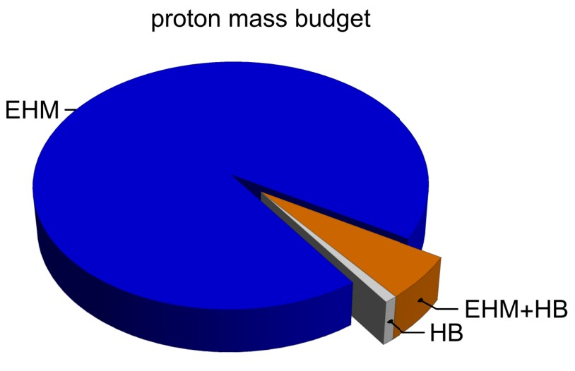
Emergence of Hadron Mass
Standard Model of Particle Physics has one obvious mass-generating mechanism
= Higgs Boson … impacts are critical to evolution of Universe as we know it
However, Higgs boson is alone responsible for just ∼ 1% of the visible mass in the Universe
Proton mass budget … only 9 MeV/939 MeV is directly from Higgs
Evidently, Nature has another very effective mechanism for producing mass:
Emergent Hadron Mass (EHM)
Alone, it produces 94% of the proton’s mass
Remaining 5% is generated by constructive interference between EHM and Higgs-boson

Slide 4
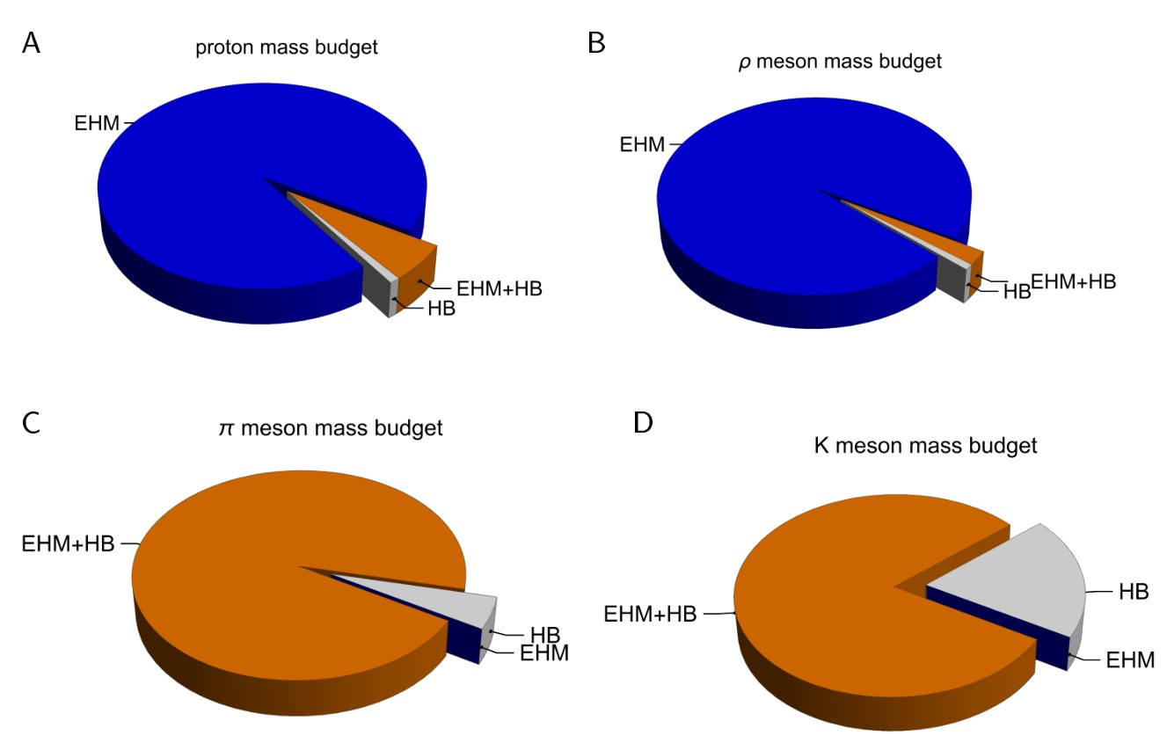
Emergence of Hadron Mass - Basic Questions
What is the origin of EHM?
Does it lie within the Standard Model, i.e., within QCD
What are the connections with …
Gluon and quark confinement?
Dynamical chiral symmetry breaking (DCSB)?
Nambu-Goldstone modes = π & K?
What is the role of Higgs in modulating observable properties of hadrons?
Without Higgs mechanism of mass generation, π and K would be indistinguishable
What is and wherefrom mass?
Proton and $ρ$-meson mass budgets are practically identical
$π$- and $K$-meson mass budgets are essentially/completely different from those of proton and $ρ$

Slide 5
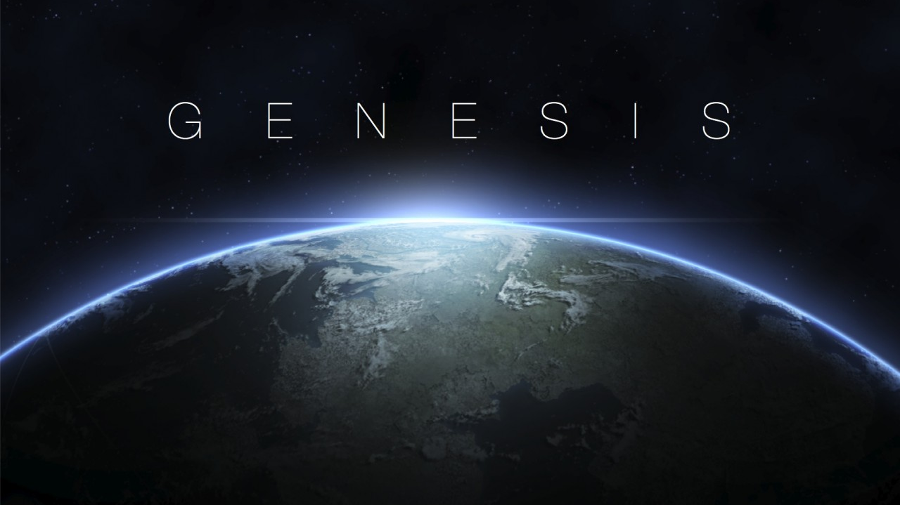

Slide 6
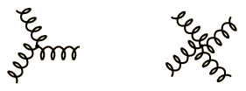
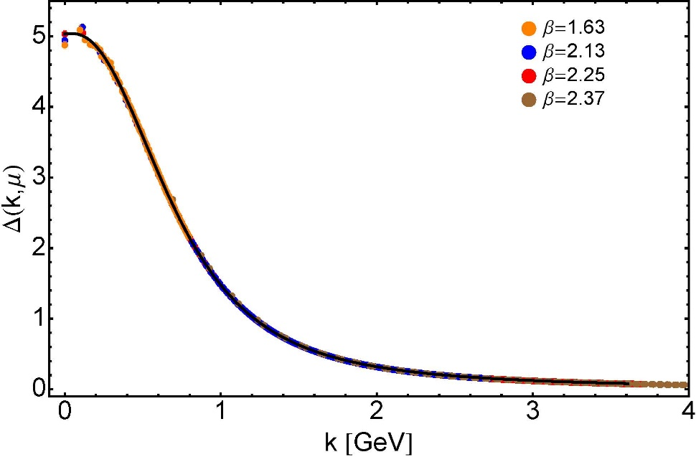
Modern Understanding Grew Slowly from Ancient Origins
More than 40 years ago
Dynamical mass generation in continuum quantum chromodynamics,
J.M. Cornwall, Phys. Rev. D 26 (1981) 1453 … $∼1070$ citations
Owing to strong self-interactions, gluon partons $⇒$ gluon quasiparticles,
described by a mass function that is large at infrared momenta
3-gluon vertex
4-gluon vertex
$$\frac{1}{m_{g}^{2}}$$
Truly mass from nothing
An interacting theory, written in terms of massless gluon fields, produces dressed gluon fields that are characterised by a mass function that is large at infrared momenta
Gluon propagator … continuum and lattice QCD agree
QCD fact
Continuum theory and lattice simulations agree
Empirical verification?

Slide 7
Modern Understanding Grew Slowly from Ancient Origins
Presentation by … Papavassiliou
EHM means
Gluons are massive
More than 40 years ago
Dynamical mass generation in continuum quantum chromodynamics,
J.M. Cornwall, Phys. Rev. D 26 (1981) 1453 … $∼1050$ citations
Owing to strong self-interactions, gluon partons $⇒$ gluon quasiparticles,
described by a mass function that is large at infrared momenta
3-gluon vertex
4-gluon vertex
$$\frac{1}{m_{g}^{2}}$$
Truly mass from nothing
An interacting theory, written in terms of massless gluon fields, produces dressed gluon fields that are characterised by a mass function that is large at infrared momenta
Gluon propagator … continuum and lattice QCD agree
QCD fact
Continuum theory and lattice simulations agree
Empirical verification?

Slide 8
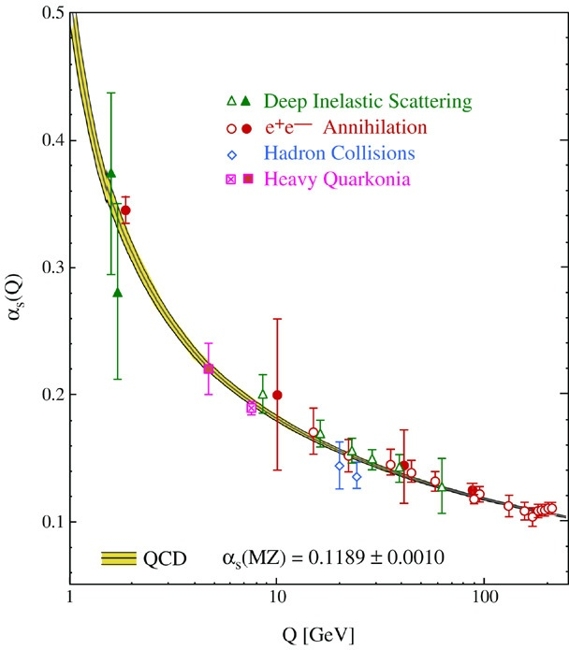
QCD’s Running Coupling
This is where we live
⇐
What’s happening
out here?!

Slide 9
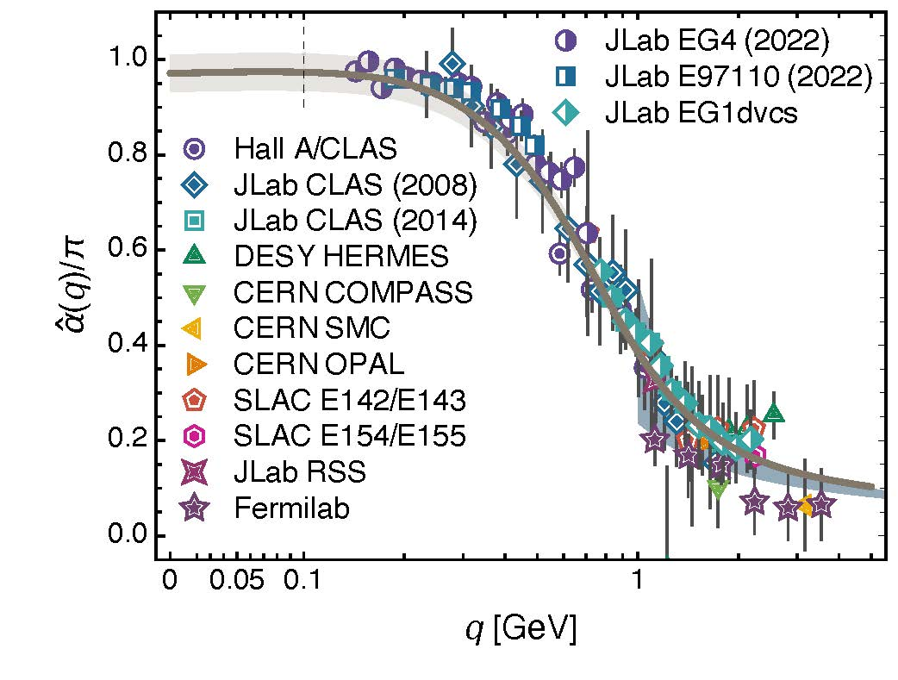
Process independent effective charge = running coupling
W orkshop on Dyson-Schwinger Equations in Modern Mathematics
and Physics (DSEMP2014) Trento, Italy, September 22-26, 2014
Effective charge from lattice QCD, Zhu-Fang Cui, Jin-Li Zhang et al.,
NJU-INP 014/19, arXiv:1912.08232 [hep-ph], Chin. Phys. C 44 (2020) 083102/1-10
2064 total downloads
Modern theory enables unique QCD analogue of
“Gell-Mann – Low”
running charge to be rigorously defined and calculated
Analysis of QCD’s gauge sector
yields a parameter-free prediction
N.B. Qualitative change in α̂_{PI}(k) at k ≈ ½ m_{p}
No Landau Pole
“Infrared Slavery” picture – linear potential – is not correct explanation of confinement
Below $k∼{{\hat{m}}_{0}}_{ },$interactions become scale independent, just as they were in the Lagrangian; so, QCD becomes practically conformal again
The QCD Running Coupling,
A. Deur, S. J. Brodsky and G. F. de Teramond, Prog. Part. Nucl. Phys. 90 (2016) 1-74
Process independent strong running coupling
Daniele Binosi et al., arXiv:1612.04835 [nucl-th], Phys. Rev. D 96 (2017) 054026/1-7

Slide 10
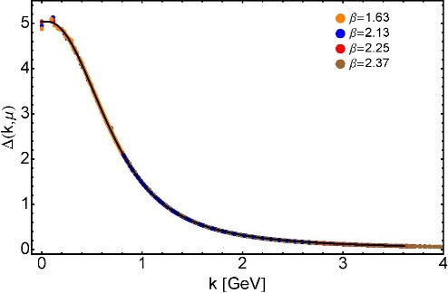
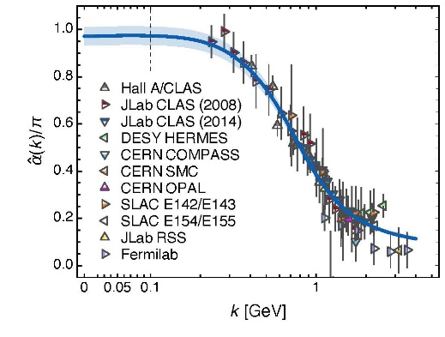
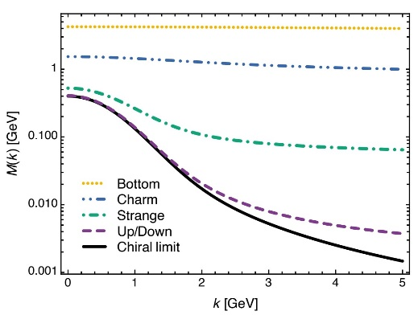
EHM Basics
Absent Higgs boson couplings, the Lagrangian of QCD is scale invariant
Yet …
Massless gluons become massive
A momentum-dependent charge is produced
Massless quarks become massive
EHM is expressed in
EVERY strong interaction observable
Challenge to Theory =
Elucidate all observable consequences of these phenomena
and highlight the paths to measuring them
Challenge to Experiment =
Test the theory predictions so that
the boundaries of the Standard Model can finally be drawn

Slide 11
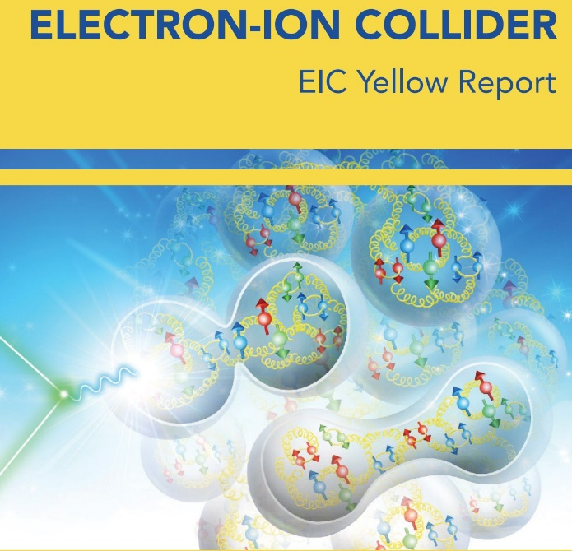
EHM at Existing and Future Facilities

Slide 12
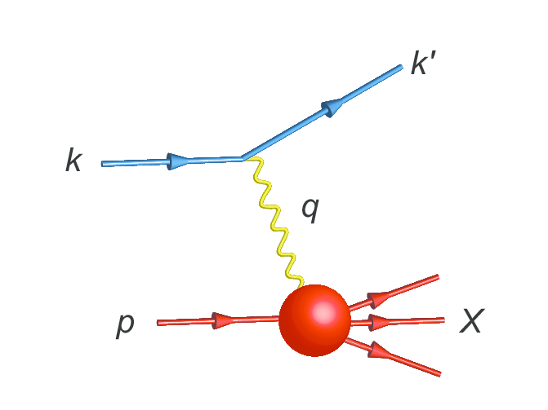
Parton Distribution Functions

Slide 13
NG Boson Distribution Functions
Insights into the Emergence of Mass from Studies of Pion and Kaon Structure, Craig D. Roberts, David G. Richards, Tanja Horn and Lei Chang, NJU-INP 034/21, arXiv: 2102.01765 [hep-ph], Prog. Part. Nucl. Phys. 120 (2021) 103883/1-65
Physics Goals:
Precise data that can be used to determine
Pion and Kaon Distribution Functions – valence, sea and glue
Provide the first complete charts of the internal structure of Nature's most fundamental Nambu-Goldstone bosons.
Today:
Existing pion data are more than 40-years-old
That data only covers the valence-quark domain
A forty-year controversy, with doubts persisting over whether the data agree with QCD predictions or challenge the truth of QCD
Regarding the kaon, worldwide, only 8 points of data exist

Slide 14
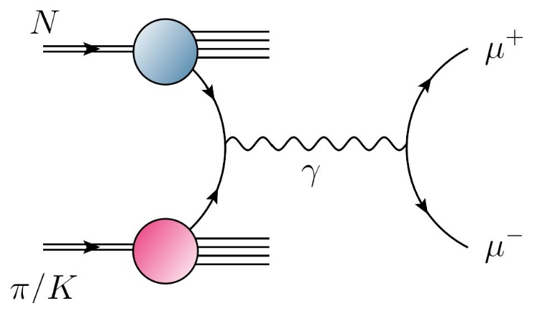
NG Boson Distribution Functions
Physics Goals:
Precise data that can be used to determine
Pion and Kaon Distribution Functions – valence, sea and glue
Provide the first complete charts of the internal structure of Nature's most fundamental Nambu-Goldstone bosons.
Future:
JLab, EIC, EicC
⇒ pion and kaon elastic electromagnetic form factors … reveal and quantify scaling
violations in hard exclusive processes … hard prediction of QCD, never seen
⇒ pion and kaon valence quark distribution functions at large $x_{B}$
AMBER
precision data to chart π and K structure: DFs of valence, sea and glue.
Glue is particularly important … because controversial, yet prominent theory predicts that pions contain (almost) zero glue.
Presentations by … Ent & Horn

Slide 15
Proton and pion DFs – QCD predictions
Valence-quark domain: there is a scale $ζ_{H}<m_{p}$ at which
$ζ>m_{p}$: val. $∝{\left(1−x\right)}^{β_{p,π}}$ , $β_{p}=3+γ_{p}$, $β_{π}=2+γ_{π}$
Gluon DFs: $β_{p,π}^{glue}≥$ $β_{p,π}^{val}+1$
Sea DFs: $β_{p,π}^{sea}≥$ $β_{p,π}^{val}+2$
Simple, direct consequences of DGLAP equations.
DF with lowest exponent defines the valence degree-of-freedom.
Notably, argument can be reversed:
if large-x glue or sea DF exponent is smaller than that of valence DF at any given scale, then it is smaller at all lower scales.

Slide 16
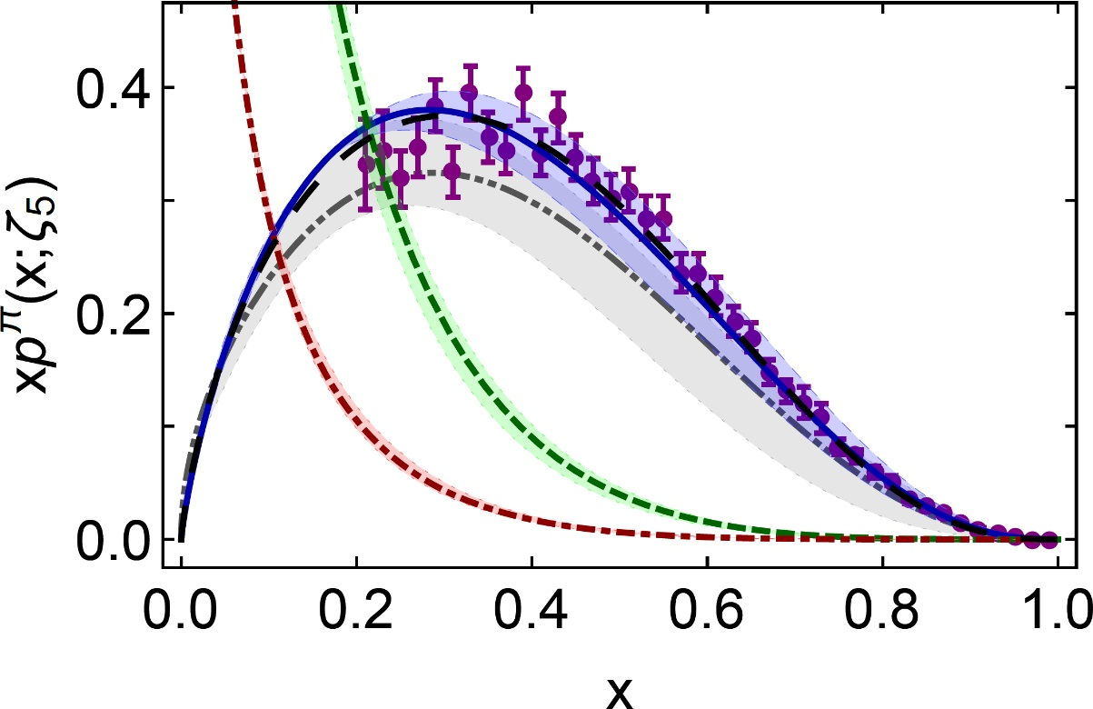
π valence-quark distributions 23 Years of Theory Evolution → 2022
Symmetry, symmetry breaking, and pion parton distributions, Minghui Ding, Khépani Raya et al., NJU-INP 003/19, arXiv:1905.05208 [nucl-th], Phys. Rev. D 101 (2020) 054014/1-14
Pion Valence Quark Distribution from Matrix Element Calculated in Lattice QCD, R. Sufian, et al. Phys. Rev. D 99 (2019) 074507
β^{contm}(ζ₅) = 2.66(12)
β^{lattice}(ζ₅) = 2.45(58)
Developments in continuum-QCD
enabled 1st parameter-free predictions of
valence, glue and sea distributions within the pion
Reveal that $uπ(x;ζ)$is hardened by EHM
Novel lattice-QCD algorithms beginning to yield results for pointwise behaviour of $uπ(x;ζ)$
Agreement between
new continuum prediction for $uπ(x;ζ)$ [Ding:2019lwe]
and recent lattice-QCD result [Sufian:2019bol]
Real strides toward understanding pion structure.
Standard Model prediction: stronger than ever before
After 30 years – new “meson target” era dawning … dense, precise data will be obtained:
M2 beam-line @ CERN … JLab12 … EIC … EicC

Slide 17
Strict Constraints on Pion Valence-quark DFs
Emergence of pion parton distributions, Z.-F. Cui (崔著钫), M. Ding (丁明慧) et al.,
NJU-INP 054/22, e-Print: 2201.00884 [hep-ph], Phys. Rev. D 105 (2022) L091502/1-8
Proposition I:
There exists at least one effective charge, $α_{1ℓ}(k^{2})$, such that, when used to integrate the one-loop DGLAP equations, an evolution scheme for parton DFs is defined that is all-orders exact
Charges of this type are discussed in
G. Grunberg, Renormalization scheme independent QCD and QED: The method of effective charges, Phys. Rev. D 29, 2315 (1984) … 617 citations
They need not be process-independent (PI); hence, not unique.
Nevertheless, a suitable PI charge is not excluded
Each such $α_{1ℓ}(k^{2})$ is:
consistent with the renormalization group;
renormalization scheme independent;
everywhere analytic and finite;
and supplies an infrared completion of any standard running coupling

Slide 18
Strict Constraints on Pion Valence-quark DFs
Emergence of pion parton distributions, Z.-F. Cui (崔著钫), M. Ding (丁明慧) et al.,
NJU-INP 054/22, e-Print: 2201.00884 [hep-ph], Phys. Rev. D 105 (2022) L091502/1-8
Proposition II:
There exists a scale, $ζ_{H}$, at which all pion properties are carried by its valence degrees-of-freedom
Nature’s G-parity symmetry $⇒u_{V}\left(x;ζ_{H}\right)=u_{V}(1−x;ζ_{H})$
$$g\left(x;ζ_{H}\right)≡0≡S(x;ζ_{H})$$
Working solely with Propositions I and II, the following can be proved
($γ_{0}^{n}$ are anomalous dimensions):
Bounds on all Mellin moments of valence-quark DF
Recursion relation for Mellin moments of valence-quark DF
… any odd moment is completely determined by the lower-order even moments

Slide 19
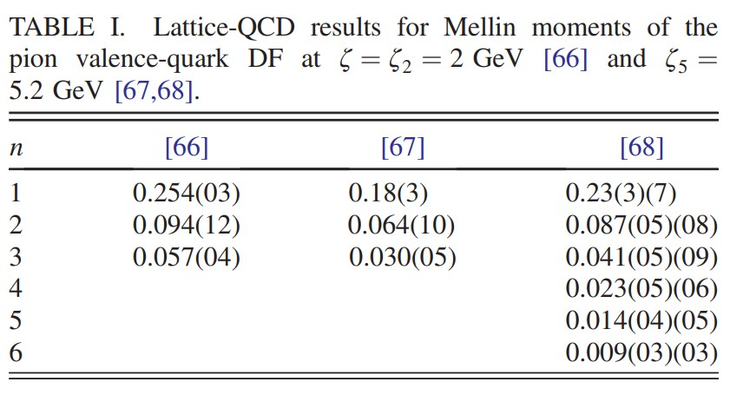
Pion Valence-quark DF from lattice-QCD moments
Emergence of pion parton distributions, Z.-F. Cui (崔著钫), M. Ding (丁明慧) et al.,
NJU-INP 054/22, e-Print: 2201.00884 [hep-ph], Phys. Rev. D 105 (2022) L091502/1-8
Lattice-QCD input
[66] B. Joó et al., Pion valence structure from Ioffe-time parton pseudodistribution functions, Phys. Rev. D 100, 114512 (2019).
[67] R. S. Sufian et al., Pion valence quark distribution from matrix element calculated in lattice QCD, Phys. Rev. D 99, 074507 (2019).
[68] C. Alexandrou et al., Pion and kaon $⟨x^{3}⟩$ from lattice QCD and PDF reconstruction from Mellin moments, Phys. Rev. D 104, 054504 (2021).

Slide 20
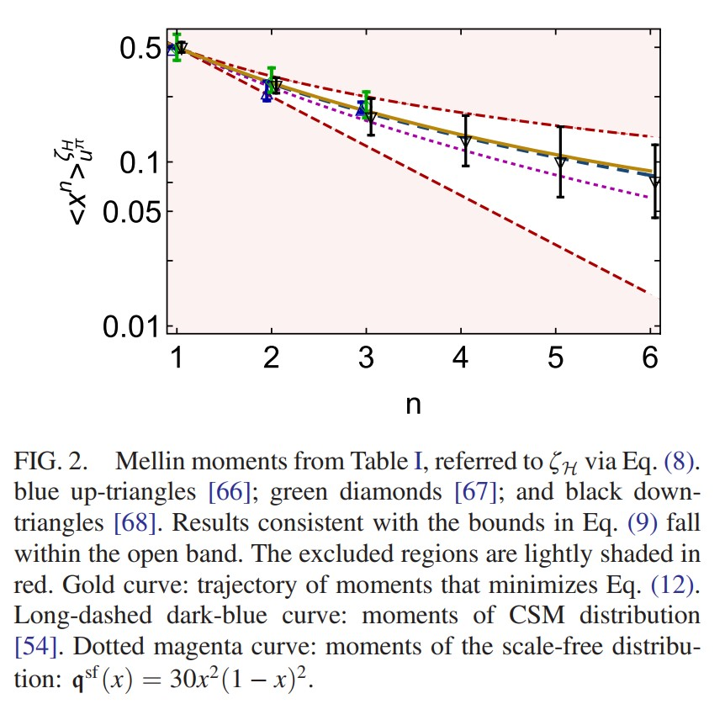
Pion Valence-quark DF from lattice-QCD moments
Emergence of pion parton distributions, Z.-F. Cui (崔著钫), M. Ding (丁明慧) et al.,
NJU-INP 054/22, e-Print: 2201.00884 [hep-ph], Phys. Rev. D 105 (2022) L091502/1-8
Lattice-QCD moments [66-68] are all consistent with the bounds … means all are consistent with Proposition II = pion DF is symmetric at $ζ_{H}$
Gold curve: best-fit trajectory of moments
Long-dashed dark-blue curve: moments of CSM distribution
Curves are indistinguishable

Slide 21
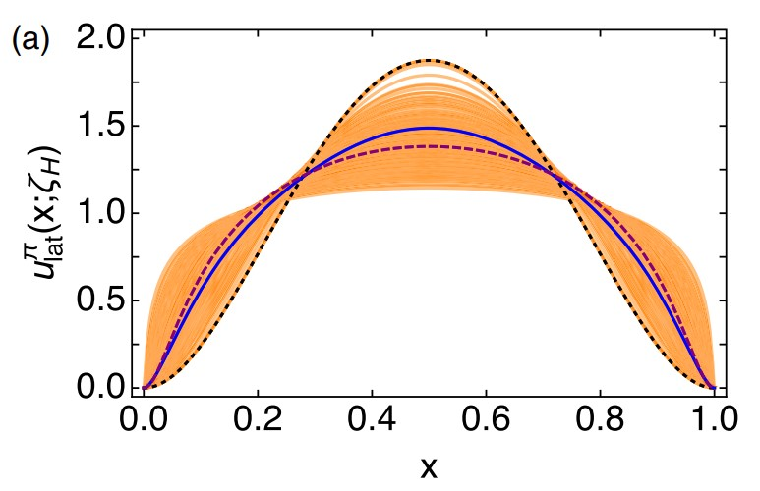
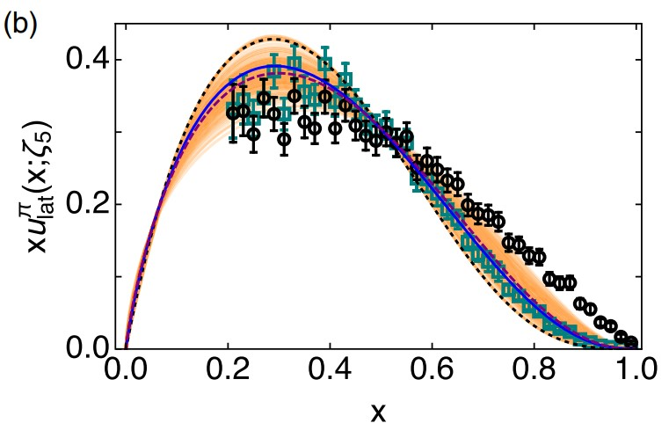
Pion Valence-quark DF from lattice-QCD moments
Emergence of pion parton distributions, Z.-F. Cui (崔著钫), M. Ding (丁明慧) et al.,
NJU-INP 054/22, e-Print: 2201.00884 [hep-ph], Phys. Rev. D 105 (2022) L091502/1-8
One-parameter ($ρ$) reconstruction function
Flexible enough to both reproduce scale-free distribution and express EHM-induced dilation, which is known feature of QCD
Using best-fit moment curve, generate ensemble of pion DFs with Gaussian-distributed uncertainty
$⇒$
Proposition I
Dashed magenta curve: central-fit result
Solid blue curve: CSM prediction

Slide 22
Pion Valence-quark DF from lattice-QCD moments
Emergence of pion parton distributions, Z.-F. Cui (崔著钫), M. Ding (丁明慧) et al.,
NJU-INP 054/22, e-Print: 2201.00884 [hep-ph], Phys. Rev. D 105 (2022) L091502/1-8
One-parameter ($ρ$) reconstruction function
Flexible enough to both reproduce scale-free distribution and express EHM-induced dilation, which is known feature of QCD
Using best-fit moment curve, generate ensemble of fits with Gaussian-distributed uncertainty
Lattice QCD & CSM in agreement
pQCD power law confirmed in nonperturbative predictions
Lattice QCD: ${\left\langle x\right\rangle }_{π}^{ζ_{5}}=0.218\left(6\right)$
CSM: ${\left\langle x\right\rangle }_{π}^{ζ_{5}}=0.20\left(1\right)$
Large-x power,
Lattice QCD = 2.45(38)
CSM = 2.81(08)
$⇒$
Proposition I
Dashed magenta curve: central-fit result
Solid blue curve: CSM prediction

Slide 23
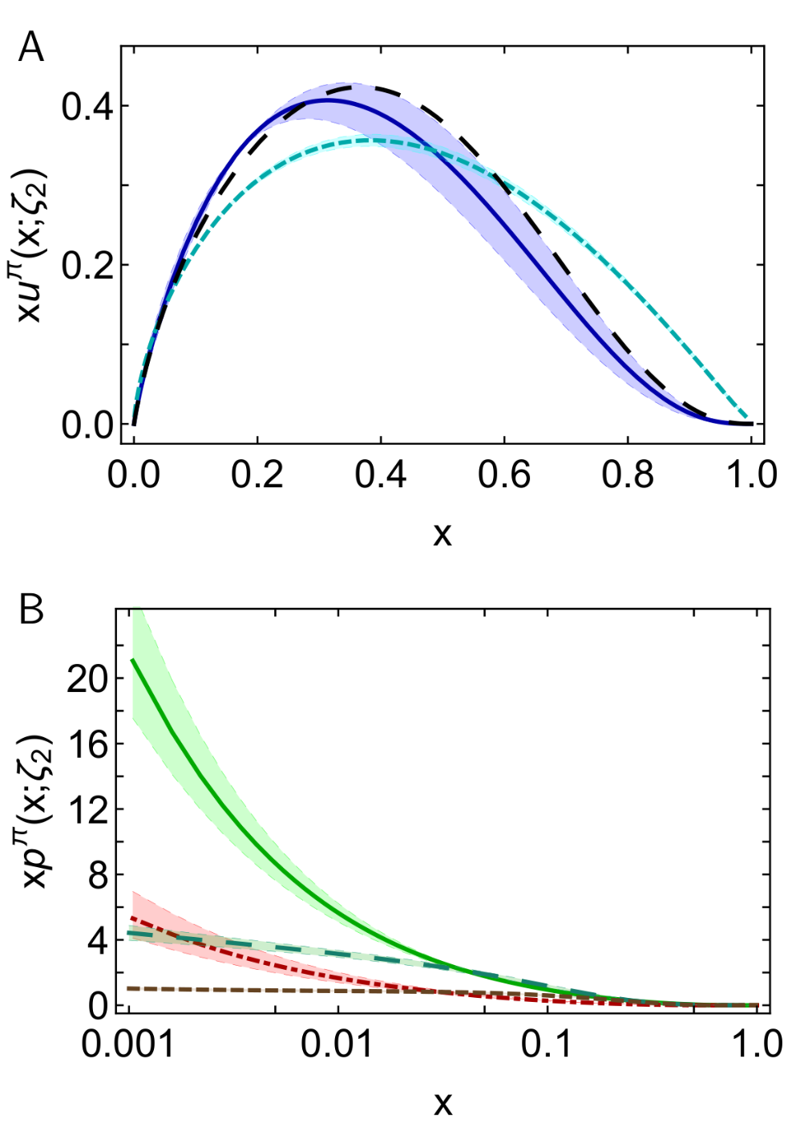
π DFs … Modern Theory Predictions vs Traditional Phenomenological Fits to Data
Valence:
momentum fraction similar
Phenomenological Fits … profile much harder
& inconsistent with QCD prediction
Glue:
Qualitative similarities on x ≥ 0.05, but marked quantitative disagreement, especially on complementary domain
Both continuum prediction and fit are very different from early phenomenology
Should be tested in new experiments that are directly sensitive to the pion’s gluon content.
Possibly: prompt photon & J/Ψ production
Sea:
Prediction and fit disagree on entire x-domain
If pion’s gluon content is considered uncertain, then fair to describe sea-quark distribution as empirically unknown
Motivation for the collection and analysis of DY data with π± beams on isoscalar targets
CSM prediction
JAM valence
DSE prediction
glue & sea
JAM:
glue & sea

Slide 24
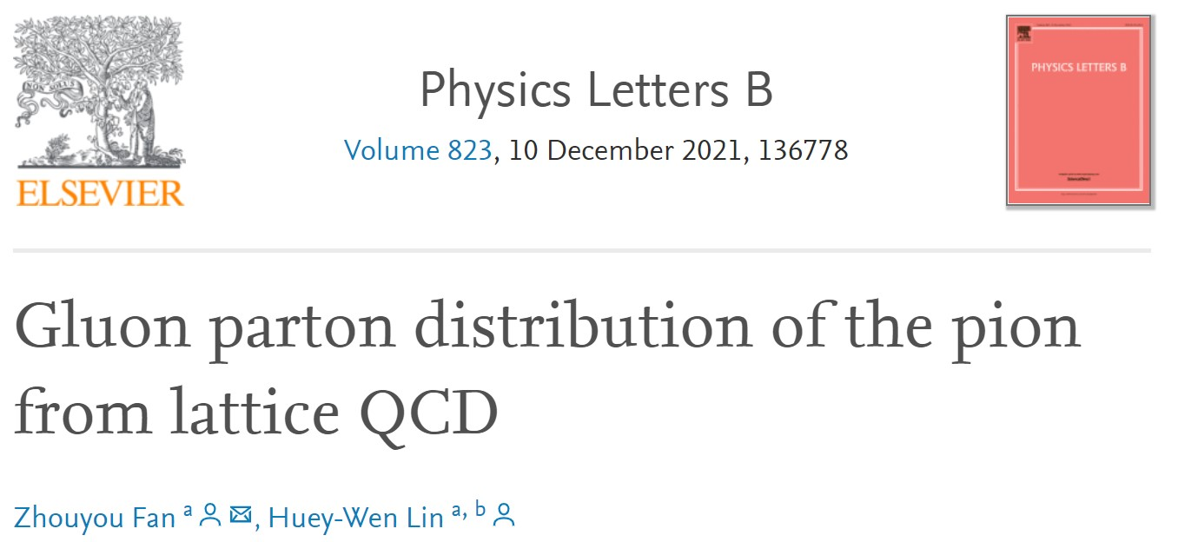
π DFs … Modern Theory Predictions vs Traditional Phenomenological Fits to Data
Valence:
momentum fraction similar
JAM … publication ignores NLL resummation … profile much harder & inconsistent with QCD prediction
Glue:
Similarities on x ≥ 0.05, but marked disagreement on important complementary domain
Both continuum prediction and JAM fit are very different from early phenomenology
Should be tested in new experiments that are directly sensitive to the pion’s gluon content.
Perhaps, prompt photon & J/Ψ production
Sea:
Prediction and fit disagree on entire x-domain
If pion’s gluon content is considered uncertain, then fair to describe sea-quark distribution as empirically unknown
Motivation for the collection and analysis of DY data with π± beams on isoscalar targets
DSE prediction
JAM valence
Breaking news …
1st lQCD results for pion’s glue DF have been released
DSE prediction
glue & sea
JAM:
glue & sea

Slide 25
Breaking news for glue in π: Continuum (Eur. Phys. J. C 80 (2020) 1064/1-20) & Lattice Predictions (arXiv:2104.06372)
Two distinct methods for tackling QCD
Agree quantitatively on $g_{ }^{π}\left(x\right)$
continuum
Phenomenological analyses
exhibit qualitatively different behaviour
Highlights need for new data and improved phenomenology in order to turn that data into a real test of QCD and our understanding of Nambu-Goldstone modes.
AMBER @ CERN can provide the necessary precise data.
lattice
Regarding the distribution of glue in the pion, Lei Chang (常雷) and Craig D Roberts,
e-Print: 2106.08451 [hep-ph], Chin. Phys. Lett. 38 (8) (2021) 081101/1-6 - Editors' Suggestion

Slide 26
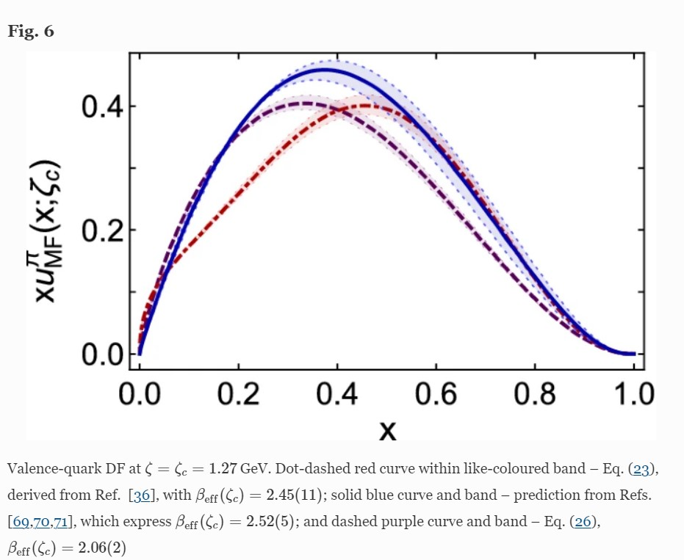
Issues with Recent JAM Fits
Concerning pion parton distributions, Z.-F. Cui (崔著钫), M. Ding (丁明慧) et al., NJU-INP 053/21, e-Print: 2112.09210 [hep-ph], Eur. Phys. J. A 58 (2022) 10/1-14
New fits place much less of pion's light-front momentum with the valence quarks
12% smaller than previous fits and existing predictions
Momentum is shifted to sea DF, leaving gluon fraction largely unchanged
Inconsistent with QCD
Internally consistent evolution says valence produces glue produces sea
Can’t have valence $↔$ sea with passive glue
Wiggly valence-quark DFs … possibly owing to
limitations introduced by the simple DF fitting Ansatz employed
and/or choosing to treat valence, glue, and sea DFs as uncorrelated at input scale
CSM prediction
JAM fits
have wiggles $⇒$ underestimate ${\left\langle 2x\right\rangle }_{V}$
QCD – valence & glue & sea DFs are intimately connected at ALL scales.
Unsound to treat them as uncorrelated/independent

Slide 27
Structure of Baryons - diquark correlations
Baryon Structure and QCD
R.T. Cahill, C. D. Roberts, J. Praschifka
Austral. J. Phys. 42 (1989) 129-145

Slide 28
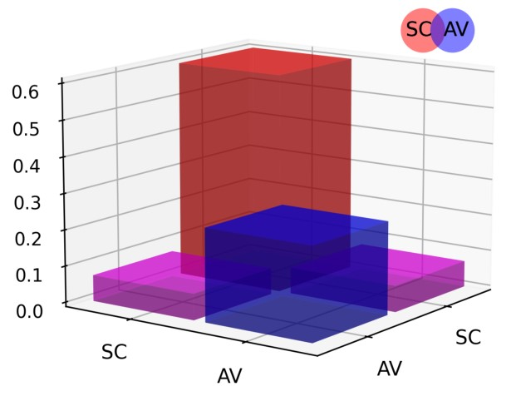
Structure of Baryons
Poincaré covariant Faddeev equation sums all possible exchanges and interactions that can take place between three dressed-quarks
Direct solution of Faddeev equation using rainbow-ladder truncation is now possible, but numerical challenges remain
For many/most applications, diquark approximation to quark+quark scattering kernel is used
Prediction: owing to EHM phenomena, strong diquark correlations exist within baryons
proton and neutron … both scalar and axial-vector diquarks are present
CSM prediction = presence of axialvector (AV) diquark correlation in the proton
AV Responsible for $≈40\%$ of proton charge

Slide 29
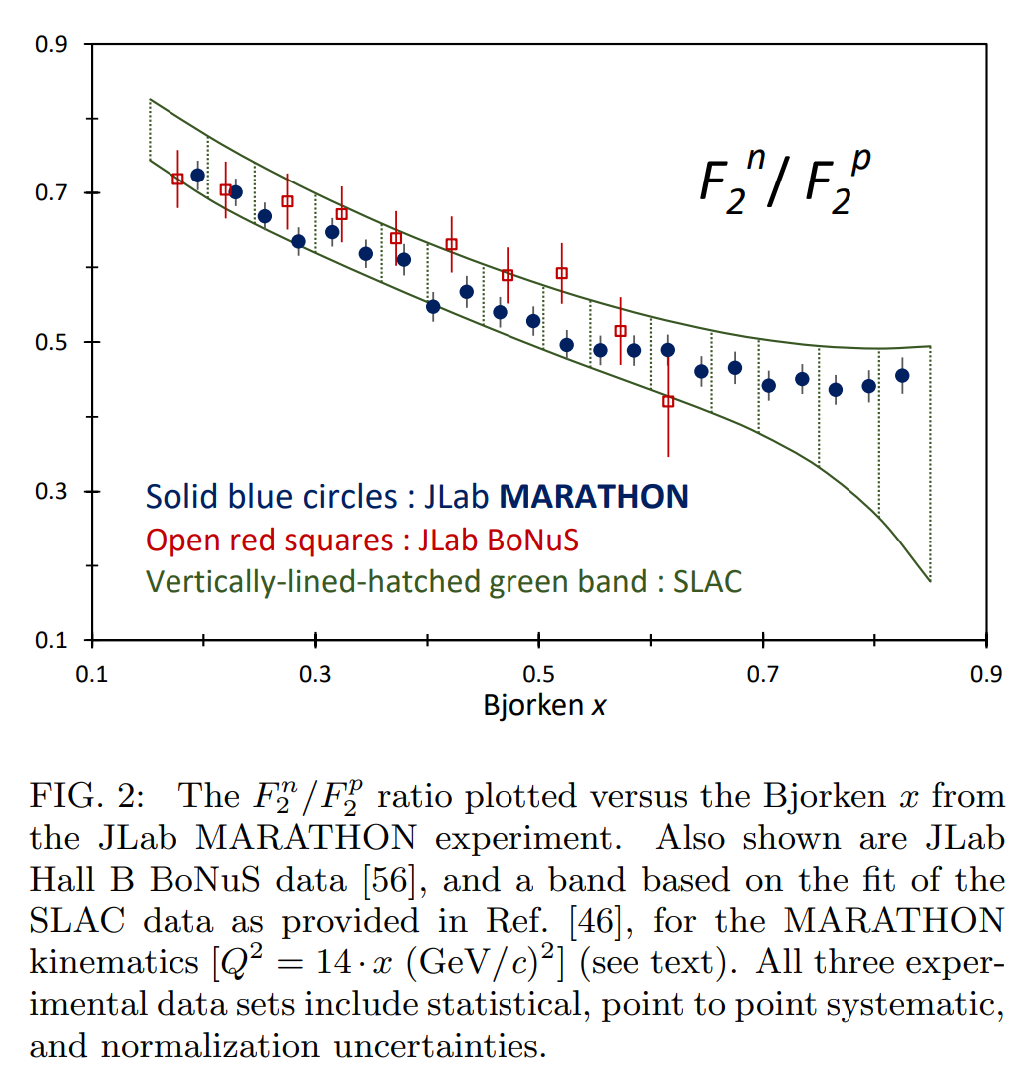
Diquarks & Deep Inelastic Scattering
The ratio of neutron and proton structure functions at large $x$ is keen discriminator between competing pictures of proton structure
Example:
Only scalar diquark in the proton (no axial-vector): ${\lim_{x→1}{\frac{F_{2}^{n}\left(x\right)}{F_{2}^{p}\left(x\right)}=\frac{1}{4}} }_{ }^{ }$
No correlations in the proton wave function (SU(4) spin-flavour) $\lim_{x→1}{\frac{F_{2}^{n}\left(x\right)}{F_{2}^{p}\left(x\right)}=\frac{2}{3}}$
Experiments have been trying to deliver reliable data on this ratio for fifty years!
MARATHON – a more-than ten-year effort, using a tritium target at JLab, has delivered precise results
$0^{+}$only
D. Abrams, et al., Measurement of the Nucleon Fn2/Fp2 Structure Function Ratio by the Jefferson Lab MARATHON Tritium/Helium-3 Deep Inelastic Scattering Experiment – arXiv:2104.05850 [hep-ex],
Phys. Rev. Lett. (2022) in press.

Slide 30
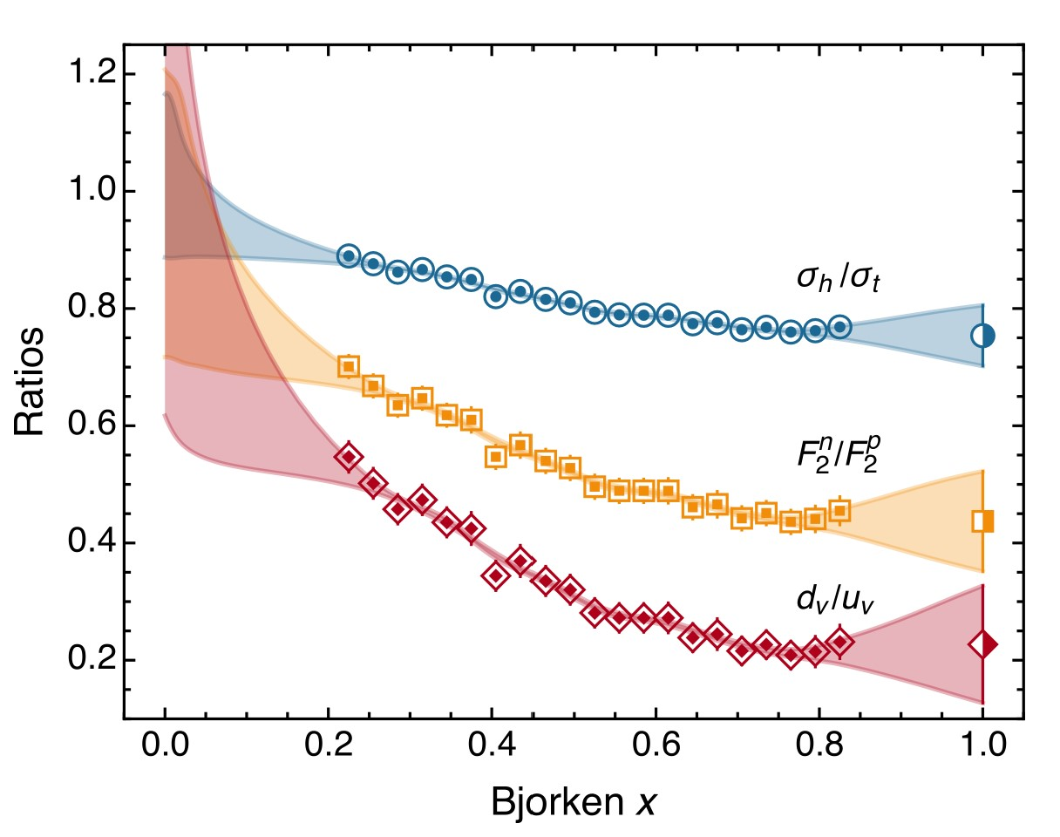
MARATHON EXPERIMENT - Schlessinger point method
Valence quark ratio in the proton, Zhu-Fang Cui (崔著钫), Fei Gao (高飞), Daniele Binosi, Lei Chang (常雷), C. D. Roberts and S. M. Schmidt, NJU-INP 049/21, e-print: 2108.11493 [hep-ph], Chin. Phys. Lett. Express 39 (04) (2022) 041401/1-5: Express Letter
New mathematical method for interpolation and extrapolation of data
based on continued-fraction representation of functions, augmented by statistical sampling
Delivers model-independent prediction for all ratios
No reference to models or physics theories
Provides benchmark against which all pictures of nucleon structure can be measured
Probability that scalar diquark only models of nucleon might be consistent with available data is 1/7,000,000

Slide 31
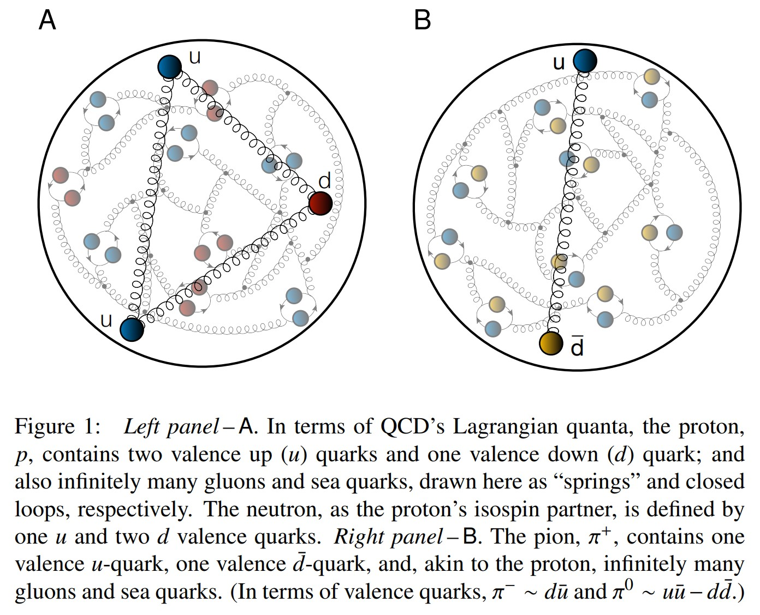
Proton and pion distribution functions in counterpoint
massive
almost massless
Despite enormous expense of time and effort, much must still be learnt before proton and pion structure may be considered understood in terms of DFs
Most simply, what are the differences, if any, between the distributions of partons within the proton and the pion?
The question of similarity/difference between proton and pion DFs has particular resonance today as science seeks to explain EHM
How are obvious macroscopic differences between protons and pions expressed in the structural features of these two bound-states?
proton
pion

Slide 32
Proton and pion distribution functions in counterpoint
Proton and pion distribution functions in counterpoint, Ya Lu (陆亚) et al.,
NJU-INP 056/22, e-Print: 2203.00753 [hep-ph], Phys. Lett. B 830 (2022) 137130
Valence-quark domain: there is a scale $ζ_{H}<m_{p}$ at which
$ζ>m_{p}$: val. $∝{\left(1−x\right)}^{β_{p,π}}$ , $β_{p}=3+γ_{p}$, $β_{π}=2+γ_{π}$
Gluon DFs: $β_{p,π}^{glue}≥$ $β_{p,π}^{val}+1$
Sea DFs: $β_{p,π}^{sea}≥$ $β_{p,π}^{val}+2$
These are simple consequences of DGLAP equations.
DF with lowest exponent
defines the valence degree-of-freedom.
Argument can be reversed:
if large-x glue or sea DF exponent is smaller than that of valence DF at any given scale, then it is smaller at all lower scales.
Proton is supposed to be a stable bound-state of three valence-quarks
Yet, modern global analyses of proton DIS and related data encompass fits with role of glue and valence-quarks reversed!
Proton has valence glue but no valence quarks!
No simultaneous global fits to proton and pion data have ever been performed
Largely because pion data are scarce
Existing approaches are unlikely to yield definitive answers because practitioners typically ignore QCD constraints

Slide 33
Proton and pion distribution functions in counterpoint
Proton and pion distribution functions in counterpoint, Ya Lu (陆亚) et al.,
NJU-INP 056/22, e-Print: 2203.00753 [hep-ph], Phys. Lett. B 830 (2022) 137130
Valence-quark domain: there is a scale $ζ_{H}<m_{p}$ at which
$ζ>m_{p}$: val. $∝{\left(1−x\right)}^{β_{p,π}}$ , $β_{p}=3+γ_{p}$, $β_{π}=2+γ_{π}$
Gluon DFs: $β_{p,π}^{glue}≥$ $β_{p,π}^{val}+1$
Sea DFs: $β_{p,π}^{sea}≥$ $β_{p,π}^{val}+2$
These are simple consequence of DGLAP equations.
CT18: large-x power of glue distribution at the scale ζ = mass_{charm} is (almost) identical to that of valence-quarks.
With this behavior, proton has valence-gluon degrees of freedom at all scales. That would make the proton a hybrid baryon, which it is not.
CT18Z: large-x power of glue distribution is a₂=1.87, whereas that on the valence quarks is a₂=3.15,
i.e., at ζ = mass_{charm} valence-quarks are subleading degrees-of-freedom. Instead, gluons dominate on what is typically called the valence-quark domain.
Further, no simultaneous global fits to proton and pion data have ever been performed
Largely because pion data are scarce
Existing approaches are unlikely to yield definitive answers because practitioners typically ignore QCD constraints

Slide 34
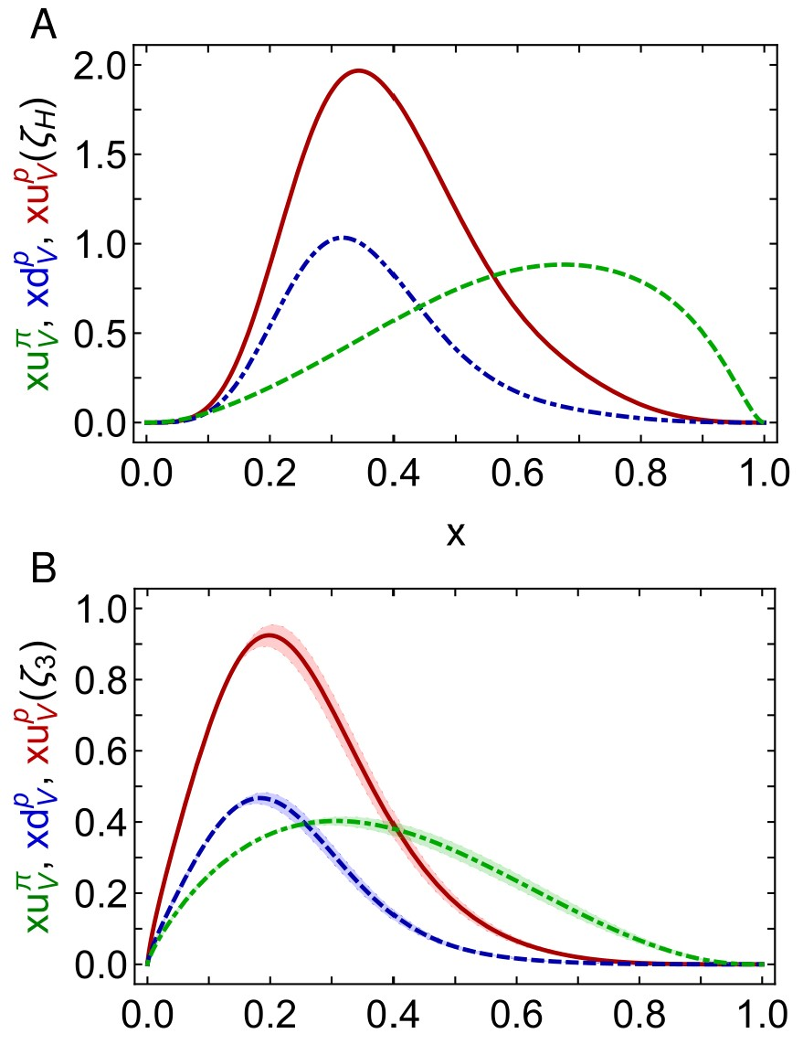
Proton and pion distribution functions in counterpoint
Proton and pion distribution functions in counterpoint, Ya Lu (陆亚) et al.,
NJU-INP 056/22, e-Print: 2203.00753 [hep-ph], Phys. Lett. B 830 (2022) 137130
Symmetry-preserving analyses using continuum Schwinger function methods (CSMs) deliver hadron scale DFs that agree with QCD constraints
Valence-quark degrees-of-freedom carry all hadron’s momentum at $ζ_{H}$:
Diquark correlations in proton, induced by EHM
${⇒u}_{V}(x)≠2d_{V}\left(x\right)$
Proton and pion valence-quark DFs have markedly different behaviour
$u^{π}(x;ζ_{H})$ is Nature’s most dilated DF
“Obvious” because ${\left(1−x\right)}^{2}$ vs. ${\left(1−x\right)}^{3}$ behaviour & preservation of this unit difference under evolution
Also “hidden” = strong EHM-induced broadening
dilation
u in proton
d in proton
u in pion
dilation

Slide 35
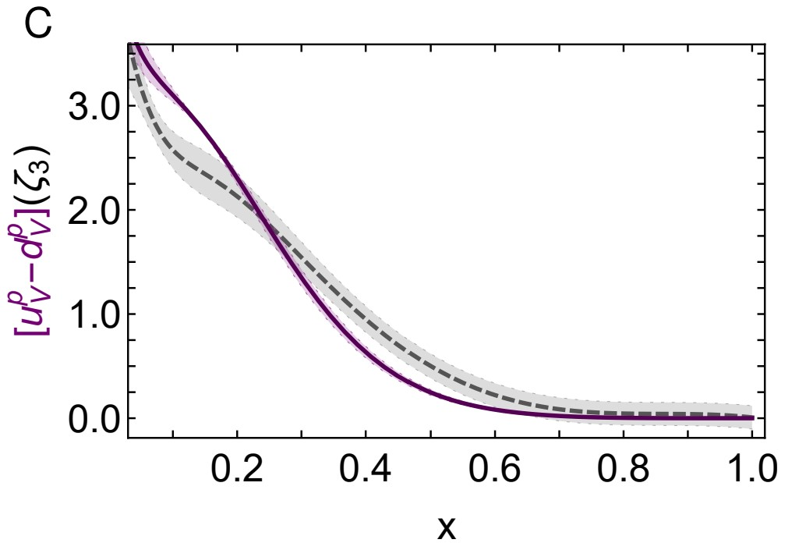
Proton valence-quark DFs: Continuum cf. Lattice
Owing to difficulties in handling so-called disconnected contributions, the calculation of individual proton valence DFs using lattice-regularised QCD (lQCD) is problematic
lQCD results are typically only available for isovector distributions, from which disconnected contributions vanish in the continuum limit.
Comparison of isovector distributions
$u^{p}\left(x;ζ_{3}\right)−d^{p}\left(x;ζ_{3}\right)$
Completely different approaches; yet good agreement, especially since refinements of both calculations may be anticipated.
Continuum: Proton and pion distribution functions in counterpoint, Ya Lu (陆亚) et al., NJU-INP 056/22, e-Print: 2203.00753 [hep-ph]
Lattice: Nucleon Isovector Unpolarized Parton Distribution in the Physical-Continuum Limit, H.-W. Lin et al., arXiv:2011.14971 [hep-lat]

Slide 36
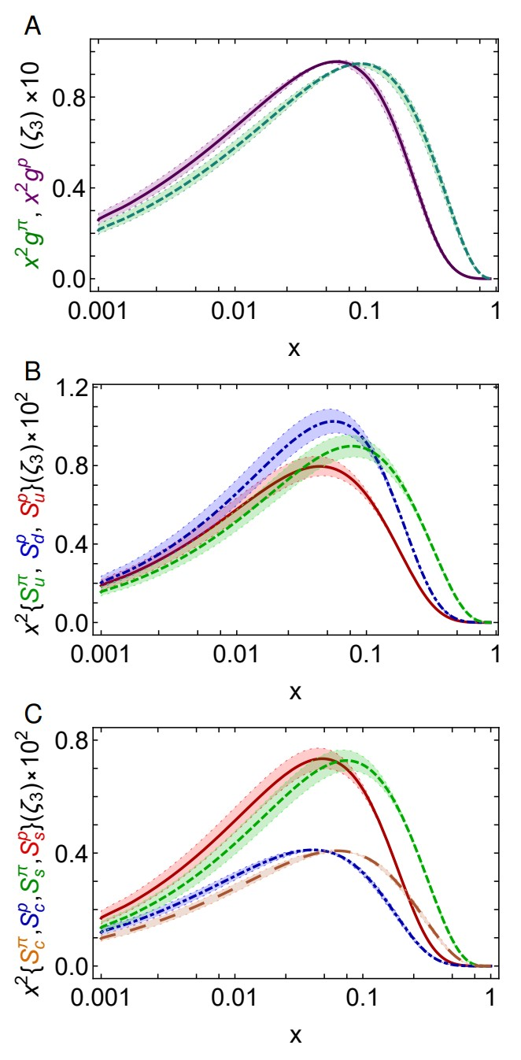
Proton and pion distribution functions in counterpoint – glue and sea
CSM prediction for glue-in-pion DF confirmed by recent lQCD simulation
[Regarding the distribution of glue in the pion, Lei Chang (常雷) and Craig D Roberts, e-Print: 2106.08451 [hep-ph], Chin. Phys. Lett. 38 (8) (2021) 081101/1-6]
Glue-in-π DF possess significantly more support on the valence domain $\left(x≥0.2\right)$ than the glue-in-p DF
Sea-in-π DF possess significantly more support on the valence domain than sea-in-p DFs.
s and c sea DFs are commensurate in size with those of the light-quark sea DFs
For s-and c-quarks, too, the pion DFs possess significantly greater support on the valence domain than the kindred proton DFs.
These outcomes are measurable expressions of EHM

Slide 37
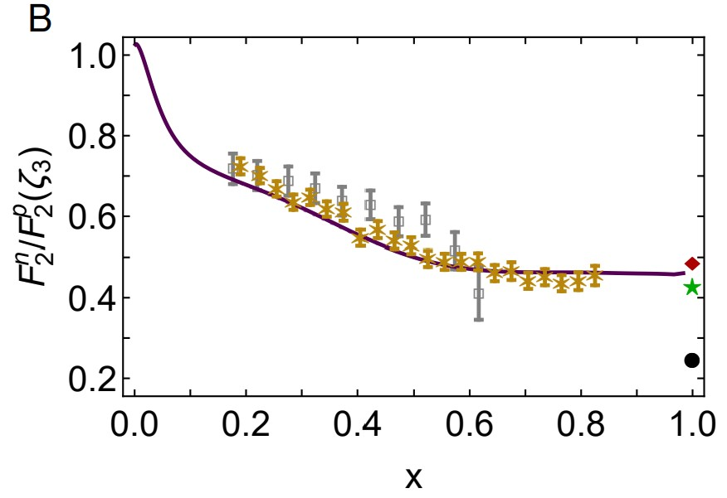
Neutron/Proton structure function ratio
CSM prediction = presence of axial-vector diquark correlation in the proton
Responsible for $≈40\%$ of proton charge
Ratio $1^{+}/0^{+}$ diquarks in proton wave function
is measure of EHM
Structure function ratio is clear window onto $d_{V}(x)/u_{V}(x)$
$U\left(x;ζ\right)=u\left(x;ζ\right)+\overline{u}\left(x;ζ\right)$, $D\left(x;ζ\right)=d\left(x;ζ\right)+\overline{d}\left(x;ζ\right)$
$Σ\left(x;ζ\right)=s\left(x;ζ\right)+\overline{s}\left(x;ζ\right)$+ $c\left(x;ζ\right)+\overline{c}\left(x;ζ\right)$
Comparison with MARATHON data
[D. Abrams, et al., Measurement of Nucleon $F_{2}^{n}/F_{2}^{p}$Structure Function Ratio by the Jefferson Lab MARATHON Tritium/Helium-3 Deep Inelastic Scattering Experiment – arXiv:2104.05850 [hep-ex], Phys. Rev. Lett. (2022) in press]
Agreement with modern data on entire x-domain – parameter-free prediction
Sea quark dominance on x<0.2
Valence quark dominance on x>0.2
🎆 Valence quark ratio in the proton, Zhu-Fang Cui, (崔著钫), Fei Gao (高飞), Daniele Binosi, Lei Chang (常雷), Craig D. Roberts and Sebastian M. Schmidt, NJU-INP 049/21, e-print: 2108.11493 [hep-ph], Chin. Phys. Lett. Express 39 (04) (2022) 041401/1-5: Express Letter
Probability that scalar diquark only models of nucleon might be consistent with available data is 1/7,000,000

Slide 38
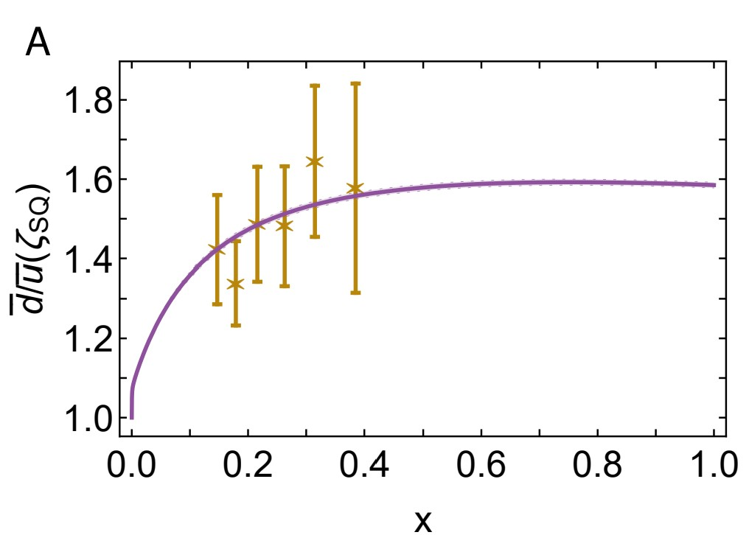
Asymmetry of antimatter in the proton
Pauli blocking: gluon splitting produces
$d+\overline{d}$ in preference to $u+\overline{u}$
Comparison with SeaQuest data
[J. Dove, et al., The asymmetry of antimatter in the proton, Nature 590 (7847) (2021) 561–565.]
Gottfried sum rule
Most recent result from global fits [CT18]: 0.110(80)
Proton and pion distribution functions in counterpoint, Ya Lu (陆亚), Lei Chang (常雷), Khépani Raya, Craig D. Roberts and José Rodríguez-Quintero, NJU-INP 056/22, e-Print: 2203.00753 [hep-ph], Phys. Lett. B 830 (2022) 137130/1-7
Parton distributions of light quarks and antiquarks in the proton, Lei Chang (常雷), Fei Gao (高飞) and Craig D. Roberts, NJU-INP 055/22, e-Print: 2201.07870 [hep-ph], Phys. Lett. B 829 (2022) 137078/1-7

Slide 39
Proton and pion distribution functions in counterpoint
CSMs have delivered 1st ever unified body of predictions for all proton and pion DFs
– valence, glue, and four-flavour-separated sea.
Within mesons & baryons that share familial flavour structure, light-front momentum fractions carried by identifiable, distinct parton classes are identical at any scale.
On the other hand, x-dependence of DFs is strongly hadron dependent
Smoking gun for EHM
At any resolving scale, ζ, those in the pion are the hardest (most dilated).
All CSM DFs comply with QCD constraints on endpoint (low- and high-x) scaling behaviour.
However, existing global fits ignore QCD constraints, so:
Fail to deliver realistic DFs, even from abundant proton data
Meson data almost nonexistent and controversial results from fits
Only after imposing QCD constraints on future phenomenological data fits will it be possible to draw reliable pictures of hadron structure.
Especially important for attempts to expose and understand differences between Nambu-Goldstone bosons and seemingly less complex hadrons.

Slide 40
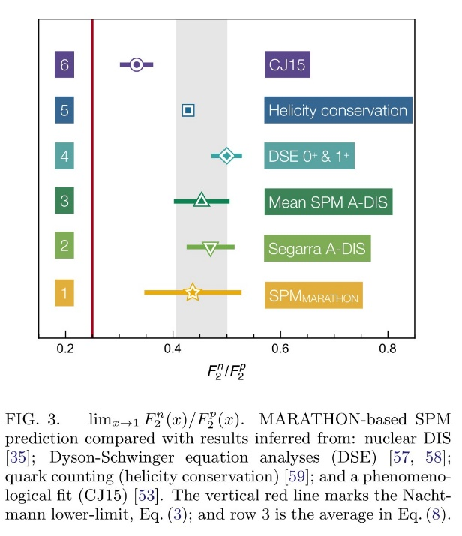
Many Other Expressions of EHM
EHM $⇒$ formation of nonpointlike diquark correlations within baryons
All baryons, including those with one or more heavy quarks
Proton possess $0^{+}$ isoscalar & $1^{+}$ isovector correlations
Marathon data $⇒$ Probability that proton contains
scalar-diquark-only = $\frac{1}{7,000,000}$
Ground state proton is not enough
Nucleon resonances
contain more correlations … $0^{−}$ isoscalar, $1^{−}$ isoscalar & $1^{−}$isovector
Nucleon-elastic & resonance transition form factors can test structural predictions
Electroweak transitions: heavy+light systems (Higgs boson dominant mass mechanism) to light (lighter) final states (in which EHM dominates) – interference between Nature’s two mass-generating mechanisms
Progress demands Synergy between Experiment + Phenomenology + Theory
$0^{+}$only
Presentations by …
d’Angelo, Segovia, Gothe, Kumano, Wilson

Slide 41
Emergent Hadron Mass
Grant no. 12135007
QCD is unique amongst known fundamental theories of natural phenomena
The degrees-of-freedom used to express the scale-free Lagrangian are not directly observable
Massless gauge bosons become massive, with no “human” interference
Gluon mass ensures a stable, infrared completion of the theory through the appearance of a running coupling that saturates at infrared momenta, being everywhere finite
Massless fermions become massive, producing
Massive baryons and simultaneously Massless mesons
These emergent features of QCD are expressed in every strong interaction observable
They can also be revealed via
EHM interference with Nature’s other known source of mass = Higgs
We are capable of building facilities that can validate these concepts, proving QCD to be
the 1st well-defined four-dimensional quantum field theory ever contemplated
This may open doors that lead far beyond the Standard Model

Slide 42
Emergent Hadron Mass
Grant no. 12135007
QCD is unique amongst known fundamental theories of natural phenomena
The degrees-of-freedom used to express the scale-free Lagrangian are not directly observable
Massless gauge bosons become massive, with no “human” interference
Gluon mass ensures a stable, infrared completion of the theory through the appearance of a running coupling that saturates at infrared momenta, being everywhere finite
Massless fermions become massive, producing
Massive baryons and simultaneously Massless mesons
These emergent features of QCD are expressed in every strong interaction observable
They can also be revealed via
EHM interference with Nature’s other known source of mass = Higgs
We are capable of building facilities that can validate these concepts, proving QCD to be
the 1st well-defined four-dimensional quantum field theory ever contemplated
This may open doors that lead far beyond the Standard Model
$${\text{L}}_{Nature}= ?$$
There are theories of many things,
But is there a theory of everything?

Slide 43
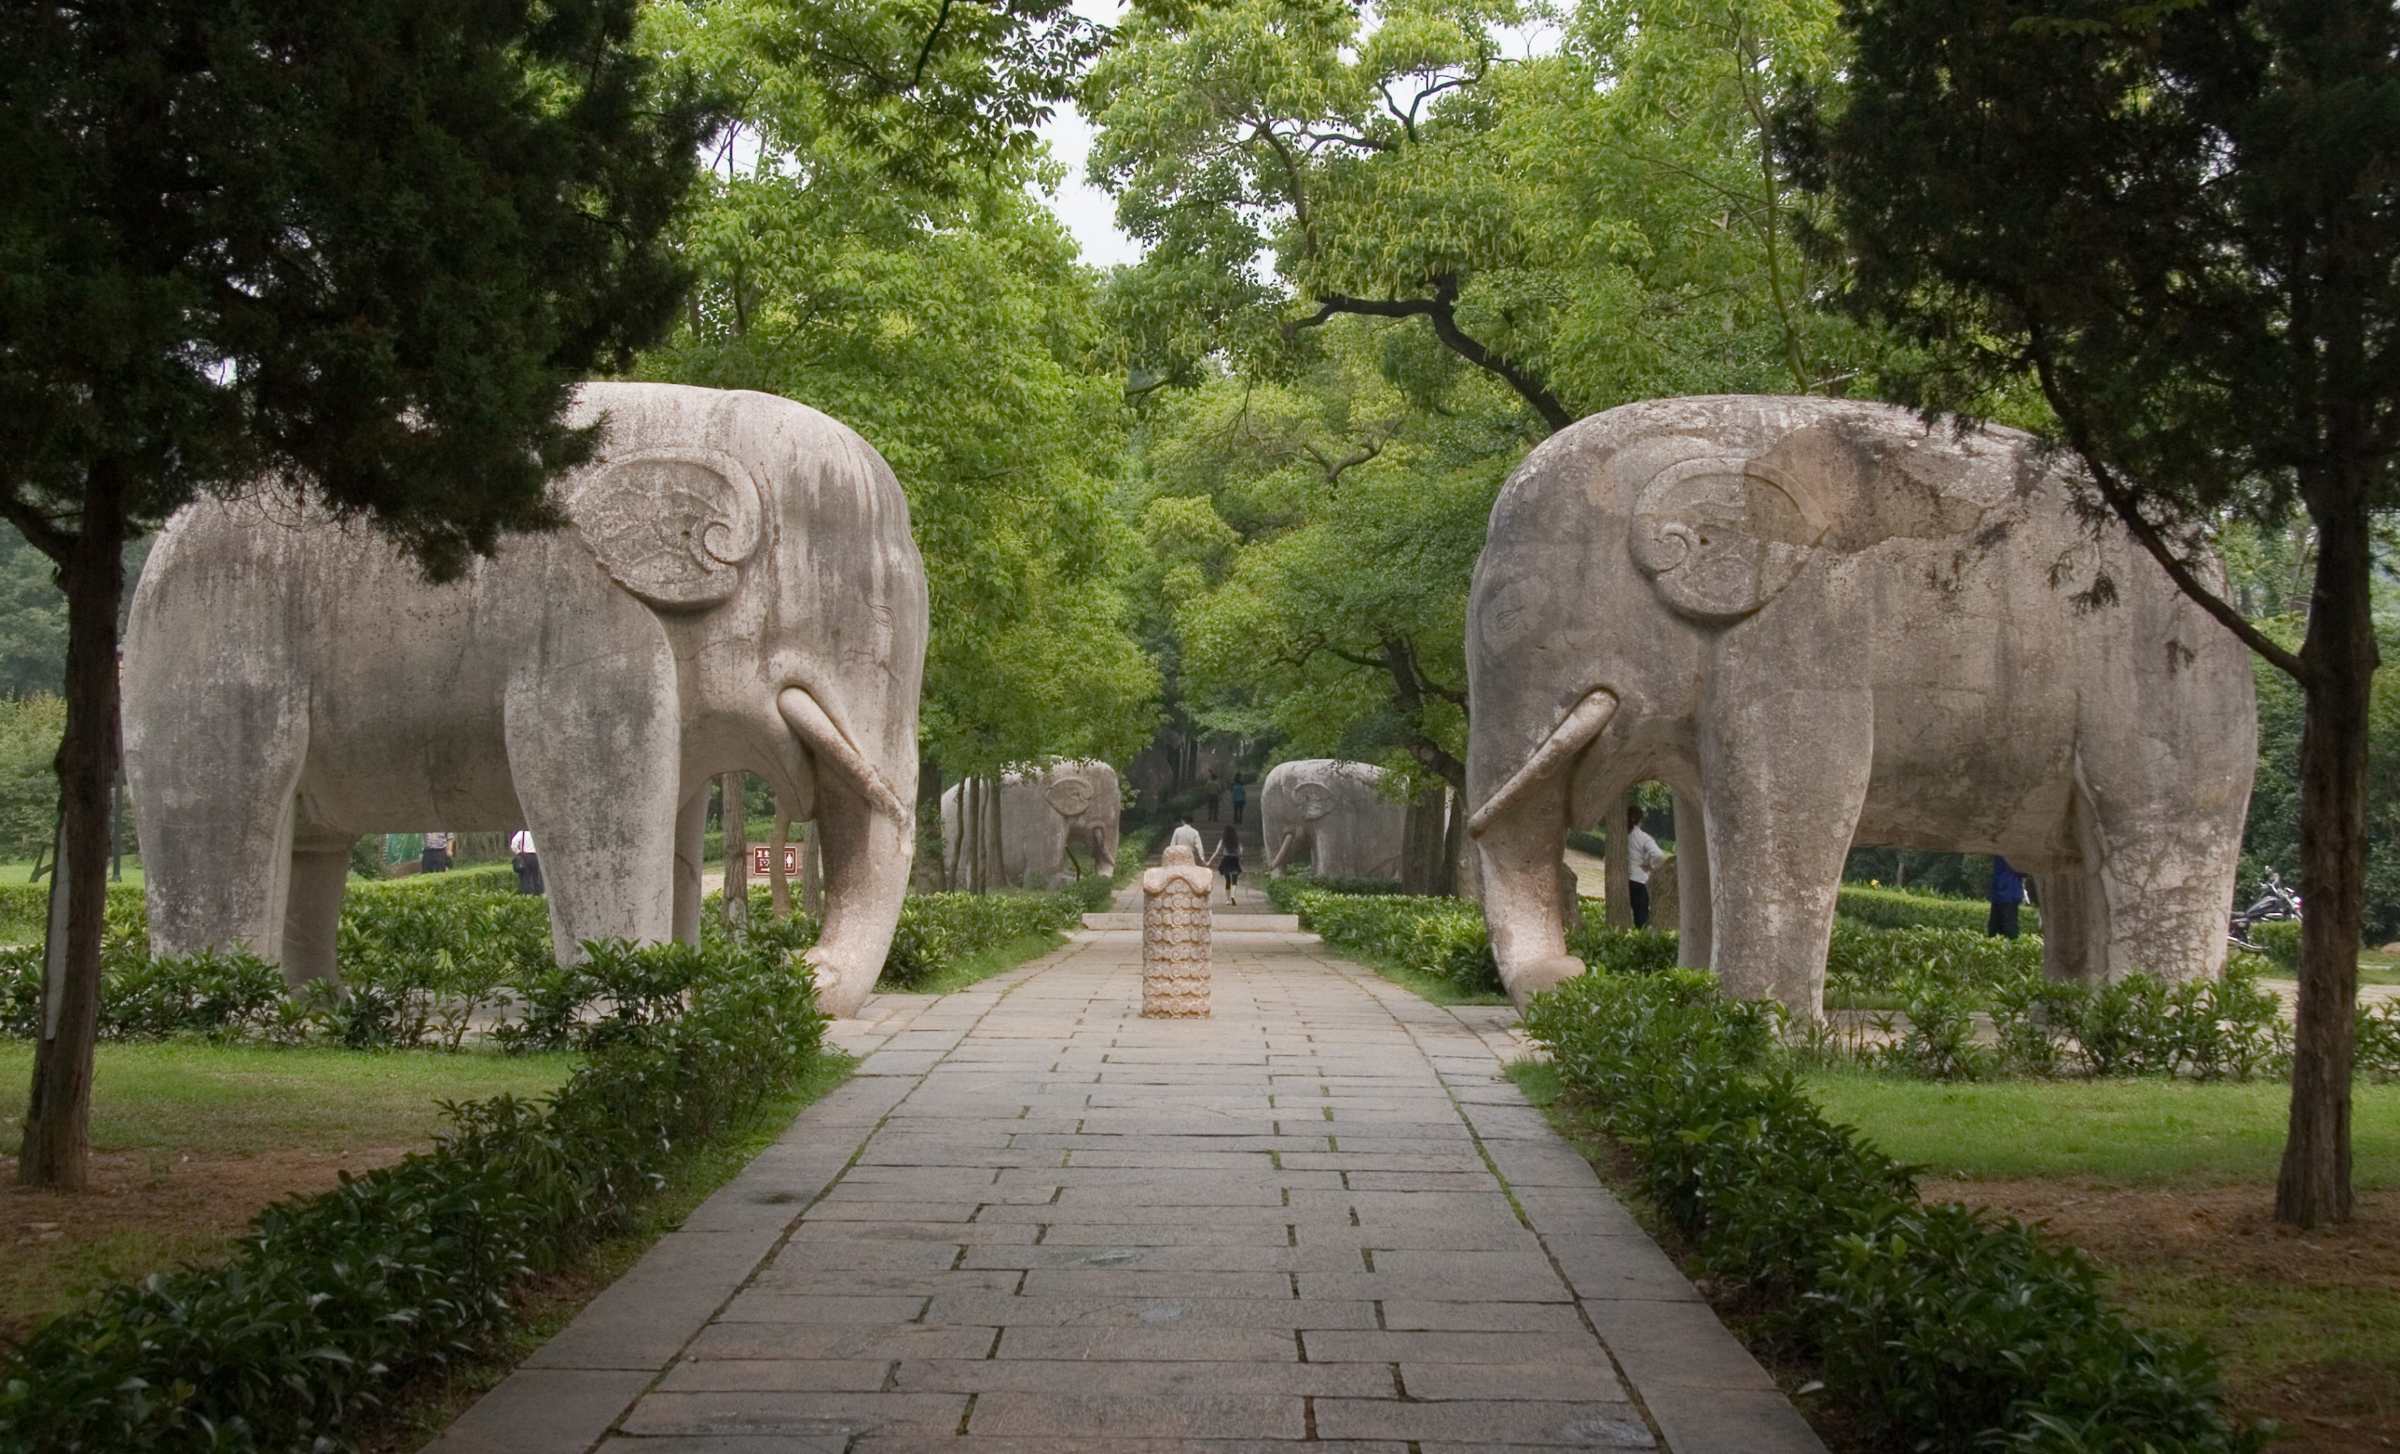
Thankyou

