Slide 1
Nuclear and Atomic transitions as laboratories for high precision tests of Quantum Gravity inspired models
Underground test of gravity-related
wave function collapse
Sandro Donadi
ISTITUTO NAZIONALE DI FISICA NUCLEARE (Trieste Section)
in collaboration with
K. Piscicchia, C. Curceanu, L. Diósi, M. Laubenstein, A. Bassi and L. Ferialdi
19/09/2022

Slide 2
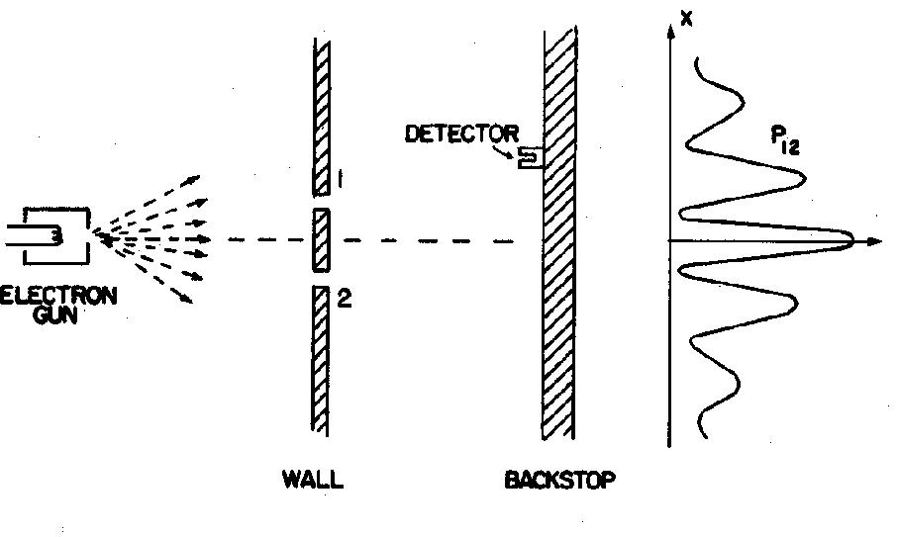
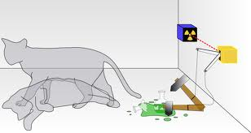
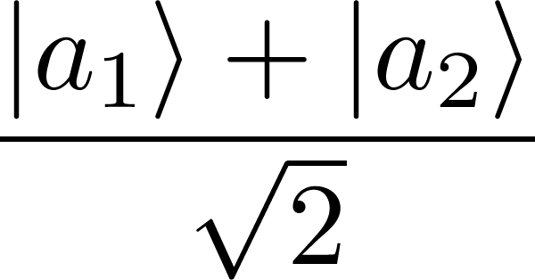
Underground test of gravity-related wave function collapse
- 19/09/2022, Sandro Donadi -
THE MEASUREMENT PROBLEM
The SchrÖdinger equation:
Linear
Deterministic
What exactly qualifies some physical systems to play the role of “measurer”?
Was the wave function of the world waiting to jump for thousands of millions of years until a single-celled living creature appeared? Or did it have to wait a little longer for some better qualified system...with a PhD?
J. S. Bell
OK
KO
The wave packet reduction postulate:
measurement
half of total cases
Non Linear
Stochastic
half of total cases
There are two different laws for the evolution of the state vectors but it is not clear when to use which one.

Slide 3
Underground test of gravity-related wave function collapse
- 19/09/2022, Sandro Donadi -
THE CSL MODEL
(CONTINUOUS SPONTANEOUS LOCALIZATIONS MODEL)
G.C. Ghirardi, P. Pearle and A. Rimini, Phys. Rev. A 42, 78 (1990).
SchrÖdinger
Stochasticity
Non linearity
First model valid also for identical particles;
Localization in space;
Amplification mechanism.
THE MASTER EQUATION

Slide 4
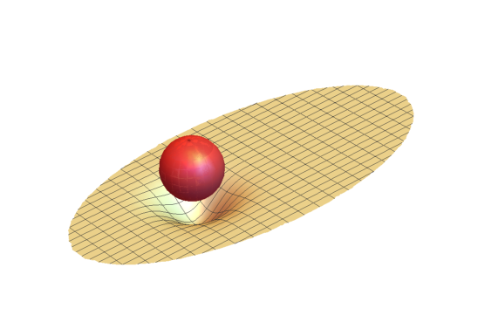
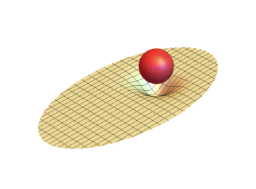
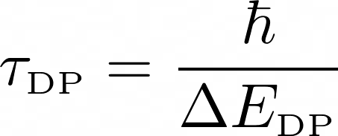
Underground test of gravity-related wave function collapse
- 19/09/2022, Sandro Donadi -
PENROSE PROPOSAL
R. Penrose, Gen. Relativ. Gravit. 28, 581–600 (1996).
R. Penrose, Found. Phys. 44, 557–575 (2014).
a
b
Proton: m ≃ 10⁻²⁷ Kg, R ≃ 10⁻¹⁵ m
𝜏_{DP}≃ 10⁶ years
Dust grain: m ≃ 10⁻¹² Kg, R ≃ 10⁻⁵ m
𝜏_{DP}≃ 10⁻⁸ s

Slide 5
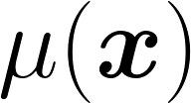
Underground test of gravity-related wave function collapse
- 19/09/2022, Sandro Donadi -
DIÓSI MODEL
L. Diósi, Phys. Rev. A 40, 1165–1174 (1989).
Schrödinger
Collapse
cannot be point-like → mass density with extension
G. Ghirardi, R. Grassi & A. Rimini, Phys. Rev. A 42, 1057 (1990)

Slide 6
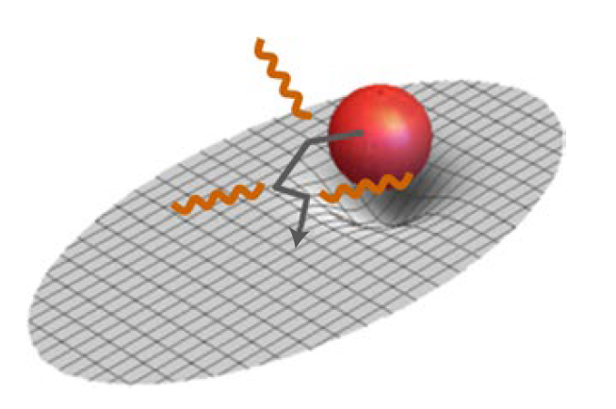
Underground test of gravity-related wave function collapse
- 19/09/2022, Sandro Donadi -
TEST OF THE MODEL
Interferometric tests, there are interesting proposals:
1) Optomechanical devices (W. Marshall, et al. Phys. Rev. Lett. 91, 130401 (2003)).
2) B.E.C. (R. Howl, R. Penrose, I. Fuentes, New J. Phys. 21, 043047 (2019)).
3) Experiments in space: no gravity ---> more time (MAQRO, CAL, etc..).
(A. Belenchia, et al. Nature 596, 32–34 (2021), G. Gasbarri et al. Commun. Phys. 4, 155 (2021))
…but they are still hard to perform.
Non interferometric tests does not require to create large superpositions!
When the system is charged, the master equation implies radiation emission, even when it is well localized! (S. Donadi, K. Piscicchia, C. Curceanu, L. Diósi, M.
Laubenstein, and A. Bassi, Nat. Phys. 17, 74 (2021).)
For the Continuous Spontaneous Localisation (CSL) model this kind of test is quite effective.

Slide 7
Underground test of gravity-related wave function collapse
- 19/09/2022, Sandro Donadi -
THEORETICAL CALCULATIONS: AN OUTLINE
Radiation emission rate:
Adjoint Master Equation:
Perturbative treatment of the collapse and the EM interaction, calculation ….. and more calculation….. and finally:
N = atomic number; Na = number of atoms;
R₀= mass density size.

Slide 8
Underground test of gravity-related wave function collapse
- 19/09/2022, Sandro Donadi -
AN EASIER APPROACH
S. L. Adler. J. Phys. A 40, 2935–2957 (2007).
Lead to the same master equation of the collapse equations —> same radiation emission

Slide 9
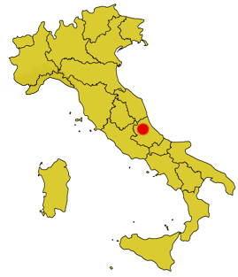
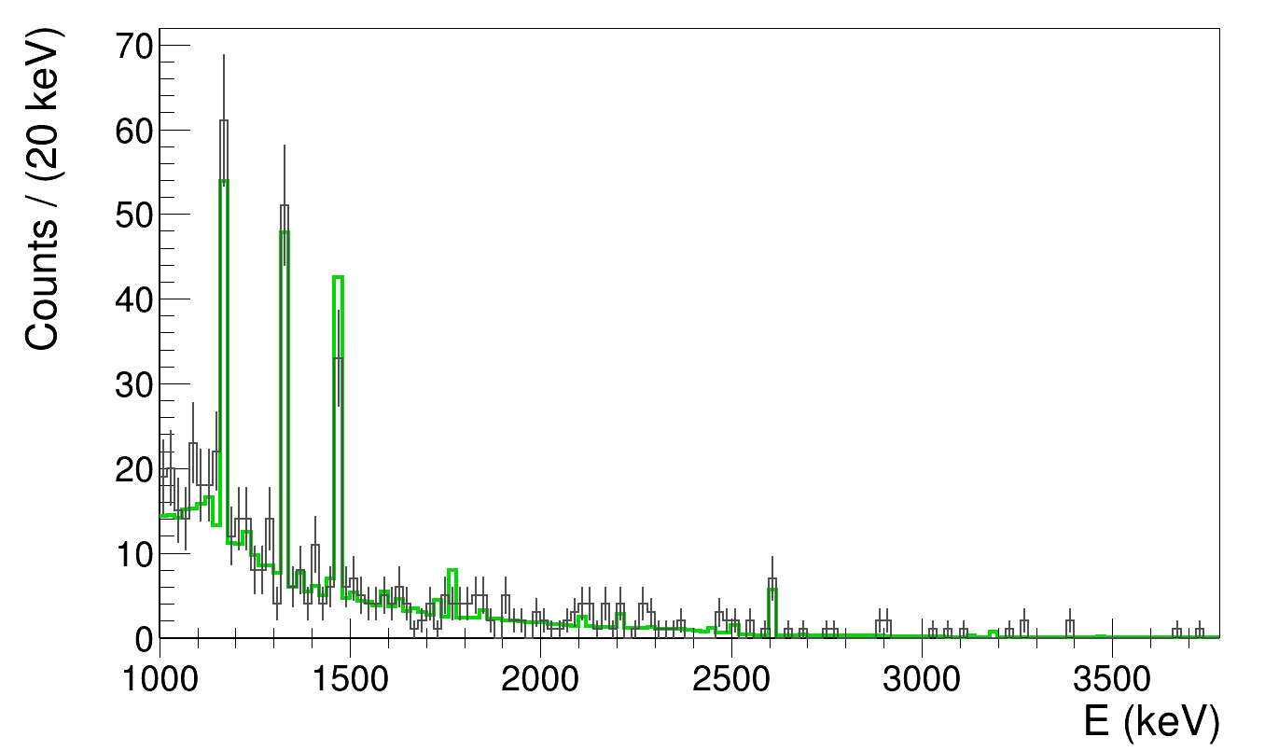
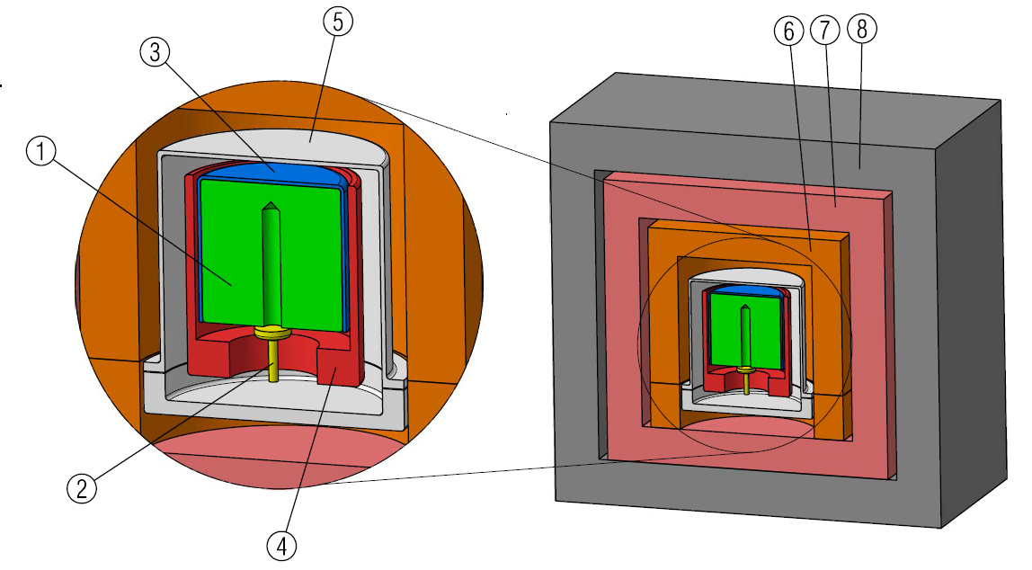
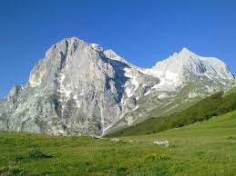
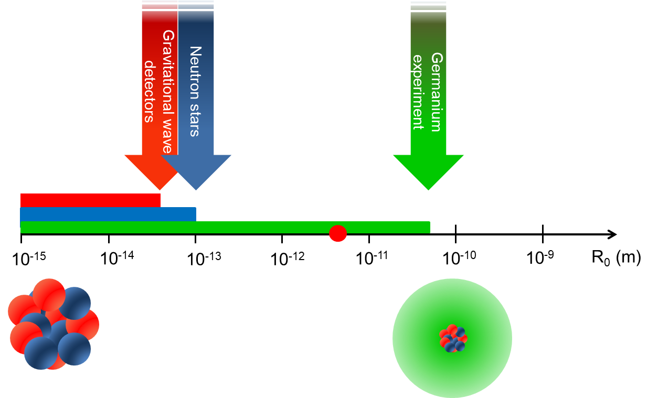
Underground test of gravity-related wave function collapse
- 19/09/2022, Sandro Donadi -
EXPERIMENTAL PART: SETUP AND MEASURED SPECTRUM
1, germanium crystal; 2, electric contact; 3, plastic insulator; 4, copper cup; 5, copper end-cup; 6, copper block and plate; 7, inner
copper shield; 8, lead shield.
Data collected in 62 days:
Grey line: measured, tot= 576
Green line: simulated, tot= 506
(95% c.l.)

Slide 10
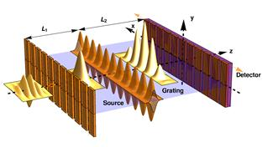
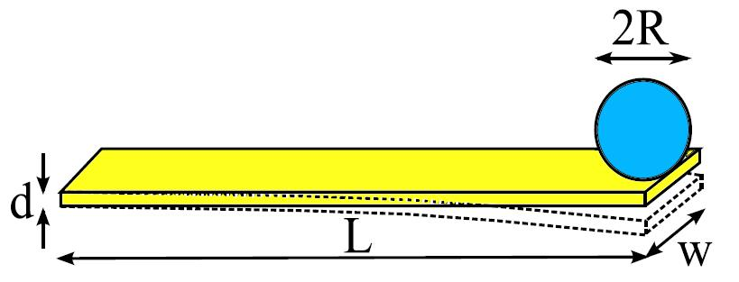
Underground test of gravity-related wave function collapse
- 19/09/2022, Sandro Donadi -
RELEVANT EXPERIMENTS
Matter-wave interferometry
- Y. Y. Fein, P. Geyer, P. Zwick, F. Kialka, S. Pedalino, M. Mayor, S. Gerlich, M. Arndt. Nature Physics 15(12), 1242 (2019).
- M. Toros, G. Gasbarri and A. Bassi, Phys. Lett. A 381(47), 3921 (2017)
Cantilever
A. Vinante, M. Bahrami, A. Bassi, O. Usenko, G. Wijts, T.H. Oosterkamp, Phys. Rev. Lett. 116, 090402 (2016).
A. Vinante et al. Phys. Rev. Lett. 125, 100404 (2020)
Cold atoms
- T. Kovachy, et al., Phys. Rev. Lett. 114, 143004 (2015)
- M. Bilardello, S. Donadi, A. Vinante and A. Bassi, Physica A 462, 764-782 (2016).
- F. Laloe, Franck, W. J. Mullin and P. Pearle, Phys. Rev. A 90 (5), 052119 (2014).

Slide 11
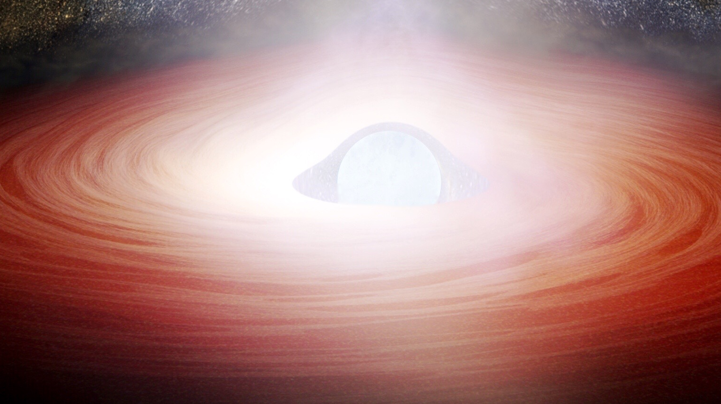
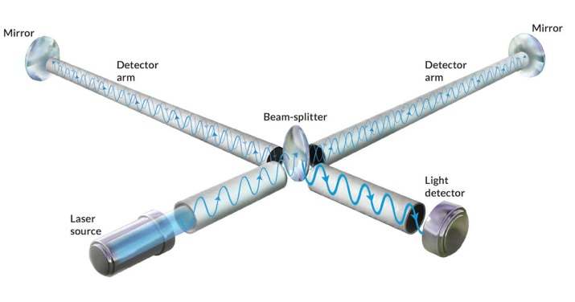
Underground test of gravity-related wave function collapse
- 19/09/2022, Sandro Donadi -
RELEVANT EXPERIMENTS
Neutron Star heating
- S. L. Adler, et al. Phys. Rev. D 99.10, 103001 (2019).
- A. Tilloy, T. M. Stace, Phys. Rev. Lett. 123, 080402 (2019).
Gravitational waves detection
- B. P. Abbott, et al., Phys. Rev. Lett. 116.6, 061102 (2016).
- B. Helou, B. Slagmolen, D. E. McClelland, and Y. Chen,
arXiv 1606.03637(2016).
- M. Carlesso, A. Bassi, P. Falferi, A.Vinante, Phys. Rev. D 94.12, 124036 (2016).
Radiation emission
- Q. Fu, Phys. Rev. A 56, 1806 (1997).
- S. Donadi, K. Piscicchia,, C. Curceanu, L. Diósi, M. Laubenstein, and A. Bassi, Nat. Phys. 17, 74–78 (2021).
- S. Donadi, K. Piscicchia, R. Del Grande, C. Curceanu, M. Laubenstein and A. Bassi, Eur. Phys. J. C 81(8), 1-10 (2021).

Slide 12
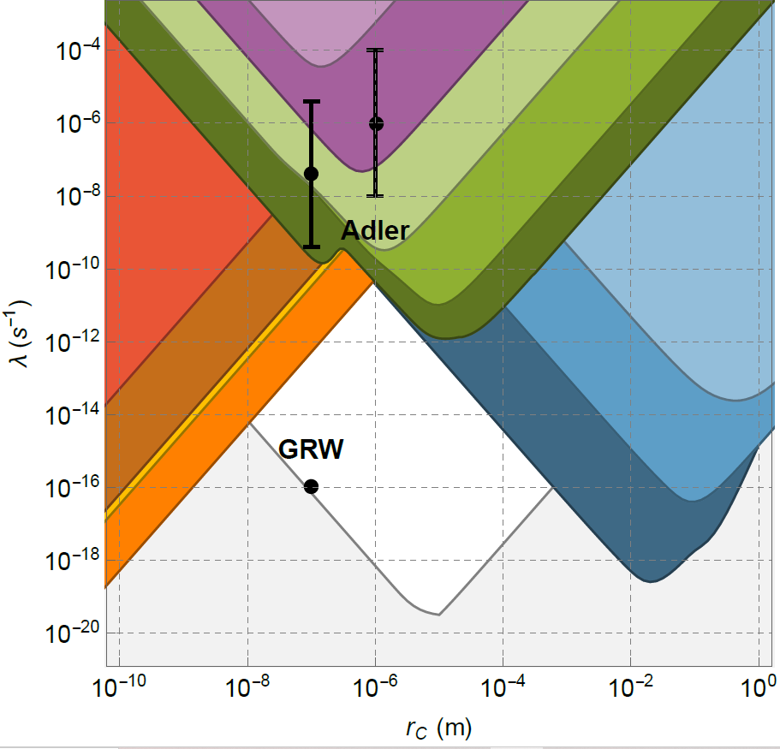
Underground test of gravity-related wave function collapse
- 19/09/2022, Sandro Donadi -
EXCLUSION PLOT, LAST UPDATE!
M. Carlesso, S. Donadi, L. Ferialdi, M. Paternostro, H. Ulbricht, A. Bassi. Nat. Phys. 18, 243 (2022).
Cantilever
Auriga
Cold gas
Cantilever
Neutron Star
LIGO
X-rays
LISA Pathfinder
Majorana
Theoretical

Slide 13
Underground test of gravity-related wave function collapse
- 19/09/2022, Sandro Donadi -
COLLAPSE DYNAMICS ARE DIFFUSIVE
Non-interferometric tests provide a powerful way to test collapse theories.
They are based on the diffusive motion induced by the noise responsible for collapse to systems.
TWO INTERESTING QUESTIONS
Is this a feature of collapse models or something more general?
Is it possible to have collapse without diffusion?
This is interesting from a phenomenological (non-interferometric tests) as well as from a more fundamental (diffusion is there or not?) point of view.

Slide 14
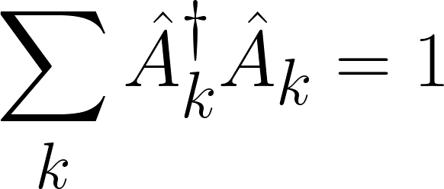
Underground test of gravity-related wave function collapse
- 19/09/2022, Sandro Donadi -
COLLAPSE DYNAMICS ARE DIFFUSIVE
We require that collapse cannot be used to do signalling in EPR-like setups. This implies the map must be linear (N. Gisin, Helv. Phys. Acta 62.4, 363-371 (1989)).
We also require the map to be completely positive → Kraus form:
We require the map to be space-translational invariant:

Slide 15
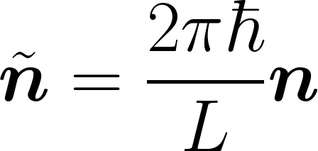
Underground test of gravity-related wave function collapse
- 19/09/2022, Sandro Donadi -
COLLAPSE DYNAMICS ARE DIFFUSIVE
We focus on maps that does not change the average momentum. Then the diffusion along the j direction is quantified by:
which takes the form:
is a probability distribution for the variable for all .

Slide 16
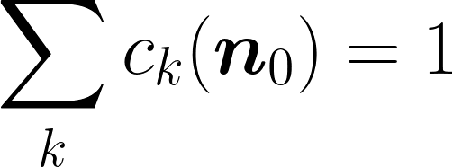
Underground test of gravity-related wave function collapse
- 19/09/2022, Sandro Donadi -
COLLAPSE DYNAMICS ARE DIFFUSIVE
Let us suppose that for all plane waves one has:
We can characterise the map:
This map cannot collapse in position.

Slide 17
Underground test of gravity-related wave function collapse
- 19/09/2022, Sandro Donadi -
COLLAPSE DYNAMICS ARE DIFFUSIVE
Let us suppose that for a specific plane wave the map induces diffusion:
Keeping in mind that for a generic state:
all states which has the component diffuse.
A model which collapses in space must affect all plane waves.
Conclusion: Collapse in space comes together with diffusion in momentum.

Slide 18
Underground test of gravity-related wave function collapse
- 19/09/2022, Sandro Donadi -
CONCLUSIONS
Collapse models solve the measurement problem by modifying the Schrödinger equation, adding proper stochastic and nonlinear terms that induce collapse in space.
Several experiments set bounds on the CSL and DP model, narrowing the allowed parameter space. The strongest bounds are coming from non-interferometric experiments.
The diffusion in momentum, typical of the GRW, CSL and DP models, it is a general feature of collapse dynamics, as long as one requires no faster than light signalling and space translational invariance.

Slide 19
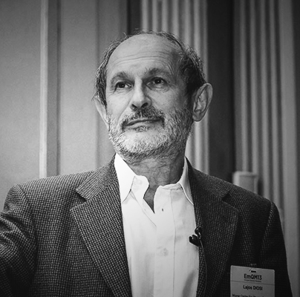
Underground test of gravity-related wave function collapse
- 19/09/2022, Sandro Donadi -
COLLABORATORS
Kristian Piscicchia
Centro Enrico
Fermi (Rome)
Catalina Curceanu
Frascati Laboratories (Rome)
Lajos Diósi
Wigner Research
Centre (Budapest)-
Matthias Laubenstein
Gran Sasso Laboratories
(Gran Sasso)
Angelo Bassi
Trieste University
(Trieste)
Luca Ferialdi
Palermo University
(Palermo)
GROUP IN TRIESTE
Angelo Bassi
(Group Leader)
José Luis
Gaona Reyes
(Post-Doc)
Anirudh
Gundhi
(PhD)
Laria
Figurato
(PhD)
Michele
Vischi
(PhD)
Francesco
Cesa
(PhD)
Giovanni Di Bartolomeo
(PhD)
THANKS

