Slide 1
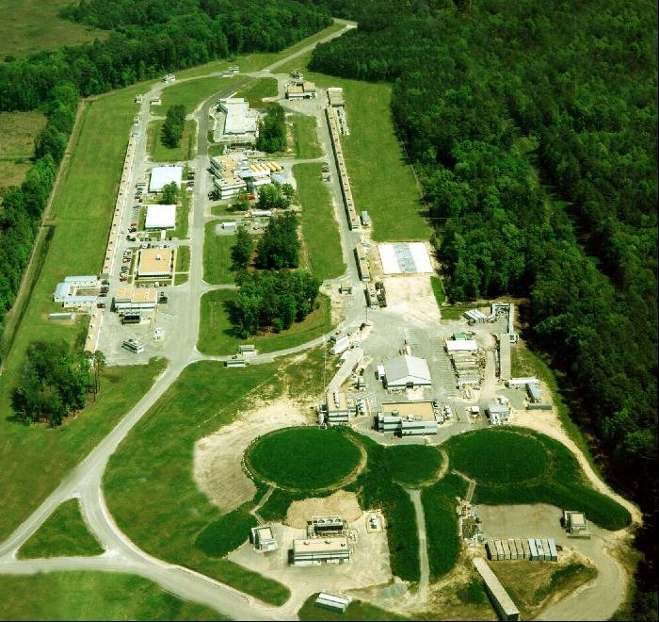
Hampton University
Spin effects and two-photon exchange in electron scattering
below the second resonance region: an effective theory approach
Jose L Goity
Hampton University and Jefferson Lab
collaboration with Christian Weiss and Cintia Willemyns
July 18-22, 2022

Slide 2
Outline
Two photon exchange and single spin asymmetries - generalities
Focus of this work: transverse target SSA- approach based on the 1/Nc expansion
Results
Comments and summary
TPE & SSA topic is very old > 60 years. Many works; let me know of your works!
historical works that established the topic of SSAs: Barut & Fronsdal; Leroy & Piketty; De Rujula, Kaplan and De Rafael; Gunther & Rodenberg;
numerous works since the 2000’s on TPE and SSA’s: Guichon & Vanderhaeghen; Blunden, Melnitchouk & Tjon; Gorshtein et al; Afanasev et al.; Myhrer et al; in DIS: Metz, Schlegel & Goeke; Afanasev, Strikman & Weiss; many more...

Slide 3
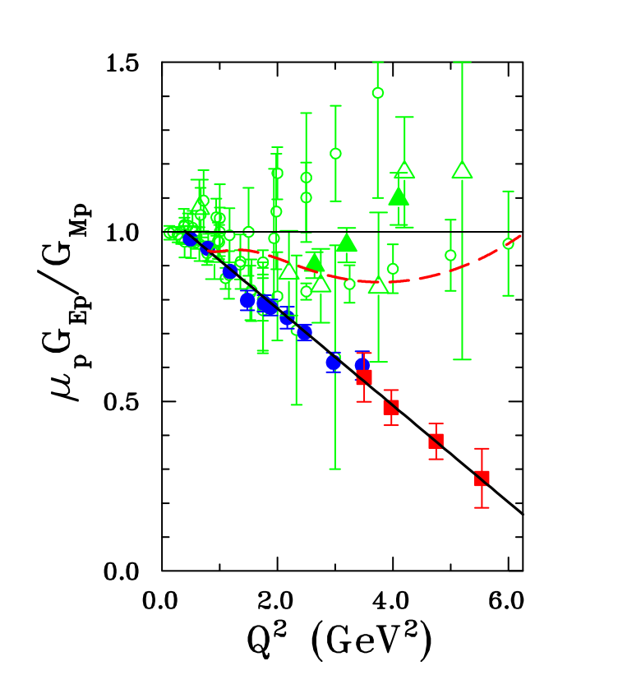
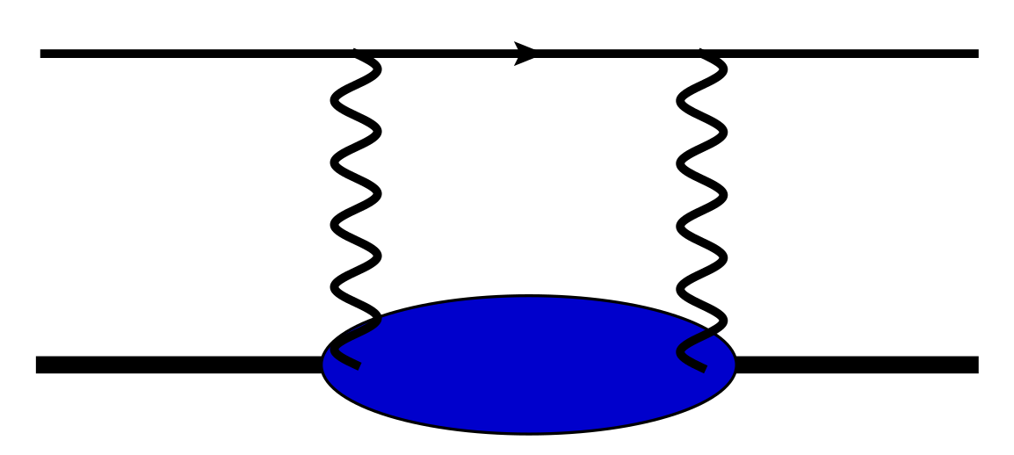
TPE: Two-photon exchange in electron-nucleon scattering
TPE order α² correction to amplitude; same order as radiative corrections – new effects
TPE is needed in the extraction of the ratio G_{E}/G_{M} via Rosenbluth separation - numerous works; elastic and inelastic contributions
general description requires the (doubly virtual) Compton amplitude
a particularly clean and interesting observable:
transverse single spin asymmetry SSA in e N scattering
SSA occurs first at TPE level - given by absorptive part of TPE amplitude: obtainable through electro-production amplitudes
we are interested in setting up a framework to study the target SSA, TSSA above the first resonance, where Δ plays a prominent role
framework based on the 1/Nc expansion - provides a low/intermediate energy power counting scheme to organize the calculation of the TSSA in that regime

Slide 4
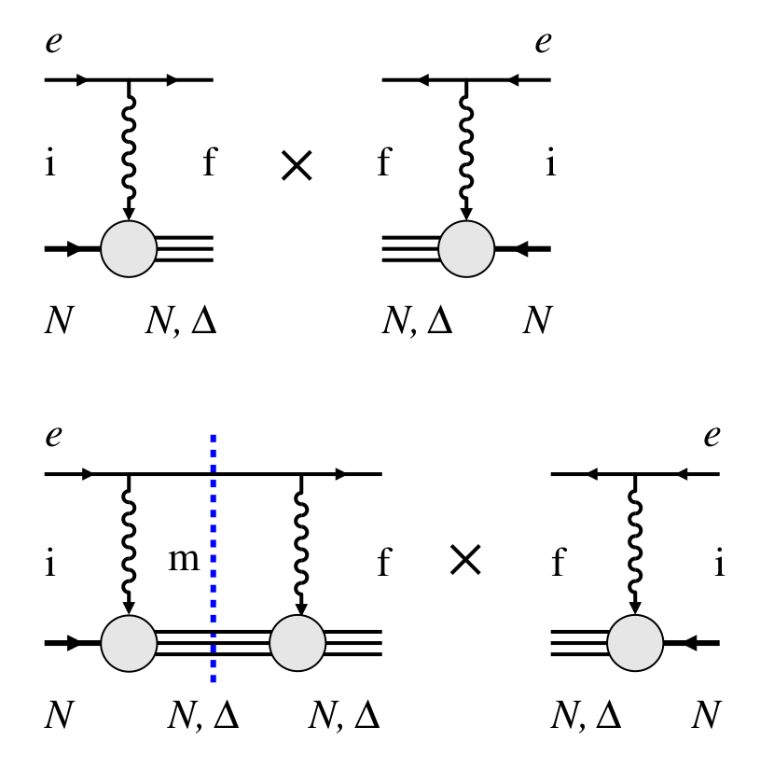
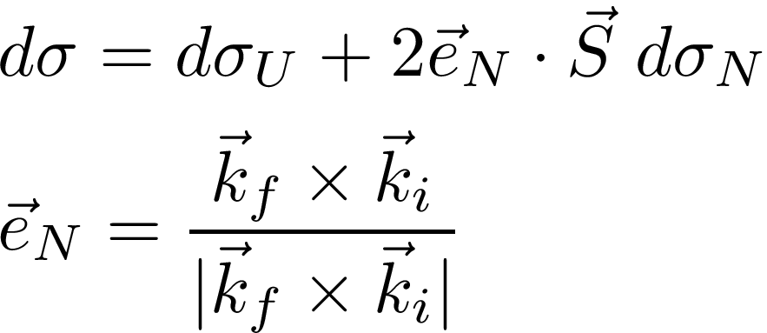
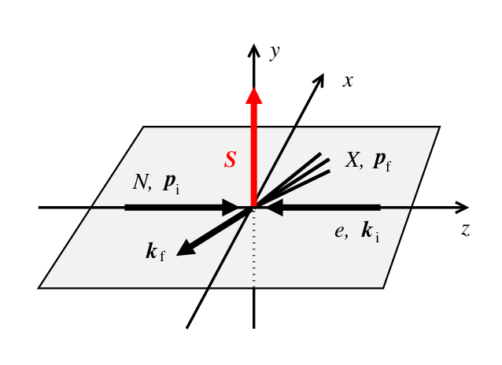
SSA generalities
double polarization asymmetries: LO in QED,
SSAs: NLO in QED
QED+QCD: T symm forbids tree level SSA (Barut-Fronsdal (1960))
SM: has CP violation = T violation: tree level possible in inelastic channels
too small to be observable (Christ-Lee (1966))
SSA requires absorptive part of 2 photon exchange amplitude
(Barut-Fronsdal (1960))
interference between absorptive part of box diagram and OPE
definition of the TSSA
All in CM frame

Slide 5
Generalities about
Only states with invariant mass below can contribute
is free of collinear and IR divergencies: key role played by gauge invariance
SSA can be selected for exclusive final states
In principle full knowledge of electroproduction helicity amplitudes determines unambiguously the SSA – limited by experimentally established amplitudes
Energy regimes: 1) low/intermediate up to onset of second resonance region: few degrees of freedom; least uncertain theoretical understanding (topic of this talk) 2) Resonance region: 1.5 to few GeV
3) High energy region: e.g., partonic regime
For Dirac target particle:
Important modifications due to anomalous magnetic moment: case of nucleons at low energy, and form factors

Slide 6
FRAMEWORK FOR TSSA BELOW SECOND RESONANCE REGION
few degrees of freedom N, Δ, πN continuum
unifying framework that treats this regime based on these dof and a rigorous
QCD expansion: 1/Nc, and at low energy in addition Chiral Perturbation Theory
implement 1/Nc expansion with N and Δ, and argue about the subleading role of the πN continuum

Slide 7
The 1/Nc EXPANSION
fundamental expansion in QCD: many phenomenological successes; LQCD also
recent tests in LQCD with Nc>3
can be implemented at hadronic level: determines Nc order of observables
particularly powerful for baryons:
at large Nc the baryon sector develops a spin-flavor SU(4) or SU(6) dynamical symmetry
N and Δ belong to an SU(4) multiplet: unification of properties
breaking of SU(4) by subleading orders in 1/Nc: formalism to describe higher orders 1/Nc
Nc scalings of basic observables:

Slide 8
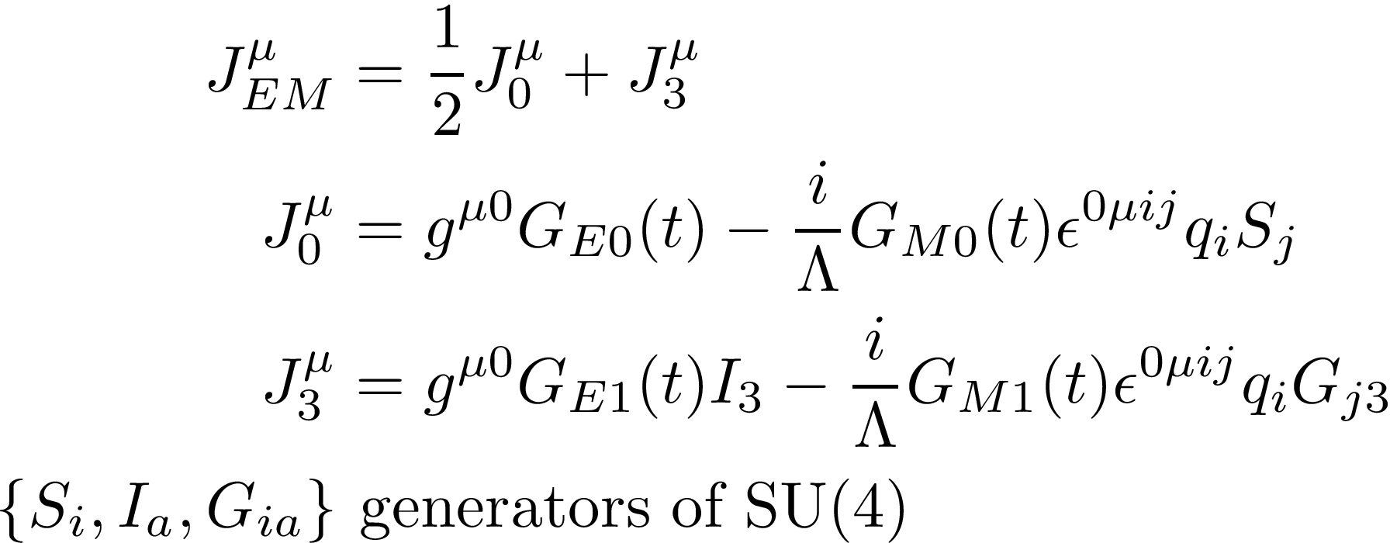
Systematic expansion in 1/Nc: LO and NLO for SSA
In regime of interest 1/Nc expansion implies NR expansion:
baryons have small velocities O(1/Nc) in CM frame
Expand the Baryon EM current to first subleading order in 1/Nc
EM current has O(Nc) term: the isotriplet magnetic one:
clearly manifested in the isosinglet vs isotriplet N magnetic moments:

Slide 9
Calculation of the TSSA

Slide 10
A first calculation: LO in 1/Nc – corresponds to large Nc limit
given in terms of the isovector magnetic current
match magnetic coupling at Nc=3 to physical one
pick LO terms in hadronic tensor: LO given by I=J t-channel rule
simple results without t-dependence of FF – shows dominance of the elastic case with intermediate state contribution of N equal ½ of the Δ
FF: is universal at LO: we use dipole form with standard scale
Inclusion of FF makes major difference: inelastic channel, Bf=Δ, becomes large and of opposite sign to elastic – non-trivial FF interplay in box
Check cancellations of IR divergencies

Slide 11
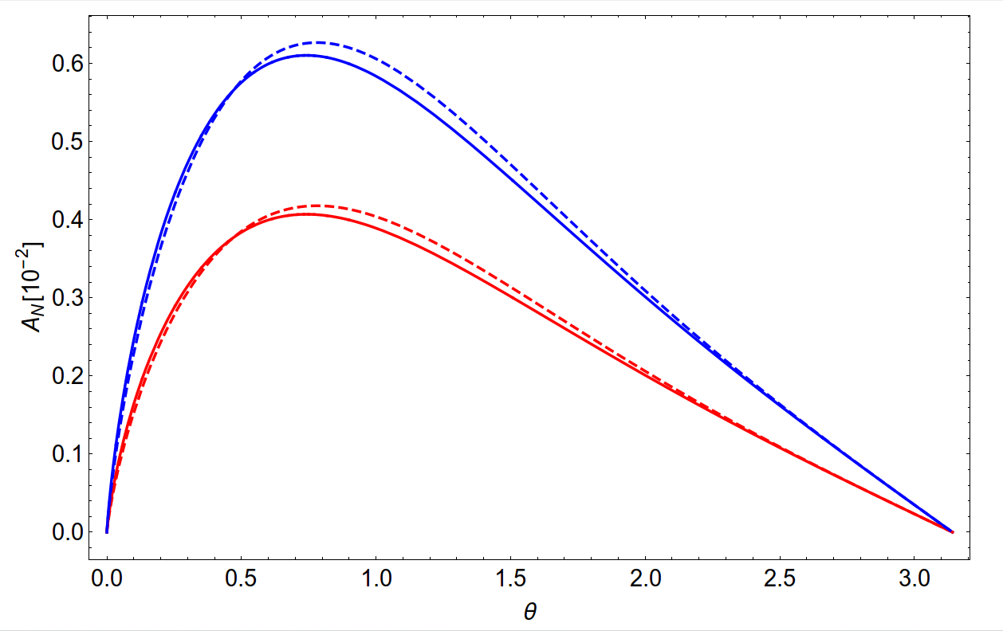
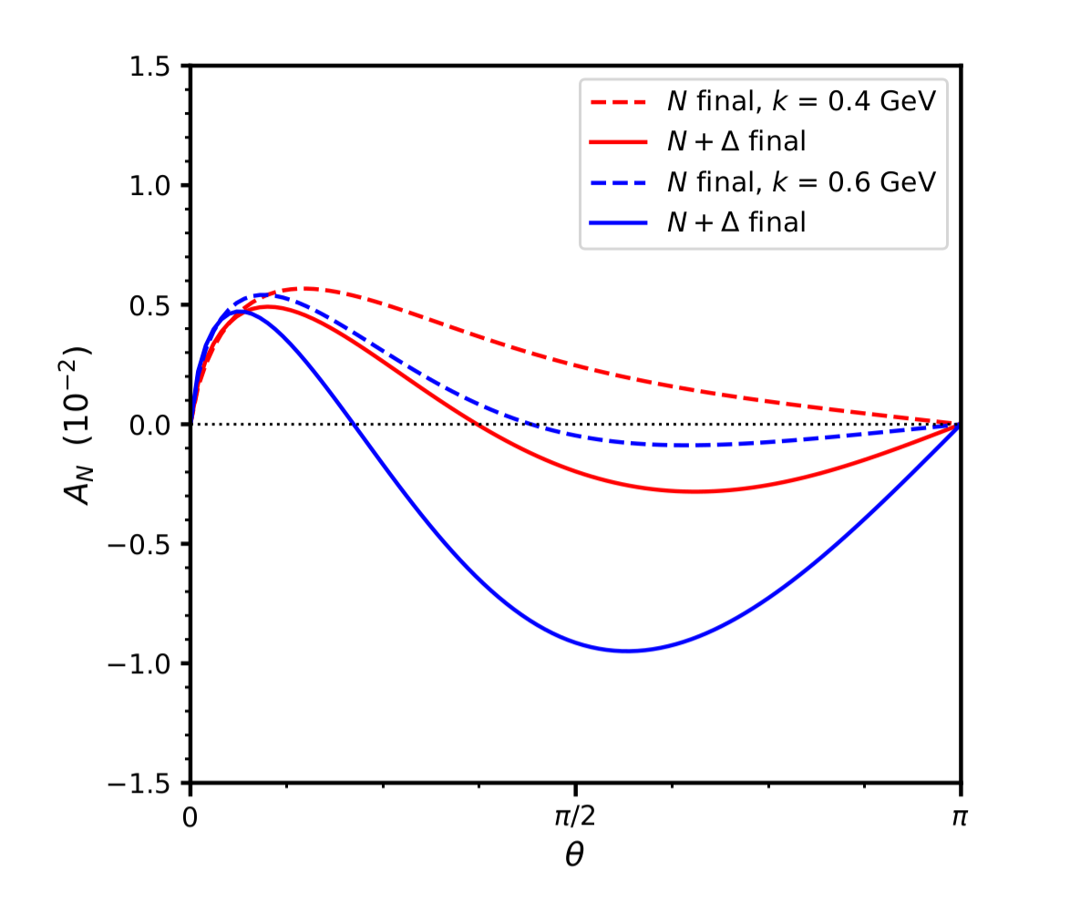
No FF
JLG, Weiss, Willemyns arXiv:2207.07588

Slide 12
Weiss, Willemyns, JLG in progress
NLO CALCULATION
decompose hadronic tensor into t-channel irreducible angular momentum and isospin components: SU(4) algebra organizes contributions in powers of 1/Nc
separate effects by N and Δ channels in the box and final state
consistent cancellations of IR and collinear divergences for each channel and for gauge invariant combinations of EM current components
validated with NR expansion of the known purely elastic case
toy calculation without t-dependence in FFs
inclusion of FFs and Δ width

Slide 13
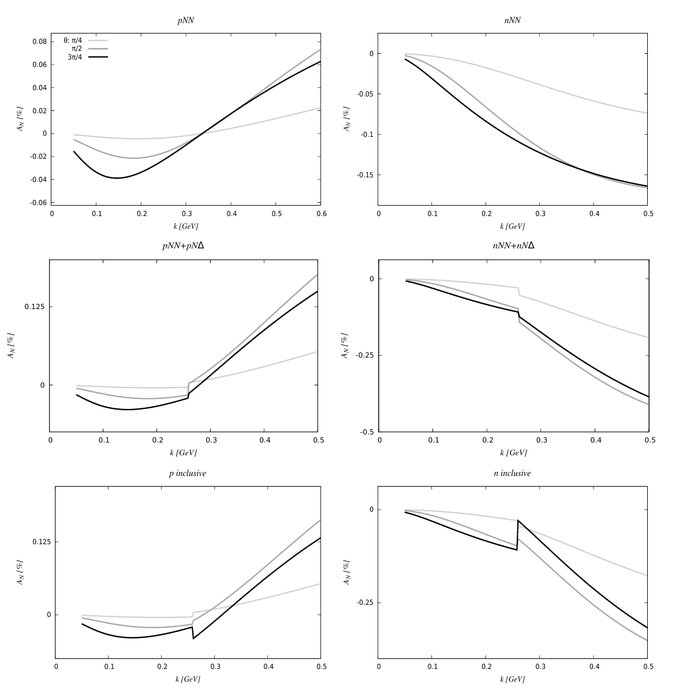
Results
PRELIMINARY
Electric component of current only appears linearly
Large Nc limit checked
Dominance of elastic asymmetry
Very small inelastic asymmetry
Kinematics taken exactly
Finite discontinuity at Δ mass

Slide 14
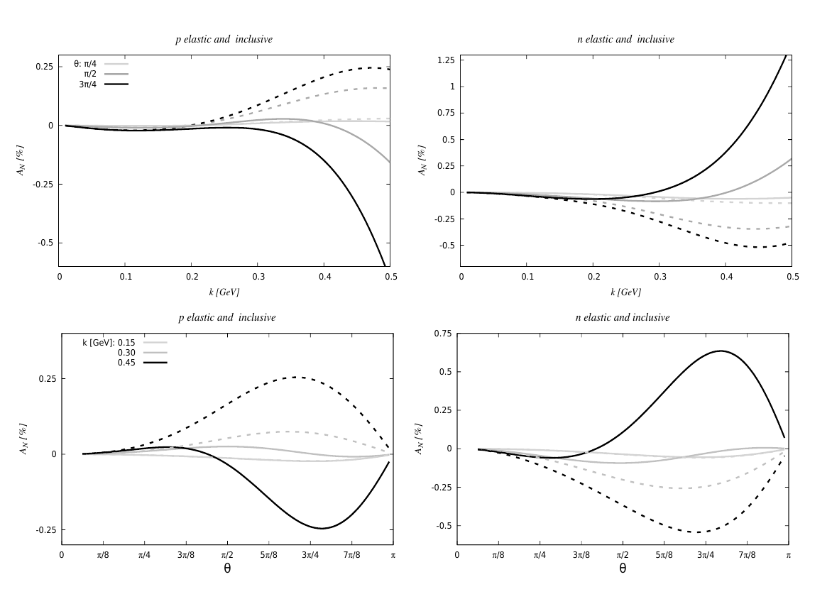
PRELIMINARY
FF play crucial role – enhances inelastic channel
Inelastic channel gives opposite sign asymmetry to elastic one: changes sign of inclusive asymmetry
sensitive energy dependence of asymmetry – we keep kinematic factors exact
Asymmetry below Δ is O(10⁻³)
Asymmetry above Δ is O(10⁻²)

Slide 15
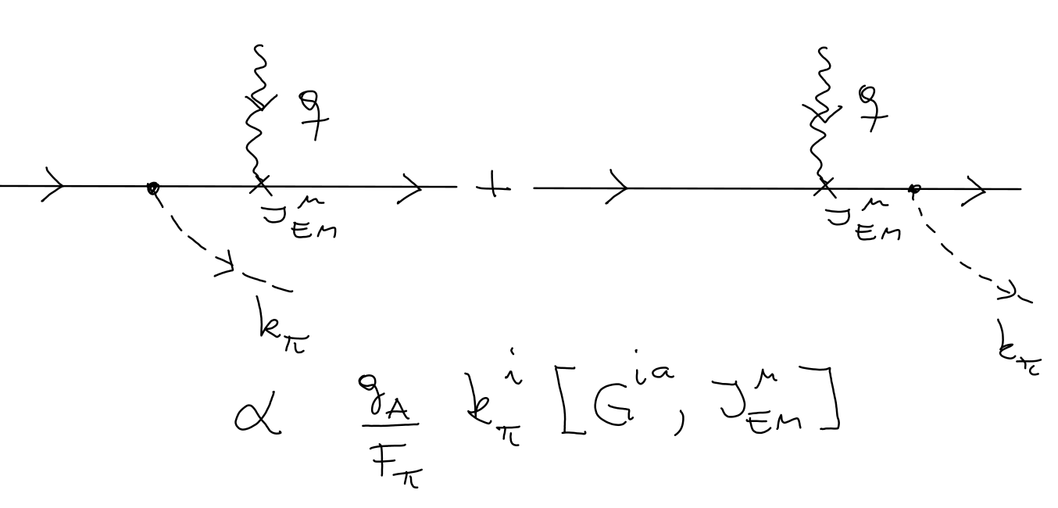
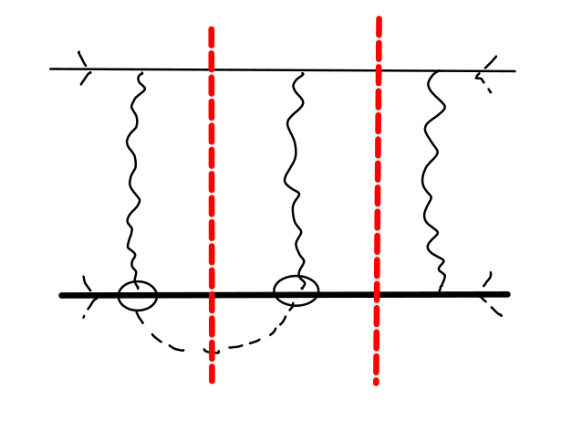
OTHER TSSA CHANNELS
- πN Continuum

Slide 16
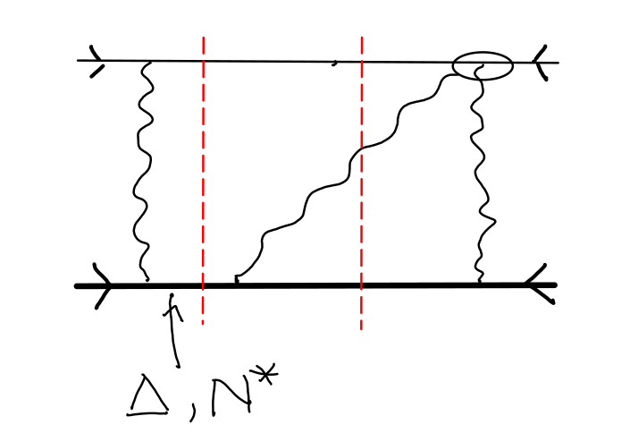
Photon emission

Slide 17
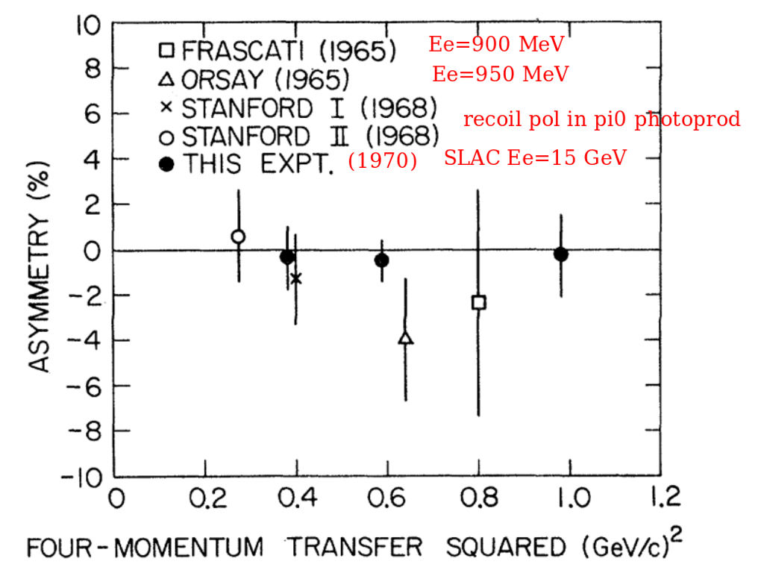
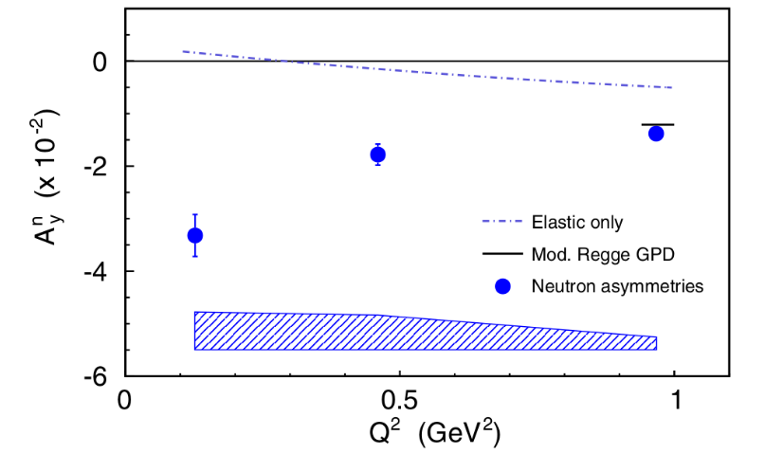
The experimental side
old expts at relatively low energy - errors too large, no definite signal of asymmetry
JLab Hall A for neutron: Ee=1.2, 2.4 & 3.6 GeV - energy a bit high for direct comparison consistent with magnitude – more complicated target
HERMES: DIS with e- and e+ beam - energy above our range
new proposal for JLab Hall A (Grauvogel et al): Ee>2.2 GeV (may use e+)
only e- beam energy in the region of our interest is MAMI @ Mainz
muon beam – available at PSI. muon or target polarization available?
very interesting evolution of TSSA at low to intermediate energies: first significant measurements would be very important and interesting!

Slide 18
Comments & summary
SSAs are important tool to study baryon structure in all energy regimes
1/Nc expansion provides one systematic approach in the energy range below second resonance region with N and Δ as effective dof
it organizes the contributions by ordering in powers of 1/Nc; helps sort out the physics in more detail
very important role played by form factors: big enhancement of Δ final state asymmetry
we need experiments eN or μN from ~.3 to few GeV
Thanks!

