Slide 1
Exotic decays
¹¹Be ⁸B ¹²B/¹²N
ECT* 6/7/2022
Notes:
I am an experimental physicist working on subatomic physics

Slide 2
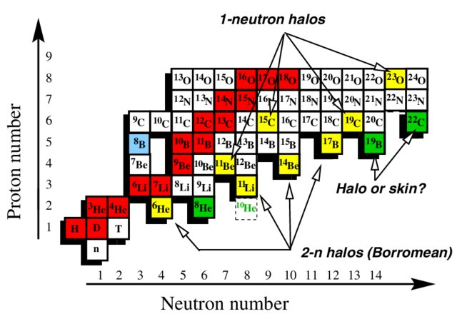

Slide 3
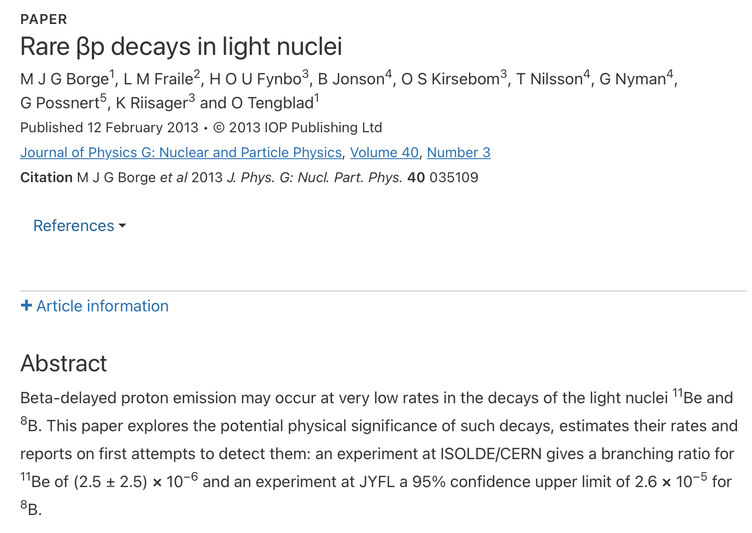
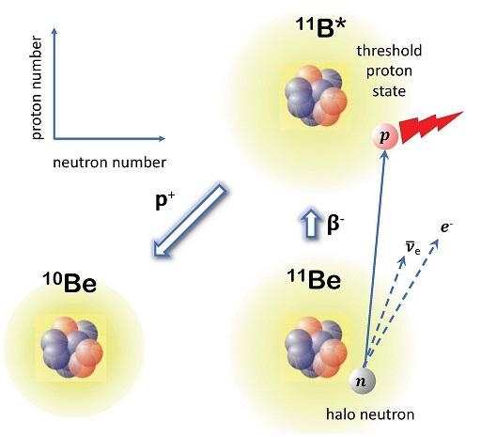
Credit: PAN

Slide 4
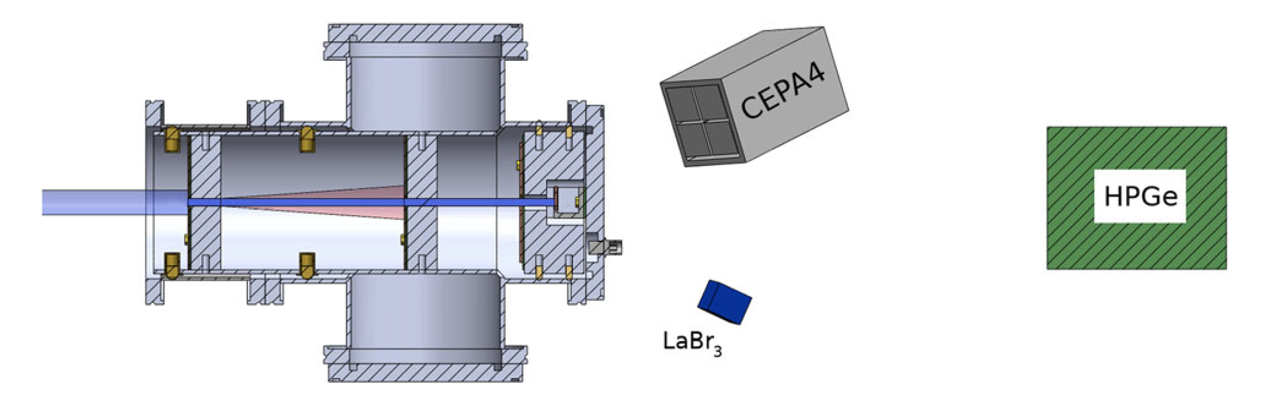
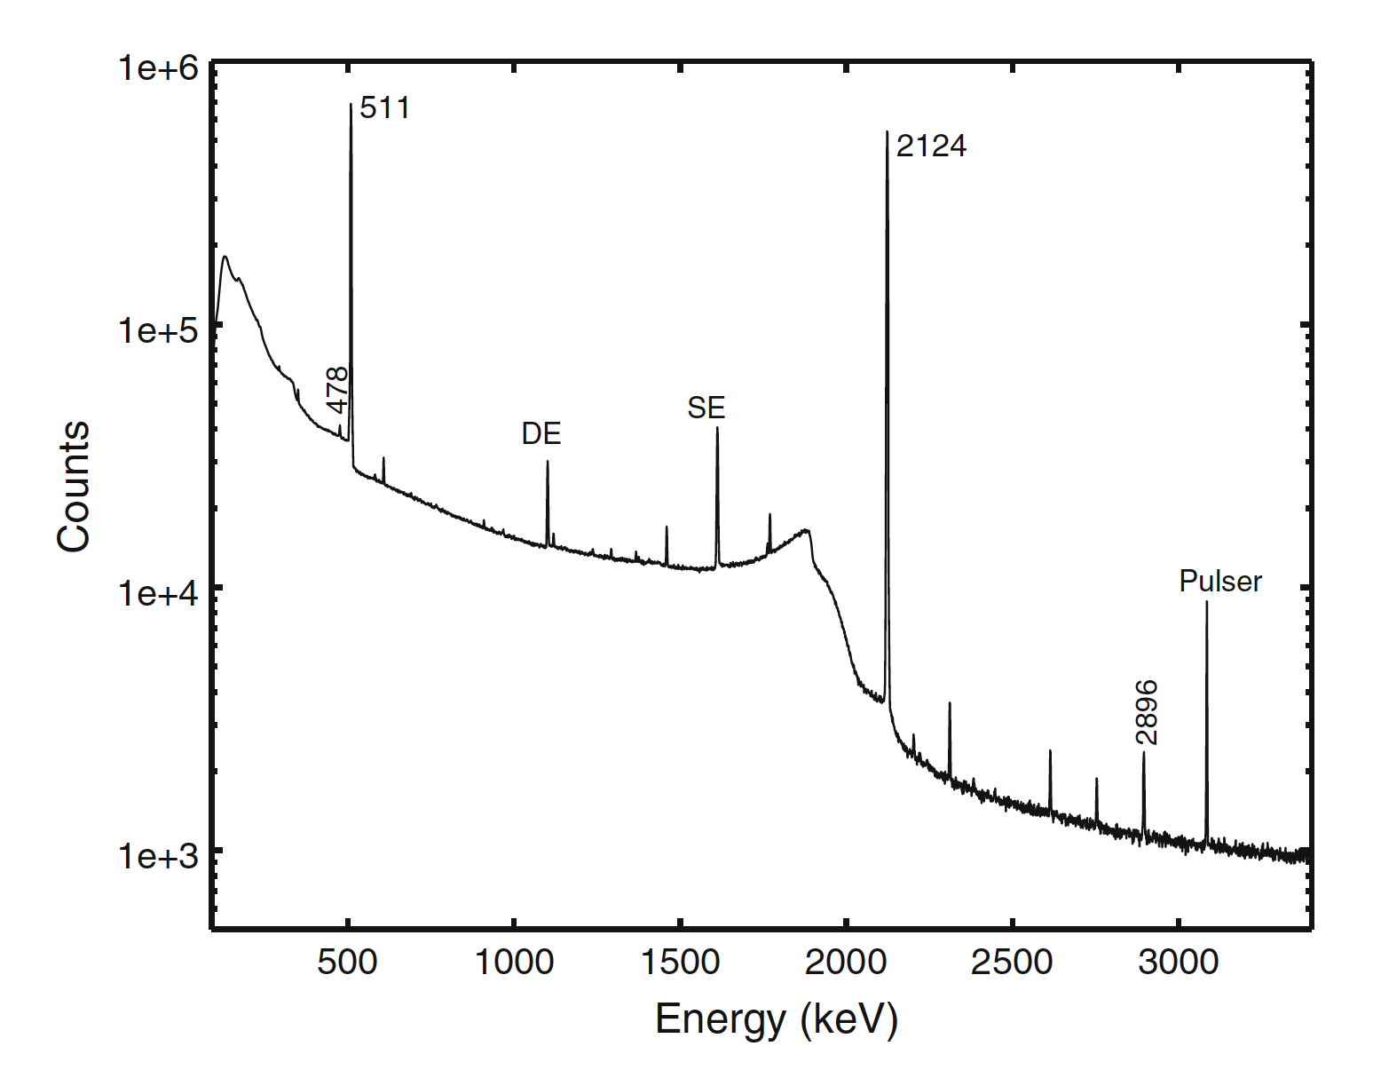
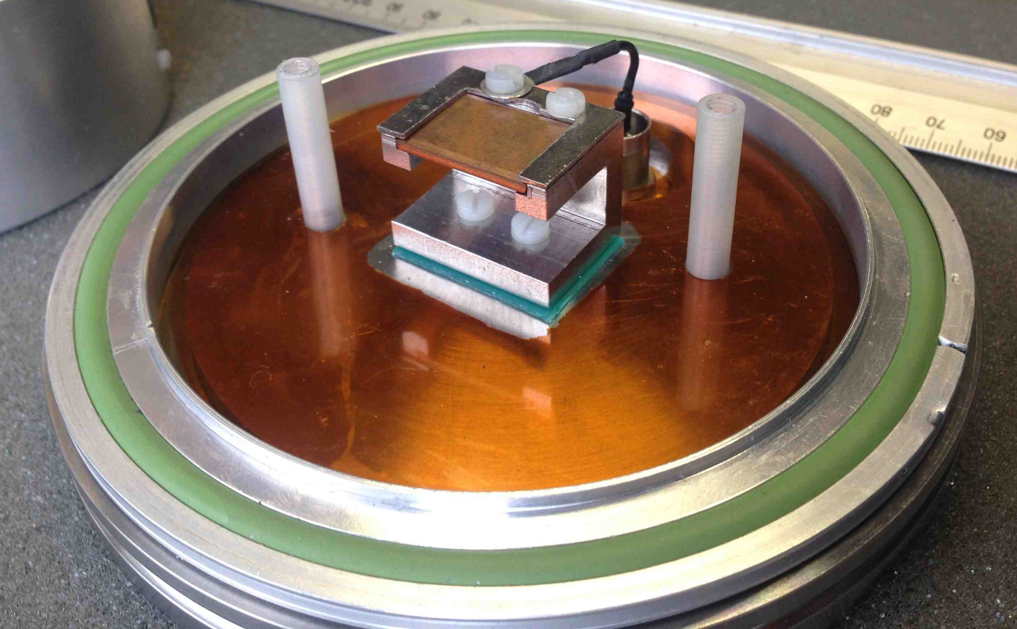

Slide 5
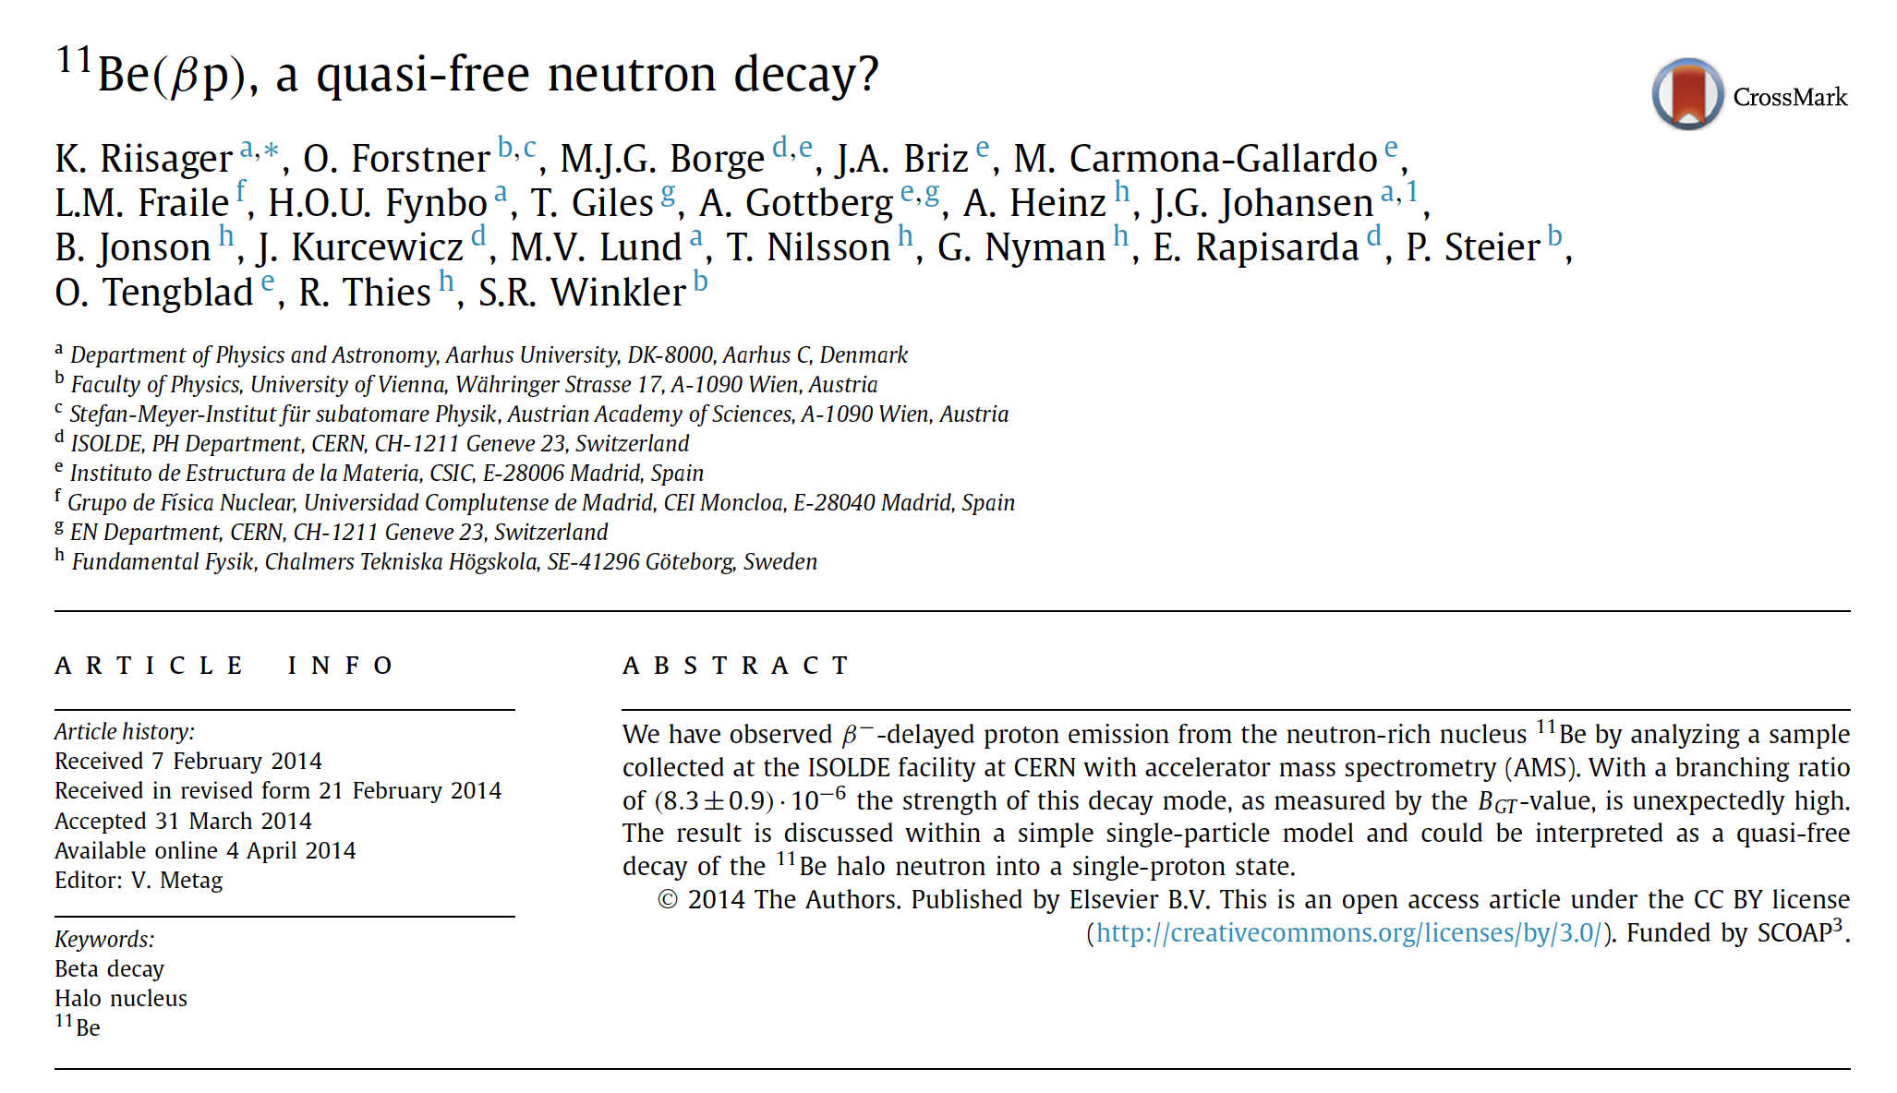
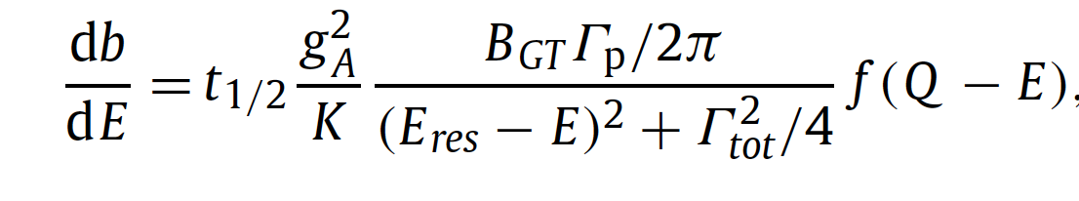

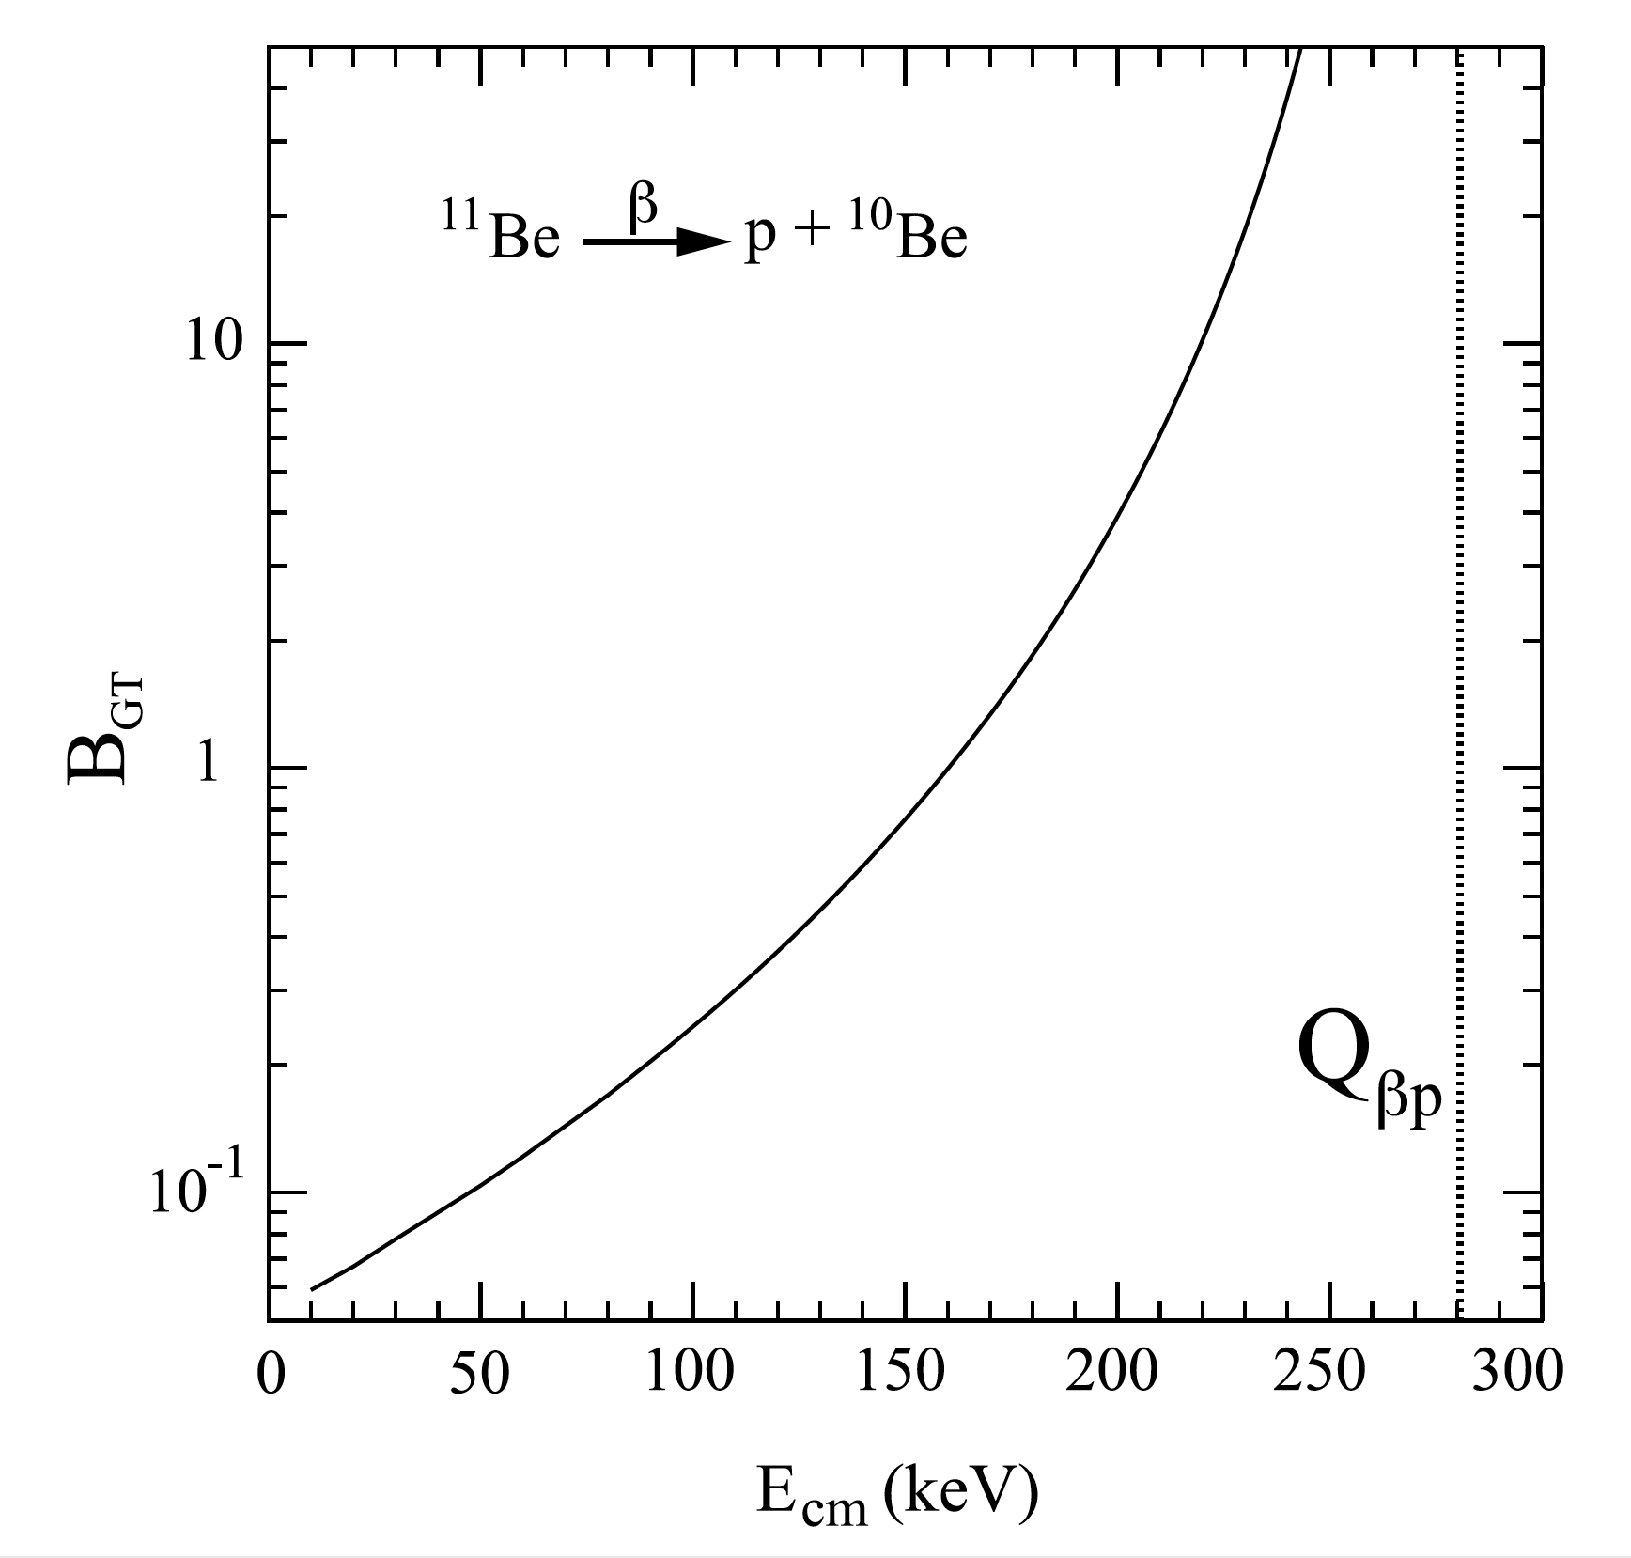
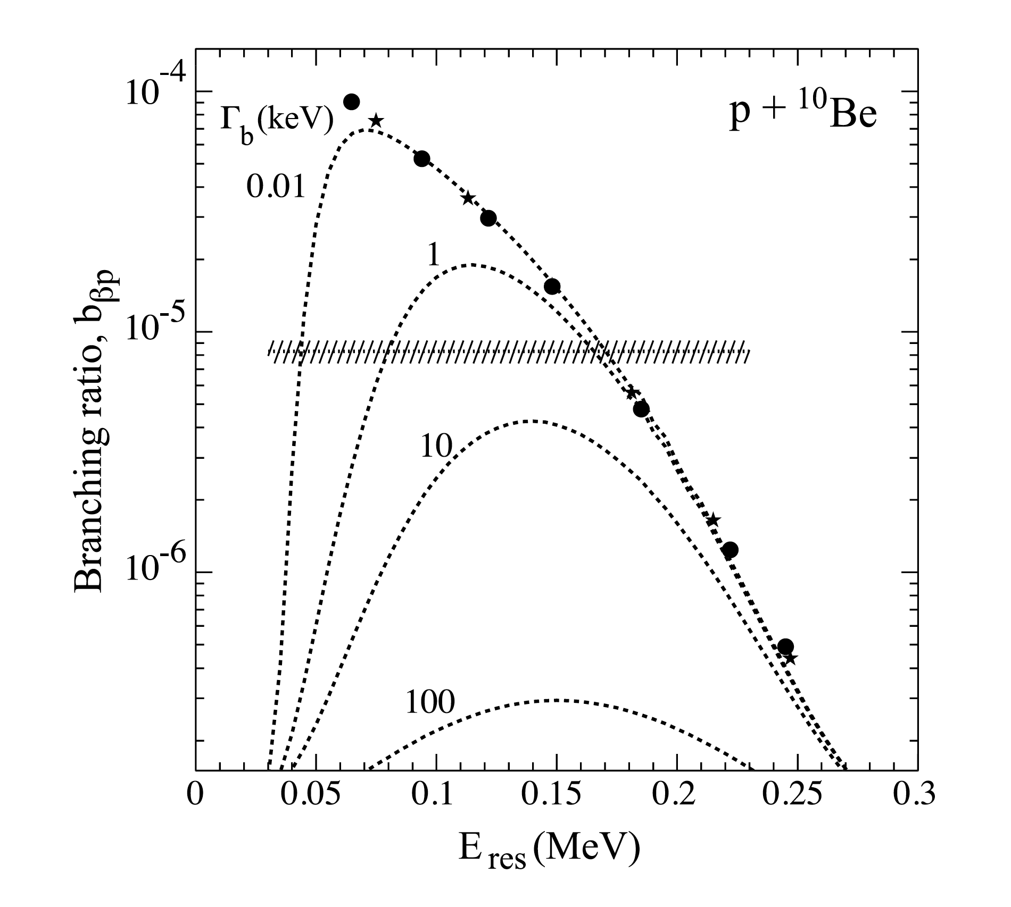
K. Riisager et al. / Physics Letters B 732 (2014) 305

Slide 6
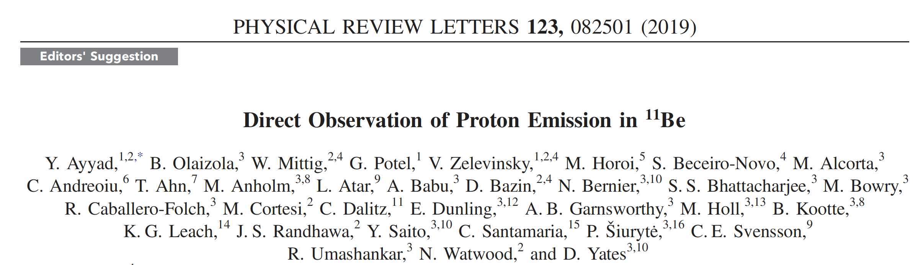
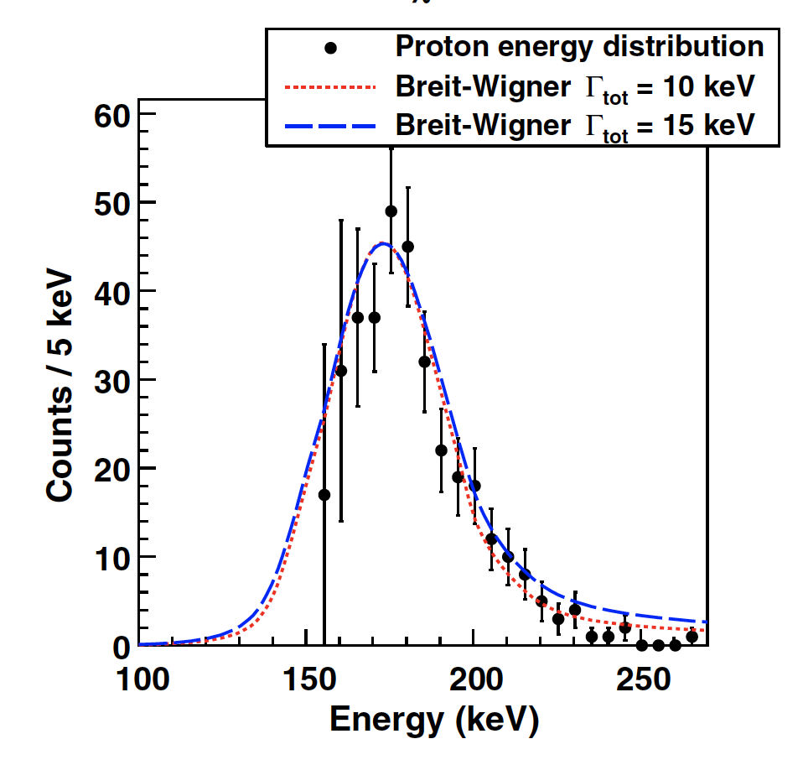
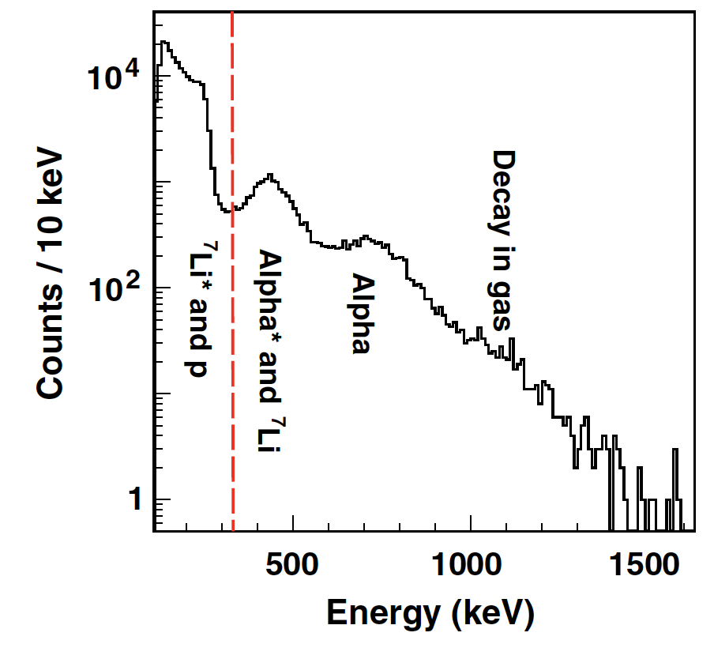
Yassid’s talk yesterday
B_{p} = 1.3(3)×10⁻⁵
E_{res}=200(20) keV
G=12(5) keV

Slide 7
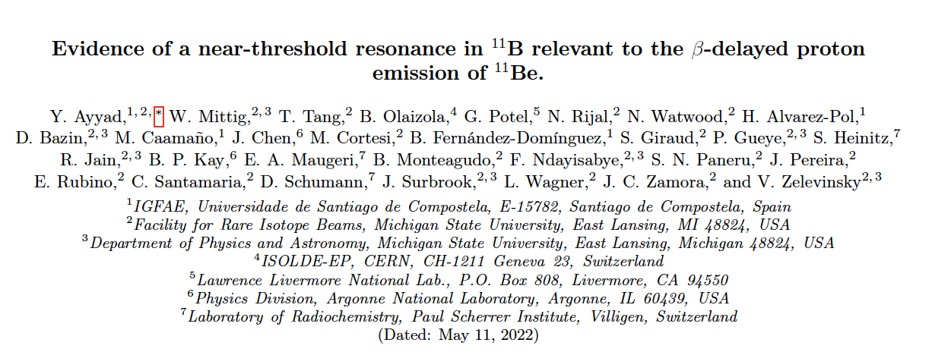
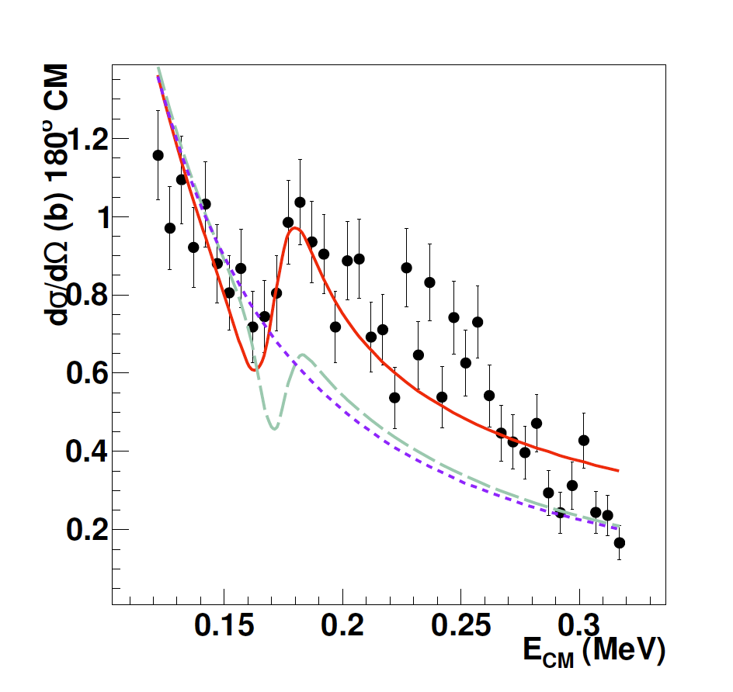
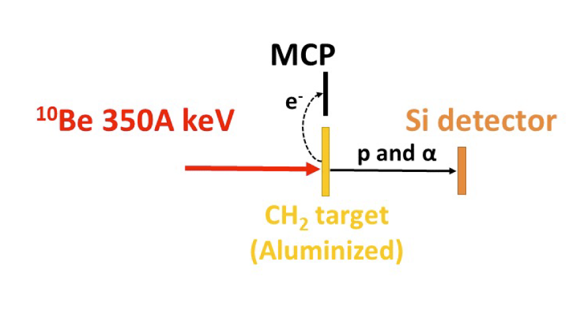
Yassid’s talk yesterday
E_{res}=170(20) keV
Γ_{p}=4.5(1.1) keV
Γ_{α}=11(3) keV

Slide 8
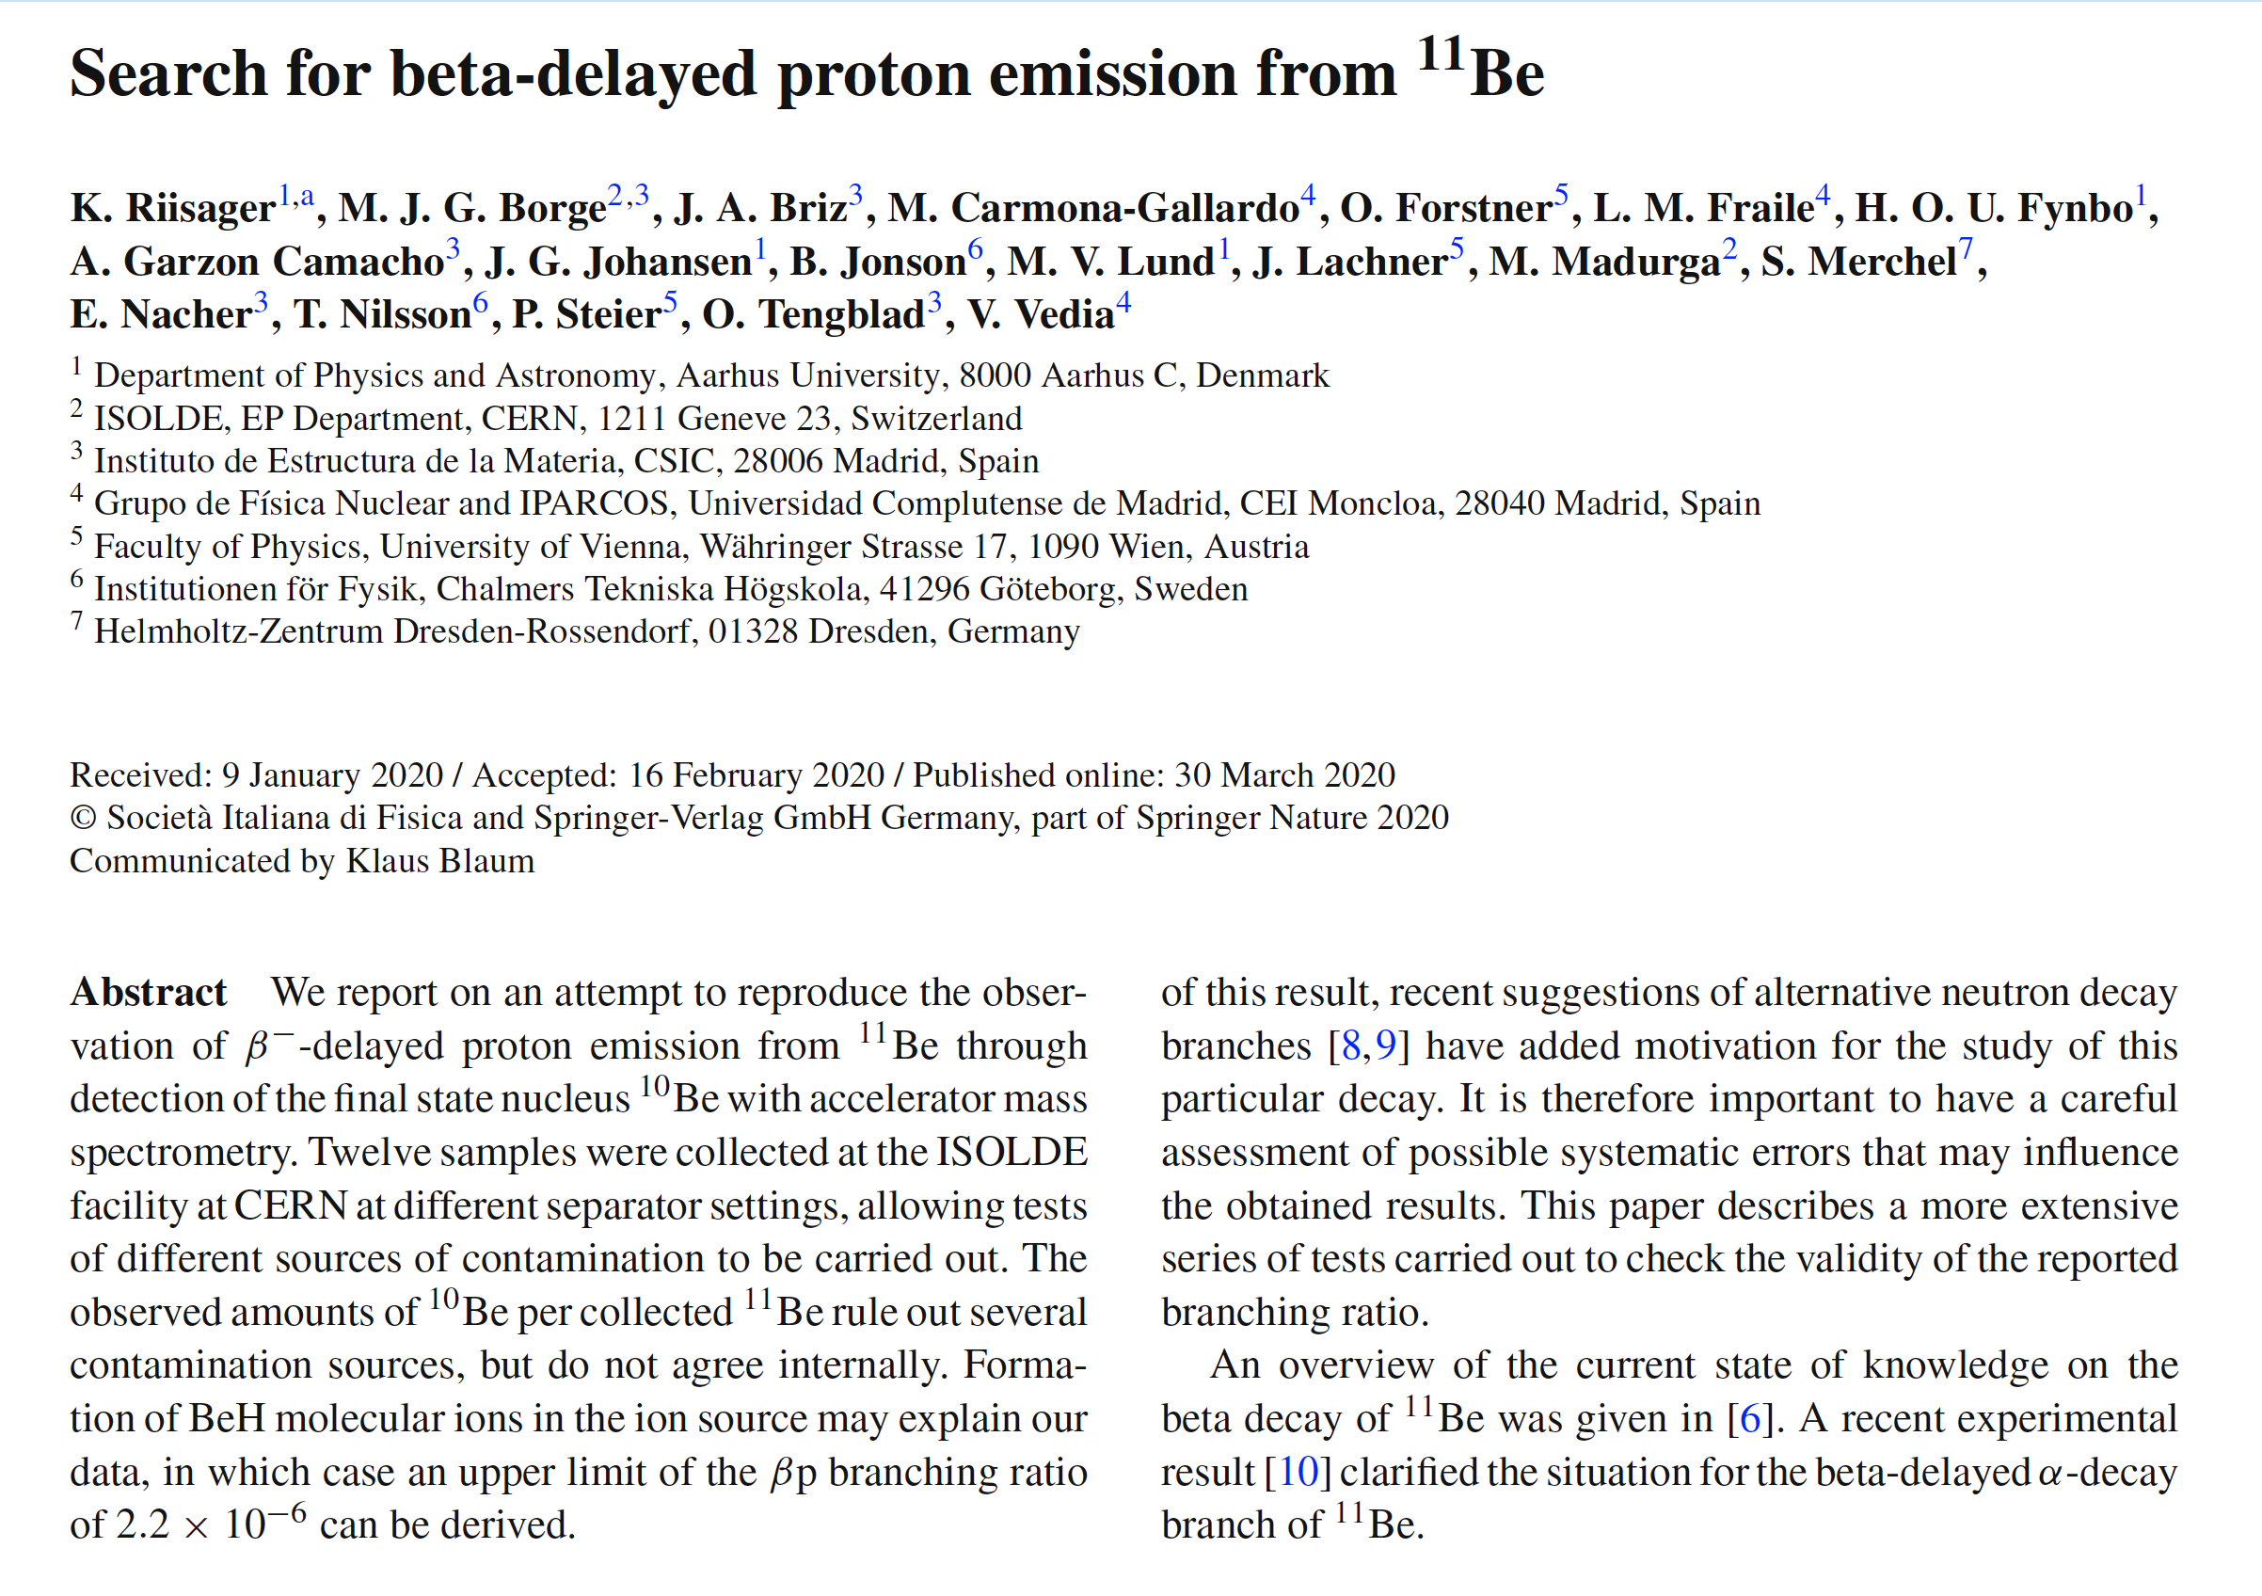
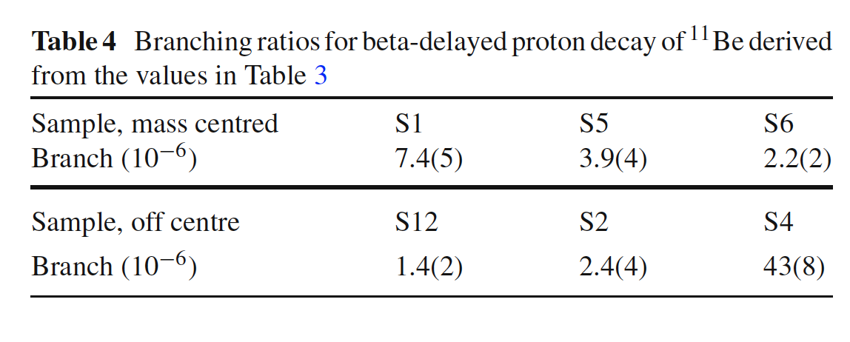
Eur. Phys. J. A (2020) 56:100

Slide 9
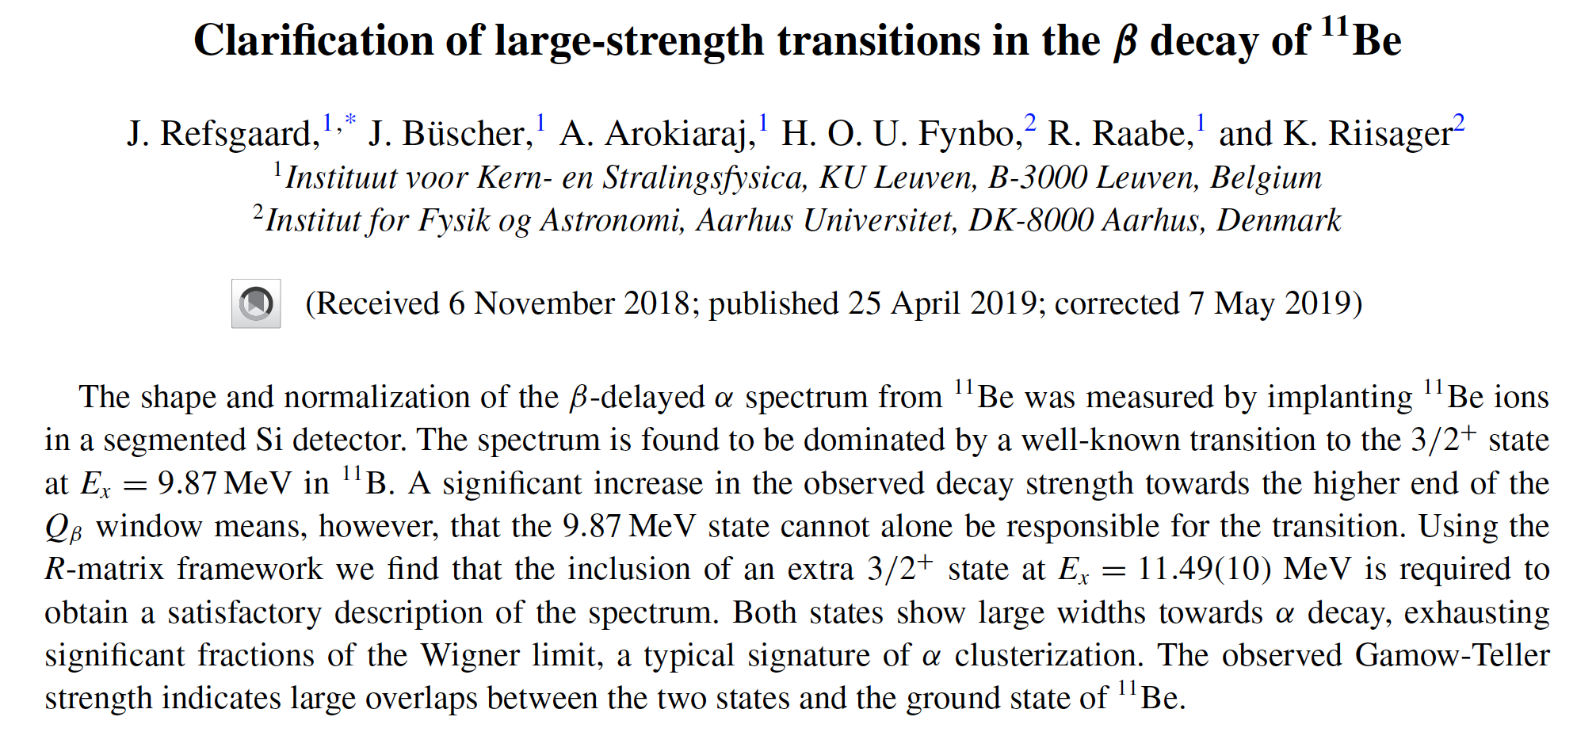
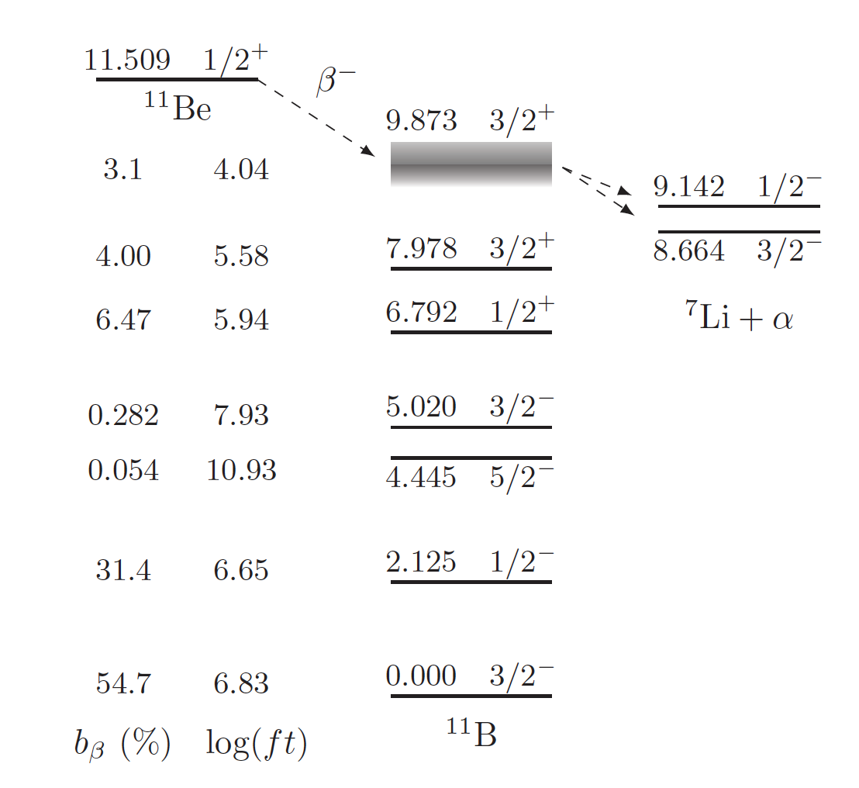
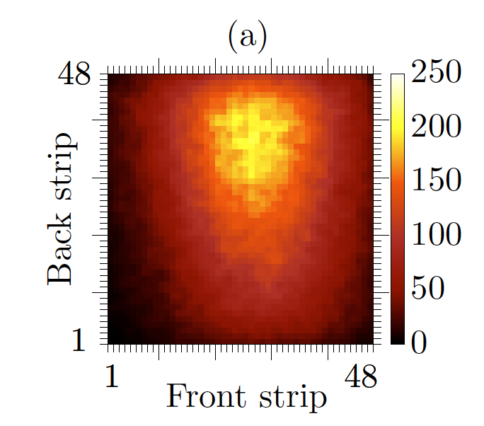
PHYSICAL REVIEW C 99, 044316 (2019)
1.8×10⁵ decay events
5.5×10⁶ implantations
B_{α}=3.30(10)%

Slide 10
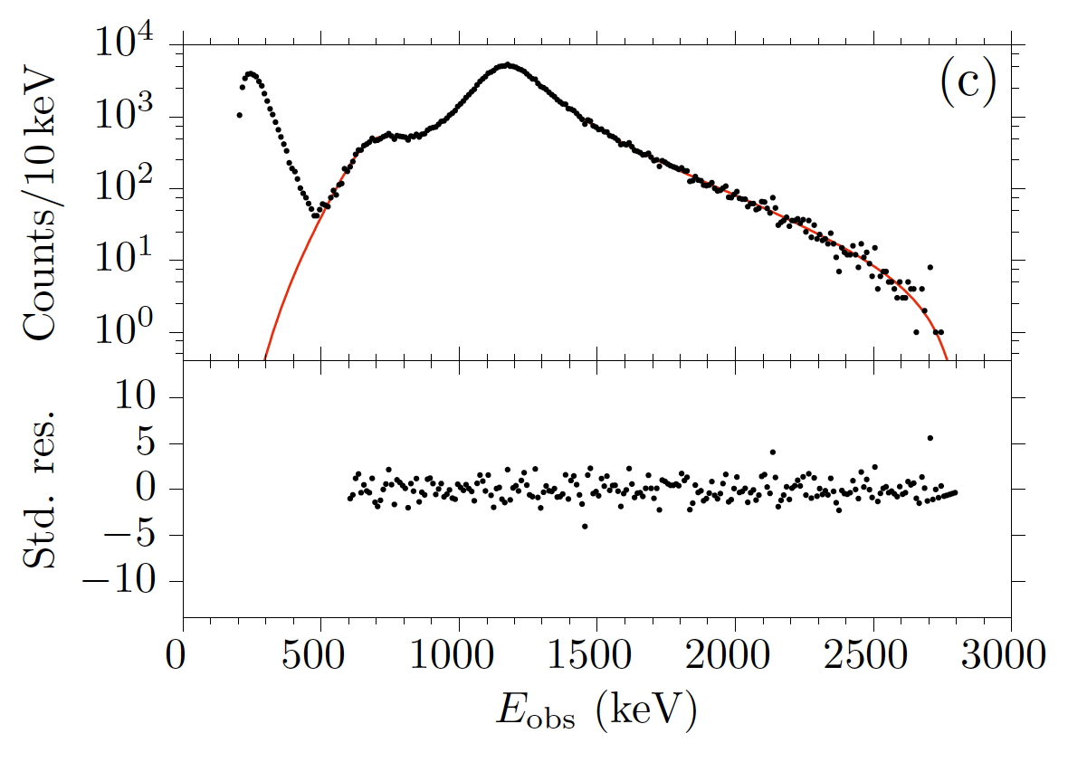
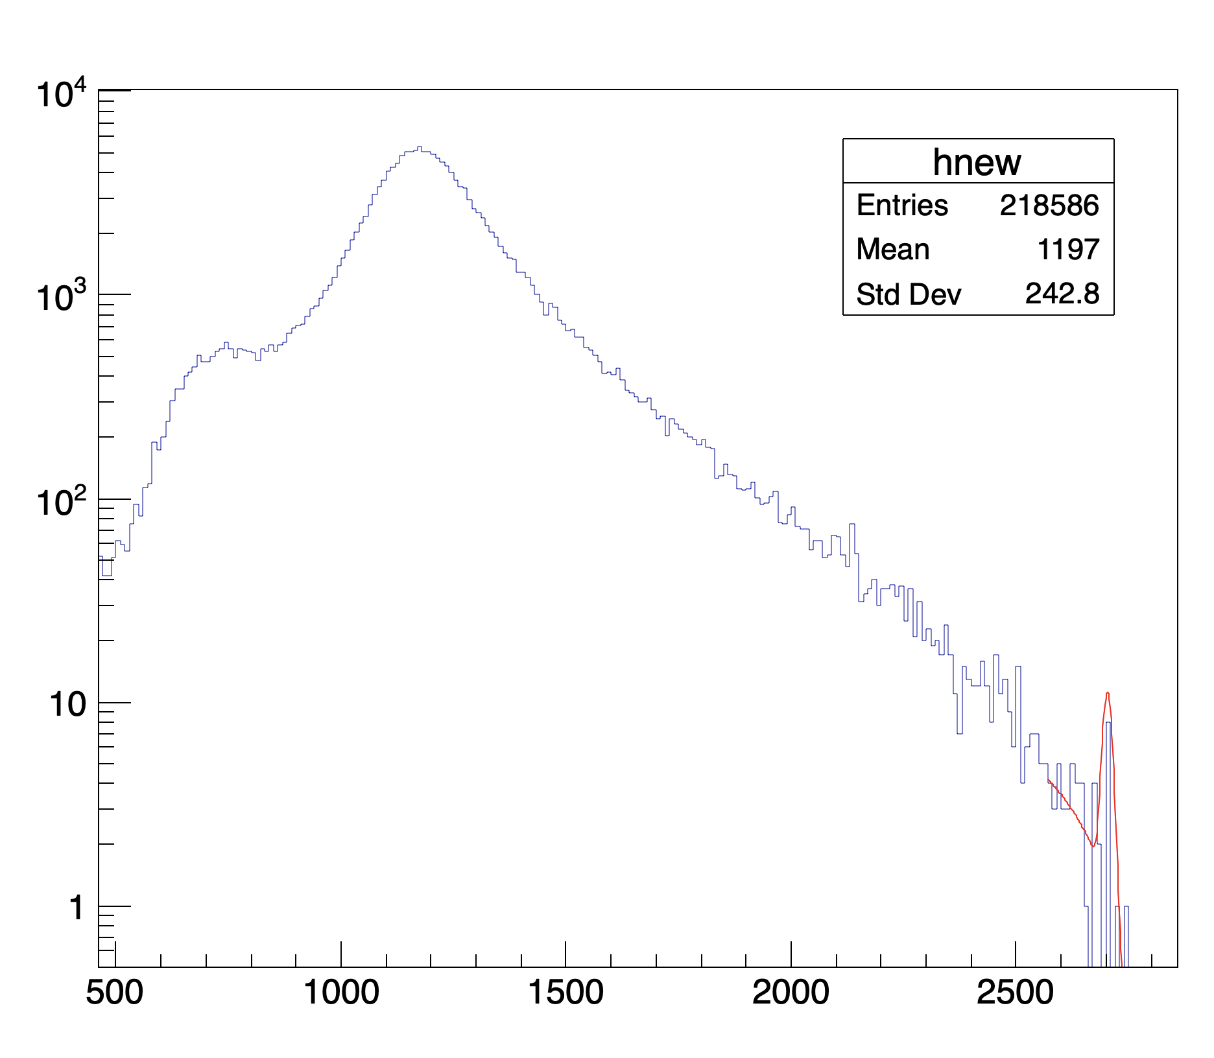
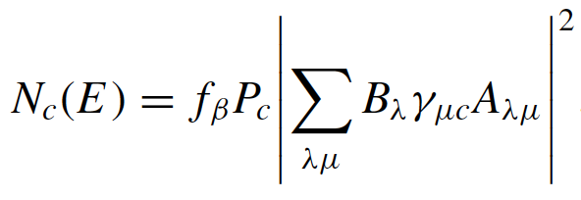
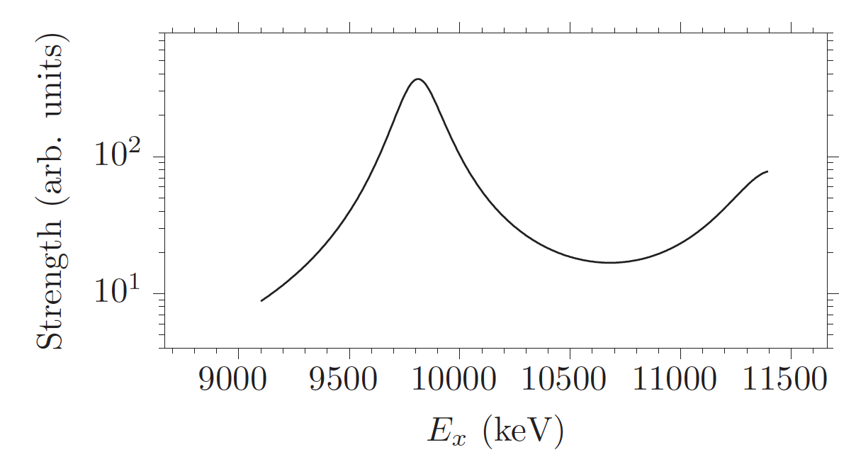
PHYSICAL REVIEW C 99, 044316 (2019)
1.8×10⁵ decay events
5.5×10⁶ implantations
B_{α−tot}=3.30(10)%
B_{α−1/2+}~2-3×10⁻⁵
~140 α-decays from ½⁺ state expected

Slide 11
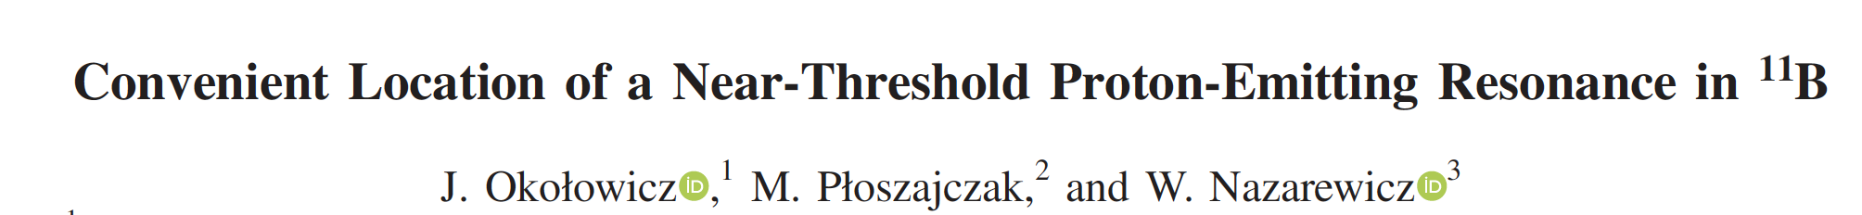
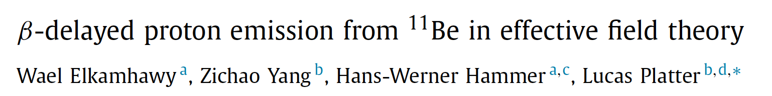
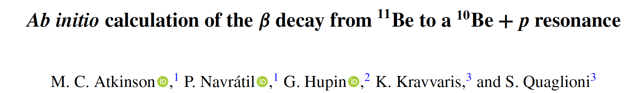
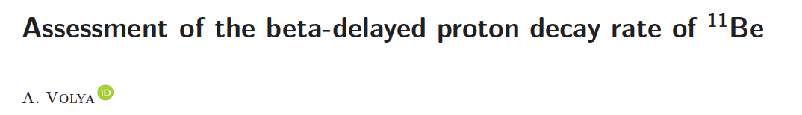
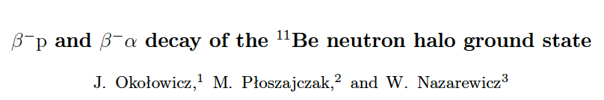

Slide 12
Credit: PAN

Slide 13
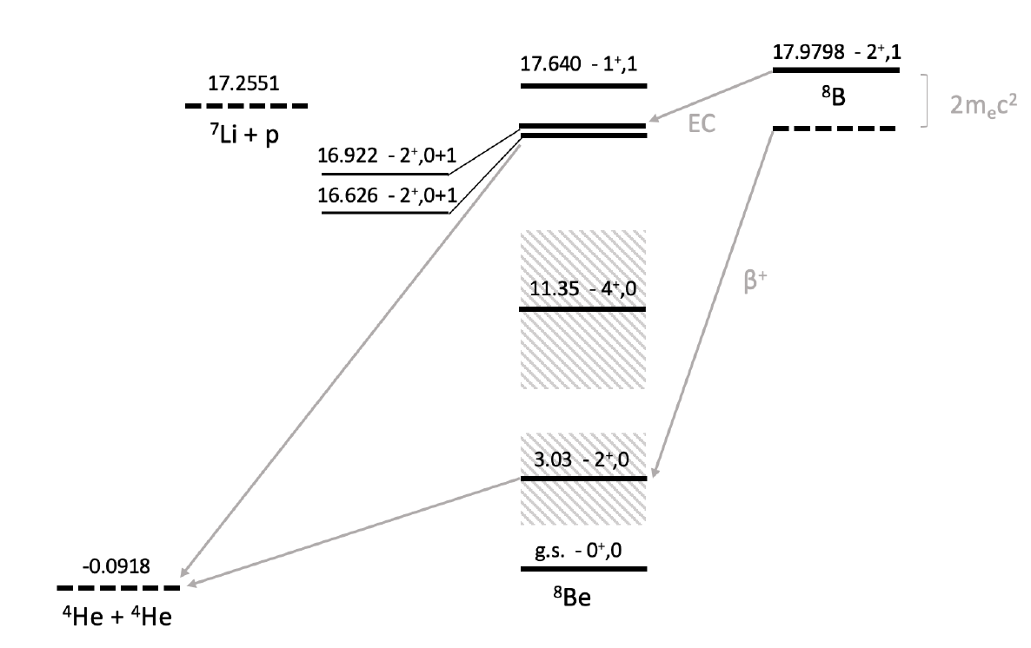
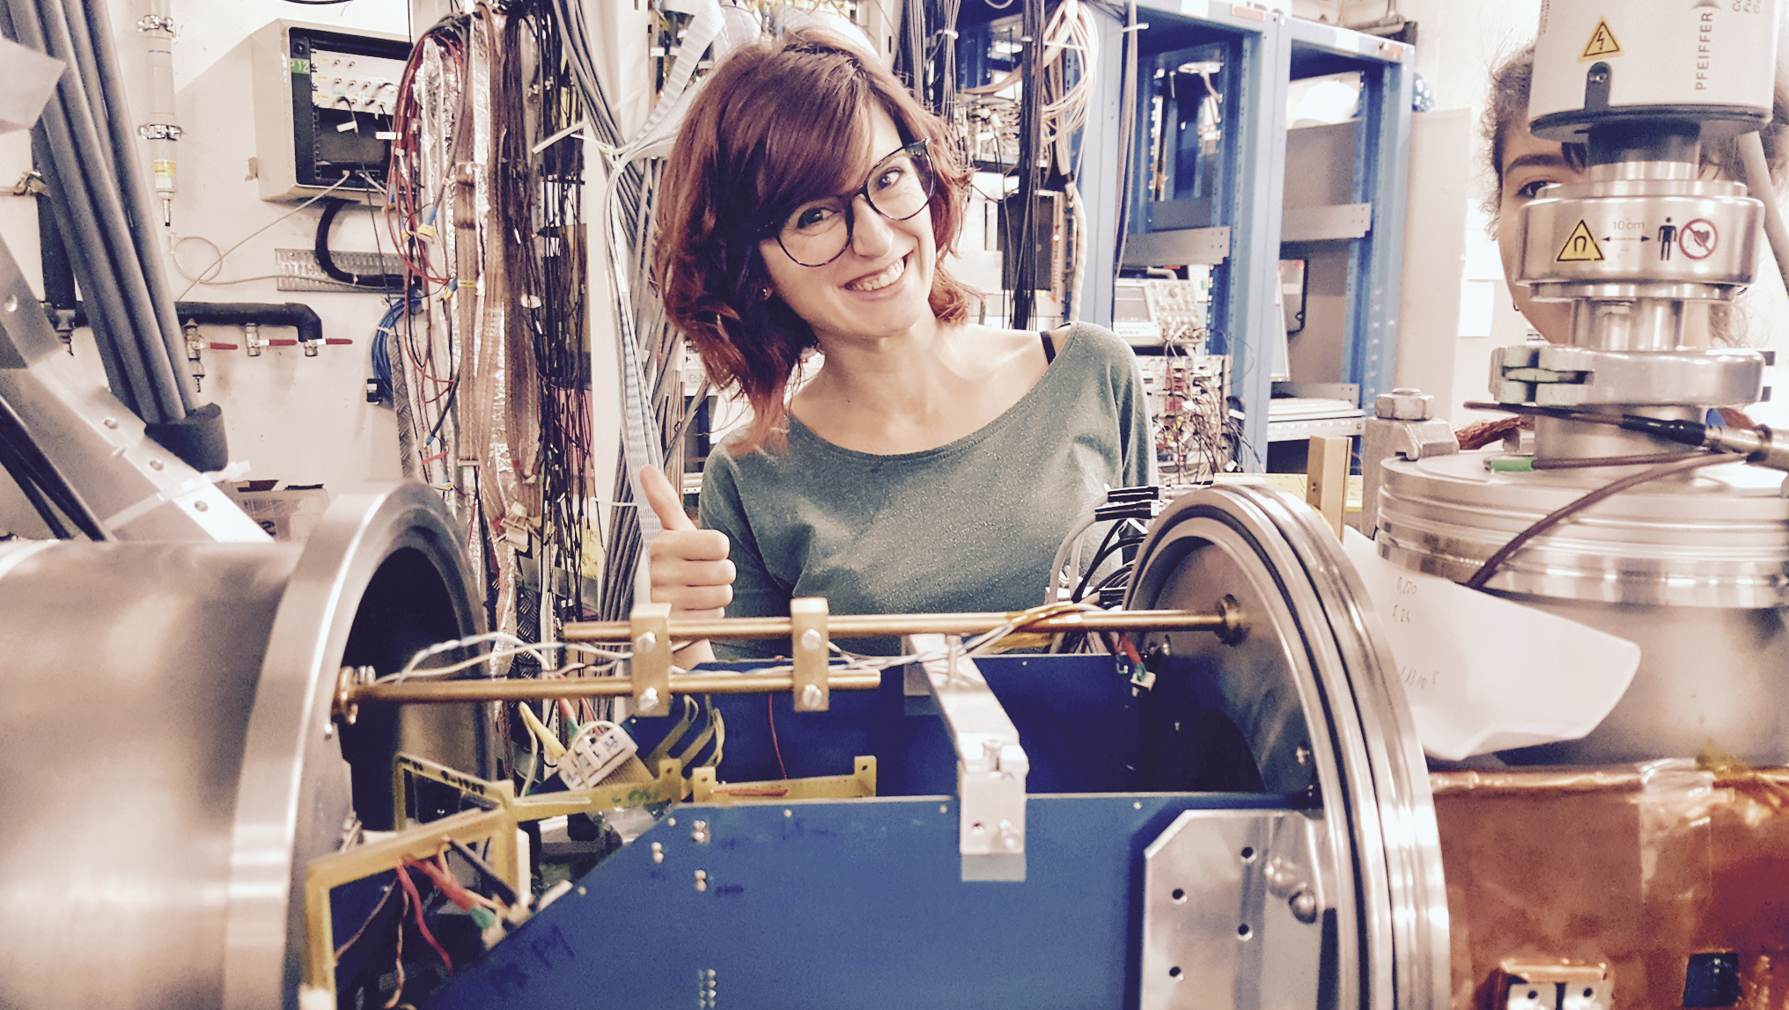
Sílvia Viñals i Onsès

Slide 14
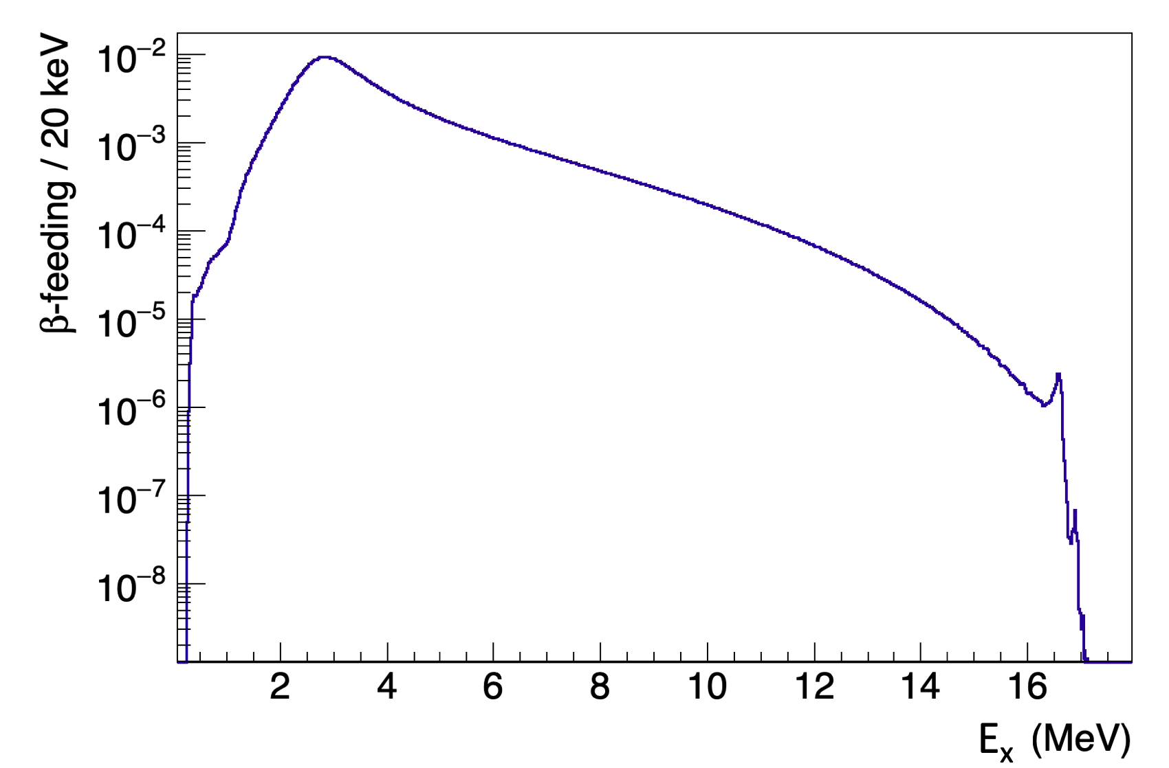
I_{β}

Slide 15
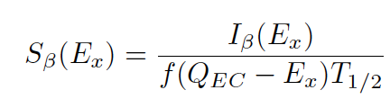
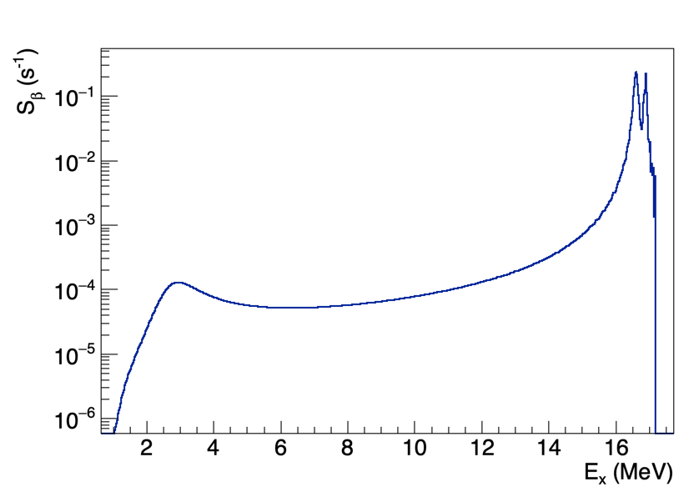
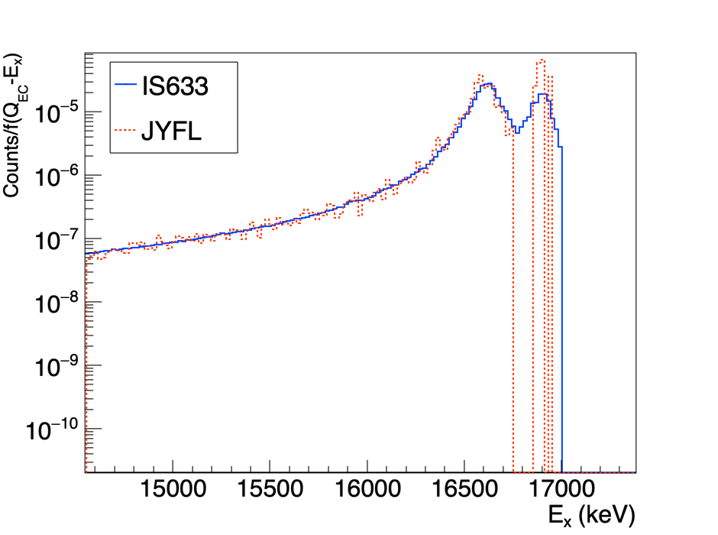

Slide 16
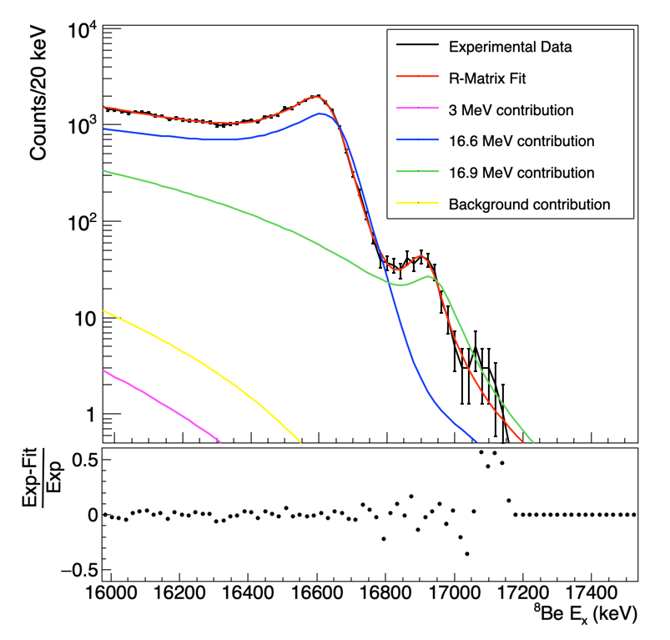
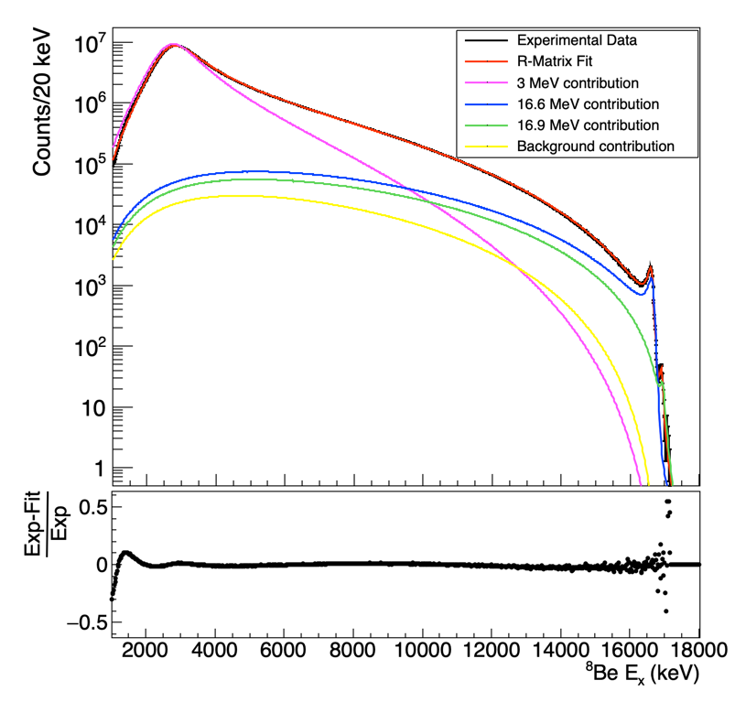
2⁺ doublet
Full spectrum

Slide 17
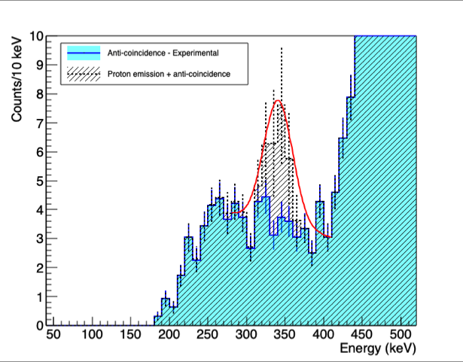
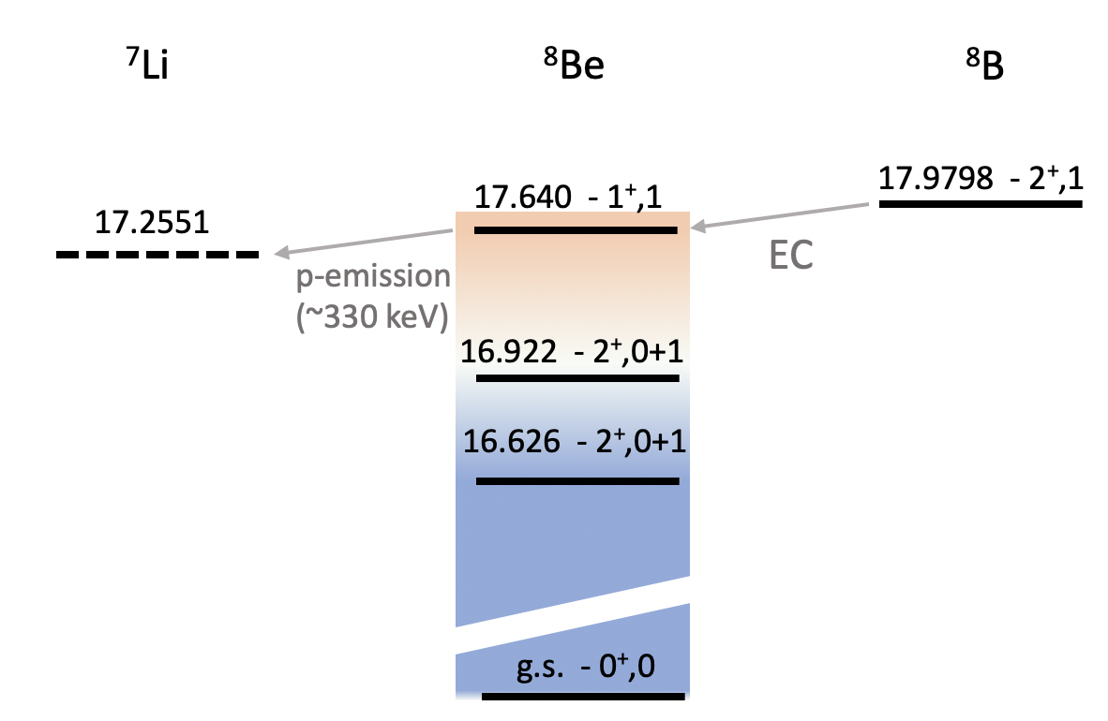
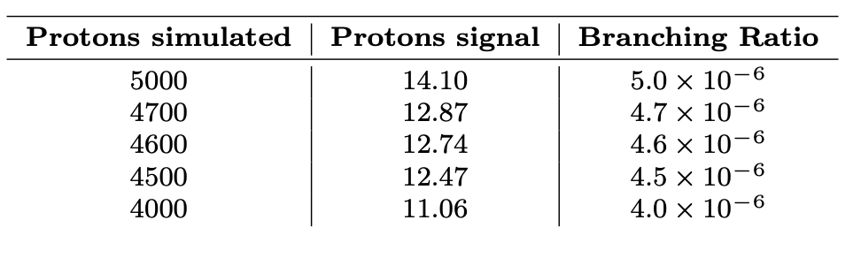
BR_{estimate.}<2.3·10⁻⁸

Slide 18
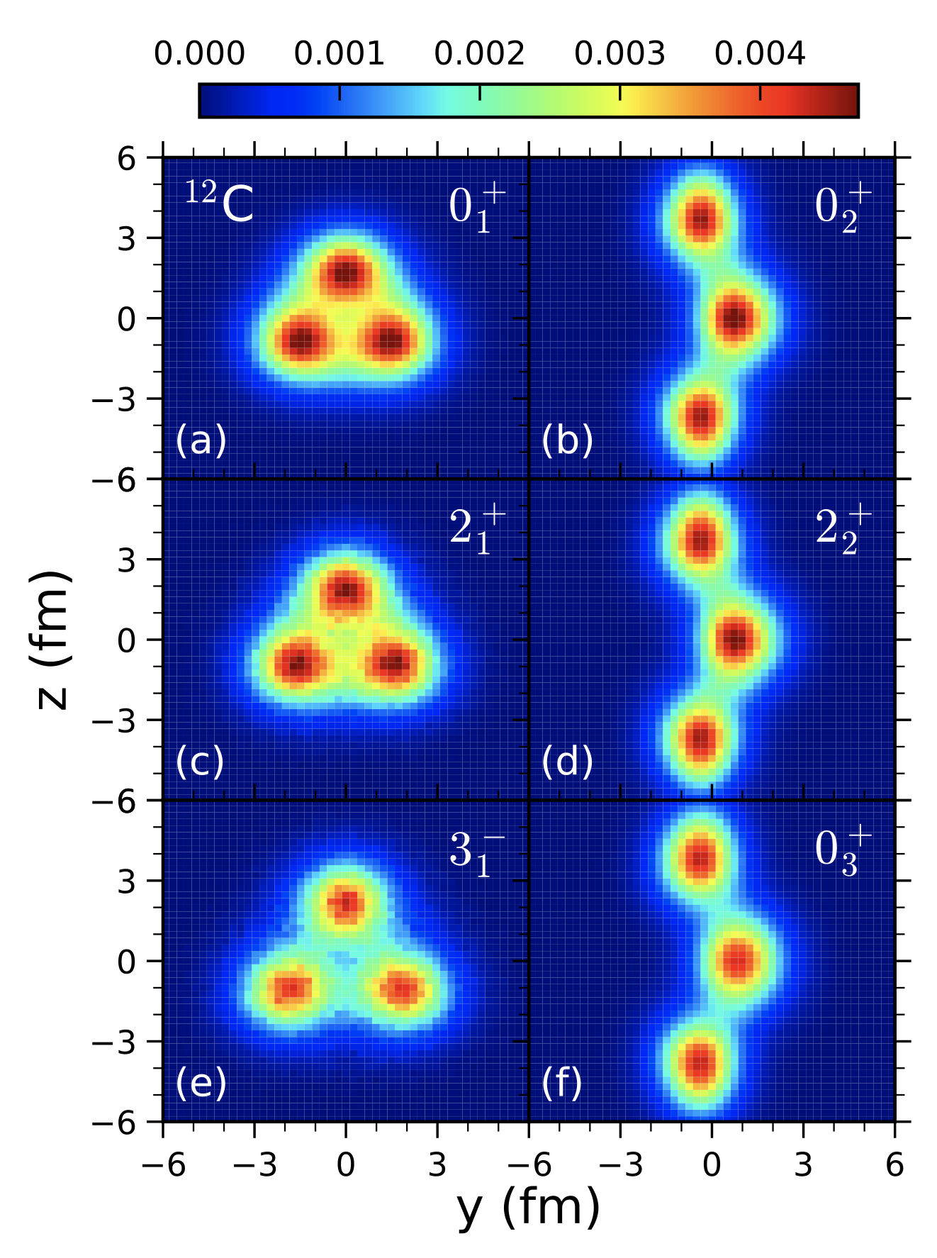
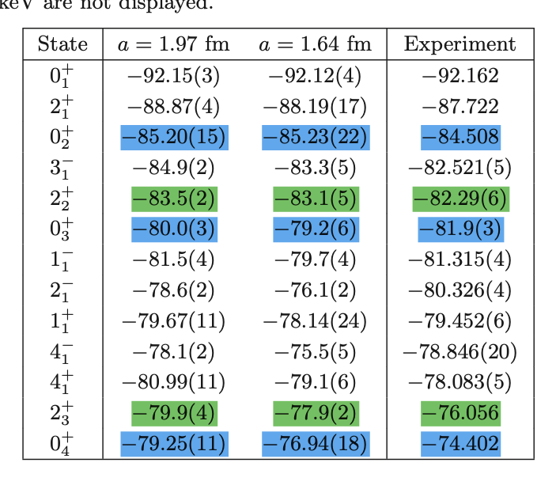
Resonances in ¹²C
or “scattering features” ?
MeV
~7
~9
~12-13
~12-14
~12-15
Shen, Lähde, Dean Lee, and Ulf-G. Meißner
Eur. Phys. J. A (2021) 57:276
c.f. Dean Lee’s talk Monday. arXiv:2202.13596

Slide 19
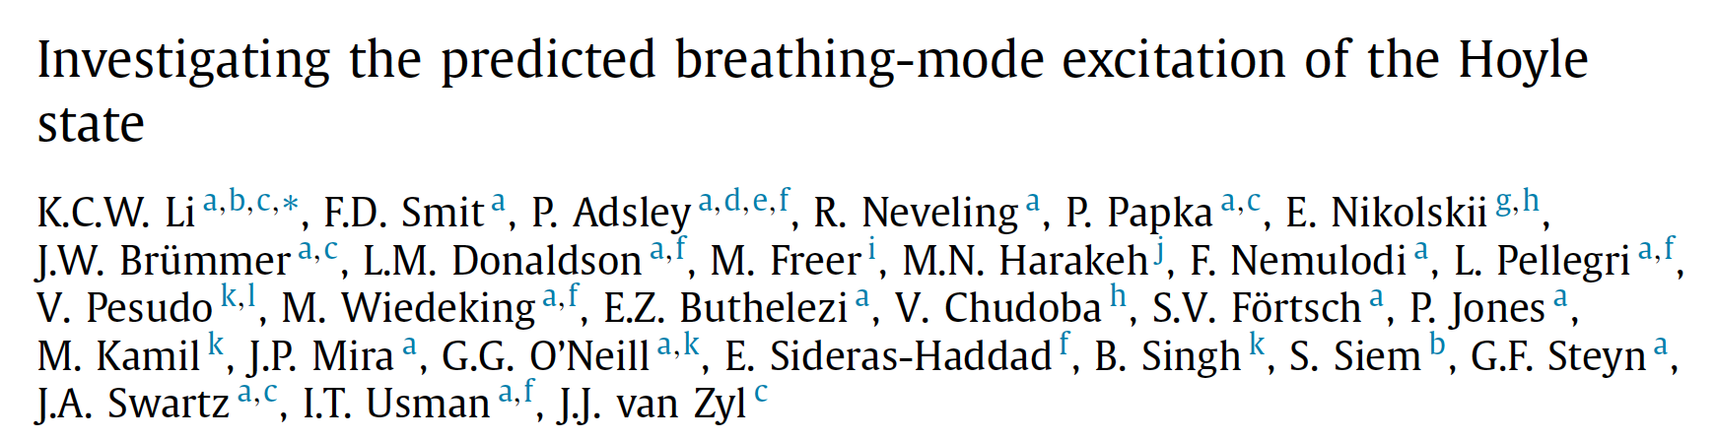
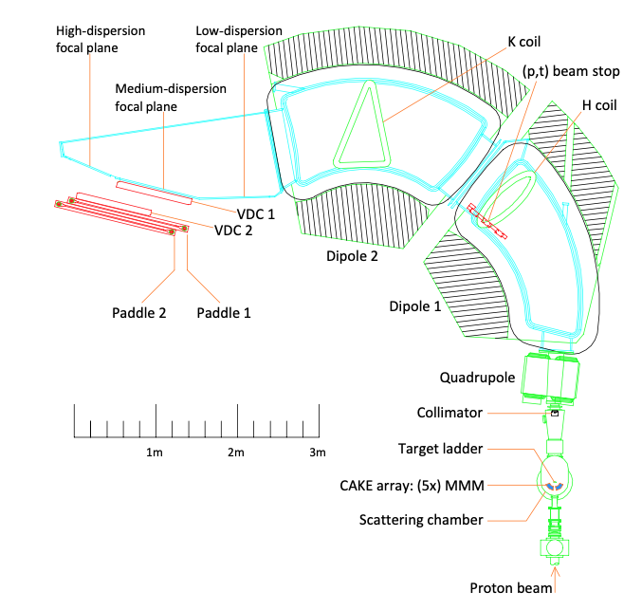
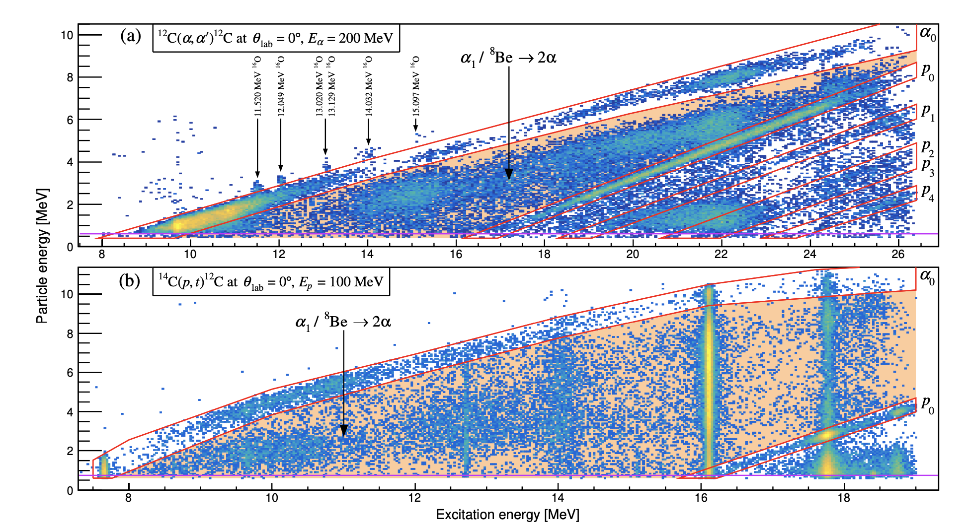
Ishikawa’s talk yesterday
Physics Letters B 827 (2022) 136928
Physical Review C 105 (2022) 024308

Slide 20
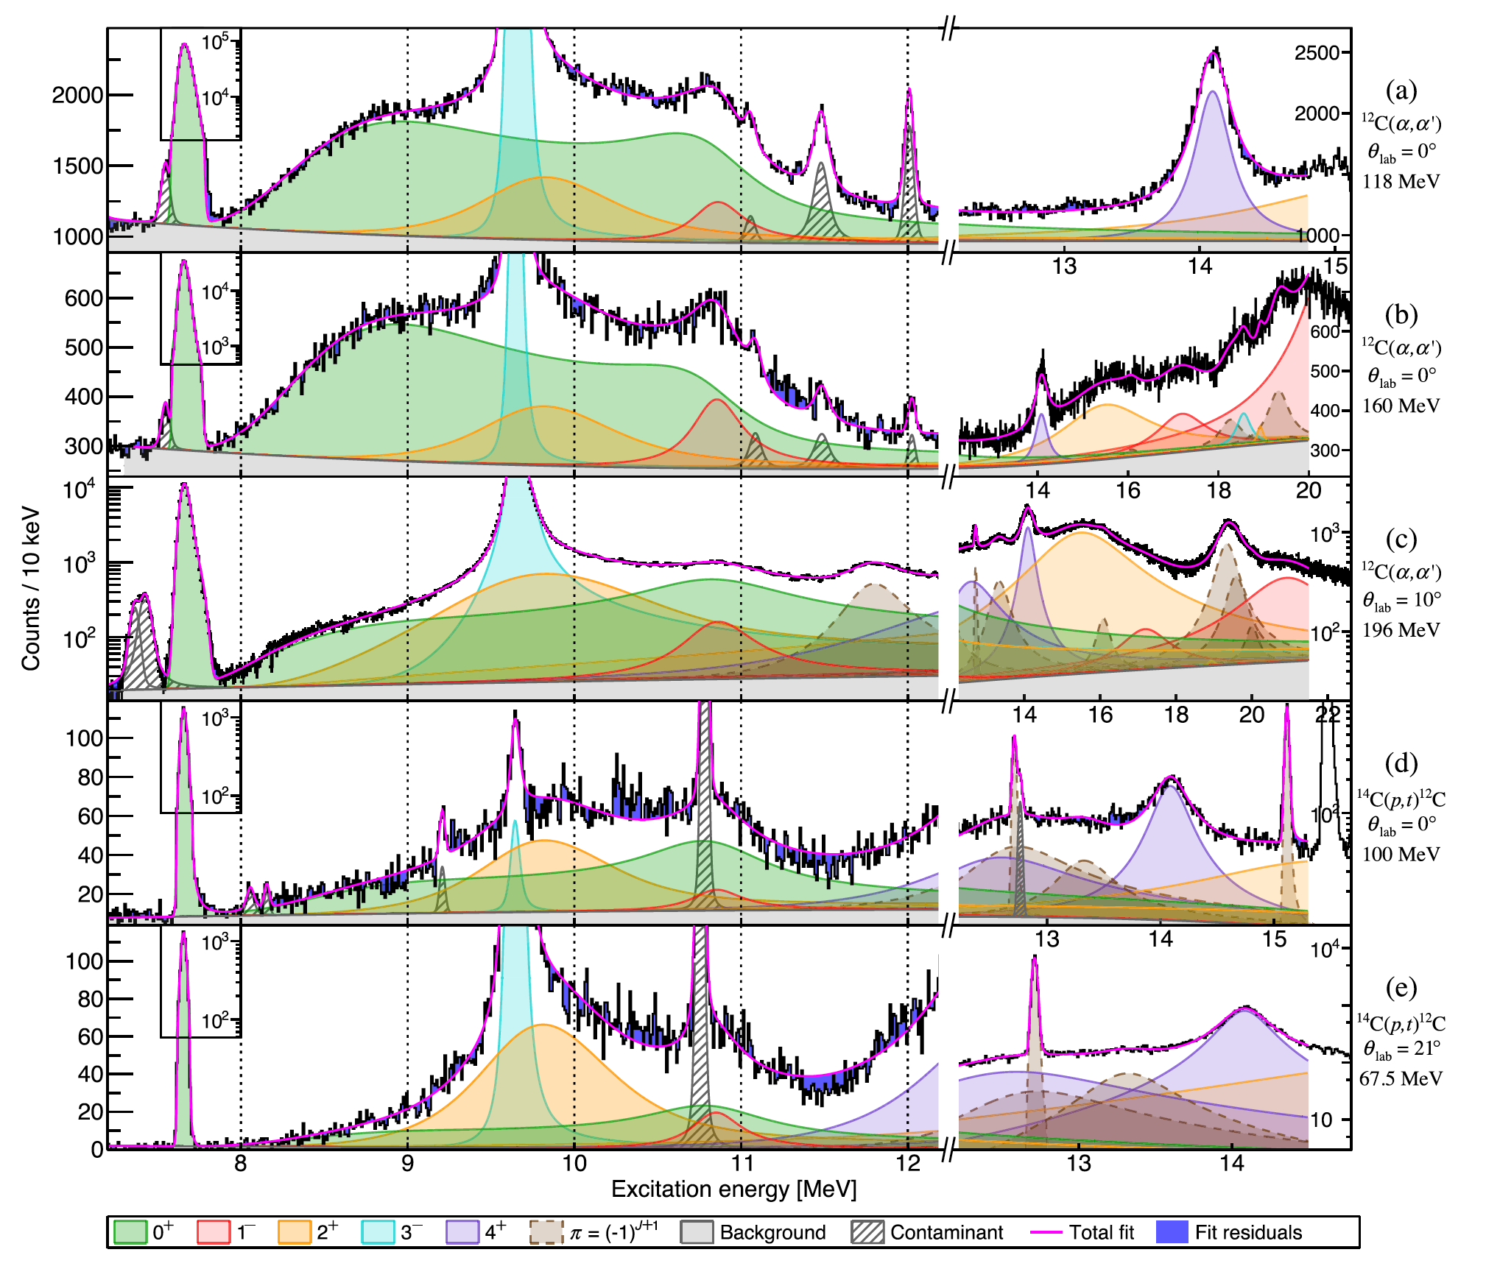
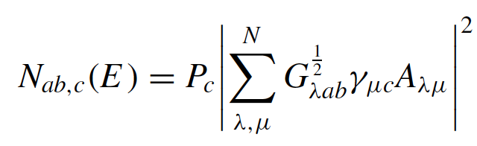

Slide 21
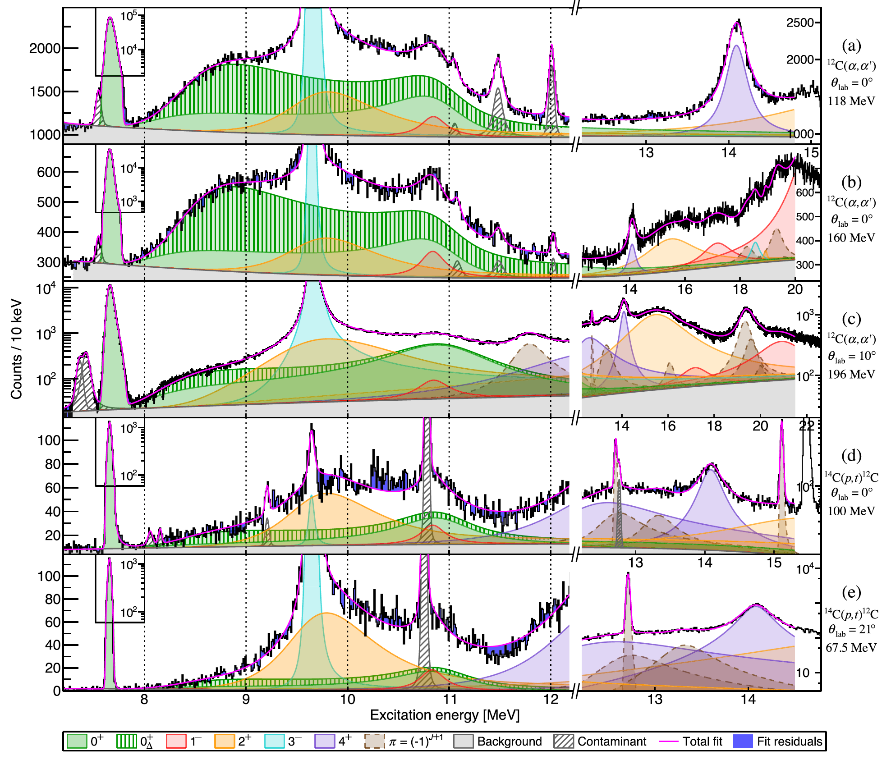

Slide 22
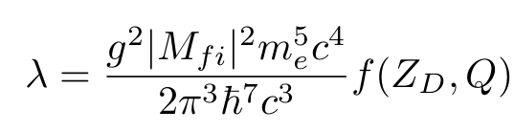

Resonances in ¹²C or “scattering features” ?

Slide 23



Direct Kinematics+ISOL
¹²C/¹¹B
¹²N/¹²B+X
¹²N/¹²B
p/d
Magnet
3α (β)
¹²N
¹²B
¹²N/¹²B
¹²N/¹²B
¹²N
¹²N
¹²B
2001
2002
2004
2006
2014
TexAT
2020
IGISOL
CERN
IGISOL
KVI
IGISOL
IGISOL
Inverse Kinematics+Separator
¹²N/¹²B+X
¹²N/¹²B
Magnets
p/d
3α (β)
¹²C/¹¹B
Notes:
In the top half of the slide I show the ISOL approach, where the produced short-lived isotopes are extracted from the target and ionised, mass separated and stopped in a thin collection foil. This foil can then be surrounded by effective detector arrays. The advantage is that this allows to measure all the three alpha-particles in coincidence with reasonable detection efficiency. The disadvantage is that there still energy loss effects in the collection foil, although much less than in the old “in beam” method. Also, the detection efficiency is dependent on the kinematics and needs to be calculated from Monte-Carlo simulations.
We have used the ISOL method at experiments at ISOLDE facility at CERN and the IGISOL beam-line in Jyvaskyla in Finland. Today I will only talk about our results from Jyvaskyla, whereas our earlier results are published in these references.
The alternative method is to use inverse kinematics shooting the heavy beam on a thin gas target and extract the produced short lived isotopes as beams of 10-20MeV/u and separate and direct them onto an implantation detector. Then the subsequent decays happen in the detector and the summed energy of the three particles is measured directly. If the detector is thin enough the energy deposition of the beta-particles is not a problem.
The advantage is that there are no energy-loss effects and that the sum energy is measured without kinematics dependent detection efficiencies, and that one can count the number of implanted ions and compare to the number of subsequent decays to extract branching ratios. The disadvantage is that the individual alpha-particle energies are not measured and that there is a small energy deposition of the beta-particles.
We have recently used the fragment method at the TRIuP facility at KVI in the Netherlands.

Slide 24

WHY New IGISOL experiments?
E₁
Momentum conservation
Energy conservation
α_{i}
E₃
E₂

Slide 25





Physics Letters B 825 (2022) 136857

Slide 26




Slide 27




B.R / (f * T_{1/2})
Q_{3α} (MeV)

Slide 28


B.R / (f * T_{1/2})
Q_{3α} (MeV)

Slide 29




+
¹²N : J. Refsgaard, PhD thesis, 2016.
¹²B/¹²N : Phys. Lett. B. 678.5 (2009), p.459-464
¹²B : A. Gad, PhD thesis, 2021

Slide 30

Nuclear resonances?
?
→
✔
✔
→

Slide 31

Robust results?
Ghost
➗
¹²N : J. Refsgaard, PhD thesis, 2016.
¹²B : A. Gad, PhD thesis, 2021

Slide 32











R-matrix Resonances
A parametrization of nuclear spectra in terms of (formal) nuclear resonances.
Standard R-matrix expression with 3-body modification.
"Balamuth" equation:
Break-up amplitude
Bose symmetrization
Coulomb correction
Dalitz distribution
No energy dependence in 12C
No Interference in 12C
No resonance parameters in 12C
Energy dependence
Interference between 12C resonances
Resonance parameters
Absolute normalization

Slide 33



¹²B
1-2MeV
2-3MeV
3-4MeV
4-5MeV
5-6MeV
¹²N

Slide 34




R-matrix - ⁸Be(peak)

Slide 35



R-matrix – ⁸Be(ex)
Data
+ Simulated acceptance
Fit
(0,0,0)
(1,2,2)
(2,2,0)
(2,0,2)

Slide 36


Novel Full R-matrix model

Slide 37


Novel Full R-matrix model

Slide 38
Thank you for your attention!

Slide 39


Ghosts and R-matrix Theory
A parametrization of nuclear spectra in terms of (formal) nuclear resonances.
E,Γ
Y : a + b
X
Inner region
Channel radius
Outer region : a + b

Slide 40


¹²N Q_{beta}=16.32
Natural parity states
15.11 1⁺
12.71 1⁺
≈10
7.65 0⁺
4.44 2⁺
g.s. 0⁺
¹²C

Slide 41


15.11 1⁺
¹²B Q_{beta}=13.37
12.71 1⁺
≈10 0⁺
7.65 0⁺
4.44 2⁺
g.s. 0⁺
¹²C
Notes:
I now present the same series of results for the mirror decay, that of 12B.
First the results from the ISOL experiment at IGISOL, Jyvaskyla.
Due to the lower Q-value in this decay the feeding to the 1+ state is now much less, but other than that the qualitative features are the same.
Note that we now see feeding to the 1+ state in this decay as well.

Slide 42

Data / observables
→ fit to phenomenological model (BW / R-matrix) including experimental response
→ parameters E, Γ, γ,…
Model of physical system
→ S-matrix, ..., scattering states, resonances, virtual states
→ parameters E, Γ, γ,…
Use parameters E, Γ, γ,… etc. to calculate something else (e.g. for astrophysics)

Slide 43
Using three-body correlations as spectroscopic tool
¹²C* α₁+ ⁸Be α₁+α₂+α₃
E₁
Momentum conservation
Energy conservation
¹²C
Q_{I}
α₁ +⁸Be
α_{i}
Q_{II}
2/3Q_{I}
α₂ + α₃
E₃
E₂
E₁ = m₂₃/(m₁+m₂₃) x Q_{I} = 2/3 xQ_{I}
Notes:
Dalitz det. By two things. INDEPENDENT
Since density of final states proportional to dE1dE2, intensity of dalitz plot (decay amplitude) proportional to matrix element squared
First is final state interactions (eg 2 body resonance). If sequential decay, then 1st particle gets 2/3 energy. This gives bands as shown in Figure.
2nd is symmetry constraints…

Slide 44




”New” IGISOL experiments
“New” IGISOL Experiments
¹²N 2014 Jonas Refsgaard
¹²B 2020 Andreas Gad, Erik Jensen

