Slide 1
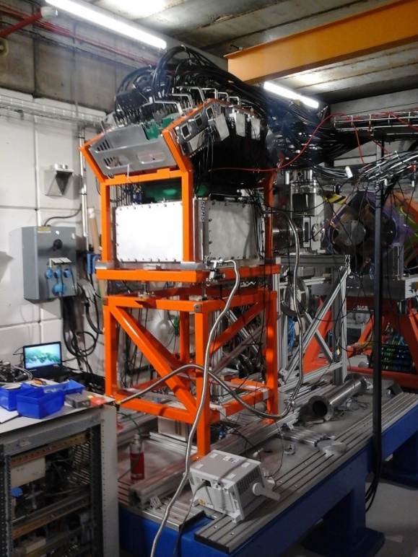
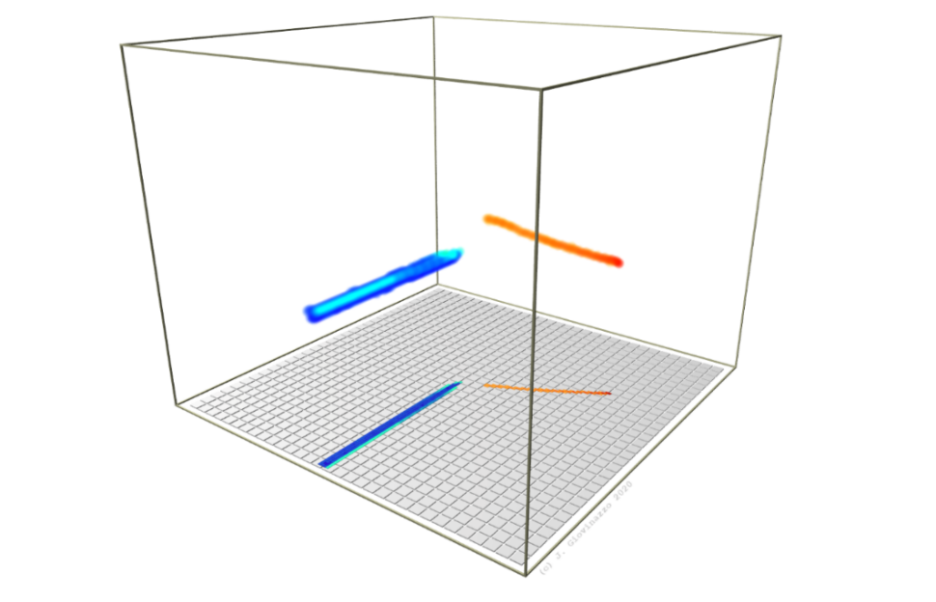



ECT* 2022 – 04-08/07/2022
nuclear physics at the edge of stability
proton(s) radioactivity studies with ACTAR TPC
J. Giovinazzo – LP2iB (former CENBG) – Bordeaux
(for E690 and E791 collaborations + ACTAR TPC + GANIL/LISE)
nuclear stability and proton emission
the need for new detection devices
time projection chamber
recent (decay) experiments
○ 2-proton radioactivity
○ isomers proton radioactivity

Slide 2

nuclear stability and proton emission
(introduction)
radioactivity towards the proton drip-line
exotic decay modes
the energy dimension
J. Giovinazzo
proton(s) radioactivity studies with ACTAR TPC
ECT* 2022 workshop – Trento – 04-08/07/2022

Slide 3
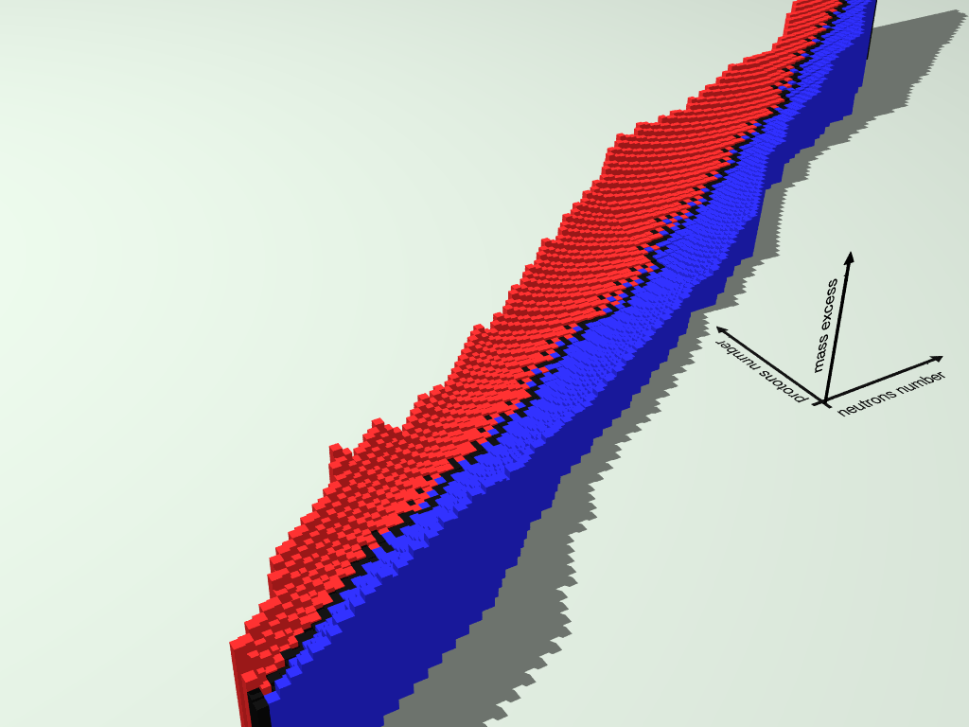


the valley of beta stability
binding energy: Bethe-Weizsäcker
$B\left(A,Z\right)$ $=a_{v}∙A$ volume
$−{ a}_{s}∙A^{\frac{2}{3}}$ surface
$−{ a}_{c}∙\frac{Z\left(Z−1\right)}{A^{1/3}}$ Coulomb
$− a_{a}∙\frac{{\left(N−Z\right)}^{2}}{A^{1/3}}$ symmetry
$± a_{p}∙A^{−1/2}$ pairing
+ shell effects (magic numbers)…
atomic mass
(mass excess)
the “valley of beta stability”
β⁺
β⁻
$$∆m=m\left({}_{Z}^{A}{X_{N}}\right)−A∙u$$
$N$ neutrons
$Z$ protons
$A=N+Z$
mass parabola
J. Giovinazzo
proton(s) radioactivity studies with ACTAR TPC
ECT* 2022 workshop – Trento – 04-08/07/2022

Slide 4
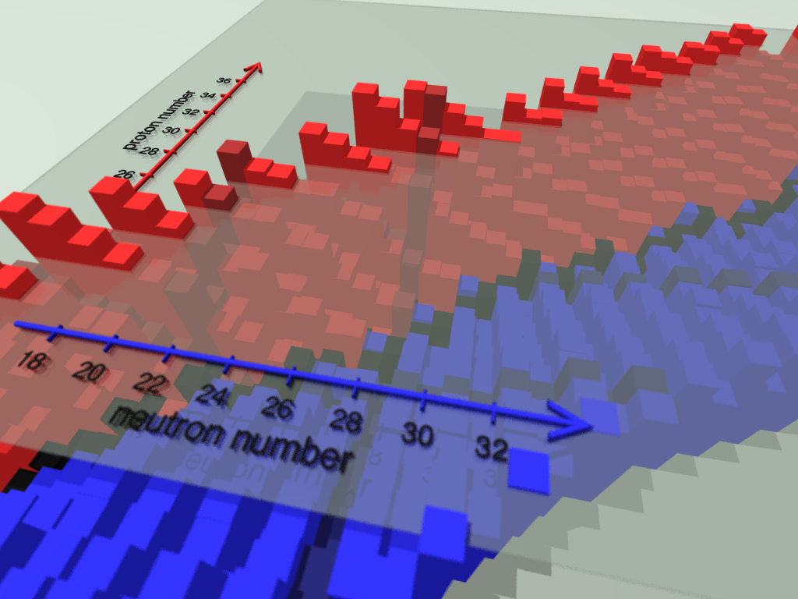
drip-lines: the frontiers of the table of isotopes
binding energy: Bethe-Weizsäcker
$B\left(A,Z\right)$ $=a_{v}∙A$ volume
$−{ a}_{s}∙A^{\frac{2}{3}}$ surface
$−{ a}_{c}∙\frac{Z\left(Z−1\right)}{A^{1/3}}$ Coulomb
$− a_{a}∙\frac{{\left(N−Z\right)}^{2}}{A^{1/3}}$ symmetry
$± a_{p}∙A^{−1/2}$ pairing
+ shell effects (magic numbers)…
proton drip-line
drip-lines
B(A,Z) < 0
unbound / nuclear force
neutron drip-line
J. Giovinazzo
proton(s) radioactivity studies with ACTAR TPC
ECT* 2022 workshop – Trento – 04-08/07/2022

Slide 5
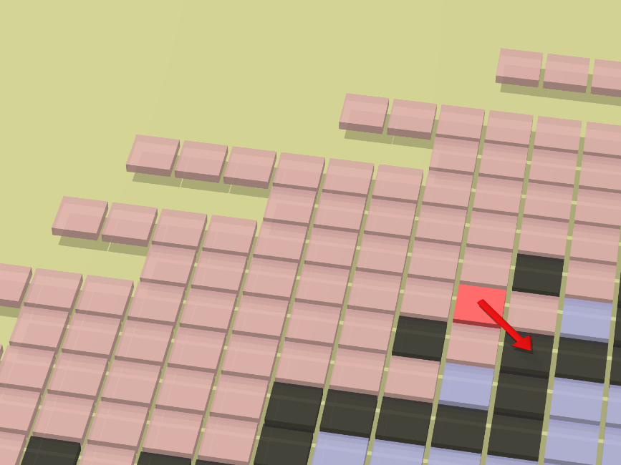


towards the proton drip-line
β decay (β⁺/EC):
β⁺ / EC
Q_{EC}
$${}_{N}^{Z}{Xa}$$
$${}_{N+1}^{Z−1}{Xb}$$
- spectroscopy and
nuclear structure
protons
neutrons
energy
radius
radius
J. Giovinazzo
proton(s) radioactivity studies with ACTAR TPC
ECT* 2022 workshop – Trento – 04-08/07/2022

Slide 6
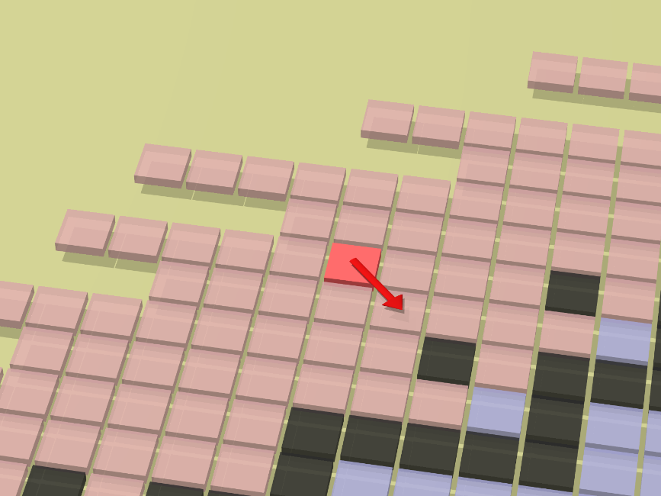

towards the proton drip-line
β and β-γ decays
β⁺ / EC
$${}_{N}^{Z}{Xa}$$
S_{P}(Xb)
Q_{EC}
γ
$${}_{N+1}^{Z−1}{Xb}$$
- spectroscopy and
nuclear structure
- precision tests of weak
interaction
protons
neutrons
energy
radius
radius
β⁺/EC decay energy: Q_{EC} ∼ few MeV
proton separation: S_{P}(Xb) > Q_{EC} (B/A ∼8 MeV)
J. Giovinazzo
proton(s) radioactivity studies with ACTAR TPC
ECT* 2022 workshop – Trento – 04-08/07/2022

Slide 7
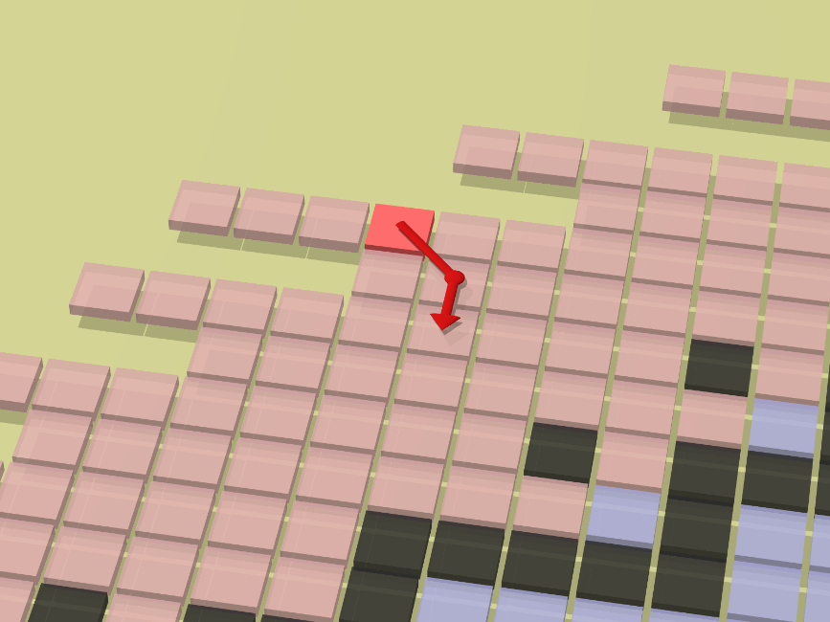



towards the proton drip-line
β-delayed proton emission
$${}_{N}^{Z}{Xa}$$
F
IAS
p
β⁺ / EC
Q_{EC}
γ
GT
${}_{N+1}^{Z−2}{Xc}$ $(+p)$
S_{P}(Xb)
Q_{EC} increases
S_{P}(Xb) decreases
$${}_{N+1}^{Z−1}{Xb}$$
β-delayed proton emission:
- nuclear astrophysics
- gamma / proton competition
proton transitions: precise probe
J. Giovinazzo
proton(s) radioactivity studies with ACTAR TPC
ECT* 2022 workshop – Trento – 04-08/07/2022

Slide 8
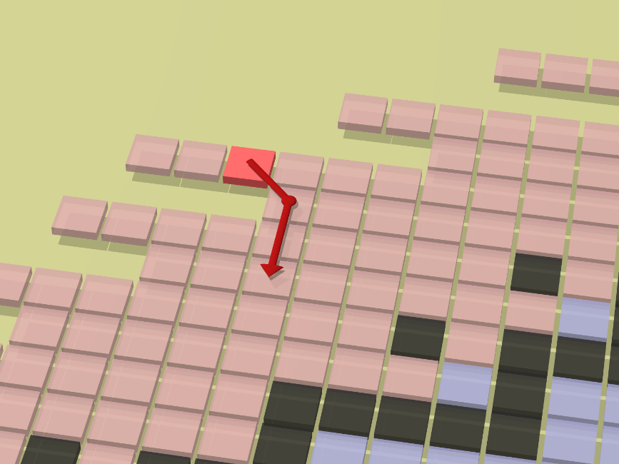



towards the proton drip-line
β-delayed multi- proton emission:
- rp-process waiting points
- search for direct 2P emission
$${}_{N}^{Z}{Xa}$$
F
IAS
2p?
β⁺ / EC
p
Q_{EC}
p
γ
GT
${}_{N+1}^{Z−3}{Xd}$ $(+2p)$
γ
${}_{N+1}^{Z−2}{Xc}$ $(+p)$
S_{2p}(Xb)
$${}_{N+1}^{Z−1}{Xb}$$
- often the only access to very exotic isotopes
- complex proton emission patterns: level densities & statistical aspects
J. Giovinazzo
proton(s) radioactivity studies with ACTAR TPC
ECT* 2022 workshop – Trento – 04-08/07/2022

Slide 9
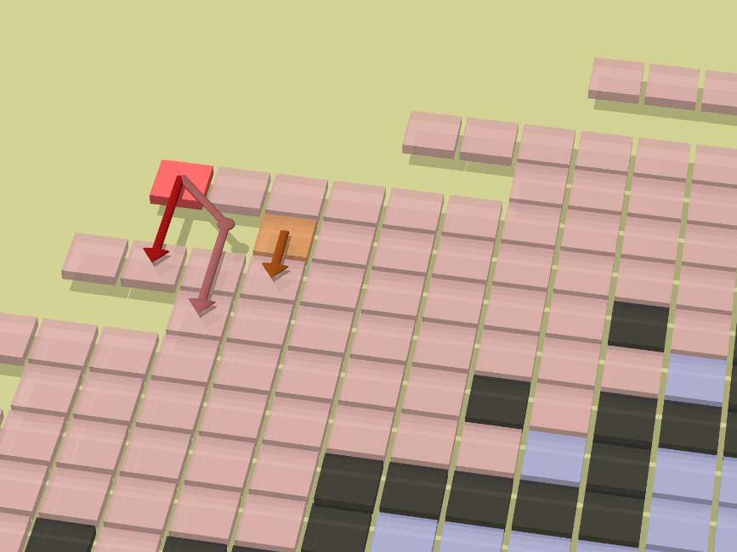
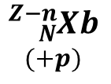

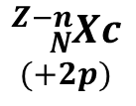


towards the proton drip-line
unbound with respect to proton(s) emission
S_{P}(Xa) < 0 and/or S_{2P}(Xa) < 0
2p
$${}_{N}^{Z}{Xa}$$
1p
$${}_{N}^{Z−n}{Xb}$$
$$(+p)$$
$${}_{N}^{Z−n}{Xc}$$
$$(+2p)$$
β⁺ / EC
F
IAS
p
GT
protons
neutrons
p
energy
p
radius
γ
${}_{N+1}^{Z−3}{Xd}$ $(+2p)$
$${}_{N+1}^{Z−1}{Xb}$$
${}_{N+1}^{Z−2}{Xc}$ $(+p)$
J. Giovinazzo
proton(s) radioactivity studies with ACTAR TPC
ECT* 2022 workshop – Trento – 04-08/07/2022

Slide 10
stability: edges of nuclear landscape
study of (quasi-)unbound nuclei
• challenging for nuclear structure models
• strong coupling to continuum
→ particle emission
proton drip-line
neutron drip-line
J. Giovinazzo
proton(s) radioactivity studies with ACTAR TPC
ECT* 2022 workshop – Trento – 04-08/07/2022

Slide 11
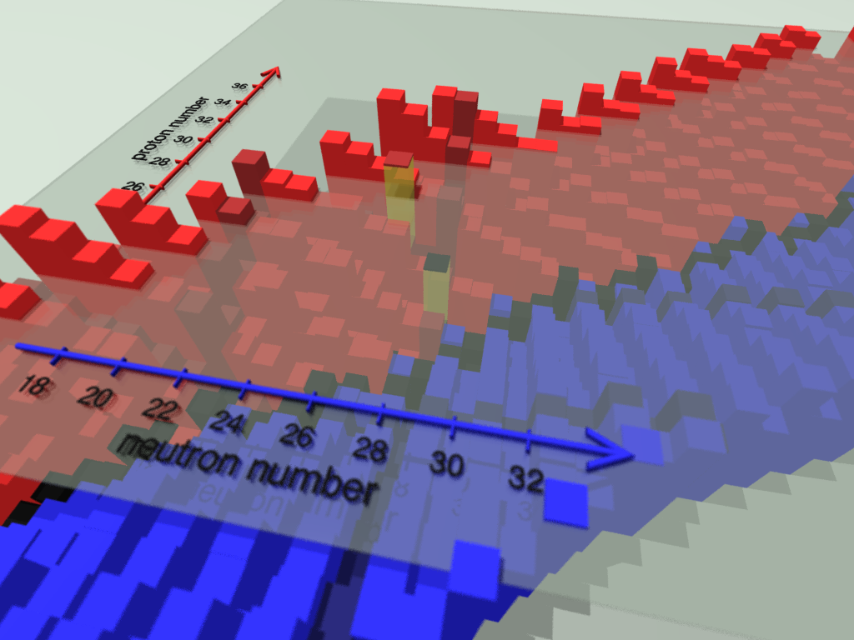
stability: edges of nuclear landscape, the energy dimension
study of (quasi-)unbound nuclei
• challenging for nuclear structure models
• strong coupling to continuum
→ particle emission
high energy isomeric states
→ similar “drip-line”
behavior
close to particle emission
threshold
mirror nuclei ⁵⁴Fe and ⁵⁴Ni
→ isospin symmetry
→ near N = Z = 28
shell closures
⁵⁴Ni
⁵⁴Fe
energy
J. Giovinazzo
proton(s) radioactivity studies with ACTAR TPC
ECT* 2022 workshop – Trento – 04-08/07/2022

Slide 12
a challenge for theoretical descriptions and experimental studies
for theory, depending on the studied question
• coupling to the continuum
• effects governed by extremely weak components of the wave functions
• emission dynamics
• isospin non-conserving terms
• …
for experiments
• difficulty to produce extremely unstable nuclei
• short half-lives
• multi-particles emission
• rare events and/or large background
• …
→ development of production facilities (RIKEN, FRIB, SPIRAL2, FAIR…)
→ need for new detection devices
(illustrated in the following experiments examples)
J. Giovinazzo
proton(s) radioactivity studies with ACTAR TPC
ECT* 2022 workshop – Trento – 04-08/07/2022

Slide 13
ACTAR TPC
a new device for nuclear physics experiments
principle of the 4D detector
technical realization
exploitation
J. Giovinazzo
proton(s) radioactivity studies with ACTAR TPC
ECT* 2022 workshop – Trento – 04-08/07/2022

Slide 14

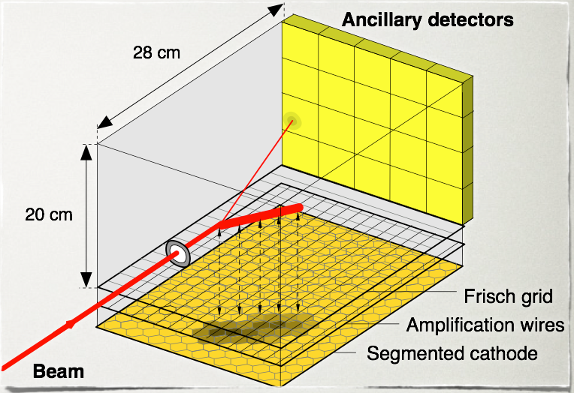

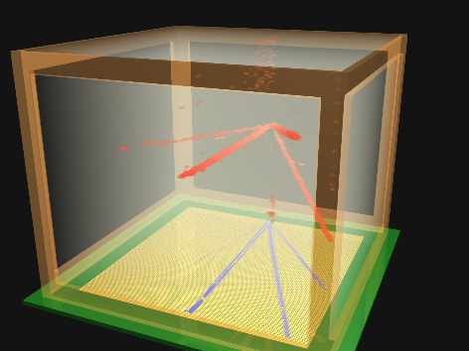

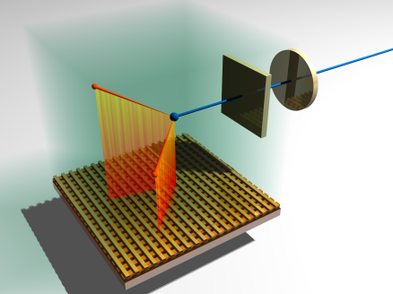

ACtive TARget & Time Projection Chamber
(ACTAR TPC)
(GANIL and coll.)
development of a new TPC
for a large (nuclear) physics case
pads (hex): 2D proj.
wires: drift time
nuclear
reactions
CENBG TPC
X-Y strips
energy & time:
2x 1D proj.
ions stopping
and decay
GANIL, CENBG,
Leuven, Santiago de C.,
IPNO, Legnaro
others such devices around the world
→ AT TPC (NSCL) / same principle, O-TPC (Warsaw) / same decay physics, ….
TexAT (TA&M) / talk of G. Rogachev
J. Giovinazzo
proton(s) radioactivity studies with ACTAR TPC
ECT* 2022 workshop – Trento – 04-08/07/2022

Slide 15
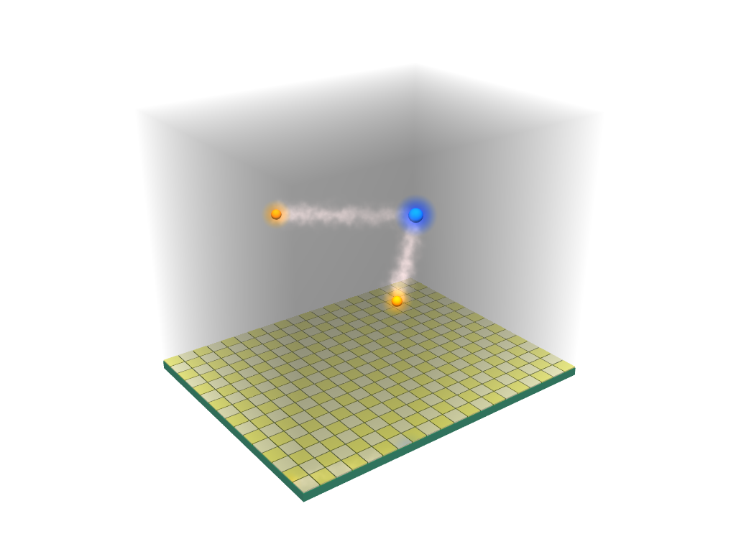
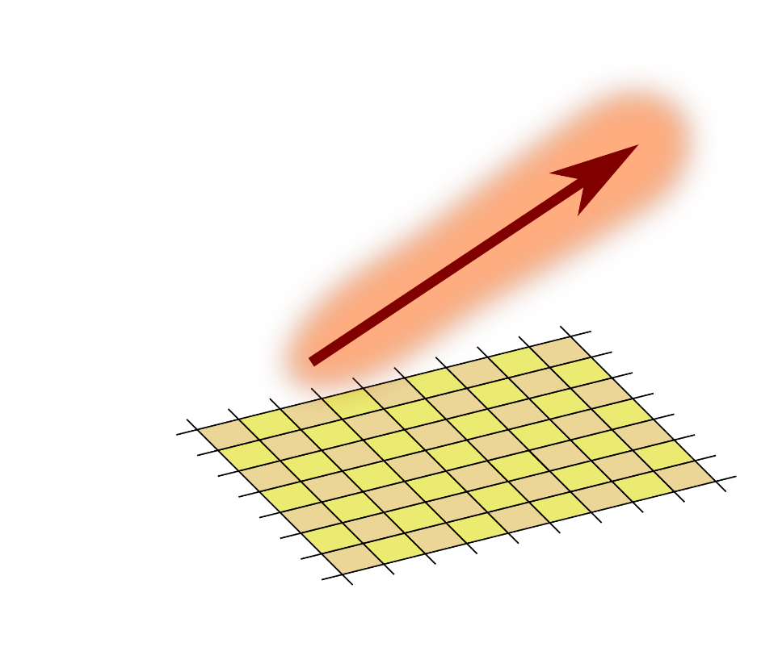
a 4D detector: tracking and energy
pads plane
(signal collection)
2D digitization
ΔE(x,y,z) ⇐⇒ ΔE[x_{i},y_{j}](z)
J. Giovinazzo (2013)
particle
track
gas
ionization
pads plane
(signal collection)

Slide 16
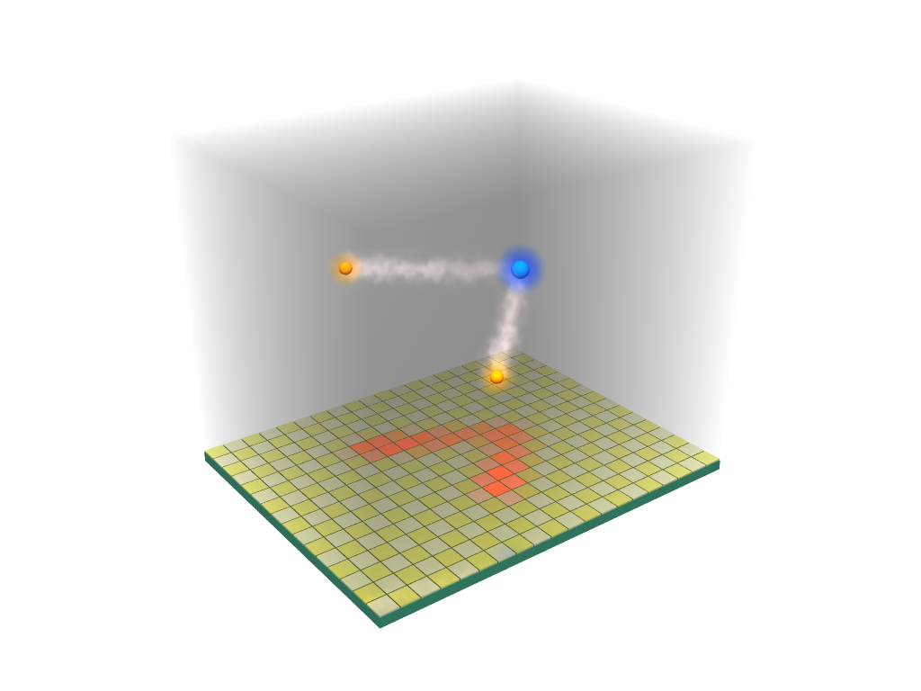
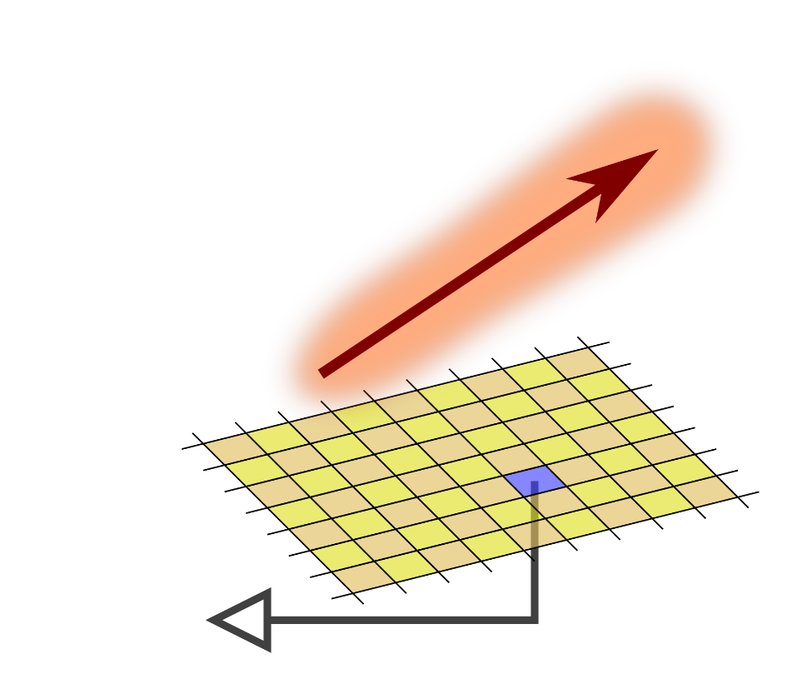
a 4D detector: tracking and energy
pads plane TPC principle
(signal collection)
2D digitization z ⇔ t
ΔE(x,y,z) ⇐⇒ ΔE[x_{i},y_{j}](z) ⇐⇒ ΔE[x_{i},y_{j}](t)
J. Giovinazzo (2013)
particle
track
gas
ionization
ionization
drift
(velocity,,
dispersion)
pads plane
(signal collection)
pad
signal

Slide 17
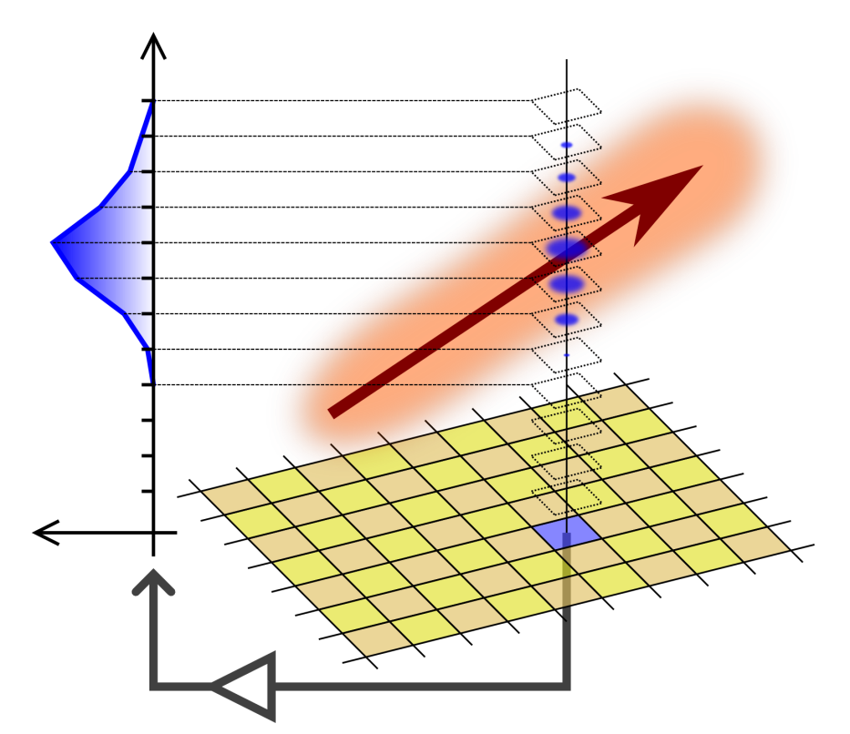
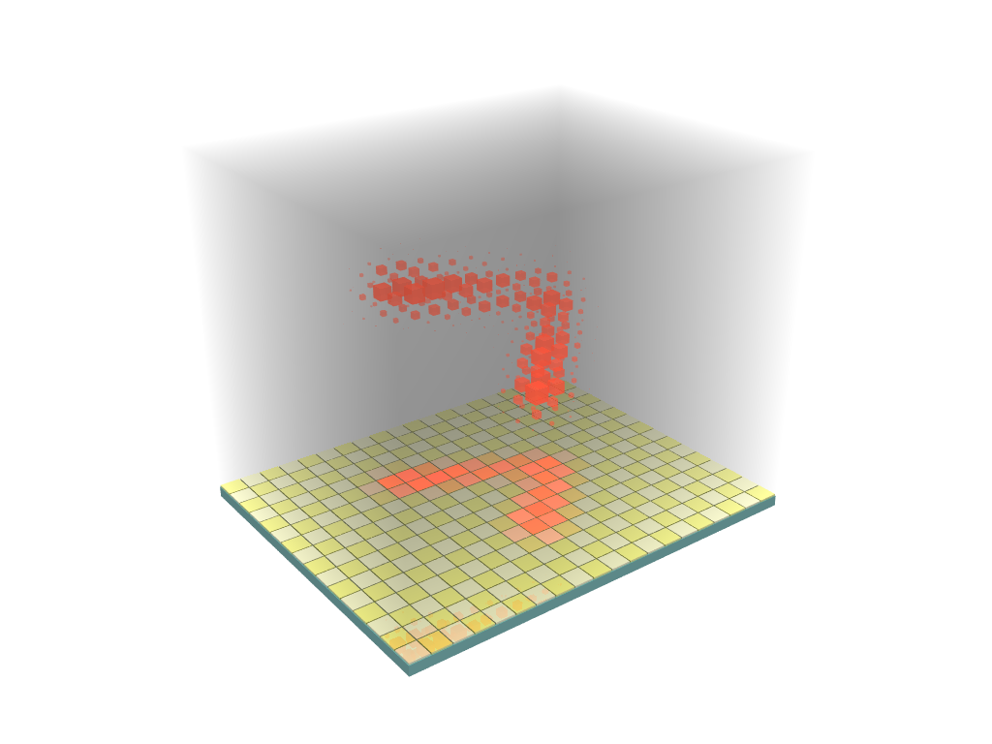

a 4D detector: tracking and energy
pads plane TPC principle time sampling
(signal collection) of signal
2D digitization z ⇔ t 3D digitization
ΔE(x,y,z) ⇐⇒ ΔE[x_{i},y_{j}](z) ⇐⇒ ΔE[x_{i},y_{j}](t) ⇐⇒ ΔE[x_{i},y_{j},t_{k}]
J. Giovinazzo (2013)
particle
track
gas
ionization
time sampling
of collected signal
ionization
drift
(velocity,,
dispersion)
3D reconstruction of
ionizations charges along
the particles trajectories
pad
signal
pads plane
(signal collection)
GET electronics

Slide 18
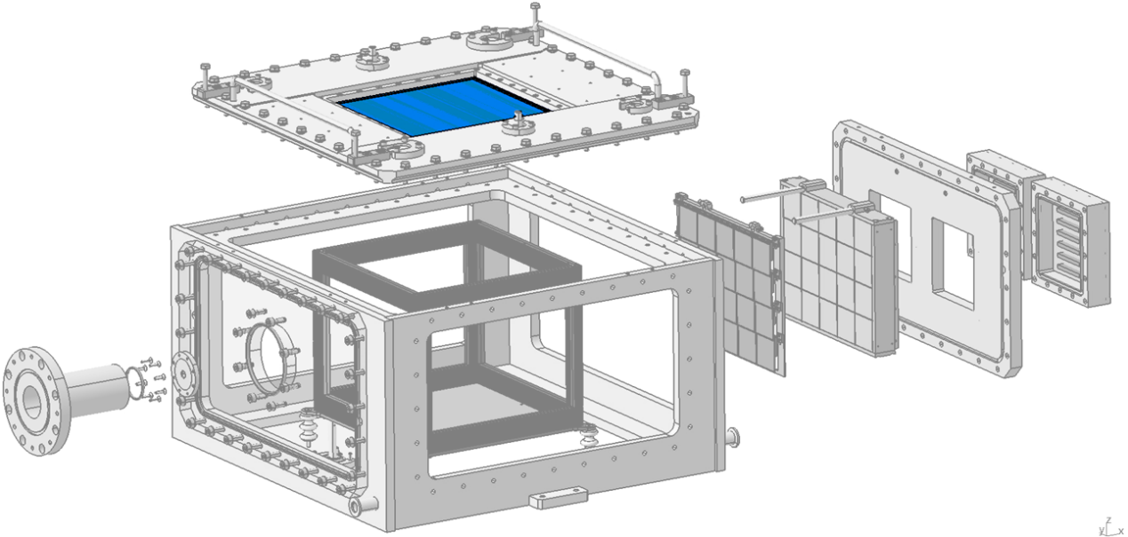
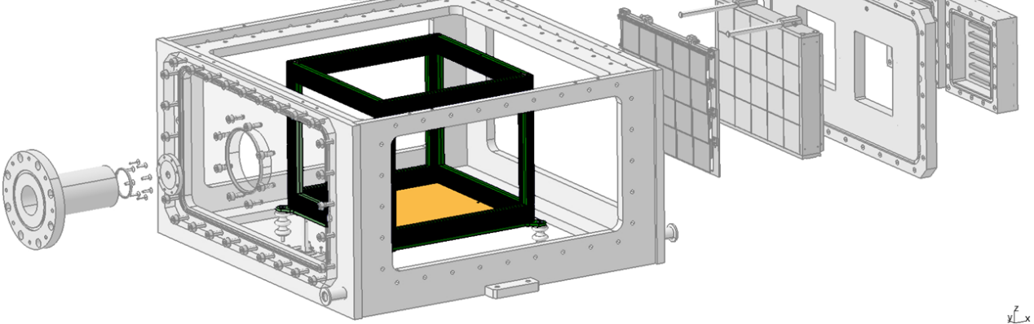
ACTAR TPC: main elements
beam
entrance
image P. Gangnant, GANIL
J. Giovinazzo
proton(s) radioactivity studies with ACTAR TPC
ECT* 2022 workshop – Trento – 04-08/07/2022

Slide 19
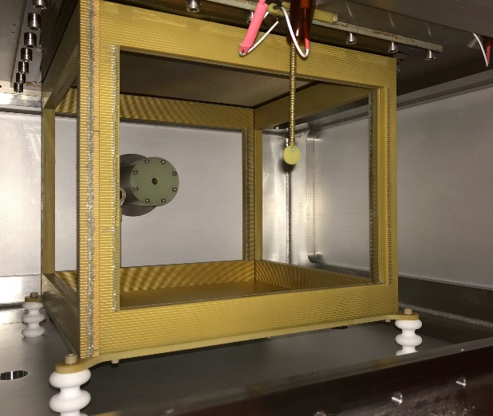
ACTAR TPC: main elements
image P. Gangnant, GANIL
drift cage (active volume)
double wires frames
1 mm pitch inside
2 mm pitch outside
98% transparency
field E ∼ 100 V/cm
photo O. Poleshchuk (2017)
J. Giovinazzo
proton(s) radioactivity studies with ACTAR TPC
ECT* 2022 workshop – Trento – 04-08/07/2022

Slide 20
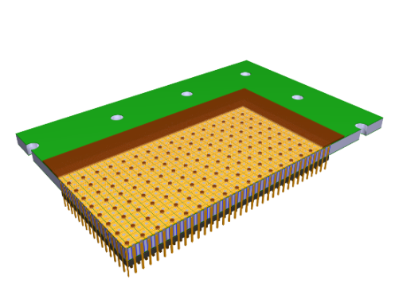
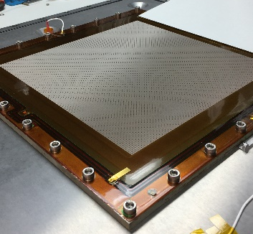
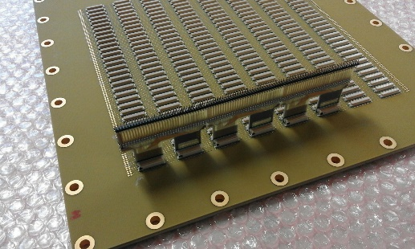
metal-core PCB
collection plane (pads)
GANIL exp. 2021
16384 pads
(128×128; 2×2 mm²)
image P. Gangnant, GANIL
multi-layer PCB
drift cage (active volume)
+ flexible PCB
connection
to read. elec.
GANIL exp. 2019
photo O. Poleshchuk (2017)
J. Giovinazzo
proton(s) radioactivity studies with ACTAR TPC
ECT* 2022 workshop – Trento – 04-08/07/2022

Slide 21
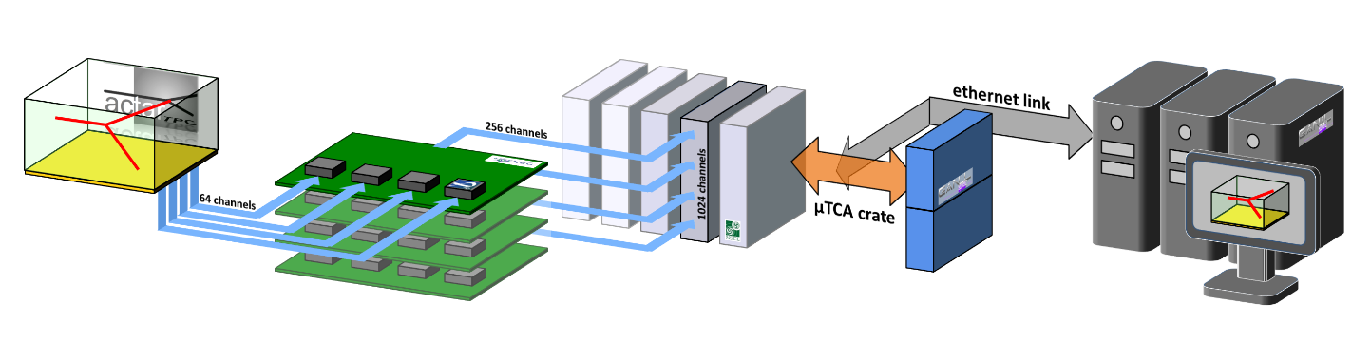

ACTAR TPC: main elements
5
metal-core PCB
collection plane (pads)
16384 pads
(128×128; 2×2 mm²)
image P. Gangnant, GANIL
multi-layer PCB
drift cage (active volume)
+ flexible PCB
connection
to read. elec.
readout electronics
photo O. Poleshchuk (2017)
detector
CoBo modules
control / acquisition
AsAd boards
image JG / CENBG (2015)
AGET chip
signal sampling
512 @ 1-100 MHz
MuTAnT
clocks distribution
and data concentration
J. Giovinazzo
proton(s) radioactivity studies with ACTAR TPC
ECT* 2022 workshop – Trento – 04-08/07/2022

Slide 22

ACTAR TPC timeline
2014
2015
2016
2017
2018
2019
2020
2021
2022
J. Giovinazzo
proton(s) radioactivity studies with ACTAR TPC
ECT* 2022 workshop – Trento – 04-08/07/2022

Slide 23
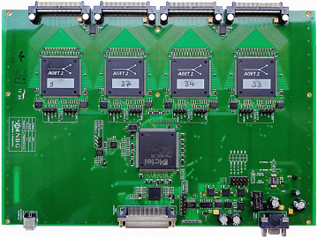
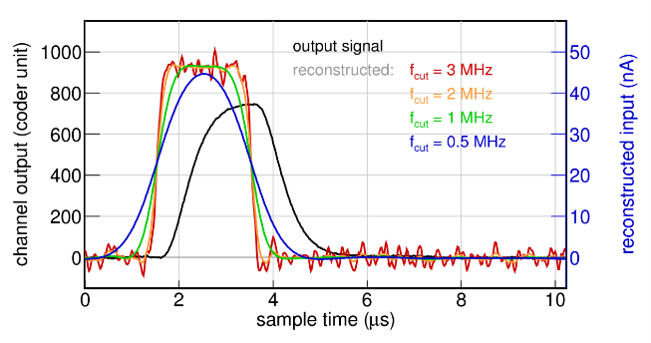
ACTAR TPC timeline
AsAd board
(response analysis)
data processing
J.G. et al. NIM 2016
2014
2015
2016
2017
2018
2019
2020
2021
2022
GET elec. dev.
GET: E.C. Pollaco et al. NIM 2018
J. Giovinazzo
proton(s) radioactivity studies with ACTAR TPC
ECT* 2022 workshop – Trento – 04-08/07/2022

Slide 24
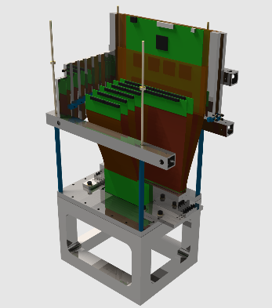
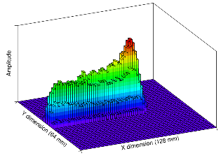

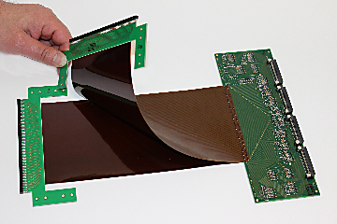
ACTAR TPC timeline – demonstrators
AsAd board
(response analysis)
CENBG
demonstrator
GANIL
demonstrator
performances
J.G. et al. NIM 2020
2014
2015
2016
2017
2018
2019
2020
2021
2022
GET elec. dev.
R&D + demonstrators
R&D demonstrators
T. Roger, et al. NIM 2018
J.G. et al. NIM 2018
J. Giovinazzo
proton(s) radioactivity studies with ACTAR TPC
ECT* 2022 workshop – Trento – 04-08/07/2022

Slide 25
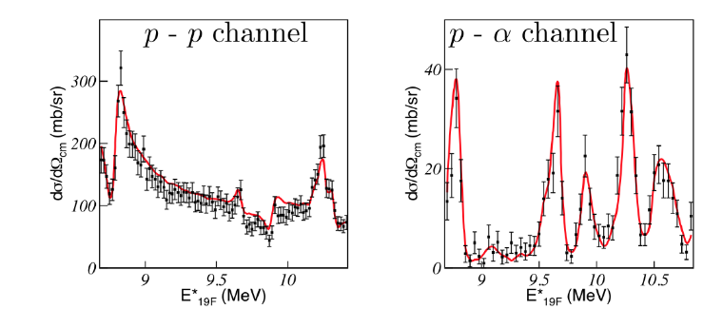
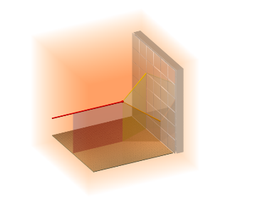
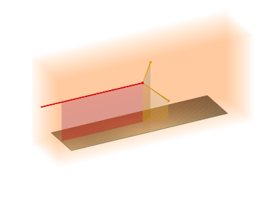
ACTAR TPC timeline – final detectors
B. Mauss, PhD thesis (GANIL)
AsAd board
(response analysis)
active target
commissioning
¹⁸O (p,p’) ¹⁸O & ¹⁸O (p, α) ¹⁸O
CENBG
demonstrator
GANIL
demonstrator
active target commissioning
B. Mauss, et al. NIM 2019
2014
2015
2016
2017
2018
2019
2020
2021
2022
GET elec. dev.
R&D + demonstrators
ACTAR TPC “reaction” geometry
“decay” geometry
image R. Raabe
image R. Raabe
J. Giovinazzo
proton(s) radioactivity studies with ACTAR TPC
ECT* 2022 workshop – Trento – 04-08/07/2022

Slide 26

ACTAR TPC timeline – current exploitation
decay mode
active target
AsAd board
(response analysis)
active target
commissioning
¹⁸O (p,p’) ¹⁸O & ¹⁸O (p, α) ¹⁸O
⁴⁸Ni 2P rad.
& exotic decays
“brochette” mode
CoulEx + (p,p’)
Ar & Si isotopes
CENBG
demonstrator
²⁰O (d,³He) ¹⁹Ne
GANIL
demonstrator
^{54m}Ni & ^{53m}Co
proton rad.
2014
2015
2016
2017
2018
2019
2020
2021
2022
GET elec. dev.
exp. exploitation
R&D + demonstrators
ACTAR TPC “reaction” geometry
“decay” geometry
image R. Raabe
image R. Raabe
J. Giovinazzo
proton(s) radioactivity studies with ACTAR TPC
ECT* 2022 workshop – Trento – 04-08/07/2022

Slide 27
ACTAR TPC timeline – future…
decay mode
active target
TRIUMF (trasnfer)
AsAd board
(response analysis)
active target
commissioning
¹⁸O (p,p’) ¹⁸O & ¹⁸O (p, α) ¹⁸O
⁴⁸Ni 2P rad.
& exotic decays
“brochette” mode
CoulEx + (p,p’)
Ar & Si isotopes
CENBG
demonstrator
²⁰O (d,³He) ¹⁹Ne
GANIL
demonstrator
^{54m}Ni & ^{53m}Co
proton rad.
RIKEN (1p,2p)
GSI/FAIR
2014
2015
2016
2017
2018
2019
2020
2021
2022
GET elec. dev.
exp. exploitation
R&D + demonstrators
ACTAR TPC “reaction” geometry
“decay” geometry
image R. Raabe
image R. Raabe
J. Giovinazzo
proton(s) radioactivity studies with ACTAR TPC
ECT* 2022 workshop – Trento – 04-08/07/2022

Slide 28
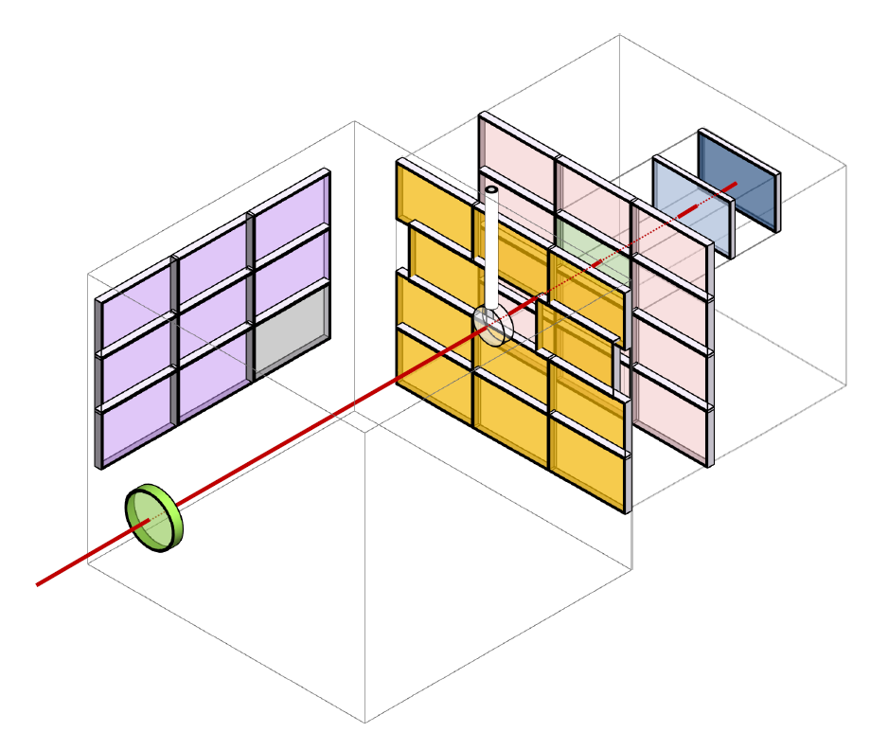
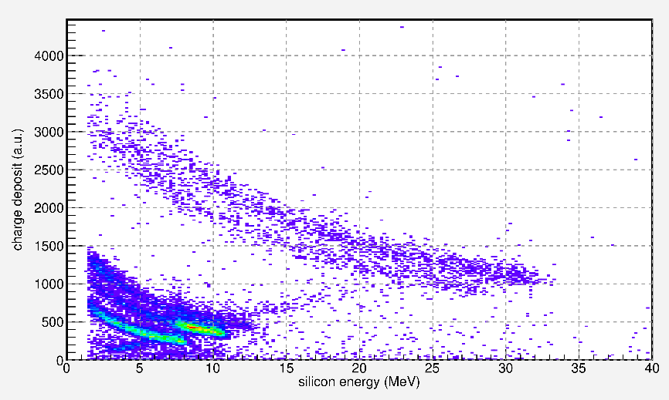
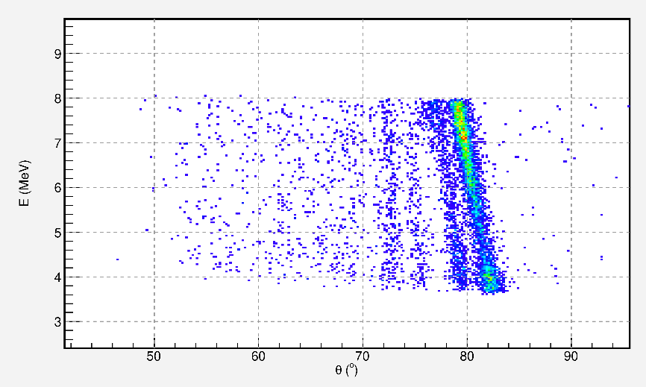
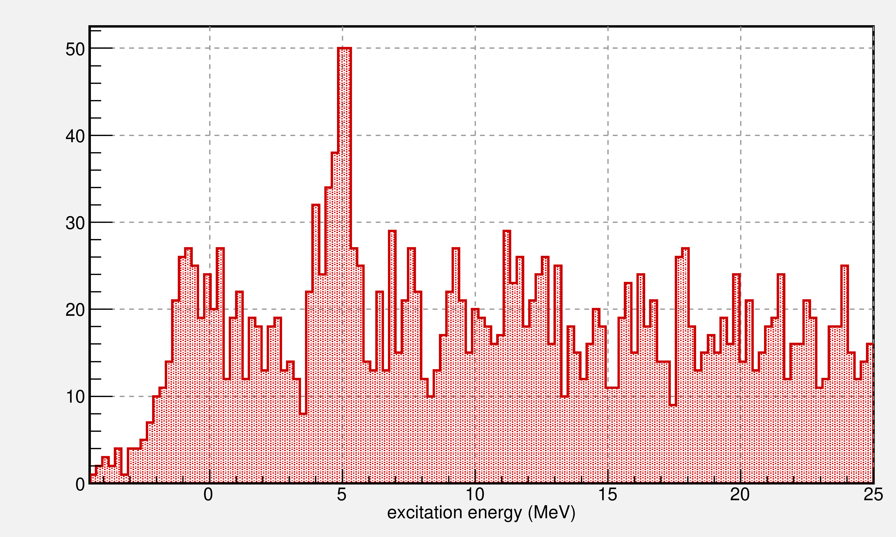
E796 (2022) – transfer: ²⁰O (d,³He) ¹⁹Ne
additional
Si detectors
particles
identification
preliminary
PhD thesis of J. Lois Fuentes (Santiago de C.)
kinematic lines (d,d’)
excitation energy
(d,³He)
J. Giovinazzo
proton(s) radioactivity studies with ACTAR TPC
ECT* 2022 workshop – Trento – 04-08/07/2022

Slide 29
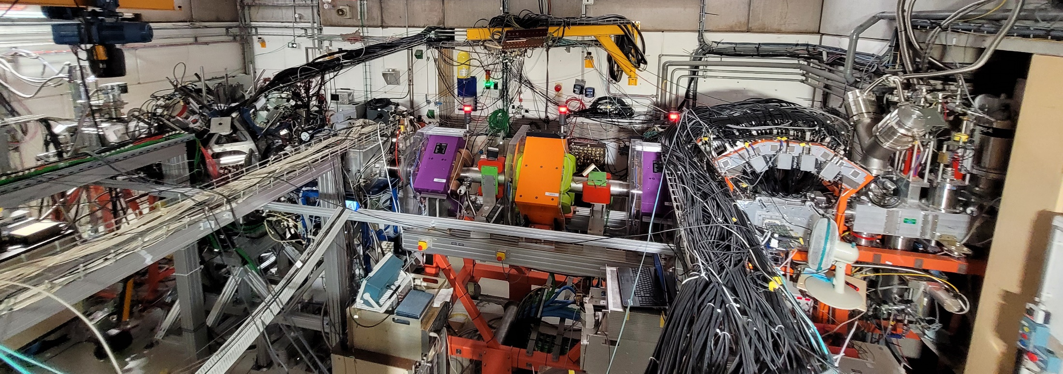
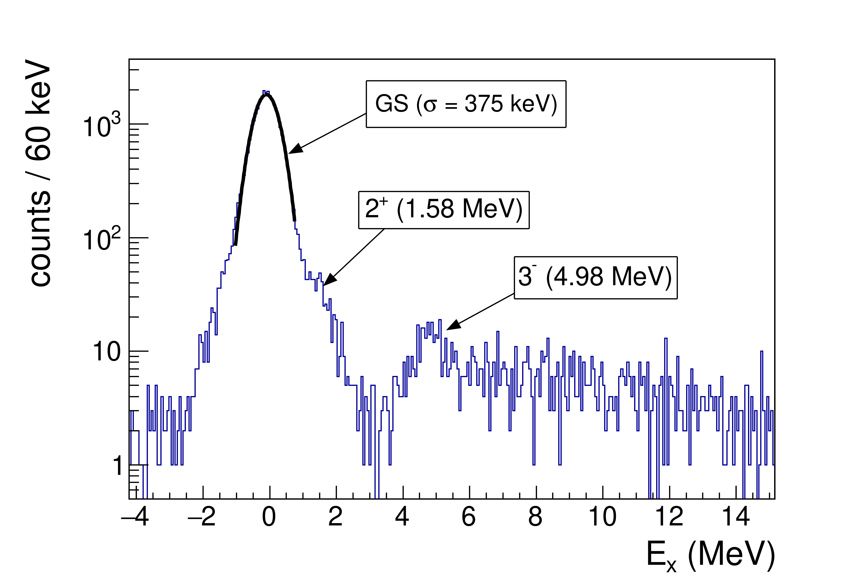
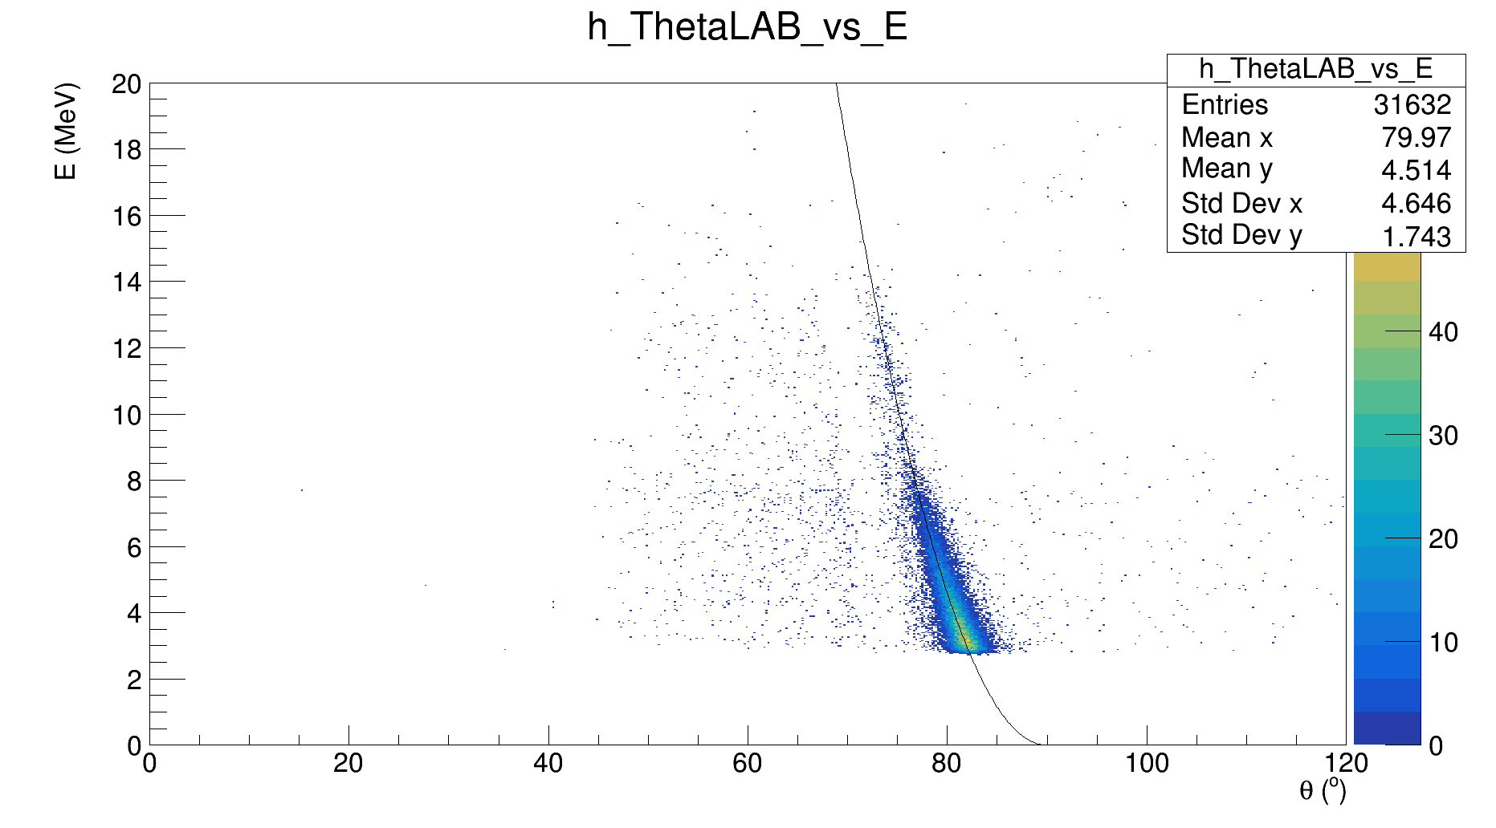
E823 (2022) – CoulEx + inel. scat. (“brochette” mode): ⁴⁶Ar, ^{32,34,36,38}Si
ACTAR TPC
(p,p’)
ZDD
(recoil)
beam
EXOGAM + PARIS
(gamma)
photo Q. Delignac
GANIL / LISE (D6)
preliminary
⁴⁶Ar (p,p’)
PhD thesis of
A. Cassisa (Prague)
J. Giovinazzo
proton(s) radioactivity studies with ACTAR TPC
ECT* 2022 workshop – Trento – 04-08/07/2022

Slide 30
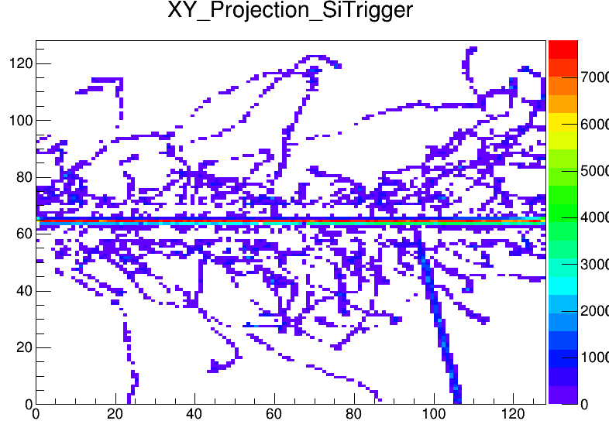
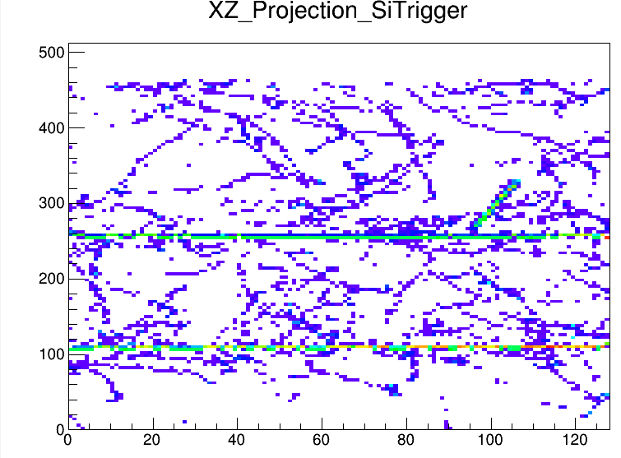
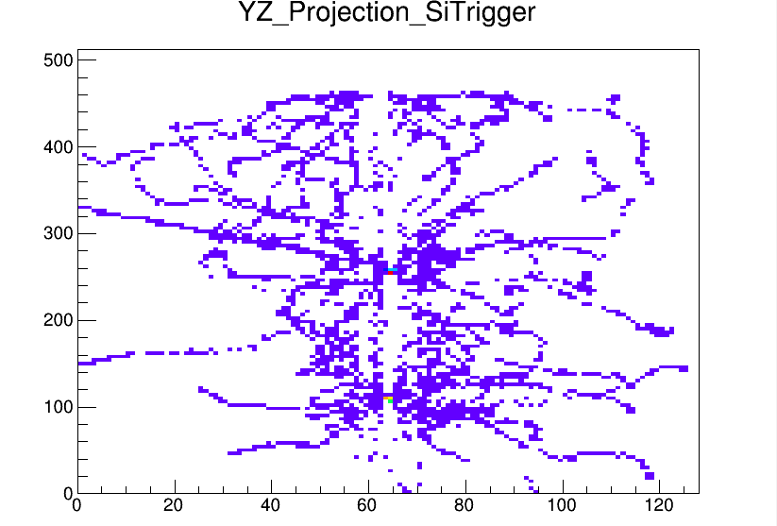
E823 (2022) – CoulEx + inel. scat. (“brochette” mode): ⁴⁶Ar, ^{32,34,36,38}Si
3D signal in ACTAR TPC
a tricky analysis !!!
scattered proton
delta
electrons
ions
pile-up
preliminary
⁴⁶Ar (p,p’)
PhD thesis of
A. Cassisa (Prague)
J. Giovinazzo
proton(s) radioactivity studies with ACTAR TPC
ECT* 2022 workshop – Trento – 04-08/07/2022

Slide 31
2-proton radioactivity of ⁴⁸Ni
and several β-xp decays
2P radioactivity
GANIL 2021 experiment
preliminary results
J. Giovinazzo
proton(s) radioactivity studies with ACTAR TPC
ECT* 2022 workshop – Trento – 04-08/07/2022

Slide 32
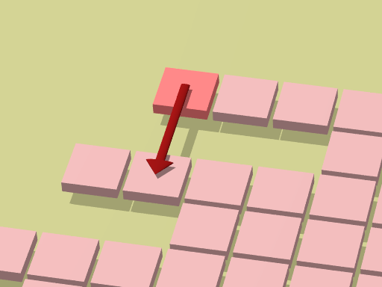
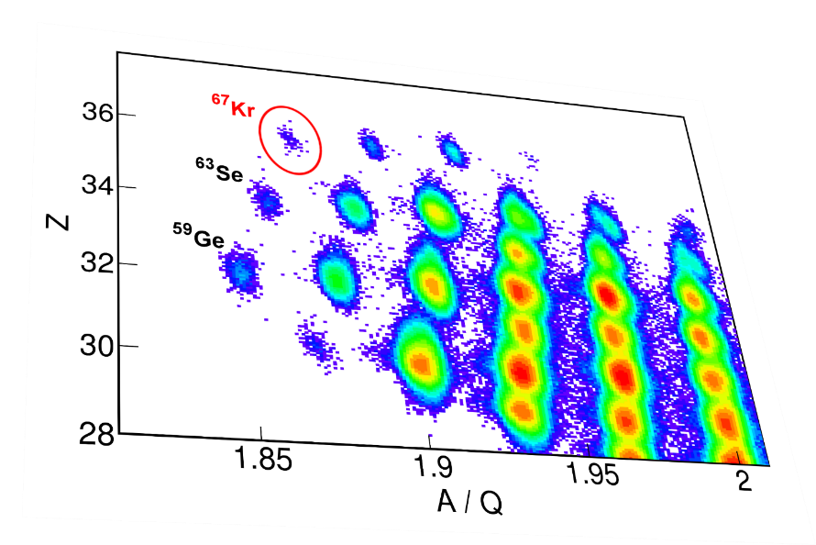
2-proton radioactivity: discovered 20 years ago…
predicted in the 60’s
• Ya.B. Zel’Dovich, V.I. Goldanskii, V.M. Galitskii
• simple theoretical description
experimental evidence 2002 (decay of ⁴⁵Fe)
• J.G. et al. (GANIL 2002), M. Pfützner et al. (GSI 2002)
• implantation in Si detectors:
→ indirect observation from global quantities:
Q value, half-life, daughter decay
• other known emitters
- ⁵⁴Zn (GANIL, B. Blank et al. 2005)
- ⁴⁸Ni (GANIL 2005 ? NSCL, L. Miernik et al. 2007)
• last observed…
- ⁶⁷Kr (RIKEN, J. G. et al. 2015)
radius
energy
2P radioactivity
even-Z isotope
1 proton emission forbidden
J. Giovinazzo
proton(s) radioactivity studies with ACTAR TPC
ECT* 2022 workshop – Trento – 04-08/07/2022

Slide 33

a limited comparison with theory
experiment: half-life (T_{1/2}) and transition energy (Q_{2P})
models based on nuclear structure
R-matrix formalism
- Barker & Brown approach
- include p-p resonance
- shell model wave functions
shell model embedded in the continuum (SMEC)
- tentative approach from Ploszajczak & Rotureau
 no dynamics
limited comparison: T_{1/2}(Q_{2P})
(with Q_{2P} taken from experiments !)
3-body model
- core+p+p system (hyperspherical harmonics)
- good dynamical description
- no intrinsic structure prediction
T_{1/2} = f(Q_{2P})
J. Giovinazzo
proton(s) radioactivity studies with ACTAR TPC
ECT* 2022 workshop – Trento – 04-08/07/2022

Slide 34







3-body model: angular & energy correlations predictions
developed by M.V. Zhukov & L.V. Grigorenko
3-body Schrödinger equation
solved in hyper-spherical
harmonics basis
L.V. Grigorenko
discussion during
W. Nazarewicz talk
prediction of distributions for
- energy sharing between protons
- proton-proton angular correlations
→ sensitive to involved orbitals / structure ?
J. Giovinazzo
proton(s) radioactivity studies with ACTAR TPC
ECT* 2022 workshop – Trento – 04-08/07/2022

Slide 35
3-body model: angular & energy correlations predictions
developed by M.V. Zhukov & L.V. Grigorenko
3-body Schrödinger equation
solved in hyper-spherical
harmonics basis
to measure
angular and energy
correlations
need for tracking
experiments…
L.V. Grigorenko
prediction of distributions for
- energy sharing between protons
- proton-proton angular correlations
→ sensitive to involved orbitals / structure ?
J. Giovinazzo
proton(s) radioactivity studies with ACTAR TPC
ECT* 2022 workshop – Trento – 04-08/07/2022

Slide 36








TPCs for direct observation of the emitted protons
⁴⁵Fe
first direct obs.
(GANIL)
⁵⁴Zn
(GANIL)
7 p-p events only
X-Y strips TPC
(Bordeaux)
J.G. et al., PRL 2006
P. Ascher et al., PRL 2011
optical TPC
(Warsaw)
experiment @ NSCL
→ 75 counts of p-p
correlations
⁴⁸Ni
confirmed as 2P emitter
⁴⁵Fe
2p
⁴⁸Ni
M. Pfützner, K. Miermik, et al., 2007
K. Miernik et al., PRL 2007
M. Pomorski et al., PRL 2011
J. Giovinazzo
proton(s) radioactivity studies with ACTAR TPC
ECT* 2022 workshop – Trento – 04-08/07/2022

Slide 37




probing structure beyond the drip line
⁴⁵Fe : 26 protons
⁴⁵Fe
2p_{1/2}
1f_{5/2}
K. Miernik et al., EPJA (2009)
2p_{3/2}
$$W\left(p^{2}\right)=24\%$$
1f_{7/2}
⁵⁴Zn : 30 protons
proton-proton angular distribution → orbitals configuration
2p_{1/2}
1f_{5/2}
⁵⁴Zn
2p_{3/2}
$$W\left(p^{2}\right)={30}_{−21}^{+33}\%$$
1f_{7/2}
P. Ascher et al., PRL (2011)
⁴⁸Ni : 28 protons
2p_{1/2}
1f_{5/2}
2p_{3/2}
⁴⁸Ni ??
doubly magic → pure configuration ?
1f_{7/2}
J. Giovinazzo
proton(s) radioactivity studies with ACTAR TPC
ECT* 2022 workshop – Trento – 04-08/07/2022

Slide 38

mixing structure and dynamics ?
L.V. Grigorenko: good dynamics
half-lives:
T_{1/2} for pure (s²,) p² and f² config.
B.A. Brown: good structure
2-proton amplitudes:
for pure (s²,) p² and f² config
“hybrid” model
“Shell model corrected half-lives”
A = A(f²) + A(p²) T_{1/2}(2P)
B.A. Brown et al.,
PRC 2019
calculation experiment(s)
⁴⁵Fe $1.8$ - $5.9$ ms $3,6±0,4$ ms OK
⁴⁸Ni $0.4$ - $1.3$ ms $4.1±0,4$ms ∼OK
⁵⁴Zn $0.6$ - $1.7$ ms ${1.98}_{−0.41}^{+0.73}$ ms ∼OK
J. Giovinazzo
proton(s) radioactivity studies with ACTAR TPC
ECT* 2022 workshop – Trento – 04-08/07/2022

Slide 39

mixing structure and dynamics ?
L.V. Grigorenko: good dynamics
half-lives:
T_{1/2} for pure (s²,) p² and f² config.
B.A. Brown: good structure
2-proton amplitudes:
for pure (s²,) p² and f² config
“hybrid” model
“Shell model corrected half-lives”
A = A(f²) + A(p²) T_{1/2}(2P)
B.A. Brown et al.,
PRC 2019
calculation experiment(s)
⁴⁵Fe $1.8$ - $5.9$ ms $3,6±0,4$ ms OK
⁴⁸Ni $0.4$ - $1.3$ ms $4.1±0,4$ms ∼OK
⁵⁴Zn $0.6$ - $1.7$ ms ${1.98}_{−0.41}^{+0.73}$ ms ∼OK
⁶⁷Kr $300$ - $900$ ms $21 ±12$ ms
2016
!?
factor
20 to 40 off !!!
(Goigoux et al., PRL 2016)
“puzzling two-proton decay of ⁶⁷Kr” ?
(title from Wang & Nazarewics, PRL 2019)
J. Giovinazzo
proton(s) radioactivity studies with ACTAR TPC
ECT* 2022 workshop – Trento – 04-08/07/2022

Slide 40

first hypothesis: transition from 2P to sequential decay ?
• possible transition region depending
on intermediate state position
⁶⁷Kr
1p
⁶⁶Br
?
unknown masses
Q_{1P} ?
2p
1p
E_{r} ?
⁶⁵Se
L. Grigorenko et al.
PRC 95 (2017) 021601(R)
?
J. Giovinazzo
proton(s) radioactivity studies with ACTAR TPC
ECT* 2022 workshop – Trento – 04-08/07/2022

Slide 41

first hypothesis: transition from 2P to sequential decay ?
(semi-analytical R-matrix calculation)
• indication of a 1p channel opening ?
• possible transition from 2P to seq. emission
transition region: S_{p} = [−340 ; −270] keV
⁶⁷Kr
1p
⁶⁶Br
?
2p
1p
E_{r} ?
⁶⁵Se
energy sharing pattern
(correlations)
L. Grigorenko et al.
PRC 95 (2017) 021601(R)
2017
0
0.5
1
E_{P1}/Q_{2P}
J. Giovinazzo
proton(s) radioactivity studies with ACTAR TPC
ECT* 2022 workshop – Trento – 04-08/07/2022

Slide 42



second hypothesis: influence of deformation ?
⁶⁷Kr
g_{9/2} intruder
state
Wang & Nazarewicz, PRL 120 (2018)
R. Bengtsson & P. Möller (nature, 2007)
recent work by Wang & Nazarewicz, PRL 120 (2018)
(Gamow Coupled Channels + coupling to core exc.)
with $\left|β_{2}\right|<0.1$ → $T_{1/2}^{2P}>220$ ms
with $β_{2}=−0.3$ → $T_{1/2}^{2P}={24}_{−7}^{+10}$ ms
agreement with exp. !
2018
J. Giovinazzo
proton(s) radioactivity studies with ACTAR TPC
ECT* 2022 workshop – Trento – 04-08/07/2022

Slide 43

second hypothesis: influence of deformation ?
⁴⁸Ni: spherical
(benchmark)
angular correlation
prediction
recent work by Wang & Nazarewicz, PRL 120 (2018)
(Gamow Coupled Channels + coupling to core exc.)
with $\left|β_{2}\right|<0.1$ → $T_{1/2}^{2P}>220$ ms
with $β_{2}=−0.3$ → $T_{1/2}^{2P}={24}_{−7}^{+10}$ ms
agreement with exp. !
⁶⁷Kr: deformed ?
(role of g_{9/2})
Wang & Nazarewicz, PRL 120 (2018)
J. Giovinazzo
proton(s) radioactivity studies with ACTAR TPC
ECT* 2022 workshop – Trento – 04-08/07/2022

Slide 44

time for new measurements
GCC…
3-body model
not available for ⁴⁸Ni
extrapolation from ⁴⁵Fe & ⁵⁴Zn
spherical
pure f²
configuration
⁴⁸Ni
consistent structure
and dynamics description
good agreement
in the case of ⁴⁵Fe…
deformed
energy
sharing
2P / seq. emission
angular
correlations
⁶⁷Kr
0
0.5
1
E_{P1}/Q_{2P}
J. Giovinazzo
proton(s) radioactivity studies with ACTAR TPC
ECT* 2022 workshop – Trento – 04-08/07/2022

Slide 45
time for new measurements
GCC…
3-body model
not available for ⁴⁸Ni
extrapolation from ⁴⁵Fe & ⁵⁴Zn
at GANIL
spherical
pure f²
configuration
⁴⁸Ni
tracking experiments
→ ACTAR TPC
consistent structure
and dynamics description
good agreement
in the case of ⁴⁵Fe…
deformed
energy
sharing
2P / seq. emission
angular
correlations
⁶⁷Kr
at RIKEN
0
0.5
1
E_{P1}/Q_{2P}
J. Giovinazzo
proton(s) radioactivity studies with ACTAR TPC
ECT* 2022 workshop – Trento – 04-08/07/2022

Slide 46

GANIL exp. 2021: aiming at ⁴⁸Ni 2-proton radioactivity
fragmentation of a 5 µA ⁵⁸Ni beam on a ^{nat}Ni target
fragments selection with LISE3 spectrometer
implantation in ACTAR TPC
production rates did not
fulfil our expectations…
identified stopped
in ACTAR
⁴⁰Ti 6100 362
⁴³Cr 21000 4300
⁴⁶Mn 41000 4700
⁴⁷Fe 12100 2200
⁴⁶Fe 960 550
⁴⁵Fe 80 13
⁴⁹Ni 170 60
⁴⁸Ni 11 7
courtesy of A. Ortega Moral
analysis by A. Ortega Moral
J. Giovinazzo
proton(s) radioactivity studies with ACTAR TPC
ECT* 2022 workshop – Trento – 04-08/07/2022

Slide 47

GANIL exp. 2021: aiming at ⁴⁸Ni 2-proton radioactivity
few observed events of ⁴⁸Ni 2-proton radioactivity
(BR(2P) ∼ 25%)
stopped in ACTAR 7
decay registered 5 (dead-time, side of the detector…)
β-p decay 2
β-3p decay 1
2-p decay 2
preliminary
⁴⁸Ni → ⁴⁶Fe + 2p
⁴⁸Ni
⁴⁶Fe → ⁴⁵Cr + e⁺ + 2p
courtesy of A. Ortega Moral
J. Giovinazzo
proton(s) radioactivity studies with ACTAR TPC
ECT* 2022 workshop – Trento – 04-08/07/2022

Slide 48









experiment side products
11 events
⁴⁵Fe (13)+7
⁴⁰Ti (∼360)
β-2p, β-p
low energy, BR
θ(2p) comparison
with previous results
⁴⁶Fe (∼ 550)
⁴³Cr (∼4330)
β-p, β-2p, BR
Protons Energy
β-p, β-2p, β-3p
BR comparison
with previous results
Protons Energy
⁴⁷Fe (∼ 2260)
⁴⁶Mn (∼4770)
⁴⁹Ni (68)
β-p, β-2p
BR
β-p, β-2p
(low E_{P} → astro)
β-p, β-2p, β-3p
BR
β-p 66.67 %
β-2p 31.58 %
β-3p 1.75 %
courtesy of A. Ortega Moral
(new results)
J. Giovinazzo
proton(s) radioactivity studies with ACTAR TPC
ECT* 2022 workshop – Trento – 04-08/07/2022

Slide 49

ACTAR TPC for low energy protons
protons just above the separation threshold
needed nuclear for astrophysics
→ study of (p,γ) resonances
problem in decay experiments:
→ huge beta background
at low energy
a TPC can be transparent to βs !
A. Saastamoinen et al. PRC 83, 045808 (2011)
E.C. Pollacco et al. NIM A 723, 102 (2013)
J. Giovinazzo
proton(s) radioactivity studies with ACTAR TPC
ECT* 2022 workshop – Trento – 04-08/07/2022

Slide 50

ACTAR TPC for low energy protons
protons just above the separation threshold
needed nuclear for astrophysics
→ study of (p,γ) resonances
problem in decay experiments:
→ huge beta background
at low energy
a TPC can be transparent to βs !
⁴⁶Mn decay (in 2021 exp. data)
• obs. of protons below 1 MeV
• study of ⁴⁶Cr ← ⁴⁵V + p
inverse reaction
missing ingredient for
type II supernovae models
preliminary
courtesy of A. Ortega Moral
J. Giovinazzo
proton(s) radioactivity studies with ACTAR TPC
ECT* 2022 workshop – Trento – 04-08/07/2022

Slide 51


an on-going analysis
PhD of A. Ortega Moral
very preliminary results
• difficult precise identification
→ for correct implantation-decay correlations
2-proton radioactivity
• search for event in the data? little hope…
• statistics will in any case be too low for an angular distribution
→ possibility to combine with previous NSCL data ?
• analyze ⁴⁵Fe 2-proton events
other exotic decays
• identify individual proton transitions in β-p, β-2p, β-3p
for decay schemes
• required algorithms under development
→ identification improvement
→ decay modes discrimination
(image analysis methods, 3D “Hough” transform…)
→ 3D charge fitting for tracks reconstruction: $\sum_{trk}{Q\left(x,y,z\right)}$
Bragg peak signal
for a 2P event
(2D fit)
J. Giovinazzo
proton(s) radioactivity studies with ACTAR TPC
ECT* 2022 workshop – Trento – 04-08/07/2022

Slide 52

some perspectives
larger set of nuclei with different structure configurations
 current facilities – limited possibilities
⬥ GANIL (95 MeV/A)
⬥ NSCL (160 MeV/A)
⬥ RIKEN (350 MeV/A)
⬥ FRIB (exp. from Warsaw team on ⁴⁸Ni ?)
 opportunities FRS / Super-FRS @ GSI / FAIR
⬥ search for isotopes
decay identification (DSSD)
⬥ tracking (ACTAR TPC)
depends on beams…
availability ?
intensities ?
?
Z = 50 (Sn)
Z = 36 (Kr)
⁶⁷Kr
⁵⁴Zn
Z = 28 (Ni)
⁴⁸Ni
⁴⁵Fe
AME 2016
isotopes
J. Giovinazzo
proton(s) radioactivity studies with ACTAR TPC
ECT* 2022 workshop – Trento – 04-08/07/2022

Slide 53
short-lived proton radioactivity of ^{54m}Ni
and proton radioactivity of ^{53m}Co
the ⁵⁴Fe – ⁵⁴Ni isospin symmetry
GANIL 2019 experiment
4D imaging of the proton radioactivity
theoretical interpretations: half-life and isospin symmetry
J. Giovinazzo
proton(s) radioactivity studies with ACTAR TPC
ECT* 2022 workshop – Trento – 04-08/07/2022

Slide 54

isospin symmetry: the case of ⁵⁴Fe & ⁵⁴Ni
mirror nuclei ⁵⁴Fe and ⁵⁴Ni
comparison of 10⁺ isomers
→ near N = Z = 28 shell closures
(key nuclei for shell model)
→ test isospin symmetry (breaking)
very few cases for such comparison…
T_{1/2} = 152(4) ns
J. Giovinazzo
proton(s) radioactivity studies with ACTAR TPC
ECT* 2022 workshop – Trento – 04-08/07/2022

Slide 55
isospin symmetry: the case of ⁵⁴Fe & ⁵⁴Ni
S_{n}
mirror nuclei ⁵⁴Fe and ⁵⁴Ni
comparison of 10⁺ isomers
→ near N = Z = 28 shell closures
(key nuclei for shell model)
→ test isospin symmetry (breaking)
very few cases for such comparison…
→ test coupling to the continuum
⁵⁴Fe isotope:
stable: easy to produce
decay of isomer
→ known from gamma spectroscopy
⁵⁴Ni isotope:
unstable (proton rich)
→ low proton separation energy
decay of isomer
→ short half-life
only accessible at fragmentation facilities (+ separator)
→ partially known from gamma spectroscopy
→ above proton emission threshold
T_{1/2} = 152(4) ns
S_{p}
unstable
stable
J. Giovinazzo
proton(s) radioactivity studies with ACTAR TPC
ECT* 2022 workshop – Trento – 04-08/07/2022

Slide 56
isospin symmetry: the case of ⁵⁴Fe & ⁵⁴Ni
T_{1/2} = 152(4) ns
⁵⁴Ni isomer decay
→ above proton emission threshold
but very high angular momentum
1.3 MeV proton (ℓ = 5) deduced
from gamma coincidence (RISING)
2.6 MeV proton (ℓ = 7) may exist
(not observed)
possible 2P branch
(expected extremely small)
D. Rudolph et al. Phys. Rev. C 78 (2008)
need for the full
decay scheme
J. Giovinazzo
proton(s) radioactivity studies with ACTAR TPC
ECT* 2022 workshop – Trento – 04-08/07/2022

Slide 57
decay of the 10⁺ isomer in ⁵⁴Ni: a real challenge !
for theory…
to be able to compute high angular momentum emission half-lives
involves extremely weak components of the wave functions (∼10⁻⁶)
for experiment…
an attempt to produce the 10⁺ isomer by fusion-evaporation
(³²S + ²⁴Mg) @ Cologne
→ not successful (Stahl et al., EPJA 2020)
J. Giovinazzo
proton(s) radioactivity studies with ACTAR TPC
ECT* 2022 workshop – Trento – 04-08/07/2022

Slide 58


decay of the 10⁺ isomer in ⁵⁴Ni: a real challenge !
for theory…
to be able to compute high angular momentum emission half-lives
involves extremely weak components of the wave functions (∼10⁻⁶)
for experiment…
standard fragmentation production
75 MeV/A ⁵⁸Ni²⁶⁺ stable beam
200 µm nat. Ni target
LISE3 fragment separator
(A,Z) separation
standard ToF – ΔE (Si) ident.
protons detection
• about 0.1% of ions produced in isomeric state
• few MeV proton signal on top of 1 GeV ion signal !
→ no standard implantation/decay in a silicon detector
primary beam
acceleration
target
separator
⁵⁴Ni
J. Giovinazzo
proton(s) radioactivity studies with ACTAR TPC
ECT* 2022 workshop – Trento – 04-08/07/2022

Slide 59
decay of the 10⁺ isomer in ⁵⁴Ni: a real challenge !
for theory…
to be able to compute high angular momentum emission half-lives
involves extremely weak components of the wave functions (∼10⁻⁶)
for experiment…
standard fragmentation production
75 MeV/A ⁵⁸Ni²⁶⁺ stable beam
200 µm nat. Ni target
LISE3 fragment separator
(A,Z) separation
standard ToF – ΔE (Si) ident.
protons detection
• about 0.1% of ions produced in isomeric state
• few MeV proton signal on top of 1 GeV ion signal !
→ no standard implantation/decay in a silicon detector
→ tracking in a gas detector (ACTAR TPC)
protons emitted out of the ion track
can be observed !
primary beam
acceleration
target
separator
first ACTAR TPC
experimental campaign
GANIL / LISE 2019
proton
ion
detector
J. Giovinazzo
proton(s) radioactivity studies with ACTAR TPC
ECT* 2022 workshop – Trento – 04-08/07/2022

Slide 60





extracting experimental information
• selection of ⁵⁴Ni and isomer decay events
• identify and separate ion and proton signal
(degraded pad plane)
beam
J. Giovinazzo
proton(s) radioactivity studies with ACTAR TPC
ECT* 2022 workshop – Trento – 04-08/07/2022

Slide 61


extracting experimental information
• selection of ⁵⁴Ni and isomer decay events
• identify and separate ion and proton signal
(degraded pad plane)
• drift velocity estimate
TPC principle: ( X , Y , T ) → ( X , Y , Z = v_{d}∙T ) → track length
from protons signal
$v_{drift}=53. 0±0.4$ mm/µs
J. Giovinazzo
proton(s) radioactivity studies with ACTAR TPC
ECT* 2022 workshop – Trento – 04-08/07/2022

Slide 62



extracting experimental information
• selection of ⁵⁴Ni and isomer decay events
• identify and separate ion and proton signal
(degraded pad plane)
• drift velocity estimate
TPC principle: ( X , Y , T ) → ( X , Y , Z = v_{d}∙T ) → track length
from protons signal
• 3D proton tracks fit
trajectory points
+ Bragg peak model
+ signal dispersion
$$λ_{L}=\frac{L}{L_{0}}$$
J. Giovinazzo
proton(s) radioactivity studies with ACTAR TPC
ECT* 2022 workshop – Trento – 04-08/07/2022

Slide 63

extracting experimental information
• selection of ⁵⁴Ni and isomer decay events
• identify and separate ion and proton signal
(degraded pad plane)
• drift velocity estimate
TPC principle: ( X , Y , T ) → ( X , Y , Z = v_{d}∙T ) → track length
from protons signal
• 3D proton tracks fit
trajectory points
+ Bragg peak model
+ signal dispersion
track length → energy
proton start / ion stop time offset
→ decay time
J. Giovinazzo
proton(s) radioactivity studies with ACTAR TPC
ECT* 2022 workshop – Trento – 04-08/07/2022

Slide 64

4D imaging of proton
radioactivity
about 3000
analyzed event
JG et al. Nature Comm. (2021)
E(T_{1/2}) ⊗ G(σ_{T})
rad. decay exp. resol.
track length ↔ proton energy
J. Giovinazzo
proton(s) radioactivity studies with ACTAR TPC
ECT* 2022 workshop – Trento – 04-08/07/2022

Slide 65



4D imaging of proton
radioactivity
JG et al. Nature Comm. (2021)
1.25 MeV ℓ = 5
2.55 MeV ℓ = 7
E(T_{1/2}) ⊗ G(σ_{T})
rad. decay exp. resol.
track length ↔ proton energy
different detection
efficiency for
1.2 and 2.5 MeV
simulation
J. Giovinazzo
proton(s) radioactivity studies with ACTAR TPC
ECT* 2022 workshop – Trento – 04-08/07/2022

Slide 66
simulation
purpose: detection efficiency estimate (branching ratio)
hidden proton signal: implantation track and masking of pads
protons escaping active volume
→ evaluation of “missed” events…
J. Giovinazzo
proton(s) radioactivity studies with ACTAR TPC
ECT* 2022 workshop – Trento – 04-08/07/2022

Slide 67


simulation
purpose: detection efficiency estimate (branching ratio)
hidden proton signal: implantation track and masking of pads
protons escaping active volume
→ evaluation of “missed” events…
simulation processes
• event generator
- simplified implantation track
- random proton emission from stop point and decay time
• tracking (Geant4)
- only for proton
• signal drift and collection
- adjust to experimental / fit data (dispersion, gain)
• signal processing (electronics)
- noise / fluctuations
- amplification
→ analysis selection procedures
J. Giovinazzo
proton(s) radioactivity studies with ACTAR TPC
ECT* 2022 workshop – Trento – 04-08/07/2022

Slide 68


final result: protons from ACTAR TPC and gammas from RISING
ACTAR TPC exp.: $R\left(\frac{P1}{P1+P2}\right)=57.33±1.90$ %
RISING campaign: $R\left(\frac{γ}{γ+P1}\right)=64.0±2. 0$ %
Global: $I_{p1}=28.4±1.3 \%$
$I_{p2}=21.1±1.6 \%$
$I_{γ}=50.5±2.3 \%$
→ comparison with theory (shell model)
J. Giovinazzo
proton(s) radioactivity studies with ACTAR TPC
ECT* 2022 workshop – Trento – 04-08/07/2022

Slide 69

final result: protons from ACTAR TPC and gammas from RISING
ACTAR TPC exp.: $R\left(\frac{P1}{P1+P2}\right)=57.33±1.90$ %
RISING campaign: $R\left(\frac{γ}{γ+P1}\right)=64.0±2. 0$ %
Global: $I_{p1}=28.4±1.3 \%$
$I_{p2}=21.1±1.6 \%$
$I_{γ}=50.5±2.3 \%$
→ comparison with theory (shell model)
proton decay half-life: $Γ=\left(C^{2}S\right)∙Γ_{SP}$
(B.A. Brown, NuShellX, with GFPX1A and KB3G interactions)
calculations in the fp shell + high ℓ orbitals:
→ 1 proton in 0h_{11/2} (ℓ = 5) or 0j_{13/2} and 0j_{15/2} (ℓ = 7)
→ T_{1/2} governed by very weak components of the wave functions (∼10⁻⁶)
fairly good agreement for the 2.55 MeV transition to the 7/2⁻ state
not satisfying for the 1.22 MeV transition to the 9/2⁻ state
(mixing with a 2nd 10+ state, less truncated space…)
J. Giovinazzo
proton(s) radioactivity studies with ACTAR TPC
ECT* 2022 workshop – Trento – 04-08/07/2022

Slide 70

⁵⁴Fe and ⁵⁴Ni mirror symmetry
complete decay scheme allows for
a detailed analysis
→ test of isospin non-conserving
terms of the interaction
→ constraints on effective isoscalar
and isovector effective charges
from B(E4)
J. Giovinazzo
proton(s) radioactivity studies with ACTAR TPC
ECT* 2022 workshop – Trento – 04-08/07/2022

Slide 71

⁵⁴Fe and ⁵⁴Ni mirror symmetry
(D. Rudolph, with code ANTOINE)
very good agreement with
experiment can be achieved
for mirror energy differences
different INC terms
D. Rudolph et al. Phys. Lett. B (2022)
study of isospin non-conserving terms
different SM
interactions
J. Giovinazzo
Imaging proton radioactivity of ^{54m}Ni with ACTAR TPC
SSNET’22 conference – Orsay – 30/05-03/06/2022

Slide 72
⁵⁴Fe and ⁵⁴Ni mirror symmetry
(D. Rudolph, with code ANTOINE)
very good agreement with
experiment can be achieved
for mirror energy differences
but some inconsistencies
in the mass region
→ not satisfying V_{Cp} parametrization
p-orbital occupation numbers
very different
for A = 54, A = 56 and A = 58
different INC terms
D. Rudolph et al. Phys. Lett. B (2022)
study of isospin non-conserving terms
different SM
interactions
J. Giovinazzo
proton(s) radioactivity studies with ACTAR TPC
ECT* 2022 workshop – Trento – 04-08/07/2022

Slide 73

⁵⁴Fe and ⁵⁴Ni mirror symmetry
(D. Rudolph, with code ANTOINE)
very good agreement with
experiment can be achieved
for mirror energy differences
but some inconsistencies
in the mass region
→ not satisfying V_{Cp} parametrization
p-orbital occupation numbers
very different
for A = 54, A = 56 and A = 58
→ deduced effective charges lead
to large discrepancies in B(E4)
for neighbor nuclei
⁵²Mn, ⁵³Fe and ⁵²Fe
D. Rudolph et al. Phys. Lett. B (2022)
J. Giovinazzo
proton(s) radioactivity studies with ACTAR TPC
ECT* 2022 workshop – Trento – 04-08/07/2022

Slide 74

isomer proton radioactivity conclusion
new type of measurement (short lived proton decay)
→ 3D tracking + decay time
→ complete decay pattern of ^{54m}Ni with ℓ = 5 and ℓ = 7 proton branches
similar measurement for ^{53m}Co with ℓ = 7 and ℓ = 9, to be published soon
first observed proton radioactivity, 1970
L.G. Sarmiento, T. Roger, to be published (2022)
J. Giovinazzo
proton(s) radioactivity studies with ACTAR TPC
ECT* 2022 workshop – Trento – 04-08/07/2022

Slide 75
isomer proton radioactivity conclusion
new type of measurement (short lived proton decay)
→ 3D tracking + decay time
→ complete decay pattern of ^{54m}Ni with ℓ = 5 and ℓ = 7 proton branches
similar measurement for ^{53m}Co with ℓ = 7 and ℓ = 9, to be published soon
first observed proton radioactivity, 1970
detailed studies of mirror symmetry in the fp shell
→ tests of isospin non conserving terms and effective charges
→ cannot successfully reproduce all experimental observables
other measurements foreseen with ACTAR TPC
→ short lived proton radioactivity of ⁶⁸Br, ⁷²Rb, ⁸⁹Rh, and ⁹³Ag
J. Giovinazzo
proton(s) radioactivity studies with ACTAR TPC
ECT* 2022 workshop – Trento – 04-08/07/2022

Slide 76
concluding remarks
first campaigns of ACTAR TPC detector
2019 & 2021 (active target and decay experiments)
very well suited for exotic decays involving charged particles !!
2-proton radioactivity (⁴⁸Ni)
→ under analysis (limited statistics)
→ experimental technique is well adapted
→ results to be extracted for other exotic decays in the mass region
(short-lived) isomers proton radioactivity
→ unique access to the full decay pattern
→ first measurement of this kind
→ ^{54m}Ni / ^{54m}Fe isospin symmetry: it makes the study possible
(even if not satisfying today)
plenty of room for more interesting measurements…
thank you for
your attention
thanks the the E690 (^{54m}Ni) collab. (D.Rudolph et al.), the E791 (⁴⁸Ni) collab. (J.G. et al.),
the ACTAR TPC collab. (T. Roger et al.), and the GANIL staff and LISE team
and the PhD students (J. Lois Fuente, A. Ortega Moral, A. Cassisa, Q. Delignac)
J. Giovinazzo
proton(s) radioactivity studies with ACTAR TPC
ECT* 2022 workshop – Trento – 04-08/07/2022

Slide 77
J. Giovinazzo
proton(s) radioactivity studies with ACTAR TPC
ECT* 2022 workshop – Trento – 04-08/07/2022

Slide 78
J. Giovinazzo
proton(s) radioactivity studies with ACTAR TPC
ECT* 2022 workshop – Trento – 04-08/07/2022

Slide 79
J. Giovinazzo
proton(s) radioactivity studies with ACTAR TPC
ECT* 2022 workshop – Trento – 04-08/07/2022

Slide 80
J. Giovinazzo
proton(s) radioactivity studies with ACTAR TPC
ECT* 2022 workshop – Trento – 04-08/07/2022

Slide 82



simulation result
11
proton group 1 (at 1.28 MeV)
$\tilde{ε}\left(P_{1}\right)=58.79±3.83 \%$
error budget
statistical $±0.29 \%$
beam suppression size $±2.52\%$
pressure $±1.19 \%$
analysis threshold $±0.50\%$
pads validation $±2.52 \%$
escape pads $±0.15\%$
collection $±0.39 \%$
amplification $±0.22 \%$
output noise $±0.14 \%$
input noise $±0.01 \%$
proton group 2 (at 2.61 MeV)
$\tilde{ε}\left(P_{1}\right)=81.67±2.15 \%$
error budget
statistical $±0.30 \%$
beam suppression size $±0.54 \%$
pressure $±1.54\%$
analysis threshold $±0.01\%$
pads validation $±0.26 \%$
escape pads $±1.34\%$
collection $±0.01 \%$
amplification $±0.01 \%$
output noise $±0.01 \%$
input noise $±0.01 \%$

Slide 83

thank you for
your attention !

Slide 84




illustration: alpha source located on the side
test with ACTAR TPC
demonstrator
“standard” analysis
signal amplitude + CFD timing
2D (X,Y) A & T
deconvolution analysis
3D (X,Y,T) signal distribution
Y dimension (mm)
Y dimension (mm)
drift time (µs)
drift time (µs)
X dimension (mm)
Y dimension (mm)
X dimension (mm)
Y dimension (mm)
it works well… what benefit ?
→ requires the empirical determination
of all channels response function

Slide 85


illustration: alpha source located on top
test with ACTAR TPC
demonstrator
“standard” analysis
signal amplitude + CFD timing
2D (X,Y) A & T
deconvolution analysis
3D (X,Y,T) signal distribution
distorted track
wrong length
it works well… and it is necessary !
→ requires the empirical determination
of all channels response function

Slide 86
isomer decay events selection
beam pads selection
beam signal suppression
signal topology analysis → rejection of unwanted events

Slide 87






isomer decay events selection
beam pads selection
beam signal suppression
signal topology analysis → rejection of unwanted events
reaction
in gas
reaction
in entrance
window
pile-up

Slide 88



isomer decay events selection
beam pads selection
beam signal suppression
signal topology analysis → rejection of unwanted events
decay protons identification
→ discontinuities
(pad plane, attenuation…)
→ scattering
• clusters analysis
• continuity reconstruction
• distance to ion stopping
B
C
A

Slide 89




ion track analysis
fit of Y(X) and T(X)
problem of stopping point definition
“blind” zones in the pad plane
increased position uncertainty
stopping point definition
use intersection of proton track with beam axis in (X,Y) plane
to verify the estimation of beam stop
conditions:
- beam stop zone
- angle with beam axis in (X,Y) plane

Slide 90




proton track analysis
problem: the starting point of the proton track is not “visible”
either in attenuation zone or in the end of ion implantation signal
→ the track fit is performed on visible pads
• the track start point needs to be extrapolated towards the ion track
• the ion stopping point is not precisely defined (+ blind zones…)
→ intersection between proton track and fitted ion track
• OK for proton tracks with large angles
• very unprecise for proton tracks with small angles
$$\vec{P_{0}}$$
$$\vec{P_{0}}$$
$$\vec{S}$$
$$\vec{S}$$

Slide 91













proton track analysis
limitation of the problem:
constraining the start point with the estimated ion stop point
set the proton start point as the projection of ion stop point on the
proton track axis
→ small change for large angles (null error at 90°)
→ limited error at small angles (otherwise diverges at 0°)
stop point error ellipse $\left(∆S_{a},∆S_{b}\right)$ with $\vec{a}∙\vec{b}=0$
induces an error on $\vec{P_{0}}=\left(x_{0},y_{0}\right)$
$∆S_{u}$ is the marginal error of $\vec{S}$ along particle direction $\vec{u}$
$∆x_{0}$ and$∆y_{0}$ fully correlated ($ρ_{x_{0}y_{0}}=1$)
$∆x_{0}=∆S_{u}∙u_{x}$
$∆y_{0}=∆S_{u}∙u_{y}$
a covariance matrix for $\left(x_{0},y_{0}\right)$ parameters needs to
be considered in addition to the global parameters
covariance matrix:
$σ_{XY}^{\left(S\right)}=\left(\begin{matrix}{\left(∆x_{0}\right)}^{2} & ∆x_{0}∙∆y_{0} \\ ∆x_{0}∙∆y_{0} & {\left(∆y_{0}\right)}^{2}\end{matrix}\right)$
$$\vec{b}$$
$$∆S_{u}$$
$$∆S_{b}$$
$$∆S_{a}$$
$$\vec{a}$$
$$r_{0}$$
$$\vec{S}$$
$$\vec{u}$$
$$\vec{P_{0}}$$
$$\vec{y}$$
$$\vec{x}$$

Slide 92





proton track (fit) model
$$\vec{S}$$
$$r_{0}$$
$$\vec{P_{0}}$$
$$\vec{P_{1}}$$
energy loss (Bragg peak)
along the trajectory path (track points) in 3D (X,Y,T)
→ start point defined by beam stop and 2 parameter $r_{0}$ for (X,Y) plane and $t_{0}$
signal dispersion along drift

Slide 93





proton track (fit) model
integration along
the trajectory
$$S_{3D}\left(x,y,t\right)=\int_{ε=0}^{1}{f_{3D}\left(x,y,t,ε\right)∙dε}$$
$$f_{3D}\left(x,y,t,ε\right)=f_{E}\left(ε\right)∙\frac{1}{{\left(2π\right)}^{3/2}∙σ_{X}\left(ε\right)∙σ_{Y}\left(ε\right)∙σ_{T}\left(ε\right)}∙e^{−\left[\frac{{∆x\left(ε\right)}^{2}}{2{σ_{X}\left(ε\right)}^{2}}+\frac{{∆y\left(ε\right)}^{2}}{2{σ_{Y}\left(ε\right)}^{2}}+\frac{{∆t\left(ε\right)}^{2}}{2{σ_{T}\left(ε\right)}^{2}}\right]}$$
energy loss along track from
Bragg peak model
(from simul., for up to 4 MeV protons)
• amplitude (scaling) parameter: $A$
• length fraction parameter: $λ_{L}$
trajectory parametrization $\vec{P}\left(ε\right)$:
• start point ${\vec{P}}_{0}←\left(r_{0},t_{0}\right)$
• stop point ${\vec{P}}_{1}←\left(x_{1},y_{1},t_{1}\right)$
• other track def. points
contribution of track point $\vec{P}\left(ε\right)$ to signal (3D dist.)
at point $\left(x,y,t\right)$: 3D signal dispersion
(variation with drift length)
• X and Y dispersion: $σ_{XY}\left(ε\right)=σ_{0}^{\left(XY\right)}+σ_{1}^{\left(XY\right)}∙\sqrt{z\left(ε\right)}$
• T (drift) dispersion: $σ_{T}\left(ε\right)=σ_{0}^{\left(T\right)}+σ_{1}^{\left(T\right)}∙\sqrt{z\left(ε\right)}$
(requires absolute $z\left(ε\right)$ estimate, while relative
time is measured)
$$λ_{L}=\frac{L}{L_{0}}$$
$$ε=0$$
$$ε=1$$

Slide 94





drift velocity from protons track analysis
time projection principle
( X , Y , T ) → ( X , Y , Z = v_{d}∙T ) → track length
track projection on T dimension
$v_{d}\left(P1\right)=54.9±1.5$ mm/µs
track length in (X,Y) plane
$\left\langle v_{d}\right\rangle =53. 1±0.4$ mm/µs
$v_{d}\left(P2\right)=53. 0±0.4$ mm/µs

Slide 95

simulation
purpose: detection efficiency estimate (branching ratio)
hidden proton signal: implantation track and masking of pads
protons escaping active volume
→ evaluation of “missed” events…
simulation processes
• event generator
- simplified implantation track
- random proton emission from stop point
• shooting ions in the gas
→ no control on stop distribution
• exp. implant. distributions
+ back tracking
ion start/stop
distributions from
experimental
tracks analysis
image of the
entrance window

Slide 96

simulation result
counting of “detected” protons based on experimental data selection criteria
number of simulated protons: $N_{Pi}$
number of detected protons: $N_{Di}$
binomial probability with detection efficiency $ε_{i}$
estimator $E\left[N_{Di}\right]=N_{Pi}∙ε_{i}$
variance $V\left[N_{Di}\right]=N_{Pi}∙ε_{i}∙\left(1−ε_{i}\right)$
efficiency (statistical):
$$ε_{i}=\frac{N_{Di}}{N_{Pi}}±\sqrt{\frac{\frac{N_{Di}}{N_{Pi}}∙\left(1−\frac{N_{Di}}{N_{Pi}}\right)}{N_{Pi}}}$$
uncertainty dominated by systematic effects

Slide 97


final result: protons from ACTAR TPC
protons analysis: $N_{i}=N_{sel}\left(P_{i}\right)$ from experiment (observed protons, not escaping)
${\tilde{ε}}_{i}=\tilde{ε}\left(P_{i}\right)$ from simulation
$${\overline{R}}_{1}=\frac{\frac{N_{1}}{{\tilde{ε}}_{1}}}{\frac{N_{1}}{{\tilde{ε}}_{1}}+\frac{N_{2}}{{\tilde{ε}}_{2}}}=57.33±1.90 \%$$

Slide 98

final result: protons from ACTAR TPC and gammas from RISING
protons analysis: $N_{i}=N_{sel}\left(P_{i}\right)$ from experiment (observed protons, not escaping)
${\tilde{ε}}_{i}=\tilde{ε}\left(P_{i}\right)$ from simulation
$${\overline{R}}_{1}=\frac{\frac{N_{1}}{{\tilde{ε}}_{1}}}{\frac{N_{1}}{{\tilde{ε}}_{1}}+\frac{N_{2}}{{\tilde{ε}}_{2}}}=57.33±1.90 \%$$
ACTAR TPC exp.: $R\left(\frac{P1}{P1+P2}\right)=57.33±1.90$ %
RISING campaign: $R\left(\frac{γ}{γ+P1}\right)=64.0±2. 0$ %
Global: $I_{p1}=28.4±1.3 \%$
$I_{p2}=21.1±1.6 \%$ $I_{p1}+I_{p2}+I_{γ}=1$
$I_{γ}=50.5±2.3 \%$
theoretical calculations
• shell model (structure) + scattering (proton emission)
• p1 /p2 ∼ 8 / 92 instead of 57 / 43
• governed by terms of the wave function of the order of 10⁻⁶

Slide 99
publications:
GET electronics samples data analysis, J. Giovinazzo et al., Nuclear Instruments and Methods in Physics Research A 840 (2016) 15–27
→ base data processing and effective signal reconstruction principle (1 electronics FE board)
GET: A generic and comprehensive electronics system for nuclear physics experiments, E.C. Pollacco et al., Nuclear Inst. and Methods in Physics Research, A 887 (2018) 81–93
→ general description of the GET electronics
Demonstrator Detection System for the Active Target and Time Projection Chamber (ACTAR TPC) Project, T. Roger et al., Nucl. Instr. And Methods A 895, 126 (2018)
→ global description of the ACTAR TPC systems
Metal-core pad-plane development for ACTAR TPC, J. Giovinazzo et al., Nuclear Inst. and Methods in Physics Research, A 892 (2018) 114–121
→ R&D on metal-core PCB for ACTAR TPC pad plane
Commissioning of the ACtive TARget and Time Projection Chamber (ACTAR TPC), B. Mauss, P. Morfouace, T. Roger, J. Pancin, G.F. Grinyer, J. Giovinazzo, V. Alcindor, H. Álvarez-Pol, A. Arokiaraj, M. Babo, B. Bastin, C. Borcea, M. Caamaño, S. Ceruti, B. Fernández-Domínguez, E. Foulon-Moret, P. Gangnant, S. Giraud, A. Laffoley, G. Mantovani, T. Marchi, B. Monteagudo, J. Pibernat, O. Poleshchuk, R. Raabe, J. Refsgaard, A. Revel, F. Saillant, M. Stanoiu, G. Wittwer, J. Yang, Nuclear Inst. and Methods in Physics Research, A 940 (2019) 498–504
→ first commissioning of the ACTAR TPC with metal
ACTAR TPC performance with GET electronics, J. Giovinazzo, J. Pancin, J. Pibernat, T. Roger, Nuclear Inst. and Methods in Physics Research, A 953 (2020) 163184
→ full demonstrator tests with alpha source, and signal reconstruction

