Slide 1
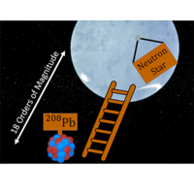
Progress and challenges in the nuclear equation of state from neutron skins and neutron stars
Farrukh J. Fattoyev
Manhattan College, Riverdale
Neutron Stars as Multi-Messenger Laboratories for Dense Matter
ECT*, European Centre for Theoretical Studies in Nuclear Physics and Related Areas
June 22, 2022

Slide 2
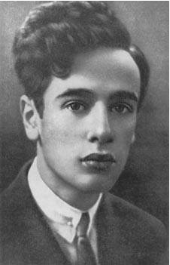
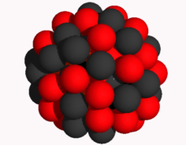
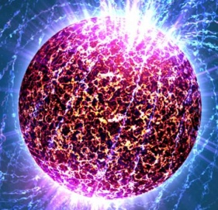
Neutron Star as Giant (Neutron-Rich) Nucleus:
Similarities and Differences
Nucleus of an atom
A ≃ 10²
ρ_{ave} ≃ 0.7 ρ₀
R ≃ 10⁻¹⁴ m
Supported by surface tension
Neutron Star
A ≃ 10⁵⁹
ρ_{ave} ≃ 2.0 ρ₀
R ≃ 10⁴ m
Supported by gravity
Feb, 1931 – Zurich
“the density of matter becomes so great that atomic nuclei come in close contact,
forming one gigantic nucleus.”
They are both governed by the same Physics:
The Physics of the Strong Interaction

Slide 3
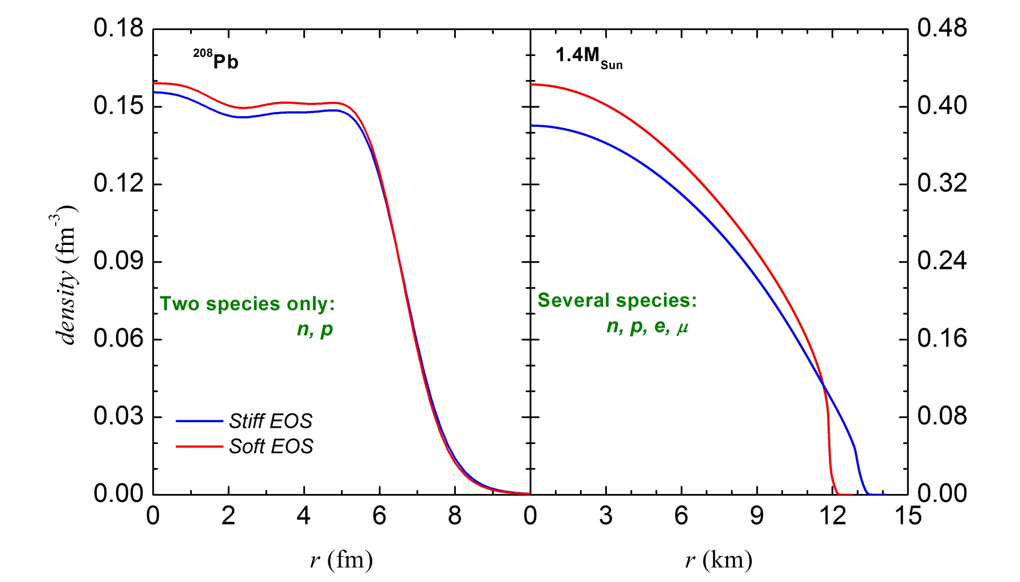
Neutron Star as a Giant Nucleus:
The Role of the Equation of State
Nucleus of an atom
^{Relativistic nuclear structure}
^{(Dirac) equation}
Neutron Star
General Relativistic stellar structure
^{(TOV) equation}

Slide 4
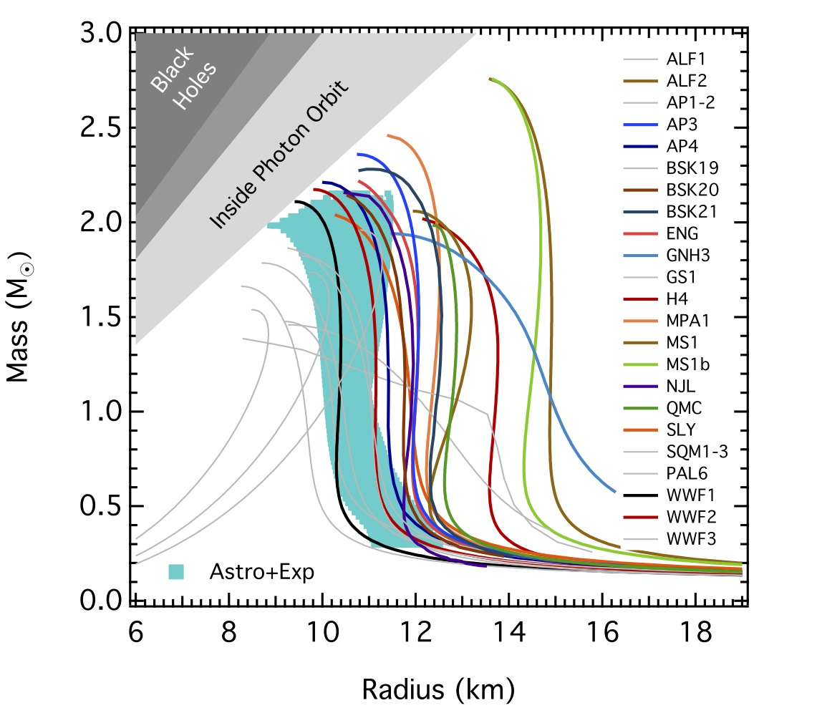
Mass-vs-Radius Relations
Isovector sector of the nuclear interaction is not well constrained.
Also, see talks
NICER constraints
by Serena Vinciguerra
and Cole Miller
Gravitational waves constraints
by Jocelyn Read
Mass-vs-Radius constraints
by Thankful Cromartie and Joonas Nattila
F. Ozel, http://xtreme.as.arizona.edu/NeutronStars/index.php/neutron-star-radii/

Slide 5
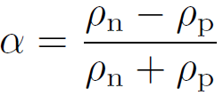
Uncertainties in the EOS: Symmetry Energy
For a neutron-rich matter it is useful to expand:
Talk by Francesca Gulminelli (Monday)
isospin asymmetry
Also, talk by Melissa Mendes (yesterday) on its role of neutron star neutrino cooling.

Slide 6
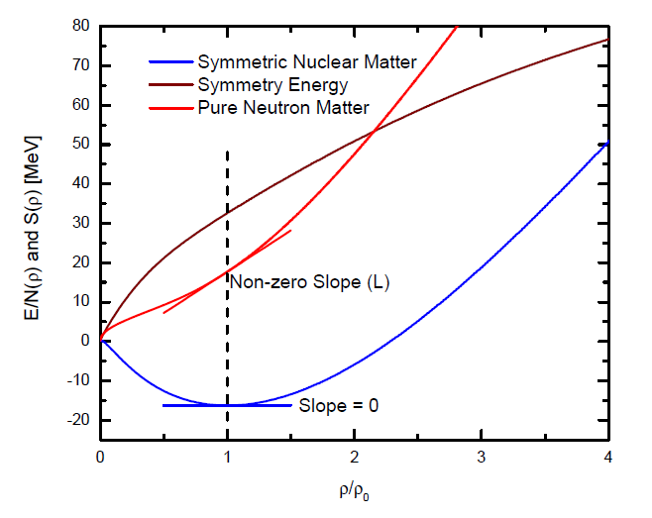
Symmetry Energy = PNM - SNM
Also, Tim Dietrich (this morning)

Slide 7
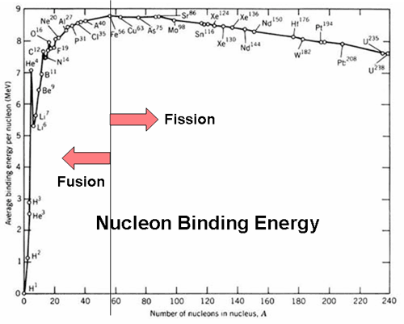
Constraining Nuclear EOS: Symmetric Nuclear Matter
Nuclear masses constrain binding energy at saturation at about less than 5% level;
Giant Monopole Resonances constrain the value of the nuclear incompressibility at about less than 10% level – Youngblood et al., PRL 82, 691 (1999); Garg, NuSym13, (2013)
High density component of the EOS is constrained by the experimental – Danielewicz et al. Science 298, 1592 (2002), and observational data – Antoniadis, et al., Science 340, 1233232 (2013).

Slide 8
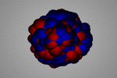
Constraining Nuclear EOS: Symmetric Nuclear Matter
Nuclear masses constrain binding energy at saturation at about less than 5% level;
Giant Monopole Resonances constrain the value of the nuclear incompressibility at about less than 10% level – Youngblood et al., PRL 82, 691 (1999); Garg, NuSym13, (2013)
High density component of the EOS is constrained by the experimental – Danielewicz et al. Science 298, 1592 (2002), and observational data – Antoniadis, et al., Science 340, 1233232 (2013).

Slide 9
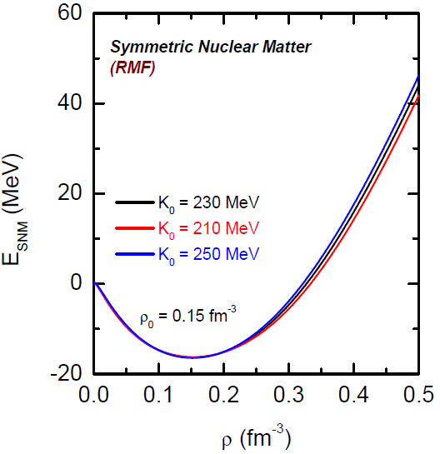
Constraining Nuclear EOS: Symmetric Nuclear Matter
Nuclear masses constrain binding energy at saturation at about less than 5% level;
Giant Monopole Resonances constrain the value of the nuclear incompressibility at about less than 10% level – Youngblood et al., PRL 82, 691 (1999); Garg, NuSym13, (2013)
High density component of the EOS is constrained by the experimental – Danielewicz et al. Science 298, 1592 (2002), and observational data – Antoniadis, et al., Science 340, 1233232 (2013).

Slide 10
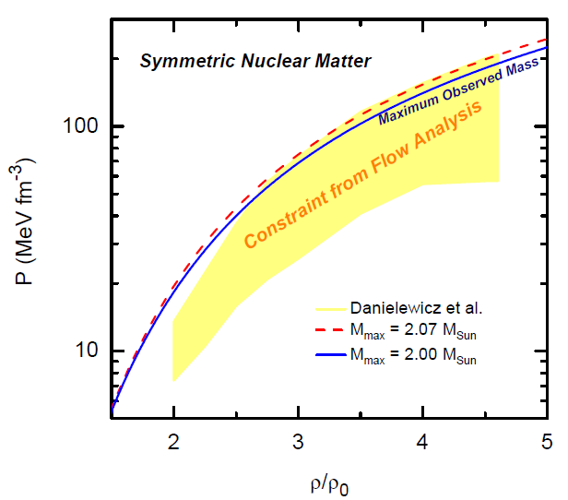
Constraining Nuclear EOS: Symmetric Nuclear Matter
Nuclear masses constrain binding energy at saturation at about less than 5% level;
Giant Monopole Resonances constrain the value of the nuclear incompressibility at about less than 10% level – Youngblood et al., PRL 82, 691 (1999); Garg, NuSym13, (2013)
High density component of the EOS is constrained by the experimental – Danielewicz et al. Science 298, 1592 (2002), and observational data – Antoniadis, et al., Science 340, 1233232 (2013).

Slide 11
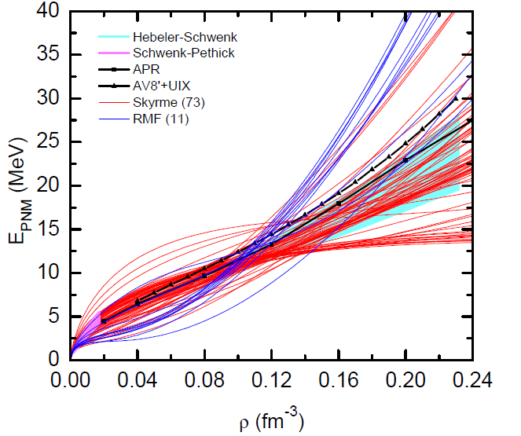
Constraining Nuclear EOS: Symmetry Energy
Symmetry Energy = Pure Neutron Matter – Symmetric Nuclear Matter
?
?
Recent theoretical progresses on chiral EFT and AFDMC (QMC) calculations have greatly constrained the EOS of PNM below saturation.

Slide 12
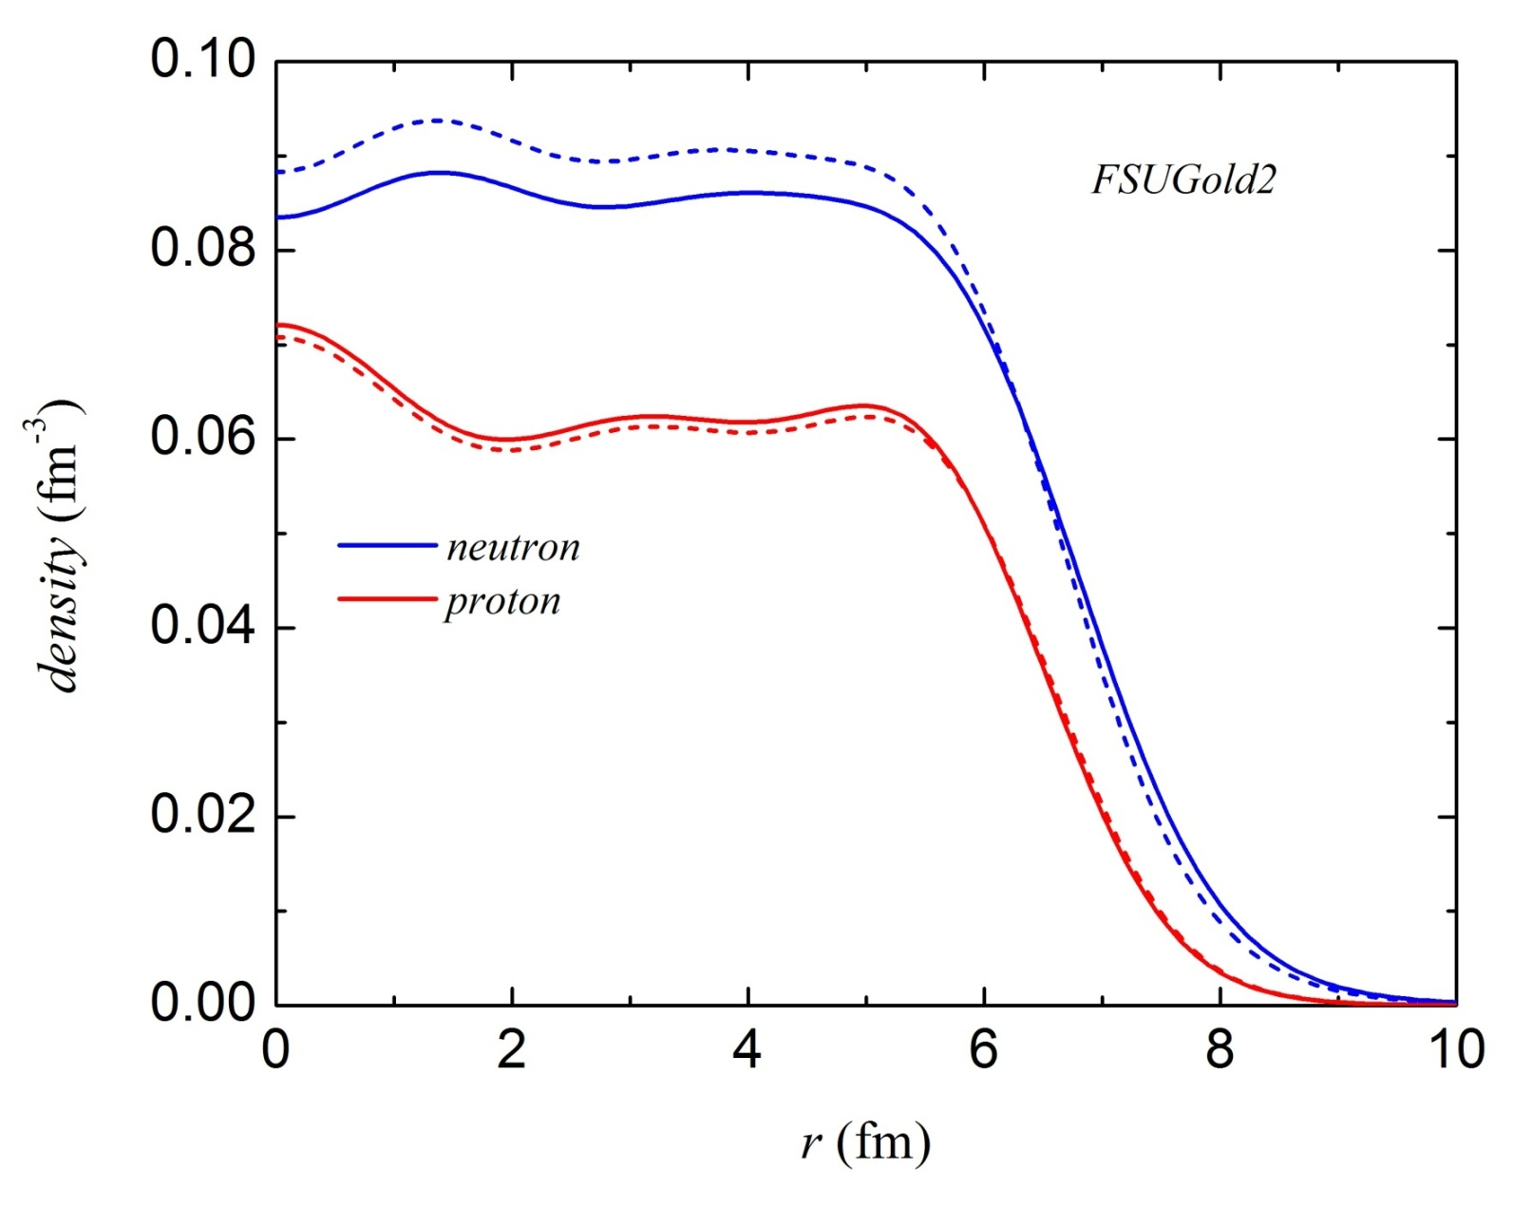
Pb-208: Where do extra 44 neutrons go?
The Development of a Neutron Skin
neutron skin
²⁰⁸Pb
PREX-II [Phys. Rev. Lett. 126, 172502, 2021] measured the neutron radius with higher accuracy.
Similarly CREX [arXiv:2205.11593, 2022] measured for the neutron skin of Ca-48.

Slide 13
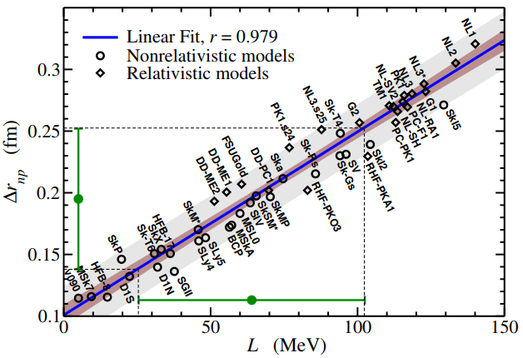
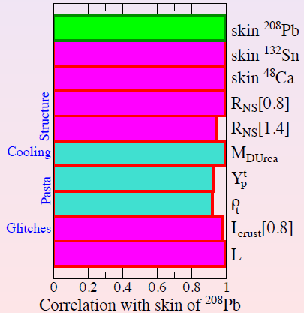
Pb-208: Where do extra 44 neutrons go?
The Development of a Neutron Skin
Roca-Maza et al., PRL106,252501(2011)
Fattoyev & Piekarewicz, PRC86,015802(2012)
Neutron skin thickness is strongly correlated with the
pressure of pure neutron matter (PNM):
Pressure of PNM pushes against surface tension ⇒ neutron skin!
Pressure of PNM pushes against gravity ⇒ neutron-star radius!
The larger is the neutron skin, the larger is the neutron-star radius!

Slide 14
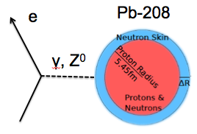
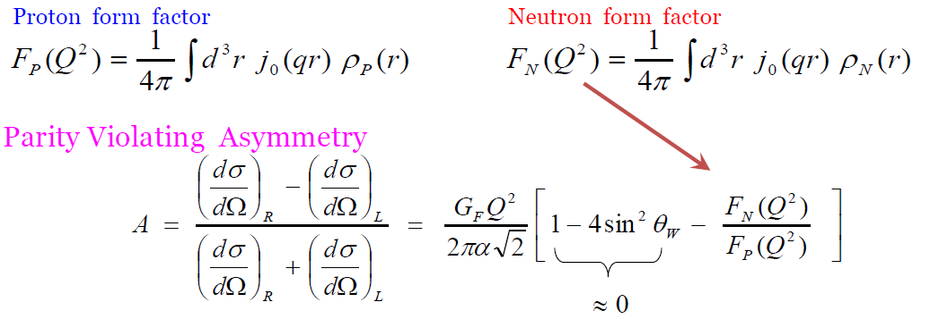
Pb-208: Where do extra 44 neutrons go?
Parity Violating Experiment
 | proton | neutron
Electric charge | 1 | 0
Weak charge | 0.07 | -0.99
Credit: Roberts Michaels
Proton form factors are known with enormous precision (Hofstadter 1950’s – to date).
Neutron form factors are as fundamental as proton form factors (still elusive after more
than 80 years of nuclear physics).
PREX-II & CREX at JLAB measured neutron radii with a 1% accuracy (2021 & 2022).
MESA at Mainz also plans to measure neutron radius with a 0.5% accuracy.

Slide 15
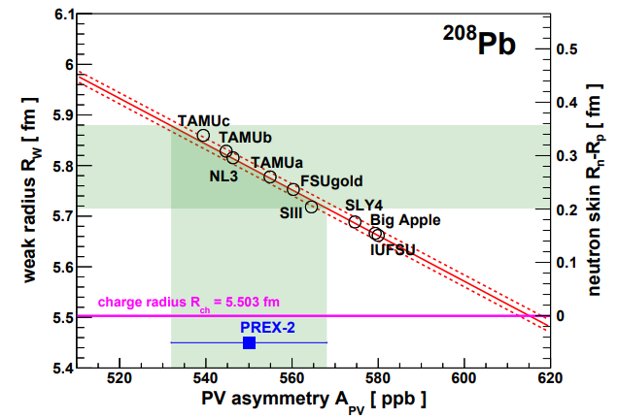
Recent Developments: PREX-II
PREX-II measured that the neutron skin thickness is large: 0.283±0.071 fm.
D. Adhikari et al. (PREX Collaboration), Phys. Rev. Lett. 126, 172502 (2021)

Slide 16
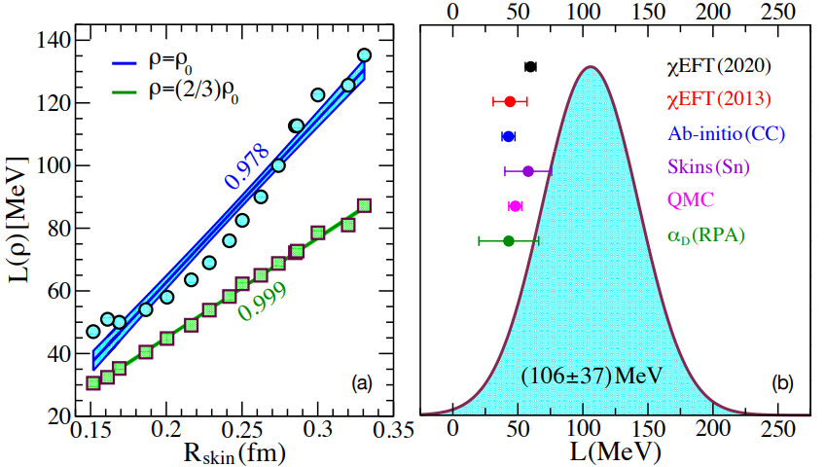
Implications of PREX-II on the EOS
Adhikari et al., Phys. Rev. Lett. 126, 172502 (2021)
Reed et al., Phys. Rev. Lett. 126, 172503 (2021)

Slide 17
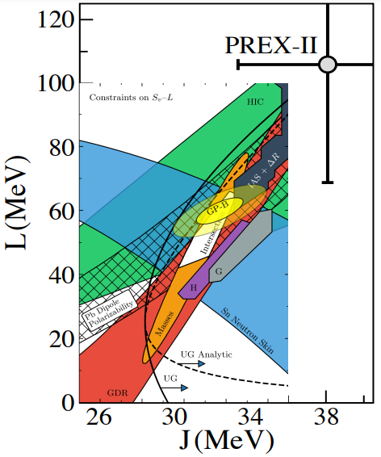
Implications of PREX-II on the EOS (Symmetry Energy)
L-vs-J constraint
Already creates a tension with some of the experimental constraints.
Adhikari et al., Phys. Rev. Lett. 126, 172502 (2021), Reed et al. Phys. Rev. Lett. 126, 172503 (2021)
C. Drichler et al., Phys. Rev. Lett. 125, 202702 (2020)
J. M. Lattimer, Ann. Rev. Nucl. Part. Sci. 62, 485 (2012).

Slide 18
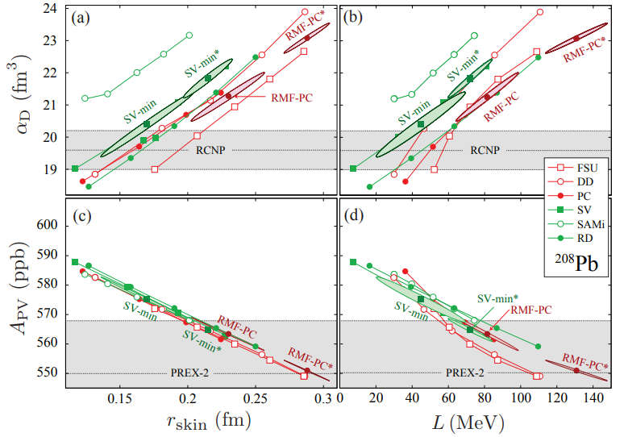
Implications of PREX-II on the EOS
(Electric Dipole Polarizability)
Reinhard et al., Phys. Rev. Lett. 127, 232501 (2021)

Slide 19
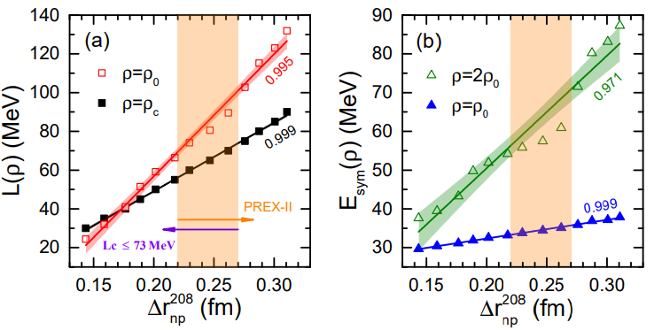
Implications of PREX-II on the EOS
(GMR, Masses, Radii)
T. G. Yue et al., Phys. Rev. Research 4, L022054 (2022)
Exp: GS properties and GMR of finite nuclei and EOS of SNM from HIC (flow data)
Obs: Maximum mass of a NS (PSR J0740+6620), GW170817, and NICER Mass-vs-Radius PSR J0030+045

Slide 20
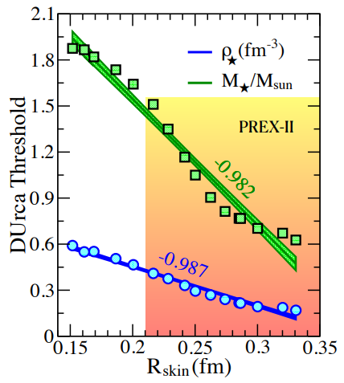
Implications of PREX-II on the EOS (Direct Urca)
Reed et al.
Phys. Rev. Lett. 126, 172503 (2021)
Recall the strong tension with
the constraints from
electric dipole polarizability
The lack of observation of cold stars (only a few observed so far) suggests that the neutrino emissivity might be suppressed by nucleon pairing or there is a phase transition at the inner regions of the star (See also Mendes talk) .

Slide 21
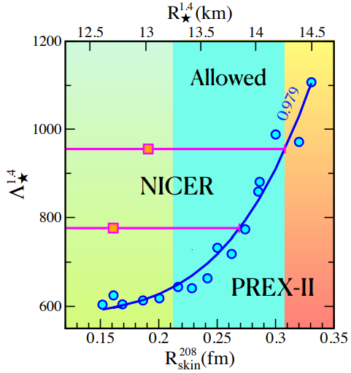
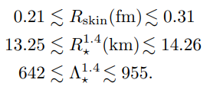
Implications of PREX-II on the EOS
(Tidal Polarizability and Neutron Star Radius)
Reed et al., Phys. Rev. Lett. 126, 172503 (2021)
Corollary:
If tidal polarizability remains small (<600), then the EOS (symmetry energy) should be soft at high density to get a consistent prediction with the observational data.

Slide 22
GW190814: Is it a neutron star or a black hole?
Fattoyev et al., Phys. Rev. C 102, 065805 (2020)

Slide 23
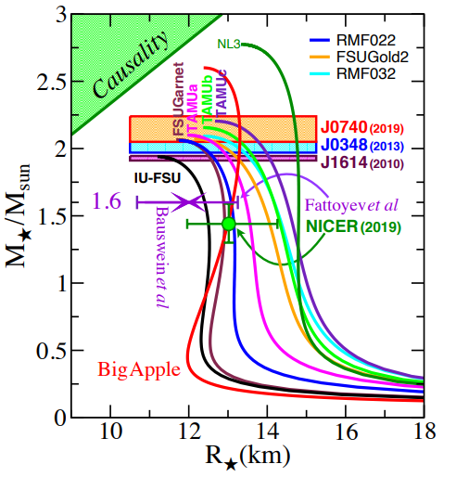
GW190814: Is it a neutron star or a black hole?
Λ = 717

Slide 24
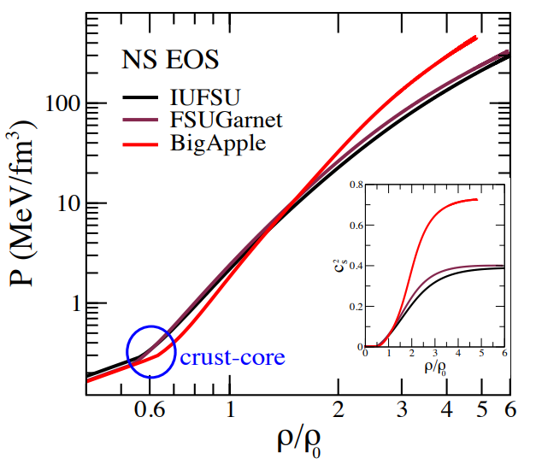
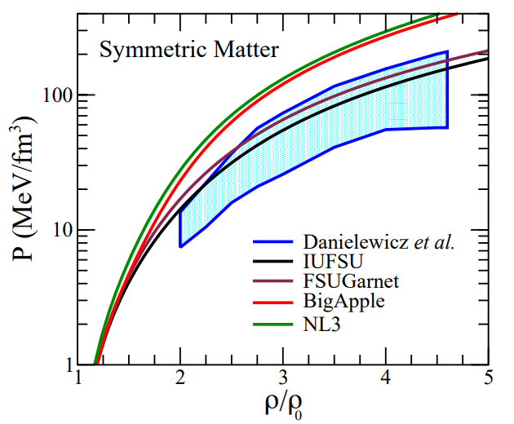
GW190814: Is it a neutron star or a black hole?
Big Apple: soft at intermediate and stiff at high densities.
Does not agree with the constraint from the flow analysis.
Strong tension with the PREX-II constraint (Agrees with the original PREX).
Perhaps gravity in the strong field regime is not fully described by General Relativity and alternative models of gravity should be tested. (see, e.g., Fattoyev, Arabian J. of Mathematics, July (2019))

Slide 25
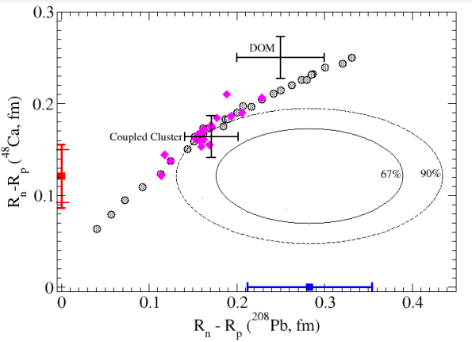
Latest Challenge: The neutron skin of Ca-48 (CREX)
Adhikari et al, arxiv: 2205.11593, 2022 – Accepted for publication in PRL
Isovector sector needs to be revisited
(in preparation)
See also, recent papers by
Reinhard et a. arXiv:2206.03134 (2022)
Yuksel & Paar, arXiv:2206.06527 (2022)
No current model
can describe them simultaneously!
While a compatible nuclear model can be obtained, the tension only grows with observation
and it opens a door to a new state of matter in neutron star interiors.

Slide 26
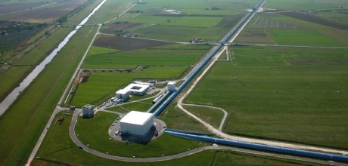
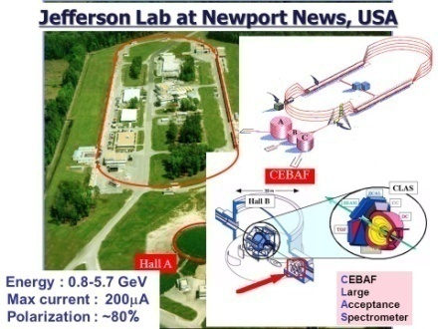
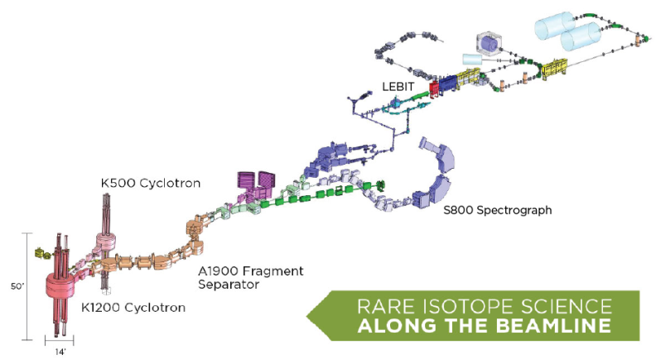
Some Concluding Remarks
Recent experimental data from neutron skins put some tight constraints on the density dependence of the symmetry energy (hence the EOS) at and below saturation.
When combined with observational data this constraint gets better and sometimes creates a strong tension.
These tensions call for an improved models of energy density functionals that can simultaneously be used as a “density ladder” from nuclei to neutron stars.
To improve the current models new isovector features must be added to describe dense matter. This new feature allows to explore particle composition, the crust-core properties as well as global structure of neutron stars.
To constrain the EOS at supra-saturation one needs a combined efforts from both the nuclear reactions and astrophysics community.

Slide 27
Acknowledgement
My Collaborators:
J. Piekarewicz, W.-C. Chen (FSU)
B.-A. Li, W. G. Newton (Texas A&M U-Commerce)
J. Carvajal (FIU)
B. T. Reed, C. J. Horowitz, A. Deibel (IU)
A.W. Steiner (UTK/ORNL)
C. Y. Tsang, M. B. Tsang, P. Danielewicz, W. G. Lynch, E. F. Brown, B. Schuetrumpf (NSCL/MSU)
S. Gandolfi, I. Sagert (Los Alamos)
A. Cumming, M. Mendes, C. Gale (McGill U.)
S. Reddy (UW)
D. Page (UNAM)
J. Xu (SINAP)
X.-H. Li (U. South China)
C. Xu (Nanjing U)
L.-W. Chen (Shanghai Jiao Tong U.)
W.-Z. Jiang (Southeast U.)
X.-T. He (Nanjing U. Aeronautics and Astronautics)
B.-J. Cai (Shanghai U.)
Thank You!

