Slide 1
Jet quenching and medium response in LBT and CoLBT model
Workshop on “Jet quenching in the Quark-gluon Plasma”, ETC Trento June 13-17, 2022
Xin-Nian Wang (LBNL)
In collaboration with: Wei Chen, Yayun He, Weiyao Ke, Tan Luo, Longgang Pang and Wenbin Zhao

Slide 2
Jets in heavy-ion collisions
Multiple scattering
Transverse momentum broadening
Jet 1
q
q
Parton energy loss
Jet suppression
Jet 2
A-A collision

Slide 3
Parton propagation in QCD medium
λ⁻¹_{mf}
q
l
TMD gluon distr.
p
k
GLV
Zhang, Qin & XNW, PRD 100 (2019) 7, 074031 Zhang & XNW PRD 105 (2022) 3, 034015
With a static potential model
variable change
collinear high-twist
Guo & XNW, Phys.Rev.Lett. 85 (2000) 3591
Notes:
\mathcal{N}_g^{\textsl{static+soft}}
=\int \frac{d\varphi}{2\pi} \frac{2\vec{k}_{\perp}\cdot\vec{l}_{\perp}}{(\vec{l}_{\perp}-\vec{k}_{\perp})^2} \left( 1-\cos[\frac{(\vec l_\perp -\vec k_\perp)^2}{2q^-z(1-z)}
y_1^-]\right)
\mathcal{N}_g^{\textsl{static+soft}}
=\int \frac{d\varphi}{2\pi} \frac{2\vec{k}_{\perp}\cdot\vec{l}_{\perp}}{(\vec{l}_{\perp}-\vec{k}_{\perp})^2} \left( 1-\cos[\frac{(\vec l_\perp -\vec k_\perp)^2}{2q^-z(1-z)}
y_1^-]\right)

Slide 4
Parton energy loss and jet transport
collinear high-twist approach
Guo & XNW, Phys.Rev.Lett. 85 (2000) 3591
Elastic energy loss
Jet transport coefficient:
pQCD (BDMPS’96)
AdS/CFT (Liu,Rajagopal &Wideman’06)
lattice QCD (Majumder’12)
Extract jet transport coefficient from parton energy loss
Notes:
\frac{dE_{el}}{dx}=\int\frac{d^3k}{(2\pi)^3}dq_\perp^2 f(k) \frac{q_\perp^2}{2k}\frac{d\sigma}{dq_\perp^2}\approx C\frac{3\pi}{2}\alpha_s^2T^2\ln\frac{s^*}{4\mu_D^2}
\frac{dE_{el}}{dx}=\int\frac{d^3k}{(2\pi)^3}dq_\perp^2 f(k) \frac{q_\perp^2}{2k}\frac{d\sigma}{dq_\perp^2}\approx \langle \frac{1}{2\omega}\rangle \hat q
\frac{dE_{rad}}{dx}\approx \frac{2C_A\alpha_s}{\pi} \hat q_{HT}(x) \int dz \frac{d\ell_\perp^2}{\ell_\perp^4}zP(z)\sin^2\frac{\ell_\perp^2 (x-x_0)}{4z(1-z)E}
\widetilde P_{a\rightarrow ag}(z)
d\sigma_h=\sum_{a,b,c} f_a\otimes f_b\otimes d\sigma_{ab \rightarrow c+X}\otimes \widetilde D_{c/h}
\widetilde D_{c/h}(z_h)\approx
\widetilde P_{a\rightarrow ag}(z) \otimes D_{a/h}(z_h)

Slide 5
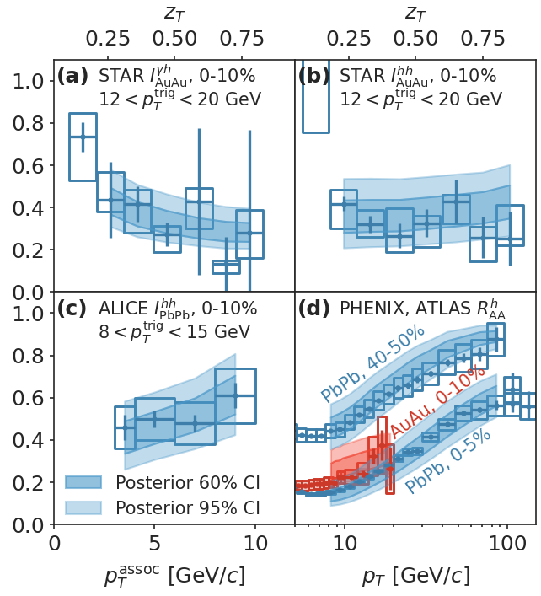
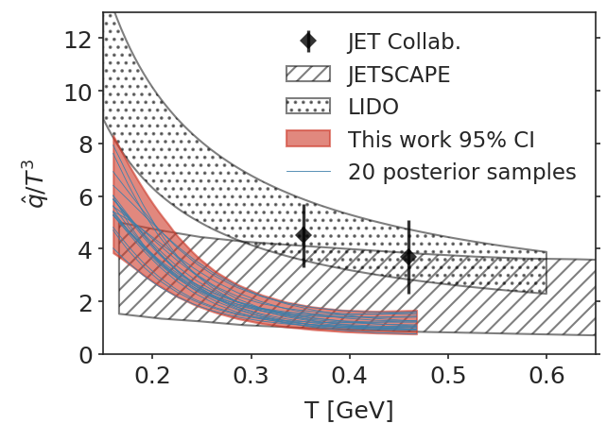
Information field-based Bayesian inference
Global inference from world data on: Single hadron R_{AA}, dihedron I_{AA} and γ-hadron I_{AA}
NLO pQCD + HT e-loss +CLVisc hydro
e-Print: 2206.02393 M. Xie, W. Ke, H. Zhang & XNW

Slide 6
Jet energy, medium response and background
Jet energy as defined in the jet reconstruction algorithm with a jet cone R
Uncorrelated background should be subtracted
Jet-induced medium response is correlated with jet: not background
Some of the energy lost by leading partons remain inside jet-cone
Notes:
Argument for jet measurement: not affected by hadronization, but

Slide 7
LBT: Linear Boltzmann Transport
Inelastic processes:
jet parton
pQCD elastic and radiative processes (high-twist)
Transport of medium recoil partons ( and back-reaction)
CLVisc 3+1D hydro bulk evolution
Back-reaction
(particle hole)
recoil parton
Li, Liu XNW & Zhu, PRL 106 (2011) 012301; He, Luo, Zhu & XNW, PRC 91 (2015) 054908
Notes:
f_i(p_i)=\frac{1}{e^{p_i\cdot u/T}\pm 1} (i=2,4)
f_i(p)=(2\pi)^3\delta^3(\vec p_i-\vec p_0)\delta^3(\vec x-\vec x_0-t\vec v_i) [i=1,3]
\frac{dN_g}{dzd^2k_\perp dt}=\frac{2\alpha_s N_c}{\pi k_\perp^4} P(z)
(\hat p\cdot u) \hat q \sin^2(\frac{t-t_0}{2\tau_f})
p_1\cdot \partial f_1=-\int dp_2dp_3dp_4(f_1f_2-f_3f_4)|M_{12 \rightarrow 34}|^2(2\pi)^4\delta^4(\sum_i p_i) + {\rm inelastic}
\frac{dN_g}{dzd^2k_\perp dt} \approx \frac{2C_A\alpha_s}{\pi k_\perp^4}P(z) \hat q (\hat p\cdot u) \sin^2\frac{k_\perp^2 (t-t_0)}{4z(1-z)E}

Slide 8
Elastic vs. Radiative
Leading parton e-loss
Jet e-loss (R=0.3)
Static medium

Slide 9
Deformed Mach cone from a radiating source
El +rescat
El+ rad
El + rad+rescat
AMPT
Static medium
LBT (default)

Slide 10
CoLBT-hydro (Coupled Linear Boltzmann Transport hydro)
Concurrent and coupled evolution of bulk medium and jet showers
LBT for energetic partons (jet shower and recoil)
Hydrodynamic model for bulk and soft partons: CLVisc
Parton coalescence (thermal-shower)+ jet fragmentation
Hadron cascade using UrQMD
Chen, Cao, Luo, Pang & XNW, PLB777(2018)86, Zhao, Ke, Chen, Luo & XNW, PRL 128(2022) 022302.
Notes:
\partial_\mu T^{\mu\nu}(x) = j^\nu (x)
\delta f(p,x) \ll f(p,x)
j^\nu(x) = \sum_i p^\nu_i \delta^{(4)}(x-x_i) \theta(p^0_{cut}-p\cdot u)
j^\nu(x) = \sum_a\int \frac{d^3p}{(2\pi)^3}\frac{p^\nu}{p^0}f_a(p)\theta(p\cdot u - p^0_{cut})
p\cdot \partial f(p) =- C(p) \;\;\; p\cdot u > p_{cut}^0

Slide 11
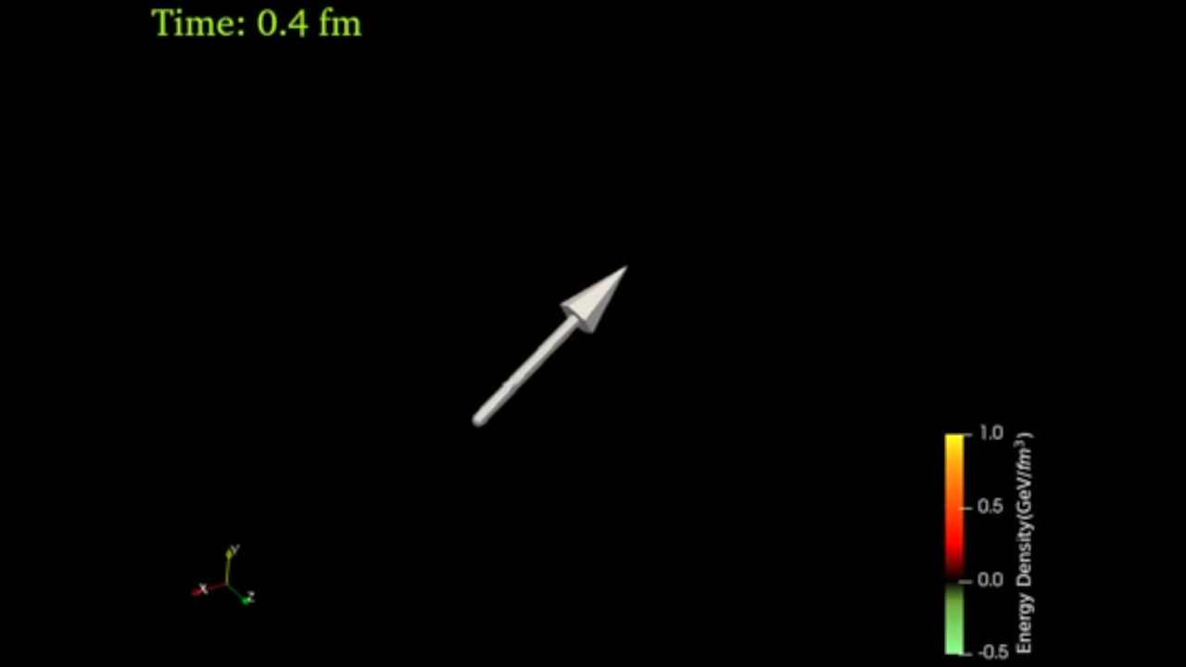
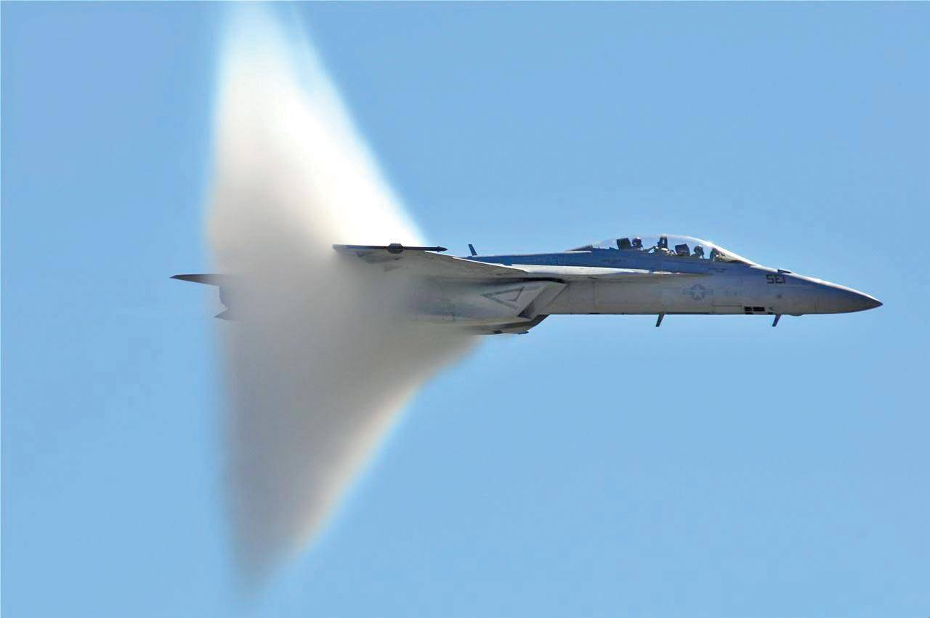
LBT: Jet-induced medium response
x
y
η_{s}
3D energy density distribution of the medium response induced by a γ-jet in a 0-10% Pb+Pb event
Notes:
f_i(p_i)=\frac{1}{e^{p_i\cdot u/T}\pm 1} (i=2,4)
f_i(p)=(2\pi)^3\delta^3(\vec p_i-\vec p_0)\delta^3(\vec x-\vec x_0-t\vec v_i) [i=1,3]
\frac{dN_g}{dzd^2k_\perp dt}=\frac{2\alpha_s N_c}{\pi k_\perp^4} P(z)
(\hat p\cdot u) \hat q \sin^2(\frac{t-t_0}{2\tau_f})

Slide 12
Jet structure and Medium response

Slide 13
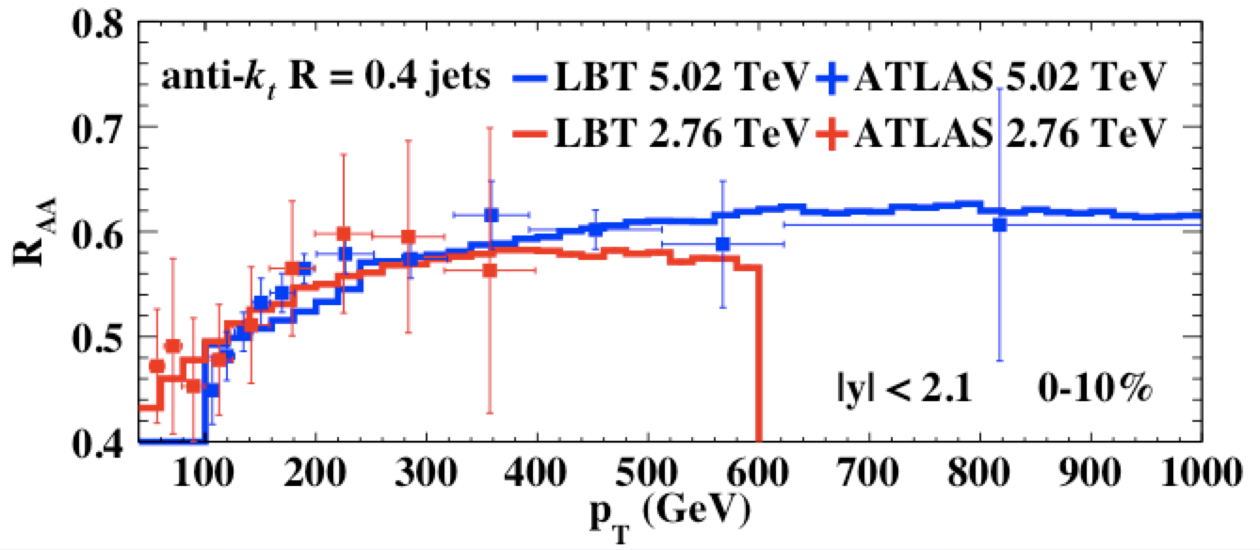
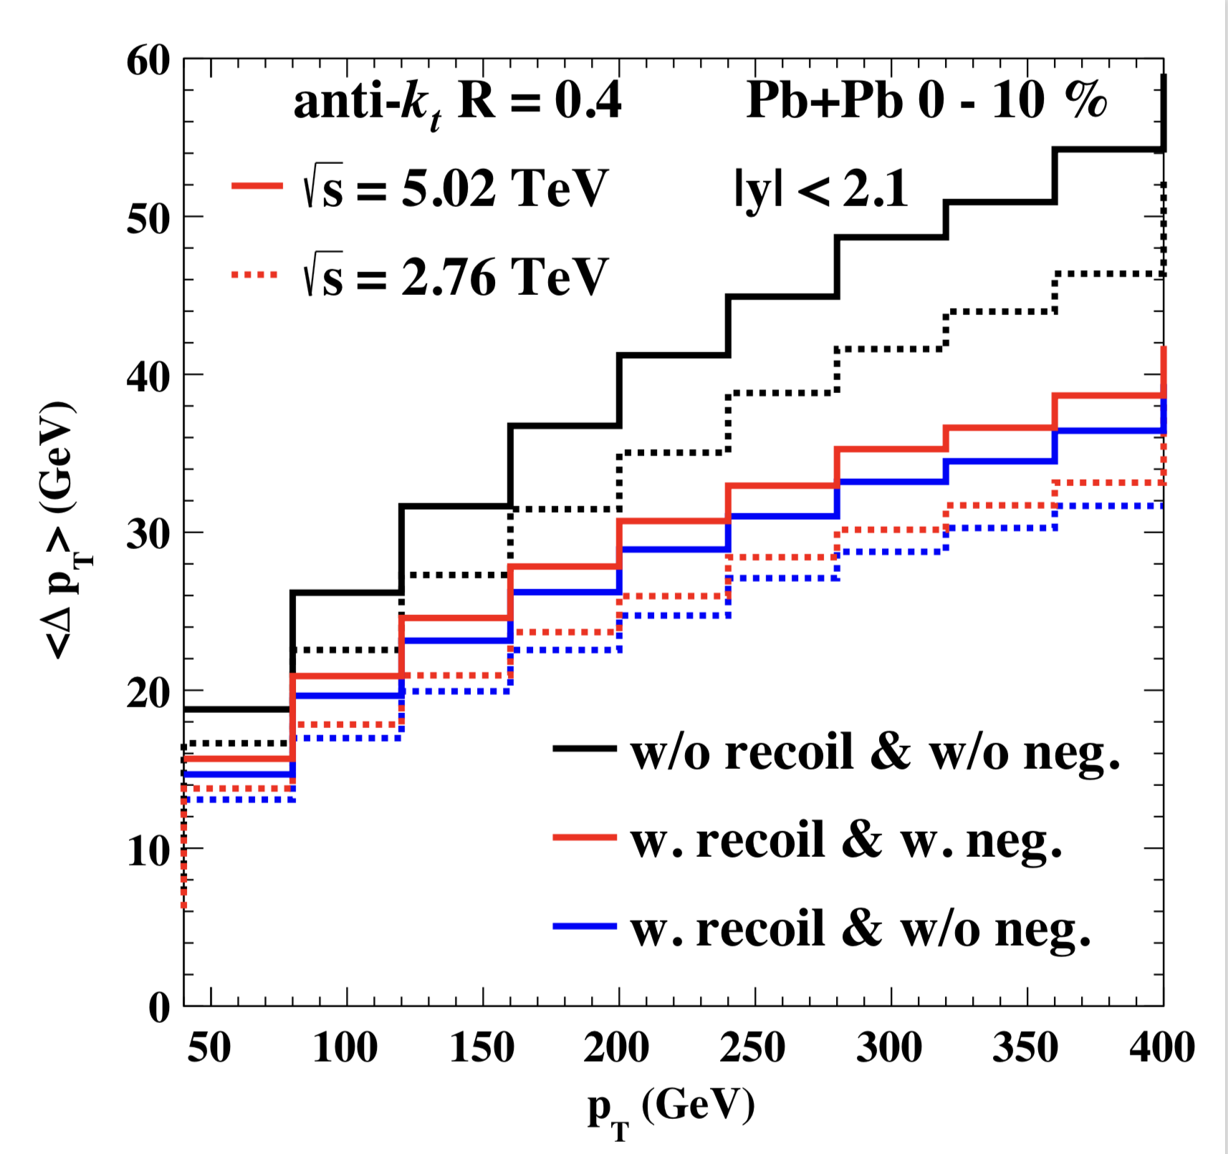
Jet suppression and energy loss
He, Cao, Chen, Luo, Pang & XNW 1809.02525
Weak p_{T} dependence: initial jet spectra and p_{T} dependence of energy loss ΔE
Week energy dependence: increase of jet energy loss and the slope of initial spectra
Medium response reduce jet net energy loss

Slide 14
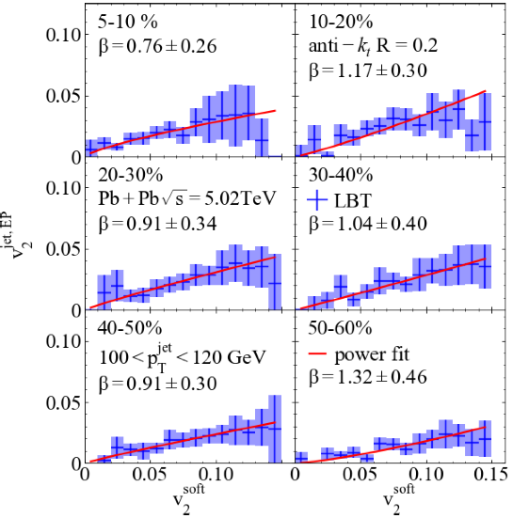
Single jet anisotropy & hard-soft correlation
He, Chen, Luo, Cao, Pang & XNW, e-Print: 2201.08408
Notes:
\langle v_n^{\rm jet} \rangle =\frac{\langle\langle v_n \cos[n(\phi^{\rm jet}-\Psi_n)] \rangle\rangle}{\sqrt{\langle v_n^2\rangle}}

Slide 15
Energy loss in γ/Z-jet at LHC
Suppression of leading and multiple jets
Zhang, Luo, XNW, Zhang, arXiv:1804.11041
Luo, Cao, He & XNW, arXiv:1803.06785

Slide 16
γ/Z-jet angular correlation
Suppression of sub-leading jets → narrower angular distribution
Zhang, Luo, XNW, Zhang, arXiv:1804.11041
Luo, Cao, He & XNW, arXiv:1803.06785

Slide 17
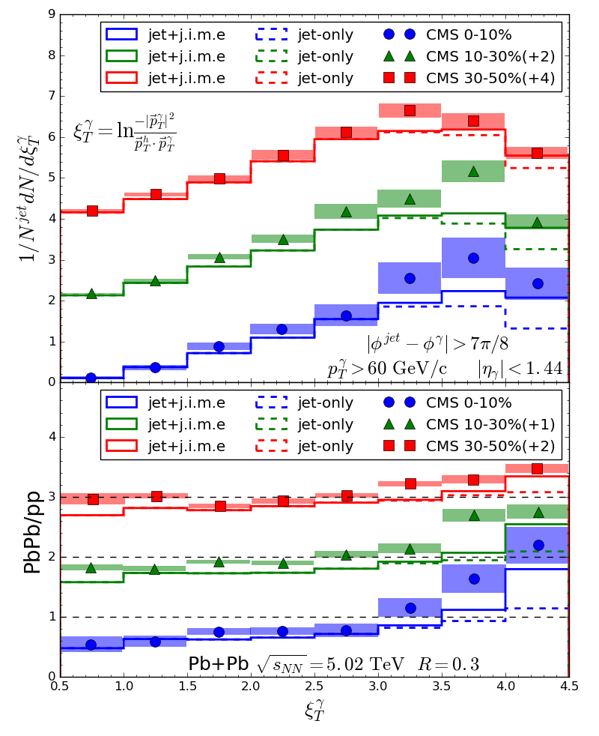
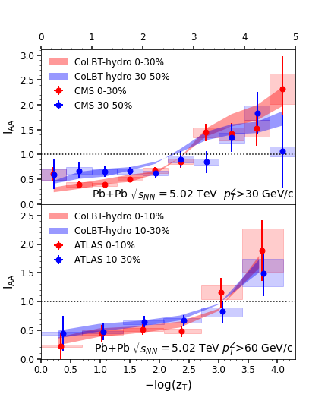
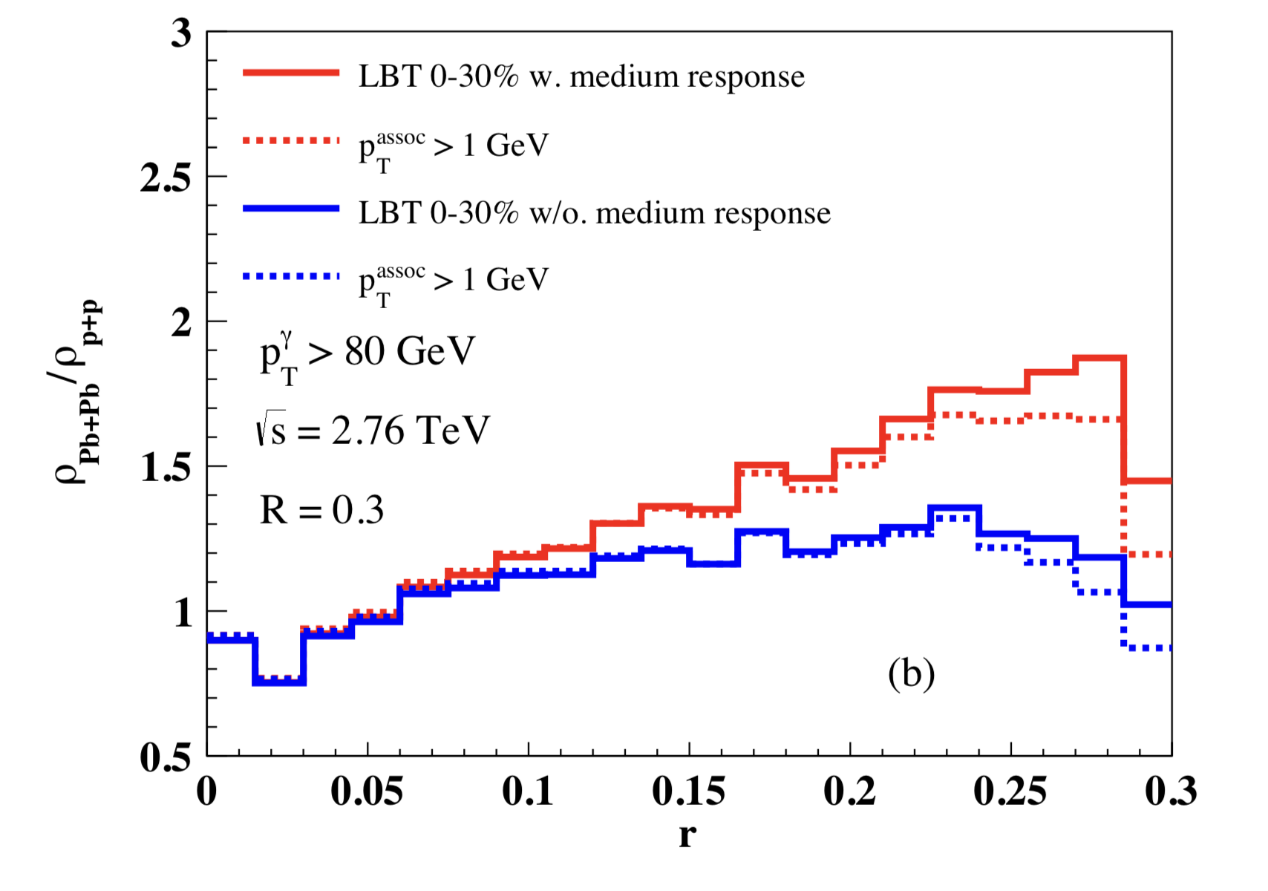
Medium modification of jet structure
γ-jet
Z-jet
Enhancement of soft hadrons
in large angles
γ-jet
With recoil
w/o recoil
Luo, Cao, He & XNW, arXiv:1803.06785
Chen, Cao, Luo, Pang & XNW,
2005.09678
Chen, Yang, He, Ke, Pang and XNW,
2101.05422

Slide 18
Signal of diffusion wake
Depletion of the background
In the γ direction
Chen, Cao, Luo, Pang, XNW,
PLB777(2018)86

Slide 19
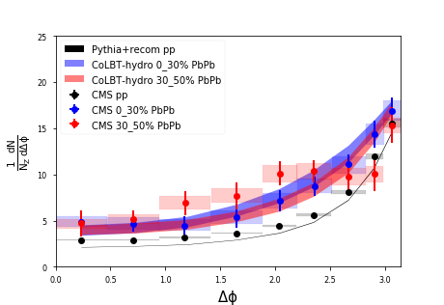
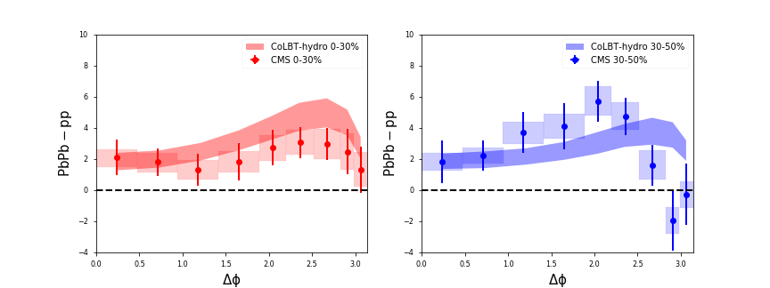
Z-hadron correlation
enhancement
of the away-side
background
enhancement
and broadening
of the jet peak
Chen, Yang, He, Ke, Pang and XNW, 2101.05422

Slide 20
MPI subtraction in Z-hadron correlation
Mixed event subtraction

Slide 21
3D structure of Mach-cone
Jet-hadron correlation in γ-jet events

Slide 22
Longitudinal jet tomography
Zhang, Owens, Wang and XNW, Phys. Rev. Lett. 103, 032302 (2009)
length
dependence
of parton
Energy loss
γ-jet asymmetry x_{γjet}=p_{T}^{jet}/p_{T}^{γ}
Can be used to select
propagation length <L>

Slide 23
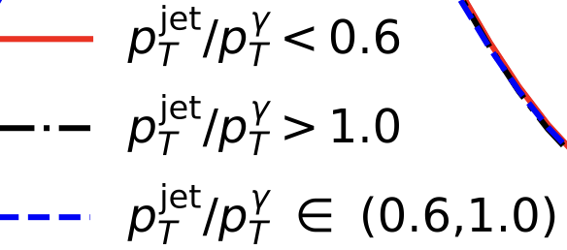
Double peak structure in η
Pb+Pb
p+p
|Δφ|>π/2
Jet-distr
MPI
DF-wake

Slide 24
Asymmetric broadening in non-uniform medium
Uniform medium
Linear spatial dependence
y
drift due
to transverse
gradient along y
Gradient
tomography
γ
jet
x
He, Pang & XNW PRL 125 (2020) 122301
Fu, Casalderrey-Solana & XNW 2204.05323

Slide 25
Enhancing the diffusion wake
Chen, Yang, He, Ke, Pang and XNW, Phys. Rev. Lett. 127 (2021) 8, 082301

Slide 26
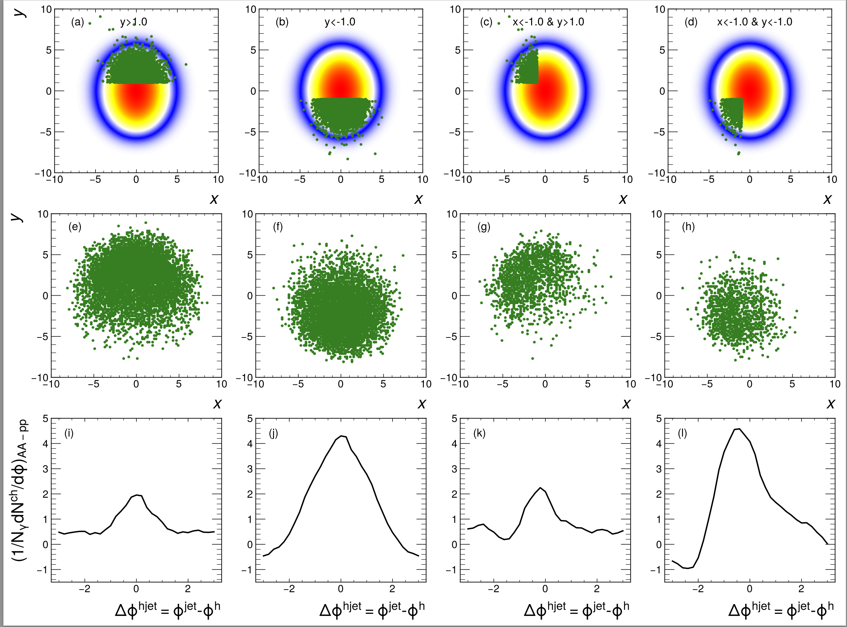
Deep learning assisted jet tomography
DL network selection
Actual distribution
γ-soft hadron correlation
Yang, He, Chen, Ke, Pang
and XNW, 2206.02393

Slide 27
Summary
Jet transport + (3+1)D hydro: elastic + radiative
Medium response reduces net jet energy loss
Medium response leads to
  enhancement of soft hadrons in jet direction
  depletion of soft hadron on the away side
Unique 3D structure of diffusion wake
Use 2D jet tomography to reveal the angular structure of Mach-cone excitation
ML assisted jet tomography a powerful tool

Slide 29
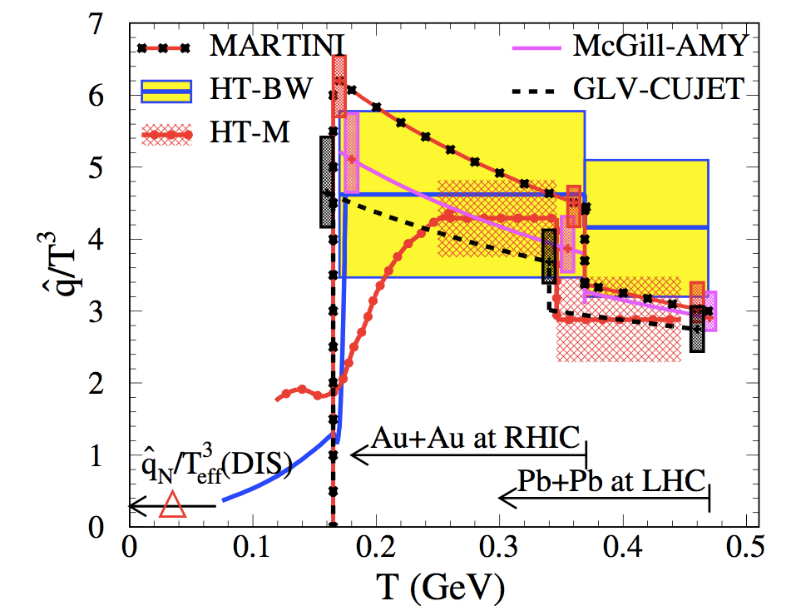
Jet transport coefficient
JET Collaboration: arXiv:1312.5003
JETSCAPE: 2102.11337
RHIC
LHC
Notes:
LHC: T_0=473 MeV qhat/T^3=3.14
RHIC: T_0=373 MeV qhat/T^3=3.47
\hat q \approx \left\{
\begin{array}{l}
1.2 \pm 0.3 \\
1.9 \pm 0.7
\end{array}
\;\; {\rm GeV}^2/{\rm fm} \;\; \text{at} \;\;
\begin{array}{l}
\text{T=370 MeV},\\
\text{T=470 MeV},
\end{array}
\right.

Slide 30
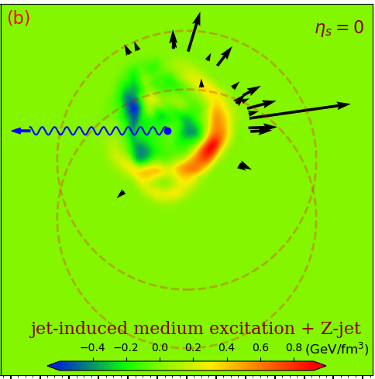
Enhancing the diffusion wake
Chen, Yang, He, Ke, Pang and XNW, 2101.05422

Slide 31
Hadron spectra from low to high p_{T}
Hydro : p_{T}<2 GeV/c
Coal.: 2<p_{T}<6 GeV/c
Frag.: p_{T}>5 GeV
radial flow
Coalescence
energy loss
Zhao, Ke, Chen, Luo and XNW, [arXiv:2103.14657 [hep-ph]]

Slide 32
Solving R_{AA}-v₂ puzzle
Zhao, Ke, Chen, Luo and XNW, arXiv:2103.14657

Slide 33
Flavor dependence
Zhao, Ke, Chen, Luo and XNW, arXiv:2103.14657

