Slide 1
Hadronic parity violation studies using molecular ions
Silviu-Marian Udrescu
PhD. Student, MIT
April 14 2022

Slide 2
Outline
Molecules are very sensitive to nuclear effects
Parity violation (PV) in molecules
Need of accurate nuclear and molecular calculations
Proposal of a new experiment for PV in molecules
Outlook

Slide 3
Why molecules?

Slide 4
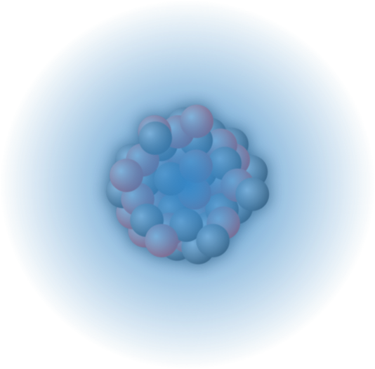
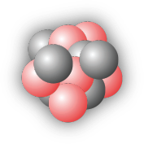
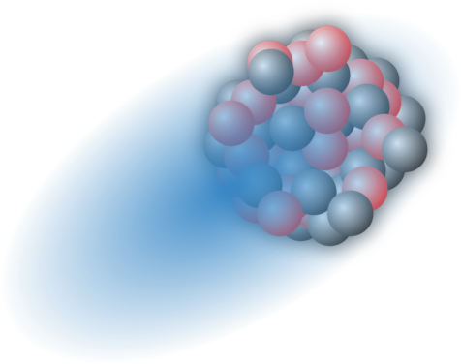



Why molecules?
$$F^{−}$$
$$Ra^{+}$$
$$Ra^{+}$$

Slide 5
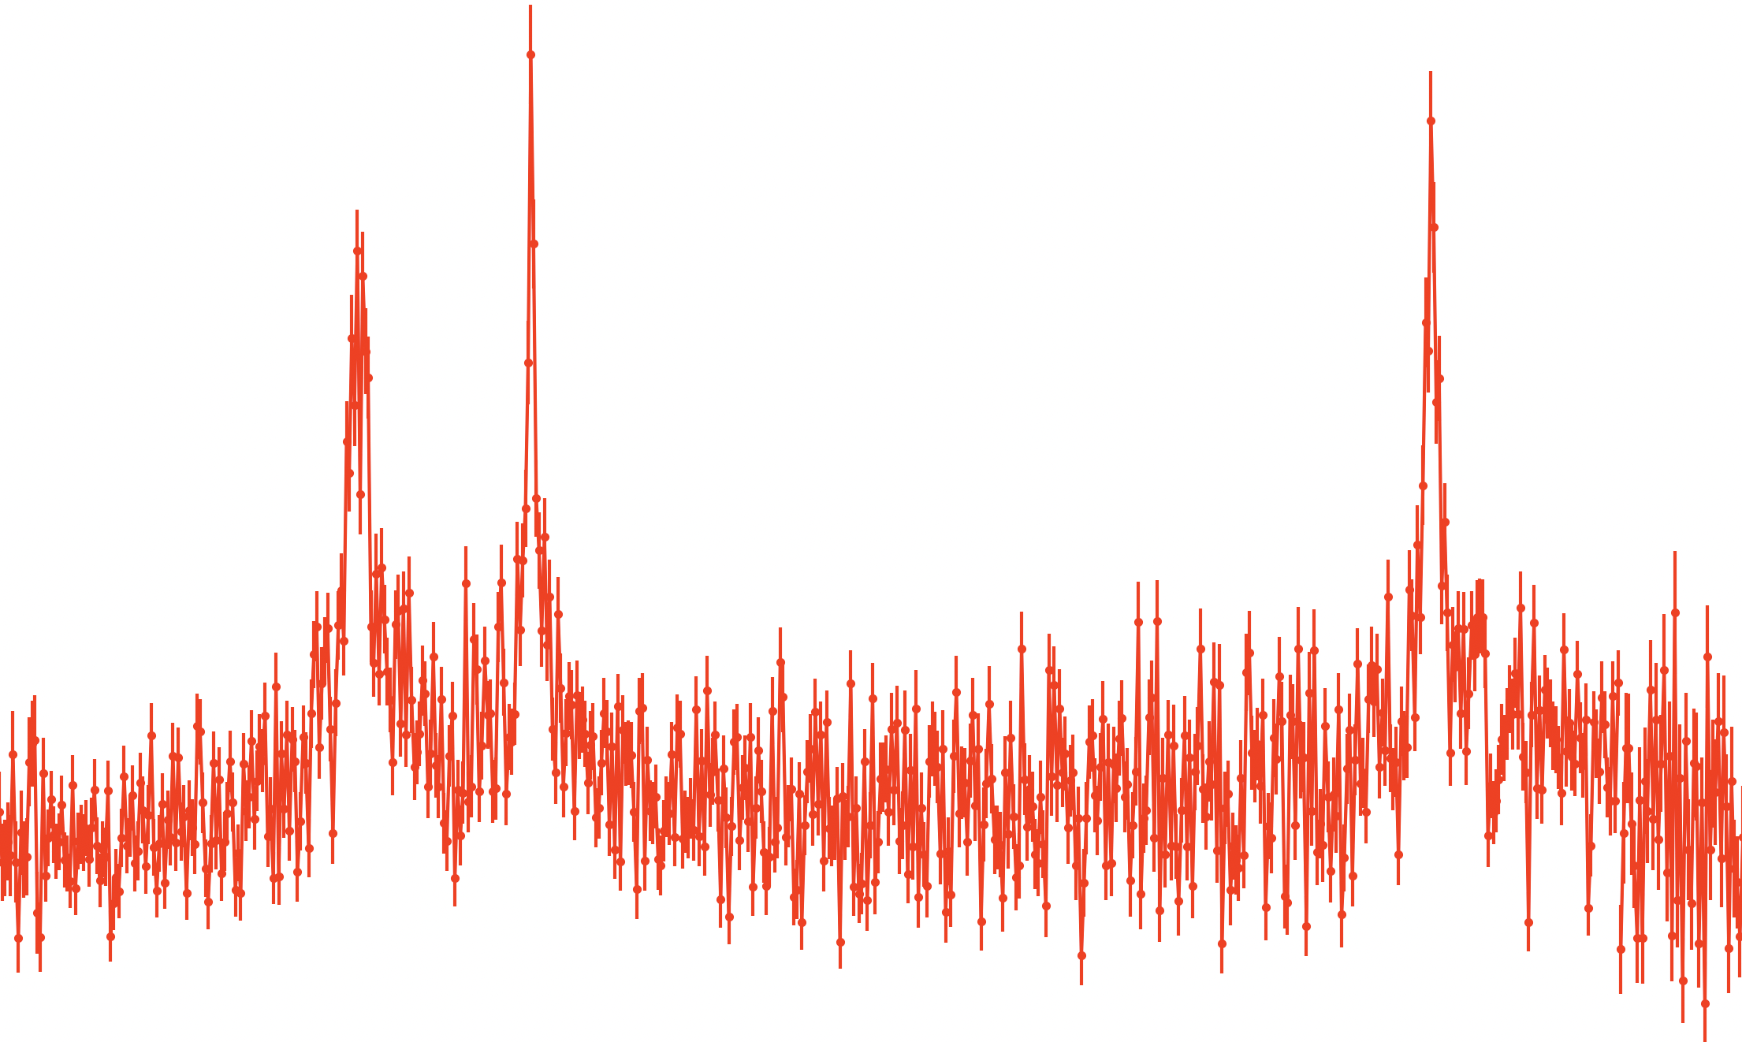
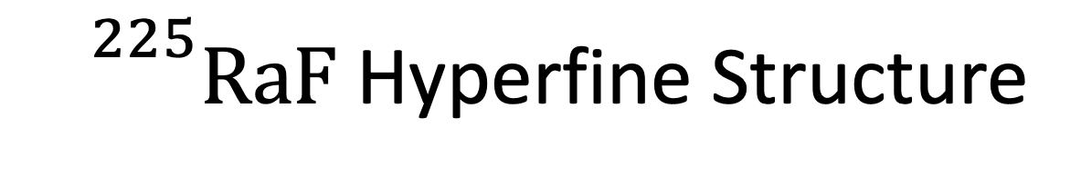
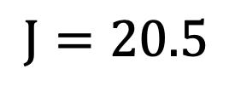
${}^{225}RaF$ Hyperfine Structure
100
$$J=20.5$$
Rate [a.u.]
20
PRELIMINARY
-4.5
0
4.5
Frequency [GHz]

Slide 6
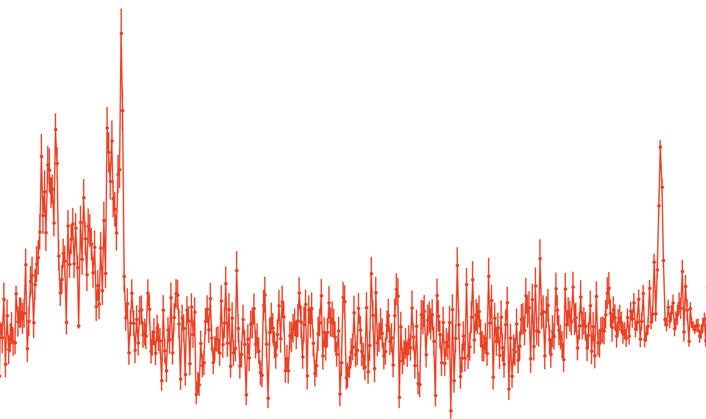
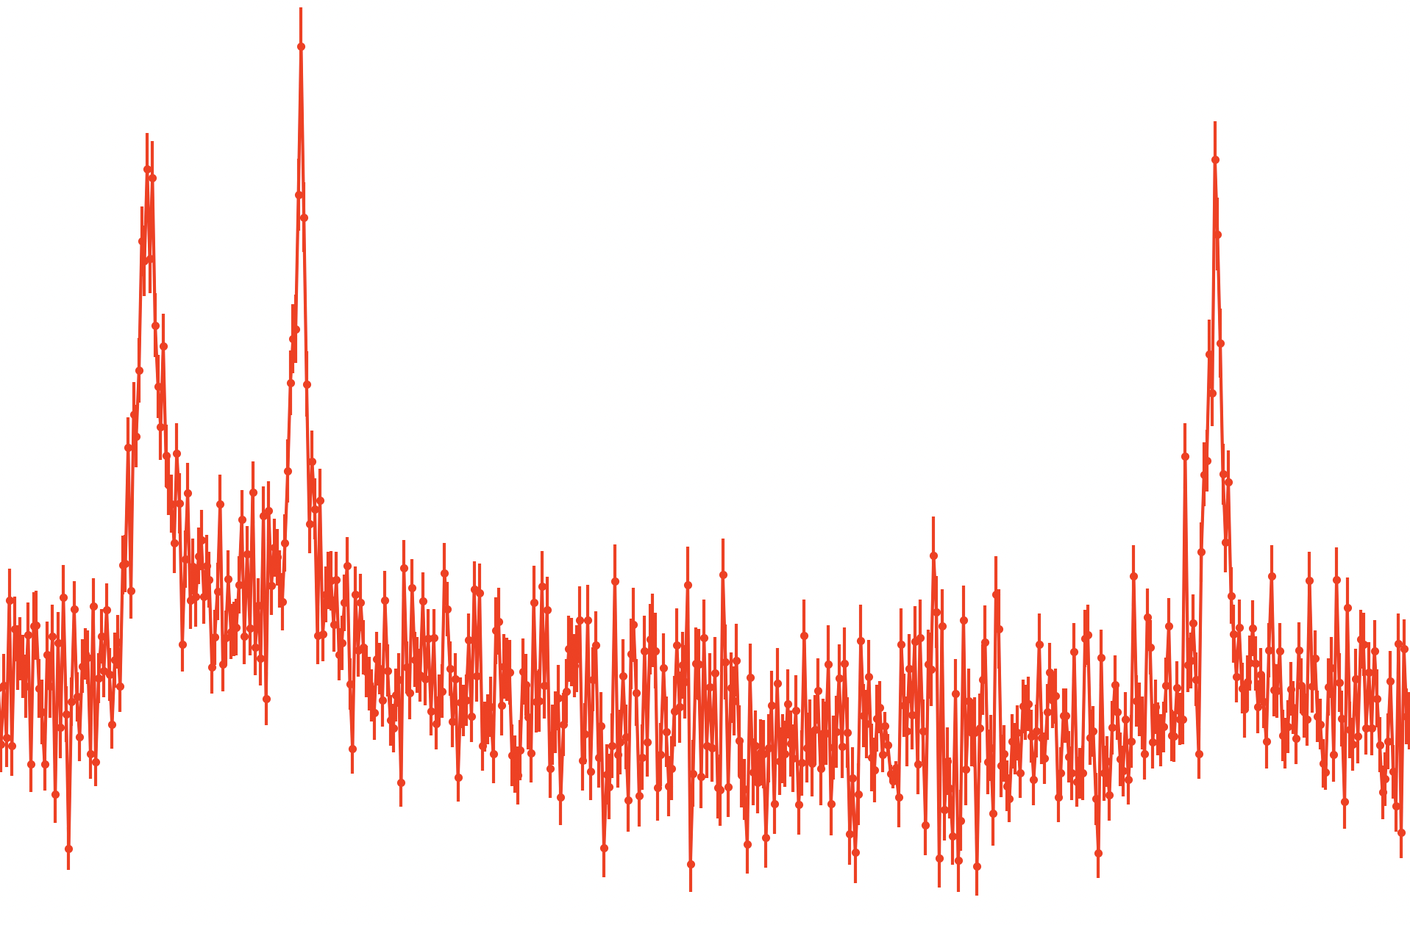
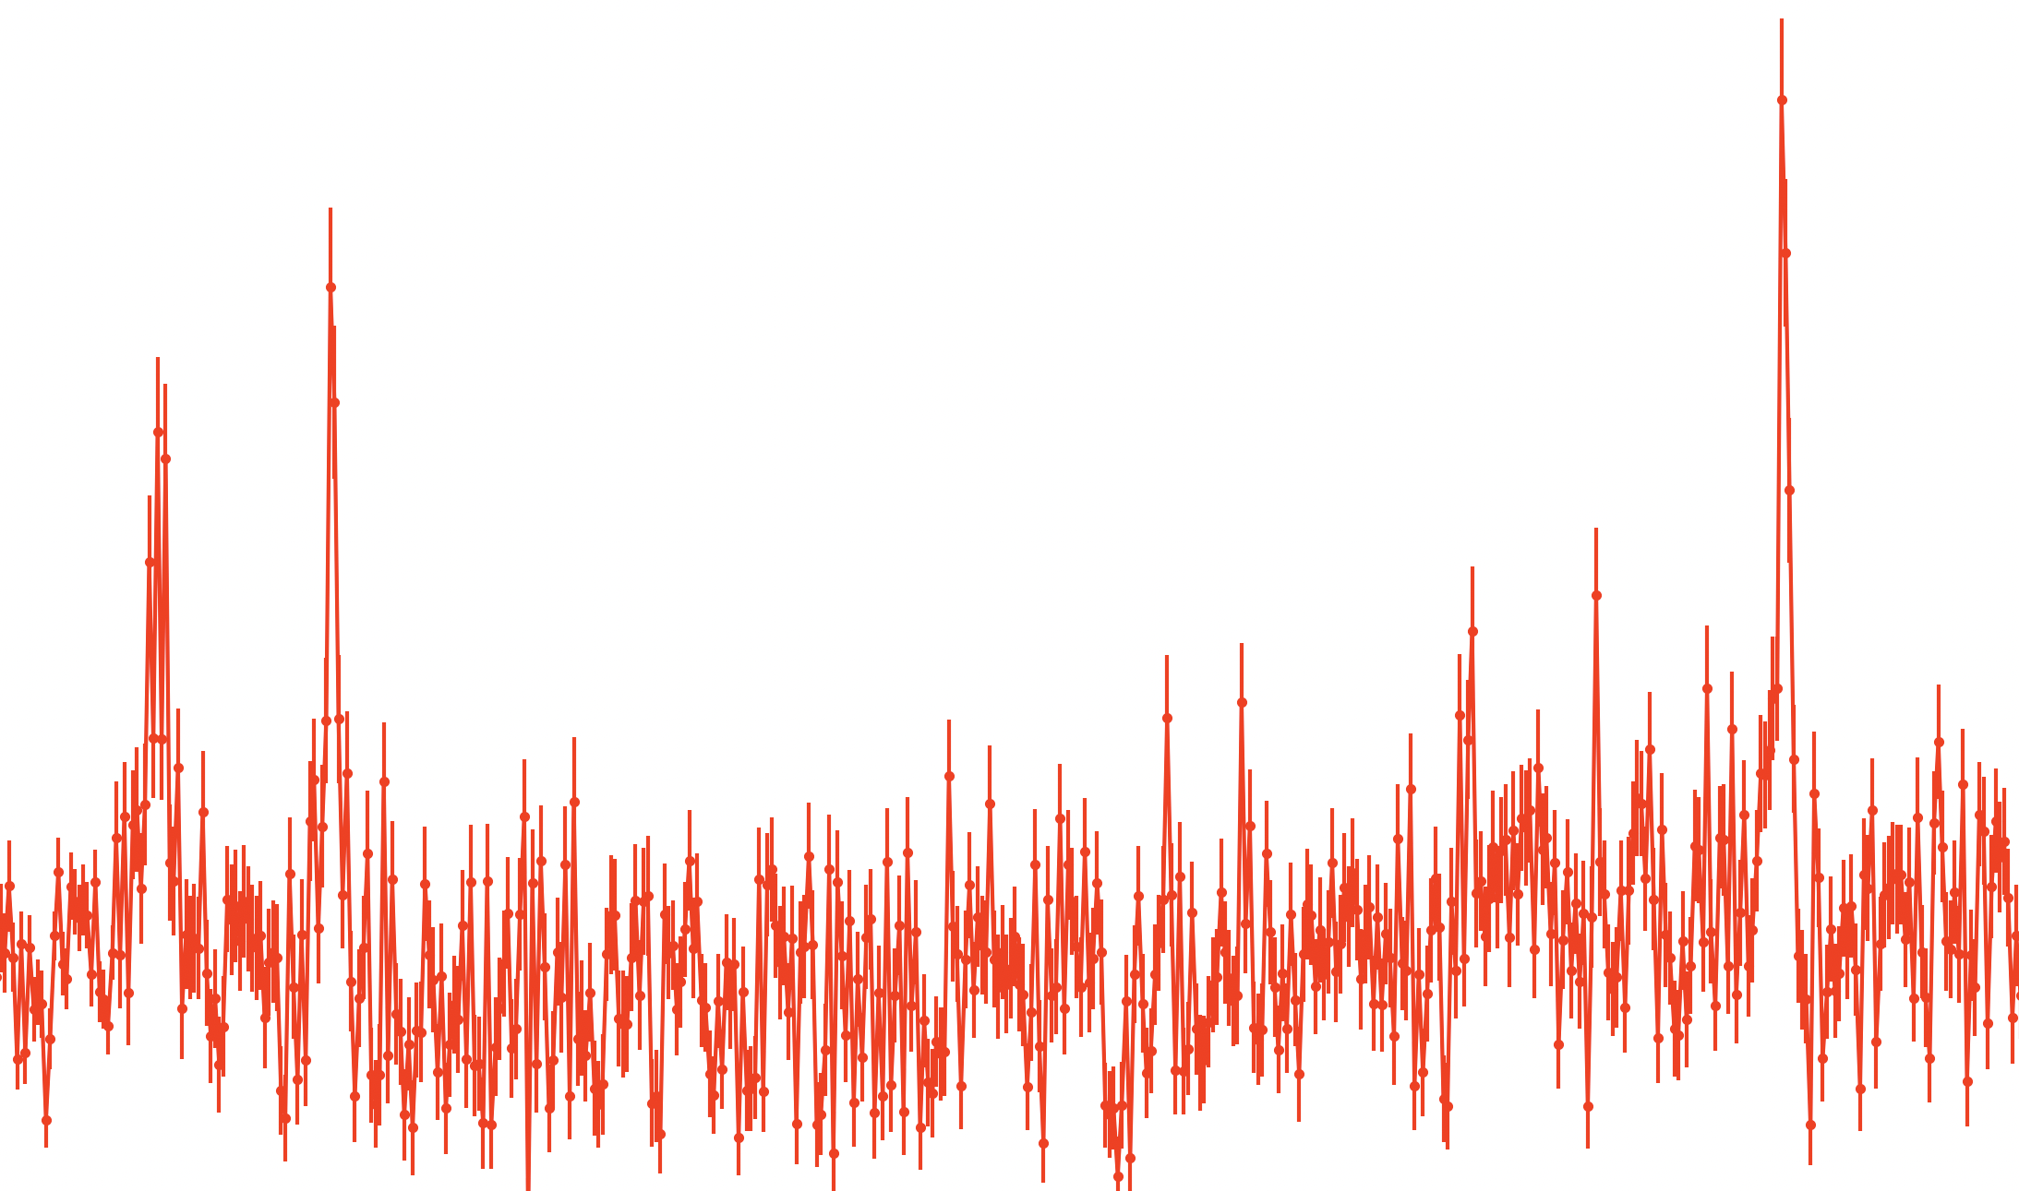
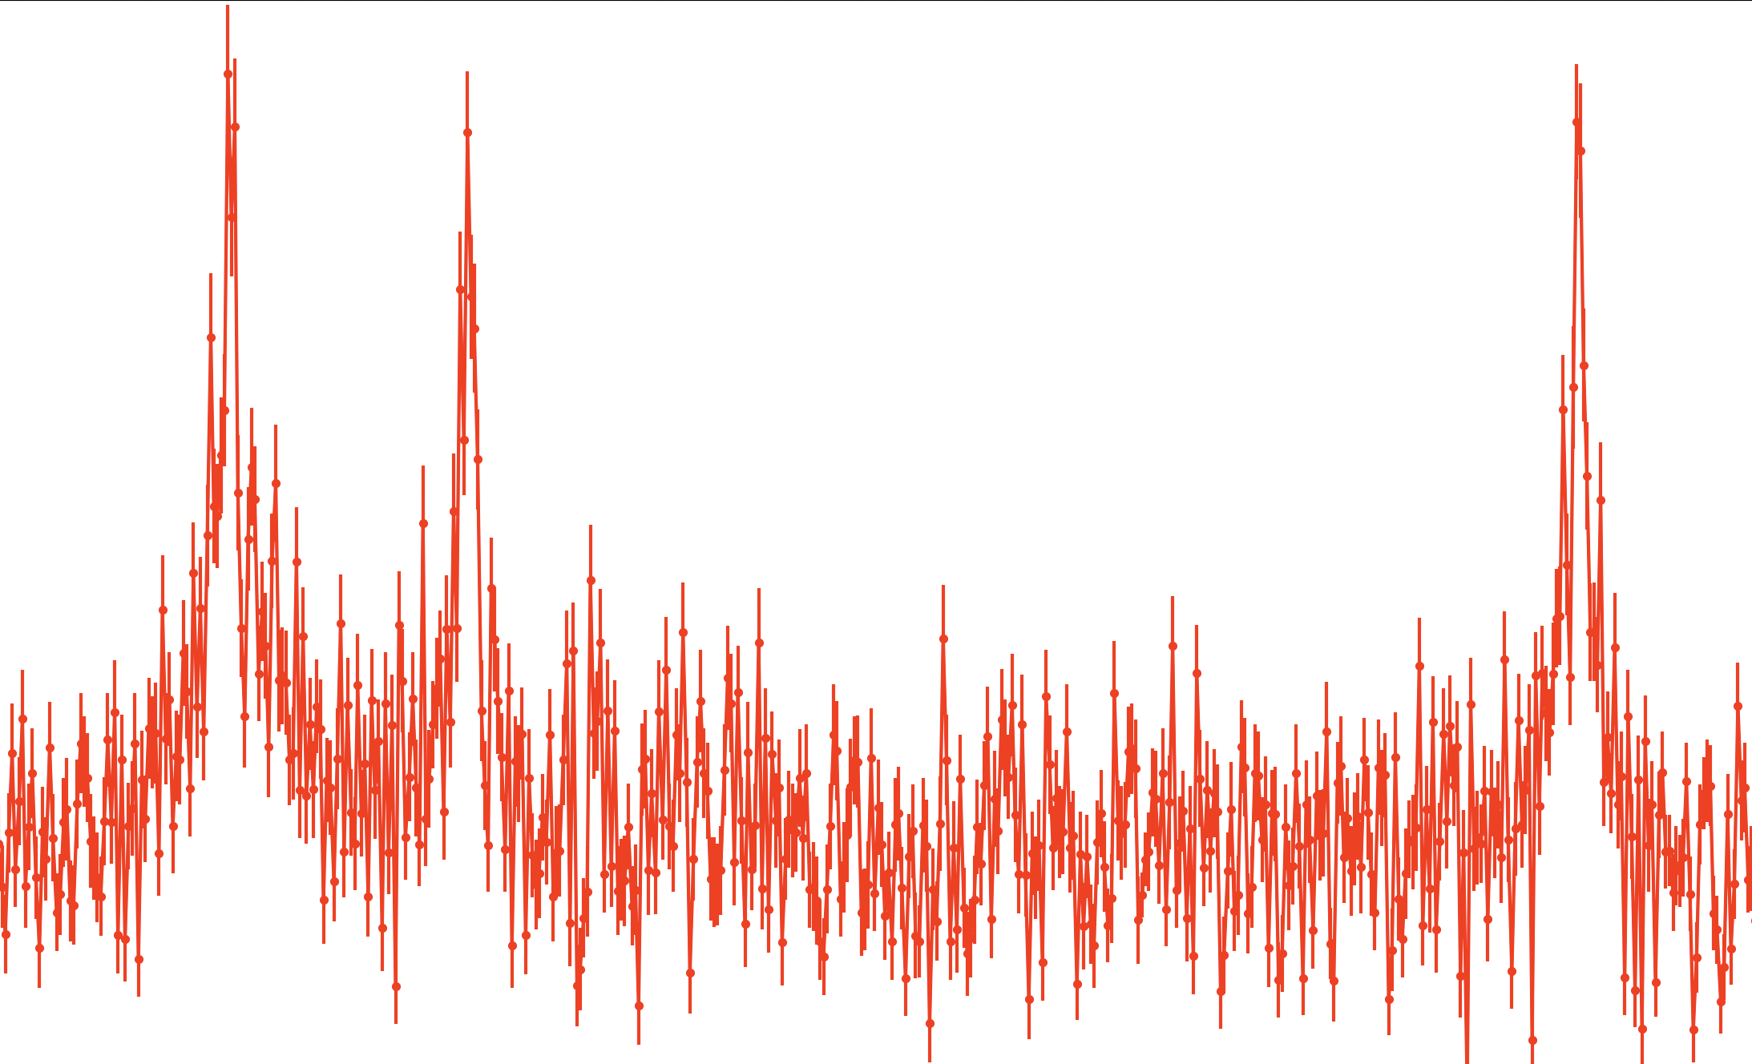
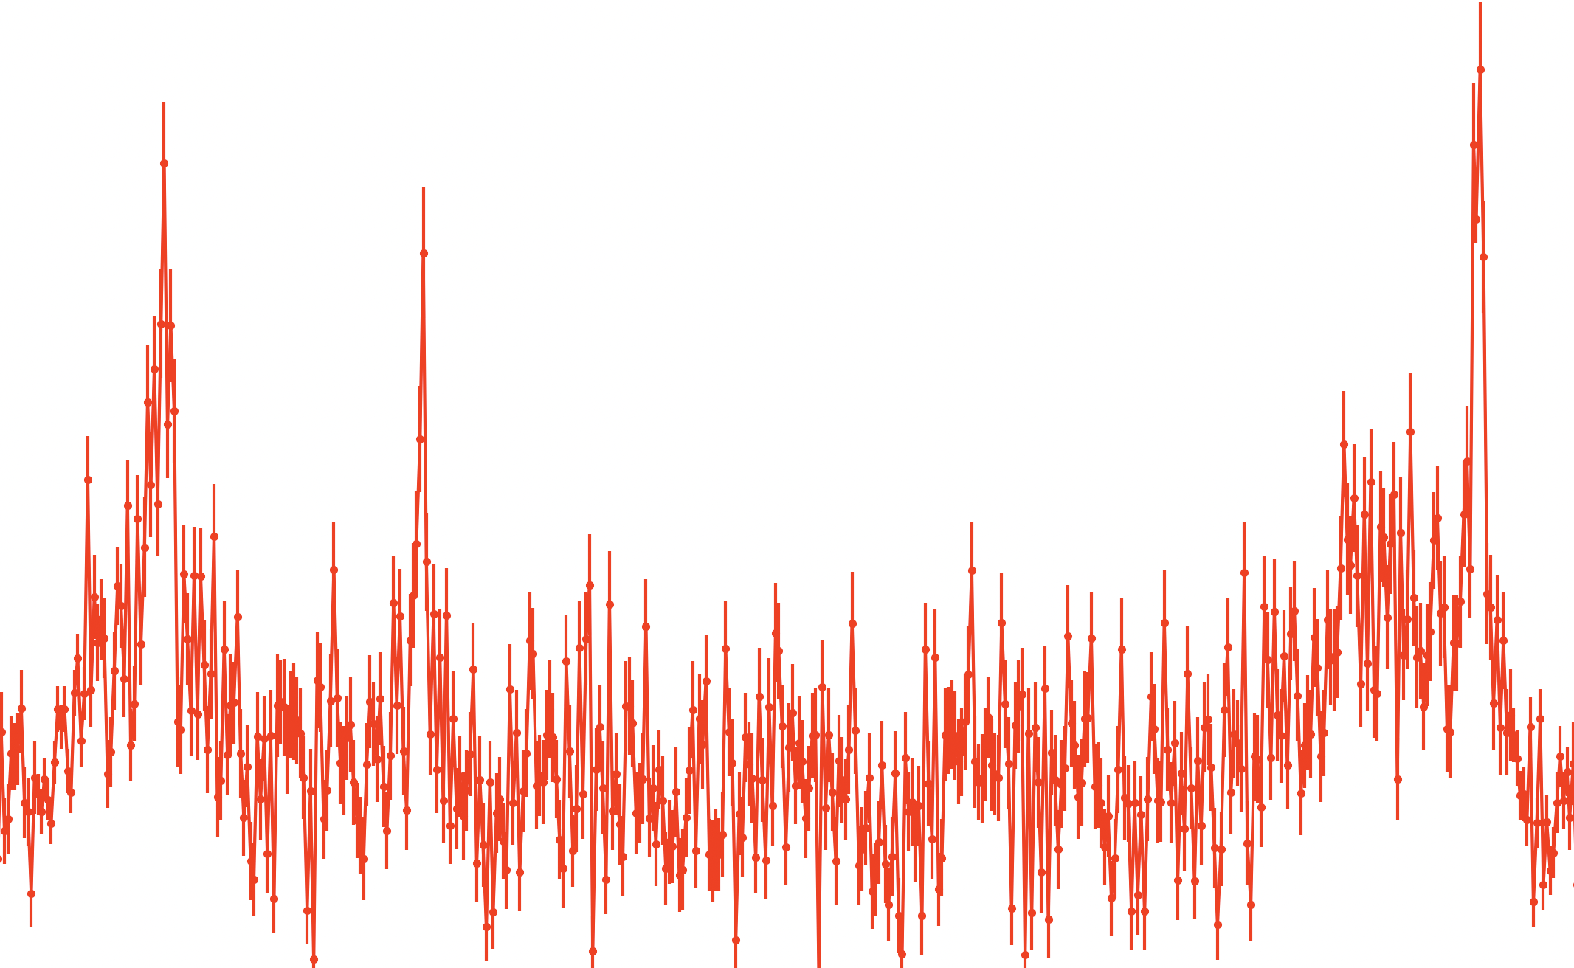






${}^{225}RaF$ Hyperfine Structure
$$J=17.5$$
$$J=18.5$$
$$J=19.5$$
Rate [a.u.]
20
-71
-63
-48
-40
-28
-19
Frequency [GHz]
100
$$J=20.5$$
$$J=21.5$$
$$J=22.5$$
Rate [a.u.]
20
PRELIMINARY
-4.5
0
4.5
18
27
39
48
Frequency [GHz]

Slide 7
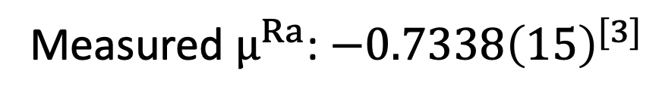
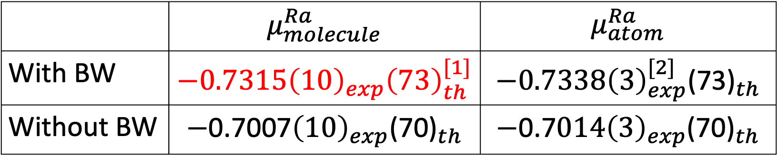
${}^{225}RaF$ Hyperfine Structure
 | $$μ_{molecule}^{Ra}$$ | $$μ_{atom}^{Ra}$$
With BW | $$−0.7315{\left(10\right)}_{exp}{\left(73\right)}_{th}^{[1]}$$ | $$−0.7338{\left(3\right)}_{exp}^{[2]}{\text{(73)}}_{th}$$
Without BW | $$−\text{0.7007}{\left(10\right)}_{exp}{\text{(70)}}_{th}$$ | $$−\text{0.7}014{\left(3\right)}_{exp}{\text{(70)}}_{th}$$
Measured $μ^{Ra}$: $−0.7338{\left(15\right)}^{[3]}$
PRELIMINARY
[1] Skripnikov, L. V., The Journal of Chemical Physics 153.11, 114114 (2020).
[2] Wendt, K., et al., Zeitschrift für Physik D Atoms, Molecules and Clusters 4.3, 227 (1987).
[3] Arnold, E., et al., Physical Review Letters 59.7, 771 (1987).

Slide 8
Why molecules?
Garcia Ruiz, et al., Nature 581.7809, 400 (2020).

Slide 9
Why molecules?
Garcia Ruiz, et al., Nature 581.7809, 400 (2020).
Udrescu, S. M., et al, Physical Review Letters 127.3, 033001 (2021).

Slide 10
Why molecules?
Garcia Ruiz, et al., Nature 581.7809, 400 (2020).
Udrescu, S. M., et al, Physical Review Letters 127.3, 033001 (2021).
In preparation

Slide 11
Why molecules?
Garcia Ruiz, et al., Nature 581.7809, 400 (2020).
Udrescu, S. M., et al, Physical Review Letters 127.3, 033001 (2021).
In preparation

Slide 12
Why molecules?

Slide 13


Atomic/Molecular Parity Violation
$$A_{e}$$
$$V_{N}$$

Slide 14
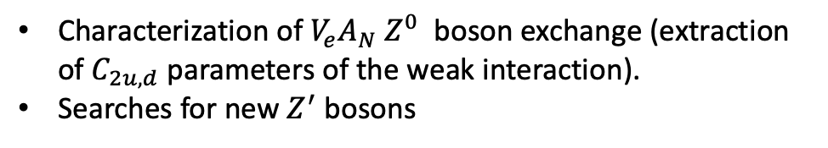
Atomic/Molecular Parity Violation
$$A_{e}$$
$$V_{N}$$
Characterization of $V_{e}A_{N} Z^{0}$ boson exchange (extraction of $C_{2u,d}$ parameters of the weak interaction).
Searches for new $Z^{′}$ bosons

Slide 15
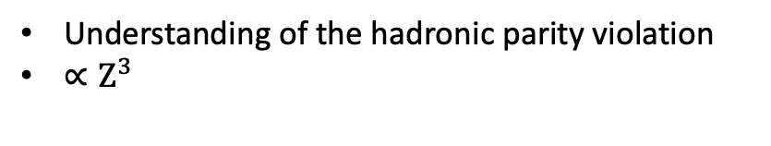
Atomic/Molecular Parity Violation
$$A_{e}$$
$$V_{N}$$
Characterization of $V_{e}A_{N} Z^{0}$ boson exchange (extraction of $C_{2u,d}$ parameters of the weak interaction).
Searches for new $Z^{′}$ bosons
Understanding of the hadronic parity violation
$∝Z^{3}$

Slide 16
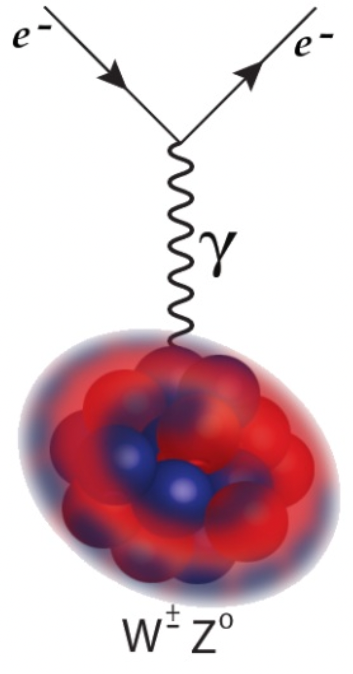
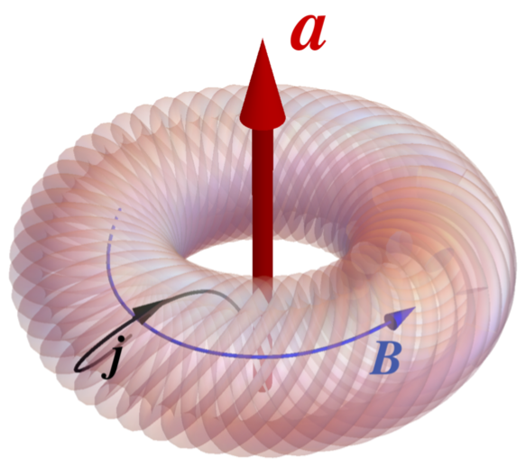

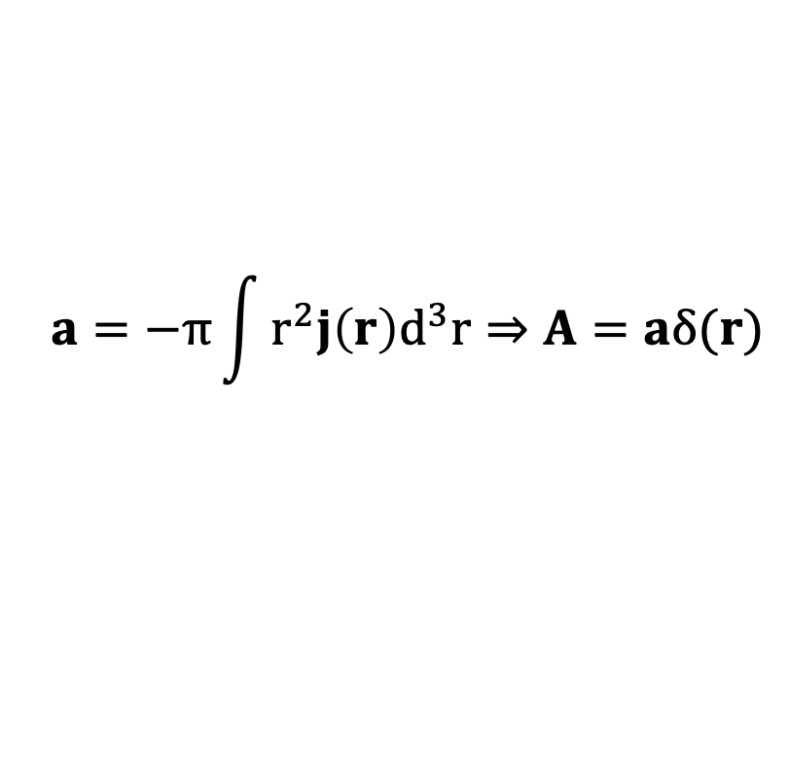
Atomic/Molecular Parity Violation
$$a=−π\int{r^{2}j\left(r\right)d^{3}r⇒A=aδ(r)}$$
$$iW= \left\langle + | H_{PV}^{mol} | −\right\rangle =κ_{a}W_{A}C$$
Safronova, M. S., et al. Reviews of Modern Physics 90.2, 025008 (2018).

Slide 17
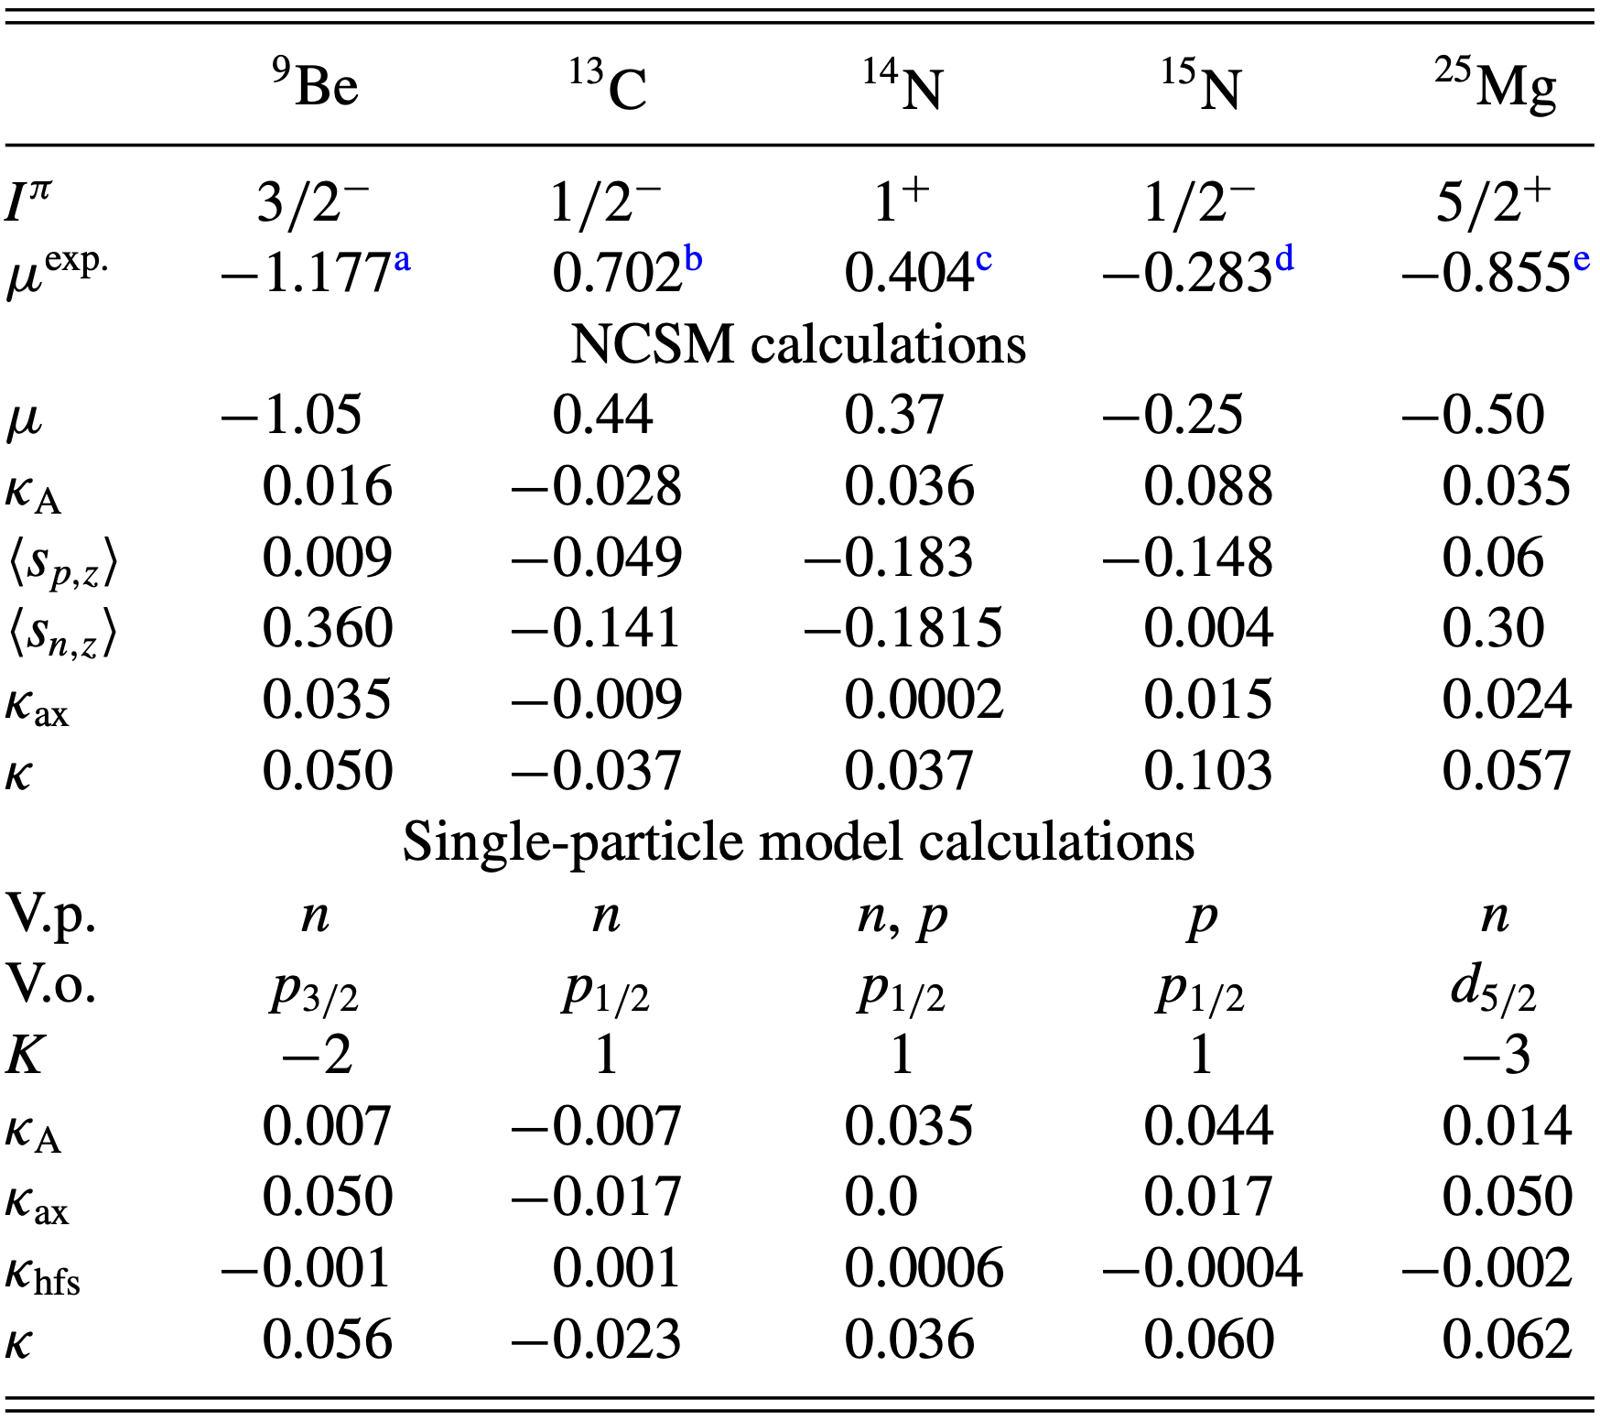
Anapole moment calculation
Hao, Yongliang, et al., Physical Review A 102.5, 052828 (2020).

Slide 18
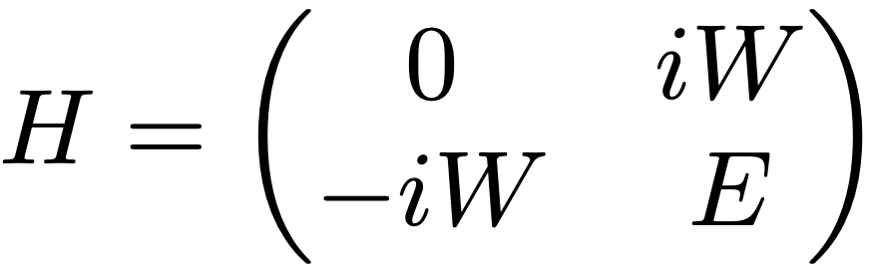
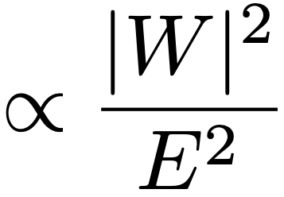


Atomic/Molecular Parity Violation
+
$$\sim 𝒪(10 GHz)$$
-
$$⇒$$
Transition rate

Slide 19
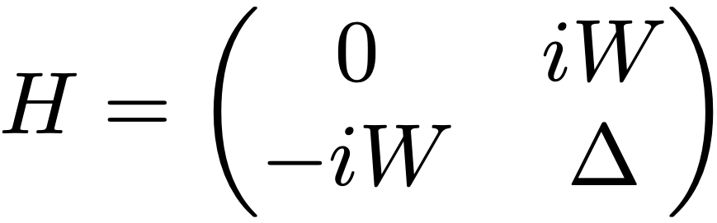
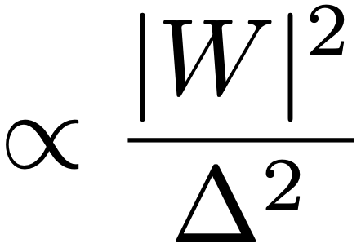



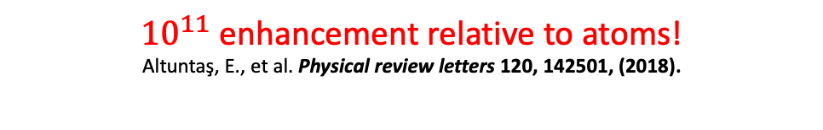


Atomic/Molecular Parity Violation
$$\vec{B}≠0$$
+
+
$$Δ$$
-
$$\sim 𝒪(1 kHz)$$
$$\sim 𝒪(10 GHz)$$
-
${10}^{11}$ enhancement relative to atoms!
Altuntaş, E., et al. Physical review letters 120, 142501, (2018).
$$⇒$$
Transition rate
$$SiO^{+}$$

Slide 20
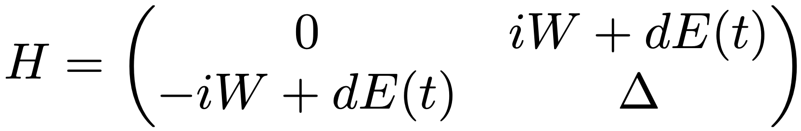
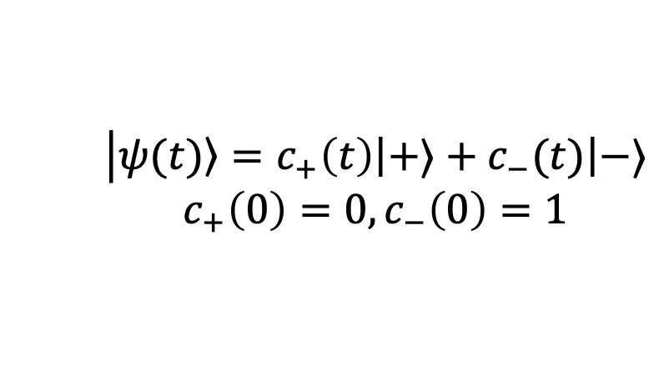
Atomic/Molecular Parity Violation
$$\vec{B}≠0$$
+
+
$$Δ$$
-
$$\sim 𝒪(1 kHz)$$
$$\sim 𝒪(10 GHz)$$
-
$$⇒$$
Transition rate
+ RF (Stark interference)
$$\left|\left.ψ(t)\right\rangle =c_{+}\left(t\right)\left|+⟩\right.+c_{−}(t)\left|−⟩\right.\right.$$
$$c_{+}\left(0\right)=0, c_{−}\left(0\right)=1$$
$$⇒$$

Slide 21
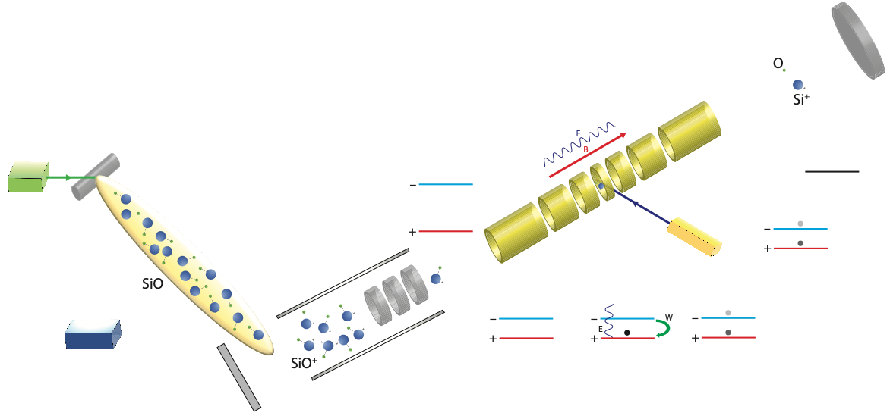
Proposed experimental setup

Slide 22

Proposed experimental setup

Slide 23
Proposed experimental setup

Slide 24

Proposed experimental setup

Slide 25
Proposed experimental setup

Slide 26
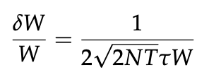
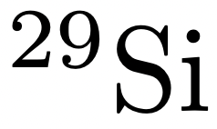
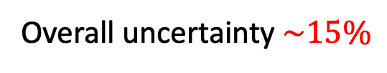
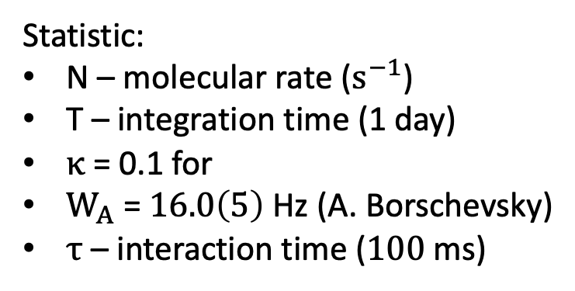
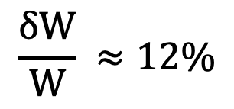

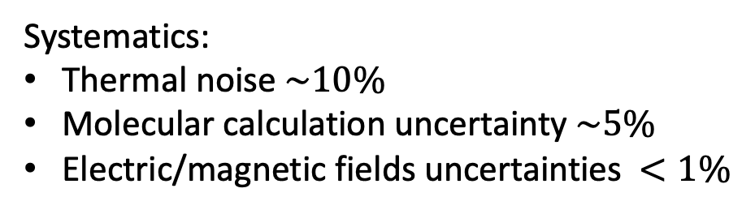
Parity violation measurements in a Penning trap
Statistic:
N – molecular rate ($s^{−1}$)
T – integration time (1 day)
$κ$ = 0.1 for
$W_{A}$ = $16.0\left(5\right)$Hz (A. Borschevsky)
$τ$– interaction time ($100$ ms)
$$\frac{δW}{W} ≈12\%$$
$$⇒$$
Systematics:
Thermal noise $\sim 10\%$
Molecular calculation uncertainty $\sim 5\%$
Electric/magnetic fields uncertainties $<1\%$
Overall uncertainty $\sim 15\%$

Slide 27
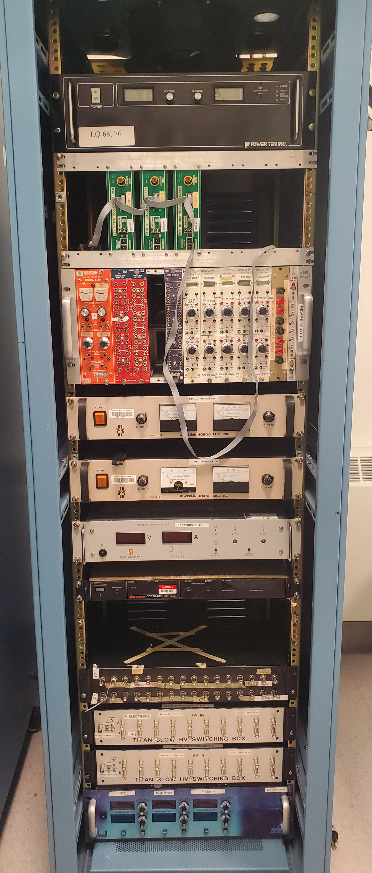
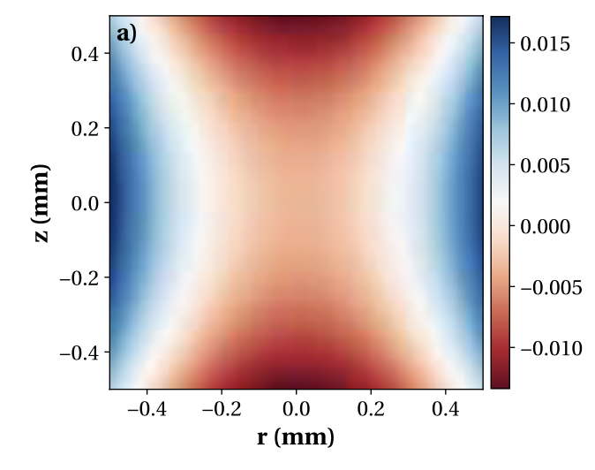
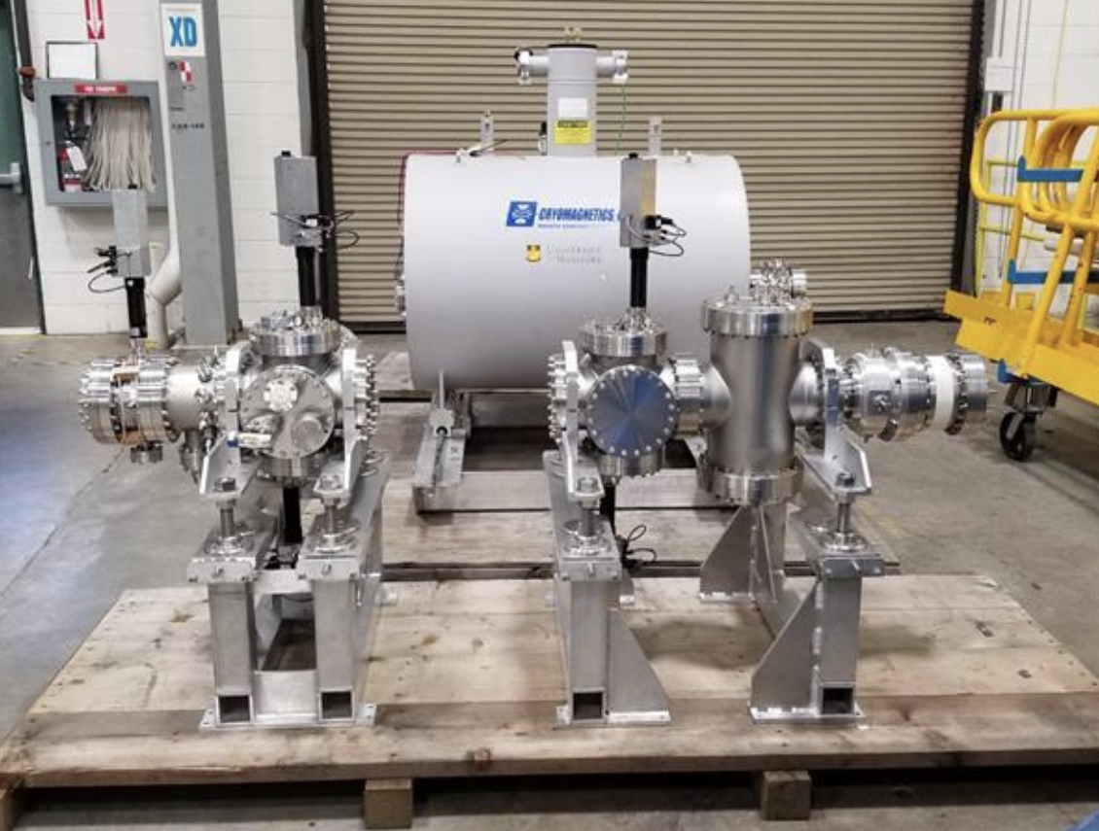
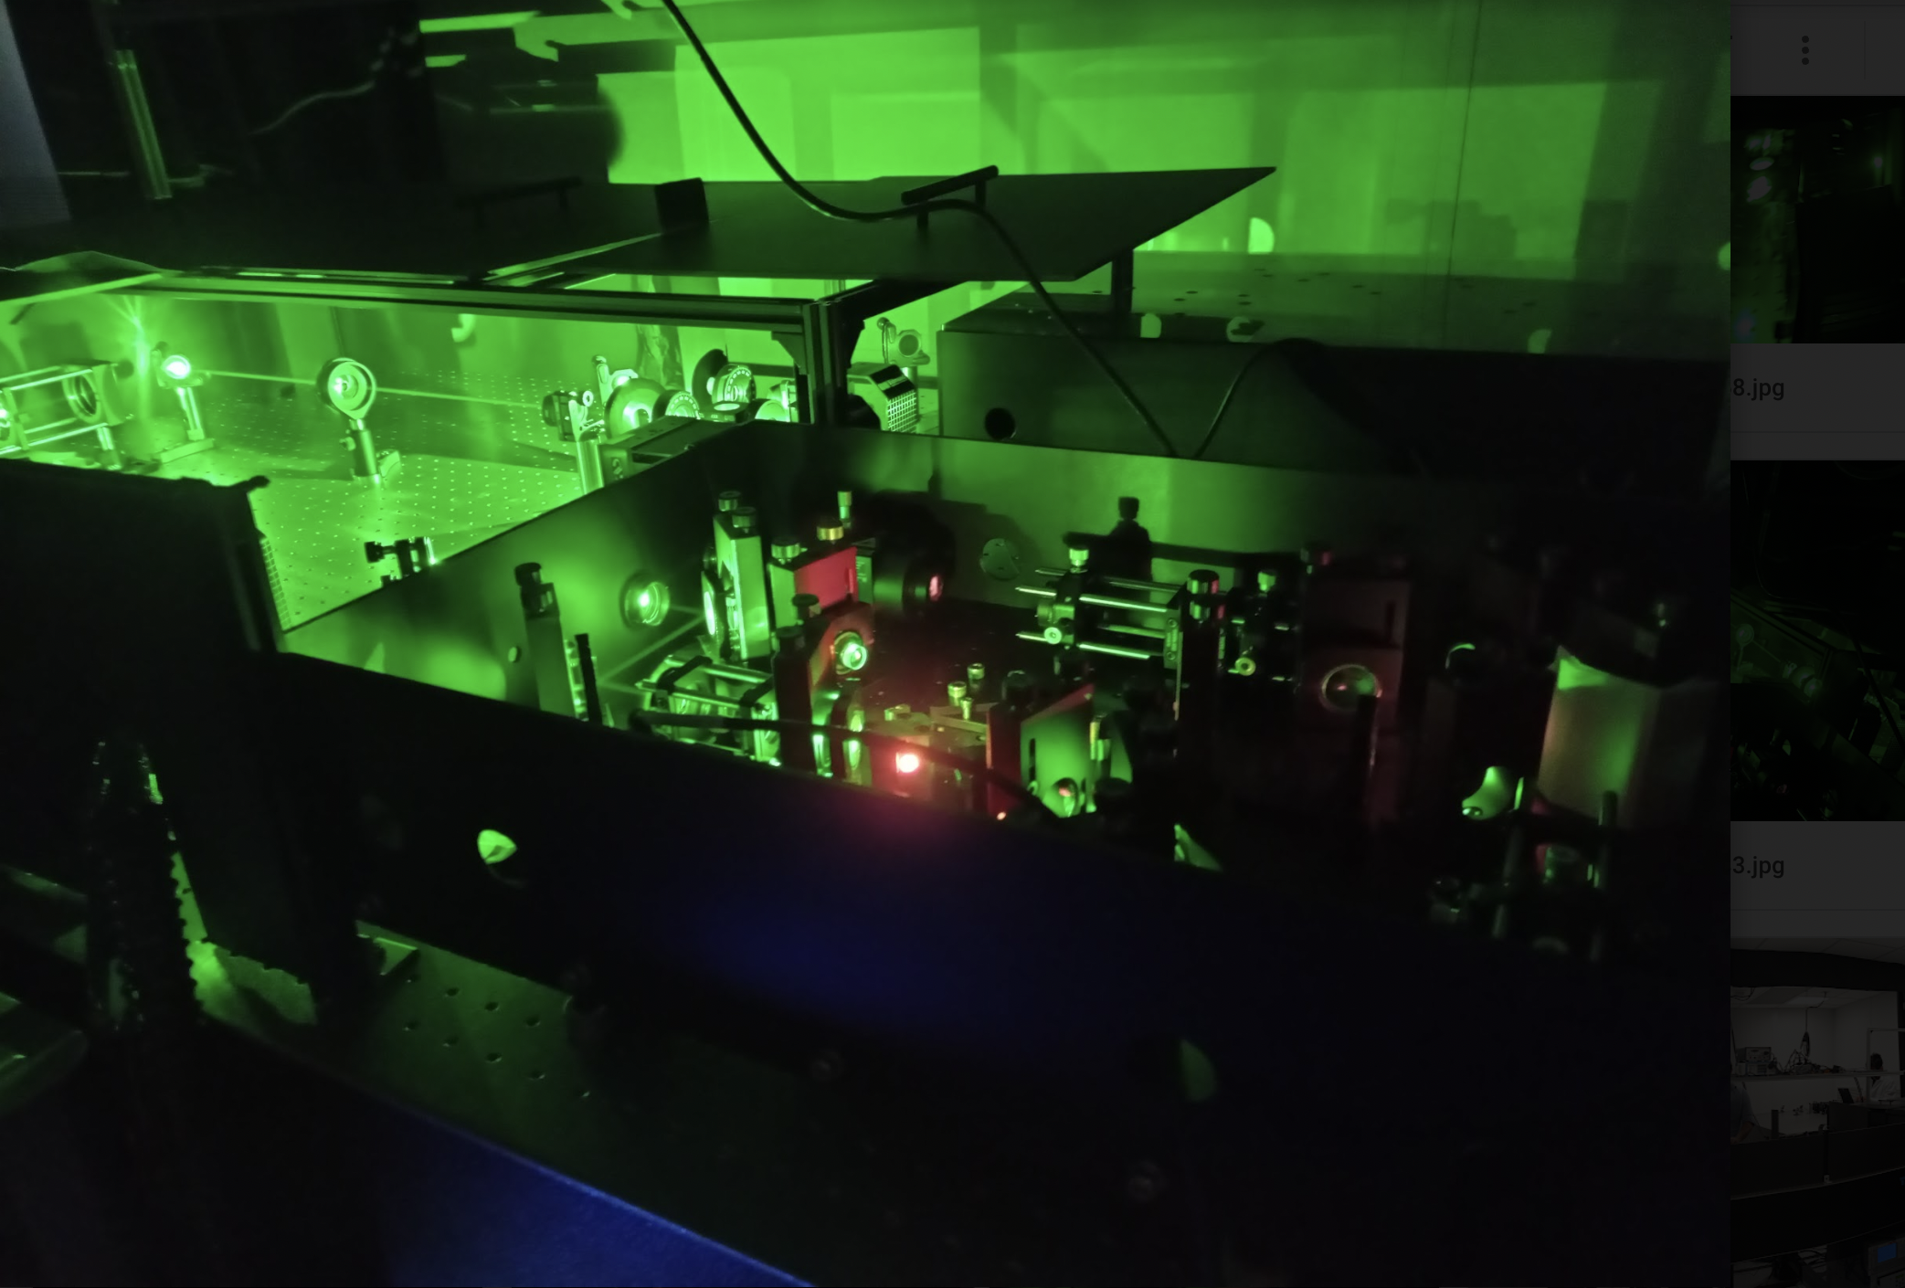
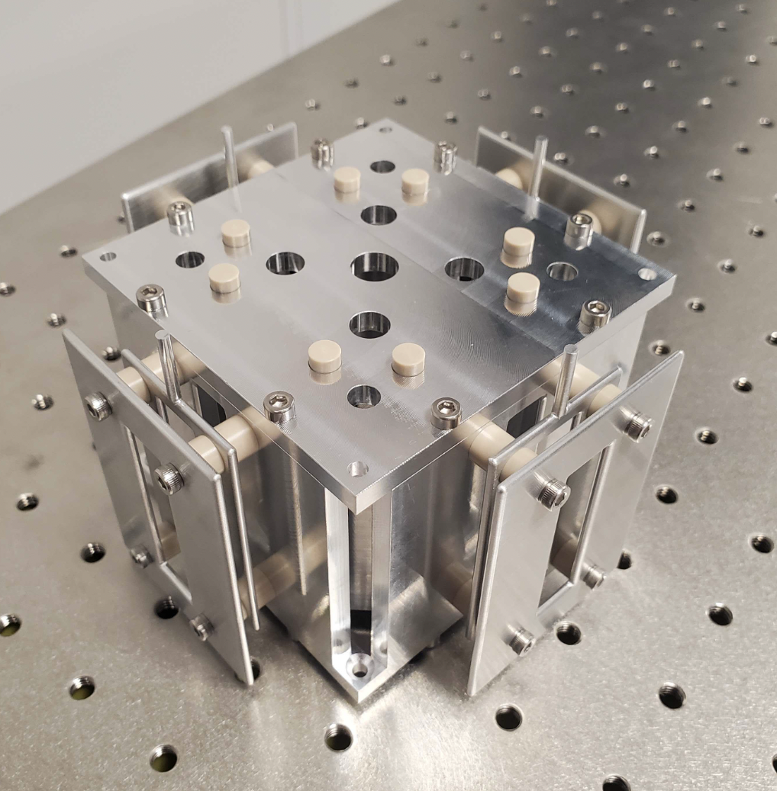
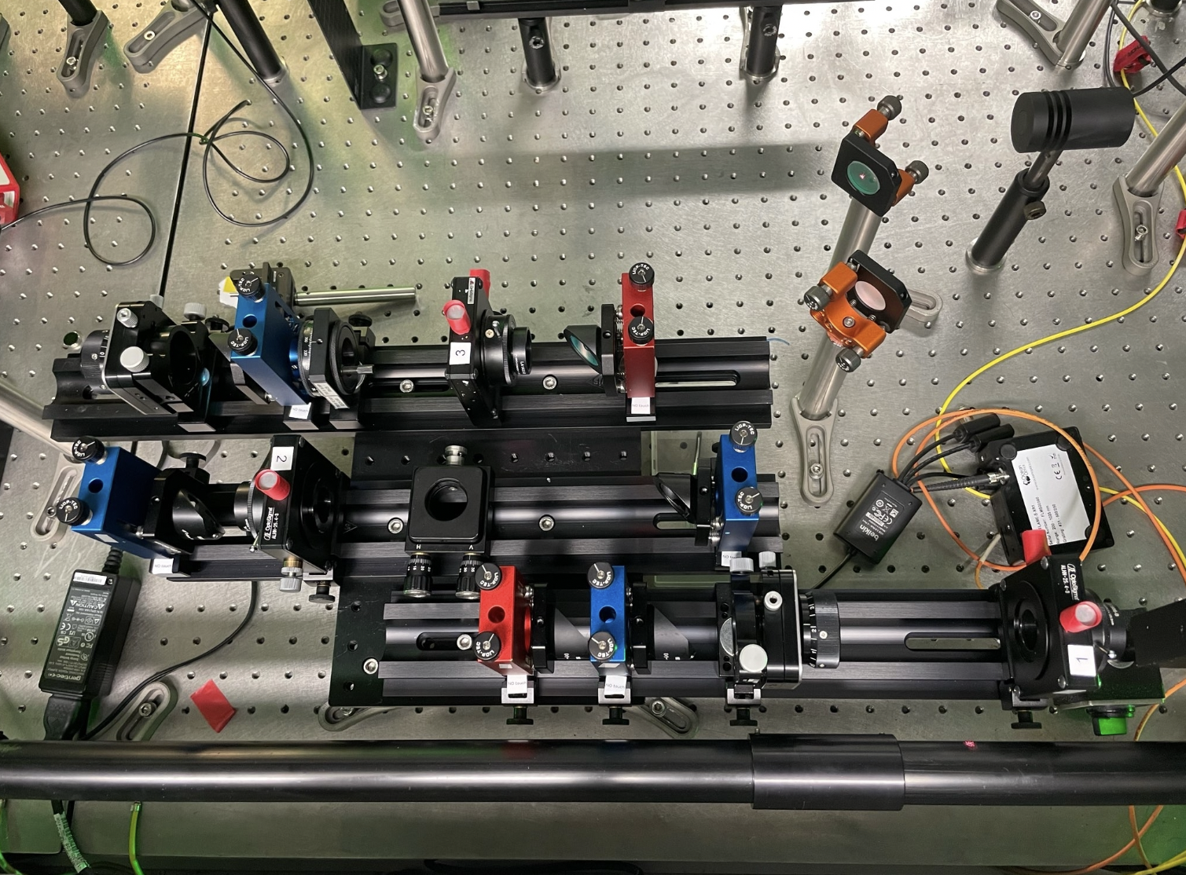
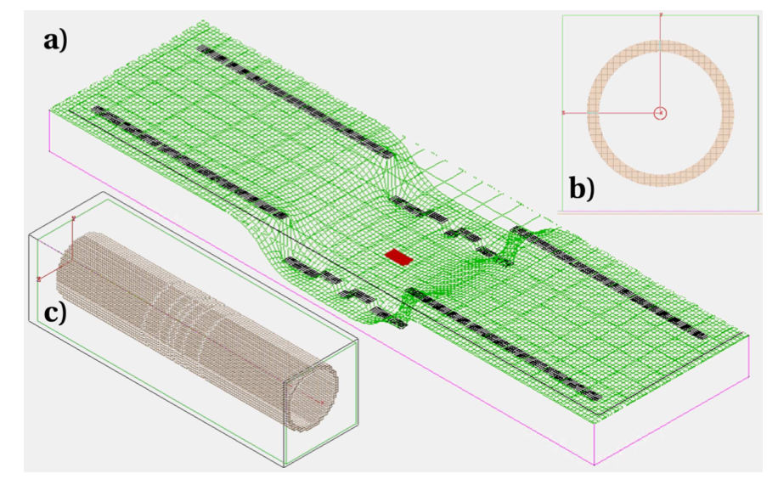
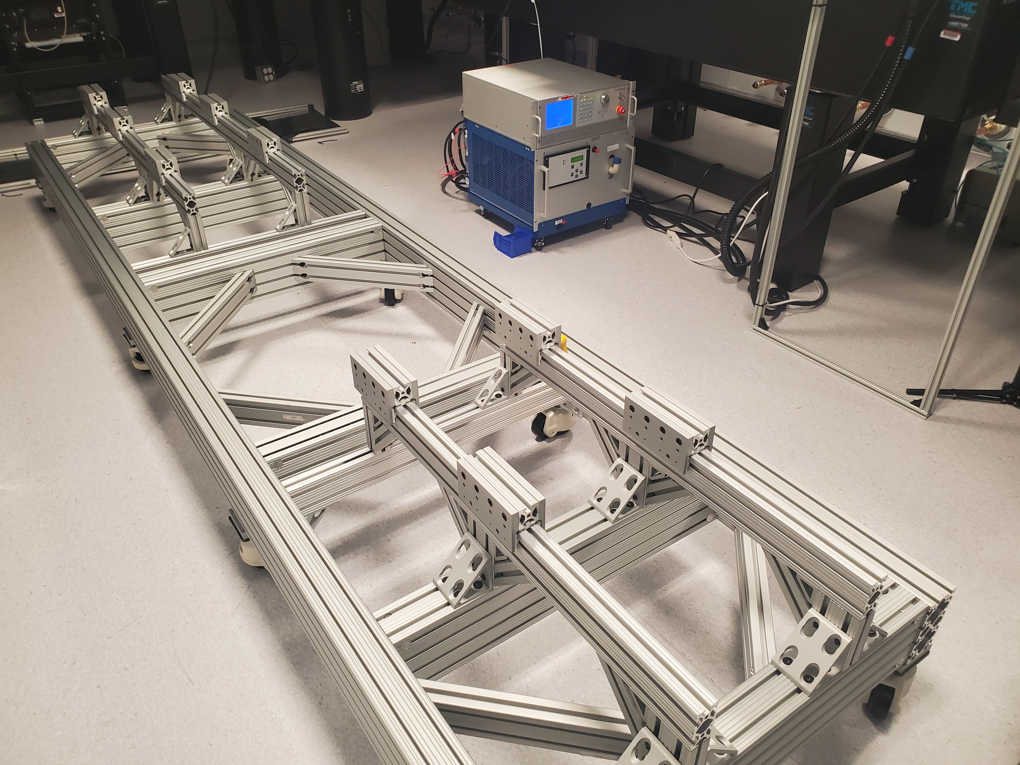
Parity violation measurements in a Penning trap

Slide 28
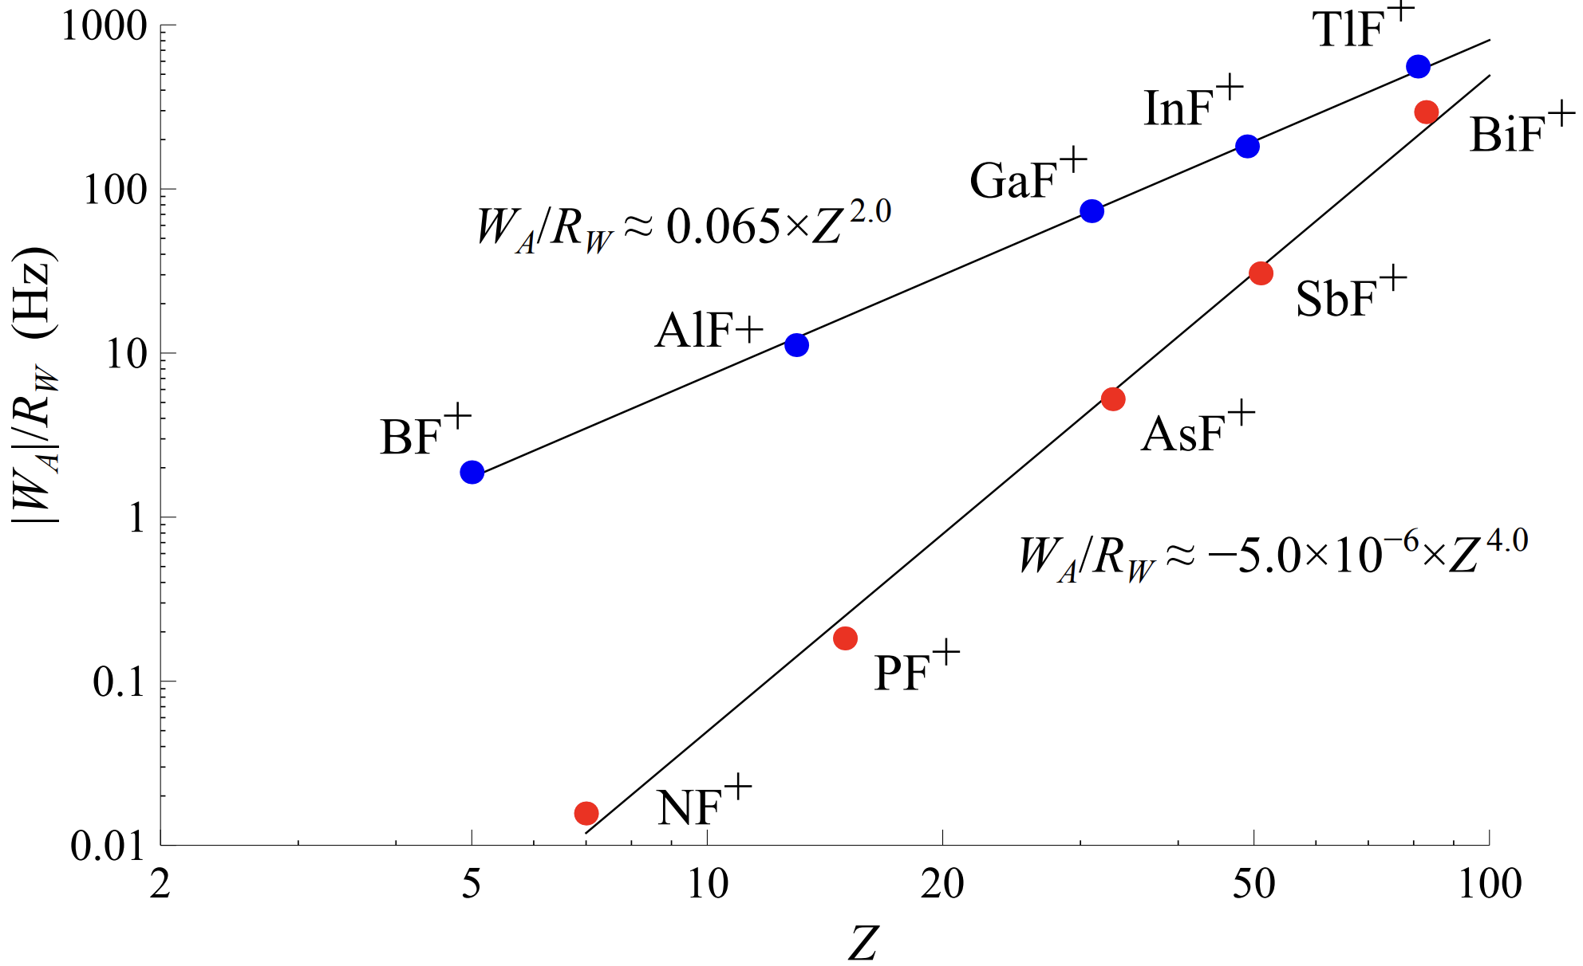

Molecular calculations
$$SiO^{+}$$
Borschevsky, A., et al., Physical Review A 86.5, 050501 (2012).

Slide 29
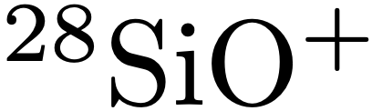
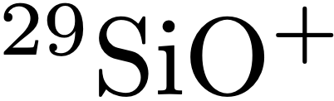
Next Steps
Systematic studies of the room temperature Penning trap setup
Performing the first laser spectroscopy of a molecular ion in a Penning trap:
Study of the hyperfine structure of
Installation and systematic studies of the cryogenic Penning trap setup
Measurement of the NSD-PV effect in diatomic molecules
More accurate calculations needed for the nuclear parameters
Measurement of the weak quadrupole moment
PV in polyatomic (chiral) molecules

Slide 30
Group at MIT:
R.F. Garcia Ruiz, I. Belosevic, A.J. Brinson, J. Karthein, S. Moroch, S.M. Udrescu, A. Vernon, S. Wilkins
External collaborators:
D. DeMille, J. Dilling,
N. Hutzler, R. Ringle
Acknowledgements:
S. Paul, A. Teigelhoefer, D. Torres
Credit: Jonas Karthein

Slide 31
Thank you!

