Slide 1
Rapidity space entanglement in gauge theories
Yizhuang Liu
Institute of Theoretical Physics,
Jagiellonian University
The talk is based on recent work 2202.02612，2203.00739 , and 2205.06724.

Slide 2
Outline
Introduction to Quantum Entanglement
High-energy process: large rapidity limit
Rapidity space entanglement : sub-critical system
Rapidity space entanglement : critical system and rapidity evolution
Rapidity space entanglement: string picture
Conclusion

Slide 3
Introduction to Quantum Entanglement
$ℋ=ℋ_{0}⨂ℋ_{1}$ , full density matrix $ρ$.
Reduced density matrix : $ρ_{0}=tr_{1}ρ$.
Entanglement entropy: $S=−trρ_{0}\ln{ρ_{0}}$. Roughly, about
How measurement in 0 affects 1.
How generic the state is.
How many channels between subsystems.
Reflects deep laws in quantum many body system, in particular, QFT.

Slide 4
Introduction to Quantum entanglement
The real space entanglement focuses on a segment in position space with length L.

Slide 5
Introduction to Quantum Entanglement
Example: real space entanglement in 1D.
Generic state: $S=𝒪\left(L\right)=ln dim ℋ$. All $2^{L}$ sates contribute.
Short range interaction: Area law, $S≤ 𝒪\left(ln L\right).$
Gapless system, $c\left(L\right)=L\frac{dS}{dL}=c+𝒪(\frac{1}{L})$.
Gapped system, $c\left(L\right)=L\frac{dS}{dL}={𝒪(e}^{−mL}$) at large distance.

Slide 6
Introduction to Quantum Entanglement
Example: real space entanglement in 1D.
Non-trivial even for free-system.
Macroscopic: replica trick, CFT based methods.
Microscopic: Fisher-Hartwig conjecture.
Open questions remain.
Relation to matrix-product states, entanglement renormalization group and string duality.

Slide 7
High-energy process: large rapidity limit
High-energy experiment: presence of a large rapidity gap $Y$.
DIS at small-$x$ : $Y=\ln{\frac{1}{x}}.$
Forward scattering with $s≫−t,$ $Y=\ln{\frac{s}{m^{2}}}$.
Very non-trivial asymptotic behavior in $Y.$
Perturbative evolution equations and saturation conjecture.
Insights from String-Gauge duality.

Slide 8
High-energy process: large rapidity limit
Nontrivial “conspiracy” between fast and slow degrees freedom.
How many entanglement between fast and slow degrees of freedom?

Slide 9
Rapidity space entanglement : sub-critical system
Meson state in the 2D QCD in large $N_{c}$ limit.
Light-front wave function: $\left|m\right\rangle =\frac{1}{\sqrt{N}}∑φ(x)|x,\overline{x}⟩$ .
$0<x<1:$ longitudinal momentum fraction.
$N$: total number of digits.
Rapidity space entanglement between sub-systems:
$\left[0,1\right]N=\left[0,x_{0}\right]N∪\left[x_{0},1\right]N$.

Slide 10
Rapidity space entanglement : sub-critical system
In the light-front formulation of QFT, there are $N$ total digits in longitudinal momentum fraction. We consider entanglement between the first $x_{0}N$ and the rest.

Slide 11
Rapidity space entanglement : sub-critical system
$S\left(x_{0}\right)=c\left(x_{0}\right)\ln{x_{0}N+}b(x_{0})$. Area law satisfied.
$c\left(x_{0}\right)$ and $b(x_{0})$ expressed in terms of quark parton distribution functions (PDFs).
For small $x_{0}$, $c\left(x_{0}\right)∼x_{0}^{2β+1}$ and $b\left(x_{0}\right)∼x_{0}^{2β+1}\ln{\frac{1}{x_{0}}}$
The same asymptotic coefficients for forward scattering: $A\left(s\right)∼s^{−2β}.$

Slide 12
Rapidity space entanglement : sub-critical system
$S\left(x_{0}\right)=c\left(x_{0}\right)lnx_{0}{N+}b(x_{0})$.
The “c function”: $c\left(x_{0}\right)=\int_{0}^{x_{0}}{q\left(x\right)+\overline{q}(x)}dx≤1$.
Expected to generalized to multi-parton wave functions in sub-critical system.

Slide 13
Rapidity space entanglement : sub-critical system
The entanglement can also be investigated in the LF $x^{−}$ direction inside a hadron state $|P^{+}⟩$ .
Naturally expressed in $λ=x^{−}P^{+}.$
$S\left(λ\right)−S_{0}\left(λ\right)=\frac{3λ^{2}}{N}\int_{0}^{1}{dxx^{2}}\left(q\left(x\right)+\overline{q}\left(x\right)\right).$
Probing quark-antitquark PDFs.

Slide 14
Rapidity space entanglement : critical system and rapidity evolution
In QCD, a famous example is the soft gluon wave function of a quarkonium system.
Emission of small-$x$ gluon generates rapidity divergences in light-front wave functions and their norm squares.
Leading divergences resumed into closed equation in planar limits.
Generates BFKL, BK-like equations in various limits/approximations.

Slide 15
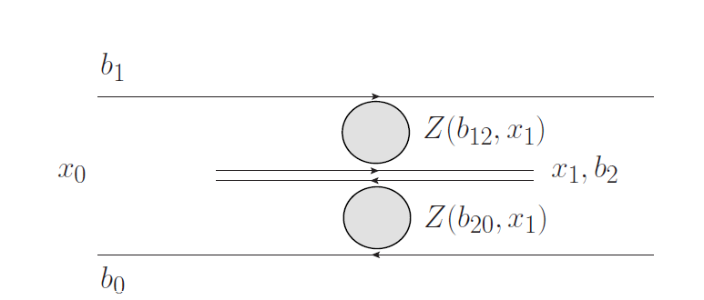
Rapidity space entanglement : critical system and rapidity evolution
Emission of the hardest soft gluon splits the original dipole into two dipoles in which softer gluons emit independently.

Slide 16
Rapidity space entanglement : critical system and rapidity evolution
Entanglement in Mueller’s dipole:
At order$α_{s}$, rapidity divergence leads to enhanced logarithmic behavior: $S∼α_{s}\ln^{2}{N+α_{s}\ln{N}}$.
Generally, to order $k$ : $S∼α_{s}^{k}\ln^{k+1}{N+α_{s}^{k}\ln^{k}{N}}$.
Needs re-summation.
Evolution equation for reduced density matrix can be written out.

Slide 17
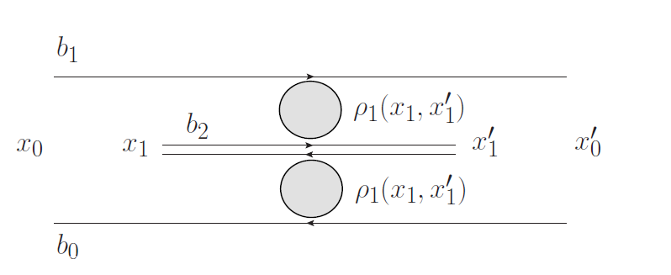
Rapidity space entanglement : critical system and rapidity evolution

Slide 18
Rapidity space entanglement : critical system and rapidity evolution
A 1D toy model .
$Z\left(y,u\right)=\sum_{n=0}^{∞}{u^{n}p_{n}(y)}$
Probability of finding $n$ soft gluon: $p_{n}(y)=e^{−ay}{\left(1−e^{−ay}\right)}^{n}$.
At large $y∼\ln{x_{0}N},$ a very wide width$∼e^{ay}$ of $p_{n}(y).$

Slide 19
Rapidity space entanglement : critical system and rapidity evolution
$p_{n}(y)=e^{−ay}{\left(1−e^{−ay}\right)}^{n}$
$\left\langle n\right\rangle ∼e^{ay}:$exponential in rapidity gap.
$S(y)−y∼\ln\left\langle n\right\rangle =a\ln{x_{0}N}.$ Linear but enhanced.
$S(y)−y=\ln\left\langle n\right\rangle ,$ the total dipole number $\left\langle n\right\rangle$ probed in inclusive process.

Slide 20
Rapidity space entanglement : critical system and rapidity evolution
Another interesting example: 1+2D QCD
Phase-space constraint: emitted soft gluon must be within the original dipole!
Unique to 1+2D. One dimensional transverse direction.

Slide 21
Rapidity space entanglement : critical system and rapidity evolution
Distribution of soft gluons is Poissonian: $p_{n}=e^{−mby}\frac{{\left(mby\right)}^{n}}{n!}$.
Peak at $\left\langle n\right\rangle =mby.$ Linear instead of exponential.
Much narrower width: ${\left\langle δn^{2}\right\rangle }^{\frac{1}{2}}∼\sqrt{mby}$.
The entropy $S−y=\frac{1}{2}\ln\left(2πe mby\right)$.
Quenching of phase space, “Kinematic saturation”.

Slide 22
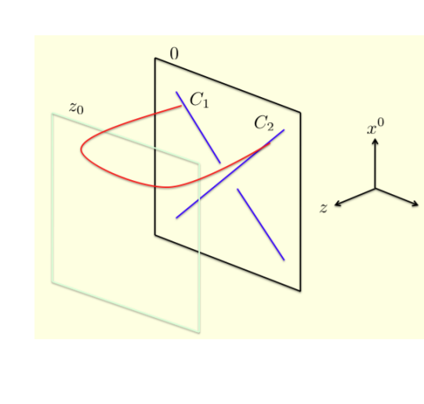
Rapidity space entanglement : string picture
In the string picture, parton-parton scattering depicted by exchange of a minimal surface.
World-sheet instanton and thermal entropy $S_{T}$.
Quantum entropy $S_{E}=S_{T}=ln \left\langle N\right\rangle .$
$S_{E}=\frac{1}{6}\frac{⟨δb_{⊥}^{2}⟩}{l_{S}^{2}}$ like Bekenstein-Hawkins black-hole.

Slide 23
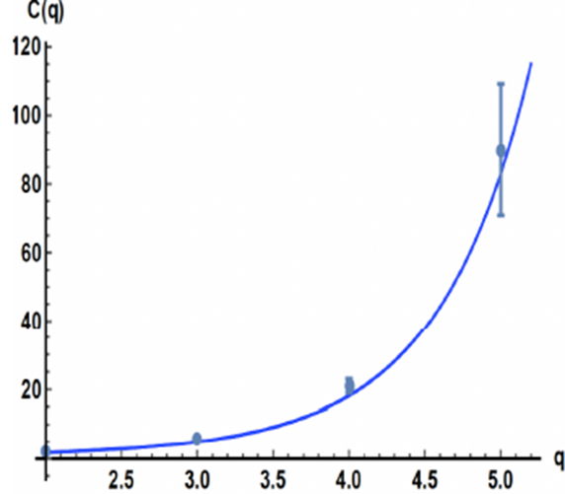
Rapidity space entanglement : string picture
$\frac{dS_{E}}{dy}≤\frac{D_{⊥}}{6}$ : chaos bound saturated.
Cascade equation for particle multiplicities.

Slide 24
Conclusion
Rapidity space entanglement as a probe of light-front limit of QFT.
Subcritical system: $S(y)=cy+b$ with $c<1$.
Critical system: $y^{n}$ in perturbative expansion. $S\left(y\right)−y=S_{1}(y)$ with $S_{1}\left(y\right)$ growth with $y$.
$1D$ reduction: $S_{1}\left(y\right)=ay$. Expected for 4D QCD. Consistent with the string picture.
Kinematic saturation in 1+2 QCD. $S_{1}\left(y\right)∼\frac{1}{2}ln{y.}$
Measured by particle multiplicity.

