Slide 1

Hadrons mass, spin and LFWFs from ILM
I. Zahed
Trento 22’

Slide 2
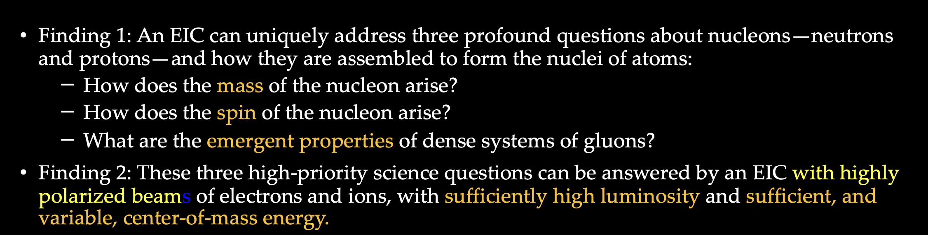
US National Academy of Science 18’

Slide 3
Outline
Vacuum
Mass
Spin
LFWs
Summary

Slide 4
Vacuum

Slide 5
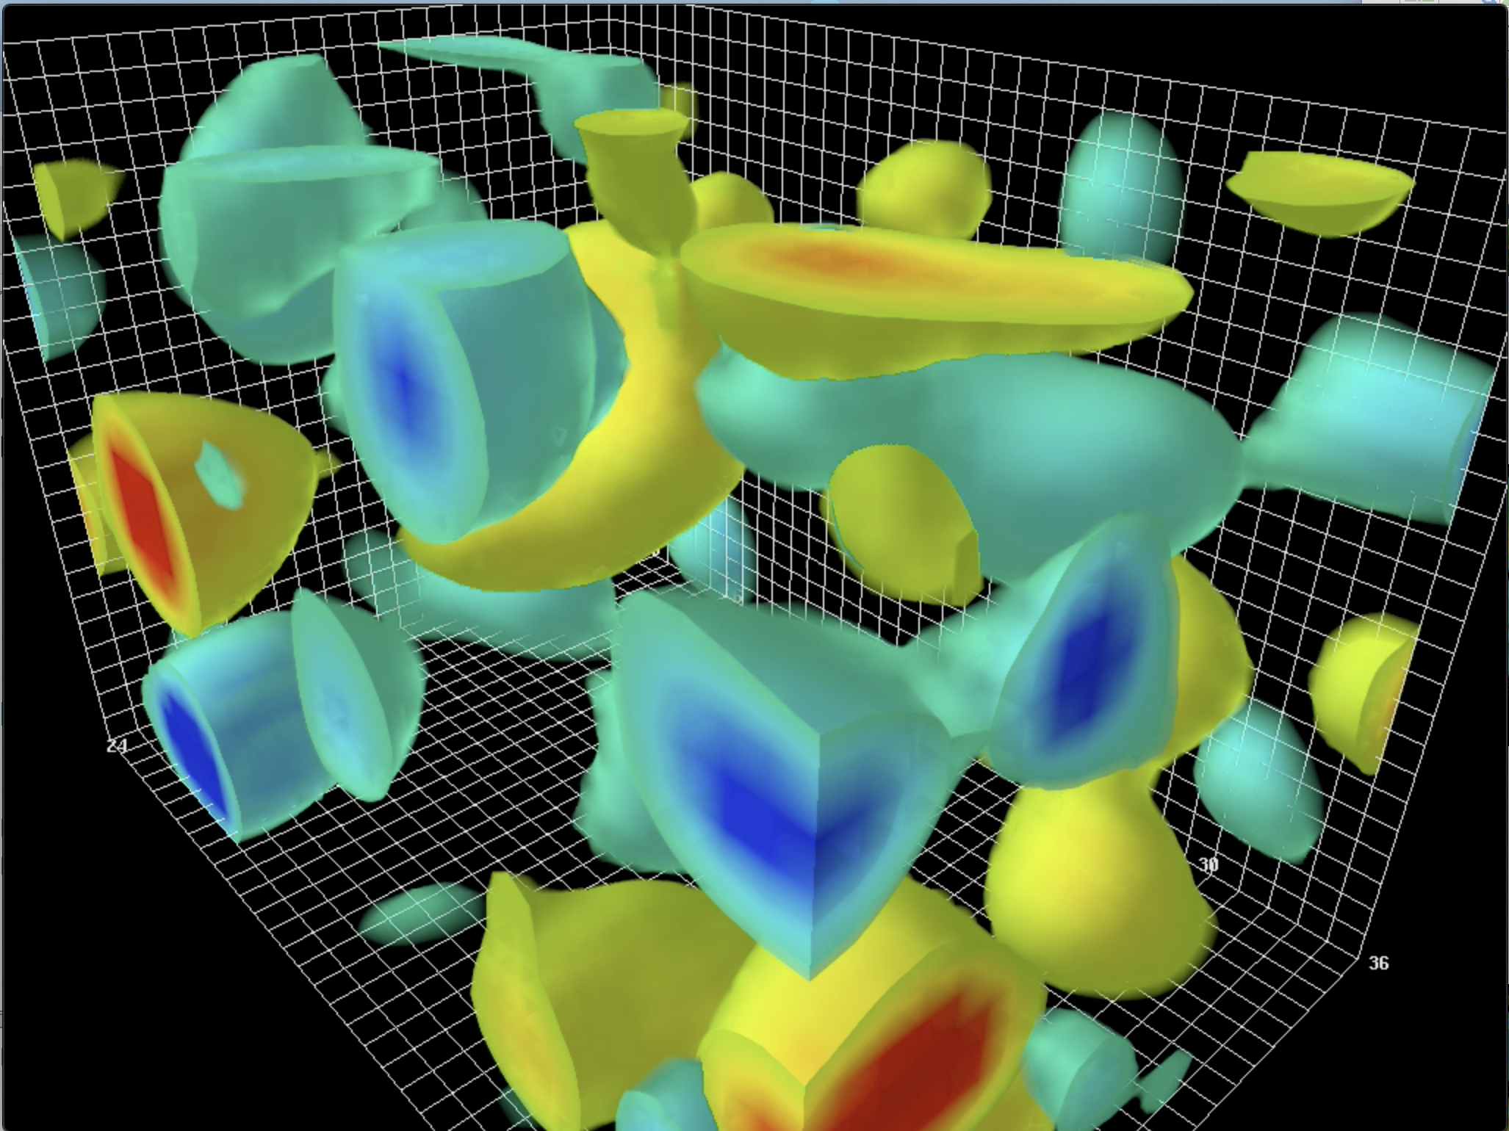
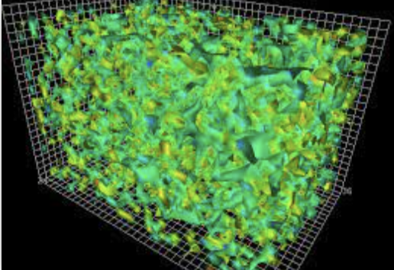
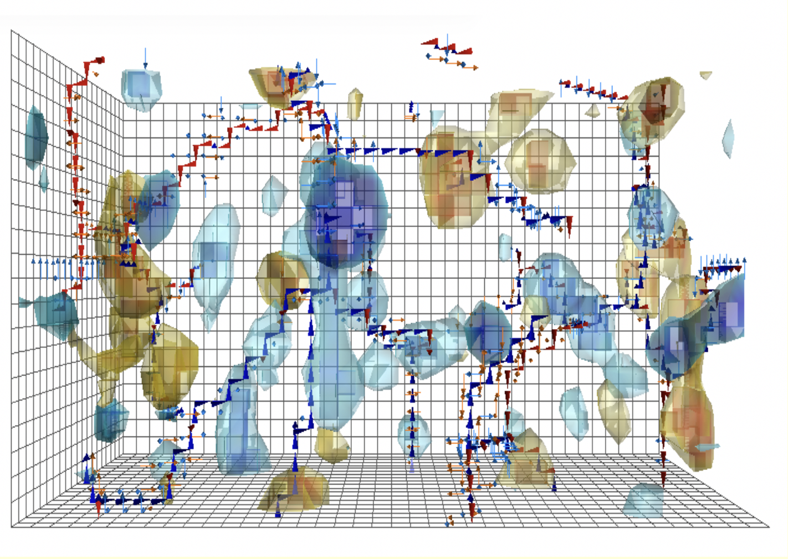
YM vacuum topologically active:
primordial glue!

Slide 6
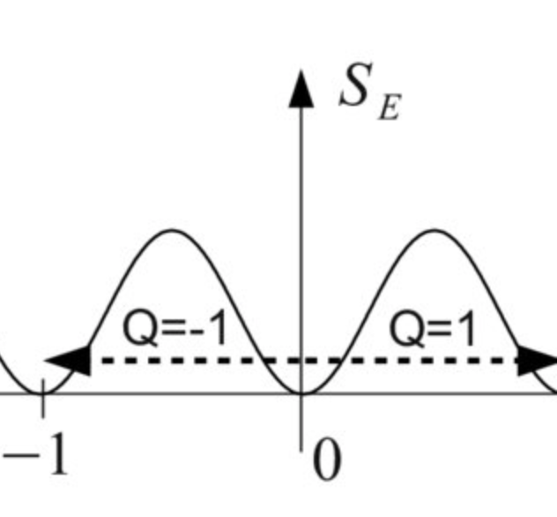
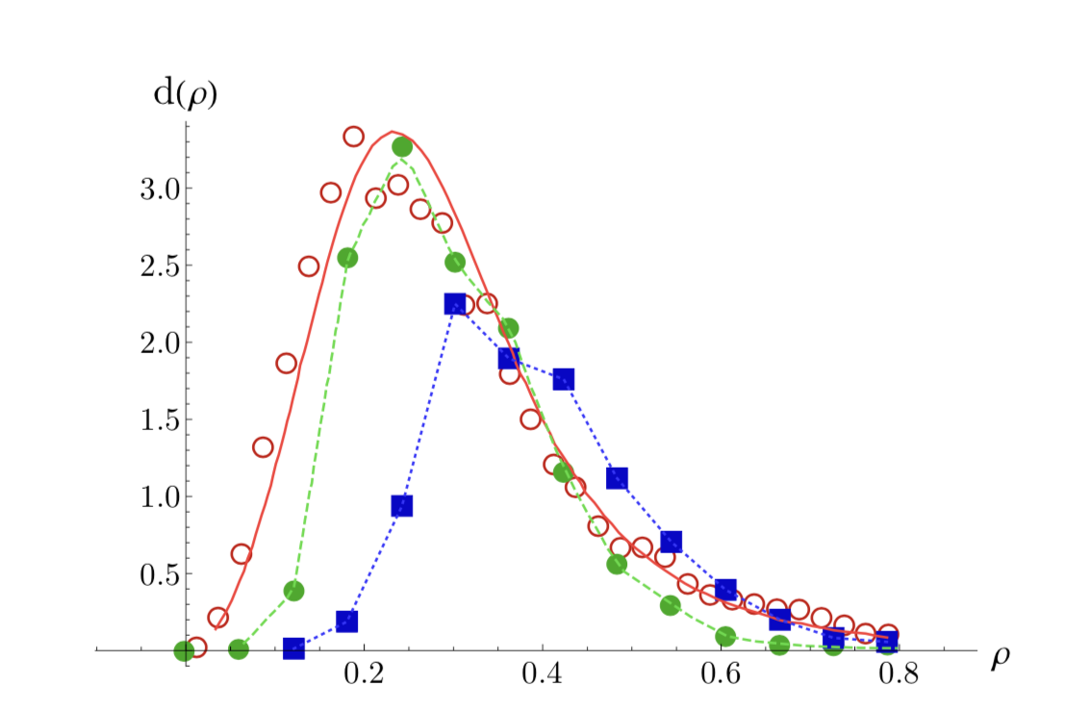
QCD Instantons : Dilute

Slide 7
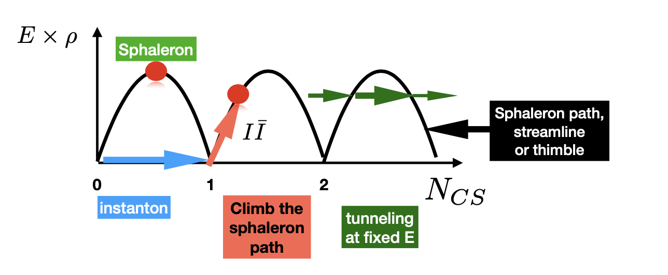
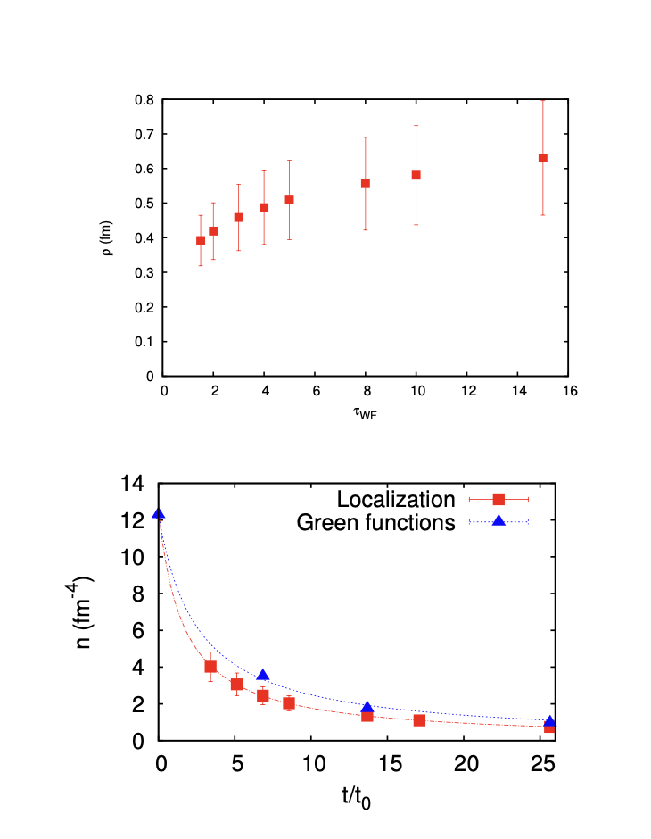
QCD instantons: Dense
Sphaleron-like tunnelings
Cooling
Athenodrou et al. 18’
Shuryak-Zahed 21’

Slide 8
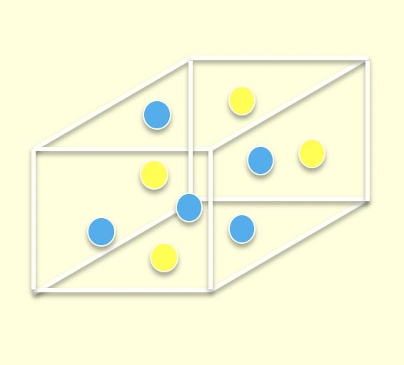
ILM

Slide 9
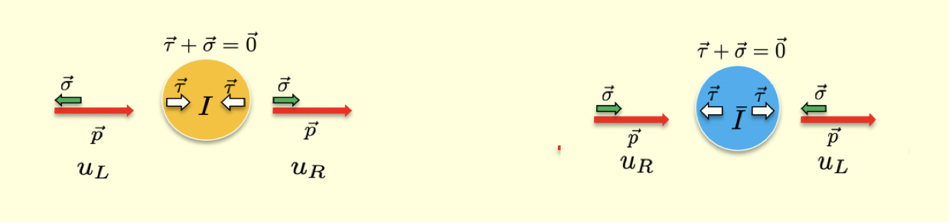
Topological origin of mass: LR mixing and zero modes

Slide 10
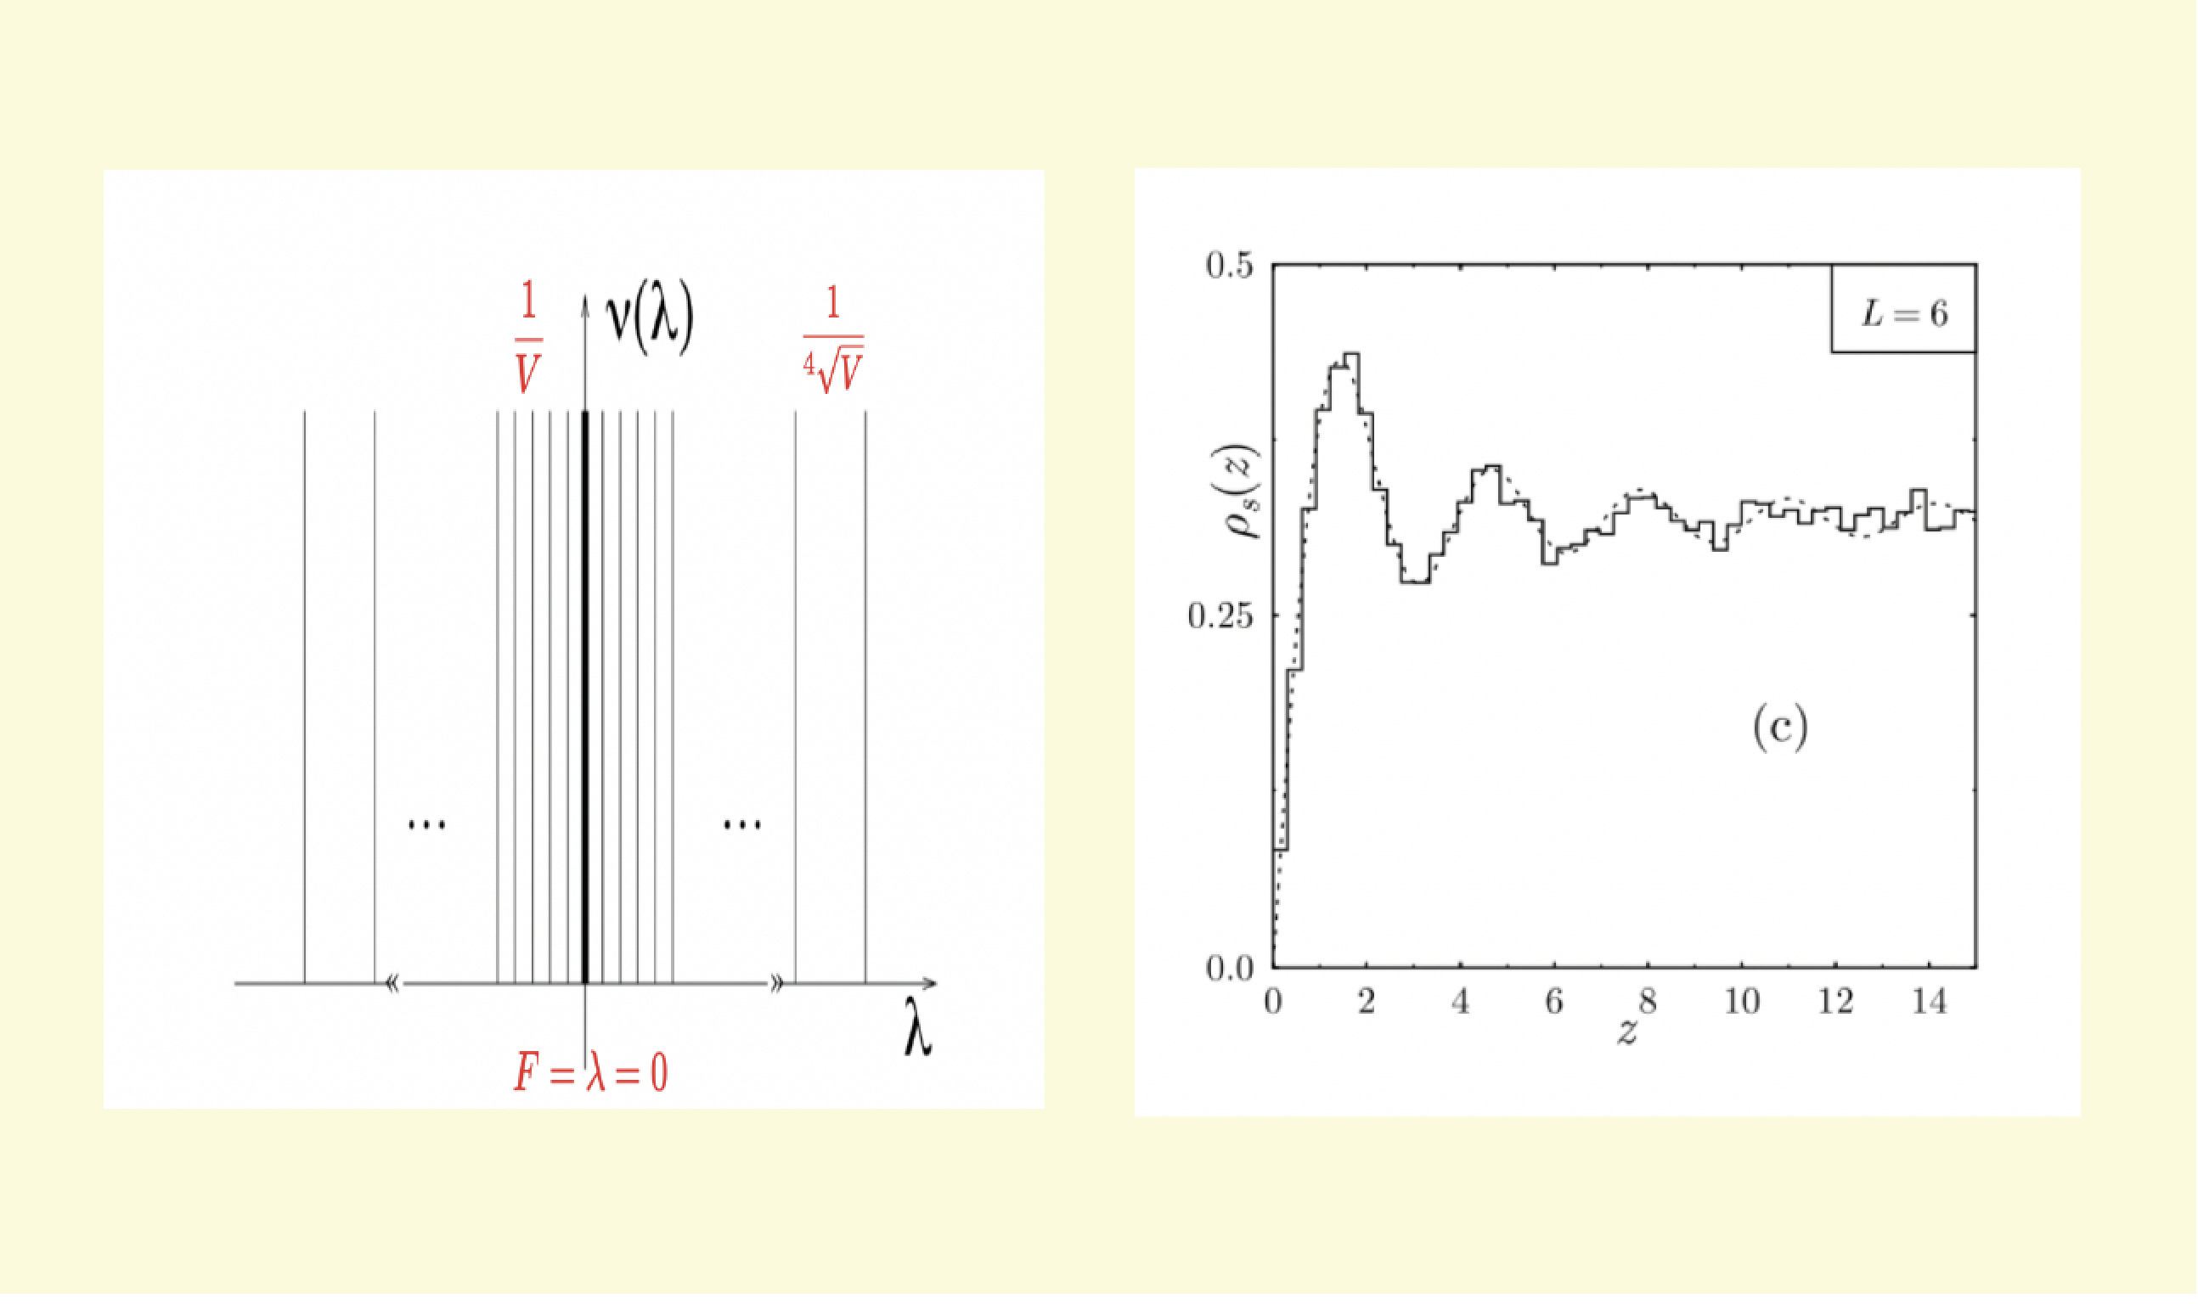
Lattice evidence for this mechanism

Slide 11
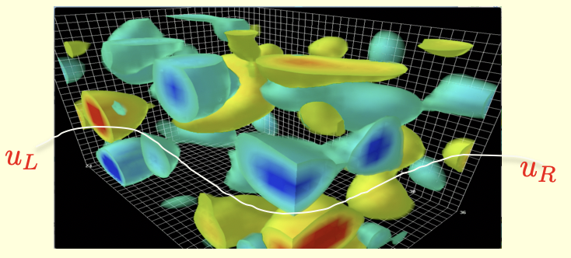
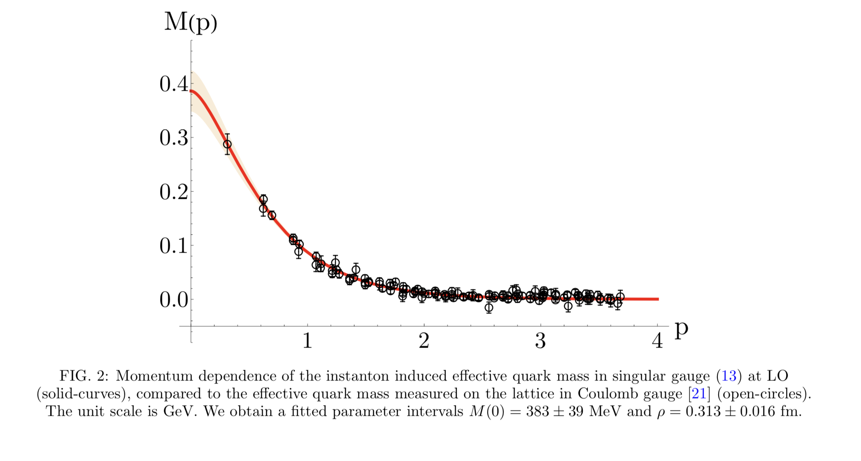
Topologically induced quark-mass in metallic regime

Slide 12
Hadronic Mass

Slide 13
Mass from EMT
Ji 97’

Slide 14
Ji mass sum rule in ILM
Scale anomaly is not a sum rule!

Slide 15
FF from ILM compressibility

Slide 16
Exception: Goldstone mode
Zahed 21’

Slide 17
Ji Mass Sum Rule

Slide 18
Hadronic (intrinsic) spin

Slide 19
Ji spin sum rule in ILM

Slide 20
Intrinsic spin and U(1) axial anomaly

Slide 21
from ILM

Slide 22
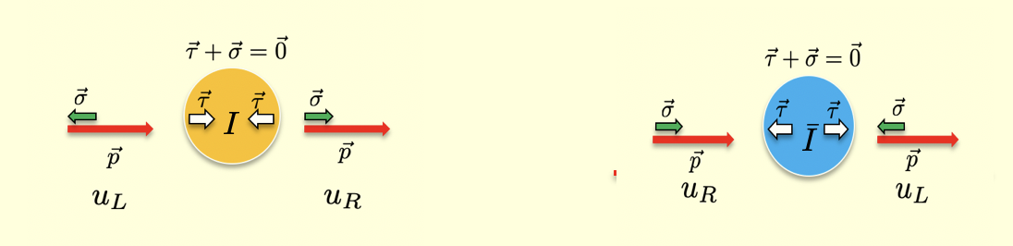
Nucleon intrinsic quark spin

Slide 23
Ji Spin sum rule

Slide 24
Light front WFs

Slide 25
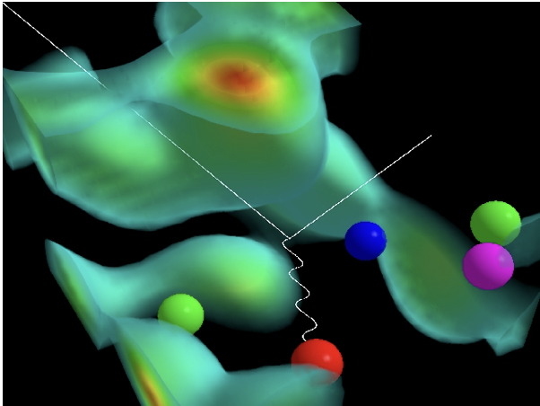
Typical pion and nucleon

Slide 26
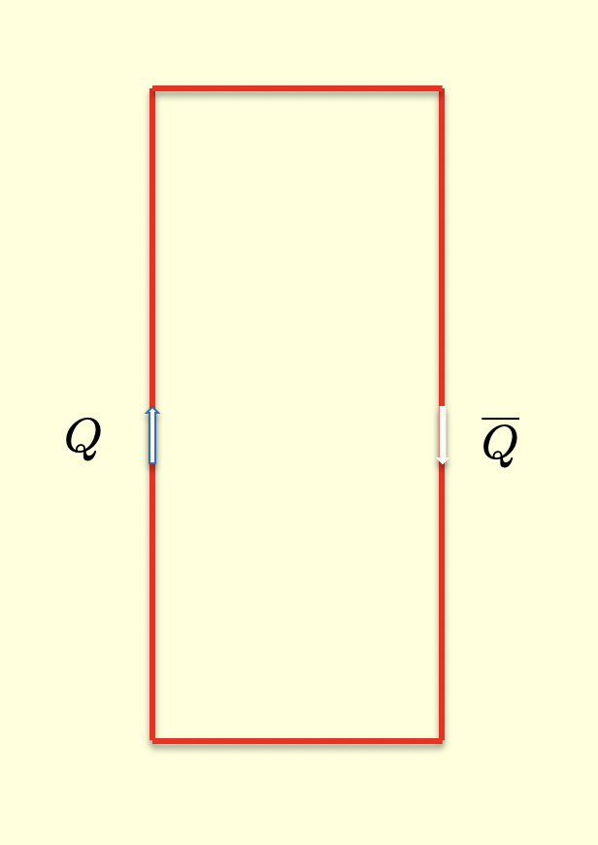
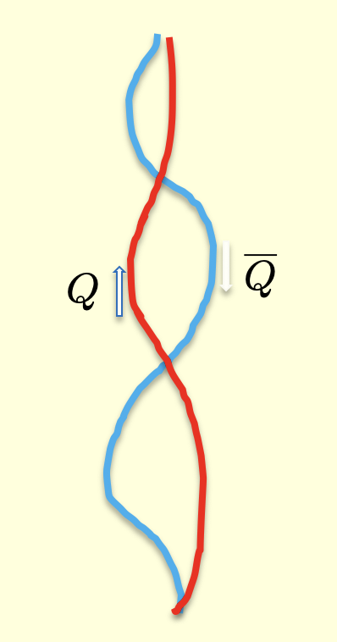
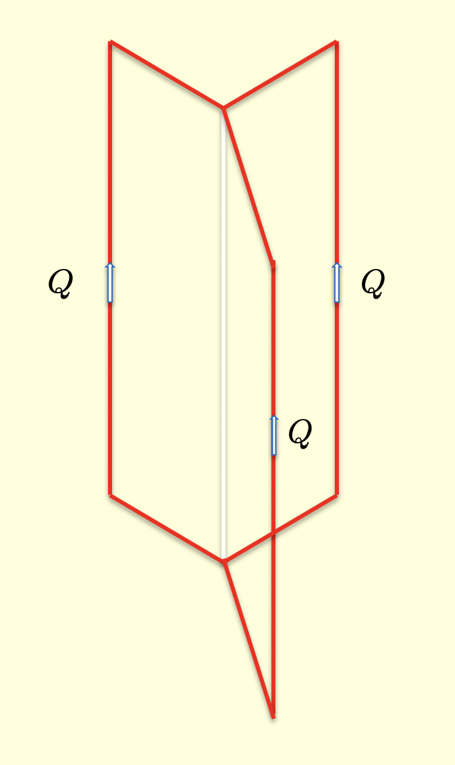
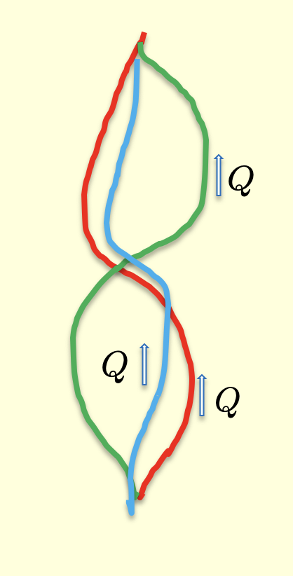
Hadrons in CM
Heavy
Light

Slide 27
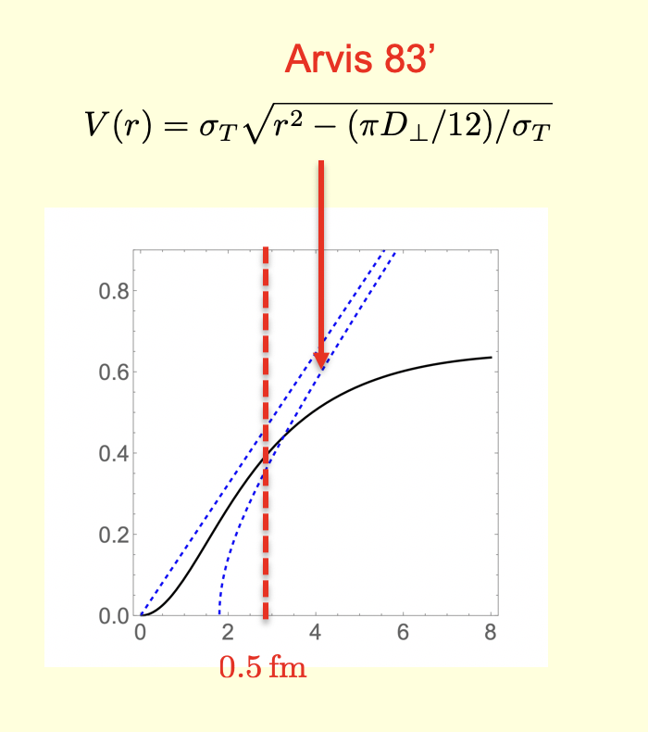
Central potential in ILM
Callan et al. 78’
Eichen-Feinberg 81’
Diakonov et al. 89’
Musakhanov et al. 16’
Shuryak-zahed 21’
Shuryak-Zahed 21’

Slide 28
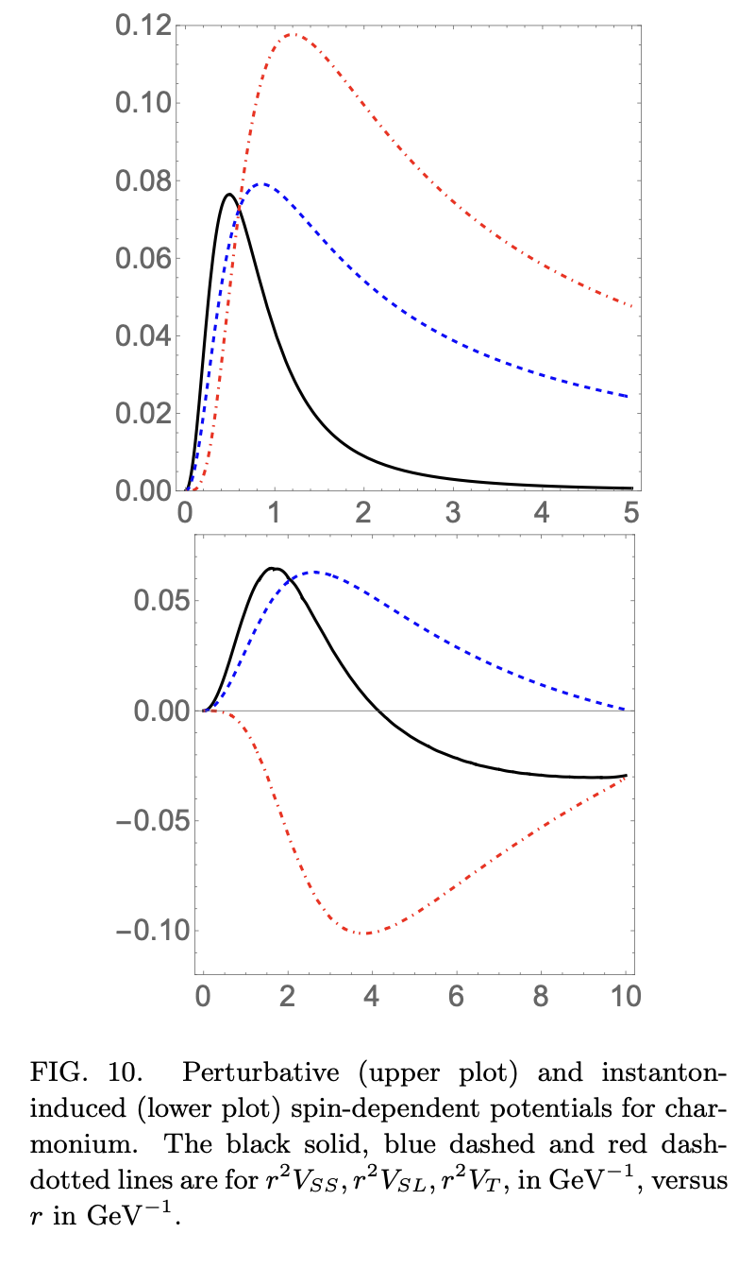
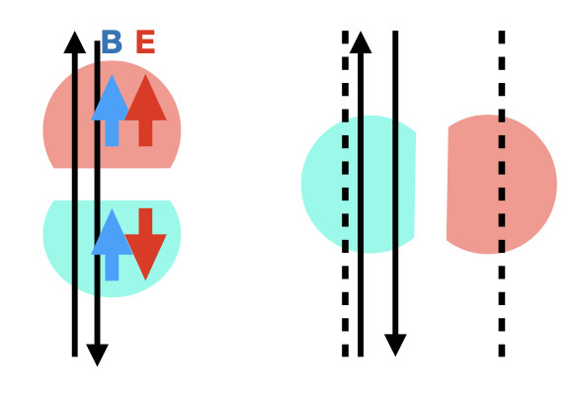
Spin potentials in ILM
0< Spin forces < 0.5 fm : ILM
Callan et al. 78’
Eichen_Feinberg 81’
Musakhanov et al. 16’
Shuryak-zahed 21’

Slide 29
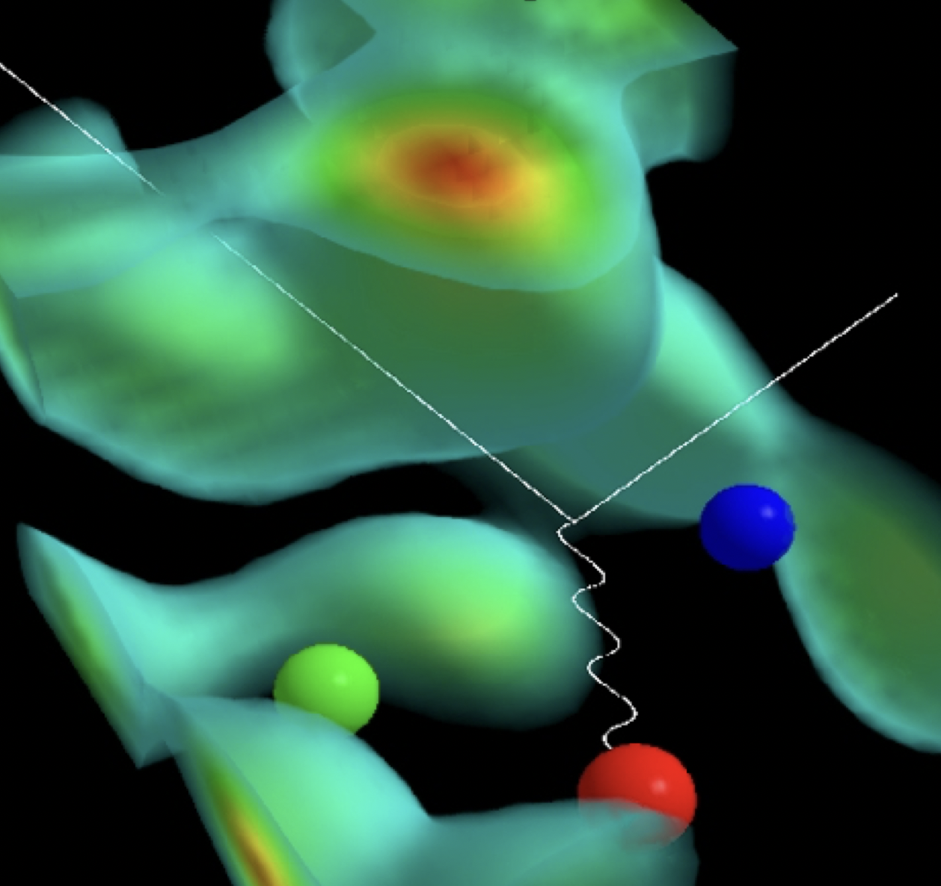
Nucleon on quasi-LF

Slide 30
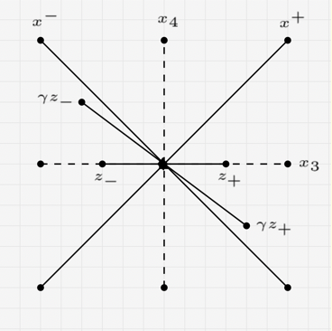
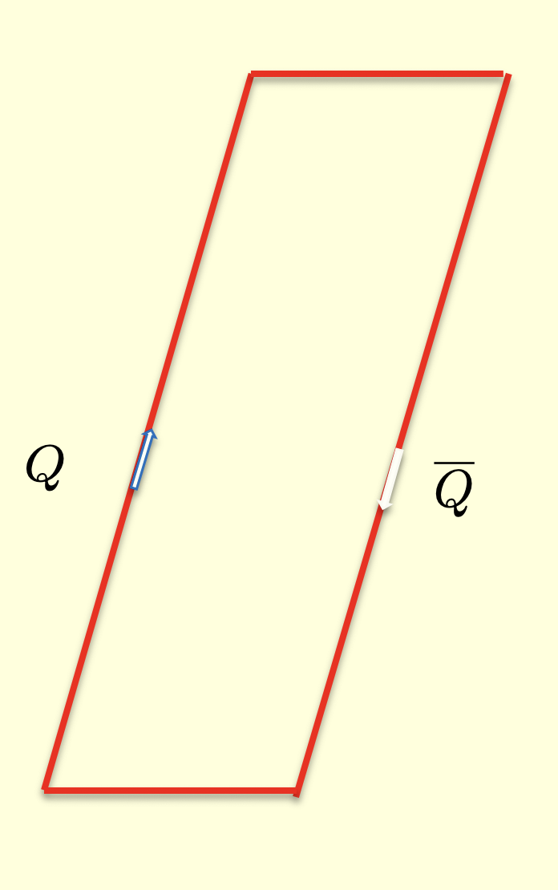
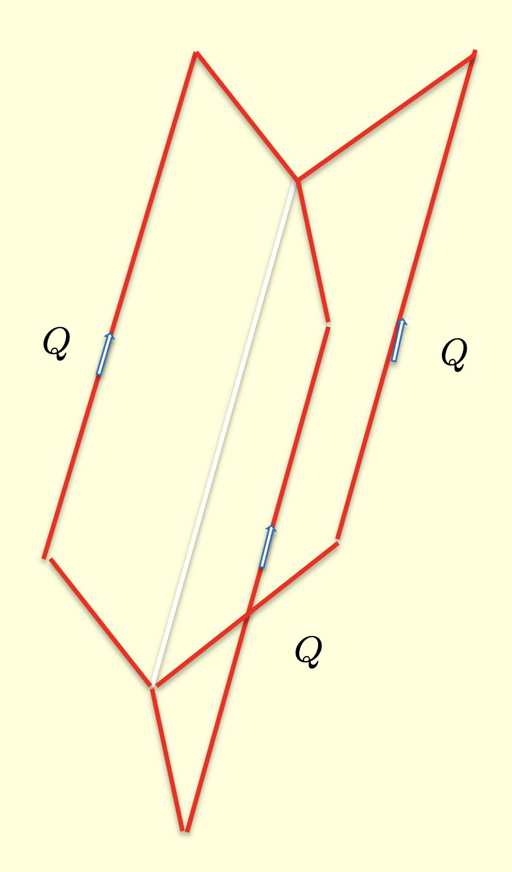
quasi-LF correlators

Slide 31
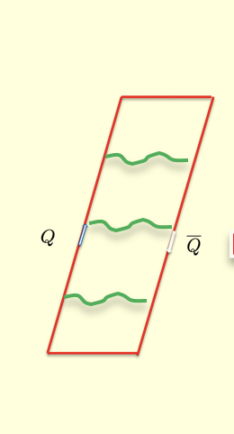
Perturbative: Coulomb and spin
Shuryak-Zahed 21’

Slide 32
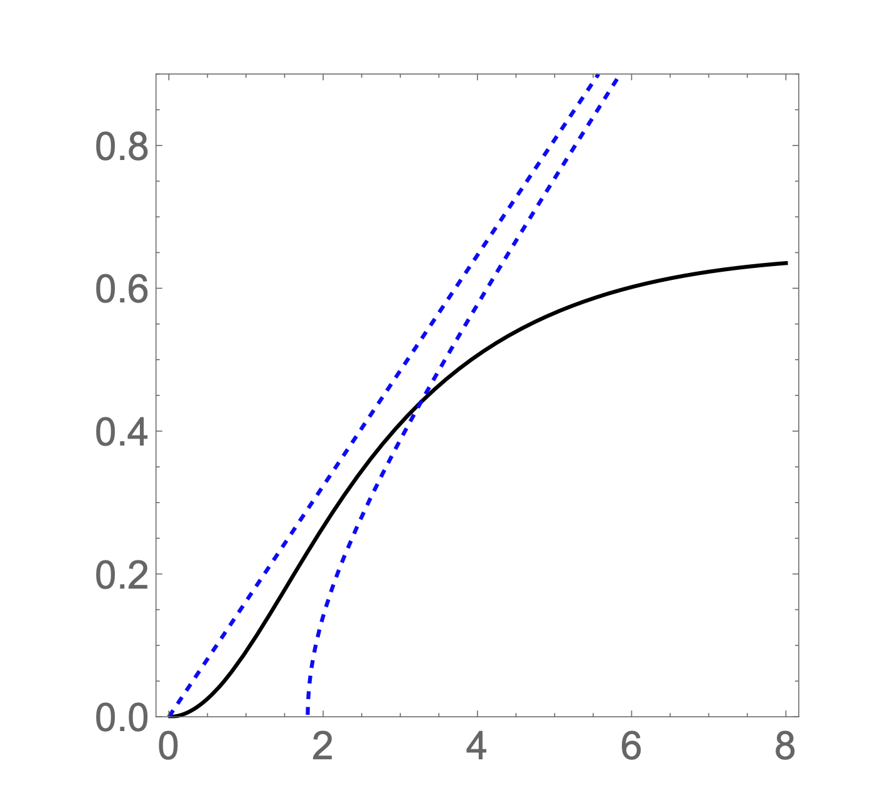
Nonperturbative from ILM
Arvis 83’
Shuryak-Zahed 21’

Slide 33
qLF Nambu-Gotto
P-vortices
ILM-Dense

Slide 34
qLF LF Hamiltonian
b-Jacobi
rij-Jacobi
Shuryak-Zahed 21

Slide 35

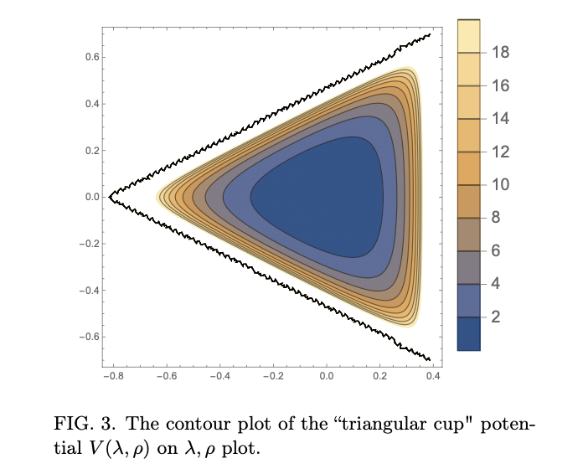
Longitudinal LFWF
Shuryak-Zahed 21’

Slide 36
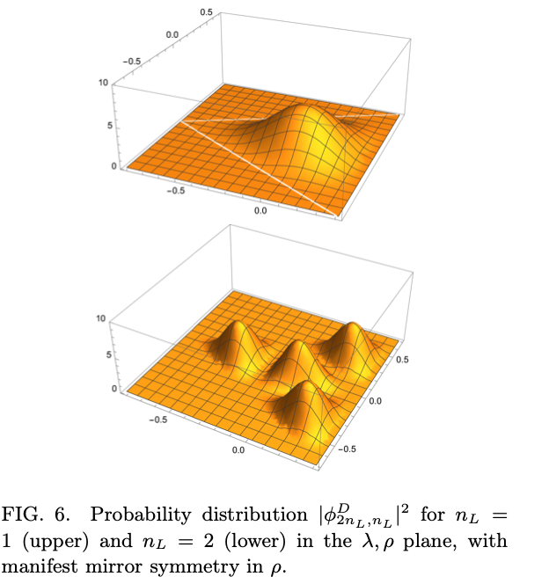
LFWFs
Shuryak-Zahed 21’

Slide 37
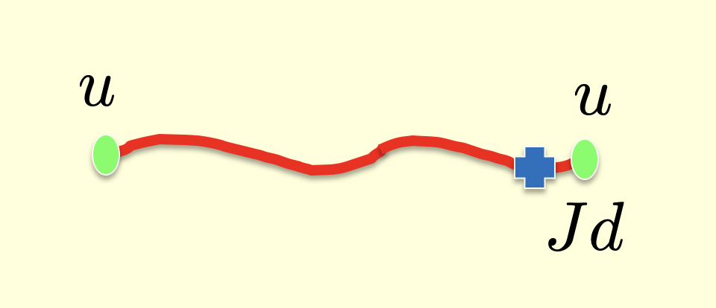
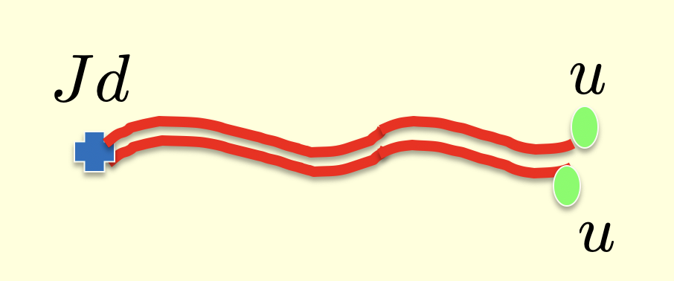
Folded string
Shuryak-Zahed 21’

Slide 38
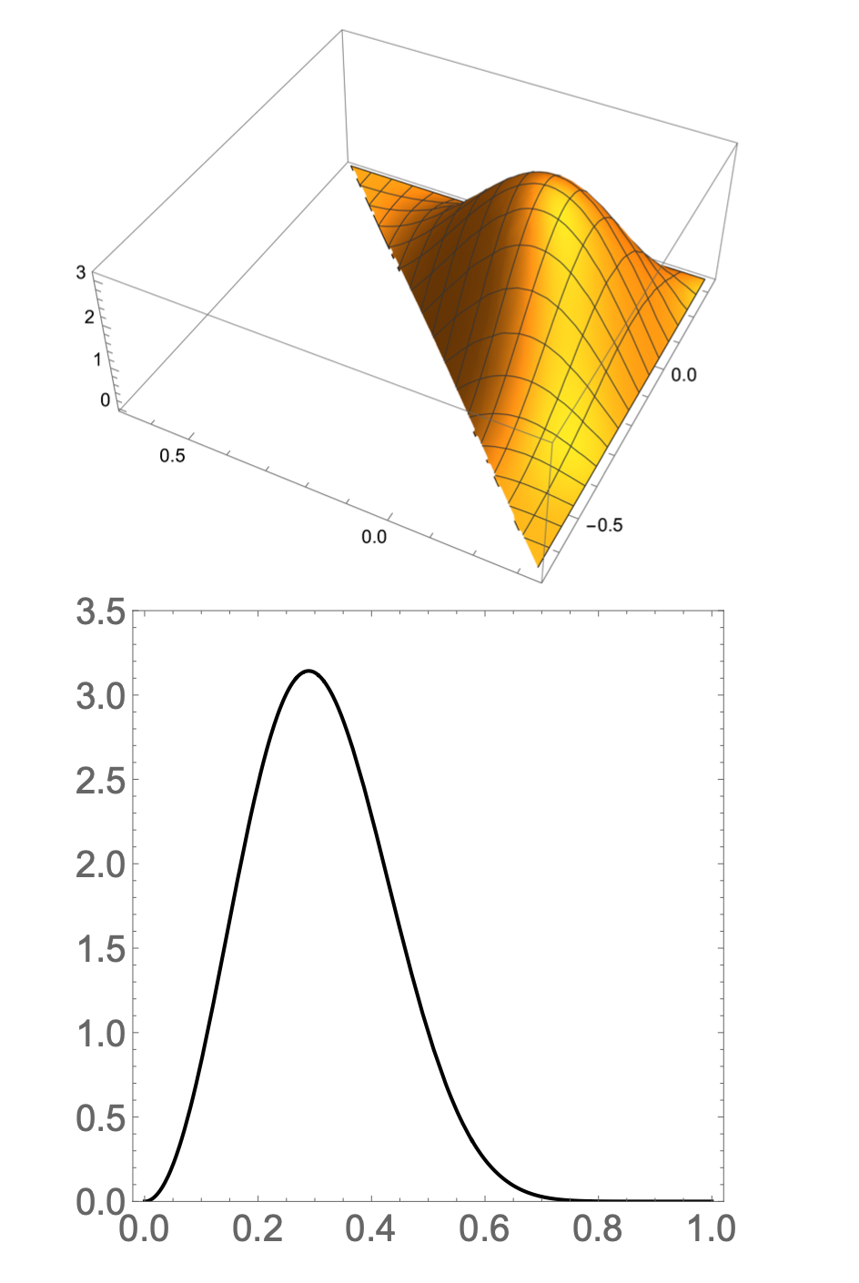
Folded LFWs
Shuryak-Zahed 21’
Drell-Yan-West

Slide 39
Summary
Vacuum : topologically active
Mass : topo-compressibility
Spin : topo-susceptibility
LFWs : quasi-LF

