Slide 1
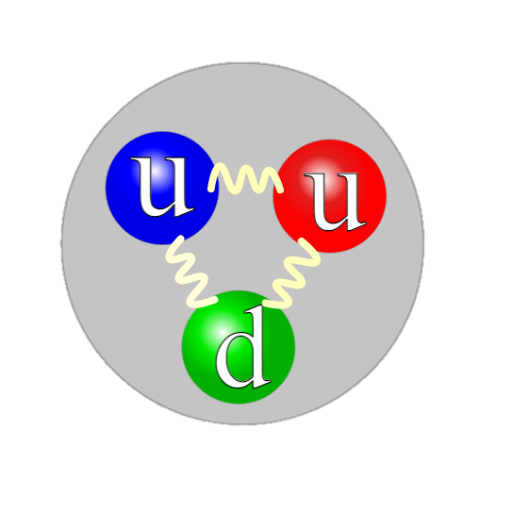
Holographic Baryons
Edwan PREAU
23/05/22
Collaborators: Elias KIRITSIS (APC), Francesco NITTI (APC) and Matti JÄRVINEN (APCTP)

Slide 2
Outline
Motivation
Introduction 1 : Baryons in the chiral Effective Field Theory
Introduction 2 : The holographic correspondence
Holographic baryon in a minimal setup
The V-QCD framework and its baryon
Summary and outlook

Slide 3
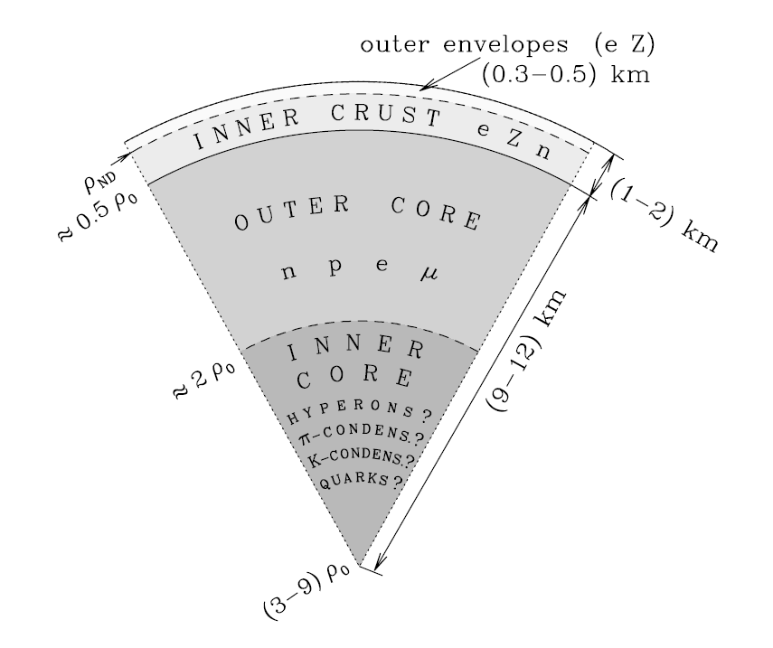
Motivation: The Neutron Star core enigma
The state of matter is known in the outer layers of Neutron Stars (NS), up to about 2 times the nuclear density ${ ρ}_{0} = 0.16 \text{f}{\text{m}}^{\text{−}\text{3}}$
It is still a mystery in the inner core ($ρ≳2ρ_{0})$
There, we reach a phase where the matter is both very dense and strongly coupled
(low energy QCD)
The neutron star structure

Slide 4
Motivation: The Neutron Star core enigma
Numerical methods (lattice QCD) are unable to reach very high densities because of the sign problem
We use the holographic method : a way of getting analytic insight into strongly coupled problems
Problem : understand baryonic physics at high density in holographic QCD
I will discuss the most elementary aspect of this problem : construct a 1-baryon state in holography
The neutron star structure

Slide 5
Baryon in Chiral Effective Field Theory
One approach that has proven successful in the study of QCD at low energy is that of the chiral effective field theory
QCD possesses an approximate symmetry : the chiral symmetry
$U{\left(N_{f}\right)}_{L}×U{\left(N_{f}\right)}_{R}$ symmetry
$$ℒ_{\text{QCD}}=−\frac{1}{2g_{YM}^{2}}\text{Tr} F_{μν}F^{μν}+\sum_{i=1}^{N_{f}}{{\overline{ψ}}^{i}\left(i γ^{μ}D_{μ}−m_{i}\right)ψ^{i}}$$
$$ψ_{L}→U_{L}ψ_{L} , ψ_{R}→U_{R}ψ_{R}$$
The chiral symmetry is spontaneously broken at low energies to $U{\left(N_{f}\right)}_{V}$ : $\left\langle {\overline{ψ}}^{i}ψ^{j}\right\rangle ≠0$
Goldstone bosons which control the low energy dynamics
$$U\left(x\right)≡{\text{e}}^{2πi Π^{a}\left(x\right)T^{a}}∈SU{\left(N_{f}\right)}_{A}$$

Slide 6
Baryon in Chiral Effective Field Theory
The low-energy Lagrangian is written as an expansion in a UV cut-off $Λ$
$$ℒ=ℒ^{(0)}+Λ^{−1}ℒ^{(1)}+Λ^{−2}ℒ^{(2)}+…,$$
which is built out of local functions of $U(x)$ invariant under the chiral symmetry
IR QCD possesses stable baryonic bound states → Where are the baryons ?
The scaling of $M_{B}$ in the large $N_{c}$ limit suggests that baryons are solitons of the weakly coupled theory of mesons :
$$M_{B}∼N_{c}∼\frac{1}{g_{meson}}$$
[Witten, 1979]

Slide 7
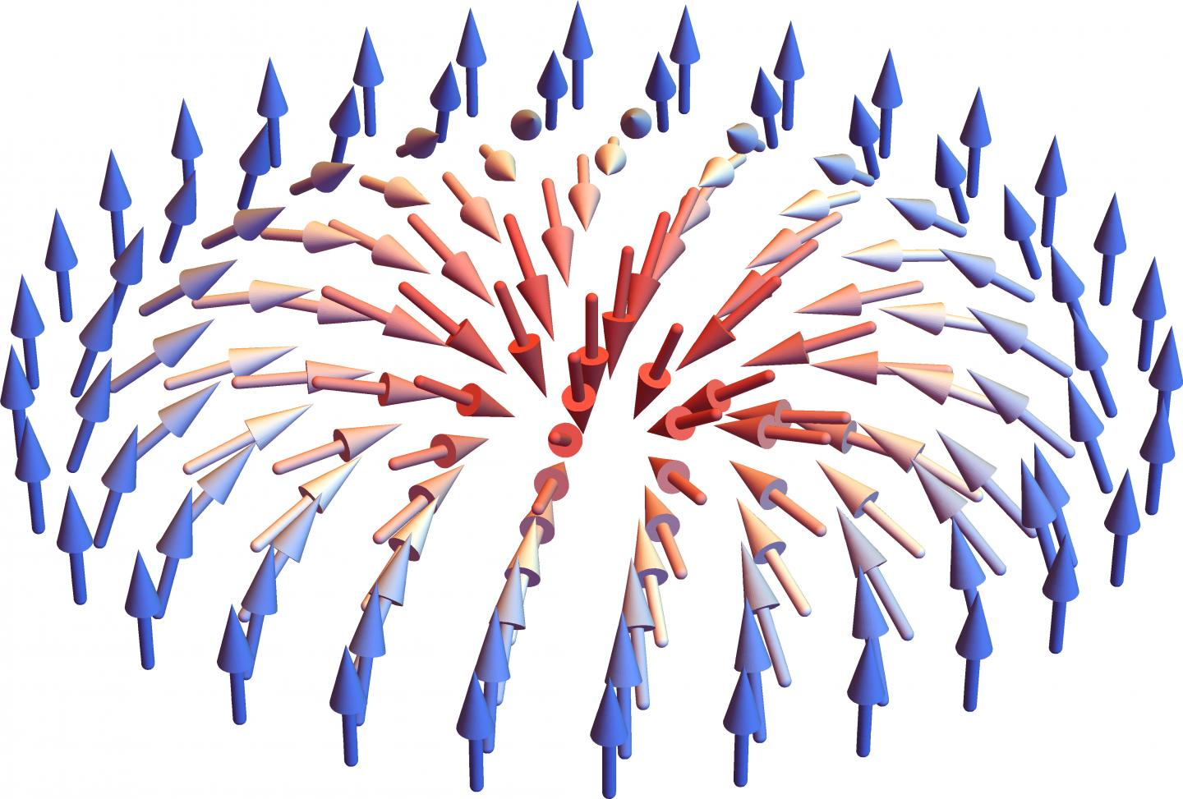
Baryon in Chiral Effective Field Theory
The leading term is the non-linear sigma model Lagrangian
$ℒ^{(2)}=\frac{1}{4}f_{π}^{2} \text{Tr} ∂U^{†}∂U , U∈SU{\left(N_{f}\right)}_{A}$
Because $Π_{3}\left(SU\left(N_{f}\right)\right)=ℤ$, this theory admits topological soliton solutions
$N_{Skyrmion}=\frac{1}{24π^{2}}\text{Tr}\int{{\left(U^{†}∧\text{d}U\right)}^{3}}$ .
But the skyrmion has to be of 0 size
→The Skyrme model introduces a quartic term that stabilizes the skyrmion size
$$ℒ_{Skyrme}=\frac{1}{4}f_{π}^{2} \text{Tr} ∂U^{†}∂U+\frac{1}{32e^{2}}\text{Tr}\left\{\left[{U^{†}∂}_{μ}U,{U^{†}∂}_{ν}U\right]\left[U^{†}∂^{μ}U, U^{†}∂^{ν}U\right]\right\} ,$$
[10.1063/1.4983805]
[Skyrme, 1961]

Slide 8
Baryon in Holographic theories
The Skyrme model gives a low-energy effective description of baryon states ($↔$ skyrmions)
Holographic theories reproduce a similar picture starting from a theory in 5D
$$N_{Baryon}=N_{instanton}=N_{Skyrmion} .$$
V-QCD is a much more complete theory of IR QCD:
Incorporates coupling to all higher mesonic excitations ($σ,ρ,ω,⋯$)
→ Contribute at high density
Chiral condensate profile around the baryon
→ (partial) chiral symmetry restoration at the center
Back-reaction of flavor onto glue → crucial at high density
$$\left\langle \overline{ψ}ψ\right\rangle$$
$$∼M_{B}^{−1}$$
8/32
$$d$$

Slide 9
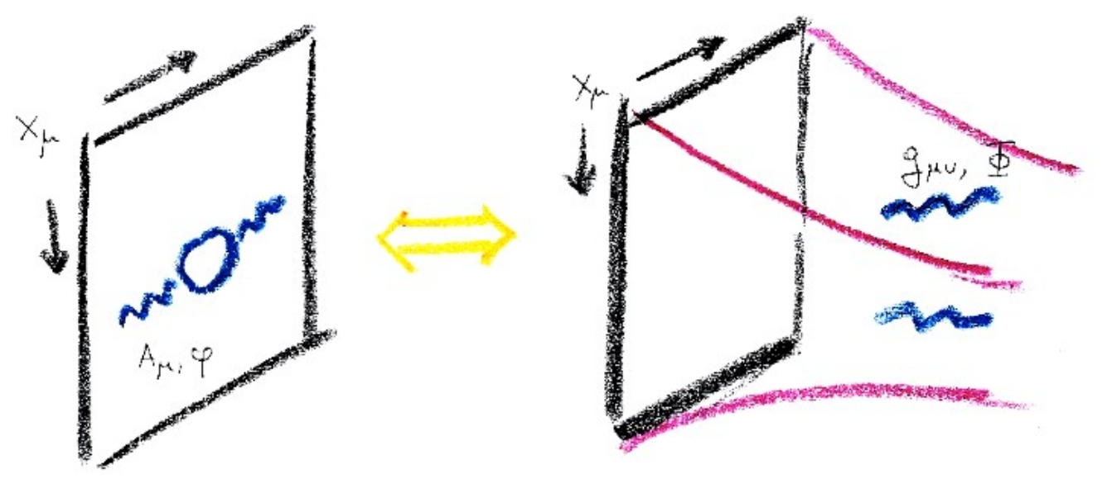
The Holographic Correspondence
Duality bewteen a QFT in 4D and a semi-classical gravitational theory in 5D.
The additional dimension z is called the holographic coordinate and identified with the energy scale such that:
UV ↔ boundary
IR ↔ center
The 4D space-time on which the QFT is defined is the boundary of the dual 5D space-time (bulk)
If the QFT is strongly coupled, then the dual theory is weakly curved.

Slide 10
The Holographic Dictionary
Every QFT operator has a dual field in the bulk of same spin
$$T_{μν}$$ | ↔ | $$g_{MN}$$
$$O$$ | ↔ | $$φ$$
G : $∂_{μ}J^{μ}=0$ | ↔ | G : $A^{M}$

Slide 11
$$\text{Ad}{\text{S}}^{\text{5}}/\text{CF}{\text{T}}^{\text{4}}$$
The original correspondence was formulated for an explicit 4D CFT : $𝒩=4$ SU(N) SYM (highly supersymmetric cousin of YM) which is dual to type IIB string theory on ${\text{AdS}}^{5}$
SYM
$$\text{Ad}{\text{S}}^{\text{5}}$$
$${\text{S}}^{\text{5}}$$
The internal space is important for the construction of the baryon in SYM

Slide 12
Holographic Baryons in SYM
The $\text{Ad}{\text{S}}^{\text{5}}/\text{CF}{\text{T}}^{\text{4}}$ duality is the one that is best understood and from which others are built.
Witten argued that a baryon state of external quarks in SYM is dual to a D5-brane (5D extended object of string theory, a generalization of a membrane) wrapped around the ${\text{S}}^{\text{5}}$. [hep-th/9805112]

Slide 13
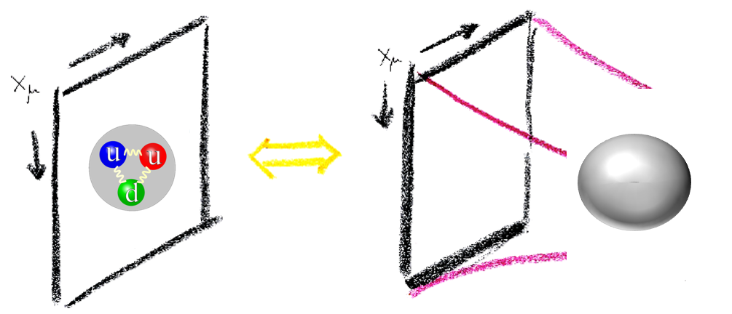
Holographic Baryon in SYM
After dimensional reduction on the sphere, the wrapped D5-brane is a point-like soliton in $\text{Ad}{\text{S}}^{\text{5}}$
Conclusion: a baryon state in the boundary theory is dual to a soliton in the bulk

Slide 14
Bottom-up holographic QCD : field content
In principle, every QCD operator has a dual field in the bulk of same spin
$$ℒ_{\text{QCD}}=−\frac{1}{2g_{YM}^{2}}\text{Tr} F_{μν}F^{μν}+\sum_{i=1}^{N_{f}}{{\overline{ψ}}^{i}\left(i γ^{μ}D_{μ}−m_{i}\right)ψ^{i}}$$
$$T_{μν}$$ | ↔ | $$g_{MN}$$
$$\text{Tr} F_{μν}F^{μν}$$ | ↔ | $$φ$$
$${\overline{ψ}}^{i} ψ^{j}$$ | ↔ | $$𝒯^{ij}$$
$U{\left(N_{f}\right)}_{\text{L}}×U{\left(N_{f}\right)}_{\text{R}}$ : $∂_{μ}J_{\text{L}\text{/}\text{R}}^{μ}=0$ | ↔ | $U{\left(N_{f}\right)}_{\text{L}}×U{\left(N_{f}\right)}_{\text{R}}$ : $A_{\text{L}\text{/}\text{R}}^{M}$
$$\text{Tr} F∧F$$ | ↔ | $$𝒶$$
$\text{(}\text{Tr} F_{μν}F^{μν})²$ | ↔ | $$φ_{2}$$

Slide 15
Holographic QCD : field content
In practice, the only operators relevant to the vacuum structure of low-energy QCD are
$$ℒ_{\text{QCD}}=−\frac{1}{2g_{YM}^{2}}\text{Tr} F_{μν}F^{μν}+\sum_{i=1}^{N_{f}}{{\overline{ψ}}^{i}\left(i γ^{μ}D_{μ}−m_{i}\right)ψ^{i}}$$
$$T_{μν}$$ | ↔ | $$g_{MN}$$
$$\text{Tr} F_{μν}F^{μν}$$ | ↔ | $$φ$$
$${\overline{ψ}}^{i} ψ^{j}$$ | ↔ | $$𝒯^{ij}$$
$U{\left(N_{f}\right)}_{\text{L}}×U{\left(N_{f}\right)}_{\text{R}}$ : $∂_{μ}J_{\text{L}\text{/}\text{R}}^{μ}=0$ | ↔ | $U{\left(N_{f}\right)}_{\text{L}}×U{\left(N_{f}\right)}_{\text{R}}$ : $A_{\text{L}\text{/}\text{R}}^{M}$
$$\text{Tr} F∧F$$ | ↔ | $$𝒶$$
Color
Flavor
CP-odd, $θ_{\text{QCD}}$

Slide 16
The Hard Wall Model : Setup
Color ($N_{c}$)
Flavor ($N_{f}$)
CP-odd
$$g_{MN}$$
$$φ$$
$$𝒯^{ij}$$
$$A_{L/R}^{M}$$
$$𝒶$$
$$\frac{N_{f}}{N_{c}}→0$$
Chiral symmetry
Instanton number
$$\int_{z,\vec{x}}{\text{F}∧\text{F}}$$
Fixed background
$${\overline{θ}}_{\text{QCD}}=0$$
For simplicity
$$\frac{ℓ^{2}}{z^{2}}({\text{dz}}^{2}+{\text{dx}}^{2})$$
$$φ=0$$
$$𝒯^{ij}=0$$
Solve the dynamics
$$𝒶=0$$

Slide 17
The Hard Wall Model : Geometry
[hep-th/0003136]
[hep-ph/0501128]
[hep-ph/0501218]
The background space-time is chosen to have ${\text{AdS}}^{5}$ geometry
$${\text{ds}}^{2}=a{\left(z\right)}^{2}\left({\text{dz}}^{2}+{\text{dx}}^{2}\right) , a\left(z\right)=\frac{ℓ}{z} ,$$
It stops on an IR wall at $z=L$ → confinement
Chiral symmetry breaking is enforced via the boundary conditions in the IR
$${\text{AdS}}^{5}$$
$$A_{L}^{μ}=A_{R}^{μ}$$
UV boundary at $z=0$

Slide 18
The Hard Wall Model : Action
[hep-th/ 0807.0316]
The action that controls the dynamics of the gauge field is composed of two terms
$$S= S_{f} + S_{CS}$$
$$−\frac{M_{5}}{2}\int{{\text{dx}}^{4}\text{dz}\frac{ℓ}{z}\left(\text{Tr} F_{MN}^{(L)}F_{(L)}^{MN}+\left\{L↔R\right\} \right)}$$
The Lagrangian is the local gauge invariant operator of lowest dimensionality
One parameter $M_{5}$ : overall normalization
$$i\frac{N_{c}}{24π^{2}}\int{\left(ω_{5}(A_{L})−ω_{5}(A_{R})\right)}$$
Topological term
CS 5-form:
$$ω_{5}\left(A\right)=\text{Tr}\left(A∧F^{2}+\frac{i}{2}A^{3}∧F−\frac{1}{10}A^{5}\right)$$

Slide 19
The Hard Wall Model : Pion Effective Action
$S_{f}=$ $−\frac{M_{5}}{2}\int{{\text{dx}}^{4}\text{dz}\frac{ℓ}{z}\left(\text{Tr} F_{MN}^{(L)}F_{(L)}^{MN}+\left\{L↔R\right\} \right)}$
For a boundary gauge transformation $U\left(x^{μ}\right)∈SU{\left(N_{f}\right)}_{A}$ , consider :
$$A_{L/R}^{z}=0 , A_{L}^{μ}=−i ∂^{μ}U U^{†}φ\left(z\right) , A_{R}^{μ}=i U^{†}∂^{μ}U φ\left(z\right) , φ\left(0\right)=1$$
The on-shell action reproduces the Skyrme action for $U\left(x^{μ}\right)↔$ pion field
$$S_{f}=\int_{z=0}{{\text{dx}}^{4}\left(\frac{1}{4}f_{π}^{2} \text{Tr} ∂U^{†}∂U+\frac{1}{32e^{2}}\text{Tr}\left\{\left[{U^{†}∂}_{μ}U,{U^{†}∂}_{ν}U\right]\left[U^{†}∂^{μ}U, U^{†}∂^{ν}U\right]\right\}\right)} ,$$
Radial gauge
Explicit expressions in terms of $φ(z)$

Slide 20
The Hard Wall Model : Baryon
Under a variation of the baryon chemical potential $δA_{B}^{0}=δμ_{B}$ :
$$δS_{\text{CS}}=\frac{N_{c}}{16π^{2}}\int_{ℳ}{{δμ}_{B}\text{dt}∧\text{Tr} \left(F_{(L)}∧F_{\left(L\right)}−F_{(R)}∧F_{(R)}\right)}$$
4D Axial Instanton Density on ($z,x^{i}$)
$$N_{B}=N_{inst}=−\frac{1}{16π^{2}}\int_{∂ℳ}{ \left(\text{Tr}\left(F_{\left(L\right)}∧A_{L}+\frac{i}{3}A_{L}^{3}\right)−\left\{L↔R\right\}\right)}$$
$$\frac{1}{24π^{2}}\text{Tr}\int_{∂ℳ}{{\left(U^{†}∧\text{d}U\right)}^{3}}=N_{skyrmion}$$
Pion ansatz $A_{L}^{μ}=−i ∂^{μ}U U^{†}φ\left(z\right)$

Slide 21
The V-QCD Framework : Setup
Color ($N_{c}$)
Flavor ($N_{f}$)
CP-odd
$$g_{MN}$$
$$φ$$
$$𝒯^{ij}$$
$$A_{L/R}^{M}$$
$$𝒶$$
$$\frac{N_{f}}{N_{c}}→0$$
Chiral symmetry
Instanton number
$$\int_{z,\vec{x}}{\text{F}∧\text{F}}$$
Fixed background
$${\overline{θ}}_{\text{QCD}}=0$$
For simplicity
$$\frac{ℓ^{2}}{z^{2}}({\text{dz}}^{2}+{\text{d}\vec{\text{x}}}^{2})$$
$$φ=0$$
$$𝒯^{ij}=0$$
Solve the dynamics
$$𝒶=0$$

Slide 22
The V-QCD Framework : Setup
Color ($N_{c}$)
Flavor ($N_{f}$)
CP-odd
$$g_{MN}$$
$$φ$$
$$𝒯^{ij}$$
$$A_{L/R}^{M}$$
$$𝒶$$
$$\frac{N_{f}}{N_{c}}→0$$
Instanton number
$$\int_{z,\vec{x}}{\text{F}∧\text{F}}$$
Fixed background
Dynamical $χ$SB
$${\overline{θ}}_{\text{QCD}}=0$$
For simplicity
$$\frac{ℓ^{2}}{z^{2}}({\text{dz}}^{2}+{\text{d}\vec{\text{x}}}^{2})$$
$$φ=0$$
Solve the dynamics
Solve the dynamics
$$𝒶=0$$

Slide 23
The V-QCD Framework : Setup
Color ($N_{c}$)
Flavor ($N_{f}$)
CP-odd
$$g_{MN}$$
$$φ$$
$$𝒯^{ij}$$
$$A_{L/R}^{M}$$
$$𝒶$$
$$\frac{N_{f}}{N_{c}}→0$$
Instanton number
$$\int_{z,\vec{x}}{\text{F}∧\text{F}}$$
Glue Dynamics
$χ$SB
$${\overline{θ}}_{\text{QCD}}=0$$
Solve the dynamics
Solve the dynamics
$$𝒶=0$$
Solve the Dynamics

Slide 24
The V-QCD Framework : Setup
Color ($N_{c}$)
Flavor ($N_{f}$)
CP-odd
$$g_{MN}$$
$$φ$$
$$𝒯^{ij}$$
$$A_{L/R}^{M}$$
$$𝒶$$
$$\frac{N_{f}}{N_{c}}\text{finite}$$
Instanton number
$$\int_{z,\vec{x}}{\text{F}∧\text{F}}$$
Glue Dynamics
$χ$SB
$${\overline{θ}}_{\text{QCD}}=0$$
Solve the dynamics
Solve the dynamics
$$𝒶=0$$
Solve the Dynamics

Slide 25
The V-QCD Framework : Action
The V-QCD action is built by deforming what is known from string theory with phenomenological parameters of the bulk theory
$$S_{V−QCD}=S_{c}+S_{f}+S_{CS}$$
$$S_{c}=M_{Pl}^{3}N_{c}^{2}\int{{\text{dx}}^{5}\sqrt{−g}\left[R−\frac{4}{3}{\left(∂φ\right)}^{2}+V_{g}(φ)\right]} ,$$
Parameters of the bulk theory
$$M_{Pl}$$ | $$V_{g}(φ)$$

Slide 26
The V-QCD Framework : Action
The V-QCD action is built by deforming what is known from string theory with phenomenological parameters of the bulk theory
$$S_{V−QCD}=S_{c}+S_{f}+S_{CS}$$
$$S_{f}={−\frac{1}{2}M}_{Pl}^{3}N_{c}\text{S}\text{Tr}\int{{\text{dx}}^{5}V_{f}(φ,𝒯)\left[\sqrt{−\text{det} A^{(L)}}+\sqrt{−\text{det} A^{(R)}}\right]} ,$$
[1112.1261]
$$A_{MN}^{\left(L\right)}≡g_{MN}+w\left(φ,𝒯\right)F_{MN}^{\left(L\right)}+\frac{κ\left(φ,𝒯\right)}{2}\left[{\left(D_{M}𝒯\right)}^{†}\left(D_{N}𝒯\right)+h.c.\right] ,$$
Parameters of the bulk theory
$$V_{f}(φ,𝒯)$$ | $$w(φ,𝒯)$$ | $$κ(φ,𝒯)$$

Slide 27
The V-QCD Framework : Action
The V-QCD action is built by deforming what is known from string theory with phenomenological parameters of the bulk theory
$$S_{V−QCD}=S_{c}+S_{f}+S_{CS}$$
[hep-th/0012210]
[hep-th/0702155]
$$S_{CS}=\frac{iN_{c}}{4π^{2}}\int{Ω_{5}(𝒯,A_{(L/R)})} ,$$
This CS term, apart from the flavor gauge fields, now contains also the tachyon.
The dependence on the tachyon appears in terms of several functions $f_{i}(𝒯)$ .
Parameters of the bulk theory
$$f_{i}(𝒯)$$

Slide 28
Previous Results in V-QCD
[1112.1261]
At T = 0 and $n_{b}=0$
Bulk solution dual to the QCD vacuum
Meson and glueball spectra
At $T≠0$ and $n_{b}=0$
Deconfinement phase transition
Chiral phase transition
At $T≠0$ and $n_{b}≠0$
Phase diagram when the baryon number is fractionalized (deconfined quarks)
We don’t know how the picture is modified when we allow for baryons to appear
Temperature [MeV]
V-QCD phase diagram
200
[1210.4516]
$$T_{χ}$$
$$T_{d}$$
100
[1312.5199]
1
Baryon Density [$ρ_{0}$]

Slide 29
Baryon in V-QCD
A baryon state is described by a soliton that solves the EoMs for $S_{V−QCD}$
We consider the approximation that the baryon is a perturbation on top of the vacuum solution :
Expand the flavor action at quadratic order in the non-abelian fields
Neglect the back-reaction of the baryon on the metric and dilaton
Procedure to compute the soliton solution:
Maximally symmetric static ansatz for the fields in bulk ($SO\left(3\right), P$)
Coupled PDE’s on 2D space $(z,ξ=\sqrt{{\vec{x}}^{2}})$
Solution obtained numerically

Slide 30
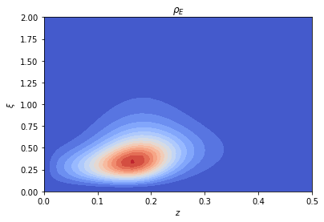
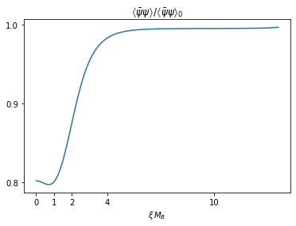
Numerical Results
The mass of the soliton is 1050 MeV (vs 938 MeV)
Chiral symmetry is partially restored at the center
The solution can be used to construct a point-like particle action for the baryon coupled to all the background fields
→ This can be used to construct the extended phase diagram at finite baryon density $ρ_{B}$

Slide 31
Summary
In holography, the duals of baryons are bulk solitons
Baryons have already been studied in holographic models of QCD which are more complete than $χ$EFT → more realistic at high density
V-QCD implements the back-reaction of the flavor sector onto the color sector
→ appropriate model to study QCD at high density (NS cores)
Computing V-QCD solitons is challenging
We obtained numerical solutions for parameters which give a consistent number for the baryon mass

Slide 32
Outlook
Compute the rotating soliton to reproduce the baryon spectrum ($N, Δ, ⋯$)
Compute the soliton at finite $m_{quark}$ → sigma term $δM_{N}=m_{u}\frac{∂M_{N}}{∂m_{u}}+m_{d}\frac{∂M_{N}}{∂m_{d}} ,$ both at 0 and finite density
Bulk solution dual to a state containing many baryons → EoS for NS matter
Generalize to finite T :
- QCD phase diagram at strong coupling
- Transport coefficients : flavor viscosities, flavor conductivities
Incorporate the (perturbative) coupling to the weak interaction
→ neutrino transport in NS

Slide 33
Appendix

Slide 34
$χ$EFT improvements
$$ℒ=ℒ^{(0)}+Λ^{−1}ℒ^{(1)}+Λ^{−2}ℒ^{(2)}+…,$$
which is built out of local functions of $U(x)$ invariant under the chiral symmetry
Missing ingredients :
Coupling to the electroweak interaction and mesonic excitations in other representations of the Lorentz group introduced by coupling $U(x)$ to vector ($ρ,…$), axial ($ω,…$) and scalar fields ($σ,…$)
QCD anomalies
$U{\left(1\right)}_{A}$ anomaly : $\text{det}(U)$
T’Hooft anomalies : Wess-Zumino term
[Witten, 1983]

Slide 35
The Hard-Wall model from SS
R
$$z=\frac{1}{U+z_{IR}^{−1}}$$
$$U=+∞$$
$$\overline{\text{D}\text{8}}$$
R
$$R^{M}$$
$$A^{M}$$
$$U=0$$
$$z=0$$
$$z=z_{IR}$$
D8
L
$$L^{M}$$
$$U=−∞$$
L
Boundary conditions at $z=z_{IR}$
$$L^{μ}−R^{μ}=0$$
$$L^{z}+R^{z}=0$$
$$∂_{z}(L^{μ}+R^{μ})=0$$

Slide 36
The Bulk Instanton
Static solution of the bulk equations of motion (EoMs) with
$\frac{1}{16π^{2}}\int_{z,\vec{x}}{\text{Tr} \left(F_{(L)}∧F_{\left(L\right)}−F_{(R)}∧F_{(R)}\right)}=1$
And $π_{3}\left(U\left(N_{f}\right)\right)=π_{3}\left(SU\left(2\right)\right)$
$→$Focus on a subgroup $SU\left(2\right)⊂U(N_{f})$
Ansatz invariant under the symmetries of the action :
3D rotations (up to global SU(2)) : $\left(t,z,\vec{x}\right)→(t,z,R. \vec{x})$
Parity : $\vec{x}→−\vec{x}$ and $L↔R$
Problem : coupled non-linear PDE’s defined on a 2D space $(ξ=\sqrt{{\vec{x}}^{2}},z)$
z
SO(3)
$$\vec{x}$$

Slide 37
The Bulk Instanton : ansatz
$A_{\left(L\right),i}^{a}=−\frac{1+φ_{2}\left(ξ,z\right)}{ξ}ε_{iak}{\hat{x}}^{k}+\frac{φ_{1}\left(ξ,z\right)}{ξ}\left(δ_{ia}−{\hat{x}}_{i}{\hat{x}}_{a}\right)+A_{ξ}\left(ξ,z\right){\hat{x}}_{i}{\hat{x}}_{a}$ ,
$$A_{\left(L\right),z}^{a}=A_{r}\left(ξ,z\right){ \hat{x}}_{a} ,$$
$${\hat{A}}_{\left(L\right),0}=Φ\left(ξ,z\right) ,$$
Where $ξ≡\sqrt{{\vec{x}}^{2}}$ and ${\hat{x}}^{i}≡x^{i}/ξ$
5 scalar fields that live on a 2D space $(ξ,z)$
SU(2)
CS
U(1)

Slide 38
The Bulk Instanton : Numerical Solution
The task is to solve the 5 coupled non –linear elliptic EoMs with boundary conditions corresponding to $N_{instanton}=1$
The gradient descent method is adapted to the problem
$$ρ_{N_{i}}$$
$$ξ$$
z

Slide 39
Quantization of the collective modes
The baryon states are found by quantizing the collective modes of the classical instanton background
Collective Modes
Translation in 3D
SU($N_{f}$) isospin rotation
Translation in z
Dilation, …
$$\vec{P}$$
0-modes
The first isospin modes give the nucleon states (I = 1/2) and isobar $Δ$ (I = 3/2)
When $N_{f}=2$ , due to rotational symmetry : $SU{\left(2\right)}_{I} \text{rotation} ⇔SU{\left(2\right)}_{S} \text{rotation}$
So the states that are computed have $S=I$

Slide 40
The Rotating Soliton
$$\vec{ω}$$
Solution of the classical bulk EoMs corresponding to a rotating soliton
The on-shell action at quadratic order in $\vec{ω}$ is $L=−M_{s}+\frac{1}{2} λ_{s} {\vec{ω}}^{2}$
Soliton mass
Soliton moment of inertia
$$\frac{1}{λ_{s} { M}_{s}}∼\frac{1}{N_{c}^{2}}≪1$$
The rotation is a perturbation if
Large $N_{c}$ limit : expand the fields at $𝒪(ω)$
$$φ=φ^{(0)}+ω φ^{(1)} ,$$
Static
Rotating

Slide 41
The Rotating Soliton : Quantization
$$φ=φ^{(0)}+ω φ^{(1)} ,$$
Substitute the ansatz into the EoMs →linear PDE’s for the $φ^{(1)}$’s
The solution is obtained numerically
We compute the on-shell action $↔$ classical Lagrangian for the rotating modes
$$L=−M_{s}+\frac{1}{2} λ_{s} {\vec{ω}}^{2}$$
Spin $s=\frac{1}{2},\frac{3}{2}, …$
Quantization : quantum rotor with eigenenergies $E_{s}=M_{s}+\frac{1}{2λ_{s}}s(s+1)$

Slide 42
The Hard Wall Model with $χSB$
Color ($N_{c}$)
Flavor ($N_{f}$)
CP-odd
$$g_{MN}$$
$$φ$$
$$𝒯^{ij}$$
$$A_{L/R}^{M}$$
$$𝒶$$
$$\frac{N_{f}}{N_{c}}→0$$
Chiral symmetry
Instanton number
$$\int_{z,\vec{x}}{\text{F}∧\text{F}}$$
Fixed background
$$χSB$$
$${\overline{θ}}_{\text{QCD}}=0$$
For simplicity
$$φ=0$$
Solve the dynamics
$$\frac{ℓ^{2}}{z^{2}}({\text{dz}}^{2}+{\text{d}\vec{\text{x}}}^{2})$$
$$𝒯^{ij}=0$$
Solve the dynamics
$$𝒶=0$$

Slide 43
The Hard Wall Model with $χSB$ : Action
[hep-th/1503.04820]
The gauge invariant kinetic term of the tachyon is added to the YM action
$$S_{YM}→S_{YM }+g_{𝒯}^{2}\int{\text{dz} {\text{dx}}^{4}}\text{Tr} \left({|D}_{M}𝒯|^2− m_{𝒯}^{2} |𝒯|^2 \right) ,$$
Tachyon normalization
$−\frac{3}{ℓ^{2}}$ fixed by the dimension of $<ψ^{i}\overline{ψ^{j}}>$
Parameters :
$$D_{M}𝒯≡∂_{M}𝒯−i A_{\left(L\right),M}𝒯+i 𝒯A_{\left(R\right),M}$$
This term contains ${\left|𝒯\right|}^{2} {\left(A_{\left(L\right)}−A_{\left(R\right)}\right)}^{2}$ which implies spontaneous $χ$SB

Slide 44
Consequences of $χSB$ on the baryon
[hep-th/1503.04820]
The boundary condition of the tachyon on the IR wall is taken to match the vacuum solution
$$A_{L}^{μ}=A_{R}^{μ}$$
$$A_{L}^{z}=−A_{R}^{z}$$
$$L_{zμ}=−R_{zμ}$$
$${\text{AdS}}^{5}$$
$$𝒯^{ij}=\left(m_{q} z +σ z^{3}\right)δ^{ij }$$
The soliton mass depends on $σ$ and it can leave the IR wall for large $σ$
metric
$$M ℓ$$
$$z$$
$$𝒦_{𝒯}, 𝒦_{A}$$
Soliton
CS
$$σ^{1/3}ℓ$$
$$ξ$$
$$0$$
$$∼1$$
$$0$$
$$𝒦_{𝒯}$$

Slide 45
The V-QCD Model : Action
The V-QCD action is built by deforming what is known from top-down holography with phenomenological parameters of the bulk theory
$$S_{V−QCD}=S_{c}+S_{f}+S_{CS}$$
$$S_{c}=M_{Pl}^{3}N_{c}^{2}\int{{\text{dx}}^{5}\sqrt{−g}\left[R−\frac{4}{3}{\left(∂φ\right)}^{2}+V_{g}(φ)\right]} ,$$
g, $φ$
Parameters of the bulk theory
$$M_{Pl}$$ | $$V_{g}(φ)$$
$N_{c} D3$-branes

Slide 46
The V-QCD Model : Action
The V-QCD action is built by deforming what is known from top-down holography with phenomenological parameters of the bulk theory
$$S_{V−QCD}=S_{c}+S_{f}+S_{CS}$$
$$S_{f}={−\frac{1}{2}M}_{Pl}^{3}N_{c}\text{STr}\int{{\text{dx}}^{5}V(𝒯)\left[\sqrt{−\text{det} A^{(L)}}+\sqrt{−\text{det} A^{(R)}}\right]} ,$$
[hep-th/0303057]
[hep-th/0012210]
Sen :
$$A_{MN}^{\left(L\right)}≡g_{MN}+F_{MN}^{\left(L\right)}+\frac{1}{2}\left[{\left(D_{M}𝒯\right)}^{†}\left(D_{N}𝒯\right)+h.c.\right] ,$$
g, $φ$
$$A_{R}^{\overline{i}\overline{j}}$$
$$q^{i}$$
$$𝒯^{i\overline{j}}$$
$${\overline{q}}^{\overline{i}}$$
$$A_{L}^{ij}$$
$N_{c} D3$-branes
$N_{f} D4$-branes
$N_{f} \overline{D4}$-branes

Slide 47
The V-QCD Model : Action
The V-QCD action is built by deforming what is known from top-down holography with phenomenological parameters of the bulk theory
$$S_{V−QCD}=S_{c}+S_{f}+S_{CS}$$
$$S_{f}={−\frac{1}{2}M}_{Pl}^{3}N_{c}\text{Tr}\int{{\text{dx}}^{5}V_{f}(φ,𝒯)\left[\sqrt{−\text{det} A^{(L)}}+\sqrt{−\text{det} A^{(R)}}\right]} ,$$
[1112.1261]
V-QCD :
$$A_{MN}^{\left(L\right)}≡g_{MN}+w\left(φ,𝒯\right)F_{MN}^{\left(L\right)}+\frac{κ\left(φ,𝒯\right)}{2}\left[{\left(D_{M}𝒯\right)}^{†}\left(D_{N}𝒯\right)+h.c.\right] ,$$
g, $φ$
$$A_{R}^{\overline{i}\overline{j}}$$
Parameters of the bulk theory
$$V_{f}(φ,𝒯)$$ | $$w(φ,𝒯)$$ | $$κ(φ,𝒯)$$
$$q^{i}$$
$$𝒯^{i\overline{j}}$$
$${\overline{q}}^{\overline{i}}$$
$$A_{L}^{ij}$$
$N_{c} D3$-branes
$N_{f} D4$-branes
$N_{f} \overline{D4}$-branes

Slide 48
The V-QCD Model : Action
The V-QCD action is built by deforming what is known from top-down holography with phenomenological parameters of the bulk theory
g, $φ$
$$A_{R}^{\overline{i}\overline{j}}$$
$$S_{V−QCD}=S_{c}+S_{f}+S_{CS}$$
$$q^{i}$$
[hep-th/0012210]
$$𝒯^{i\overline{j}}$$
$$S_{CS}=\frac{iN_{c}}{4π^{2}}\int{Ω_{5}(𝒯,A_{(L/R)})} ,$$
[hep-th/0702155]
$${\overline{q}}^{\overline{i}}$$
$$A_{L}^{ij}$$
$N_{c} D3$-branes
$N_{f} D4$-branes
$N_{f} \overline{D4}$-branes
When $𝒯=0$ , $Ω_{5}$ is the CS 5-form
In String Theory, the tachyon dependence is known only in the maximally supersymmetric case
We generalize this result : $Ω_{5}$ is the sum of all 5-forms built from $(A,F,D𝒯)$ with coefficients $f_{i}(𝒯)$
Parameters of the bulk theory
$$f_{i}(𝒯)$$

