Slide 1


Dynamics and correlations of two-nucleon decay
NUCLEAR PHYSICS AT THE EDGE OF STABILITY
Simin Wang
Fudan University
Collaborators: W. Nazarewicz, R.J. Charity, L.G. Sobotka …

Slide 2
Outline
Introduction
The Models
  Theoretical status
  Gamow coupled-channel method (GCC)
  Time-dependent approach (TD)
What can we learn from 2p decay
  Structure
  Continuum effect
  Interplay between nuclear and Coulomb interactions
Summary
See R.J. Charity’s talk
See M. Płoszajczak and W. Nazarewicz’s talks

Slide 3
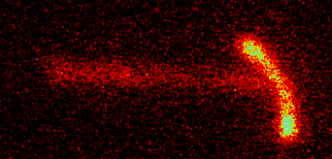
Exotic decay modes
Open quantum systems
Two-proton (2p) decay
⁴⁵Fe
g.s. 2p emitters: ⁴⁵Fe, ⁴⁸Ni, ¹⁶Ne, ⁶Be ...
other cases: ¹⁷Na*, ²²Mg*, ²⁸S*, ²²Al (β2p) ...
M. Pfützner et al., RMP 84, 567 (2012)
K. Miernik et al. PRL 99, 192501 (2007)
V. Goldansky, NP 19, 482 (1960)
Introduction
The Models
2p Decay
Summary
Exotic decay modes
2p decay candidates
Interesting aspects

Slide 4
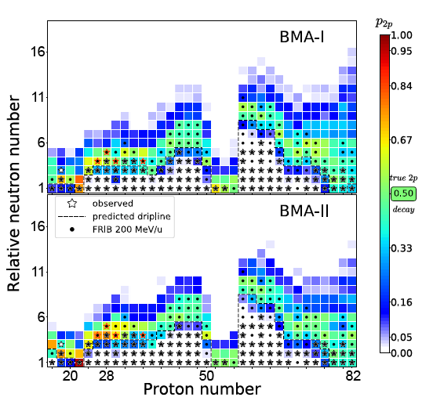
Two-proton (2p) decay candidates
Theoretical predictions of 2p decay
Probability of 2p emitter
DFT
UQ
2p decay
L. Neufcourt et al. PRC 101, 014319 (2020)
E. Olsen, et al. PRL 11 (2013) 139903
Introduction
The Models
2p Decay
Summary
Exotic decay modes
2p decay candidates
Interesting aspects

Slide 5
nucleon-nucleon correlation
p-shell
⁴⁵Fe
See R.J. Charity’s talk
sd-shell
K. Miernik et al. PRL 99, 192501 (2007)
T.B. Webb et al. PRL 99, 192501 (2007)
Different patterns of pp correlations, which boost the interest of 2p-decay studies.
Introduction
The Models
2p Decay
Summary
Exotic decay modes
2p decay candidates
Interesting aspects

Slide 6
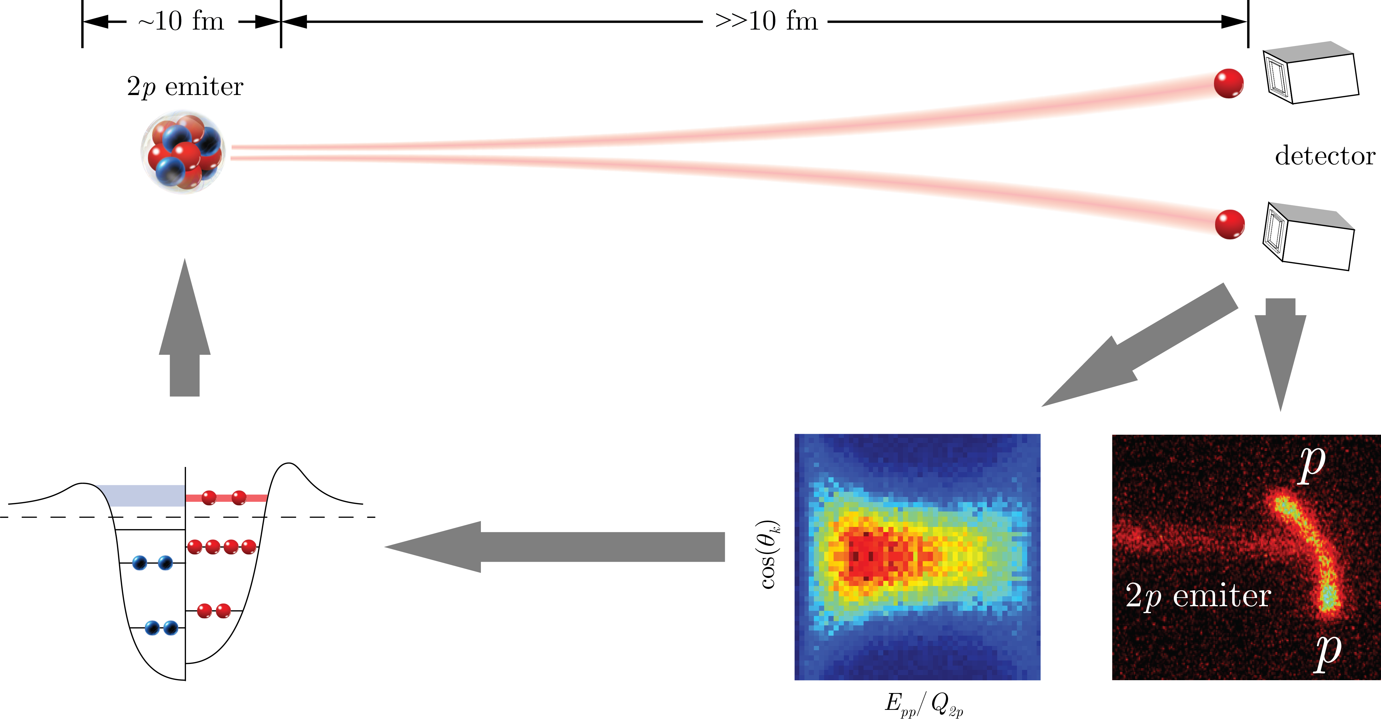
What can we learn from 2p decay?
Structure
Decay/Reaction
Structural information
Continuum effect
Interplay between nuclear and Coulomb interactions
pairing correlation
structure
¹²O
Self-consistent model
Numerical method
K. Miernik et al., PRL 99, 192501 (2007)
“characteristics”
“fingerprint”
T.B. Webb et al., PRC 100, 024306 (2019)
Introduction
The Models
2p Decay
Summary
Exotic decay modes
2p decay candidates
Interesting aspects

Slide 7

Theoretical status
Simplified model
2 protons form a pair and decay as a cluster
3-body model
Correct asymptotic behavior
Frozen core: no core excitation or deformation
Shell-model embedded in the continuum (SMEC)
Configuration mixing considered
Without the proper 3-body asymptotic behavior
CDCC, R-matrix, EQMD …
Jacobi coordinates
W. Nazarewicz, et al. PRC 53, 740 (1996)
B.A. Brown et al., PRC 67, 041304 R (2003)
L.V. Grigorenko, PPN 40, 674 (2009)
Structure
Decay/reaction
J. Rotureau et al., NPA 767, 13 (2006)
See J. Casal’s talk
Computational methods
A. Lovell et al., PRC 59, 034605 (2017)
Models
Y.G. Ma et al., PLB 743, 306 (2015)
To understand the pairing correlation as well as the mechanism of 2p decay, the structure and decay aspects should be treated on the same footing.
Introduction
The Models
2p Decay
Summary
Theoretical status
GCC
TD

Slide 8
Gamow coupled-channel (GCC) method
The 3-body Hamiltonian can be written as:
Total wave-function
valence protons deformed core
  Jacobi coordinates
    No center-of-mass motion
    Correct 3-body asymptotic behavior
  Berggren basis
    Bound, scattering, and outgoing Gamow states
    Structure and decay information on the same footing
(New)
Berggren basis
(New)
barrier
Bottom line: the objective of this work is to analyze how nuclear structure impacts decay properties and dynamics.
(r)
Introduction
The Models
2p Decay
Summary
Theoretical status
GCC
TD

Slide 9
Puzzle of 2p decay in ⁶⁷Kr
Experimentally,
T. Goigoux et al., PRL 117, 162501 (2016)
Theoretically, 3-body model, frozen core
WKB method
There might be deformation and configuration mixing.
L. V. Grigorenko et al., PRC 68, 054005 (2003)
T. Goigoux et al., PRL 117, 162501 (2016)
M. Goncalves et al., PLB 774, 14 (2017)
GCC
Introduction
The Models
2p Decay
Summary
Exotic structure
Continuum effect
Nuclear vs Coulomb

Slide 10
Lifetime of ⁶⁷Kr as deformation evolution
valence
SW and W. Nazarewicz, PRL 120, 212502 (2018)
1/2[321] becomes available for the valence protons when β₂ close to -0.3, which dramatically increases the 2p decay width of ⁶⁷Kr. As a result,
Decay primarily depends on small angular momentum components.
Introduction
The Models
2p Decay
Summary
Exotic structure
Continuum effect
Nuclear vs Coulomb

Slide 11
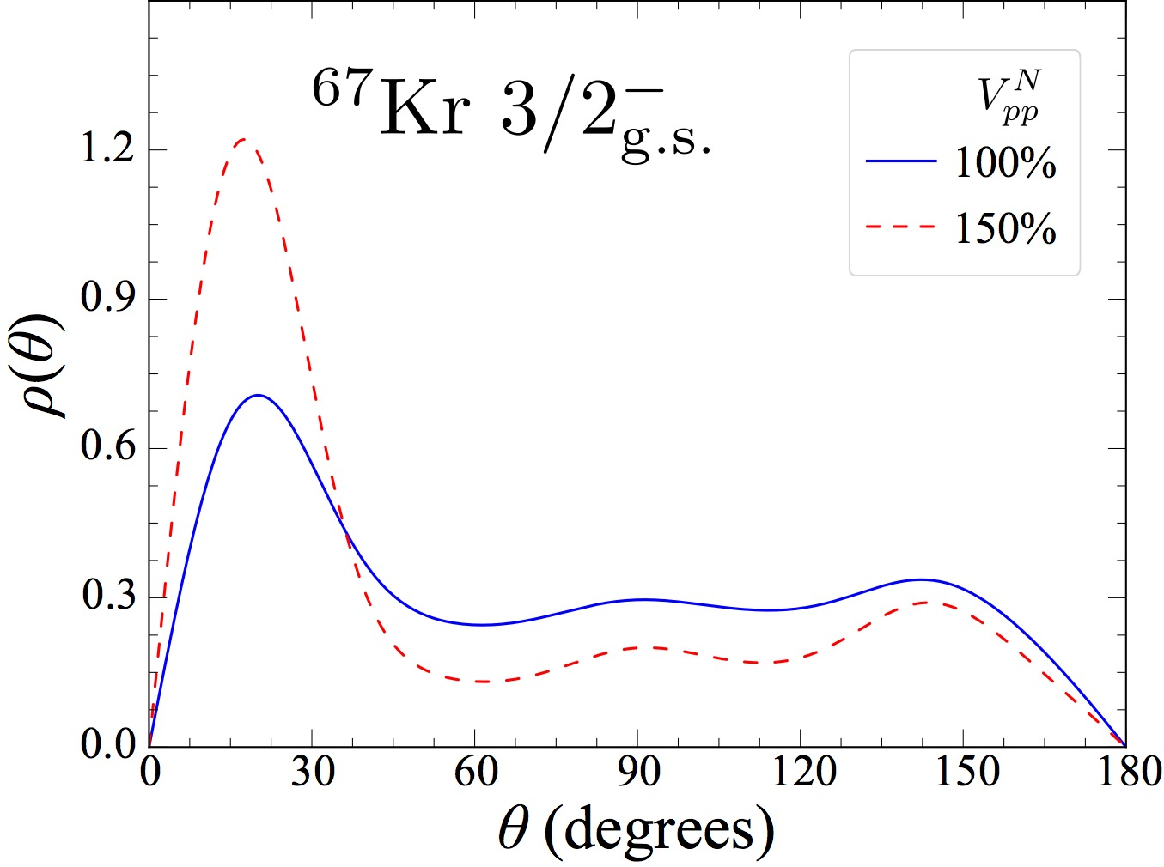
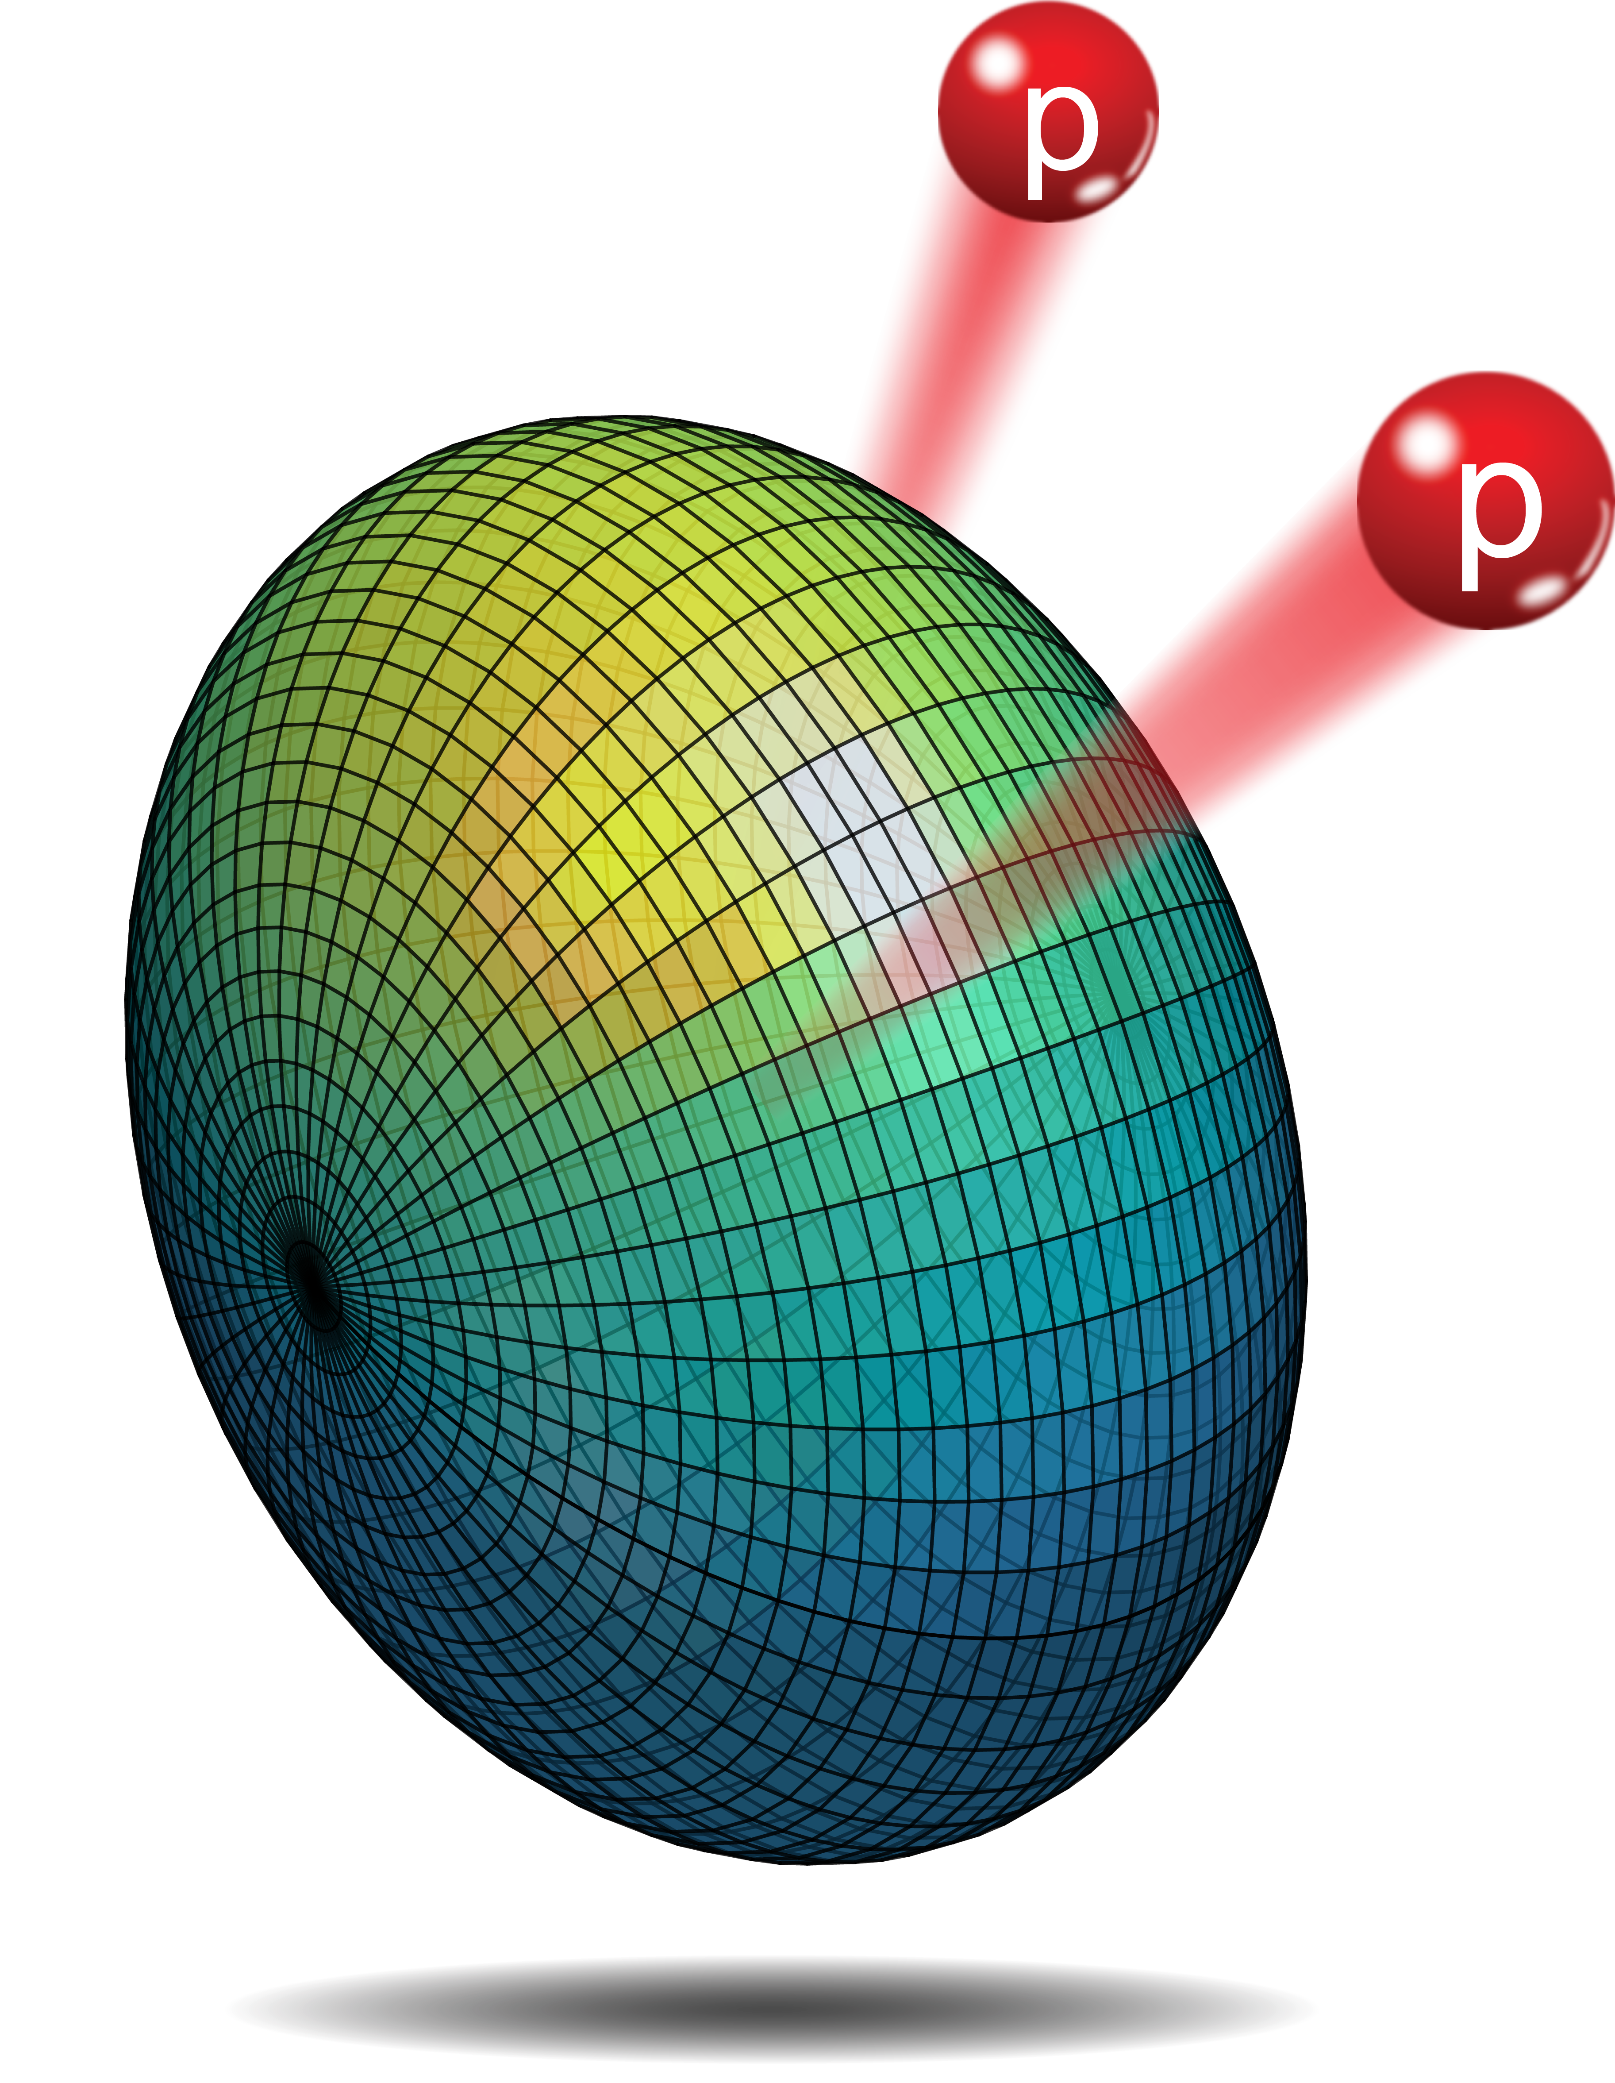
Diproton in ⁶⁷Kr
2p angular distribution
Low-l continuum is crucial for deformed 2p decay.
Diproton Cooper-pair benefits tunneling.
Introduction
The Models
2p Decay
Summary
Exotic structure
Continuum effect
Nuclear vs Coulomb

Slide 12
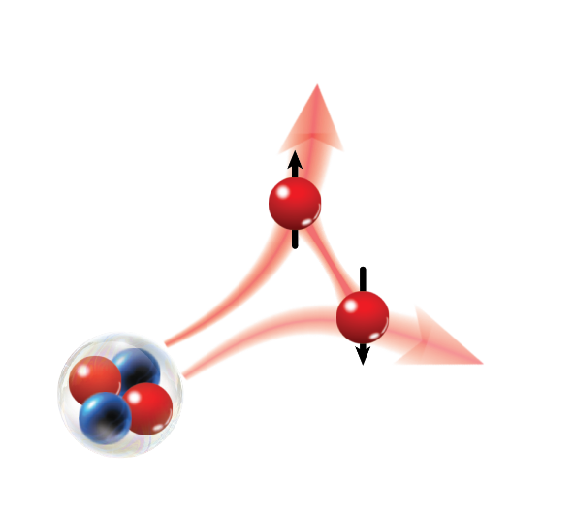
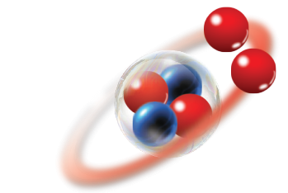
Time evolution
Our objective is to study the dynamics and mechanism of 2p decay
Time dependent approach
  Time propagator can be expanded with Chebyshev polynomials.
  Configuration mixing and proper asymptotic behavior.
Open quantum system
Configuration mixing
Correlation
GCC
~500 fm
High precision in asymptote
Coulomb field
Introduction
The Models
2p Decay
Summary
Theoretical status
GCC
TD

Slide 13
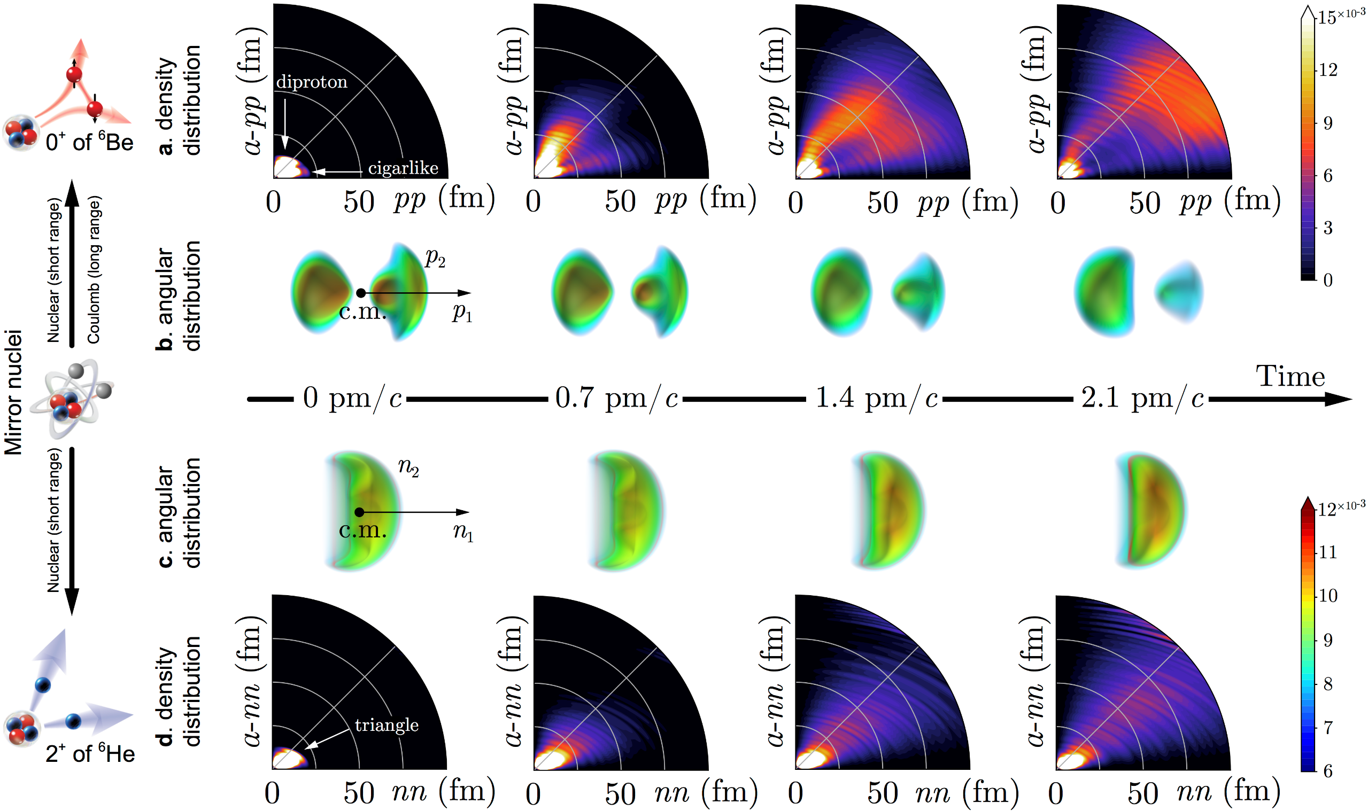
Ground-state of ⁶Be
Probability current
  Particle number changes in V
SW and W. Nazarewicz et al., PRC 99, ﻿054302 (2019)
Introduction
The Models
2p Decay
Summary
Exotic structure
Continuum effect
Nuclear vs Coulomb

Slide 14


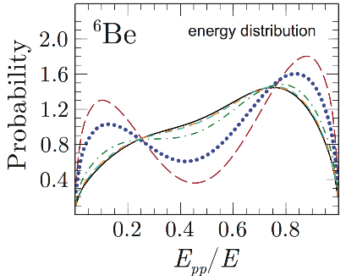

2p decay in ⁶Be
Protons inside nucleus
Two types of tunneling:
diproton (primarily)
cigarlike
Diproton branch bends
due to Coulomb repulsion
Asymptotic correlation begin to converge
SW and W. Nazarewicz, PRL 126, 142501 (2021)
Introduction
The Models
2p Decay
Summary
Exotic structure
Continuum effect
Nuclear vs Coulomb

Slide 15
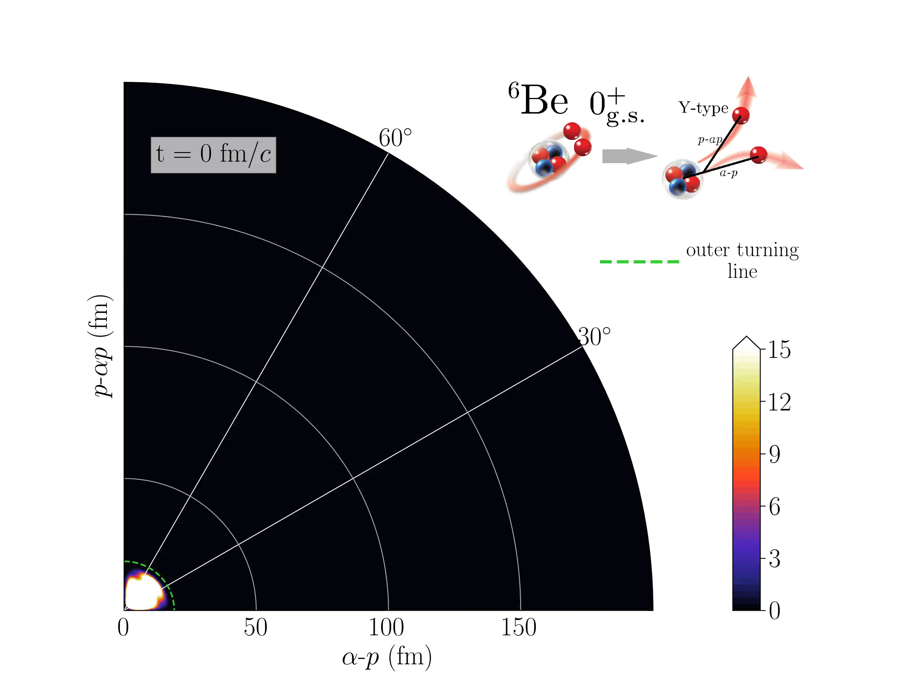
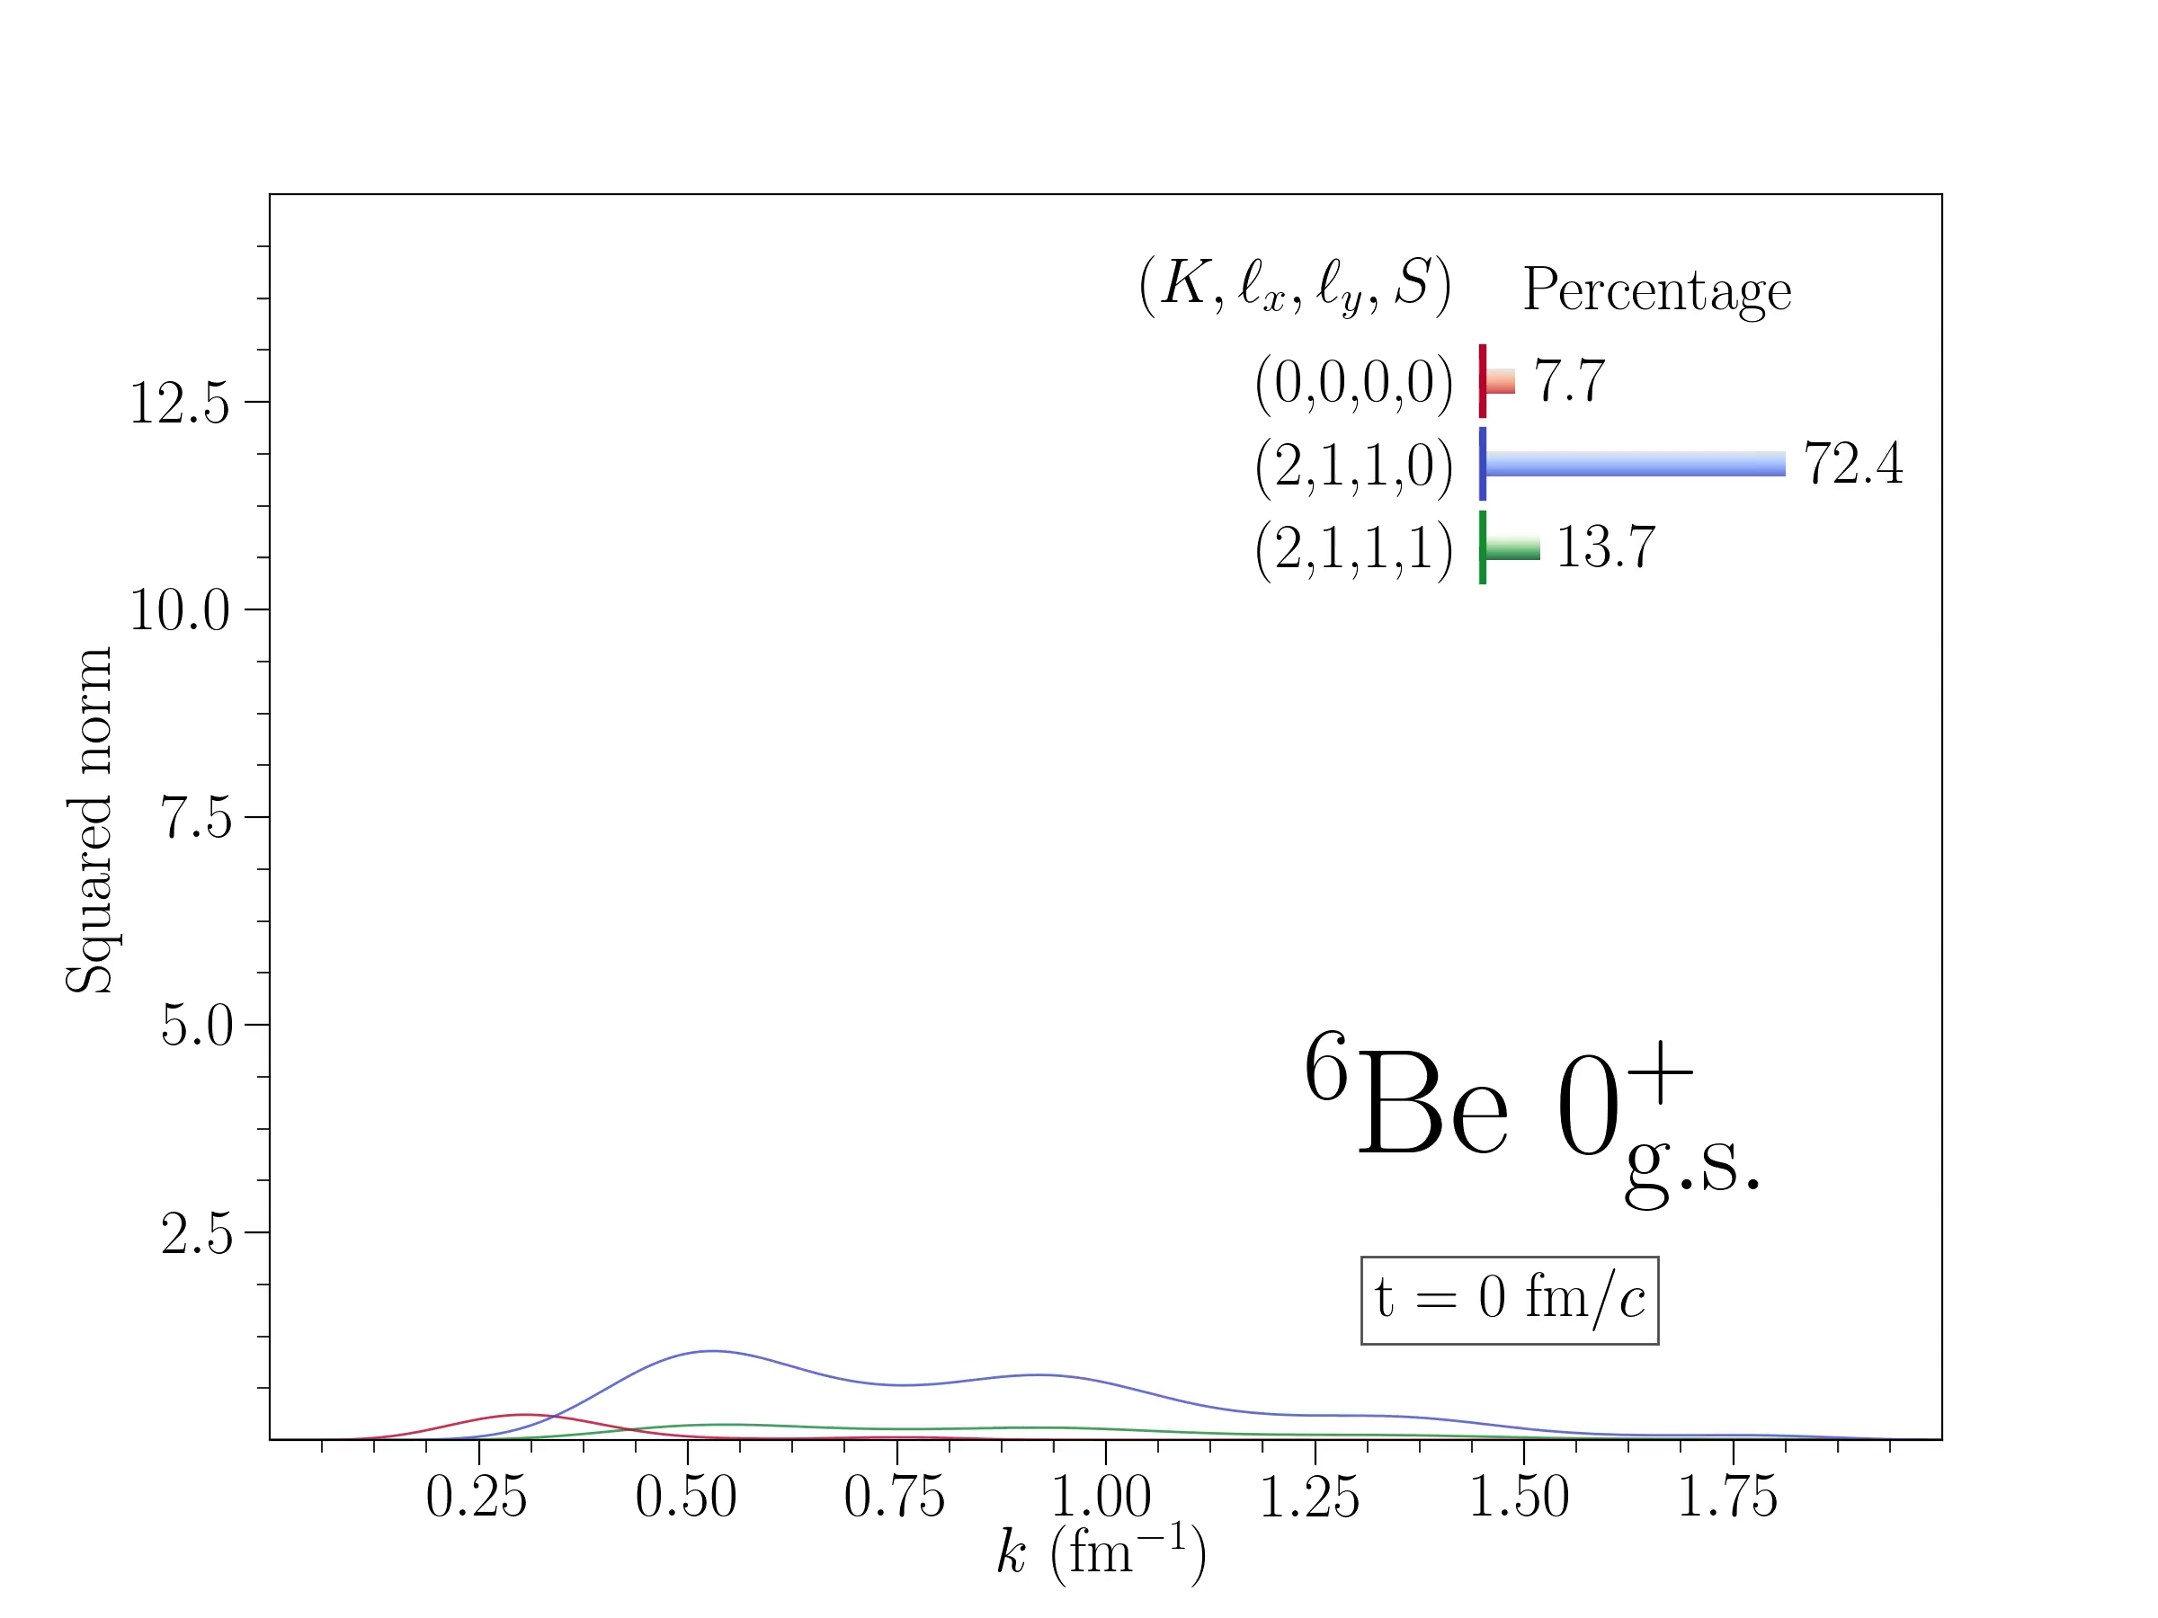
Density and configuration evolution
Density evolution in Jacobi-Y coordinate
Configuration evolution of ⁶Be
s wave
p wave
Protons are emitted simultaneously.
Gradual transition from p wave to s wave during the 2p decay process.
SW and W. Nazarewicz, PRL 126, 142501 (2021)
Introduction
The Models
2p Decay
Summary
Exotic structure
Continuum effect
Nuclear vs Coulomb

Slide 16
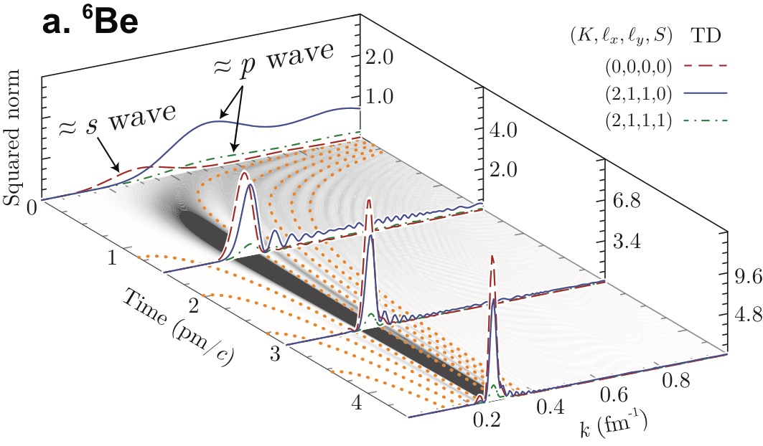
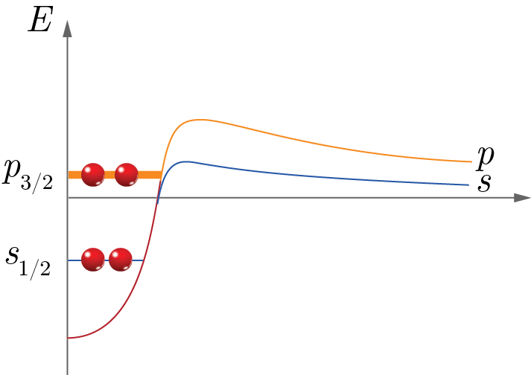
Configuration evolution of ⁶Be
Jacobi
Single-particle
(s, s)
(p, p)
(d, d)
(f, f)
(0, 0)
dinucleon
Dinucleon needs both positive- and negative-parity orbitals.
Diproton structure forms a bridge from p wave to s wave.
Introduction
The Models
2p Decay
Summary
Exotic structure
Continuum effect
Nuclear vs Coulomb

Slide 17
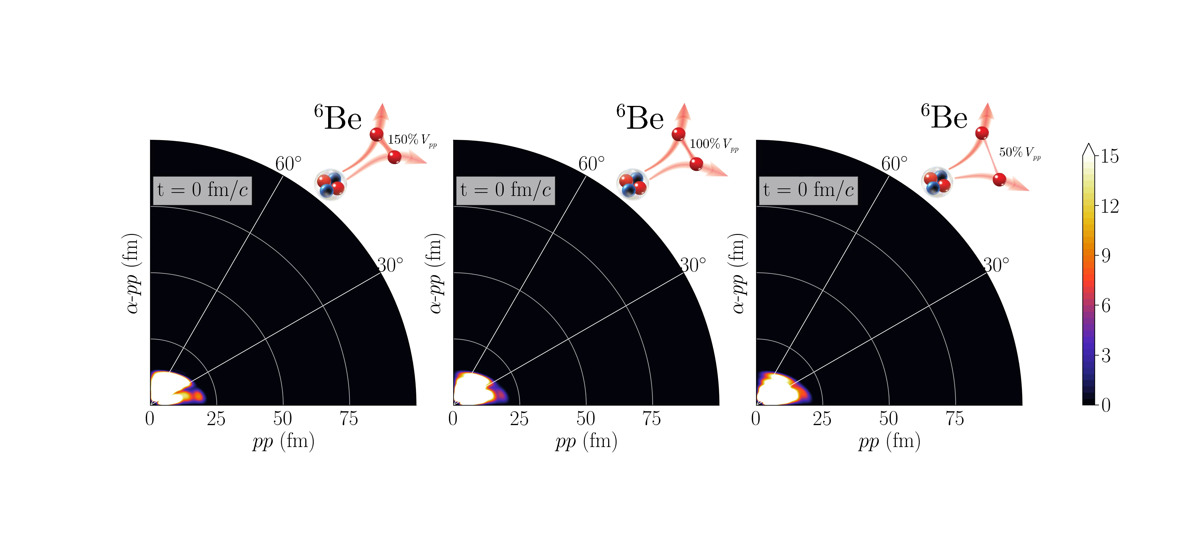
Decay dynamics with different pairing
Strong pairing
Standard pairing
Weak pairing
The decay dynamics as well as correlation strongly depend on the pairing strength.
Strong pairing results in a larger decay width, which indicates that pairing will benefit the 2p tunneling.
Introduction
The Models
2p Decay
Summary
Exotic structure
Continuum effect
Nuclear vs Coulomb

Slide 18
Asymptotic correlations
E_{pp} and Y-type angular correlations are strongly impacted by nucleon-nucleon interaction.
Introduction
The Models
2p Decay
Summary
Exotic structure
Continuum effect
Nuclear vs Coulomb

Slide 19
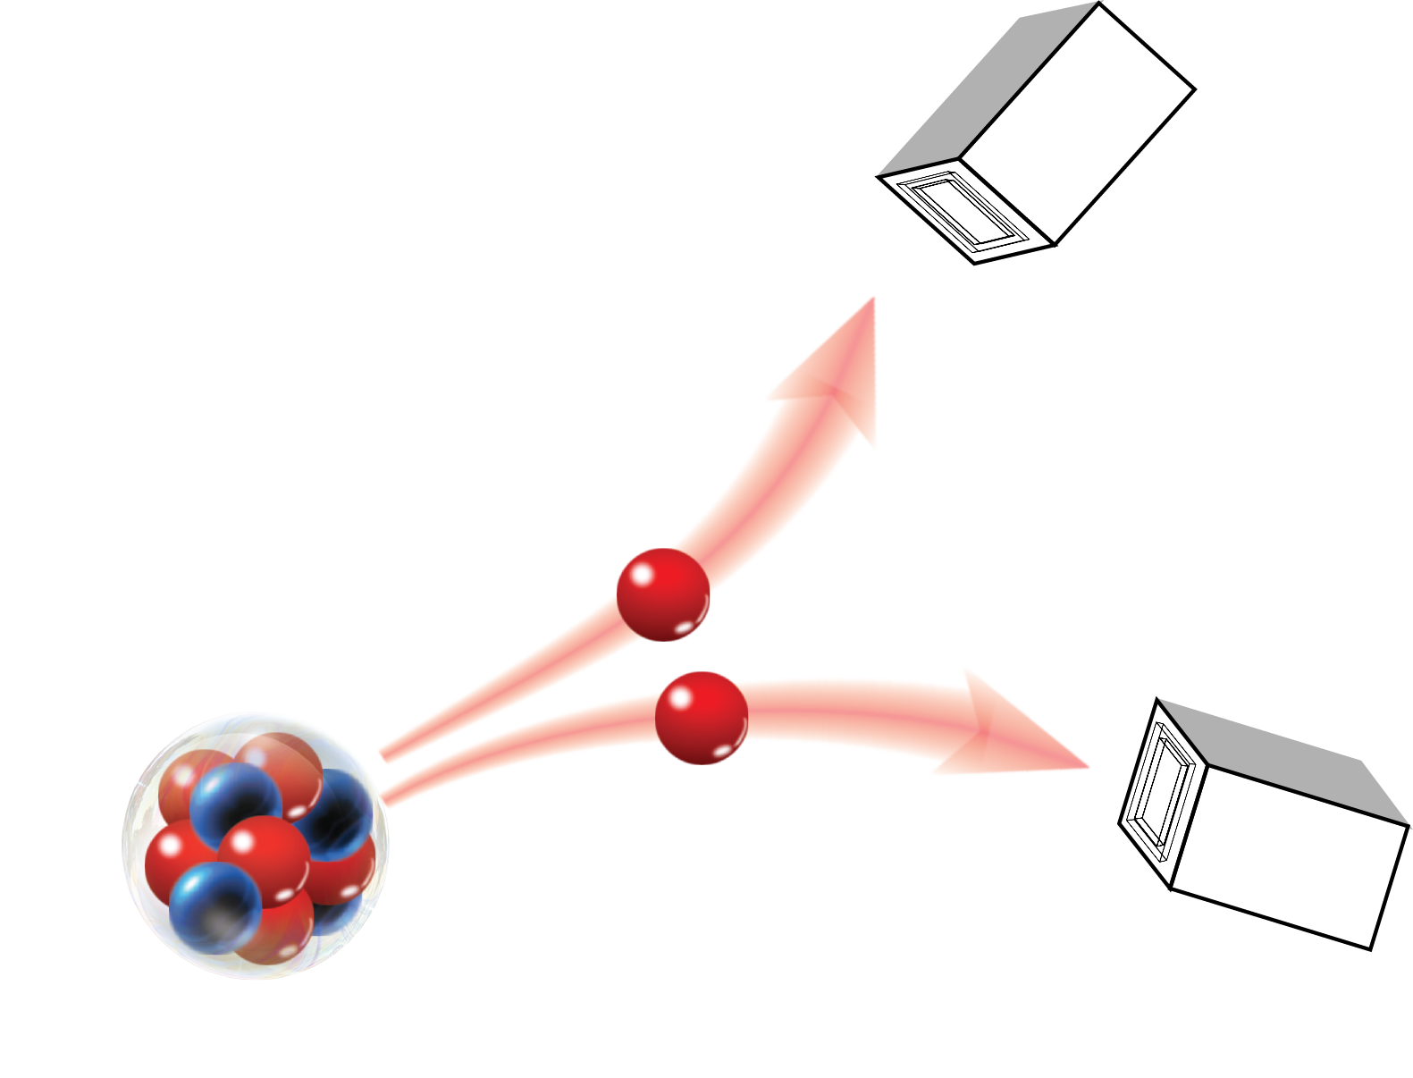
Pairing correlation of ¹²O
Decipher nuclear structure information through nucleon-nucleon correlation.
Correlation: 73% s-wave
Structure s(¹²O) > s(⁶Be)
Long-range correlation Coulomb vs Nuclear
Introduction
The Models
2p Decay
Summary
Exotic structure
Continuum effect
Nuclear vs Coulomb

Slide 20
Summary
What can we learn from 2p decay?
  Structure:
  1. Deformation might change decay process
  2. Low-l orbitals are crucial for decay width
  Continuum effect:
  1. Benefit for dinucleon/clustering
  2. Make a bridge for the transition among orbitals
  Pairing interaction
  1. Strongly impacts decay dynamics
  2. Manifests itself in asymptotic (E_{pp} and Jacobi-Y angular) correlations
Introduction
The Models
2p Decay
Summary
What can we learn
Perspectives

Slide 21
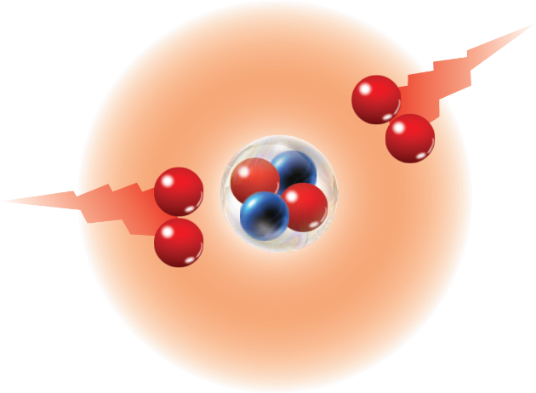
Perspectives: correlations of 2p decay
Correlations needed: ⁴⁸Ni, ⁵⁴Zn, ⁶⁷Kr … .
2p + 2p decay: ⁸C and ¹⁸Mg?
See S. Koyama and Y. Jin’s talks
Introduction
The Models
2p Decay
Summary
What can we learn
Perspectives

Slide 22
Perspectives: 2n decay
Mirror?
2p decay
2n decay
The symmetry and asymmetry between 2p and 2n decays.
Candidates: ¹⁶Be, ²⁶O …
See B. Monteagudo and A. Revel’s talks
To be continued …
Introduction
The Models
2p Decay
Summary
What can we learn
Perspectives
Notes:
A story for another day

Slide 23
Asymptotic correlations: 2p vs 2n
pp: subthreshold resonance L.P. Kok, PRL 45, 427 (1980)
k = 0.0647−i0.0870 fm⁻¹; E = −140 keV; Γ = 934 keV
nn: antibound state, k = −i0.0559(33) fm⁻¹ V.A. Babenko, PAN 76, 684 (2013)
Notes:
Just a spoiler. It regards to Olivier’s question yesterday that, if we change 2p to 2n decay, whether there will be a narrow peak in the small Enn region.

Slide 24










Thank you for your attention!
Collaborations:
  W. Nazarewicz (MSU)
  R.J. Charity (WU)
  L.G. Sobotka (WU)
  N. Michel (IMP)
  J. Wylie (MSU)
  M. Płoszajczak (GANIL)
  …
…

Slide 25
Backup slides

Slide 26
Asymptotic correlations of ¹¹O
Measured Jacobi-Y correlation of ¹¹O
Time-dependent calculation
T. Webb et al., in preparation
T. Webb et al., PRC 101, 044317 (2020)
T. Webb, S.M. Wang et al., PRL 122, 122501 (2019)
Distinct correlation patterns for different states.
Useful tool to study inner structure.

Slide 27
Evolutions of pairing correlations

