Slide 1
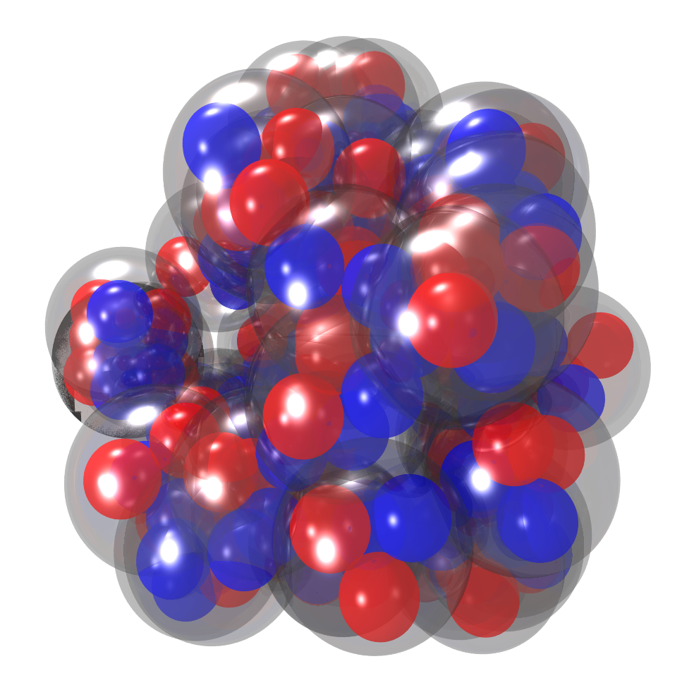
Alpha Condensation?
Martin Freer
University of Birmingham

Slide 2
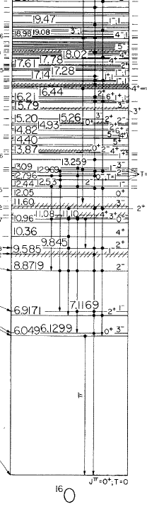
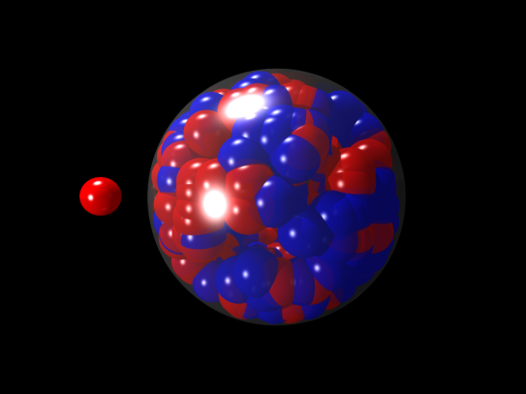


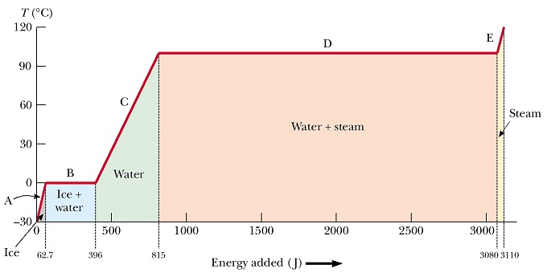

Temperature
12.1 MeV: proton decay threshold
15.7 MeV: neutron decay threshold
Energy

Slide 3
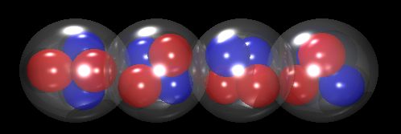
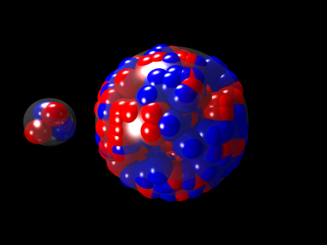
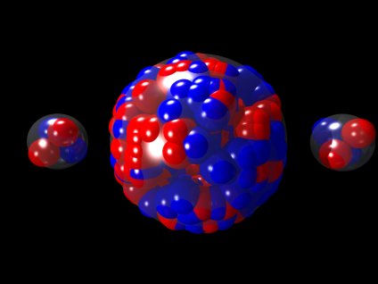
Temperature
12.1 MeV: proton decay threshold
15.7 MeV: neutron decay threshold
7.16 MeV: alpha decay threshold
Energy
14.6 MeV: 2alpha decay threshold

Slide 4
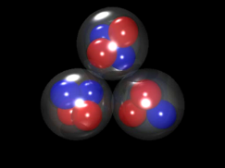
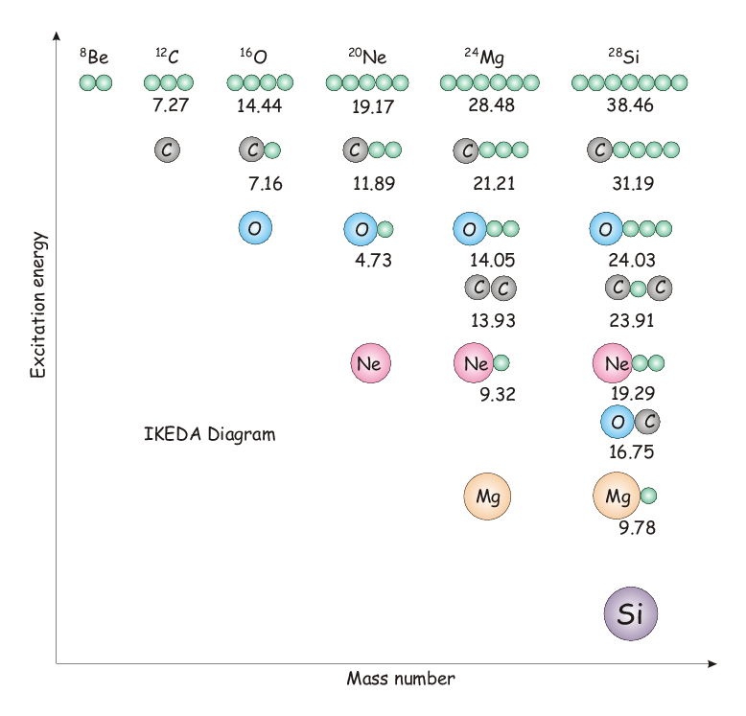
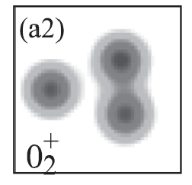

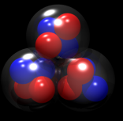
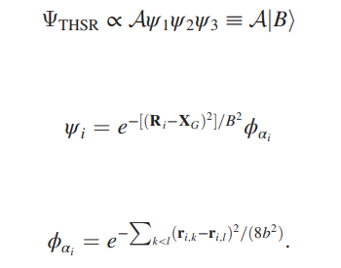

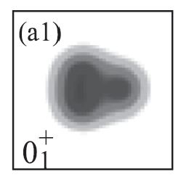
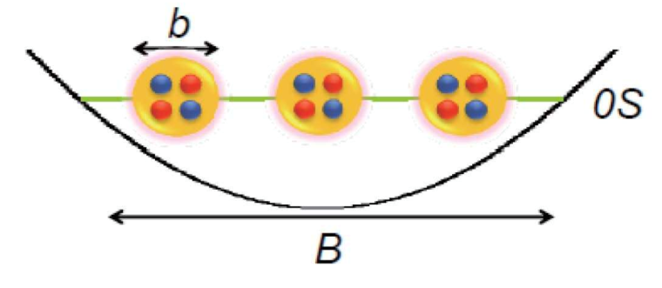

Slide 5
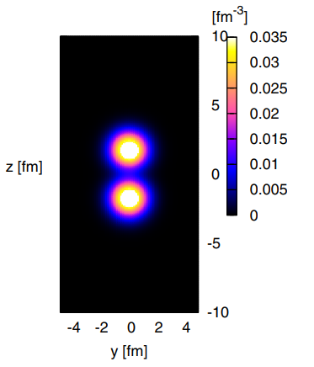
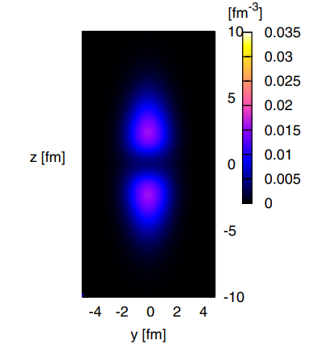
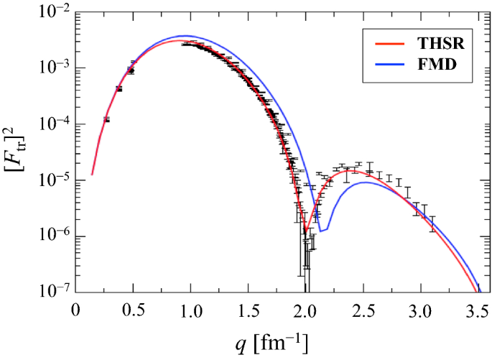
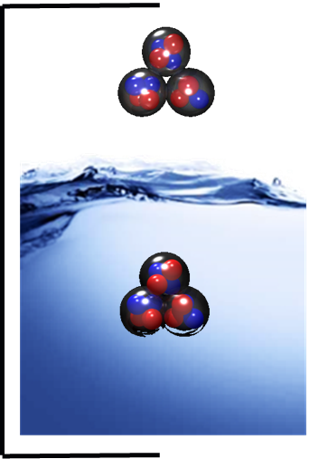
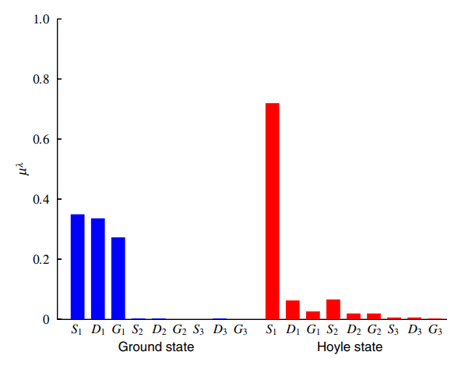
~70% bosonic
Occupancy for each alpha
A. Tohsaki, H. Horiuchi, P. Schuck, G. Röpke, Colloquium: status of α-particle condensate structure of the Hoyle state. Rev. Mod. Phys. 89, 011002 (2017).

Slide 6
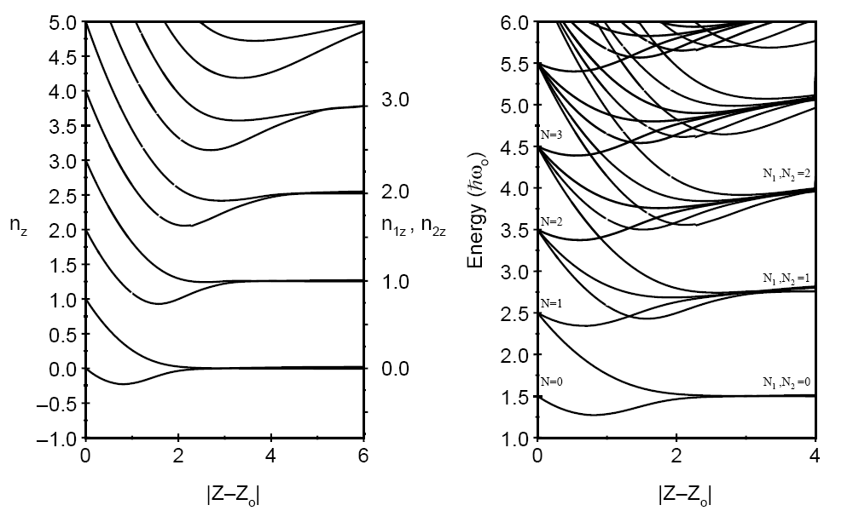
Separation into clusters (two-centre oscillator)

Slide 7
Quantum numbers of fused levels

Slide 8
The Harvey Diagram
(n_{x},n_{y},n_{z})

Slide 10
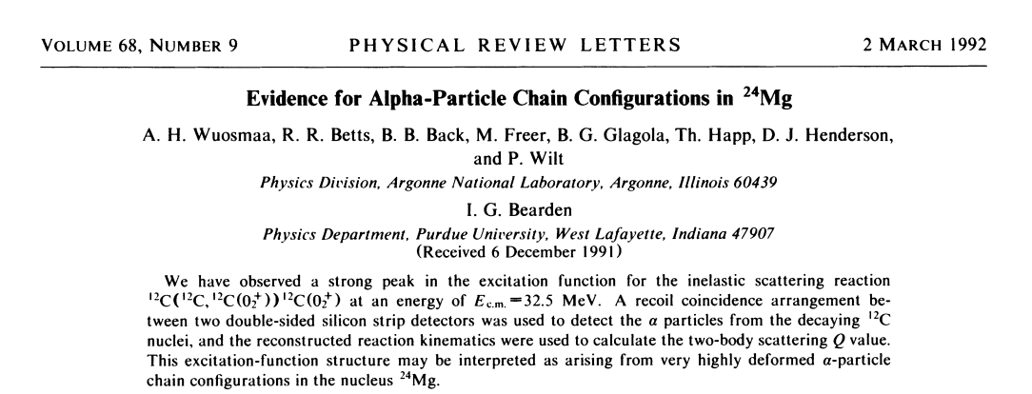
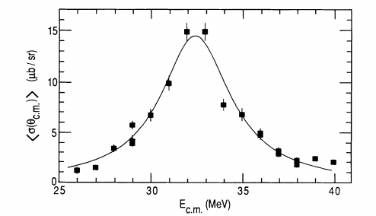
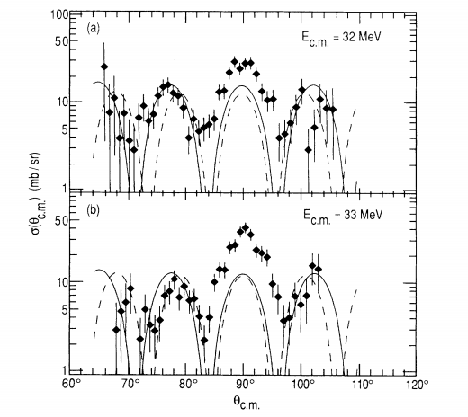
²⁴Mg
Ex
Shape Eigenstate
J(J+1)

Slide 11
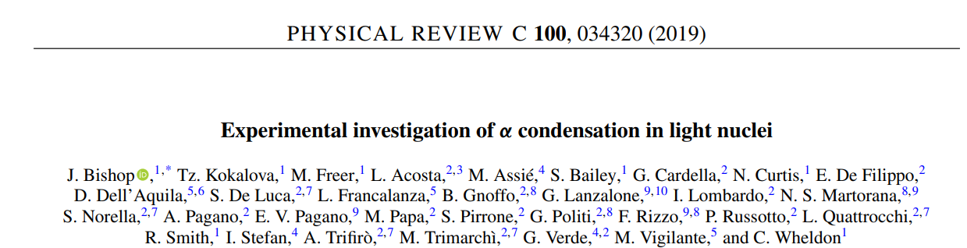
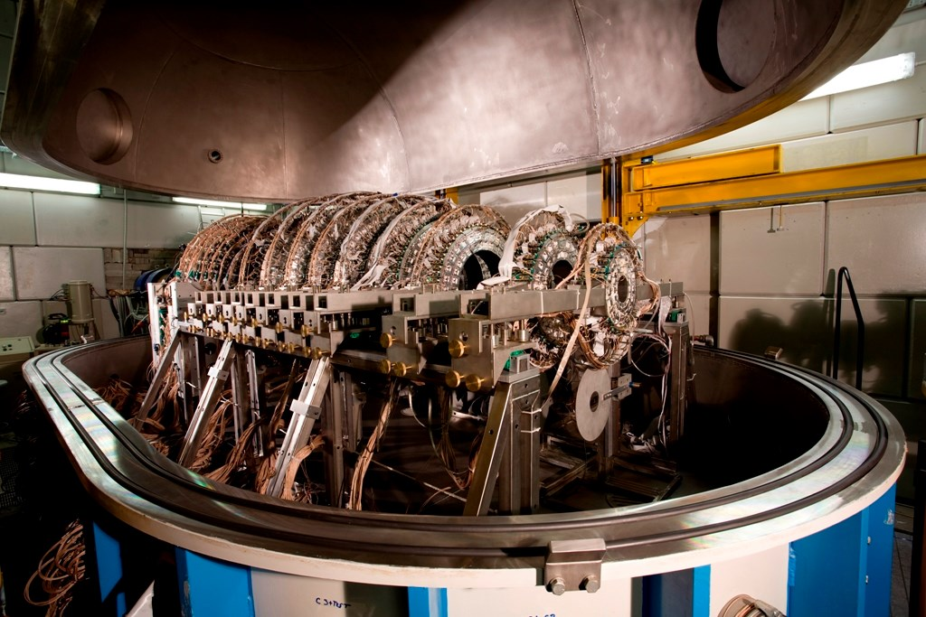
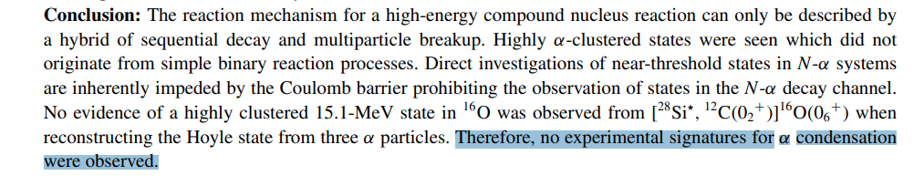
²⁸Si

Slide 12
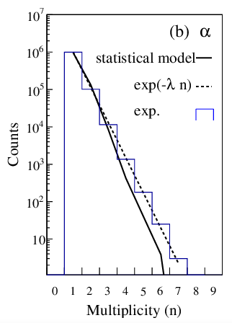
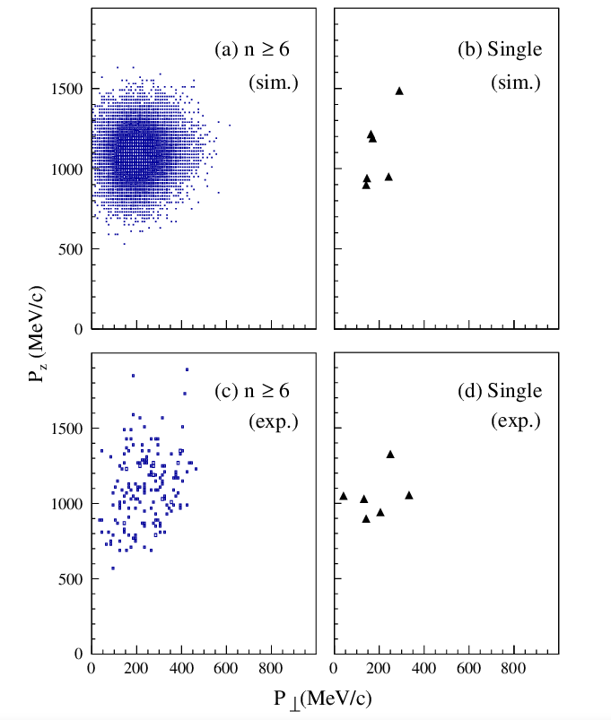
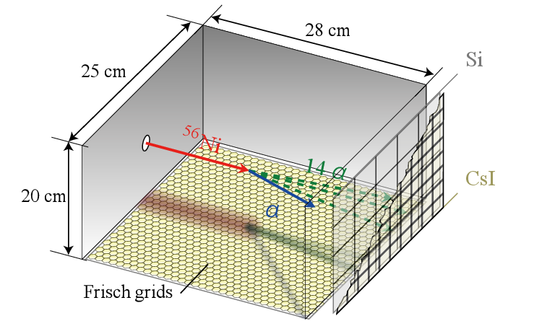
⁵⁶Ni:
Bagchi, S., Akimune, H., Gibelin, J. et al. Signature of a possible α-cluster state in N=Z doubly-magic 56Ni. Eur. Phys. J. A 56, 290 (2020).

Slide 13
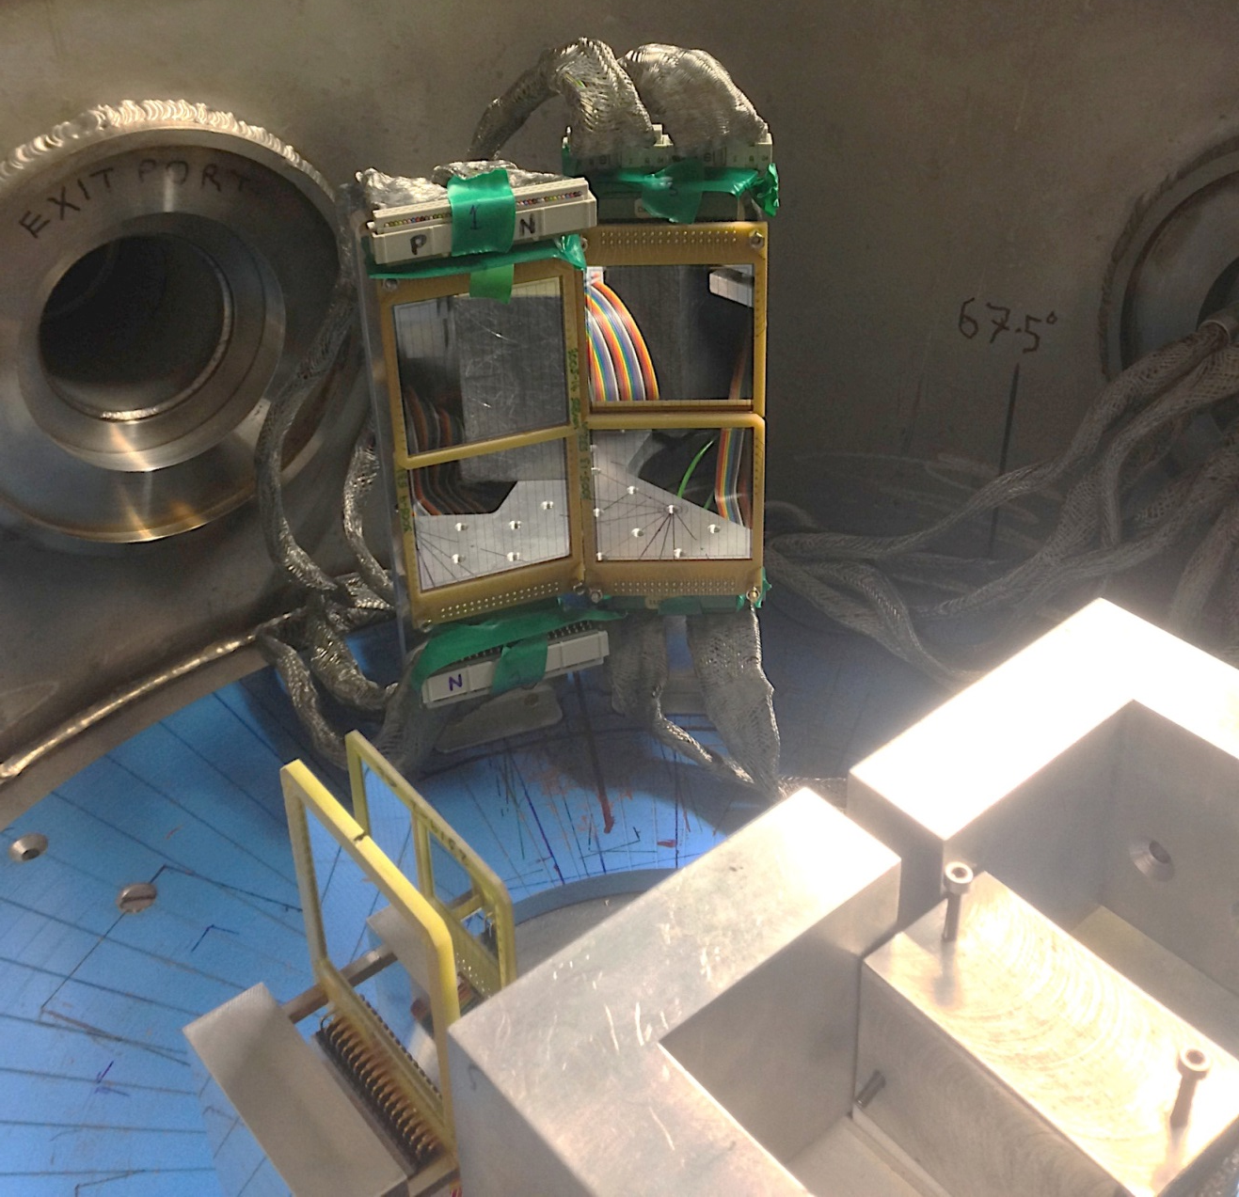
New Measurement of the Direct Decay from the Hoyle State – Robin Smith
Decay particles striking separate DSSDs gives a lower background
α
α
α
α

Slide 14
93,000 Hoyle state decays were measured
Over 60 hours of beam time
0.03% background

Slide 15
Break-up channel identification
ε ≈ 0.5
ε ≈ ?

Slide 16
Dalitz Analysis
2.4 × 10⁴ events

Slide 17
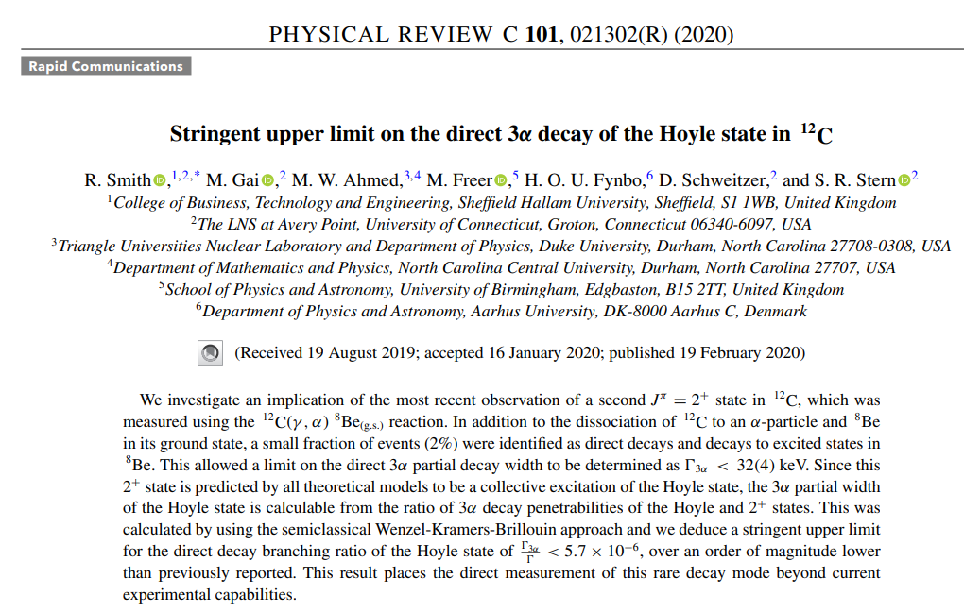
Fitted projected Dalitz plots
0% BR
0.05% BR
0.1% BR
BR < 0.047% (95% C.L.)

Slide 18
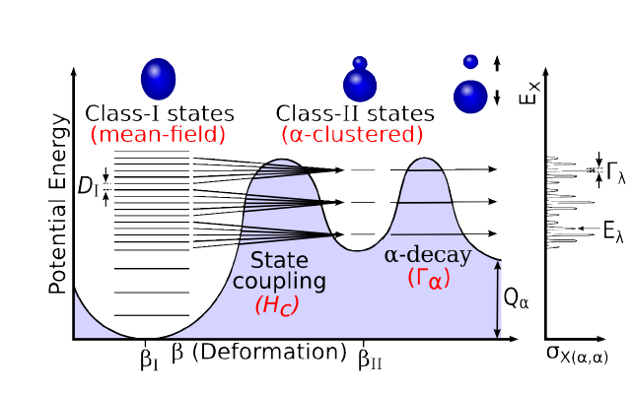

Slide 19
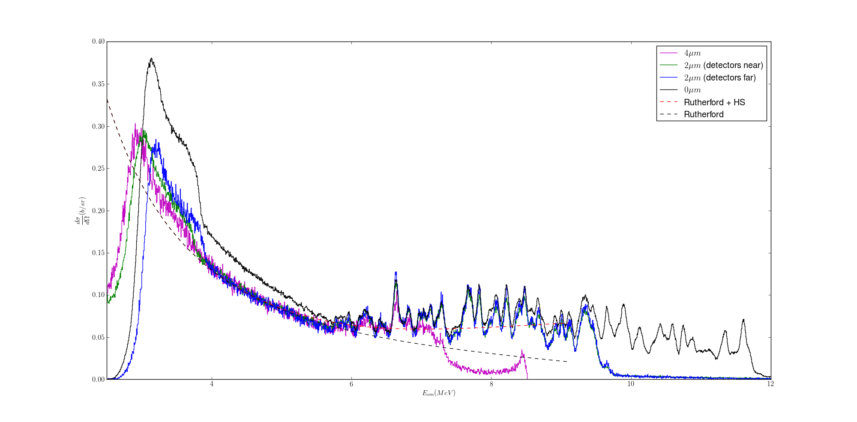
¹⁴N
Alpha-particle states in Ti isotopes
Havar (2-5um)
⁴He (gas)
Telescope

Slide 20

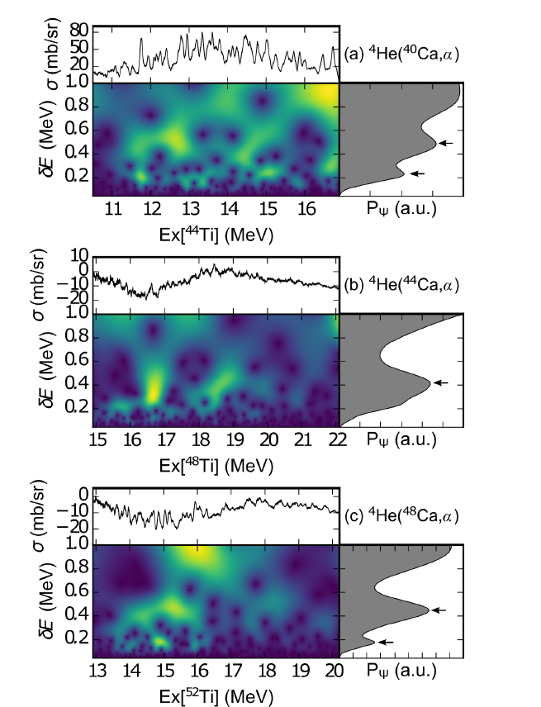

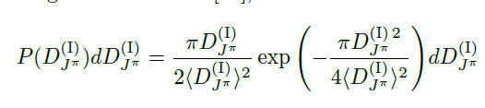

Slide 21
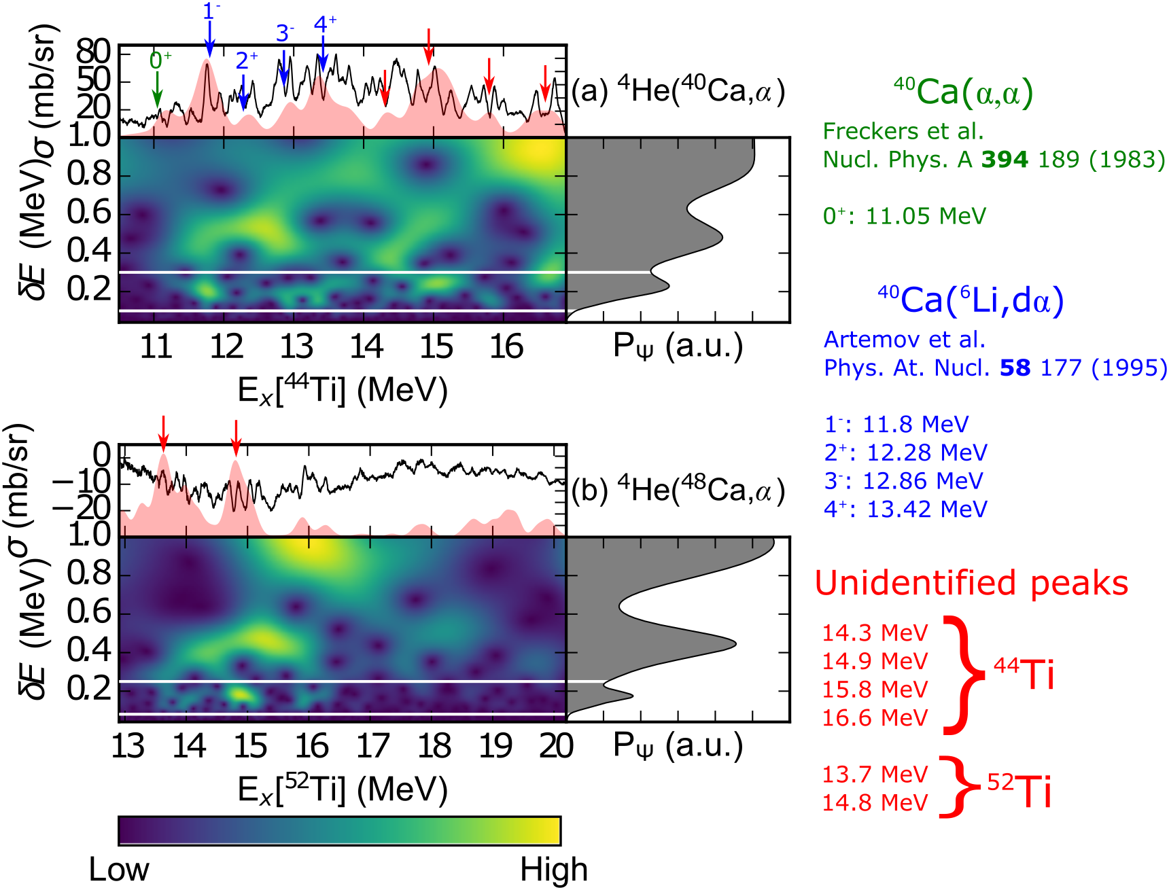
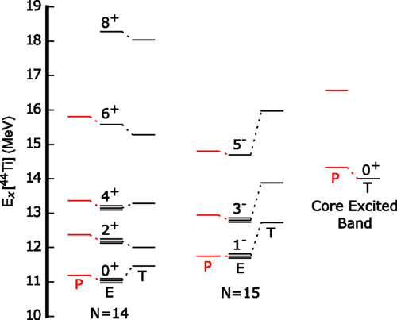

Slide 22
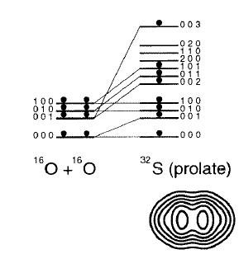
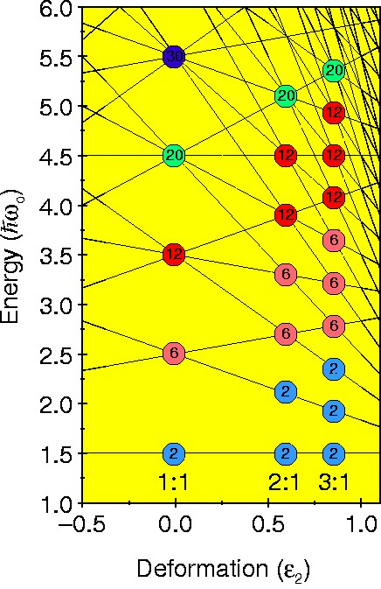
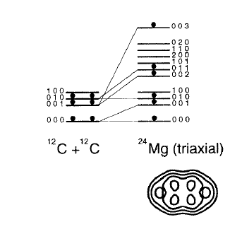
Cluster Symmetries

Slide 23
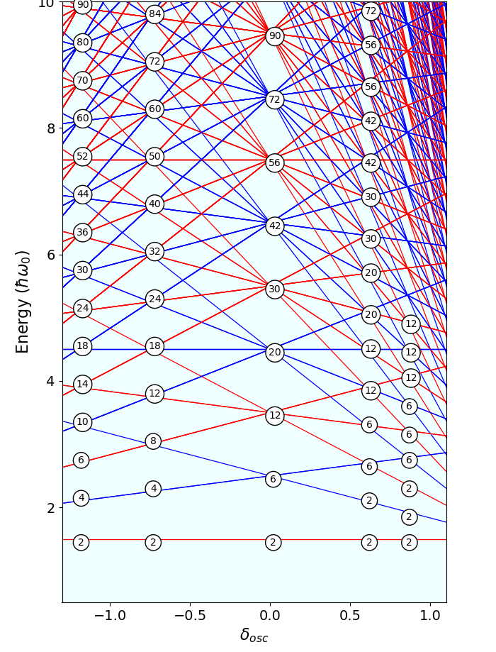
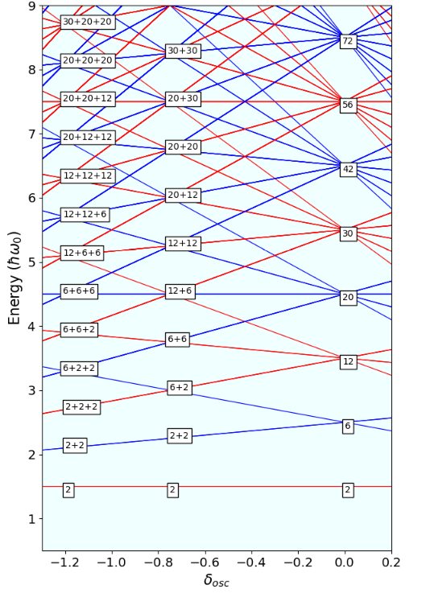

Slide 24
.
.
.
.
.
.
.
.
.
.
.
.
.
.
.
.
.
.
.
.
.
.
20
12
12
12
12
6
6
6
6
2
2
2
2
30
20
20
20
12
12
12
6
6
6
2
2
2
.
.
.
.
.
.
.
.
.
30
30
30
20
20
20
12
12
12
6
6
6
2
2
2
20
20
20
12
12
12
12
6
6
6
6
2
2
2
2
12
12
12
12
12
6
6
6
6
6
2
2
2
2
2
12
12
6
6
6
6
6
2
2
2
2
2
.
.
.
.
.
.
.
.
.
.
.
.
20
12
12
12
12
6
6
6
6
2
2
2
2
30
20
20
20
12
12
12
6
6
6
2
2
2
12
12
6
6
6
6
6
2
2
2
2
2
20
12
12
12
12
6
6
6
6
2
2
2
2
30
20
20
20
12
12
12
6
6
6
2
2
2
12
12
6
6
6
6
6
2
2
2
2
2
12
12
6
6
6
6
6
2
2
2
2
2
20
12
12
12
12
6
6
6
6
2
2
2
2
30
30
20
20
12
12
6
6
2
2
12
12
6
6
6
6
6
2
2
2
2
2
30
30
20
20
12
12
6
6
2
2
42
30
30
20
20
12
12
6
6
2
2
56
42
30
20
12
6
2
1:5
1:4
1:3
1:2
1:1
2:1
3:1
4:1
5:1

Slide 25
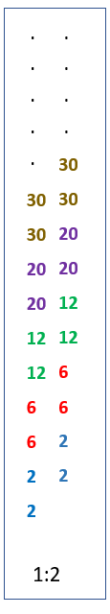
The Harvey Diagram
(n_{x},n_{y},n_{z})

Slide 26
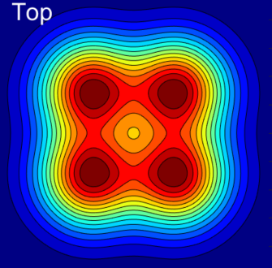
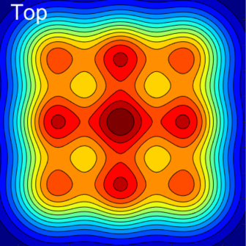
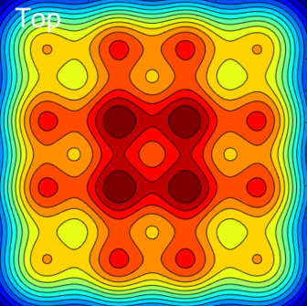
+
+
+
+
+
+
[0, 0, 0]
[0, 1, 0]
[0, 2, 0]
[0, 3, 0]
[1, 0, 0]
[1, 1, 0]
[1, 2, 0]
[1, 3, 0]
[2, 0, 0]
[2, 1, 0]
[2, 2, 0]
[2, 3, 0]
[3, 0, 0]
[3, 1, 0]
[3, 2, 0]
[3, 3, 0]
[0, 0, 0]
[0, 1, 0]
[0, 2, 0]
[1, 0, 0]
[1, 1, 0]
[1, 2, 0]
[2, 0, 0]
[2, 1, 0]
[2, 2, 0]
[0, 0, 0]
[1, 0, 0]
[0, 1, 0]
[1, 1, 0]

Slide 27
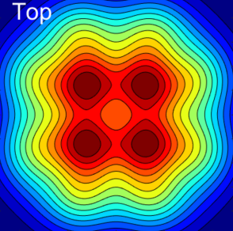
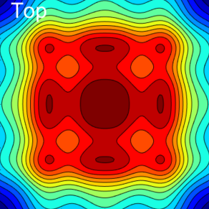

¹⁶O’s
+
+
+
+
+
+

Slide 28
.
.
.
.
.
.
.
.
.
.
.
.
.
.
.
.
.
.
.
.
.
.
20
12
12
12
12
6
6
6
6
2
2
2
2
30
20
20
20
12
12
12
6
6
6
2
2
2
.
.
.
.
.
.
.
.
.
30
30
30
20
20
20
12
12
12
6
6
6
2
2
2
20
20
20
12
12
12
12
6
6
6
6
2
2
2
2
12
12
12
12
12
6
6
6
6
6
2
2
2
2
2
12
12
6
6
6
6
6
2
2
2
2
2
.
.
.
.
.
.
.
.
.
.
.
.
20
12
12
12
12
6
6
6
6
2
2
2
2
30
20
20
20
12
12
12
6
6
6
2
2
2
12
12
6
6
6
6
6
2
2
2
2
2
20
12
12
12
12
6
6
6
6
2
2
2
2
30
20
20
20
12
12
12
6
6
6
2
2
2
12
12
6
6
6
6
6
2
2
2
2
2
12
12
6
6
6
6
6
2
2
2
2
2
20
12
12
12
12
6
6
6
6
2
2
2
2
30
30
20
20
12
12
6
6
2
2
12
12
6
6
6
6
6
2
2
2
2
2
30
30
20
20
12
12
6
6
2
2
42
30
30
20
20
12
12
6
6
2
2
56
42
30
20
12
6
2
1:5
1:4
1:3
1:2
1:1
2:1
3:1
4:1
5:1

Slide 29
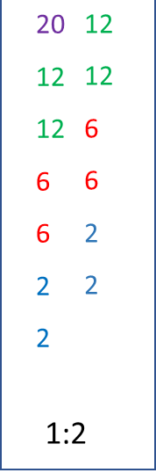
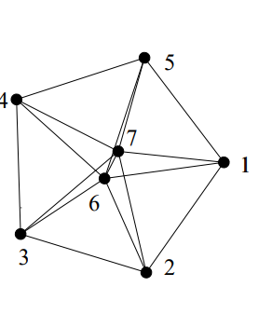


Cluster interpretation
⁵²Ti [3x¹⁶O+α: ³²S*+²⁰Ne ]
²⁸Si [¹⁶O+¹²C[3α]: ²⁰Ne+⁸Be]
¹²C [3α: ⁸Be+ α]
⁴He

Slide 30
Alpha Particle States Alpha Condensation?
Martin Freer
University of Birmingham

