Slide 1
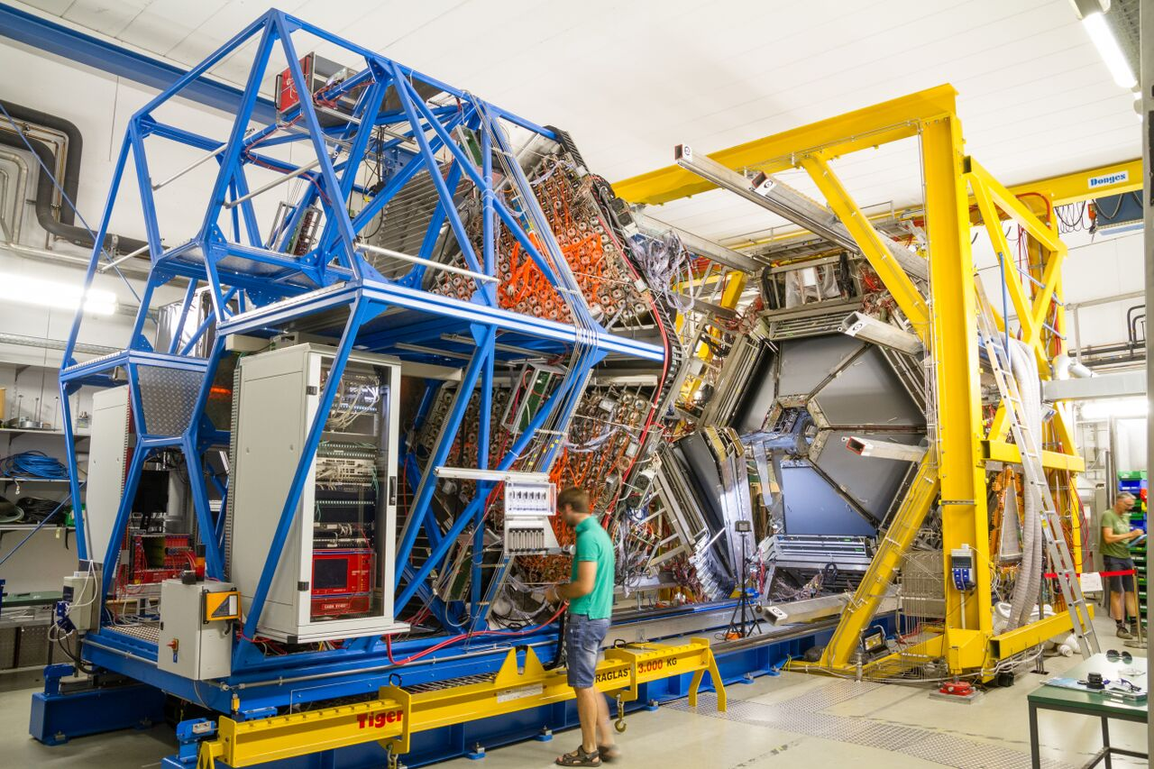
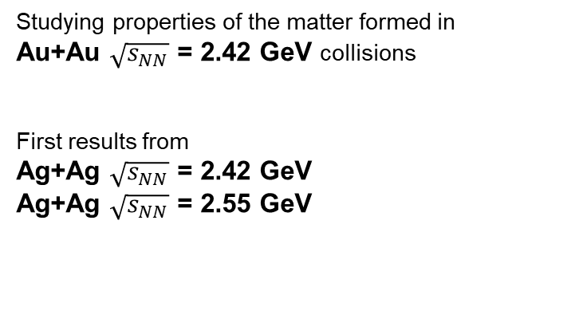
Characterizing baryon dominated matter with HADES measurements
Szymon Harabasz for the HADES Collaboration
Studying properties of the matter formed in
Au+Au $\sqrt{s_{NN}}$ = 2.42 GeV collisions
First results from
Ag+Ag $\sqrt{s_{NN}}$ = 2.42 GeV
Ag+Ag $\sqrt{s_{NN}}$ = 2.55 GeV

Slide 2
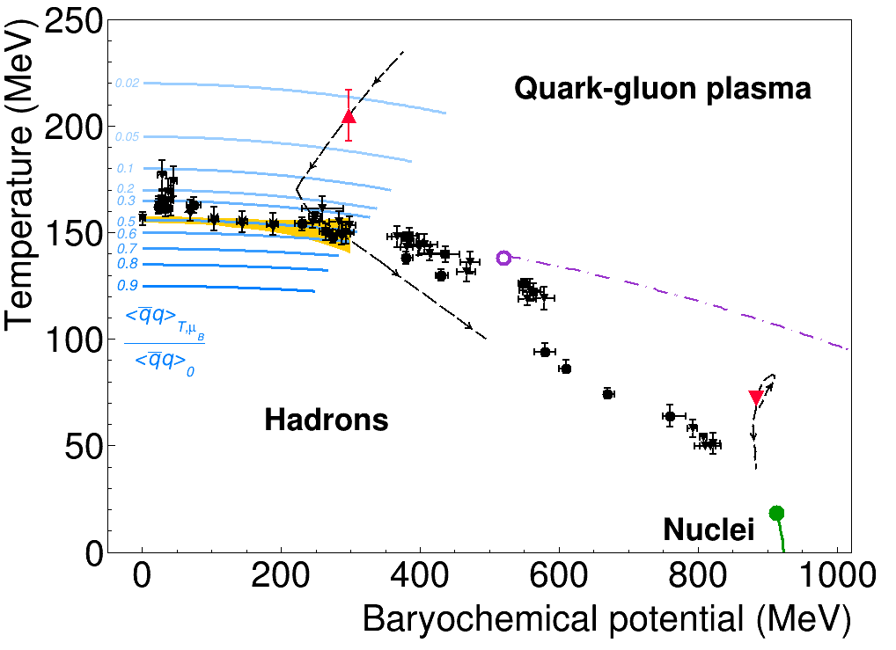
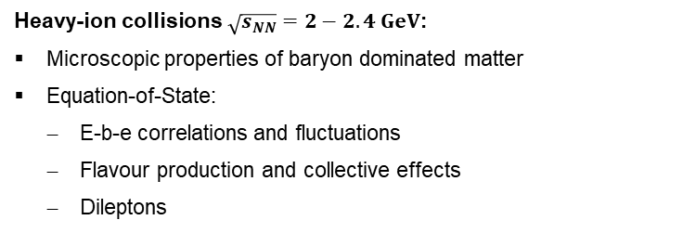
The HADES physics case
Exploring high μ_{B} region of QCD phase diagram
Focus on rare and penetrating probes
Address various aspects of baryon-meson coupling
Heavy-ion collisions $\sqrt{s_{NN}}=2−2.4 GeV$:
Microscopic properties of baryon dominated matter
Equation-of-State:
  E-b-e correlations and fluctuations
  Flavour production and collective effects
  Dileptons
HADES
Pion and nucleon beams:
Reference measurements (vacuum, cold QCD matter)
Electromagnetic structure of baryons and hyperons
HADES, Nature Phys. 15 (2019) 10, 1040-1045
A. Andronic et al., Nature 561 (2018) no.7723
LQCD: S. Borsanyi et al. [Wuppertal-Budapest Collab.], JHEP 1009 (2010) 073
LQCD: A. Bazavov et al., PLB 795 (2019) 15-21

Slide 3
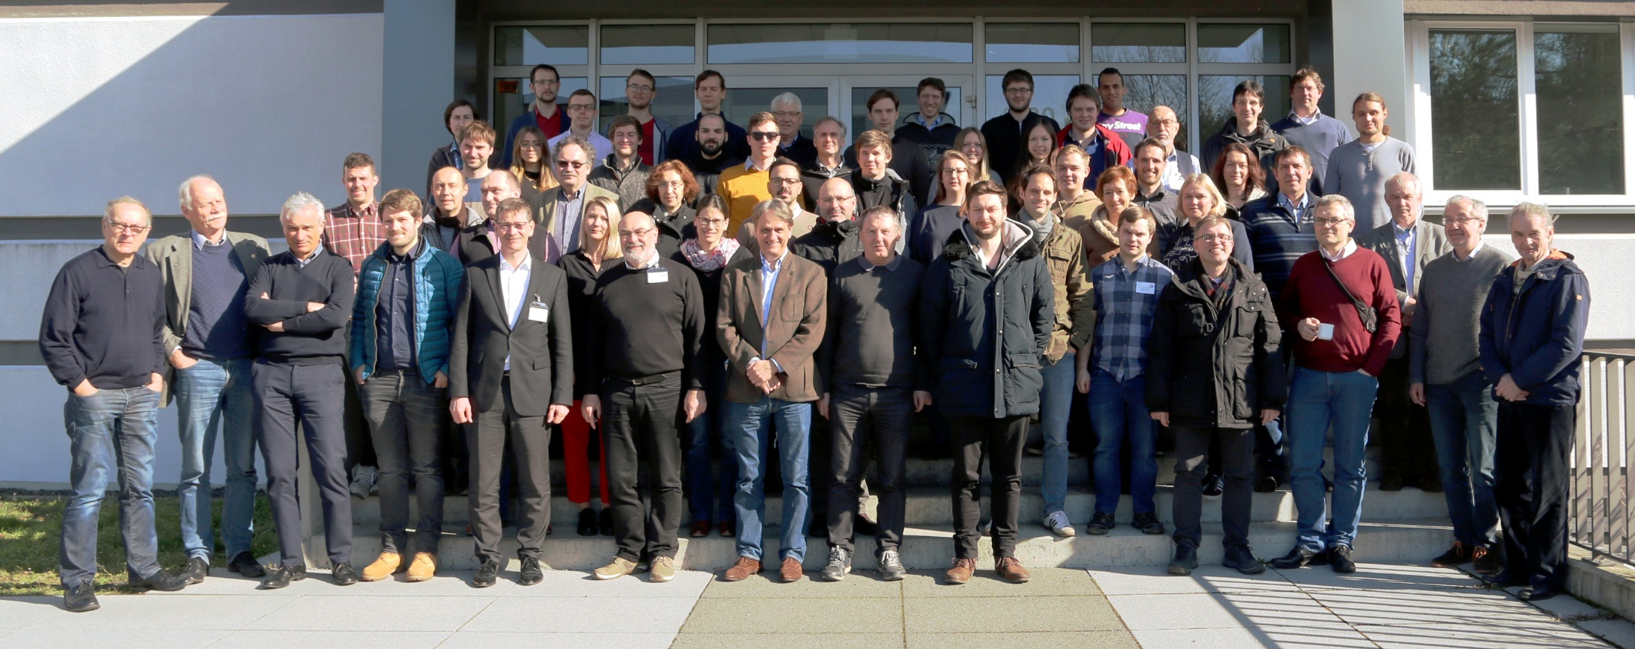
On behalf of the HADES Collaboration
~170 members, 26 institutions from 10 countries (16 from Germany)
38. HADES Collaboration Meeting, 2-6 March 2020

Slide 4
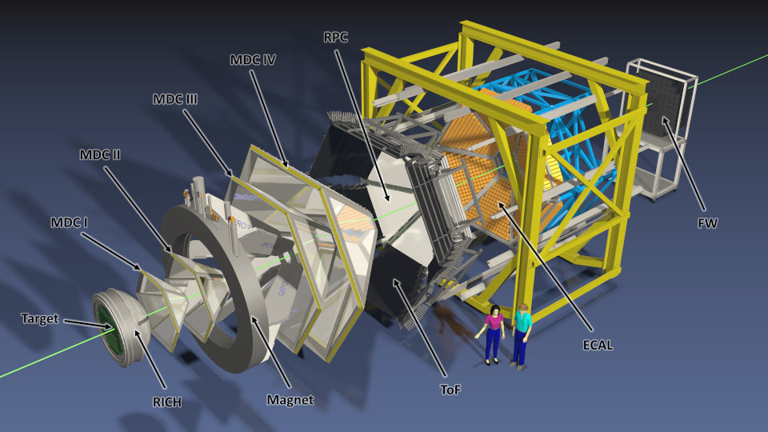
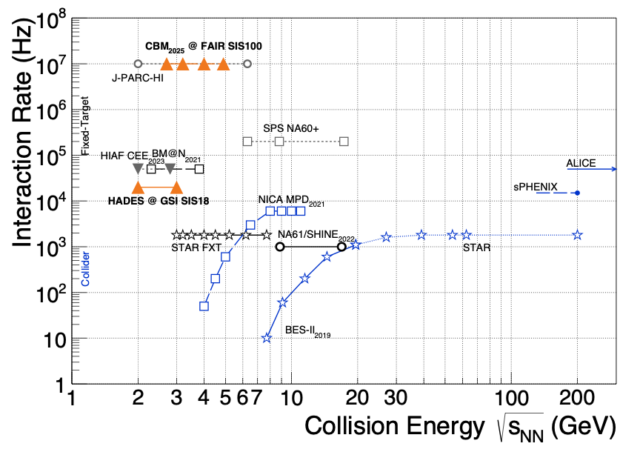
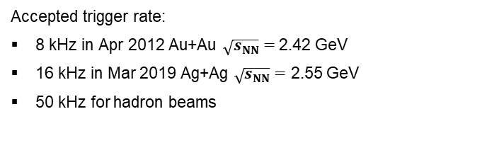
Meet the HADES
(High Acceptance Di-Electron Spectrometer)
T. Galatyuk, Nucl.Phys. A982 (2019); CBM, EPJA 53 3 (2017) 60
Accepted trigger rate:
  8 kHz in Apr 2012 Au+Au $\sqrt{s_{NN}}=$ 2.42 GeV
  16 kHz in Mar 2019 Ag+Ag $\sqrt{s_{NN}}=$ 2.55 GeV
  50 kHz for hadron beams
Fixed-target setup
Acceptance: full azimuth, polar from 18º to 85º

Slide 5
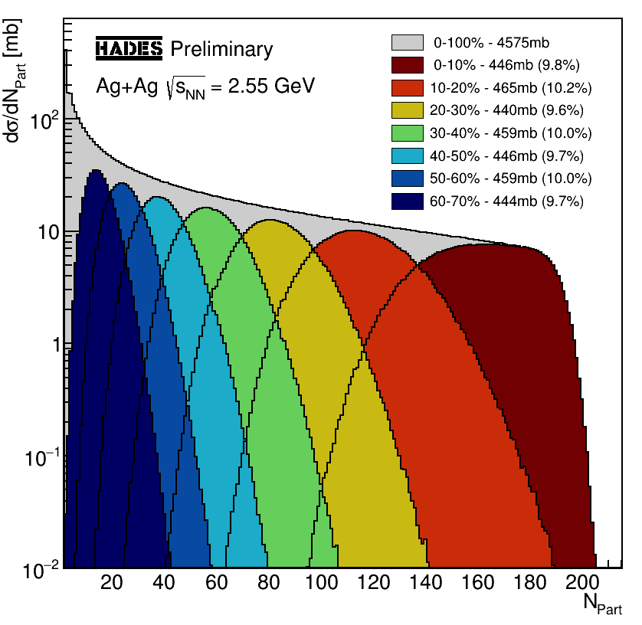
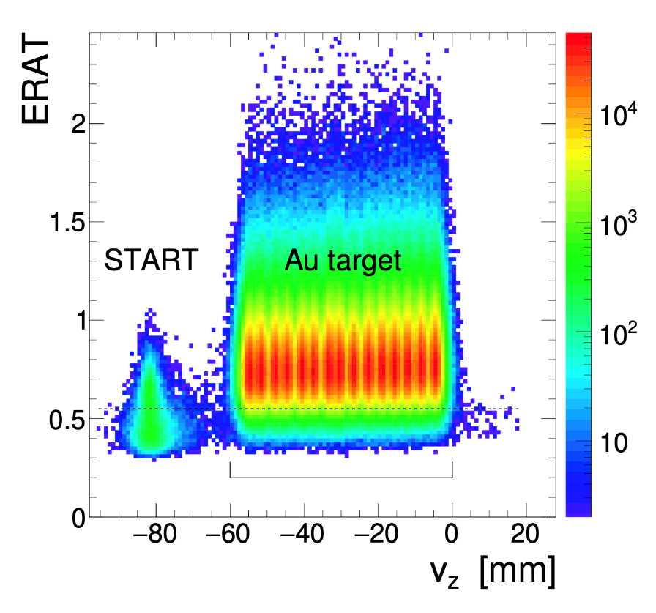

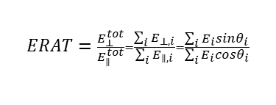
Event selection and particle identification
Au (Ag) beam on 15-fold segmented Au (Ag) target
7×10⁹ Au+Au events recorded
15×10⁹ Ag+Ag events recorded
  Velocity, Momentum
  dE/dx in MDC and ToF
  RICH information
Event pile-up $≤2×{10}^{−4}$
Segmented target + Start + VETO
$$ERAT=\frac{E_{⊥}^{tot}}{E_{∥}^{tot}}=\frac{\sum_{i}{E_{⊥,i}}}{\sum_{i}{E_{∥,i}}}=\frac{\sum_{i}{E_{i}sinθ_{i}}}{\sum_{i}{E_{i}cosθ_{i}}}$$
Tetyana Galatyuk | HADES results | RFBR Grants for NICA | 20-23 Oct 2020

Slide 6
Electromagnetic Probes

Slide 7
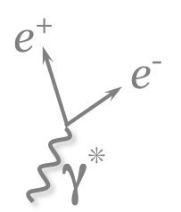
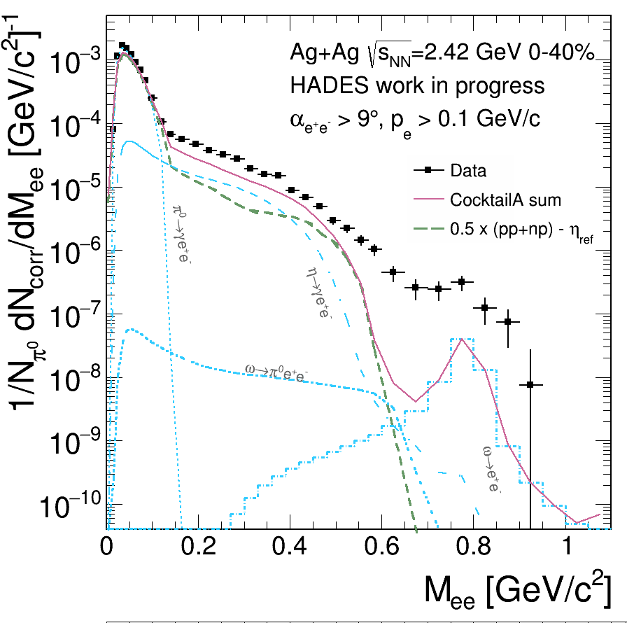
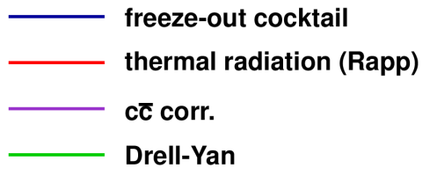
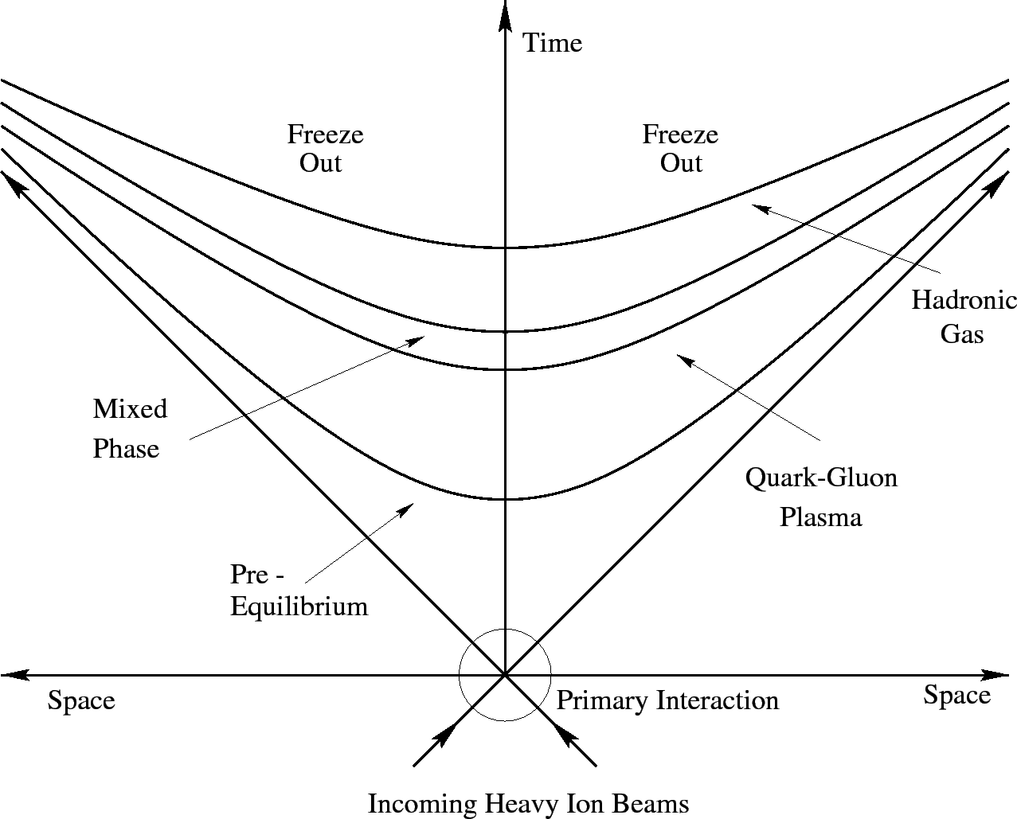
Electromagnetic probes of strongly interacting matter
Photons (virtual and real):
Don’t undergo strong interaction
Probe all the stages of heavy-ion collisions
Radiation from hot and dense matter is isolated by subtracting:
First-chance NN collisions
Freeze-out

Slide 8
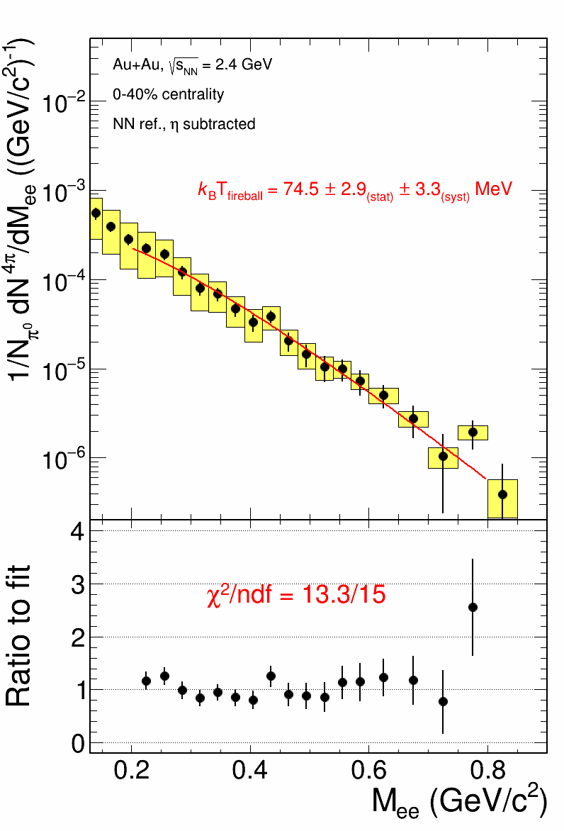

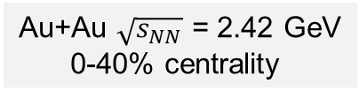
Thermal dileptons at high μ_{B}
Au+Au $\sqrt{s_{NN}}$ = 2.42 GeV
0-40% centrality
HADES
preliminary
Thermal dilepton production rates
L. D. McLerran, T. Toimela, PRD 31 (1985) 545
$$\frac{dN_{ll}}{d^{4}qd^{4}x}=−\frac{α_{em}^{2}}{π^{3}}\frac{L\left(M^{2}\right)}{M^{2}}f^{B}\left(q_{0},T\right)ImΠ_{em}(M,q,T,μ_{B})$$
Boltzmann factor
HADES Collab., MS in preparation, cf. also Nature Physics 15 (2019) 1040
Boltzmann factor dominates the exponential shape of the spectrum if ImΠ_{EM}/M² does not change much with M
Slope of the invariant mass not affected by the fireball expansion
True measure of the (average) source temperature

Slide 9
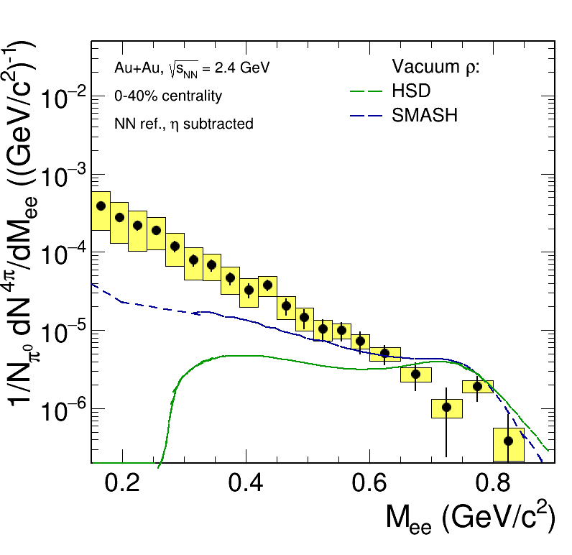
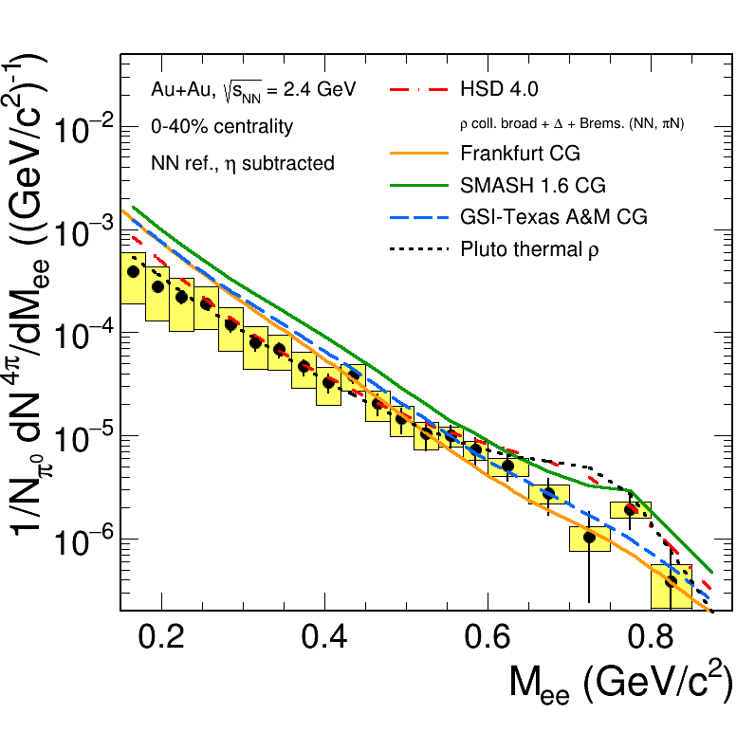

Thermal dileptons at high μ_{B}
Au+Au $\sqrt{s_{NN}}$ = 2.42 GeV
0-40% centrality
$$\frac{dN_{ll}}{d^{4}qd^{4}x}=−\frac{α_{em}^{2}}{π^{3}}\frac{L\left(M^{2}\right)}{M^{2}}f^{B}\left(q_{0},T\right)ImΠ_{em}(M,q,T,μ_{B})$$
HADES
preliminary
Spectral function
HADES
preliminary
Melting of ρ clearly visible
Collisional broadening
is not sufficient to account for that
Note new GiBUU calculations
A. Larionov et al., PRC 102 (2020) 064913
ρ melting handled properly by local equilibrium (CG) approach
pn bremsstrahlung corrected with the factor (parameters fitted to the d+p data):
CG FRA: PRC 92 (2015) 014911
CG GSI-Texas A&M: EPJA, 52 5 (2016) 131
CG SMASH: PRC 98 (2018) 054908
HSD: PRC 87 (2013) 064907
PLUTO: J. Phys. Conf. Ser 219 (2010) 032039

Slide 10
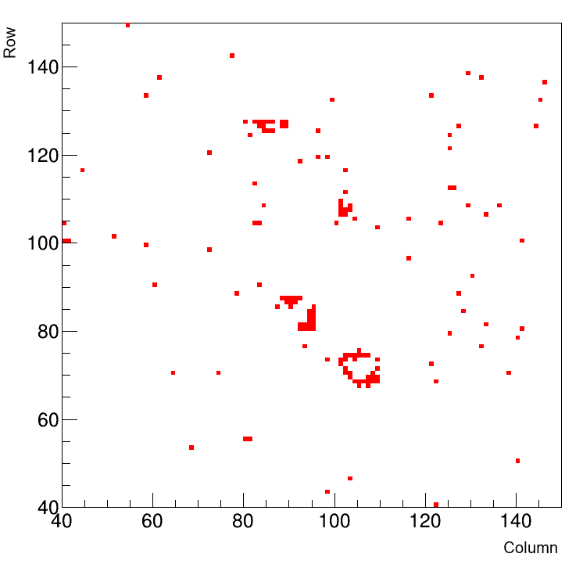
March 2019 Ag+Ag beam time upgrade of the RICH detector
Higher ring detection efficiency
Suppression of the combinatorial backgound via ring properties
PMT-based photodetector for HADES RICH
Event display of the
RICH detector
Number of raw signal pairs
Experiment | # analyzed events | M_{ee} < 0.12 GeV/c² | 0.12 < M_{ee} < 0.45 GeV/c² | M_{ee} > 0.45 GeV/c²
Au+Au (s_{NN})^{1/2} = 2.42 GeV | 2.4 x 10⁹ | 1.15×10⁵ | 1.53×10⁴ | 581
Ag+Ag (s_{NN})^{1/2} = 2.42 GeV | 5.9 x 10⁸ | 1.12×10⁵ | 1.59×10⁴ | 901
Ag+Ag (s_{NN})^{1/2} = 2.55 GeV | 4.0 x 10⁹ | 8.80×10⁵ | 1.53×10⁵ | 10916
Very high quality of the data!

Slide 11
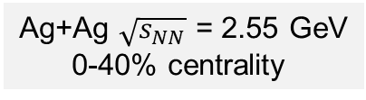
Momentum-dependent dilepton spectra
Vector mesons peaks (ω, φ) visible, especially cleat at high momentum
Possibility to study cross-sections and im-medium modifications of the spectral shape
Ag+Ag $\sqrt{s_{NN}}$ = 2.55 GeV
0-40% centrality
HADES work in progress
HADES work in progress

Slide 12
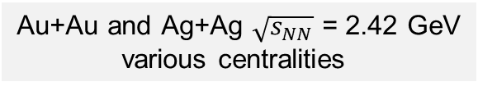
Dileptons in Ag+Ag vs. Au+Au
Three days of data taking at this energy
Dilepton statistics similar as in the whole Au+Au run
Au+Au and Ag+Ag $\sqrt{s_{NN}}$ = 2.42 GeV
various centralities
HADES work in progress
Comparable <A_{part}>
10-20% centrality
30-40% centrality

Slide 13

Reconstruction of scalar mesons
Photon Conversion Method
π⁰ / η → γγ → e⁺e⁻e⁺e⁻
Constrain freeze-out contribution to dilepton spectra
Possibility to compare with π±
Ag+Ag $\sqrt{s_{NN}}$ = 2.55 GeV
0-40% centrality

Slide 14
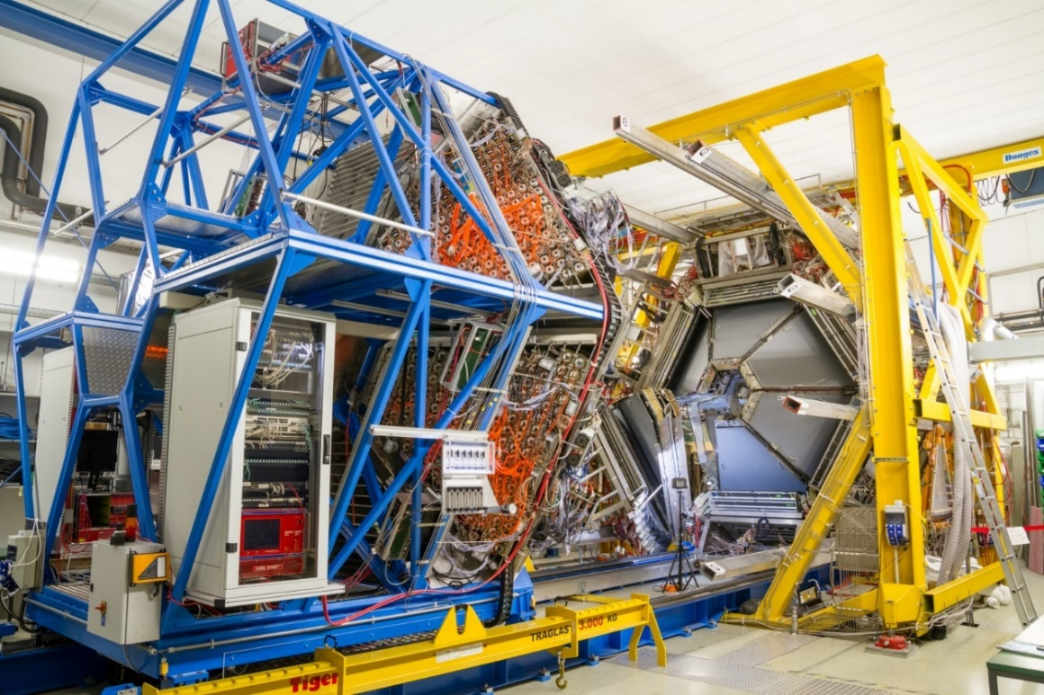
Reconstruction of scalar mesons: ECal
π⁰ ( η ) → γγ
Photons detected in ECal
Constrain freeze-out contribution to dilepton spectra
Possibility to compare with π±
Ag+Ag $\sqrt{s_{NN}}$ = 2.55 GeV
0-40% centrality
October 2018

Slide 15
Hadron Production and collectivity

Slide 16
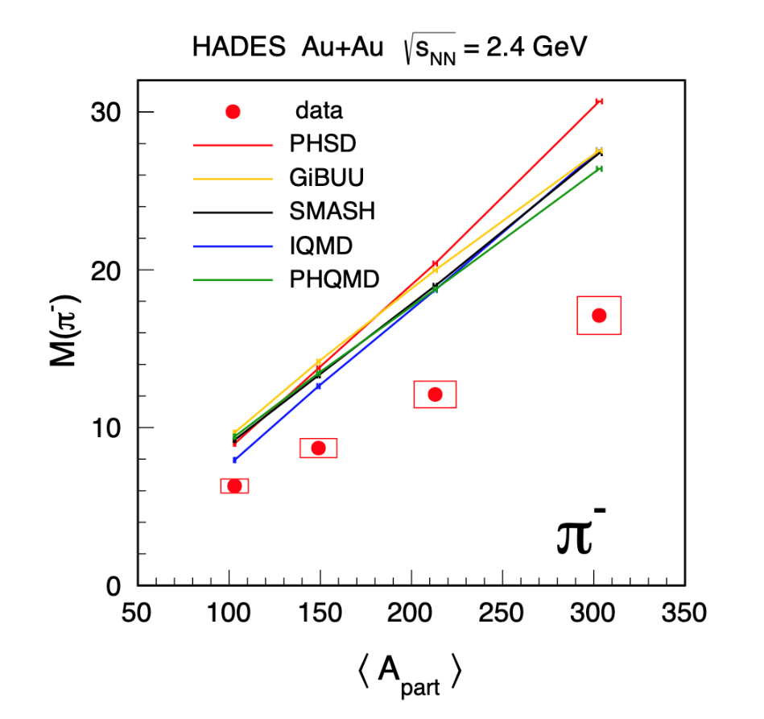
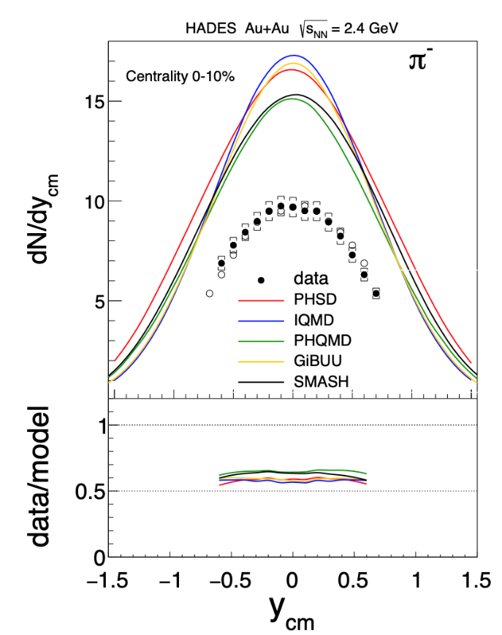
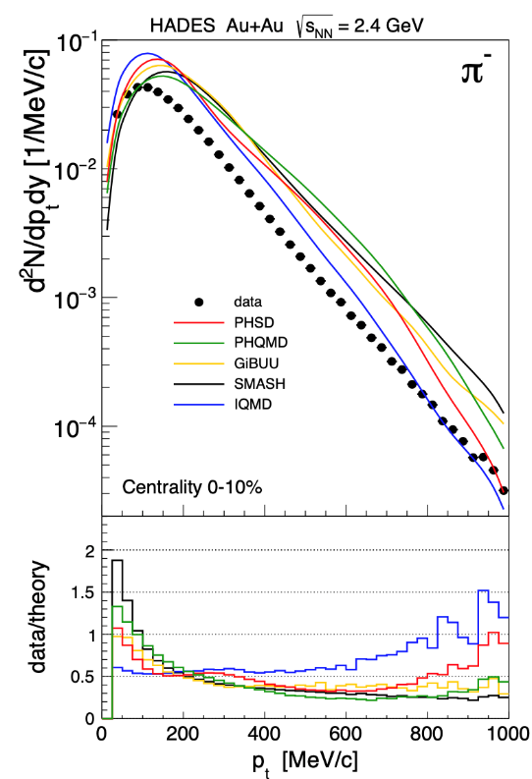
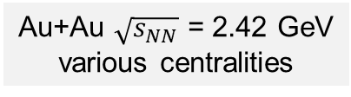
Pion production: case not yet closed
Au+Au $\sqrt{s_{NN}}$ = 2.42 GeV
various centralities
HADES Collaboration, EPJA 56 (2020) 10, 259
https://www.hepdata.net/record/ins1796710
Example for $π^{−}$, same holds for $π^{+}$
Tension between experimental data and kinetic transport models
Is there something fundamentally missing?

Slide 17
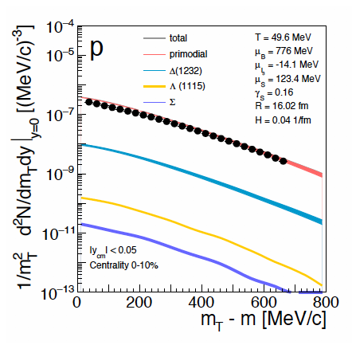
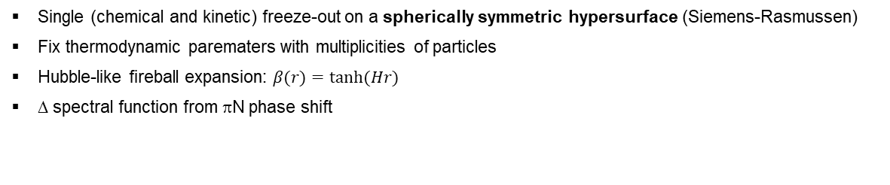
Bulk properties of matter with Statistical Hadronization Model
Au+Au $\sqrt{s_{NN}}$ = 2.42 GeV
0-40% centrality
SH, W. Florkowski, T. Galatyuk et al., PRC 102 (2020) 5, 054903
see also: A. Motornenko et al., arXiv:2104.06036 [hep-ph]
Single (chemical and kinetic) freeze-out on a spherically symmetric hypersurface (Siemens-Rasmussen)
Fix thermodynamic parematers with multiplicities of particles
Hubble-like fireball expansion: $β(r)=tanh⁡(Hr)$
Δ spectral function from πN phase shift
see also: G. Inghirami et al., arXiv:2106.04543 [nucl-th]
P.M. Lo et al., PRC 96 (2017) 015207

Slide 18
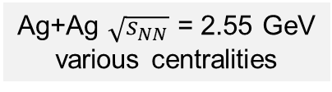
Pion production in Ag+Ag
Ag+Ag $\sqrt{s_{NN}}$ = 2.55 GeV
various centralities
HADES work in progress
HADES work in progress
Possibility for further investigations dependent on system size and collision energy

Slide 19
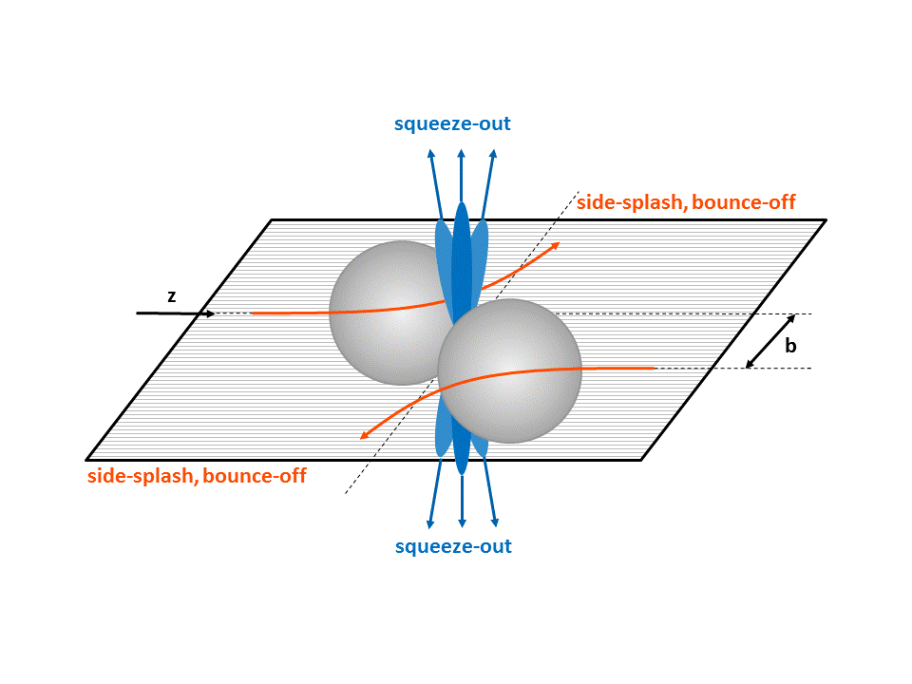
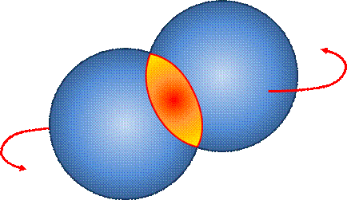
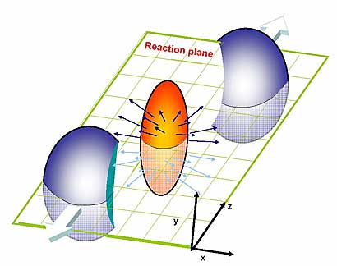
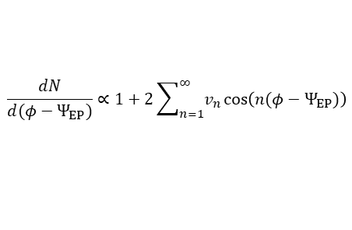
Azimuthal anisotropy with respect to reaction plane
Fourier coefficients of the distribution
$$\frac{dN}{d(φ−Ψ_{EP})}∝1+2\sum_{n=1}^{∞}{v_{n}\cos\left(n(φ−Ψ_{EP})\right)}$$
v₁ antisymmetric around y = 0
Intermediate energy, v₂ < 0
High energy, v₂ > 0
Sensitivity to:
QCD equation of state
Nuclear symmetry energy
[v₂(y_{cm}) for protons]
First-order phase transition
Y. Wang et al., PLB 802 (2020) 135249
J. Steinheimer et al., PRC 89 (2014) 054913

Slide 20
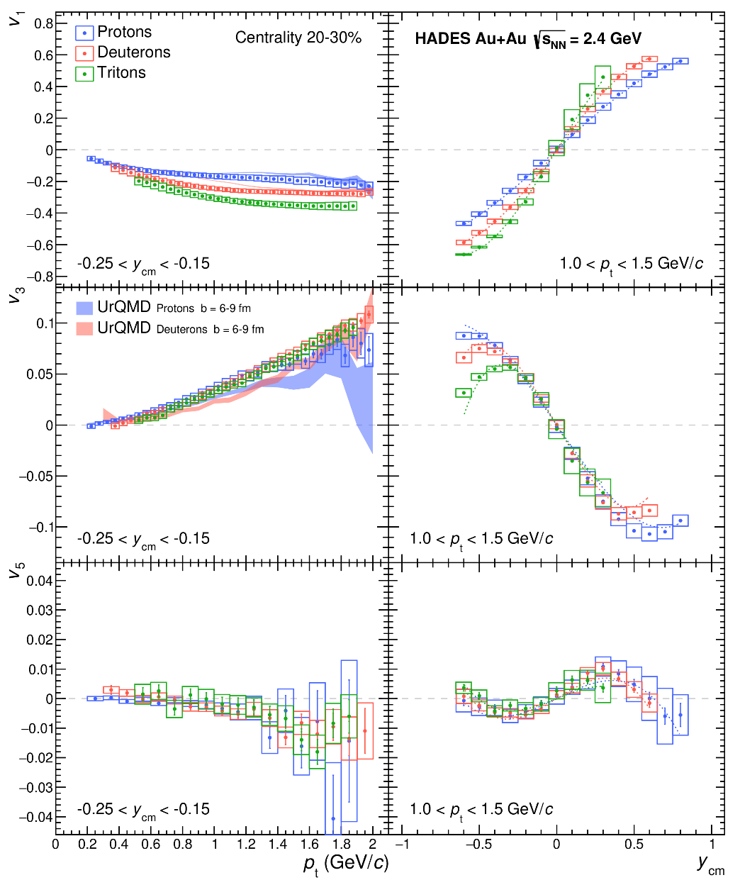
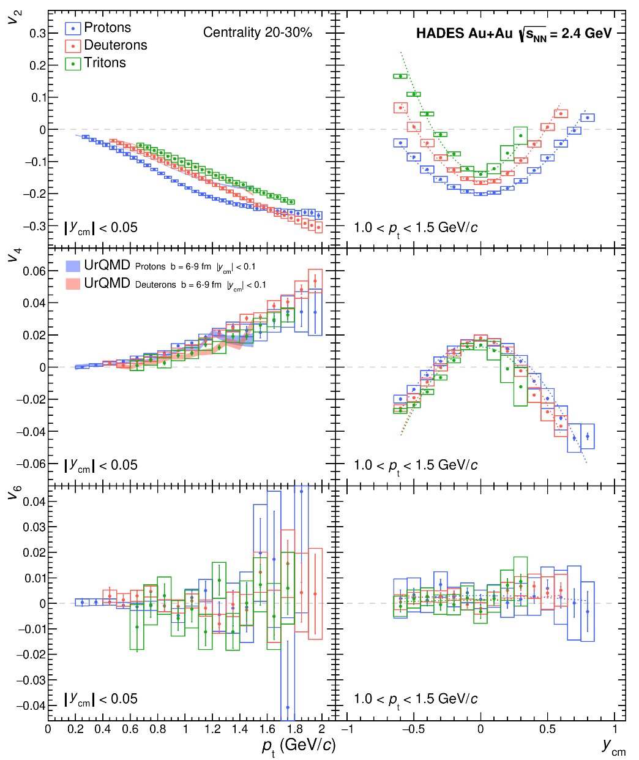

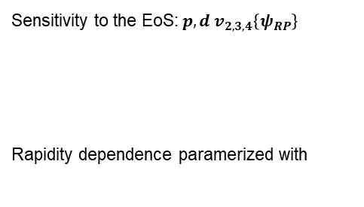





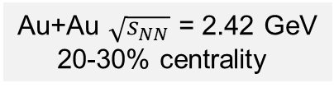

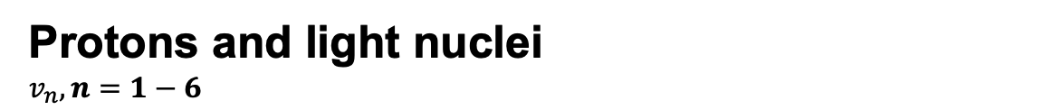


Protons and light nuclei
$v_{n}, n=1−6$
Au+Au $\sqrt{s_{NN}}$ = 2.42 GeV
20-30% centrality
HADES Collaboration, PRL 125 (2020) 262301,
https://www.hepdata.net/record/ins1797626
$$v_{1}$$
$$v_{2}$$
Sensitivity to the EoS:${ p, d v}_{2,3,4}\left\{ψ_{RP}\right\}$
Rapidity dependence paramerized with
$$V_{sk}=−124\left(\frac{ρ_{int}}{ρ_{0}}\right)+71{\left(\frac{ρ_{int}}{ρ_{0}}\right)}^{2}$$
$$v_{3}$$
$$v_{4}$$
UrQMD: P. Hillmann et al., J. Phys. G47 (2020) 055101
$$v_{5}$$
$$v_{6}$$
$$v_{1,3,5}\left(y_{cm}\right)=ay_{cm}+by_{cm}^{3}$$
$$v_{2,4,6}\left(y_{cm}\right)=c+dy_{cm}^{2}$$

Slide 21


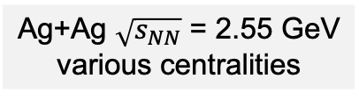

Anisotropy coefficients for pions
Ag+Ag $\sqrt{s_{NN}}$ = 2.55 GeV
various centralities
$v_{1}$ of $π^{−}$
$v_{2}$ of $π^{−}$
$v_{3}$ of $π^{−}$
HADES work in progress
HADES work in progress
HADES work in progress
Statistics sufficient to extract yields with high precision and flow harmonics up to n = 3

Slide 22
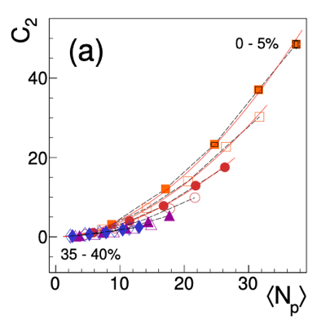
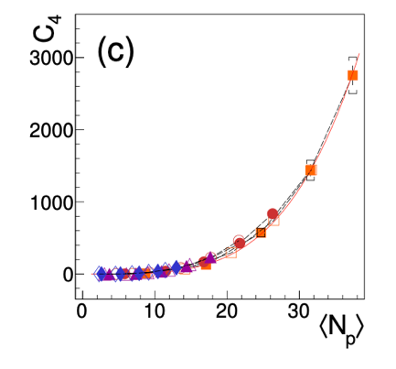





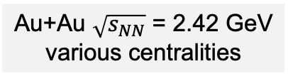




Critiacl fluctuations
Au+Au $\sqrt{s_{NN}}$ = 2.42 GeV
various centralities
STAR Collaboration, PRL 126 (2021) 092301
Ling, Stephanov, PRC 93, 034915 (2016)
Cumulants $k_{n}$ hold information on multi-particle correlators $Cn$
Bzdak, Koch, Strodthoff, PRC 95, 054906 (2017)
Investigate $Cn$ vs. $\left\langle N_{p}\right\rangle$ to isolate relevant physics, $Cn ∝{\left\langle N_{p}\right\rangle }^{α}$
HADES Collaboration, PRC 102 (2020) 2, 024914
https://www.hepdata.net/record/ins1781493
$α≃n →$ signature of multi-particle correlations ($Δy_{corr}>1)$
Collision Energy $\sqrt{s_{NN}}$ (GeV)
$\hat{p}=\frac{p}{T^{4}}$ reduced pressure
$C_{2}∝{\left\langle N_{p}\right\rangle }^{α}$
$α=1.86±0.04$
$C_{4}∝{\left\langle N_{p}\right\rangle }^{α}$
$α=3.89±0.14$
$$\frac{1}{VT^{3}}k_{n}=\frac{∂^{n}\hat{p}}{∂{\hat{μ}}^{n}}$$
Direct link to EoS
$\hat{μ}=\frac{μ}{T}$ reduced chemical potential
Further progress with data:
Applying identity method
Analyzing new Ag+Ag data
cf. B. Friman et al., EPJC 71 (2011) 1694
M. Stephanov, PRL107 (2011) 052301
A. Rustamov, M.I. Gorenstein, PRC 86 (2012) 044906

Slide 23
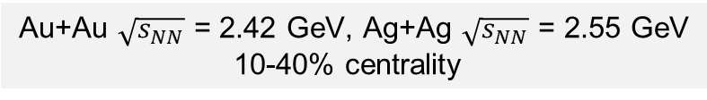
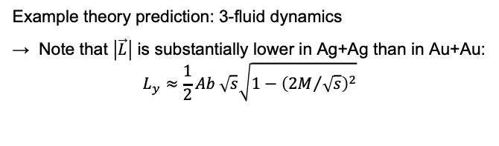
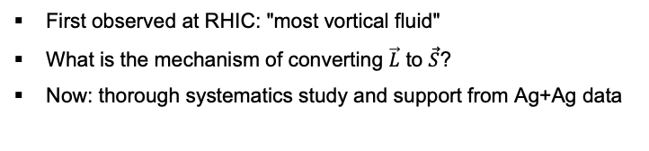
Global spin polarization
Au+Au $\sqrt{s_{NN}}$ = 2.42 GeV, Ag+Ag $\sqrt{s_{NN}}$ = 2.55 GeV
10-40% centrality
First observed at RHIC: "most vortical fluid"
What is the mechanism of converting $\vec{L}$ to $\vec{S}$?
Now: thorough systematics study and support from Ag+Ag data
Example theory prediction: 3-fluid dynamics
Note that $\left|\vec{L}\right|$ is substantially lower in Ag+Ag than in Au+Au:
$L_{y}≈\frac{1}{2}Ab \sqrt{s}\sqrt{1−{\left({2M}/{\sqrt{s}}\right)}^{2}}$

Slide 24
Strangeness

Slide 25
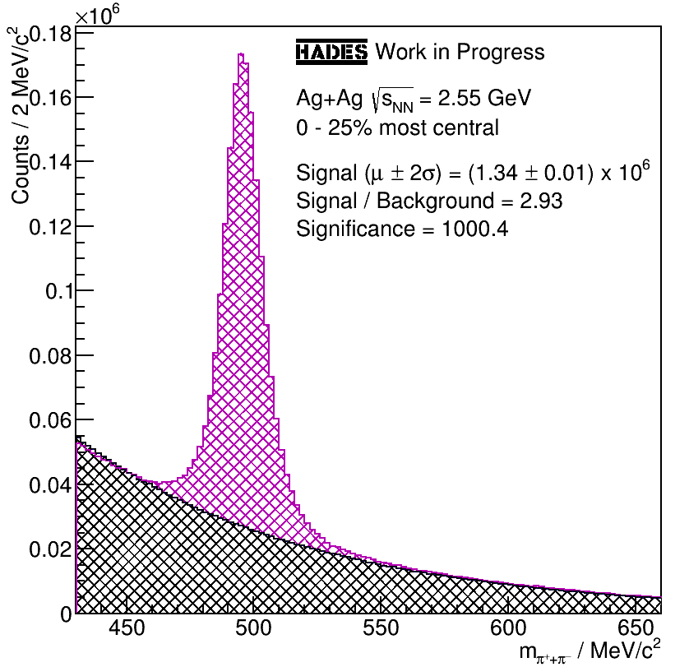
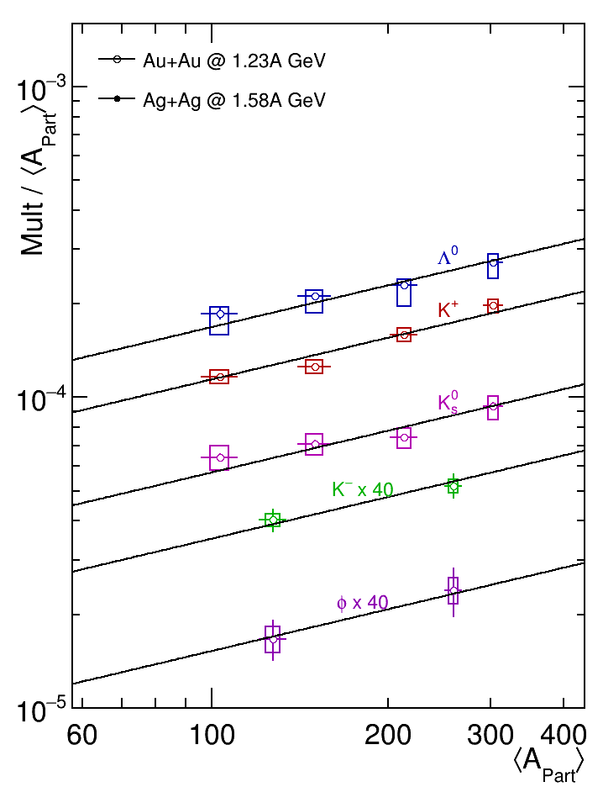
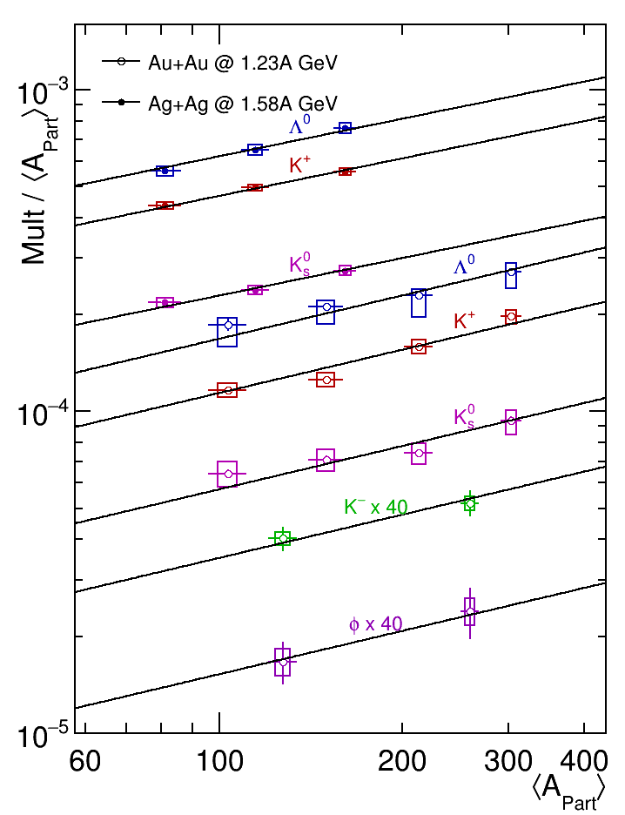
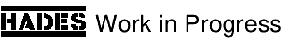




System with multi-particle correlations?
Au+Au: HADES Collaboration, PLB 793 (2019) 457
https://www.hepdata.net/record/ins1709767
Ag+Ag: HADES Collaboration, work in progress
Universal scaling with participant number
Does not reflect the hierarchy of NN production thresholds
        $K^{+}Λ: −130 MeV 0 MeV$
        $K^{+}K^{−}: −440 MeV −320 MeV$
        Power law α: 1.44 1.39
Scaling with absolute total of strangeness
not with individual hadron states
Connection to meson cloud?
Au+Au $\sqrt{s_{NN}}$ = 2.42 GeV
Ag+Ag $\sqrt{s_{NN}}$ = 2.55 GeV
K. Fukushima, T. Kojo, W. Weise, PRD 102 (2020) 096017
Quantum percolation at ρ ~ 1.8ρ₀

Slide 26
Intermezzo:
Baryons as extended objects
Exclusive analysis of pp → pp e⁺e⁻ at $\sqrt{s}=2.42$ GeV
Exclusive analysis of π⁻p → n e⁺e⁻ at $\sqrt{s}=1.49$ GeV
Data: PRC 95, 065205 (2017)
QED: point like γ∗NR, Heavy Ion Phys. 17, 27 (2003)
I&W: two component quark model, PRC 69, 055204 (2004)
R&P: covariant constituent quark model, PRD 93, 033004 (2016)
S&M brems.: PRC 82, 062201 (2010)
Rise of the ratio to the point-like "QED" description:
Characteristic to the Vector Meson Dominance
Related to the pion cloud

Slide 27






Charged kaons and $φ→K^{+}K^{−}$
Ag+Ag $\sqrt{s_{NN}}$ = 2.55 GeV
0-30% centrality
Good statistics in the new data set
Systematics is under investigation

Slide 28
Future perspectives

Slide 29







The upgraded HADES detector
Five new detector systems
Improved physics performance through instrumentation
of the very forward region using FAIR technology.
In particular important for the Hyperon Program.
iTOF
TransFAIR, Jülich
APD read-out
Enhances trigger purity
Forward RPC
LIP Coimbra
Based on R&D for neuLAND
TRB3 read-out
STS2
Jagiellonian Univ.
PANDA straw technology
PANDA PASTTREC FEE chip
STS1
TransFAIR, Jülich
PANDA straw technology
PANDA PASTTREC FEE chip
T0
GSI, TU Darmstadt
LGAD technology
In-beam detector

Slide 30














LGAD-based T0 detector for HADES and beyond
Prototyping phase
Finished
Well established performance
J.Pietraszko et al., Eur. Phys. J. A (2020) 56:183
https://doi.org/10.1140/epja/s10050-020-00186-w
HADES T0 full system
Sensor production at FBK - on-going
First set of sensors available at GSI for QA
Ready for test beam in 06.2021
Applications:
HADES Forward Wall system
HADES T0 barrel
ToF systems for IonCT
Energy Recovery Linacs (TU-DA)
Tracking system for 𝑒𝑒 experiment
EDM searches, JEDI at COSY
Beam monitoring at GSI/FAIR
T0 system for CBM at FAIR
….
New HADES sensor
mounted to the PCB
Infrastructure for HADES T0 ready
→ 47 ps time precision
→ SYSTEM ready for beam 01.2022

Slide 31





HADES proposals for GSI’s General Physics Advisory Committee (G-PAC)
Requires LGAD
technology and profits from DAQ upgrade
No special needs
Requires LGAD
technology and profits from DAQ upgrade
Requires maxmimum
beam intensity
and rigidity
Requires maxmimum
beam intensity
and rigidity
No special needs
40% granted
planned for 2022,
but too close after
p+p run - declined.
100 % granted
run scheduled for 2022
Not granted due to limited
available beam time
Not granted due to limited
available beam time
Not granted due to limited
available beam time

Slide 32
Summary
  Rich set of HADES data is useful to constrain the models and give insight into physics phenomena:
    Dilepton spectra in energy, centrality and system size dependence
    Pion spectra: tension with transport models
    Azimuthal anisotropies of pions, protons and light nuclei
    Criticality
    Global spin polarization
    Yields of strange particles
    Pion cloud

Slide 33
Thank you for youR attention

Slide 34
Extra slides

Slide 35





Heavy-ion collisions
Big goal: properties of strongly interacting matter at extreme temperatures and densities
Equation of state
Transport coefficients (viscosity, electrical conductivity, ...)
Phase structure
Conjectured phase diagram (could be even richer)
Features need to be proven experimentally
Idea: heat up and compress nuclear matter: heavy-ion collisions
  μ_{B} depends on density of baryons minus antibaryons
Different collision energies → different T and μ_{B}
Wikimedia Commons
MADAI.us
First-chance
NN collisions
QGP
Hadronic matter
Freeze-out
τ ~1 – 20 fm
(~10⁻²³ s)
Now established by ab initio QCD calculations on a lattice

Slide 36



Robustness of the data
Au+Au $\sqrt{s_{NN}}$ = 2.42 GeV, 0-40%
Target rapidity
Projectile rapidity
Mid-rapidity in the middle of the acceptance
Extrapolation and extracting 4π particle yields more reliable
For 10% most central events spectator contribution is negligible
Target rapidity
Projectile rapidity

Slide 37



Dependence on centrality and system size
Au+Au and Ag+Ag $\sqrt{s_{NN}}$ = 2.42 GeV
various centralities
Integrated yield – four-volume – life-time
  Dileptons as chronometer
Tendency towards lower excess yield
at the same <A_{part}> in Ag+Ag than in Au+Au
Temperature measured by the slope of the spectrum
  Dileptons as thermometer
Temperatures consistent in the two systems
N. Schild, HK 22.2
Thu, 17:00

Slide 38

Bulk Properties of the Matter with Thermal Event Generator (Therminator 2)
SH, W. Florkowski, T. Galatyuk et al., PRC 102 (2020) 5, 054903
Ingredients of the method:
Single (chemical and kinetic) freeze-out on a spherically symmetric hypersurface
(Siemens-Rasmussen blast-wave model)
Fix thermodynamic parematers with multiplicities of particles:
  Solve numerically 6 equations for 6 parameters:
Au+Au $\sqrt{s_{NN}}$ = 2.42 GeV, 0-10%
T = 49.6 MeV
μ_{B} = 776 MeV
μ_{I3} = -14.1 MeV
μ_{S} = 123.4 MeV
γ_{S} = 0.16
R = 16.02 fm
protons (incl. those bound in light nuclei): 124.1
π⁺: 9.3
π⁻: 17.1
K⁺: 0.0598
K⁻: 0.00056
Λ: 0.0822
Hubble-like fireball expansion: 𝑣(𝑟)=tanh⁡(𝐻𝑟)
  Proton m_{t} spectrum at mid-y is fitted
  to get the expansion velocity profile: H = 0.04 fm⁻¹
Δ spectral function from πN phase shift
P.M. Lo et al., PRC 96 (2017) 015207

Slide 39



Strangeness in Microscopic Transport
SMASH
GiBUU+HS
arbitrary
normalization
of theory curves
As much as 26% of K⁻ from φ decays
Ratio of φ το K⁻ and slopes of the spectra well described by UrQMD, SMASH and GiBUU (incl. bootstrap of Hagedorn States)
Absolute yields of strange particles not yet there
HADES Collaboration, PLB 778 (2018) 403
https://www.hepdata.net/record/ins1519164
J. Steinheimer et al., J. Phys. G 43 (2016) 1, 015105
V. Steinberg et al., PRC 99 (2019) 064908
K. Gallmeister et al., PRC 98 (2018) 024915

Slide 40




Correlatd Pion-Proton Pair Emission
HADES Collaboration, MS. submitted
Analysis of π⁺p and π⁻p pairs
High statistics allows multi-differential analysis
Understanding of “kinematical” mass shift with S-matrix formalism
Comparison to microscopic transport
P.M. Lo, EPJC 77 (2017) no.8, 533
R. Dashen et al., Phys. Rev. 187 (1969) 345
R.Venugopalan et al., NPA 546 (1992) 718
W. Weinhold, B. Friman, PLB 433 (1998) 236
UrQMD, T. Reichert et al., 2004.10539 [nucl-th]; Astron.Nachr. 340 (2019) 9-10, 1018-1022

Slide 41





3D HBT (𝜋⁻ 𝜋⁻) image of Au+Au collision zone
Identical particle correlations from Au-Au collisions, a.f.o. relative event-plane angle $Φ$ and pair momentum
Size modulations available for 6 bins
in pair momentum
Initial (nuclear overlap) eccentricity
is relaxed at freeze-out $ε_{initial}>ε_{final}$.
HADES, Phys.Lett.B 795 (2019) 446-45
HADES, 1910.07885 [nucl-ex]
$Φ=∠yb$ (long axis and impact parameter)

