Slide 1



Statusbericht zum Flaggschiff Quantentechnologie
Tommaso Calarco
Photonik-Ausschuss, 8.12.2017

Slide 2


Slide 3

THE QUANTUM FLAGSHIP
culmination point uniting all stakeholders
A long-term, large-scale research initiative
Foster world-leading knowledge and skills
Bring quantum technologies from the lab to the market
Develop technologies and open research facilities for quantum in Europe
Bring together research institutions, academia, industry, enterprises, and policy makers, in a joint and collaborative initiative on an unprecedented scale

Slide 4



THE QUANTUM FLAGSHIP AT A GLANCE
2018-2021
Ramp-up phase
October 2018
2000+
experts
1 billion €
152 million €
141 proposals
20 projects
10 years

Slide 5
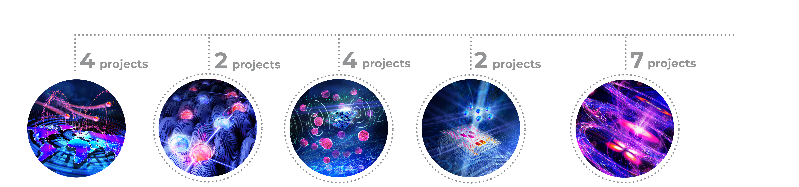










APPLICATION PILLARS
Simulating Complex Systems for
Advanced Design and Development
Addressing Foundational Challenges For
Development Of Quantum Technologies
For a Secure Digital Society and a Quantum-enabled Internet
Bringing Accuracy And Performance To
Unprecedented Levels
Computing Power To Overcome Currently Unsolvable Problems
Quantum Internet - secure communication and applications
By 2021 quantum simulators 20x more precise
By 2021, sensors with resolution 1000x better
By 2021, quantum computers of 50-100 qubits demonstrating first quantum applications
Discover & understand new fundamental quantum principles

Slide 6
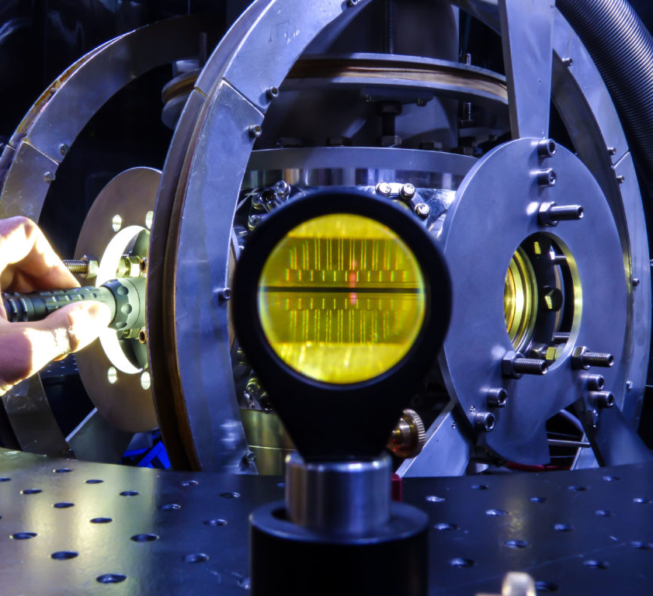

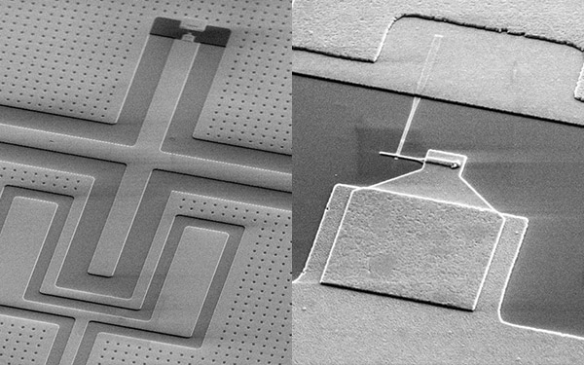
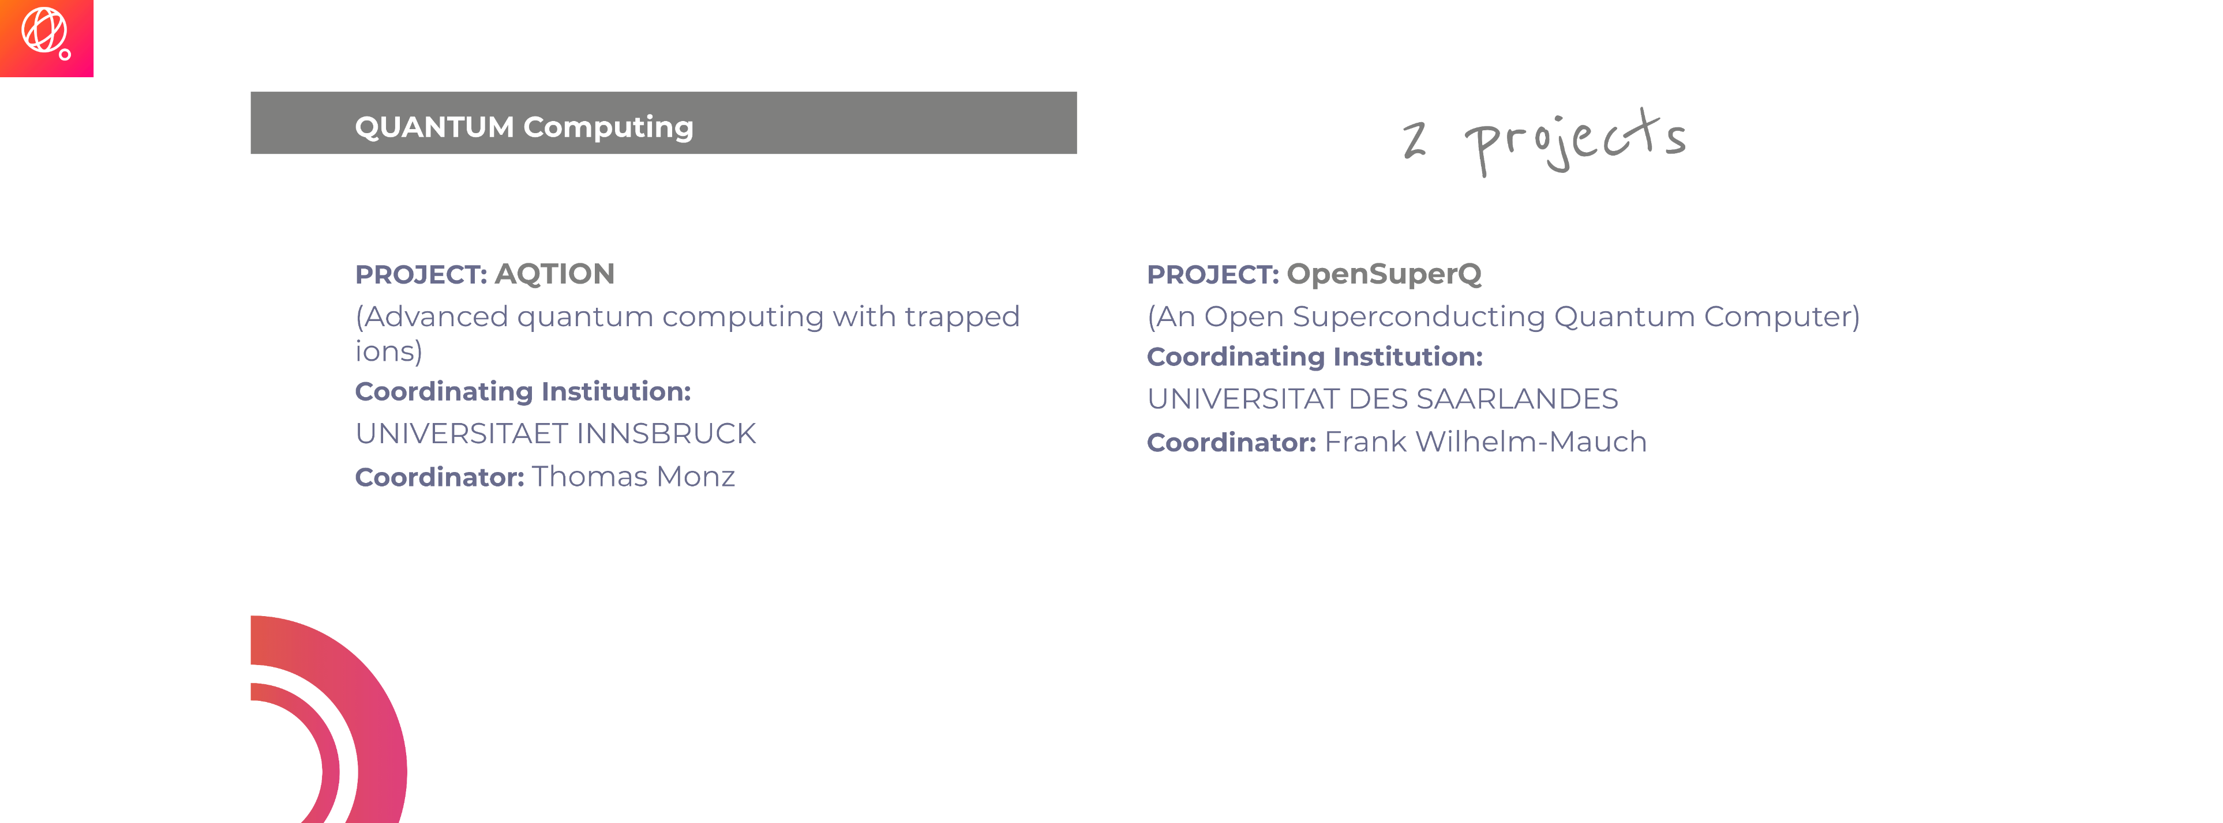


Slide 7
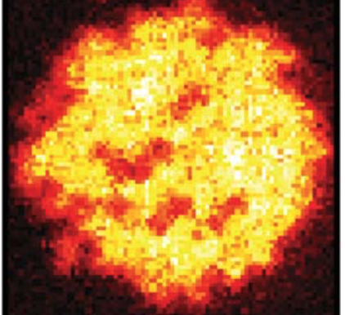
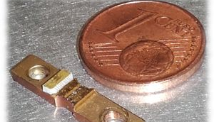

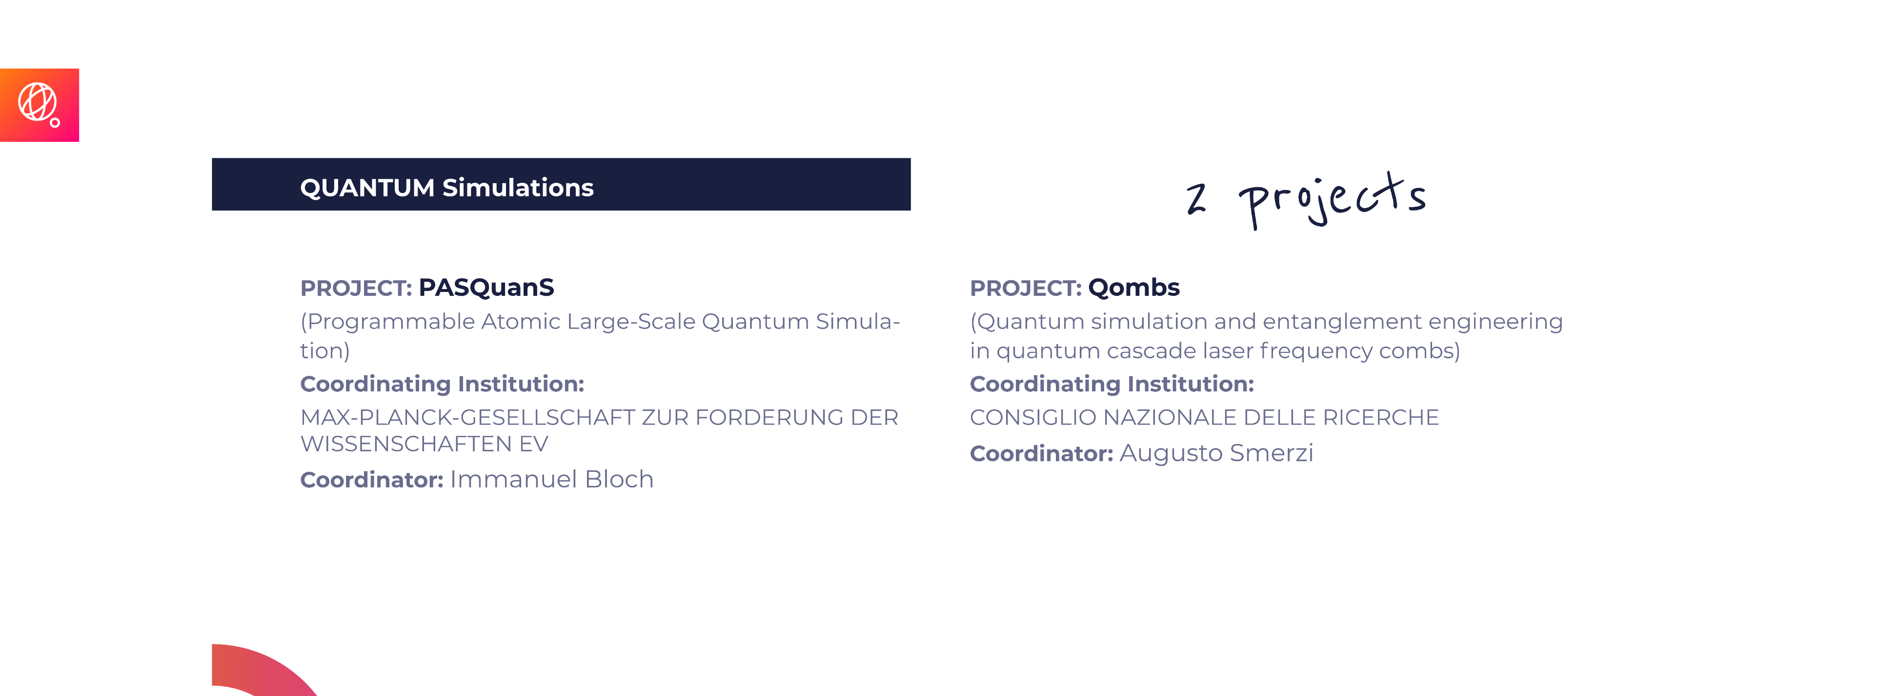


Slide 8



SRA OBJECTIVES
Simulating Complex Systems for
Advanced Design and Development
Computing Power To Overcome Currently Unsolvable Problems
By 2021 quantum simulators 20x more precise
By 2021, quantum computers of 50-100 qubits demonstrating first quantum applications

Slide 9
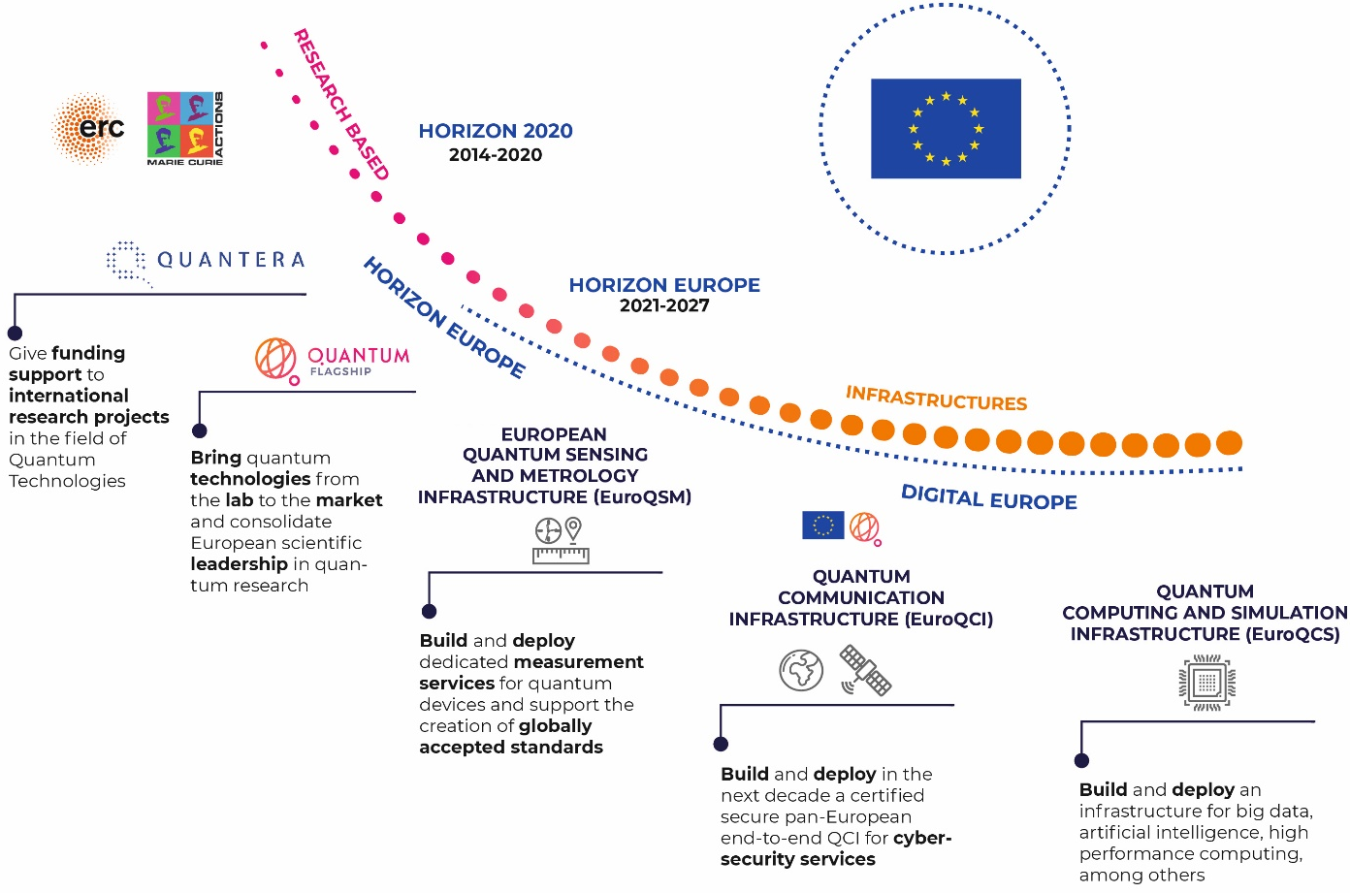
FROM VISION TO REALITY – THE EU’S COMMITMENT

Slide 10
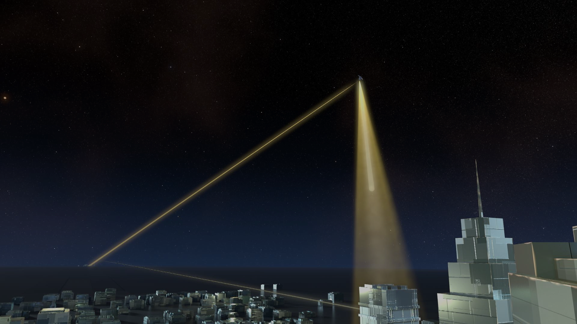




QUANTUM COMMUNICATION INFRASTRUCTURE
Integrate quantum cryptography into critical communication systems
Combine terrestrial and satellite components for wide coverage
Protection of data networks, clock synchronization,
e-voting,…
Backbone infrastructure
for the quantum internet

Slide 11





QUANTUM COMPUTATION & SIMULATION INFRASTRUCTURE
Classical quantum simulation hardware in HPC
Quantum testbed facilities for hardware developers
Quantum computation and simulation hardware (ion traps, super-/semi-conducting qubits, spin qubits, phtonic circuits, neutral atoms)
Quantum application database (verification/validation, algorithms, apps)

Slide 12
ECT* role
FP5
FP6 (2002-2006)
FP7 (2007-2013)
H2020 (2014)
H2020 (2014-2020)
HE (2021-2027)
ACQUIRE (2000)
QUIPROCONE (2000)
ACQP (2003)
QUROPE (2007)
CHIST-ERA (2009)
Strategic report (roadmap) exercise
Cartography of European QIST groups/structures
QIST worldwide (US, Japan, Australia, Singapore)
ERA-NET initiative
Call for projects in QIFT (2010)
Coordinate QUTE working group/QUARTET
Help HLSC in delivering the flagship’s strategic research agenda, implementation and governance
QUIE²T (2010)
Community monitoring and overview
Strategy, vision sustainability
Dissemination
Establishment of Virtual Institutes
Creation of qurope.eu portal
Unify, structure and strengthen the QIPC community in Europe
Develop a common strategy, vision and goals
Congregate and coordinate all QIPC projects / actions at the EU level
Integration and cross-fertilization across disciplines
Encourage young researchers
Increase awareness
Int. cooperation

Slide 13
ECT* role
FP5
FP6 (2002-2006)
FP7 (2007-2013)
H2020 (2014)
H2020 (2014-2020)
HE (2021-2027)
ACQUIRE (2000)
QUIPROCONE (2000)
ACQP (2003)
SCALA (2005)
ERA-Pilot QIST (2005)
QUROPE (2007)
CHIST-ERA (2009)
Strategic report (roadmap) exercise
Cartography of European QIST groups/structures
QIST worldwide (US, Japan, Australia, Singapore)
ERA-NET initiative
Call for projects in QIFT (2010)
Coordinate QUTE working group/QUARTET
Help HLSC in delivering the flagship’s strategic research agenda, implementation and governance
QUIE²T (2010)
Community monitoring and overview
Strategy, vision sustainability
Dissemination
Establishment of Virtual Institutes
Creation of qurope.eu portal
Unify, structure and strengthen the QIPC community in Europe
Develop a common strategy, vision and goals
Congregate and coordinate all QIPC projects / actions at the EU level
Integration and cross-fertilization across disciplines
Encourage young researchers
Increase awareness
Int. cooperation

Slide 14
ECT* role
FP5
FP6 (2002-2006)
FP7 (2007-2013)
H2020 (2014)
H2020 (2014-2020)
HE (2021-2027)
ACQUIRE (2000)
QUIPROCONE (2000)
ACQP (2003)
SCALA (2005)
ERA-Pilot QIST (2005)
QUROPE (2007)
CHIST-ERA (2009)
Strategic report (roadmap) exercise
Cartography of European QIST groups/structures
QIST worldwide (US, Japan, Australia, Singapore)
ERA-NET initiative
Call for projects in QIFT (2010)
Coordinate QUTE working group/QUARTET
Help HLSC in delivering the flagship’s strategic research agenda, implementation and governance
QUIE²T (2010)
Community monitoring and overview
Strategy, vision sustainability
Dissemination
Establishment of Virtual Institutes
Creation of qurope.eu portal
Unify, structure and strengthen the QIPC community in Europe
Develop a common strategy, vision and goals
Congregate and coordinate all QIPC projects / actions at the EU level
Integration and cross-fertilization across disciplines
Encourage young researchers
Increase awareness
Int. cooperation

Slide 15
ECT* role
FP5
FP6 (2002-2006)
FP7 (2007-2013)
H2020 (2014)
H2020 (2014-2020)
HE (2021-2027)
ACQUIRE (2000)
QUIPROCONE (2000)
ACQP (2003)
ICT-Beyond limits (2011)
SCALA (2005)
FET-Flagship Pilot SA (failed)
ERA-Pilot QIST (2005)
QUROPE (2007)
CHIST-ERA (2009)
Strategic report (roadmap) exercise
Cartography of European QIST groups/structures
QIST worldwide (US, Japan, Australia, Singapore)
ERA-NET initiative
Call for projects in QIFT (2010)
Coordinate QUTE working group/QUARTET
Help HLSC in delivering the flagship’s strategic research agenda, implementation and governance
QUIE²T (2010)
Community monitoring and overview
Strategy, vision sustainability
Dissemination
Establishment of Virtual Institutes
Creation of qurope.eu portal
Unify, structure and strengthen the QIPC community in Europe
Develop a common strategy, vision and goals
Congregate and coordinate all QIPC projects / actions at the EU level
Integration and cross-fertilization across disciplines
Encourage young researchers
Increase awareness
Int. cooperation

Slide 16
ECT* role
FP5
FP6 (2002-2006)
FP7 (2007-2013)
H2020 (2014)
H2020 (2014-2020)
HE (2021-2027)
ACQUIRE (2000)
QUIPROCONE (2000)
ACQP (2003)
ICT-Beyond limits (2011)
SCALA (2005)
FET-Flagship Pilot SA (failed)
ERA-Pilot QIST (2005)
QUROPE (2007)
CHIST-ERA (2009)
QUTE-Europe (2013)
Strategic report (roadmap) exercise
Cartography of European QIST groups/structures
QIST worldwide (US, Japan, Australia, Singapore)
ERA-NET initiative
Call for projects in QIFT (2010)
Industry monitoring and overview
General awareness
Establishment of Virtual Facilities
Quantum Manifesto
Sustainability (flagship)
Coordinate QUTE working group/QUARTET
Help HLSC in delivering the flagship’s strategic research agenda, implementation and governance
QUIE²T (2010)
Community monitoring and overview
Strategy, vision sustainability
Dissemination
Establishment of Virtual Institutes
Creation of qurope.eu portal
Unify, structure and strengthen the QIPC community in Europe
Develop a common strategy, vision and goals
Congregate and coordinate all QIPC projects / actions at the EU level
Integration and cross-fertilization across disciplines
Encourage young researchers
Increase awareness
Int. cooperation

Slide 17

ECT* role
FP5
FP6 (2002-2006)
FP7 (2007-2013)
H2020 (2014)
H2020 (2014-2020)
HE (2021-2027)
ACQUIRE (2000)
QUIPROCONE (2000)
ACQP (2003)
ICT-Beyond limits (2011)
SCALA (2005)
FET-Flagship Pilot SA (failed)
ERA-Pilot QIST (2005)
CHIST-ERA (2009)
QUTE-Europe (2013)
Flagship preparation
QT CSA (2018)
Strategic report (roadmap) exercise
Cartography of European QIST groups/structures
QIST worldwide (US, Japan, Australia, Singapore)
QUROPE (2007)
ERA-NET initiative
Call for projects in QIFT (2010)
Industry monitoring and overview
General awareness
Establishment of Virtual Facilities
Quantum Manifesto
Sustainability (flagship)
Coordinate QUTE working group/QUARTET
Help HLSC in delivering the flagship’s strategic research agenda, implementation and governance
Comm. platform for all stakeholders
Promote Flagship objectives
Facilitate connections between industry/academia
Help shaping the Flagship during and beyond H2020
Outreach events
Facilitate dialogue policy, industry, academia
Help the networking of QT national activities
QUIE²T (2010)
Community monitoring and overview
Strategy, vision sustainability
Dissemination
Establishment of Virtual Institutes
Creation of qurope.eu portal
Unify, structure and strengthen the QIPC community in Europe
Develop a common strategy, vision and goals
Congregate and coordinate all QIPC projects / actions at the EU level
Integration and cross-fertilization across disciplines
Encourage young researchers
Increase awareness
Int. cooperation

Slide 18
ECT* role
FP5
FP6 (2002-2006)
FP7 (2007-2013)
H2020 (2014)
H2020 (2014-2020)
HE (2021-2027)
ACQUIRE (2000)
QUIPROCONE (2000)
ACQP (2003)
ICT-Beyond limits (2011)
SCALA (2005)
FET-Flagship Pilot SA (failed)
ERA-Pilot QIST (2005)
CHIST-ERA (2009)
QUTE-Europe (2013)
Flagship preparation
QT CSA (2018)
?
Strategic report (roadmap) exercise
Cartography of European QIST groups/structures
QIST worldwide (US, Japan, Australia, Singapore)
QUROPE (2007)
ERA-NET initiative
Call for projects in QIFT (2010)
Industry monitoring and overview
General awareness
Establishment of Virtual Facilities
Quantum Manifesto
Sustainability (flagship)
Coordinate QUTE working group/QUARTET
Help HLSC in delivering the flagship’s strategic research agenda, implementation and governance
Comm. platform for all stakeholders
Promote Flagship objectives
Facilitate connections between industry/academia
Help shaping the Flagship during and beyond H2020
Outreach events
Facilitate dialogue policy, industry, academia
Help the networking of QT national activities
QUIE²T (2010)
Community monitoring and overview
Strategy, vision sustainability
Dissemination
Establishment of Virtual Institutes
Creation of qurope.eu portal
Unify, structure and strengthen the QIPC community in Europe
Develop a common strategy, vision and goals
Congregate and coordinate all QIPC projects / actions at the EU level
Integration and cross-fertilization across disciplines
Encourage young researchers
Increase awareness
Int. cooperation

