Slide 1
Istituto Nazionale Fisica Nucleare - Laboratori Nazionali di Frascati
STRANEX
Recent progress and perspectives in STRANge EXotic atoms studies and related topics
Trento, 21-25 / 10/ 2019

Slide 2
Silicon Drift Detectors for
Kaonic atoms spectroscopy at DAΦNE,
SIDDHARTA-2 experiment
M. Miliucci
On behalf of SIDDHARTA-2 collaboration
Marco.Miliucci@lnf.infn.it

Slide 3
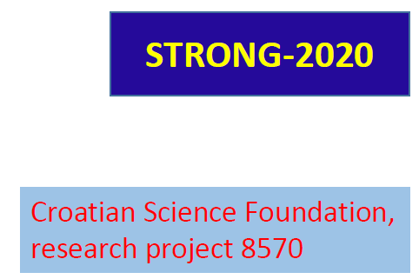
SIDDHARTA – 2 Collaboration
Silicon Drift Detectors for Hadronic Atom Research by Timing Application
LNF-INFN, Frascati, Italy
SMI-ÖAW, Vienna, Austria
Politecnico di Milano, Italy
IFIN –HH, Bucharest, Romania
TUM, Munich, Germany
RIKEN, Japan
Univ. Tokyo, Japan
Victoria Univ., Canada
Univ. Zagreb, Croatia
Helmholtz Inst. Mainz, Germany
Univ. Jagiellonian Krakow, Poland
ELPH, Tohoku University
Trento, 24/10/2019

Slide 4
Outline
Kaonic atoms physics at DAΦNE
New Silicon Drift Detectors (SDDs) technology for precision KD measurements
SDDs in DAΦNE
Conclusions

Slide 5
Outline
Kaonic atoms physics at DAΦNE
New Silicon Drift Detectors (SDDs) technology for precision KD measurements
SDDs in DAΦNE
Conclusions and outlooks

Slide 6
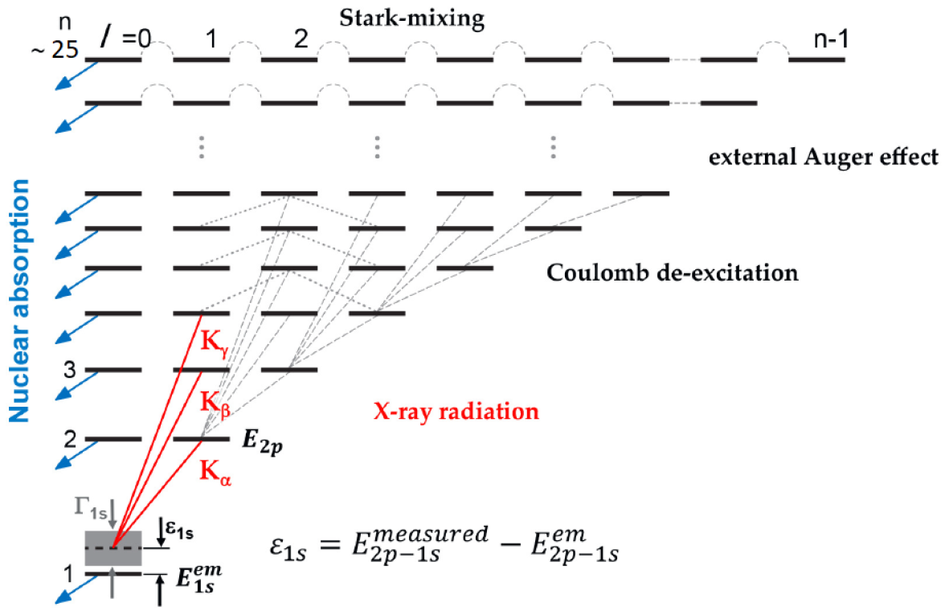
Cascade process → strong interaction
ε_{1s} , Γ_{1s}
KN interaction at threshold
Trento, 24/10/2019

Slide 7
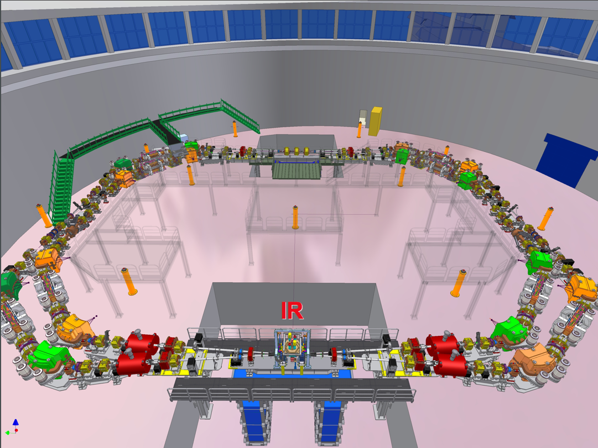
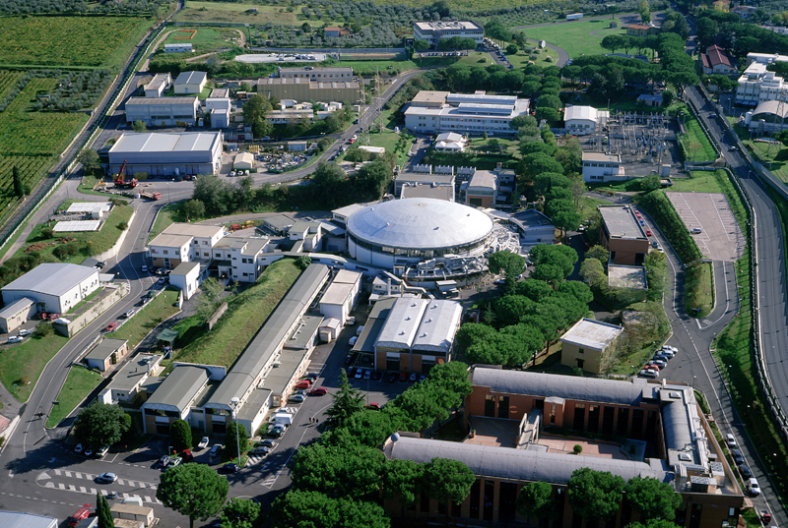
I.N.F.N.– Laboratori Nazionali di Frascati
Φ → K⁻ K⁺ (49.1%)
Monochromatic low-energy K⁻ (~127 MeV/c ; Δp/p = 0.1%)
Electromagnetic (asynchronous) bkg
Hadronic (syncronous) bkg
ADA e ADONE
ATLAS
NAUTILUS
SIDDHARTA
Centro di
Calcolo
DAΦNE
DAΦNE
DAFNE-L
BTF
FISA
e⁻
e⁺
FINUDA
DEAR
Auditorium

Slide 8
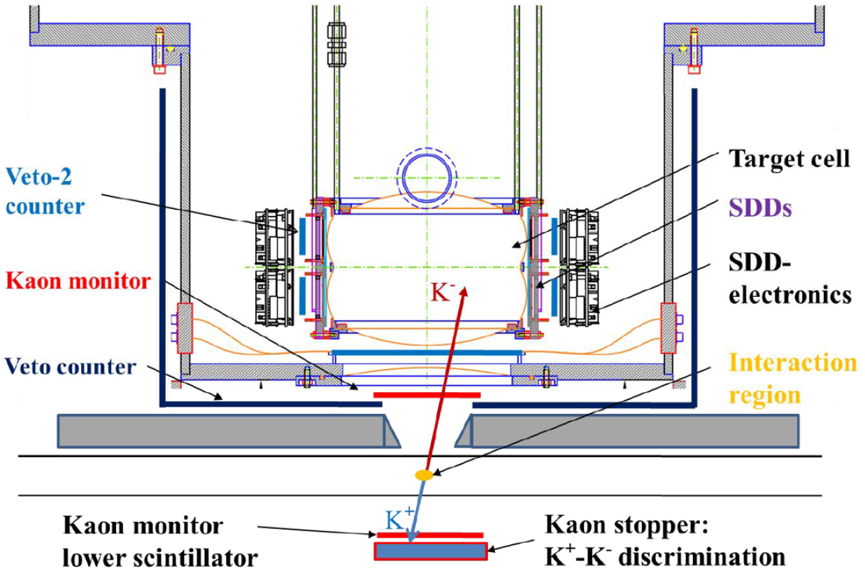
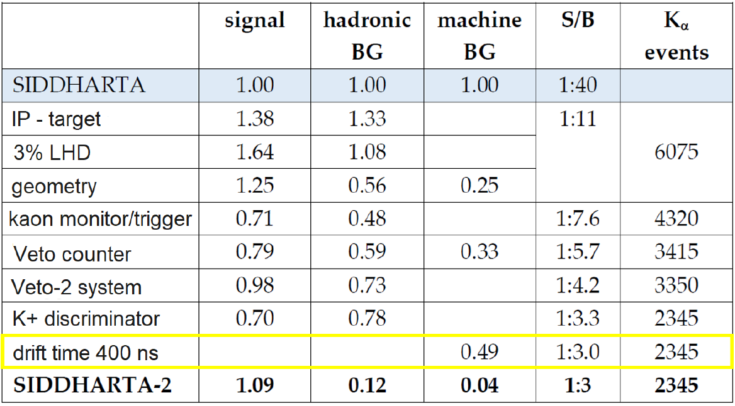
KD yield < 0.1 %
(10 times lower than KH)
Bazzi et al., Nuclear Physics A 907, 69-77 (2013)
Bazzi et al., Nuclear Physics A 954, 7–16 (2016)
SIDDHARTA 2
MC Kaonic deuterium

Slide 9
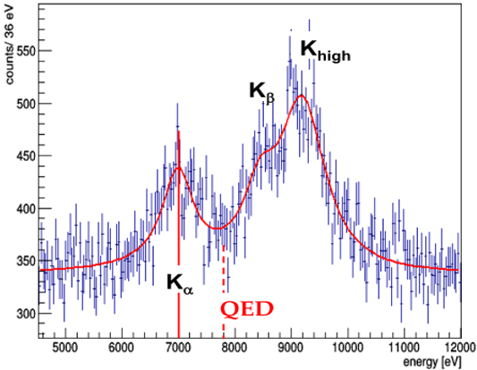
MC Kaonic deuterium
KD yield < 0.1 %
$$\int{L}={800pb}^{−1}$$
density: 3% (LHD)
detector area: 246 cm²
ε = -800 ± 30 eV
Γ = 750 ± 75 eV
Same precision as SIDDHARTA, which gave the most precise measurement of KH so far
Trento, 24/10/2019

Slide 10
Outline
Kaonic atoms physics at DAΦNE
New Silicon Drift Detectors (SDDs) technology for precision KD measurements
SDDs in DAΦNE
Conclusions

Slide 11
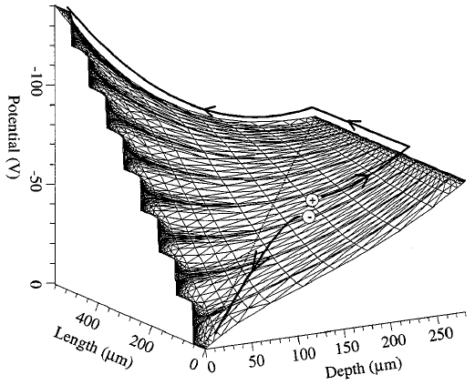
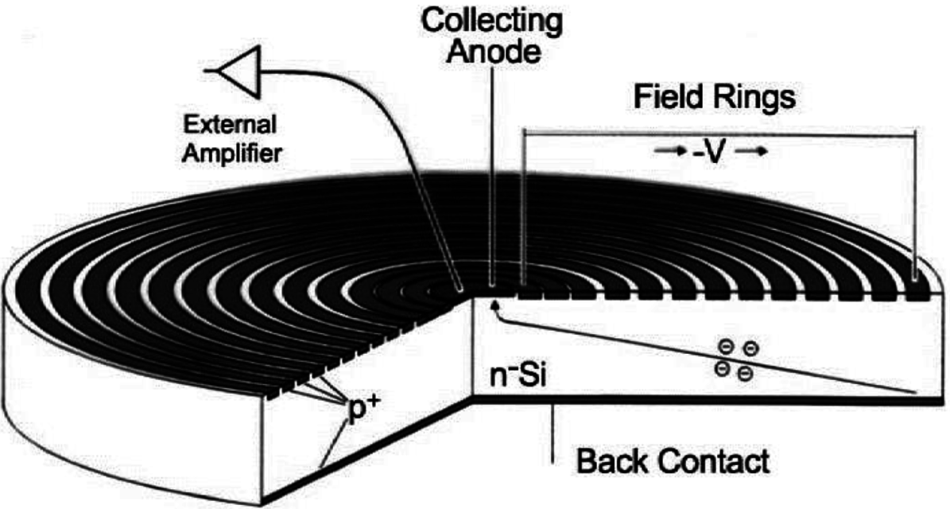
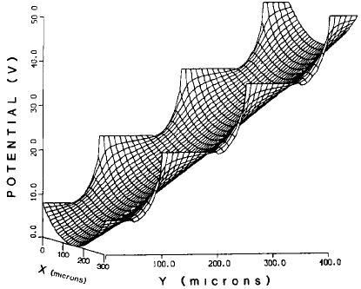
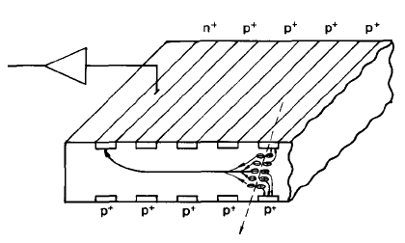
Silicon Drift Chamber (SDC)
Silicon Drift Detector (SDD)
RN
Back
[1]
[2]
Anode
[1] P. Rehak at al, Nucl. Instr. Meth. Phys. Res. A235, (1985)
[2] C. Fiorini et al., IEEE transactions on nuclear science, 47(4) (2000)
Trento, 24/10/2019

Slide 12
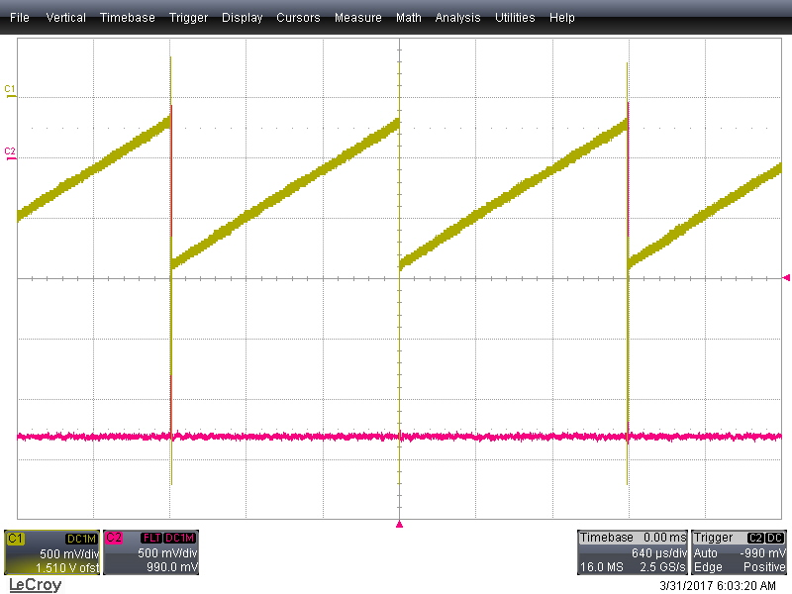
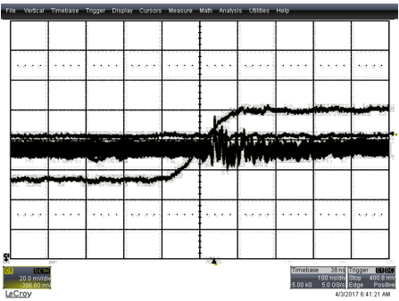
New technology SDD (FBK + PoliMi + LNF)
SDD ramp & CUBE RESET
X-Ray edge
640μs/div
100ns/div
3x1 array (SDD:1x1x0.045 cm³)
4x2 array (SDD:0.8x0.8x0.045 cm³)
Trento, 24/10/2019

Slide 13
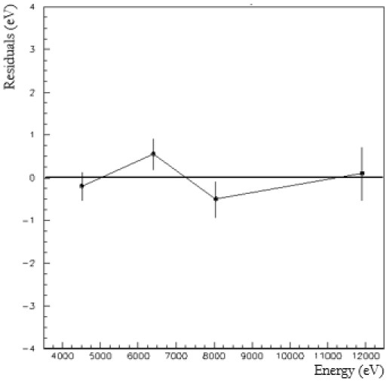
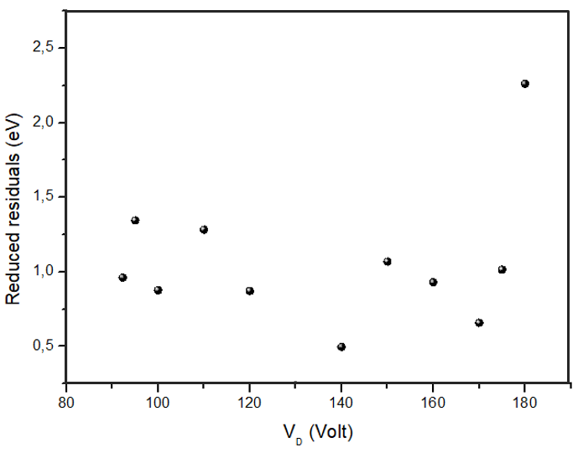
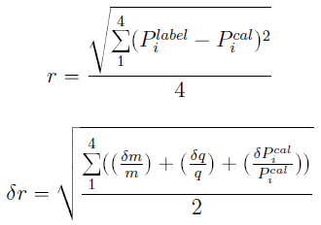
Linearity
Fe_{Kα}
Br_{Kα}
Ti_{Kα}
Cu_{Kα}
Miliucci et al., Condens. Matter, 4(2) (2019)
Trento, 24/10/2019

Slide 14
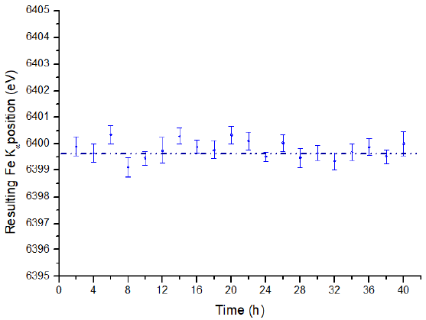
Long time run
Ti-Br calibration
Fe K_{α} : 6399.8 ± 0.4 eV
ΔE_{mean} = 0.2 ± 0.4 eV
Miliucci et al., Condens. Matter, 4(2) (2019)
Trento, 24/10/2019

Slide 15
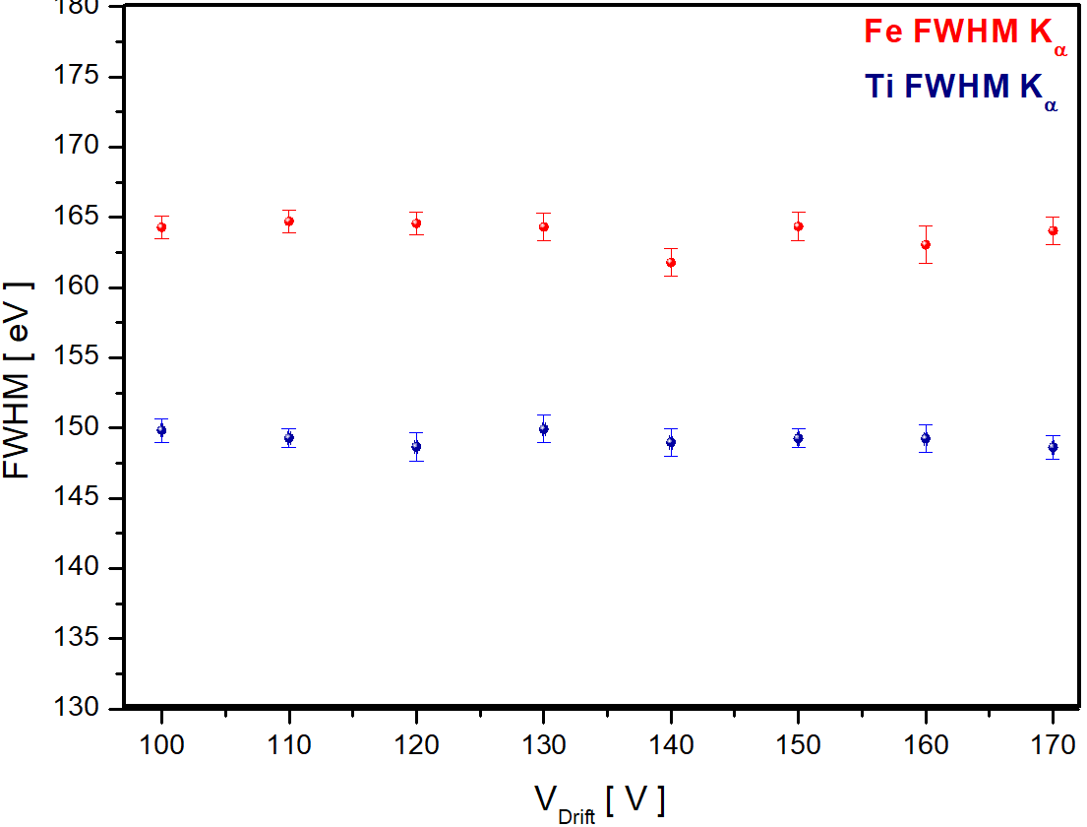
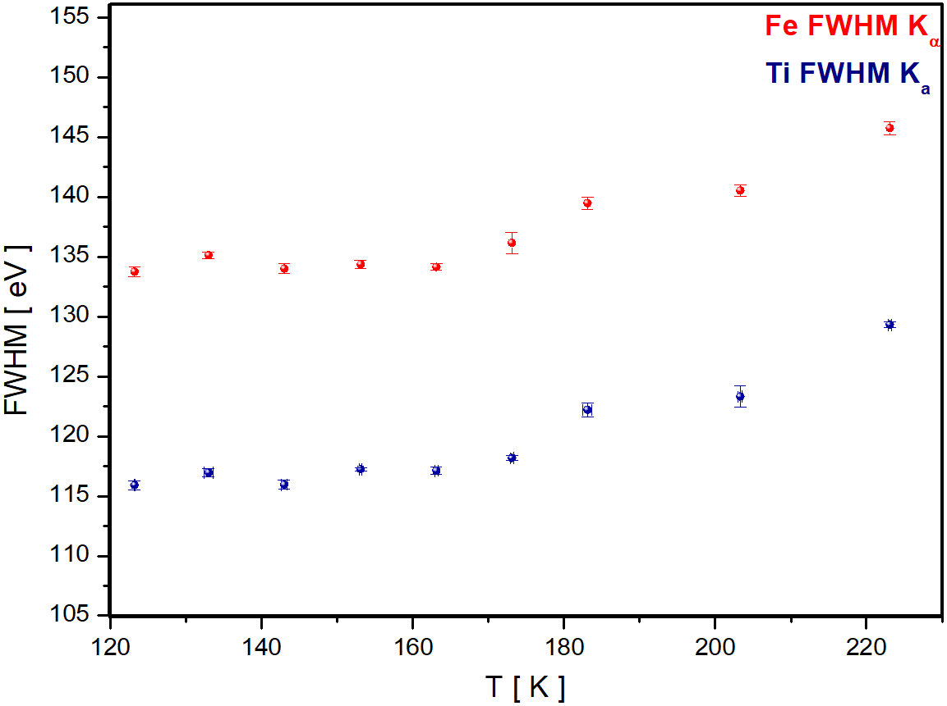
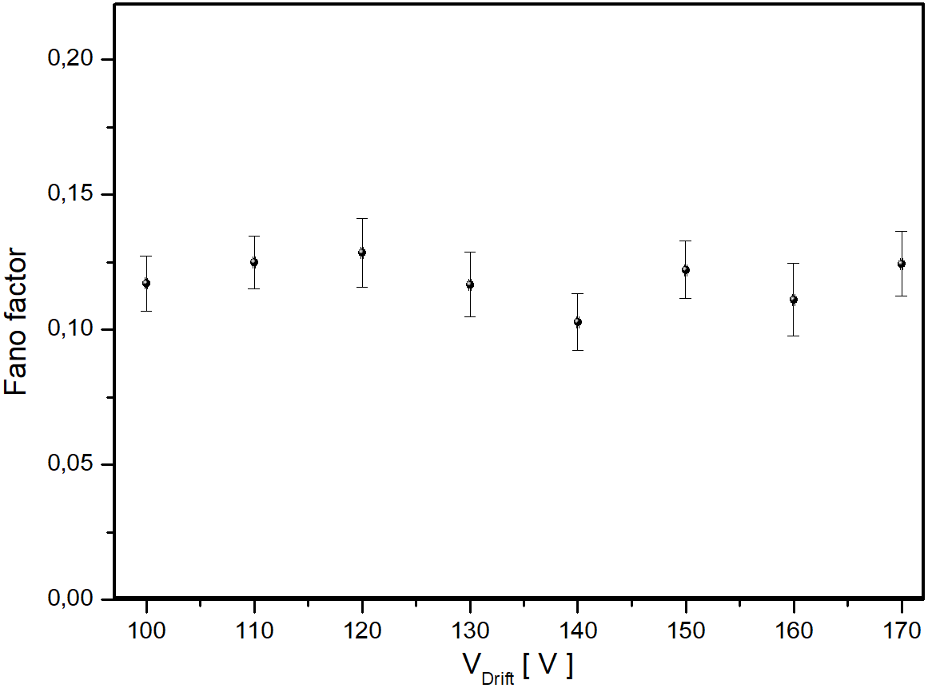
Energy resolution
Voltage scan Temperature scan
FF = 0.118 ± 0.009
FF = 0.116 ± 0.009
Miliucci et al., Condens. Matter, 4(2) (2019)
Trento, 24/10/2019

Slide 16
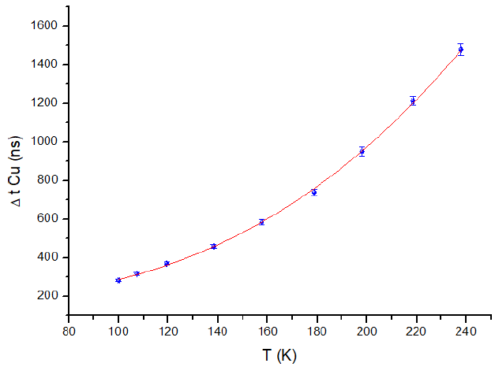
Drift time (temperature scan)
µ: mobility ~ T^{-n}
Trento, 24/10/2019

Slide 17
Outline
Kaonic atoms physics at DAΦNE
New Silicon Drift Detectors (SDDs) technology for precision KD measurements
SDDs in DAΦNE
Conclusions

Slide 18
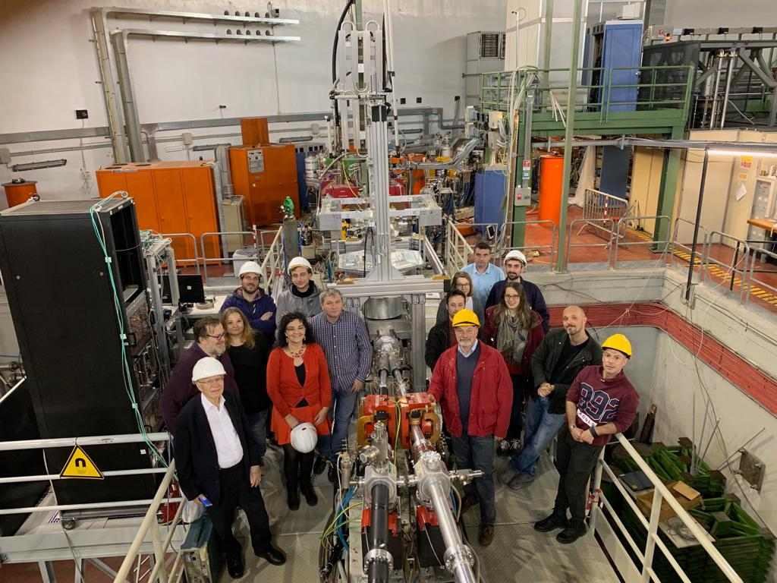
Sharp & Succesfull SIDDHARTINO installation
(April 2019)
Trento, 24/10/2019

Slide 19
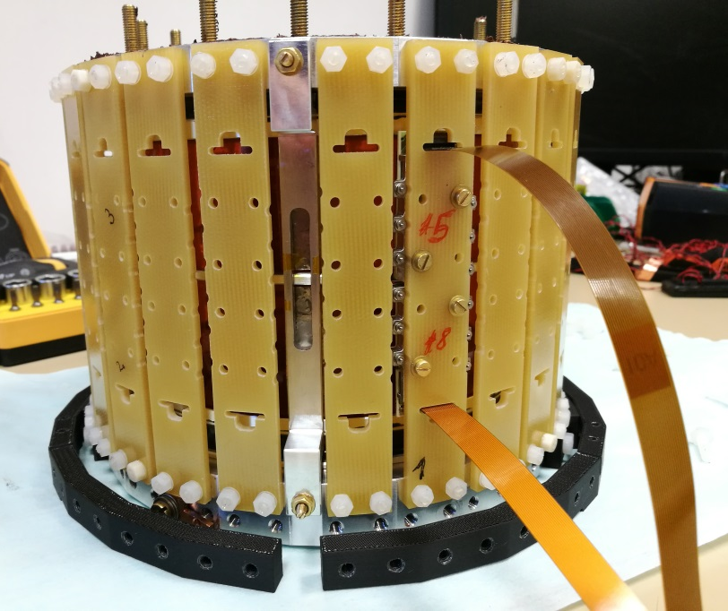
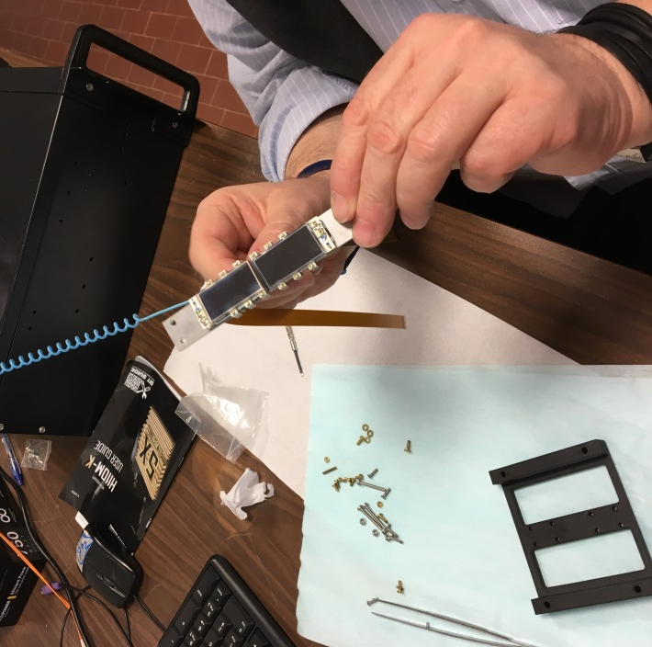
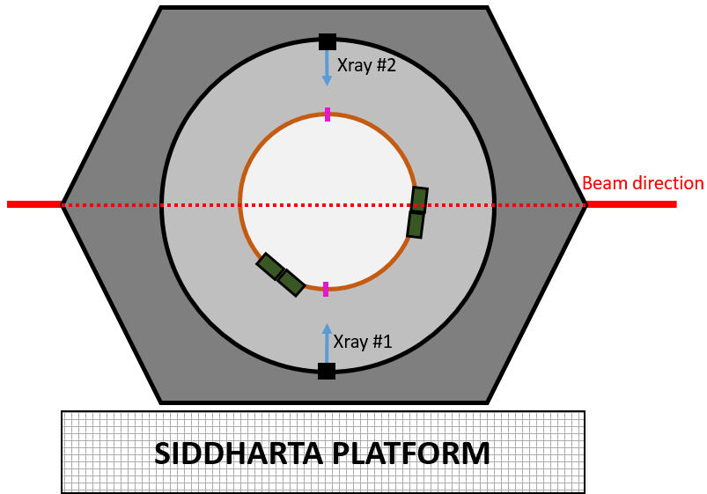
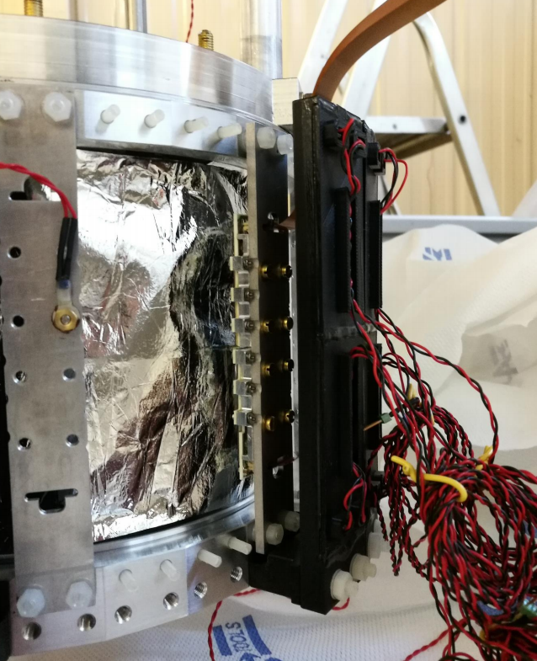
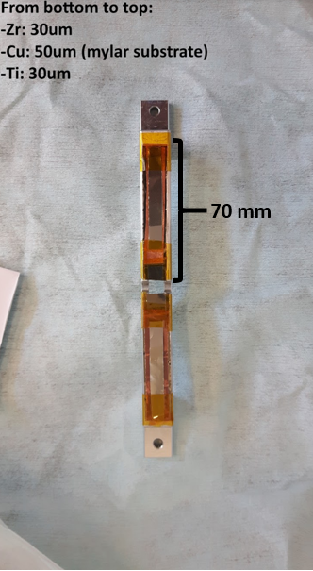
SIDDHARTINO top view
He cooling
SDDs+Veto 2
Beam direction
Trento, 24/10/2019

Slide 20
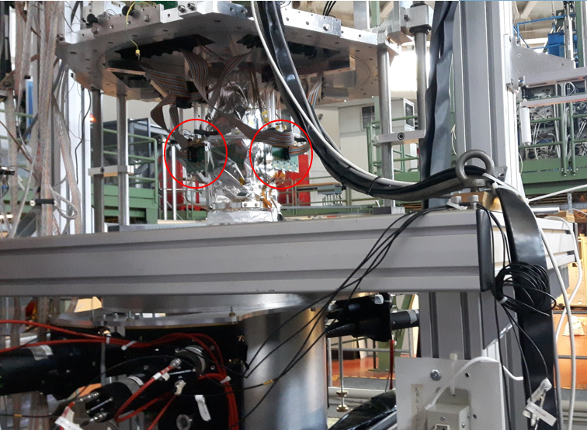
Trento, 24/10/2019

Slide 21
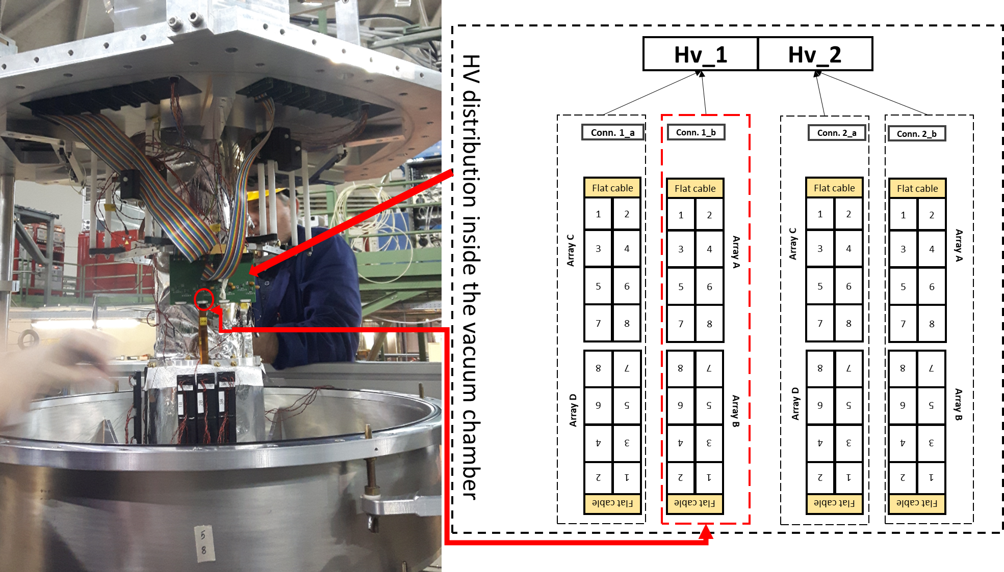
SIDDHARTINO HV Map
Trento, 24/10/2019

Slide 22
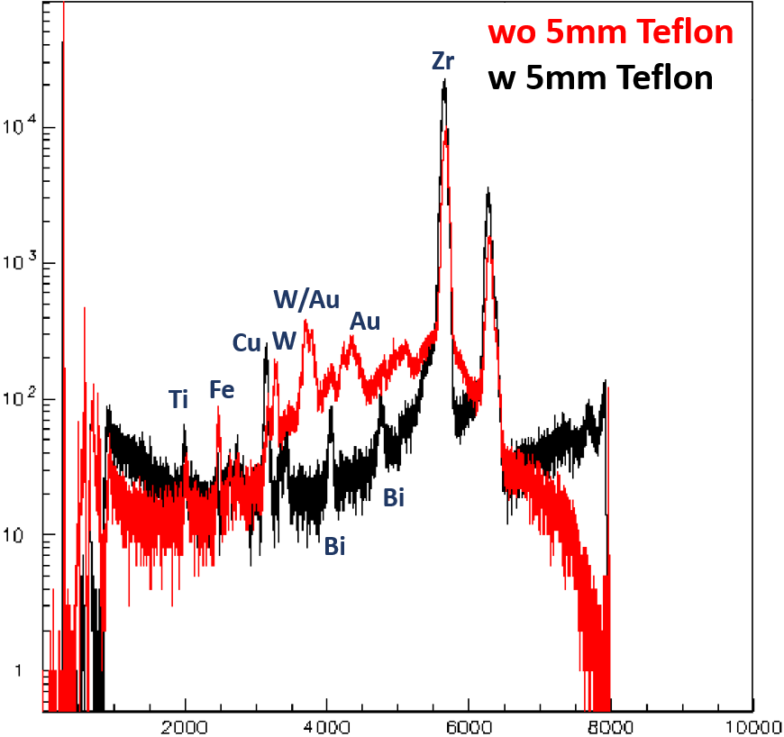
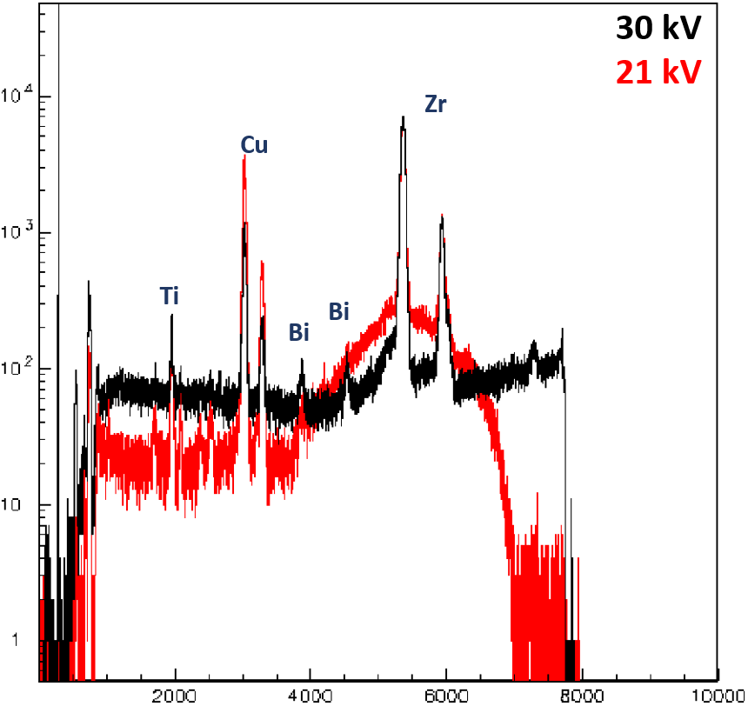
Calibration optimization
Trento, 24/10/2019

Slide 23
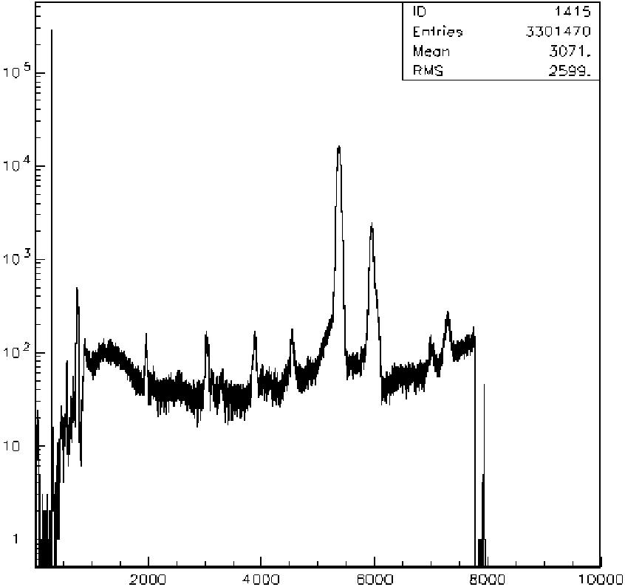
Zr
Ti
Cu
Zr
Bi
Pd
Ag
Target
Ag
Ti
Cu
Bi
Pd
Ceramic
Trento, 24/10/2019

Slide 24
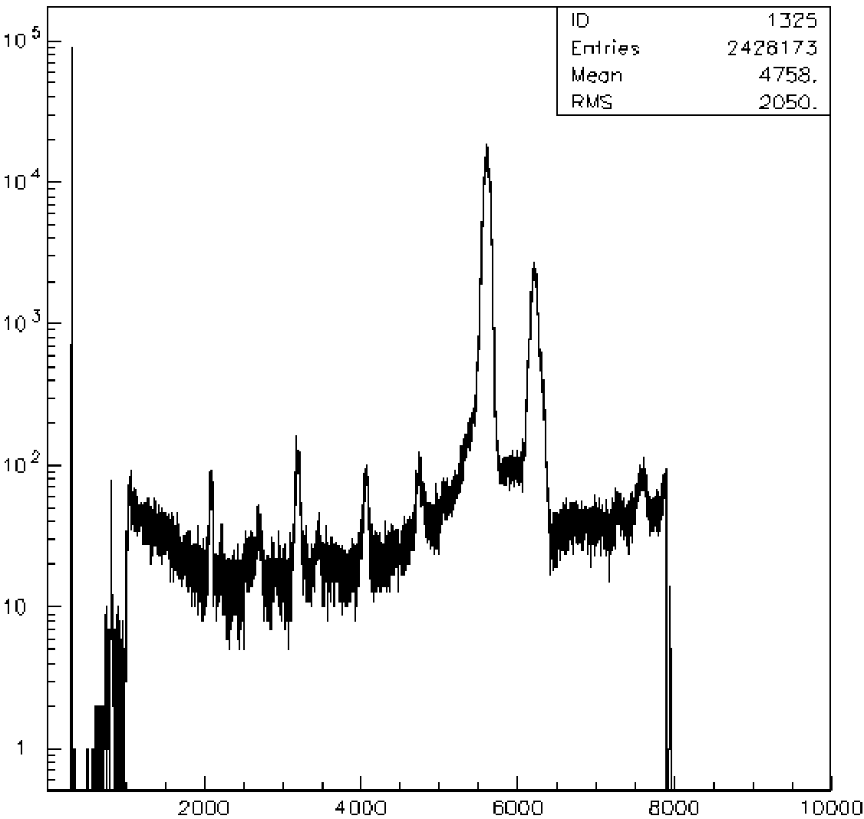
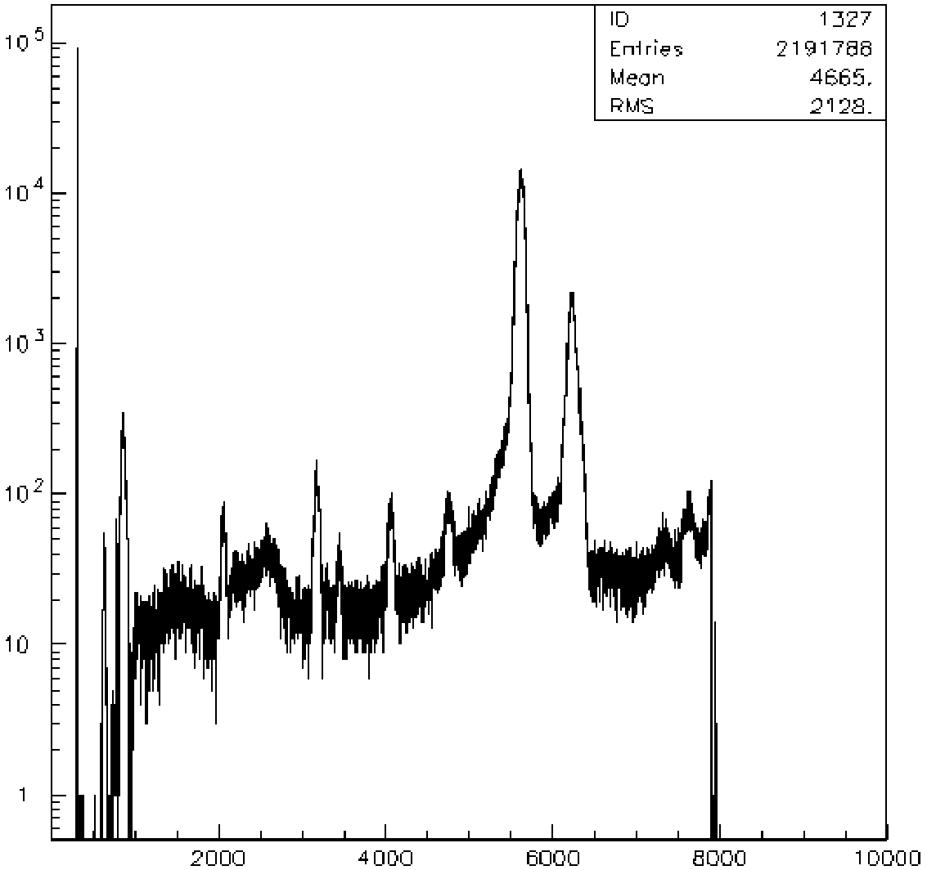
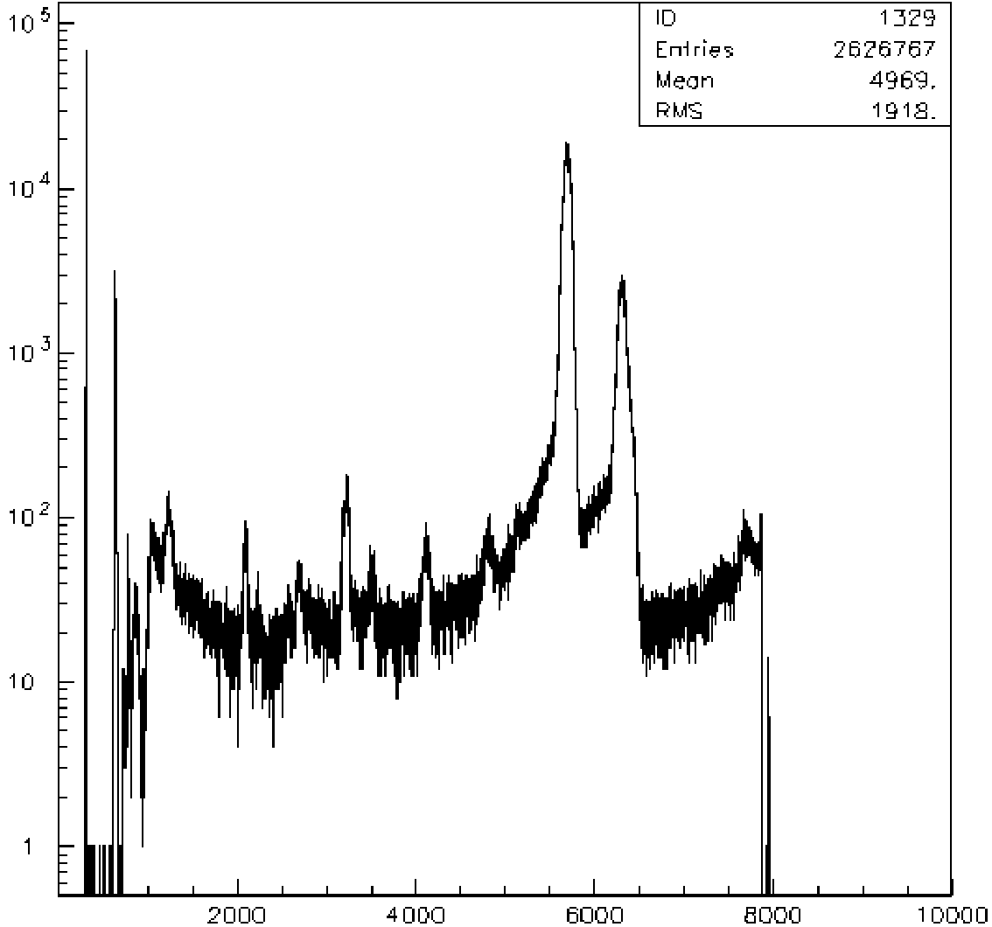
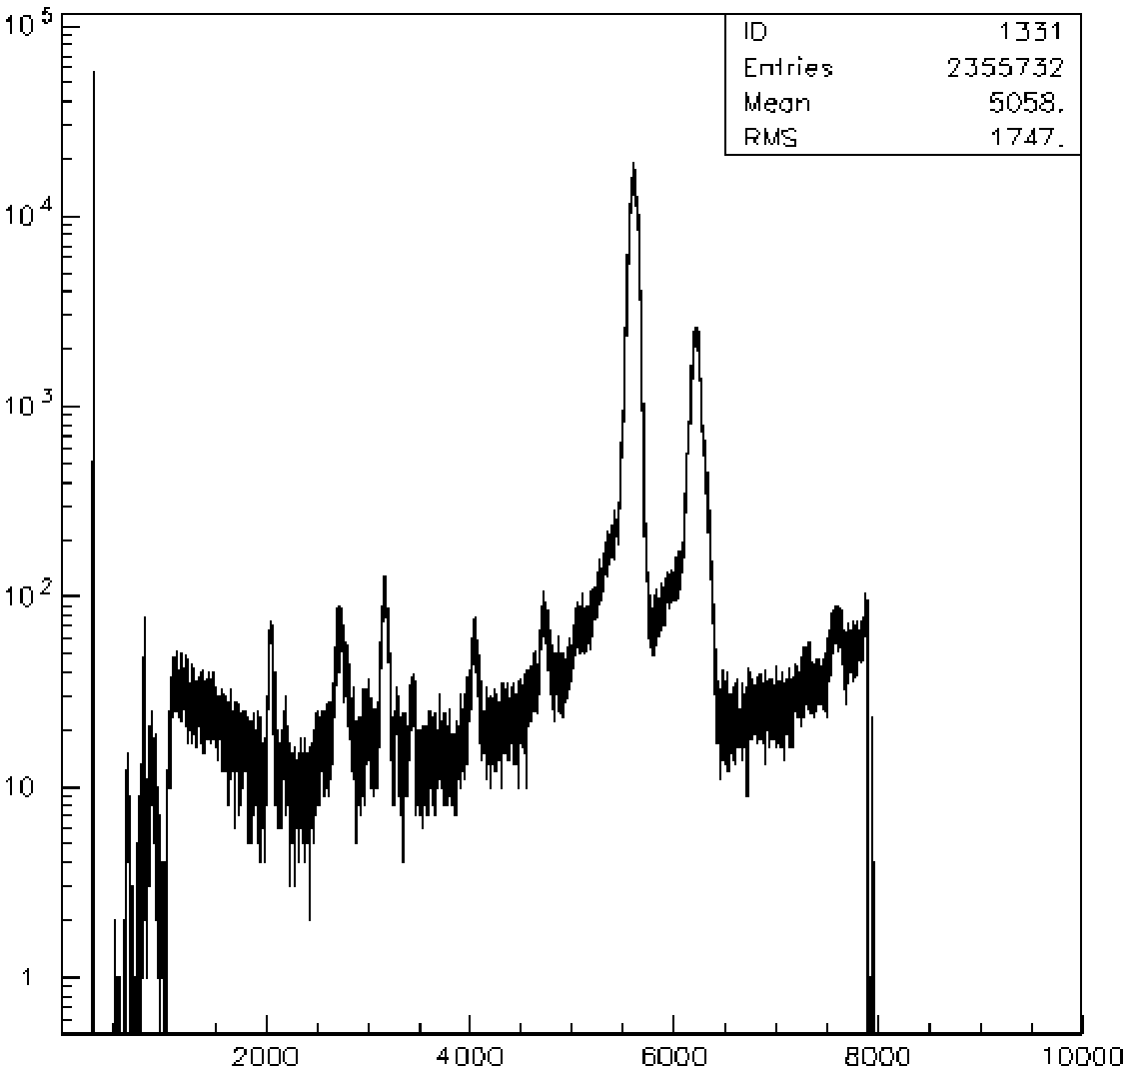
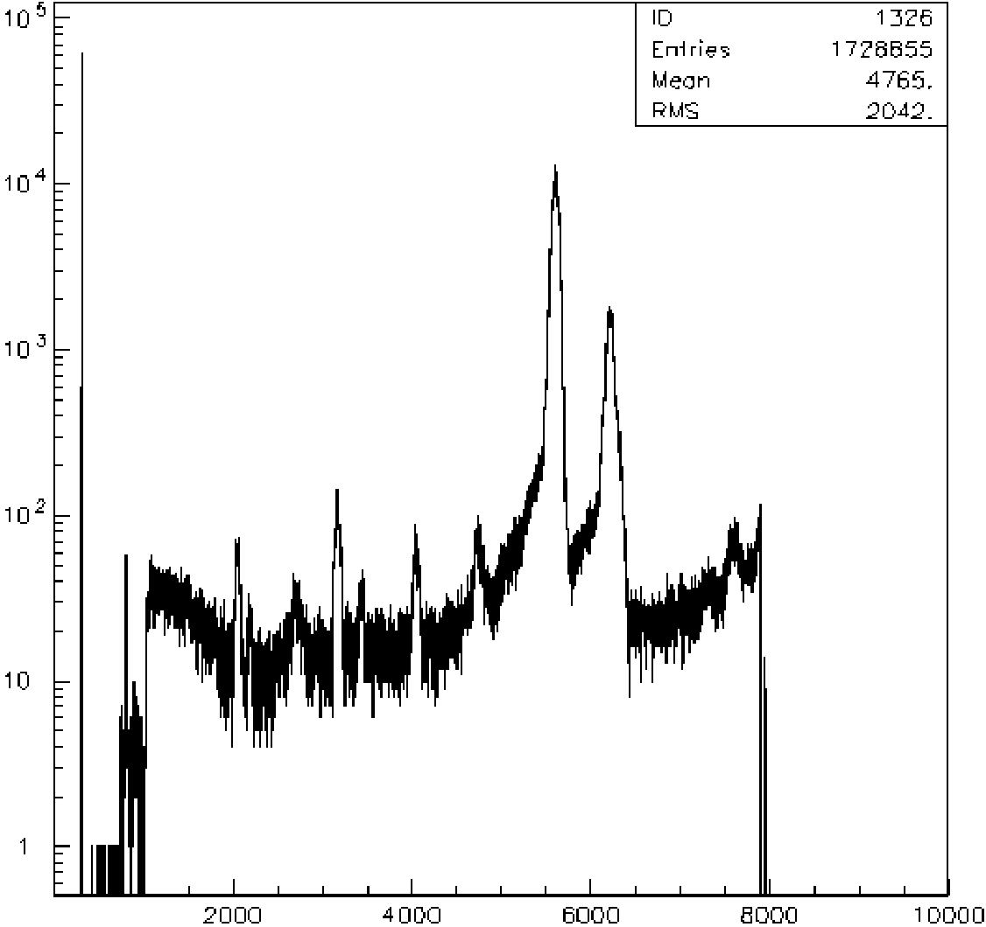
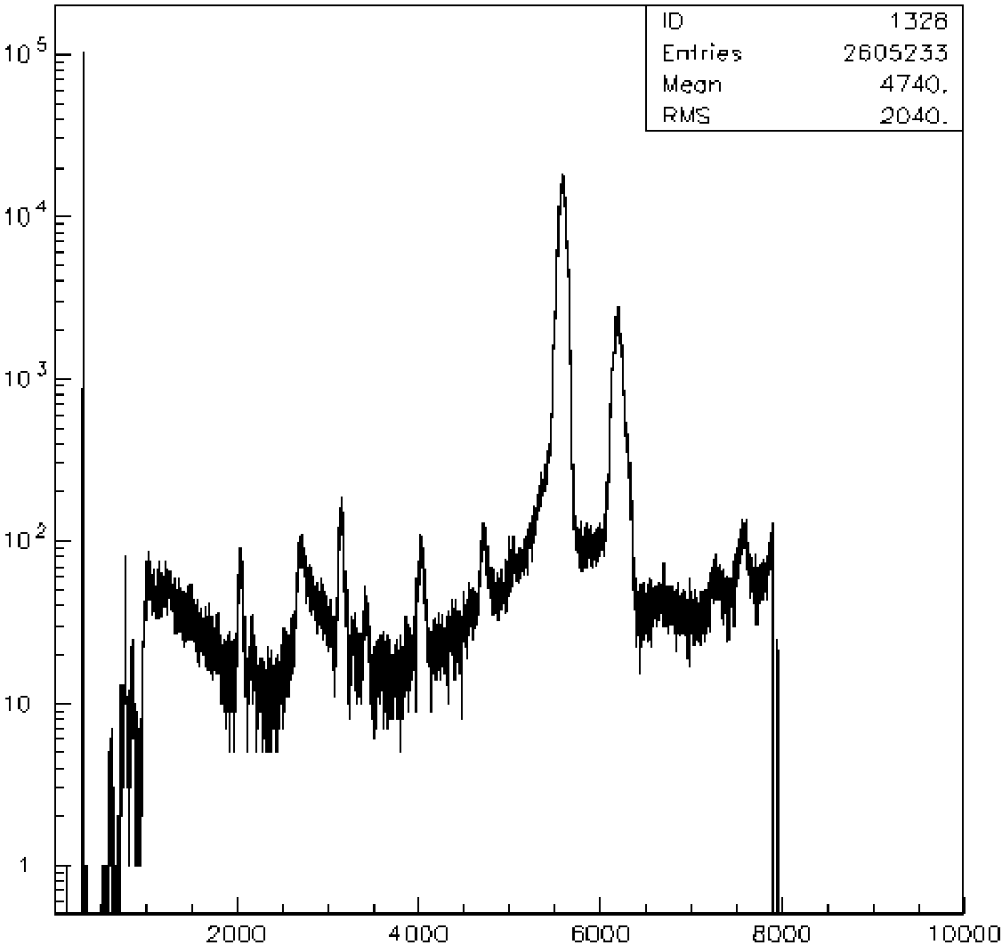
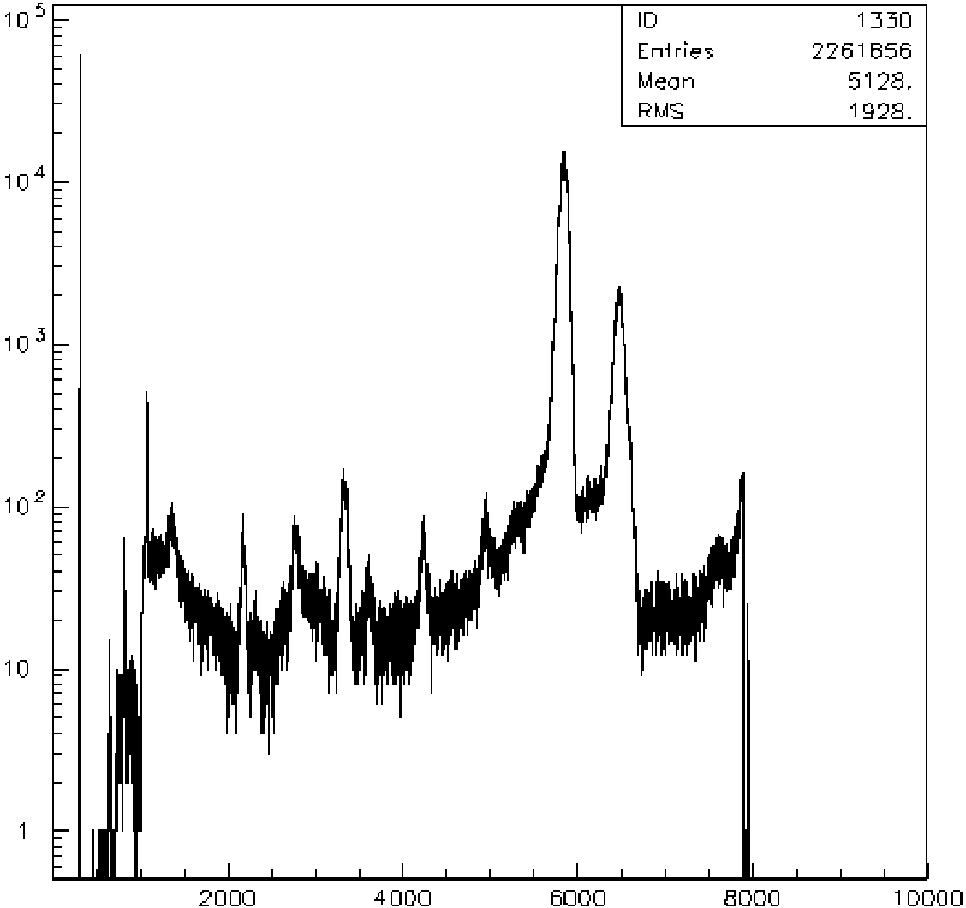
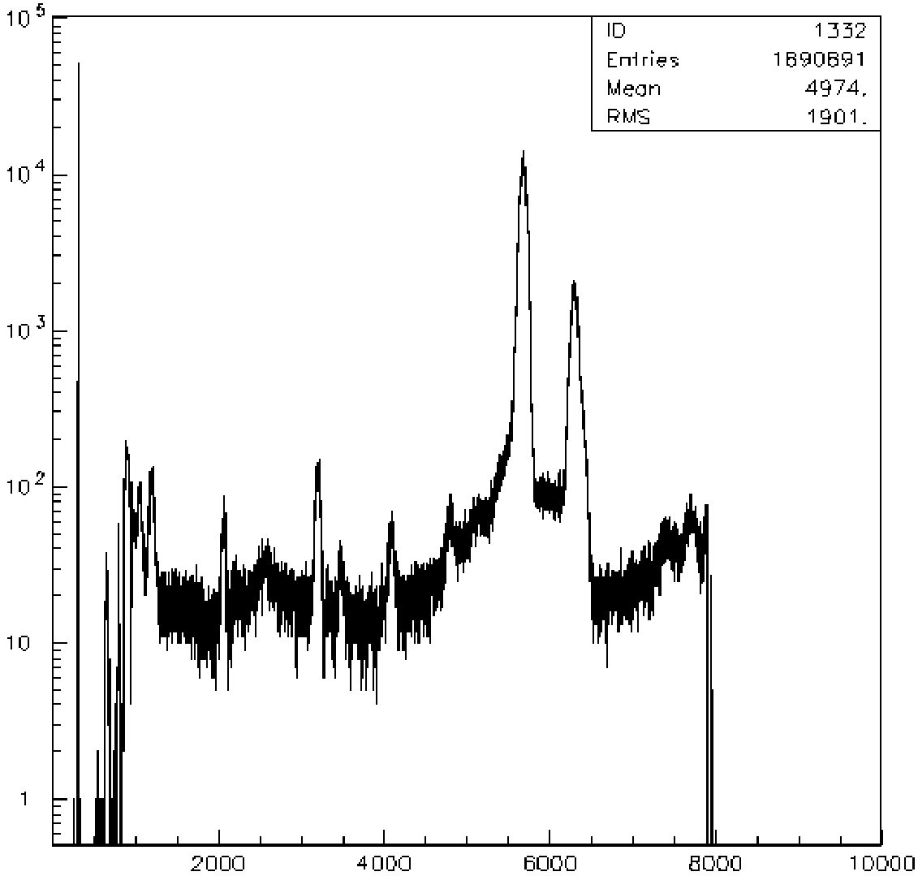
X-ray tube (35kV,40uA)_SDD 107
Trento, 24/10/2019

Slide 25
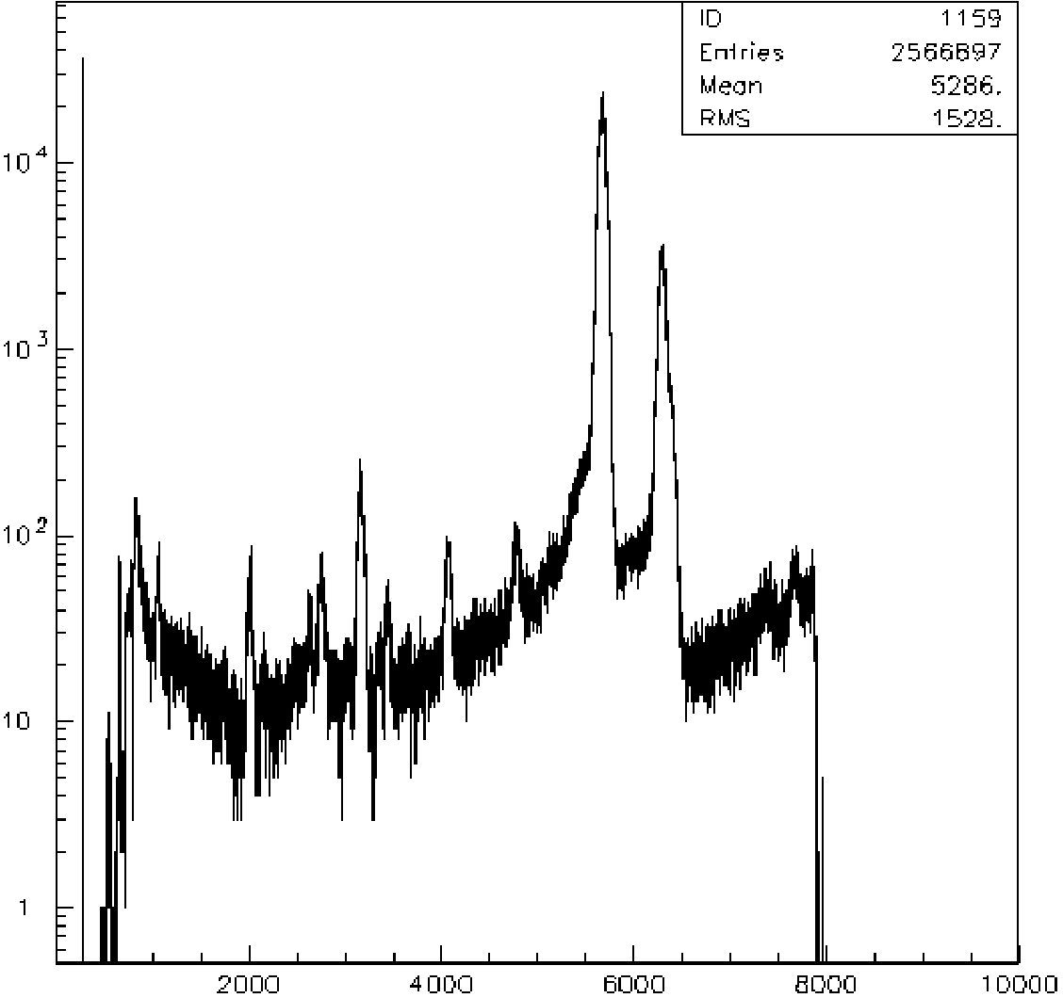
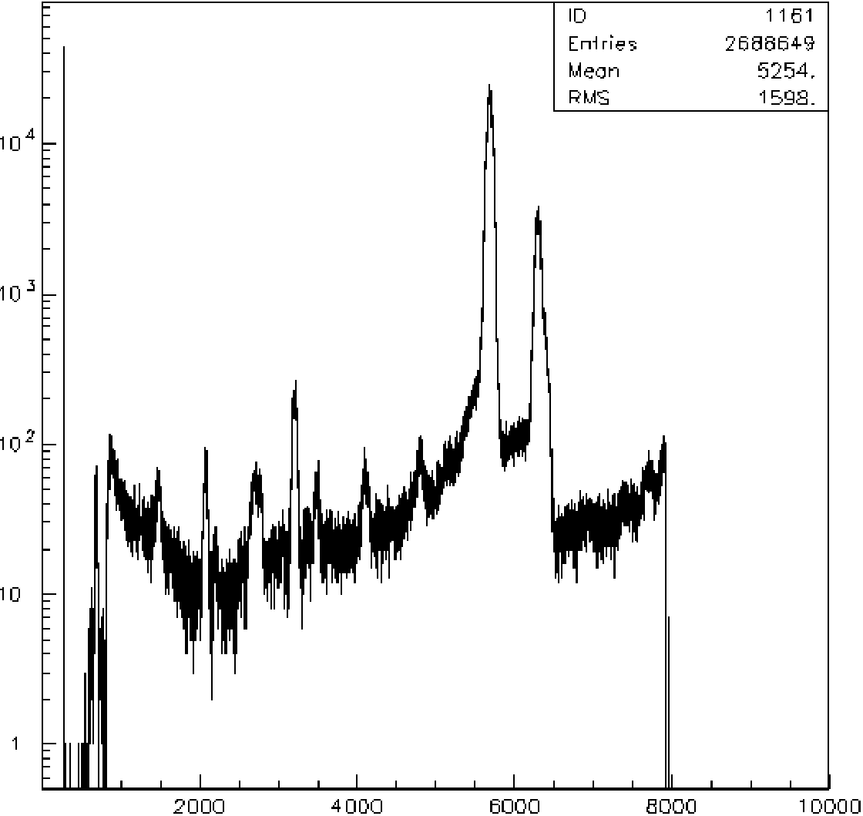
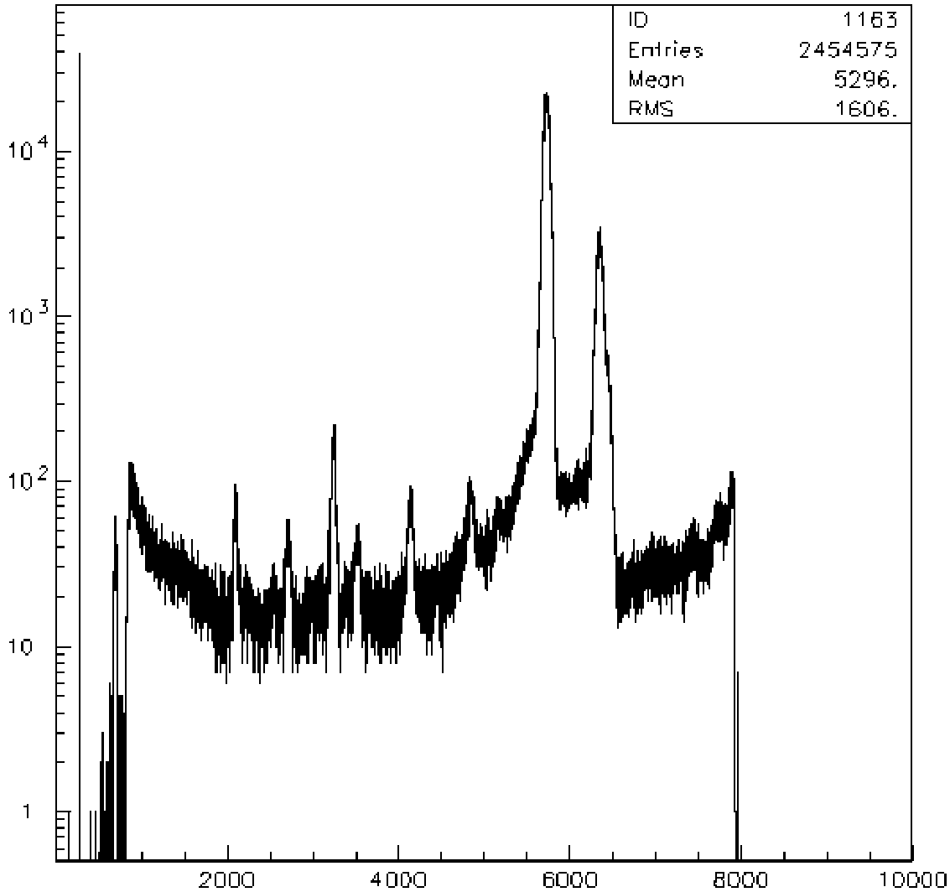
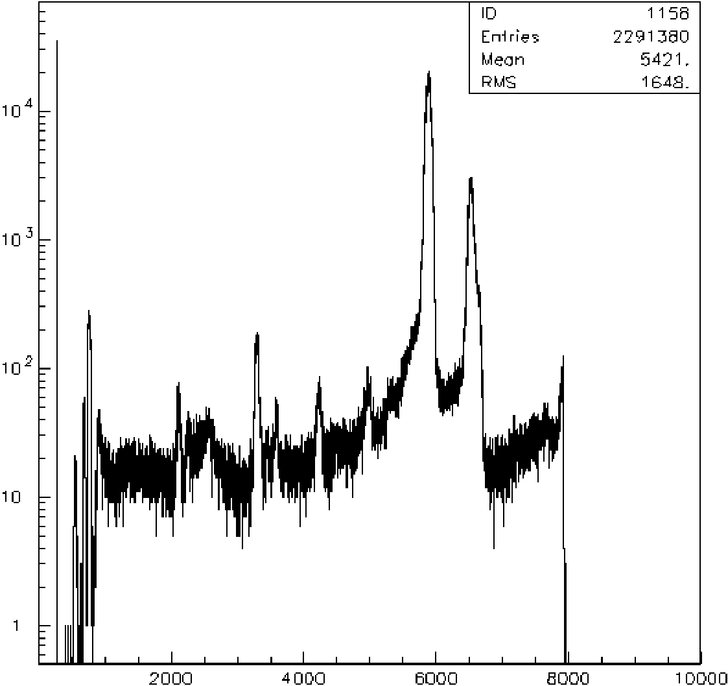
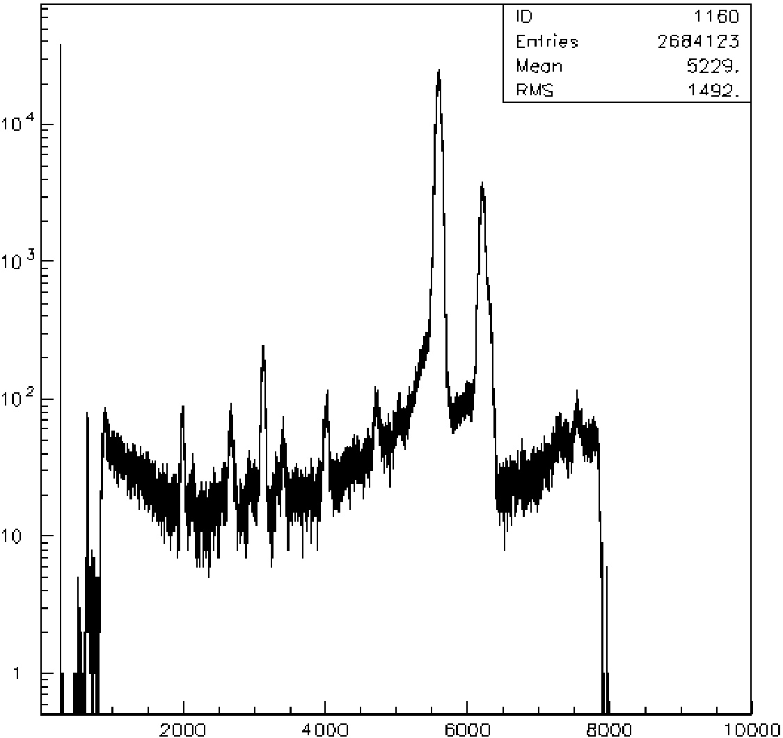
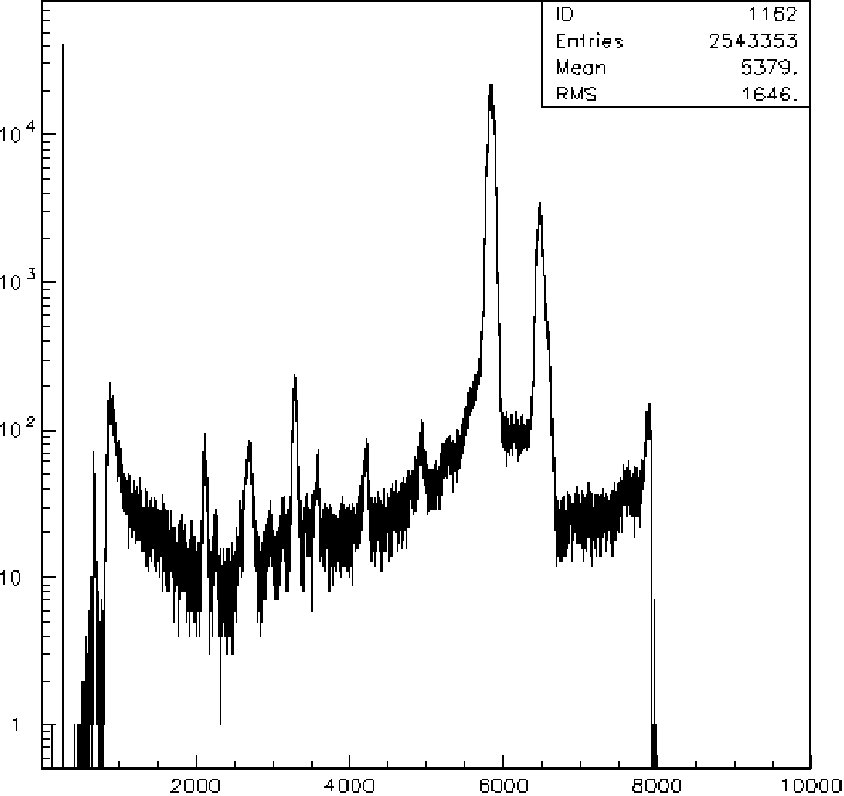
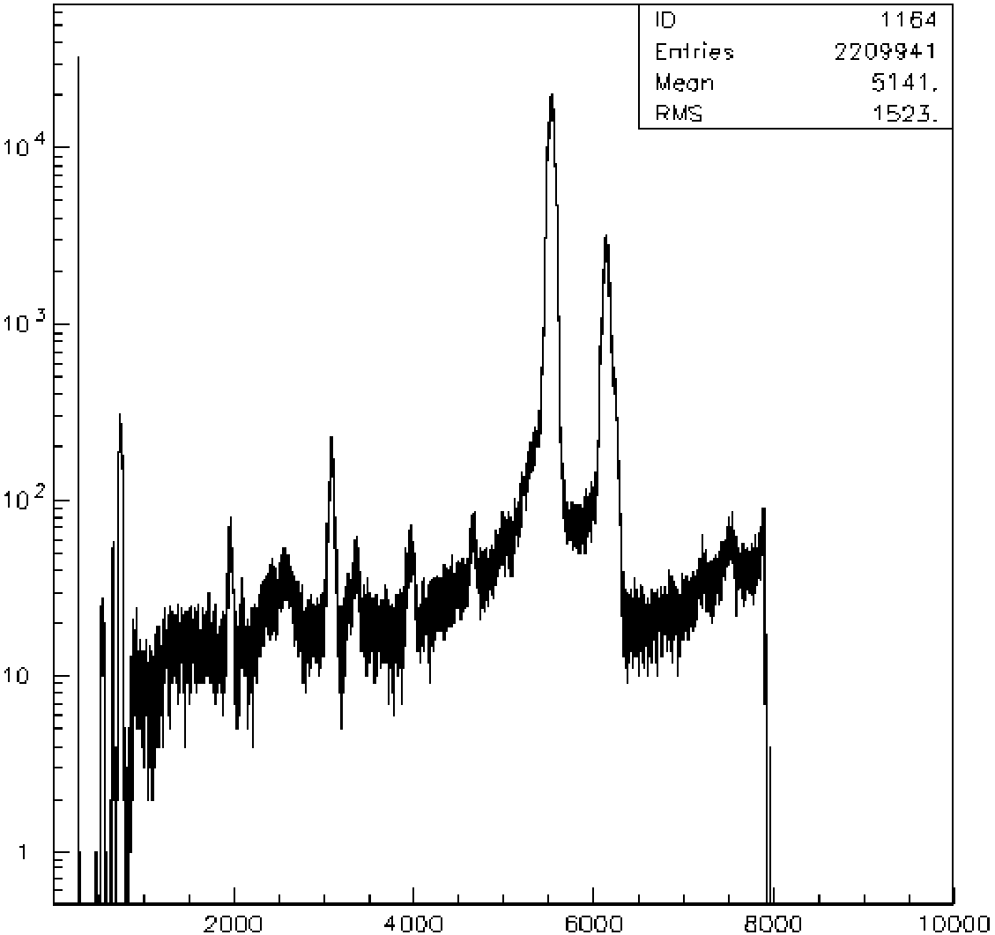
X-ray tube (35kV,40uA)_SDD 53
Trento, 24/10/2019

Slide 26
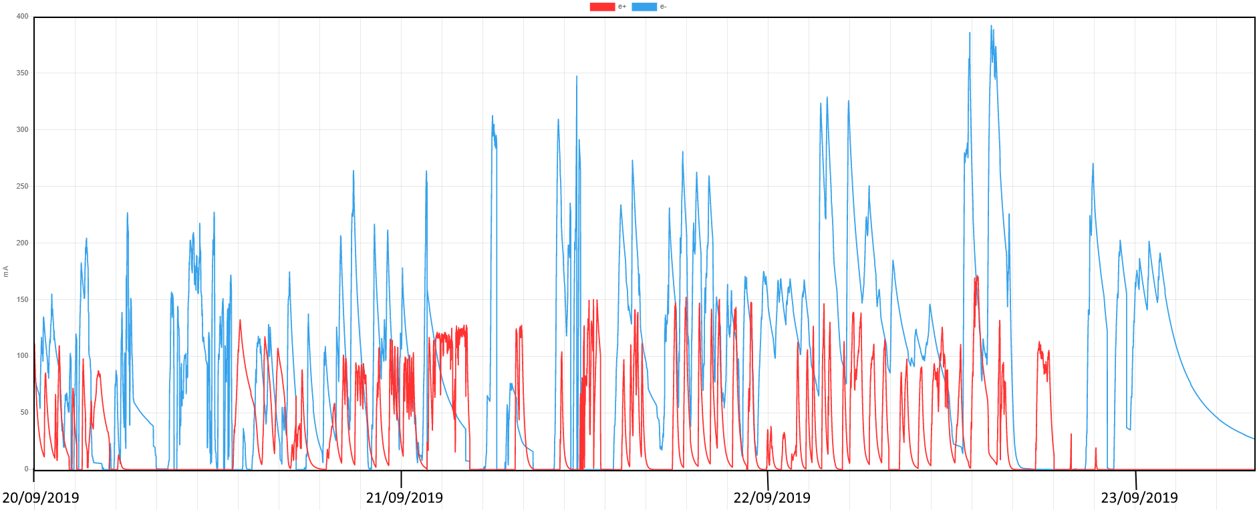
SDDs response during “DAΦNE Commissioning’’
e+ / e- beams
Preliminary quantitative considerations
Background from the beam
Normal vs Parallel comparison
Trento, 24/10/2019

Slide 27
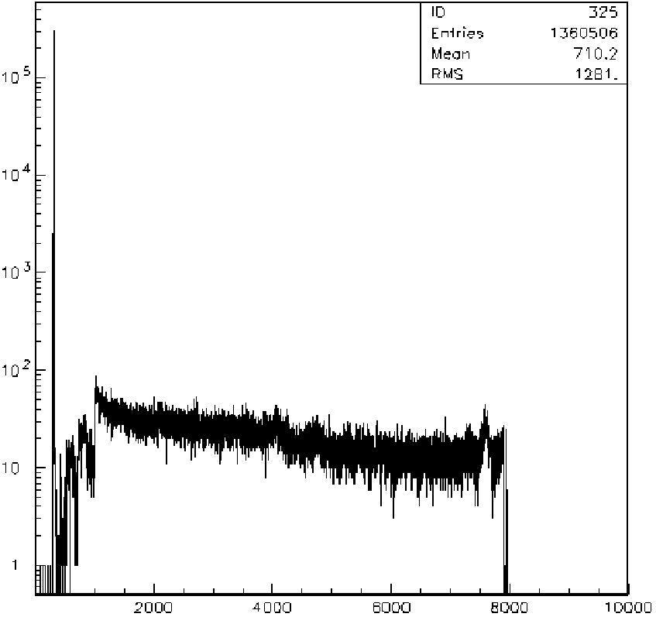
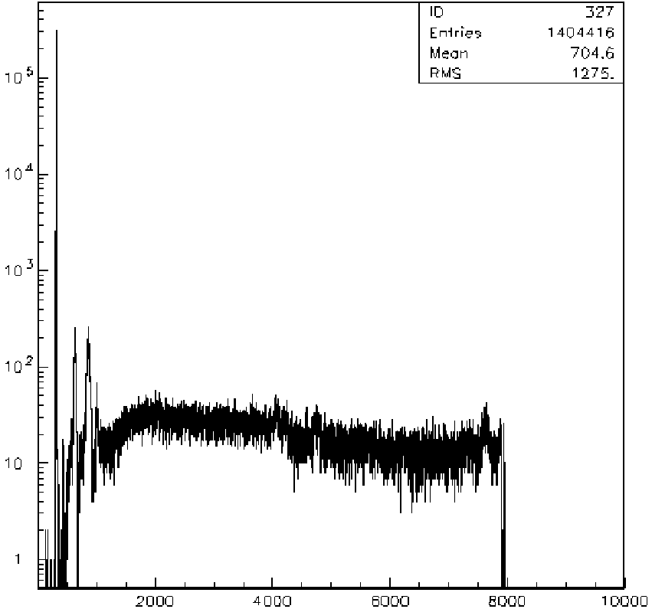
X-ray tube (35kV,40uA)_SDD 107
Trento, 24/10/2019

Slide 28
X-ray tube (35kV,40uA)_SDD 53
Trento, 24/10/2019

Slide 29
‘‘DAΦNE commissioning’’ bakground
SDD 107 (parallel w.r.t. beam)
SDD 53 (normal w.r.t beam)
SDD 53
SDD 107
Energy (KeV)
Trento, 24/10/2019

Slide 30
Outline
Kaonic atoms physics at DAΦNE
New Silicon Drift Detectors (SDDs) technology for precision KD measurements
SDDs in DAΦNE
Conclusions

Slide 31
Lab tests for optimization of new technology Silicon Drift Detectors for the SIDDHARTA-2 experiment:
Linearity & Stabilty (≈eV);
Energy resolution (140 ~ 160 eV @ Mn K_{α})
Time resolution (< 400 ns @ Cu K_{α})
Preliminary e+/e- beam characterization of Silicon Drift Detectors during the DAΦNE commissioning:
Homogeneus background spread over the entire spectra
X-Rays emission of SDDs structural elements activated by the beam, almost outside the ROI
No significative correlation between the beam direction and the SDDs positioning
Trento, 24/10/2019

Slide 32
THANK YOU
Marco.Miliucci@lnf.infn.it
Trento, 24/10/2019

