Slide 1


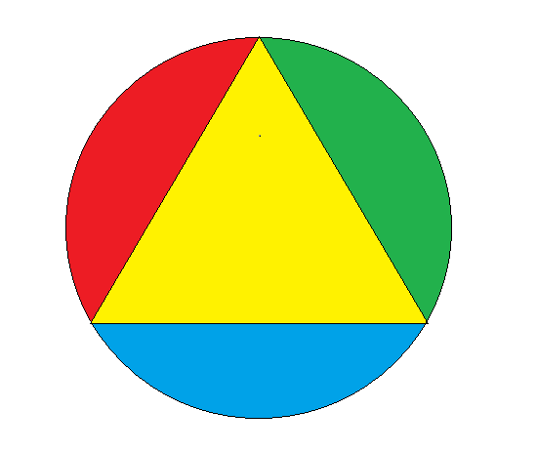


X and Gamma ray precision measurements for fundamental physics and radioprotection
X
INFN-CSN5
Young Researcher Grant 2015, n. 17367/2015.
O
E
S
Progetto SICURA
Alessandro Scordo
Laboratori Nazionali di Frascati, INFN
“STRANEX: Recent progress and perspectives in STRANGe Exotic atoms studies and related topics”
ECT*, Trento, 24/10/2019
Notes:
1
1

Slide 2
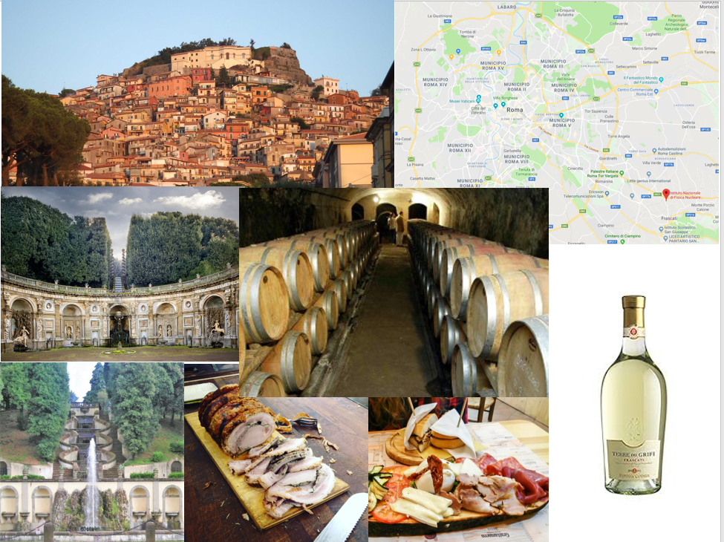
Frascati: a good place for photon detection…

Slide 3
Nested talk: outline
Low energy range (1-50 keV)
Bragg spectrometer TES
(VOXES)
Possible K-atom measurements
Frascati wine di sfondo
High energy range (> 50 keV)
CsI(Tl)
→ SICURA project
CdZnTe
HPGe (SIDDHARTA-2)
STRONG 2020 - ASTRA
CdTe

Slide 4
Nested talk: outline
Possible K-atom measurements
Frascati wine di sfondo

Slide 5
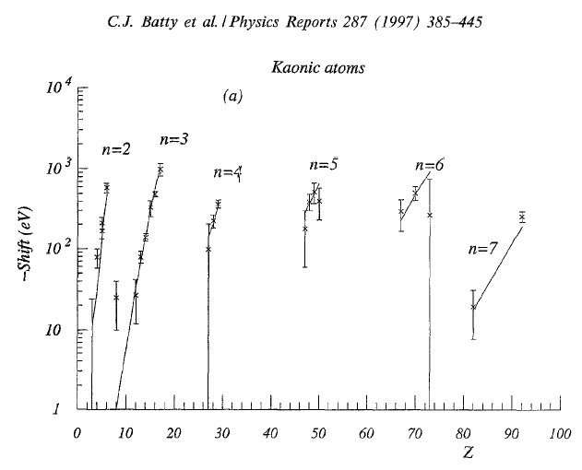
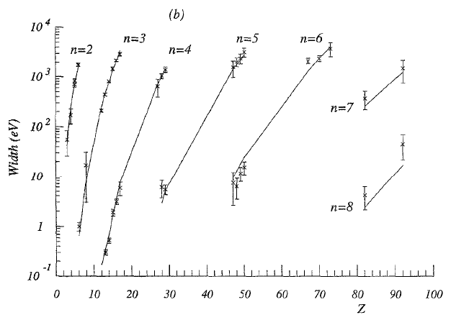
Kaonic atoms measurements: energy ranges
KO (4→3) @ 39.5 keV
KC (3→2) @ 63 keV
K^{3,4}He (2→1)
@ 30 keV
KPb (9→8) @ 290 keV
KN (4→3) @ 30 keV
KBe (3→2) @ 27 keV
KPb (8→7) @ 420 keV
KC (4→3) @ 22 keV
KLi (3→2) @ 15 keV
CdTe
CdZnTe & HPGe
Bragg spectrometer & TES

Slide 6

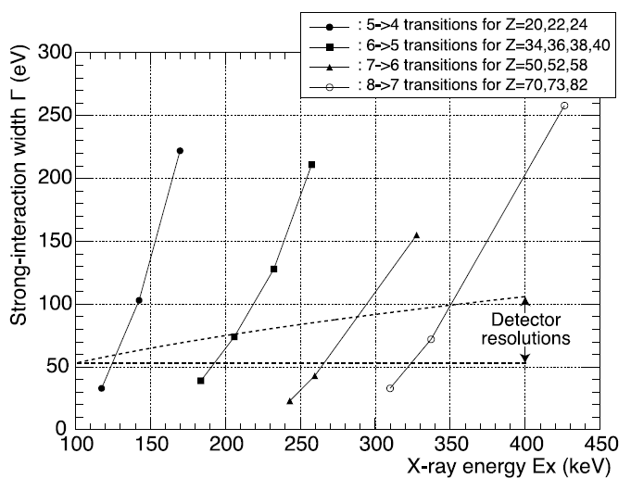
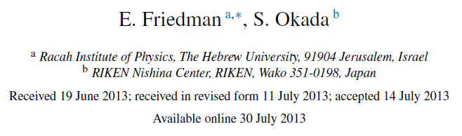
Kaonic atoms measurements: energy ranges
New TES for ~ 100 keV
under production @ NIST
CdZnTe → STRONG-2020
HPGe → SIDDHARTA-2
CdZnTe & CsI(Tl) → SICURA
LNF is very active in high precision photon measurements!!!

Slide 7
Nested talk: outline
Possible K-atom measurements
Frascati wine di sfondo
High energy range (> 50 keV)
CsI(Tl)
→ SICURA project
CdZnTe

Slide 8
CdZnTe + CsI(Tl) (+ ³He)
detectors: the SICURA project
Development of a portable and integrated low cost probe for applications in radioprotection and anti-terrorism
(italian achronym works better…)
2019-2021 project financed by Regione Lazio
LNF hosting institution
Radiation Dispersal Devices (RDD) or dirty bombs
IAEA Incident and trafficking database, ITDB:
from 1995 to 2016 almost 3000 cases of illegal traffic of radioactive sources.
Tens of these cases involve Plutonium or Enriched Uranium sources.

Slide 9
CdZnTe + CsI(Tl) (+ ³He)
detectors: the SICURA project
Probes for monitoring already exist in:
Ports, customs, borders
Airports
Waste destructors
Garbage dumpsites
But are missing in:
Big events (sports, music, etc)
High population density sites
(schools, hospitals, etc.)
Need for widespread diffusion of easy-to-use probes
‘’Easy to get sources’’:
Am-241 (59.5 keV)
Ir-192 (300-600 keV)
Ra-226 (185 keV)
Cs-137 (662 keV)
Co-60 (1173, 1332 keV)
+ n sources (< 15 MeV) (α,n)
U.S. Department of Health and Human Services
CdZnTe (High resolution)
+
CsI(Tl) (High efficiency)
+
³He (widespread n counter)

Slide 10
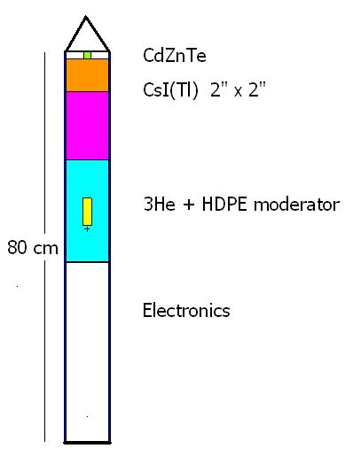
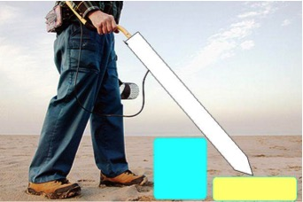
Proposed probe characteristics:
Cylindrical holder with ending spike for insertion
High efficiency X+Gamma detector
CsI(Tl) 2”x2” solid state readout sensing background level overcoming- Alert stage
High resolution X+Gamma detector
CdZnTe semi-spherical
Precise element identification - Identification stage
High efficiency thermal neutron counter
³He 4 cm x diam 1.27 cm with polyethilene moderator
E <15 MeV neutron detection
The SICURA detector
On the ground demonstration at the end of 2020 !!!
(want to be part of it??? Unmissable…)

Slide 11
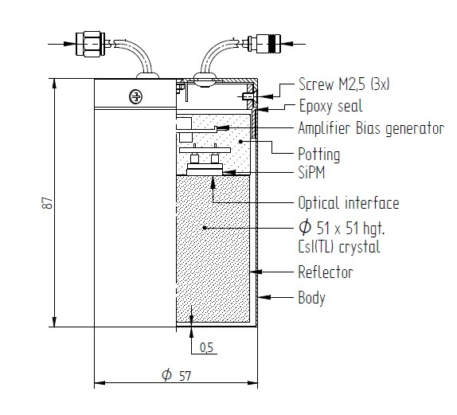
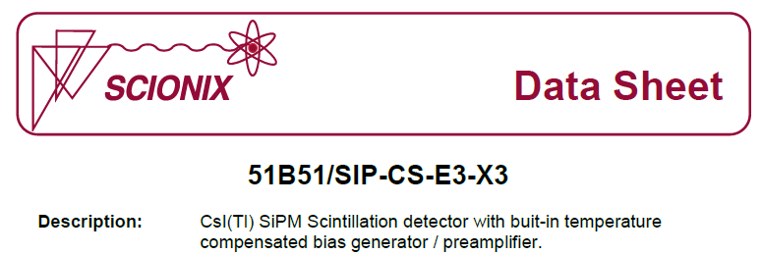
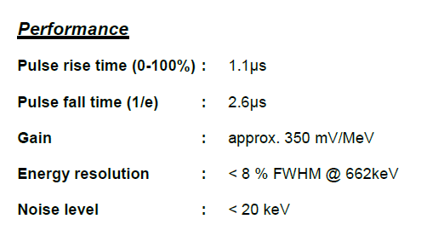
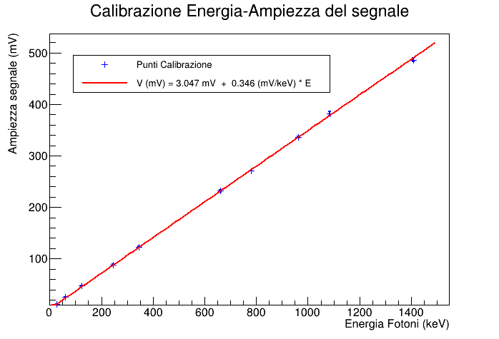
CsI(Tl) alert stage: performances
Radionuclide | FWHM [%] | Energia [keV]
²⁴¹Am | 53.25 % | 26.34
²⁴¹Am | 23.51 % | 59.54
⁵⁷Co | 20.53 % | 123,66*
¹⁵²Eu | 18.42 % | 121.78
¹⁵²Eu | 14.58 % | 244,70
¹⁵²Eu | 13.06 % | 344,28
¹³⁷Cs | 10.77 % | 661,66
¹⁵²Eu | 12.30 % | 778,90
¹⁵²Eu | 18.55 % | 964,08
¹⁵²Eu | 8.45 % | 1085,87
¹⁵²Eu | 9.65 % | 1408,01
Energy – Amplitude Calibration
Amplitude (mV)
Energy (keV)

Slide 12
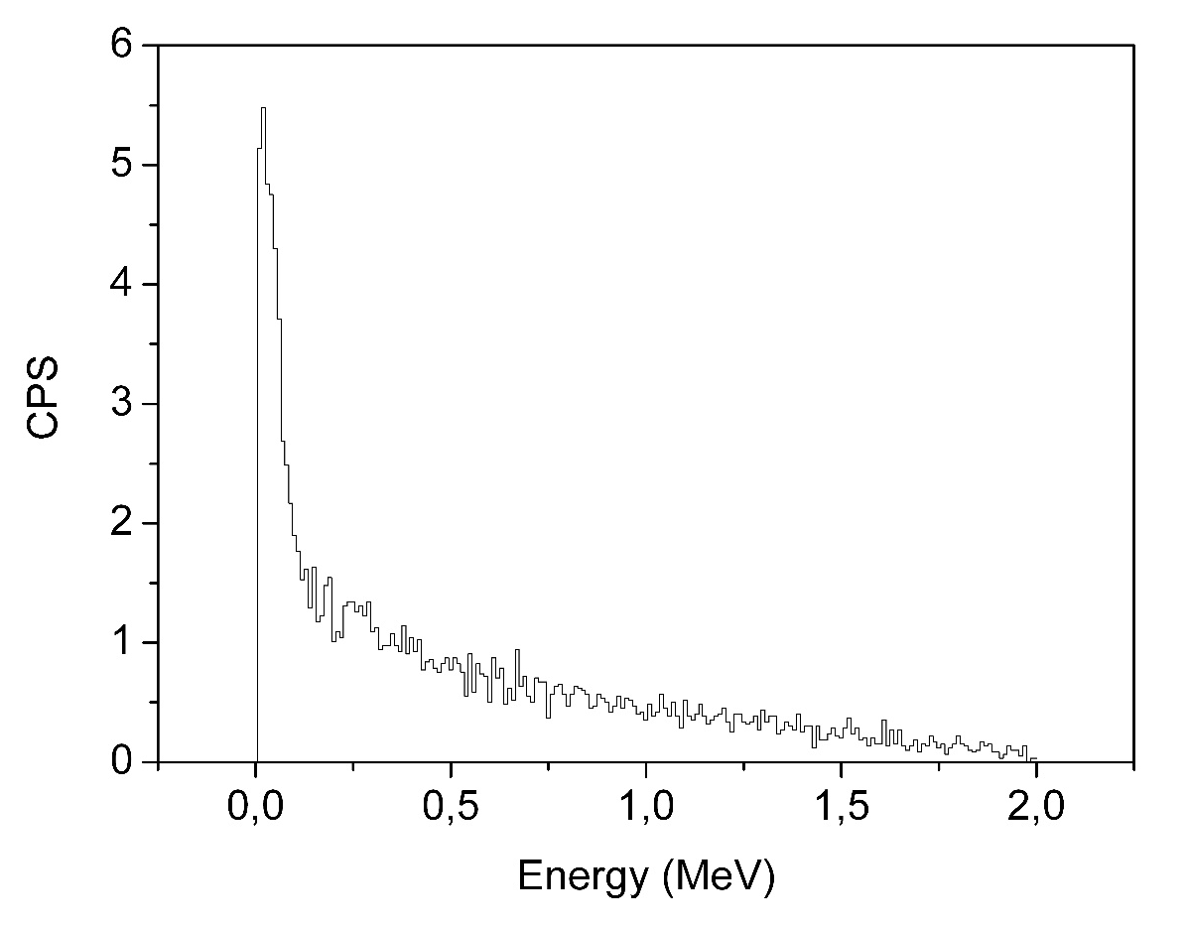
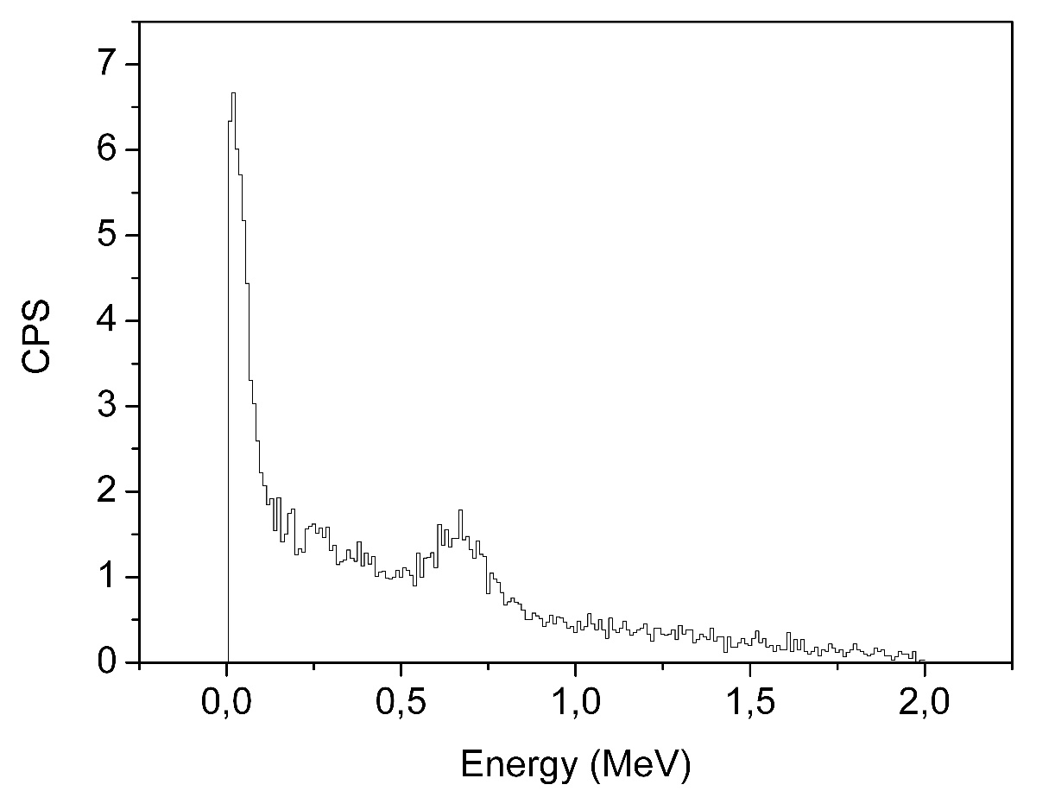
Bkg 0.2 μSv/h Bkg + 10 kBq Cs
(10s 25 cm distance)
CsI(Tl) alert stage: expected results
Kaonic atoms:
Not good for precise masurements but could be used for yields

Slide 13
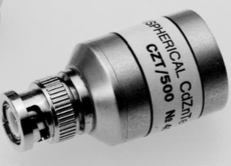
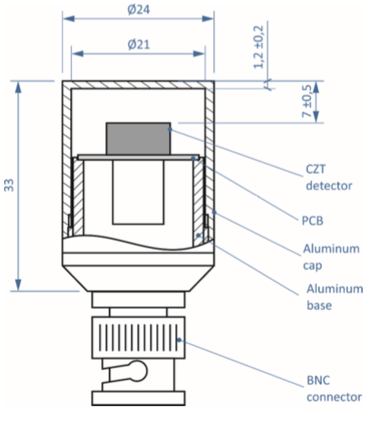

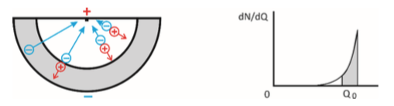
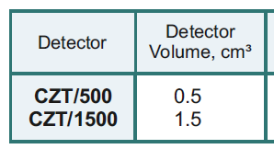
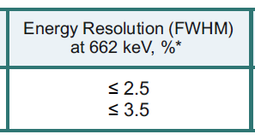
CdZnTe identification stage: performances
Energia (keV) | Radionuclide | FWHM
13,90 | ²⁴¹Am | 33%
59,54 |  | 11,25%
31,96 | ¹³³Ba | 20,23%
80,90 |  | 7,03%
276,40 |  | 3,45%
302,80 |  | 3,34%
356,01 |  | 3,23%
383,80 |  | 2,80%
121,78 | ¹⁵²Eu | 5,17%
244,69 |  | 3,94%
411,12 |  | 3,32%
443,96 |  | 2,52%
1408,01 |  | 2,72%
661,66 | ¹³⁷Cs | 2,38%
122,06 | ⁵⁷Co | 5,04%
136,47 |  | 3,64%

Slide 14
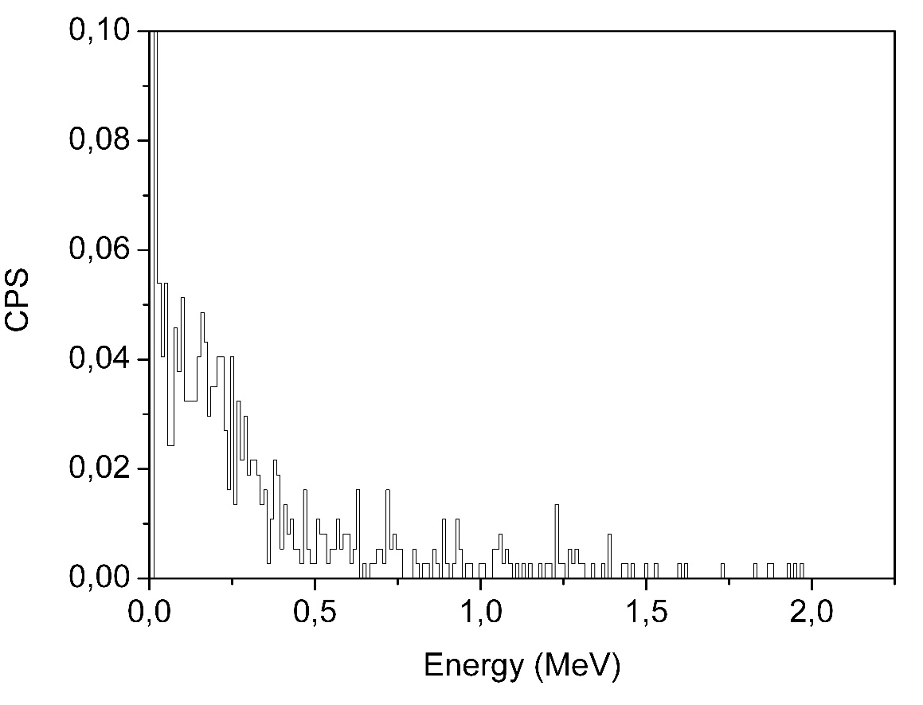
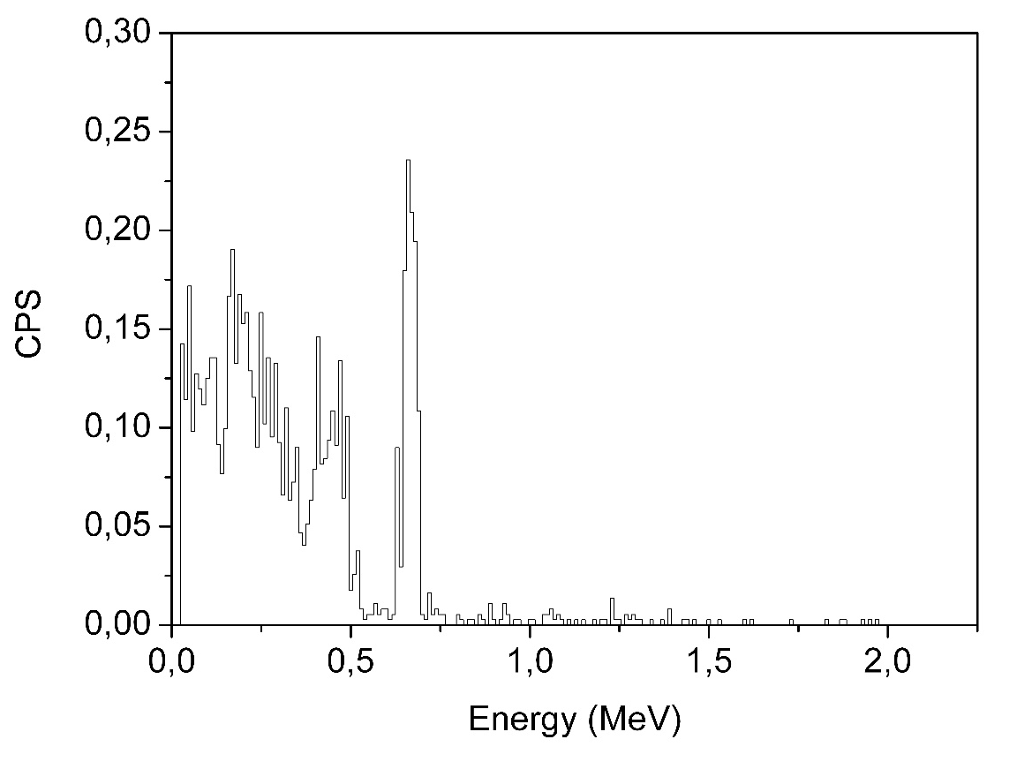
Bkg 0.2 μSv/h Bkg + 100 kBq Cs
(10 s at 25 cm distance)
CdZnTe identification stage: expected results
ASTRA
STRONG-2020
10-100 keV range
100 keV-1 MeV range
Kaonic atoms:
FWHM < 3% @ 600 keV

Slide 15
Nested talk: outline
Frascati wine di sfondo
High energy range (> 50 keV)
CdZnTe
STRONG 2020 - ASTRA
CdTe

Slide 16
Advanced ultra-fast solid STate detectors for high precision RAdiation spectroscopy
ASTRA
Organization legal name | Short name | Activity leader
Austrian Academy of Sciences, Stefan Meyer Institute, Austria | OEAW | J. Zmeskal
Istituto Materiali per Elettronica e Magnetismo, CNR, Parma, Italy | CNR | A. Zappettini
Jagiellonian University, Krakow, Poland | UJ | P. Moskal
Laboratori Nazionali di Frascati (LNF) – INFN, Italy | INFN | A. Scordo
Politecnico Milano, Dipartimento di Elettronica, Italy | POLIMI | C. Fiorini
University of Zagreb, Croatia | UNIZG | D. Bosnar
The main objective of the ASTRA project is to develop beyond state-of-art ultra-fast CdZnTe/CdTe radiation detector systems for high-precision measurements of gamma- and X-ray events in a broad energy range, few keV to MeV.

Slide 17
R & D of CdZnTe and CdTe Detectors
Cadmium Telluride (CdTe) and Cadmium Zinc Telluride (CdZnTe) are very promising semiconductor materials for X-ray and gamma ray detection.
The high atomic numbers of the materials (Z_{Cd/Te}=48, 52) provide a high quantum efficiency in comparison with Si.
The larger band-gap energy (Eg∼1.5 eV, compared to Si Eg∼1.1 eV) allows the operation of the detector at room temperature.
  CdTe energy range up to 50 keV resolution 500 eV (FWHM) @ 20 keV
  CZT energy range 0.05 – 1 MeV resolution 1 keV (FWHM) @ 200 keV
energy resolution is slight worse than achieved with Si-detectors or HPGe, BUT better timing and high rate capability

Slide 18

Nested talk: outline
Low energy range (1-50 keV)
Bragg spectrometer
(VOXES)
Frascati wine di sfondo

Slide 19


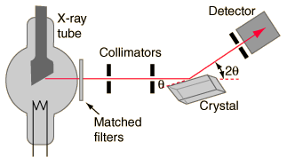
Bragg spectrometers
High resolution can be achieved depending on the quality of the crystal and the dimensions of the detectors
Geometry of the detector determines also the energy range of the spectrometer
But….
In accelerator environments particles may hit the detector
Background reduction capability is mandatory
Typical d (Si) ≈ 5.5 Å
θ_{B} < 10° for E > 6 keV (forward & difficult)
…and most of all…
Point-like source needed
Limitation in efficiency
Notes:
19
19

Slide 20
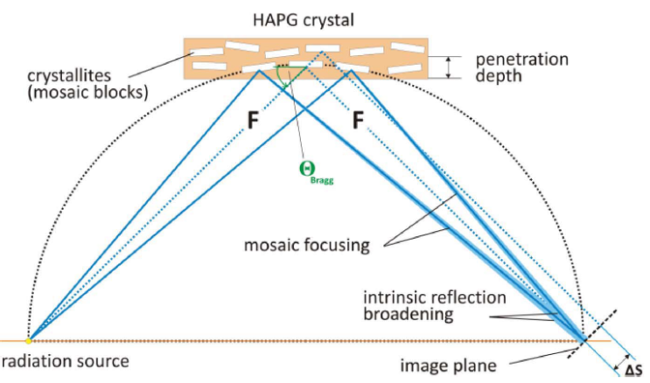
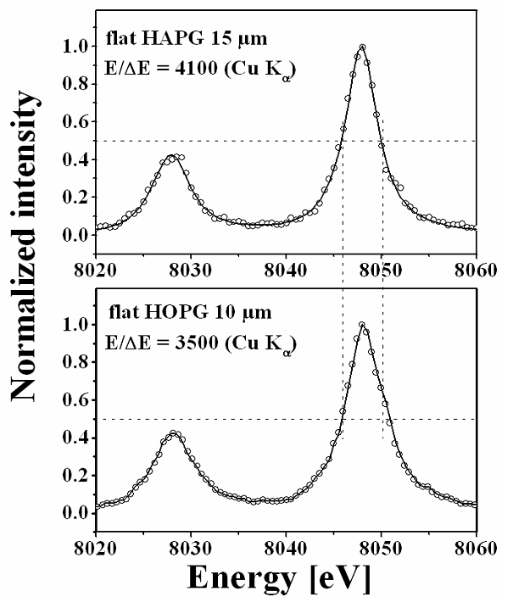
Mosaic crystals
Mosaic crystal consist in a large number of nearly perfect small crystallites.
Mosaicity makes it possible that even for a fixed incidence angle on the crystal surface, an energetic distribution of photons can be reflected
nλ=2dsinθ
Increase of efficiency
(focusing) ~ 50
Loss in resolution
E/∆E=4100 (CuK_{α})‏
Pyrolitic Graphite mosaic crystals (d = 3.354 Å):
Highly Oriented Pyroliltic Graphite (HOPG, Δθ≈1°)
Highly Annealed Pyrolitic Graphite (HAPG, Δθ≈0.07°)
E/∆E=3500 (CuK_{α})‏
flexible HAPG has twice higher spectral resolution, while flexible HOPG – approximately twice higher reflectivity
H. Legall, H. Stiel, I. Grigorieva, A. Antonov et al.,
FEL Proc. 2006
Notes:
20
20

Slide 21

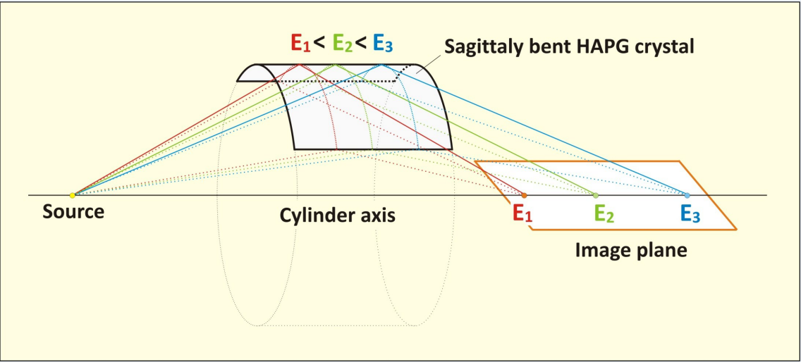
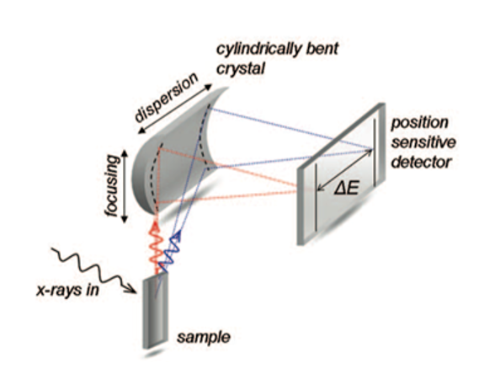
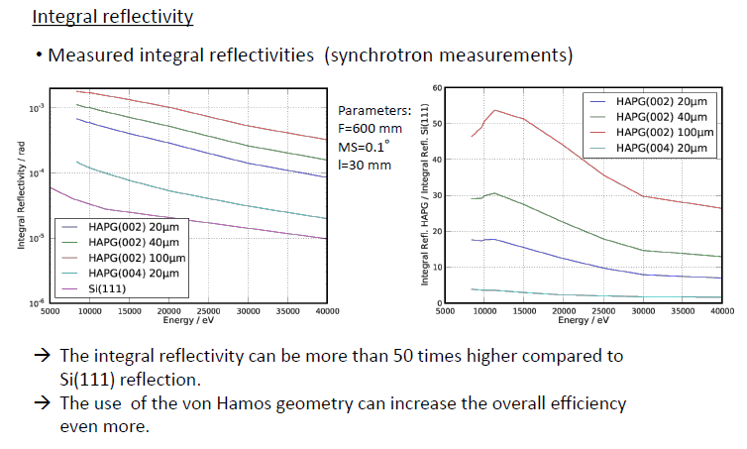
HAPG: Highly Annealed Pyrolitic Graphite
Bending does not influence resolution and intensity
Mosaic spread down to 0.05 degree
Integral reflectivity ~ 10² higher than for other crystals
Variable thickness (efficiency)
Excellent thermal and radiation stability
Notes:
21
21

Slide 22
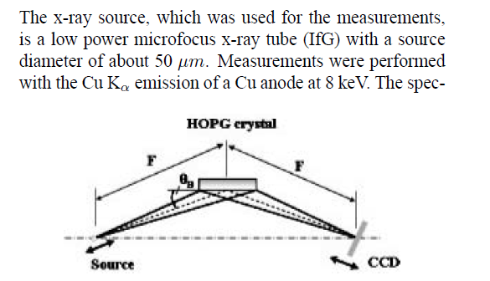
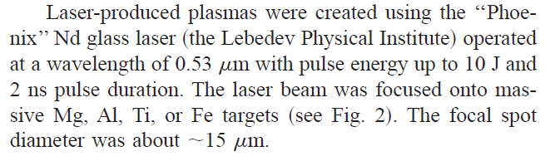
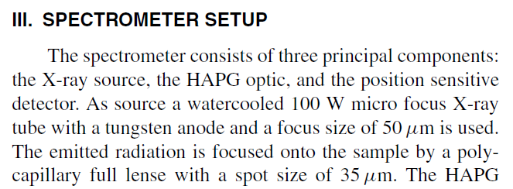
The source size problem
What has been done so far?
Bragg spectroscopy is usually exploited by XAS, XES, synchrotron light users, etc…
This means:
Point-like sources
High yields (no need to increase them)
1 eV (Si, Mica, etc) or 2-3 eV (HAPG) resolution is very easily achievable
But what if we really need wider sources for higher statistics?
Or what if our photons come from a diffused isotropic source?
Notes:
22
22

Slide 23
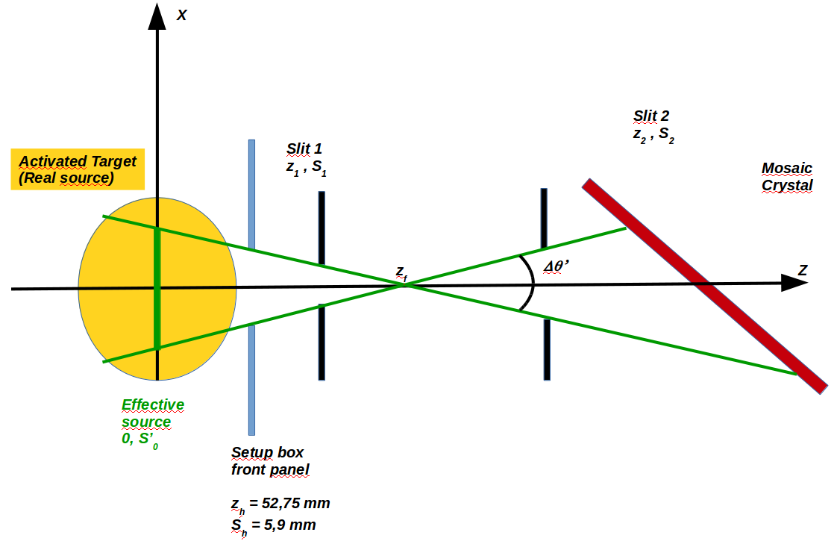
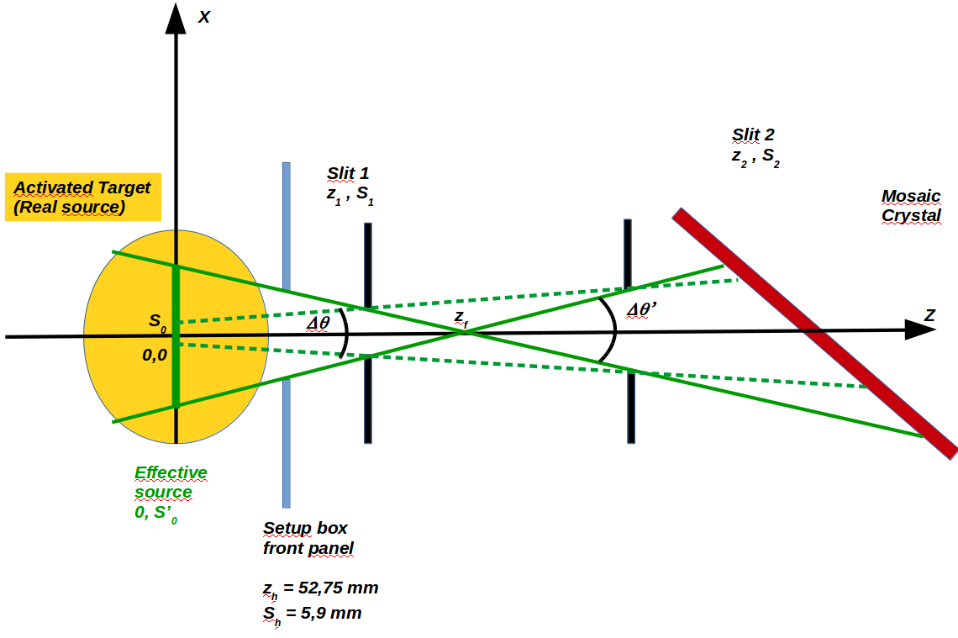
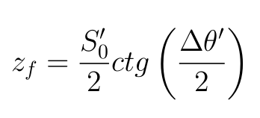
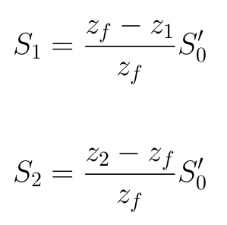
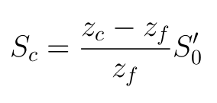
Horizontal spread
For each ∆θ’ , S₀’ pair, the
2 values of the slits can be
found; first, we
define the position of the intersection point z_{f} :
Then, the 2 slits aperture are defined by:
and the vertical illuminated portion of the HAPG is
Notes:
23
23

Slide 24
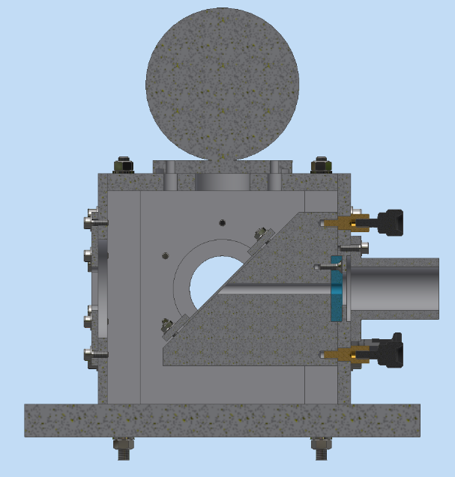
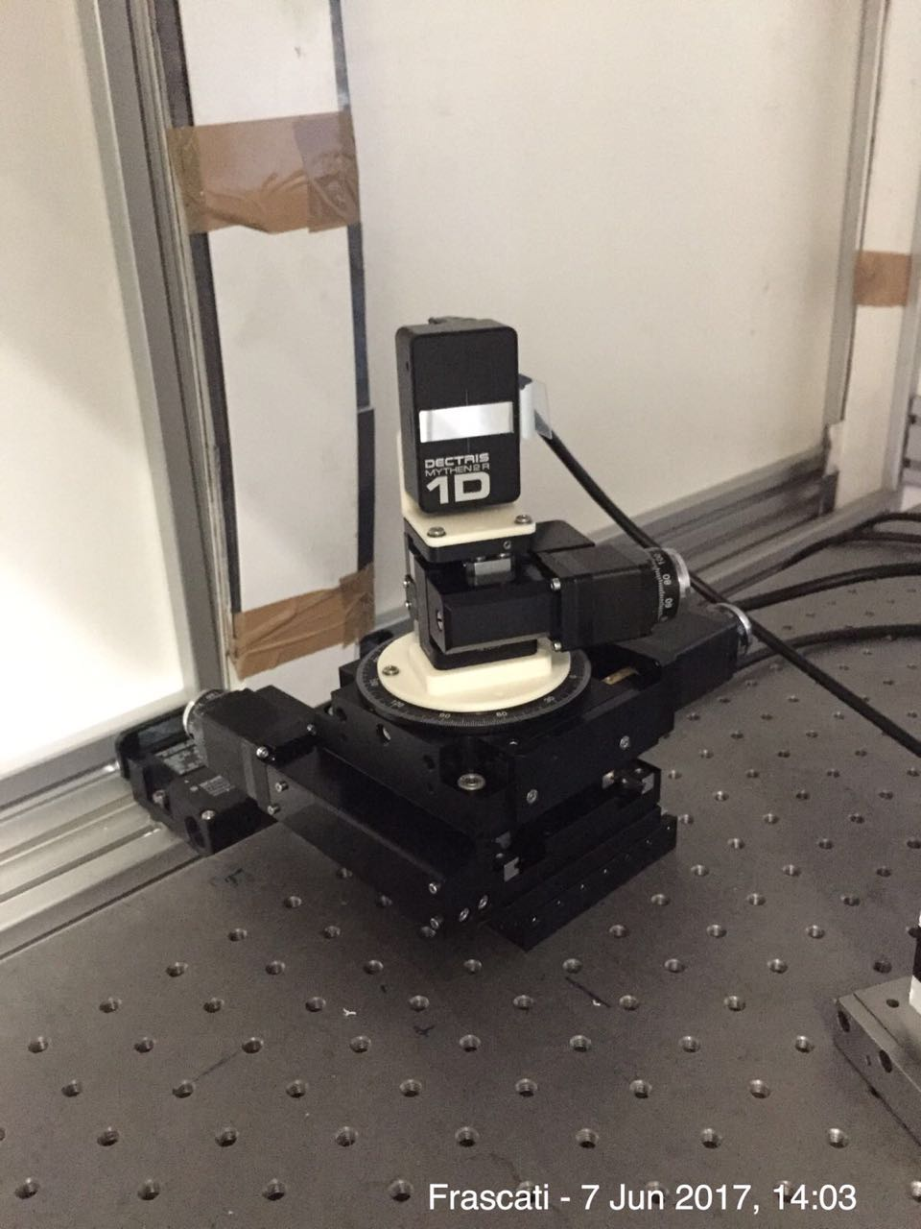
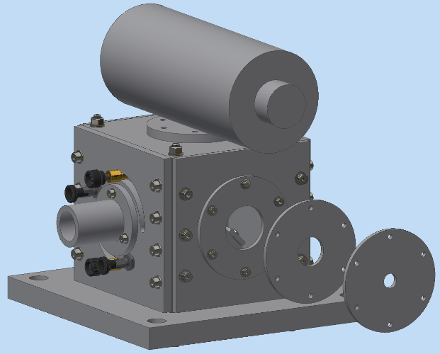
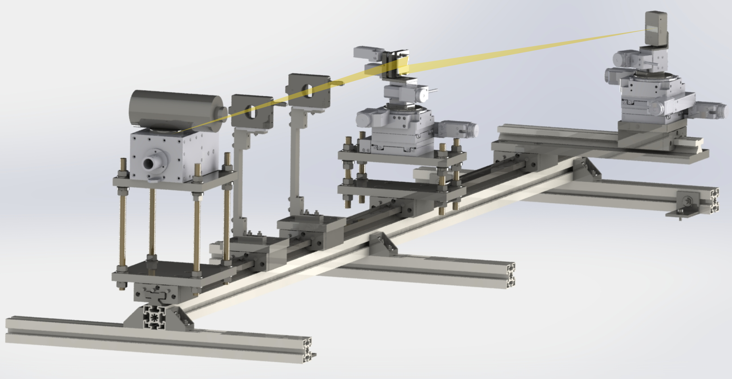
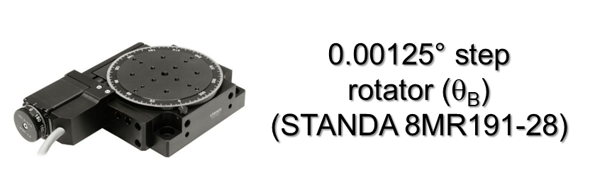
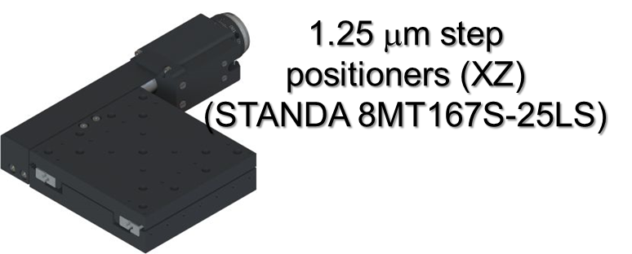
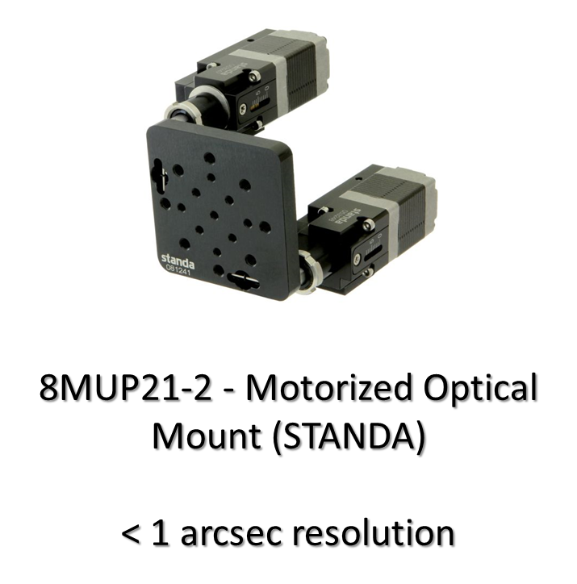
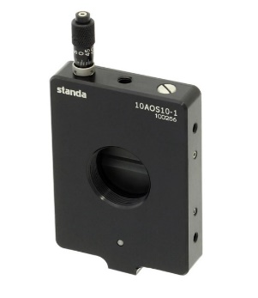
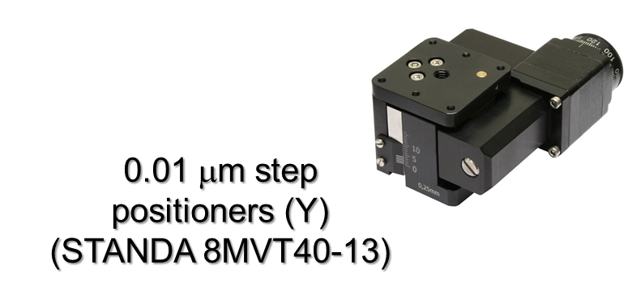
Step-0 (jul 16 – dec 16): Lab equipment and first spectrum
Experimental apparatus
Designed at SMI
Designed & realized @ SMI
Dectris Ltd
MYTHEN2 detector:
32 x 8 mm surface
640 channels → 50 μm resolution
4-40 keV range
Working @ room temperature
0-10 mm opening
26 mm circular frame
< 1 μm sensitivity
Slits
(STANDA 10MAOS10-1)
Notes:
24

Slide 25
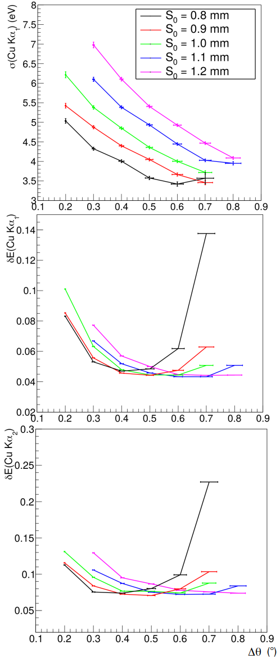
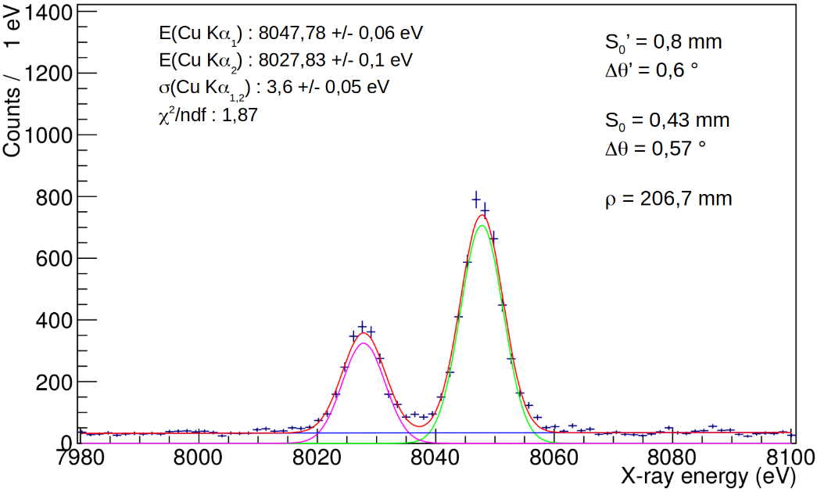

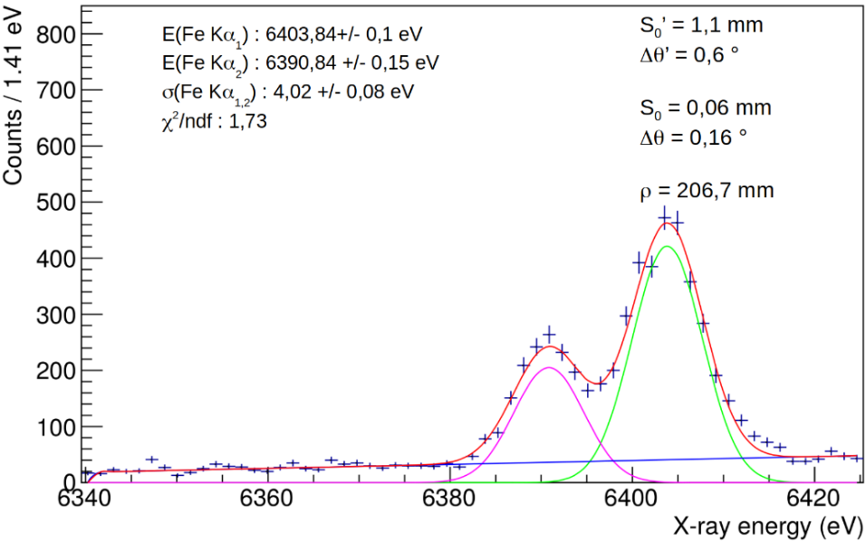
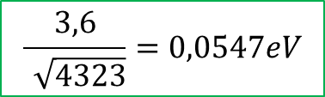
Single element spectra
In the limit of a background free pure gaussian peak, the precision is related to the resolution via:
$$\frac{3,6}{\sqrt{4323}}=0,0547eV$$
Given the energy and ρ_{c} it is alwasy possible to find the optimal configuration to obtain the best peak position precision
Valid for all energies
(tested for 6-20 keV)

Slide 26
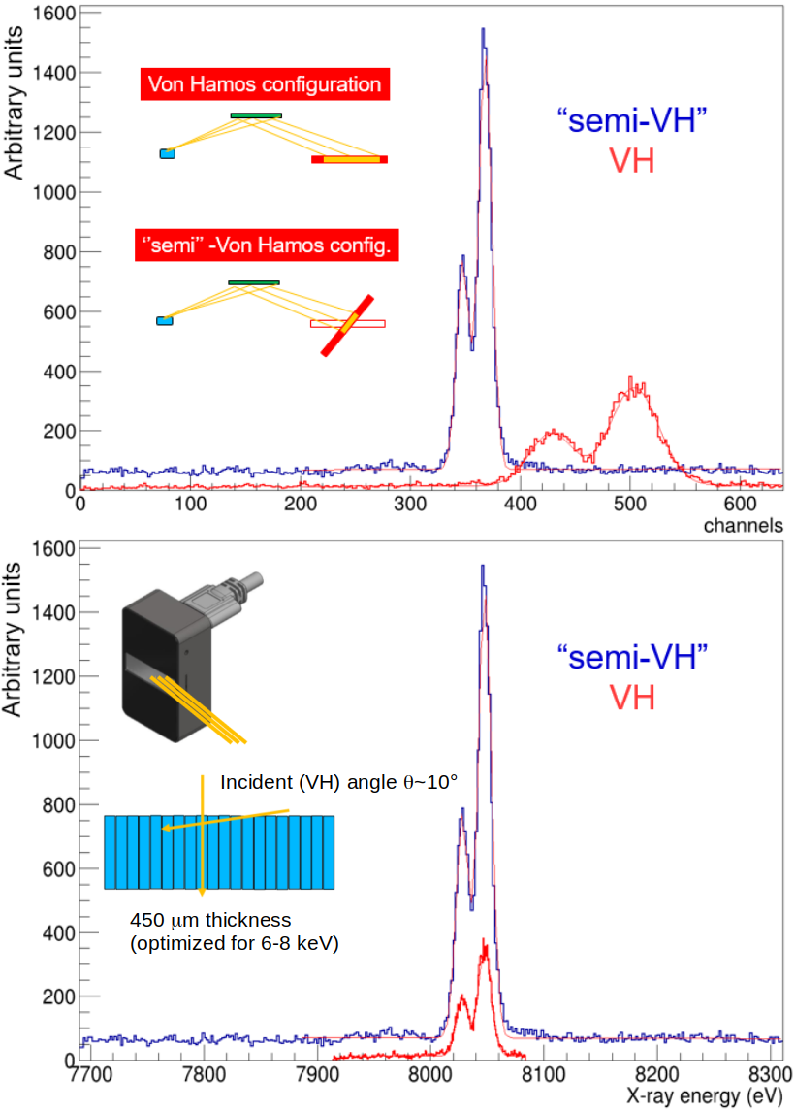
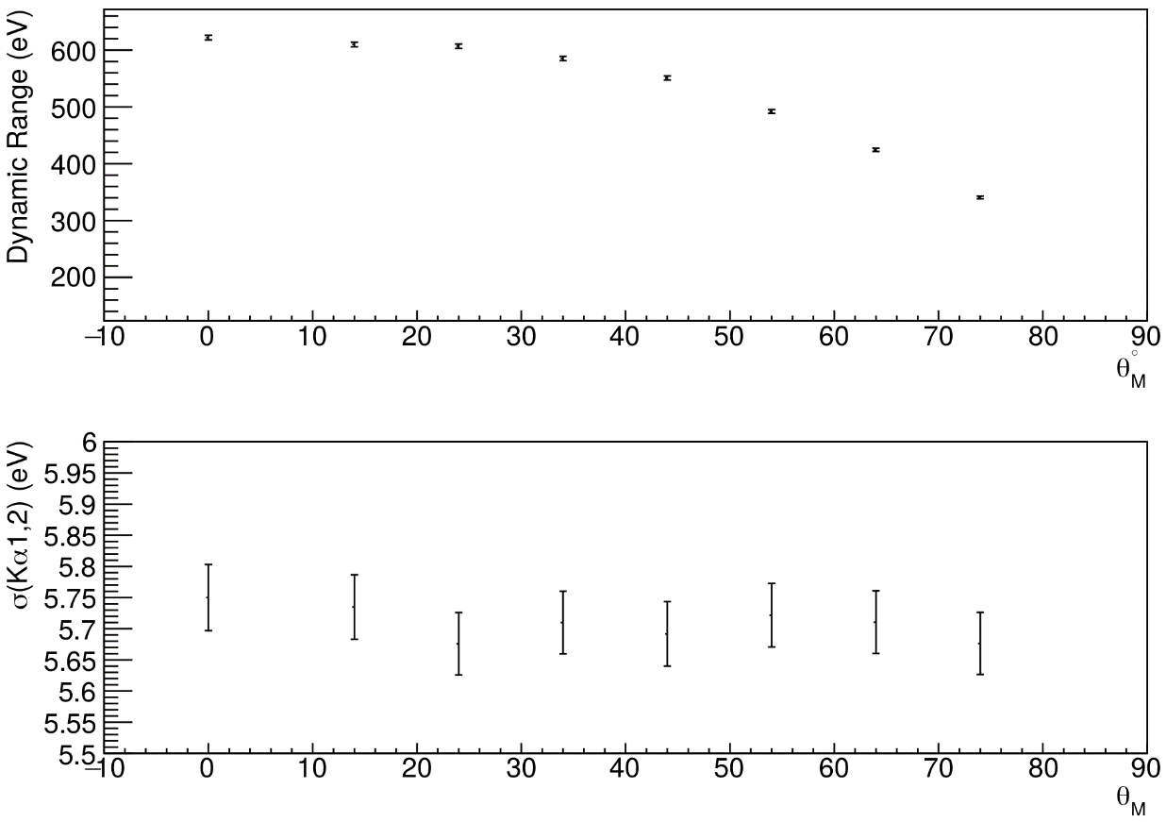
Semi VH configuration: wider dynamic range
Position detector rotation allows a wider dynamic range and a higher efficiency without worsening peak resolution
Notes:
26
26

Slide 27


Multi element spectra
700 eV dynamic range (one shot)
Resolution still at 6 eV level (σ)
>1 keV dynamic range
Resolution still at 1,2 ‰
Almost 2 mm source size

Slide 28

Results summary
Publications:
VOXES, a new high resolution X-ray spectrometer for low yield measurements with diffused sources
Acta Phys.Polon. B48 (2017) 1715
VOXES: a high precision X-ray spectrometer for diffused sources with HAPG crystals in the 2–20 keV range
JINST 13 (2018) no.04, C04002
Pyrolitic Graphite Mosaic Crystal Thickness and Mosaicity Optimization for an Extended Source Von Hamos X-ray Spectrometer.
Condens. Matter 2019, 4(2), 38
High resolution multielement XRF spectroscopy of extended and diffused sources with a graphite mosaic crystal based Von Hamos spectrometer
Accepted for publicatio in to Journal of Atomic
Analytical Spectroscopy

Slide 29
Impact
Medical Applications
(Mammography)
FAIR
(exotic atoms)
HAPG technology development
JPARC
(K-atoms)
X
PSI
(π-atoms)
E
O
S
Particle and Nuclear Physics
X-ray spectroscopy (DAΦNE-Luce)
DAΦNE
(K-atoms)
LNGS
(PEP)
Industry, art and Safety: Elemental Mapping
Foundations:Quantum Mechanics
Notes:
29
29

Slide 30



VOXES on DAΦNE
To be realized:
Shielding around Detector
Solid support structure (alignement)
Available:
Multi - Crystal support structure
Target (Solid or Liquid/Gas)
Optics
Alignement support
Target box
Detector
DAQ (integ. KM)
Notes:
30
30

Slide 31


(Future) VOXES on DAΦNE (?)
Possibility to use a gaseous target to increase efficiency
Possibility to measure different lines in parallel (cascade process)
e+
e-
K-
KC (4→3) @ 22 keV (n=2)
KC (7→4) @ 19.1 keV
KC (5→4) @ 10.2 keV
KC (6→4) @ 15.7 keV
KC (6→5) @ 5.5 keV
KC (5→4) @ 10.2 keV
Notes:
31
31

Slide 32



K- mass precision measurement
The main disagreement is between the two most recent and precise measurements (x-ray energies from kaonic atoms):
M. Tanabashi et al.(Particle Data Group), Phys. Rev. D 98, 030001 (2018).
m_{K}=493.696±0.007 MeV
A.S. Denisov et al.
JEPT Lett. 54 (1991)558
K⁻ ¹²C, crystal diffraction spectrometer
(6.3 eV at 22.1 keV), 4f-3d
m_{K}=493.636±0.011 MeV
K.P. Gall et al.
Phys. Rev. Lett. 60 (1988)186
K⁻ Pb, K⁻ W; HPGe detector (1 keV), K⁻Pb (9 -> 8),
K⁻Pb (11 -> 10), K⁻W (9 -> 8), K⁻W (11 -> 10),

Slide 33









K- mass error (rough) estimation
VOXES spectrometer
& TES
KC(5→4) : 10,2 keV
KC(6→5) : 5,5 keV
δm = 10 keV enough to reduce total error at 5-7 keV
δm <= 5 keV is the real goal for a new measurement
K- mass error:
KPb(9→8) : 290 keV
Higher energy
detectors

Slide 34
Frascati: a good place for photon detection…

Slide 35

…and more wine is coming…
Transportable and Agile Spectrometer for metal Trace in Edible liquids : TASTE
INFN-CNTT commision
“Research 4 Innovation 2020” awarded
Thanks for your attention
Notes:
35
35

