Slide 1

Search for η-mesic ³He
in pd → pdπ⁰ reaction
using WASA-at-COSY detector
MSc Aleksander Khreptak
STRANEX: Recent progress and perspectives in STRANge EXotic atoms studies and related topics
ECT*, Trento
October 21, 2019
Notes:
Good afternoon.
My name is Aleksander Khreptak. I am a PhD student at Jagiellonoan University in Kraków, Poland.
My scientific goal is the search for mesic nuclei.
In the frame of my PhD thesis I am analyze data from the experiment of the proton-deuteron collisions, which was carried out in May 2014.

Slide 2
Plan
Motivation for a search
Experiment with the WASA-at-COSY detector
Data analysis
Excitation function
Summary
Aleksander Khreptak Search for η-mesic ³He
Notes:
This is plan of my today presentation.
In the beginning a few words about the object of my research – a mesic nucleus and motivation for a search.
Next, about the experiment in the Juelich Research Center, about accelerator facility and WASA-at-COSY detector.
In the year 2014 experiment for the search of the Helium eta bound state was carried out. I am analysing data from this experiment.
Next, data analysis, in particular: calculation of the luminosity, selection cuts, particle identification and excitation function calculation.
At the end summary and plans for future of the search.

Slide 3
Motivation for a search
The scientific aim of our research is experimental confirmation of the existence of mesic nucleus: a new kind of nuclear matter consisting of nucleons and mesons.
In 1986 Haider and Liu [1] postulated the existence of η-mesic nuclei in which the η meson is bound within a nucleus via the strong interaction, however, until now it has not been confirmed experimentally.
[1] Q. Haider, L. C. Liu, Phys. Lett. B 172, 1986, 257.
n
η
p
p
Aleksander Khreptak Search for η-mesic ³He
Notes:
The scientific aim of my research is experimental confirmation of the existence of mesic nucleus. That is a new kind of nuclear matter consisting of nucleons and mesons.
The search for new kind of nuclear matter is a very exciting experimental challenge.
But the confirmation of the existence of a mesic nucleus would be interesting on its own account, and in addition it would allow for better understanding of mesons structure and their interactions with nucleons.
A mesic nucleus would be a system of nucleus and meson bound via strong interaction.
In 1986, Haider and Liu postulated the hypothesis of a eta-mesic nucleus.
Since Haider and Liu the bound states have been searched in many experiments at numerous laboratories by different collaborations.
But no experiment confirm of the existence of meson-nucleon bound state. There are only signals which might be interpreted as an indications of the eta-mesic nuclei.

Slide 4
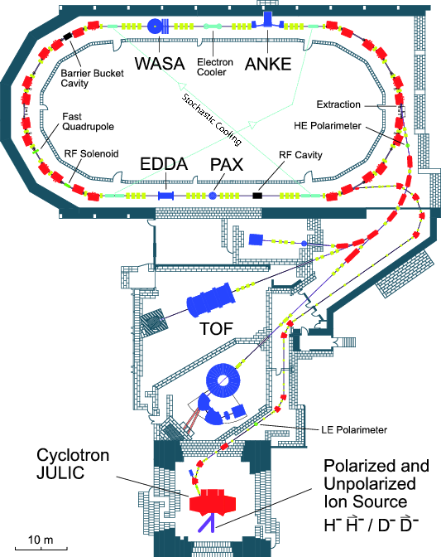
COSY (COoler SYnchrotron) accelerator facility [2]
The cyclotron JULIC provides both unpolarized and polarized proton and deuteron beams for injection into the COSY ring, where they are accelerated and stored.
Circumference of the synchrotron ring is equal to 184 m.
COSY operates in the momentum range of 0.3 − 3.7 GeV/c.
[2] H.-H. Adam et al., WASA-at-COSY Collaboration, arXiv:nucl-ex/0411038
Aleksander Khreptak Search for η-mesic ³He
Notes:
The measurement was carried out using the WASA detector installed at the COoler SYnchrotron in the Juelich Research Center in Germany.
Circumference of the synchrotron ring is equal to 184 m.
COSY operates in the momentum range from 0.3 to 3.7 GeV/c.
The cyclotron provides proton or deuteron beams for injection into the COSY ring, where they are accelerated and stored.
The WASA-at-COSY detector was installed at one of the two straight sections of the COSY ring.

Slide 5
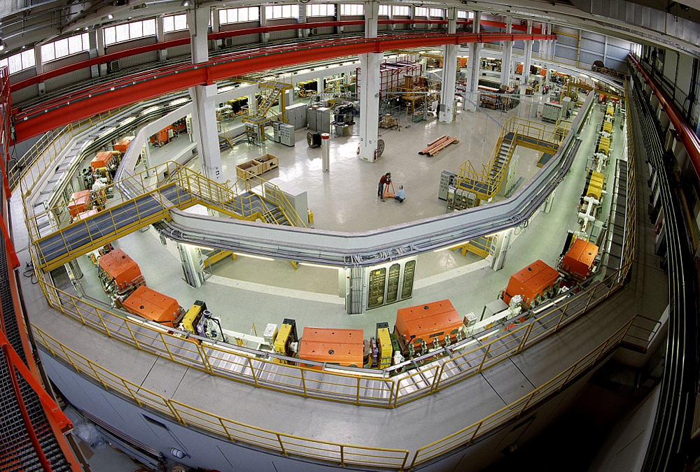
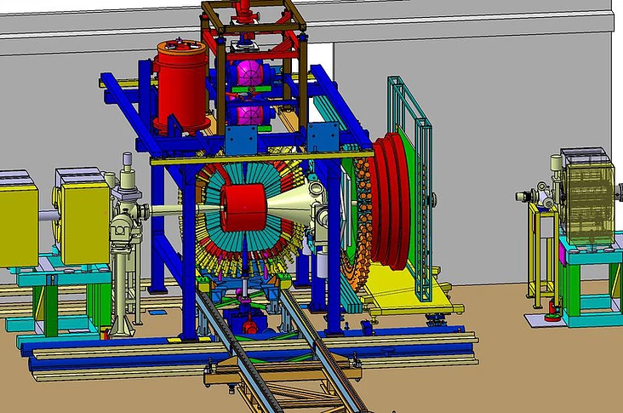
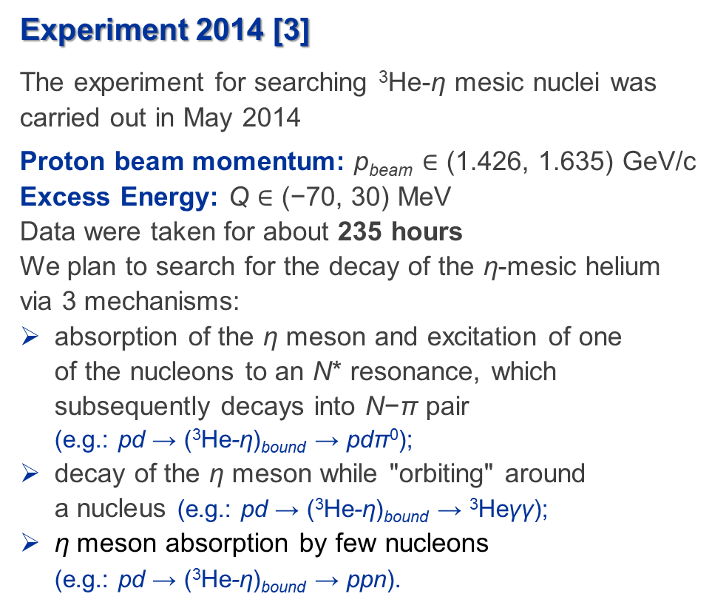
Experiment 2014 [3]
The experiment for searching ³He-η mesic nuclei was carried out in May 2014
Proton beam momentum: p_{beam} $∈$ (1.426, 1.635) GeV/c
Excess Energy: Q $∈$ (−70, 30) MeV
Data were taken for about 235 hours
We plan to search for the decay of the η-mesic helium via 3 mechanisms:
absorption of the η meson and excitation of one
of the nucleons to an N* resonance, which subsequently decays into N−π pair
(e.g.: pd → (³He-η)_{bound} → pdπ⁰);
decay of the η meson while "orbiting" around
a nucleus (e.g.: pd → (³He-η)_{bound} → ³Heγγ);
η meson absorption by few nucleons
(e.g.: pd → (³He-η)_{bound} → ppn).
[3] P. Moskal, W. Krzemień, M. Skurzok, COSY proposal No. 186.3 (2014)
Aleksander Khreptak Search for η-mesic ³He
Notes:
The measurement of current experiment was carried out in 2014.
The proton beam momentum was varied between 1.426 GeV/c and 1.635 GeV/c, corresponding to the excess energy ranging from −70 MeV to 30 MeV.
Data were taken for about 235 hours.
We plan to search for the decay of the η-mesic helium via the absorption of the η meson on one of the nucleons, excitation of this nucleon to the N* resonance state, and subsequent decay of resonance into the nucleon-pion pair.
In current experiment in addition to the resonance mechanism we verify new hypothesis with the non-mesonic final state. That is decay of the eta meson while it is still "orbiting" around the nucleus. Also, eta meson can be absorpt by few nucleons.
I am analysing the first mechanism.
The uniqueness of our data with respect to other experiments are: (a) high statistics (b) exclusive measurement of all reaction products, (c) continuous changing of the beam momentum during the accelerator cycle, (d) close to 4π acceptance of the WASA detector, (e) possibility of testing of different hypotheses about the creation and decay of the mesic nucleus.

Slide 6
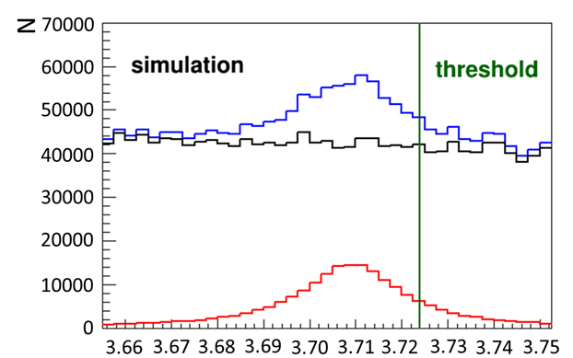

Experimental method
The signatures of the η-mesic nuclei are searched for by studying the excitation function for the chosen decay channels of the ³He-η system in the vicinity of the η production threshold
pd → pdπ⁰ and pd → (³He-η)_{bound} → pdπ⁰
pd → pdπ⁰
pd → (³He-η)_{bound} → pdπ⁰
$\sqrt{s_{pd}}$ [GeV/c²]
Aleksander Khreptak Search for η-mesic ³He
Notes:
The signatures of the eta-mesic nuclei are searched for by studying the excitation function for the chosen decay channels of the Helium-eta system near of the eta production threshold.
The blue line means the signal, that is the sum of the main reaction and the background immediate reaction.
Black denotes the simulation of the background reaction: meson creation without bound state. The red line is the result of subtracting of blue and black lines.
We expect to see such a peak near the threshold, which would indicate that the reaction occurs not only directly, but also through the creation and decay bound state of meson and nucleon.

Slide 7
Data analysis
Luminosity determination
Selection criteria
Detection and reconstruction efficiency
Excitation function
Aleksander Khreptak Search for η-mesic ³He
Notes:
The analysed data set consists of 950 runs.
The main part of the analysis was devoted to selection and reconstruction of events corresponding to the studied process. This analysis is described step by step in the following slides.
The first, calculation of luminosity via the quasi-elastic proton-proton scattering in the proton-deuteron collisions.
Next, efficiency estimation based on Monte Carlo simulation.
At the end, determining the excitation function.

Slide 8
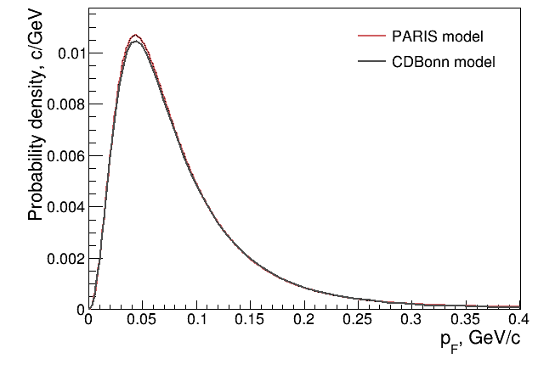
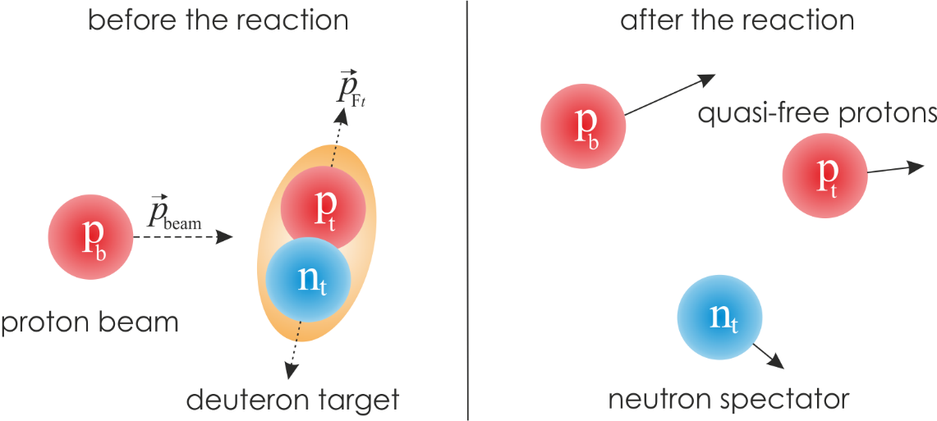
Luminosity determination via quasi-free reaction
In order to luminosity dtermination we used the quasi-elastic proton-proton scattering in the proton-deuteron colisions: pd→ppn_{spectator}.
Simulation
p_{beam} was generated with uniform density distribution
(1.426, 1.635) GeV/c
The neutron momentum vectors was
generated with Fermi momentum
distribution of nucleons inside deuteron
Aleksander Khreptak Search for η-mesic ³He
Notes:
Luminosity is the ratio of the number of events detected in a certain time to the interaction cross-section.
Luminosity is dependent on the particle beam parameters (beam width and particle flow rate) and on the target properties (target size and density).
The precise luminosity determination as a function of excess energy is important for the normalization of the obtained excitation function for studied reaction and for the interpretation of the result in view of the hypothesis of the Helium-eta bound state production
It can be estimated from reaction with known cross section.
In order to determine the luminosity we used the quasi-elastic proton-proton scattering in the proton-deuteron collisions.
In this reaction protons from the beam are scattered on the protons in the deuteron target.
We assume that the neutrons are acting only as spectators which means that they do not take part in reactions.
The Monte Carlo simulations of this reaction were carried out. The proton beam momentum was generated with uniform probability density distribution in the range corresponding to the experimental ramping.
The deuteron target is considered as a proton-neutron bound systems. The neutron momentum vectors are distributed isotropically in the spherical coordinates of the deuteron with Fermi momentum distribution of nucleons inside deuteron.
Fermi momentum distributions of proton and neutron bound inside a deuteron derived from two different potential models, namely PARIS [for main calculations] and CDBonn [for systematics error calculations] are shown in the slide.

Slide 9
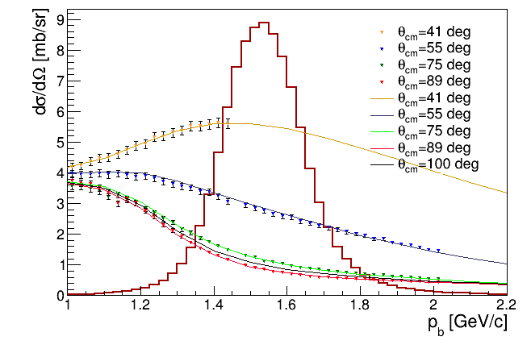
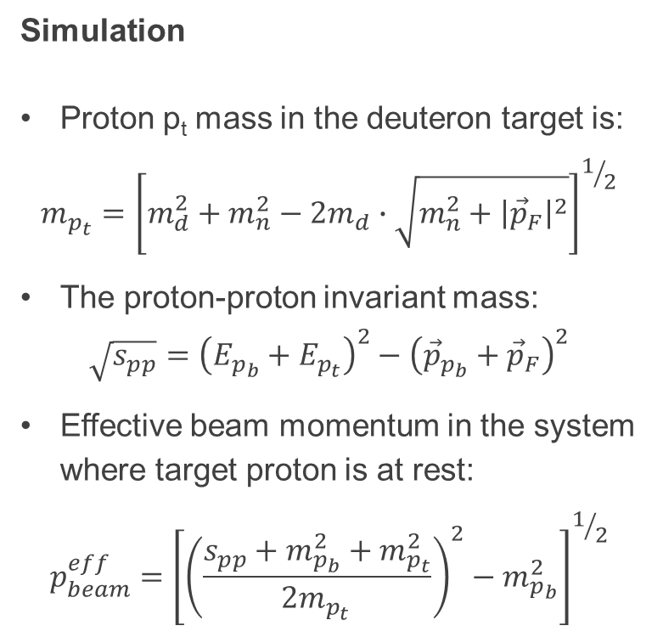


Luminosity determination via quasi-free reaction
Simulation
Proton p_{t} mass in the deuteron target is:
$$m_{p_{t}}={\left[m_{d}^{2}+m_{n}^{2}−2m_{d}∙\sqrt{m_{n}^{2}+{\left|{\vec{p}}_{F}\right|}^{2}}\right]}^{1/2}$$
The proton-proton invariant mass:
$$\sqrt{s_{pp}}={\left(E_{p_{b}}+E_{p_{t}}\right)}^{2}−{\left({\vec{p}}_{p_{b}}+{\vec{p}}_{F}\right)}^{2}$$
Effective beam momentum in the system where target proton is at rest:
$$p_{beam}^{eff}={\left[{\left(\frac{s_{pp}+m_{p_{b}}^{2}+m_{p_{t}}^{2}}{2m_{p_{t }}}\right)}^{2}−m_{p_{b}}^{2}\right]}^{1/2}$$
$p_{beam}^{eff}$ [GeV/c]
$$\frac{dσ}{dΩ}\left(θ^{∗},p_{beam}^{eff}\right)$$
Aleksander Khreptak Search for η-mesic ³He
Notes:
Because of the binding energy, the proton inside the deuteron has a smaller mass than the real proton. Neutron is spectator and we consider it as a particle with it’s real mass.
Based on Fermi momentum values, proton mass in the deuteron target was calculated according to equation.
Next, the proton-proton invariant mass was calculated according to equation. Where Epb, Ept are energies and ppb is momentum beam and targed protons and pF is Fermi momentum of proton inside target.
Effeective beam momentum wass calculated in the system where target proton is at rest.
The momenta of outgoing particles were used as an input in the simulation of the detection system response with the GEANT computing package.
For each of simulated event, we assign a weight corresponding to the differential cross section, which is uniquely determined by the scattering angle and the total proton-proton collision Energy.
The differential cross section for quasi free pd reaction is a function of the scattering angle in the proton-proton centre-of-mass system and effective proton beam momentum seen from the proton in the proton-proton system. In order to calculate it, we have used the cross section values for proton-proton elastic scattering proton-proton computed based on the SAID program.
The distribution of the effective beam momentum, as well as a comparison of the SAID calculations and the existing differential cross section from the EDDA measurements are shown in the slide.
As we can see, the differential cross sections calculated using the SAID programme are in agreement with distributions measured by the EDDA collaboration.

Slide 10
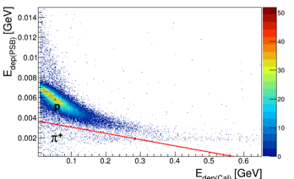
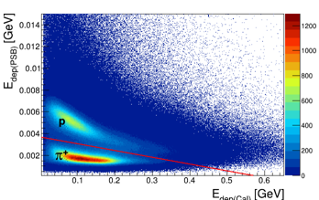
Luminosity determination via quasi-free reaction
Cuts
Spectrum of the energy loss in the Plastic Scintillator Barrel shown as a function of the energy deposited in the Electromagnetic Calorimeter:
pd → ppn_{spectator}
data
Aleksander Khreptak Search for η-mesic ³He
Notes:
In order to reject events corresponding to the charged pions registered in the Central Detector, the simple grafical cut on the energy deposited in the Electromagnetic Calorimeter (SEC) vs. energy deposited in Plastic Scintillator Barrel (PSB) spectrum was applied.

Slide 11
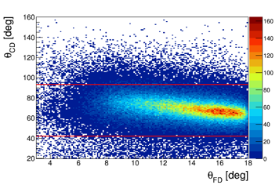
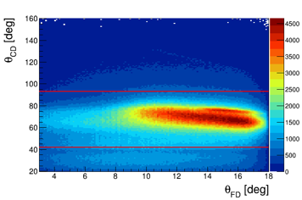
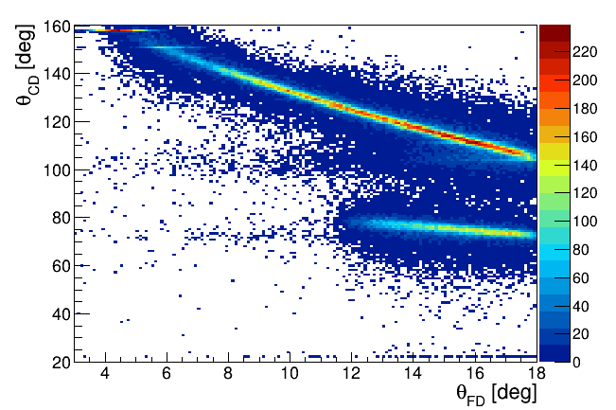
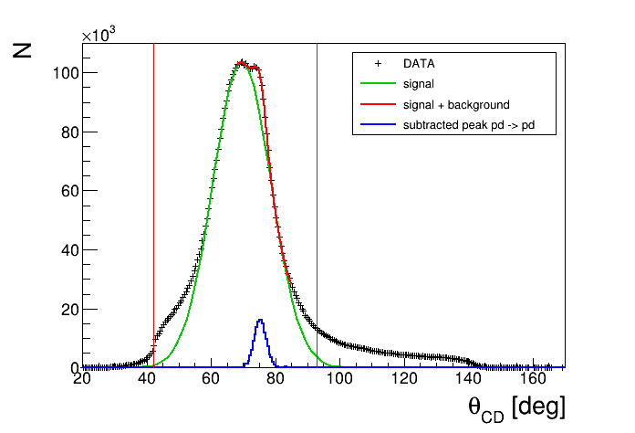
Luminosity determination via quasi-free reaction
Cuts
Correlations between the polar angles θ_{FD} and θ_{CD}
pd → ppn_{spectator}
data
pd → pd
Aleksander Khreptak Search for η-mesic ³He
Notes:
The background coming from deuteron from elastic proton-deuteron scattering was subtracted applying the cut in polar angle at 93 degrees.
The cut for 45 degrees is related to the fact, that there is a coupling of the forward and cental parts of the scintilator barrel and we have false events.
In order to subtract background coming from elastic scattering protons polar angle distribution was fitted by Gaussian function. Next, the peak from these protons was subtracted.

Slide 12
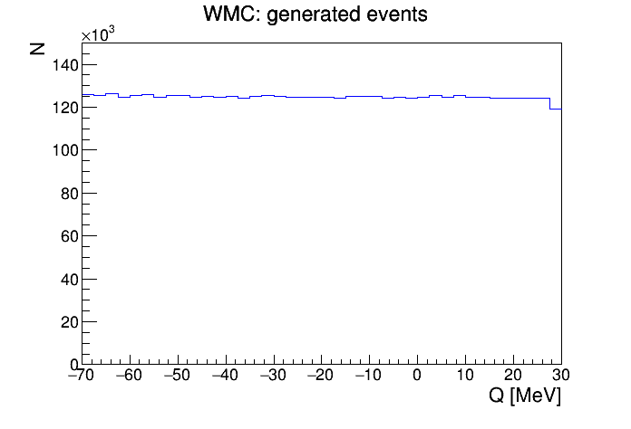
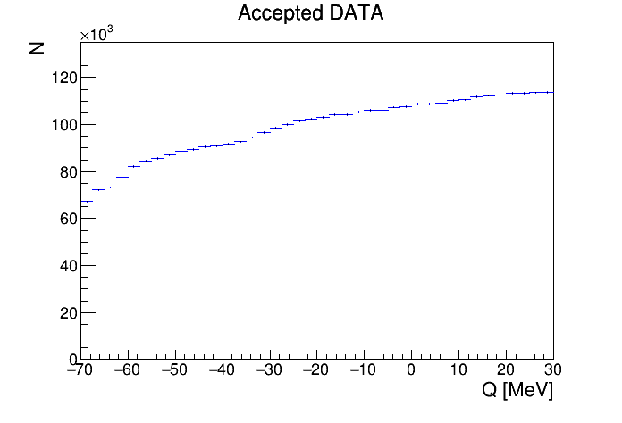
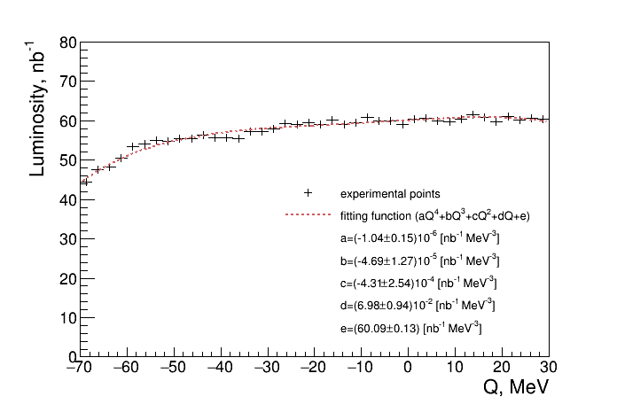
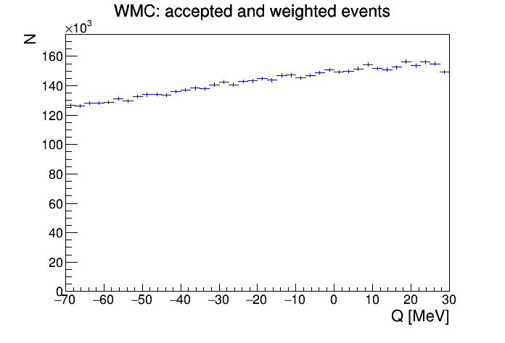
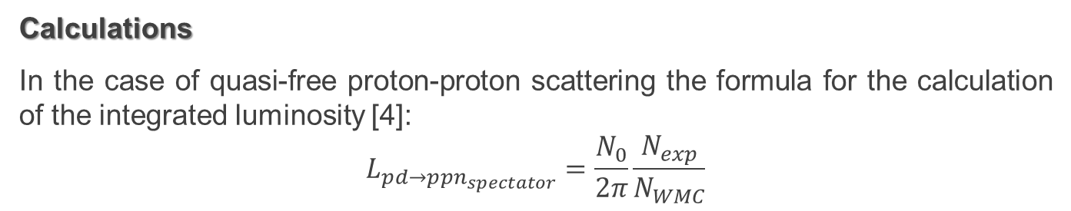

Luminosity determination via quasi-free reaction
Calculations
In the case of quasi-free proton-proton scattering the formula for the calculation of the integrated luminosity [4]:
$$L_{pd→ppn_{spectator}}=\frac{N_{0}}{2π}\frac{N_{exp}}{N_{WMC}}$$
$$L=(2295 ±3_{stat}±{91}_{syst})$$
N₀
N_{exp}
N_{WMC}
[4] P. Moskal and R. Czyżykiewicz, AIP Conf. Proc. 950, 118 (2007).
Aleksander Khreptak Search for η-mesic ³He
Notes:
In order to determine the luminosity dependence on the excess Energy we used the method discribed in this article.
After all cuts and application of conditions described above, the number of experimental events was determined and the luminosity was calculated.
The luminosity variation (increase and then decrease) is caused by the change of the beam-target overlapping during the acceleration cycle.
The obtained total integrated luminosity is equal to 2295 reverse nanobarns.

Slide 13
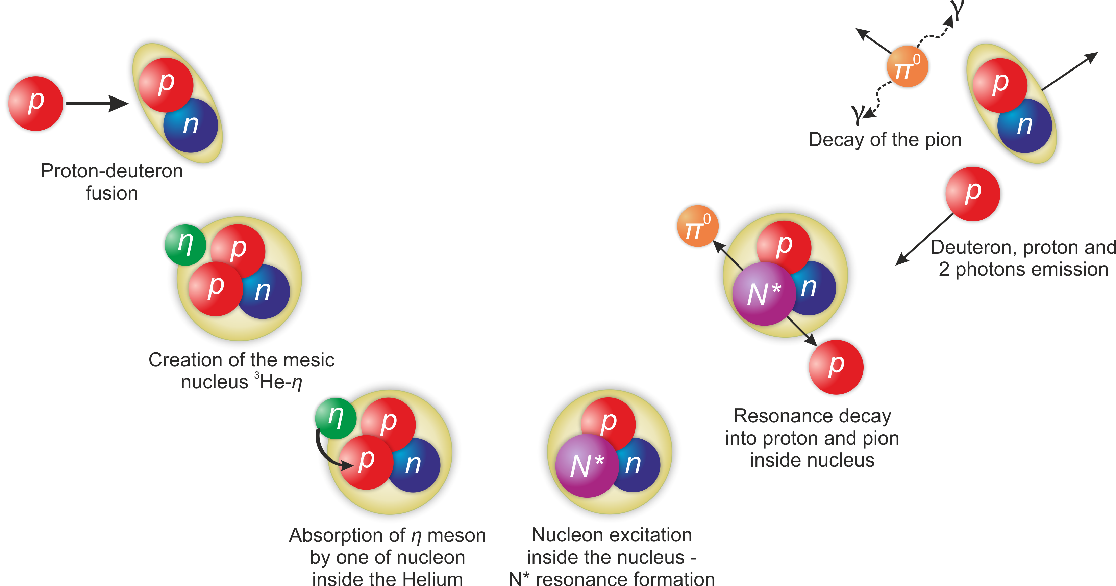
Simulation of pd → (³He-η)_{bound} → pdπ⁰ → pdγγ reaction
Aleksander Khreptak Search for η-mesic ³He
Notes:
One of the hypothesis postulates that reaction of the eta-mesic nucleus production and decay proceeds via next scheme.
According to this hypothesis the eta-mesic nucleus is produced in proton-deuteron collision.
Such reaction leads to the formation of helium nuclei interacting with the eta meson via strong interaction.
Next the eta meson might be absorbed by one of the nucleons inside helium.
It causing to excitation this nucleon to resonance N*.
Next, the resonance decays into the proton-pion pair, and subsequently pi meson decays into two quanta.
As a result of such decay of the mesic-nucleus the deuteron, proton and neutral pion, which decay into two quants. All particles and quants could be measured in the detector.

Slide 14





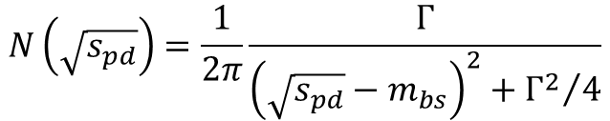
Simulation assumptions
Breit-Wigner distribution Spectator model
probability density [c/GeV]
$$\sqrt{s_{pd}}$$
$$m_{{}_{}^{3}{He−η}}$$
$$m_{{}_{}^{3}{He}}+m_{η}$$
p_{Fermi} [GeV/c]
$$B_{s}$$
$$N\left(\sqrt{s_{pd}}\right)=\frac{1}{2π}\frac{Γ}{{\left(\sqrt{s_{pd}}−m_{bs}\right)}^{2}+{Γ^{2}}/4}$$
$$m_{{}_{}^{3}{He−η}}=m_{{}_{}^{3}{He}}+m_{η}−B_{s}$$
Aleksander Khreptak Search for η-mesic ³He
Notes:
The mass of a created bound state is a sum of eta and Helium masses reduced by binding energy.
It is assumed that the considered bound state has a resonance-like structure with fixed binding energy Bs and width Gamma. Therefore, the invariant mass of the whole system spd is distributed randomly according to the Breit-Wigner distribution which is given by formula.
It is assumed, that, just before the decay, resonance momentum distribution can be well approximated by the Fermi momentum distribution for nucleons inside Helium. The deuteron plays the role of a spectator which according to the momentum conservation in the Helium system moves with the Fermi momentum in the opposite direction to the resonance. The spectator is considered as a real particle registered in the experiment and in the analysis.

Slide 15
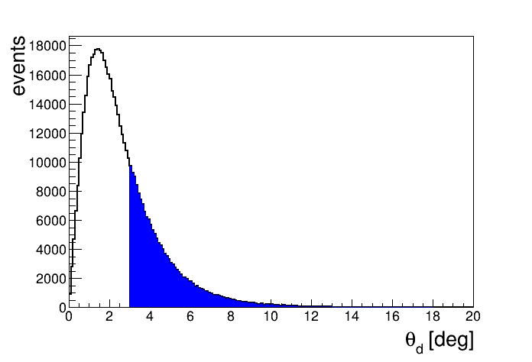
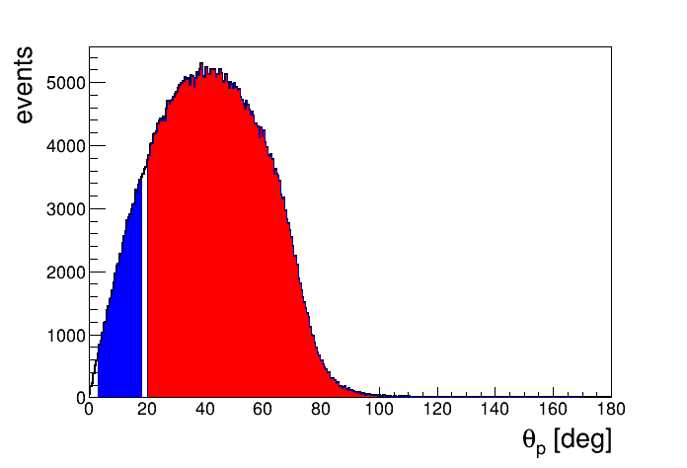
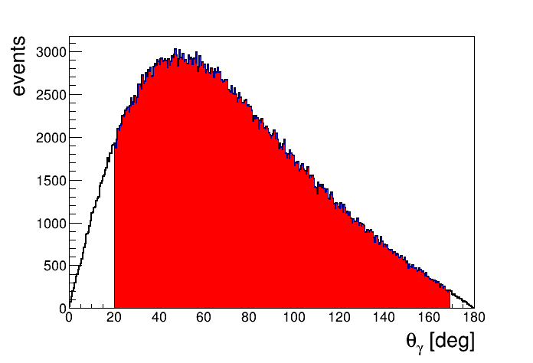
Scattering angle distribution of deuteron, proton and gammas
deuteron
proton
FD
FD
CD
gamma
CD
Aleksander Khreptak Search for η-mesic ³He
Notes:
Angular distributions for the outgoing deuteron, proton and gamma quanta are shown in this slide.
An angular ranges covered by respective parts of WASA-at-COSY detection setup are marked with shaded areas.
All the deuterons are outgoing into the forward detector. Gamma quanta we can register only in the Central detector.
On the other hand, most of the protons are registered in the central detector, but a small part of protons outgoing to the forward detector.
This allows us to identify most of the protons and gamma quanta in the Central detector.

Slide 16
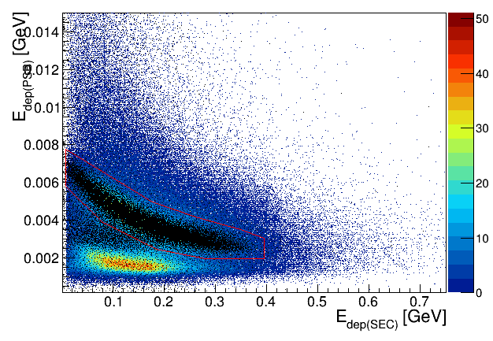
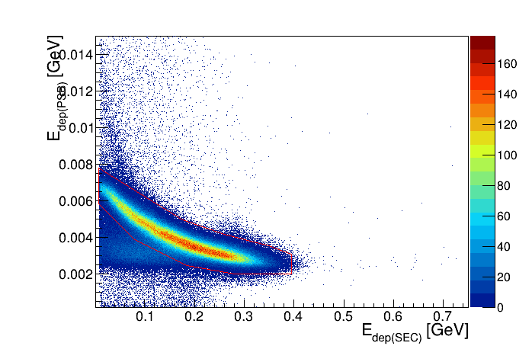
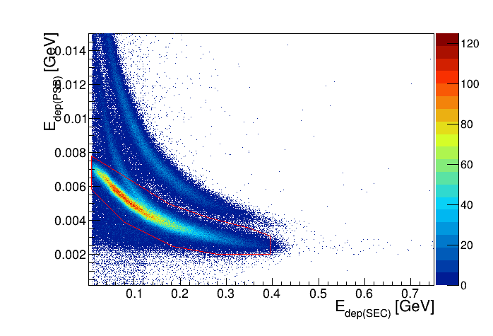

Proton identification in Central Detector
Spectrum of the energy loss in the Plastic Scintillator Barrel shown as a function of the energy deposited in the Electromagnetic Calorimeter:
colour – data
black – simulation
pd → (³He-η)_{bound} → pdπ⁰
p
$$π^{+}$$
pd → pdπ⁰
Aleksander Khreptak Search for η-mesic ³He
Notes:
Protons was separated in spectrum of the energy loss in the Plastic Scintillator Barrel shown as a function of the energy deposited in the Electromagnetic Calorimeter by simply graphical cut.

Slide 17
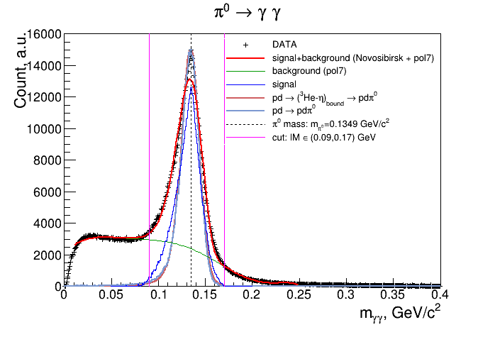
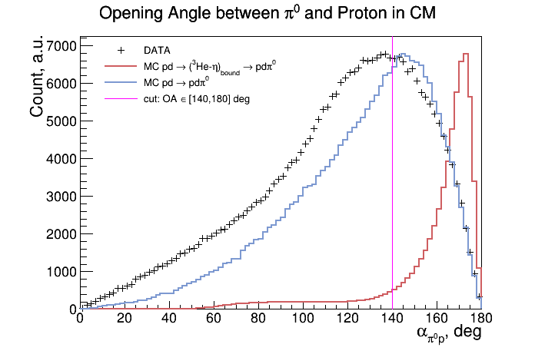
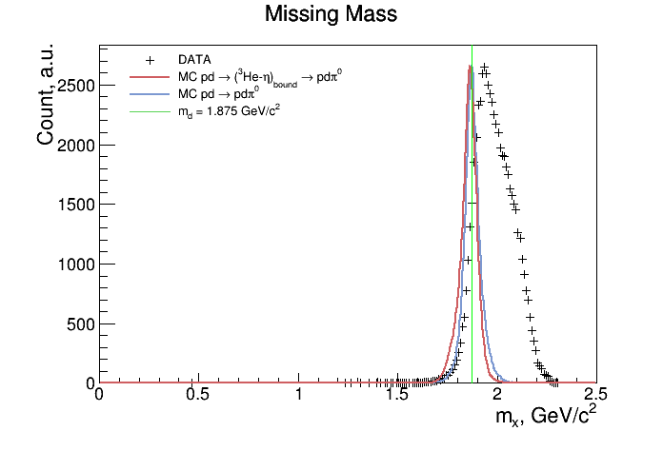
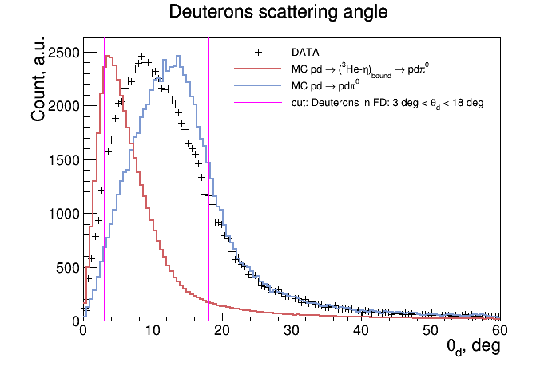
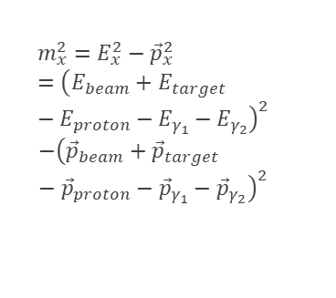
Selection criteria
$$m_{x}^{2}=E_{x}^{2}−{\vec{p}}_{x}^{2}={\left(E_{beam}+E_{target}−E_{proton}−E_{γ_{1}}−E_{γ_{2}}\right)}^{2}$$
$$−{\left({\vec{p}}_{beam}+{\vec{p}}_{target}−{\vec{p}}_{proton}−{\vec{p}}_{γ_{1}}−{\vec{p}}_{γ_{2}}\right)}^{2}$$
Aleksander Khreptak Search for η-mesic ³He
Notes:
Pions from reaction are registered in the Central Detector.
The neutral pions are reconstructed from the invariant mass of two gamma quanta outgoing from its decay.
In the analysis, all events with at least two neutral clusters in electromagnetic calorimeter are selected.
Next, all gamma pair combinations are considered, and for each pair the invariant mass is calculated.
In case of more than two clusters, we take into account only this combination of clusters for which the difference between pion mass and invariant mass of two gamma quanta is minimal.
The cut applied in invariant mass spectrum, based on Monte Carlo simulations, is presented in the slide.
Based on the spectrum obtained from simulations we applied also a cut in the proton-pion opening angle in the center of mass frame corresponding to the range between 140 and 180 degrees.
Deuteron was identified via the missing mass technique.
Knowing a four momenta of proton beam, deuteron target, outgoing proton and gamma quanta and employing the principle of momentum and energy conservation we can calculate the missing mass.
Unfortunately, the missing mass spectrum contains a lot of background from reactions with more than two gamma quanta in the decay channel and peak of this spectrum is shifted.
From simulations deuterons are registered in the Forward Detector, which covers the range of polar angles from 3 to 18 degrees.

Slide 18
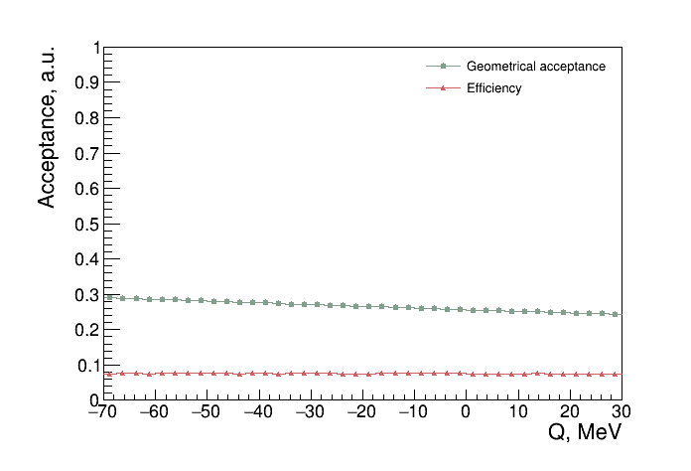
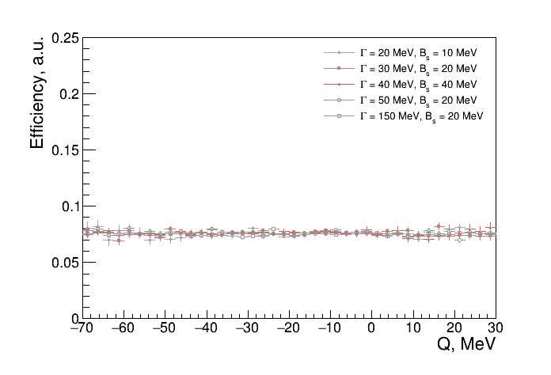
Reconstruction efficiency
Aleksander Khreptak Search for η-mesic ³He
Notes:
The experimental data are collected with non perfect geometrical acceptance as well as non-perfect detection and reconstruction efficiency.
The overall reconstruction efficiency, was determined based on the Monte Carlo simulation carried out taking into account detection system response and all selection cuts.
The efficiency was calculated as a ratio of the number of events accepted by detection system to the number of generated events.
The geometrical acceptance of the WASA-at-COSY detector for the studied reaction is equal to about 30% while the full efficiency including all cuts applied in the analysis is about 8% and is smooth in the whole excess energy range and is independent to bound state widths and the binding energies.

Slide 19
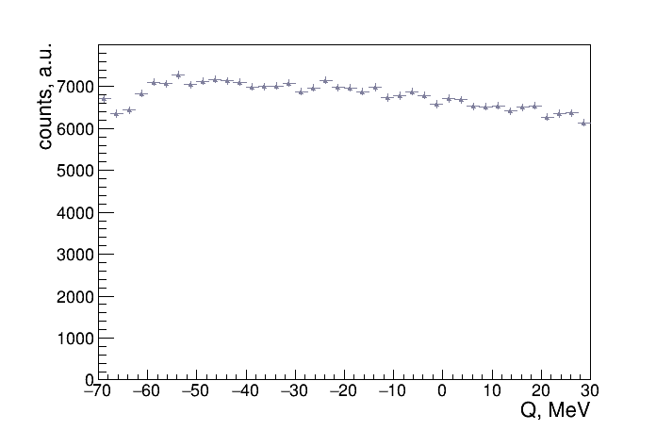
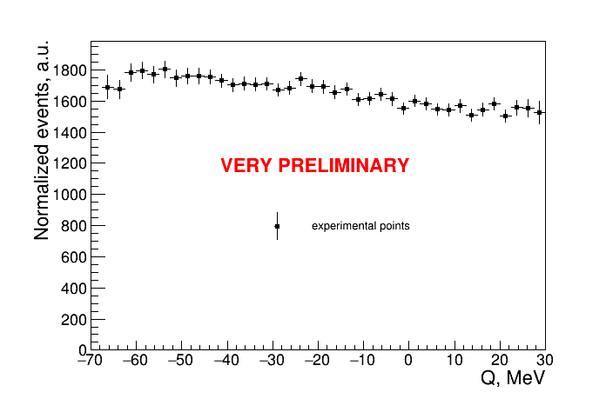
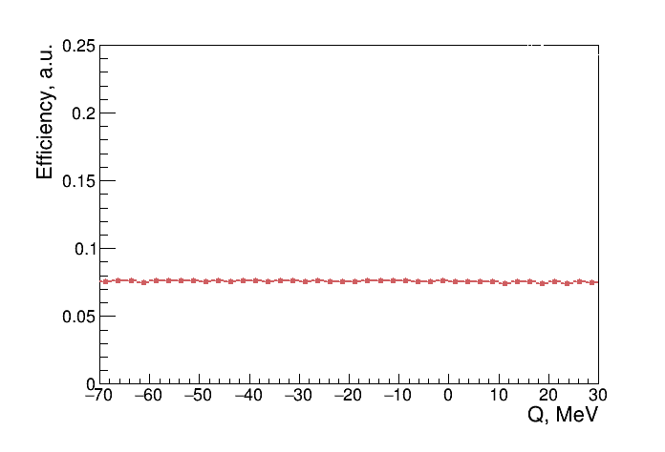
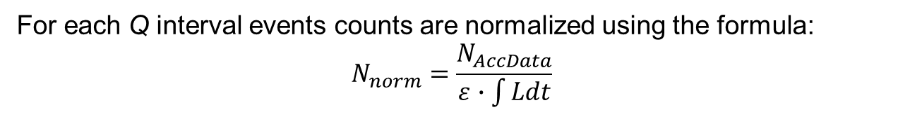
Excitation function
For each Q interval events counts are normalized using the formula:
$$N_{norm}=\frac{N_{AccData}}{ε∙\int{Ldt}}$$
N_{AccData}
ε
L
Aleksander Khreptak Search for η-mesic ³He
Notes:
In order to calculate cross sections the number of events in each excess energy interval was divided by the corresponding integrated luminosity determined based on quasi-free proton proton scattering and corrected for total efficiency.
There are only statistical errors shown by the vertical bars. Systematic studies will be carried out.
The obtained excitation function of the proton-deuteron reaction does not reveal the resonance-like structure which could be interpreted as the indication of the bound state of Helium and eta.
The search for eta-mesic Helium is complex due to huge background contribution. This background largely comprises proton-deuteron proces.

Slide 20
Summary
Exclusive measurement of the pd → pdπ⁰ → dpγγ reaction was carried out with WASA-at-COSY detector using the ramped beam technique
Luminosity was determined using quasy-free pd → ppn_{spectator} reaction
(L = 2295 ± 3_{stat} ± 91_{syst} nb^{–1})
Unfortunately, no bound state signal in excitation function
Next step will be to determine an upper limit for the cross-section for formation of the ³He-η bound state and its decay into the pdπ⁰ channel
Systematic studies will be carried out
Aleksander Khreptak Search for η-mesic ³He
Notes:
So, we can summarize.
Exclusive measurement of proton-deuteron fusion reactions was carried out with the WASA-at-COSY detection system.
For this analysis luminosity was determined using quasy-free reaction and it is equal to about 2300 reverse nanobarns.
The obtained excitation functions do not show any narrow structure which could be a signature of the bound state.
The next step will be to determine an upper limit for the cross-section for formation of the Helium-eta bound state and its decay into the proton-deuteron-pion channel.
Also, systematic studies will be carried out.

Slide 21

Thank You!
Notes:
Thank You for attention!

