Slide 1
Diquark relevant studies from Lattice QCD
Ying Chen
Institute of High Energy Physics,
Chinese Academy of Sciences, China
ECT* Workshop, Trento, Italy, Sep. 23-27, 2019

Slide 2
Outline
I. A brief introduction to lattice QCD
II. Effective masses of quarks and diquarks
III. Diquark correlation (?) in nucleon
IV. Summary

Slide 3
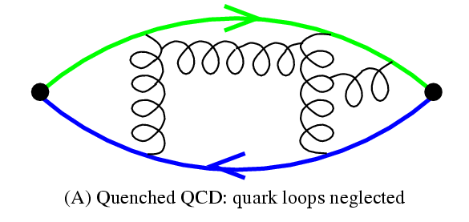
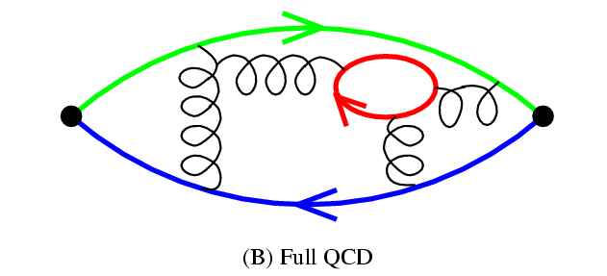
I. A brief introduction to lattice QCD
The lattice formulation of QCD---Lattice QCD

Slide 4
Masses and two-point functions
$$C_{ij}\left(\vec{p},t\right)=\sum_{\vec{x}}{e^{−i\vec{p}⋅x}}⟨Ω|T𝒪_{i}\left(\vec{x},t\right)𝒪_{j}^{+ }\left(0\right)|Ω⟩$$
$$\sum_{n,\vec{p}}{|n,\vec{p}⟩⟨n,\vec{p}|\frac{1}{2E_{n}\left(\vec{p}\right)V}}=1, \left\langle n,\vec{p} | m,{\vec{p}}^{′}\right\rangle =δ_{mn}δ_{\vec{p},{\vec{p}}^{′}}2E_{n}(\vec{p})V$$
Where $|n,\vec{p}⟩$ is the eigenstate of the Hamiltonian $\hat{H}$ of lattice QCD in the Euclidean spacetime
$$\hat{H}\left|n,\vec{p}\right\rangle =E_{n}\left(\vec{p}\right)|n,\vec{p}⟩$$
$$E_{n}^{2}\left(\vec{p}\right)=m_{n}^{2}+{\vec{p}}^{2}$$
For a free particle
The spacetime translation invariance implies
$$𝒪\left(\vec{x},t\right)=e^{\hat{H}t }e^{−i\hat{\vec{p}}⋅\vec{x}} 𝒪\left(0\right)e^{−\hat{H}t }e^{i\hat{\vec{p}}⋅\vec{x}}$$
$$C_{ij}\left(\vec{p},t\right)=\sum_{n}{\frac{Z_{in}Z_{jn}^{∗}}{2E_{n}\left(\vec{p}\right)}e^{−E_{n}\left(\vec{p}\right)t}→\frac{Z_{i1 }Z_{j1}^{∗}}{2E_{1}\left(\vec{p}\right)}e^{−E_{1}\left(\vec{p}\right)t}}$$
$$Z_{in}∼⟨Ω\left|𝒪_{i}\left(0\right)\right|n⟩$$

Slide 5
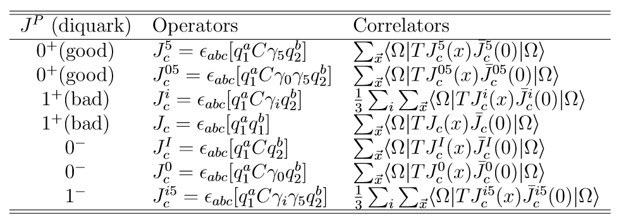
II. Effective masses of quarks and diquarks
Y. Bi, H. Cai, YC, M. Gong, Z. Liu H.X. Qiao, Y.B. Yang, Chin. Phys. C (40), 073106 (2016), arXiv: 1510.07354 (hep-lat)
We focus on the color antitriplet (3*) diquarks in this work,
only which are possible in the formation of baryon states;
The diquarks with quantum numbers $J^{P}=0^{+},1^{+},0^{−}, 1^{−}$ are
considered,

Slide 6
Mixed action setup:
sea quarks: domain wall fermions (DW)
valence quarks: overlap fermions (OV)
both are chiral fermions on the lattice
Chiral symmetry is an intrinsic symmetry of QCD;
Chiral symmetry plays an important role in the low energy QCD regime.
Chiral fermions obey the exact chiral symmetry on spacetime lattice;
With chiral fermions on lattice, the renormalization of the current quark mass is multiplicative rather than additive.

Slide 7
Gauge configurations with $N_{f}=2+1$ dynamical DW quarks
generated by RBC/UKQCD Collaboration
Overlap fermions as valence quarks
Chiral fermion guarantees
$$m_{π}^{2}∝m_{q}$$

Slide 8
1. Mass difference of Nucleon and $Δ$
Interpolation field operator for nucleon
$$η\left(x\right)=ε^{abc}[u^{aT}\left(x\right)Cγ_{5}d^{b}\left(x\right)] u^{c}(x)$$
Interpolation field operator for Delta ($Δ^{++}$)
$$η_{i}\left(x\right)=ε^{abc}[u^{aT}\left(x\right)Cγ_{i}u^{b}\left(x\right)] u^{c}(x)$$
In the rest frame of the baryon, the 3/2-projection operator is
$$𝓟_{ij}^{\frac{3}{2}}=δ_{ij}−\frac{1}{3}γ_{i}γ_{j}$$
$${\tilde{η}}_{i}^{\frac{3}{2}}=𝓟_{ij}^{\frac{3}{2}} η_{j}$$
For parity-positive baryons,
$$C_{B}\left(t\right)=Tr \left(1+γ_{4}\right)\sum_{\vec{x}}{⟨η(\vec{x},t)}\overline{η}(0)⟩=\sum_{n}{Z_{n}Z_{n}^{∗} e^{−m_{n}t}}$$

Slide 9
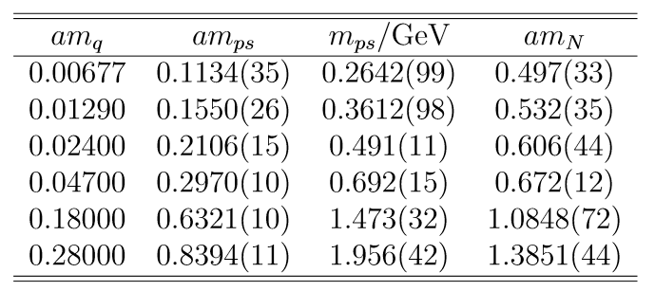
Pion, nucleon and Delta masses from three ensembles :
C005
C02
Cf004

Slide 10
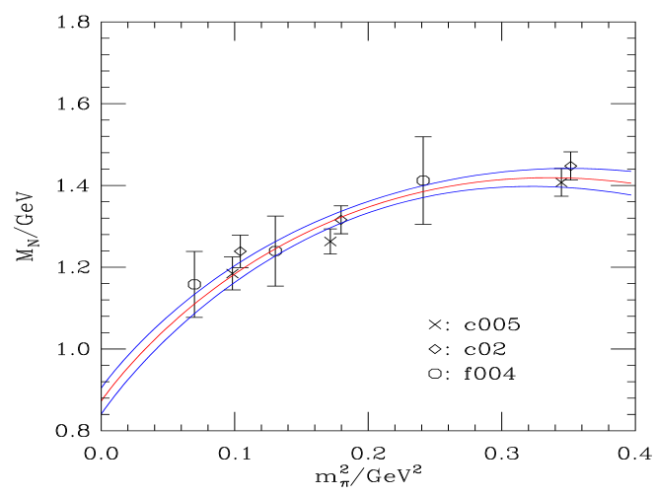
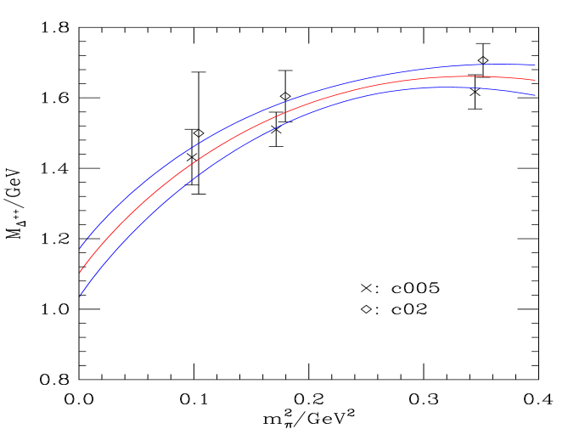
The chiral extrapolation based on ChPT,
$$M_{N}(m_{π})=M_{N}(0)−4c_{1}m_{π}^{2}−\frac{3g_{A}^{2}}{32πf_{π}^{2}}m_{π}^{3}$$
$$M_{Δ}\left(m_{π}\right)=M_{Δ}(0)−4d_{1}m_{π}^{2}−\frac{3H_{A}^{2}}{32πf_{π}^{2}}m_{π}^{3}$$
Practically, we use the following parameters
$$g_{A}=1.267, f_{π}=92.4,$$
$H_{A}=\frac{9}{5}g_{A}$ for hyperon
$$M_{N}\left(m_{π}=140MeV\right)=953\left(30\right)MeV$$
$$M_{Δ}\left(m_{π}=140MeV\right)=1183\left(64\right)MeV$$
$M_{Δ}−M_{N}=272\left(56\right) MeV$ (c005)
$M_{Δ}−M_{N}=304\left(108\right) MeV$ (c02)
$M_{Δ}−M_{N}≈292 MeV$ (expt. )

Slide 11
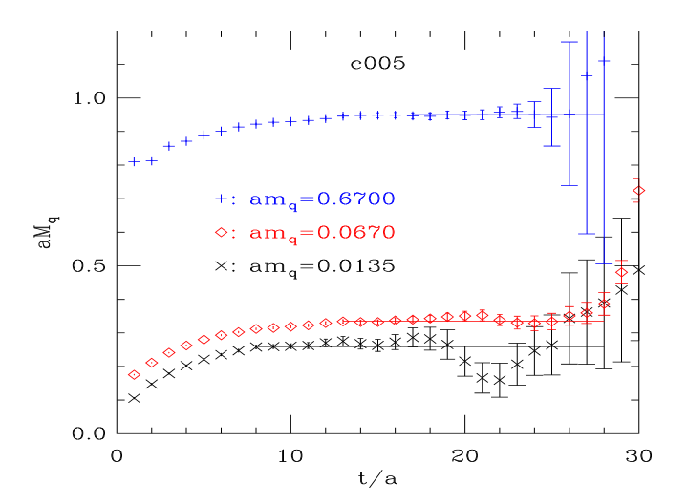
2. The effective masses of quarks
Instead of studying the mass function $M\left(p\right)$ of the full quark propagator in momentum space, we introduce the effective mass of a quark which is derived as follows (in Landau gauge):
Considering the correlator of quark fields
$$C_{q}\left(t\right)=\sum_{\vec{x}}{Tr\left\langle ψ\left(\vec{x},t\right)\overline{ψ}\left(0\right)\right\rangle }≡\sum_{\vec{x}}{Tr S_{F}\left(\vec{x},t;0\right)}$$
In order to explore its time dependence,
we define the effective mass function,
$$aM_{q}^{eff}(t)=\ln{\frac{C_{q}\left(t\right)}{C_{q}\left(t+1\right)}}$$
This implies that
$$C_{q}\left(t\right)∼e^{−M_{q}t}, t→∞$$

Slide 12
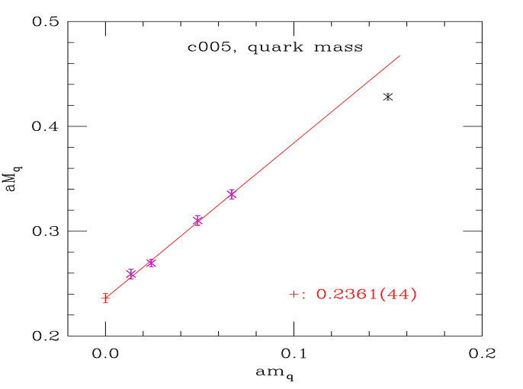
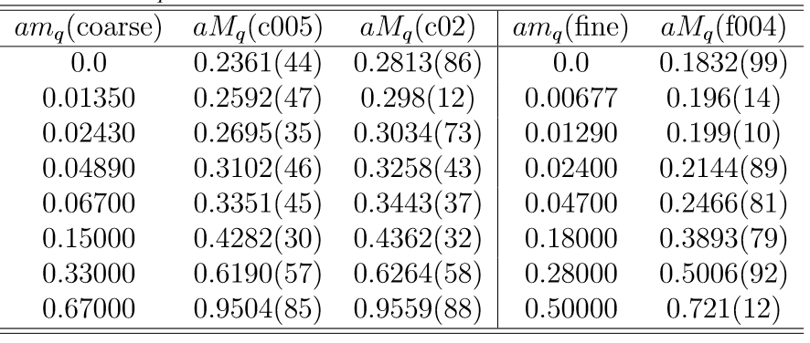
Quark masses for various valence quark masses on all three ensembles. The ﬁrst line is a linear extrapolation in $am_{q}$ to the chiral limit with the lowest four quark masses.
The sea quark masses in ensembles c005 and f004 are similar,
while sea quark mass of c02 is heavier
$$M_{q}=427\left(25\right) MeV \left(c005\right)$$
$$M_{q}=413\left(12\right) MeV \left(f004\right)$$
$$M_{q}=492\left(19\right) MeV \left(c02\right)$$
$$M_{s}=586\left(16\right) MeV \left(c005\right)$$
$M_{s}=603\left(15\right) MeV \left(f004\right)$
$$M_{s}=575\left(23\right) MeV \left(f004\right)$$
Note that our light sea quark masses are still heavier than physical
light quark masses.

Slide 13
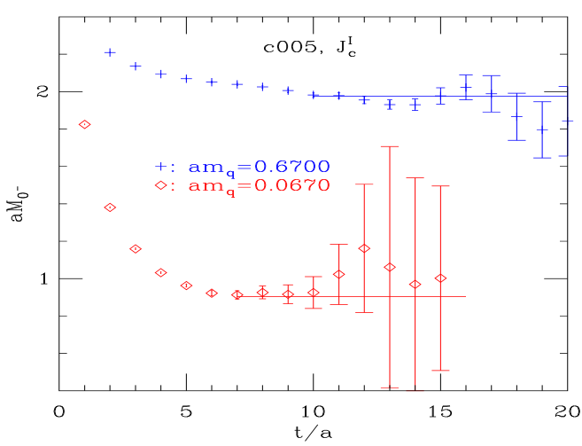
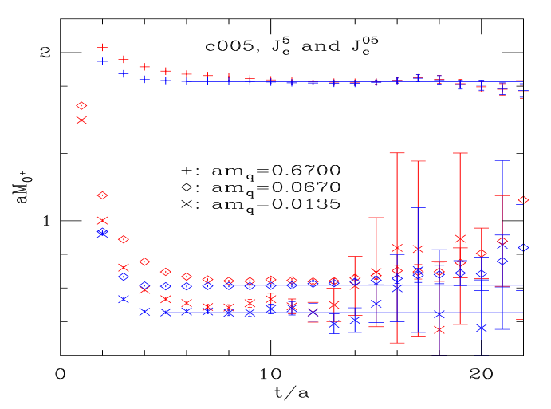
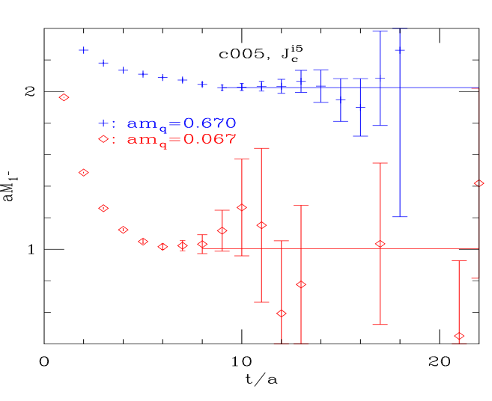
3. The effective masses of diquarks
$$aM_{J^{P}}^{eff}(t)=\ln{\frac{C_{J^{P}}\left(t\right)}{C_{J^{P}}\left(t+1\right)}}$$

Slide 14
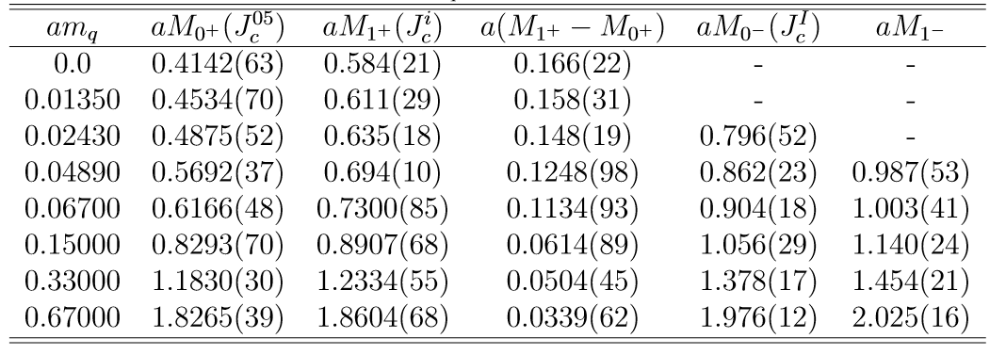
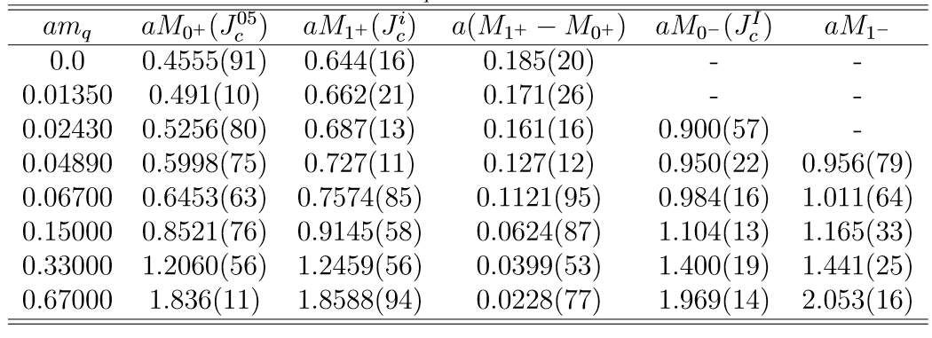
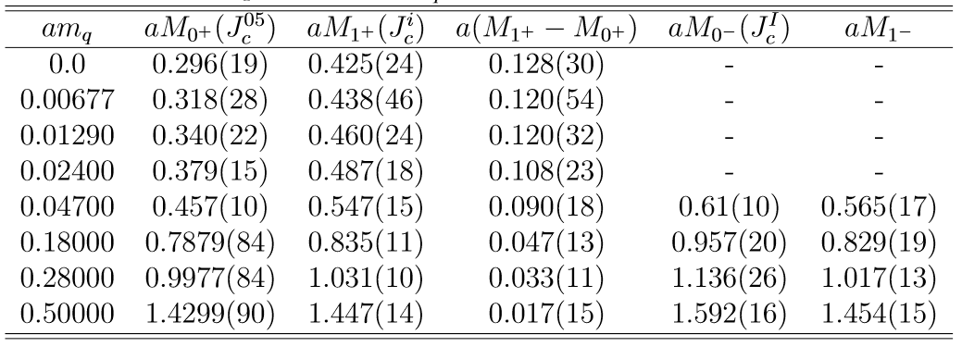
C005
C02
Cf004

Slide 15
After chiral extrapolation linearly in $m_{π}^{2}$, we get
$$M_{0^{+}}=725\left(20\right) MeV \left(c005\right)$$
$$M_{0^{+}}=690\left(47\right) MeV \left(f004\right)$$
$$M_{0^{+}}=797\left(24\right) MeV \left(c02\right)$$
$$M_{1^{+}}=1022\left(44\right) MeV \left(c005\right)$$
$M_{1^{+}}=990\left(60\right) MeV \left(f004\right)$
$$M_{1^{+}}=1127\left(28\right) MeV \left(c02\right)$$
3. The $1^{+}−0^{+}$ diquark mass difference $Δm=M_{1^{+}}−M_{0^{+}}$
Diquark correlations come from spin dependent forces.
$Δm$is expected to scale like $\frac{1}{m_{q1}m_{q2}}$ at large quark mass.
In the chiral limit, the mass diﬀerence goes to a constant.
Ansatz for diquarks composed of two degenerate quarks

Slide 16
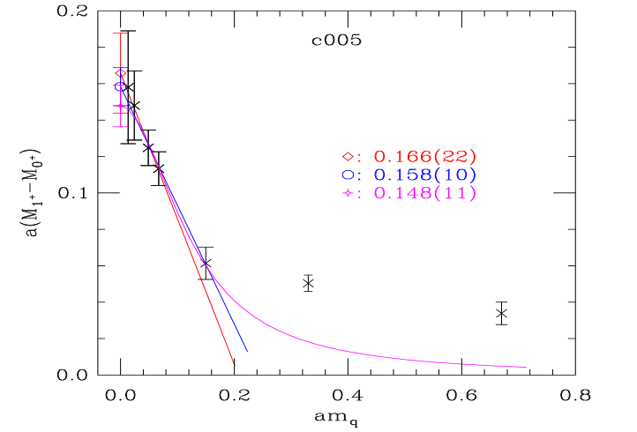
The red straight line is a linear extrapolation in $am_{q}$ to the
chiral limit using the lowest four data points.
The blue straight line uses the lowest ﬁve data points.
The magenta curve is the ﬁt using
$Δm=\frac{a_{1}}{1+a_{2}m_{q}^{2}}$
to the lowest ﬁve points.
Different extrapolations give compatible results.

Slide 17
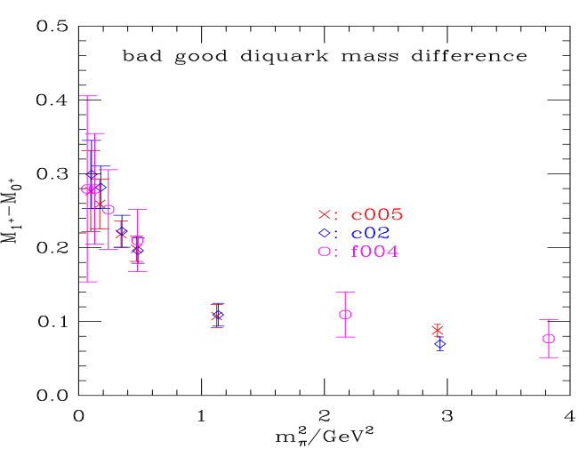
$Δm=M_{1^{+}}−M_{0^{+}}$ seems insensitive to sea quark masses and
the discretization uncertainty is smaller than the statistical errors;
So we using a universal function form (in $m_{π}^{2}$ ) to fit the results of the three ensemble .
Finally, we get
$$Δm=M_{1^{+}}−M_{0^{+}}=285\left(25\right)\left(45\right)MeV$$

Slide 18
4. Final results in this part
Effective masses of light quarks ($M_{q}$) and strange quarks ($M_{s}$):
$$M_{q}=427\left(25\right) MeV \left(c005\right)$$
$$M_{q}=413\left(12\right) MeV \left(f004\right)$$
$$M_{q}=492\left(19\right) MeV \left(c02\right)$$
$$M_{s}=586\left(16\right) MeV \left(c005\right)$$
$M_{s}=603\left(15\right) MeV \left(f004\right)$
$$M_{s}=575\left(23\right) MeV \left(c02\right)$$
Effective masses of scalar and axial vector diquarks:
$$M_{0^{+}}=725\left(20\right) MeV \left(c005\right)$$
$$M_{0^{+}}=690\left(47\right) MeV \left(f004\right)$$
$$M_{0^{+}}=797\left(24\right) MeV \left(c02\right)$$
$$M_{1^{+}}=1022\left(44\right) MeV \left(c005\right)$$
$M_{1^{+}}=990\left(60\right) MeV \left(f004\right)$
$$M_{1^{+}}=1127\left(28\right) MeV \left(c02\right)$$
The $1^{+}−0^{+}$ diquark mass difference is determined to be
$$Δm=M_{1^{+}}−M_{0^{+}}=285\left(25\right)\left(45\right)MeV$$
which almost saturates the mass difference of nucleon
and $Δ$
We also calculated the related quantities of $\left(us\right)$ diquarks (refer to our paper for details).

Slide 19
III. Diquark correlation (?) in nucleon
1. The Bethe-Salpeter wave functions of nucleon and the Roper
We introduce a type of spatially extended baryon operators
$$η\left(\vec{x},t;\vec{r}\right)=ε^{abc}[u^{aT}\left(\vec{x},t\right)Cγ_{5}d^{b}\left(\vec{x},t\right)] u^{c}(\vec{x}+\vec{r},t)$$
We calculate the following correlation function in the
Coulomb gauge
$$C_{N}\left(r, t\right)=\frac{1}{N_{r}}Tr \left(1+γ_{4}\right)\sum_{\vec{x},\left|\vec{r}\right|=r}{⟨η\left(\vec{x},t;\vec{r}\right)}{\overline{η}}^{W}(0)⟩=\sum_{n}{φ_{n}(r) e^{−m_{n}t}}$$
Bethe-Salpeter wave function
$$φ_{n}\left(r\right)∝⟨Ω|η\left(0,0;\vec{r}\right)|n⟩$$
$φ_{n}\left(r\right)$ and $m_{n}$ can be derived by the simultaneous fit to
$C_{N}\left(r, t\right)$ with different $r$.

Slide 20
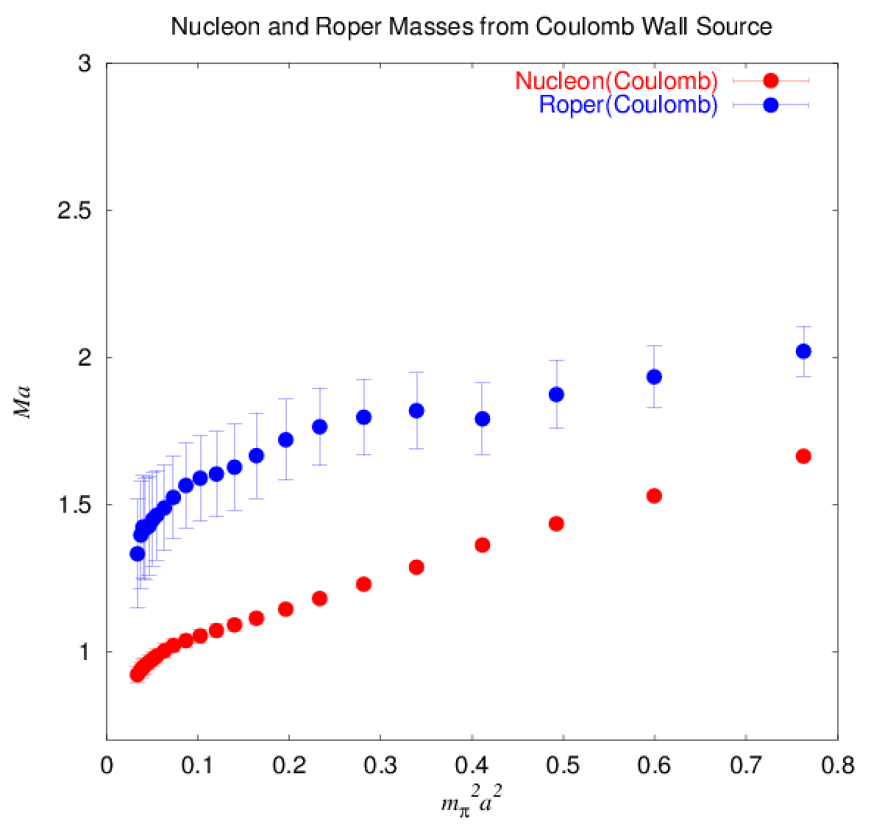
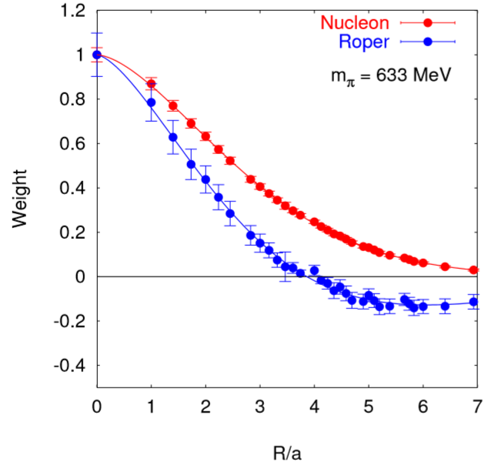
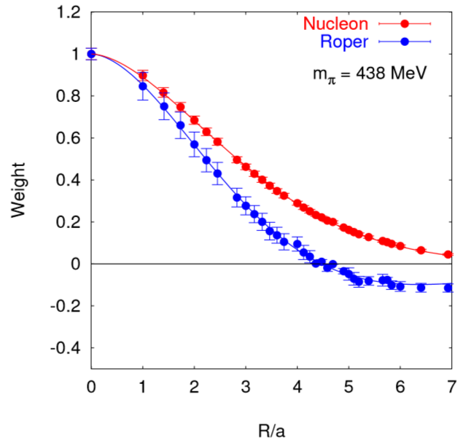
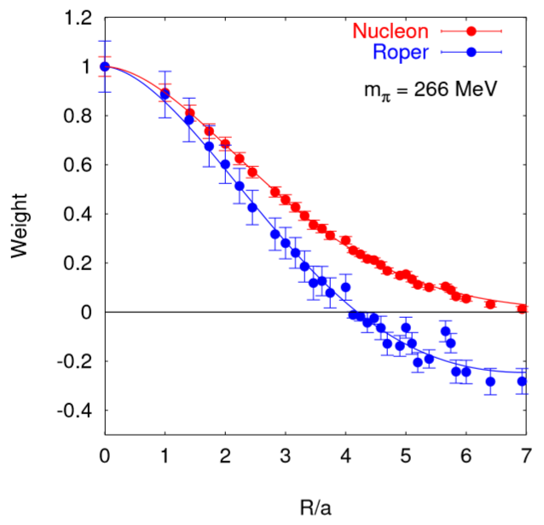
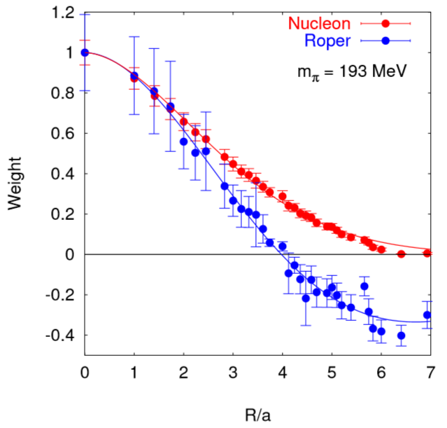
The lattice setup
Quenched approximation: Iwasaki’s gauge action
Overlap fermion for valence quarks.
$L^{3}×T={16}^{3}×28，a^{−1}=0.987 GeV$

Slide 21
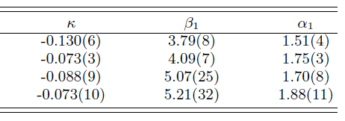
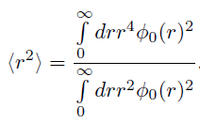
The mass of the first excited state is compatible with the mass
of Roper state, and the wave function has one radial node. This
implies that Roper may be the first radially excited state.

Slide 22
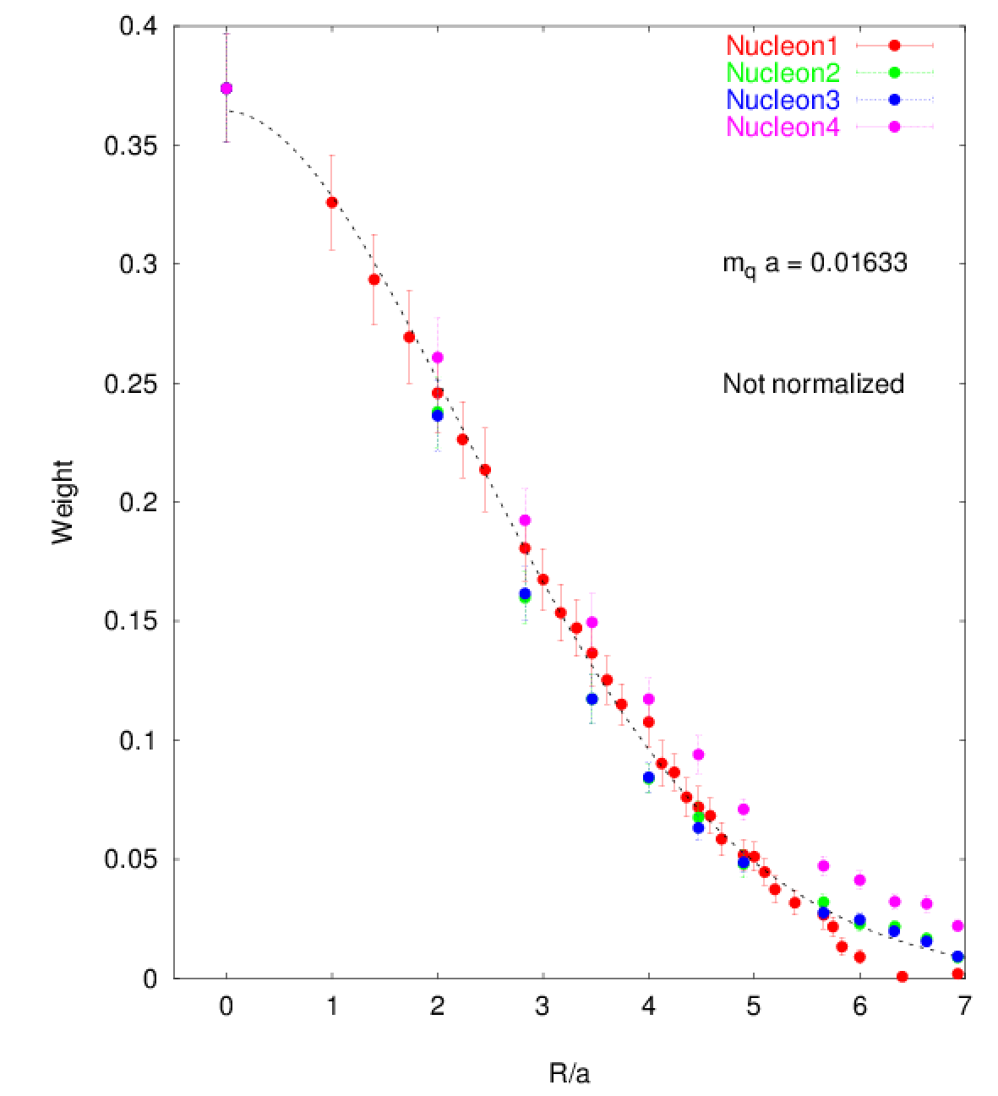
The above observation hints that the nucleon (and Roper) can be
viewed as a two-body system of quark-diquark. However,
$$η_{2}\left(\vec{x},t;\vec{r}\right)=ε^{abc}[u^{aT}\left(\vec{x}+\vec{r},t\right)Cγ_{5}d^{b}\left(\vec{x},t\right)] u^{c}(\vec{x}−\vec{r},t)$$
$$η_{3}\left(\vec{x},t;\vec{r}\right)=ε^{abc}[u^{aT}\left(\vec{x},t\right)Cγ_{5}d^{b}\left(\vec{x}+\vec{r},t\right)] u^{c}(\vec{x}−\vec{r},t)$$
$$η_{4}\left(\vec{x},t;\vec{r}\right)=ε^{abc}[u^{aT}\left(\vec{x}+\vec{r},t\right)Cγ_{5}d^{b}\left(\vec{x}−\vec{r},t\right)] u^{c}(\vec{x},t)$$
The BS wave functions
show that there is no
obvious special correlations
between any two quarks.

Slide 23
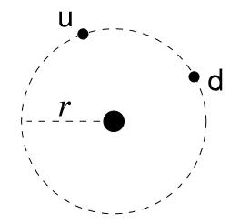
2. Diquark correlation in baryons
C. Alexandrou, Ph. de Forcrand, B. Lucini, Phys. Rev. Lett. 97 (2006) 222002.
A baryon system made up of a diquark and a static quark
Baryon operator
Light quark density operator
Propagator of the static quark
The spatial distribution of light quarks in the baryon can be
derived though the four-point function

Slide 24
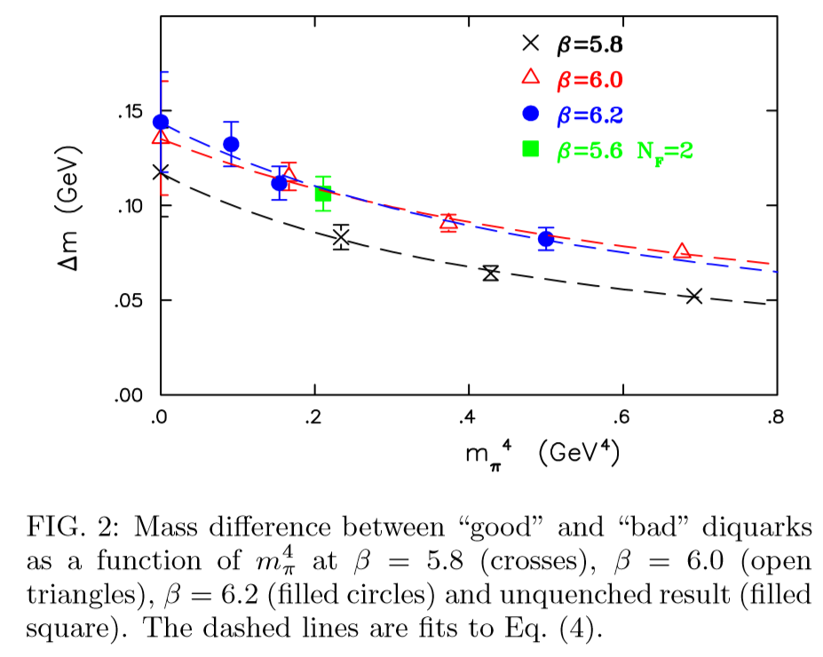
The mass difference of two baryons
with $0^{+}$ and $1^{+}$ diquark, respectively
The mass difference can be well
described by the following formula
∆m is consistent with the predicted
2/3 of the ∆-nucleon mass
diﬀerence
$$\frac{Δm}{Δm_{ΔN}}=0.67\left(7\right), 73\left(8\right), 0.67(8)$$

Slide 25
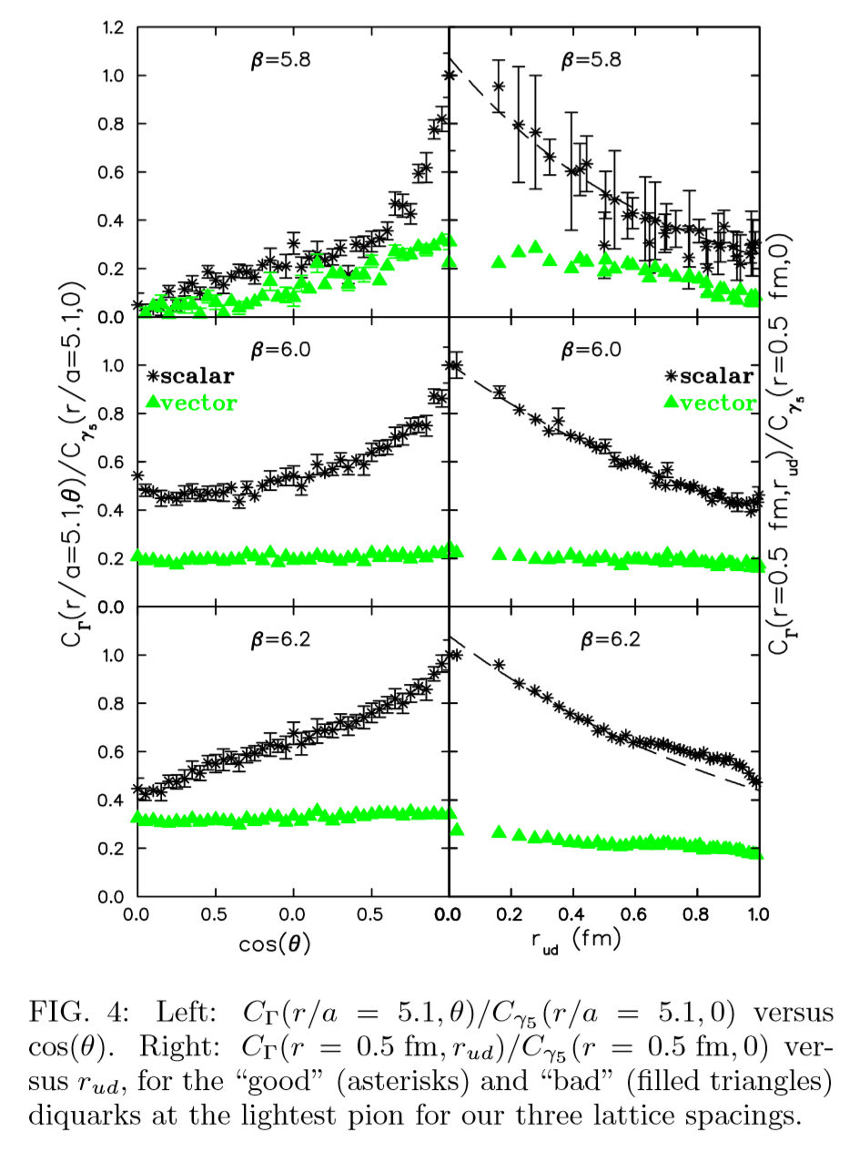
$$θ$$
The distribution of the $0^{+}$diquark peaked
at $θ=0$ implies that the two quark tend to
be close to each other——correlation.
The correlation of $1^{+}$ diquark is weak.
From the $r_{ud}$ fall-off of the
distribution, one can estimate the
size of the diquark
$$r_{0}≈1.1±0.2 fm$$

Slide 26
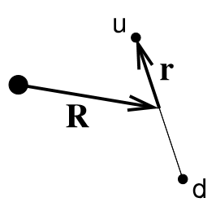
A refined calculation
J. Green, J. Negele, M. Engelhardt and P. Varilly, arXiv:1012.2353 (hep-lat)

Slide 27
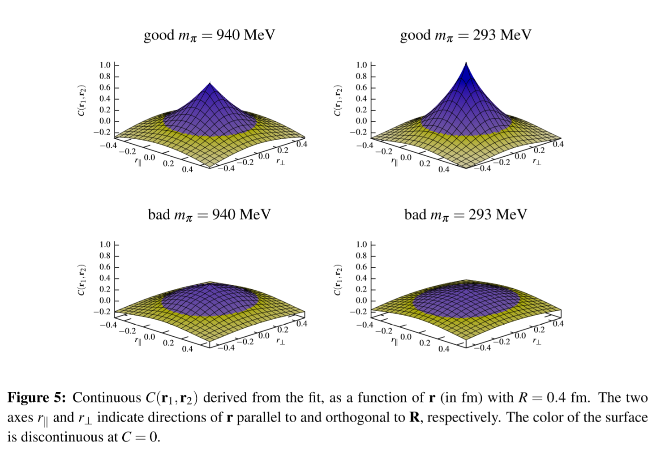
The diquark radius is approximately the same as hadron half-density radius, so the diquark size is comparable to the hadron size.

Slide 28
IV. Summary
The quark correlators and diquark correlators are calculated in a fixed
gauge-Landau gauge
Their fall-off in the time direction can be described by exponential
functions, very similar to those of massive particles.
The parameters of the exponentials may be taken as the effective
masses of quarks and diquarks. But they are gauge dependent.
The physical meaning of these mass parameters is worthy of further
investigation.
It seems that there can be diquark-correlation, but diquarks are unlikely point-like (or very compact）objects in baryons.

Slide 29
Thanks!

Slide 31
The situation will be much more complicated if the multi-channel coupling
is considered and if there are three particle interactions.

