Slide 1

Diquark correlations and production cross section of baryons at Belle
Makoto Takizawa
(Showa Pharmaceutical Univ.,
J-PARC Branch, KEK Theory Center, KEK,
Theoretical Research Division,
Nishina Center, RIKEN)
on behalf of the Belle Collaboration
Based on PRD97, 072005 (2018)

Slide 2
Outline
Motivation
Introduction of Belle experiment
(for theorists)
Reconstruction of baryons
Inclusive differential cross sections
Feed down

Slide 3
Outline
Direct production cross sections
Discussion and Summary

Slide 4
Motivation

Slide 5
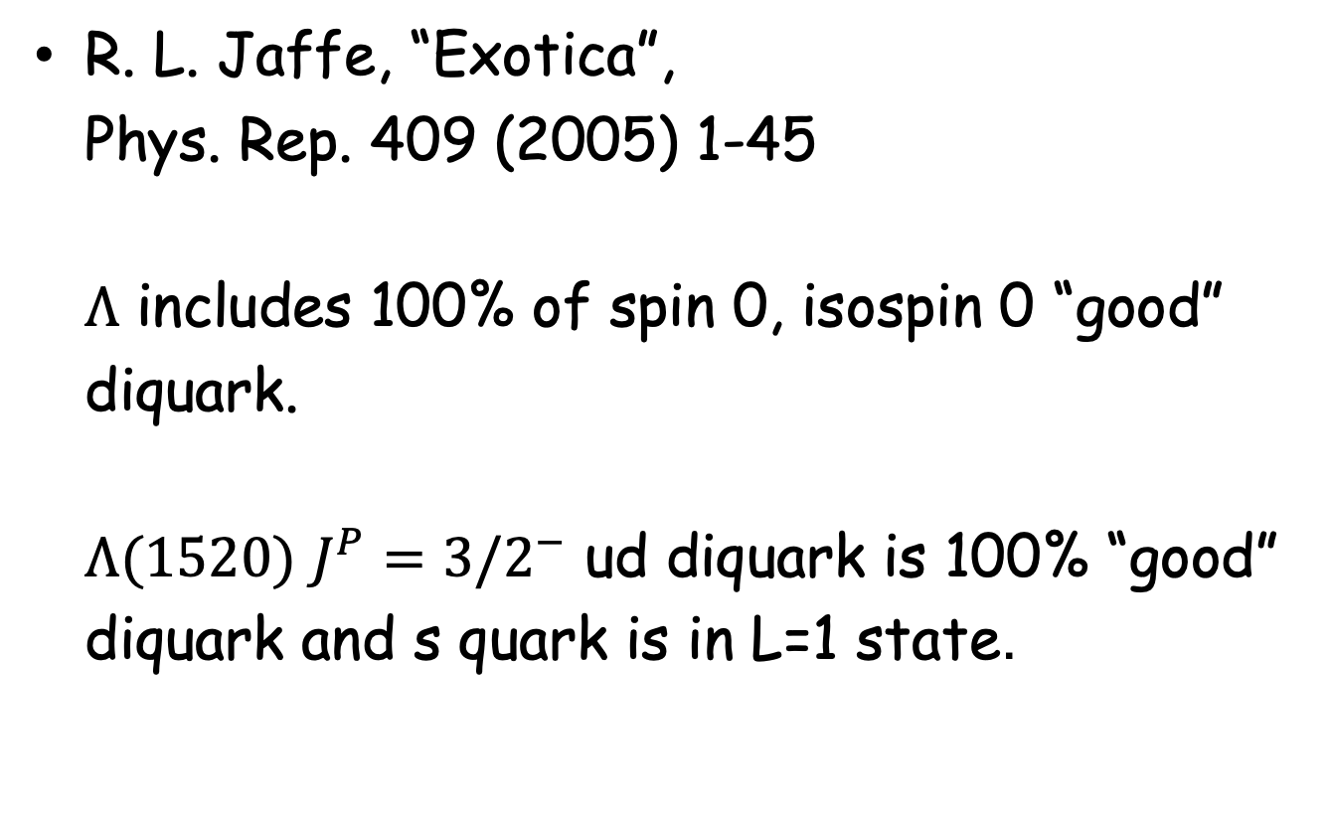
R. L. Jaffe, “Exotica”,
Phys. Rep. 409 (2005) 1-45
$Λ$ includes 100% of spin 0, isospin 0 “good” diquark.
$Λ(1520)$ $J^{P}=3/2^{−}$ ud diquark is 100% “good” diquark and s quark is in L=1 state.

Slide 6
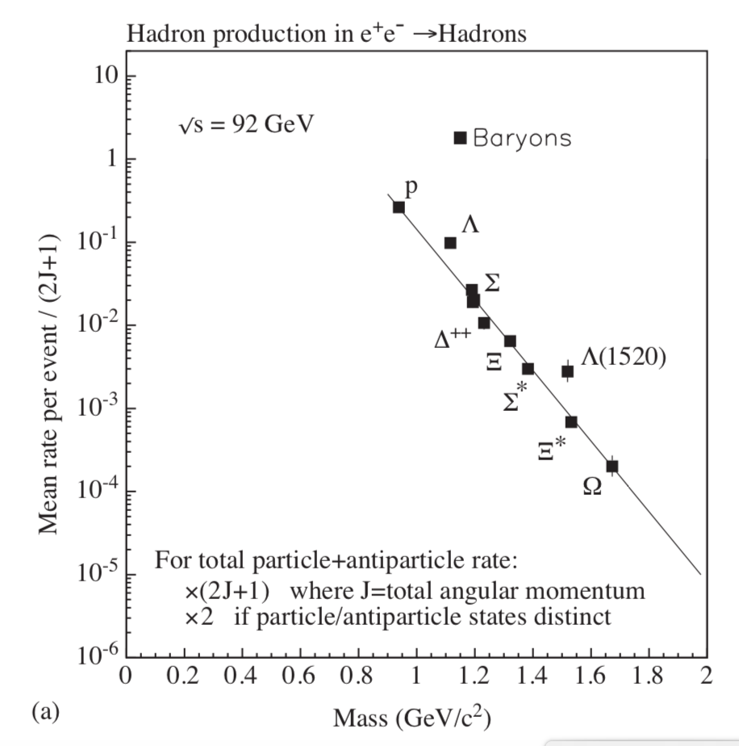
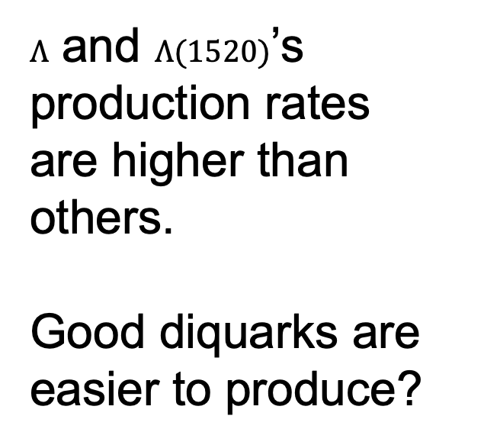
$Λ$ and $Λ(1520)$’s production rates
are higher than others.
Good diquarks are easier to produce?

Slide 7
How about charmed baryon production rates?
Since the color-magnetic spin-spin interaction between light and charm quarks is weaker, the diquark properties may be seen in charmed baryons clearly.
There are enough number of charmed baryon production at Belle experiment.
So, let’s study charmed baryon production rates as well as hyperon production rates!

Slide 8
Introduction of
Belle experiment
(for theorists)

Slide 9
Belle experiment is the experiment at KEK B factory with Belle detector dedicated for the CP violation physics of B mesons

Slide 10
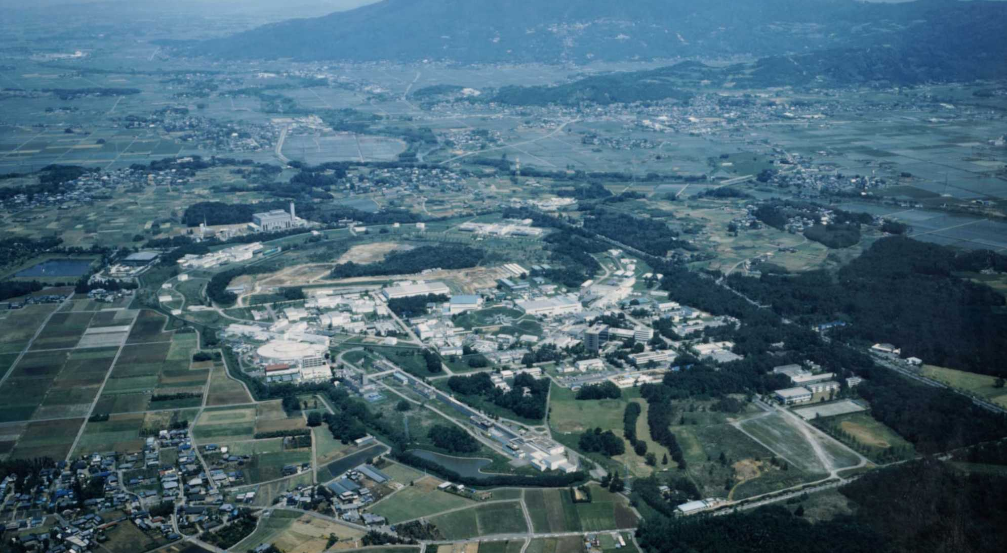
KEK B factory
KEK is located about 60km north east from Tokyo

Slide 11
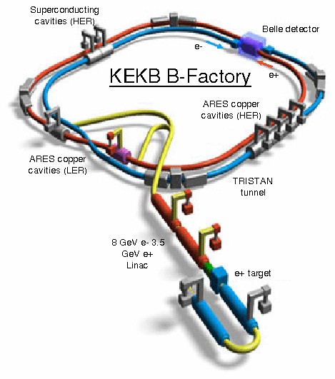
8GeV(e⁻) ×3.5GeV(e⁺)
Peak Luminosity
2.1×10³⁴ cm⁻² s⁻¹
Integrated luminosity
1040 fb⁻¹

Slide 12
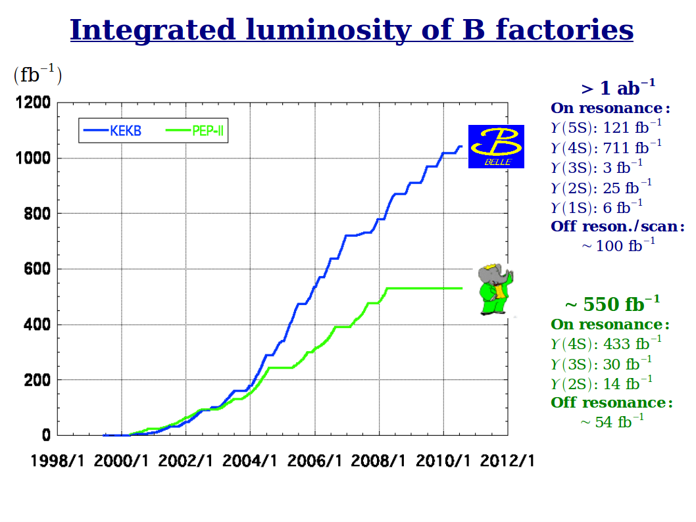

Slide 13
Cross section and luminosity
Cross section , Unit: barn, symbol: b
1 b = 10⁻²⁴ cm²
Total cross section of
with E_{cm} in unit of GeV.
(E is the electron energy in cm system.)
Event rate = luminosity × cross section

Slide 14
In the case of KEK B factory
Event rate of
=87/(10.5)² ×21 〜16.6/sec
Event number of
=87/(10.5)² ×(nb/fb)×1000〜8×10⁸
Event number of
=(2/3)^2×Nc×87/(10.5)² ×(nb/fb)×1000〜1.1×10⁹
Not only B factory, but also charm factory!
772×10⁶ B Bbar pairs

Slide 15
Upsilon(4S) production rate
About Upsilon(4S)
M = 10.5794 GeV
J^{PC} =1⁻ ⁻ same as photon!
Width = 20.5 MeV
B⁺ B⁻ & B⁰ B^{0bar} threshold = 10.559 GeV
B B* threshold = 10.604 GeV
Upsilon(4S) -> e⁺ e⁻ fraction = 1.57×10⁻⁵
Upsilon(4S) -> B B^{bar} fraction > 96%
B meson production -> B factory!

Slide 16
at E_{cm} = M with full width of Upsilon(4S)

Slide 17
〜1nb
Total number of Upsilon(4S)
〜 1.1nb/fb×700 = 770 M

Slide 18
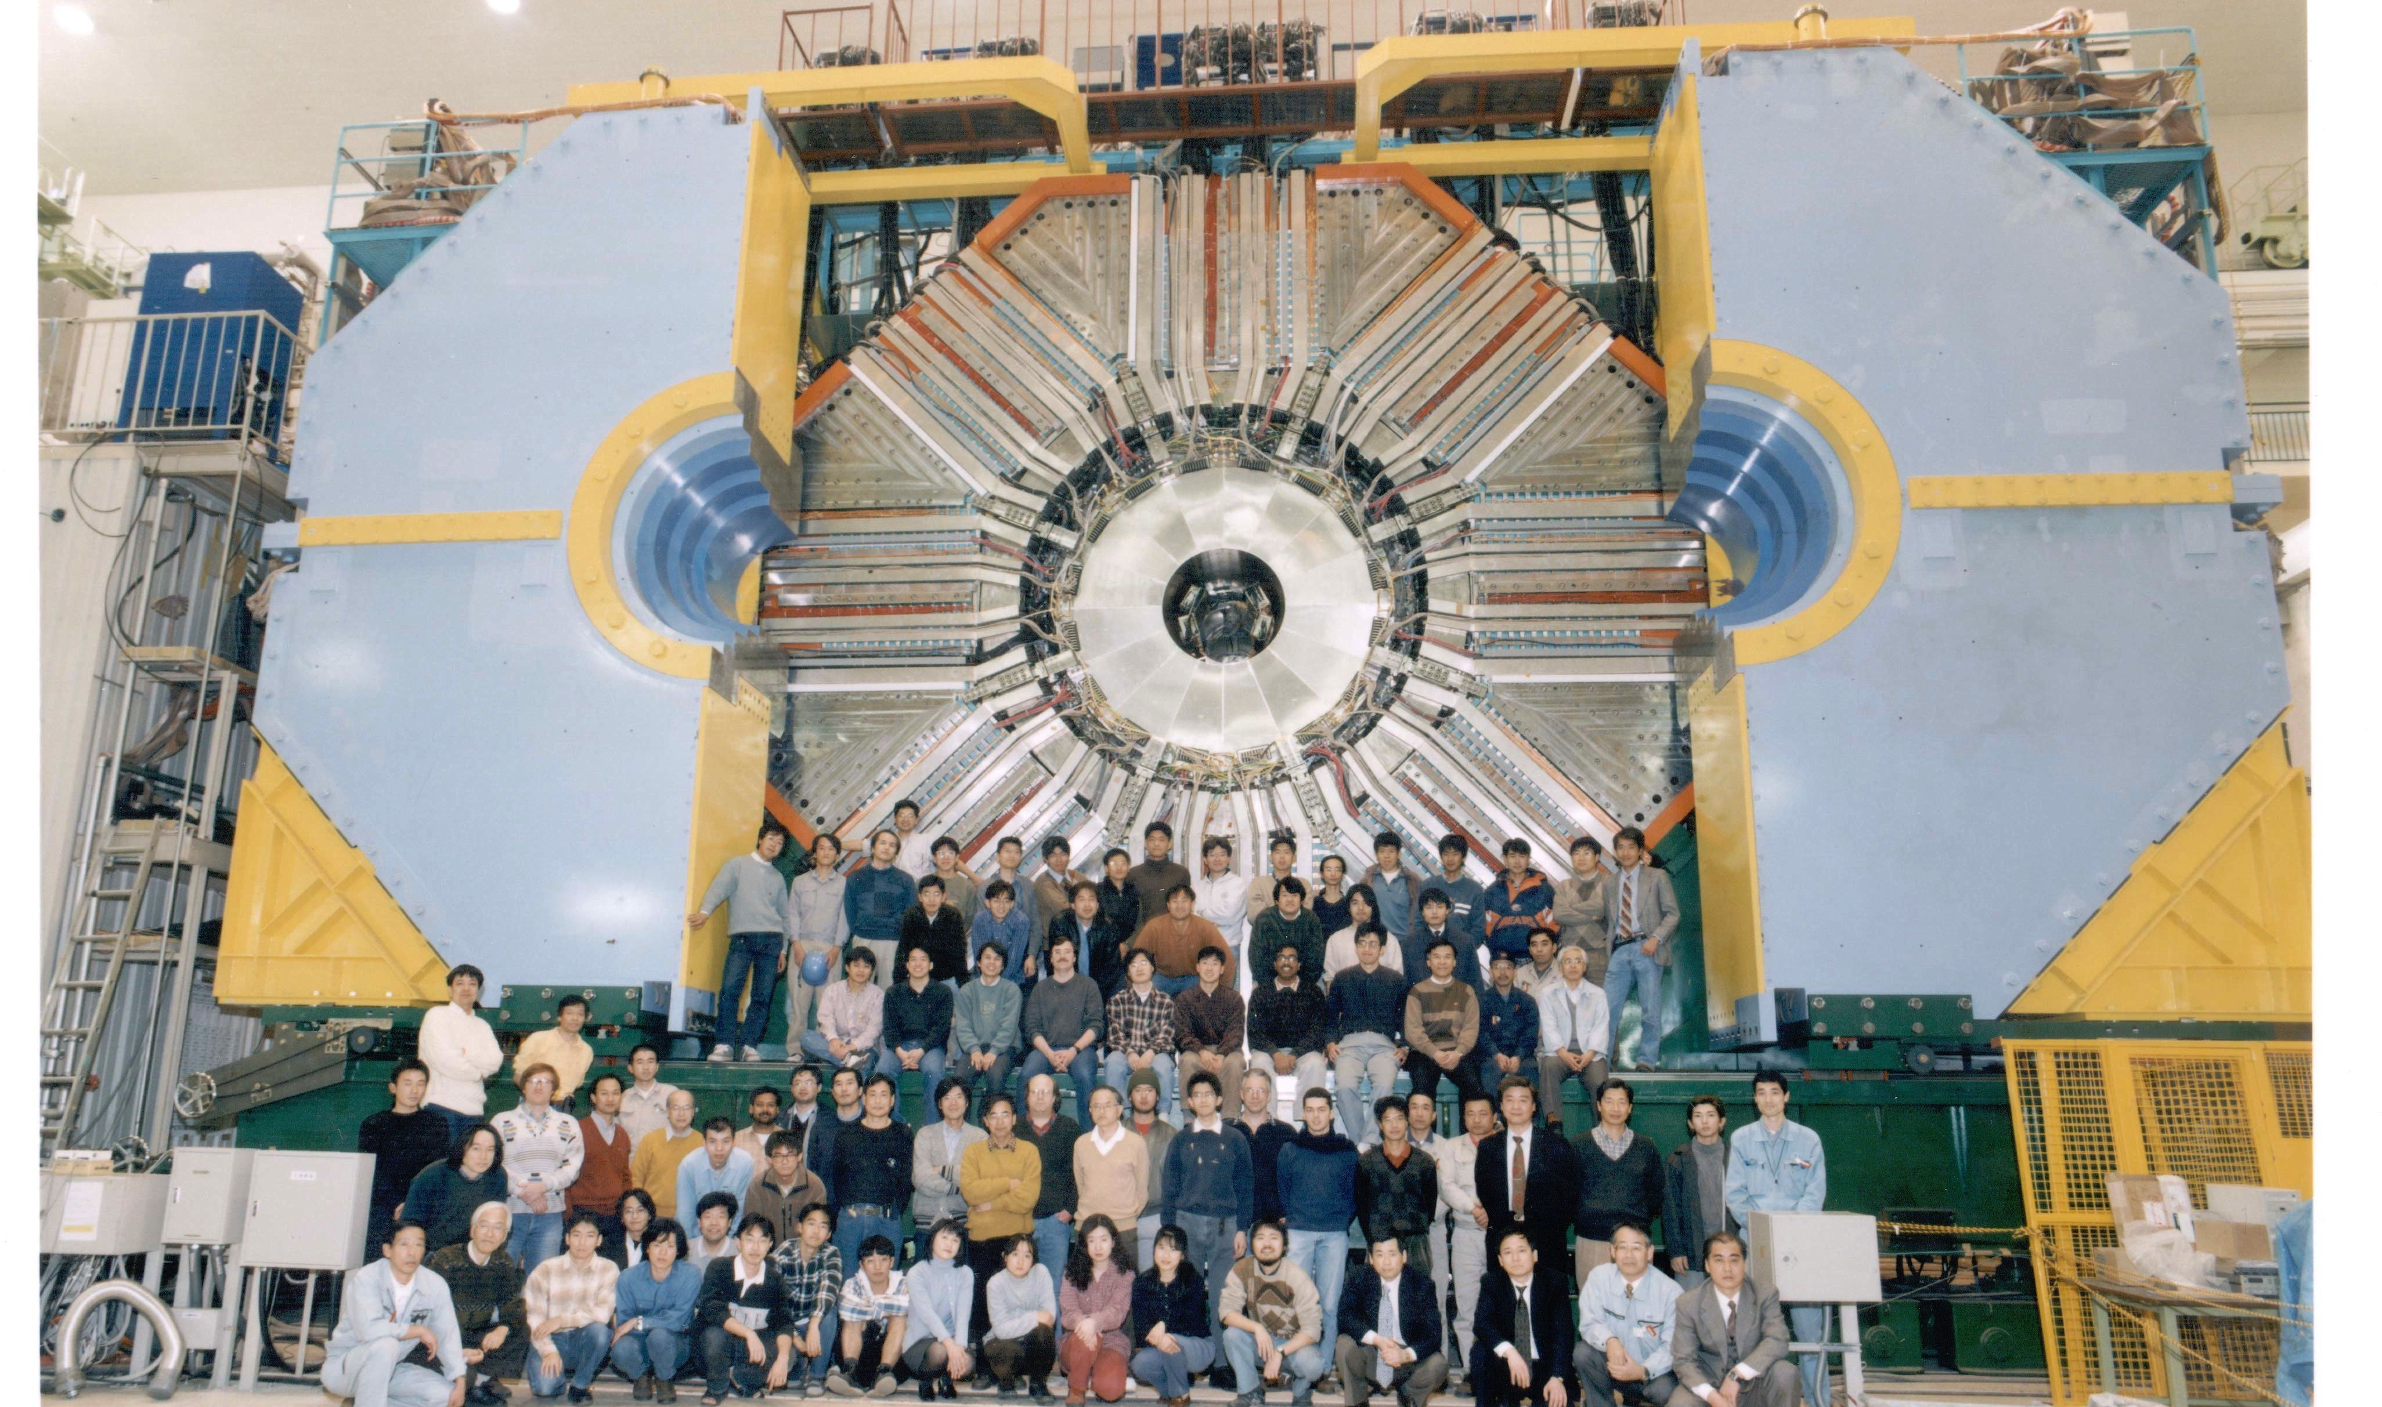
Belle detector
(already disassembled)

Slide 19
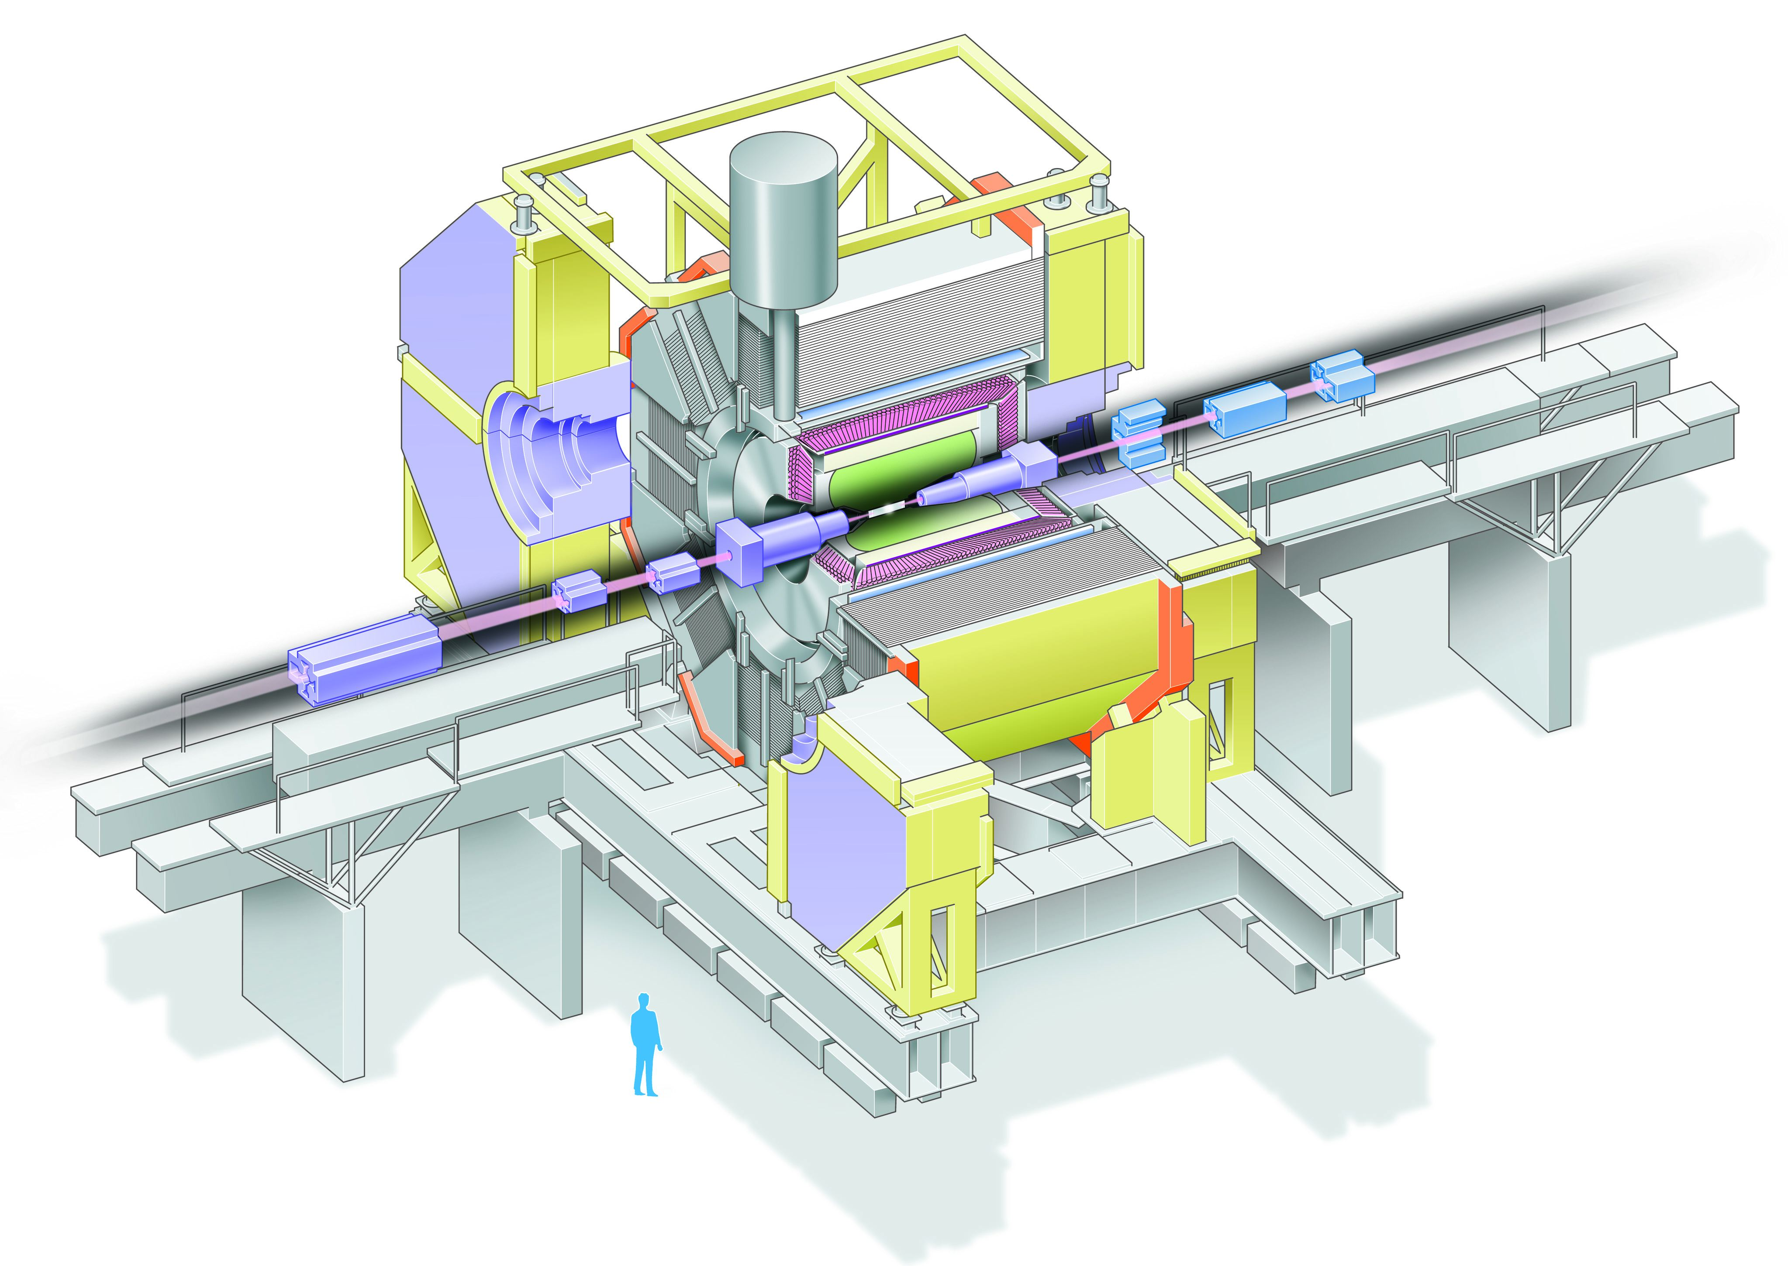
Belle Detector
Aerogel Cherenkov cnt.
n=1.015~1.030
SC solenoid
1.5T
CsI(Tl)
16X₀
3.5 GeV e⁺
TOF counter
8 GeV e⁻
Central Drift Chamber
small cell +He/C₂H₆
Si vtx. det.
3/4 lyr. DSSD
μ / K_{L} detection
14/15 lyr. RPC+Fe

Slide 20
High resolution, multipurpose,
good PID, 4π spectrometer
Loose event selection

Slide 21
Data analyses at Belle
Detected particles
photon
electron, muon
Charged hadrons:pion, kaon, proton
Neutral hadrons:K_{L}
π⁰-> γγ, eta-> γγ, Ks -> ππ, λ-> pπ
K_{L} is not used for hadron physics, but for cp violation physics.
Energy, momentum, track, vertex point
Combinations of these data are used for reconstruction of hadron resonances
For more detail, see PR D 67, 032003 (2003)

Slide 22
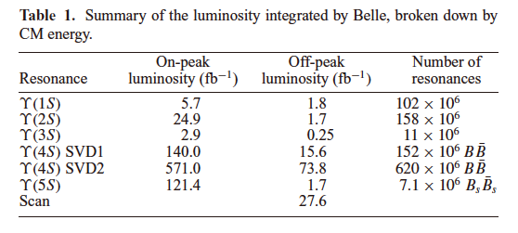
Physics runs
Reference: J. Brodzicka et. al., PTEP, 2012, 04D001

Slide 23
Off-resonance data
60MeV below the resonance peak in order to determine the non-BB^{bar} background
Energy scan data
between (10.5794GeV) and
(11.019GeV)

Slide 24
Belle II Experiment
Upgrade of Belle experiment
KEK B-factory -> Super KEK B-factory
40 times luminosity
Belle detector -> Belle II detector
More layers of VXD, CDC,
New Tech: TOP counter,
High speed DAQ

Slide 25
Reconstruction of baryons

Slide 26
Used data
Integrated luminosity
: 562. fb⁻¹ @ on ϒ(4S) resonance data for charmed baryons
(√s =10.58 GeV)
: 79.3 fb⁻¹ @ continuum data for hyperons, charmed baryons
(√s =10.52 GeV)

Slide 27

Reconstruction of S=-1 hyperons
$Λ →p π$
$Σ^{0} → Λ γ$
${Σ\left(1385\right)}^{+}(J^{P}= {\frac{3}{2}}^{+})→ Λ π^{+}$
$Λ\left(1520\right)(J^{P}= {\frac{3}{2}}^{−})→K^{−} p$

Slide 28
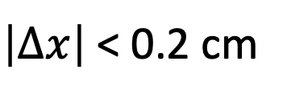
Decay topology
momentum
vector of Λ
π⁻
IP: Interaction point
of e⁻ and e⁺
p
IP
cτ=7.89cm
Δx
π⁺ or γ
(Σ⁰) (Σ^{∗+})
$\left|∆x\right|$ < 0.2 cm

Slide 29
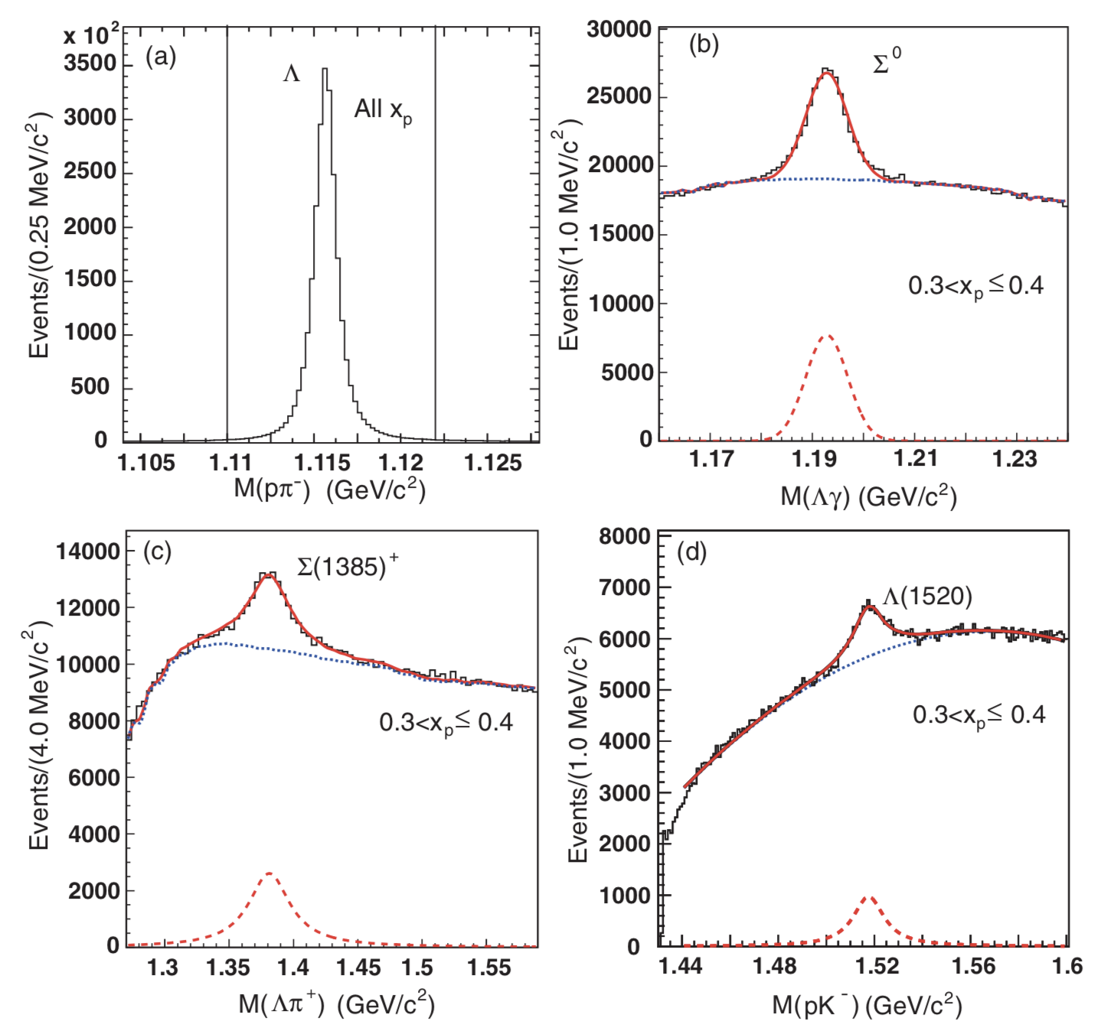
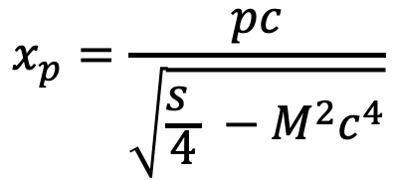
Reconstruction of S=-1 hyperons
Hadron-scaled
momentum:
$$x_{p}=\frac{pc}{\sqrt{\frac{s }{4} −M^{2}c^{4}}}$$

Slide 30

Reconstruction of S=-2, -3 hyperons
$Ξ^{−}→Λ π^{−}$
$Ω^{−} → Λ{ K}^{−}$
${Ξ(1530)}^{0}(J^{P}= {\frac{3}{2}}^{+})→Ξ^{−}π^{+}$

Slide 31
Decay topology
p
π⁻
π⁻
(Κ⁻)
Λ
cτ=4.9
(2.4) cm
IP
Ξ⁻ (Ω⁻)
π⁺ (Ω_{c}⁰)

Slide 32
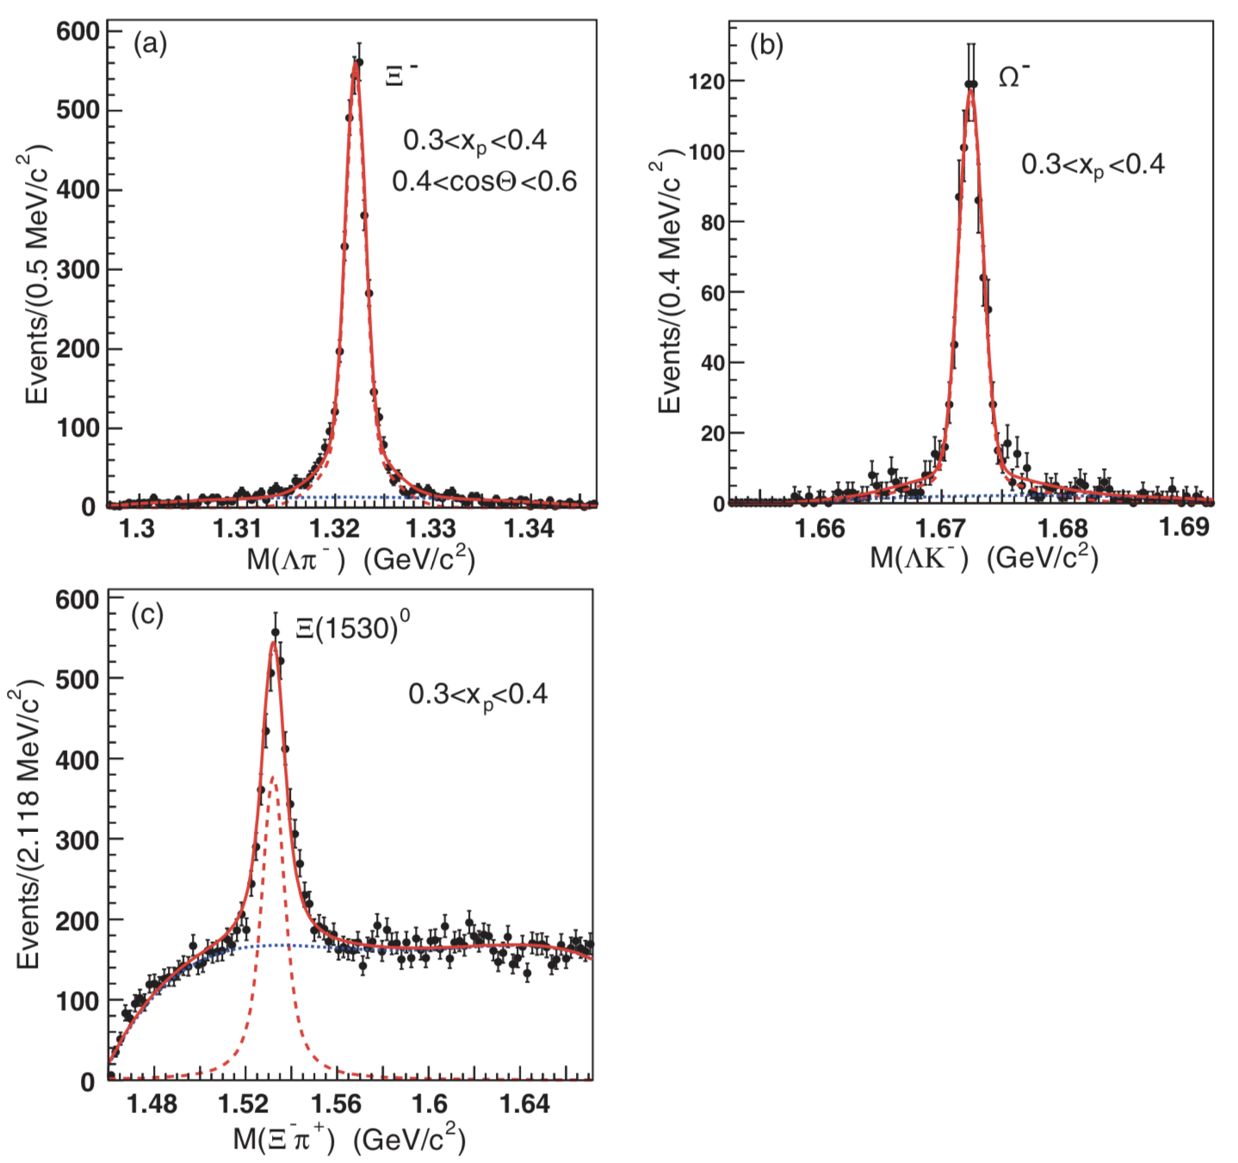
Reconstruction of S=-2, -3 hyperons

Slide 33
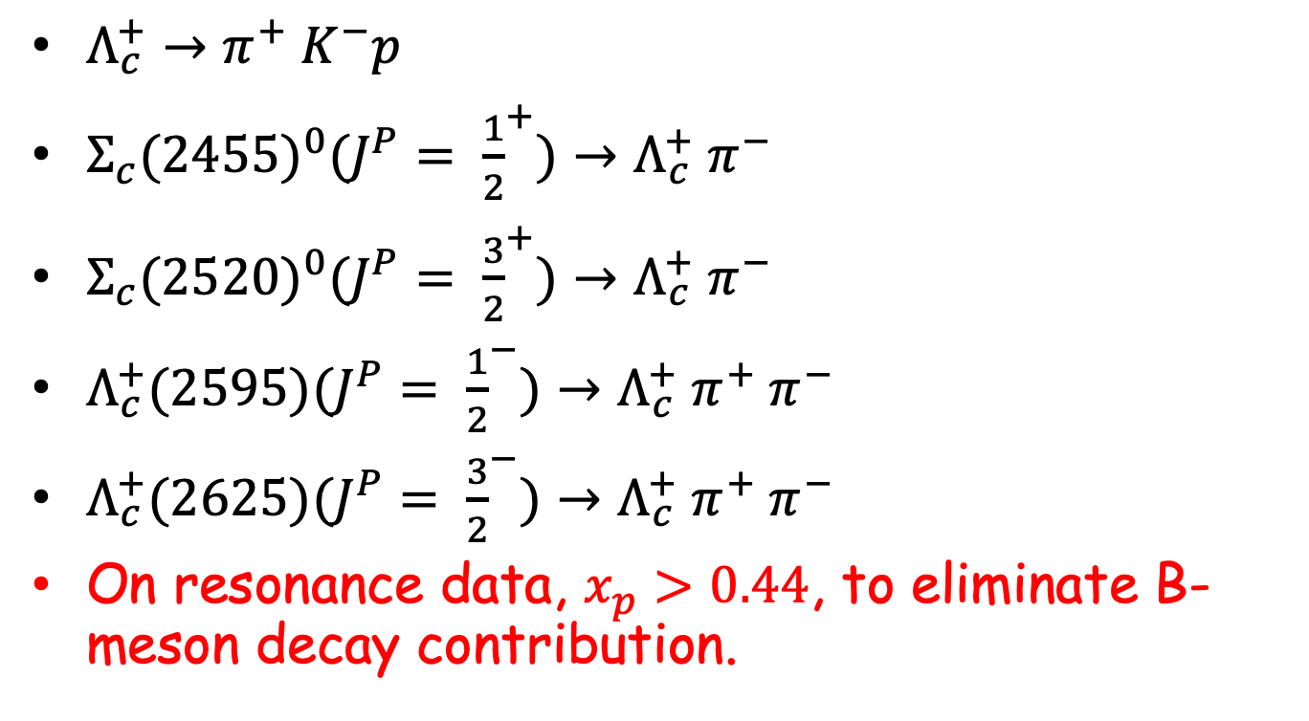
Reconstruction of charmed baryons
$Λ_{c}^{+}→π^{+}{ K}^{−}p$
${Σ_{c}(2455)}^{0}(J^{P}= {\frac{1}{2}}^{+})→Λ_{c}^{+}{ π}^{−}$
${Σ_{c}(2520)}^{0}(J^{P}= {\frac{3}{2}}^{+})→Λ_{c}^{+}{ π}^{−}$
$Λ_{c}^{+}(2595)(J^{P}= {\frac{1}{2}}^{−})→{Λ_{c}^{+} π}^{+}{ π}^{−}$
$Λ_{c}^{+}(2625)(J^{P}= {\frac{3}{2}}^{−})→{Λ_{c}^{+} π}^{+}{ π}^{−}$
On resonance data, $x_{p}>0.44$, to eliminate B-meson decay contribution.

Slide 34
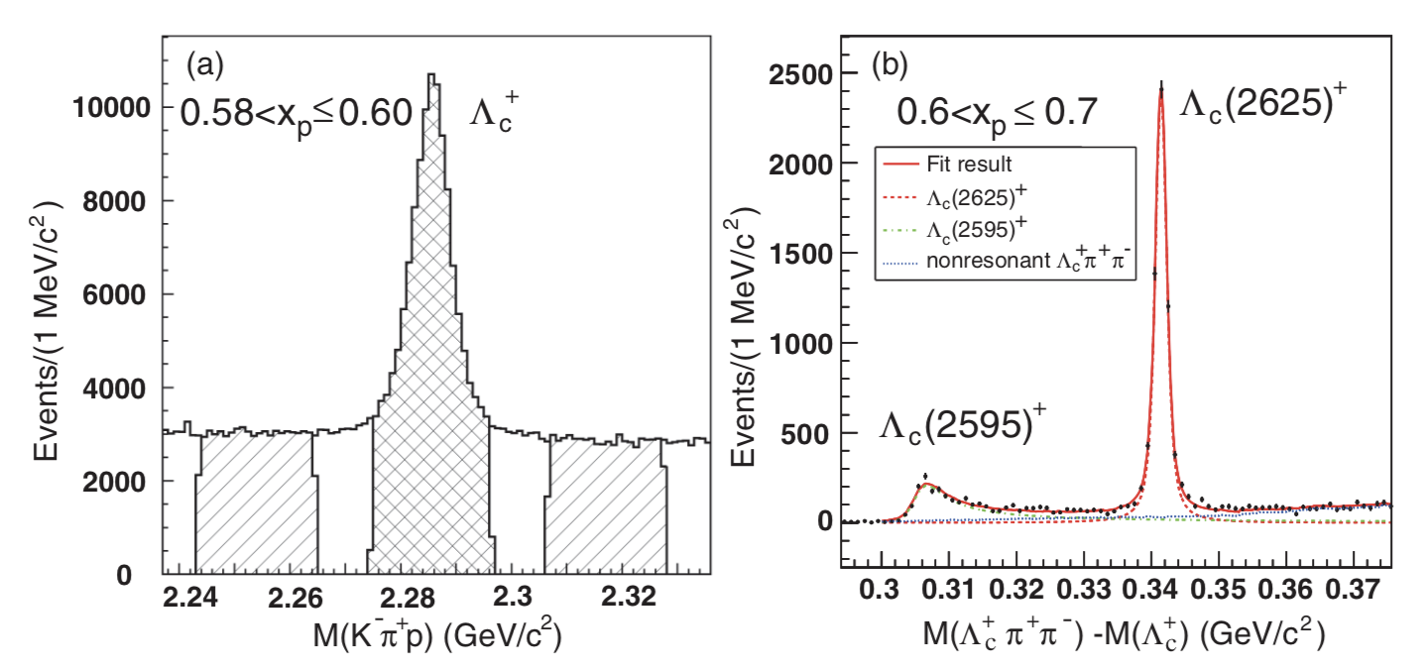
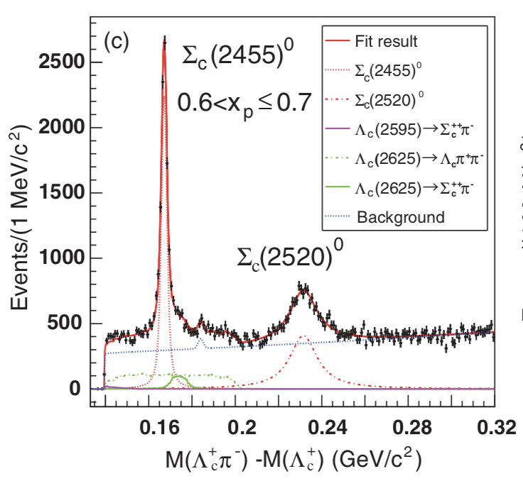
Reconstruction of charmed baryons

Slide 35
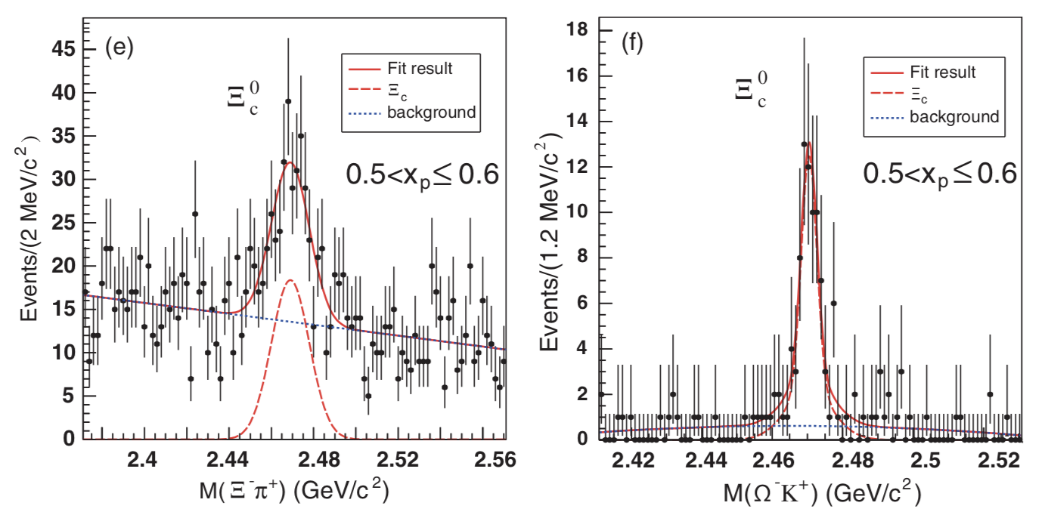

Reconstruction of charmed baryons
${Ξ_{c}}^{0}→Ξ^{−}{ π}^{+}$, $Ω^{−}$ $K^{+}$

Slide 36
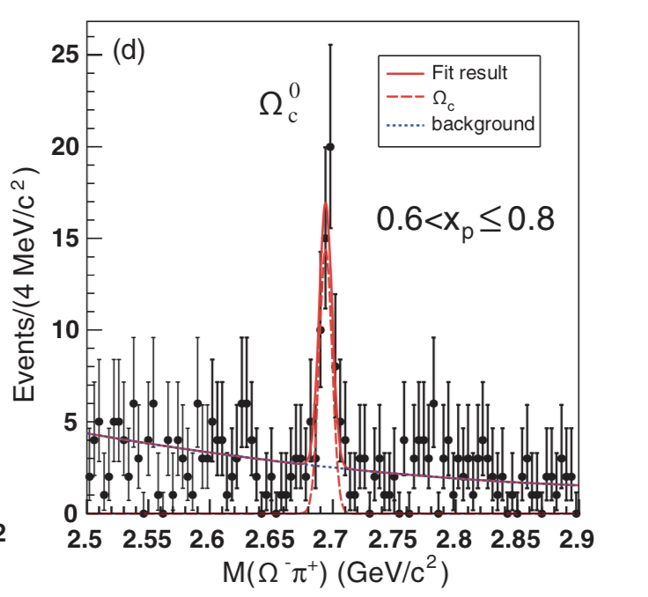

Reconstruction of charmed baryons
$Ω_{c}^{0}→Ω^{−}$ $π^{+}$

Slide 37
Inclusive differential cross sections

Slide 38
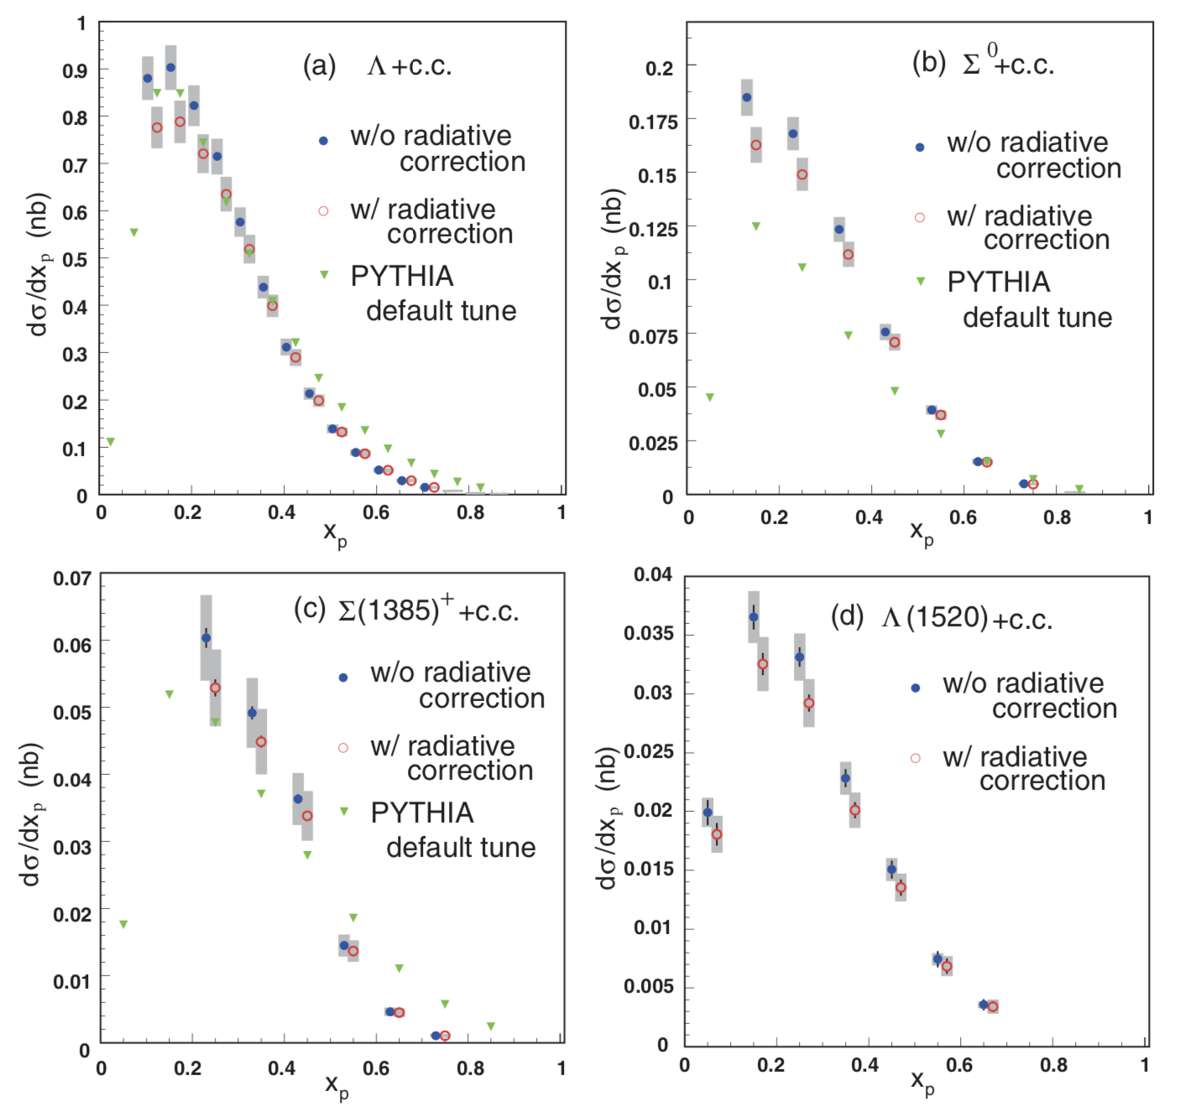
Inclusive cross sections:hyperons

Slide 39
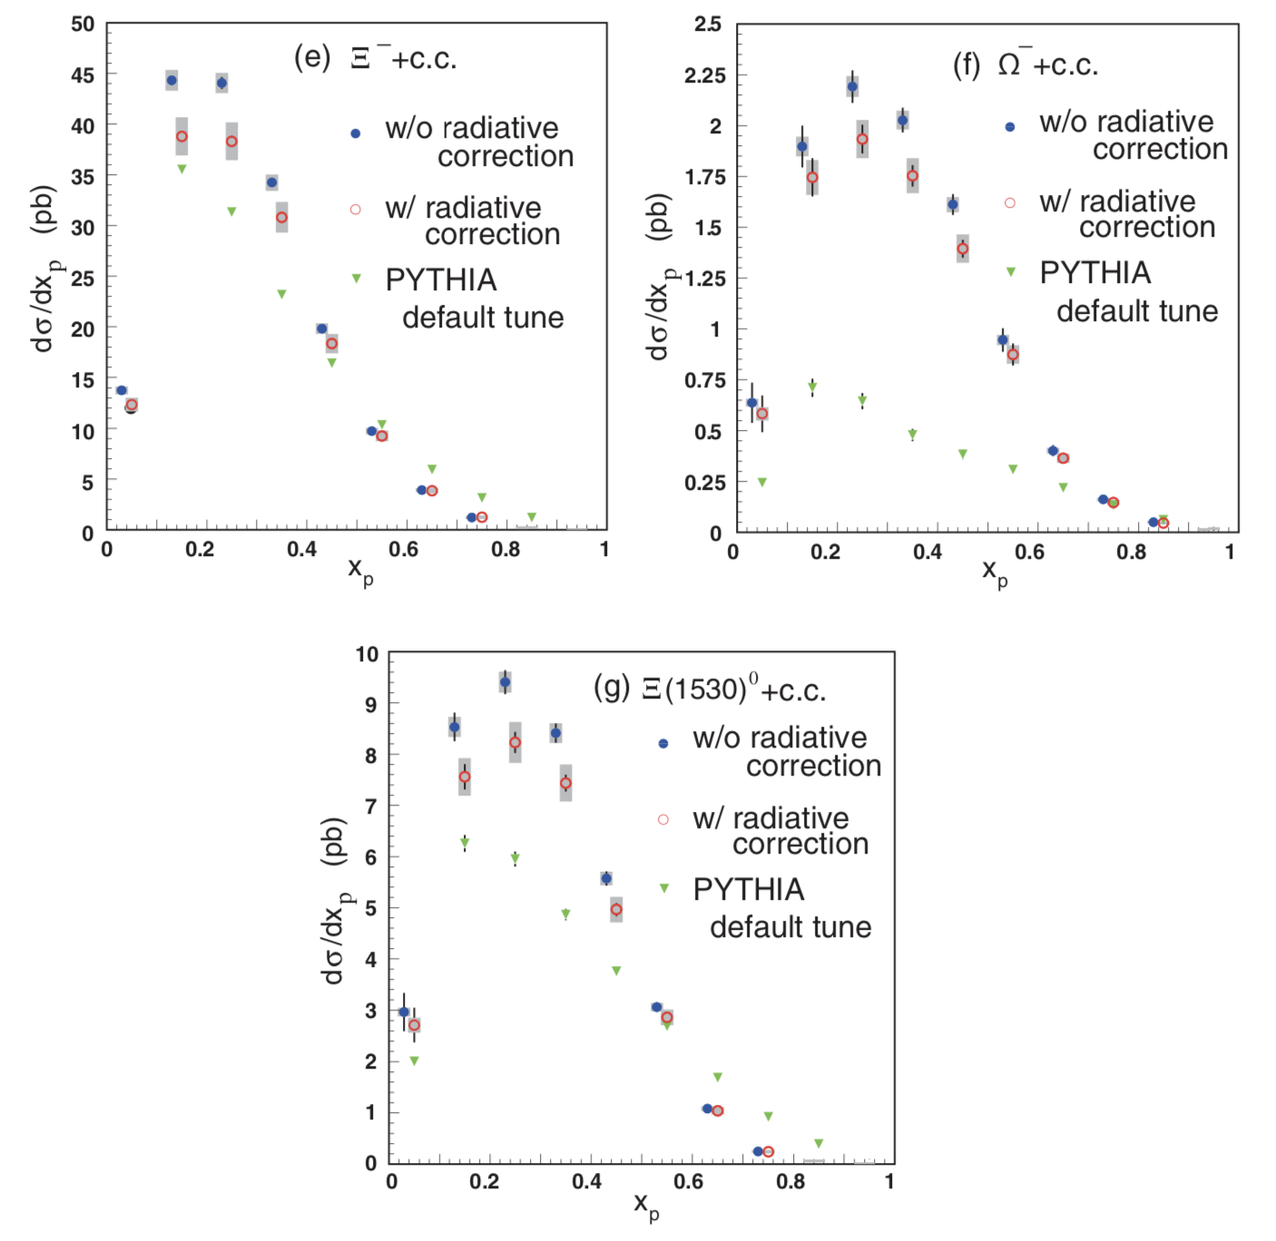
Inclusive cross sections:hyperons

Slide 40
Inclusive cross sections:hyperons
Peaks around x_{p}~0.2-0.3
→ hyperons are produced in soft processes.
Peak positions for Ω⁻ and Ξ(1530) seem slightly higher than the other hyperons.
Total cross sections for S=-1 hyperons are obtained using Hermite interpolation assuming dσ/dx_{p}=0 at x_{p}=0,1.

Slide 41
Inclusive cross sections: charmed baryons
In order to increase statistics, both of on ϒ(4S) and off-resonance data are used.
B-meson decay contribution concentrate in low x_{p}, and is eliminated by selecting x_{p}>0.44.
Λ_{c}⁺
B-decay
γ* →cc
x_{p}>0.44

Slide 42
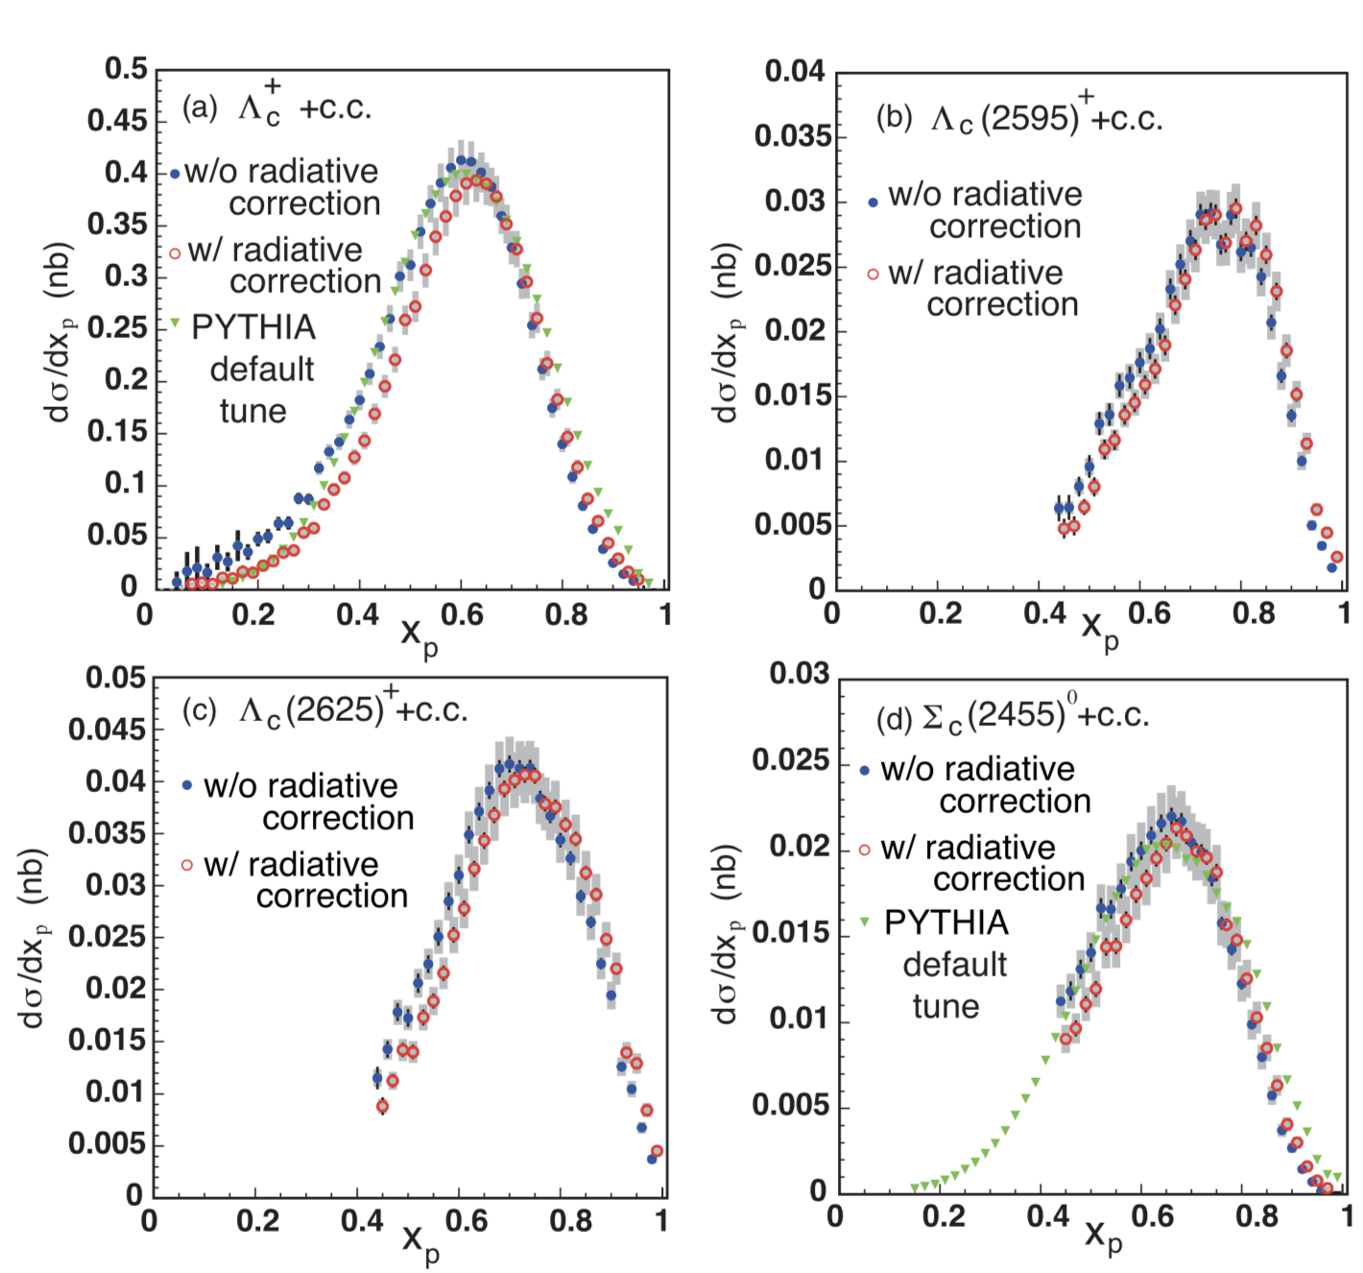
Inclusive cross sections: charmed

Slide 43
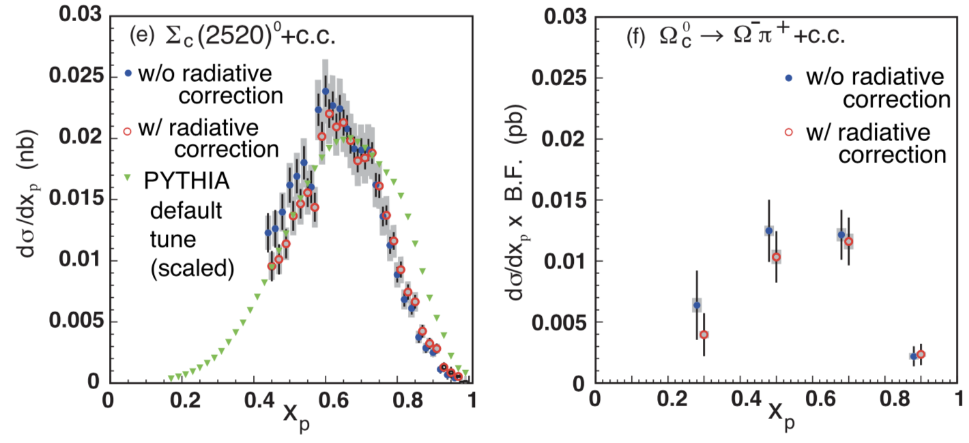
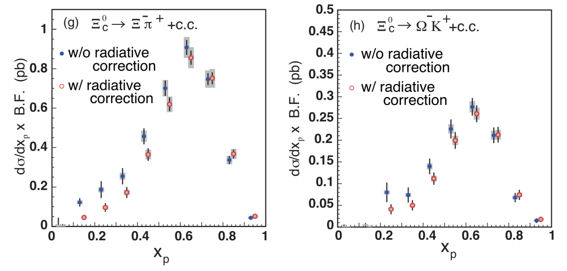
Inclusive cross sections: charmed

Slide 44
Inclusive cross sections: charmed
Peaks around x_{p}~0.6-0.7
→ charm quarks are produced in
e⁺e⁻ →g* →cc.
Peak positions for heavier particles seem higher.
More energetic fragmentation process is necessary to produce heavy particle?
Total cross sections of excited states are obtained by fitting Lund fragmentation model.

Slide 45
Comparison of visible cross section with previous measurements

Slide 46
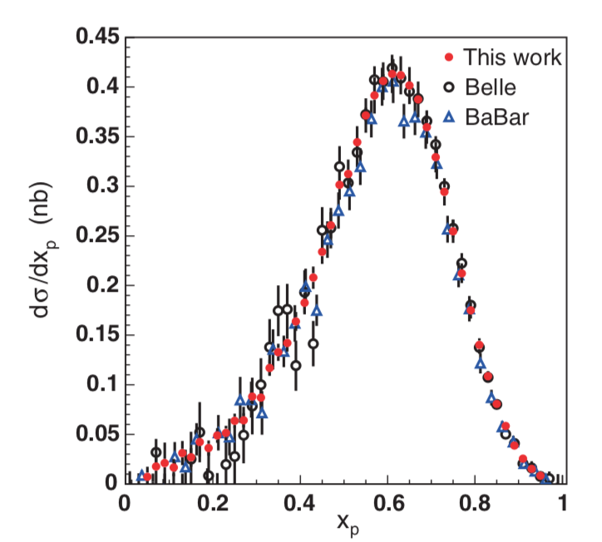

Comparison of visible cross section with previous measurements
$$Λ_{c}$$

Slide 47
Comparison of visible cross section with previous measurements
Cross sections before feed-down subtraction are consistent with previous measurements but much higher precision.

Slide 48
Feed down

Slide 49
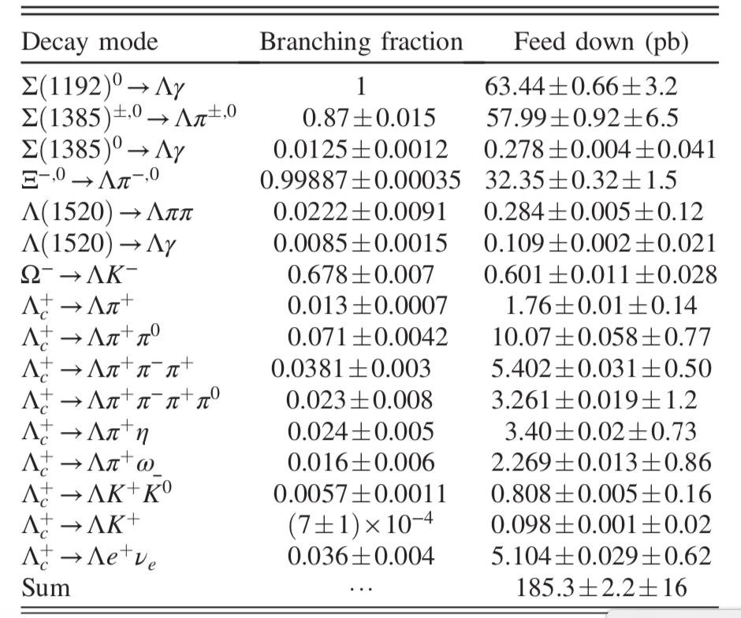
Feed down

Slide 50
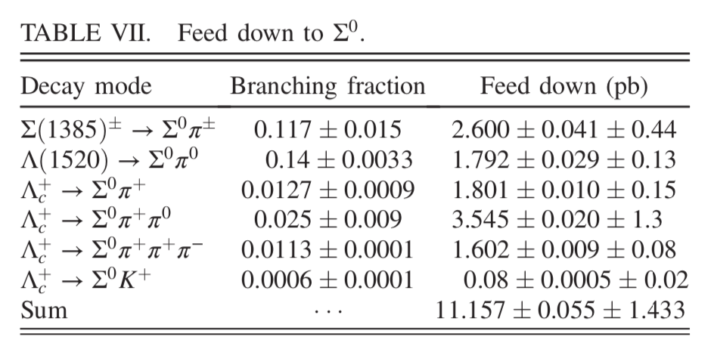
Feed down

Slide 51
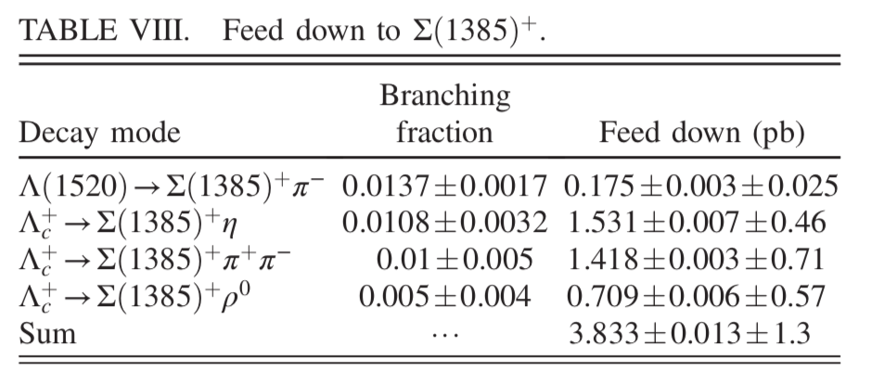
Feed down

Slide 52
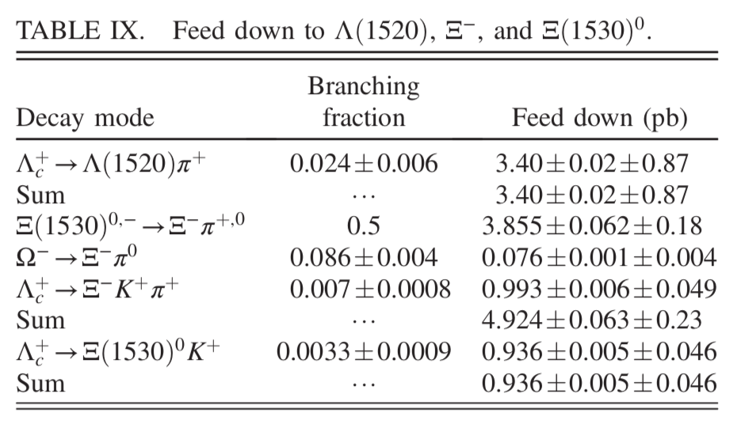
Feed down

Slide 53
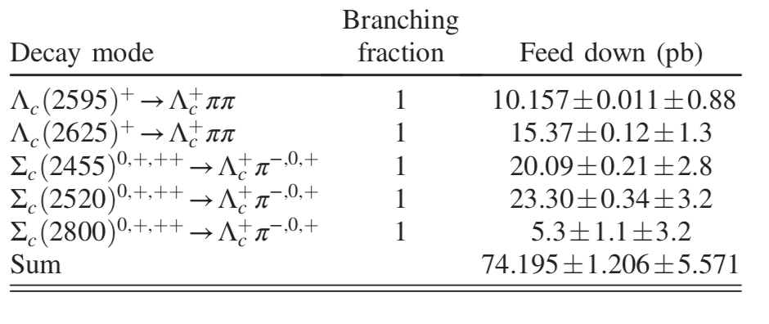
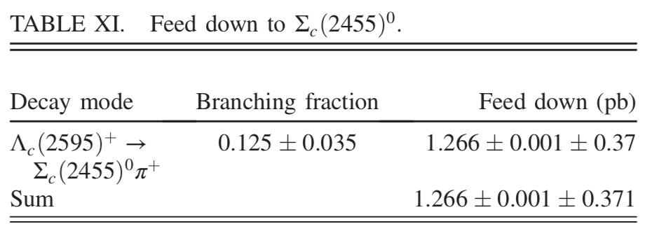
Feed down

Slide 54
Direct production cross sections

Slide 55
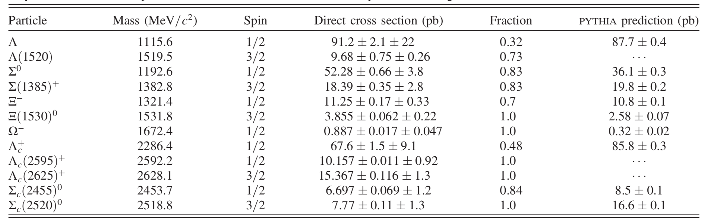
Direct production cross sections
Feed-downs are subtracted.

Slide 56
Direct production cross sections

Slide 57
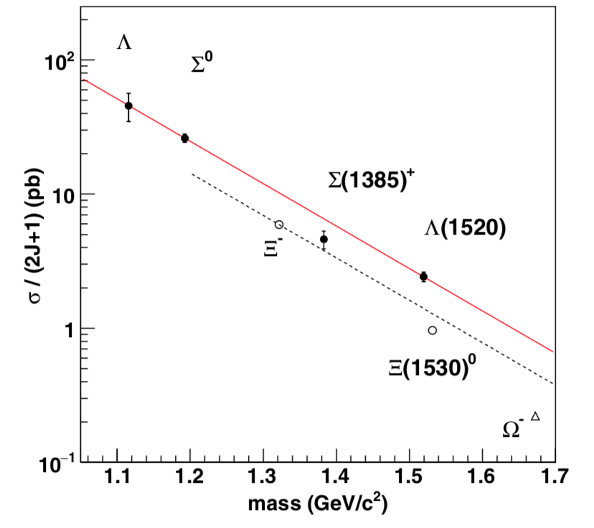
Hyperon results
Fit with a₀exp(a₁m),
Slope parameter
-7.3± 0.3 (GeV/c²)⁻¹
Exponential with same slope of S=-1

Slide 58
Hyperon results
  No enhancement
  Note:inclusive cross sections are consistent with ARGUS.
  Decuplet Suppression
  spin=1 diquark in
  decuplet members?
  ss^{bar} suppression

Slide 59
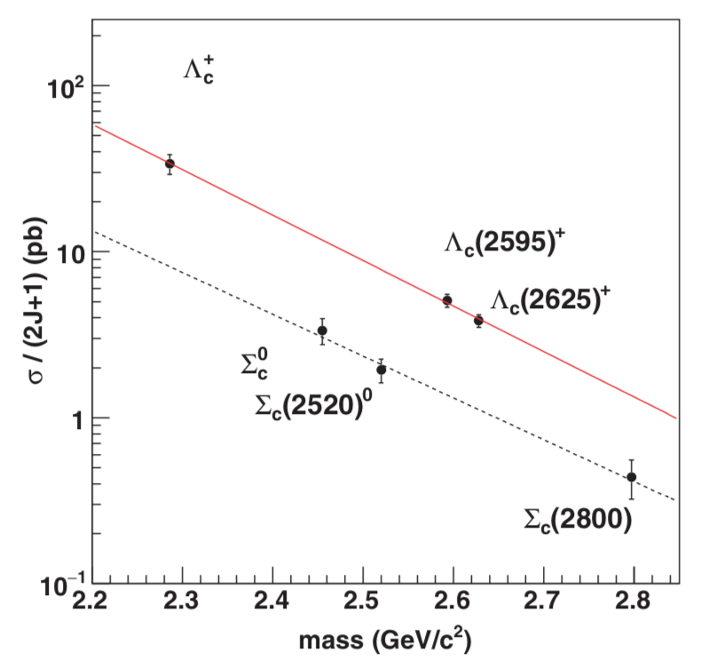

Charmed baryon results
Slope parameters
Λ_{c} : -6.3± 0.5 (GeV/c²)⁻¹
Σ_{c} : -5.8± 1.0 (GeV/c²)⁻¹
consistent
Suppression for Σ_{c} family by the factor of ~3
$Σ_{c}\left(2800\right):$Belle, PRL 94, 12202

Slide 60
Discussion and summary

Slide 61
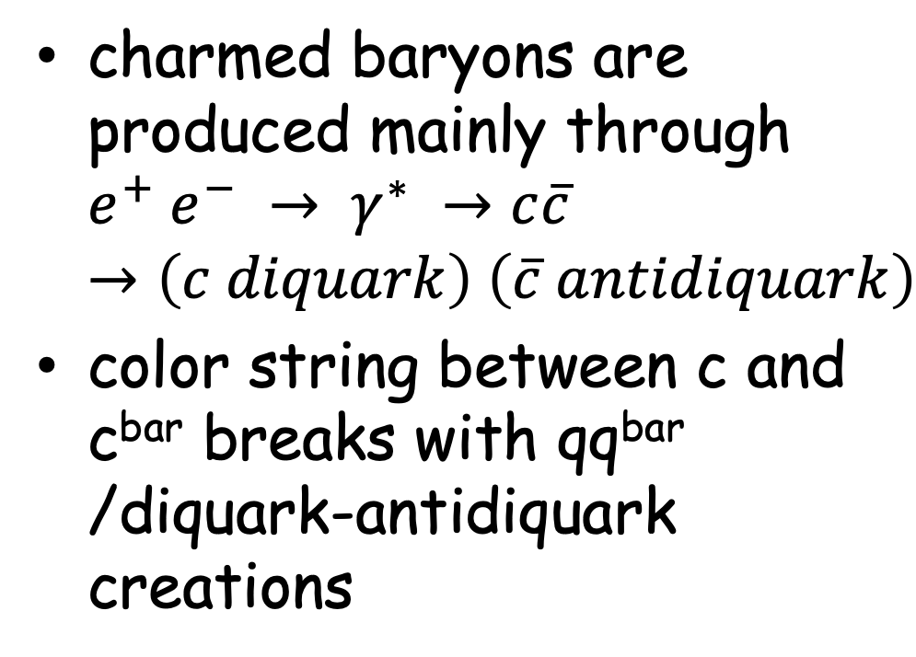
Discussion
c
anti-diquark
e⁺
e⁻
charmed baryons are produced mainly through
$e^{+} e^{−} → γ^{∗} →c\overline{c}$
$→\left(c diquark\right) \left(\overline{c} antidiquark\right)$
color string between c and c^{bar} breaks with qq^{bar} /diquark-antidiquark creations
diquark
c

Slide 62
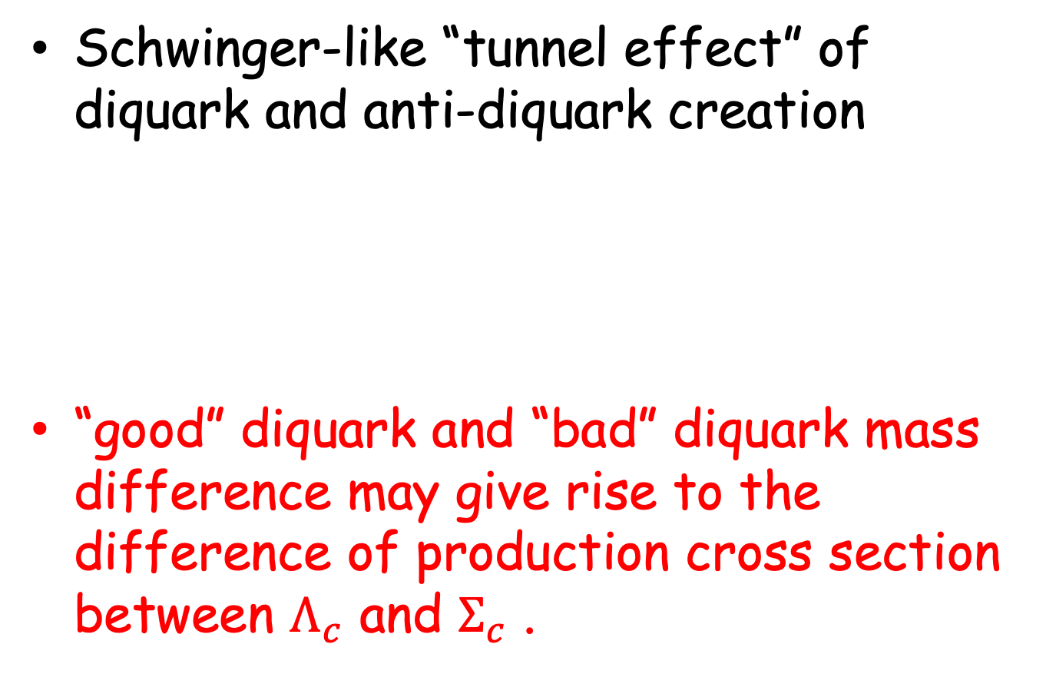
Discussion
Schwinger-like “tunnel effect” of diquark and anti-diquark creation
“good” diquark and “bad” diquark mass difference may give rise to the difference of production cross section between $Λ_{c}$ and $Σ_{c}$ .
μ: diquark mass
κ: gluonic string tension
B. Andersson et al., Phys. Scripta. 32, 574 (1985)

Slide 63

Discussion
Λ_{c} : spin-0 light diquark (“good” diquark),
Σ_{c} : spin-1 heavy diquark (“bad” diquark)
d
d
u
u
Λ_{c}(2286)⁺
Σ_{c}(2455)

Slide 64
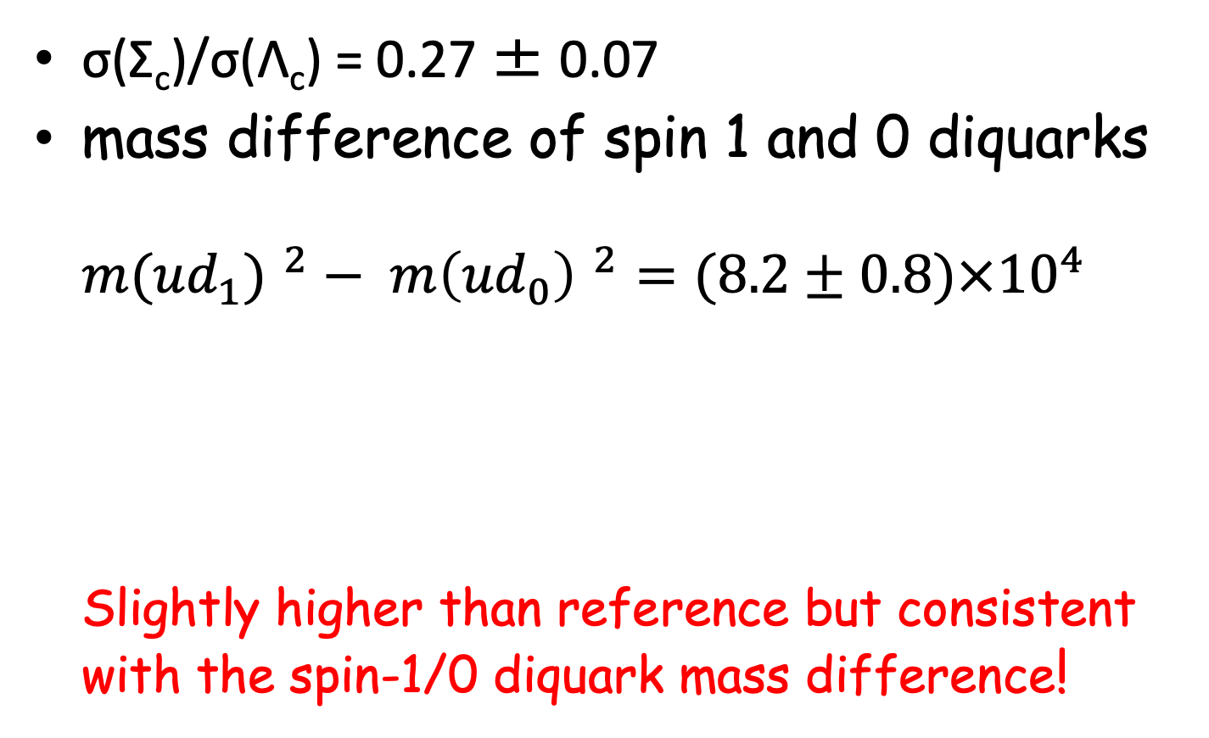
Discussion
σ(Σ_{c})/σ(Λ_{c}) = 0.27 ± 0.07
mass difference of spin 1 and 0 diquarks
${m({ud}_{1}) }^{2}− {m\left({ud}_{0}\right) }^{2}=(8.2±0.8)×{10}^{4}$
Slightly higher than reference but consistent with the spin-1/0 diquark mass difference!
(MeV/c²)²
B. Andersson et al., Phys. Rept. 97, 31 (1983)

Slide 65
Summary
Production cross sections of hyperons and charmed baryons are measured near the ϒ(4S) energy using Belle data.
dσ/dx_{p} distributions for hyperons
  Slightly higher Peak positions for Ω- and Ξ(1530)
dσ/dx_{p} distributions for charmed baryons
  Peak positions for heavier particles seem higher.

Slide 66
Summary
“Inclusive” total cross sections for hyperons
  Consistent with previous measurements with much higher precision
Direct total cross sections
  Clear exponential dependence on baryon masses
  No enhancements for Λ, Λ(1520)
  Suppression of decuplet hyperons and Σ_{c} family
  Suggesting diquark structure in ground and low-lying Λ_{c}, Σ_{c}

Slide 67
Summary
“Inclusive” total cross sections for hyperons
  Consistent with previous measurements with much higher precision
Direct total cross sections
  Clear exponential dependence on baryon masses
  No enhancements for Λ, Λ(1520)
  Suppression of decuplet hyperons and Σ_{c} family
  Suggesting diquark structure in ground and low-lying Λ_{c}, Σ_{c}

Slide 68
Summary
How about production cross section for exotic hadrons?
Further understanding of production mechanism.
Tuning of event generator for collider experiments.

Slide 69
Back up

Slide 70
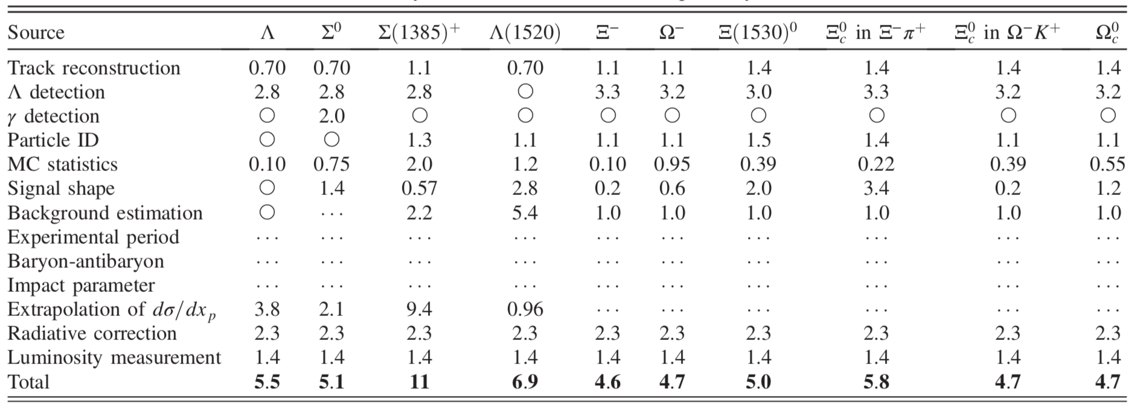
Systematic uncertainties

Slide 71
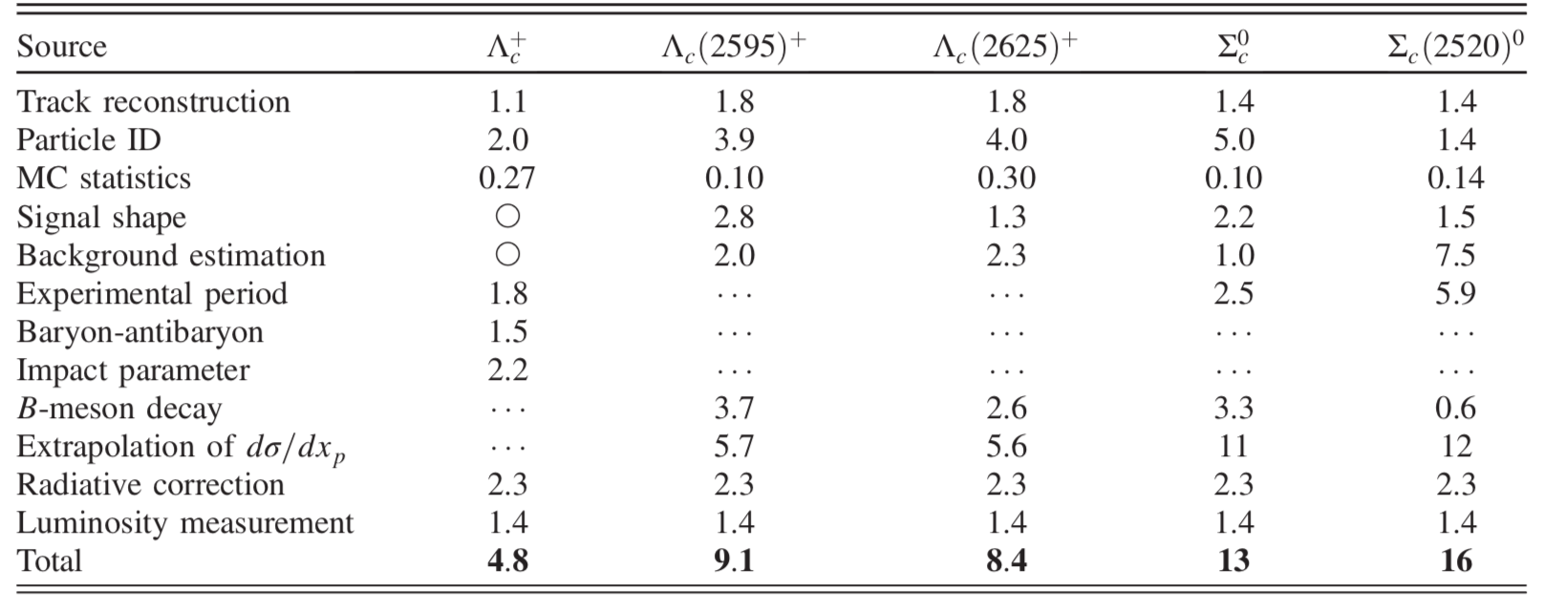
Systematic uncertainties

