Slide 1
EIC Potential for Hadron Structure Measurements
Rolf Ent
ECT* Workshop
Diquark Correlations in Hadron Physics
September 23-27, 2019, ECT*, Trento, Italy

Slide 2
Introduction: Why an Electron-Ion Collider
Interactions and structure are mixed up in nuclear matter: Nuclear matter is made of quarks that are bound by gluons that also bind themselves. Unlike with the more familiar atomic and molecular matter, the interactions and structures are inextricably mixed up, and the observed properties of nucleons and nuclei, such as mass & spin, emerge out of this complex system.
Gaining understanding of this dynamic matter is transformational: Gaining detailed knowledge of this astonishing dynamical system at the heart of our world will be transformational, perhaps in an even more dramatic way than how the understanding of the atomic and molecular structure of matter led to new frontiers, new sciences and new technologies.
The Electron Ion Collider is the right tool: A new US-based facility, EIC, with a versatile range of beam energies, polarizations, and species, as well as high luminosity, is required to precisely image the quarks and gluons and their interactions, to explore the new QCD frontier of strong color fields in nuclei – to understand how matter at its most fundamental level is made.

Slide 3
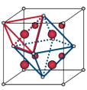
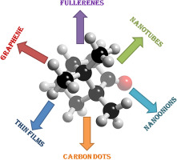
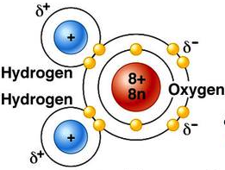
Nuclear Femtography – Subatomic Matter is Unique
Localized mass and charge centers – vast “open” space:
Molecule:
Crystal:
Nanomaterial:
“Water”
Rare-Earth metal
Carbon-based
Interactions and structure are mixed up in nuclear matter: Nuclear matter is made of quarks that are bound by gluons that also bind themselves. Unlike with the more familiar atomic and molecular matter, the interactions and structures are inextricably mixed up, and the observed properties of nucleons and nuclei, such as mass & spin, emerge out of this complex system.
Not so in proton structure!

Slide 4
Nuclear Femtography - Imaging
In other sciences, imaging the physical systems under study
has been key
to gaining new
understanding.
Structure mapped
in terms of
b_{T} = transverse position
k_{T} = transverse momentum

Slide 5
Exploring the 3D Nucleon Structure
After decades of study of the partonic structure of the nucleon we finally have the experimental and theoretical tools to systematically move beyond a 1D momentum fraction (x_{Bj}) picture of the nucleon.
    High luminosity, large acceptance experiments with polarized beams and targets.
    Theoretical description of the nucleon in terms of a 5D Wigner distribution that can be used to encode both 3D momentum and transverse spatial distributions.
Deep Exclusive Scattering (DES) cross sections give sensitivity to electron-quark scattering off quarks with longitudinal momentum fraction (Bjorken) x at a transverse location b.
Semi-Inclusive Deep Inelastic Scattering (SIDIS) cross sections depend on transverse momentum of hadron, P_{h⊥}, but this arises from both intrinsic transverse momentum (k_{T}) of a parton and transverse momentum (p_{T}) created during the [parton → hadron] fragmentation process.
Nuclear Femtography

Slide 6
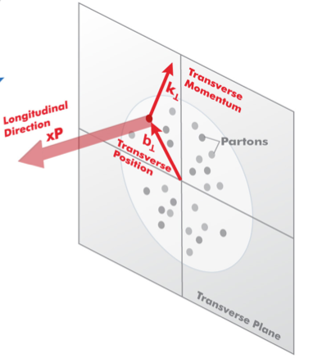

3D Structure of Nucleons and Nuclei
EIC is a machine to completely map the 3D structure of the nucleons and nuclei
We need to measure positions and momenta of the partons transverse to its direction of motion.
These quantities (k_{T}, b_{T}) are of the order of a few hundred MeV.
Also their polarization!
k_{T}, b_{T} (~100 MeV)
Proton and Ion Beam
Need to keep [100 MeV]_{T}/E_{proton,Ion} manageable (~ >10⁻³) ➔ E_{proton} ~< 100 GeV
Electron-Ion Collider: Cannot be HERA or LHeC: proton energy too high

Slide 7
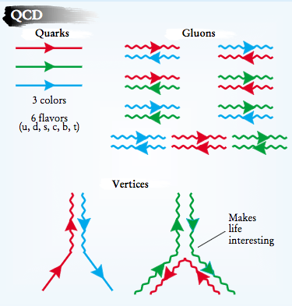
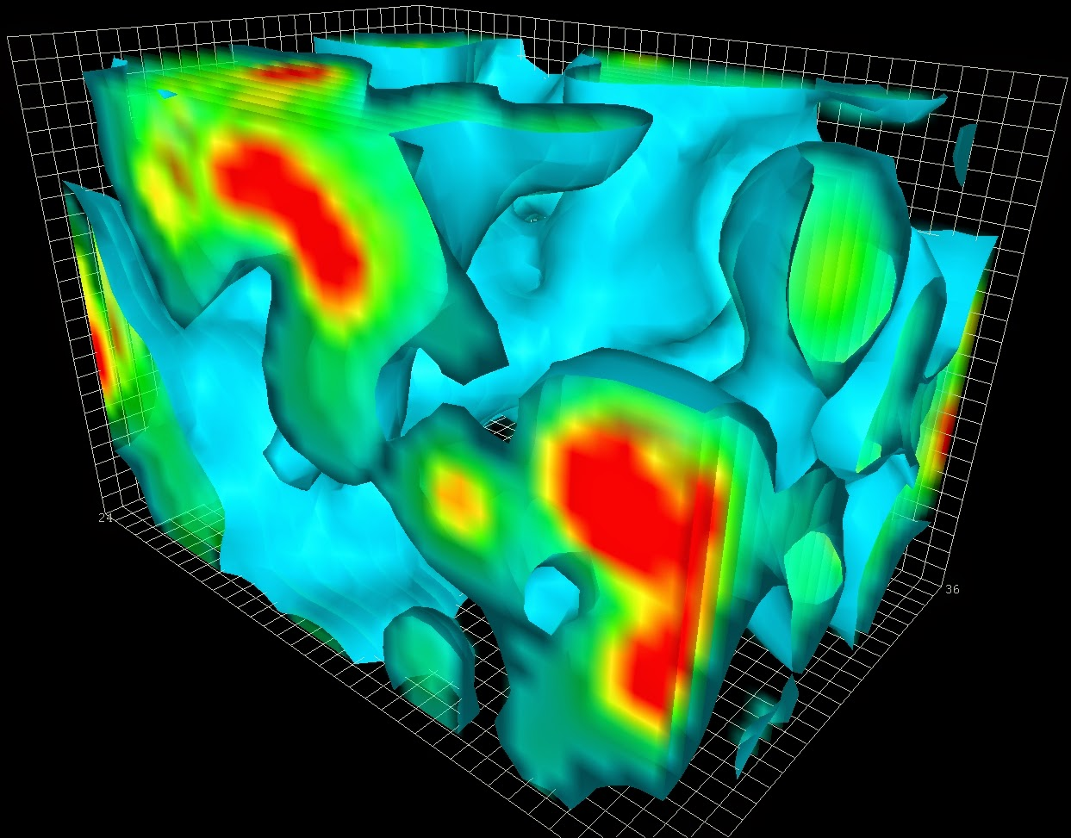

Subatomic Matter is Unique
Interactions and Structure are entangled
because of gluon self-interaction.
Observed properties such as mass and spin emerge from this complex system.
EIC needed to explore the gluon dominated region
JLAB 12 to explore the valence quark region

Slide 8
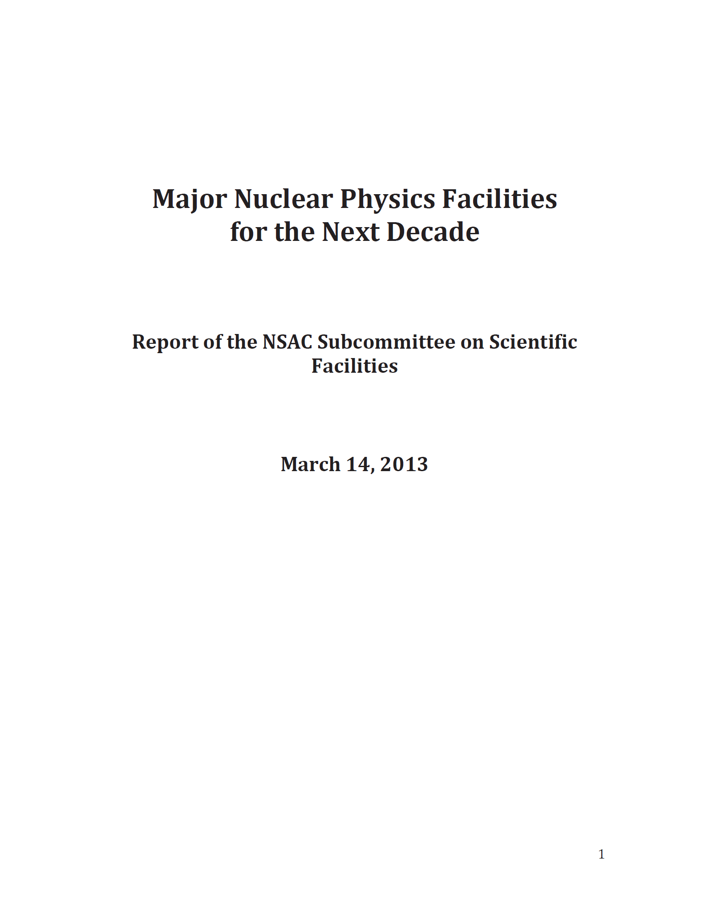
U.S. Electron-Ion Collider Planning 2007-18
2007 Nuclear Science Advisory Committee (NSAC) Long-Range Plan
“An Electron-Ion Collider (EIC) with polarized beams has been embraced by the U.S. nuclear science community as embodying the vision for reaching the next QCD frontier”
2013 Electron Ion Collider White Paper
(Writing committee convened by Jefferson Lab and BNL)
2013 NSAC Subcommittee on Future Facilities
Identified EIC as absolutely central to the nuclear science program of the next decade
2015 NSAC Long-Range Plan
“We recommend a high-energy high-luminosity polarized EIC as the highest priority for new facility construction following the completion of FRIB.”
2018 National Academy of Sciences (NAS) – Assessment of U.S. Based Electron-Ion Collider Science
“…the committee finds a compelling scientific case for such a facility. The science questions that an EIC will answer are central to completing an understanding of atoms as well as being integral to the agenda of nuclear physics today.”

Slide 9
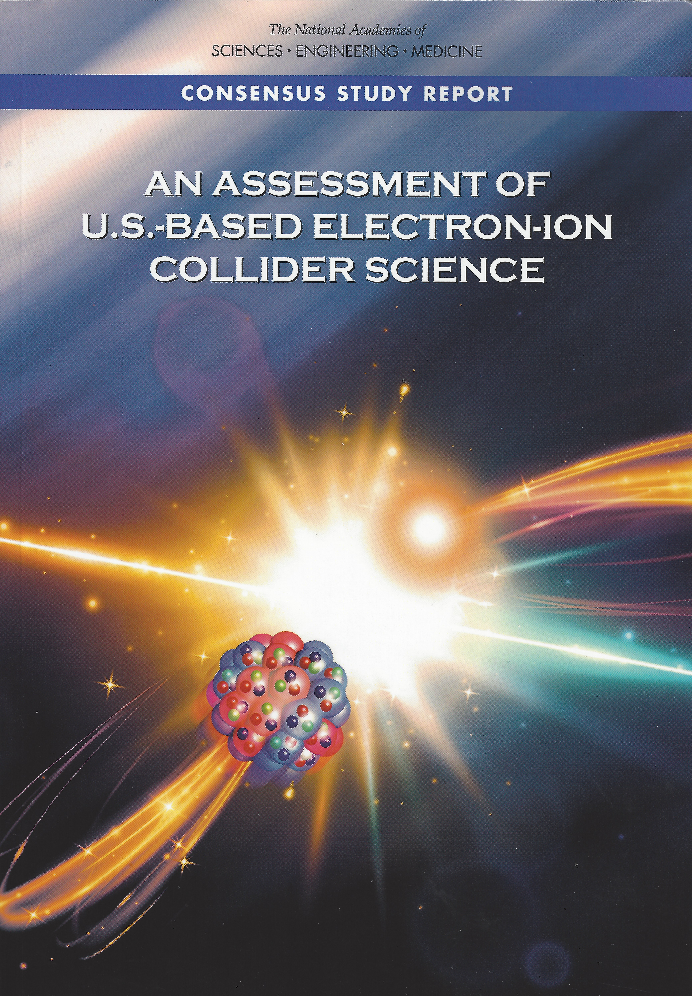
Findings of the NAS committee
Finding 1: An EIC can uniquely address three profound questions about nucleons — neutrons and protons — and how they are assembled to form the nuclei of atoms:
  How does the mass of the nucleon arise?
  How does the spin of the nucleon arise?
  What are the emergent properties of dense systems of gluons?
Finding 2: These three high-priority science questions can be answered by an EIC with highly polarized beams of electrons and ions, with sufficiently high luminosity and sufficient, and variable, center-of-mass energy.
Finding 3: An EIC would be a unique facility in the world and would maintain U.S. leadership in nuclear physics.
Finding 4: An EIC would maintain U.S. leadership in the accelerator science and technology of colliders and help to maintain scientific leadership more broadly.
EIC science is compelling,
timely and fundamental
Developed by NAS committee with broad science perspective

Slide 10
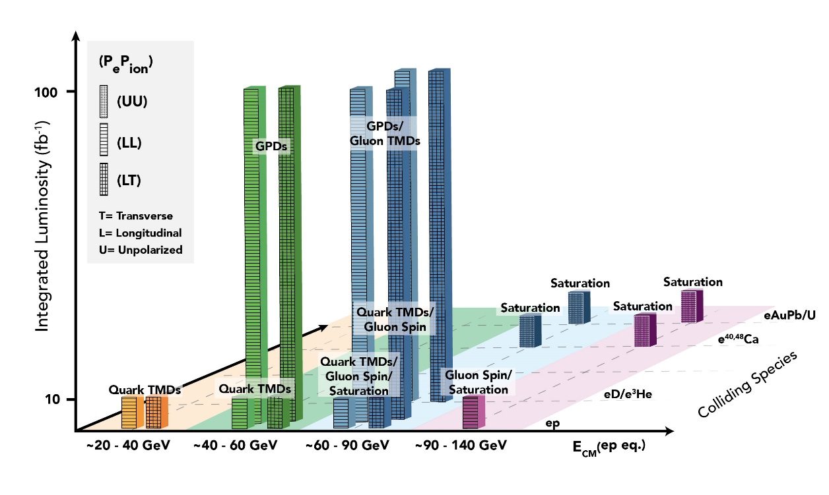

EIC Scientific Program: White Paper Science Goals
The total integrated luminosity to complete whitepaper program is ~700 fb⁻¹
This made some assumptions, e.g., that wherever the EIC White Paper assumed spin-polarized runs with e-p, there likely also would be similar spin-polarized e-d or e-³He runs, both longitudinal and transverse.
At L_{avg} = 10³⁴ cm⁻²s⁻¹ this program requires 7 years of operation.
Luminosity, polarization and versatility of the EIC is key

Slide 11
Growing Relevance of Accelerators Worldwide
From: Dr. Robert W. Hamm

Slide 12
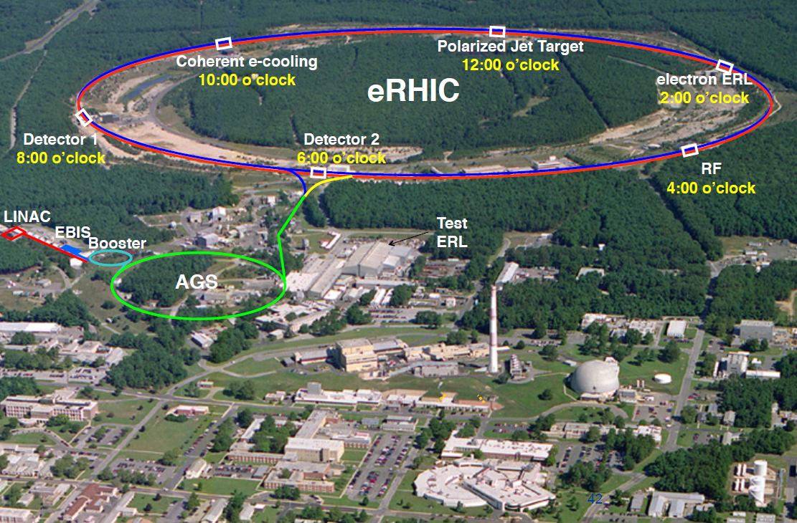
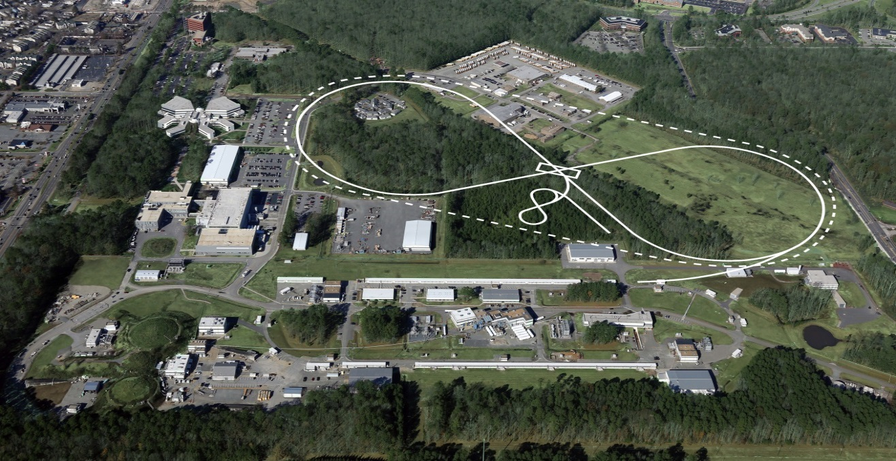
US-Based EIC PROPOSALs
Brookhaven Lab
Long Island, NY
JLEIC
Jefferson Lab
Newport News, VA

Slide 13
Physics vs. EIC Design Requirements
What the nuclear physicists dream off and drives the EIC designs, with upgrade paths included either in luminosity or in CM energy
EIC range – with 100% acceptance
10³⁴
Flexibility in energies
Polarization – e⁻ and p/d/³He
Range of nuclei – H to Pb/U
Excellent acceptance
Good particle identification and resolution
100
Luminosity (cm⁻² sec⁻¹)
10³³
Integrated Luminosity (fb⁻¹/yr)
10
10³²
1
Polarized luminosity and the capability to measure physics of interest is what counts
40
80
120
√s (GeV)

Slide 14
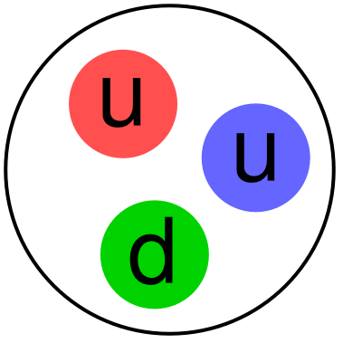
EIC Final State Particles
Possible to get 100% acceptance for the whole event
Scattered electron
Ion beamline
Electron beamline
Particles Associated with Initial Ion
Particles associated with struck parton
Beam elements limit forward acceptance
Central Solenoid not effective for forward
Central
Detector
Beam Elements

Slide 15

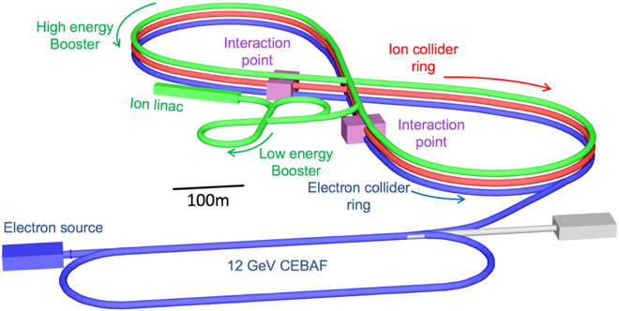
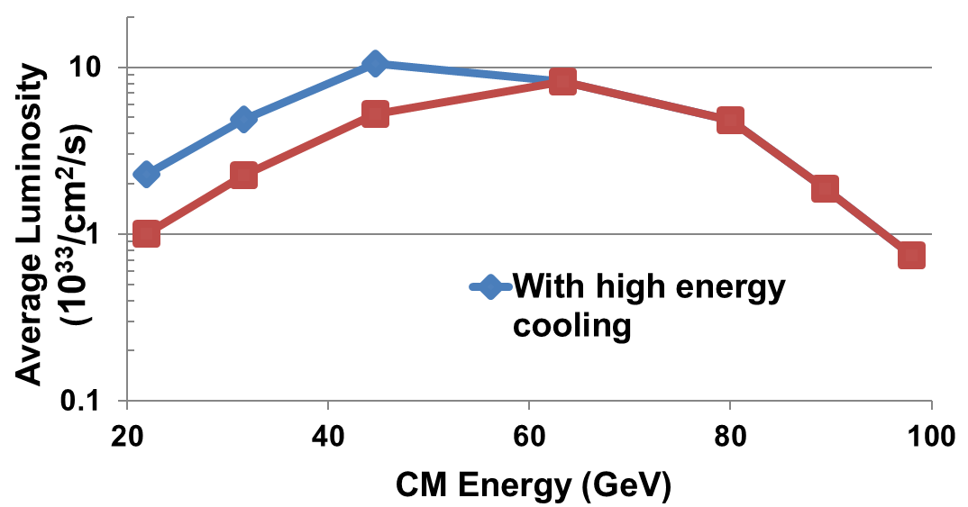
Jefferson Lab Electron Ion Collider
JLEIC Design Concept:
  Existing CEBAF serves as a full-energy electron injector
  Optimized for high luminosity and high polarization, well-matched to luminosity requirements
  Innovative figure-8 design guarantees high polarization, including deuteron
  Full acceptance detector and interaction region
  Energy Range:
√s : 20 to 100 - 140 GeV (magnet technology choice)
  Cut-and-cover tunnel configuration compatible with future upgrade to E_{CM} = 140 GeV
100 fb⁻¹/yr
JLEIC offers an appropriate balance between performance and risk

Slide 16
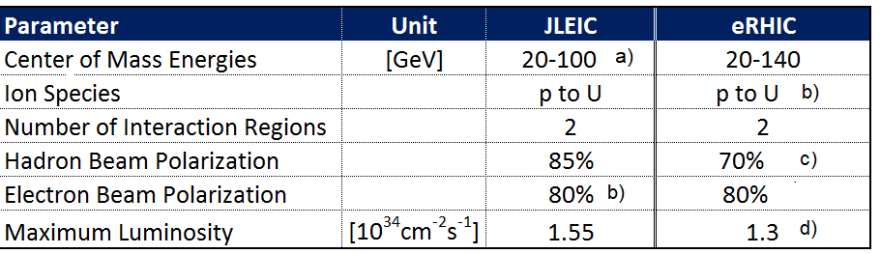
Key EIC Machine Parameters
as required by the NSAC LRP & NAS
80%
b) c)
f)
80%-85%
a) upgradable to 140 GeV
F. Willeke, BNL, July 2019

Slide 17
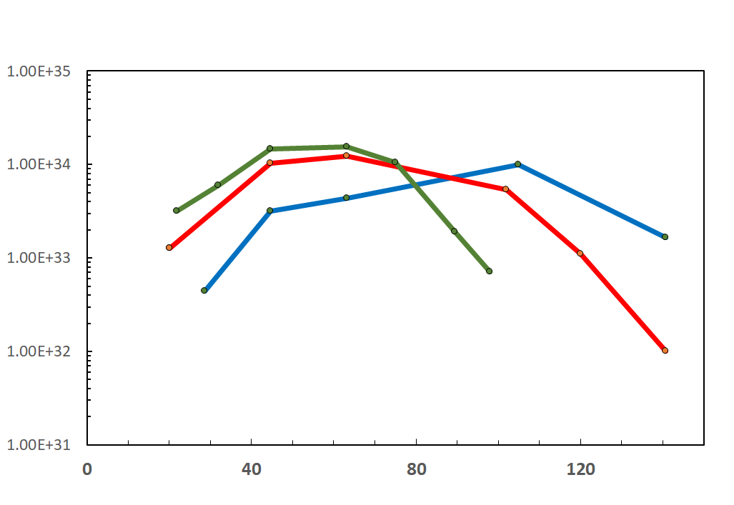
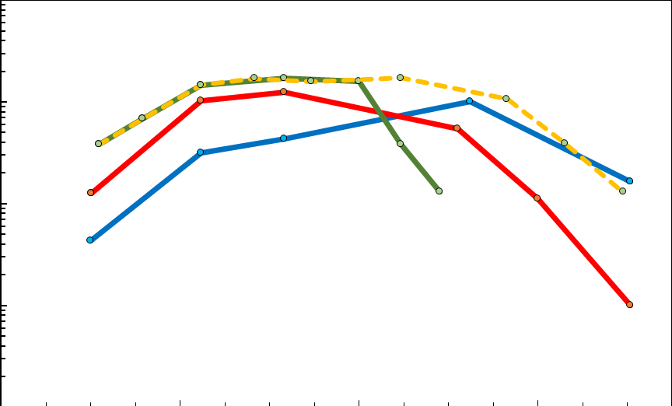
EIC Luminosity
F. Willeke, BNL, July 2019
IR Designs can be adjusted to obtain peak luminosity at different center of mass energies. The curves below show luminosity vs E_{cm} with IRs optimized for high or low center of mass energy. With two IRs, in principle both optimization can coexist in the same machine
10³⁴
10³³
10³²
10³¹
Accumulated Luminosity [fb⁻¹y⁻¹]
Luminosity [cm⁻²s⁻¹]
Tomography (p/A), Transverse Momentum
Distribution and Spatial Imaging
JLEIC
eRHIC
Optimization for high E_{cm}
-
-
-
-
100
10
1
Spin and Flavor Structure of
the Nucleon and Nuclei
eRHIC
Optimization
for E_{cm}=45 GeV
JLEIC Energy Upgrade
Internal
Landscape of the Nucleus
QCD at Extreme Parton Densities-
Saturation
Center of Mass Energy [GeV]
Note: For electron ion collisions, the E_{cm} scale needs to be reduced by a factor (Z/A)^{1/2}

Slide 18

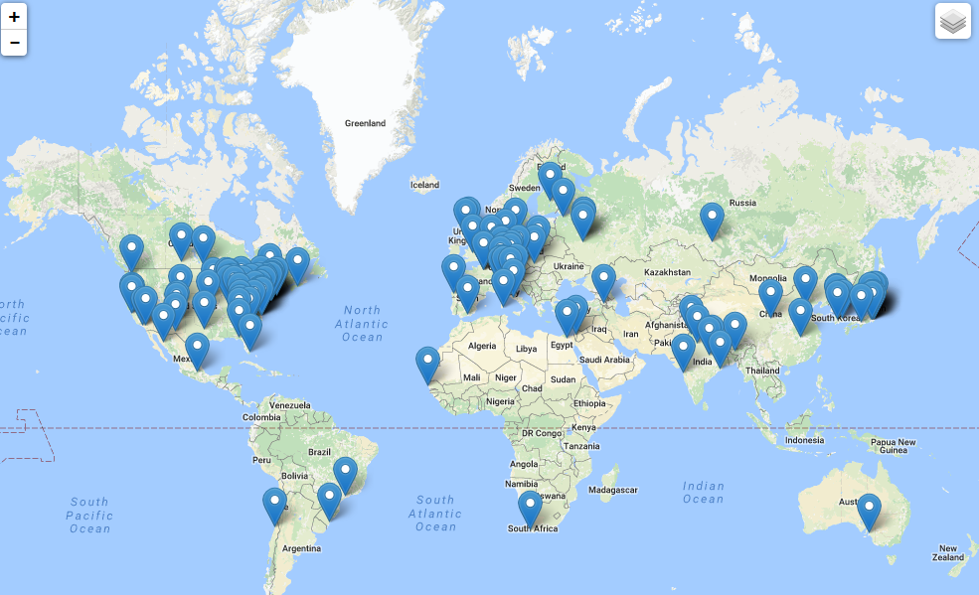
Worldwide Interest in EIC Physics
The EIC Users Group: EICUG.ORG
Formed 2016 – now 925 collaborators, 30 countries, 190 institutions... (Sep. 22, 2019)
Map of institution’s locations
Annual EICUG meeting
2016 UC Berkeley, CA
2016 Argonne, IL
2017 Trieste, Italy
2018 Washington, DC
2019 Paris, France
2020 Miami, FL
2021 Warsaw, Poland
Eagerly awaiting CD-0 after very positive National Academy of Science report on EIC

Slide 19
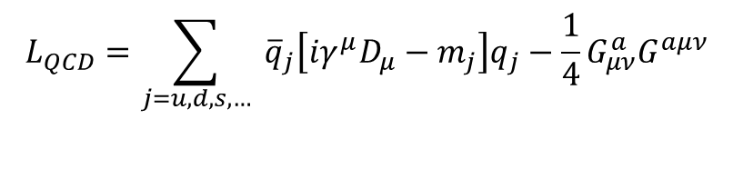
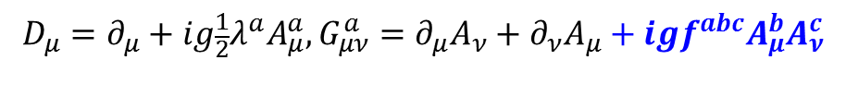
EIC: 21st Century QCD Laboratory
To explore the fundamental structure and dynamics of the matter in the visible world
Interactions arise through fundamental symmetry principles
Properties of the visible universe emerge through complex structure of the QCD vacuum
The proton is a highly relativistic system described by QCD, a fully relativistic quantum field theory.
Lattice QCD is an increasingly powerful means to carry out ab initio QCD calculations of hadron structure in the rest frame.
The goal of the EIC is to provide us with an understanding of the internal structure of the proton and more complex atomic nuclei that is comparable to our knowledge of the electronic structure of atoms themselves, which lies at the heart of modern technologies.
$$L_{QCD}=\sum_{j=u,d,s,…}{ {\overline{q}}_{j}\left[iγ^{μ}D_{μ}−m_{j}\right]q_{j}−\frac{1}{4}G_{μν}^{a}G^{aμν}}$$
$$D_{μ}=∂_{μ}+ig\frac{1}{2}λ^{a}A_{μ}^{a}, G_{μν}^{a}=∂_{μ}A_{ν}+∂_{ν}A_{μ}+igf^{abc}A_{μ}^{b}A_{ν}^{c}$$

Slide 20

EIC – World’s First Polarized eN Collider
A spin factory of polarized electrons and polarized protons/light nuclei:
imaging the quarks and gluons
How are the sea quarks and gluons, and their spins, distributed in space and momentum inside the nucleon?
How do the nucleon properties emerge from them and their interactions?

Slide 21
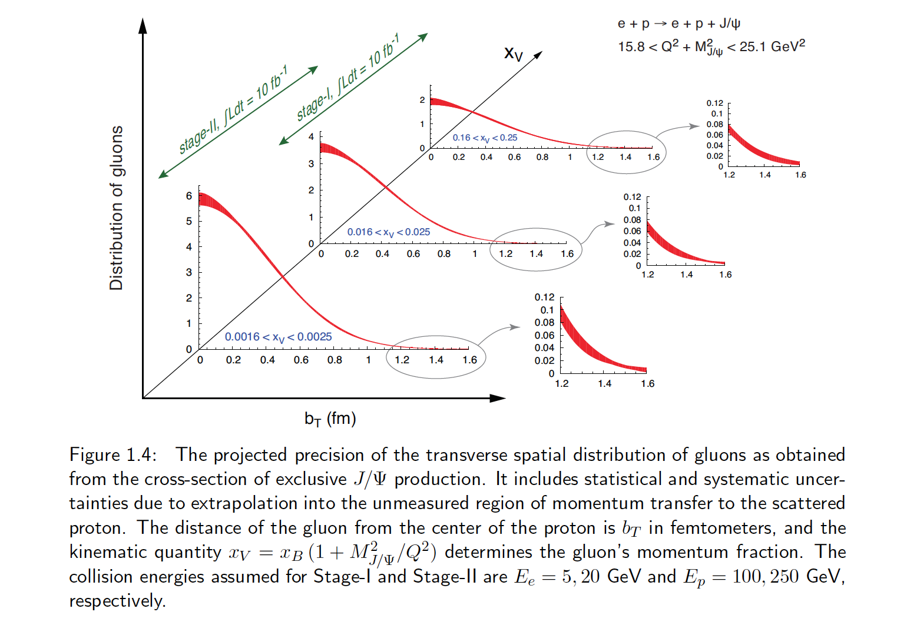

Transverse Spatial Distribution of Gluons
How are gluons spatially distributed in a proton or a nucleus?
Is the distribution smooth?
How does it differ from the charge distribution?
First ever tomographic images of ocean of gluons within matter !

Slide 22
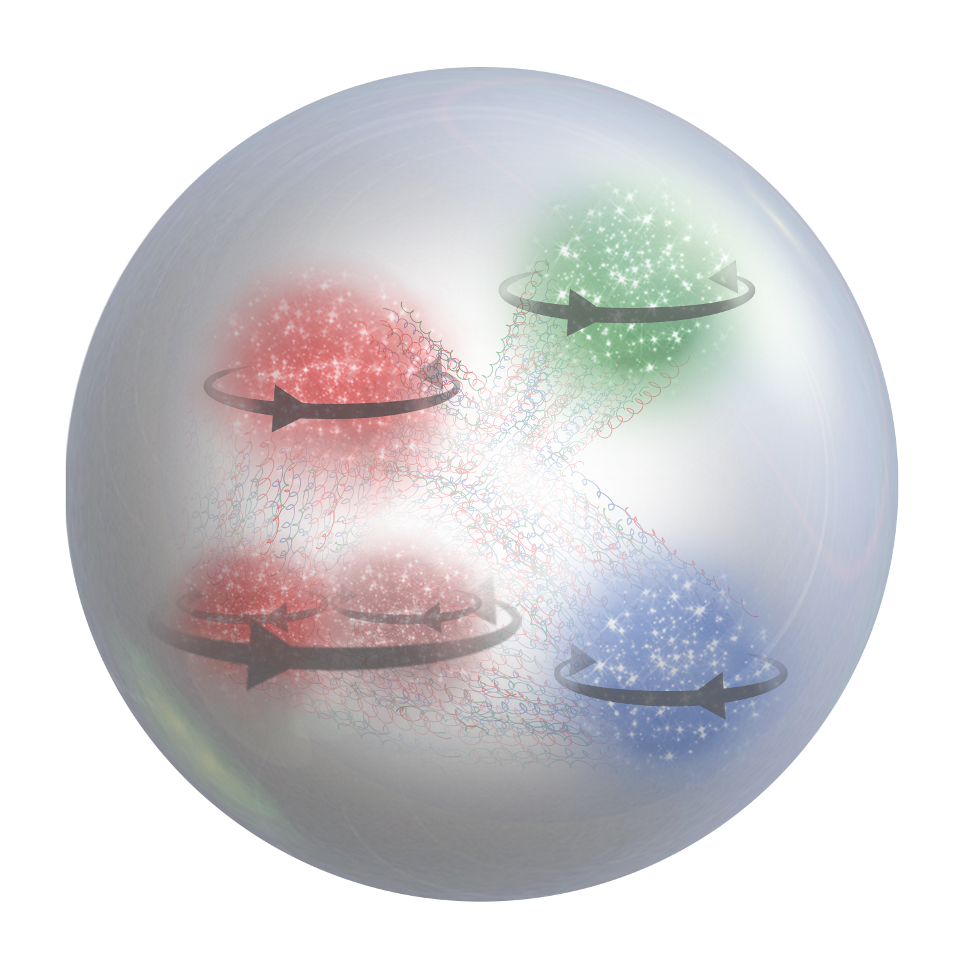

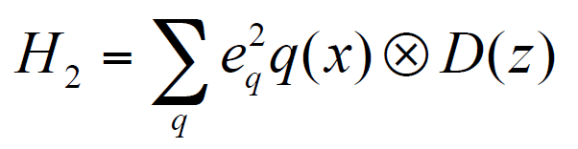


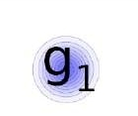


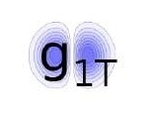
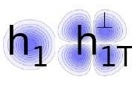
Features of 3D Distributions/TMDs
σ
f
Ex. TMD PDF for a given combination of parton and nucleon spins
quark polarization
U
L
T
transverse position and momentum of partons are correlated with the spin orientations of the parent hadron and the spin of the parton itself
transverse position and momentum of partons depend on their flavor
transverse position and momentum of partons are correlated with their longitudinal momentum
spin and momentum of struck quarks are correlated with remnant
quark-gluon interaction play a crucial role in kinematical distributions of final state hadrons, both in semi-inclusive and exclusive processes
T
U
f₁
h₁
Boer-Mulders
nucleon polarization
L
g_{1L}
T
h_{1L}
helicity
worm-gear
T
,
T
T
f_{1T}
g_{1T}
h₁
h_{1T}
Sivers
worm-gear
transversity
pretzelosity

Slide 23
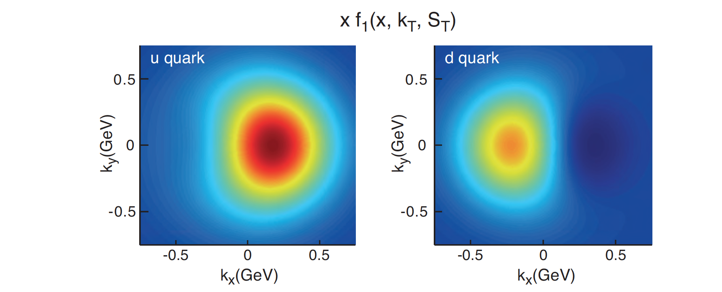
Transverse Momentum Distributions
Spin and the ability to look at transverse momentum together give a powerful new window into QCD
TMDs directly related to orbital motion
For example, we can explore for the first time interference in quantum phases due to color force – impossible with purely longitudinal experiments

Slide 24
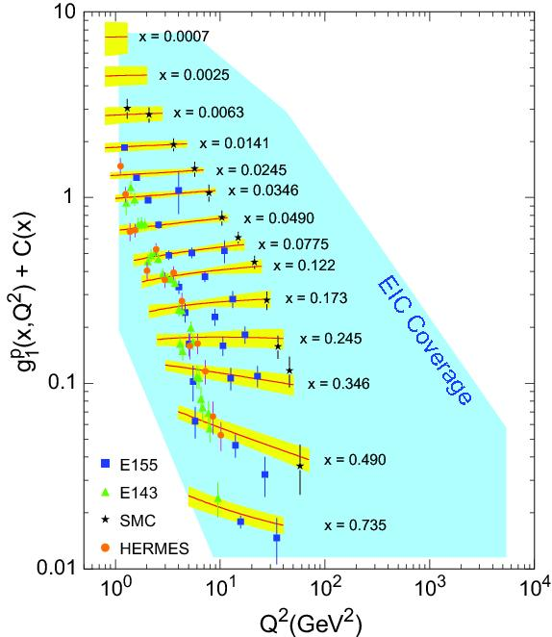
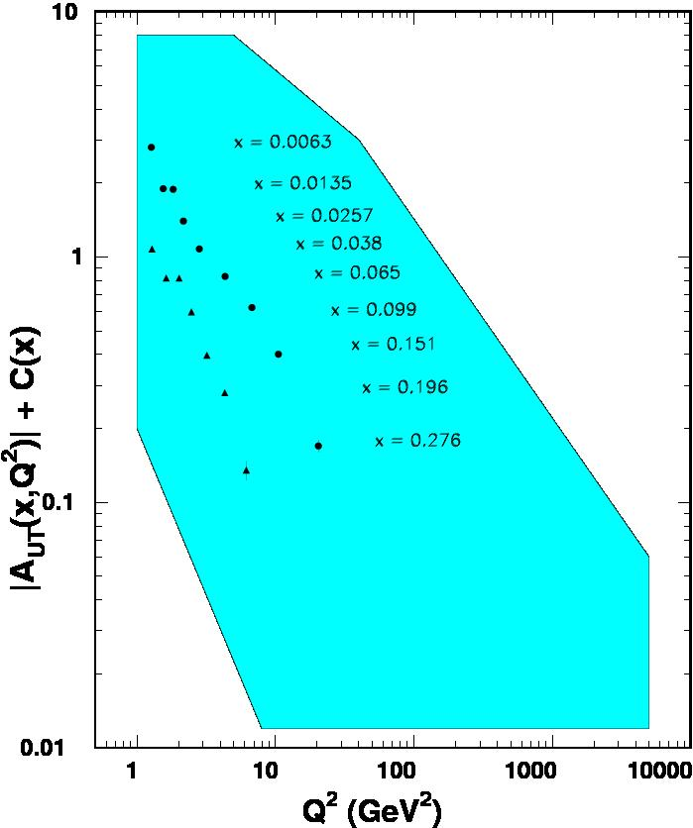

World Data on F₂^{p}
World Data on g₁^{p}
World Data on h₁^{p}
F_{UT}^{sin(φh+φs)}(x,Q²) + C(x) $∝h1$
Note: need to update plots for COMPASS data
An EIC makes it possible!
EIC coverage
COMPASS
HERMES
transverse spin ~ angular momentum
momentum
spin

Slide 25
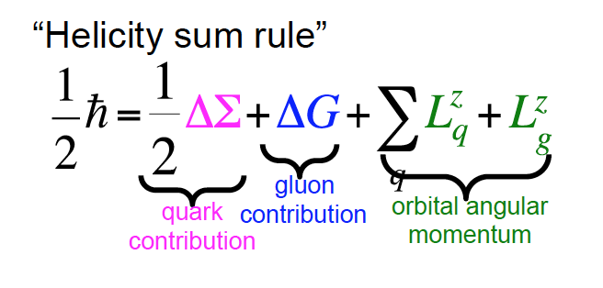
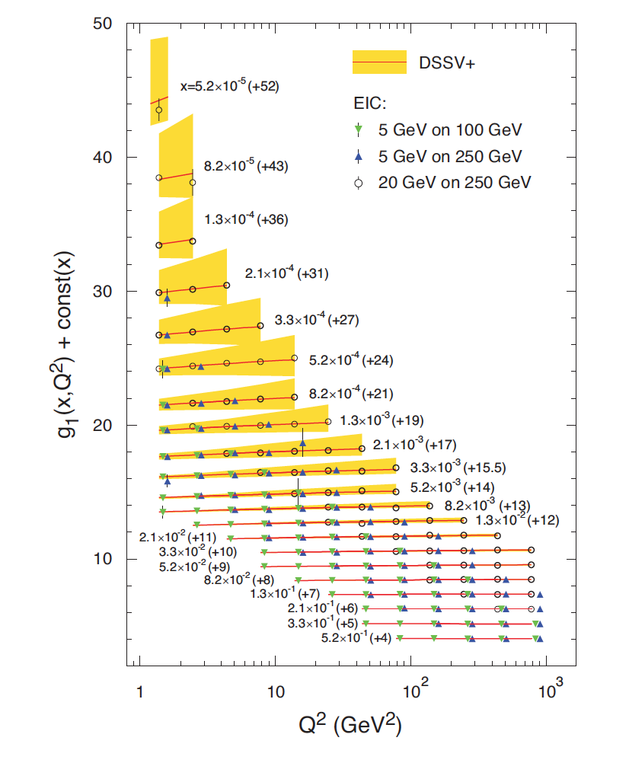
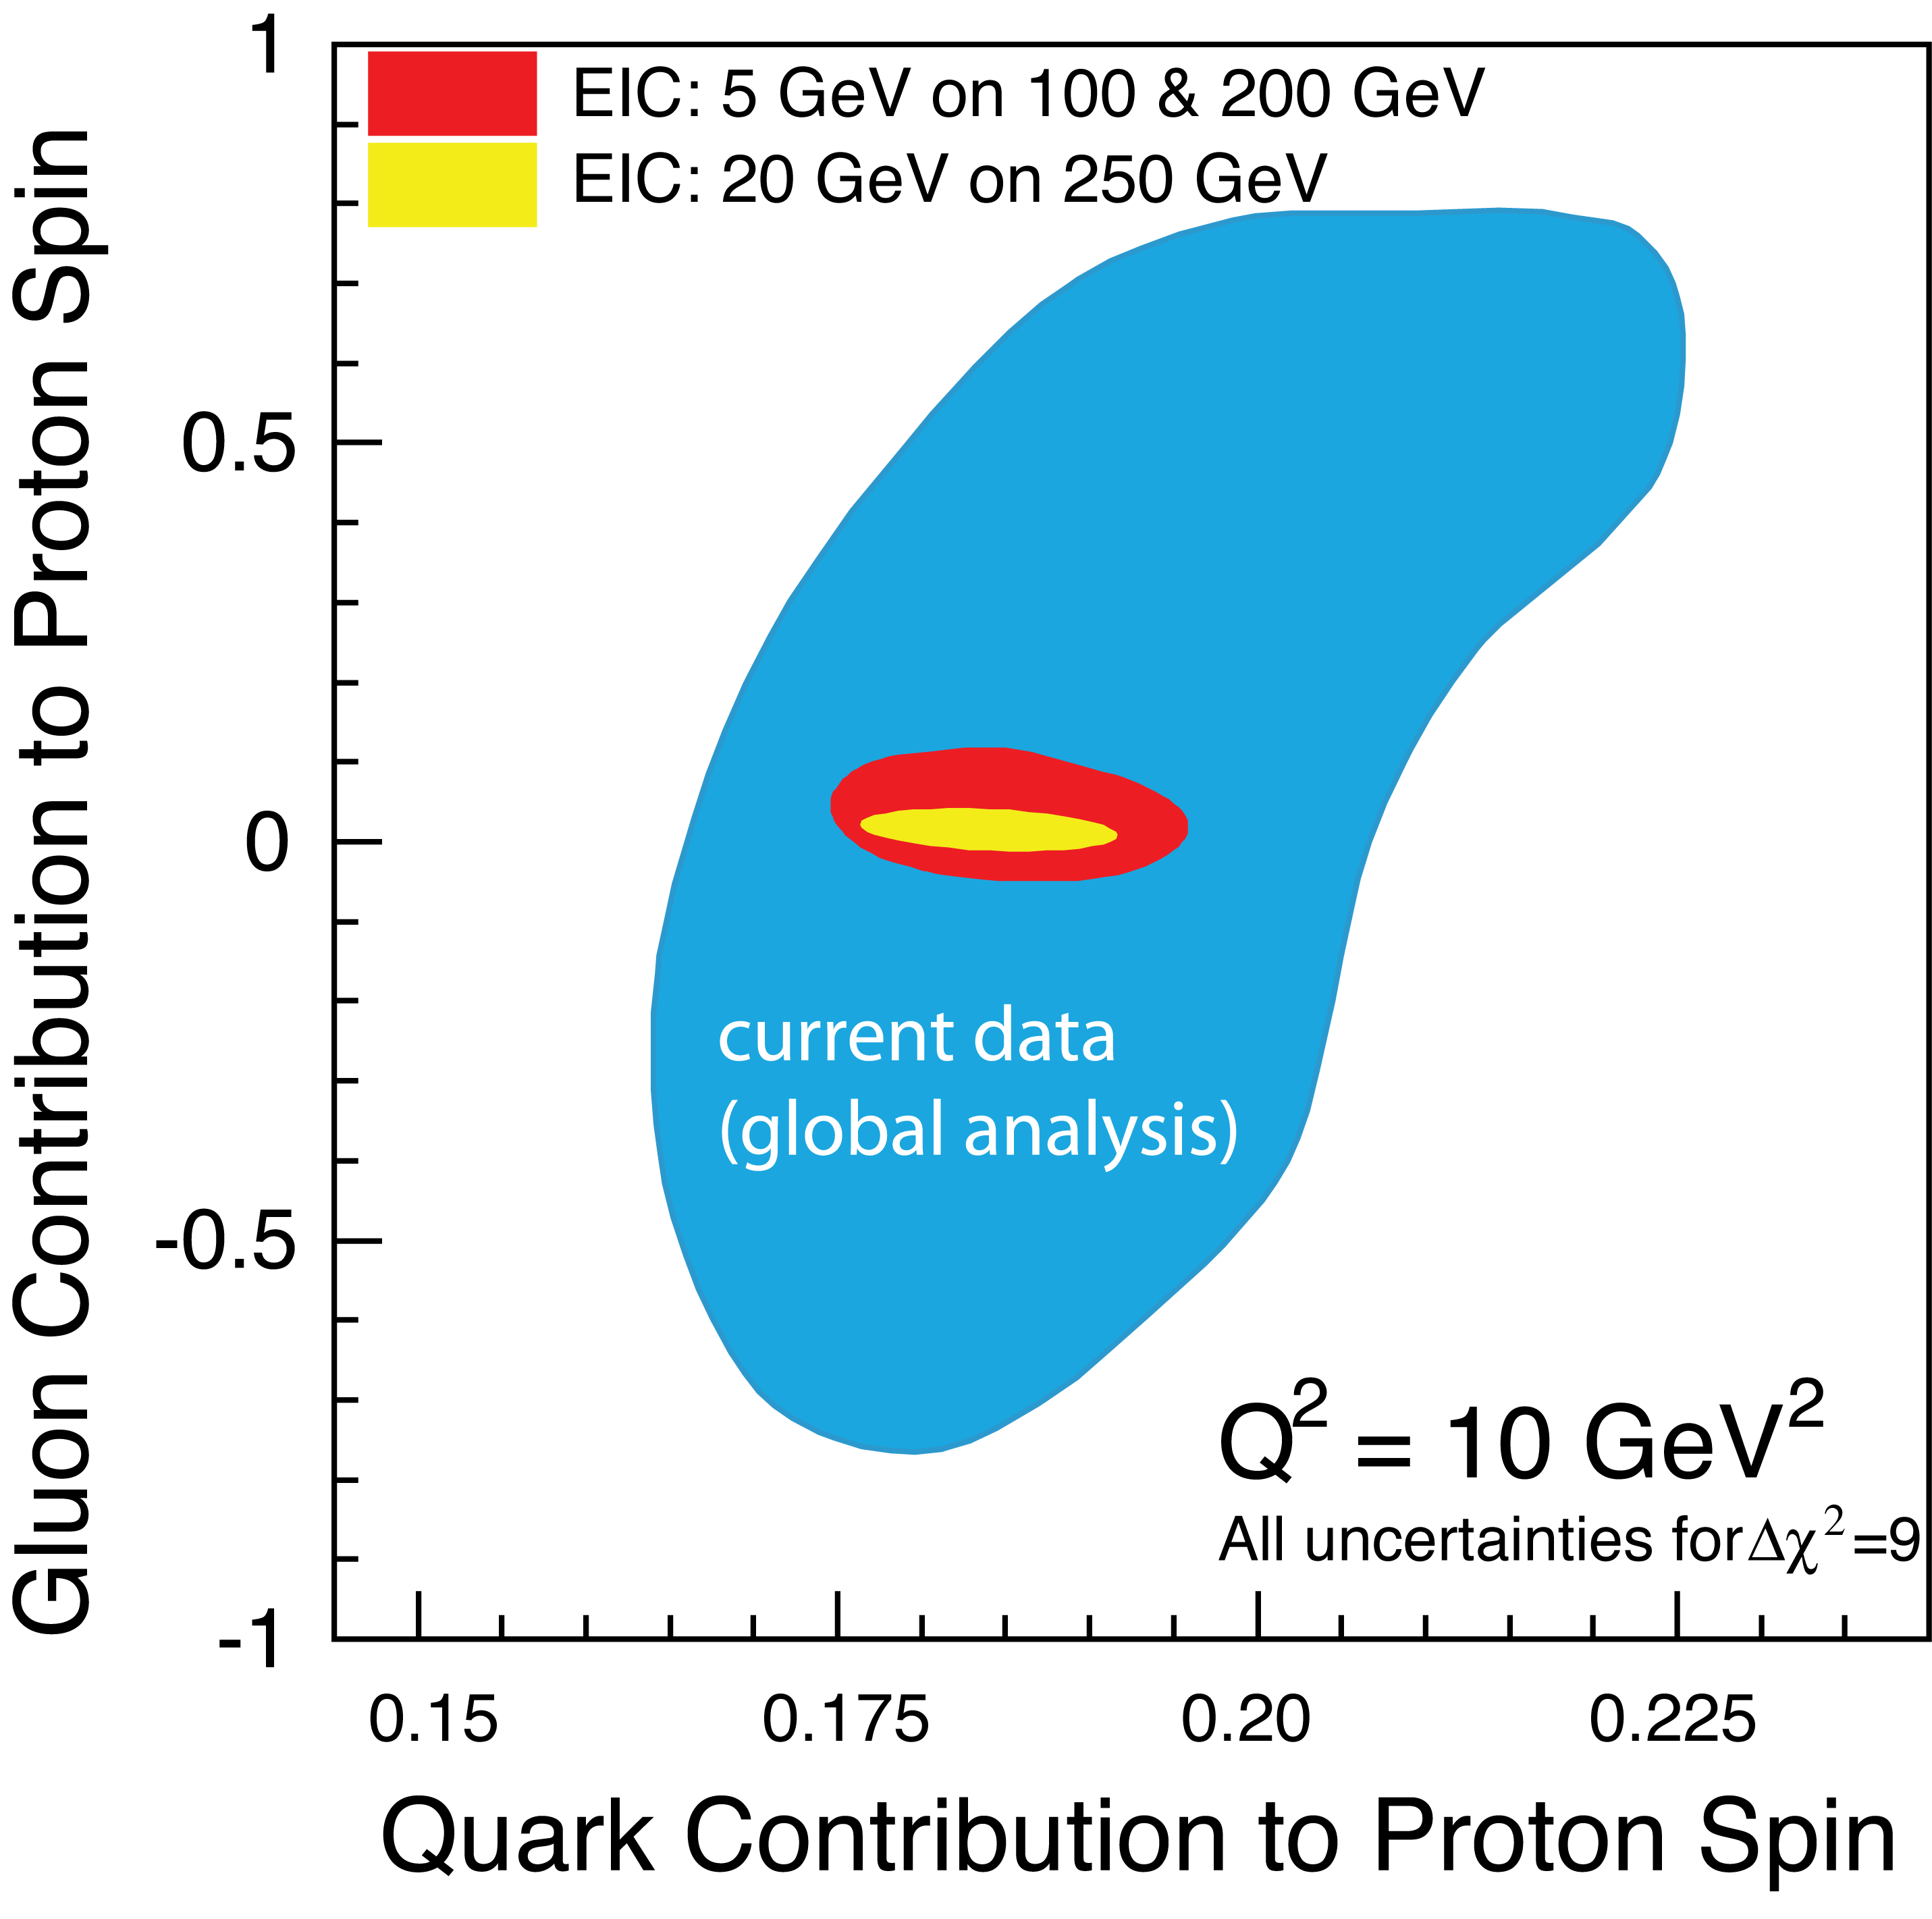

THE INCOMPLETE HADRON: SPIN PUZZLE
EIC projected measurements:
Precise determination of polarized PDFs of
quark sea and gluons ➔ precision ΔG and ΔΣ
➔ Determination of L_{q} + L_{g}

Slide 26
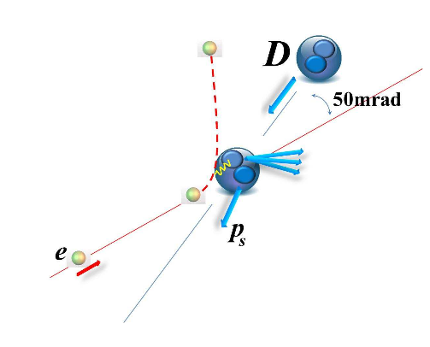
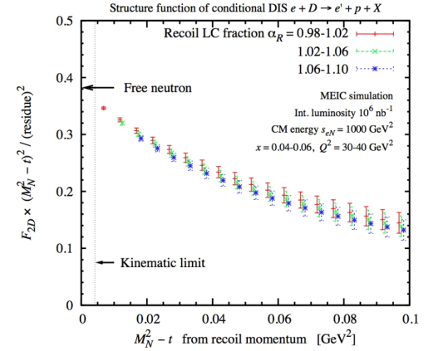
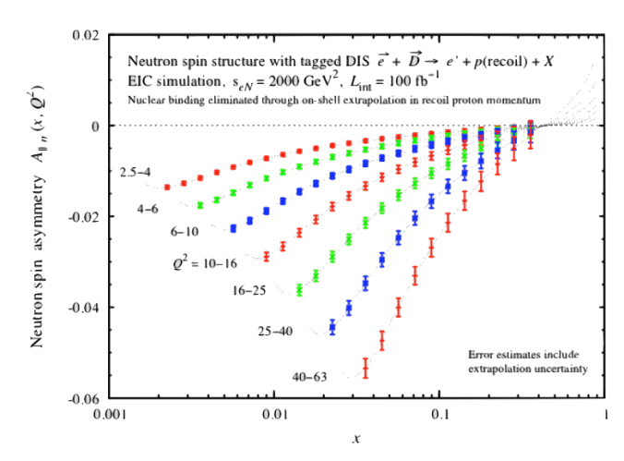

EIC Science: Deuterons and neutron targets
Figure-8 design enables polarized (vector and tensor)
deuteron beams (>80% polarization).
Collider → allows a precision measurement of the spectator nucleon.
First precision measurement of polarized (and unpolarized) neutron is possible at EIC
Extrapolation
from bound to
free neutron
under control
Polarized
Neutron
Structure
F₂^{n} can be extracted at % level accuracy
Investigate nuclear effects at the level of partons with Tensor Polarization Observables
Polarized Deuteron Structure Function b₁
Are quarks sensitive to the shape of the nucleus?
-

Slide 27
World Data on F₂^{p}
World Data on g₁^{p}
World Data on h₁^{p}
Similar for F₂^{n}
Similar for g₁^{n}, g₂^{p}, g₂^{n}
and b₁^{d}
Similar for h₁^{n}
F_{UT}^{sin(φh+φs)}(x,Q²) + C(x) $∝h1$
Note: need to update plots for COMPASS data
An EIC makes it possible!
EIC coverage
COMPASS
HERMES
transverse spin ~ angular momentum
momentum
spin

Slide 28
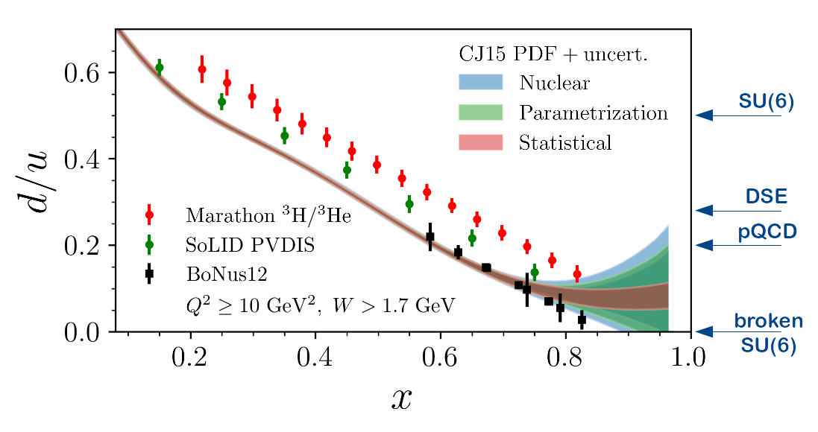
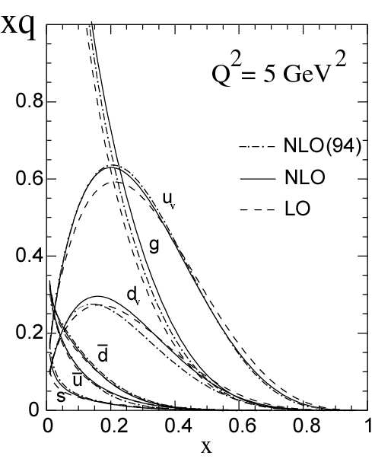
Measuring High-x Structure Functions
REQUIRES:
High beam polarization
High electron current
High target polarization
Large solid angle spectrometers
Projected JLab 12 GeV d/u Extraction
Marathon ³H/³He completed!
x →1 predictions | F₂^{n}/F₂^{p} | d/u | A₁^{n} | A₁^{p}
SU(6) | 2/3 | 1/2 | 0 | 5/9
Diquark Model/Feynman | 1/4 | 0 | 1 | 1
Quark Model/Isgur | 1/4 | 0 | 1 | 1
Perturbative QCD | 3/7 | 1/5 | 1 | 1
QCD Counting Rules | 3/7 | 1/5 | 1 | 1
!
!
12 GeV will access the regime (x > 0.3), where valence quarks dominate

Slide 29
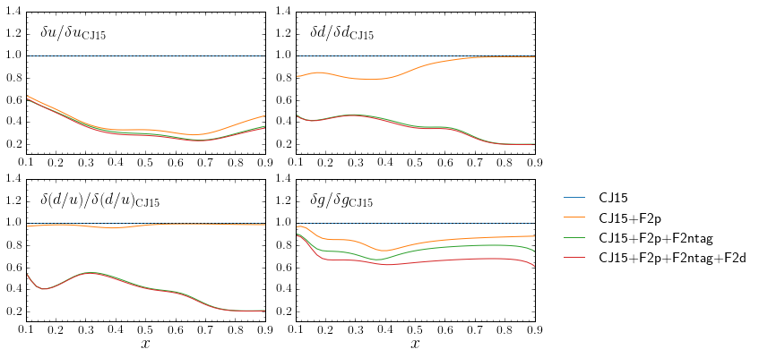
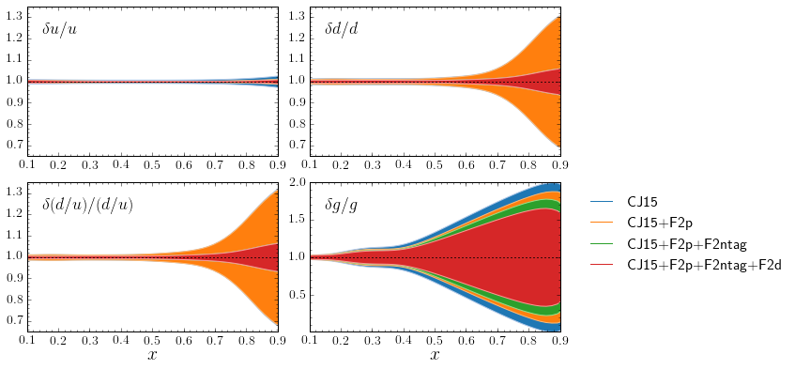
EIC e-d (with n_{tag}) projection with 100/fb luminosity
d quark precision will become comparable to current u!!
(becomes ~5% at x = 0.9)
similar improvement in g(x)
The u quark uncertainty becomes less than ~1%; may be important for large mass BSM new particles.
With d quark nailed by F₂^{n}, fitting F₂^{d} data will explore details of nuclear effects

Slide 30
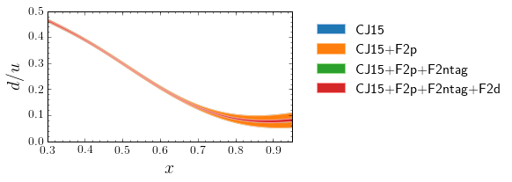
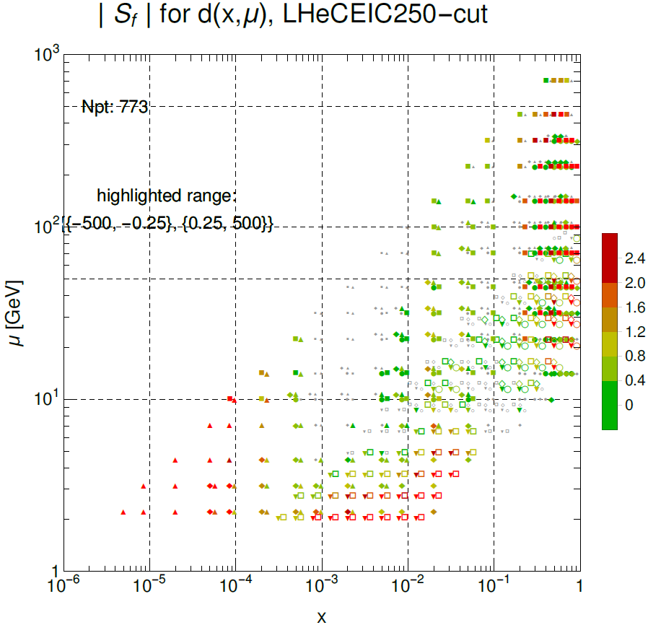
Improved d(x) precision oF EIC is good news
The d-quark goes from a few 10% to ~few% percent level
Resolve long-standing mystery of d/u at large x, bell-weather for fundamental models of nucleon structure
Sensitivity confirmed with PDFSense!

Slide 31
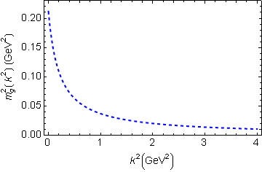
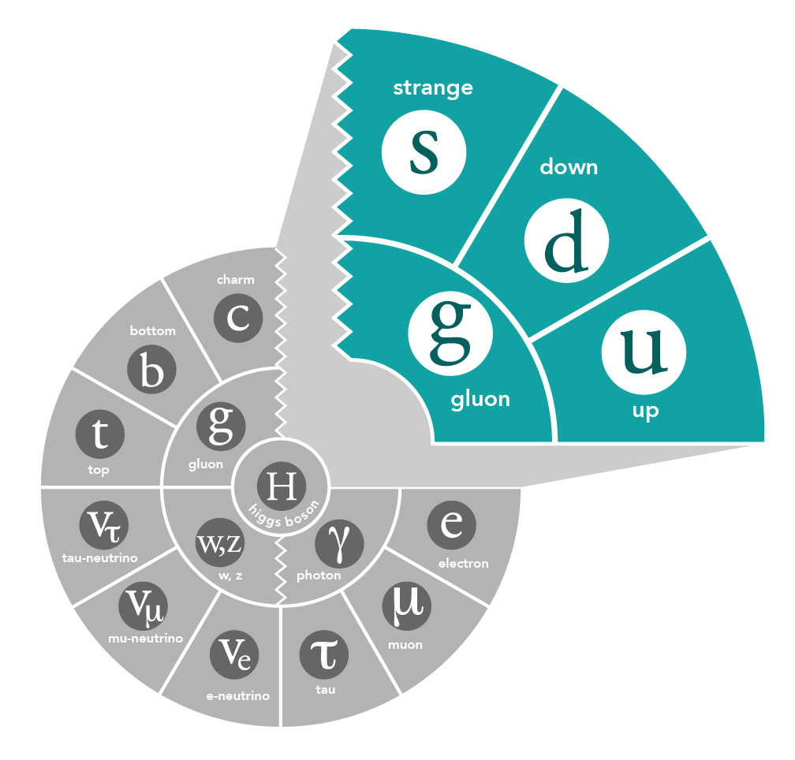
Mass of the Visible Universe
Gluon mass-squared function
The strange quark is at the boundary - both emergent-mass and Higgs-mass generation mechanisms are important.
Emergent mass of the visible universe

Slide 32
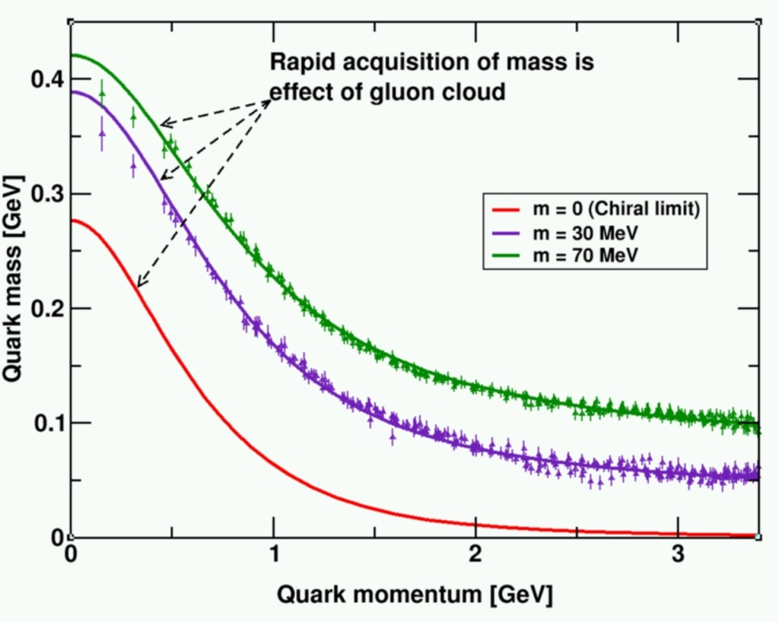
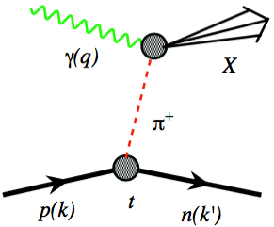
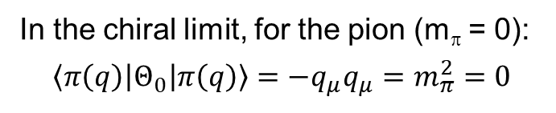
The Incomplete Hadron: Mass Puzzle
“Mass without mass!”
Bhagwat & Tandy/Roberts et al
Proton: Mass ~ 940 MeV
  constituents acquire mass by DχSB,
  most of mass generated by dynamics
Kaon: Mass ~ 490 MeV
  boundary between emergent-mass and Higgs-mass generation mechanisms
Pion: Mass ~ 140 MeV
  exists only if mass is dynamically generated
EIC’s expected contribution in:
In the chiral limit, for the pion (m_{π} = 0):
$$\left\langle π\left(q\right)\left|Θ_{0}\right|π\left(q\right)\right\rangle =−q_{μ}q_{μ}=m_{π}^{2}=0$$
Quark-gluon energy:
quark-gluon momentum fractions
Sometimes interpreted as that in the chiral limit the gluons disappear and thus contribute nothing to the pion mass: is the pion empty or full of gluons?
On the other hand, from phenomenological view, at a given scale, there is far less glue in the kaon than in the pion. All measurable at EIC.
For π and K with Sullivan process

Slide 33
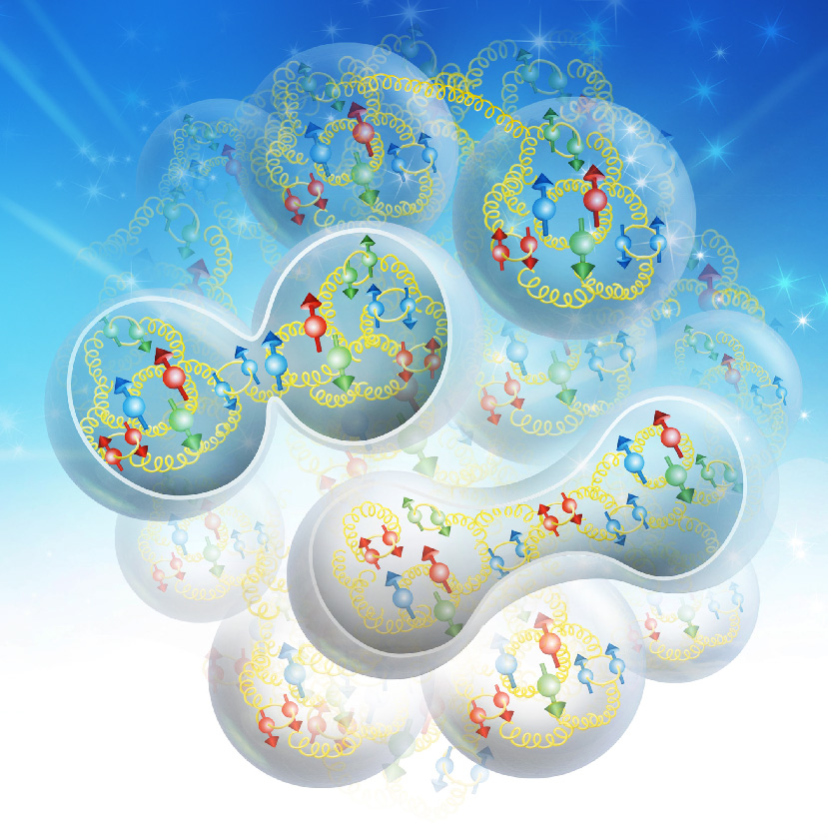
EIC – Versatility is Key
EIC: A Versatile Collider with a Hermetic Detector
How do color-charged quarks and gluons, and colorless jets, interact with a nuclear medium?
How do the confined hadronic states emerge from these quarks and gluons?
How do the quark-gluon interactions create nuclear binding?

Slide 34
EIC – Versatility and Luminosity is Key
Why would pion and kaon structure functions, and even measurements of pion structure beyond (pion GPDs and TMDs) be feasible at an EIC?
L_{EIC} = 10³⁴ = 1000 x L_{HERA}
Detection fraction @ EIC in general much higher than at HERA
Fraction of proton wave function related to pion Sullivan process is roughly 10⁻³ for a small –t bin (0.02).
Hence, pion data @ EIC should be comparable or better than the proton data @ HERA, or the 3D nucleon structure data @ COMPASS
If we can convince ourselves we can map pion (kaon) structure for –t < 0.6 (0.9) GeV², we gain at least a decade as compared to HERA/COMPASS.
Ratio of the F₂ structure function related to the pion Sullivan process as compared to the proton F₂ structure function in the low-t vicinity of the pion pole, as a function of Bjorken-x (for JLab kinematics)

Slide 35
Emergence of hadrons from partons
Nucleus as a Femtometer sized filter
Unprecedented ν, the virtual photon energy range @ EIC : precision & control
Energy loss by light vs. heavy quarks:
Control of ν by selecting kinematics;
Control the medium by selecting ions
Colored quark emerges as color neutral hadron ➔ What is nature telling us about confinement?
Identify π vs. D^{0 (charm)} mesons in e-A collisions: Understand energy loss of light vs. heavy quarks traversing nuclear matter
Need the collider energy of EIC and its control on parton kinematics

Slide 36
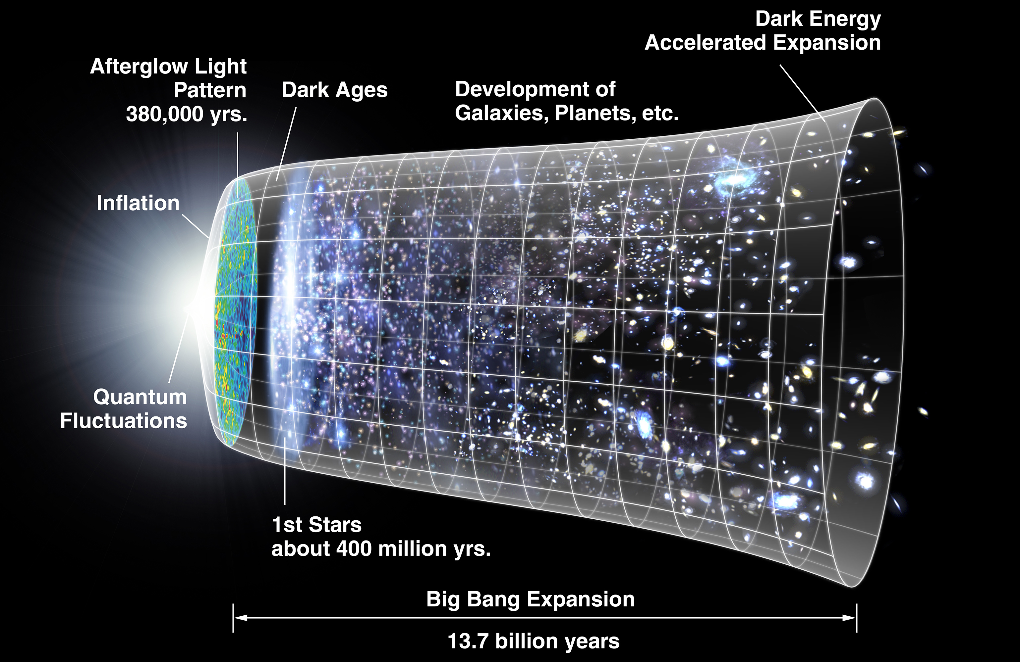
Timeline of the Universe
In Steven Weinberg’s seminal treaty on The First Three Minutes, a modern view of the origin of the universe, he conveniently starts with a ‘first frame” when the cosmic temperature has already cooled to 100,000 million degrees Kelvin, carefully chosen to be below the threshold temperature for all hadrons. Two reasons underlie this choice, the first that the quark-gluon description of hadrons was not universally accepted yet at that time, the second that the choice evades questions on the emergence of hadrons from quarks and gluons.

Slide 37

Lessons from the 70s to Now
The emergence of hadrons – mass from massless gluons and nearly-massless quarks
Basis on Parton Model Intuition:
Localization in space-time & momentum
Lorentz contraction, time dilation, causality
Sharp separation of scales (…)
Ideas about string-like hadronization
Issues: no direct connection with field theory
Sharp separation of scales?
Final state evolution in space-time??
1977
Space-time view of parton model idea of hadronization (in γ*p CM frame)
History/timeline
Late 60s/early 70s: Parton Model
QCD ~ 1974
Factorization ~ 1980
~2008 Transverse spin physics provokes new definition of pdfs (TMDs) - Back to need for separation of scales

Slide 38
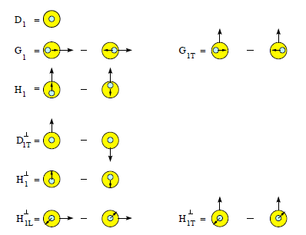
Twist-2 3D Fragmentation Functions
D_{a}^{h}(z, p_{t}²; Q²)
Unpolarized
Spin-spin correlations
Polarizing FF
Polarizing FF
Spin-momentum correlations
Collins
Collins

Slide 39
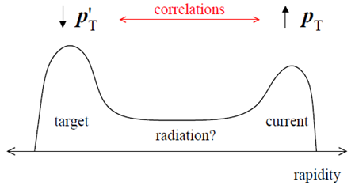
Towards a QM Description of the Final State
Balancing the transverse momentum – candles of space-time
Baryon formation more sensitive to di-quark correlations?
D_{a}^{h}(z, p_{t}²; Q²)
From 1D to 3D fragmentation:
Many more variables,
  Many more angles
Multi-dimensional data
Fine binnings
Understanding of the 3D structure of fragmentation into a hadron requires studies of transverse momentum, spin and hadron species dependence
First step is always unpolarized cross sections → JLab/12 GeV (but limited in kinematics)

Slide 40
Towards a QM Description of the Final State – cont.
    The Collins Function – candle of DχSB
Recall the origin of the Collins function as motivated by forward π spin asymmetry.
Requirements for non-zero effect:
Interference – helicity must be heavily broken. Can’t be by small current quark mass as ~ m_{q}/Q. Chiral symmetry breaking (in dynamical situation) can do it.
Transverse momentum correlations.
(in transverse
basis)
δq(x) ~
-

Slide 41

Exotic Glue in Nuclei
Exotic Glue in Nuclei =
gluons not associated with individual nucleons in nucleus
operator in nucleon = 0 & operator in nuclei ≠ 0
Targets with J ≥ 1 have leading twist gluon contribution
Δ(x,Q²): double helicity flip (Jaffe and Manohar, 1989)
Changes both photon and target helicity by two units…
Measurable in unpolarized Deep Inelastic Scattering with a transversely polarized J ≥ 1 target like the deuteron as azimuthal variation.
Parton model interpretation:
Δ(x,Q²) informs how much more momentum of a transversely polarized particle is carried by a gluon with spin aligned rather than perpendicular to it in the transverse plane.
Shanahan, Detmold, et al.
LQCD calculation: gluon transversity distribution in the deuteron, m_{π} = 800 MeV → First evidence for non-nucleonic gluon contributions to nuclear structure

Slide 42

EIC – World’s First eA Collider
gluon
emission
gluon recombination
?=?
The Nucleus:
A laboratory for QCD
How does a dense nuclear environment affect the quarks and gluons, their correlations, and their interactions?
What happens to the gluon density in nuclei? Does it saturate at high energy, giving rise to a gluonic matter with universal properties in all nuclei, even the proton?

Slide 43
Nuclear Parton Distributions
What do we know of gluons in nuclei? Essentially nothing!
Ratio of Parton Distribution Functions of Pb over Proton:
Without EIC, large uncertainties in nuclear (light) sea quarks and gluons
An EIC with projected F_{L} and F_{L}^{CC} will significantly reduce uncertainties
Impossible for current and future pA data at RHIC & LHC data to achieve
From: Salvatore Fazio talk at INT 2017-3 program, also arXiv:1709.00076
Similar findings for impact of charm at large x by Weiss et al, arXiv:1610.08536

Slide 44




Exposing different layers of the nuclear landscape with electron scattering
History:
Electromagnetic
Elastic electron-nucleus scattering → charge distribution of nuclei
Present/Near-future:
Electroweak
Parity-violating elastic electron-nucleus scattering (or hadronic reactions e.g. at FRIB) → neutron skin
Future:
Color dipole
φ Production in coherent electron-nucleus scattering → gluon spatial distribution of nuclei
Fourier transform gives unprecedented info on gluon spatial distribution, including impact of gluon saturation

Slide 45


GLUON SATURATION – WHAT TO MEASURE?
Many ways to get to gluon distribution in nuclei, but diffraction most sensitive:
Diffractive event
No activity in proton direction
A 7 TeV equivalent electron bombarding the proton … but nothing happens to the proton in 10-15% of cases
Predictions for eA for such hard diffractive events range up to: 25-30%... given saturation models
(EIC: utilize g ~ A^{1/3} x s^{0.3} to hunt for c.q. map onset of saturation)

Slide 46


New Avenues
Nature, 557, May 17, 2018
Pressure in the Proton
  First determination using DVCS (Deeply Virtual Compton Scattering) data
  Interior pressure in proton is > pressure inside a neutron star! Who knew that!
  Lattice calculation motivates determination of gluon GPDs at EIC
Polarized Deuteron Structure
  Inclusive Deep Inelastic Scattering on a Tensor-Polarized Deuteron Beam
  Map the Structure Function b1
  Are quarks sensitive to the doughnut or dumbbell shape of the nucleus?
Hot Spots in the Nucleus
  Simulated proton density fluctuations x = 10⁻³
  Accessible with 3D tomography
  Responsible for ridge behavior found in Heavy-Ion reactions at high energies?
-

Slide 47
Recent status – DOE/NP UPDATE and upcoming EICUG Activities

Slide 48
The Technical Foundations for EIC: Accelerator R&D
  The EIC will be one of the most complex and sophisticated collider accelerators ever built. The machine requirements push the state-of-the-art on many fronts including the high degree of beam polarization, high luminosity, beam cooling, beam dynamics, crab cavities for both beams, and an interaction region with complex magnets. EIC will be unique facility in the world and will maintain leadership in accelerator science and technology of colliders.
    NP Community Panel Review: Panel review charged with identifying high priority accelerator R&D aimed at technical risk reduction. Dr. Kevin Jones of SNS chaired this international panel. Panel Report published February 2017 (https://science.energy.gov/np/community-resources/reports/ )
    Bi-Annual FOA : Competitive accelerator R&D based on priorities established in EIC panel report. Funding level: ~$9-11 M per year for FY18 and FY19.
    Strong collaborations formed at the labs and with universities to advance different EIC concepts with collaborative common R&D effort.
T. Hallman – DOE Nuclear Physics
EICUG meeting, July 2019

Slide 49
Current Status and Path forward of EIC
The “wickets” are substantially aligned for a major step forward on the EIC
A Mission Need Statement for an EIC has been approved by DOE
An Independent Cost Review (ICR) Exercise mandated by DOE rules for projects of the projected scope of the EIC is very far along
DOE is moving forward with a request for CD-0 (approve Mission Need)
DOE has organized a panel to assess options for siting and consideration of “best value” between the two proposed concepts
The Deputy Secretary is the Acquisition Executive for this level of DOE Investment
The FY 2020 President’s Request includes $ 1.5 million OPC. The FY 2020 House Mark includes $ 10 million OPC and $ 1 million TEC.
T. Hallman – DOE Nuclear Physics
EICUG meeting, July 2019

Slide 50
The International Foundation for EIC: Meeting at IUPAP
DOE encourages international cooperation in EIC activities, including nuclear and accelerator sciences, detector and accelerator R&D, computing, engineering and construction efforts.
DOE-led EIC meeting with international funding agency and government representatives during the 5th IUPAP nuclear science symposium has been scheduled on August 3 at the University of Notre Dame London.
Attending are representatives of Australia, Brazil, Canada, France, Germany, Japan, Korea, India, Italy, Russia, UK and South-Africa.
Invitations are also being sent to CERN, Poland, Sweden, Romania
T. Hallman – DOE Nuclear Physics
EICUG meeting, July 2019

Slide 51
Activity Name |  | 2014 | 2015 | 2016 | 2017 | 2018 | 2019 | 2020 | 2021 | 2022 | 2023 | 2024 | 2025 | 2026 | 2027 | 2028
 | NSAC Long Range Plan
 | NAS Study
 | CD0 – assumed
 | CD1 (Down-select)
 | CD2/CD3
 | NSAC LRP – assumed
 | EIC construction
 | EIC physics case
 | EICUG formation
 | EICUG meetings
 | Expression of Interest
 | Physics/Detector book I
 | Call for Detectors/ Collaboration Formation
 | Design of Detectors
 | Down-select to Two Full-Size Detectors
 | Detector/IR TDRs, Detector/IR Construction
DOE Driven
2030
User Group Driven
2030
CD0 = DOE “Mission Need” statement; CD1 = design choice and site selection
CD2/CD3 = establish project baseline cost and schedule

Slide 52
EIC PHYSICS and detector conceptual development

Slide 53
EIC PHYSICS and detector conceptual dev. - continued
Further information @ EICUG Quarterly (remote) Phone Meeting
October 24, 2019

Slide 54
Summary
EIC Program aim: Revolutionize the QCD understanding of nucleon and nuclear structure and associated dynamics. Explore new states of QCD.
EIC will enable us to embark on a precision study of the nucleon and the nucleus at the scale of sea quarks and gluons, over all of the kinematic range that are relevant. JLab12 will have set the foundation at the scale of valence quarks!
What we learn at JLab12 and later EIC, together with advances enabled by experiments elsewhere, QCD phenomenology and LQCD studies, may open the door to a transformation of Nuclear Science, and Hadron Structure in particular.
Outstanding questions raised both by the science at RHIC/LHC and at HERMES/COMPASS/Jefferson Lab, have naturally led to the science and design parameters of the EIC
There exists world wide interest in collaborating on the EIC
Accelerator scientists at RHIC and JLab, in collaboration with many outside interested accelerator groups, can provide the intellectual and technical leadership to realize the EIC, a frontier accelerator facility.
The future of QCD-based nuclear science demands an Electron Ion Collider (and the wind seems in our sails!)

Slide 56



NAS Report on EIC Requirements
Note: consistent with 2013 white paper and 2015 NSAC Long Range Plan

Slide 57
Determining large-x Parton Distributions with EIC
Procedure: use projected EIC data in CTEQ-Jefferson Lab “CJ” PDF Fits
So far, have used JLEIC 10x100 GeV² projections in bins 0.1 < x < 0.9 for:
F₂^{p}
F₂^{n} from deuterium with tagged proton spectator
F₂^{d}
Measurements ranging to high (up to a few 1000 GeV2) will enable studies of target mass, higher twist, pert/nonpert. studies)
Can check on-shell extrapolation by measuring F₂^{p} from deuterium with tagged neutron spectator, comparing to proton target data
Can check nuclear corrections to F₂^{d} against F₂^{n (tagged)}
A. Accardi (Hampton),
R. Ent, J. Furletova,
C. Keppel, K. Park,
R. Yoshida (JLab),
M. Wing (UC London)

Slide 58
Improved d(x) precision oF EIC is good news
The d-quark goes from a few 10% to ~few% percent level
Resolve long-standing mystery of d/u at large x, bell-weather for fundamental models of nucleon structure
D/(p+n) in one experiment for the first time – unprecedented handle on nuclear medium modifications
Facilitate accurate neutron excess/isoscalar corrections
  Important also for neutrino physics and nuclear PDFs

Slide 59
New Emphasis on studies with pdfsense

Slide 60
New Emphasis on studies with pdfsense

Slide 61



New Paradigm for Nucleon Structure
5D
TMDs
– Confined motion in a nucleon
(semi-inclusive DIS)
GPDs
– Spatial imaging
(exclusive DIS)
Requires
− High luminosity
− Polarized beams and targets
− Sophisticated detector systems
3D
Major new capability with JLab12

Slide 62

TMDs and 3D FFs
D_{a}^{h}(z, p_{t}²; Q²)
Pretzelosity

