Slide 1

The Three Dimentional Structure of the Nucleon: interplay between experiment and theory
From the point of view of an experimentalist…
Patrizia Rossi

Slide 2
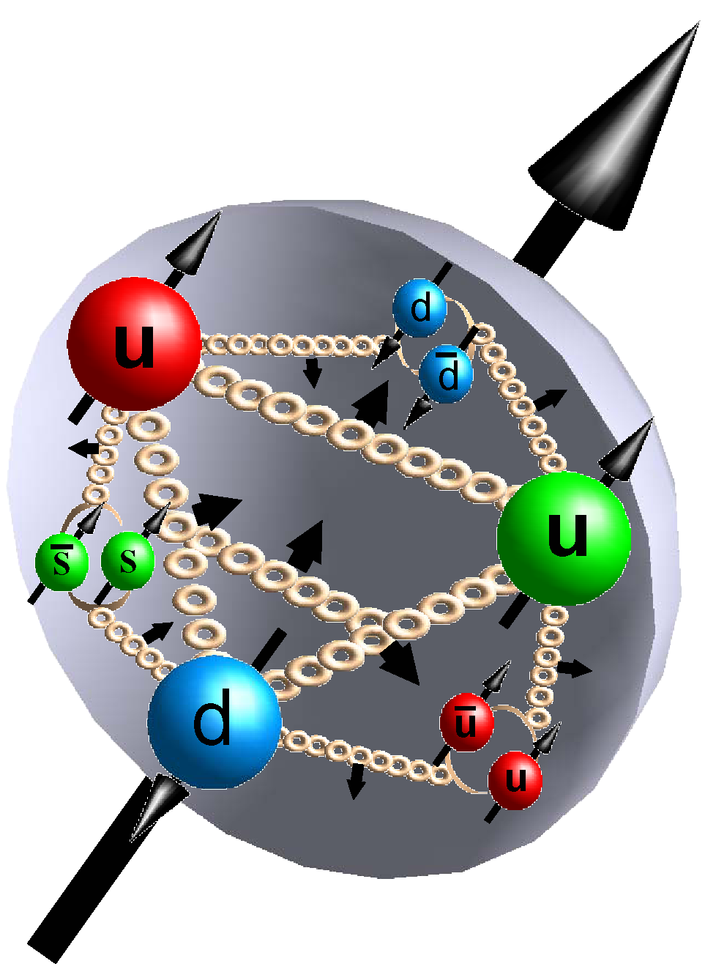
Introduction
QCD is seemingly simple, and its consequences are straightforward in the domain of hard scattering where perturbation theory applies. However, the beauty of the hadron world is its diversity. The existence of hadrons, their properties, and their binding into nuclei do not appear in the Lagrangian of QCD. They all emerge as a result of its strong coupling. Strong coupling QCD creates complex phenomena, much richer than known 40 years ago: a richness that ensures
colour confinement and accounts for more than 95% of the mass of the visible Universe. How strong coupling QCD really works requires a synergy between experiment and theory.
M. Pennington JLAB-THY-16-2239

Slide 3

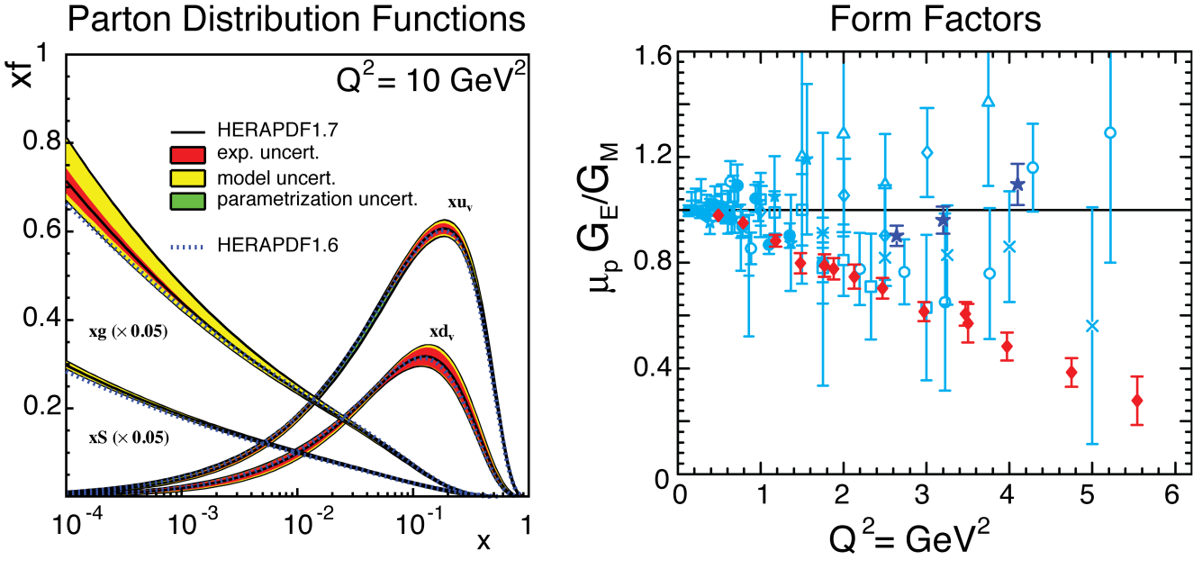
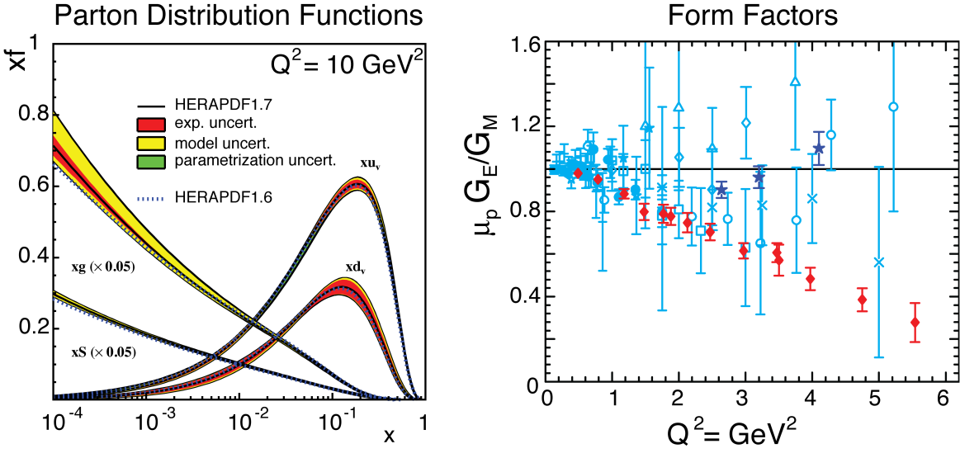
Unified View of the Nucleon Structure
Tansverse Momentum Dependent distributions
Generalized Parton
Distributions
3D
∨
∨
PDFs
f₁^{u}(x), .. h₁^{u}(x)‏
Form Factors
G_{E}(Q²), G_{M}(Q²)‏
1D

Slide 4
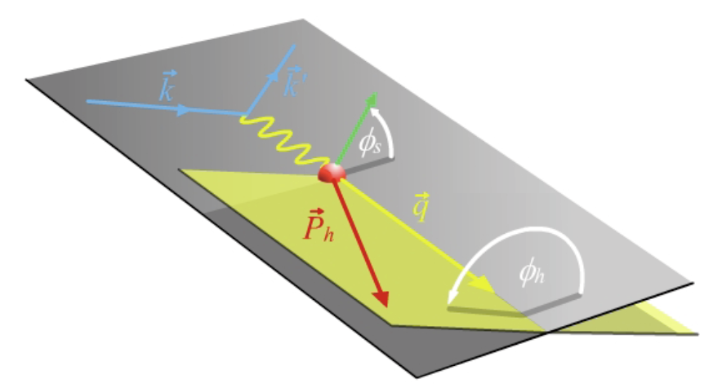
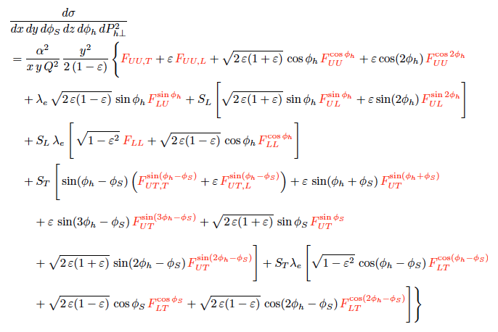
Transverse Momentum Dependent PDFs
Q²=(k-k’)² ν=E-E’ x=Q²/2Mν z=E_{h}/ν y=ν/E
target angle
Scattering Plane
hadron angle
Assuming single photon exchange, the lepton-hadron cross section can be expressed in a model-independent way by a set of structure functions
The structure functions encode the correlations between transverse momentum of quarks (k⊥) and the spin of the quark/nucleon
Observables are azimuthal dependences of single and double spin asymmetries
A. Bacchetta et al., JHEP 0702:093, 2007

Slide 5
How to gain information about TMDs?
Being non perturbative in nature, the TMDs are very difficult to be calculated in full QCD. Therefore, they have been studied in different QCD inspired models.
A variety low-energy QCD- inspired models have been employed to model the TMDs
  light-cone constituent quark models
  quark-diquark models
  bag model
  covariant parton model
  chiral quark-soliton model
  spectator model
  …….
  For a review B. Pasquini, C. Lorce’ hep-ph 1203.5006
They all have in common to oversimplify the complexity of the QCD dynamics in hadrons, but studies in different models based on different assumptions, help to unravel the non-perturbative aspects of TMDs.

Slide 6
How to gain information about TMDs?
We can gain some insight for these functions by comparison with the experimental data.
Phenomenological extractions: TMDs are extracted from the experimental data of SSAs considering the Gaussian ansatz
➔ A consistent procedure for extraction of TMDs from data with controlled systematic errors is needed.

Slide 7
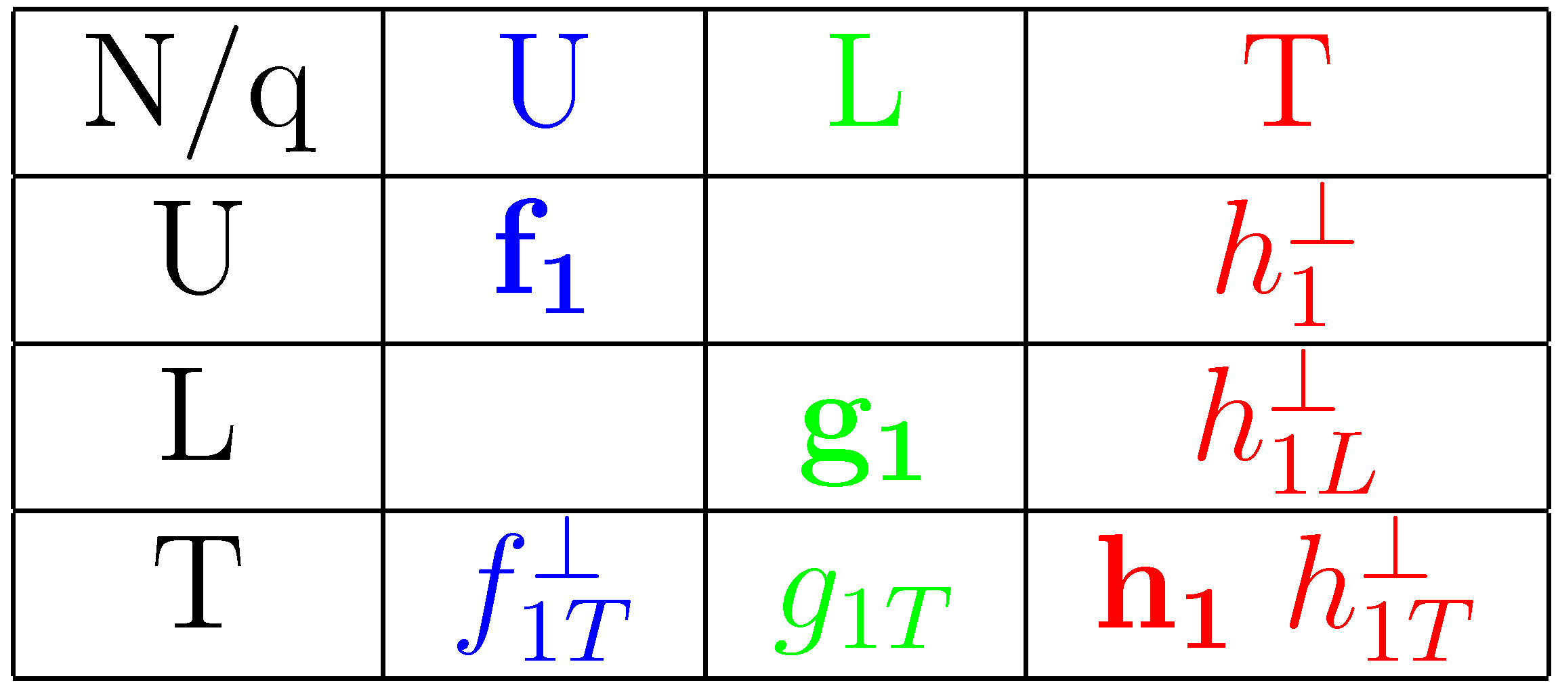
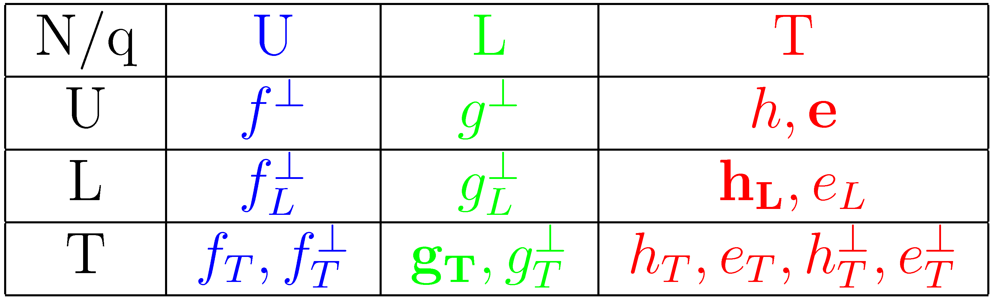
Transverse Momentum Dependent PDFs
Leading order: 8 Leading Twist TMDs, 16 Twist-3 TMDs
f (x, k⊥) Leading Twist
f (x, k⊥) Twist-3
 | D₁ | H₁⊥
D (z, p⊥)
Leading Twist: Probability denstities
Twist-3: - Provide informations on quark-gluon correlations
a key for understanding long-range quark-gluon dynamics
- They are not small in the kinematics of fixed target experiments
they should be properly accounted for a reliable TMDs extraction
Each of these observable is sensitive to specific properties of the nucleon structure, and contributes from different perspective to form a global and comprehensive view

Slide 8
Everything is mixed up

Slide 9
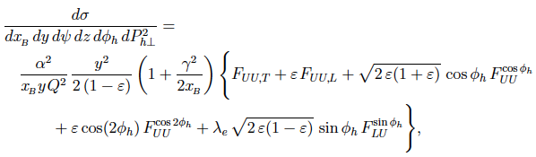
Unpolarized SIDIS
HT
HT
HT
HT
F_{UU}: φ_{h}- integrated cross section. Transverse momentum dependence of the Multiplicities provides leverage in the quest to unfold, from the transverse hadron momentum P_{hT} , the intrinsic quark k_{T} and fragmentation p_{T}
F_{UU} cos2φ_{h}: h₁⊥ describes correlation between the transverse momentum and transverse spin of quarks; H₁⊥ describe fragmentation of transversely polarized quarks into an unpolarized hadron
9

Slide 10
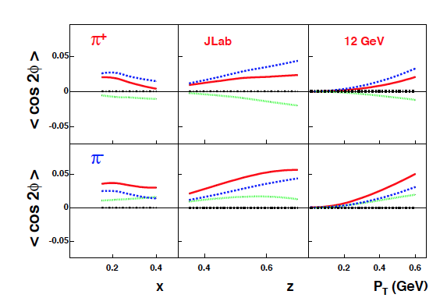
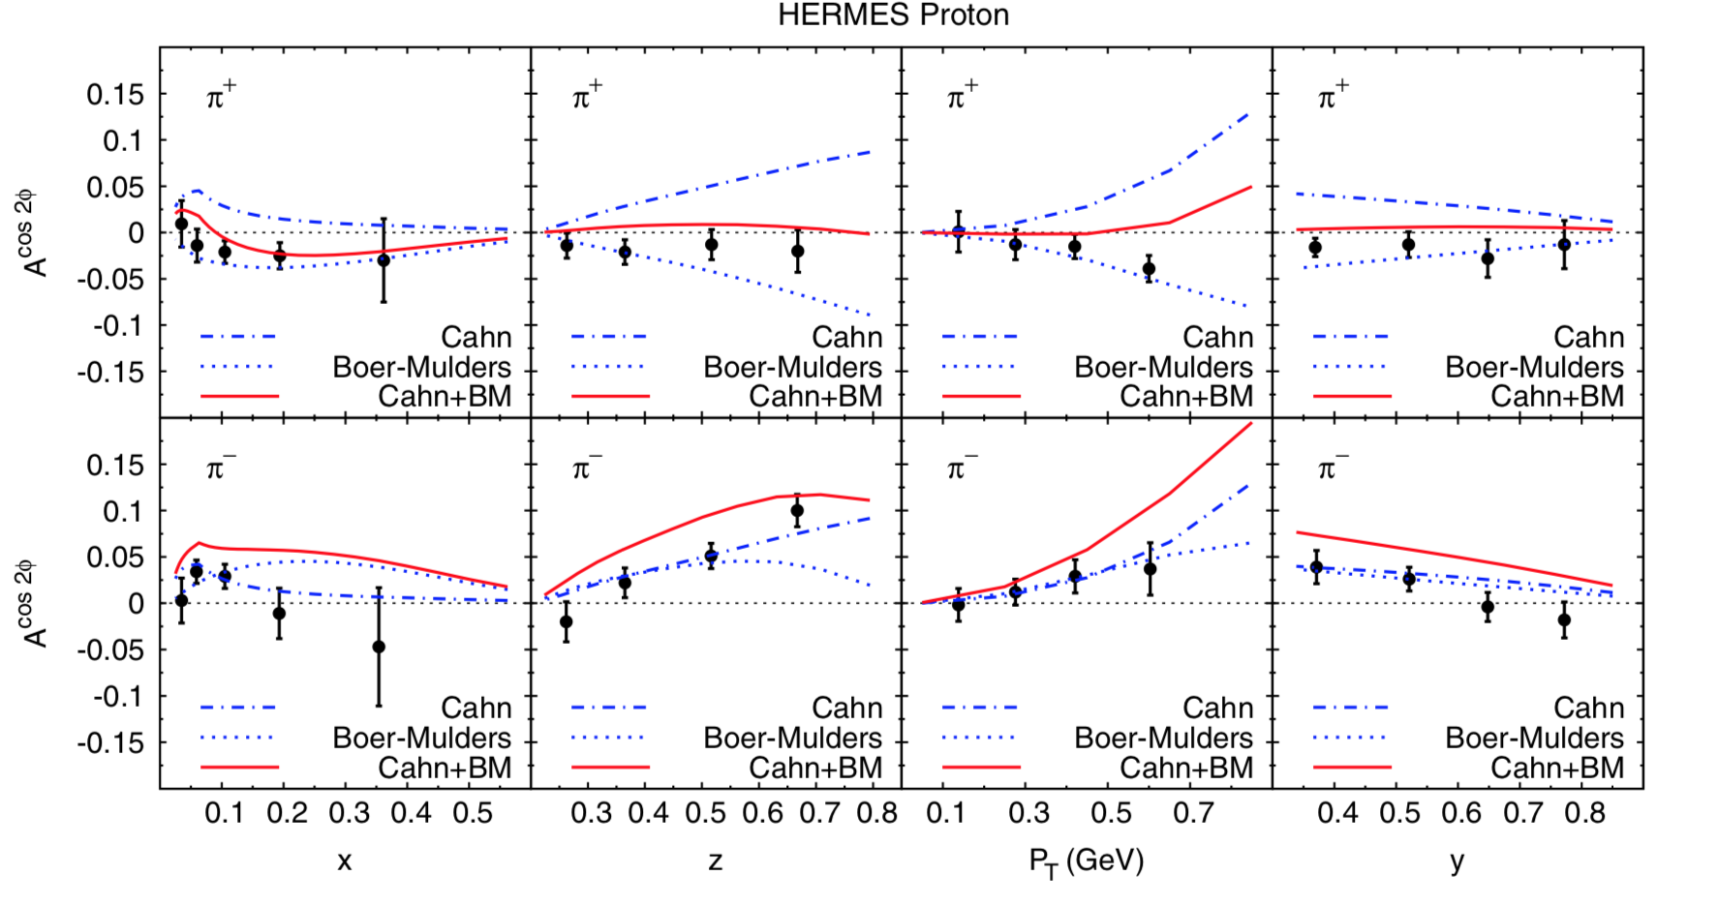
Leading Twist cos2φ
BM + h.t. Cahn + pert. gluon
Cahn Boer-Mulders O(α_{s}) QCD
Non trivial modulations from the Cahn and Boer-Mulders effects
For modest Q² cos2φ is in most cases dominated by a higher-twist effect
V. Barone et al. Phys.Rev.D78:045022 (2008)
Data consistent with the main theoretical expectations
V. Barone et al. Phys.Rev.D81:114026 (2010)

Slide 11
Small is big

Slide 12
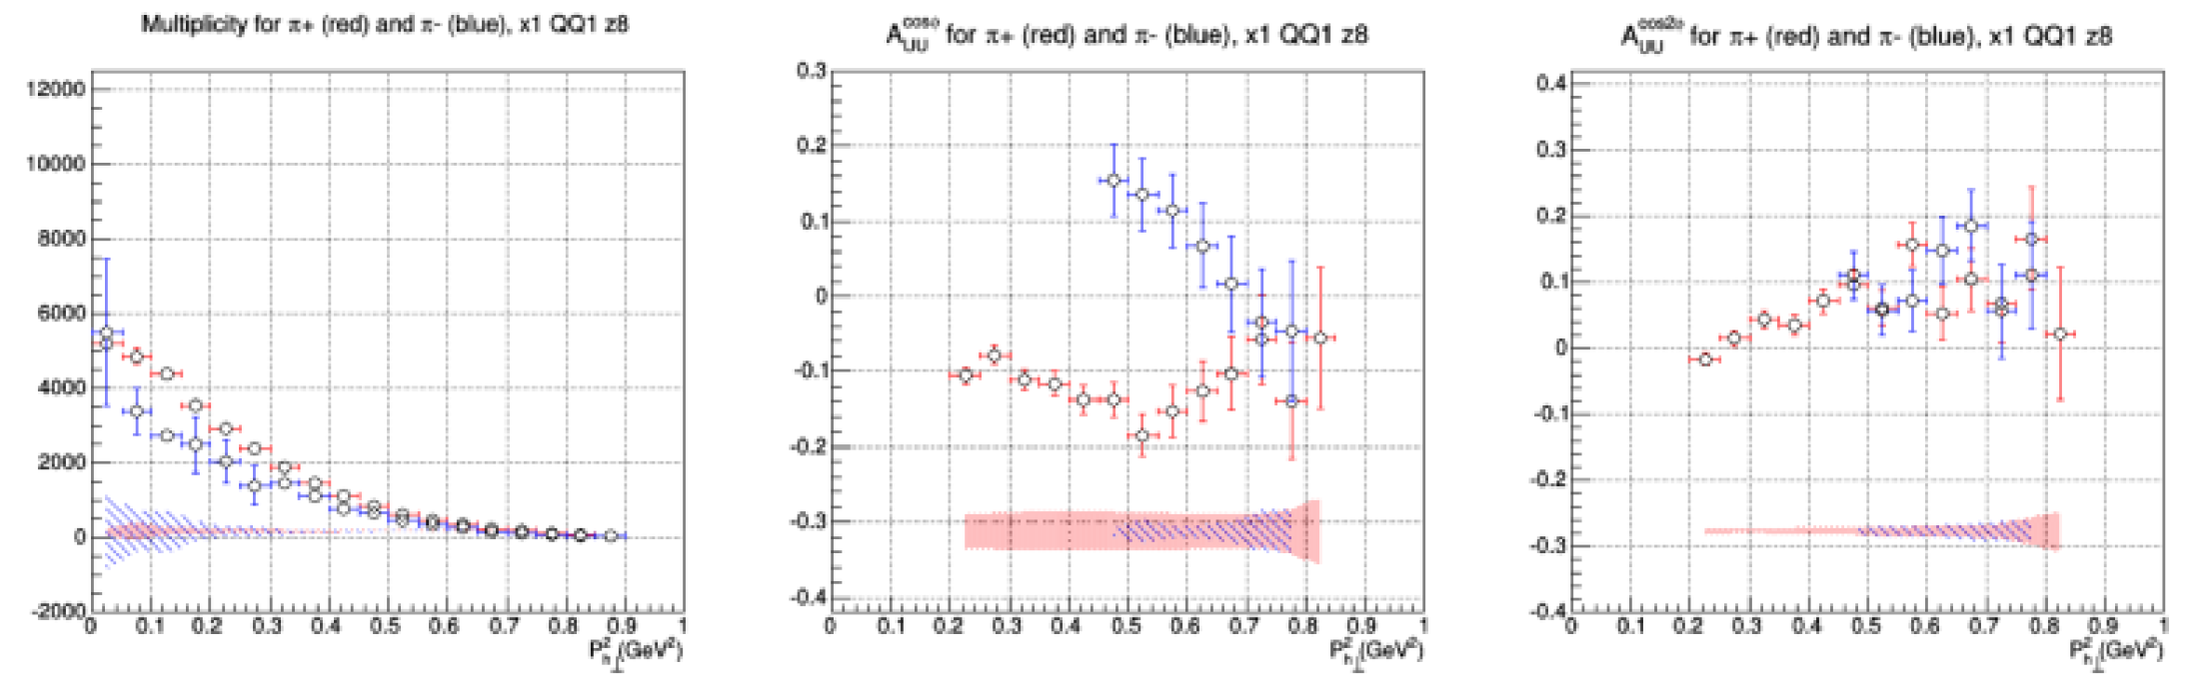
Unpolarized SIDIS from CLAS @ 6 GeV
Cahn + BM
N. Harrison
Preliminary
-
Symmetric behavior indicates large BM contribution

Slide 13

Which model fits the stage best?

Slide 14
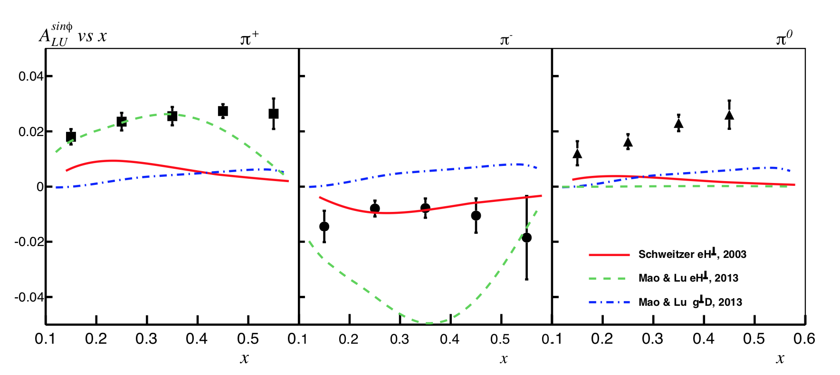
Higher Twist: F_{LU} sinφ
e_{a}(x): chiral quark-soliton model in the large-Nc limit
PRD 67, 114010 (2003)
e_{a}(x): spectator model with
scalar and axial-vector diquarks
EPJC 73, 2557 (2013)
g^{⊥a}: spectator model with
scalar and axial-vector diquarks
EPJC 73, 2557 (2013)
A_{LU} measured with CLAS @ 5.5 GeV with better than 1% stat. precision permits comparison with several reaction models
No satisfactory understanding of contribution from each function
Large difference between different models
Interpretation of HT e(x) (quark-gluon-quark correlations) as force on the quarks (Burkardt Phys.Rev. D88 (2013) 114502 )

Slide 15
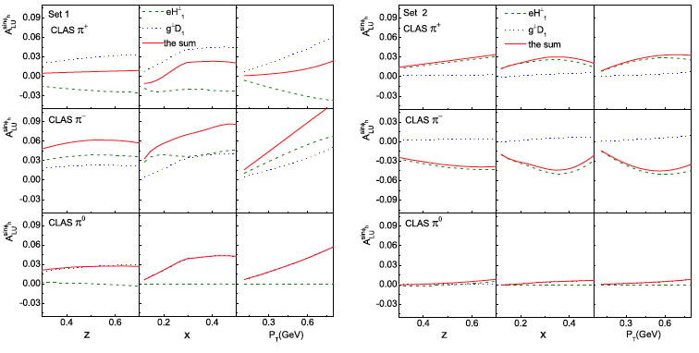
Diquark Spectator Model for e(x)
It includes the scalar and the axial-vector diquark components
W. Mao, Z. Lu EPJC 73, 2557 (2013)
Two sets of the twist-3 TMD DFs e and g ⊥ obtained using two different choices for the propagator of the axial-vector diquark, together with different relations between the quark flavors and the diquark types
Different approaches leads to quite different TMD DFs, including their flavor dependences, sizes and signs.

Slide 16
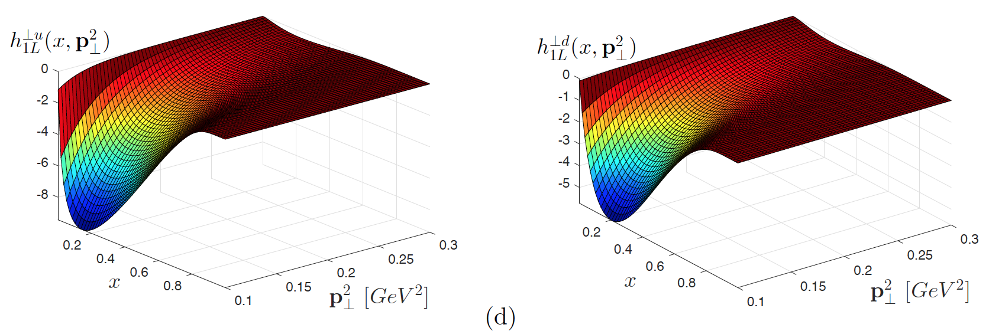
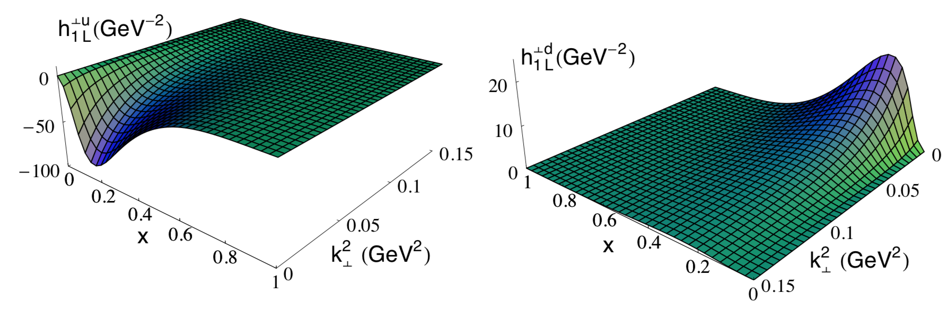
The warm-gear TMD
Transversely polarized quarks in a longitudinally polarized proton
Light-Front Quark-Diquark Model (LFQDM)
T. Maji, D.Chakrabarti, PRD94,094020(2016)
The model contains both the scalar and vector diquark with the light front wave functions modeled from the AdS/QCD prediction.
Light-Cone Constituent Quark Model (LCCQM)
B. Pasquini, S. Cazzaniga, S. Boffi, Phys.Rev.D78:034025,2008
The hadronic state is decomposed in terms of N-parton Fock states truncated to consider only valence quarks. Coefficients are the momentum light-cone wave function.
In LFQDM the distributions are negative for both u and d quarks, whereas in LCCQM is negative for u quark but positive for d quark.

Slide 17
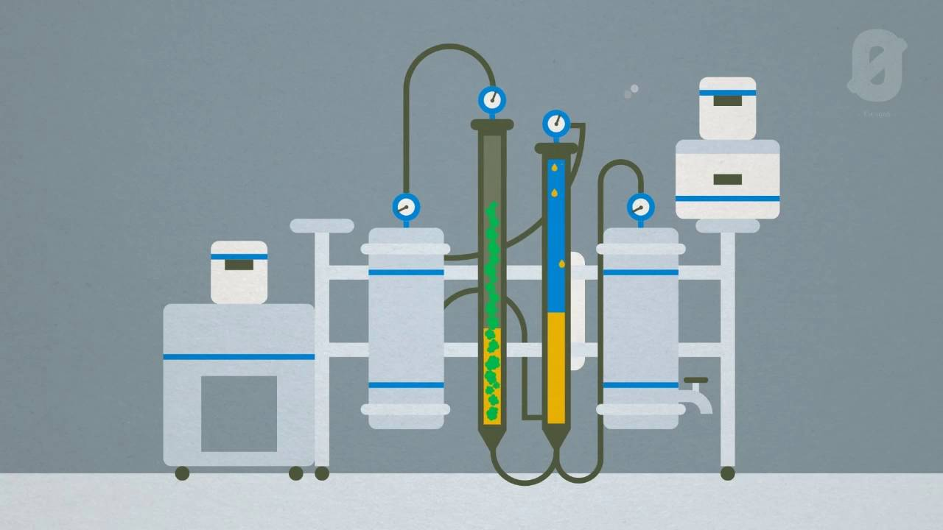
The Critical Extraction Process

Slide 18
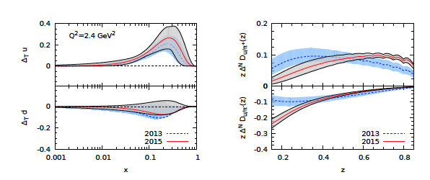
Transversity and Collins Extraction
Global analysis of SIDIS ((HERMES+COMPASS) & e⁺e⁻ data (BaBar) using a simple phenomenological model for PDFs & FFs
Transversity
Collins
Anselmino et al. Phys.Rev. D92 (2015) no.11, 114023
u, d Transversity compatible with the previous extractions
Collins quite different ( ≠parametrisation for the disfavoured Collins function)
The extraction is subject to a number of initial assumptions:. a Gaussian shape for the TMDs, a complete separation between transverse and longitudinal d.o.f., a Gaussian width of the unpolarised TMD-FFs fixed solely by SIDIS data
« […] higher statistics and higher precision multidimensional data, for asymmetries and unpolarised multiplicities, will help clarifying the picture «

Slide 19
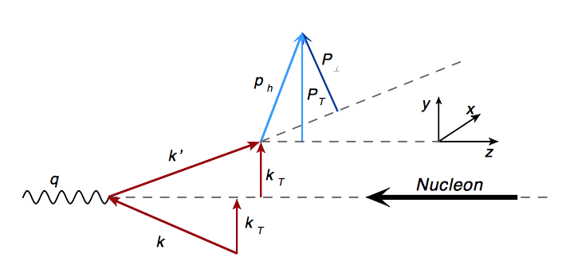
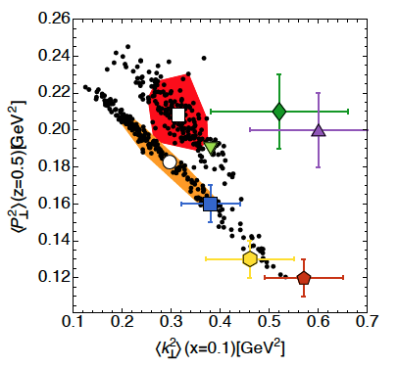
k_{T} extraction
Correlation between transverse momenta in TMD FFs and in TMD PDFs
Fit simultaneously SIDIS (HERMES, COMPASS), DY, and Z boson data
Factorized functional form with Gaussian dependence on kT
Condition on P²_{hT} : P²_{hT} / z² << Q² (for TMD factorization)
Correlation between k_{T} and P_{T} very loose !
More experimental data needed to extend the coverage in x , z , Q²
→The 12 GeV physics program at JLab will be very important to constrain TMD distributions at large x
JHEP06(2017)081
Notes:
Pavia Group results, Q² = 1 GeV²

Slide 20
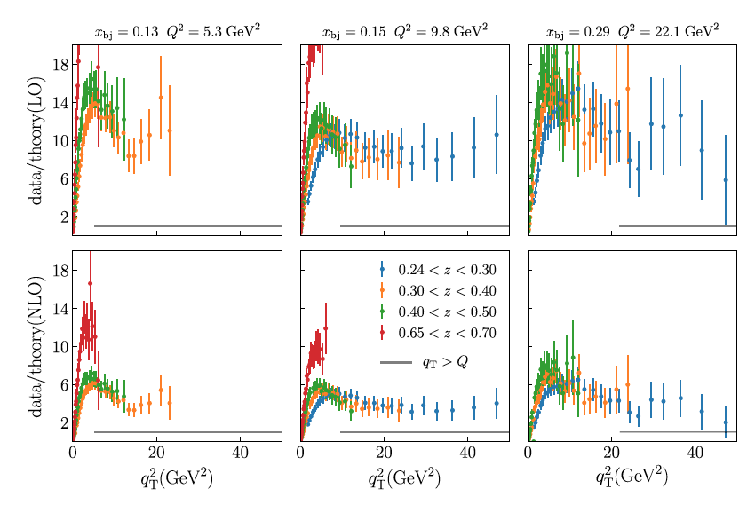
Challenges with Transverse Momentum in SIDIS
q_{T}=-P_{T}/z
In SIDIS processes there are two scales: Q and q_{T}
For q_{T}~Q : fixed order calculation with pure collinear factorization is expected to be very realible
COMPASS data
z large enough to be in the current fragmentation region
The measurements disagree with leading order and next-to-leading order calculations most significantly at the more moderate values of x close to the valence region.
Gonzalez-Hernandez et al, PRD 98, 114005 (2018)
20

Slide 21
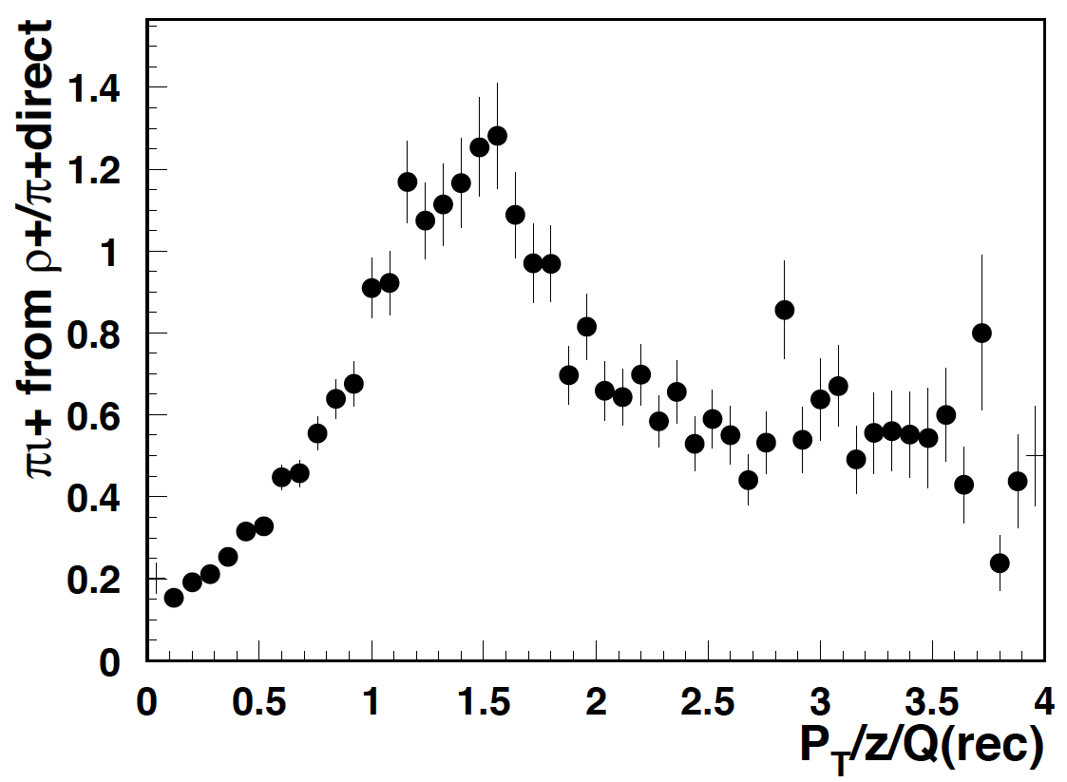
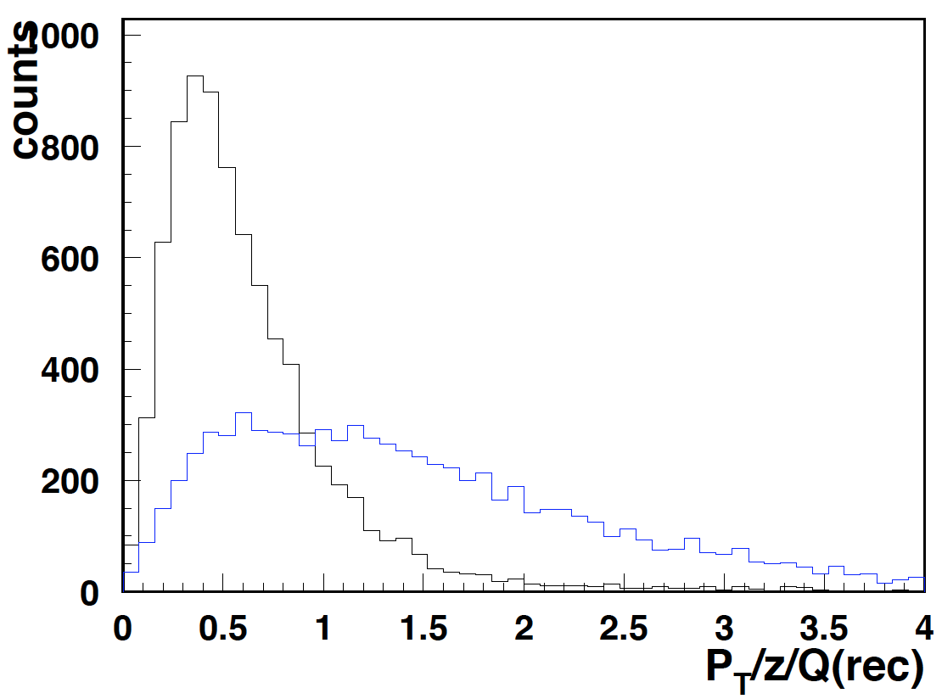
Does it matter if π comes from correlated pairs?
H. Avakian’s plots
Predictions from MCs for CLAS12 indicate very significant fraction of inclusive pions coming from correlated dihadrons.
Understanding the fraction of pions from “correlated dihadrons” will be important to make sense out of q_{T} distributions
Measure multiplicity of exclusive and semi-iclusive dihadrons π⁺π⁰, π⁺π⁻, π⁻π⁰ for proton and deuteron targets
Large acceptance detectors are needed to detect more than one hadron in the final state
q_{T} =P_{T}/ z_{ρ}
Q²>2
perturbative?
q_{T}=P_{T}/ z_{π}
21

Slide 22
Take-away message
We need very precise data (high statistics ➜ high luminosity) in a wide x and Q² range, in the P_{T} interval relevant for TMDs studies, with polarized/unpolarized targets, and detecting different hadrons in the final states (for flavour separation)
  to check against different models
  to disentangle the different TMDs contributions, leading and higher twists
➜ JLab12 and future EIC play a crucial role to study TMDs in SIDIS processes
We need an analysis framework to enable the extraction and the interpretation of the 3D PDFs, and allow testing different extraction procedures, estimating systematics related to different assumptions and models used, as well as assessing sensitivity to kinematic limitations, radiative corrections, etc..
Notes:
PAC days

Slide 23
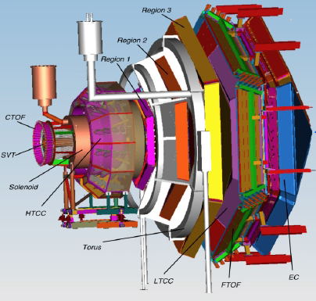
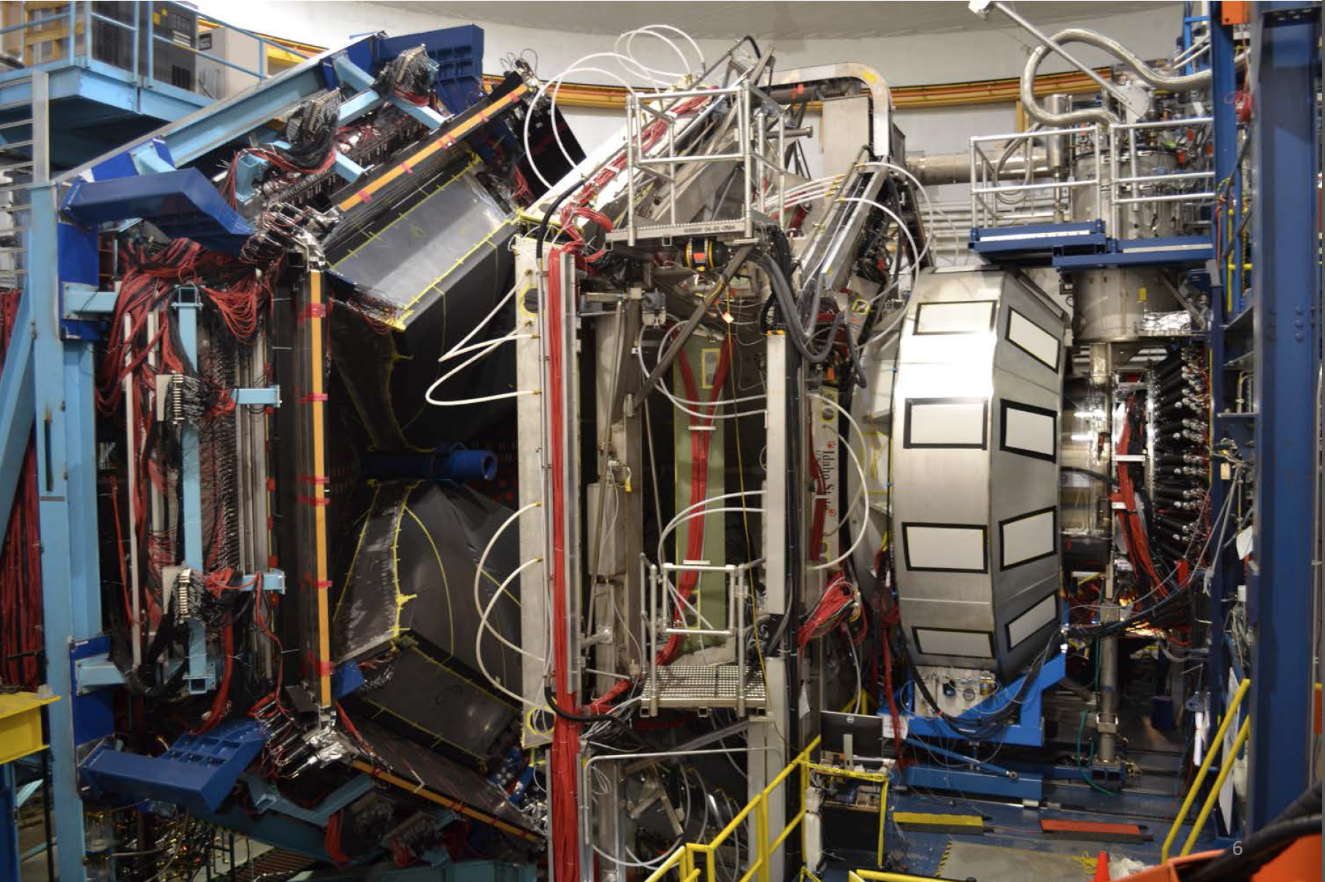
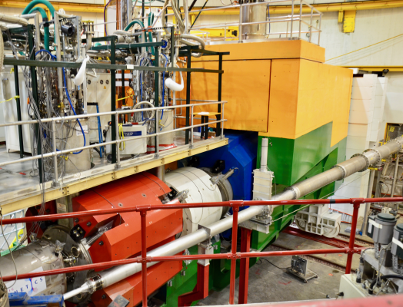
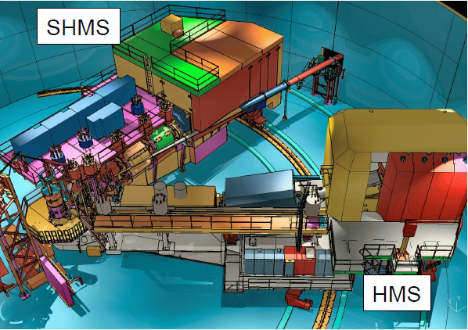
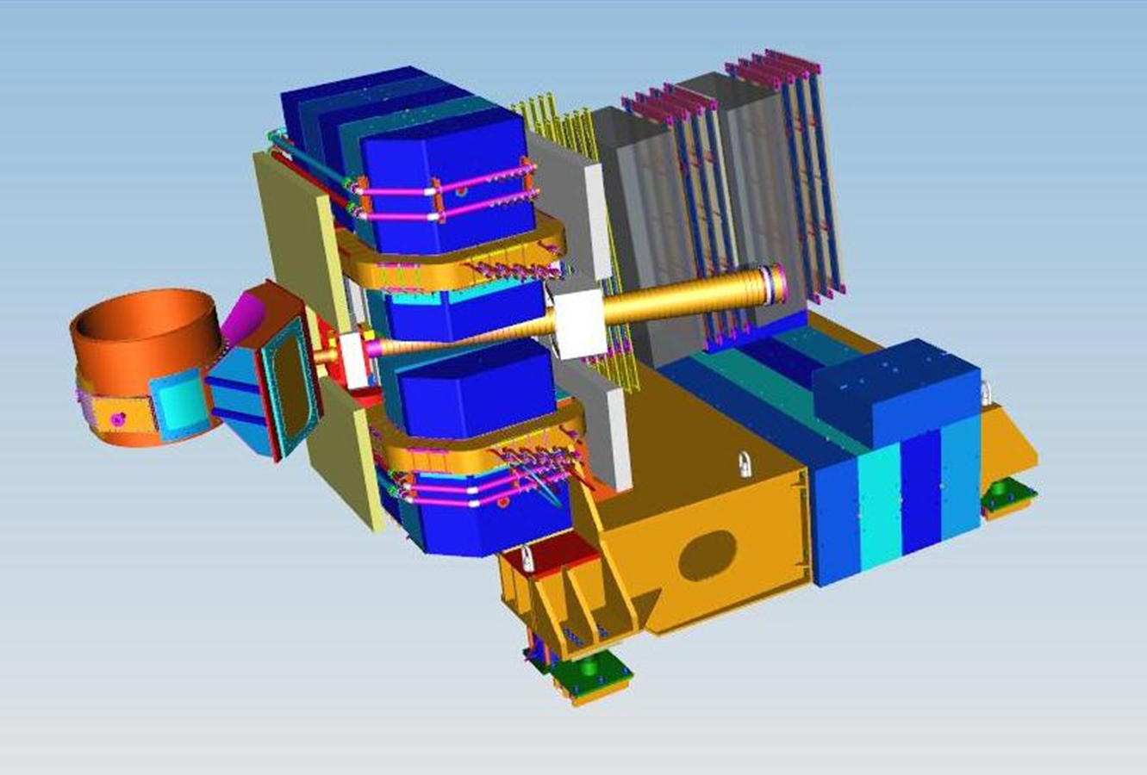
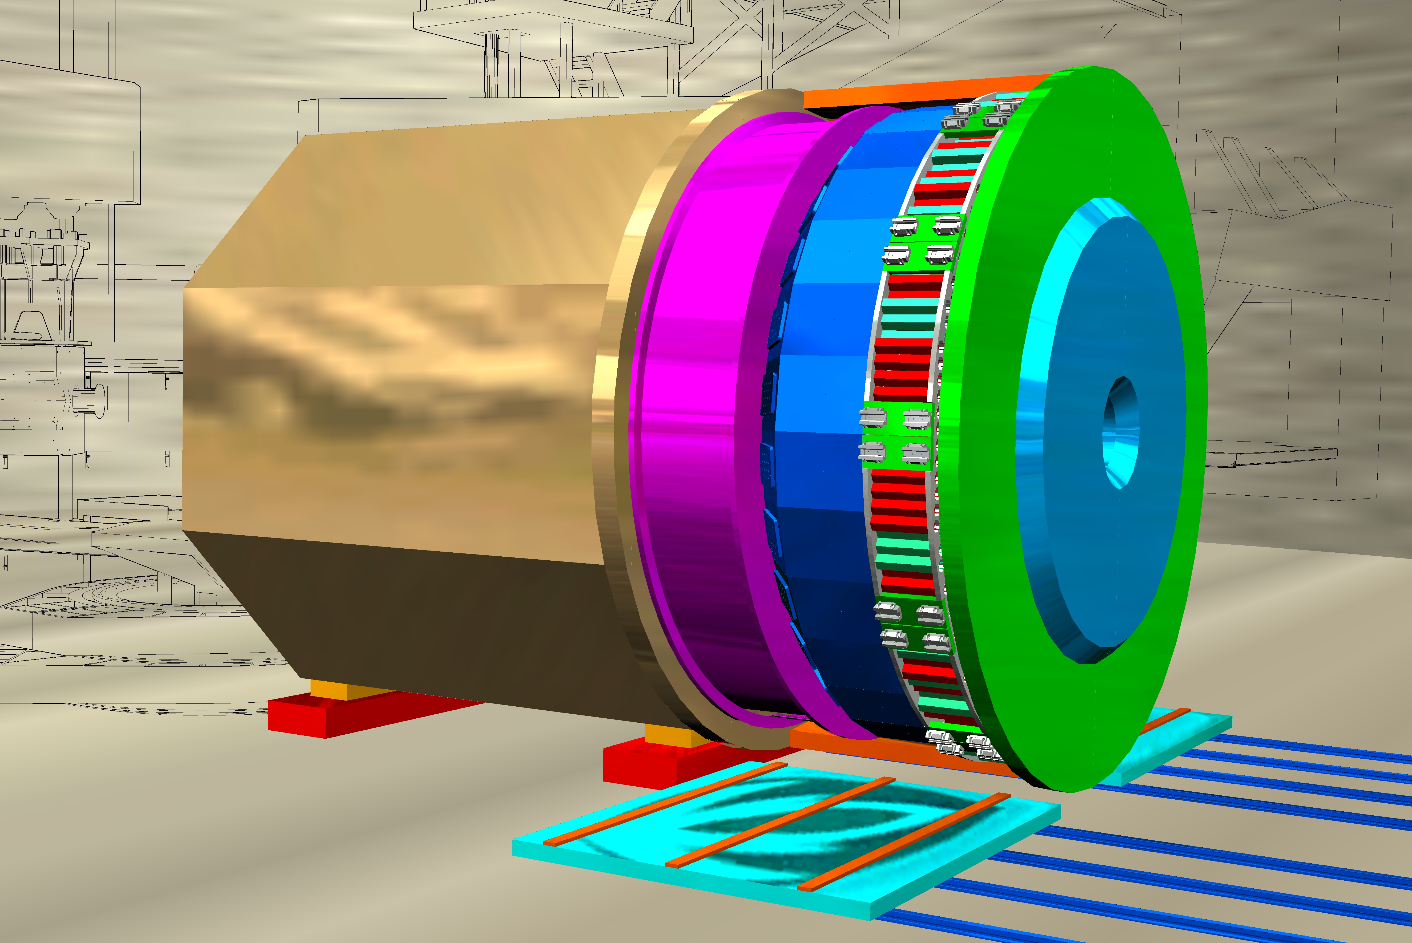
Major Capabilities with JLab @ 12 GeV
Hall B - CLAS12
Hall C – HMS & SHMS
Large acceptance spectrometer
Max Luminosity 10³⁵
Unpolarized, Longitudinally and Transversely Polarized Hydrogen & Deuterium Targets
High precision spectrometer
High Luminosity ~10³⁸
Unpolarized Hydrogen & Deuterium Targets
SBS
Apparatus under construction
Moderately large acceptance
Full PID (π and k)
SoLID
Relatively High Luminosity ~10³⁶ cm-2s-1
Quite Large Acceptance (2π)
Longitudinal & Transversely polarized ³He
Transversely polarized NH3
Hall A - SBS
Hall A - SoLID
Combination of high resolution measurements from spectrometers with large acceptance data from CLAS12 and SoLID would allow to pin down all TMDs in the valence region

Slide 24
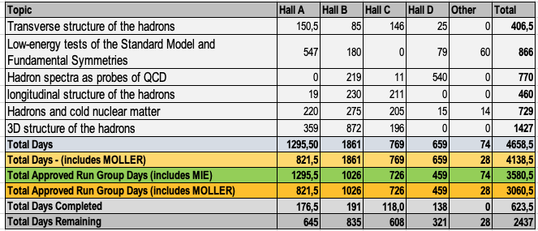
Approved Program

Slide 25
SIDIS 12 GeV Program in Hall B
Physics data taking for TMDs studies started in February 2018
Run Group A:
  10.2-10.6 GeV polarized electrons (P>80%)
  Unpolarized Liquid-hydrogen target
  ~300 mC, ~50% of approved beam time
Run Group B:
  10.2-10.5 GeV polarized electrons (P>80%)
  Unpolarized Liquid-deuterium target
  ~84 mC, ~24% of approved beam time
Plots based on 100 min. of data taking
25

Slide 26
π Beam Spin Asymmetry - A_{LU}
SSA in SIDIS sensitive to quark-gluon interaction and color forces
With <2% of expected unpolarized target data, CLAS12 already provides a measurement comparable to previous experiments
Will allow fine multidimensional binning to study the dependence on Q² and other variables
26

Slide 27
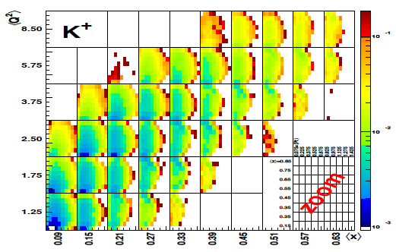
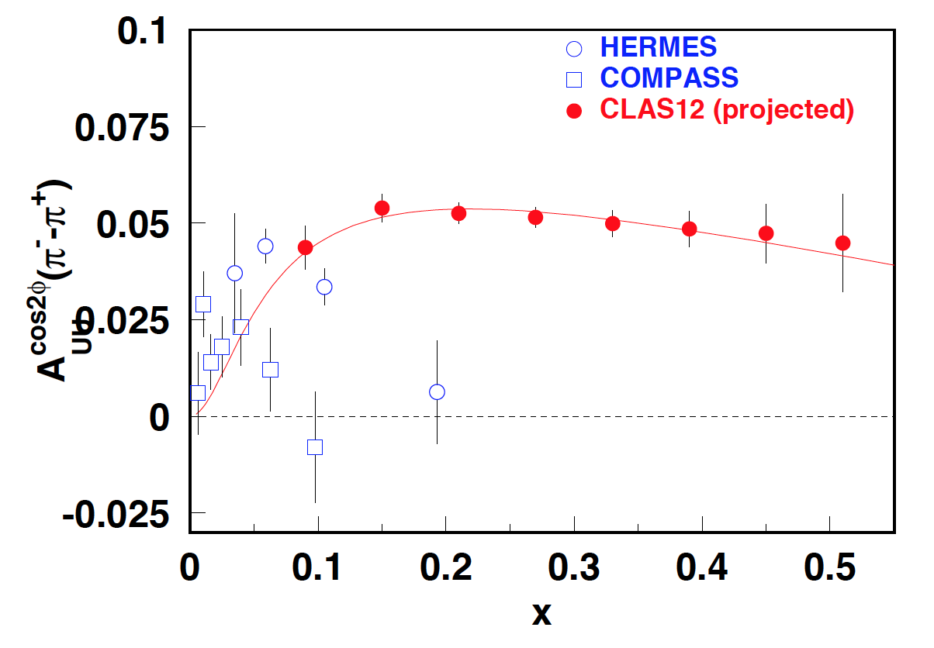

Boer-Mulders Asymmetries with CLAS12
H₂ (e,e’π)
High precision data set on π and K azimuthal asymmetries with unpol. H and D targets in the region 0.06≤ x 0.8, 0≤ PT≤1.5, 0.2≤ z ≤0.8
Competing mechanisms (Cahn) and perturbative and radiative contributions to first order are expected to be “flavor blind” → in the first approximation, those effects cancel in the difference of the asymmetries for π⁻ and π⁺
Notes:
h₁⊥ from LCCQM
[B. Pasquini, F. Yuan PRD81:114013,2010]

Slide 28
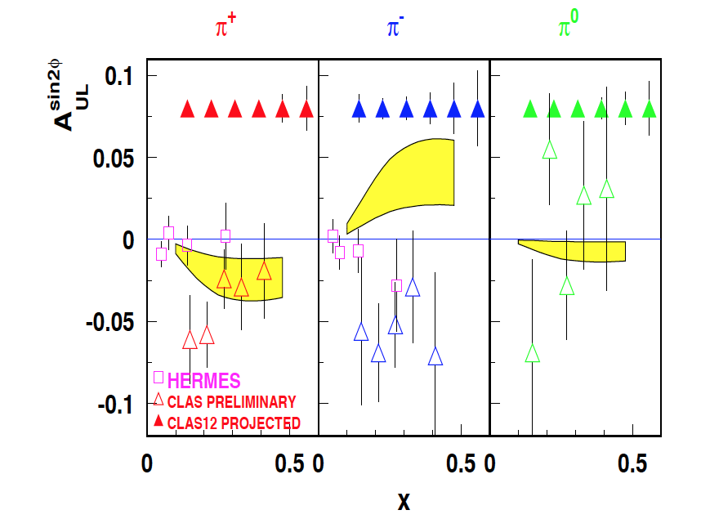
Longitudinally Polarized Target with CLAS12
SIDIS experiments with Long. Polarized Target NH₃ and ND₃ foreseen in 2021
Estimated results using for h⊥_{1L} calculated in the chiral quark-soliton model [A.V. Efremov et al, Czech. J. Phys. 55 (2005)]
The model assumes the so-called “Lorentz-invariance relations” that connect h⊥_{1L} with h₁ . This measurement will check out experimentally to which extent such relations actually hold
Data from CLAS @ 6 GeV seem to favore the Light-Front Quark-Diquark Model (LFQDM)
Notes:
PAC days

Slide 29
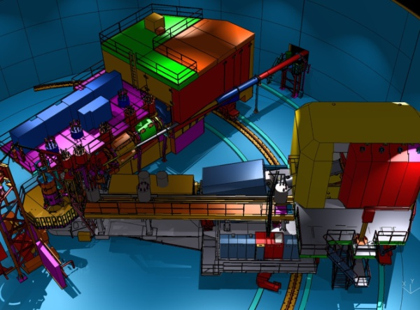
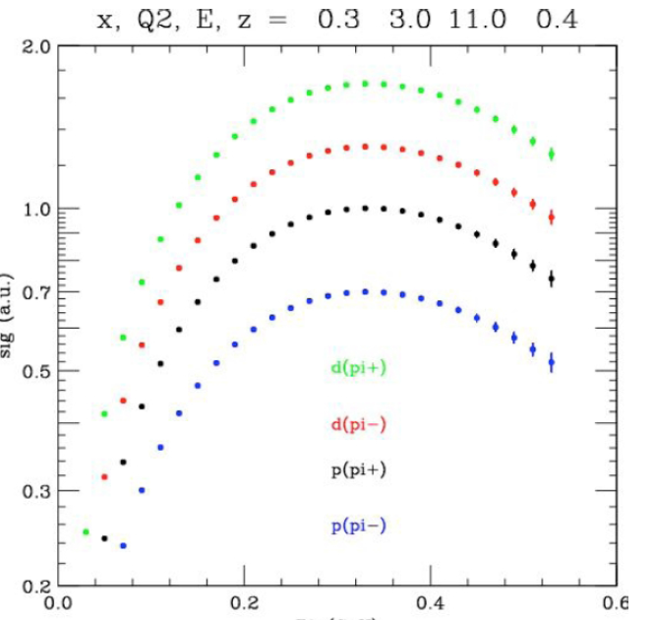
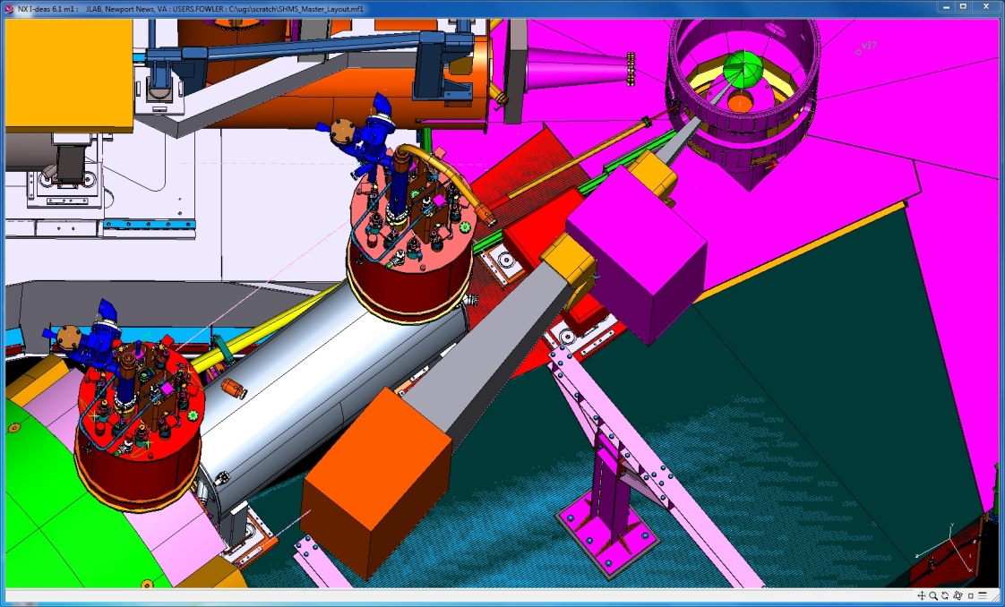
Hall C: SHMS + HMS (+ NPS)
Precision magnetic-spectrometer setup for high luminosity measurements
π^{+/-} K^{+/-} configuration
Precise measurements of absolute cross-sections (O 1%) and pT dependence π^{+/-/0} & K^{+/-} on p & d 0.2 < x < 0.5, 2 < Q² < 5 GeV², 0.3 < z < 0.5, P_{t} < 0.5 GeV
SHMS
HMS
L/T separations in SIDIS
Measurements of hadronic multiplicities provide a crucial input for studies of k_{T} dependence of unpolarized distributions
Data taking for charged hadrons started in March 2018: 100% complete
Data taking for neutral pion foreseen for 2021
NPS
Magnet
Cross Section (a.u.)
Detector
π⁰ configuration
P_{t} (GeV)
29
29
Notes:
PAC days

Slide 30
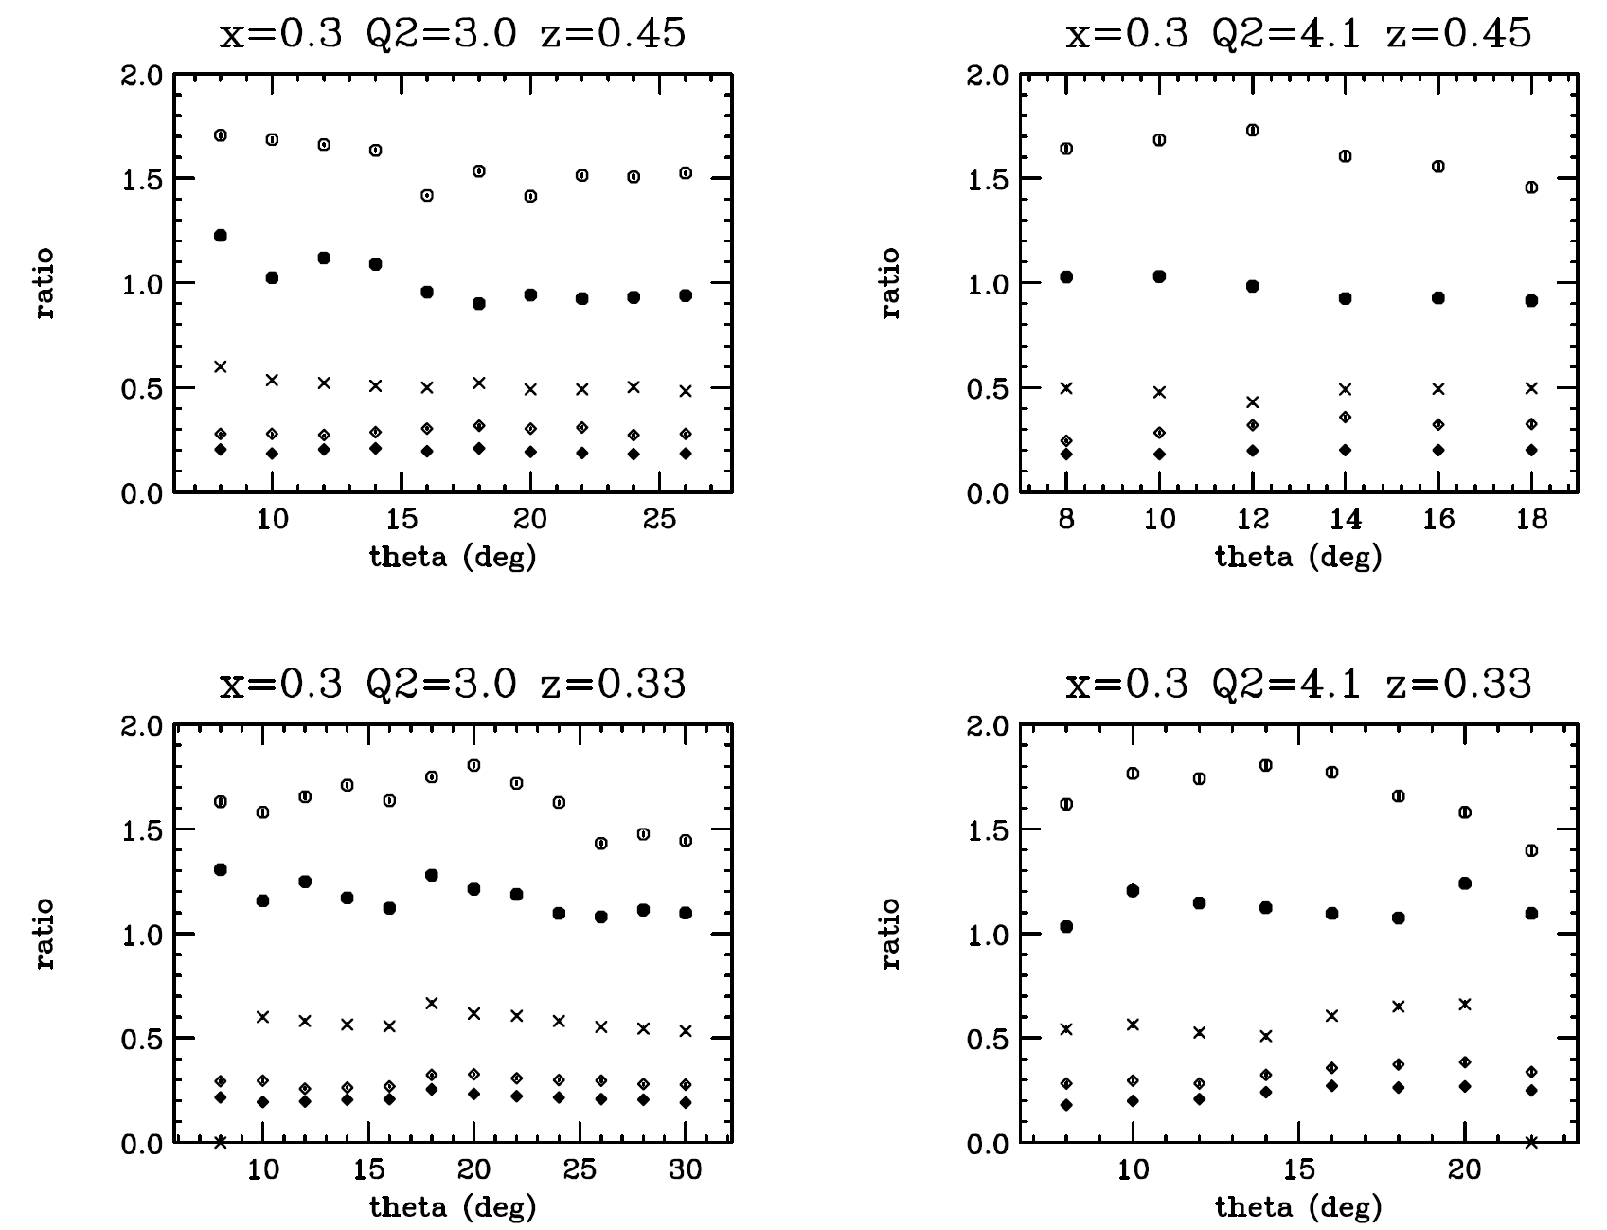
Quasi-Online Results – Pions
Not normalized by target density: just ratios of counts/mC corrected for computer dead time.
Ratio to π+ from LH2 of
π+ from LD2 (open circles)
π+ from Al (open diamonds)
π- from LH2 (crosses)
π- from LD2 (filled circles)
π- from Al (filled diamonds)
Notes:
PAC days

Slide 31
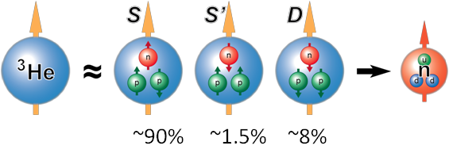
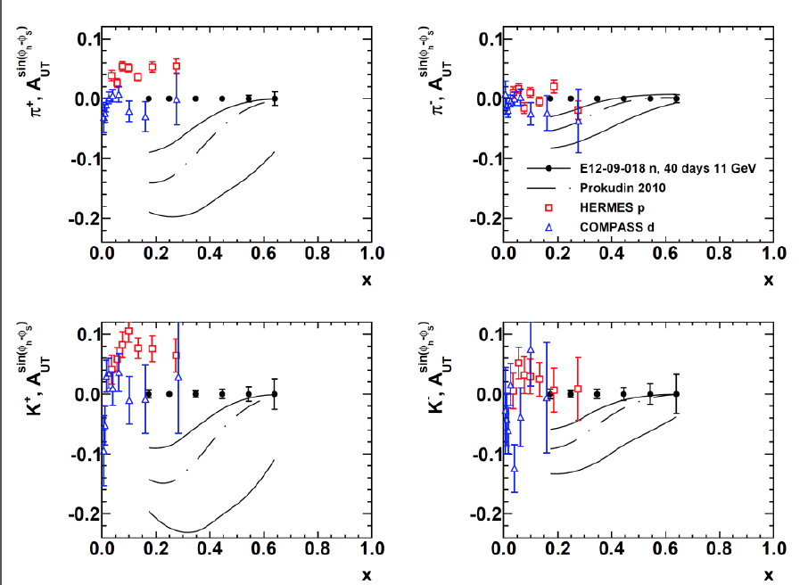
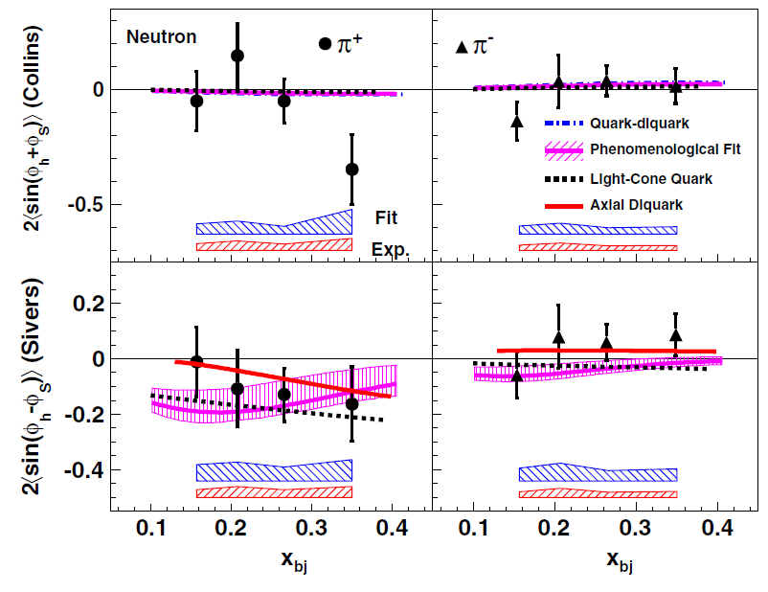
The neutron Sivers Asymmetry with SBS
Impact of the data from a short-duration run (~2 months) with small-acceptance spectrometers demonstrates power of ³He target (<P_{T}> = 55%) and lays foundation for high statistical FOM @11 GeV
This experiment will achieve statistical FOM for the neutron ~100X better than HERMES proton data and ~1000X better than the previous Jlab neutron data at 6 GeV.
Kaon and neutral pion data will aid flavor decomposition, and understanding of reaction-mechanism effects.
Notes:
PAC days

Slide 32
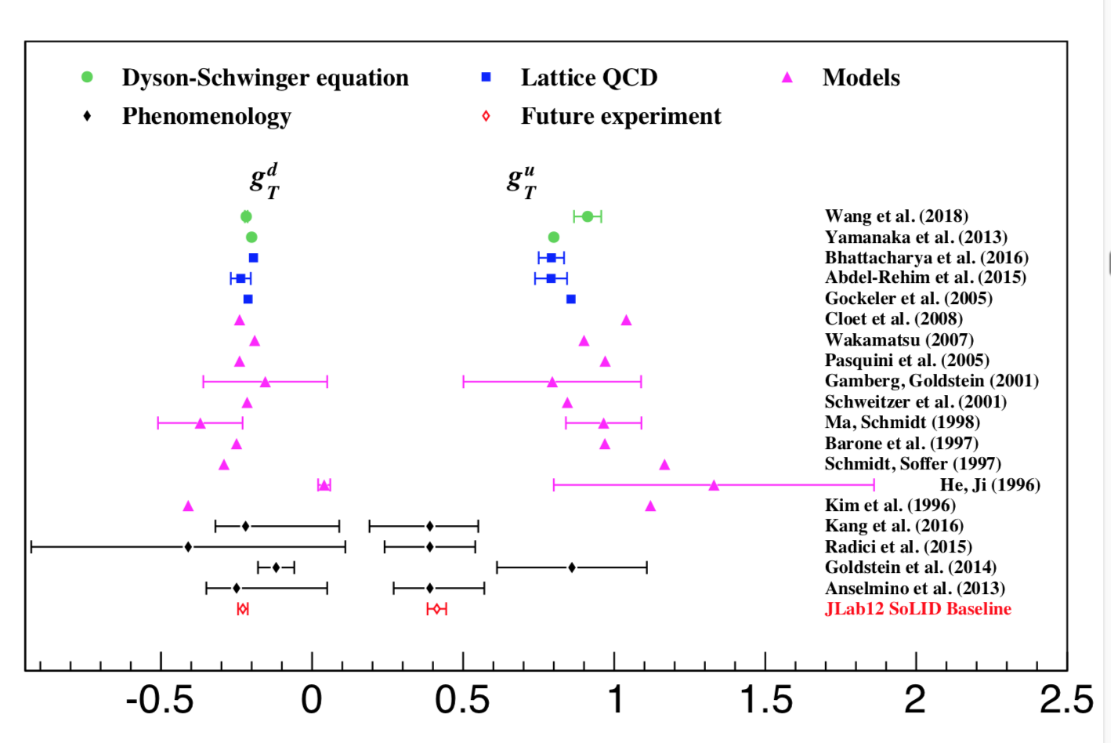
SoLID impact on Tensor Charge
A fundamental QCD quantity: matrix element of local operators
Moment of the transversity distribution: valence quark dominant
Calculable in lattice QCD
Notes:
PAC days

Slide 33
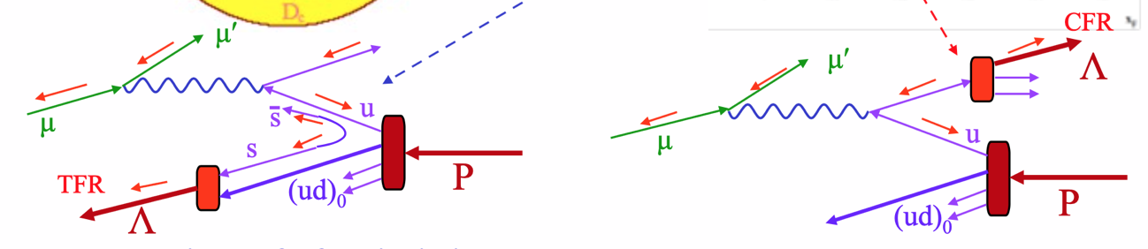
Λ production in Deep Inelastic Scattering
e’
Current Fragmentation Region:
Λ is produced from the struck quark
e
e’
Target Fragmentation Region:
Λ is produced from the remnant diquark
e
Studying the correlation of Λ produced in the Target and the kaon in the Current Region can give hint on the diquark stracture of the proton
Fracture Functions: simoultaneously encoding the information on the interacting quark and on the fragmentation of the spectator system
Notes:
there are 16 independent fracture functions, which describe the conditional probabilities of finding unpolarized
or polarized quarks inside unpolarized or polarized nucleons fragmenting into the final observed hadron
Fracture Functions = Fragmentation + Structure : probability that when a quark q is struck in a proton target is produced the hadron h

Slide 34
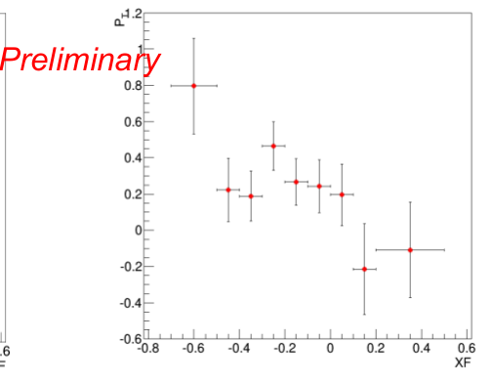
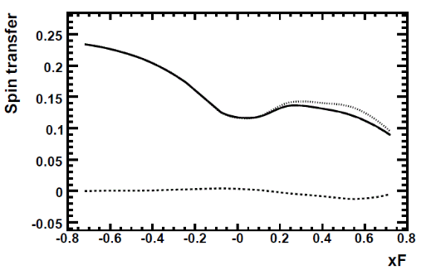
Λ Polarization in CLAS
CLAS – e1f
Intrinsic Strangeness model
Ellis et al. EPJ C52, 283
Polarization transfer from target
remnant (sea strange quarks)
CLAS data in agreement with the model in TFR
∝ΔM^{L}
∝ f₁ G₁^{q→Λ}

Slide 35
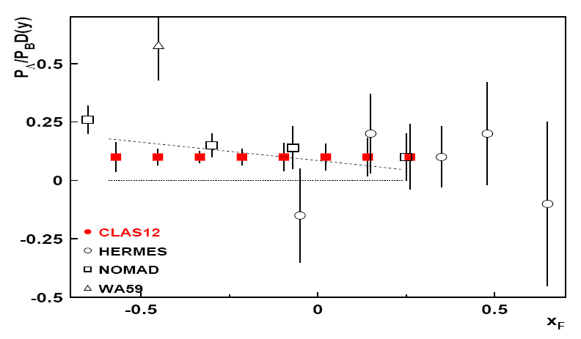
Projected Results
projections for CLAS12
2000h at 10³⁵ s⁻¹ cm⁻²
standard unpolarized target conditions
ISM - Intrinsic Strangeness Model
Ellis et al., EPJ C25,603
Longitudinal polarization transfer
meson cloud
Melnitchouk & Thomas, ZP A353,311

Slide 36
ExtractionVAlidation framework (EVA)
Main goal: assist extraction of 3D PDFs, by testing different extraction procedures and estimating systematics related to different assumptions and models used in the extraction procedure.
SIDIS,DY,e+/e-
experiments
Hard Scattering MC+RC
QCD fundamentals
Library for Structure Function (SF) calculations has
3D PDF and FF (models,
parametrizations)
Radiative
x-section
x-section calculations
SF calculations
Hard Scattering Data Counts
(x-sections, multiplicities,….)
Defined set of assumptions
Extract SFs
Extract 3D PDFs
phenomenology
Validation of extracted 3D PDFs (for a given set of assumptions)
TED (Theory Experiment Dialogue) meetings at JLab to finalize goals and coordinate efforts

Slide 37


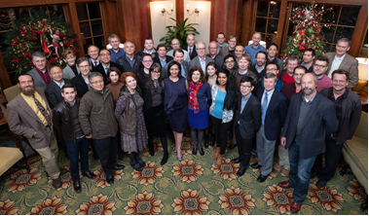
Virginia Center for Nuclear Femtography
Funded by Commonwealth to “…..to facilitate the application of modern developments in data science to the problem of imaging and visualization of sub-femtometer scale structure of protons, neutrons, and atomic nuclei”
  Seven (of fourteen) joint lab/university initiatives funded by the Commonwealth of Virginia
Multi-disciplinary, bringing together nuclear theorists and experimentalists, mathematicians, computer scientists,… … and architects and artists!
Workshop at University of Virginia
FEMTOGRAPHY 2018
37
Notes:
PAC days

Slide 38
Summary
The 3D world is complex. Studies of azimuthal distributions of hadrons in SIDIS indicate that there are significant correlations between spin and the transverse distribution of quarks.
To have a correct understanding of the measured data the contributing effects should be reliably estimated:
  Sizable higher twist asymmetries indicate the quark-gluon correlations may be significant at moderate Q².
  Fraction of inclusive pions coming from correlated dihadrons
To pindown the complexity of the 3D nucleon structure we need:
  Precise data
  Modeling of spin-orbit correlation to help understanding the dynamics
  Development of a reliable techniques for the extraction of 3D PDFs and fragmentation functions from the multidimensional experimental observables with controlled systematics. This requires close collaboration of experiment, theory and computing
The Jlab program at 12 GeV has a broad approved SIDIS program that spans over three experimental halls. Combination of high resolution measurements from spectrometers with large acceptance data from CLAS12 and SoLID would allow to pin down all TMDs in the valence region
“Theory Experiment Dialogue” meetings at JLab has been established to finalize goals and coordinate efforts as well as a Virginia Center for Nuclear Femtography.

