Slide 1
Spectrum and structure of positive and negative parity baryons
Chen Chen
University of Giessen
Diquark Correlations in Hadron Physics:
Origin, Impact and Evidence
23-27 September 2019
ECT*

Slide 2
Non-Perturbative QCD:
Hadrons, as bound states, are dominated by non-perturbative QCD dynamics – Two emergent phenomena
Confinement: Colored particles have never been seen isolated
Explain how quarks and gluons bind together
DCSB: Hadrons do not follow the chiral symmetry pattern
Explain the most important mass generating mechanism for visible matter in the Universe
Neither of these phenomena is apparent in QCD 's Lagrangian, HOWEVER, They play a dominant role in determining the characteristics of real-world QCD!

Slide 3
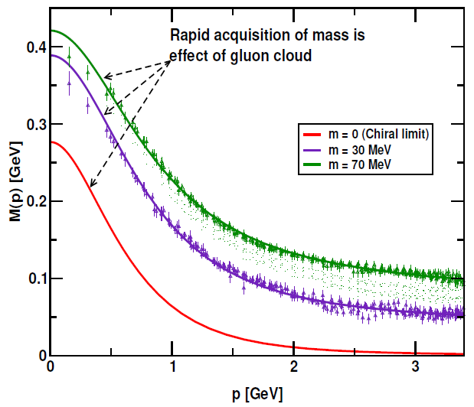
Non-Perturbative QCD:
From a quantum field theoretical point of view, these emergent phenomena could be associated with dramatic, dynamically driven changes in the analytic structure of QCD 's Schwinger functions (propagators and vertices). The Schwinger functions are solutions of the quantum equations of motion (Dyson-Schwinger equations).
Dressed-quark propagator:
Mass generated from the interaction
of quarks with the gluon.
Light quarks acquire a HUGE constituent mass.
Responsible of the 98% of the mass of the
proton and the large splitting between
parity partners.

Slide 4
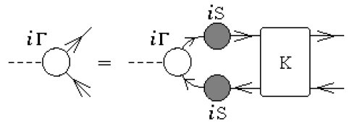
Hadrons: Bound-states in QFT
Mesons: a 2-body bound state problem in QFT
Bethe-Salpeter Equation
K - fully amputated, two-particle irreducible, quark-antiquark scattering kernel
Baryons: a 3-body bound state problem in QFT.
Faddeev equation: sums all possible quantum field theoretical exchanges and interactions that can take place between the three dressed-quarks that define its valence quark content.

Slide 5
Hadrons: Bound-states in QFT
Mesons: a 2-body bound state problem in QFT
Bethe-Salpeter Equation
K - fully amputated, two-particle irreducible, quark-antiquark scattering kernel
Baryons: a 3-body bound state problem in QFT.
Faddeev equation: sums all possible quantum field theoretical exchanges and interactions that can take place between the three dressed-quarks that define its valence quark content.

Slide 6
2-body correlations
Mesons: quark-antiquark correlations -- color-singlet
Diquarks: quark-quark correlations within a color-singlet baryon.
Diquark correlations:
In our approach: non-pointlike color-antitriplet and fully interacting.
Diquark correlations are soft, they possess an electromagnetic size.
Owing to properties of charge-conjugation, a diquark with spin-parity J^P may be viewed as a partner to the analogous J^{-P} meson.

Slide 7
2-body correlations
Quantum numbers:
(I=0, J^P=0^+): isoscalar-scalar diquark
(I=1, J^P=1^+): isovector-pseudovector diquark
(I=0, J^P=0^-): isoscalar-pesudoscalar diquark
(I=0, J^P=1^-): isoscalar-vector diquark
(I=1, J^P=1^-): isovector-vector diquark
Tensor diquarks
Three-body bound states
Quark-Diquark two-body bound states

Slide 8
2-body correlations
Quantum numbers:
(I=0, J^P=0^+): isoscalar-scalar diquark
(I=1, J^P=1^+): isovector-pseudovector diquark
(I=0, J^P=0^-): isoscalar-pesudoscalar diquark
(I=0, J^P=1^-): isoscalar-vector diquark
(I=1, J^P=1^-): isovector-vector diquark
Tensor diquarks
Three-body bound states
Quark-Diquark two-body bound states
M. Oettel, G. Hellstern, Reinhard Alkofer, H. Reinhardt , Phys.Rev. C58 (1998) 2459-2477
Martin Oettel, Mike Pichowsky, Lorenz von Smekal, Eur.Phys.J. A8 (2000) 251-281
Jorge Segovia, Bruno El-Bennich, Eduardo Rojas, Ian C. Cloet, Craig D. Roberts, Shu-Sheng Xu, Hong-Shi Zong, Phys.Rev.Lett. 115 (2015) no.17, 171801
G. Eichmann, H. Sanchis-Alepuz, R. Williams, R. Alkofer, C. S. Fischer, Prog.Part.Nucl.Phys. 91 (2016) 1-100

Slide 9
DSE
One may now separate DSE studies into three classes:
class A, model-independent statements about QCD;
class B, illustrations of such statements using well-constrained model elements and possessing a traceable connection to QCD;
class C, QCD-kindred model: inspired from previous studies of hadronic observables.
Our analysis is understood to be valid at ζ ≃ 1 GeV. QCD evolution handles the communication between the choices of this scale.

Slide 10
QCD-kindred model
The dressed-quark propagator
Diquark amplitudes
Diquark propagators
Faddeev amplitudes

Slide 11
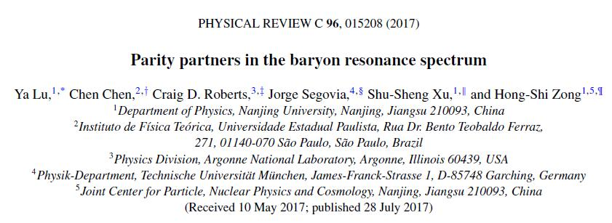
QCD-kindred model
Diquark masses (in GeV):
The first two values (positive-parity) provide for a good description of numerous dynamical properties of the nucleon, Δ-baryon and Roper resonance.
Masses of the odd-parity correlations are based on those computed from a contact interaction.

Slide 12
QCD-kindred model
Diquark masses (in GeV):
The first two values (positive-parity) provide for a good description of numerous dynamical properties of the nucleon, Δ-baryon and Roper resonance.
Masses of the odd-parity correlations are based on those computed from a contact interaction.
Such values are typical; and in truncations of the two-body scattering problem that are most widely used (RL), isoscalar-vector and isovector-vector correlations are degenerate.
Normalization condition → couplings:
Faddeev kernels: 22 × 22 matrices are reduced to 16 × 16 !

Slide 13
QCD-kindred model
There is an absence of spin-orbit repulsion owing to an oversimplification of the gluon-quark vertex when formulating the RL bound-state equations. We therefore employ a simple artifice in order to implement the missing interactions.
We introduce a single parameter into the Faddeev equation for J^P=1/2^{+-} baryons: gDB, a linear multiplicative factor attached to each opposite-parity (-P) diquark amplitude in the baryon’s Faddeev equation kernel.
gDB is the single free parameter in our study.

Slide 14
QCD-kindred model
Solution to the 50 year puzzle -- Roper resonance: Discovered in 1963, the Roper resonance appears to be an exact copy of the proton except that its mass is 50% greater and it is unstable…

Slide 15
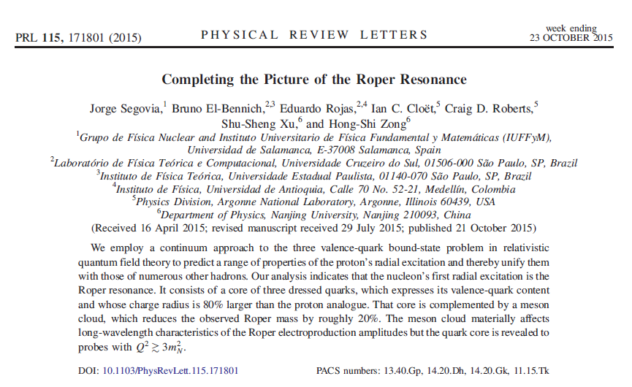
QCD-kindred model
Solution to the 50 year puzzle -- Roper resonance: Discovered in 1963, the Roper resonance appears to be an exact copy of the proton except that its mass is 50% greater and it is unstable…

Slide 16
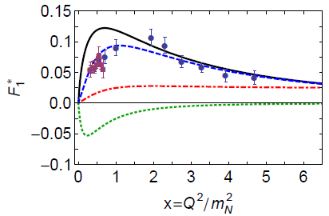
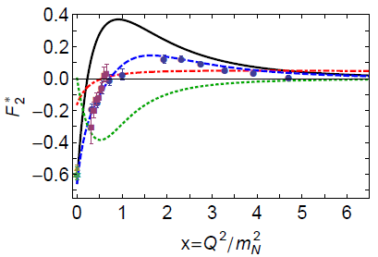
QCD-kindred model
Solution to the 50 year puzzle -- Roper resonance: Discovered in 1963, the Roper resonance appears to be an exact copy of the proton except that its mass is 50% greater and it is unstable…

Slide 17
Part A

Slide 18
Part A
The four lightest baryon (I=1/2, J^P=1/2^{+-}) isospin doublets: nucleon, roper, N(1535), N(1650)
Masses
Rest-frame orbital angular momentum
Diquark content
Pointwise structure

Slide 19
Masses
We choose gDB=0.43 so as to produce a mass splitting of 0.1 GeV (the empirical value) between the lowest-mass P=- state (N(1535)) and the first excited P=+ state (Roper).
Our computed values for the masses of the four lightest 1/2^{+-} baryon doublets are listed here, in GeV:
Pseudoscalar and vector diquarks have no impact on the mass of the two positive-parity baryons, whereas scalar and pseudovector diquarks are important to the negative parity systems.

Slide 20
Masses
The quark-diquark kernel omits all those resonant contributions which may be associated with meson-baryon final-state interactions that are resummed in dynamical coupled channels models in order to transform a bare baryon into the observed state.
The Faddeev equations analyzed to produce the results should therefore be understood as producing the dressed-quark core of the bound state, not the completely dressed and hence observable object.
In consequence, a comparison between the empirical values of the resonance pole positions and the computed masses is not pertinent. Instead, one should compare the masses of the quark core with values determined for the meson-undressed bare excitations, e.g.,
where M^0_B is the relevant bare mass inferred in the associated dynamical coupled-channels analysis.
The relative difference is just 1.7%. We consider this to be a success of our calculation.

Slide 21
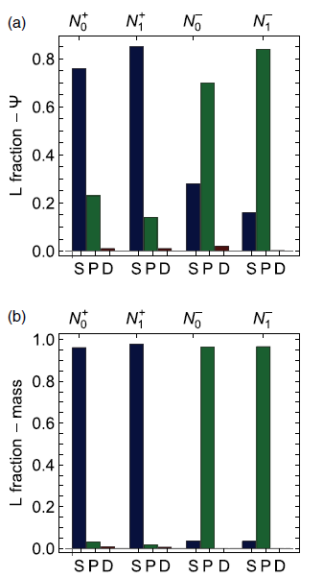
Rest-frame orbital angular momentum
(a) Computed from the wave functions directly.
(b) Computed from the relative contributions to the masses.
(b) delivers the same qualitative picture as that presented in (a). Therefore, there is little mixing between partial waves in the computation of a baryon’s mass.
The nucleon and Roper are primarily S-wave in nature. On the other hand, the N(1535)1/2^-,N(1650)1/2^- are essentially P-wave in character.
These observations provide support in quantum field theory for the constituent-quark model classifications of these systems.

Slide 22
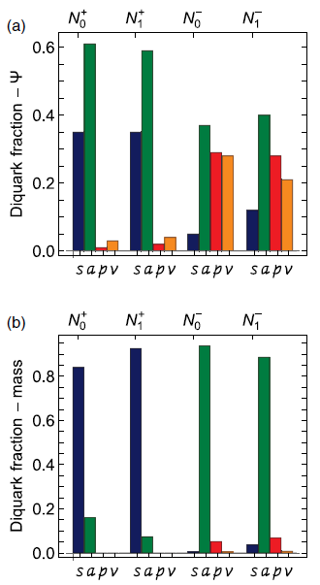
Diquark content
(a) Computed from the amplitudes directly.
(b) Computed from the relative contributions to the masses.
From (a): The amplitudes associated with these negative-parity states contain roughly equal fractions of even and odd parity diquarks. Positive-parity states: negative-parity diquarks are almost ZERO.
From (b): In each, there is a single dominant diquark component. There are significant interferences between different diquarks.

Slide 23
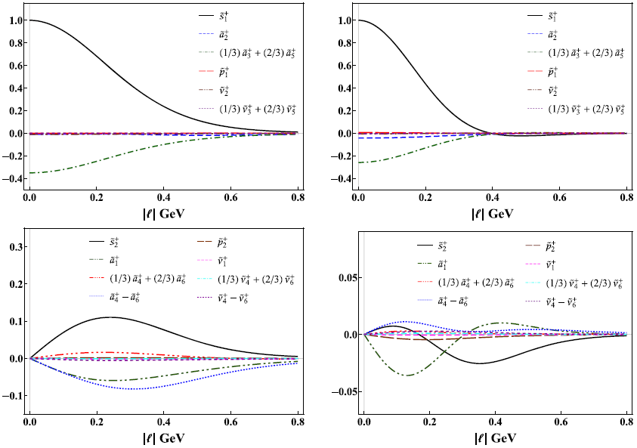
Pointwise structure
We consider the zeroth Chebyshev moment of all S- and P-wave components in a given baryon’s Faddeev wave function.
Nucleon’s first positive-parity excitation: all S-wave components exhibit a single zero; and four of the P-wave projections also possess a zero. This pattern of behavior for the first excited state indicates that it may be interpreted as a radial
excitation.

Slide 24
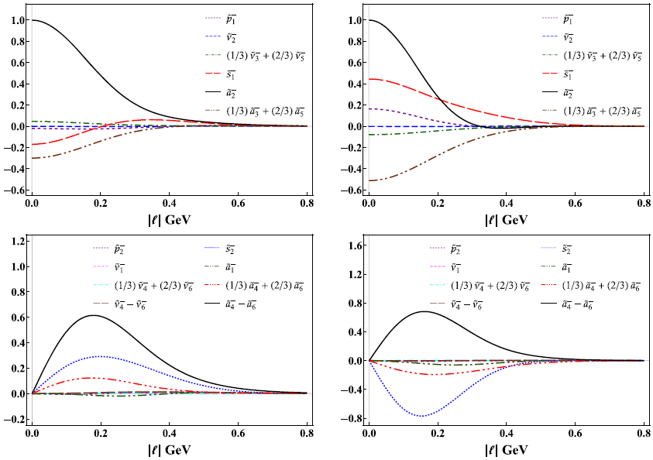
Pointwise structure
For N(1535)1/2^-,N(1650)1/2^- : the contrast with the positive-parity states is STARK.
In particular, there is no simple pattern of zeros, with all panels containing at least one function that possesses a zero.
In their rest frames, these systems are predominantly P-wave in nature, but possess material S-wave components; and the first excited state in this negative parity channel—N(1650)1/2^−—has little of the appearance of a radial excitation, since most of the functions depicted in the right panels of the figure do not possess a zero.

Slide 25
Part A - Summary & Outlook
By including all kinds of diquarks, we performed a comparative study of the four lightest baryon (I=1/2, J^P=1/2^{+-}) isospin doublets in order to both elucidate their structural similarities and differences.
The two lightest (I=1/2, J^P=1/2^+) doublets are dominated by scalar and pseudovector diquarks; the associated rest-frame Faddeev wave functions are primarily S-wave in nature; and the first excited state in this 1/2^+ channel has very much the appearance of a radial excitation of the ground state.
In the two lightest (I=1/2, J^P=1/2^-) systems, TOO, scalar and pseudovector diquarks play a material role. In their rest frames, the Faddeev amplitudes describing the dressed-quark cores of these negative-parity states contain roughly equal fractions of even and odd parity diquarks; the associated wave functions of these negative-parity systems are predominantly P-wave in nature, but possess measurable S-wave components; and, the first excited state in this negative parity channel has little of the appearance of a radial excitation.
NEXT: N(1720)3/2^+, N(1520)3/2^-, form factors, PDAs, PDFs, …

Slide 26
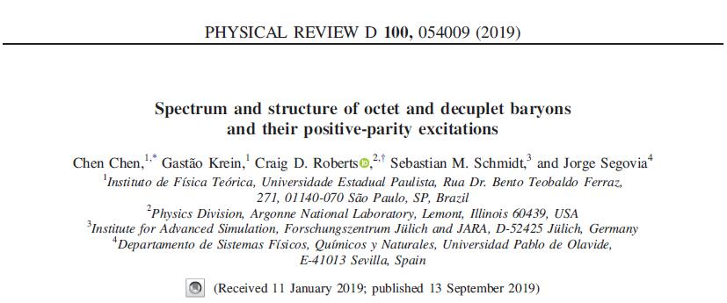
Part B

Slide 27
Part B
Spectrum and structure of octet & decuplet baryons and their positive-parity excitations
Masses
Rest-frame orbital angular momentum
Diquark content
Pointwise structure

Slide 28
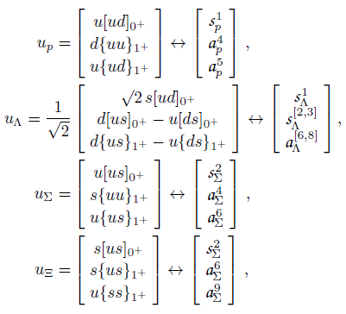
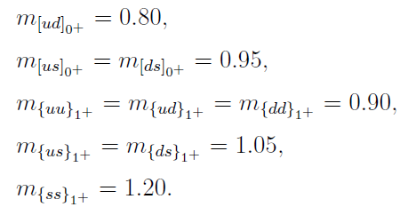
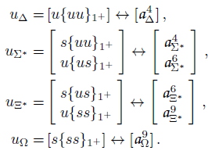
QCD-kindred model
Spin-flavor structure:
Diquark masses (in GeV):
The values of m_[ud] & m_{uu/ud/dd} provide for a good description of numerous dynamical properties of the nucleon, Δ-baryon and Roper resonance.
Other masses are derived therefrom via an equal-spacing rule: viz. replacing by a s-quark bring an extra 0.15 GeV (~ Ms - Mu).

Slide 29
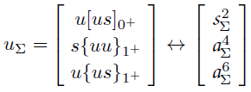
Masses
Ʃ-Λ mass splitting
While the Ʃ and Λ are associated with the same combination of valence-quarks, their spin-flavor wave functions are different: the Λ contains more of the (lighter) scalar diquark correlations than the Ʃ

Slide 30
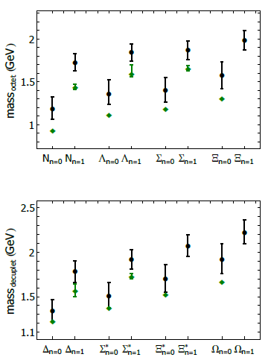
Masses
The computed masses are uniformly larger than the corresponding empirical values.
The quark-diquark kernel omits all those resonant contributions associated with meson-baryon final-state interactions, which typically generate a measurable reduction.
The Faddeev equations analyzed to produce the results should be understood as producing the dressed-quark core of the bound state, NOT the completely dressed and hence observable object.

Slide 31
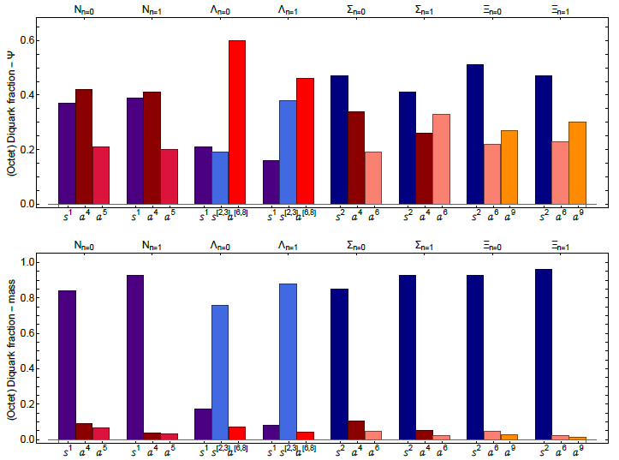
Diquark content (Octet)
Upper: Computed from the amplitudes directly.
Lower: Computed from the relative contributions to the masses.
Lower : In each, there is a single dominant diquark component: scalar diquark
Difference -> the lack of interference between diquark components

Slide 32
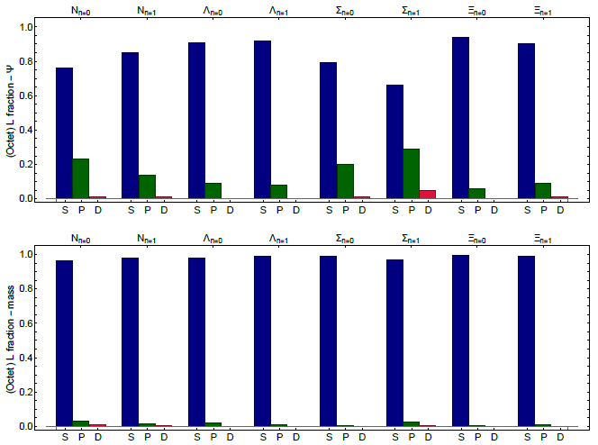
Rest-frame orbital angular momentum (Octet)
Upper: Computed from the wave functions directly.
Lower: Computed from the relative contributions to the masses.
Both measures deliver the same qualitative picture of each baryon's internal structure. So there is little mixing between partial waves in the computation of a baryon's mass.

Slide 33
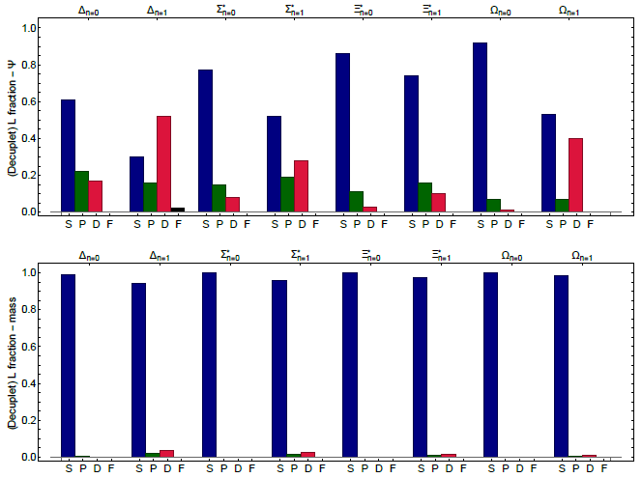
Rest-frame orbital angular momentum (Decuplet)
Upper: Computed from the wave functions directly.
Lower: Computed from the relative contributions to the masses.
In both panels that S-wave strength is shifted into D-wave contributions within decuplet positive-parity excitations.

Slide 34
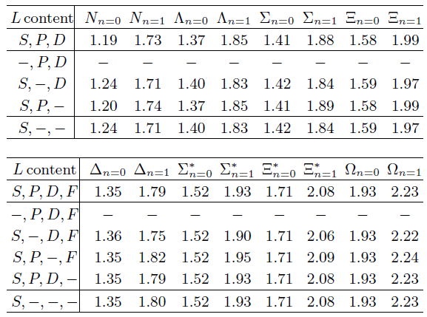
Rest-frame orbital angular momentum

Slide 35
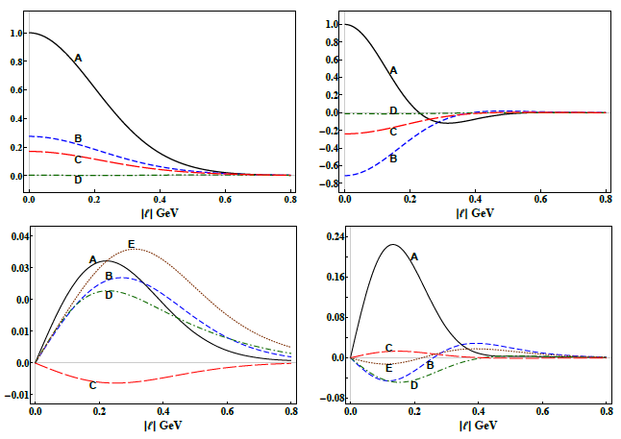
Pointwise structure (Octet – Λ baryon)
The zeroth Chebyshev moment of all S- and P-wave components in a given baryon’s Faddeev wave function.
Each projection for the ground-state is of a single sign (+ or -).
First excitation: all S- and P-wave components exhibit a single zero at some point. It may be interpreted as the simplest radial excitation of its ground-state partner.

Slide 36
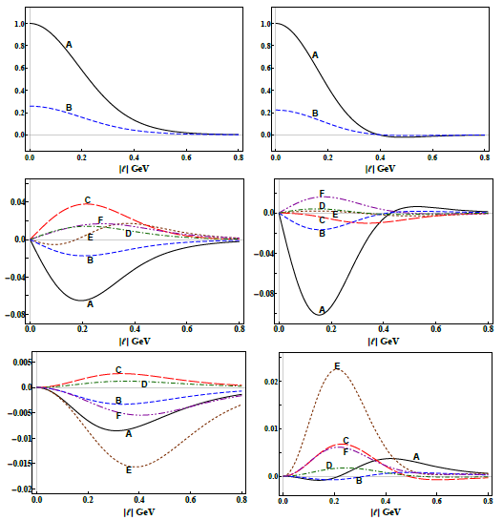
Pointwise structure (Decuptet – Ξ* baryon)

Slide 37
Part B - Summary & Outlook
We computed the spectrum and Poincare-covariant wave functions for all favor-SU(3) octet and decuplet baryons and their first positive-parity excitations.
Negative-parity diquarks are negligible in these positive-parity baryons.
In its rest-frame, every system considered may be judged as primarily S-wave in character; and the first positive-parity excitation of each octet or decuplet baryon exhibits the characteristics of a radial excitation of the ground-state.
Next: Negative-parity partners; Form factors & axial couplings; PDFs, PDAs, GPDs, TMDs...

Slide 38
Part A - Summary & Outlook
By including all kinds of diquarks, we performed a comparative study of the four lightest baryon (I=1/2, J^P=1/2^{+-}) isospin doublets in order to both elucidate their structural similarities and differences.
The two lightest (I=1/2, J^P=1/2^+) doublets are dominated by scalar and pseudovector diquarks; the associated rest-frame Faddeev wave functions are primarily S-wave in nature; and the first excited state in this 1/2^+ channel has very much the appearance of a radial excitation of the ground state.
In the two lightest (I=1/2, J^P=1/2^-) systems, TOO, scalar and pseudovector diquarks play a material role. In their rest frames, the Faddeev amplitudes describing the dressed-quark cores of these negative-parity states contain roughly equal fractions of even and odd parity diquarks; the associated wave functions of these negative-parity systems are predominantly P-wave in nature, but possess measurable S-wave components; and, the first excited state in this negative parity channel has little of the appearance of a radial excitation.
NEXT: N(1720)3/2^+, N(1520)3/2^-, form factors, PDAs, PDFs, …

Slide 39
Thank you!

Slide 40
Rest-frame orbital angular momentum
Upper: octet baryons
Lower: decuplet baryons
Every one of the systems considered is primarily S-wave in nature.
P-wave components play a measurable role in octet ground-states & first positive-parity excitations: they are attractive in ground-states & repulsive in the excitations
Decuplet systems: the ground-state masses are almost completely insensitive to non-S-wave components; and in the first positive parity excitations, P-wave components generate a little repulsion, some attraction is provided by D-waves.

Slide 41
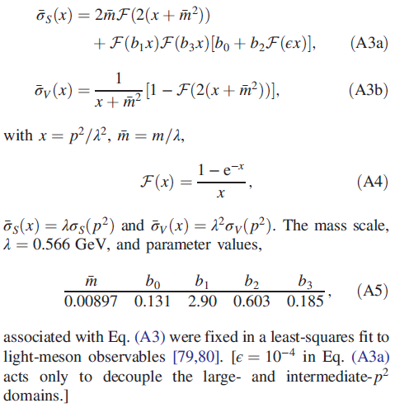
QCD-kindred model
The dressed-quark propagator
algebraic form:

Slide 42
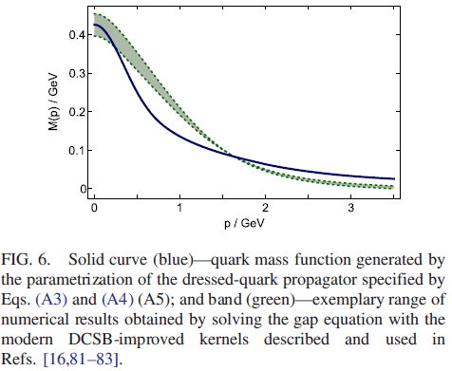
QCD-kindred model
The dressed-quark propagator
Based on solutions to the gap equation that were obtained with a dressed gluon-quark vertex.
Mass function has a real-world value at p^2 = 0, NOT the highly inflated value typical of RL truncation.
Propagators are entire functions, consistent with sufficient condition for confinement and completely unlike known results from RL truncation.
Parameters in quark propagators were fitted to a diverse array of meson observables. ZERO parameters changed in study of baryons.
Compare with that computed using the
DCSB-improved gap equation kernel (DB).
The parametrization is a sound representation of contemporary
numerical results, although simple and introduced
long beforehand.

Slide 43
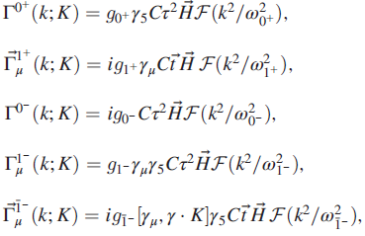
QCD-kindred model
Diquark amplitudes: five types of correlation are possible in a J=1/2 bound state: isoscalar scalar(I=0,J^P=0^+), isovector pseudovector, isoscalar pseudoscalar, isoscalar vector, and isovector vector.
The LEADING structures in the correlation amplitudes for each case are, respectively (Dirac-flavor-color),
Simple form. Just one parameter: diquark masses.
Match expectations based on solutions of meson and diquark Bethe-Salpeter amplitudes.

Slide 44
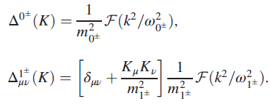
QCD-kindred model
The diquark propagators
The F-functions: Simplest possible form that is consistent with infrared and ultraviolet constraints of confinement (IR) and 1/q^2 evolution (UV) of meson propagators.
Diquarks are confined.
free-particle-like at spacelike momenta
pole-free on the timelike axis
This is NOT true of RL studies. It enables us to reach arbitrarily high values of momentum transfer.

Slide 45
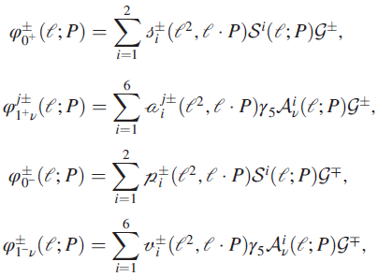
QCD-kindred model
The Faddeev ampitudes:
Quark-diquark vertices:

Slide 46
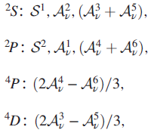
QCD-kindred model
Both the Faddeev amplitude and wave function are Poincare covariant, i.e. they are qualitatively identical in all reference frames.
Each of the scalar functions that appears is frame independent, but the frame chosen determines just how the elements should be combined.
In consequence, the manner by which the dressed quarks’ spin, S, and orbital angular momentum, L, add to form the total momentum J, is frame dependent: L, S are not independently Poincare invariant.
The set of baryon rest-frame quark-diquark angular momentum identifications:
The scalar functions associated with these combinations of Dirac matrices in a Faddeev wave function possess the identified angular momentum correlation between the quark and diquark.

Slide 47
Quark-diquark picture
A baryon can be viewed as a Borromean
bound-state, the binding within which
has two contributions:
Formation of tight diquark correlations.
Quark exchange depicted in the shaded
area.
The exchange ensures that diquark correlations within the baryon are fully dynamical: no quark holds a special place.
The rearrangement of the quarks guarantees that the baryon's wave function complies with Pauli statistics.
Modern diquarks are different from the old static, point-like diquarks which featured in early attempts to explain the so-called missing resonance problem.
The number of states in the spectrum of baryons obtained is similar to that found in the three-constituent quark model, just as it is in today's LQCD calculations.

Slide 48
2-body correlations
Quantum numbers:
(I=0, J^P=0^+): isoscalar-scalar diquark
(I=1, J^P=1^+): isovector-pseudovector diquark
(I=0, J^P=0^-): isoscalar-pesudoscalar diquark
(I=0, J^P=1^-): isoscalar-vector diquark
(I=1, J^P=1^-): isovector-vector diquark
Tensor diquarks
Three-body bound states
Quark-Diquark two-body bound states
G. Eichmann, H. Sanchis-Alepuz, R. Williams, R. Alkofer, C. S. Fischer, Prog.Part.Nucl.Phys. 91 (2016) 1-100
CC, B. El-Bennich, C. D. Roberts, S. M. Schmidt, J. Segovia, S-L. Wan, Phys.Rev. D97 (2018) no.3, 034016

