Slide 1
Future Circular e+e- Colliders
F. Bedeschi
LFC19, Trento
Settembre 2019
Outline
Current physics landscape
Current directions
FCC-ee
  Key measurements
  Current status
Conclusions

Slide 2
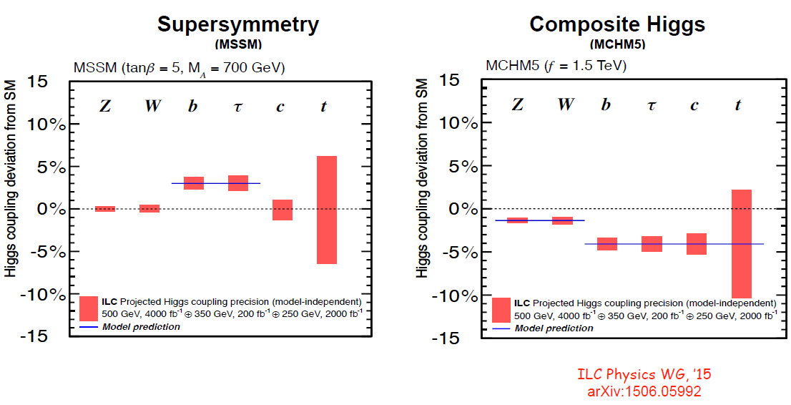
Current physics landscape
Higgs properties SM-like.
  After HL-LHC precision level of several %
  Deviation from SM: δ ~ v²/M² v = 246 GeV
    M scale of new physics
    M ~ 1 – 10 TeV → δ ~ 6 – 0.06%
  Need < ~ % sensitivity → beyond HL-LHC
Granada 2019

Slide 3
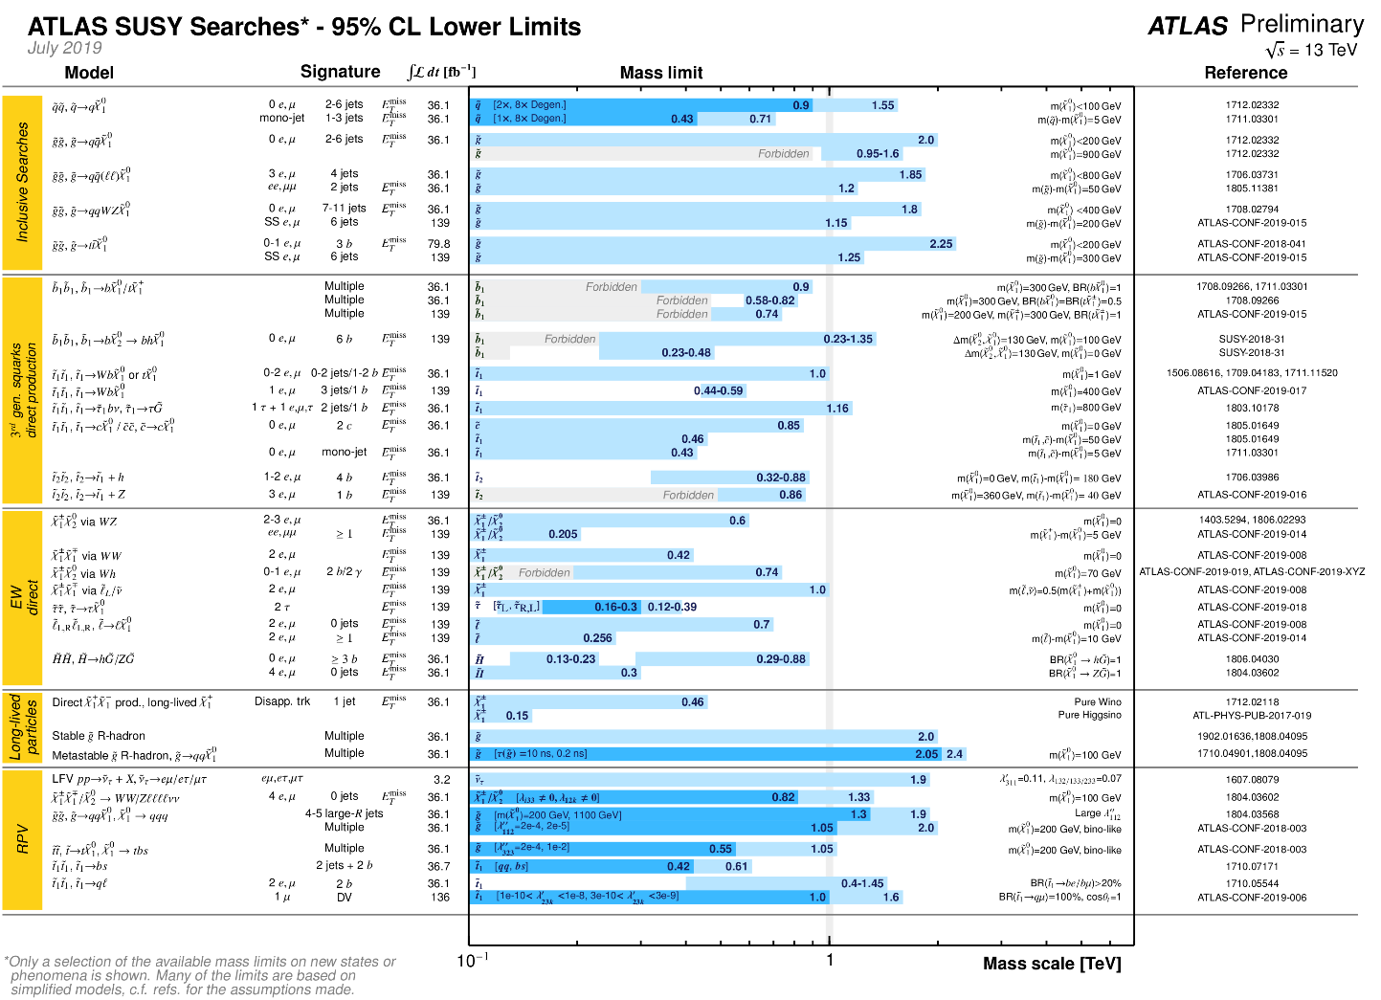
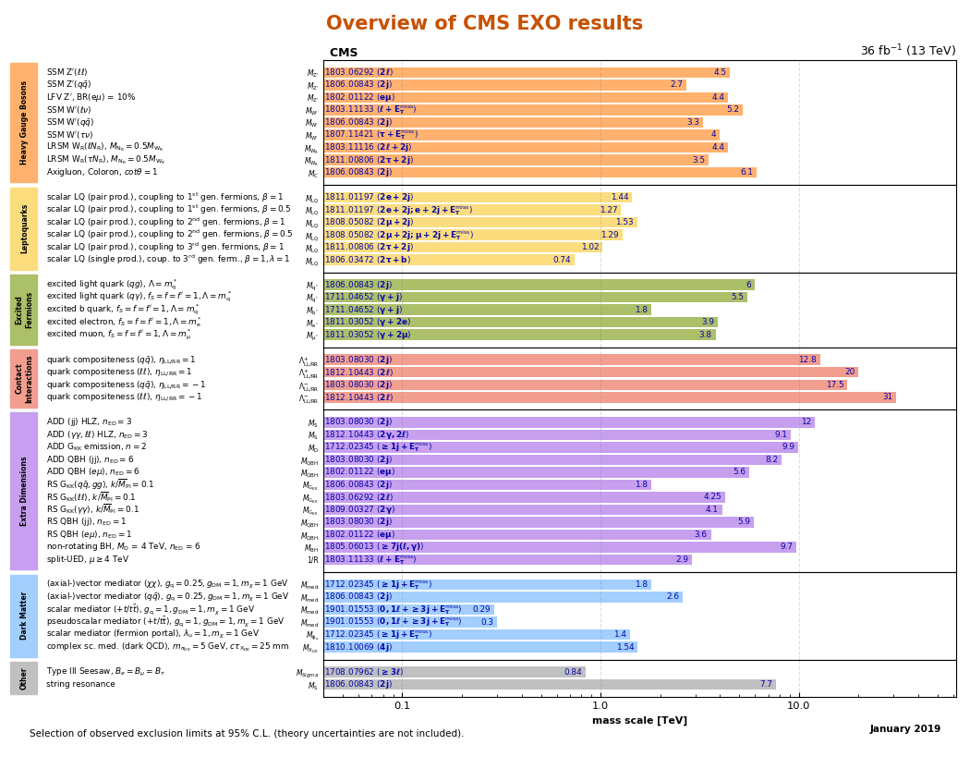
Current physics landscape
No (additional) signs of BSM physics.
    After intensive searches at LHC → M_{NP} > 1 TeV

Slide 4
Current physics landscape
Higgs properties SM-like.
  At current precision level of several %
No (additional) signs of BSM physics.
  After intensive searches at LHC
… but SM is an insufficient description
  Prevalence of matter over anti-matter.
    Not explained by current values of CKM elements
  Neutrinos have masses – not acquired in the SM.
  Compelling evidence for the existence of dark matter in the Universe with no candidate particle(s) in the SM.
What new next accelerator to go beyond SM?

Slide 5
Current directions
ICFA statement - Tokyo, March 2019:
  “ICFA confirms the international consensus that the highest priority for the next global machine is a “Higgs Factory” capable of precision studies of the Higgs boson. ……………………………………………………………… ICFA notes with satisfaction the great progress of the various options for Higgs factories proposed across the world. All options will be considered in the European Strategy for Particle Physics Update and by ICFA.
ICFA report – LP2019, Toronto, August 2019:
  Worldwide effort for e+e- Higgs Factory must not fail!
    Linear or Circular
    Asia or Europe (or elsewhere?)
Recent comments on ESPPU preparations (B. Vachon – LP2019)
  Emerging consensus for the importance of a “Higgs factory” to fully explore properties of the Higgs, EW sector, etc.
  Need to prepare a clear path towards highest energy.

Slide 6
Higgs factories
e+e- linear
  ILC
  CLIC
e+e- circular
  FCC-ee
  CepC
μ+μ- circular
  μ-HF
Requirement: high luminosity O(10³⁴) at the Higgs energy scale
Usually, compared to the LHC – which is, as a machine :
27 km long
SC magnets (8T)
150 MW power total
~ 10 years to build
Cost “1 LHC Unit” *
V. SHILTSEV, Granada 2019
Difficult

Slide 7
Luminosity comparison
Z
W
H
tt
100 x LEP

Slide 8
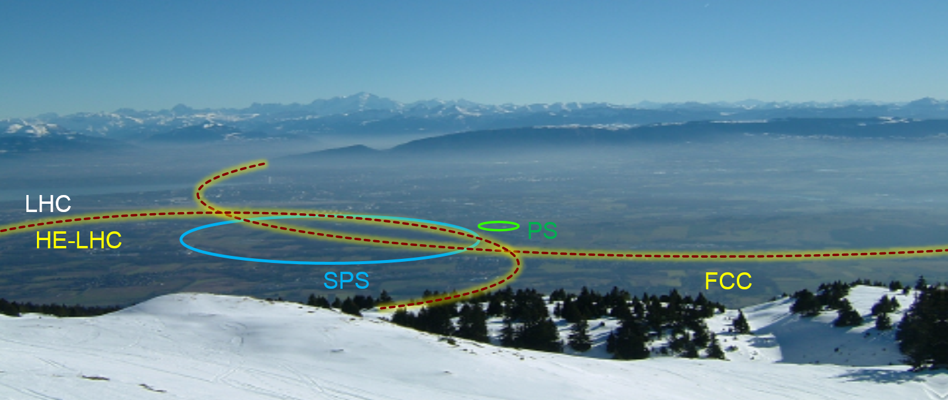
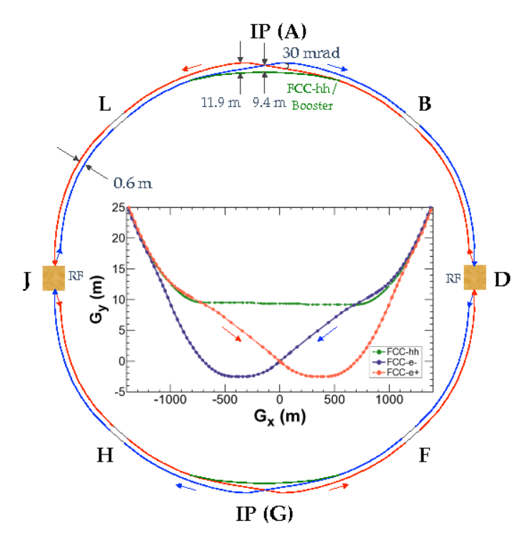
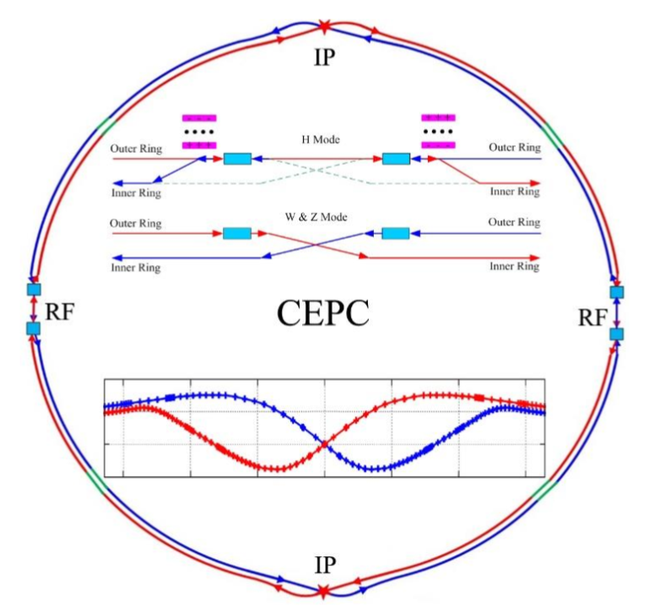
Circular e+e- Higgs Factories
Key facts:
  100 km tunnel, three rings (e-, e+, booster)
  SRF power to beams 100 MW (60 MW in CepC)
  Total site power <300MW (tbd)
  Cost est. FCCee 7.4 (tunnel)+ 3.1 BCHF (machine) (+1.1BCHF for tt)
    (“< 6BCHF” cited in the CepC CDR)
V. SHILTSEV, Granada 2019

Slide 9
Physics at FCC-ee
Higgs factory
  10⁶ e+e- → HZ
EW & Top factory
  3x10¹² e+e- → Z
  10⁸ e+e- → W+W- ;
  10⁶ e+e- → tt
Flavor factory
  5x10¹² e+e- → bb, cc
  10¹¹ e+e- → 𝛕+𝛕-
Potential discovery of NP
  ALPs, RH ν’s, …

Slide 10
Higgs production
asd
Very clean production
in e+e-
pp @ LHC
e+e-

Slide 11
Higgs total width
Higgs recoil provides model independent measurement of coupling to Z
  σ(HZ) ∝ g²_{HZ}
  Critical:
    Beam energy spread: SR+BS
    Tracking resolution
Total width combining with
decays in specific channels
L = 5 ab⁻¹

Slide 12
Higgs coupling fits
Kappa framework
  Extension BRinv measured at FCC-ee
  BRunt 100% correlated with Γ_{H}
EFT framework
  Leading order NP effects weighted sum of all dim-6 operators
  → 59 B&L conserving operators
  Includes interference with SM operators
  Simultaneous fit of Higgs, EWPO, aTGC, topEW
  Fit results projected into effective Higgs couplings

Slide 13
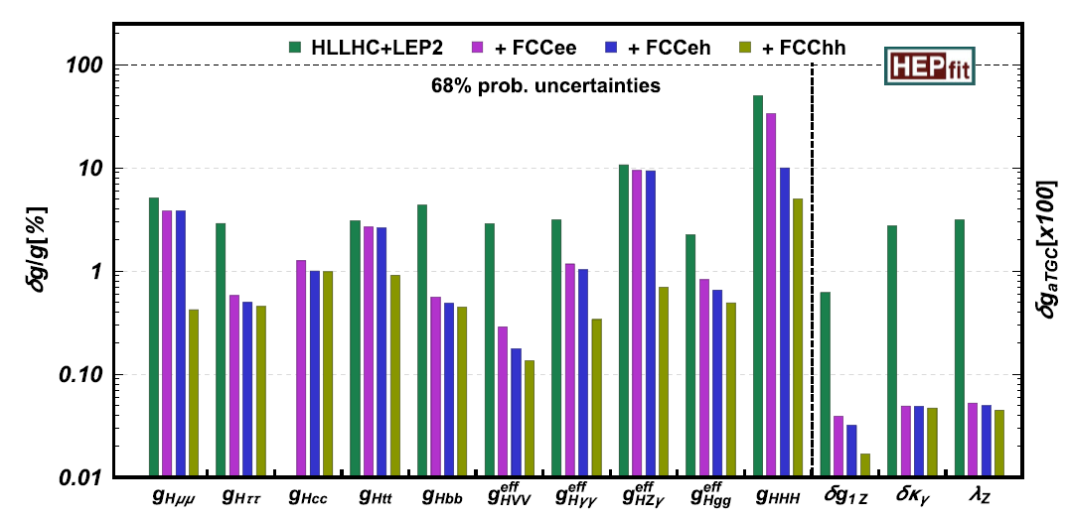
Higgs coupling fits
Results limited only by statistics
κ EFT

Slide 14
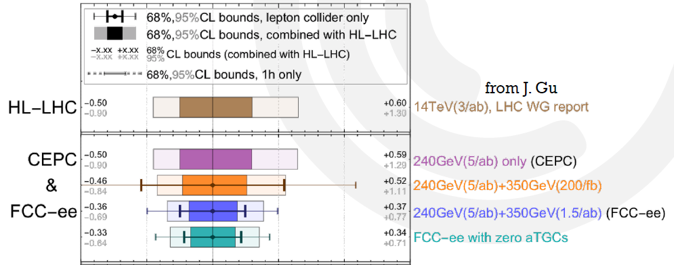
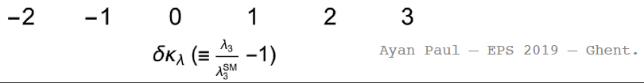
Triple Higgs
No direct production @ FCC-ee
  Sensitivity through loop effects

Slide 15
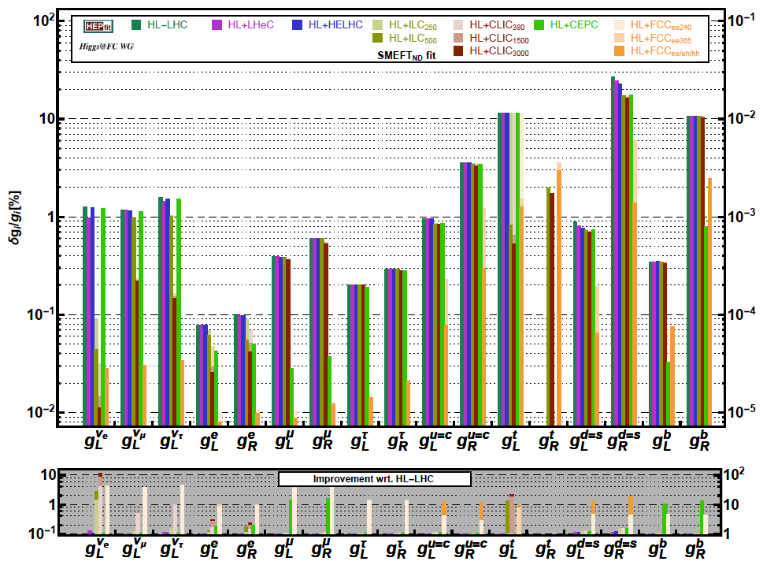
EWK
Outstanding program of precision EWK measurements
  O(10-100) better than LEP precision
  Substantially reduce parametric uncertainties in theory
EFT: Zff couplings

Slide 16
EWK examples
W mass/width → 0.5/1.2 MeV resolution
  WW threshold scan/ direct measurements check and improve
Top quark mass/width → 17/45 MeV resolution
  tt threshold scan – N³LO, ISR and FCCee luminosity spectrum

Slide 17
NP sensitivity from EFT fits
EWK observables
From exclusive fits
  Reach to several 10’s TeV
Theory uncertainties
  Parametric~ exp. precision
  Theory precision need
    3 loop Z pole
    2 loop WW
Higgs observables

Slide 18
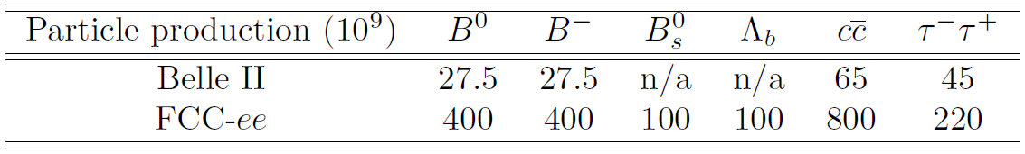
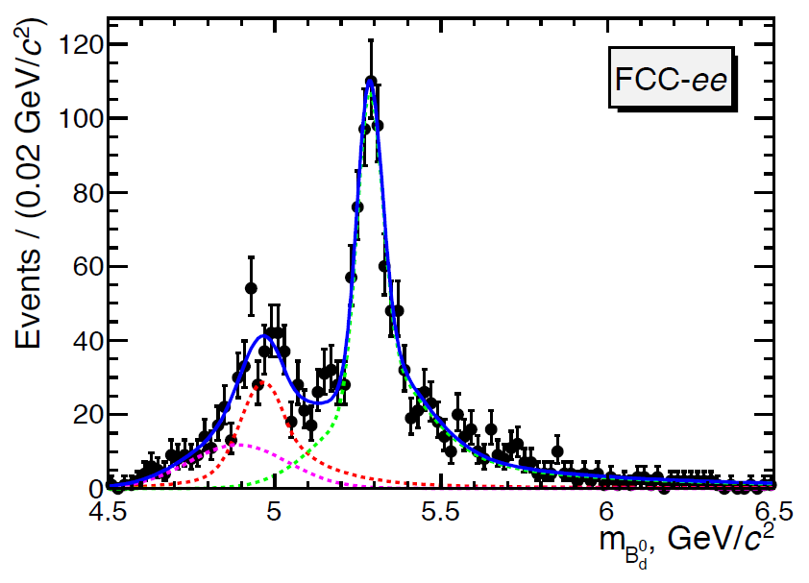
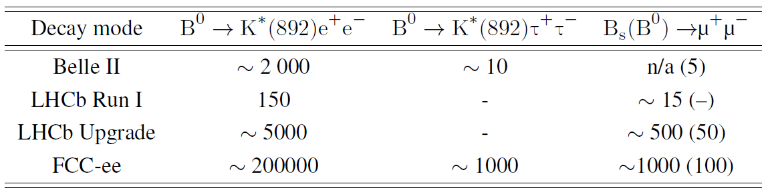
Heavy flavors
Large heavy flavor production at Z pole
  Very clean, well separated, pairs
Example:
  Lepton universality
  in B⁰ → K^{*0} τ+τ-

Slide 19
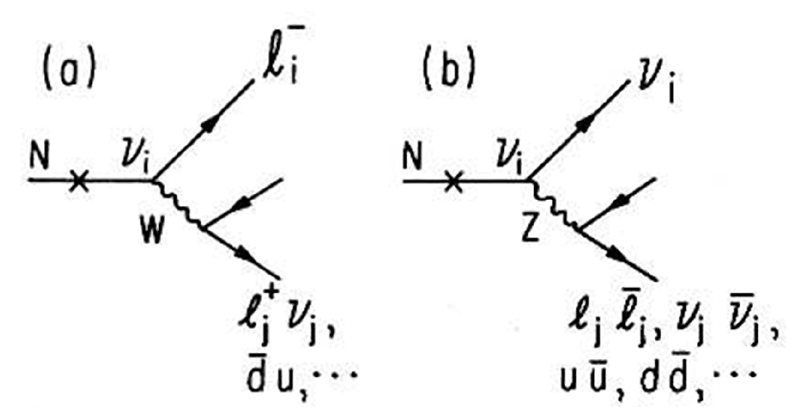
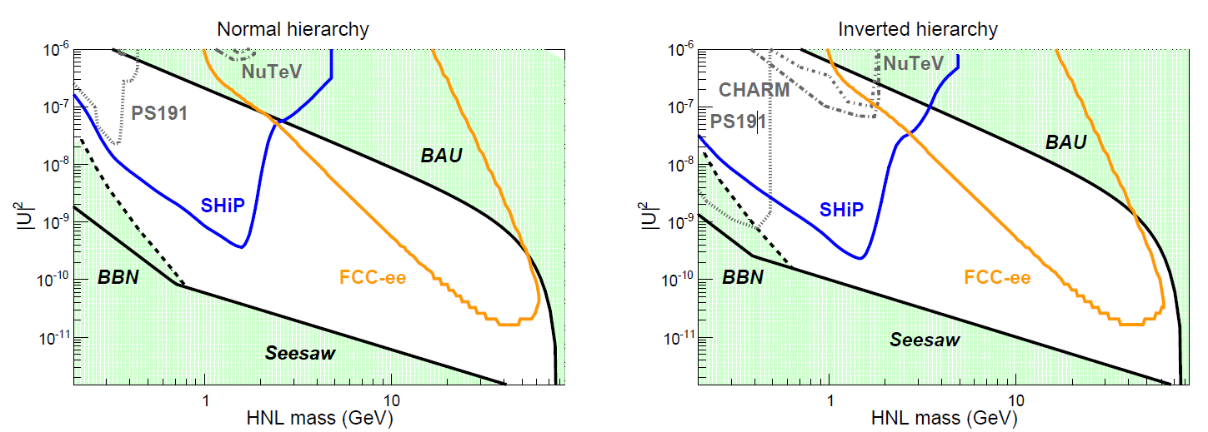
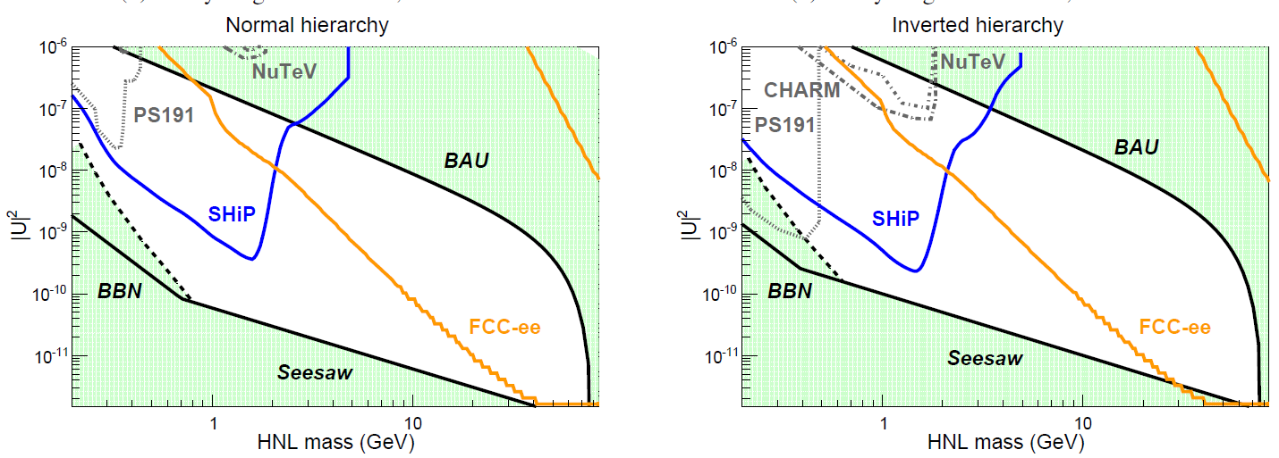
Direct NP search example: HNL
HNL mix with active neutrino’s
  Fully reconstructable decay with W
  Small mixing → long lifetime
10 cm < cτ < 100 cm
10¹² Z
0.01 cm < cτ < 500 cm
10¹³ Z

Slide 20
Accelerators
The planned machines

Slide 21
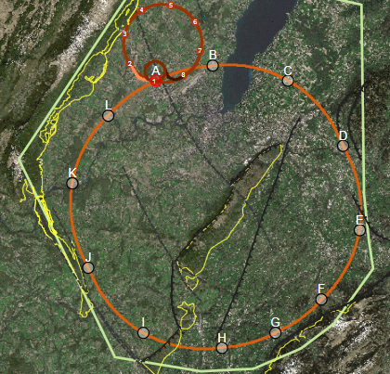
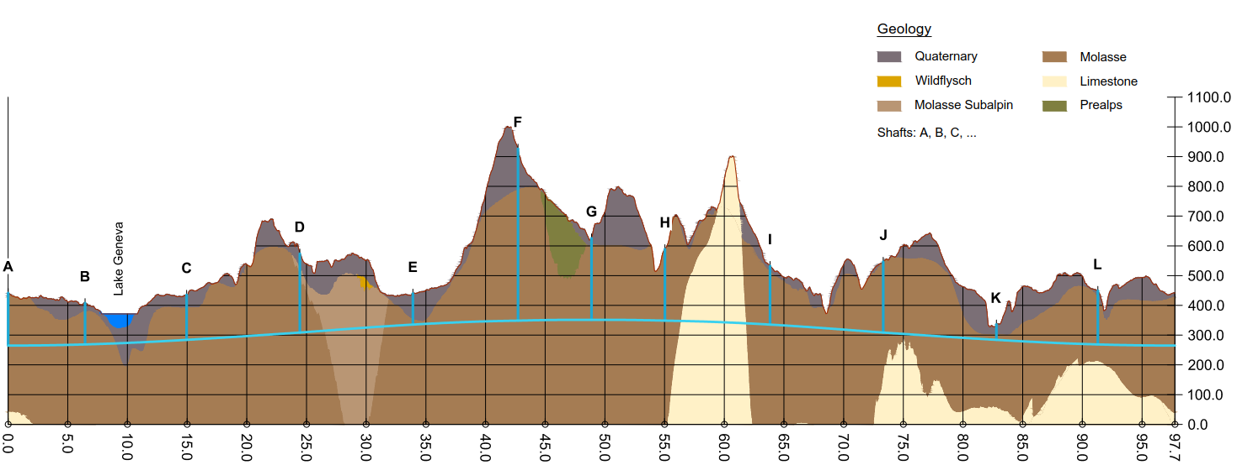
FCC integrated program
inspired by succesful LEP – LHC programs at CERN
Implementation studies in Geneva basin:
baseline position was established considering:
minimum risk for construction, fastest and cheapest construction
efficient connection to CERN accelerator complex
Total construction duration 7 years
First sectors ready after 4.5 years
M. BENEDIKT, Granada 2019

Slide 22
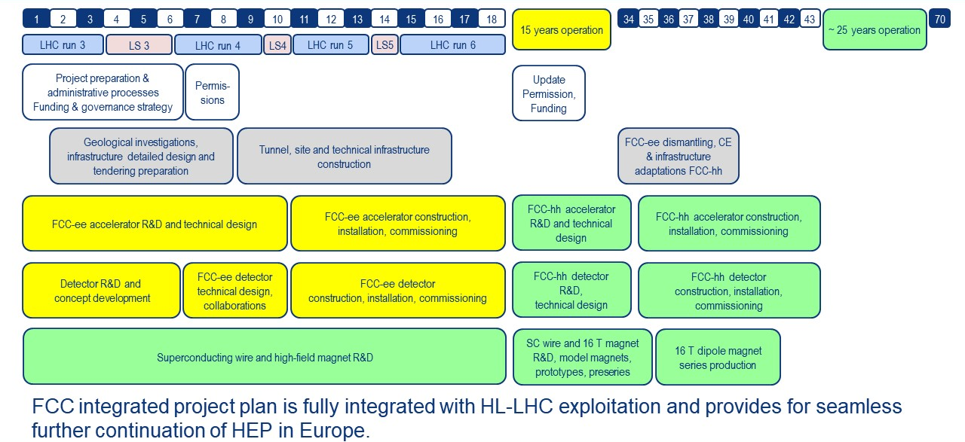
FCC-ee + FCC-hh
M. BENEDIKT, Granada 2019

Slide 23
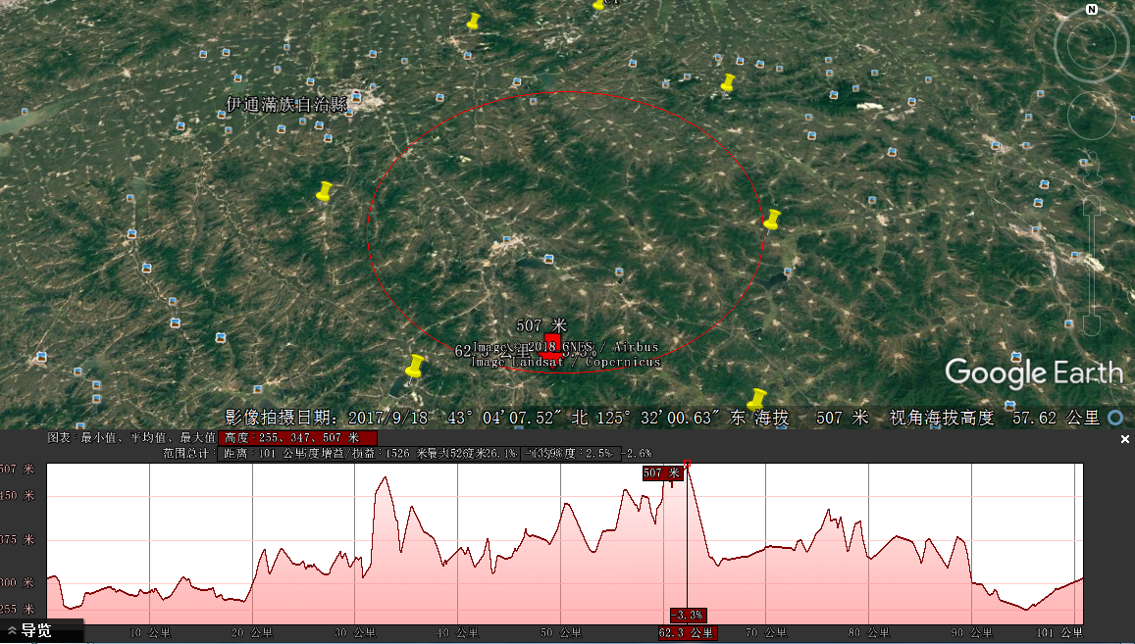

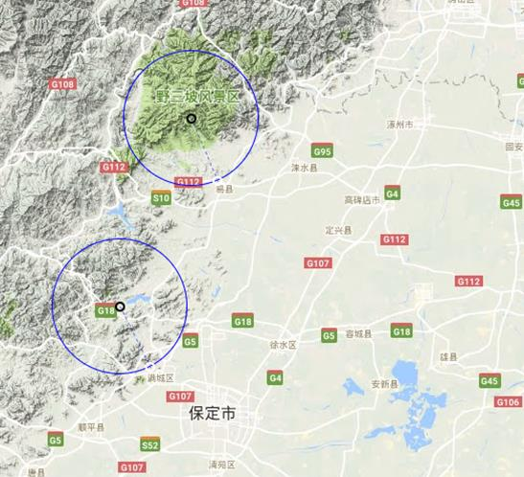
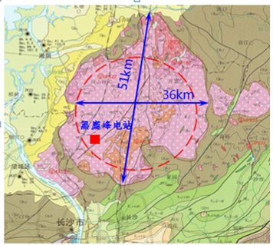
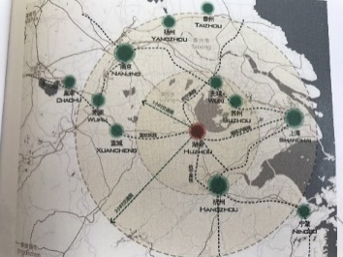

CEPC-SppC: site studies
CEPC Site Selections
1) Qinhuangdao, Hebei ProvinceCompleted 2014）
2) Huangling, Shanxi Province（Completed 2017)
3) Shenshan, Guangdong Province(Completed 2016)
4) Baoding (Xiong an), Hebei Province (Started August 2017)
5) Huzhou, Zhejiang Province (Started March 2018)
6) Chuangchun, Jilin Province (Started May 2018)
7) Changsha, Hunan Province (Started Dec. 2018)
6
1
Huanghe Company particitated
2
4
1)
4
7
2)
5
3
3)
J. Gao, Granada 2019

Slide 24
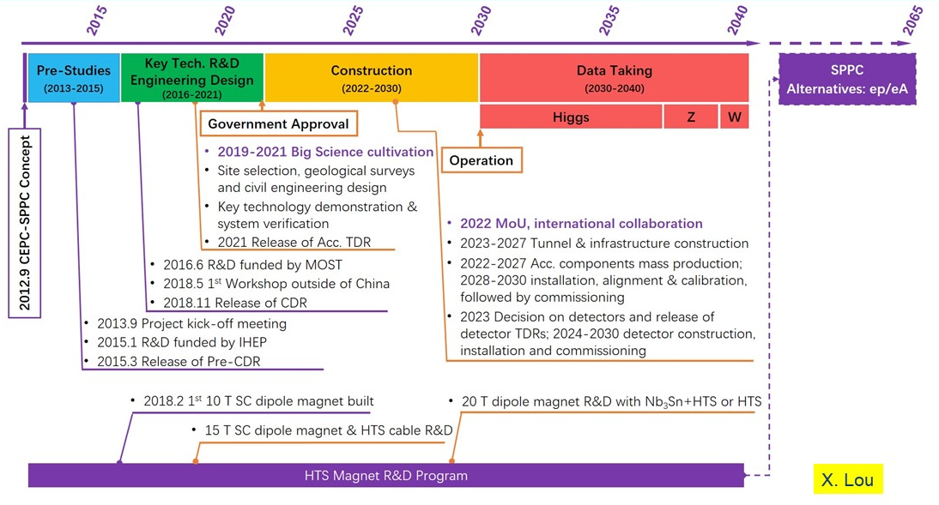
CEPC

Slide 25

Conclusions
Huge potential of physics from FCC-ee (or CepC)
  Study Higgs x10 better than HL-LHC
  EWPO x10-100 better than LEP
  ➔ sensitivity to NP in the 10’s TeV range
  Large potential for HF studies complementary to LHC-b/Belle II
  Direct sensitivity to new physics
Can match right time scale immediately after HL-LHC
Setup infrastructure for highest energy with FCC-hh
  Gain time for high field magnet development
  Same infrastructure could be used for a multi TeV muon collider
Let’s do it!

Slide 26
Additional Slides

Slide 27
LHC BSM exclusion
1 TeV
5 TeV

Slide 28
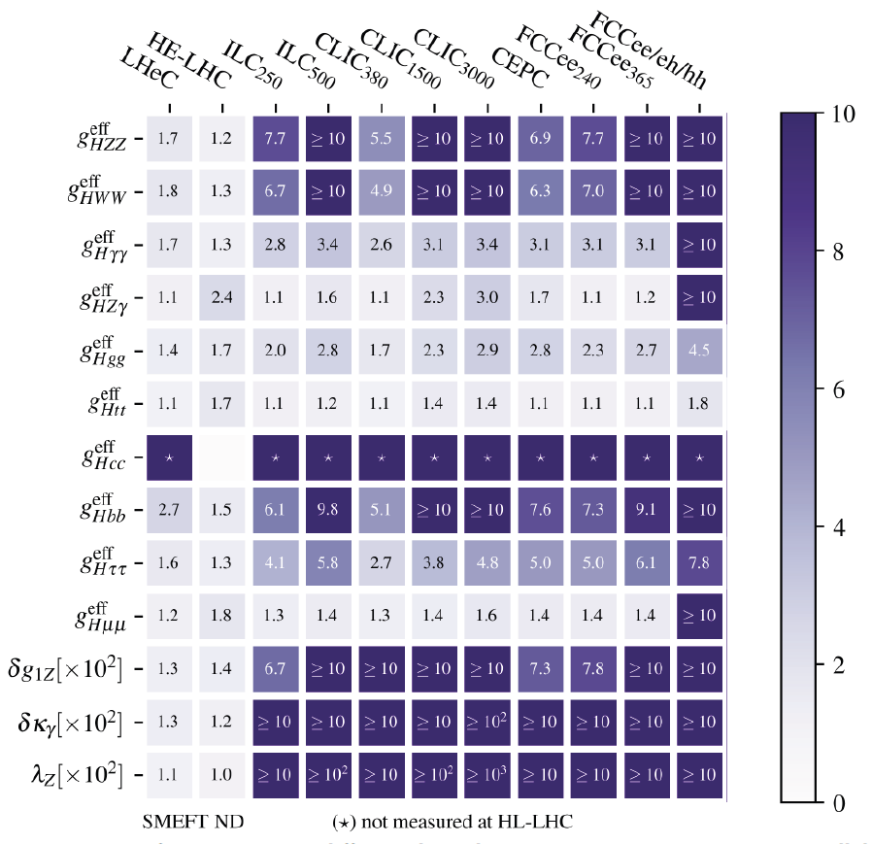
Higgs coupling comparison
Improvement factors relative to HL-LHC

Slide 29
e⁺e⁻ Ring Higgs Factories
Advantages:
  Based on mature technology (SRF) and rich experience
    → lower risk
  High(er) luminosity and ratio luminosity/cost;
    Up to 4 IPs, EW factories
  100 km tunnel can be reused for a pp collider in the future
  Transverse polarization (τ~ 18 min at tt) for E calibration O(100keV)
  CDRs addressed key design points, mb ready for ca 2039 start
  Very strong and broad Global FCC Collaboration
V. SHILTSEV, Granada 2019

Slide 30
Challenges of e⁺e⁻ Ring HF’s
Power limited regime
  Synchrotron radiation power from both beams limited to 100 MW (P/η=total site power) → current I is set by power
Luminosity
  Determined by bend radius ρ, beam-beam parameter ξ_{y}, beta function at the IP β_{y}* and power
  Beam life ~18 min requires full energy booster ring
V. SHILTSEV, Granada 2019

Slide 31
Linear Colliders e+e- Higgs Factories
Advantages:
  Based on mature technology (Normal Conducting RF, SRF)
  Mature designs: ILC TDR, CLIC CDR and test facilities
  Polarization (ILC: 80%-30% ; CLIC 80% - 0%)
  Expandable to higher energies (ILC to 0.5 and 1 TeV, CLIC to 3 TeV)
  Well-organized international collaboration (LCC) → “we’re ready”
  Wall plug power ~130-170 MW (i.e. <= LHC)
Pay attention to:
  Cost more than LHC ~(1-1.5) LHC
  LC luminosity < ring (e.g., FCC-ee), upgrades at the cost:
    e.g. factor of 4 for ILC: x2 Nbunches and 5 Hz → 10 Hz
  Limited LC experience (SLC), two-beam scheme (CLIC) is novel,
    klystron option as backup
  Wall plug power may grow >LHC for lumi / E upgrades
V. SHILTSEV, Granada 2019

Slide 32
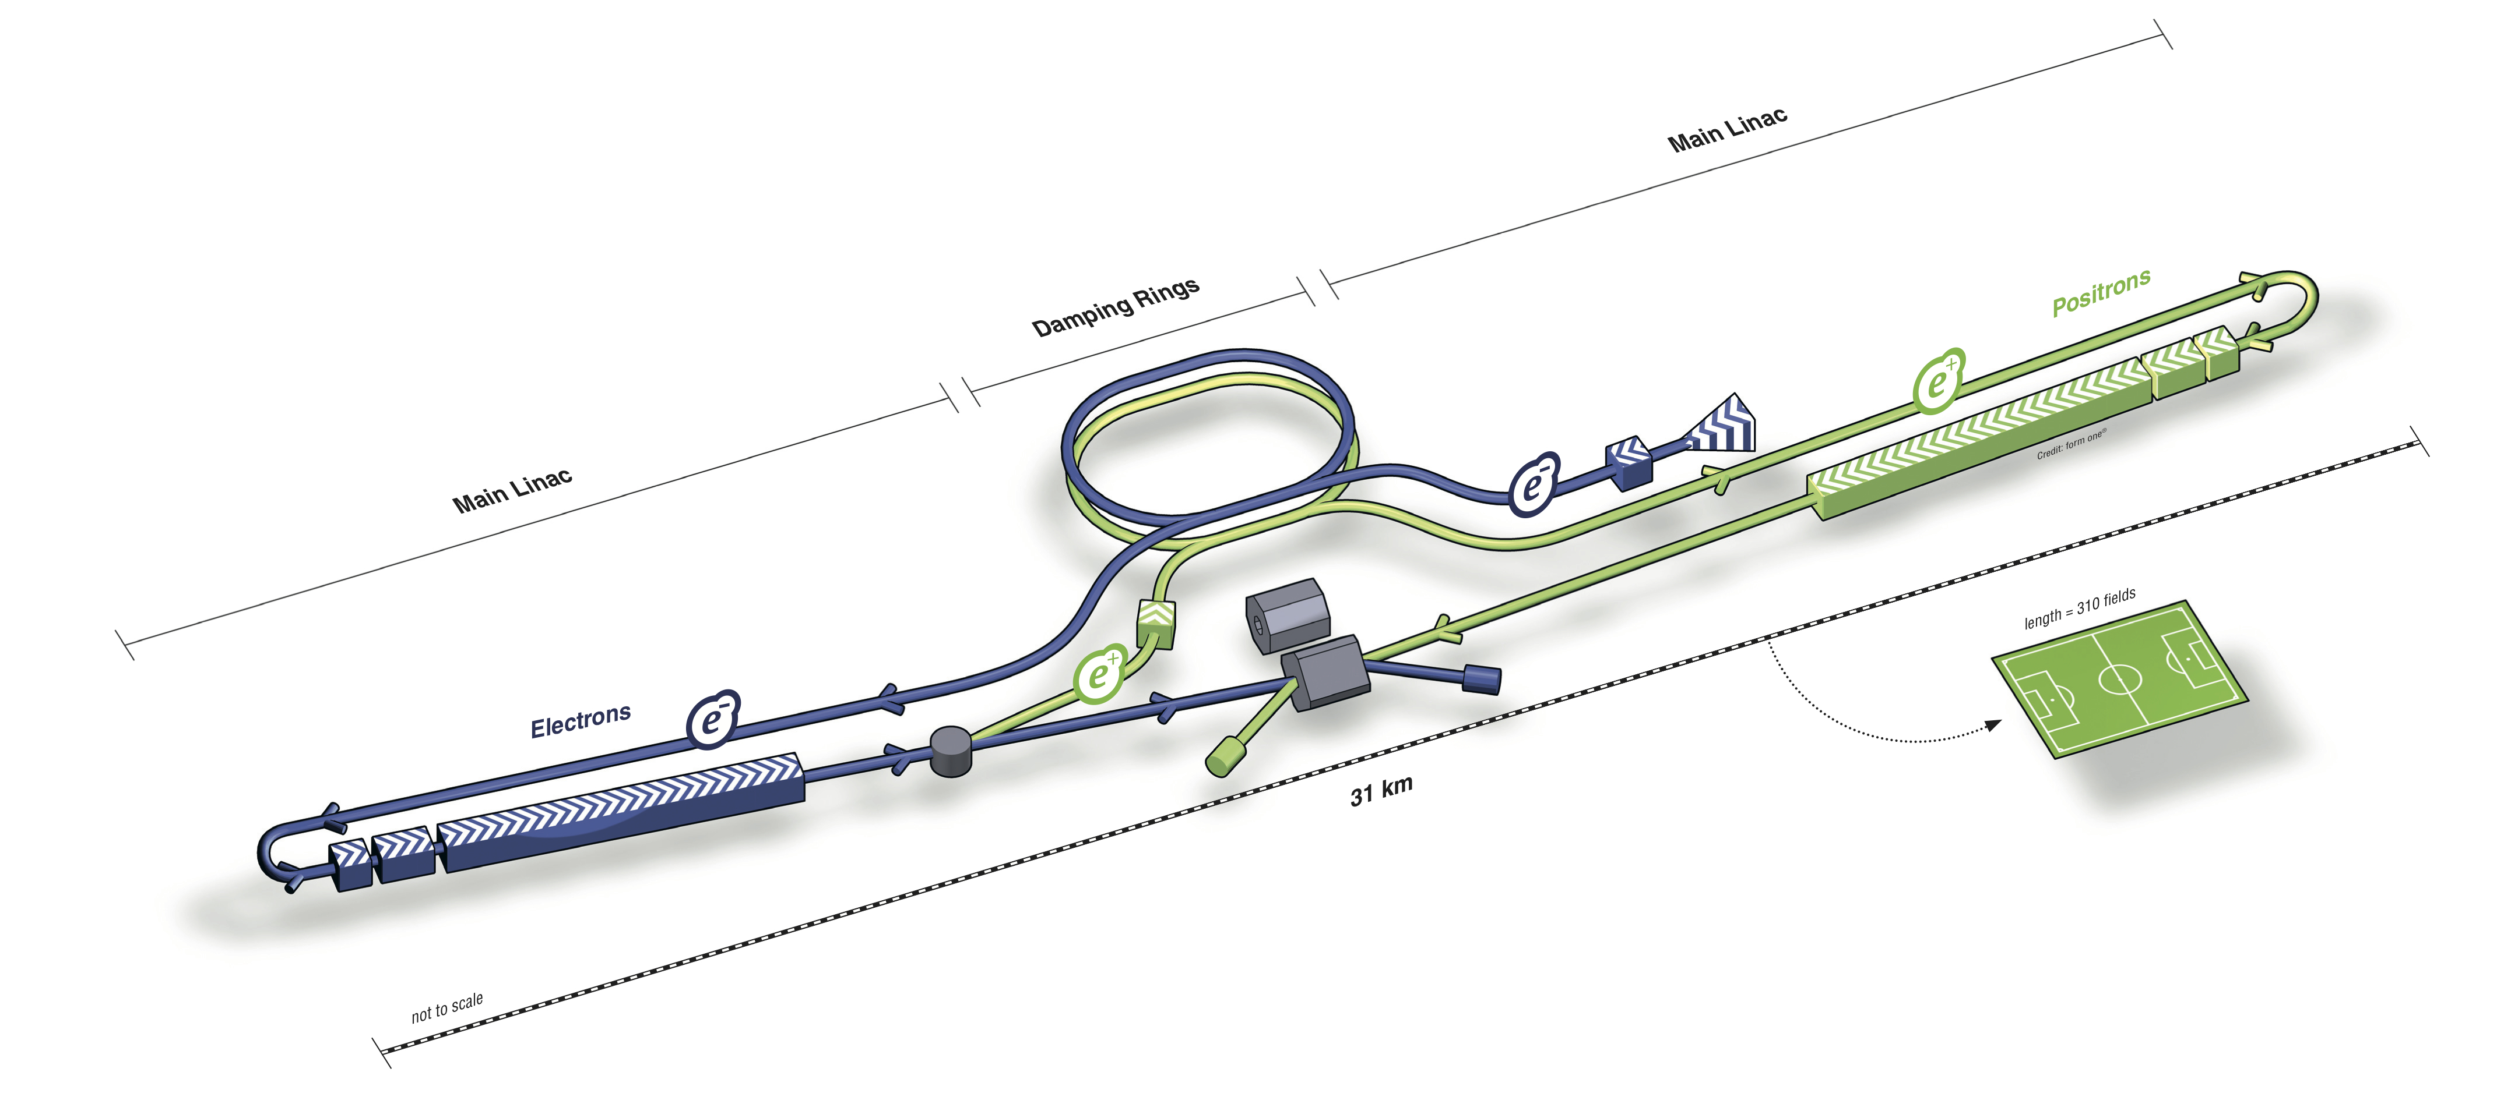
International Linear Collider
Descoped
500→250 GeV
V. SHILTSEV, Granada 2019
Key facts:
  20 km, including 5 km of Final Focus
  SRF 1.3 GHz, 31.5 MV/m, 2 K
  130 MW site power @ 250 GeV c.m.e.
  Cost estimate 700 B JPY = 5.8 B€

Slide 33
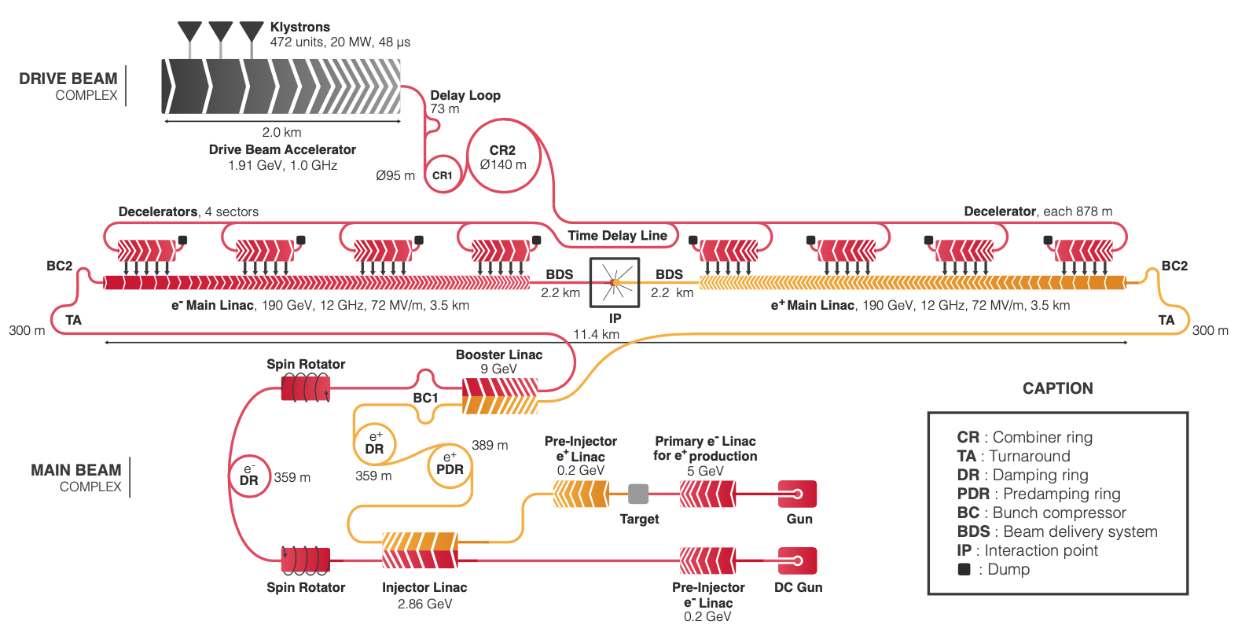
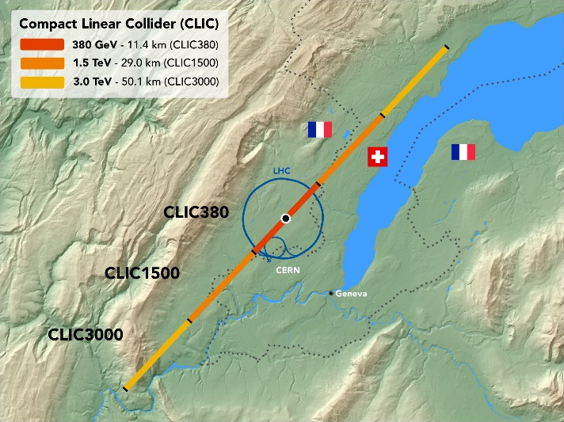
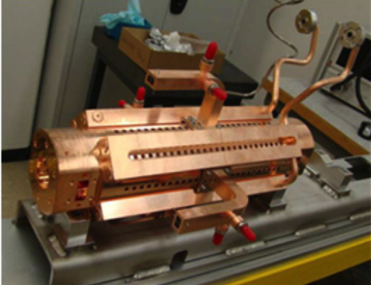
Compact LInear Collider
V. SHILTSEV, Granada 2019
Key facts:
  11 km main linac @ 380 GeV c.m.e.
  NC RF 72 MV/m, two-beam scheme
  168 MW site power (~9MW beams)
  Cost est. 5.9 BCHF (klystrons + 1.4 BCHF)

Slide 34
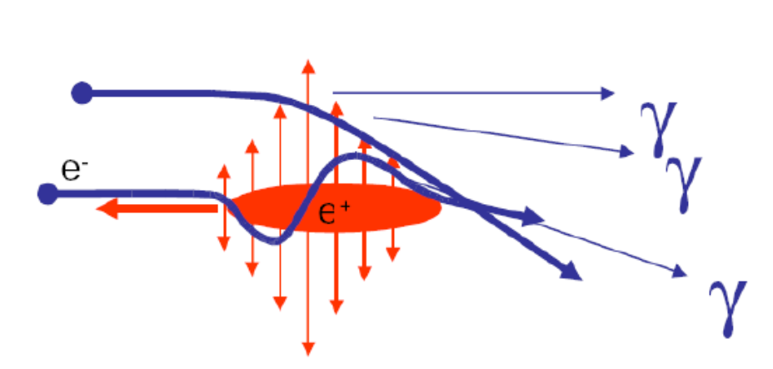
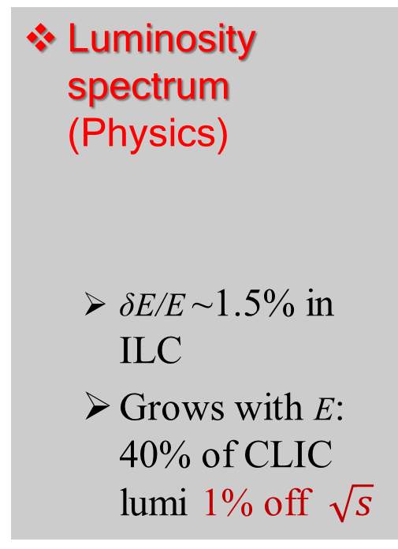
Challenges of Linear Colliders Higgs Factories
Luminosity spectrum (Physics)
  δE/E ~1.5% in ILC
  Grows with E: 40% of CLIC lumi 1% off $\sqrt{s}$
Beam Current
(RF power limited, beam stability)
  Challenging e+ production (two schemes)
  CLIC high-current drive beam bunched at 12 GHz
Beam Quality
(Many systems)
  Record small DR emittances
  0.1 μm BPMs
  IP beam sizes
ILC 8nm/500nm
CLIC 3nm/150nm
V. SHILTSEV, Granada 2019

Slide 35
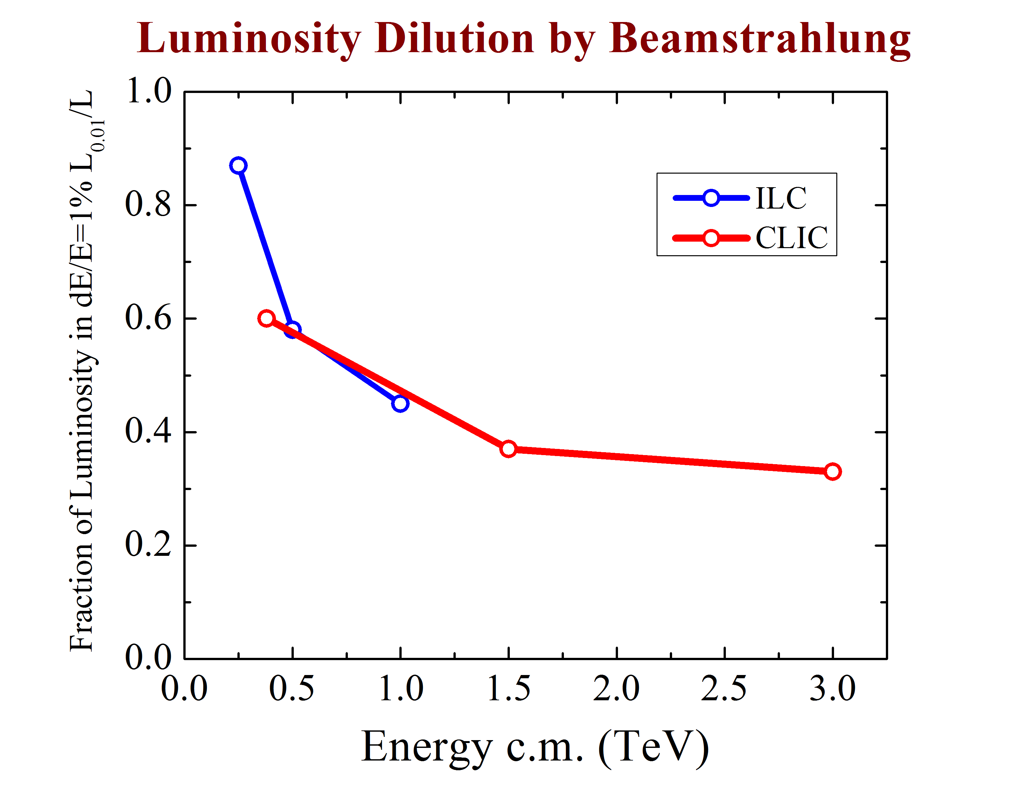
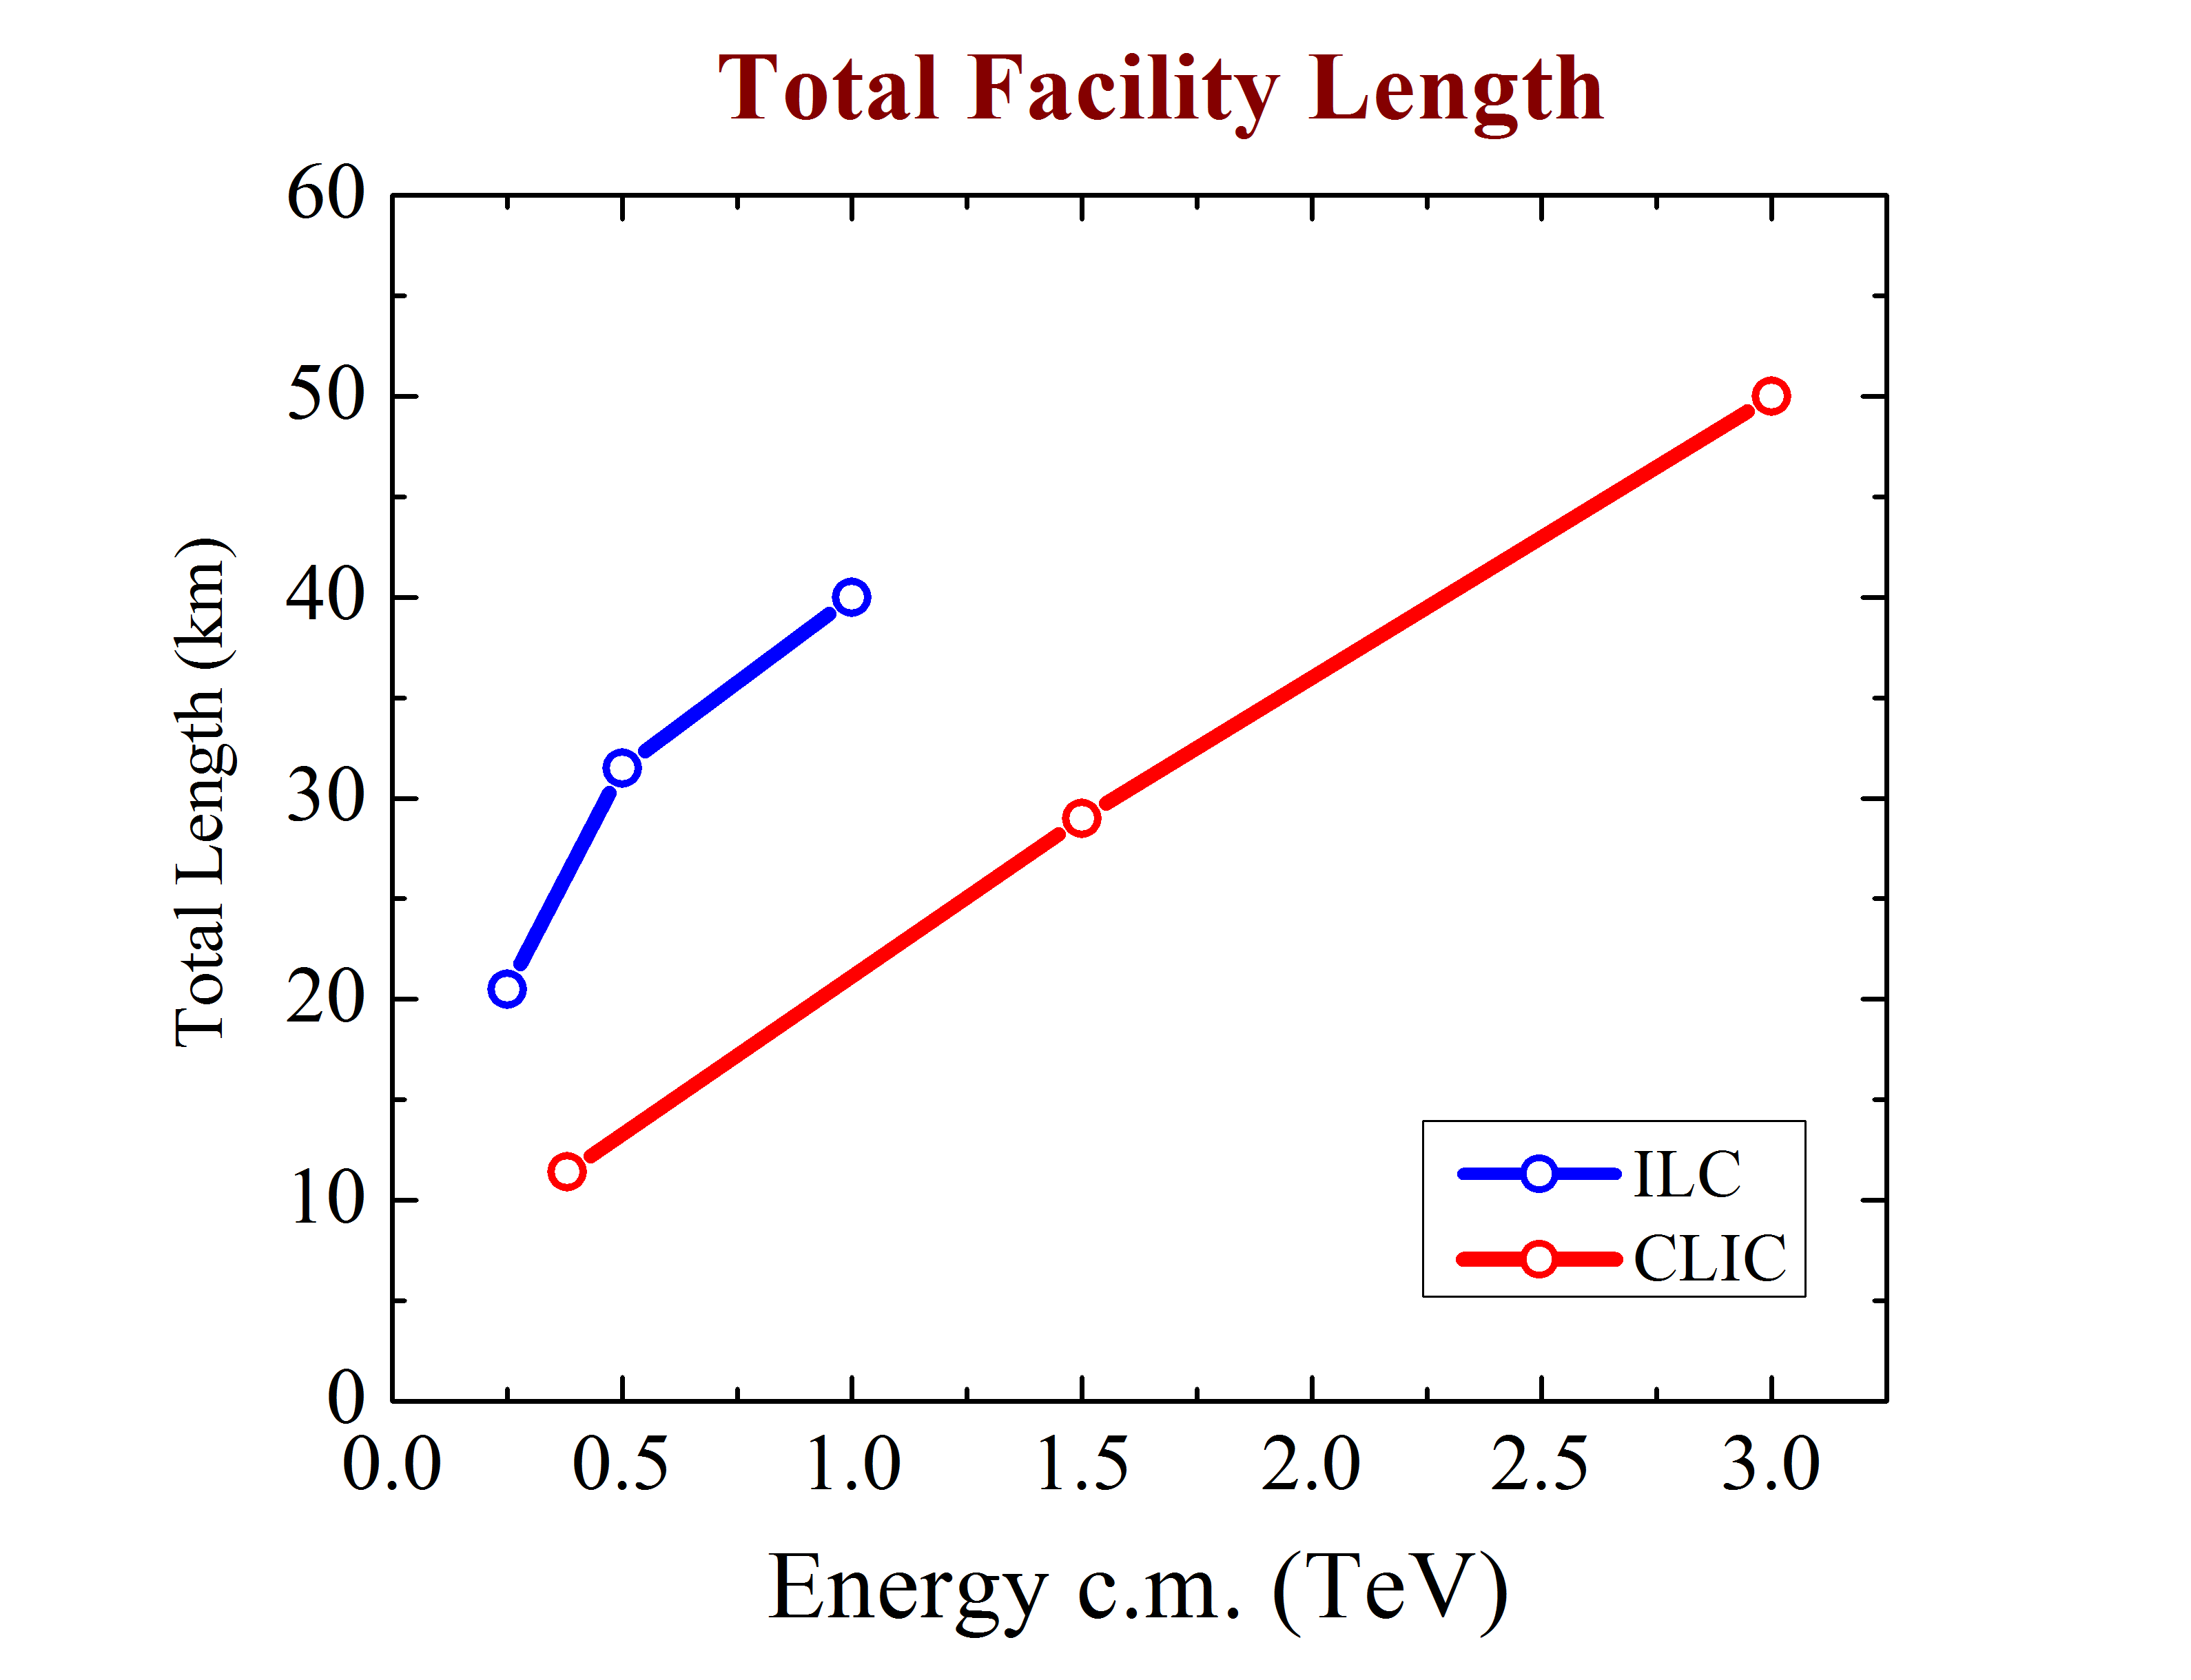
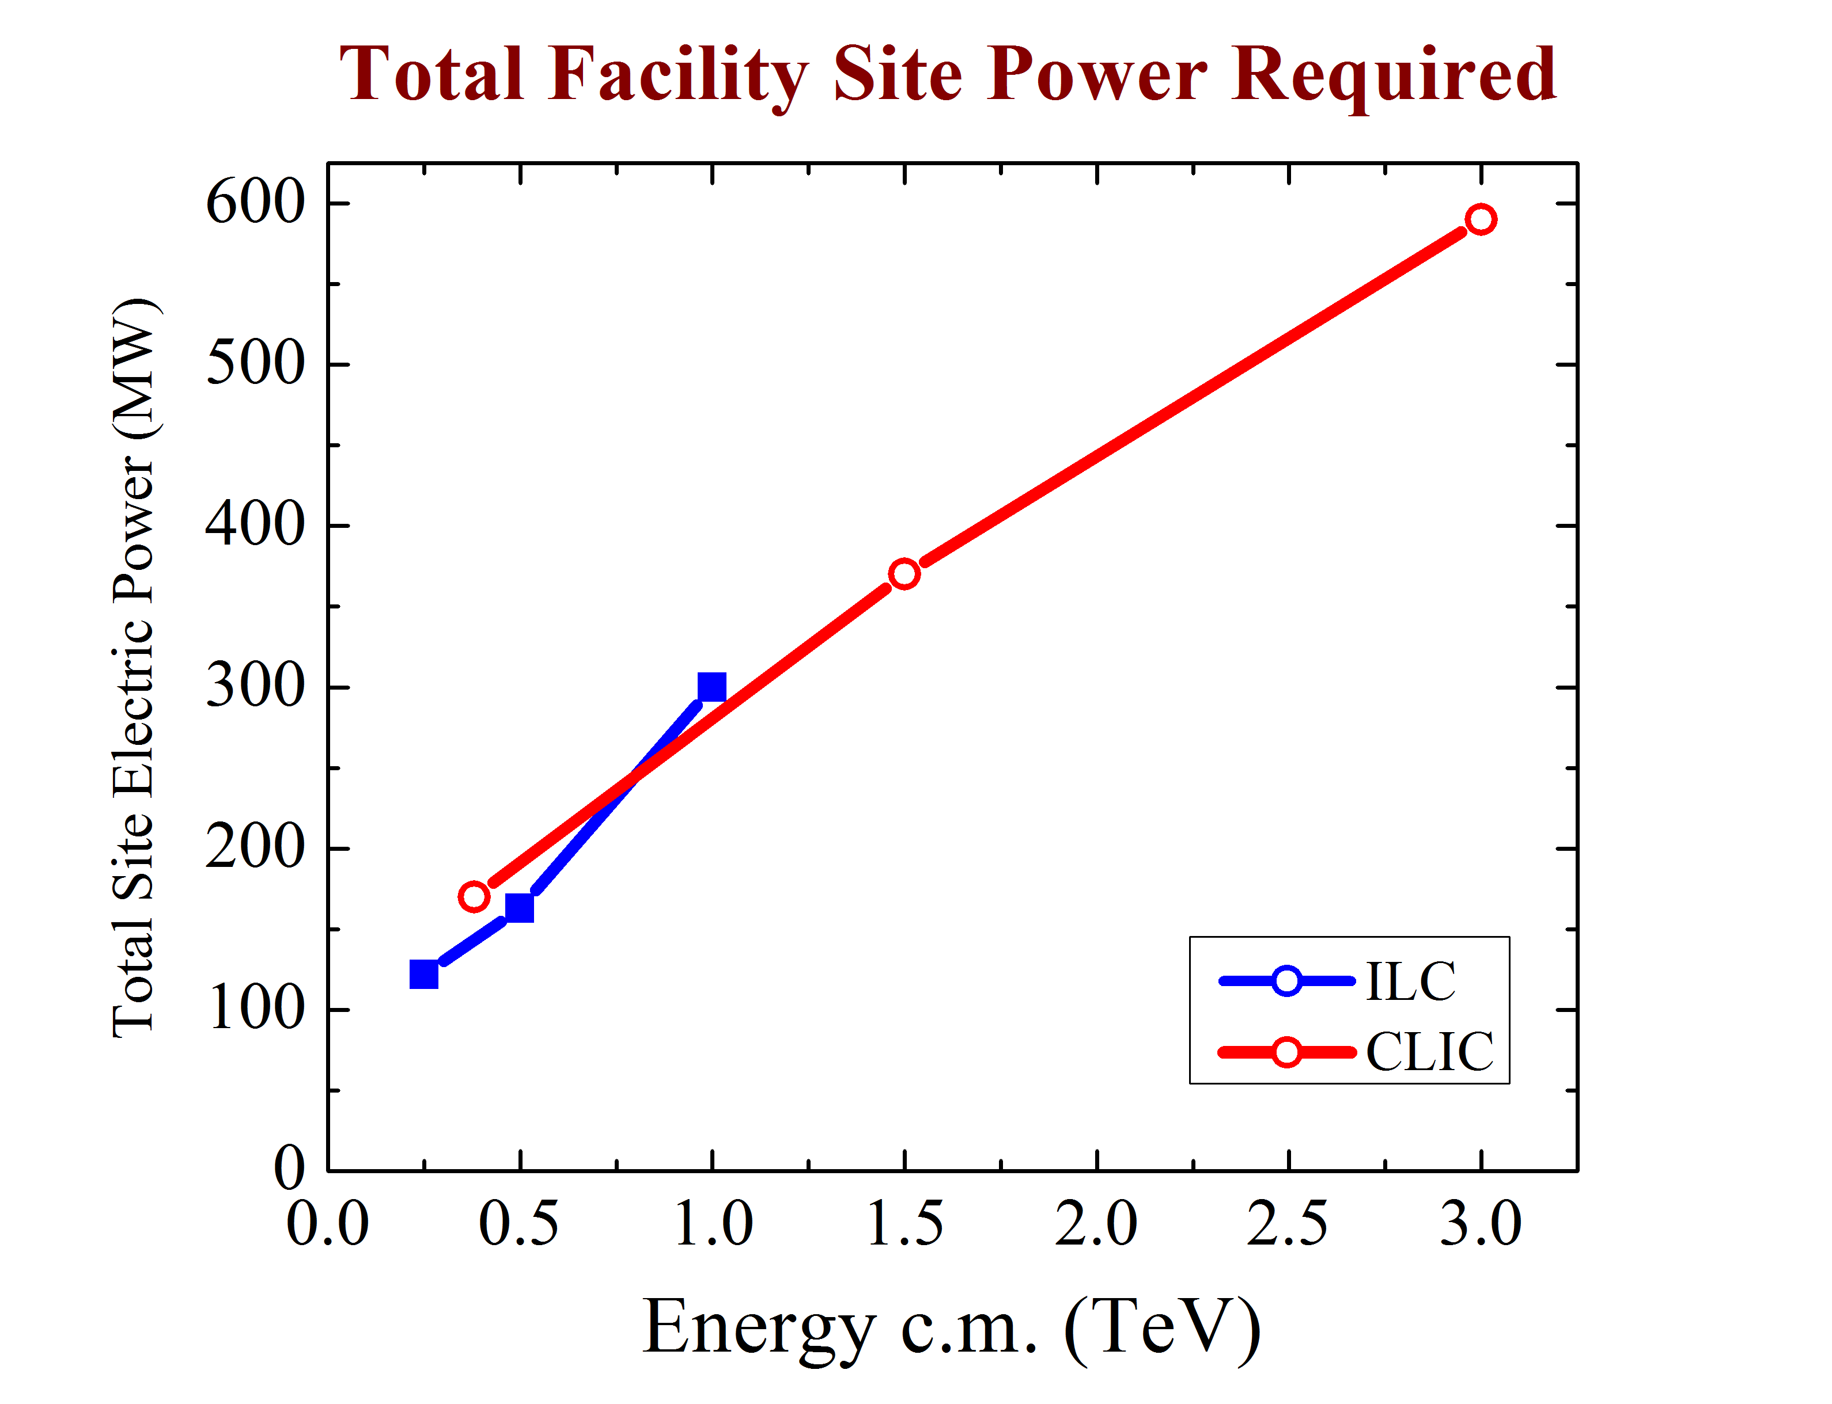
Limits of Linear e⁺e⁻ Colliders
Both ILC and CLIC offer staged approach to ultimate E
The limits are set by:
  Cost
    ILC TDR 1 TeV 17 B$
    CLIC CDR 3 TeV 18.3BCHF
  Electric power required
  Total length
  (complication of) Beamstrahlung
LHC
CERN
V. SHILTSEV, Granada 2019

Slide 36
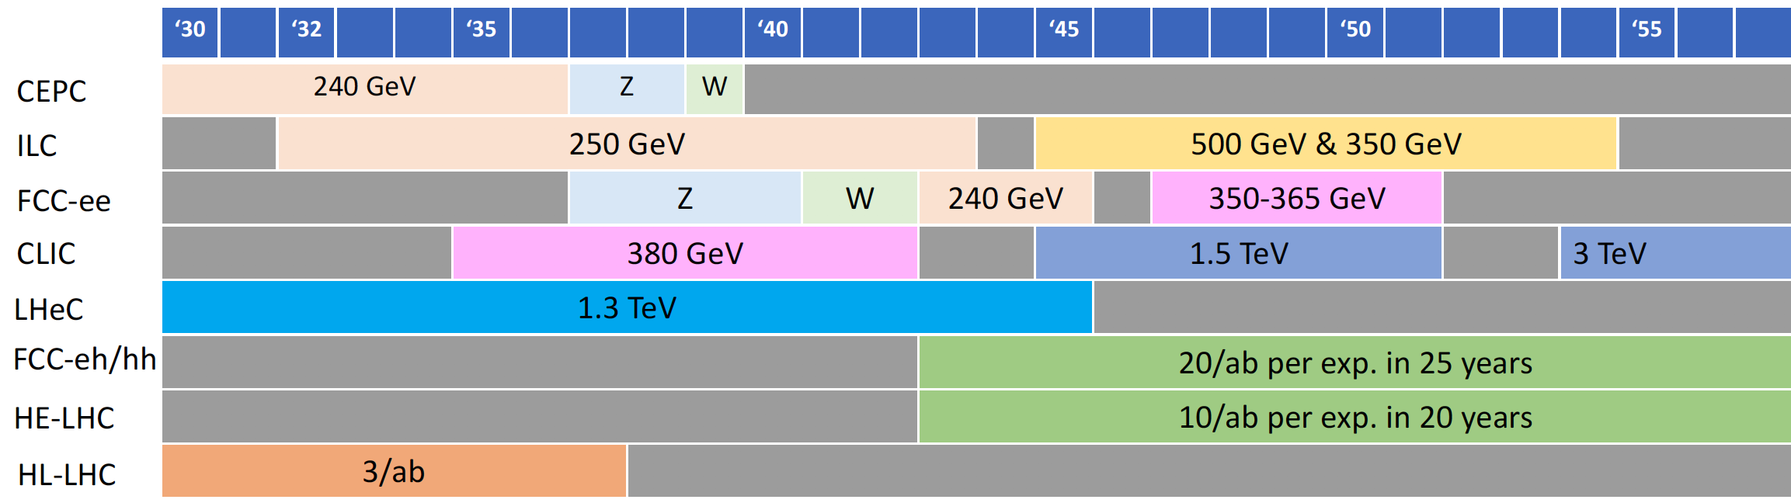
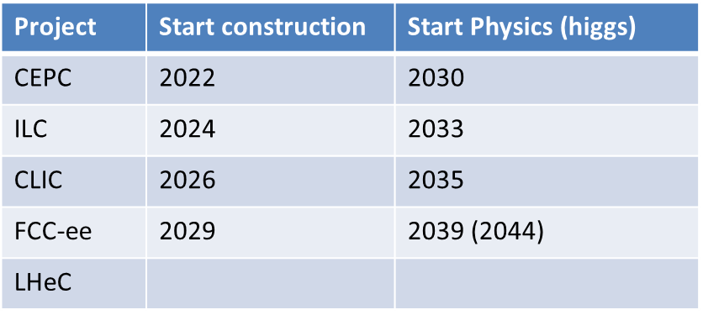
Schedules
Very optimistic!!!
D. SCHULTE, Granada 2019

Slide 37
Other comparisons
F2 “Energy Efficiency”
  Green : 100-200 MW
  Yellow : 200-400 MW
  Red : > 400 MW
F1 “Technology Readiness” :
  Green - TDR
  Yellow - CDR
  Red - R&D
F3 “Cost” :
  Green : < LHC
  Yellow : 1-2 x LHC
  Red : > 2x LHC
V. SHILTSEV, Granada 2019

Slide 38
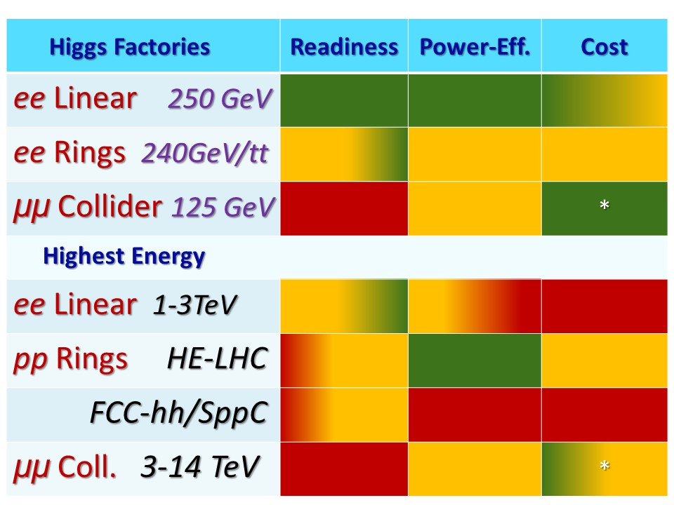
Other comparisons
V. SHILTSEV, Granada 2019

Slide 39
Comparison table
Project | Type | Energy [TeV] | Int. Lumi. [a⁻¹] | Oper. Time [y] | Power [MW] | Cost
ILC | ee | 0.25 | 2 | 11 | 129 (upgr. 150-200) | 4.8-5.3 GILCU + upgrade
 |  | 0.5 | 4 | 10 | 163 (204) | 7.98 GILCU
 |  | 1.0 |  |  | 300 | ?
CLIC | ee | 0.38 | 1 | 8 | 168 | 5.9 GCHF
 |  | 1.5 | 2.5 | 7 | (370) | +5.1 GCHF
 |  | 3 | 5 | 8 | (590) | +7.3 GCHF
CEPC | ee | 0.091+0.16 | 16+2.6 |  | 149 | 5 G$
 |  | 0.24 | 5.6 | 7 | 266
FCC-ee | ee | 0.091+0.16 | 150+10 | 4+1 | 259 | 10.5 GCHF
 |  | 0.24 | 5 | 3 | 282
 |  | 0.365 (+0.35) | 1.5 (+0.2) | 4 (+1) | 340 | +1.1 GCHF
LHeC | ep | 60 / 7000 | 1 | 12 | (+100) | 1.75 GCHF
FCC-hh | pp | 100 | 30 | 25 | 580 (550) | 17 GCHF (+7 GCHF)
HE-LHC | pp | 27 | 20 | 20 |  | 7.2 GCHF

Slide 40
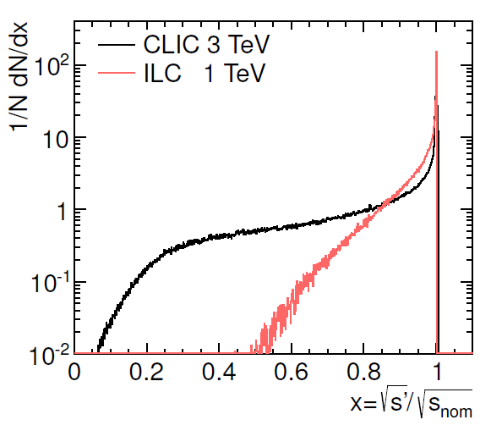
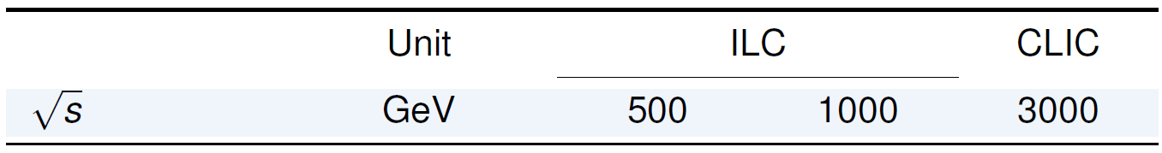
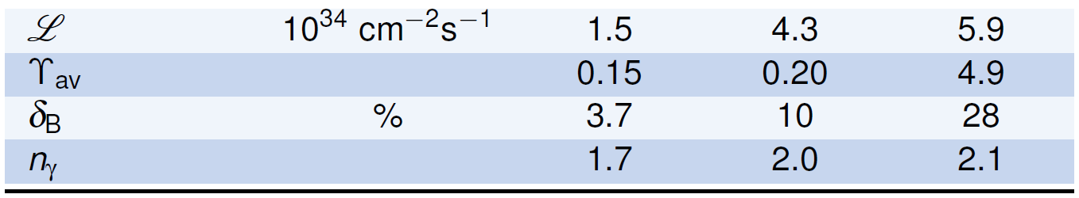

Beamstrahlung
δ$BS ∝ \left(\frac{ECM}{σz}\right)\frac{N2}{σx2}$
  ILC 240 ~ 1.6%

