Slide 1



Looking for states analogous to the ¹²C Hoyle state in heavier nuclei
Marina Barbui
Workshop: Light clusters in nuclei and nuclear matter: Nuclear structure and decay, heavy ion collisions, and astrophysics
September 2-6, 2019

Slide 2
Outline
Motivation
Why we use a thick target in inverse kinematics
Experimental setup for the reaction ²⁰Ne + α at 12 AMeV and 9.7 AMeV
Show that with this technique we can identify states near the threshold in ⁸Be (α -multiplicity 2) and ¹²C (α - multiplicity 3)
Interesting results for ¹⁶O (α - multiplicity 4)
Interesting results for ²⁴Mg

Slide 3
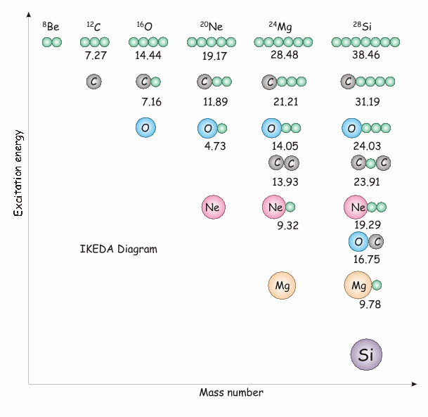
Alpha clustering in nuclei
Estimated limit N = 7-10α for self-conjugate nuclei Yamada and Schuck PRC 69, 024309, Bai and Ren PRC 97, 05301
Ikeda diagram (K. Ikeda, N. Takigawa, and H. Horiuchi, Prog. Theor, Phys. Suppl. Extra Number, 464, 1968.)
Many theoretical works have brought to the picture of alpha cluster nuclei described as a diluted gas of alphas in the lowest S state. (PRL 87, 192501; PRC 75, 037303).
Possible existence of alpha condensates in nuclear matter.
Experimentally only few not conclusive works are available for ¹⁶O or heavier
Look for states analogous to the ¹²C Hoyle state using the thick target inverse kinematics technique
M.Barbui et al. PRC 98, 044601,2018

Slide 4
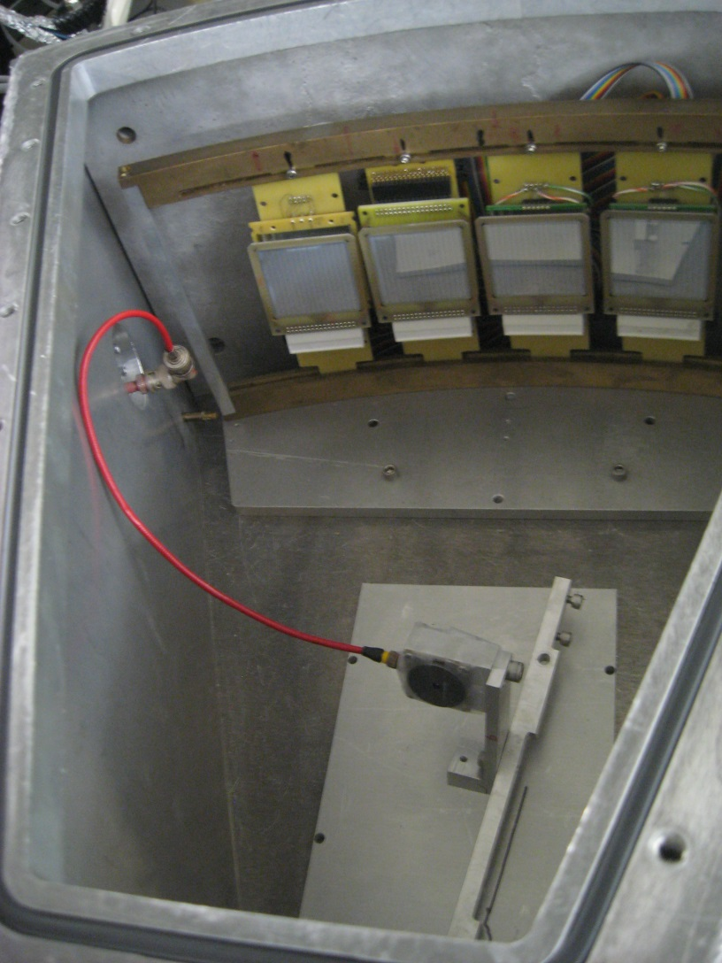
The thick target inverse kinematics technique
Pressurized chamber
⁴He gas, pressure sufficient to stop the beam before the detectors
4 ΔE-E telescopes
Allows covering a large range of incident energies in the same experiment.
In the inverse kinematics, the reaction products are focused at forward angles.
Allows measuring reaction products emitted at 0º.
This Method has been used several times to study resonant elastic scattering or transfer reactions and is used here for the first time to detect multiple alpha emission.
Limit: The position of the interaction point inside the gas has to be reconstructed with some assumptions
Monitor detector
²⁰Ne Beam
Havar window

Slide 5
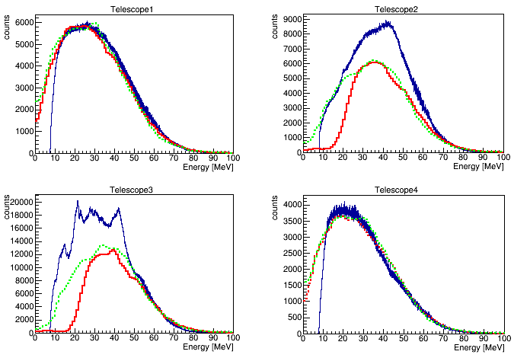
Events with alpha multiplicity 1
At 12AMeV the statistical evaporation plays an important role. This contribution is estimated using the PACE4 code and the HIPSE, both run with beam energy steps of 0.5 MeV/nucleon

Slide 6
Events with alpha multiplicity 1
The resonant elastic scattering is our reference reaction. We can compare the result with existing cross sections and have a double check for the beam intensity obtained from the monitor.
Alphas are punching through
In agreement with the excitation function measured in 10-15 keV energy steps in normal kinematics at 168º in the center of mass By R. Abegg and C.A. Davis

Slide 7
Events with alpha multiplicity 2
Data
12AMeV
Background estimated with HIPSE
Background
Subtraction

Slide 8
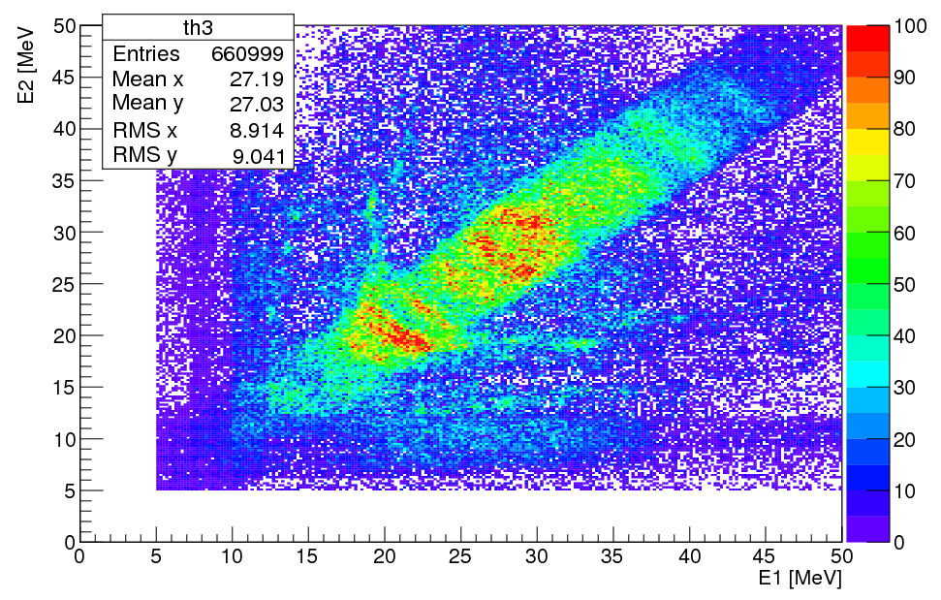
Events with alpha multiplicity 2
9.7 AMeV
After subtracting the background

Slide 9
Events with alpha multiplicity 2
α
²⁰Ne @ 12 and 9.7 AMeV +⁴He
2 alphas in the same event are correlated in time ΔT<30 ns
²⁰Ne
⁸Be
α
α
¹⁶O
Reconstruction of the interaction point with a recursive calculation based on conservation of energy and momentum and the assumptions:
The 2 alphas come from a ⁸Be
The ¹⁶O is in the ground state
Ek_α_lab -> Ek(⁸Be)
E*(⁸Be) = E_{cm}_α₁+E_{cm}_α₂+ Qgg
Since the 2 alphas have similar and quite large energy in the laboratory and travel similar flightpaths the energy loss correction almost cancels out when we calculate ⁸Be excitation energy specially at energies close to the threshold.

Slide 10
Events with alpha multiplicity 2

Slide 11
Events with alpha multiplicity 2

Slide 12
Events with alpha multiplicity 3
α
²⁰Ne @ 12 AMeV +⁴He
3 alphas in the same event are correlated in time ΔT<30 ns
²⁰Ne
¹²C₁
α
α
α
¹²C₂
Reconstruction of the interaction point with a recursive calculation based on conservation of energy and momentum and the assumptions:
The 3 alphas come from a ¹²C
The other ¹²C is in the ground state
Ek_α_lab -> Ek(¹²C₁)
E*(¹²C₁) = E_{cm}_α₁+E_{cm}_α₂+E_{cm}_α₃+ Qgg (7.26MeV)
Since the 3 alphas have similar and quite large energy in the laboratory and travel similar flightpaths the energy loss correction almost cancels out when we calculate ¹²C excitation energy specially at energies close to the threshold.

Slide 13
Events with alpha multiplicity 3
Relative energy of the three couples of alpha particles -> Tells us if the decay is proceeding through the ⁸Be ground state.
Dalitz Plot -> Information about the energy and momentum of the emitted alpha particles.
Hoyle
(3-) at 9.64 MeV

Slide 14
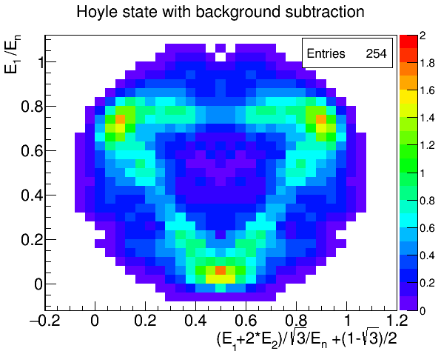
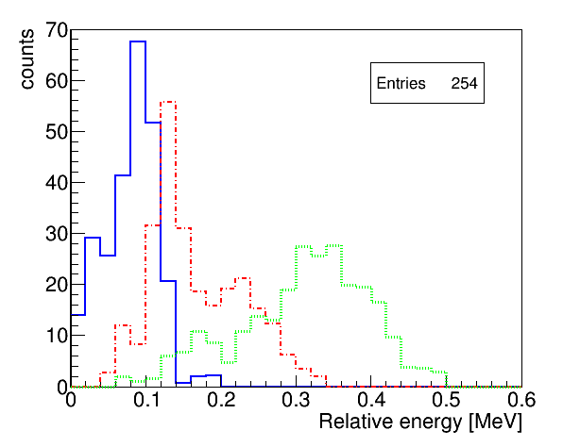
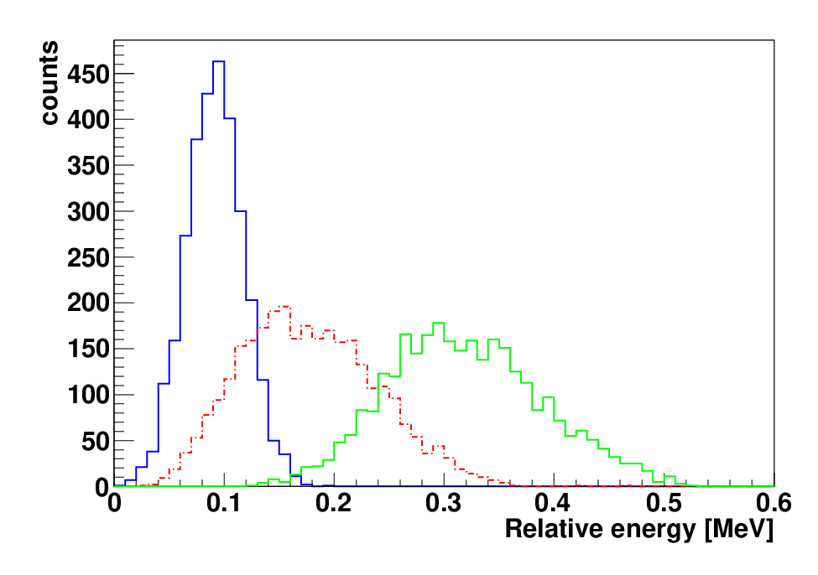
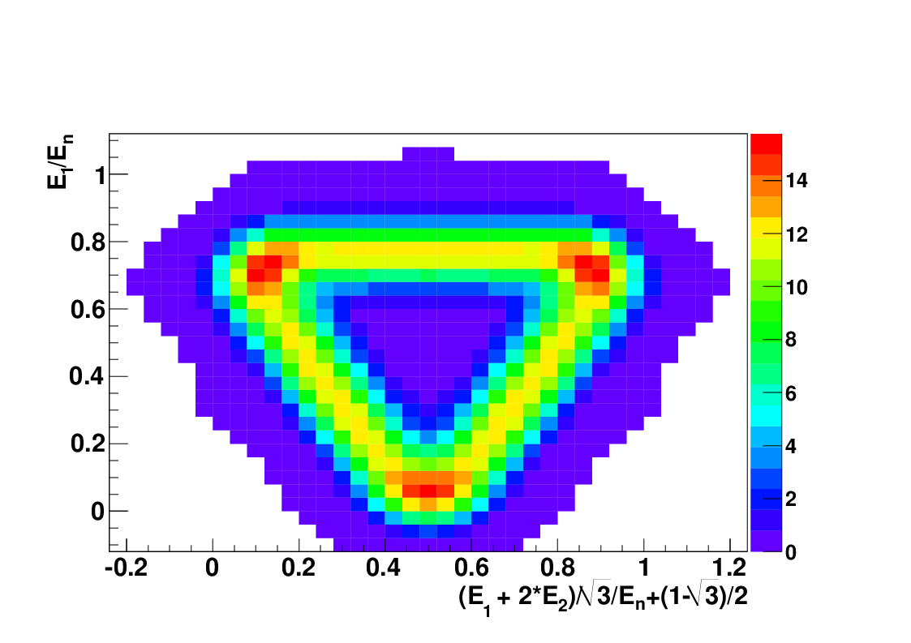
7.65 MeV (0+) Hoyle State decays through ⁸Be_{gs}
Experiment
In agreement with Monte Carlo simulation of the Hoyle state decaying through the ⁸Be ground state
Simulation

Slide 15
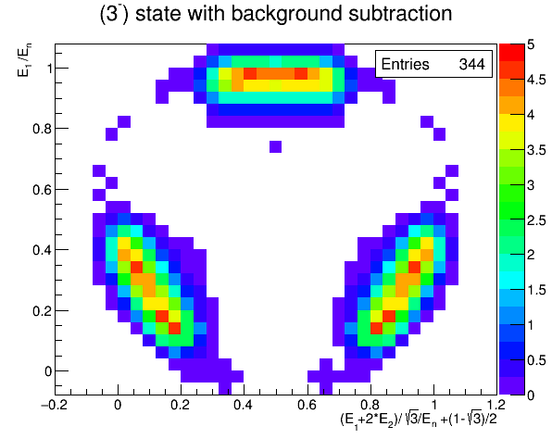
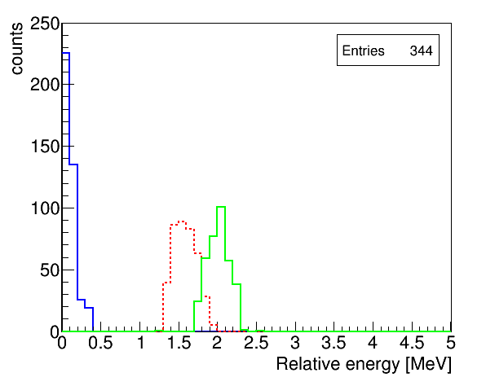
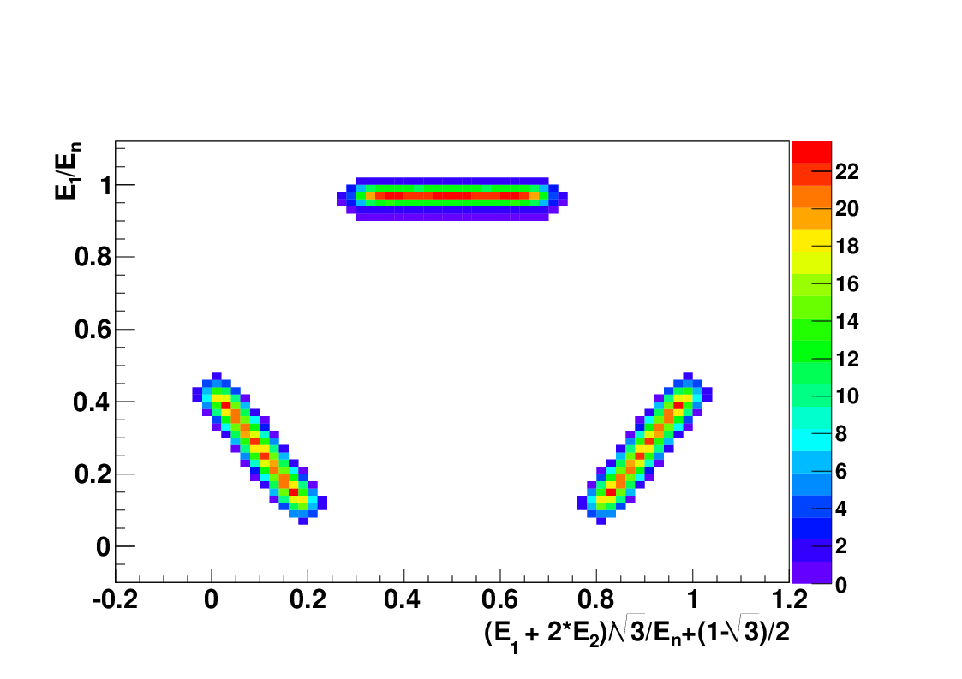
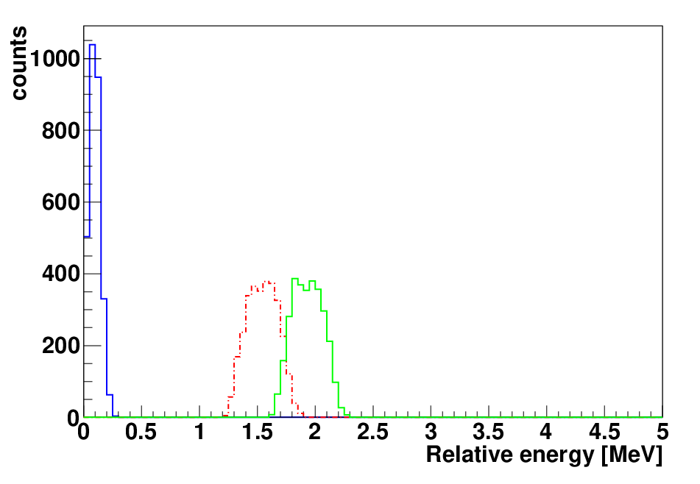
9.64 MeV (3-) decays through ⁸Be_{gs}
Experiment
In agreement with Monte Carlo simulation of a 3- state decaying through the ⁸Be ground state
Simulation

Slide 16
Events with alpha multiplicity 4
α
²⁰Ne @ 12 and 9.7 AMeV +⁴He
4 alphas in the same event are correlated in time ΔT<30 ns
²⁰Ne
¹⁶O
α
α
α
α
⁸Be
α
α
Reconstruction of the interaction point with a recursive calculation based on conservation of energy and momentum and the assumptions:
The 4 alphas come from a ¹⁶O
The ⁸Be is in the ground state
Ek_α_lab -> Ek(¹⁶O)
E*(¹⁶O) = E_{cm}_α₁+E_{cm}_α₂+E_{cm}_α₃+E_{cm}_α₄+ Qgg (14.4 MeV)
Only α-particles with energy larger than 13 MeV are selected in order to cut those from the ⁸Be emitted in opposite direction.

Slide 17

Events with alpha multiplicity 4
Energy | Γ(Be)/ Γ(Hoyle) This work 12 AMeV | Γ(Be)/ Γ(Hoyle) This work 9.7 AMeV | Γ(Be)/ Γ(Hoyle) Freer et al. PRC 51, 1662
15.2±0.2 | 1±0.7 | 0.96 ± 0.3
17.1 | 0.6±0.3 | 0.7 ± 0.3 | 0.65 ± 0.16
17.5 |  | 0.6 ± 0.3 | 0.72 ± 0.18
19.7 | 0.43±0.2 | 0.6 ± 0.5 | 0.47 ± 0.15
21.4 | 5.3±2.8 | 3 ± 1 | >3 ± 1.1

Slide 18
²⁴Mg Excitation energy
Possible state at around 34 MeV decaying into 6 alpha particles. This energy is close to the 33.4 MeV predicted by Yamada and Schuck for a state analogous to the Hoyle state in ¹²C.
From multiplicity 4 events

Slide 19
Conclusions
Using the suggested technique it is possible to identify states near the alpha decay threshold in ⁸Be and ¹²C.
4α events -> show a structure at 15.2 MeV possible candidate for a state analogous to the Hoyle state in ¹⁶O (candidate 0+ state predicted at Ex 15.1 MeV). The few events in this peak decay equally into
- alpha + ¹²C_{(Hoyle)}
- 2 ⁸Be_{(gs)}
Possible state in ²⁴Mg decaying into 6 alpha particles at around 34 MeV.

Slide 20
Thank you for your attention!
M. Barbui, K. Hagel, J. Gauthier, R.Wada, S. Wuenschel, X-G. Cao V.Z Goldberg and J.B. Natowitz (Cyclotron Institute, Texas A&M University, College Station, TX, USA )
R. T. deSouza, S. Hudan (Indiana University, Bloomington, IN, USA)
D. Fang (Shanghai Institute of Applied Physics (SINAP), Chinese Academy of Sciences, Shanghai, China)

