Slide 1
Shape of ¹²C
M. Kimura (Hokkaido Univ.)
Introduction
Rebuilding nuclear shape
Shape of ¹²C
Summary
Appendix : Shape of ²⁰Ne

Slide 2
1. Introduction
Two different aspects of ¹²C

Slide 3
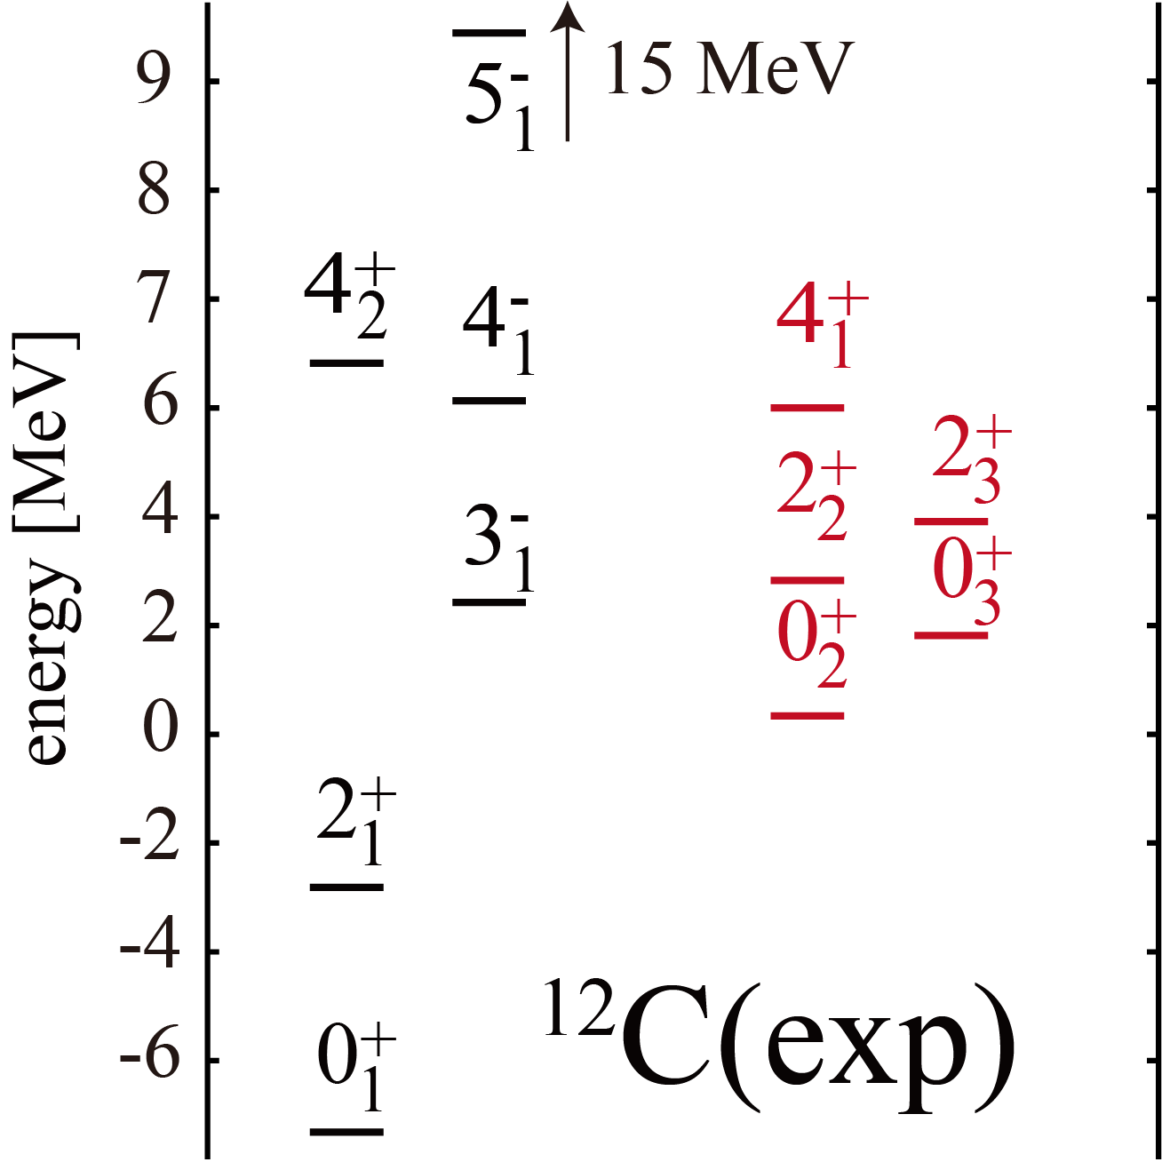
Two different aspects of ¹²C
Alpha particle BEC
A. Tohsaki, H. Horiuchi, P. Schuck, G. Röpke,
PRL87, 192591 (2001).
₊
The Hoyle state (0 ) and neighboring states are Bose-Einstein condensate
of α particles.
₂
They have no shape

Slide 4
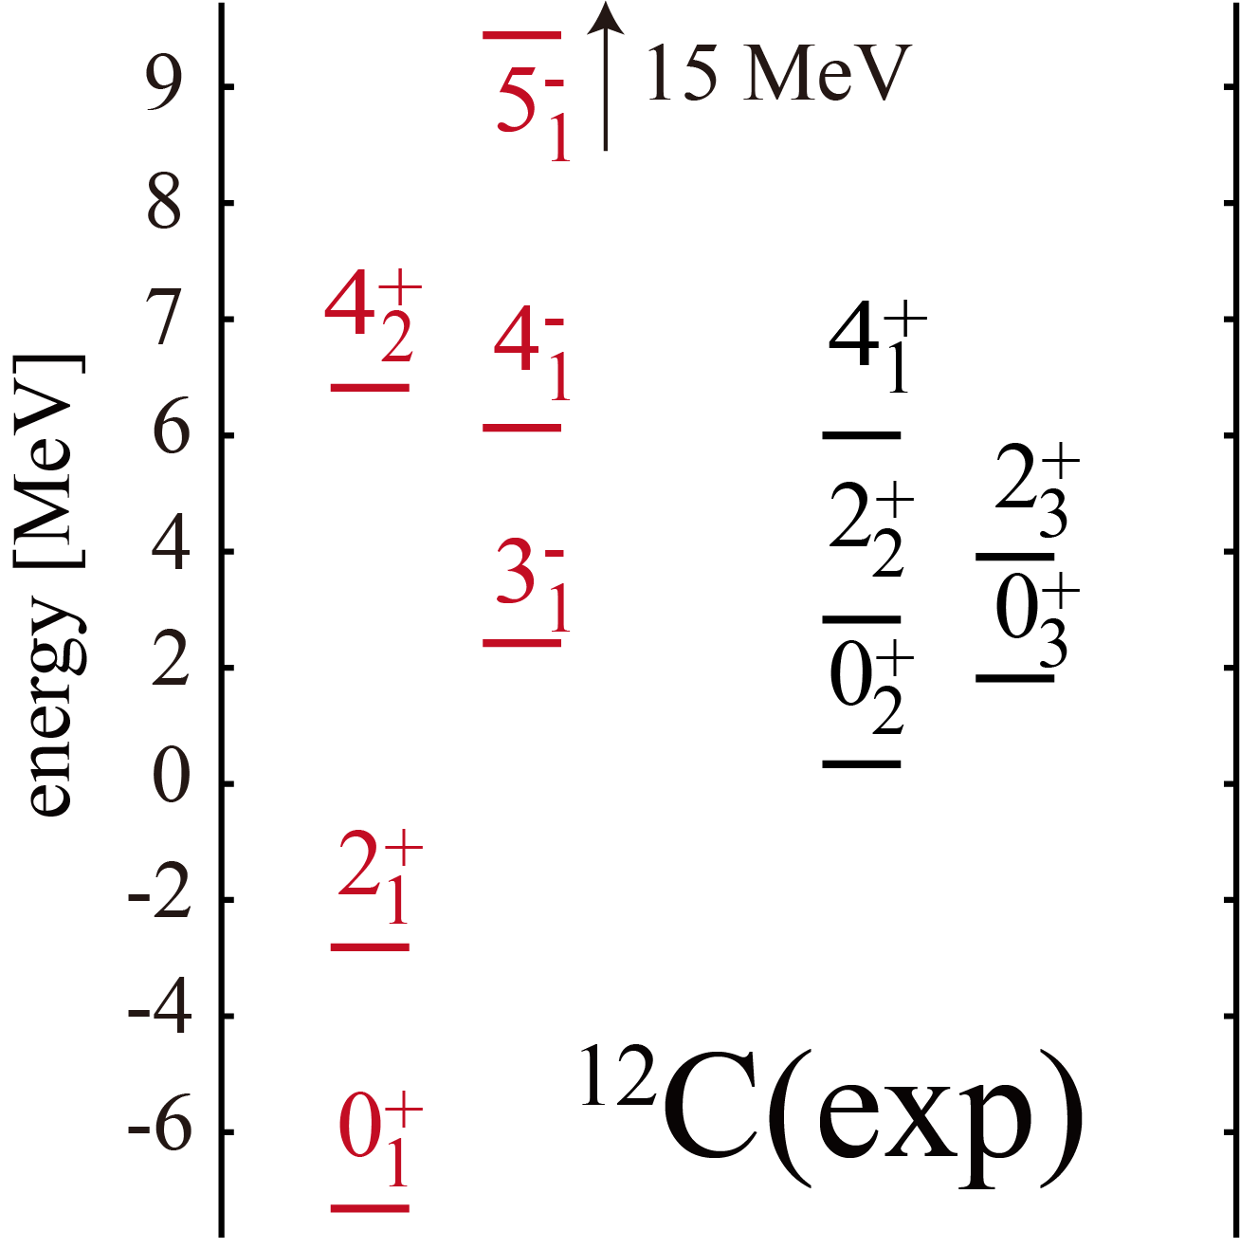
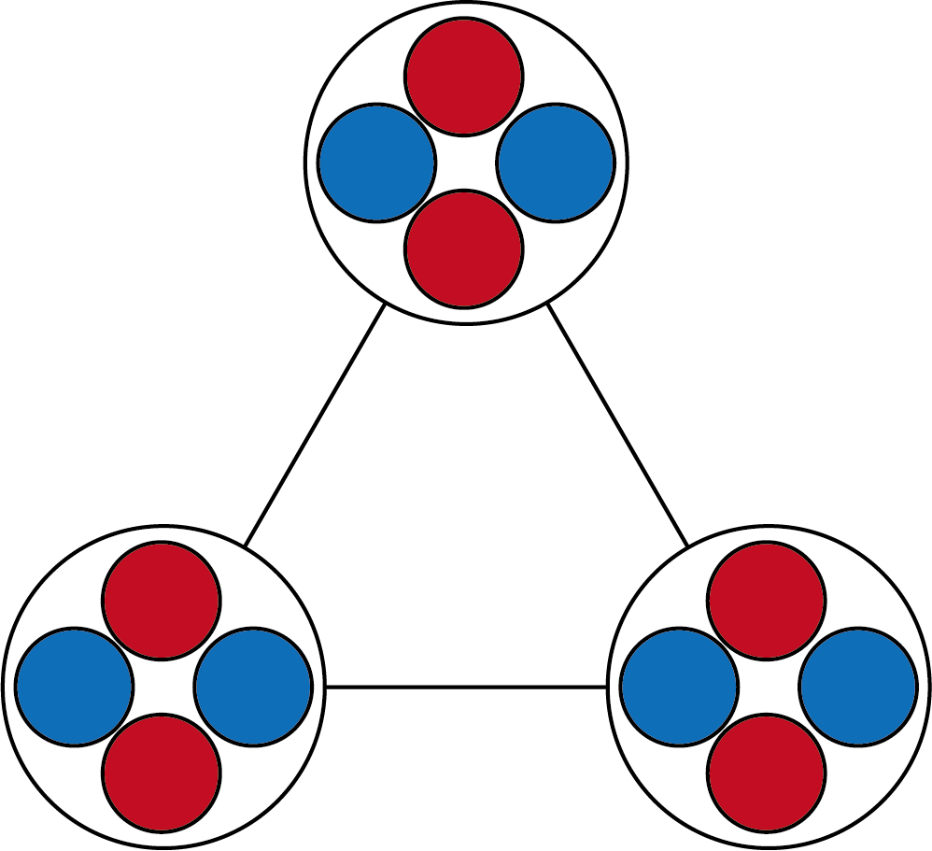
Two different aspects of ¹²C
Spinning triangle states
R. Bijker and F. Iachello, PRC61, 067305 (2000).
Three alpha particles locate
in a triangle configuration (D_{3h})
◎ Owing to the symmetry, 0⁺, 2⁺, 4±, 5⁻
states constitute “ground band”
◎ 4⁺ and 4⁻ states should degenerate
◎ 5⁻ state should exist

Slide 5
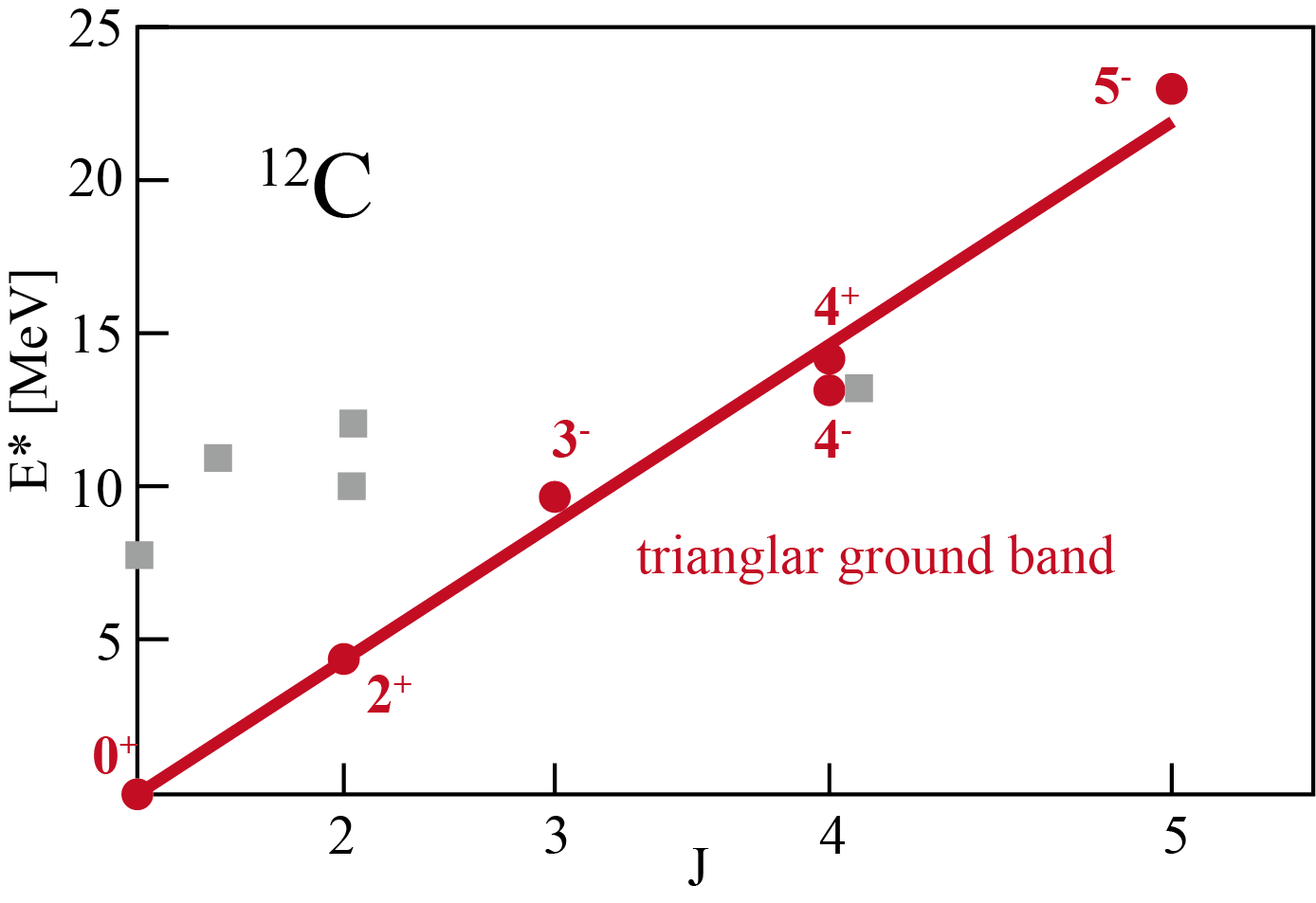
Two different aspects of ¹²C
Spinning triangle states
R. Bijker and F. Iachello, PRC61, 067305 (2000).
Three alpha particles locate
in a triangle configuration (D_{3h})
D.J. Marín-Lámbarri, et al. PRL113, 012502(2014)

Slide 6
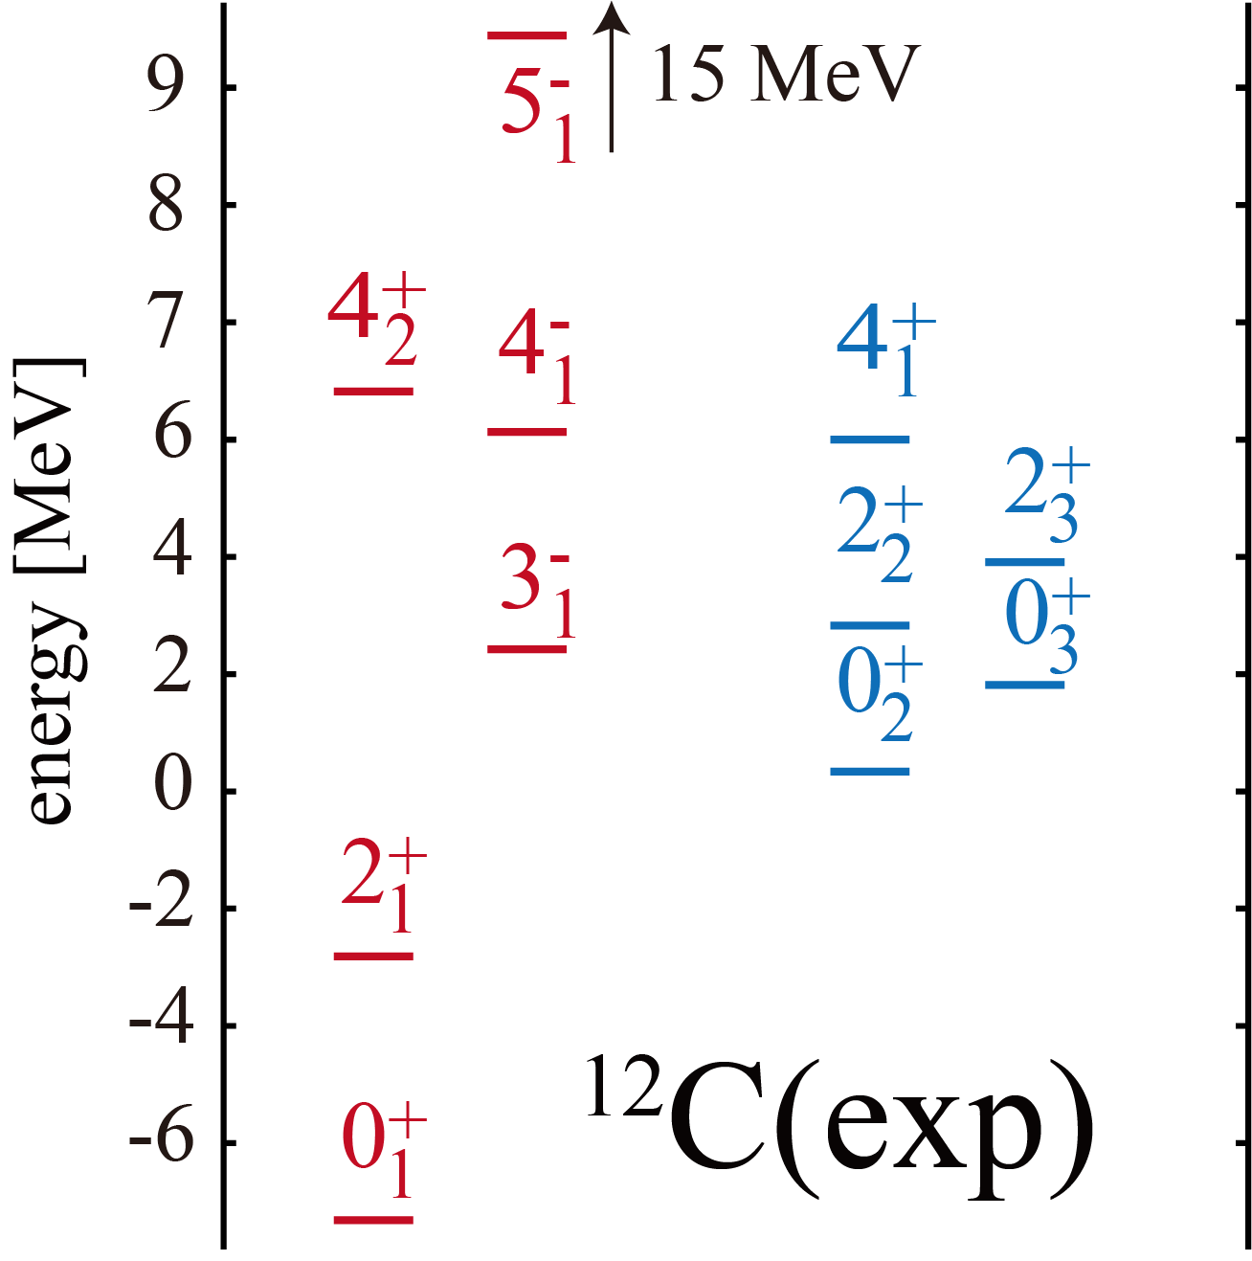
Two different aspects of ¹²C
Two different phases coexist in a single nucleus
Triangle
Cristal
Bosonic
Gas

Slide 7
Motivation of this work
The shape of this band will be rebuilt from observables
We focus on “triangular ground band”
We want to look at the shape of this band
Triangle
Cristal

Slide 8
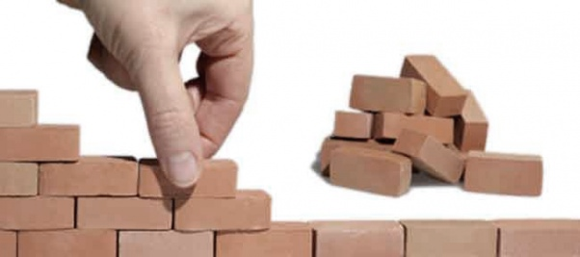
2. Rebuilding nuclear shape

Slide 9
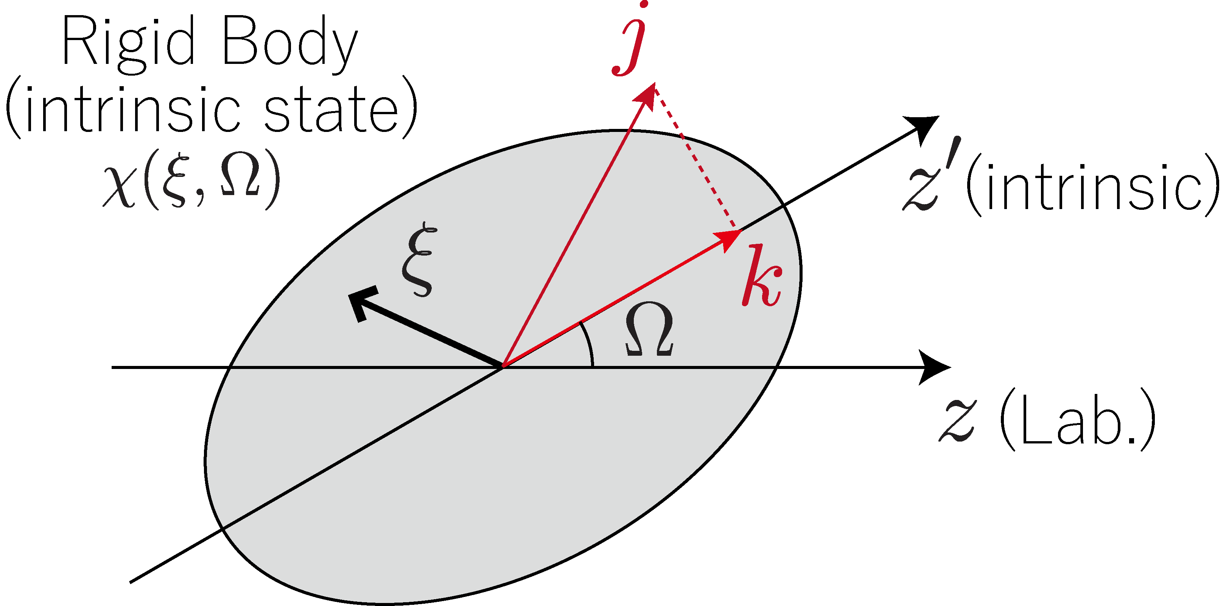
Rebuilding nuclear shape from observables
◎ Rigid rotor
observable
unobservable

Slide 10
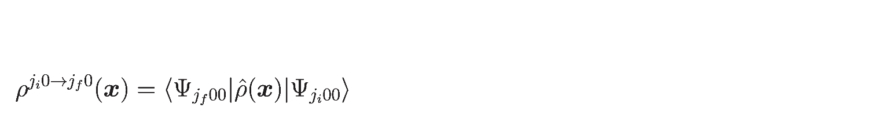
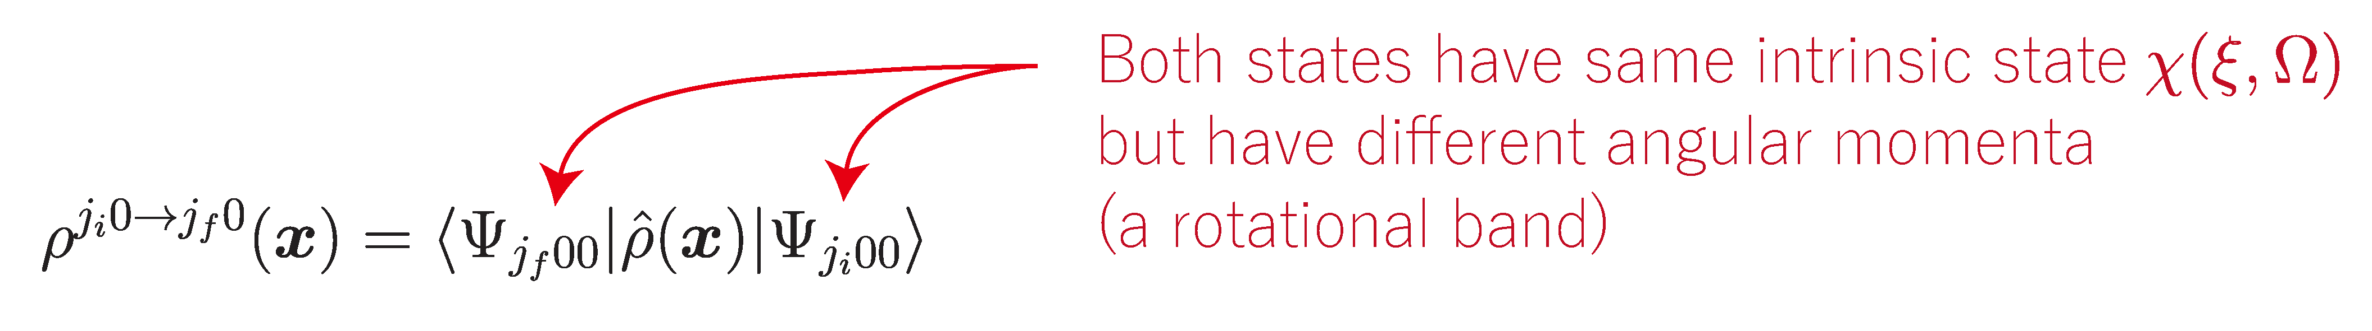
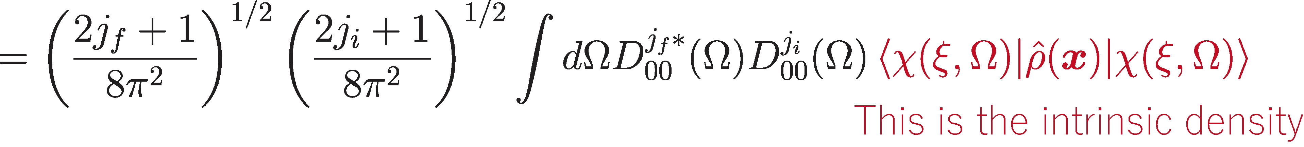
Rebuilding nuclear shape from observables
◎ Rigid rotor
◎ Transition density (measured by electron scatt.)
◎ Multipole decomposition of the intrinsic density

Slide 11
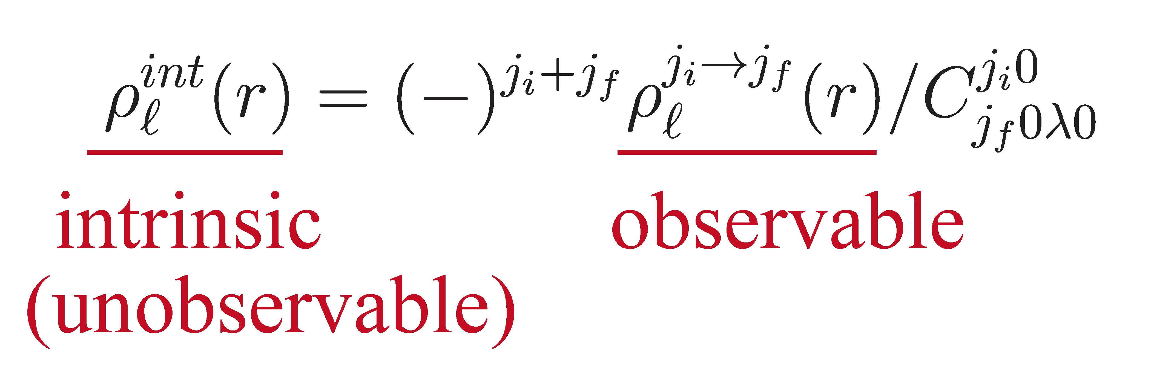
Rebuilding nuclear shape from observables
◎ Rigid rotor
◎ Transition density (measured by electron scatt.)
◎ We obtain an important formula
◎ Wigner-Eckert theorem
₊
₊
₋
±
₋
₁
₁
₁
₁
₁

Slide 12
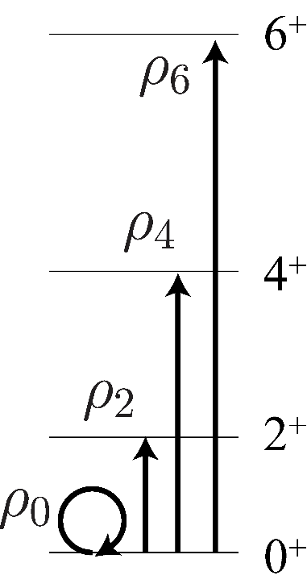
Rebuilding nuclear shape from observables
Actually, in 70’s, this relationship has already been used
to reconstruct the quadrupole deformed intrinsic density
from (e,e’) experiment
¹⁵²Sm; intrinsic density
◎ It must be interesting if we apply this
formula to light clustered nuclei
L.S. Carcman et al., PRC78, 1388 (1978).

Slide 13
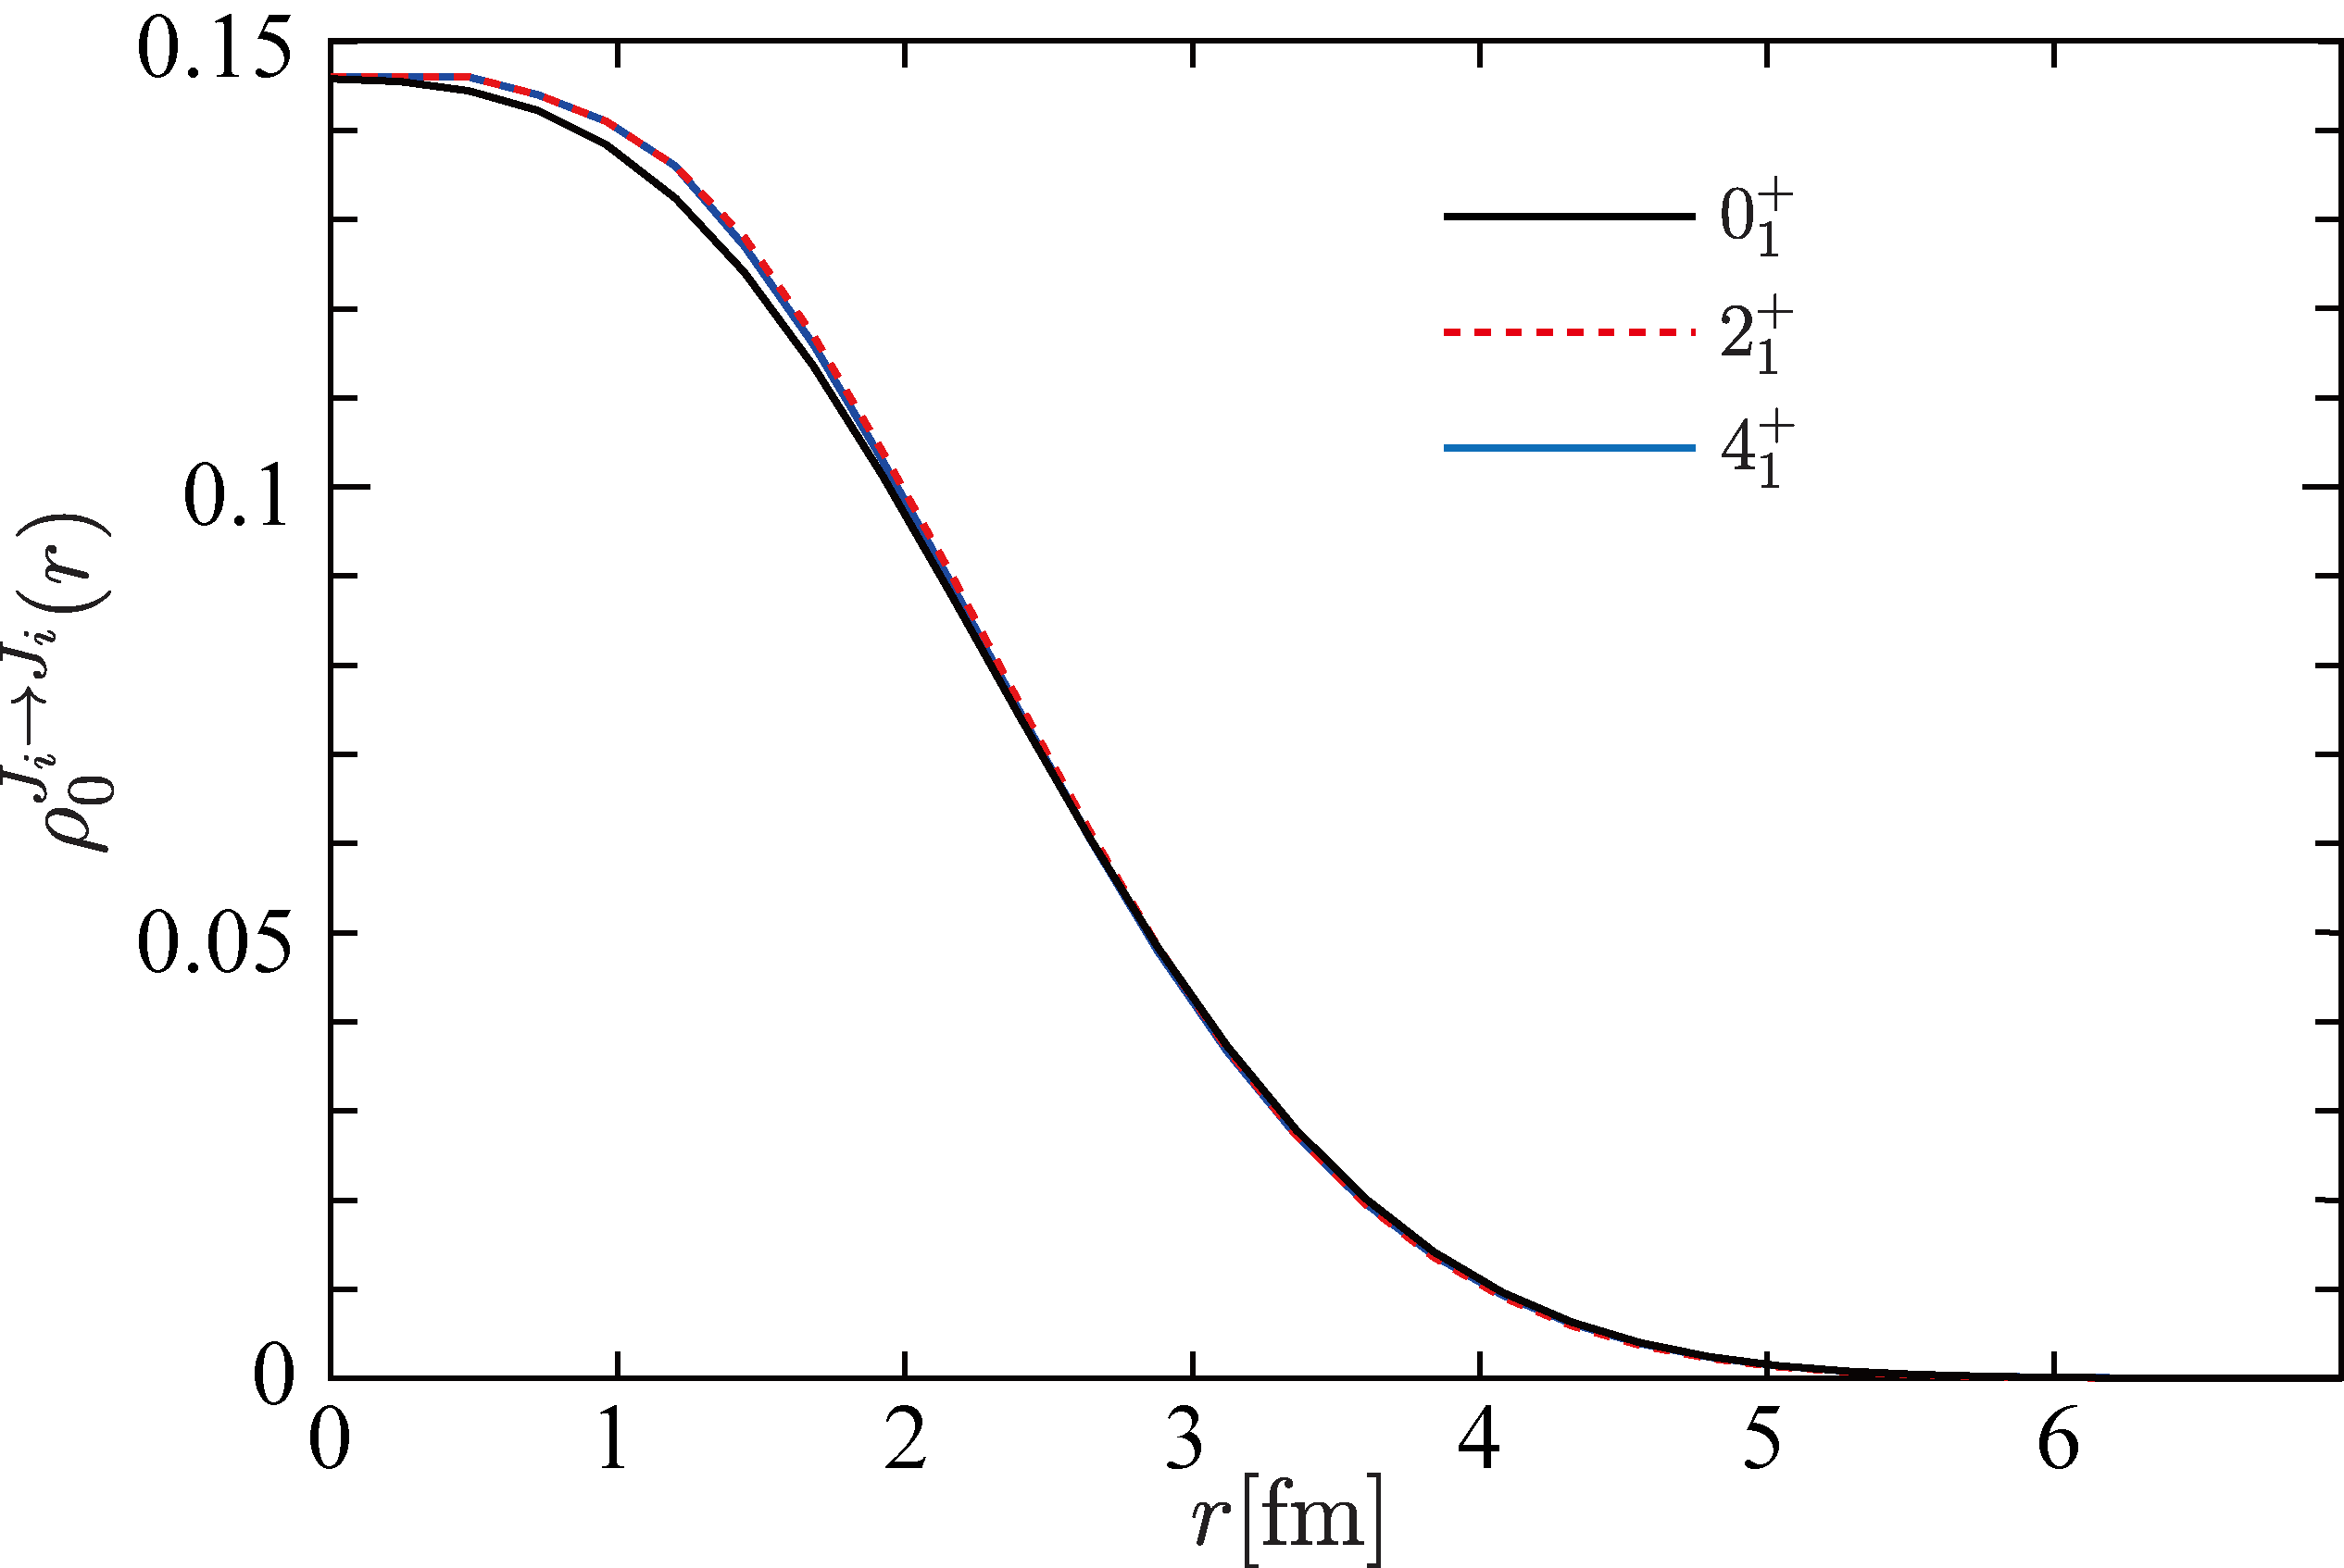
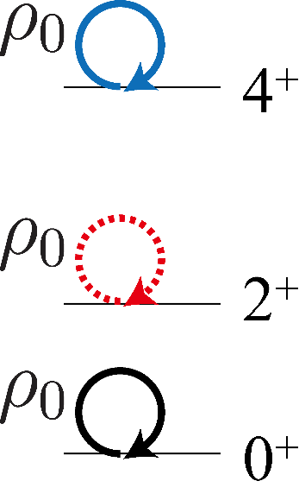
Rebuilding nuclear shape from observables
◎ Diagonal and off-diagonal densities (transition density)
are calculated by a cluster model.
⁸Be
diagonal ( )
densities
⁸Be

Slide 14
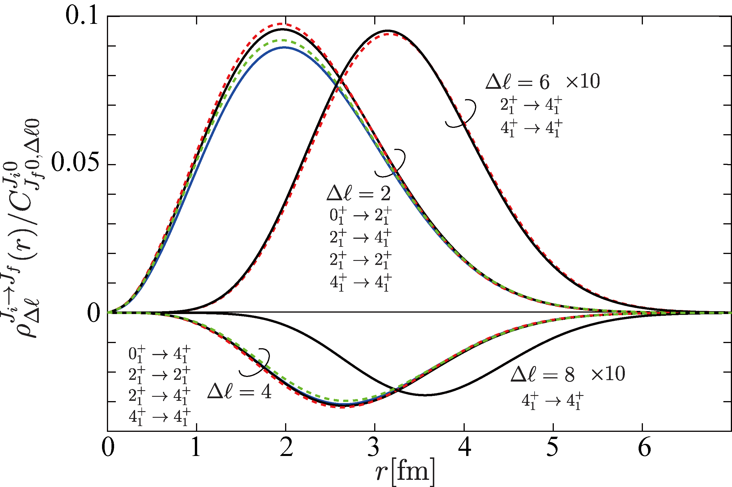
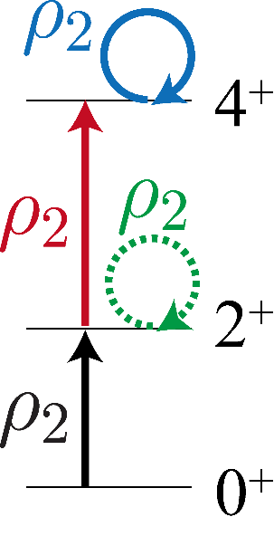
Rebuilding nuclear shape from observables
◎ Diagonal and off-diagonal densities (transition density)
are calculated by a cluster model.
⁸Be
⁸Be

Slide 15
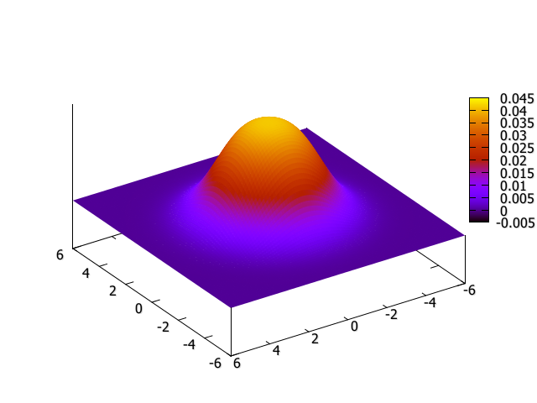
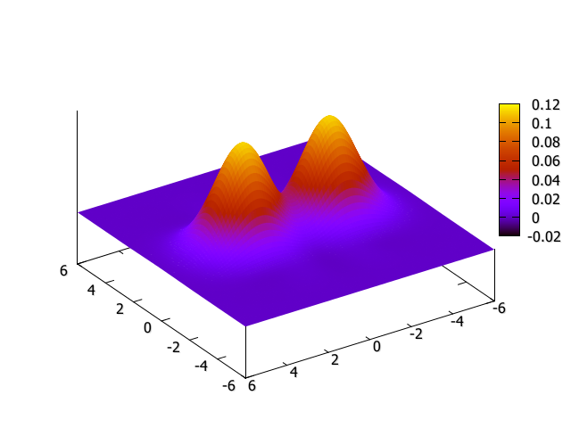

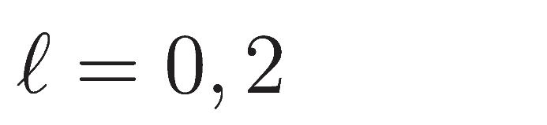
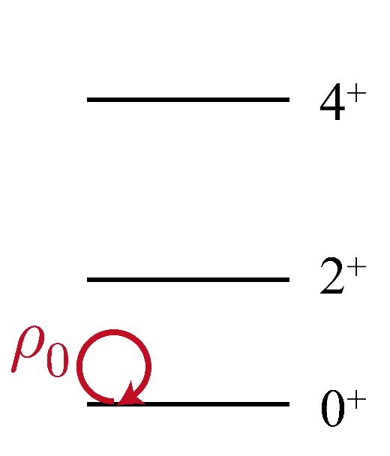
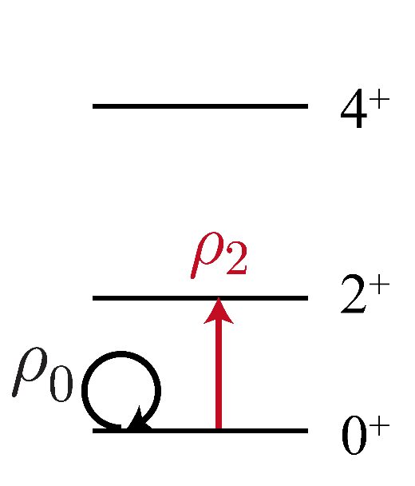
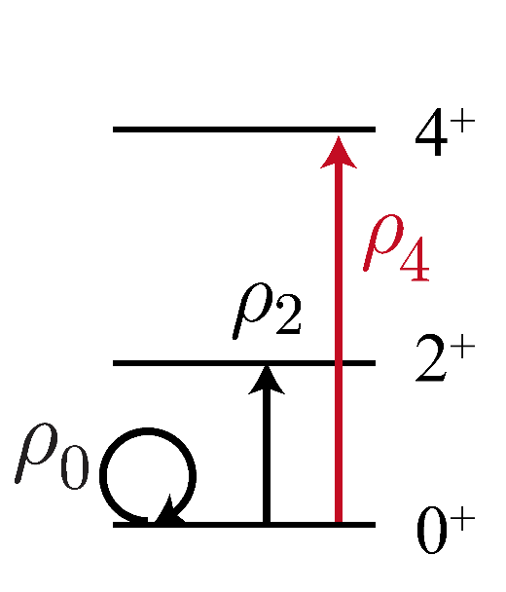
Rebuilding nuclear shape from observables
Superpose the transition densities divided by CG
to rebuild the shape of ⁸Be

Slide 16
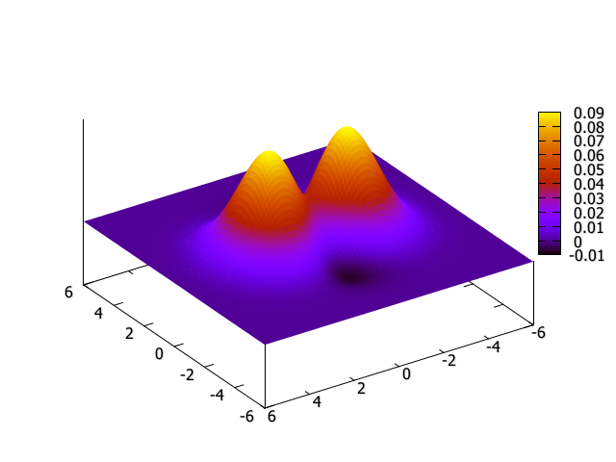
Rebuilding nuclear shape from observables
◎ Why ¹⁵²Sm and ⁸Be look so different?
ｰ Both of them have strong quadrupole collectivity
ｰ The same formula has bee applied
¹⁵²Sm: deformed
⁸Be: clustered

Slide 17
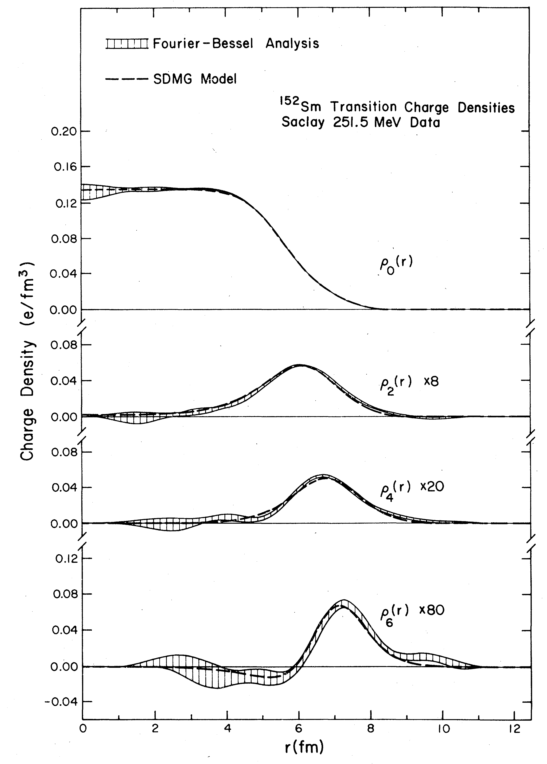
Rebuilding nuclear shape from observables
◎ ¹⁵²Sm and ⁸Be have different transition density distributions
¹⁵²Sm has transition densities
only in the peripheral region
Deviation from spherical shape
occurs in the peripheral region

Slide 18
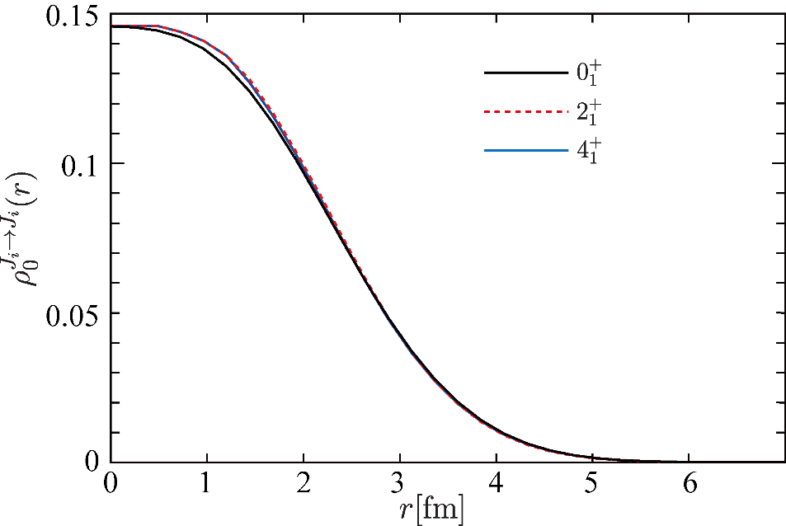
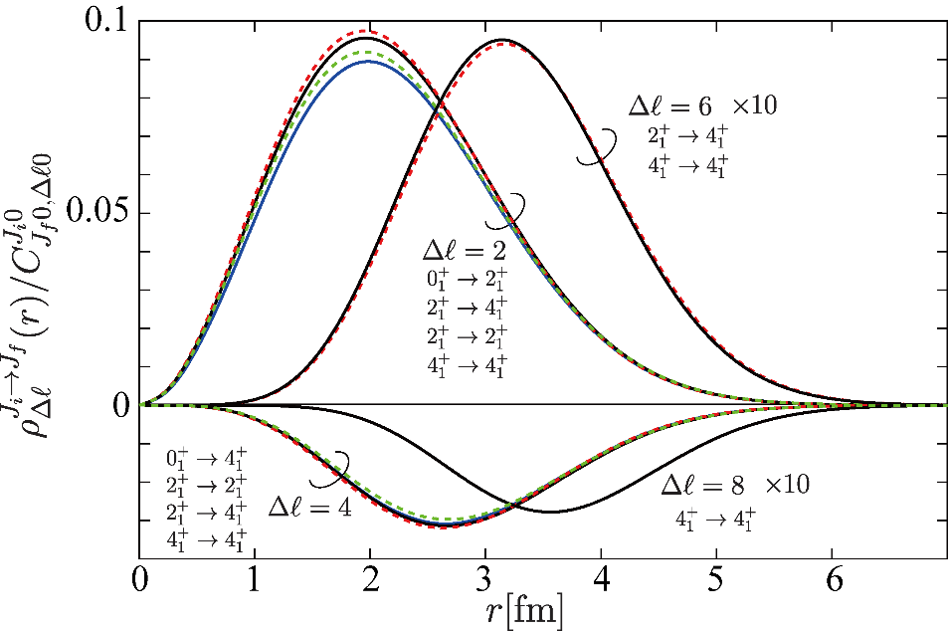
Rebuilding nuclear shape from observables
◎ ¹⁵²Sm and ⁸Be have different density distributions
⁸Be has transition densities
in the inside
Deviation from spherical shape
occurs in the whole system
(clustered)

Slide 19
Shape of ¹²C

Slide 20
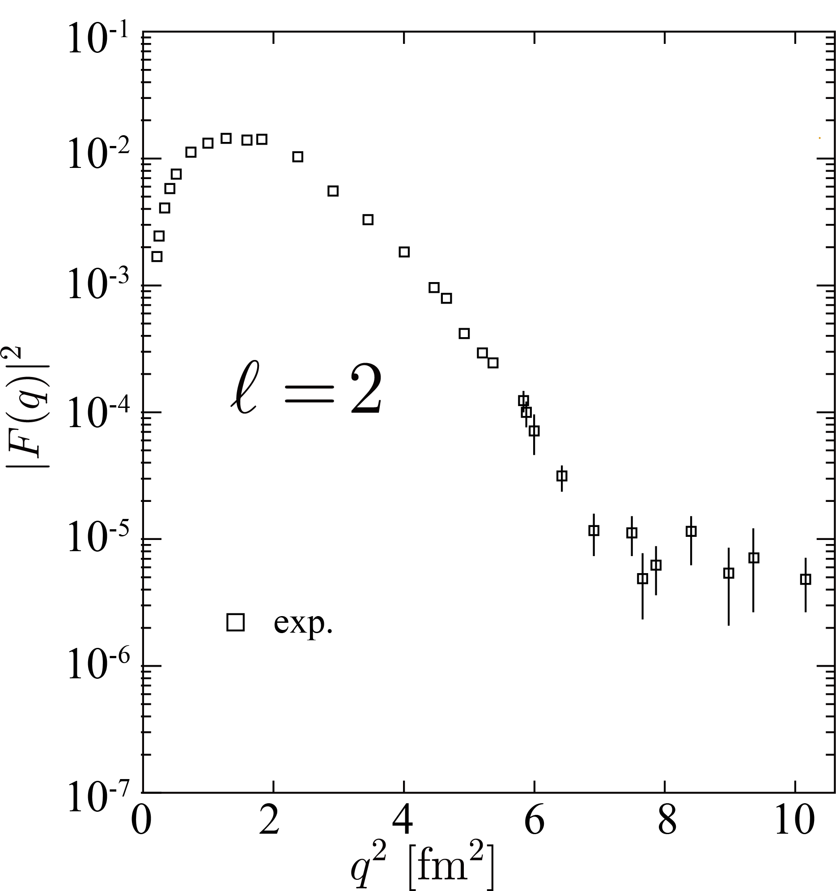
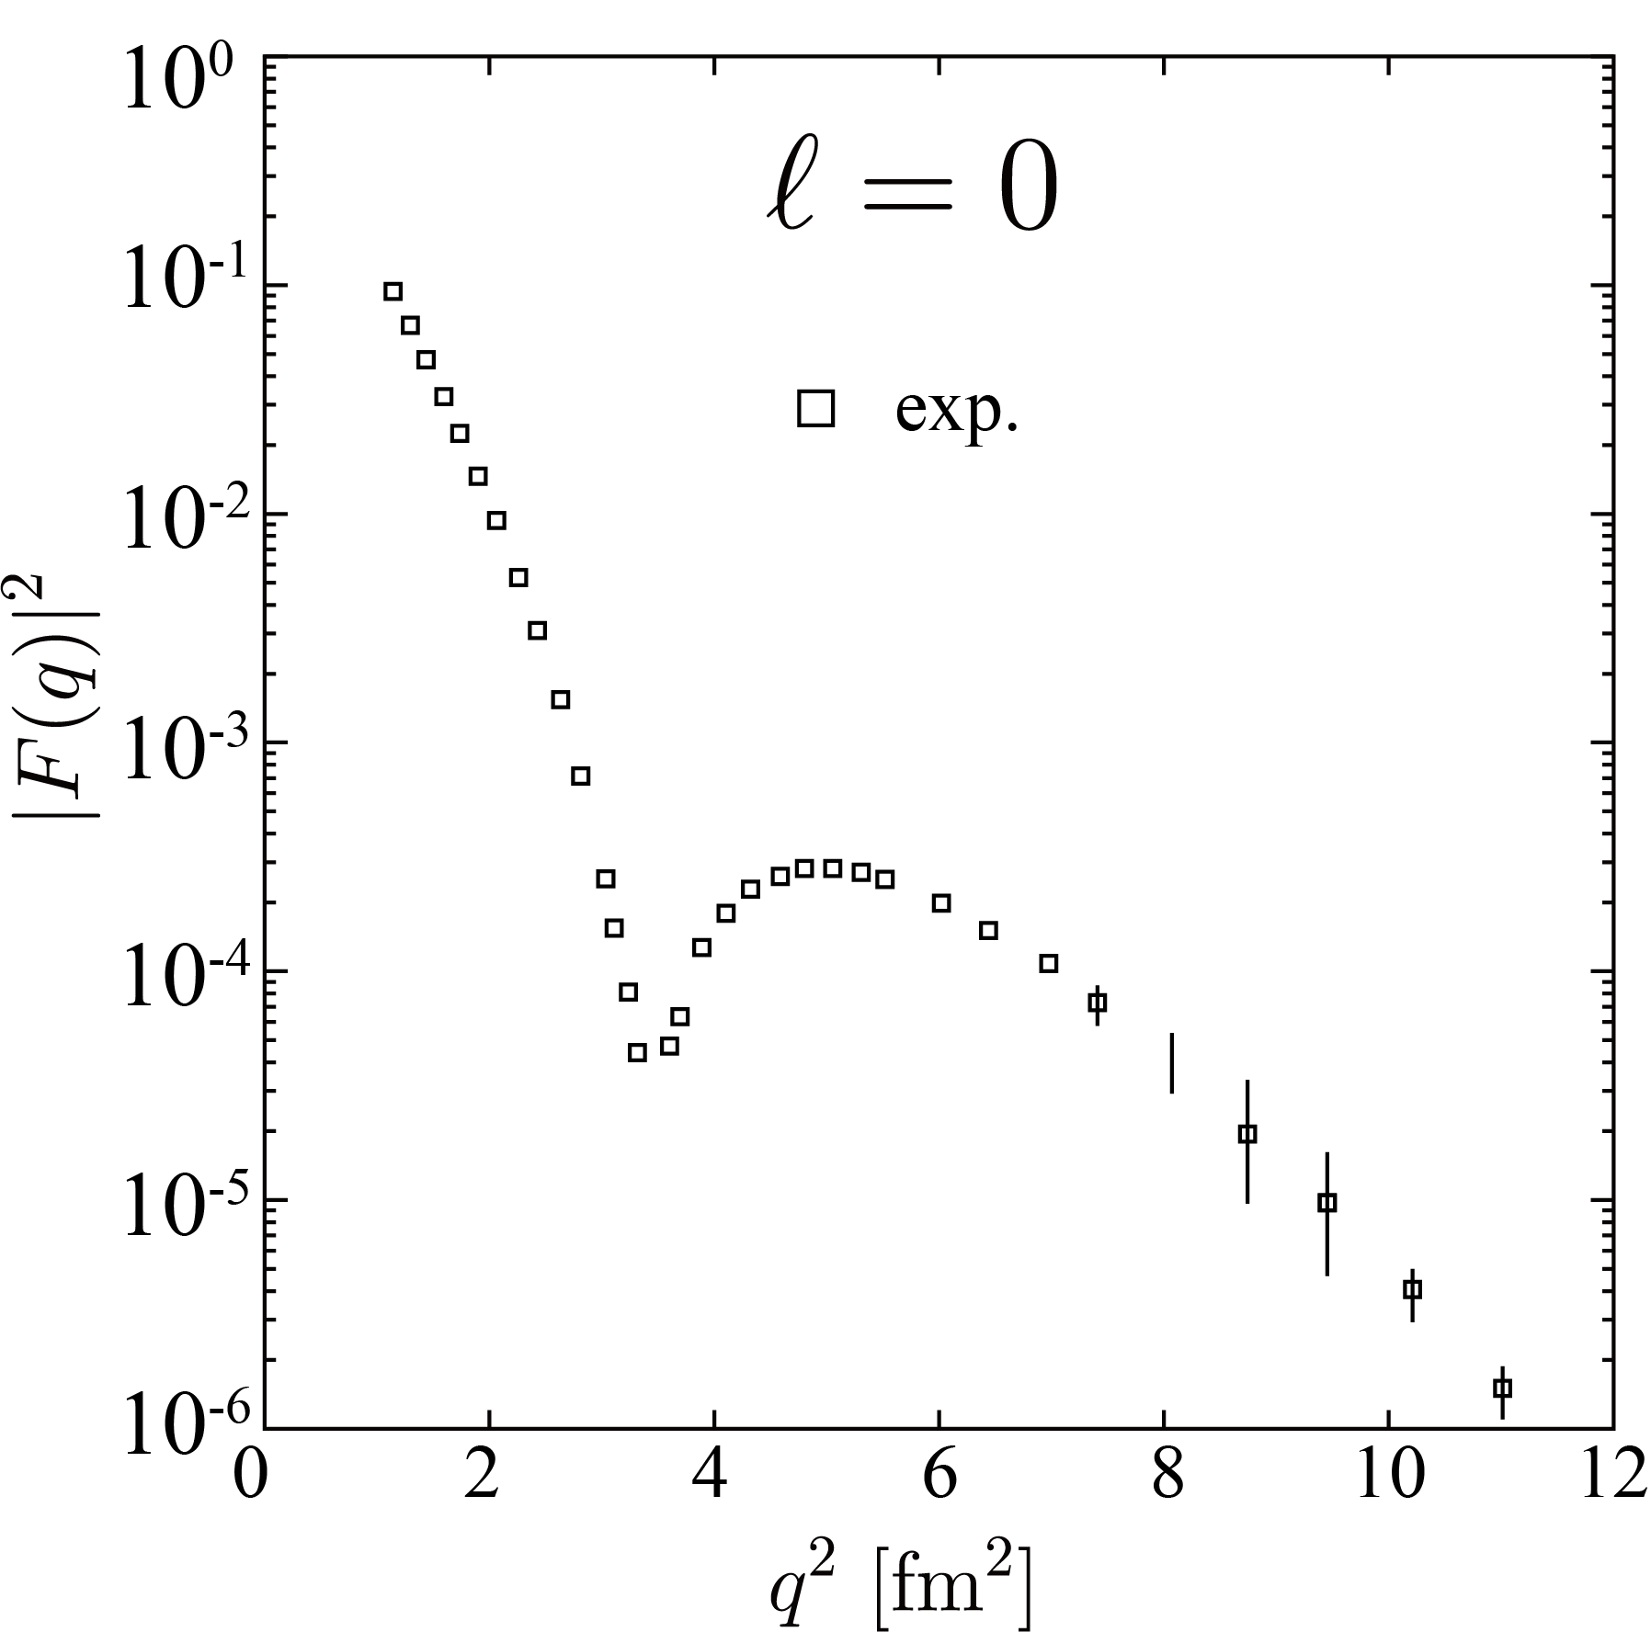
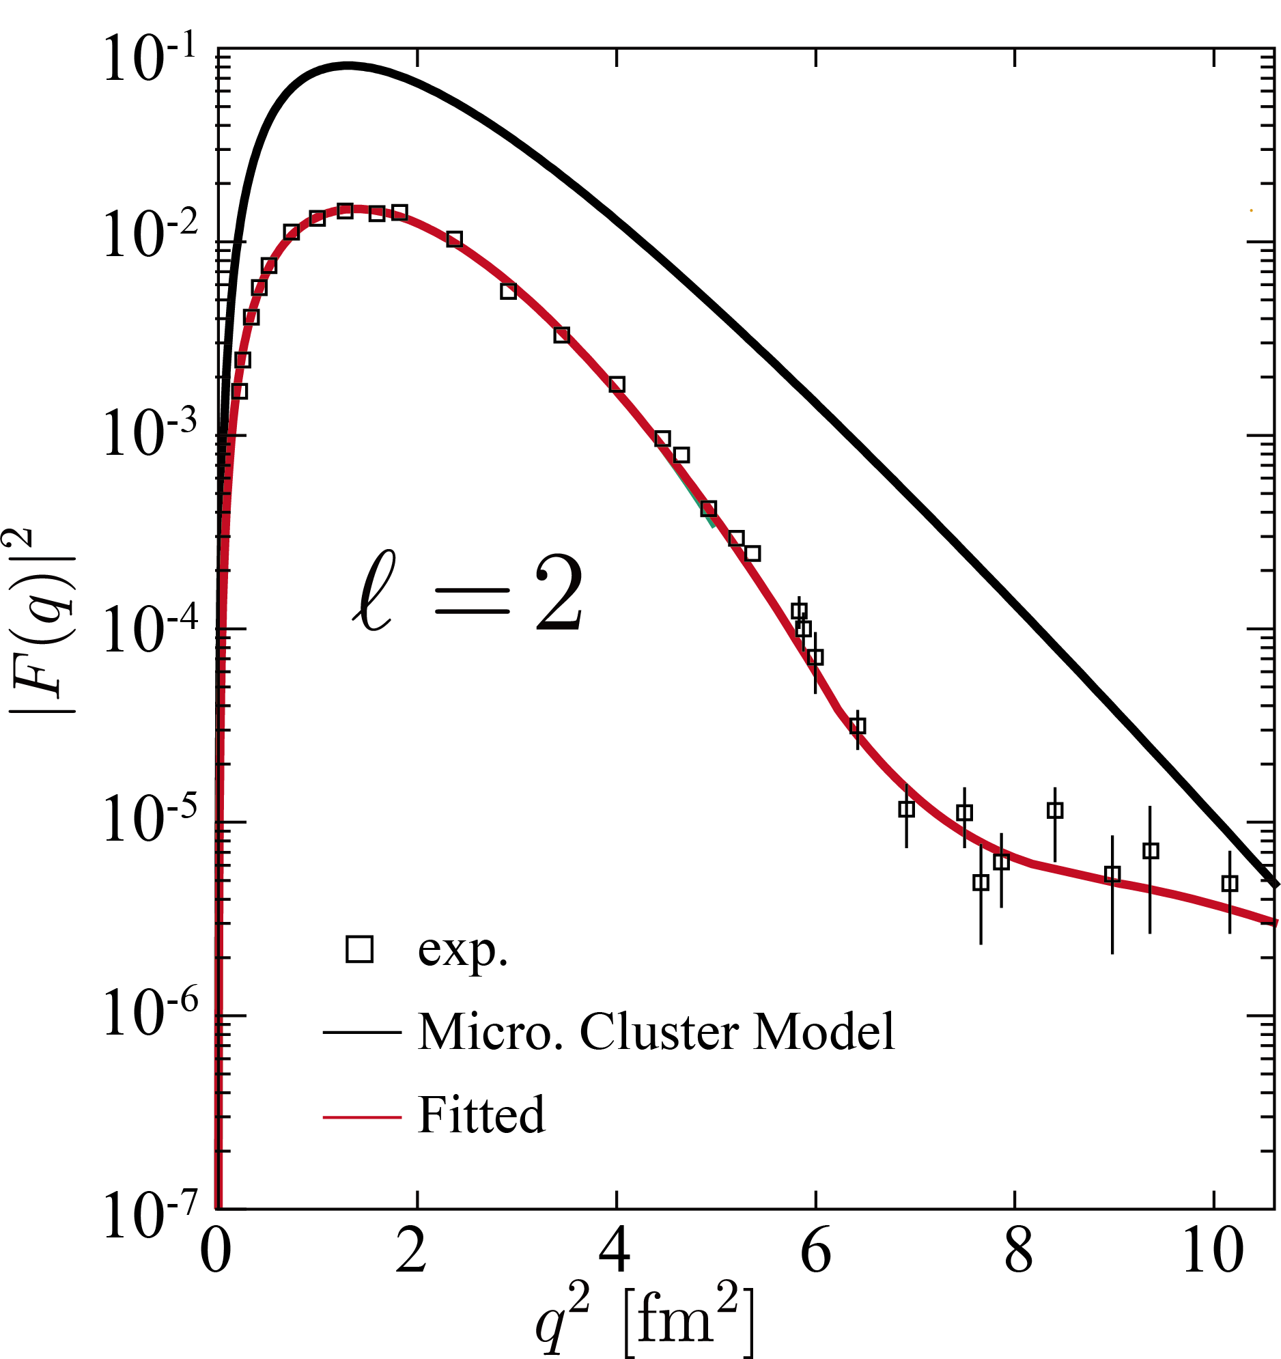
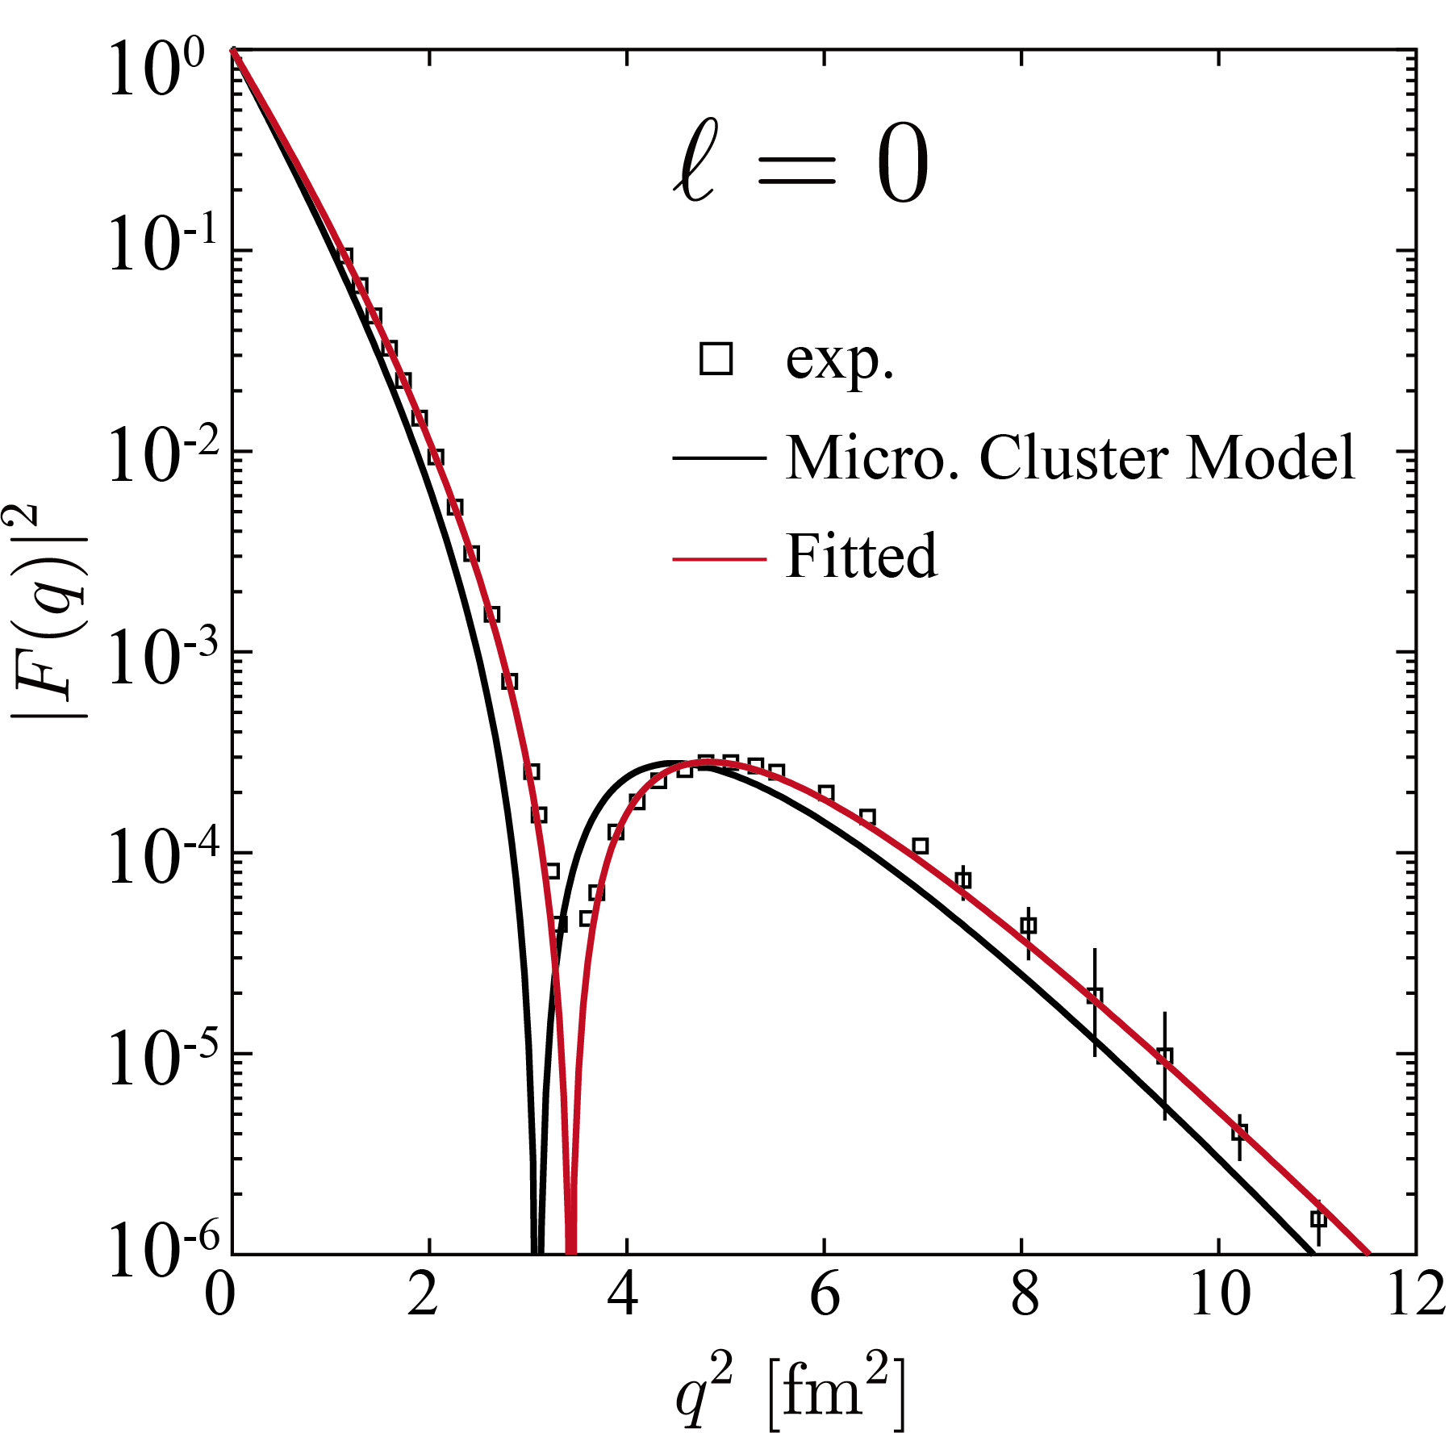
Transition density of ¹²C
◎ Transition formfactor of ¹²C is already measured by
electron scattering
◎ Transition density is reconstructed by Fourier-Bessel fit

Slide 21
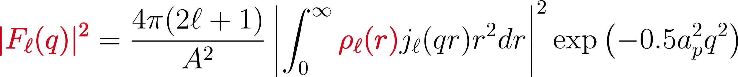
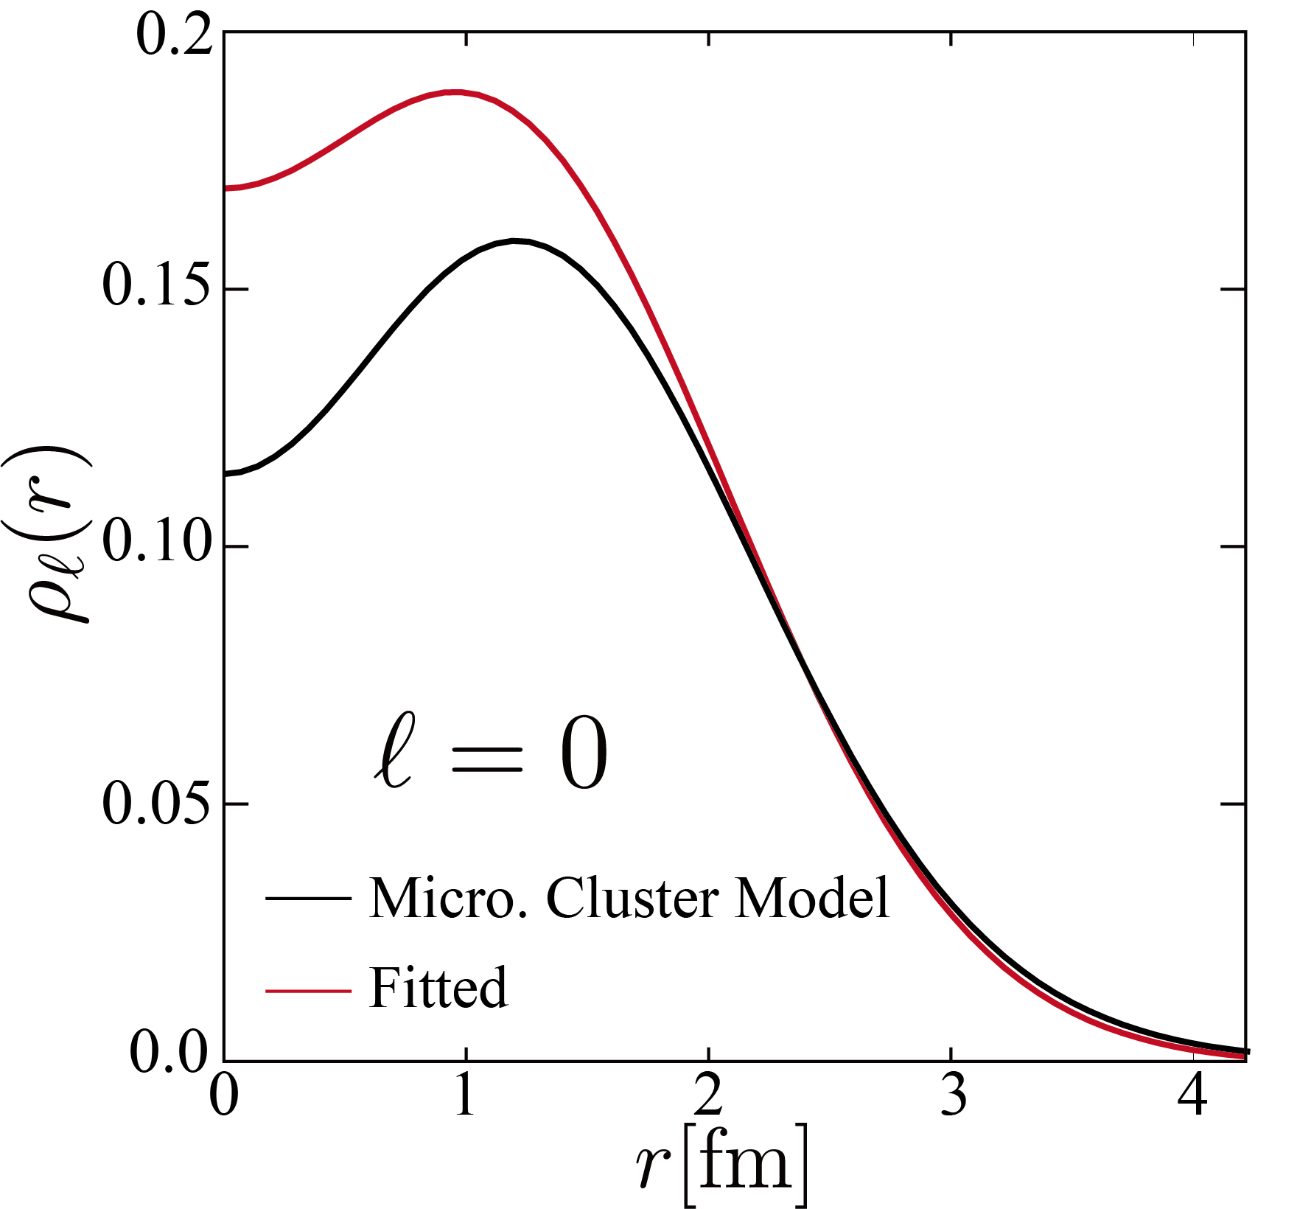
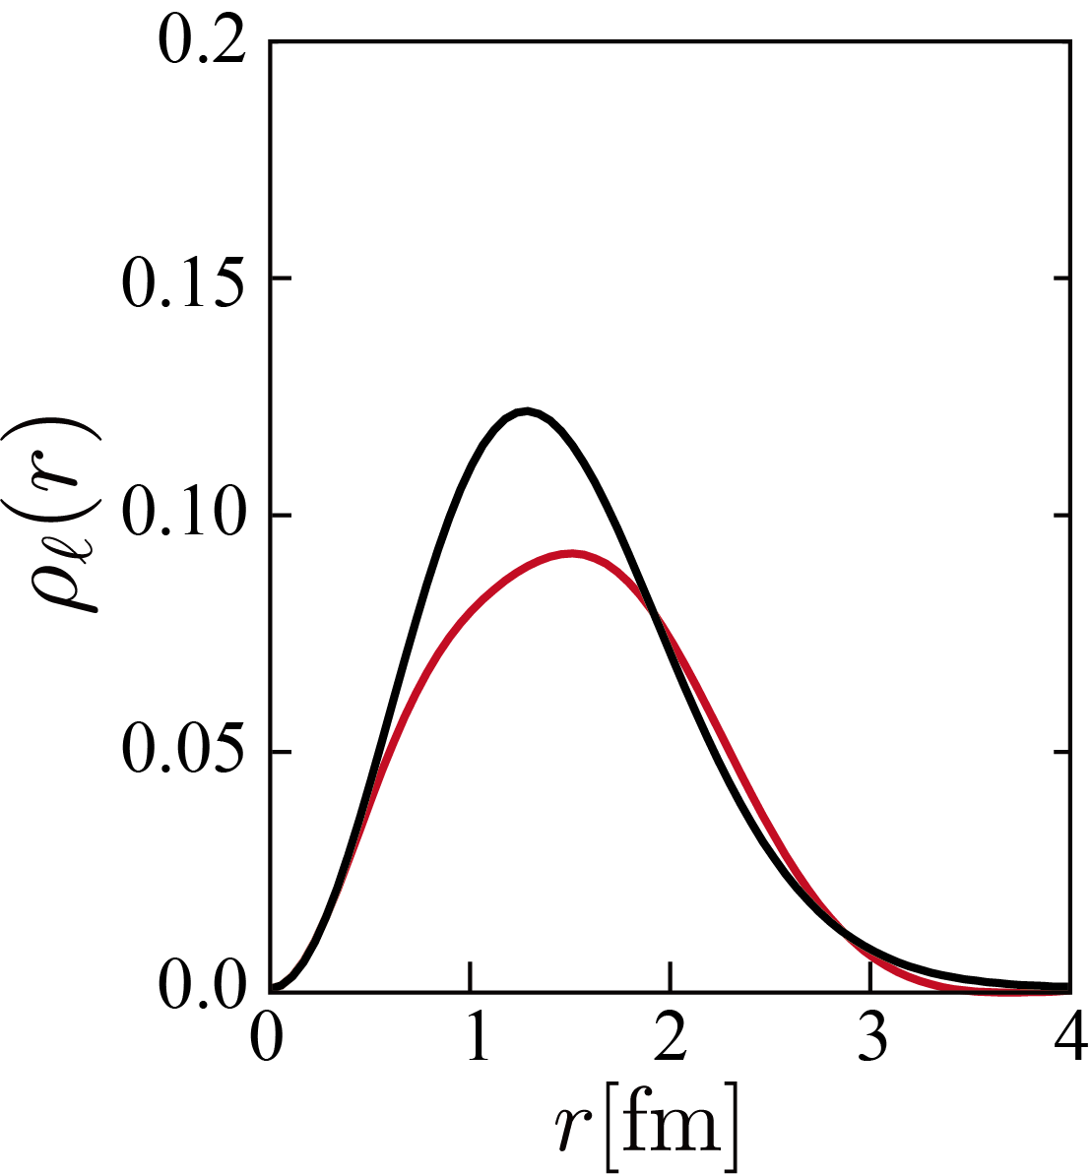
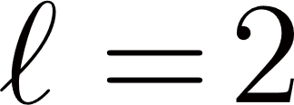
Transition density of ¹²C

Slide 22
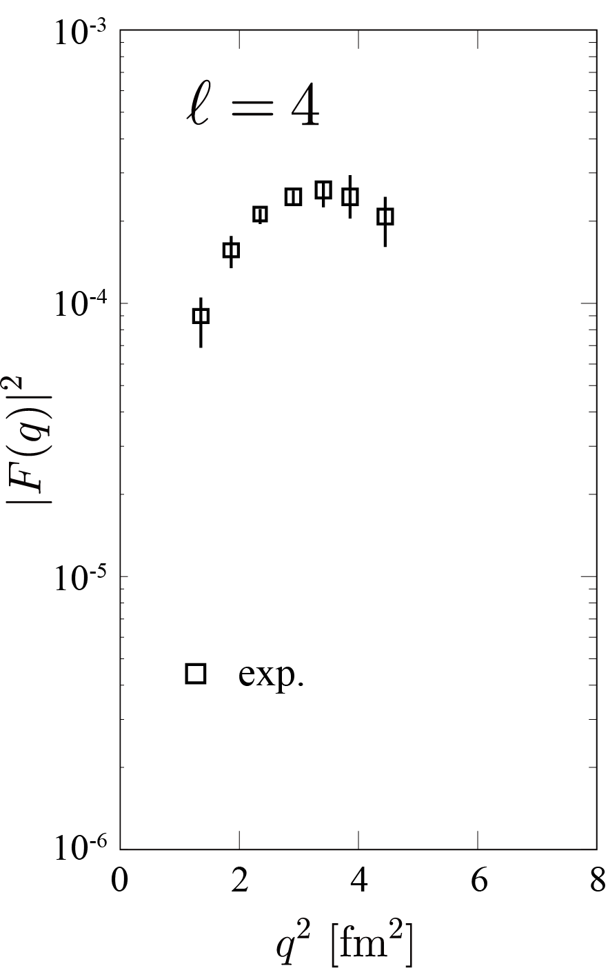

Transition density of ¹²C
◎ The data point for
transition form factor
is not enough for fitting
◎ Form factor for
is calculated by a model
named “real-time evolution
method”
◎ Zhou Bo will introduce this
model on Wednesday

Slide 23
Real-Time evolution method
○ The result is identical to the THSR (positive-parity)
R. Imai et al., PRC99, 064327(2019).

Slide 24
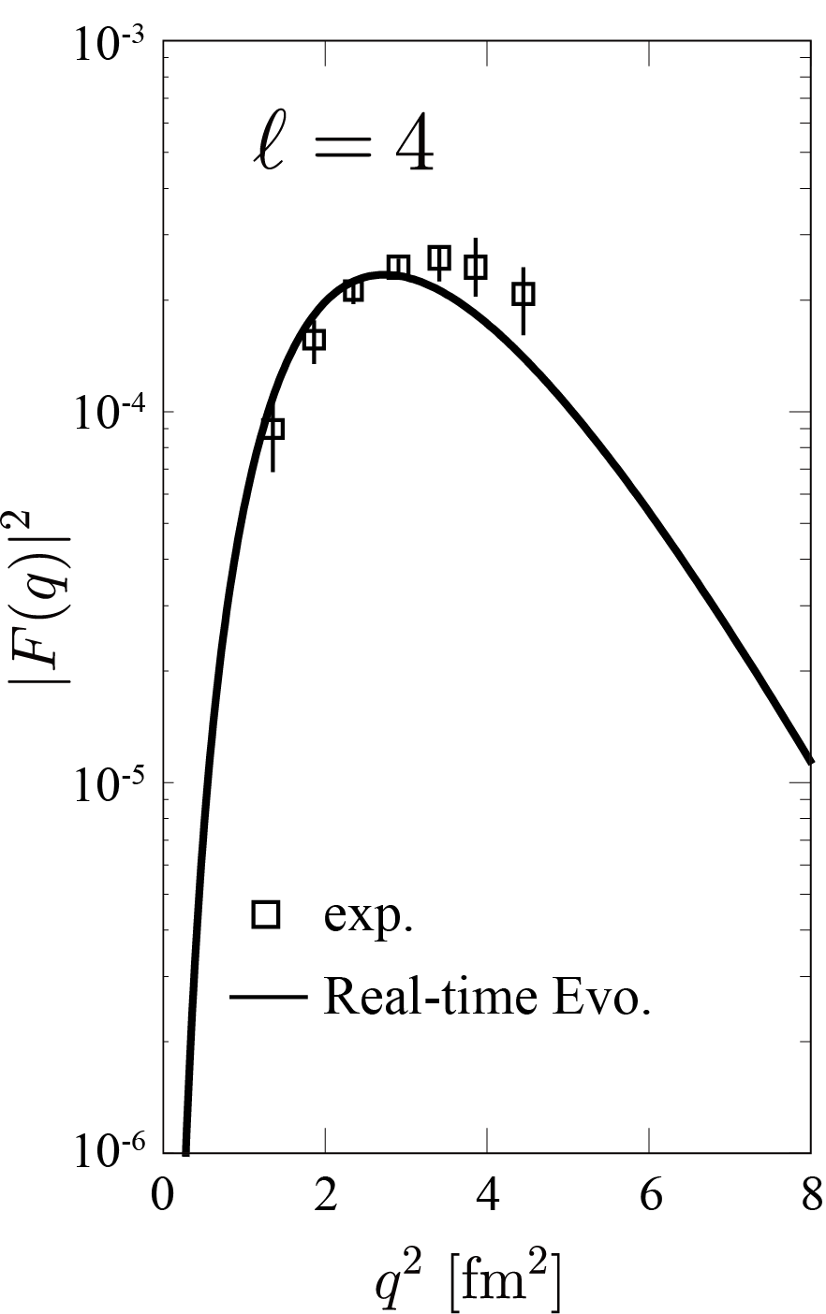
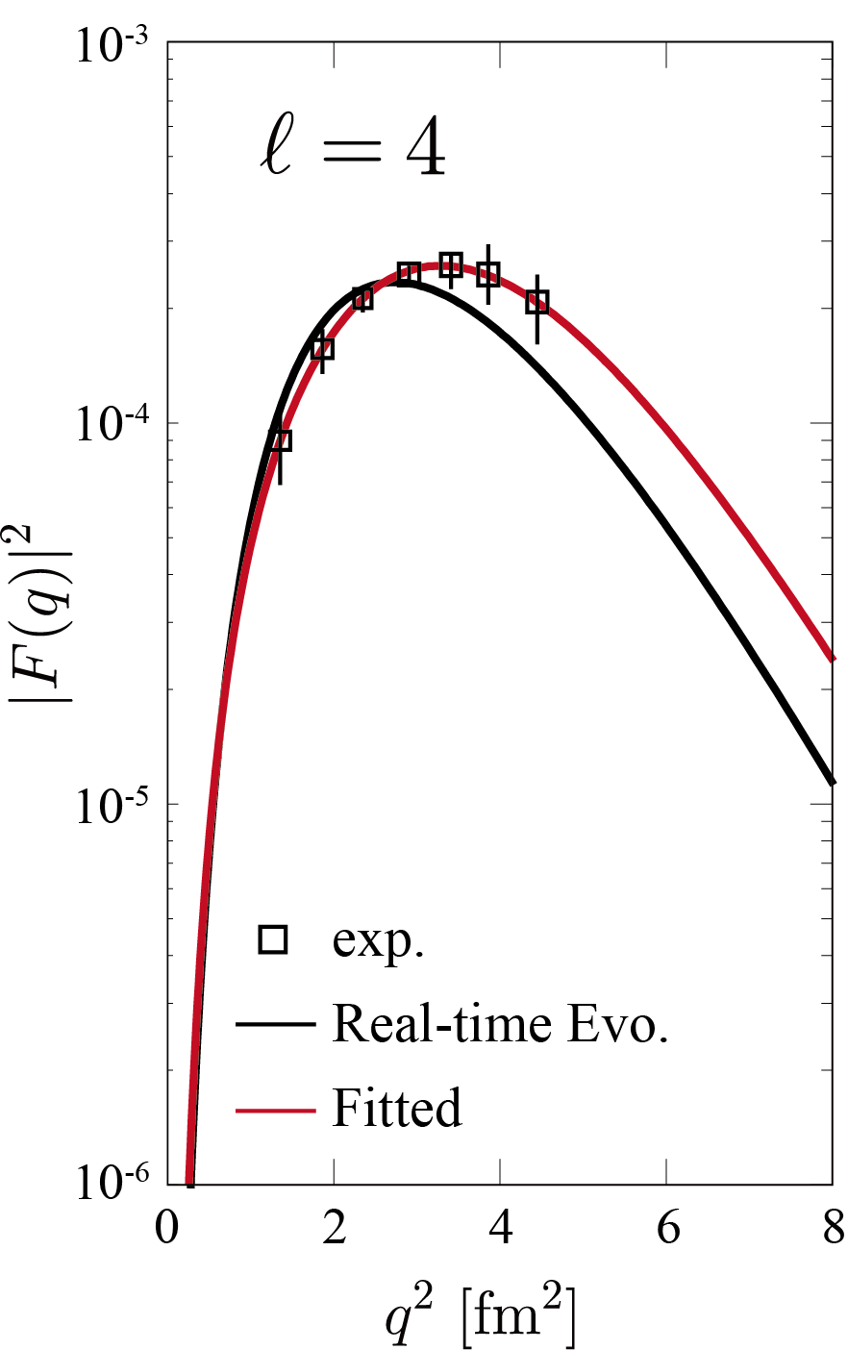
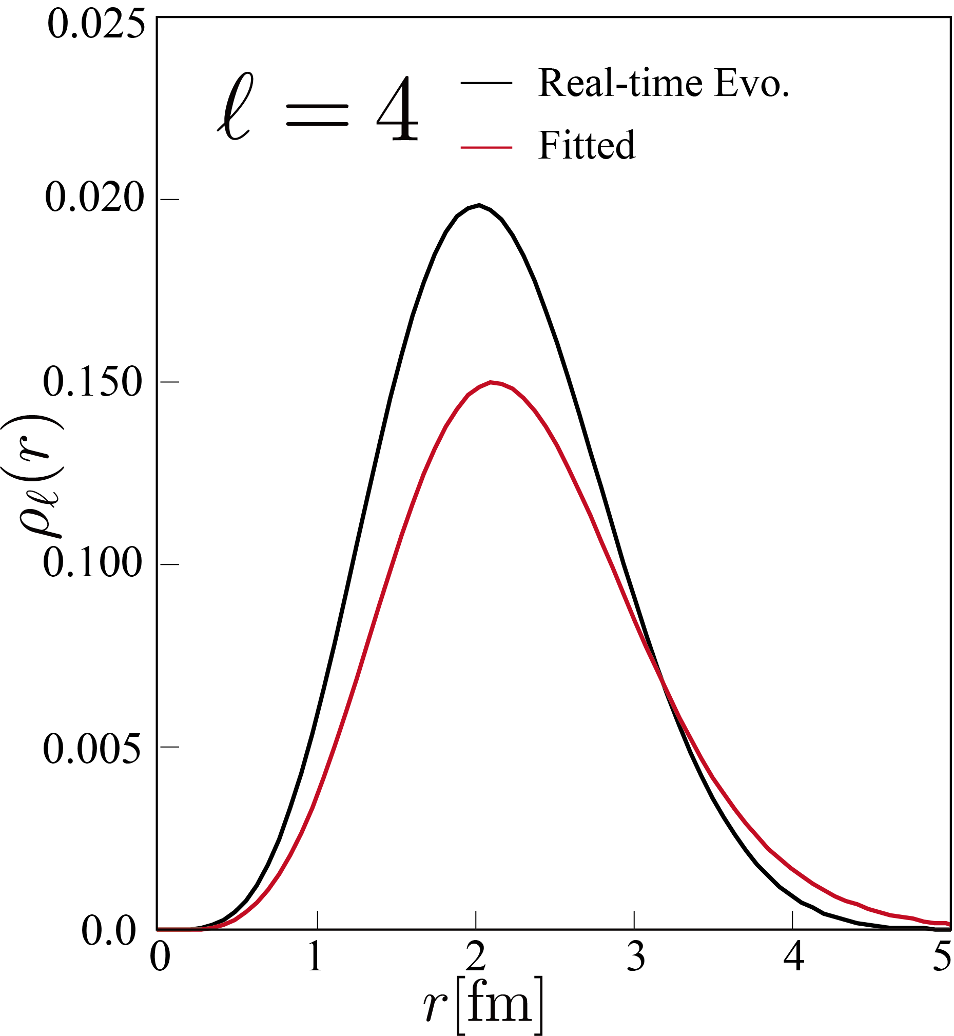
Rebuilding nuclear shape from observables

Slide 25
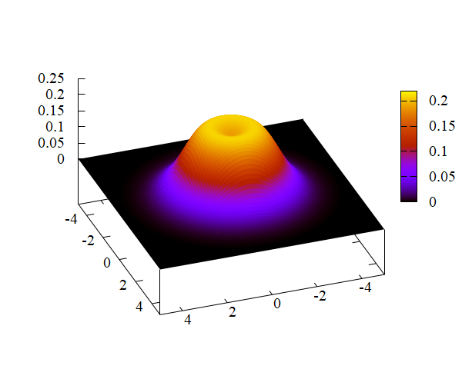
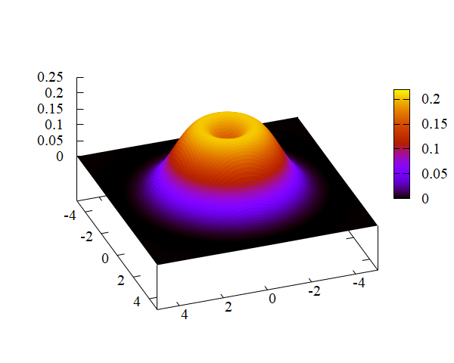
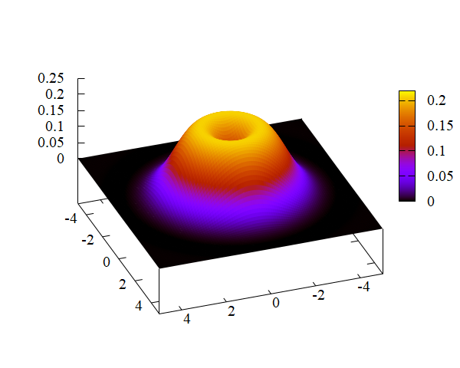
Shape of ¹²C
○ Transition densities are superposed
○ It shows toroidal density distribution
(oblate deformed with hollow at the center)
○ This is due to the clustering
which reduces s_{1/2} occupation probability
○ And this is essentially same
with Nakada et al.
A. Nakada et al, PRL27, 745 (1971).

Slide 26
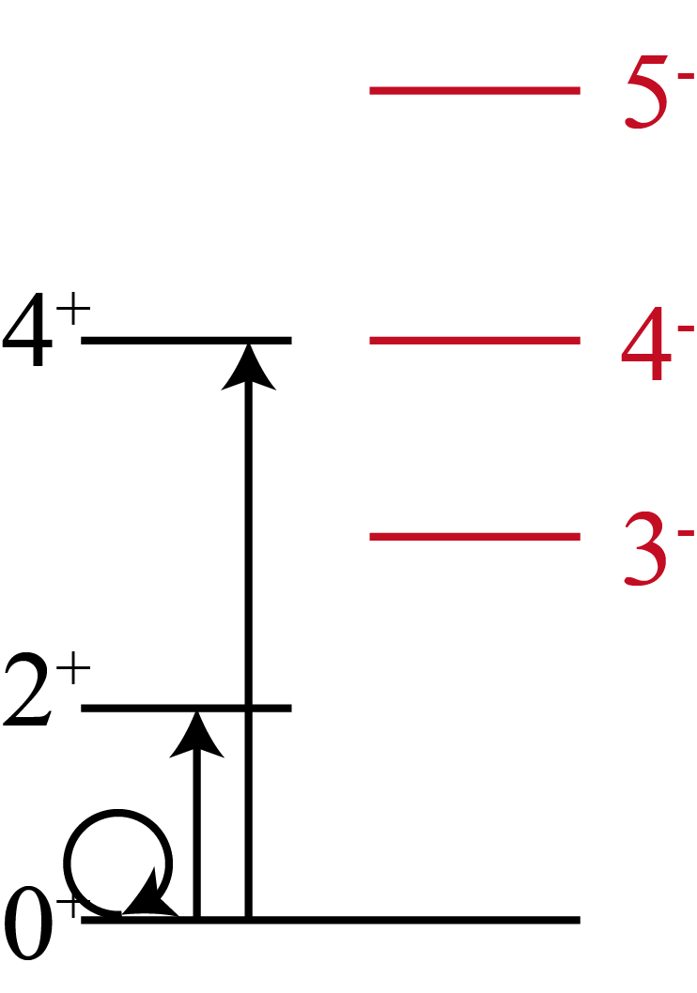
Shape of ¹²C
○ R. Bijker and F. Iachello suggested the spinning triangle
picture (0⁺, 2⁺, 3⁻, 4±, 5⁻ ground band)
○ Let us regard them as a single state
R. Bijker and F. Iachello, PRC61, 067305 (2000).
D.J. Marín-Lámbarri, et al. PRL113, 012502(2014)

Slide 27
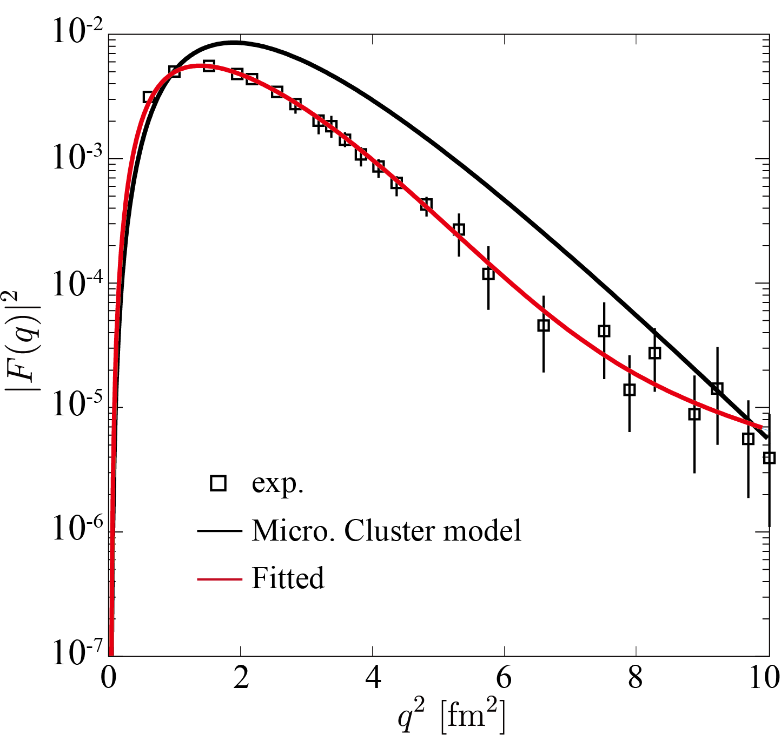
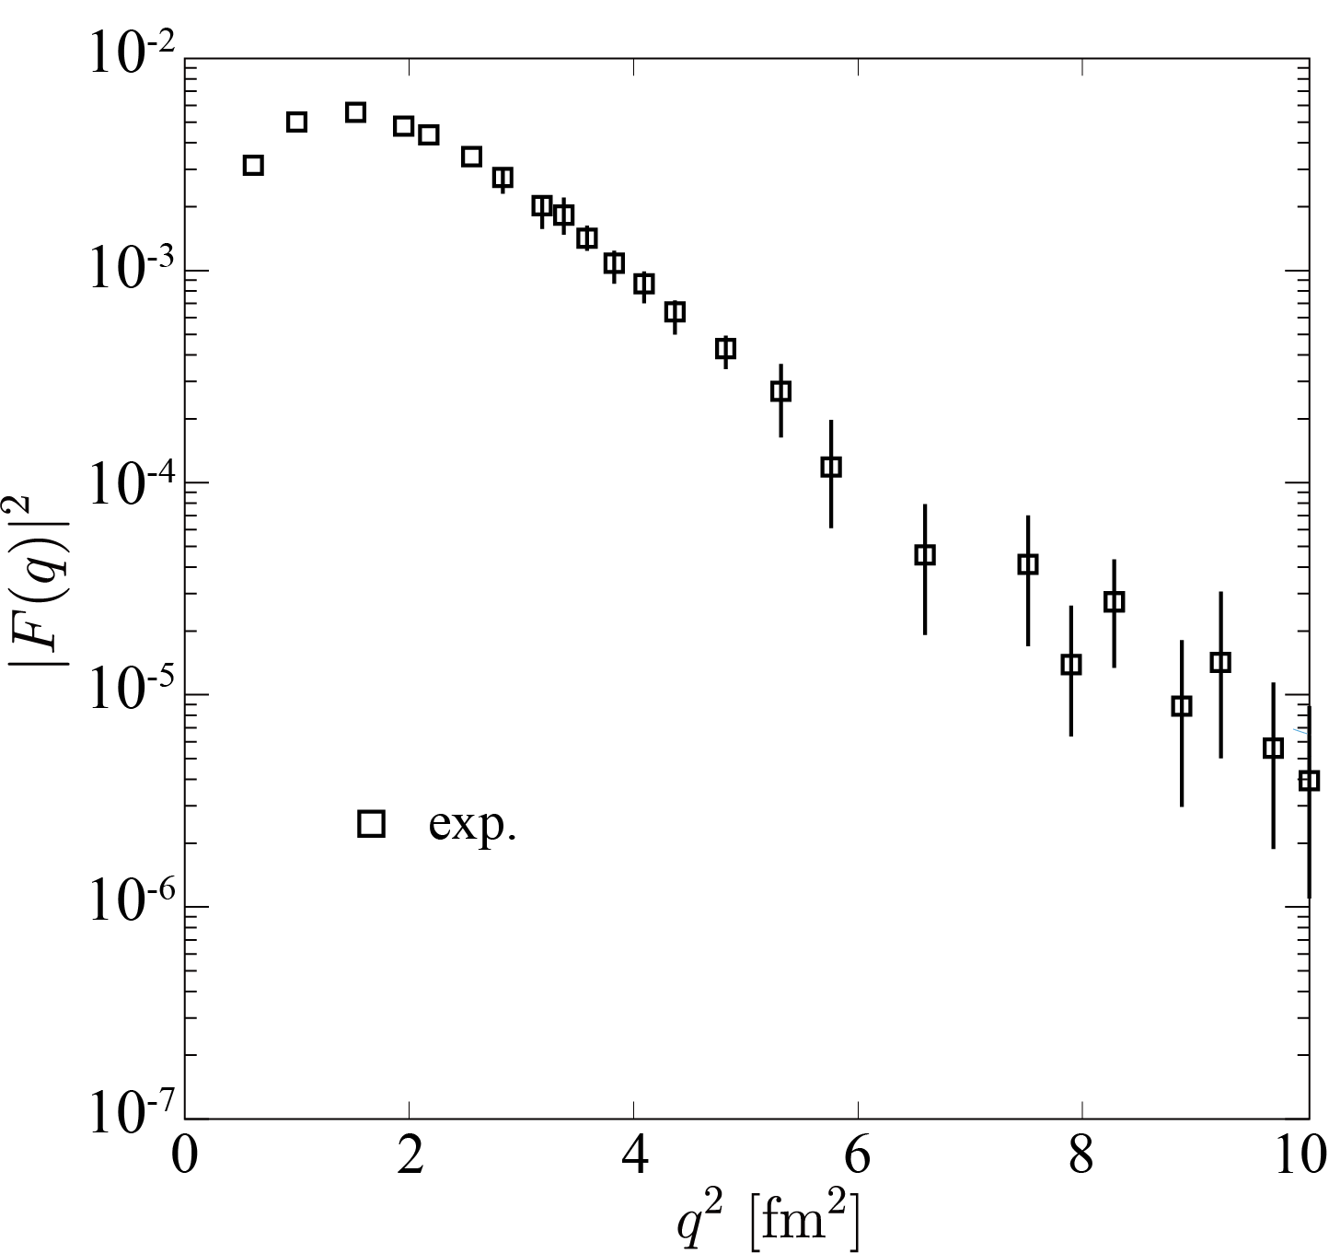
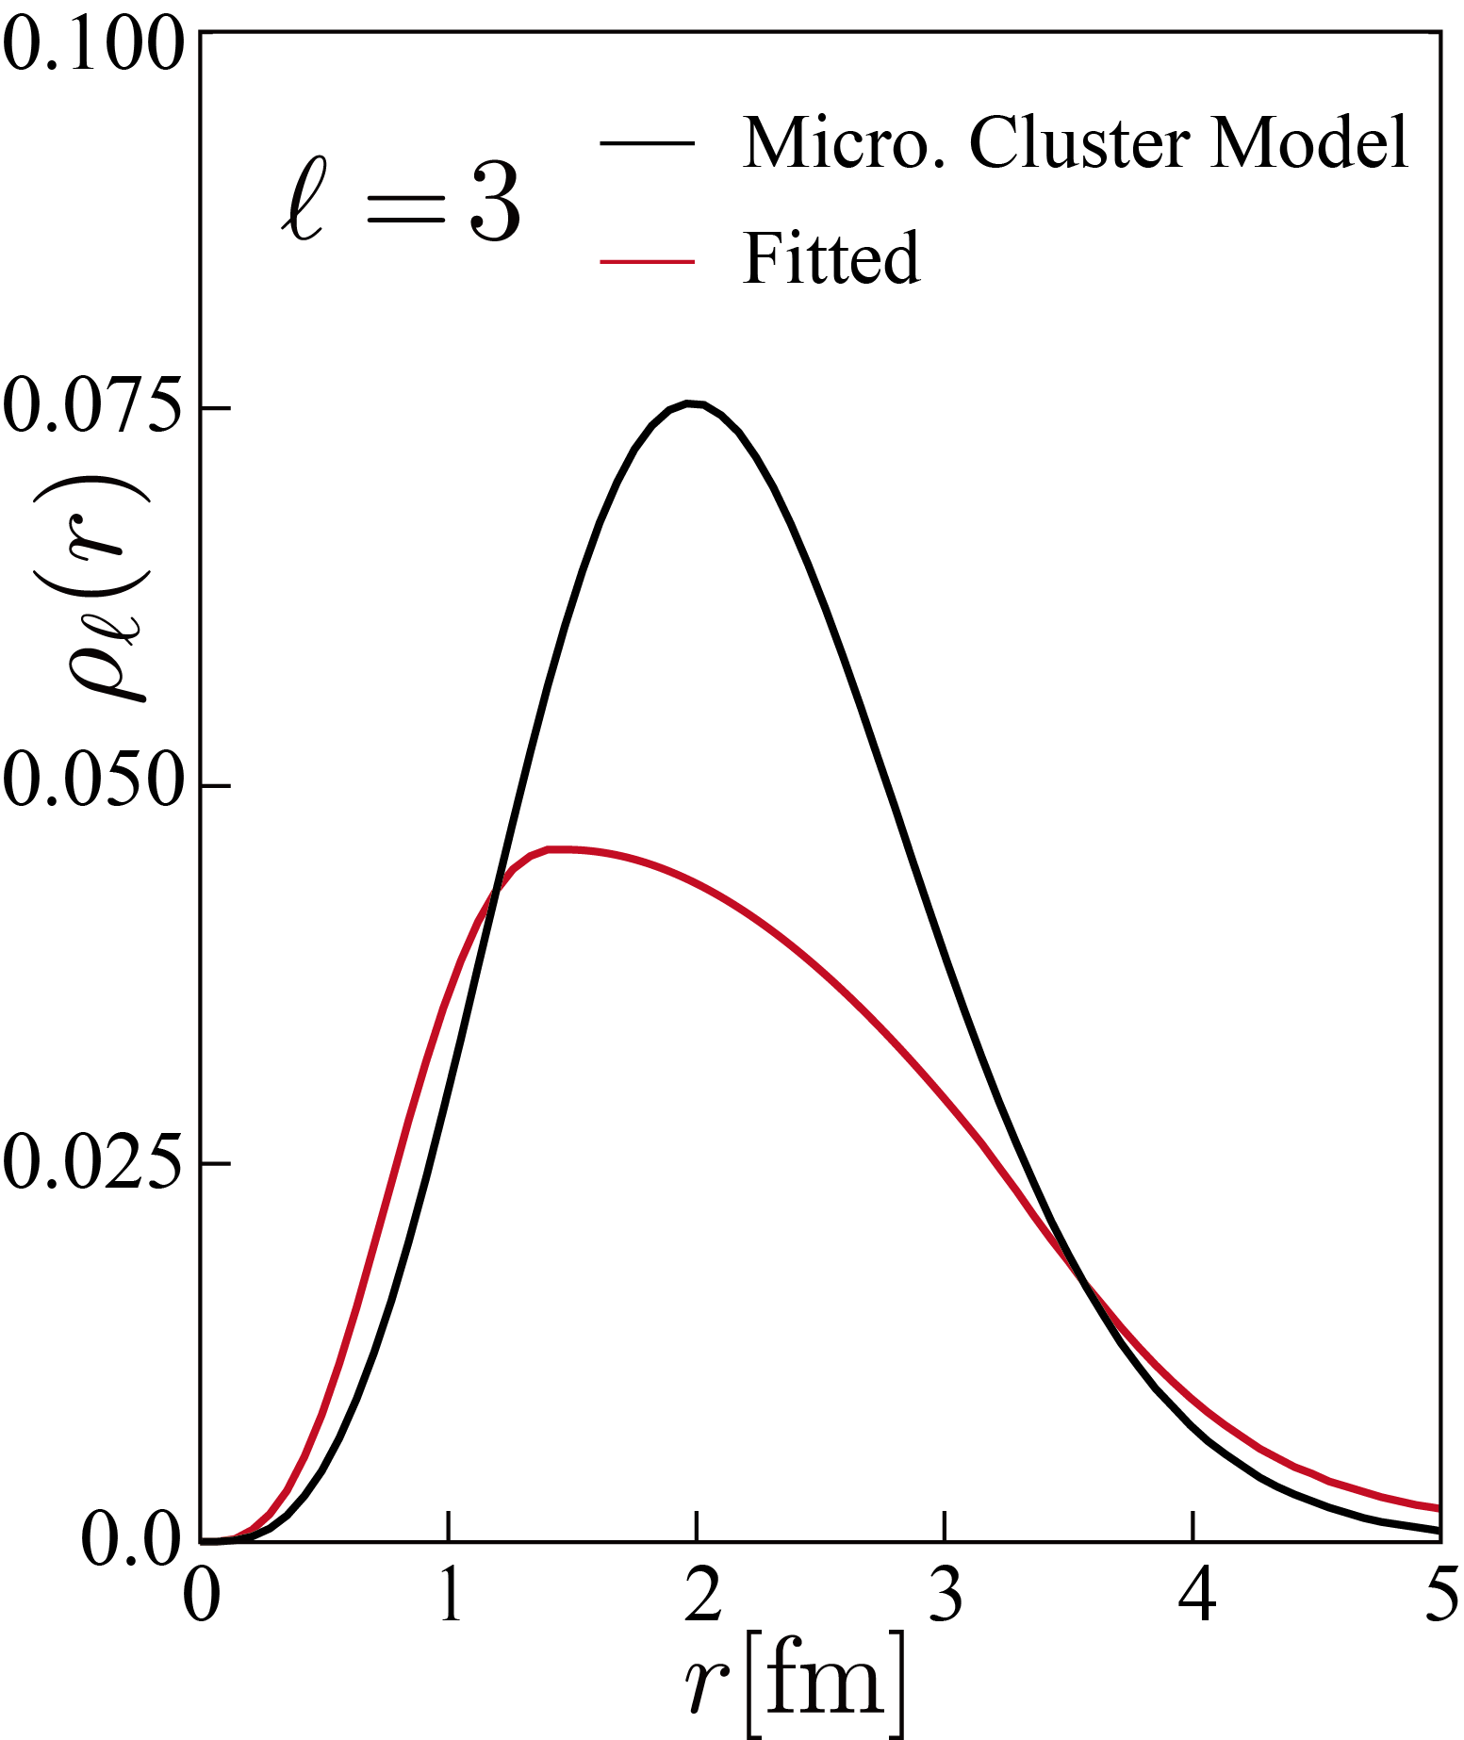
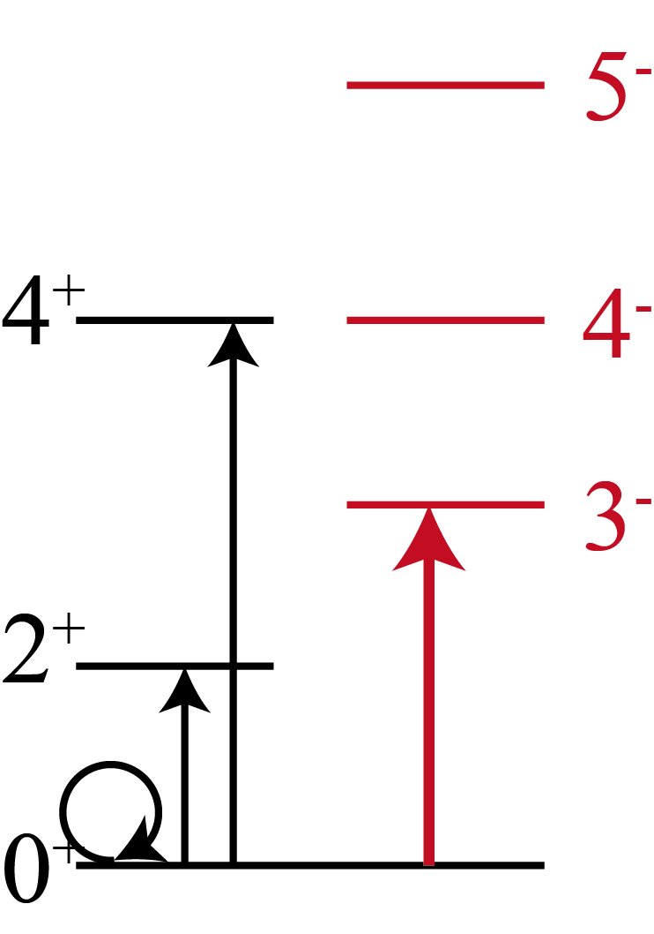

Shape of ¹²C
○ Form Factor for 3- state was already measured
H. Crannel, et al., Int. Conf. on nuclear physics
with electromagnetic interactions, Mainz, 1979.

Slide 28
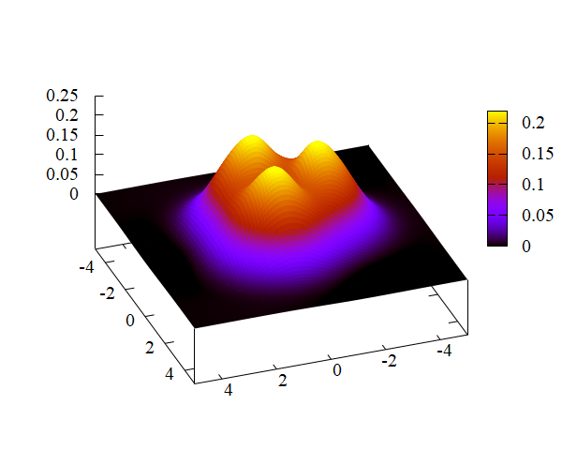
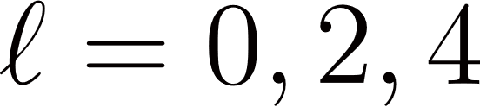
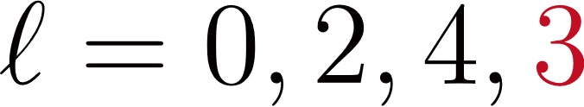
Shape of ¹²C
○ We regard 0⁺, 2⁺, 3⁻, 4±, 5⁻ states as a single rotational band
and superpose the transition densities

Slide 29
Summary
◎ Assuming the rigid rotor model, the relationship between
the transition density and intrinsic density was discussed
◎ If we regard the 0⁺, 2⁺, 3⁻, 4±, 5⁻ states as a single
rotational band, their transition densities beautifully yield
3α clustered intrinsic state
◎ Hoyle family do not show
the rotational nature
(no intrinsic state ! )

