Slide 1
Ab initio study of high-momentum physics in s-shell nuclei
Mengjiao L YU
Research Center for Nuclear Physics, Osaka University
Light clusters in Nuclei and Nuclear Matter
ECT*, Trento, Italy, July 25th, 2019

Slide 2
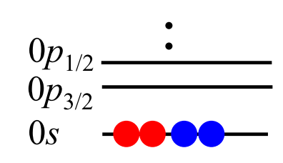
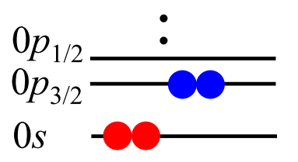
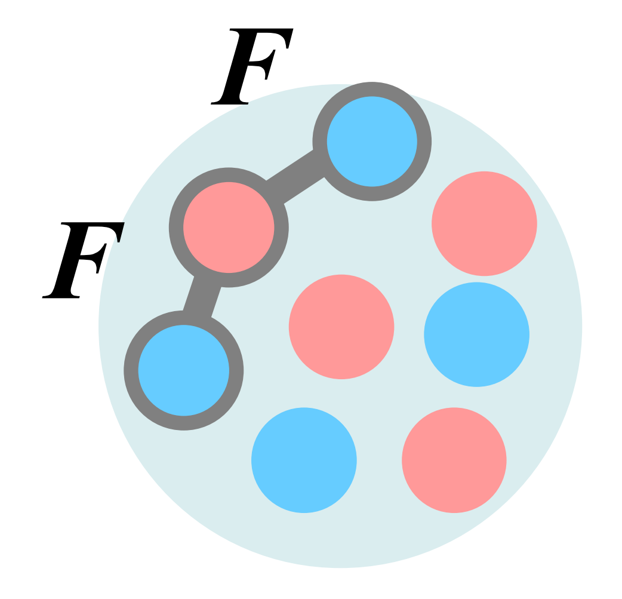
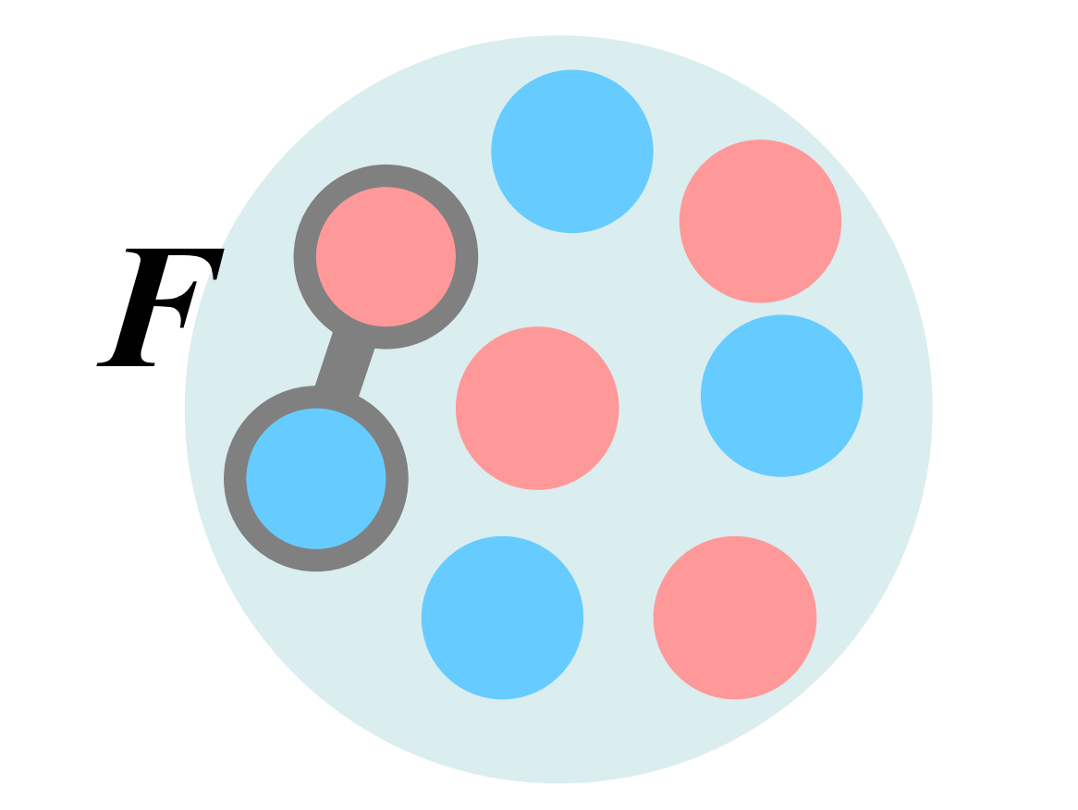
NN-correlations in ab initio calculations
Strong short-range repulsion in AV8’ bare interaction
Strong tensor attraction in AV8’ ( > 50% of total attraction)
Particle-hole excitations
Many-body correlations
……
[1] R. B. Wiringa, V. G. J. Stoks, and R. Schiavilla, Phys. Rev. C 51, 38 (1995).

Slide 3
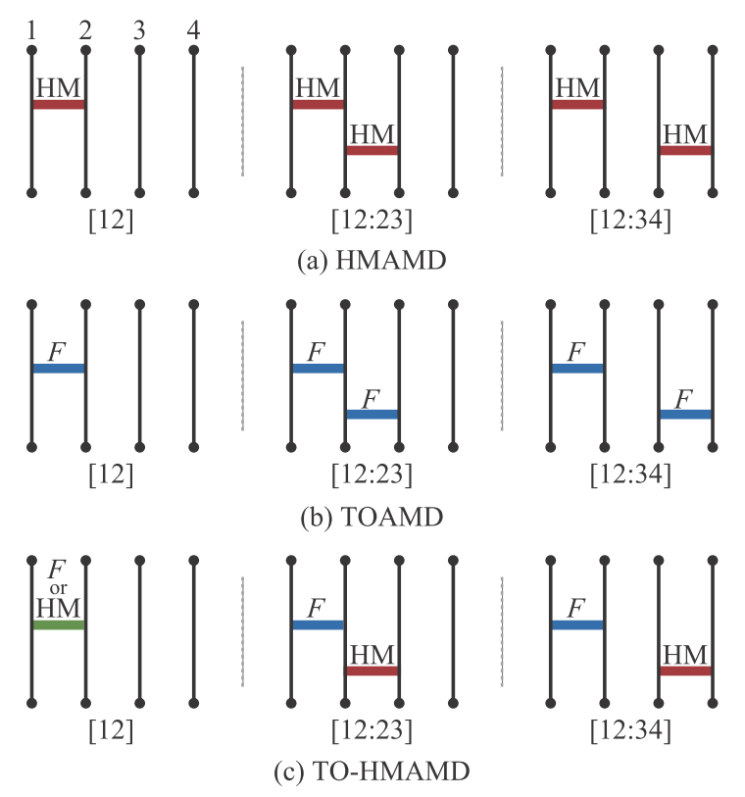
Correlation diagrams of AMD based approaches for ab initio calculation
The AMD wave function which is widely used in microscopic calculation of nuclear cluster systems is adopted as the reference state
where $φ$ is single nucleon state of Gaussian form
$NN$-correlation is not explicitly described in AMD reference function

Slide 4
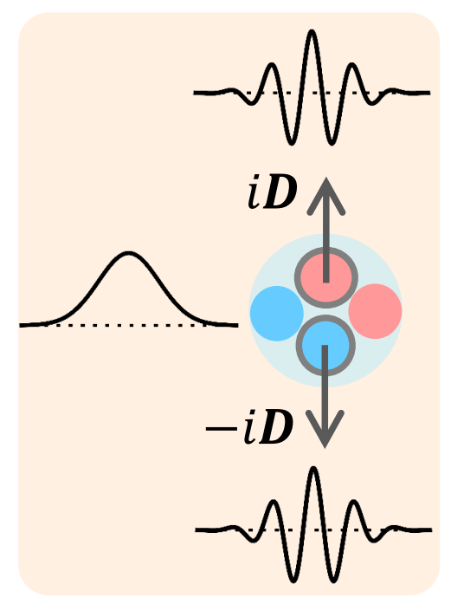
The HMAMD treatment of $NN$ correlations
The HM excitation of $NN$-pairs are described by introducing imaginary shifts for Gaussian wave packets in AMD reference state
$$Ψ_{HMAMD}\left(D_{α}\right)=det \{|\left.φ_{1}\left(r_{1}\right)φ_{2}\left(r_{1}\right)⋯φ_{A}\left(r_{A}\right)\right\rangle \}$$
where two paired nucleons are shifted in momentum space [1,2]
$$φ_{1,2}\left(r_{1,2}\right)={\left(\frac{2ν}{π}\right)}^{3/4}e^{−ν{\left(r_{1,2}±iD_{α}\right)}^{2}}χ_{1,2}$$
$$φ_{i=3\sim A}\left(r_{i}\right)={\left(\frac{2ν}{π}\right)}^{3/4}e^{−ν{\left(r_{i}\right)}^{2}}χ_{i}$$
[1] N. Itagaki and A. Tohsaki, Phys. Rev. C 97, 014304 (2018).
[2] H. Matsuno, Y. Kanada-En’yo, and N. Itagaki, Phys. Rev. C 98, 054306 (2018).
the total wave function in “Single HMAMD” (1st-order)
$$\left|Ψ\right\rangle =\left|Ψ_{AMD}\right\rangle +\sum_{α}{C_{α}}|Ψ_{HMAMD}\left(D_{α}\right)⟩$$

Slide 5
Application of HMAMD in finite nuclei (³H)
D_{z}
D_{x}
$$p$$
$$n$$
$$p$$
$$n$$
$$n$$
$$n$$
……
$$n$$
$$n$$
$$n$$
$$n$$
$$p$$
$$p$$
$$n$$
$$p$$
$$n$$
$$p$$
$$n$$
$$n$$
$$D_{p↑,n↑}$$
$${−D}_{p↑,n↑}$$
$$D_{p↑,n↓}$$
$${−D}_{p↑,n↓}$$
$$D_{n↑,n↑}$$
$${−D}_{n↑,n↑}$$

Slide 6
Angular momentum projection of HMAMD bases
$$p$$
$$p$$
$$p$$
$$\hat{P}(\frac{1}{2},\frac{1}{2},\frac{1}{2})$$
$$n$$
$$n$$
$$n$$
$$n$$
$$n$$
$$n$$
³H, HMAMD, rotated in space
³H, HMAMD, angular momentum projected
³H, HMAMD
$${\hat{P}}_{MK}^{J}=\frac{2J+1}{8π^{2}}\int{{{(D}_{MK}^{J})}^{∗}\left(Ω\right)R\left(Ω\right)d(Ω)}$$

Slide 7
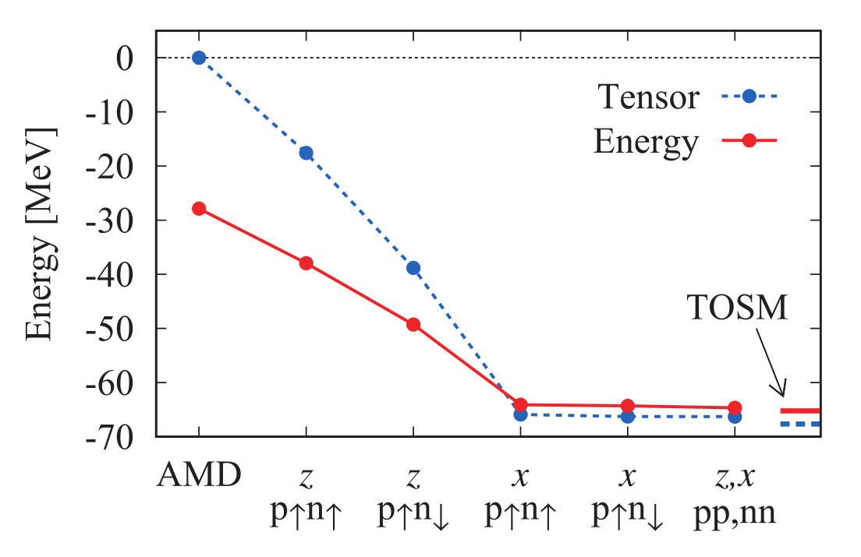
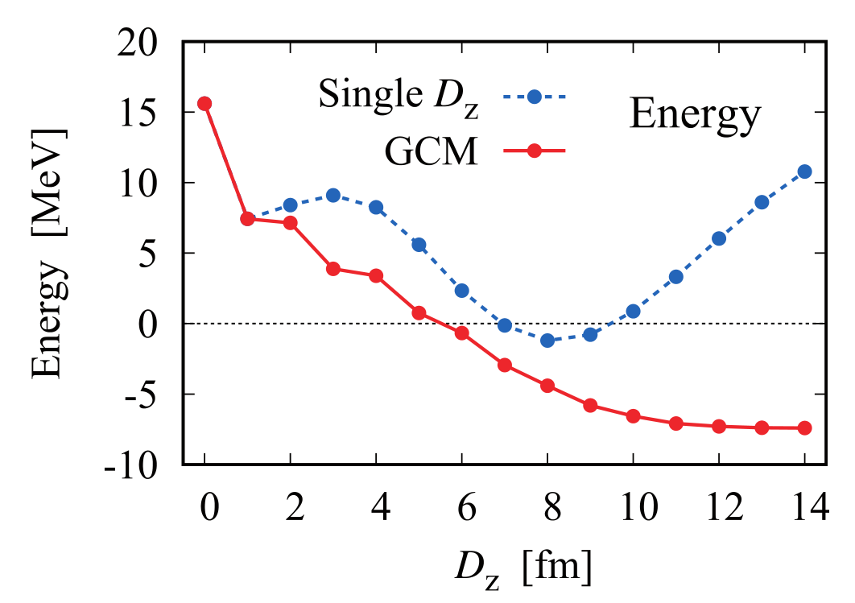
Application of HMAMD on ³H nuclei
Treatment of tensor correlation (Furutani–Tamagaki force)
Treatment of central correlation (AV4’ force)
T. Myo, PTEP 2018, 031D01 (2018)
Representation of NN contact
T. Myo, H. Toki, K. Ikeda, H. Horiuchi, T. Suhara, M. Lyu, M. Isaka, and T. Yamada, Prog. Theor. Exp. Phys. 2017, 111D01 (2017)
Q. Zhao, M. Lyu, Z. Ren, T. Myo, H. Toki, K. Ikeda, H. Horiuchi, M. Isaka, and T. Yamada, Phys. Rev. C 99, 034311 (2019)

Slide 8
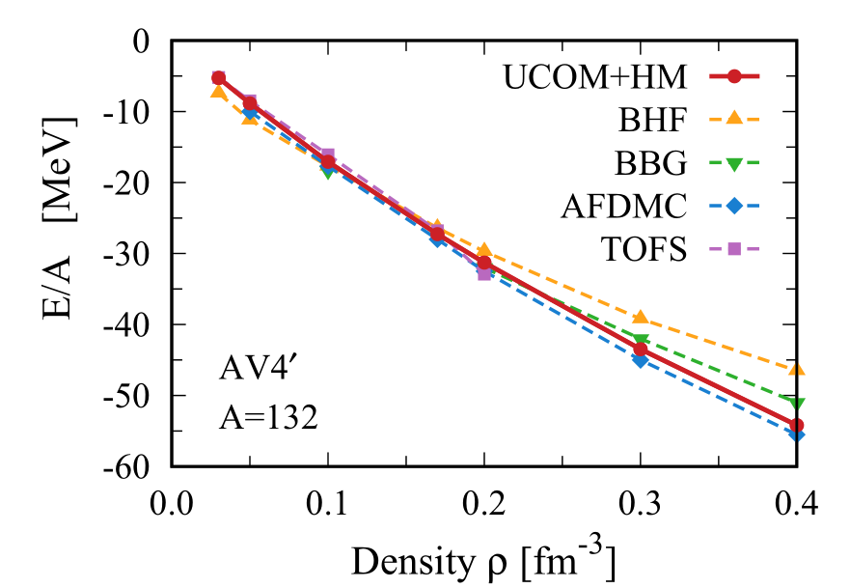
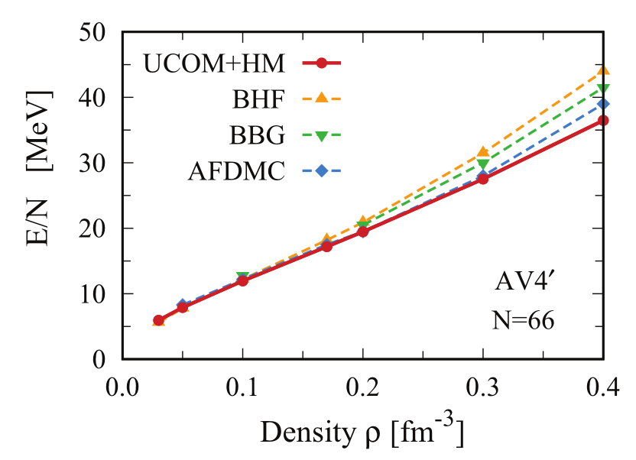
Application of HMAMD on infinite nuclear matter
Symmetric Nuclear Matter
Neutron Matter
T. Myo, H. Takemoto, M. Lyu, N. Wan, C. Xu, H. Toki, H. Horiuchi, T. Yamada, and K. Ikeda, Phys. Rev. C 99, 024312 (2019)

Slide 9
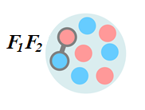
The TOAMD treatment of NN correlation
The general formulation of TOAMD wave function [1]
$$|Φ_{TOAMD}〉=(1+F_{D_{1}}+F_{S_{1}}+F_{D_{2}}F_{S_{2}}+F_{D_{3}}F_{D_{4}}+F_{S_{3}}F_{S_{4}}+⋯)|Φ_{AMD}〉$$
AMD part
Single nucleon state
$$|Φ_{AMD}〉=det \{φ_{1}⋯φ_{A}\}$$
$$φ\left(r\right)∝e^{−ν{\left(\vec{r}−\vec{Z}\right)}^{2}}χ_{σ}χ_{τ}$$
Single correlation function (1F-term)
Double correlation function (2F-term, ladder)
Double correlation function (2F-term, 3-body)
$$F1$$
$$F1$$
$$F1$$
$$F2$$
$$F2$$

Slide 10
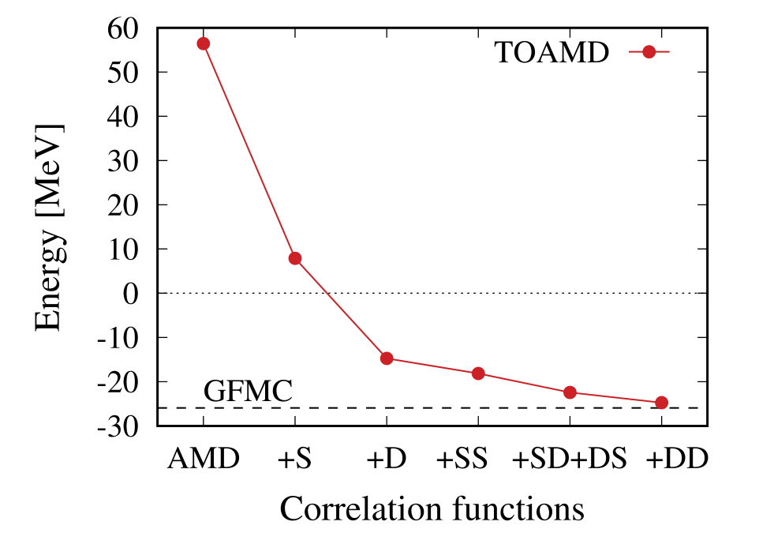
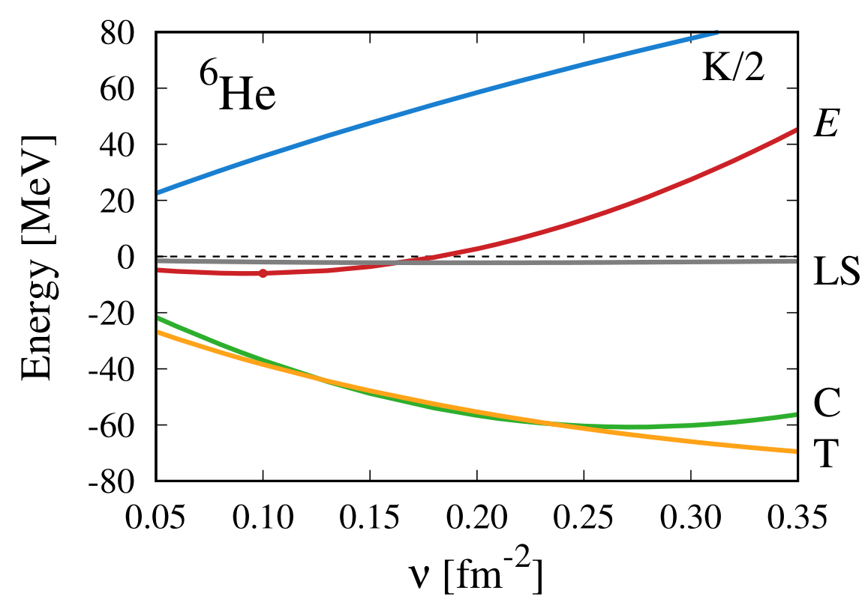
The TOAMD treatment of finite nuclei
⁴He
T. Myo, H. Toki, K. Ikeda, H. Horiuchi, T. Suhara, Phys. Lett. B 769, 213 (2017).
T. Myo, H. Toki, K. Ikeda, H. Horiuchi, M. Lyu, submitted to Phys. Rev. C (2019).

Slide 11
The formulation of TO-HMAMD
The general formulation of TO-HMAMD wave function
Correlation functions in Gaussian expansion
The TO-HMAMD bases are characterized by
channels of correlation function F (2+4=6)
ranges in Gaussian expansion $a$ ($n_{G}$)
HM pair kinds (6)
magnitudes of imaginary shifts ($n_{D}$)

Slide 12
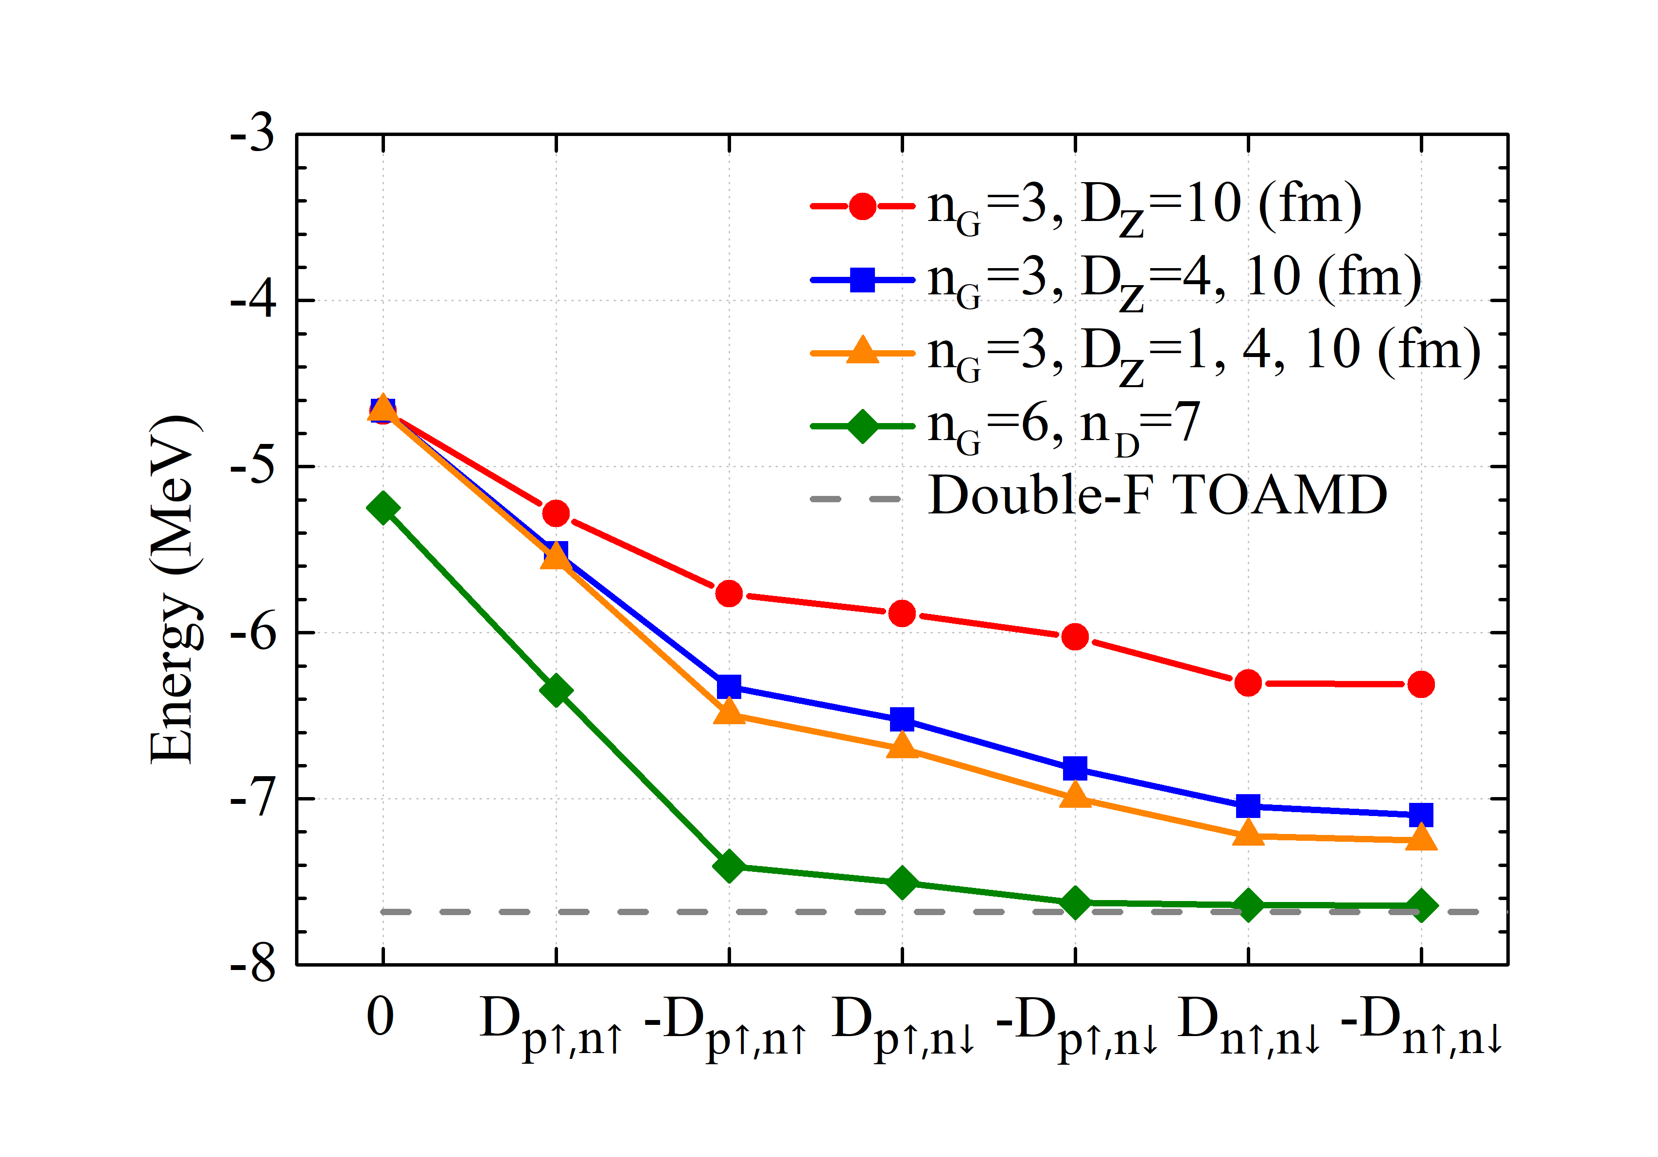
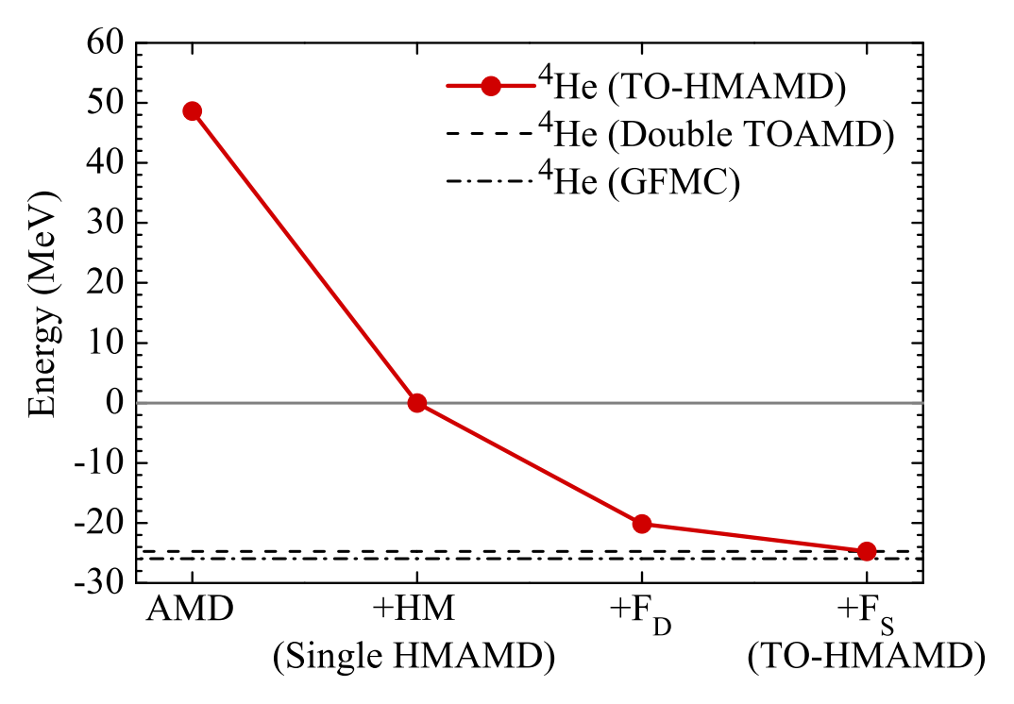
Convergence of TO-HMAMD and Double TOAMD
Single TOAMD
³H
M. Lyu, M. Isaka, T. Myo, H. Toki, K. Ikeda, H. Horiuchi, T. Suhara, and T. Yamada, Prog. Theor. Exp. Phys. 2018, 011D01 (2018)
M. Lyu, T. Myo, M. Isaka, H. Toki, K. Ikeda, H. Horiuchi, T. Suhara, and T. Yamada Phys. Rev. C 98, 064002 (2018)

Slide 13
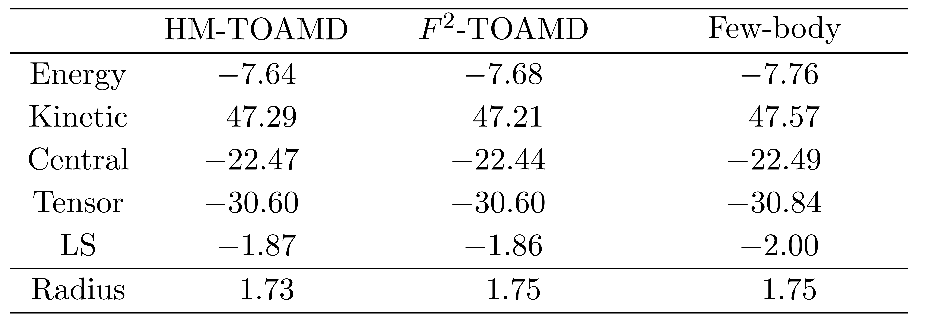
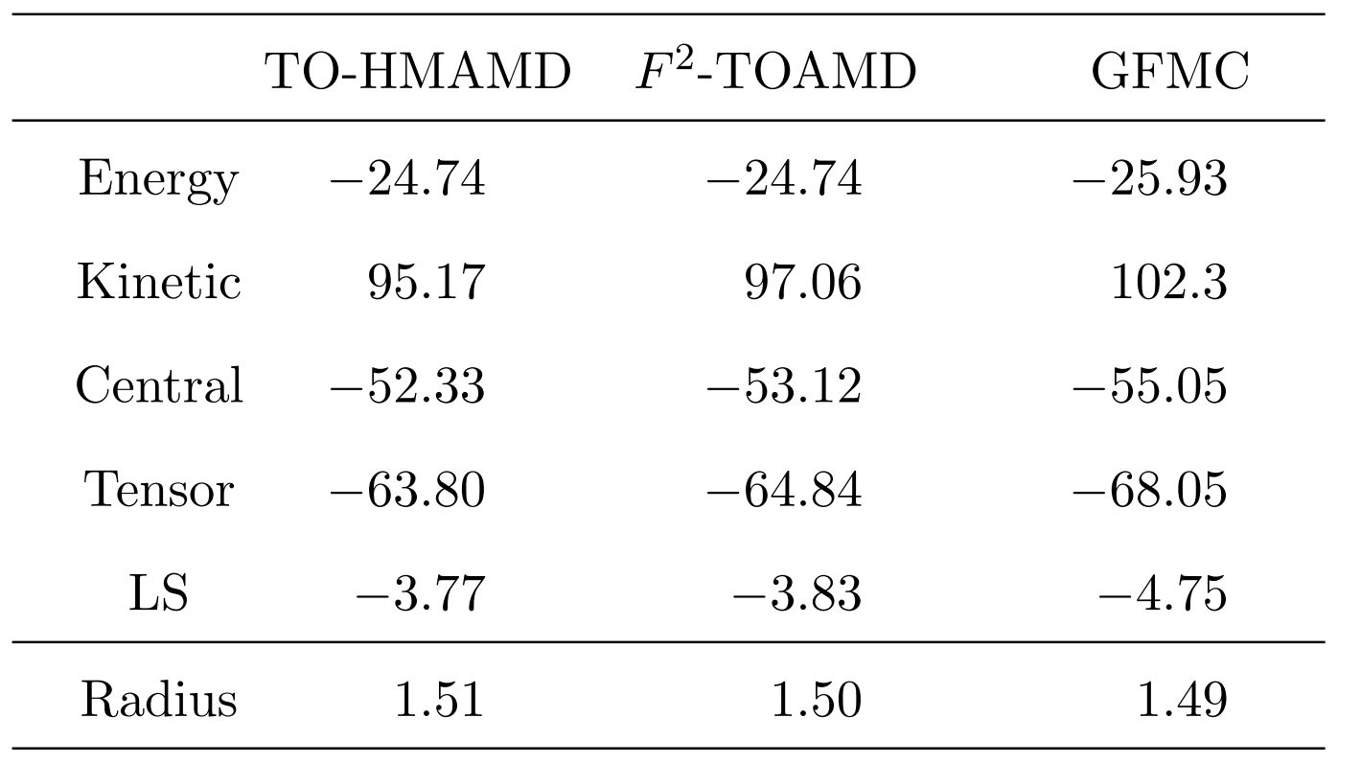
Energy, radius and components of ³H and ⁴He with bare interaction
³H
⁴He
[1] M. Lyu, M. Isaka, T. Myo, H. Toki, K. Ikeda, H. Horiuchi, T. Suhara, and T. Yamada, Prog Theor Exp Phys 2018, 011D01 (2018).

Slide 14
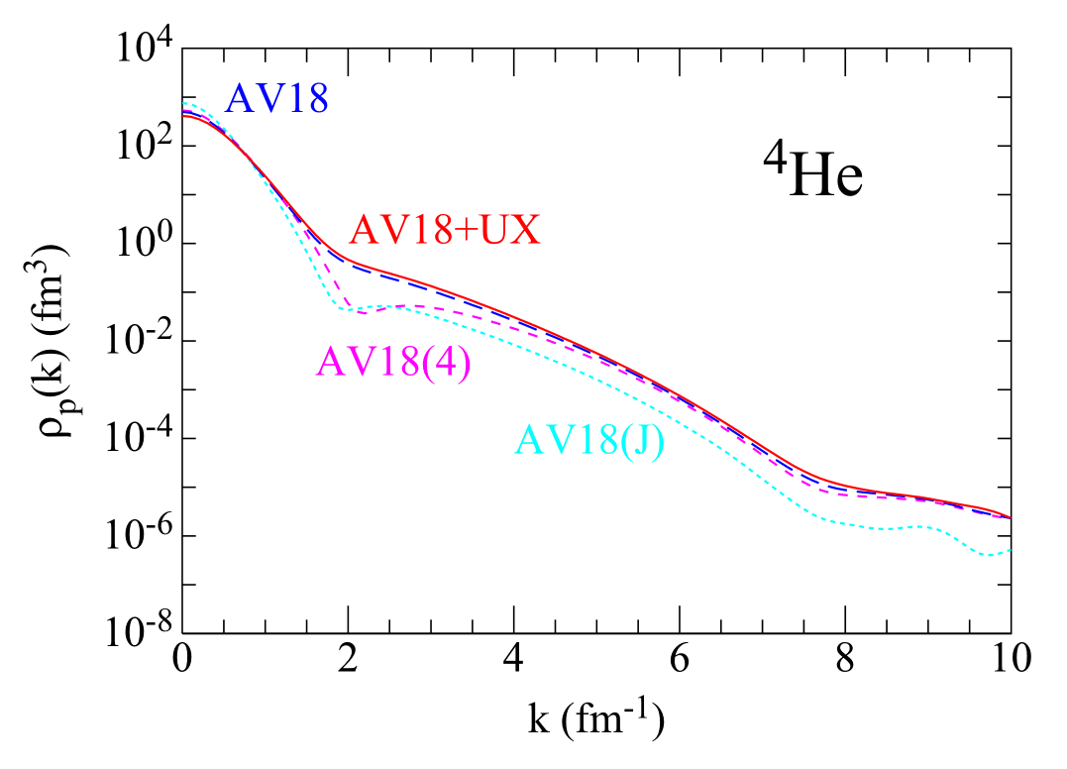
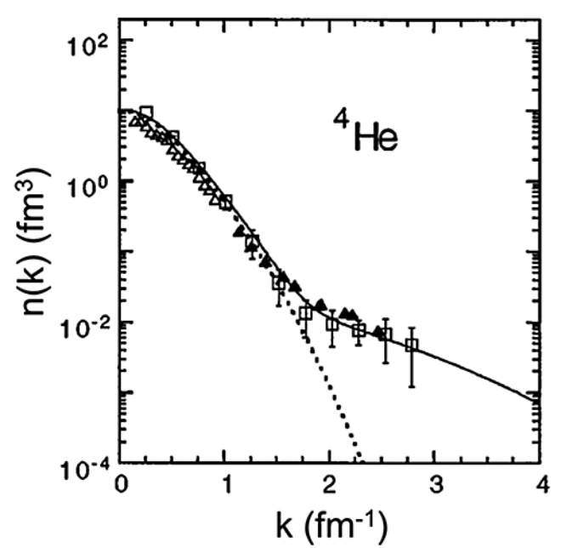
High-momentum component induced by tensor/short-range interaction
Fig. Nucleon momentum distribution [Ciofi degli Atti et al., Phys. Rev. C 53, 1689 (1996)].
Fig. Proton momentum distribution by GFMC [Wiringa et al., Phys. Rev. C 89, 024305 (2014)].

Slide 15
What’s the contribution from each participant of NN-correlations?
ab initio wave function (TO-HMAMD)
First order
Central
AMD
Middle-range
Short-range
Tensor
Many-body
Fig. Concept diagram of the components in ab initio wave
function of different correlation-functions
Fig. Proton momentum distribution by GFMC [Wiringa et al., Phys. Rev. C 89, 024305 (2014)].

Slide 16
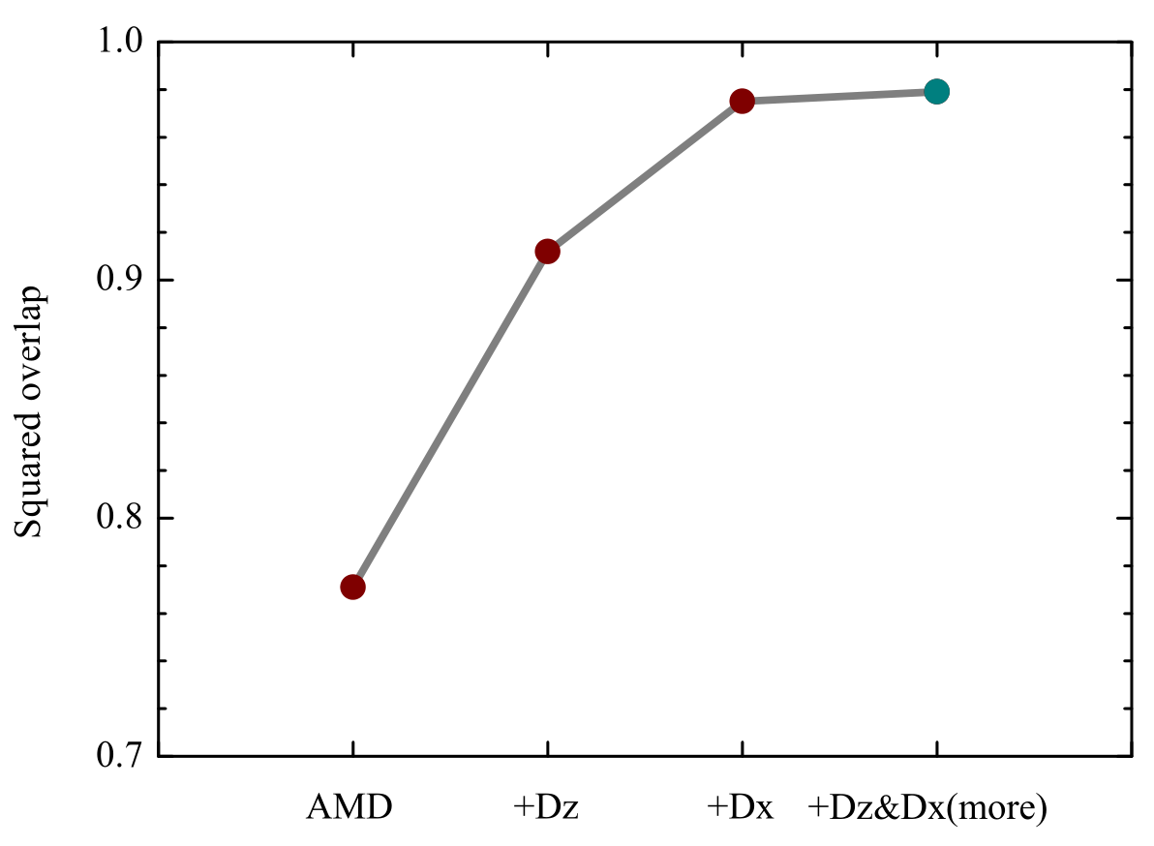
Expansion of ab initio wave function by HMAMD bases
We expand the ab initio wave function $|Ψ⟩$ by the HMAMD bases
The right-hand-side is projection of $|Ψ⟩$ in the HMAMD functional space, which is denoted as “$|Ψ in HMAMD⟩$”
We define the overlap between ab initio wave function $|Ψ⟩$ and its projection in HMAMD model space, to show the quality of expansion
O = $\left|\left\langle Ψ \right| Ψ in HMAMD\right\rangle {\left.​\right|}^{2}$
and
0 $≤$ O $≤$ 1

Slide 17
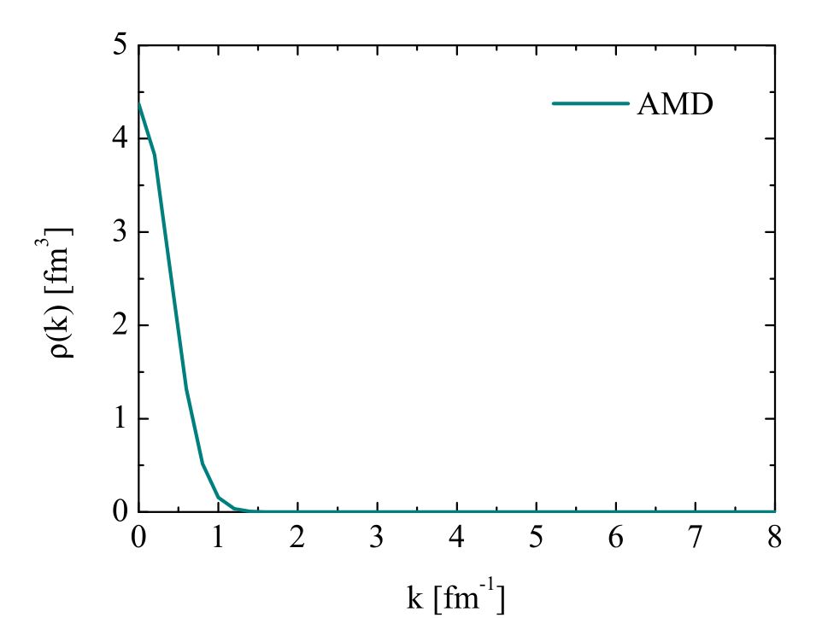
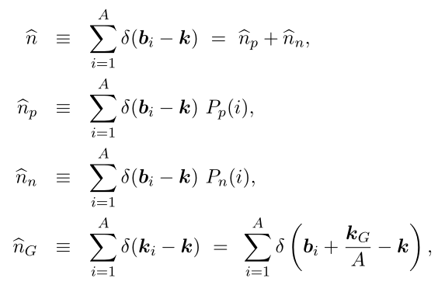
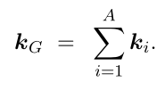
Momentum distribution of AMD wave function (preliminary)
The momentum distribution operators are defined as
where
b_{i}: single-particle momentum in the c.m. frame
Fig. Momentum distribution of $|AMD⟩$ with $R=0$
$\hat{n}$_{G}: c.m. motion in the laboratory frame
Formulae and code developed for momentum distribution of AMD wave function

Slide 18
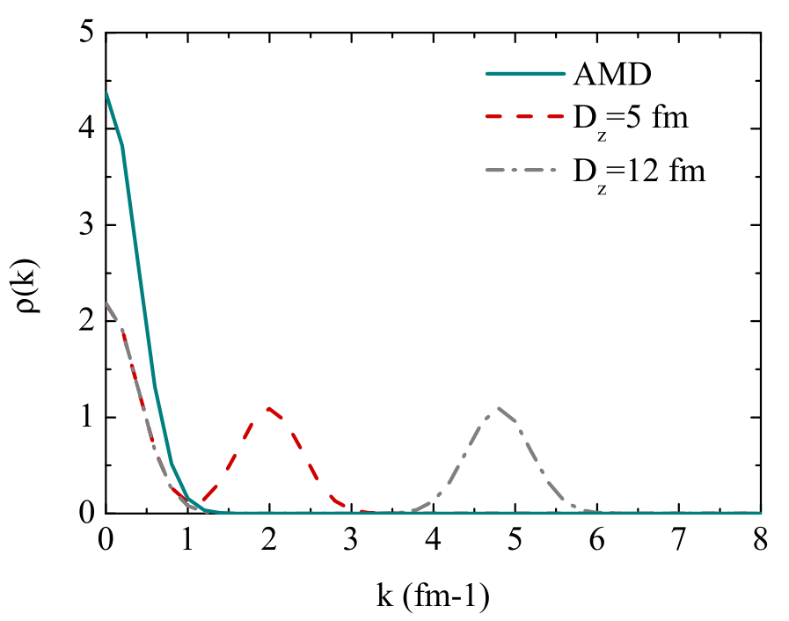
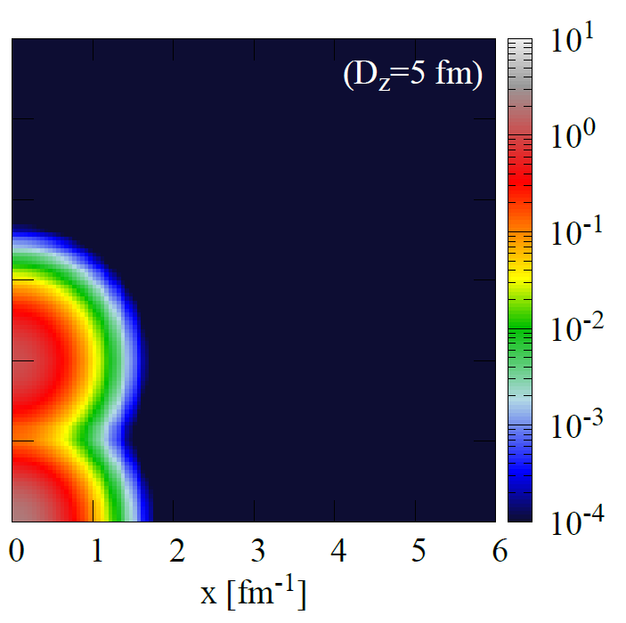
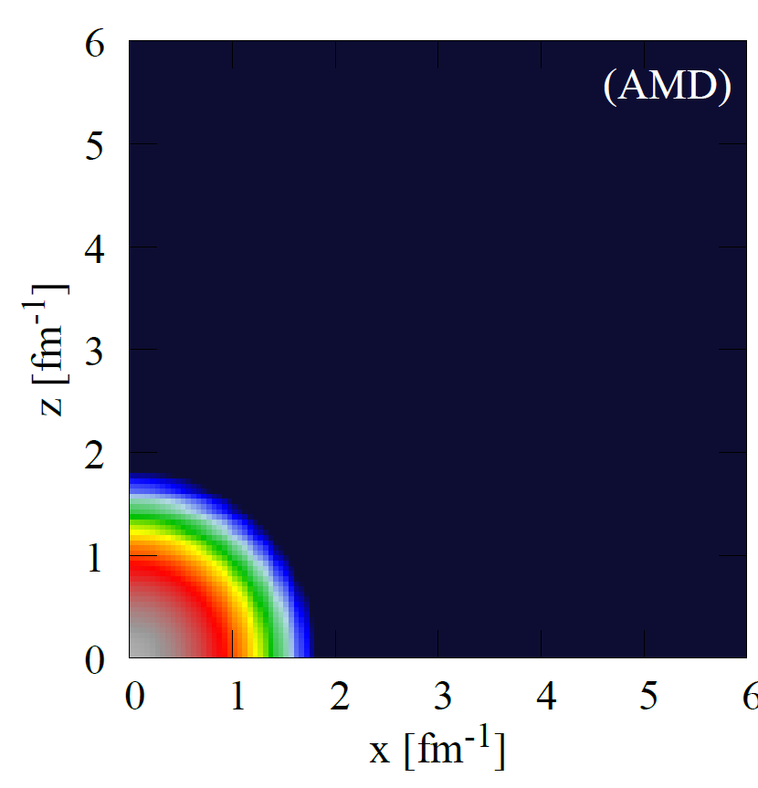
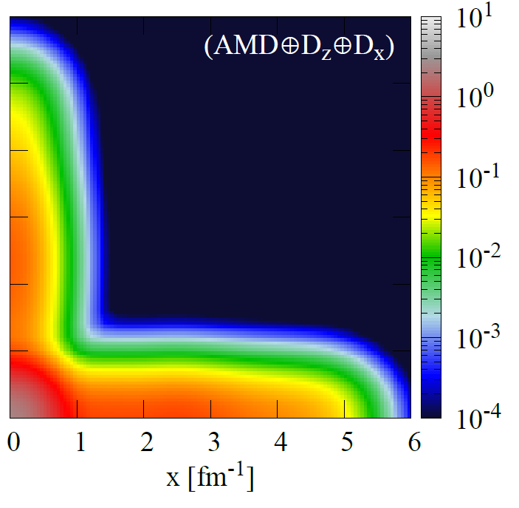
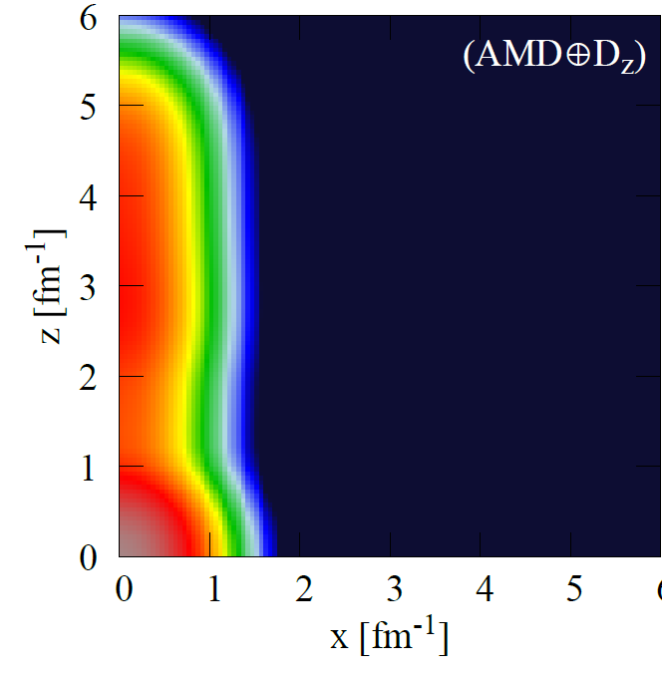
Momentum distribution of HM-AMD bases (intrinsic frame)
(fm³)
(fm³)

Slide 19
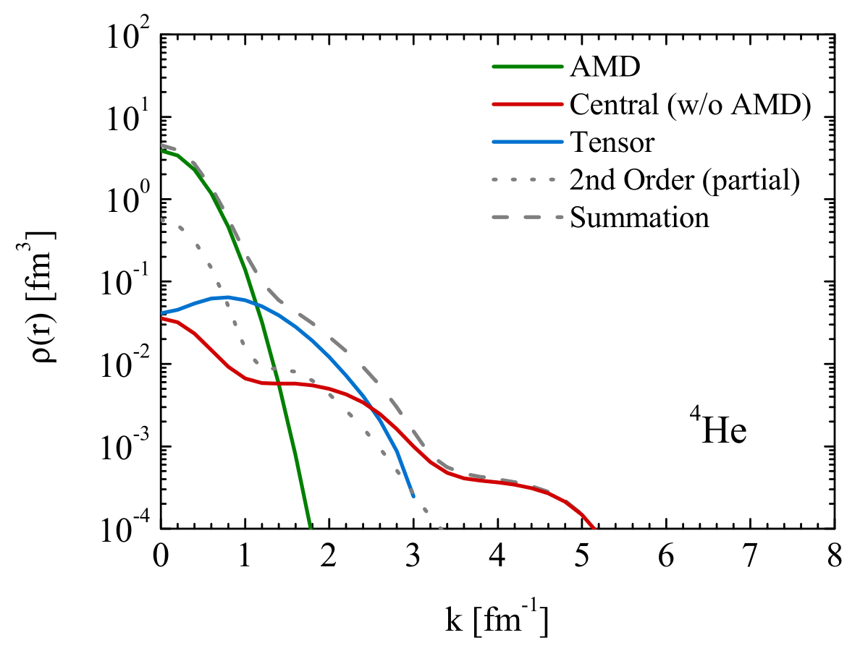
Momentum distribution of $4$He (very preliminary)
Each component wave function is constructed to be orthogonal with above
Fig. Momentum distribution of ⁴He and each of its component

Slide 20
Thank you very much

