Slide 1
Isoscalar transitions and α clusters in heavy nuclei
M. Ito¹, M. Nakao¹, T. Okuno¹, S. Ebata²
¹Department of Pure and Applied Physics, Kansai University
²Lab. For Advanced Nuclear Energy, Institute of Innovative Research, TIT
1. Background: Isoscalar transitions in light nuclei (^{16,18}O, ¹²Be)
2. Our subjects: Monopole and dipole transitions in heavy nuclei
3. Framework: α potential model + complex boundary condition
4. Results(1): IS0 and IS1 transitions in ⁴⁴Ti = α + ⁴⁰Ca
5. Results(2): IS1 in ^{104～110}Te = α + ^{100～106} Sn ( E1 in ¹³⁵Cs = α + ¹³¹I )
5. Discussion and future studies: Improvement of calculations

Slide 2
$$R$$
α clustering phenomena and monopole transition
1. α clustering phenomena in nuclei
O(IS0)～R²
α cluster structures appear in excited states of lighter systems
⁸Be = 2α, ¹²C = 3α, ¹⁶O=α +¹²C, … ⇒ Identified by E_{x}(0_{ex}⁺), Γ_{α}, etc
$$R$$
below ～15 MeV
2. Isoscalar monopole (IS0) transition and α cluster structures
IS0 transition is strongly enhanced if α cluster structures are well developed
$$M\left(IS0\right)= \left\langle 0_{f}^{+} | \sum_{i=1}^{A}{r_{i}^{2}} | 0_{1}^{+}\right\rangle$$
Discrete IS0 strength at E_{x} < 15 MeV is possible to be described by α cluster model
IS0 will be new (or modern) probe to assign α cluster structure
cf. E_{x} > 15 MeV in M.F. model
3. Investigations on IS0 transition
(2hw～30 MeV)
IS0 transitions are mainly investigated in lighter systems.
^{12,13}C ⇒ 3α, ^{16,18}O ⇒ α +^{12,14}C, ¹²Be ⇒ α + ⁸He are compared with experiments

Slide 3
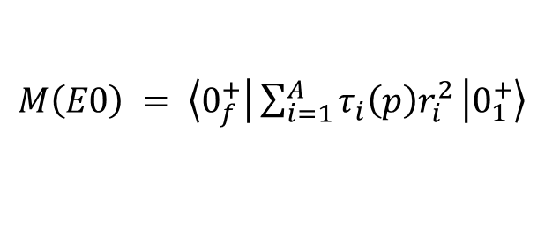
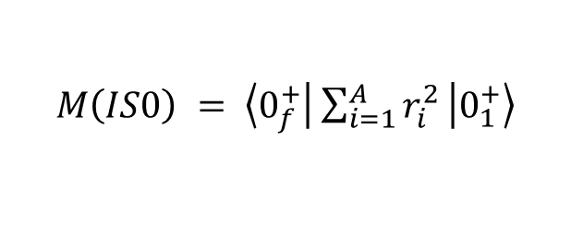
Monopole transition in ^{16,18}O with α cluster model
¹⁶O: 4α model
¹⁸O: α + ¹⁴C coupled-ch.
$$M\left(IS0\right) = \left\langle 0_{f}^{+} | \sum_{i=1}^{A}{r_{i}^{2}} | 0_{1}^{+}\right\rangle$$
$$M\left(E0\right) = \left\langle 0_{f}^{+} | \sum_{i=1}^{A}{τ_{i}\left(p\right)r_{i}^{2}} | 0_{1}^{+}\right\rangle$$
M. Nakao et al., PRC98 (2018)
T. Yamada et al.,
PRC85 (2012)
M.F. model cal.
( 4.3 MeV )
( fm² )
( fm² )
Cluster model cal.
Ratio to weisskopf unit (W.U.)
Theory (0₁⁺ ⇒ 0₂⁺) = 1.1 W.U.
Experiment (0₁⁺ ⇒ 0₂⁺) = 1.5 W.U.
^{16,18}O → α + ^{12,14}C excitation nicely describe discrete strength below E_{x} < 15 MeV

Slide 4
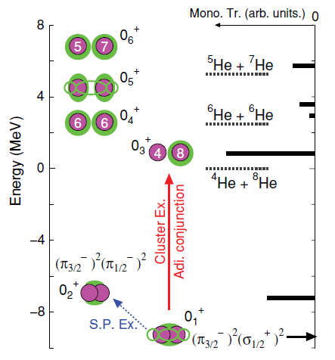
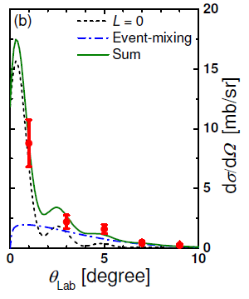
IS0 transitions in ¹²Be
IS0 strength is enhanced for ¹²Be → α + ⁸He excitation;
M. Ito and K. Ikeda, RPP77 (2014)
Theoretical cal. of IS0 transition
Exp. of ¹²C + ¹²Be
M(IS0)～2 W.U.
～3.5 W.U.
Z. H. Yang et al.
PRL112 (2014)

Slide 5
Our subject: Extension of IS transition to heavier systems
1. Studies of IS transition ( A < 50 )
$$\hat{O}\left(IS0\right)=\sum_{i}{r_{i}^{2}}$$
① IS0 transition is effective probe to identify cluster structures
② IS1 transition is proposed as a new probe for asymmetric cluster with N=Z
Y. Chiba et al., PRC93, 034319 (2016)
$$\hat{O}\left(IS1\right)=\sum_{i}{r_{i}^{3}}Y_{1,0}\left({\hat{r}}_{i}\right)$$
α + ¹⁶O in ²⁰Ne and α + ⁴⁰Ca in ⁴⁴Ti
2. Studies of cluster structure in heavy systems
⁴⁴Ti with α + ⁴⁰Ca is deeply studied by microscopic and α potential models
Heavier systems (Actinide, rare-earth, …) are extensively studied by α potential model
Intensive contributions from B. Buck et al. → Ground and negative rot. band struture
Our subject: Studies on IS0 and IS1 transitions in heavier systems
3. Today’s report
We discuss continuum strength of isoscalar transitions by potential model for
IS0 and IS1: ⁴⁴Ti with α + ⁴⁰Ca model
IS1: ¹⁰⁴Te with α + ¹⁰⁰Sn and Te isotopes
¹⁰⁴Te Exp. K. Auren et al., PRL121 (2018)

Slide 6
Framework (1): Potential and boundary condition
$$ν_{NN}^{ }\left(s,ρ\right)$$
1. Double folding model
$$ρ_{α}\left(r_{α}\right)$$
$$U_{DF}=\iint{ρ_{α}\left(r_{α}\right)ρ_{Ca}\left(r_{Ca}\right)ν_{NN}^{DDM3Y}\left(s,ρ\right) dr_{α}dr_{Ca}}$$
$$ρ_{Ca}\left(r_{Ca}\right)$$
⁴He
⁴⁰Ca
Exp. Charge F.F.
M.F. model ( by S. Ebata )
2. Schrödinger equation
$$χ(r)$$
$$\left(T + V(r) −E \right) χ(r)=0$$
$$r$$
⁴He
⁴⁰Ca
Nuclear interaction
$$V\left(r\right)=N_{r}∙U_{DF}(r)+V_{C}(r)+V^{PF}$$
Double Folding pot.
(N_{r} is optimized)
Coulomb pot.
(Uniform charge)
Pseudo pot.
(Pauli’s principle of α + ⁴⁰Ca)
3. Boundary condition for continuum strength
We apply absorbing boundary condition (ABC) or complex scaling method (CSM)
ABC: M. Iwasaki et al., PTEP2015
CSM: S. Aoyama et al., PTPS116, 1 (2006).

Slide 7
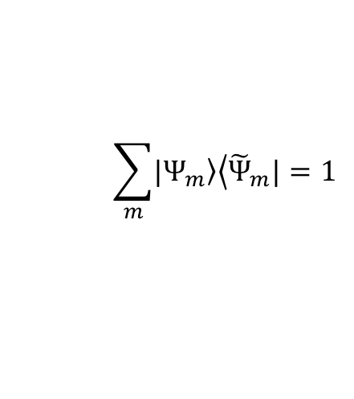
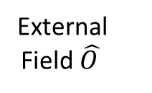
Framework (2) : Calculation of Strength function
Scattering State
$$E_{ν}$$
Bound State
$$E_{0}$$
External
Field $\hat{O }$
⁴⁰Ca
Breakup
α
⁴⁰Ca
α
Final state $Ψ_{ν}$
Initial state $Ψ_{0}$
$$S_{λ}\left(E\right)=\sum_{ν}{{\left|\left\langle Ψ_{ν} | \hat{O_{λ}} | Ψ_{0}\right\rangle \right|}^{2}}δ\left(E−E_{ν}\right)$$
$$\sum_{m}{\left.|Ψ_{m}\right\rangle \left\langle {\tilde{Ψ}}_{m}|\right.}=1$$
Extended Completeness Relation of
ABC or CSM solutions
ABC or CSM Solution
$$S_{λ}\left(E\right)=−\frac{1}{π}\sum_{m}{Im\left[\frac{\left\langle Ψ_{O} | {\hat{O_{λ}}}_{ }^{†} | Ψ_{m}\right\rangle \left\langle {\tilde{Ψ}}_{m} | {\hat{O_{λ}}}_{ } | Ψ_{O}\right\rangle }{E−E_{m}}\right]}$$
Smooth continuum
strength function is
possible to calculate
Complex Energy

Slide 8
Operators for IS transitions (α + ⁴⁰Ca)
⁴He
⁴⁰Ca
$$χ(r)$$
1. IS Monopole and Dipole Operators (Rel. part)
$$r$$
$$α$$
$${\hat{O}}_{λ=0}=\frac{4×40}{44}r^{2}$$
T. Yamada et al., PTP120 (2008)
$${\hat{O}}_{λ=1}=\sqrt{3}⋅\left\{\frac{5}{3}\left(\frac{40}{44}\sum_{i∈α}{ξ_{i}^{2}}−\frac{4}{44}\sum_{i∈Ca}{ξ_{i}^{2}}\right)RY_{1,0}\left(\hat{r}\right)−\frac{4⋅40⋅\left(4−40\right)}{{44}^{2}}R^{3}Y_{1,0}\left(\hat{r}\right) \right\}$$
Y. Chiba et al., PRC93 (2016)
2. Single particle strength (A=44)
$$M_{s.p.}^{λ=1}=\sqrt{\frac{3}{16π}}⋅{\left(1.2A^{1/3}\right)}^{3}∼18.57 fm^{3}$$
$$M_{s.p.}^{λ=0}=\frac{3}{5}⋅{\left(1.2A^{1/3}\right)}^{2}∼10.77 fm^{2},$$
3. Energy weighted sum rule (EWSR)
$$M_{sum}^{λ=0}=\frac{2ℏ^{2}A}{M}\left\langle r^{2}\right\rangle ,$$
$$M_{sum}^{λ=1}=\frac{3}{4π}\frac{ℏ^{2}A}{2M}×\left(11\left\langle r^{4}\right\rangle −\frac{25}{3}{\left\langle r^{2}\right\rangle }^{2}\right)$$
$$∼47322 MeV⋅fm^{4}$$
$$∼288107 MeV⋅fm^{6}$$

Slide 9
Result of α + ⁴⁰Ca (1) : IS0 strength function
※ Naïve M.F. $E_{x}>2hw=30$ MeV
$$0_{2}^{+}$$
$$0_{2}^{+}$$
IS0 transition S(E) [fm⁴/MeV]
$$∼1.5 times$$
EWSR : 25%
Excitation energy [MeV]
Excitation energy [MeV]
This strength appears below 15MeV
which is lower than M.F. model
Fraction
of EWSR
$${\int_{0}^{E}{εS_{λ=0}\left(ε\right)dε}}/{M_{sum}^{λ=0}}$$

Slide 10
Result of α + ⁴⁰Ca (2) : IS1 strength function
※ Naïve M.F. $E_{x}>1hw=15$ MeV
$$1_{1}^{−}$$
$$1_{2}^{−}$$
$$1_{2}^{−}$$
$$∼4.5 times$$
IS1 transition S(E) [fm⁶/MeV]
EWSR : 6%
$$1_{1}^{−}$$
Excitation energy [MeV]
Excitation energy [MeV]
This strength appears around 5MeV
which is lower than M.F. model
Fraction
of EWSR
$${\int_{0}^{E}{εS_{λ=1}\left(ε\right)dε}}/{M_{sum}^{λ=1}}$$

Slide 11
Result of ¹⁰⁴Te (1) : DF potentials for Te isotopes
We have applied α + Sn cluster model to Te isotopes and tuned strength
of DF potentials so as to reproduce α binding energies
Exp. data
Theories
α B. E. is systematically reproduced with strength of Nr = 1.03
Double Folding Potentials with DDM3Y will be reliable
Notes:
同じ計算を他のテルルについても行ったのがこの図です。横軸が質量数、縦軸がα粒子の束縛エネルギーを表していて、オレンジが実験値、青が理論値を表します。ポテンシャルの強さは一律で1.03に設定したところ、テルル同位体のα粒子の束縛エネルギーを系統的に再現することができました。このことは採用したDouble Folding Potentialの信頼性が高いことを意味します。

Slide 12
Result of ¹⁰⁴Te (2) : Rotational spectra of α + ¹⁰⁰Sn
The energy spectra is calculated by applying complex scaling method
proton
Odd $L$
$${}_{}^{103}{\text{Sb} }$$
Theoretical
Prediction
$$9^{−}$$
$$7^{−}$$
$$5^{−}$$
$${16}^{+}$$
$$3^{−}$$
$L$=1
$${14}^{+}$$
$$α$$
$${}_{}^{100}{\text{Sn} }$$
$${12}^{+}$$
$$1^{−}$$
9MeV
$${10}^{+}$$
$$8^{+}$$
4.36MeV
$$6^{+}$$
$$4^{+}$$
$L$=0
$$2^{+}$$
$$α$$
$${}_{}^{100}{\text{Sn} }$$
$${}_{}^{104}{\text{Te} }$$
$$0^{+}$$
Even $L$
$L=1$ state appears at lower excitation energy
Notes:
最後に回転エネルギーの結果について説明します。角運動量Lを変えることによって、回転エネルギーを計算しました。これはその結果です。これは理論的な予言です。こちらがLが偶数、こちらがLが奇数です。これらに対応する実験データがまだないので、今後実験的な測定が望まれます。ここで注目してほしいのは、★このL=1の状態です。★その励起エネルギーは約４MeVです。一番下の基底状態はαとスズがL=0で結合している状態で、こちらの励起状態はL=1で回転している状態になります。
★陽子が１つ励起したと仮定する通常の場合はその励起エネルギーは約９MeVになります。L=1のクラスター状態はその半分以下の励起エネルギのところに表れました。★すなわち、低励起領域にL=1状態が確認されたということです。これはクラスター構造の一つの特徴です。

Slide 13
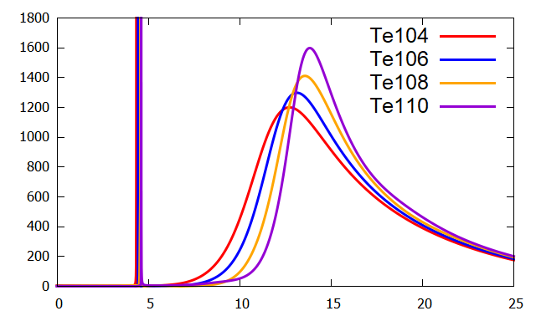
Result of ¹⁰⁴Te (3): IS1 strength function
IS1 strength [fm⁶/MeV]
Ex > 1 hw =9 MeV
Transition strength is the most enhanced in ¹⁰⁴Te
Ratio to WU
$$E[MeV]$$
Mass numbers
Peaks at Ex～5 MeV appear in even Te isotopes
Peak energy is lower than 1hw = 9 MeV for nucleon excitation
Strength in ${}_{}^{104}{Te}$ is the most enhanced of all other systems
Notes:
続いて、Teの同位体を議論します。
これらの色分けされた線はTe104からTe110までの強度関数の計算結果を表します。
いずれのTe同位体にも鋭いピークが約5MeV付近に表れることが分かりました。
また、１陽子を放出する反応強度はこの辺りに表れるため、すべての励起強度はこちらの領域よりも低い領域に表れることが分かりました。
また、１粒子強度との比を取った系統性はこのようになります。横軸は質量数、縦軸はWeisskopf Unitとの比です。
質量数が小さくなるにしたがって遷移強度は増大していて、Te104が最も増大していました。

Slide 14
Summary
Importance of IS0 and IS1 transition
IS0 and IS1 are naturally enhanced when cluster structures are developed
⇒ Effective probe to identify cluster structure at Ex < 15 MeV
Important subject: Extension of analyses on IS0 and IS1 to heavier systems
Results
Macroscopic α potential model gives IS1 strength with
E_{x} < 10 MeV
S_{tot}(0₁⁺⇒1⁻) ～ 1.w.u.
Γ < 1 MeV
Realistic
Unrealistic
Unrealistic
α pot.model is possible
to describe final 1⁻ state
Shell – cluster coupling
must be considered for
Initial 0₁⁺ state
Spreading width must
be considered for final
1⁻ state
(Meaningful result for application )

Slide 15
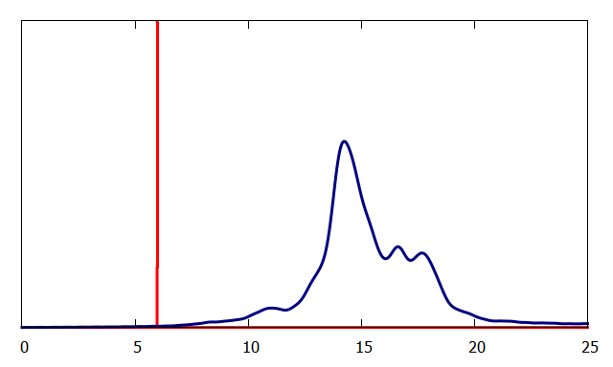
Application to transmutation of nuclear waste
Dipole strength of ${}_{ }^{135}{Cs}→{}_{ }^{131}I+α ,{}_{ }^{134}{Xe}+p$
～1 w.u.
$${}_{ }^{135}{Cs}→{}_{ }^{134}{Xe}+p$$
M.F. cal. by S. Ebata at TITech
Electric dipole strength (a.u.)
$${}_{ }^{135}{Cs}→{}_{ }^{131}I+α$$
Total ～10 w.u.
Photon Energy [MeV]
${}_{ }^{135}{Cs}→{}_{ }^{134}{Xe}+p⇒$ E_{peak}～ 14MeV
α potential model gives
Low energy strength
${}_{ }^{135}{Cs}→{}_{ }^{131}I+α$ ⇒ E_{peak}～ 6MeV
Low energy γray is effective probe for α emission
Notes:
最後にα分解と陽子分解の遷移強度を比較します。
赤線は我々の計算によって求めた$α$粒子を放出する場合の強度で、青線は陽子を放出する場合の強度です。
これは東工大の共同研究者に計算を依頼しました。
縦軸は任意スケールですが、陽子放出の場合ピーク位置は約14MeV、α粒子放出の場合ピーク位置は約6MeVになりました。
したがって、α分解に要するγ線の照射エネルギーはより小さいことが分かりました。

