Slide 1




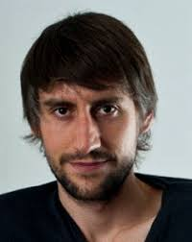



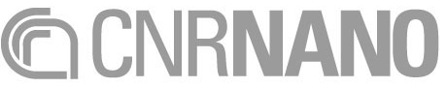
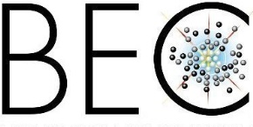


Emulating analog gravity with cavity polaritons
H. S. Nguyen E. Galopin, A. Lemaître, L. Le Gratiet, I. Sagnes,
A. Amo
Now Assistant
Professor
Lyon, France
J. Bloch
Palaiseau
France
D. Gerace
P. Grisins
I. Carusotto
D. Sanvitto
Lecce
Pavia
Trento

Slide 2
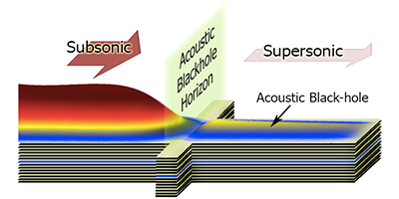
Emulating analog gravity with cavity polaritons
Nguyen et al. PRL 114, 036402 (2015)

Slide 3
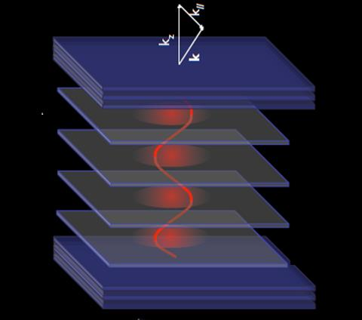

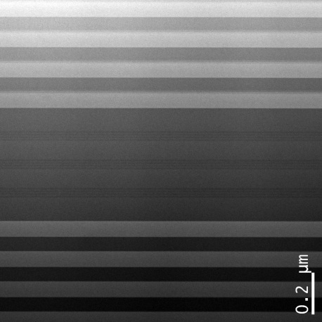
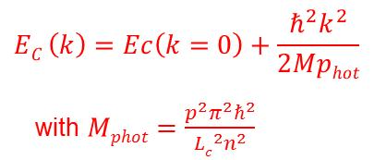
Microcavity polaritons
Angle θ (º)
AlGaAs
Mirror
k_{in-plane}
Quantum
wells
Photon
Cavity
Emission energy (eV)
Emission energy (eV)
Mirror
c
k_{in-plane} (μm⁻¹)
Optical cavity
Bragg mirror
GaAs/AlAs
Cavity
Bragg mirror
GaAs/AlAs
TEM, G. Patriarche, LPN

Slide 4
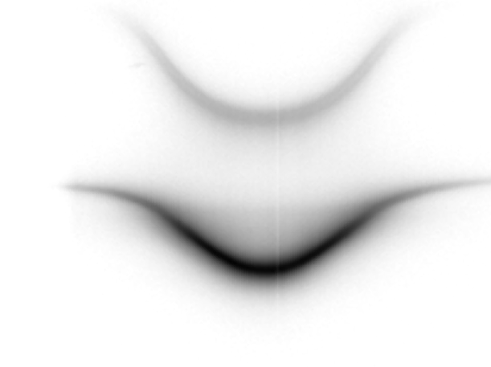
Microcavity polaritons
T = 5 K
Angle θ (º)
AlGaAs
Mirror
Upper polariton
k_{in-plane}
Quantum
wells
Photon
Cavity
Emission energy (eV)
Exciton
Mirror
~ 15meV
Lower polariton
Microcavity polaritons : mixed exciton-photon states
k_{in-plane} (μm⁻¹)
Properties
Photonic component Small effective mass, large group velocity
Optical excitation, detection
Excitonic component
Interactions - χ⁽³⁾ (dominated by exchange)

Slide 5
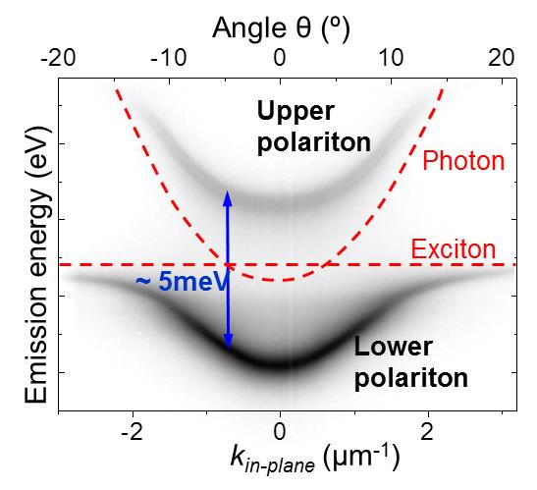
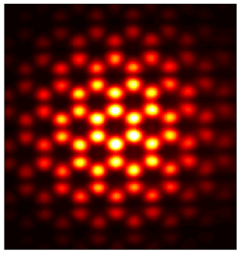

Probing polariton states
Imaging of k-space
θ
k// = ω/c sin(θ)
Imaging of real space
1
0
10 μm
Density
Interferometry
Coherence
g⁽¹⁾
g⁽²⁾
- vortices
- solitons
Notes:
The partial photonic character renders a very low mass
The partial excitonic character provides the system with strong non-linearities

Slide 6
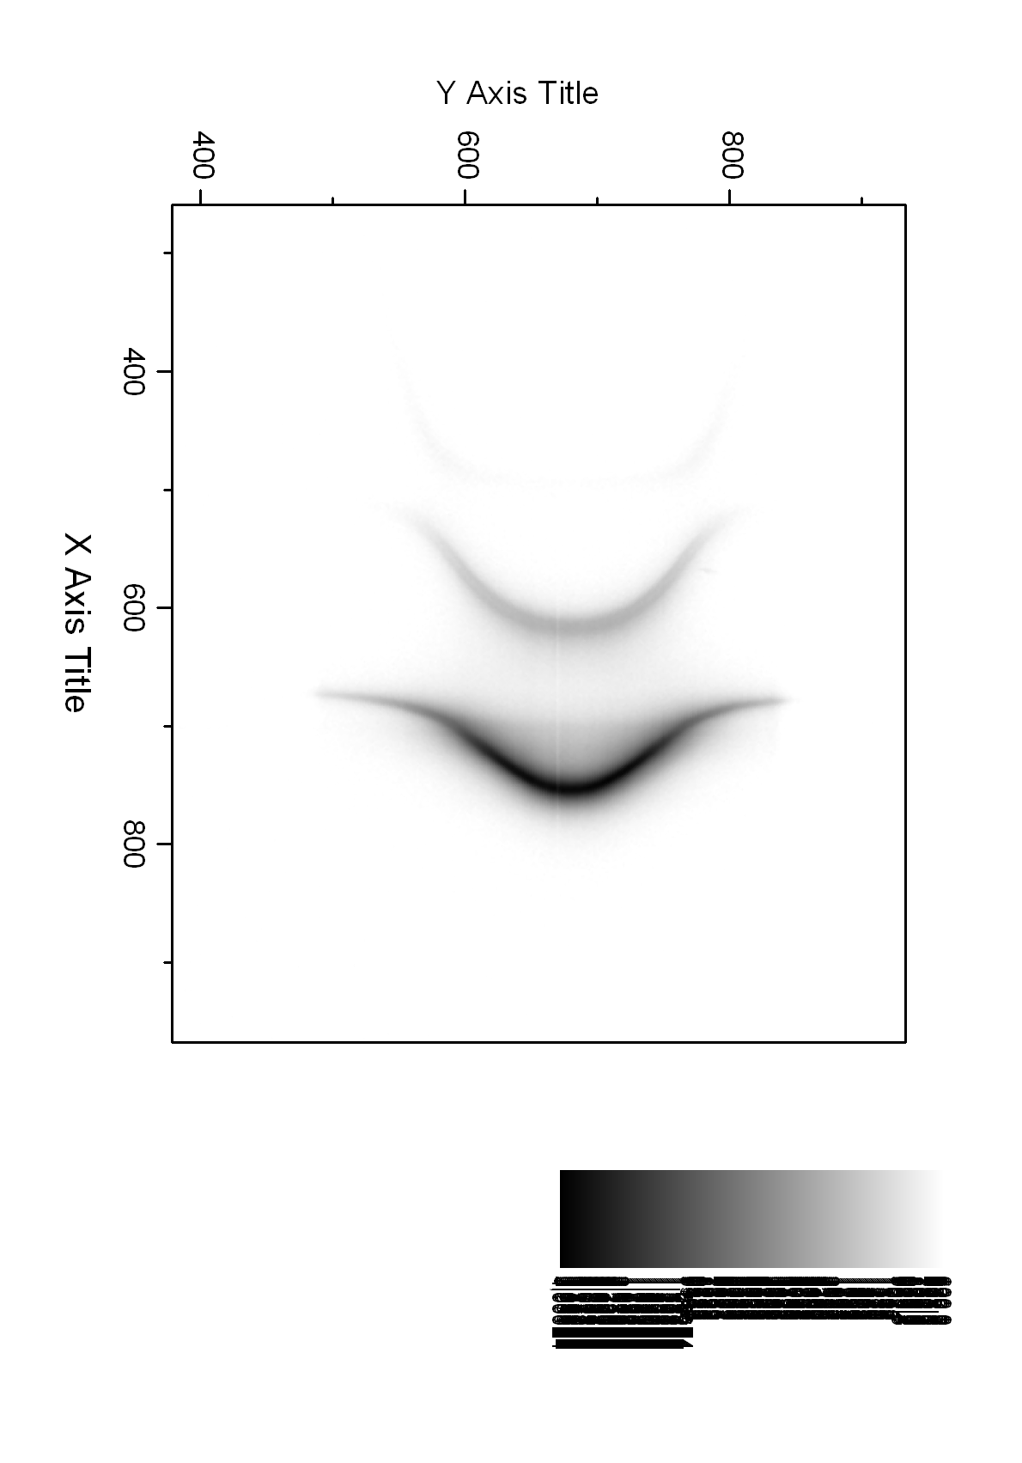
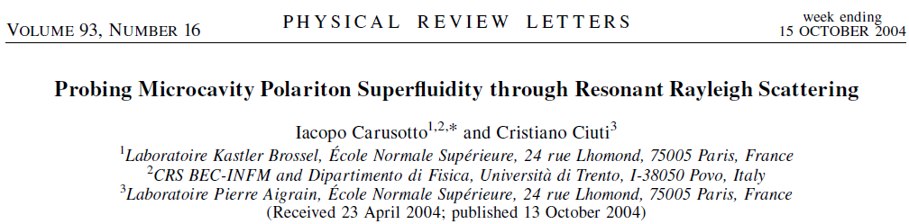
Polariton interactions: superfluidity
Resonant excitation
Non-linear Schrödinger equation
LPB
CW Pump
pol-pol interaction
CW Pump
decay
potential
Carusotto, Ciuti, Rev. Mod. Phys. 85, 299 (2013)
See also: Bolda, et al., PRL 86, 416 (2001),
Chiao, et al., PRA 60, 4114 (1999)
Notes:
Probably, if you know what a polariton is you are right now in the polariton session in room

Slide 7
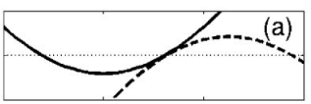
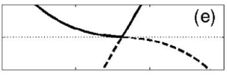
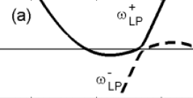
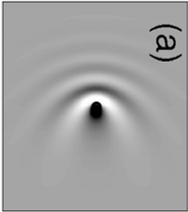
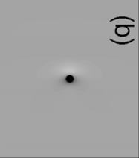
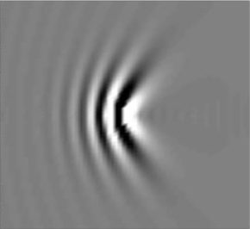
Superfluidity: theory
Non-linear Schrödinger equation
Resonant excitation
LPB
pol-pol interaction
CW Pump
decay
potential
CW Pump
Low power
High power
High power
low momentum
high momentum
c_{s}
c_{s}
v_{f} < c_{s}
v_{f} > c_{s}
E
E
k_{p}
E
k
0
k
0
k
0
FLOW
Elastic scattering
Superfluid
Supersonic
Carusotto and Ciuti, PRL 93, 166401 (2004)
Notes:
Probably, if you know what a polariton is you are right now in the polariton session in room

Slide 8
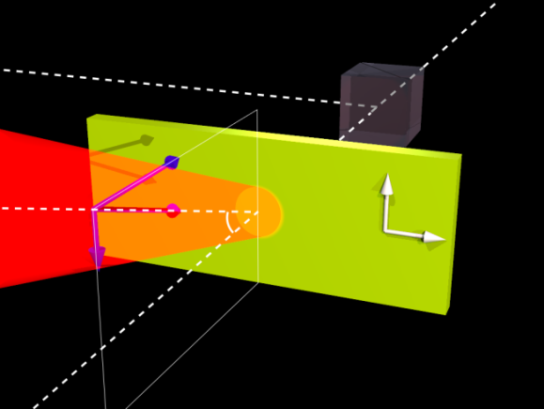
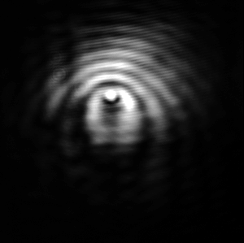
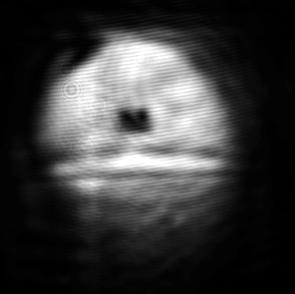
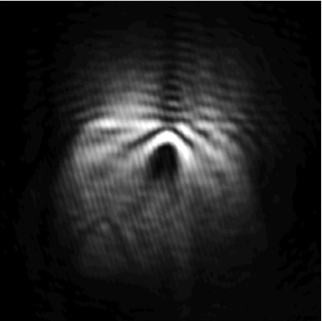
Superfluidity: experiment
Near field CCD
Resonant excitation
(d)
Far field CCD
Structural defect as a probe
k_{z}
LPB
k
Y
k║
q
X
CW Pump
Excitation laser
Microcavity
Low power
High power
High power
low momentum
high momentum
c_{s}
c_{s}
v_{f} < c_{s}
v_{f} > c_{s}
E
E
k_{p}
E
k
0
k
0
k
0
FLOW
30 µm
Elastic scattering
Superfluid
Supersonic
Amo et al., Nat, Phys. 5, 805 (2009)
See also: Kohnle et al., PRL 106, 255302 (2011)
Notes:
Probably, if you know what a polariton is you are right now in the polariton session in room

Slide 9
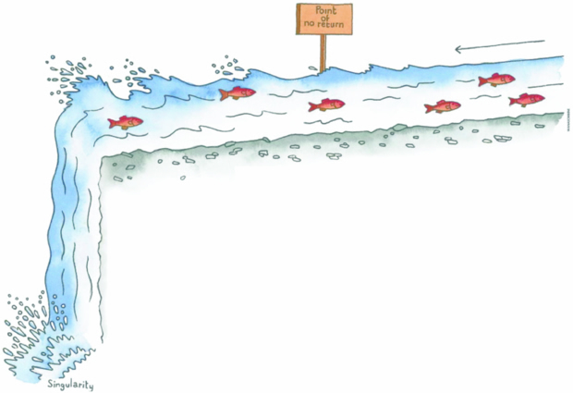
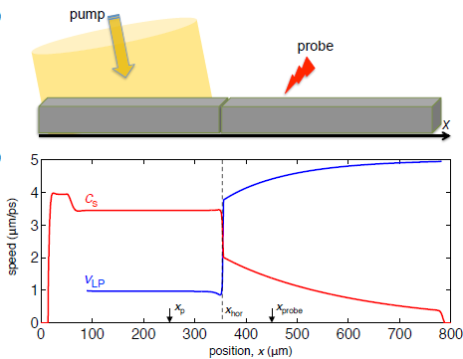

Subsonic-supersonic transition
engineered
obstacle
V < c
V < c
V > c
Solnyshkov et al PRB 84, 233405 (2011)
Gerace and Carusotto PRB 86, 144505 (2012)
Enhanced Hawking
temperature (T_{H} ~ 1-15 K)

Slide 10
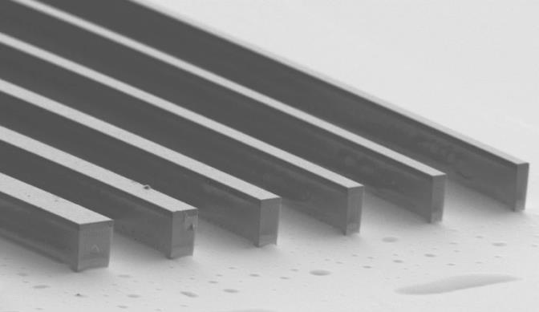
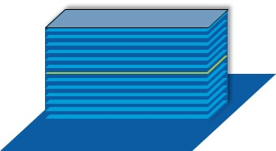
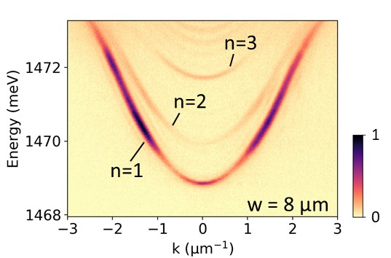
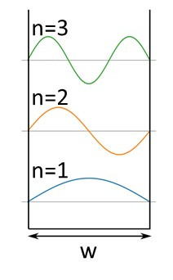
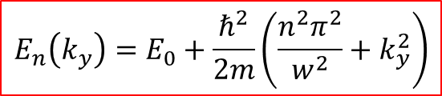
Polariton in 1D cavities
Electron beam lithography
+ ion dry etching
Polariton lateral confinement
20 µm
Quantization of k_{x}:
k_{x}= nπ/w n=1,2,3,…
1D polariton sub-bands
$$E_{n}\left(k_{y}\right)=E_{0}+\frac{ℏ^{2}}{2m}\left(\frac{n^{2}π^{2}}{w^{2}}+k_{y}^{2}\right)$$
k_{y} (µm⁻¹)

Slide 11
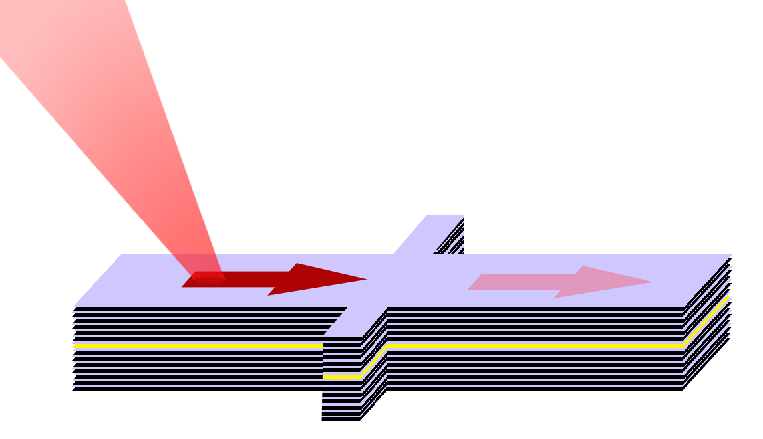
Subsonic-supersonic transition
Resonant excitation E₀
1 µm
1.3 µm
3 µm
UPSTREAM V < c
DOWNSTREAM V > c
High density
Low density
Higher transmission
E_{kin} ~ 0.5 meV
V(x)
x
0.85 meV
Nguyen et al. PRL 114, 036402 (2015)

Slide 12

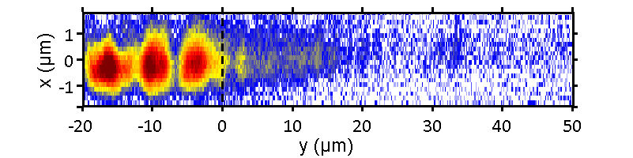
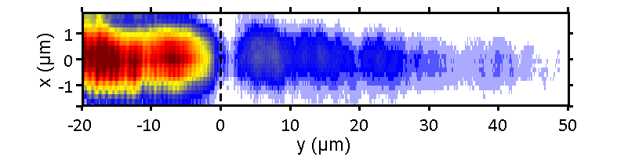
Subsonic-supersonic transition
Measurements in real-space:
Low density in the Upstream
High density in the Upstream
Defect position
Defect position
p = 7 mW
p = 100 mW
Simulation
Simulation
Interference pattern in the Upstream
Existence of a back scattering flow
Not superfluid
Suppression of back scattering in the Upstream
→ Superfluid/Subsonic !

Slide 13

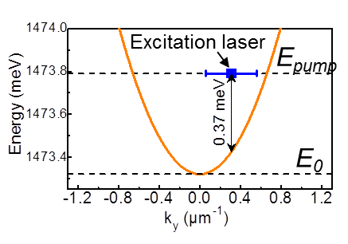
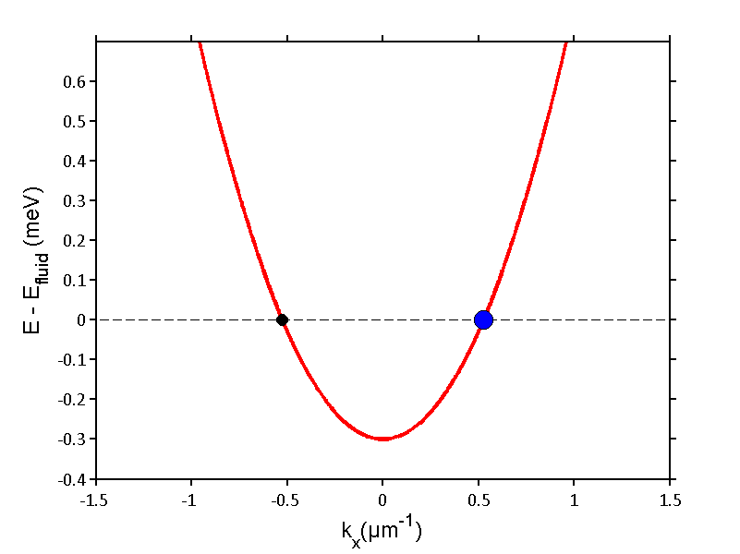
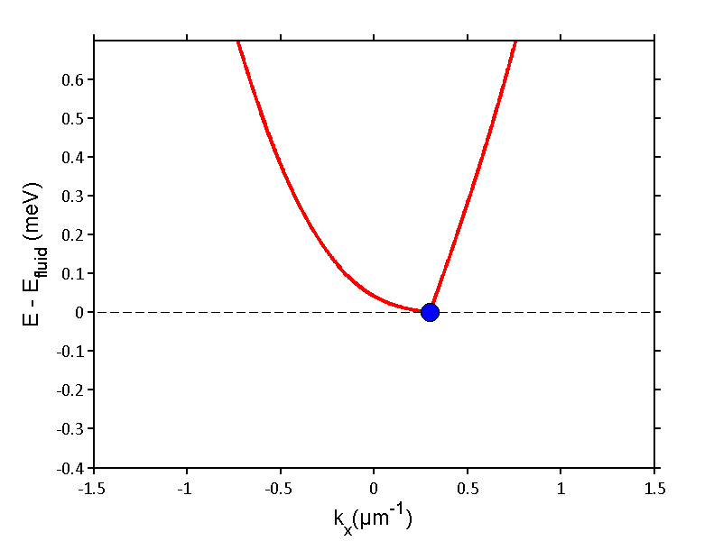
Momentum space
UPSTREAM
7 mW
reflection
Energy
Scattered
Fluid
80 mW
k
reflection
100 mW
subsonic
Energy
Fluid
k

Slide 14
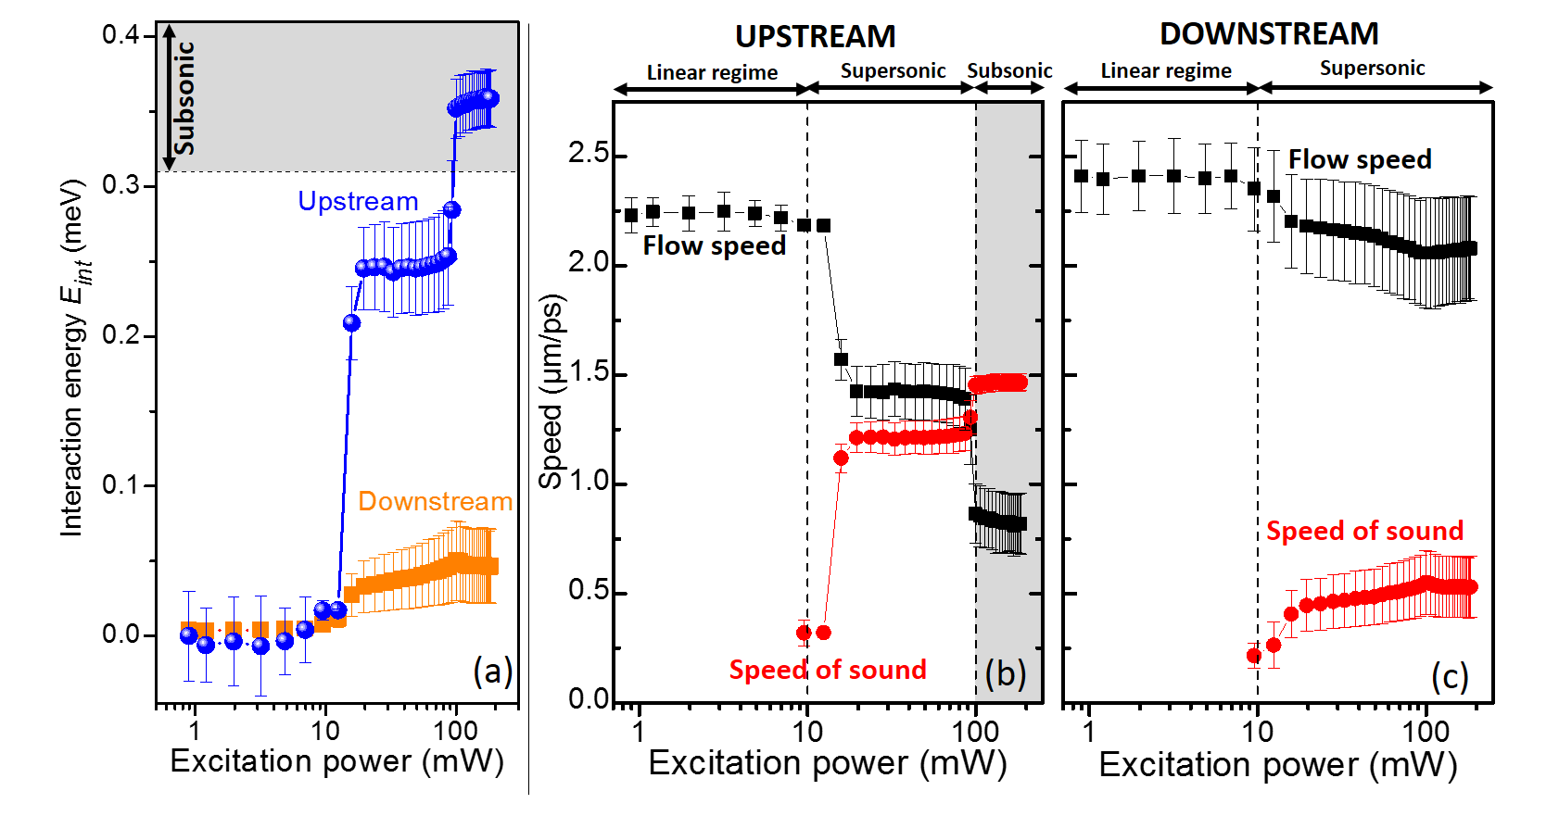
Momentum space
UPSTREAM
7 mW
reflection
80 mW
Flow speed
reflection
Speed of
sound
100 mW
subsonic

Slide 15
An acoustic black hole for polaritons
Nguyen et al. PRL 114, 036402 (2015)
Notes:
15 et 16.
Mois je trouve toujours qui sont plus belles les images où on voit l’espace de k en fonction de la puissance en amont et en aval, et on voit la transition superfluide. Sais-tu de quoi je parle?
Même si elle ne correspondent pas exactement à celles de la figure sur le slide 13.
Tu choisis.

Slide 16
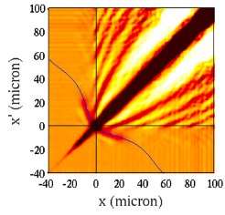



Conclusions and prospects
Realization an acoustic black hole for polariton
Nguyen et al. PRL 114, 036402 (2015)
Measure of spatial correlations?
$$×{10}^{−4}$$
Pjotrs Grišins et al., Phys. Rev. B 94, 144518 (2016)
Recati, N. Pavloff, and I. Carusotto,
Phys. Rev. A 80, 043603 (2009)
$$g^{(2)}\left(x, x′\right)−1$$

Slide 17
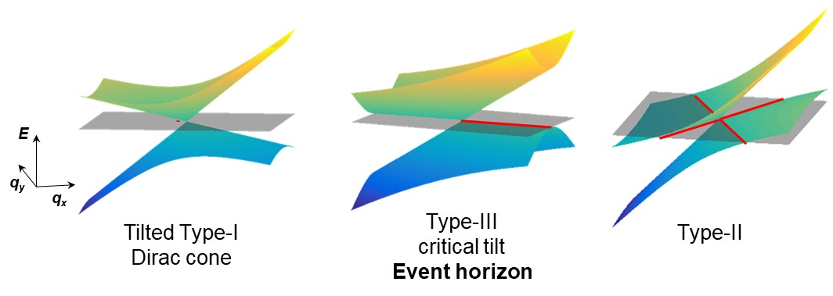
Conclusions and prospects
Tilted Dirac cones in 2D materials emulate black hole metric
G. E. Volovik and K. Zhang, JETP Lett. 104, 645 (2016)
H. Huang et al., Phys. Rev. B 98, 121110 (2018)

Slide 18
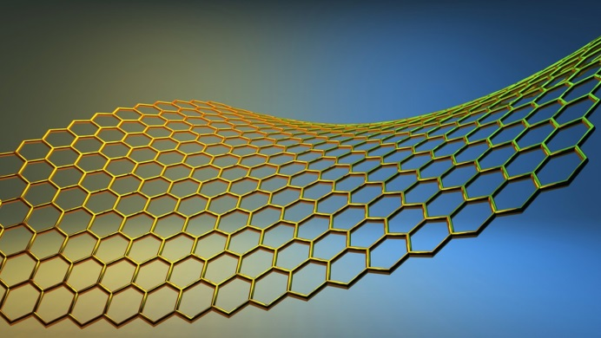
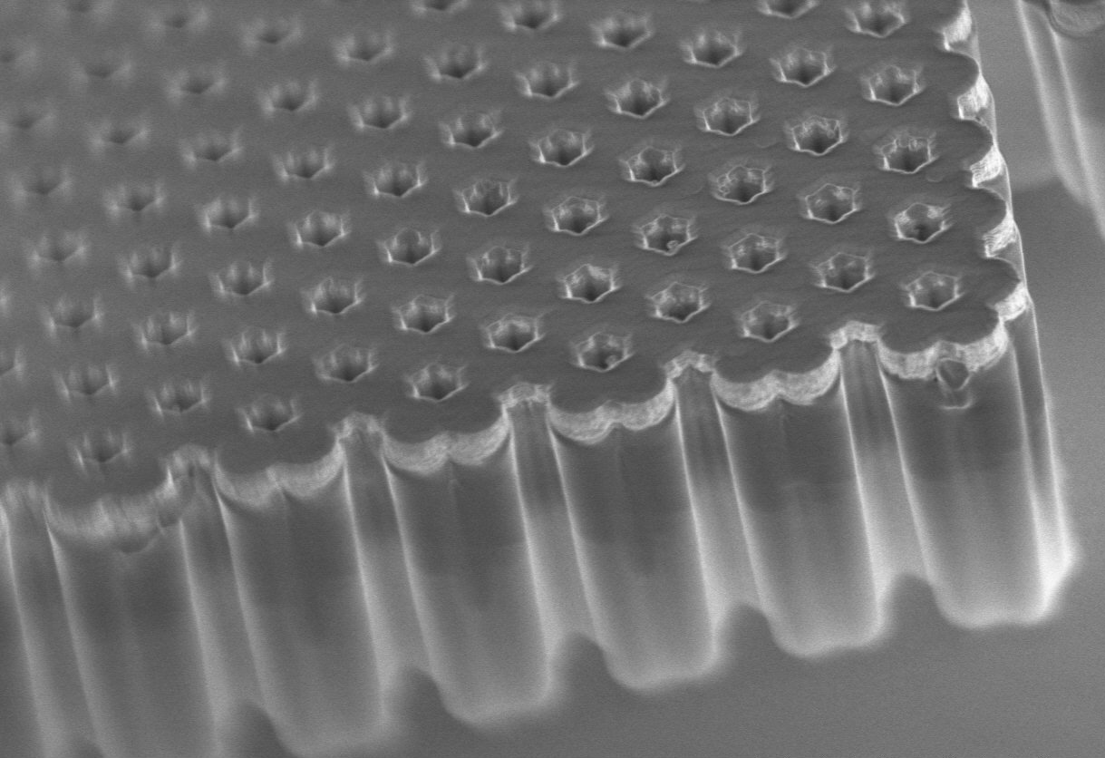
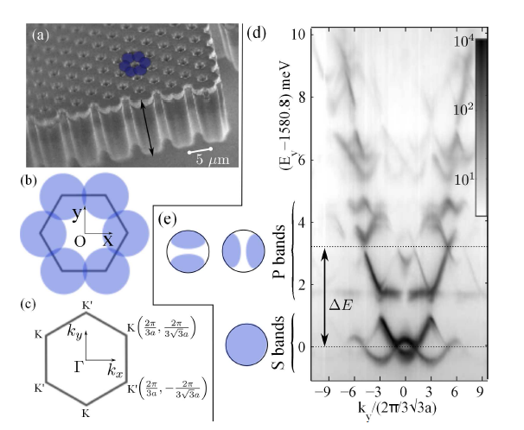
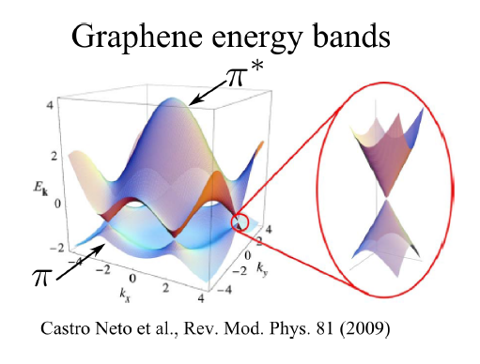
Polariton honeycomb lattice
Graphène
Pillar diameter = 3 µm
Interpillar distance a = 2.4 µm
4 μm
Energy (meV – 1577)
Dirac cones
Jacqmin et al., PRL 112, 116402 (2014)
See also Yamamot (Stanford), Krizhanovskii (Sheffield)

Slide 19
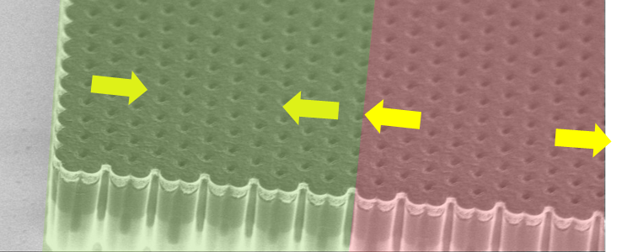
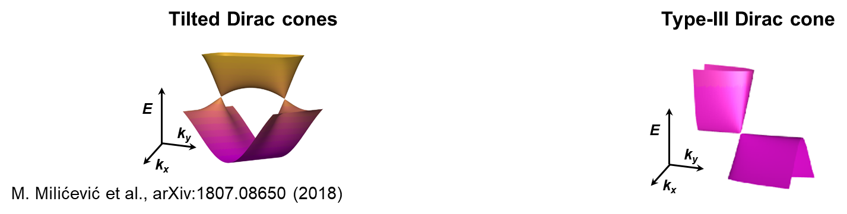
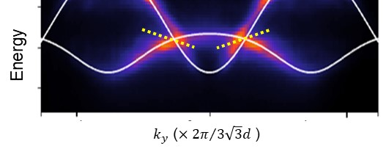
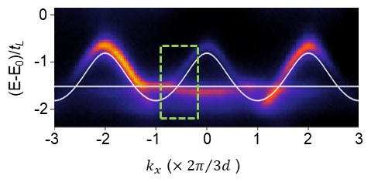
Uniaxial strain in polariton graphene: tilted and type III Dirac cones
COMPRESSION
EXPANSION
M. Milicevic et al., to appear in PRX (Arxiv1807.08650)

Slide 20
Acoustic black holes
Sonic Horizon
Subsonic: V(x) < c(x)
Supersonic: V(x) > c(x)
Sonic black hole
Sound waves emitted in the supersonic region cannot propagate to the subsonic region, as light cannot escape from the black hole
V(x)
Fluid speed
c(x)
Sound speed
(courtesy S. Robertson)

Slide 21
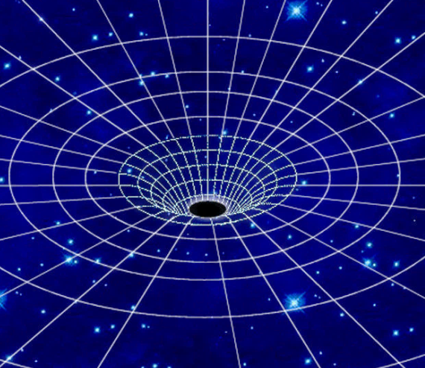
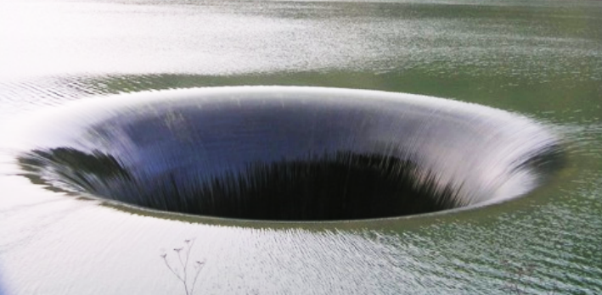
Hydrodynamic blackhole analogues
Cosmological blackhole
Hydrodynamic analogue
Event Horizon
c : speed of light
c_{s} : speed of sound
W. G. Unruh, PRL 46, 1351 (1981), PRD 51 2827 (1995)
“The propagation of sound waves in accelerating fluids is formally equivalent to light waves in the proximity of a black hole event horizon.”
Studying Hawking radiation in hydrodynamic analogues
  It is possible to demonstrate that the scalar field of the velocity (i.e. ) is described by the Euler-Lagrange equation of a metric:

