Slide 1

Summary and discussion for Wednesday:
Theory NEEDS for Beta decay Experiments searching for beyond the standard model physics
Doron Gazit
Racah Institute of Physics
Hebrew University of Jerusalem
I will disregard super-allowed beta decays in this talk (covered yesterday)

Slide 2
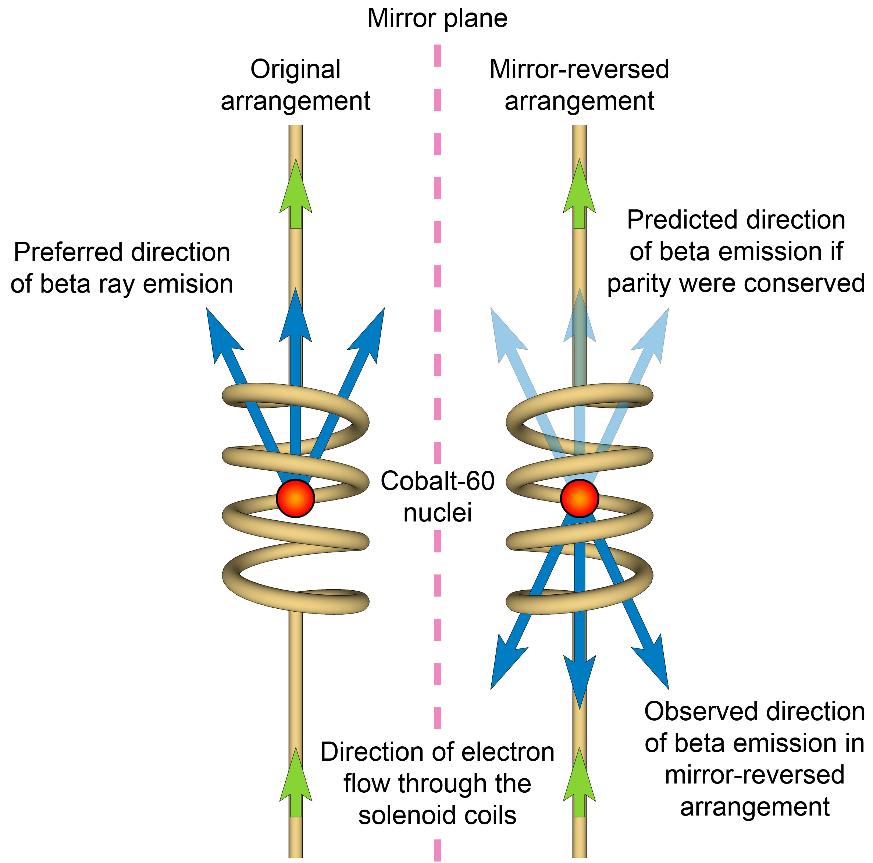
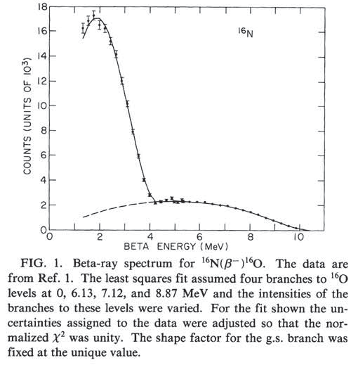
BSM efforts using nuclear beta decays
Introduction
β decays
Precision Correlation Studies
Precision spectrum studies
Neutrino hypothesized
KATRIN
Parity breaking
V-A structure

Slide 3
BSM efforts using nuclear beta decays
Introduction
β decays
Precision Correlation Studies
Precision spectrum studies
Neutrino hypothesized
KATRIN
Parity breaking
V-A structure

Slide 4
BSM efforts using nuclear beta decays
Introduction
β decays
Precision Correlation Studies
Precision spectrum studies
”New Physics” searches using beta decays have been moving back and forth, from spectrum to correlation studies.
Atomic traps acted as the catalyst for precision correlation studies, and many experiments have been constructed since ~2005.
In the last couple of years, the seesaw seems to tilt towards precision spectrum studies again, based on theoretical expectations for the size of the effect.

Slide 5
From Symmetry considerations to the cross-section

Slide 6
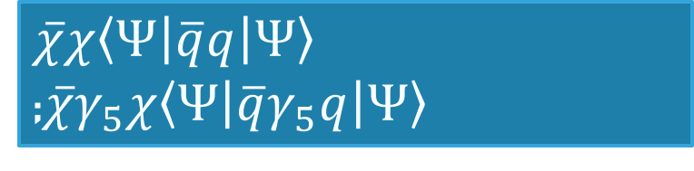
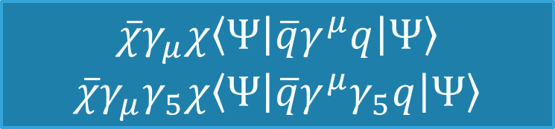
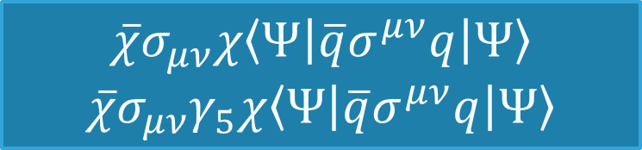

Low energy reaction of a spin $\frac{1}{2}$ particle with a nucleus
Lee-Yang approach
Effective Lagrangians
Couplings:
$$e.g., \frac{μ}{2}\overline{χ}σ_{μν}χF^{μν}$$
U(1): anapole,
E/M dipole
$\overline{χ}χ〈Ψ\left|\overline{q}q\right|Ψ〉$ ;$\overline{χ}γ_{5}χ〈Ψ\left|\overline{q}γ_{5}q\right|Ψ〉$
Scalar, Pseudo-scalar
$$\overline{χ}γ_{μ}χ〈Ψ\left|\overline{q}γ^{μ}q\right|Ψ〉$$
$$\overline{χ}{γ_{μ}γ}_{5}χ〈Ψ\left|\overline{q}{γ^{μ}γ}_{5}q\right|Ψ〉$$
Vector, Axial-vector
$$\overline{χ}σ_{μν}χ〈Ψ\left|\overline{q}σ^{μν}q\right|Ψ〉$$
$$\overline{χ}{σ_{μν}γ}_{5}χ〈Ψ\left|\overline{q}σ^{μν}q\right|Ψ〉$$
Tensor, Pseudo-tensor

Slide 7
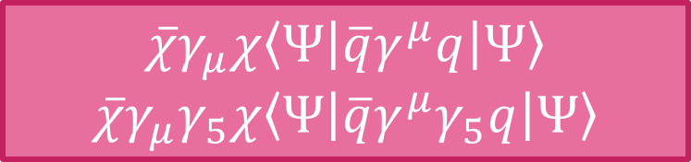
Low energy reaction of a spin $\frac{1}{2}$ particle with a nucleus
Lee-Yang approach
Effective Lagrangians
Couplings:
$$e.g., \frac{μ}{2}\overline{χ}σ_{μν}χF^{μν}$$
U(1): anapole,
E/M dipole
$\overline{χ}χ〈Ψ\left|\overline{q}q\right|Ψ〉$ ;$\overline{χ}γ_{5}χ〈Ψ\left|\overline{q}γ_{5}q\right|Ψ〉$
Scalar, Pseudo-scalar
This is the Weak Interaction
Vector, Axial-vector
$$\overline{χ}γ_{μ}χ〈Ψ\left|\overline{q}γ^{μ}q\right|Ψ〉$$
$$\overline{χ}{γ_{μ}γ}_{5}χ〈Ψ\left|\overline{q}{γ^{μ}γ}_{5}q\right|Ψ〉$$
Vector, Axial-vector
$$\overline{χ}γ_{μ}χ〈Ψ\left|\overline{q}γ^{μ}q\right|Ψ〉$$
$$\overline{χ}{γ_{μ}γ}_{5}χ〈Ψ\left|\overline{q}{γ^{μ}γ}_{5}q\right|Ψ〉$$
$$\overline{χ}σ_{μν}χ〈Ψ\left|\overline{q}σ^{μν}q\right|Ψ〉$$
$$\overline{χ}{σ_{μν}γ}_{5}χ〈Ψ\left|\overline{q}σ^{μν}q\right|Ψ〉$$
Tensor, Pseudo-tensor

Slide 8
Size of “New Physics” Beyond Standard Model
Lee-Yang approach

Slide 9
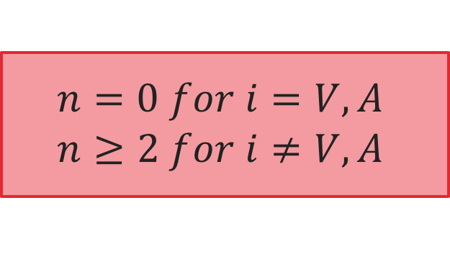
Size of “New Physics” Beyond Standard Model
Lee-Yang approach
$$n=0 for i=V,A$$
$$n≥2 for i≠V,A$$
NEW PHYSICS SCALE
For the simplest BSM operator (n=2), a 3 TeV scale means $ε^{BSM}≈{10}^{−3}$

Slide 10
From The quark to the nucleon
Lee-Yang approach
Taking a matrix element between nucleonic states:

Slide 11
From The quark to the nucleon
Quark to nucleon
Taking a matrix element between nucleonic states:

Slide 12
From The quark to the nucleon
Quark to nucleon
Taking a matrix element between nucleonic states:

Slide 13
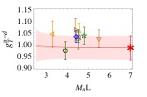


From The quark to the nucleon - non standard couplings
Quark to nucleon
The $ε^{′}s$ are small, not the nuclear charges!
$$≈0.8−1.2$$

Slide 14
From The quark to the nucleus
Quark to Nucleus
Effective Lagrangians
Couplings:
$$e.g., \frac{μ}{2}\overline{χ}σ_{μν}χF^{μν}$$
U(1): anapole,
E/M dipole
$\overline{χ}χ〈Ψ\left|\overline{q}q\right|Ψ〉$ ;$\overline{χ}γ_{5}χ〈Ψ\left|\overline{q}γ_{5}q\right|Ψ〉$
Scalar, Pseudo-scalar
This is the Weak Interaction
Vector, Axial-vector
$$\overline{χ}γ_{μ}χ〈Ψ\left|\overline{q}γ^{μ}q\right|Ψ〉$$
$$\overline{χ}{γ_{μ}γ}_{5}χ〈Ψ\left|\overline{q}{γ^{μ}γ}_{5}q\right|Ψ〉$$
Vector, Axial-vector
$$\overline{χ}γ_{μ}χ〈Ψ\left|\overline{q}γ^{μ}q\right|Ψ〉$$
$$\overline{χ}{γ_{μ}γ}_{5}χ〈Ψ\left|\overline{q}{γ^{μ}γ}_{5}q\right|Ψ〉$$
$$\overline{χ}σ_{μν}χ〈Ψ\left|\overline{q}σ^{μν}q\right|Ψ〉$$
$$\overline{χ}{σ_{μν}γ}_{5}χ〈Ψ\left|\overline{q}σ^{μν}q\right|Ψ〉$$
Tensor, Pseudo-tensor
Probe “current” of known Lorentz symmetry
Nuclear “current” of the same symmetry
Decoupled from probe physics!

Slide 15
Nucleus interaction with a probe, EFT point of view:
Low energy QCD has (accidental) scale separation
Low energy EFT –
Cutoff Λ_{br}>>Q dictates viable deg. of freedom
EFT Lagrangian
Nuclear potential
Nöther current
  Theoretical uncertainty quantification:
  Power Counting: systematic expansion
  RG invariance: cutoff variation
Wave functions
Nuclear
current
Nuclear Matrix Element of characteristic momentum Q

Slide 16




How to find the nuclear currents?
The scattering operators
Couplings:
Nuclear currents
U(1): anapole,
E/M dipole
$$J_{μ}^{EM}$$
These have pion poles
Scalar, Pseudo-scalar
$$πN σ terms$$
Vector, Axial-vector
$$The weak gauge!$$
Tensor, Pseudo-tensor
$$form factors from lattice$$

Slide 17
How to find the nuclear currents?
Couplings:
Nuclear currents
U(1): anapole,
E/M dipole
$$J_{μ}^{EM}$$
These have pion poles
Scalar, Pseudo-scalar
$$πN σ terms$$
Vector, Axial-vector
$$The weak gauge!$$
Tensor, Pseudo-tensor
$$form factors from lattice$$
No pion pole for
tensor sources???
(Catá, Mateu 2007)

Slide 18
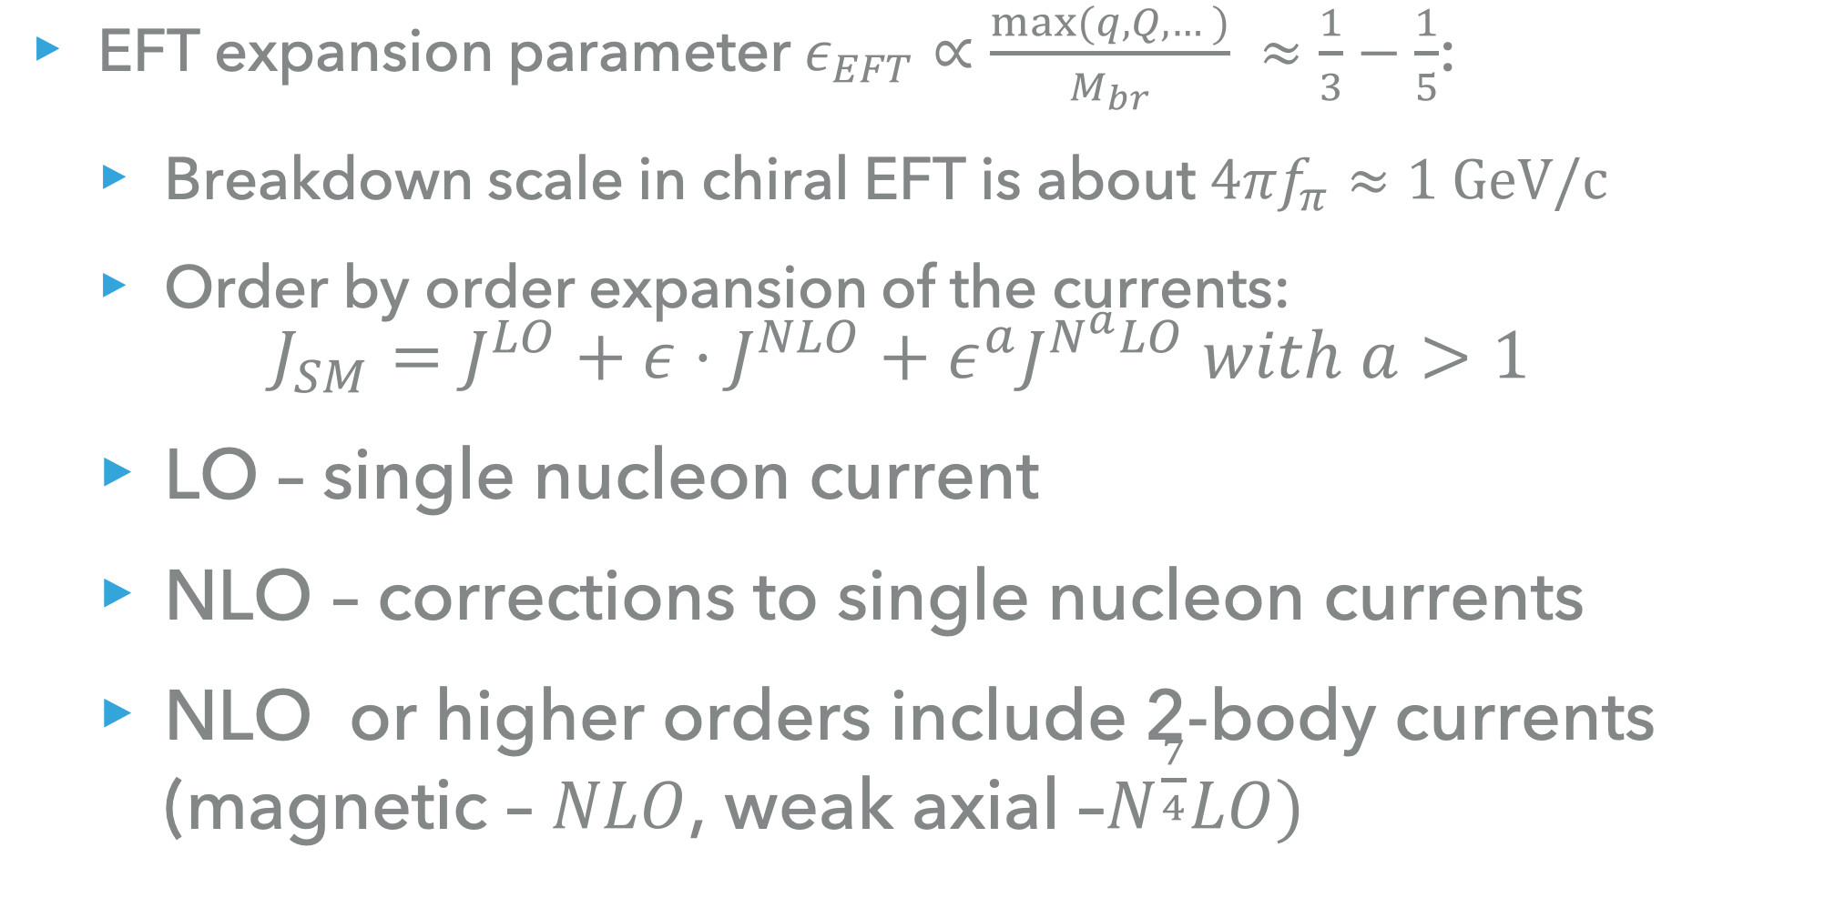
Small parameter expansion of the operators
EFT expansion parameter $ε_{EFT}∝\frac{max⁡(q, Q,…)}{M_{br}} ≈\frac{1}{3}−\frac{1}{5}$:
  Breakdown scale in chiral EFT is about $4πf_{π}≈1 GeV/c$
  Order by order expansion of the currents:
  $J_{SM}=J^{LO}+ε⋅J^{NLO}+ε^{a}J^{N^{a}LO} with a>1$
  LO – single nucleon current
  NLO – corrections to single nucleon currents
  NLO or higher orders include 2-body currents (magnetic – $NLO$, weak axial –$N^{\frac{7}{4}}LO)$
Pavon Valderama, Phillips; PRL (2015)

Slide 19

Small parameter expansion of the operators
EFT expansion parameter $ε_{EFT}∝\frac{max⁡(q, Q,…)}{M_{br}} ≈\frac{1}{3}−\frac{1}{5}$:
  Breakdown scale in chiral EFT is about $4πf_{π}≈1 GeV/c$
  Order by order expansion of the currents:
  $J_{SM}=J^{LO}+ε⋅J^{NLO}+ε^{a}J^{N^{a}LO} with a>1$
Pavon Valderrama, Phillips; PRL (2015)

Slide 20
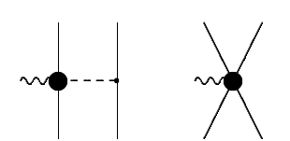
Small parameter expansion of the operators
EFT expansion parameter $ε_{EFT}∝\frac{max⁡(q, Q,…)}{M_{br}} ≈\frac{1}{3}−\frac{1}{5}$:
  Breakdown scale in chiral EFT is about $4πf_{π}≈1 GeV/c$
  Order by order expansion of the currents:
  $J_{SM}=J^{LO}+ε⋅J^{NLO}+ε^{a}J^{N^{a}LO} with a>1$
Single nucleon current
1 pion exchange
Contact term
e.g., axial vector current
LO, NLO
N³LO
N^{7/4}LO
Pavon Valderama, Phillips; PRL (2015)

Slide 21
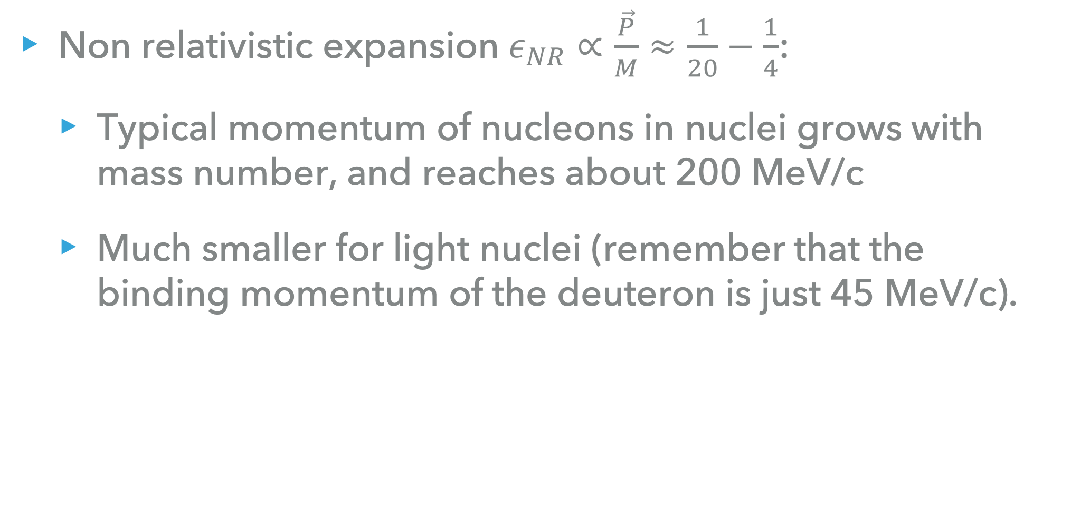
Small parameter expansion of the operators
Non relativistic expansion $ε_{NR}∝\frac{\vec{P}}{M}≈\frac{1}{20}−\frac{1}{4}$:
  Typical momentum of nucleons in nuclei grows with mass number, and reaches about 200 MeV/c
  Much smaller for light nuclei (remember that the binding momentum of the deuteron is just 45 MeV/c).

Slide 22
Cross-section evaluation

Slide 23
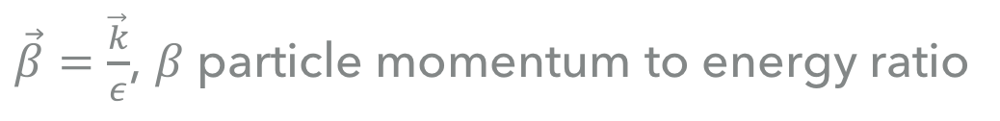

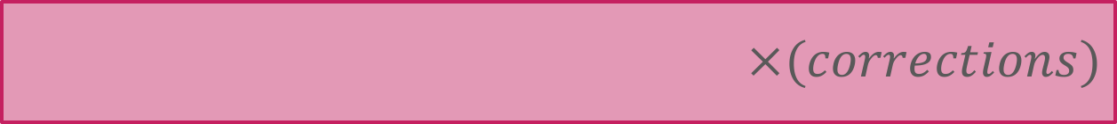
Precision β-decay studies to pinpoint BSM effects
Differential β decay rate
Momentum transfer
$\vec{β}=\frac{\vec{k}}{ε}$, $β$ particle momentum to energy ratio
$\vec{ν}$ neutrino momentum
$$×(corrections)$$
Nuclear structure dependent corrections:
Shape/recoil corrections
Radiative corrections
Nuclear structure (almost) independent corrections:
Atomic and electronic corrections
Radiative corrections
Finite size of the nucleus
…

Slide 24




Precision β-decay studies to pinpoint BSM effects
Differential β decay rate
Momentum transfer
$\vec{β}=\frac{\vec{k}}{ε}$, $β$ particle momentum to energy ratio
$\vec{ν}$ neutrino momentum
$$∝q^{J}$$
Nuclear dependent part
$$∝q^{J−1}$$
Assuming V-A structure
$$∝q^{J}$$
$$∝{\hat{E}}_{JM}$$
Nuclear-probe coupling operators
We have similar expressions for Tensor and Scalar structures, and interferences.[Glick-Magid, Gazit, unpublished]

Slide 25




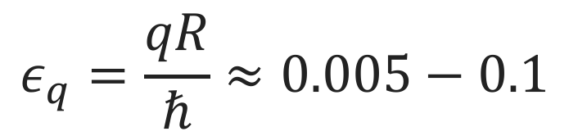
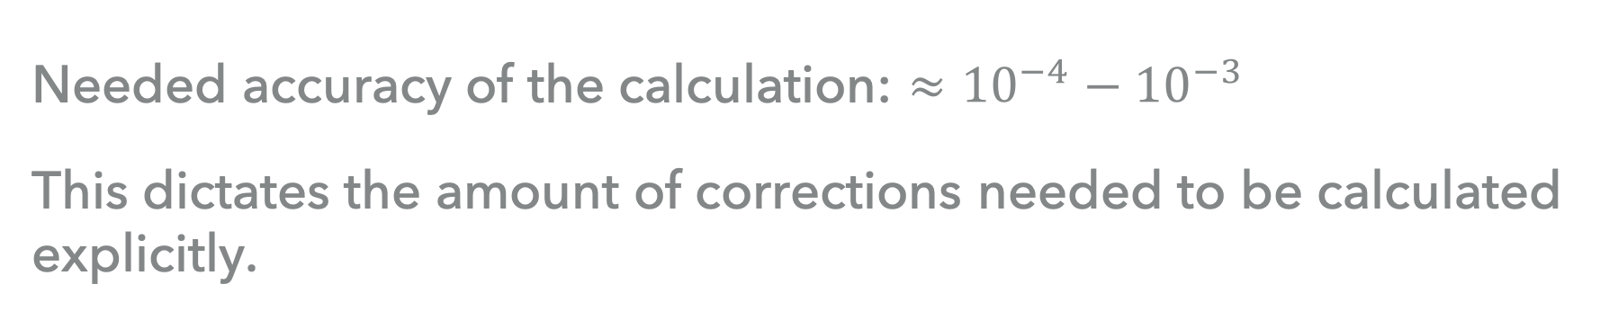
Calculation of the nuclear Matrix element
Needed accuracy of the calculation: ${≈{10}^{−4}−10}^{−3}$
This dictates the amount of corrections needed to be calculated explicitly.
$$∝q^{J}$$
$$∝q^{J−1}$$
$$ε_{q}=\frac{qR}{ℏ}≈0.005−0.1$$
$$∝q^{J}$$
$$≈\sqrt{\frac{J}{J+1}}{\hat{E}}_{JM}$$

Slide 26
Calculation of the nuclear Matrix element
Needed accuracy of the calculation: ${≈{10}^{−4}−10}^{−3}$
This dictates the amount of corrections needed to be calculated explicitly.
$$∝q^{J}$$
$$∝q^{J−1}$$
$$ε_{q}=\frac{qR}{ℏ}≈0.005−0.1$$
$$∝q^{J}$$
The most important factor determining the accuracy of a theoretical calculation of a specific nucleus
$$≈\sqrt{\frac{J}{J+1}}{\hat{E}}_{JM}$$

Slide 27





Precision β-decay studies to pinpoint BSM effects
Differential β decay rate
Momentum transfer
$\vec{β}=\frac{\vec{k}}{ε}$, $β$ particle momentum to energy ratio
$\vec{ν}$ neutrino momentum
$$∝q^{J}$$
$$∝q^{J−1}$$
$$∝q^{J}$$
$$∝{\hat{E}}_{JM}$$
Classification of β decays
$$ΔJ^{π}=0^{+}$$
(Super)allowed - Fermi transition
$$∝ε_{q}^{0}$$
$$ΔJ^{π}={0,1}^{+}$$
Allowed – Fermi/Gamow-Teller
$$ΔJ^{π}={0,1,2}^{−}$$
First forbidden transition
$$∝ε_{q}^{1}$$

Slide 28


Precision β-decay studies to pinpoint BSM effects
e.g., allowed transitions
$$ΔJ^{π}={0,1}^{+}$$
Fermi
Accurate to LO in $ε_{q}$ and $ε_{BSM}$
Gamow-Teller
Correlation coefficient
Assumptions: vanishing momentum transfer (q=0).

Slide 29



Precision β-decay studies to pinpoint BSM effects
e.g., allowed transitions
$$ΔJ^{π}={0,1}^{+}$$
Assuming V+T structure
$$+\frac{{\left|C_{T}\right|}^{2}+{\left|C_{T}^{′}\right|}^{2}}{2}$$
$$+$$
NLO in $ε_{BSM}$

Slide 30
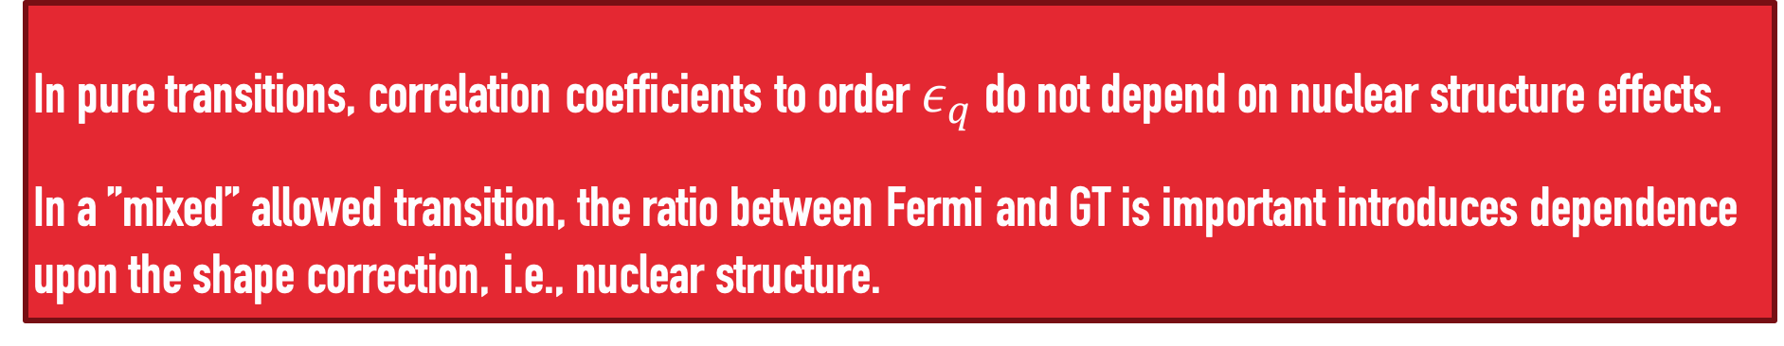
Precision β-decay studies to pinpoint BSM effects
e.g., allowed transitions
$$ΔJ^{π}={0,1}^{+}$$
Fermi
Accurate to LO in $ε_{q}$ and $ε_{BSM}$
Gamow-Teller
Correlation coefficient
Assumptions: vanishing momentum transfer (q=0).
In pure transitions, correlation coefficients to order $ε_{q}$ do not depend on nuclear structure effects.
In a ”mixed” allowed transition, the ratio between Fermi and GT is important introduces dependence
upon the shape correction, i.e., nuclear structure.

Slide 31
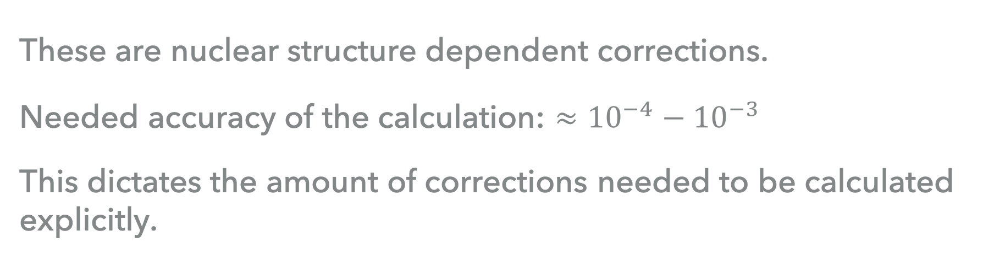
Shape/recoil corrections
These are nuclear structure dependent corrections.
Needed accuracy of the calculation: ${≈{10}^{−4}−10}^{−3}$
This dictates the amount of corrections needed to be calculated explicitly.
$$∝q^{J}$$
$$∝q^{J−1}$$
$$∝q^{J}$$
NLO Chiral EFT suppression
additional factor 3-5
$$≈\sqrt{\frac{J}{J+1}}{\hat{E}}_{JM}$$
In beta decays, shape corrections are few per-milles, thus P/M and at least EFT NLO corrections should be calculated explicitly to reach needed accuracy

Slide 32
Shape/recoil corrections
e.g., allowed transitions
Nuclear effects are important to pinpoint BSM effects:

Slide 33

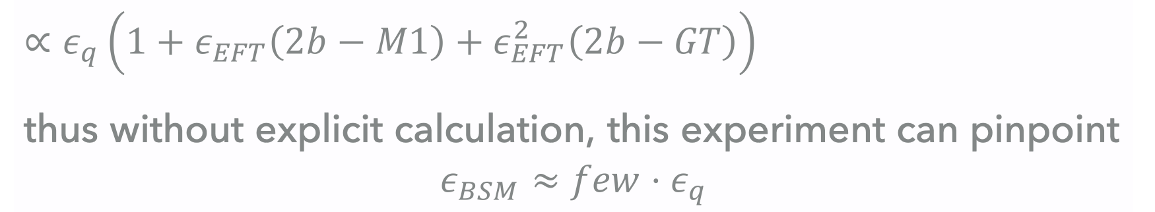

Shape/recoil corrections
e.g., allowed transitions
$$∝q^{J}$$
$$∝q^{J−1}$$
$∝ε_{q}\left(1+ε_{EFT}\left(2b−M1\right)+ε_{EFT}^{2}\left(2b−GT\right)\right)$
thus without explicit calculation, this experiment can pinpoint
$$ε_{BSM}≈few⋅ε_{q}$$

Slide 34
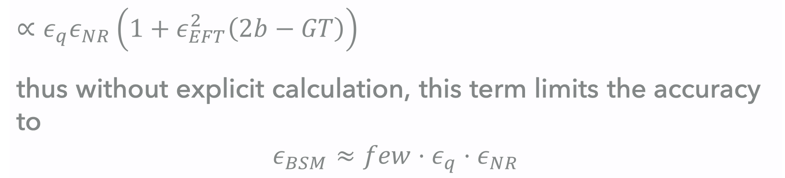
Shape/recoil corrections
e.g., allowed transitions
$$∝q^{J}$$
$$∝q^{J−1}$$
$∝ε_{q}ε_{NR}\left(1+ε_{EFT}^{2}\left(2b−GT\right)\right)$
thus without explicit calculation, this term limits the accuracy to
$$ε_{BSM}≈few⋅ε_{q}⋅ε_{NR}$$

Slide 35
Precision β-decay studies to pinpoint BSM effects
e.g., allowed transitions
i.e., for pure Gamow-Teller transition, with tensor interactions:
Naïve standard model prediction:
In the presence of tensor couplings:
Thus, measurements of correlation coefficients indicative to BSM tensor type of couplings
However, in a specific nucleus – the sensitivity to BSM couplings is QUADRATIC…

Slide 36
Precision β-decay studies to pinpoint BSM effects
e.g., allowed transitions
Caveats:
Sensitive to combination of tensor couplings, with spectrum averaging of energy, thus
in a specific nucleus – the sensitivity to BSM couplings is QUADRATIC…
Spectrum, i.e., integration over angle, sensitive to Fierz term, i.e., insensitive
to fully right handed couplings.
These have induced a community return to spectra measurements.

Slide 37





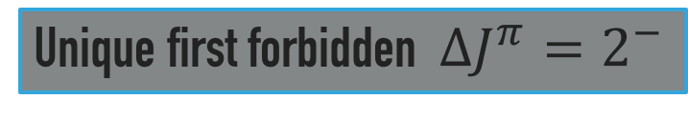
Precision β-decay studies to pinpoint BSM effects
Unique first forbidden $ΔJ^{π}=2^{−}$
$$∝q^{J}$$
$$∝q^{J−1}$$
$$∝q^{J}$$
$$≈\sqrt{\frac{J}{J+1}}{\hat{E}}_{JM}$$
Glick-Magid, DG, et al, Beta spectrum of unique first forbidden decays as a
novel test for fundamental symmetries, Phys. Lett. B767, 285 (2017)

Slide 38

Precision β-decay studies to pinpoint BSM effects
Unique first forbidden $ΔJ^{π}=2^{−}$
Spectrum, i.e., integration over angle:
Glick-Magid, DG, et al, Beta spectrum of unique first forbidden decays as a
novel test for fundamental symmetries, Phys. Lett. B767, 285 (2017)

Slide 39
Precision β-decay studies to pinpoint BSM effects
Unique first forbidden $ΔJ^{π}=2^{−}$
Unique possibility to separate between left and right-handed couplings!
Glick-Magid, DG, et al, Beta spectrum of unique first forbidden decays as a
novel test for fundamental symmetries, Phys. Lett. B767, 285 (2017)

Slide 40

Shape corrections
Unique first forbidden $ΔJ^{π}=2^{−}$

Slide 41
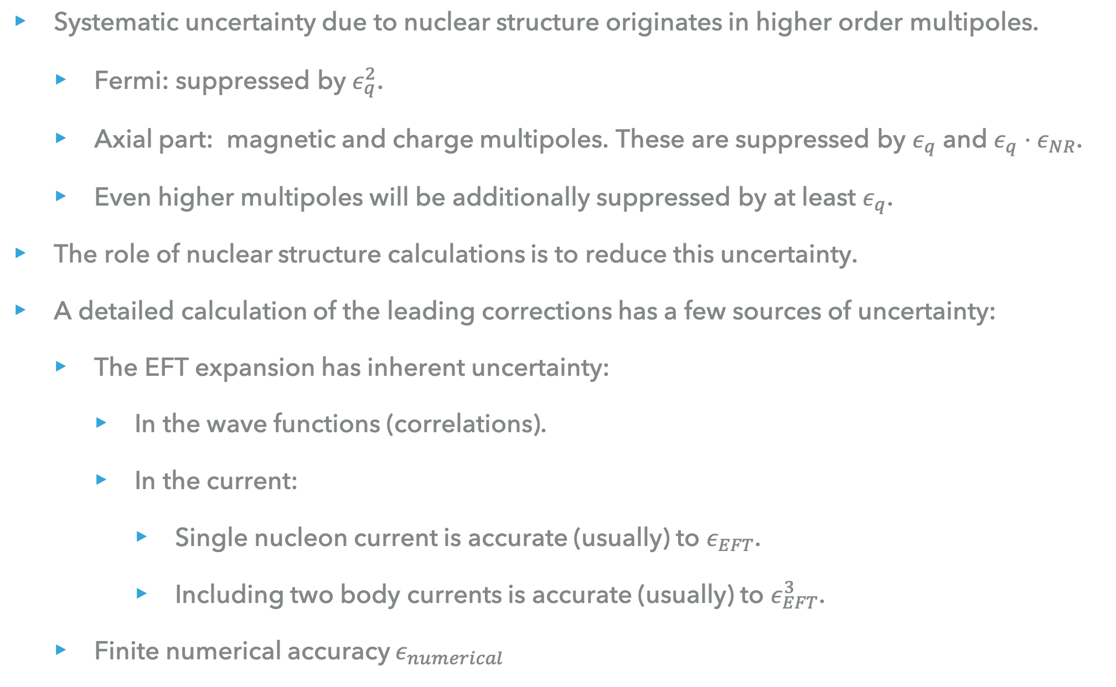
Summary
Summary
Systematic uncertainty due to nuclear structure originates in higher order multipoles.
  Fermi: suppressed by $ε_{q}^{2}$.
  Axial part: magnetic and charge multipoles. These are suppressed by $ε_{q}$ and $ε_{q}⋅ε_{NR}$.
  Even higher multipoles will be additionally suppressed by at least $ε_{q}$.
The role of nuclear structure calculations is to reduce this uncertainty.
A detailed calculation of the leading corrections has a few sources of uncertainty:
  The EFT expansion has inherent uncertainty:
    In the wave functions (correlations).
    In the current:
      Single nucleon current is accurate (usually) to $ε_{EFT}$.
      Including two body currents is accurate (usually) to $ε_{EFT}^{3}$.
  Finite numerical accuracy $ε_{numerical}$
The subject
of tomorrow’s
talks.

Slide 42
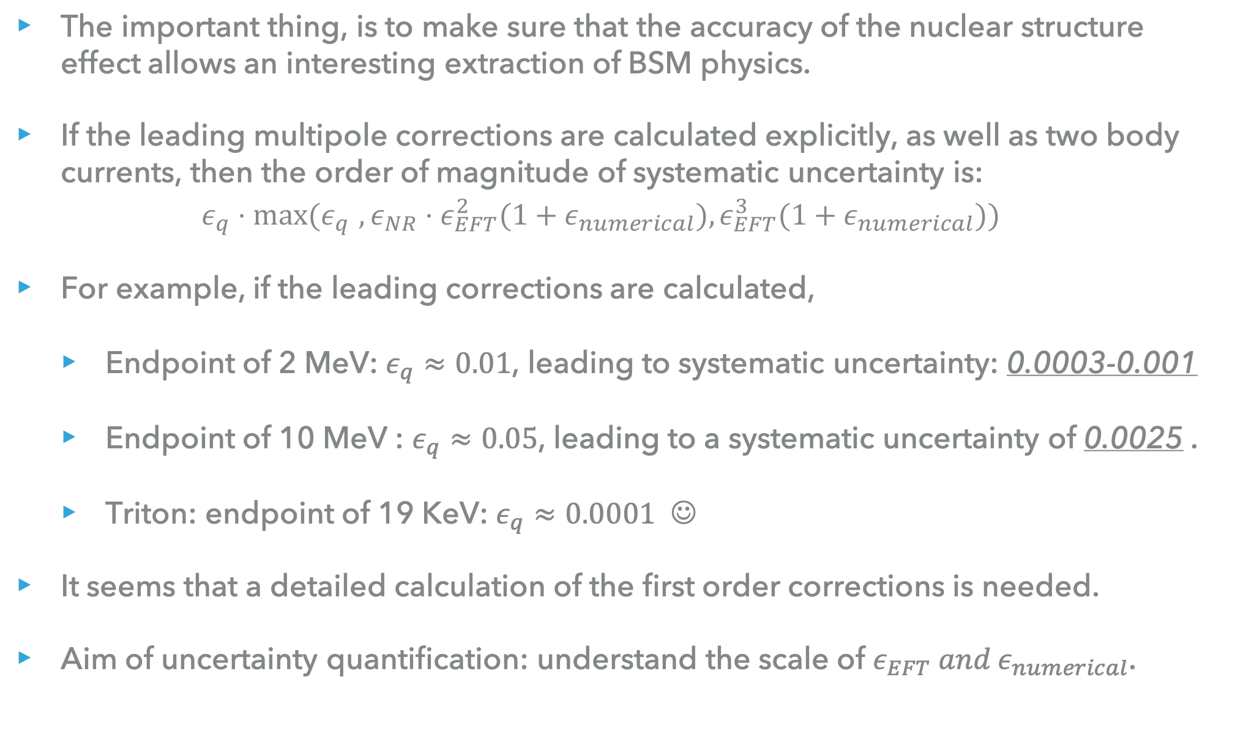
Summary
Summary
The important thing, is to make sure that the accuracy of the nuclear structure effect allows an interesting extraction of BSM physics.
If the leading multipole corrections are calculated explicitly, as well as two body currents, then the order of magnitude of systematic uncertainty is:
$ε_{q}⋅{max⁡(ε}_{q}^{}, {ε_{NR}⋅ε}_{EFT}^{2}(1+ε_{numerical}),ε_{EFT}^{3}(1+ε_{numerical}))$
For example, if the leading corrections are calculated,
  Endpoint of 2 MeV: $ε_{q}≈0.01$, leading to systematic uncertainty: 0.0003-0.001
  Endpoint of 10 MeV : $ε_{q}≈0.05$, leading to a systematic uncertainty of 0.0025 .
  Triton: endpoint of 19 KeV: $ε_{q}≈0.0001$ ☺
It seems that a detailed calculation of the first order corrections is needed.
Aim of uncertainty quantification: understand the scale of $ε_{EFT} and ε_{numerical}$.

Slide 43
On-going experiments in saraf

Slide 44
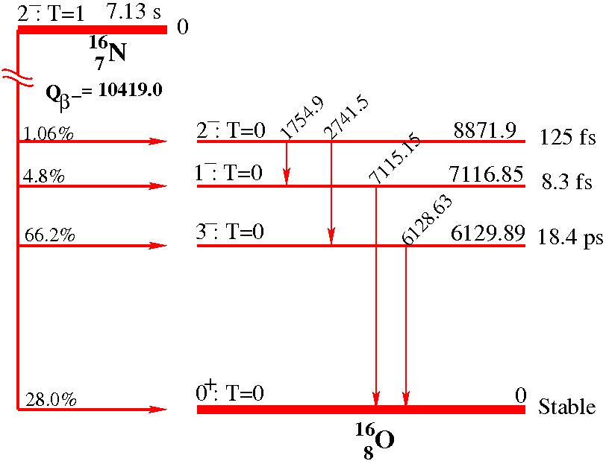
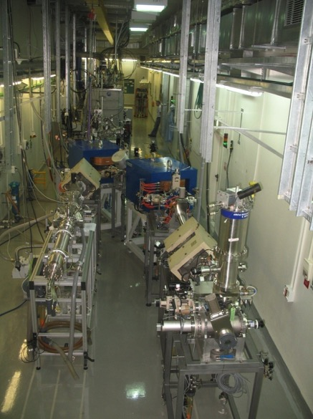
¹⁶N→¹⁶O – nuclear physics test case
SARAF Phase I
@
Soreq Center – Israel
Different β−ν correlation properties for GT and unique 1st forbidden – BSM test
Unique 1st forbidden spectrum – BSM test

Slide 45
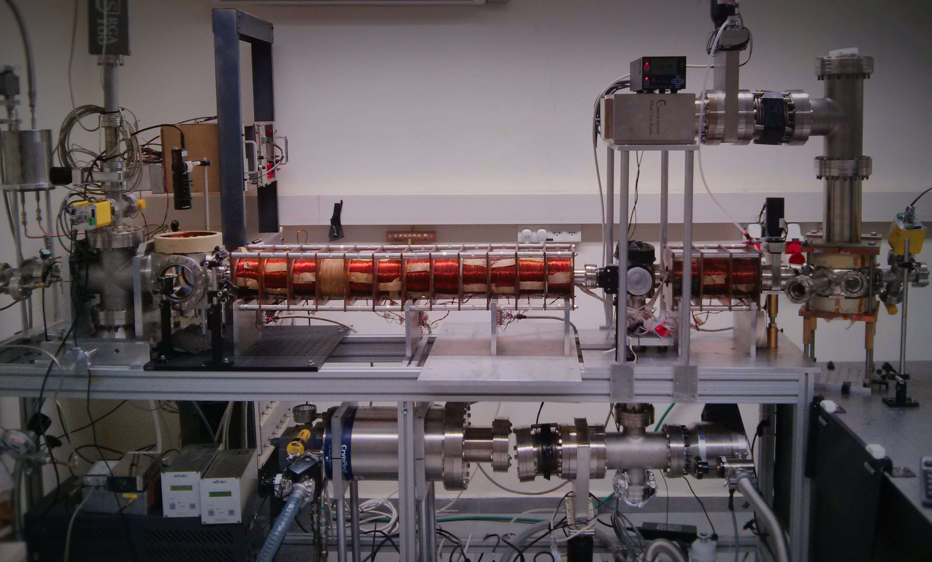
Neon isotopes
DAMA,
DM-ice, ANAIS experiments
PICASSO, SIMPLE, COUPP experiments

