Slide 1


CTEQ-TEA parton distribution functions now and in the future
Pavel Nadolsky
Southern Methodist University
CTEQ-TEA (Tung et al.) working group
Shanghai Jiao Tong University: J. Gao
Kennesaw State University: M. Guzzi
Michigan State University: J. Huston,
J. Pumplin, D. Stump, C. Schmidt, J. Winter,
C.-P. Yuan
Southern Methodist University: Tim Hobbs,
P. Nadolsky, B. T. Wang, K. P. Xie
Xinjiang University: S. Dulat, T.-J. Hou, I. Sitiwaldi

Slide 2
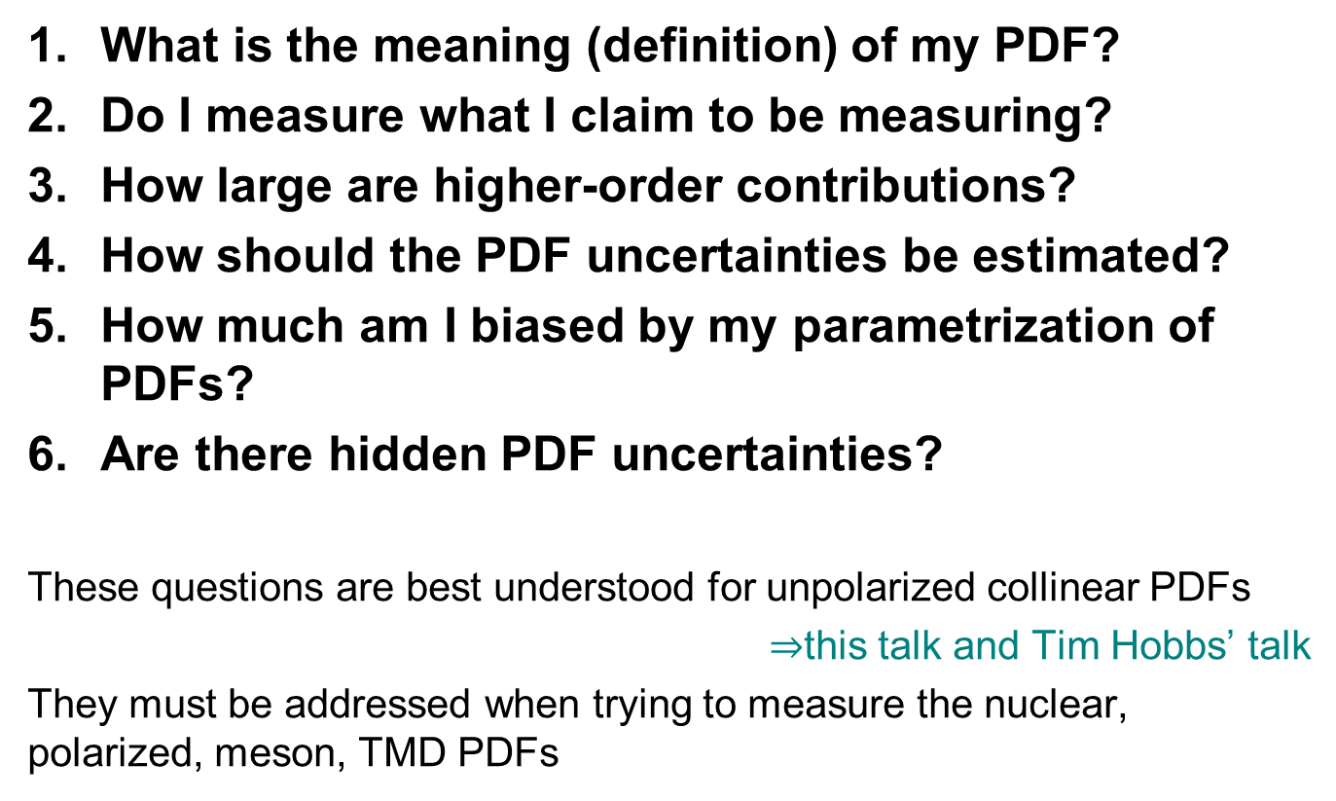
Frequently asked questions
What is the meaning (definition) of my PDF?
Do I measure what I claim to be measuring?
How large are higher-order contributions?
How should the PDF uncertainties be estimated?
How much am I biased by my parametrization of PDFs?
Are there hidden PDF uncertainties?
These questions are best understood for unpolarized collinear PDFs
$⇒$this talk and Tim Hobbs’ talk
They must be addressed when trying to measure the nuclear, polarized, meson, TMD PDFs

Slide 3
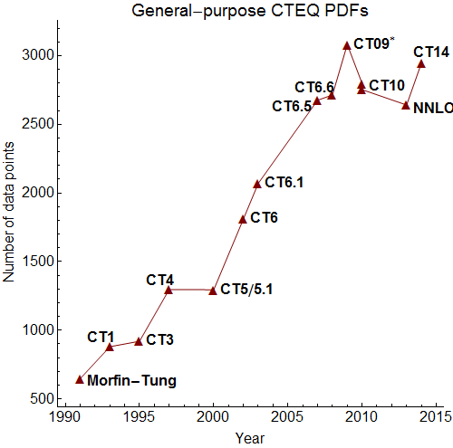
Coordinated Theoretical Experimental study of QCD
Initiated around 1990 to stimulate interactions between
Experimentalists and theorists, especially at the newly built Tevatron
High-energy physics and hadronic physics communities
This is achieved by various initiatives:
Global analysis (the term coined by J. Morfin and Wu-Ki Tung) constrains PDFs or other nonperturbative functions with data from diverse hadronic experiments
Workshops and summer schools
Annual Wu-Ki Tung award for junior researchers working on intersections of experiment and theory [nomination deadline August 15 each year]
…
2018: new experiments
(LHC, EIC, LHeC,…)! New objectives!

Slide 4
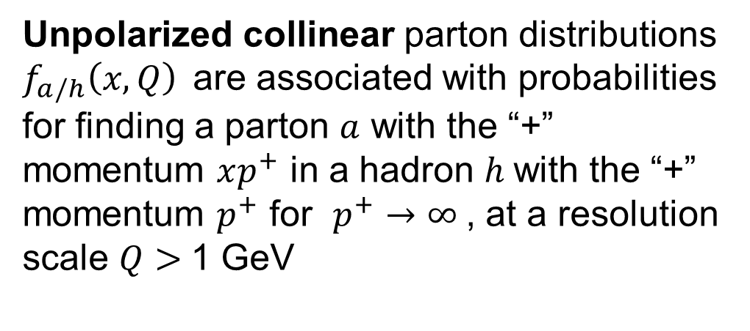
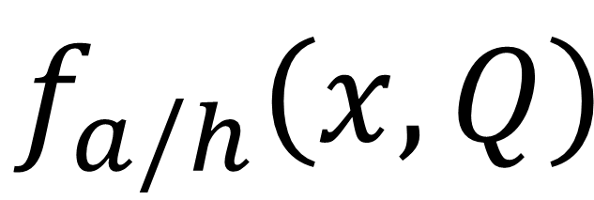
$$f_{a/h}\left(x,Q\right)$$
Unpolarized collinear parton distributions $f_{a/h}\left(x,Q\right)$are associated with probabilities for finding a parton $a$ with the “+” momentum $xp^{+}$ in a hadron $h$with the “+” momentum $p^{+}$ for $p^{+}→∞$, at a resolution scale $Q>$1 GeV

Slide 5
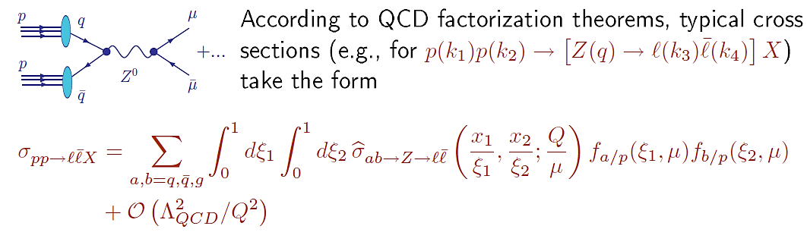
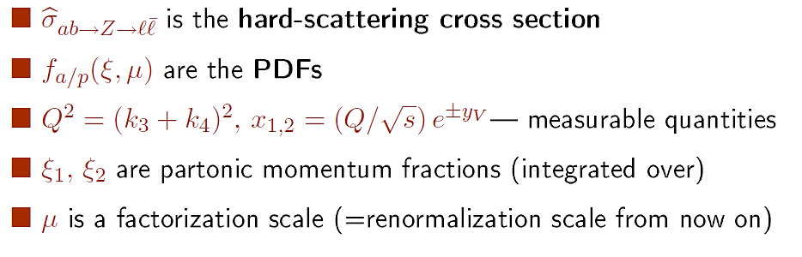
PDFs: key nonperturbative functions for LHC predictions

Slide 6
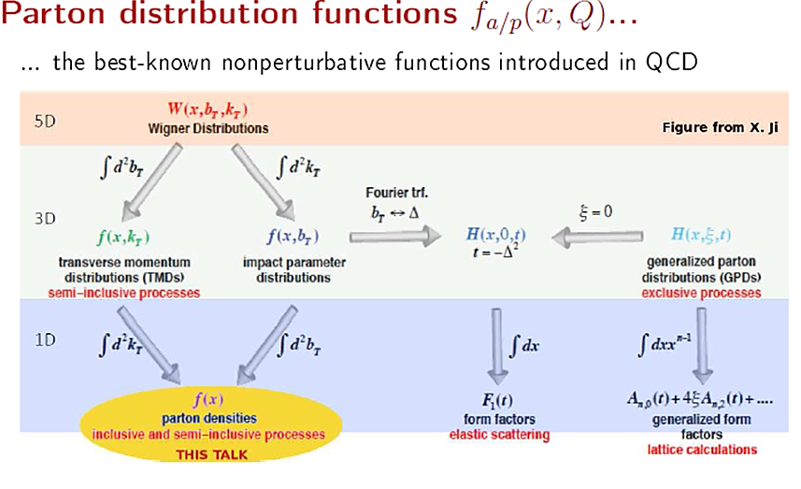
… can be obtained from Wigner distribution functions $W_{a/p}(x,p,s)$
… provide the baseline input for studies of polarized, nuclear, TMD, … PDFs

Slide 7
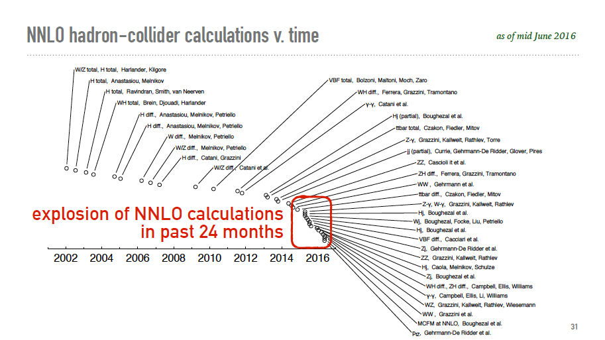
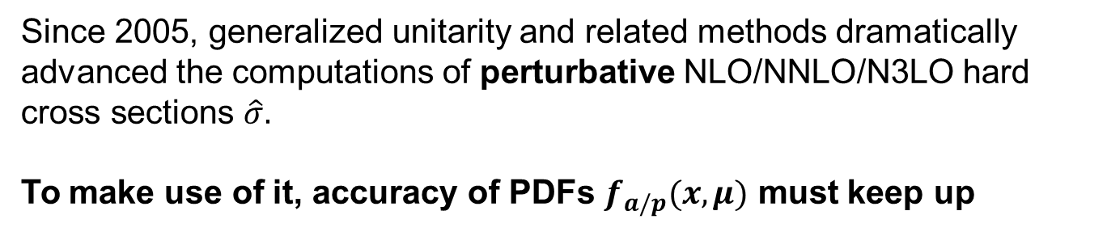
Perturbative QCD loop revolution
Figure by G. Salam
Since 2005, generalized unitarity and related methods dramatically advanced the computations of perturbative NLO/NNLO/N3LO hard cross sections $\hat{σ}.$
To make use of it, accuracy of PDFs $f_{a/p}(x,μ)$ must keep up

Slide 8
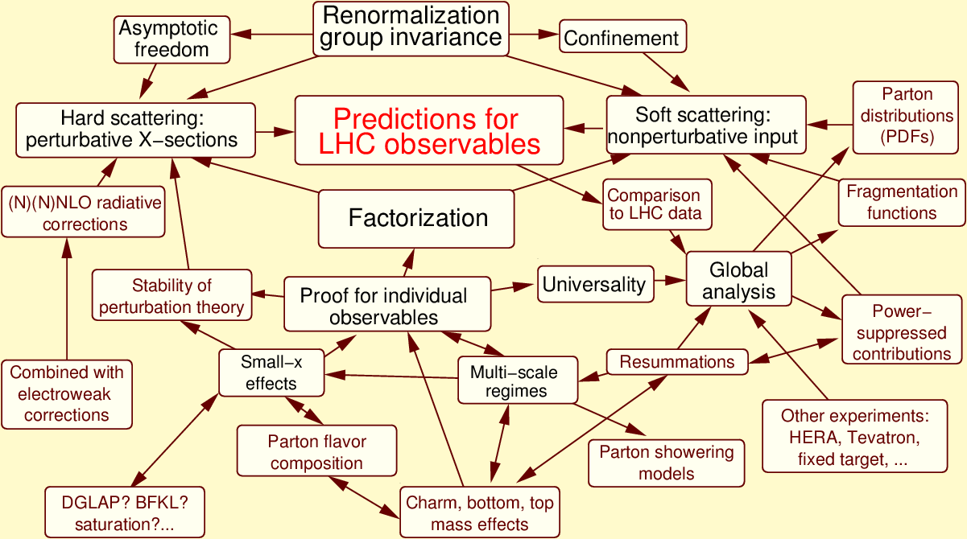
Concepts of perturbative QCD at the LHC
At the (N)NNLO accuracy level, multiple aspects affect the PDF behavior

Slide 9
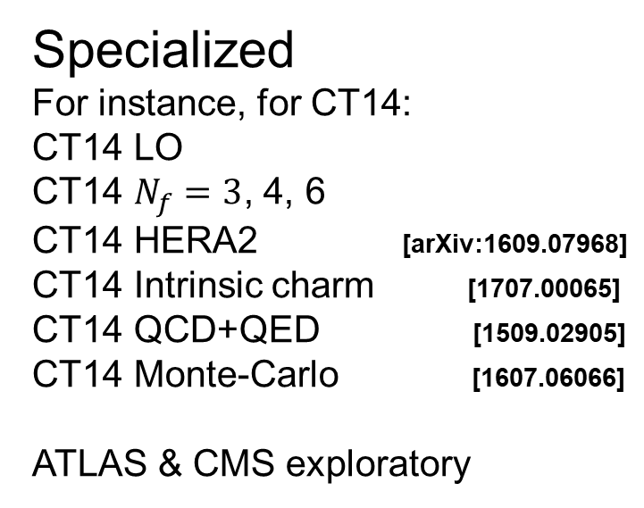
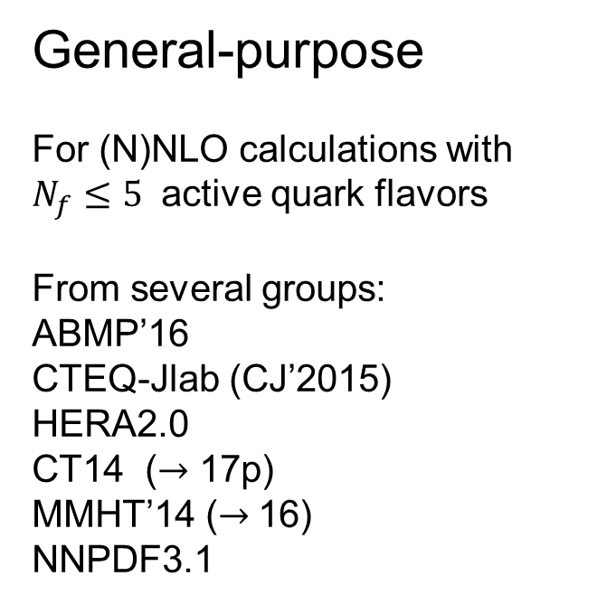
Classes of PDFs
General-purpose
For (N)NLO calculations with $N_{f}≤5$ active quark flavors
From several groups:
ABMP’16
CTEQ-Jlab (CJ’2015)
HERA2.0
CT14 ($→$ 17p)
MMHT’14 ($→$16)
NNPDF3.1
Specialized
For instance, for CT14:
CT14 LO
CT14 $N_{f}=3$, 4, 6
CT14 HERA2 [arXiv:1609.07968]
CT14 Intrinsic charm [1707.00065]
CT14 QCD+QED [1509.02905]
CT14 Monte-Carlo [1607.06066]
ATLAS & CMS exploratory
Combined [1509.03865]
PDF4LHC’15=CT14+MMHT’14+NNPDF3.0

Slide 10
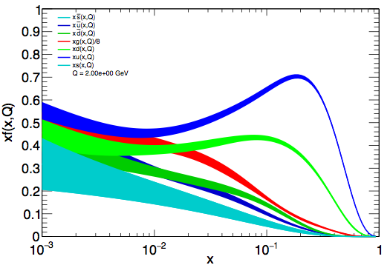
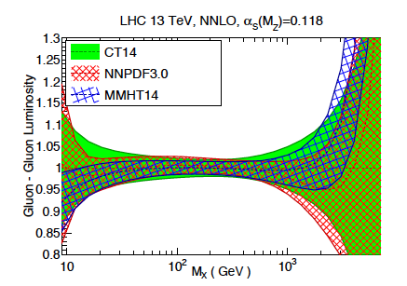

CT14 Parton distributions
2015 major release on general-purpose PDFs, CT14 NNLO/NLO sets including alternative $α_{s}$ series and $N_{f}=3,4,6$ [1506.07443]
CT14 NNLO PDFs
combined HERA charm production, H1 FL data in NC DIS
early LHC Run I data on W/Z charged lepton rapidity and asymmetry data;
old D0 W-electron asymmetry data superseded by the new one with full luminosity;
inclusive jet production from ATLAS and CMS
more flexible parametrization for gluon, d/u at large-x, both d/u and dbar/ubar at small-x, 28 eigenvectors comparing to 25 for CT10
u
d
g
s
gluon-gluon luminosity
http://hep.pa.msu.edu/cteq/public/index.html

Slide 11
Toward a new generation of PDFs
[“CT17preliminary” PDFs]
Will the [high-luminosity] LHC fully constrain the PDFs?

Slide 12

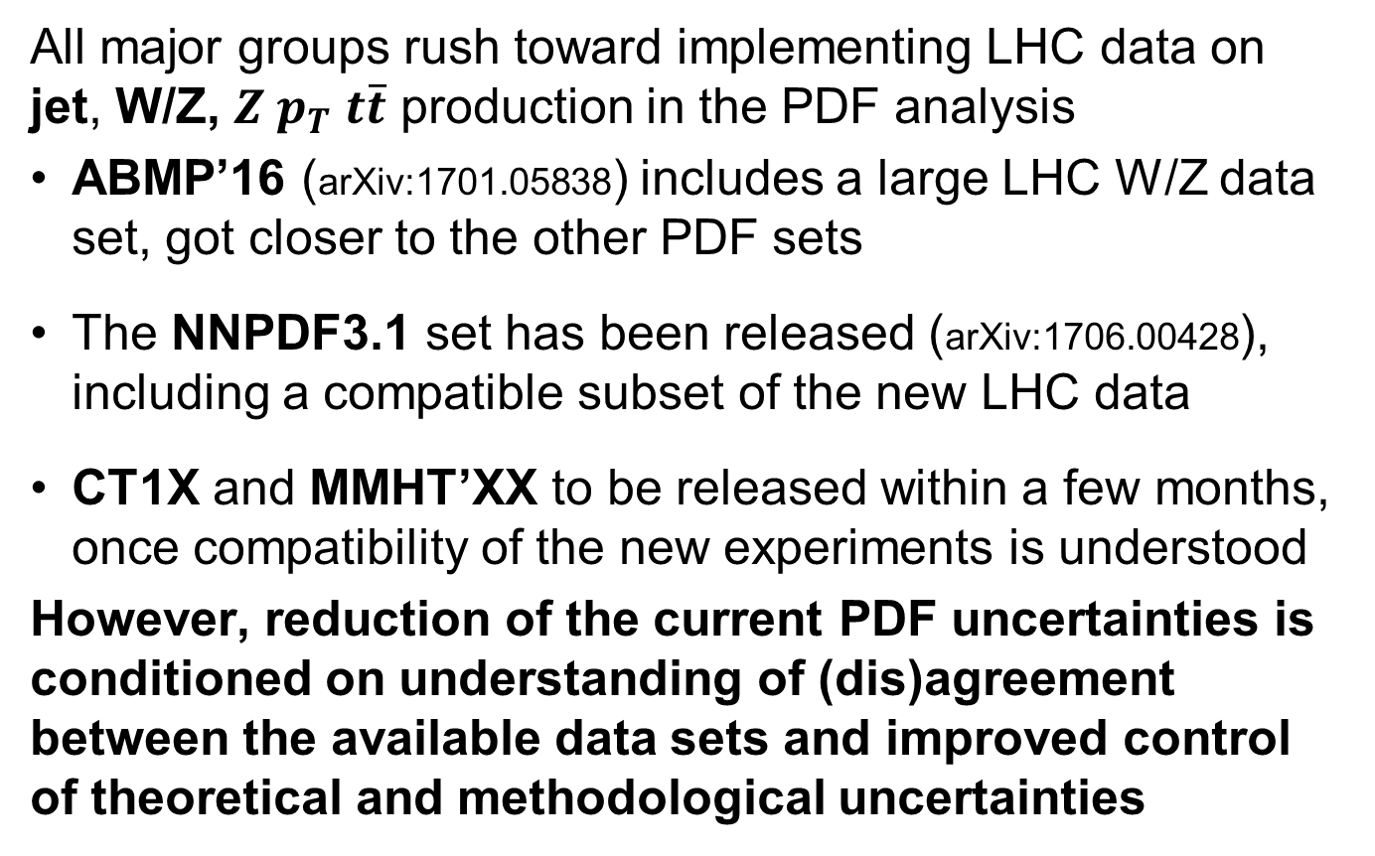
2017-18: explicit and implicit advancements
All major groups rush toward implementing LHC data on jet, W/Z, $Z p_{T}$ $t\overline{t}$ production in the PDF analysis
ABMP’16 (arXiv:1701.05838) includes a large LHC W/Z data set, got closer to the other PDF sets
The NNPDF3.1 set has been released (arXiv:1706.00428), including a compatible subset of the new LHC data
CT1X and MMHT’XX to be released within a few months, once compatibility of the new experiments is understood
However, reduction of the current PDF uncertainties is conditioned on understanding of (dis)agreement between the available data sets and improved control of theoretical and methodological uncertainties
$⇒$ S. Moch

Slide 13
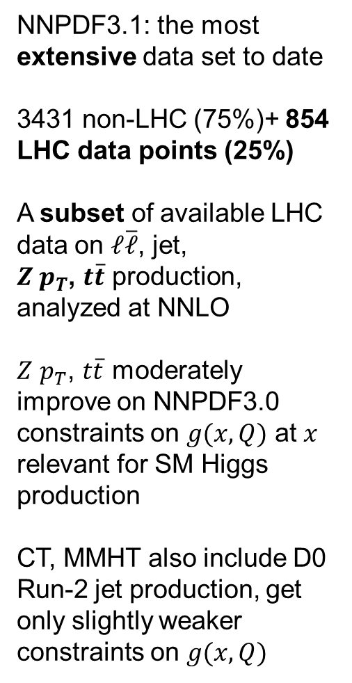
NNPDF3.1: the most extensive data set to date
3431 non-LHC (75%)+ 854 LHC data points (25%)
A subset of available LHC data on $ℓ\overline{ℓ}$, jet,
$Z p_{T}$, $t\overline{t}$ production, analyzed at NNLO
$Z$ $p_{T}$, $t\overline{t}$ moderately improve on NNPDF3.0 constraints on $g(x,Q)$ at $x$ relevant for SM Higgs production
CT, MMHT also include D0 Run-2 jet production, get only slightly weaker constraints on $g(x,Q)$
Impressive
arXiv:1706.00428
Tevatron
and LHC

Slide 14
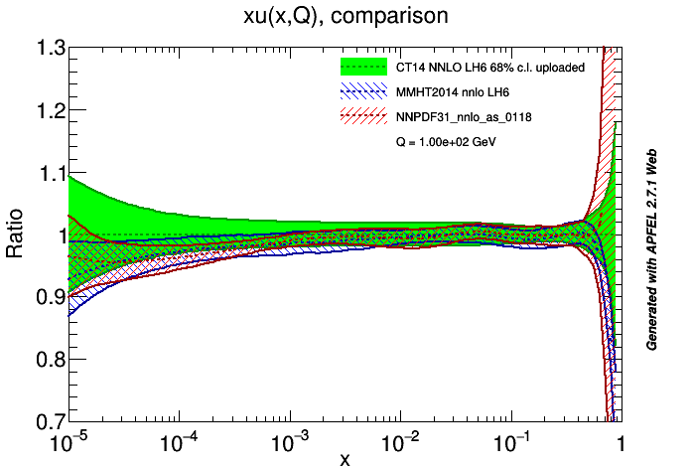
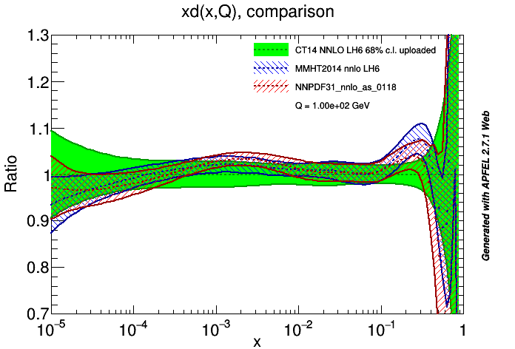
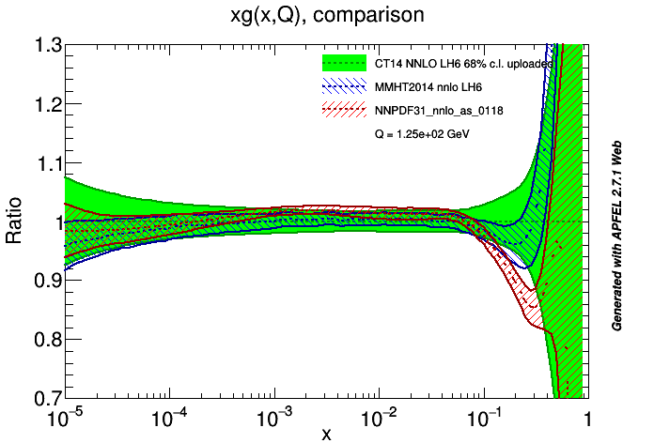
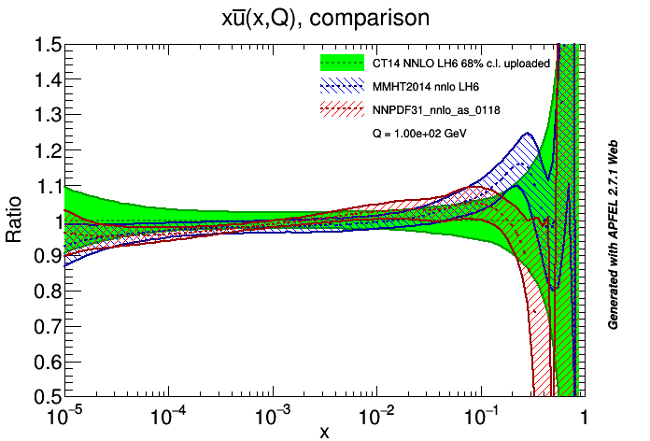
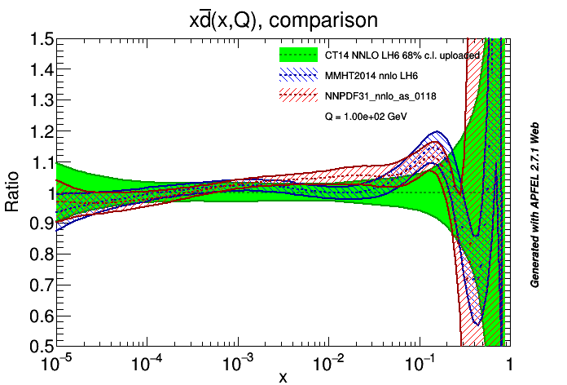
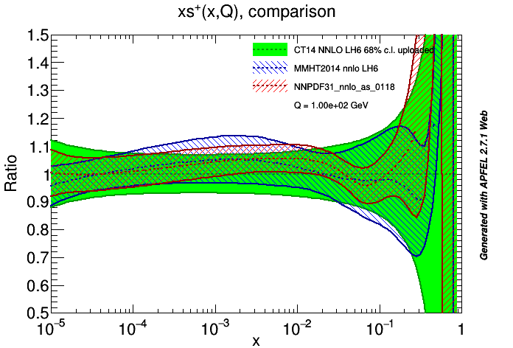
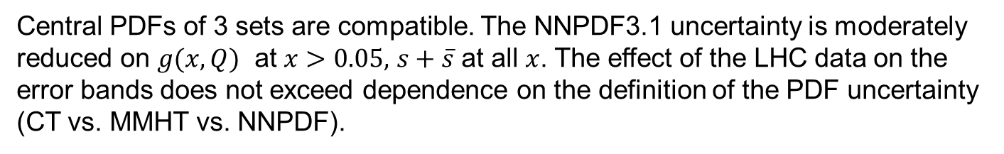
CT14, MMHT14, NNPDF3.1 PDFs
Central PDFs of 3 sets are compatible. The NNPDF3.1 uncertainty is moderately reduced on $g(x,Q)$ at $x>0.05,$ $s+\overline{s}$ at all $x$. The effect of the LHC data on the error bands does not exceed dependence on the definition of the PDF uncertainty (CT vs. MMHT vs. NNPDF).

Slide 15
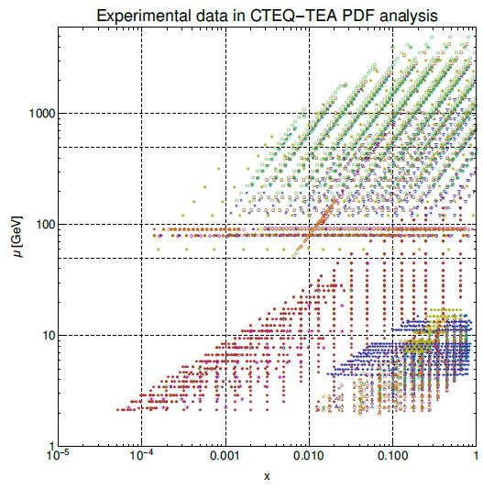

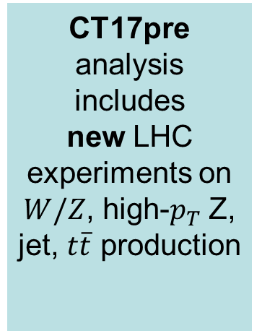
Inclusive jets
CT17pre analysis includes
new LHC experiments on $W/Z$, high-$p_{T}$Z, jet, $t\overline{t}$ production
W, Z prod. {
$t\overline{t}$, $Z$ $p_{T}$
HERA DIS
Fixed-target DIS & DY

Slide 16
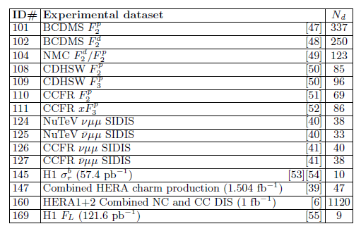
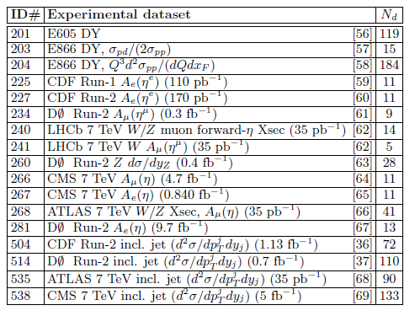
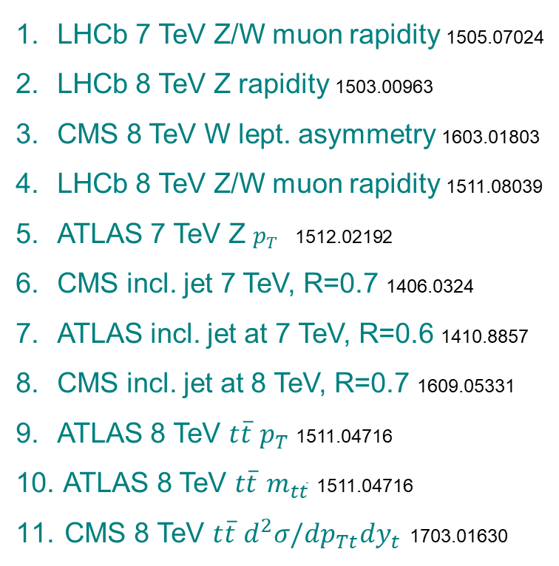

Experiments in the CT14 HERA2 fit
New experiments in the CT17pre fit
LHCb 7 TeV Z/W muon rapidity 1505.07024
LHCb 8 TeV Z rapidity 1503.00963
CMS 8 TeV W lept. asymmetry 1603.01803
LHCb 8 TeV Z/W muon rapidity 1511.08039
ATLAS 7 TeV Z $p_{T} \text{1512.02192}$
CMS incl. jet 7 TeV, R=0.7 1406.0324
ATLAS incl. jet at 7 TeV, R=0.6 1410.8857
CMS incl. jet at 8 TeV, R=0.7 1609.05331
ATLAS 8 TeV $t\overline{t}$ $p_{T}$1511.04716
ATLAS 8 TeV $t\overline{t}$ $m_{t\overline{t}}$ 1511.04716
CMS 8 TeV $t\overline{t}$ $d^{2}σ/dp_{Tt}dy_{t}$ 1703.01630
$N_{d}$ is the number of data points

Slide 17
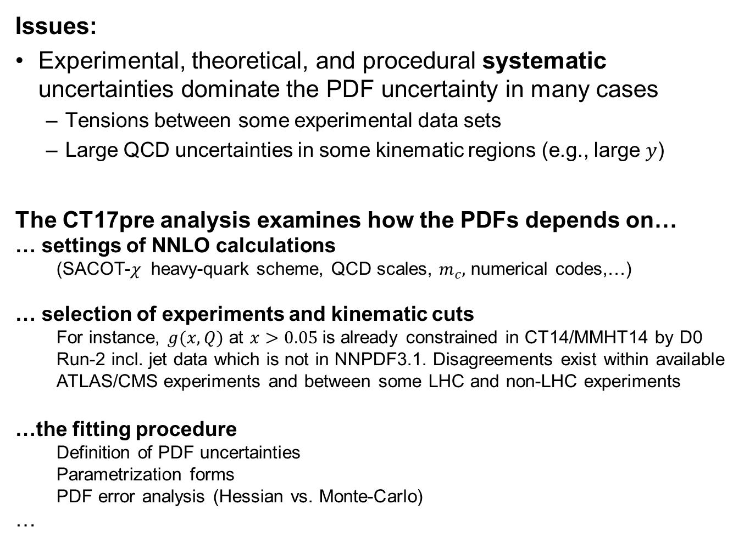
CT17p: preliminary PDFs with new LHC data
Issues:
Experimental, theoretical, and procedural systematic uncertainties dominate the PDF uncertainty in many cases
  Tensions between some experimental data sets
  Large QCD uncertainties in some kinematic regions (e.g., large $y$)
The CT17pre analysis examines how the PDFs depends on…
… settings of NNLO calculations
  (SACOT-$χ$ heavy-quark scheme, QCD scales, $m_{c},$ numerical codes,…)
… selection of experiments and kinematic cuts
  For instance, $g(x,Q)$ at $x>0.05$is already constrained in CT14/MMHT14 by D0 Run-2 incl. jet data which is not in NNPDF3.1. Disagreements exist within available ATLAS/CMS experiments and between some LHC and non-LHC experiments
…the fitting procedure
  Definition of PDF uncertainties
  Parametrization forms
  PDF error analysis (Hessian vs. Monte-Carlo)
…

Slide 18
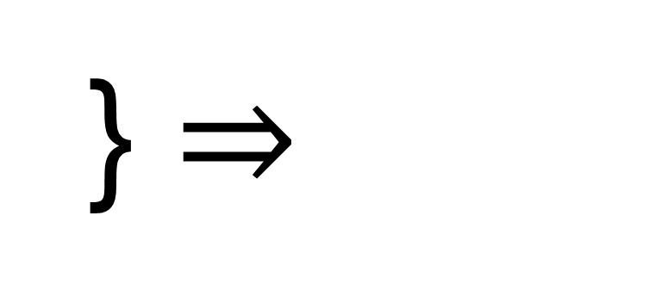
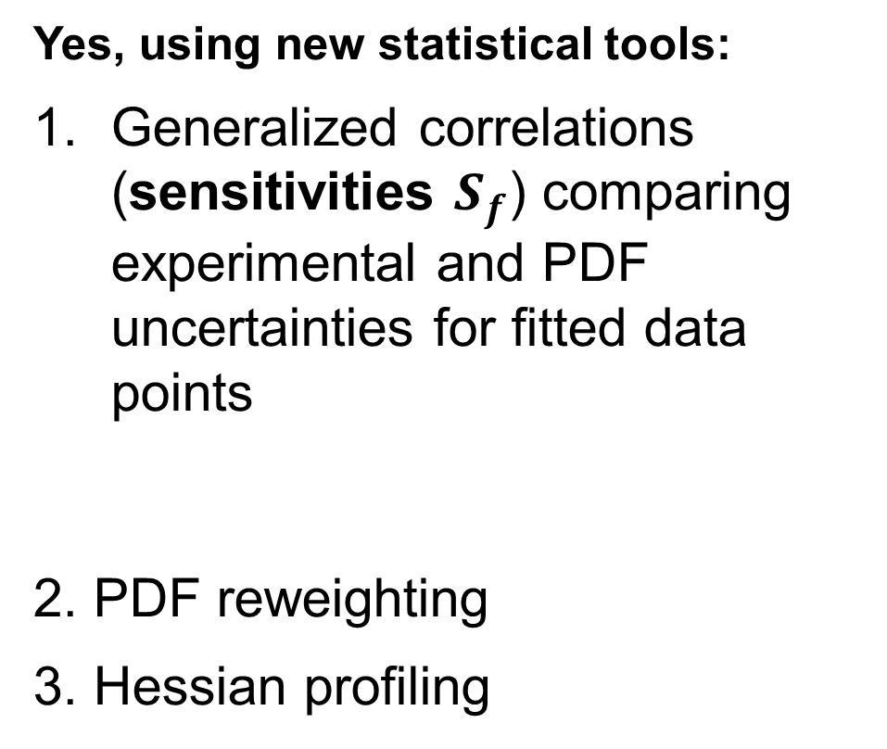
How sensitive is an experiment to a PDF?
Can we estimate it before doing the global fit?
Yes, using new statistical tools:
Generalized correlations (sensitivities $S_{f}$) comparing experimental and PDF uncertainties for fitted data points
2. PDF reweighting
3. Hessian profiling
PDFSense (1803.02777)
http://metapdf.hepforge.org/PDFSense
} $⇒$
mcgen (1607.06066)
ePump (1806.07950)

Slide 19
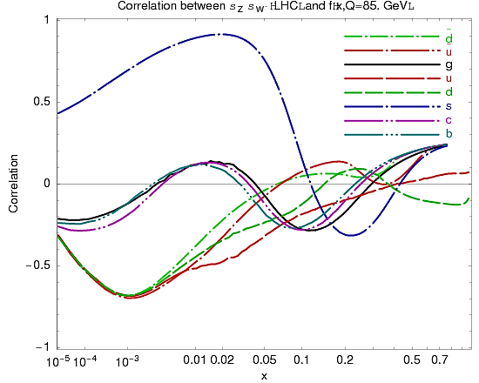
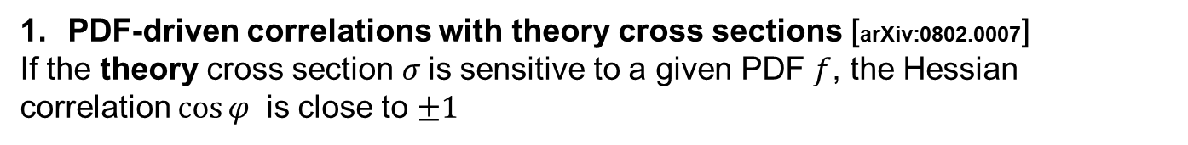
Statistical methods to identify the PDF dependence
PDF-driven correlations with theory cross sections [arXiv:0802.0007]
If the theory cross section $σ$is sensitive to a given PDF $f$, the Hessian correlation $\cos{φ }$ is close to $±1$
Correlation between $σ_{W}/σ_{Z}$ and f(x,Q=85 GeV)
Strangeness drives the PDF uncertainty!
Before the fit

Slide 20
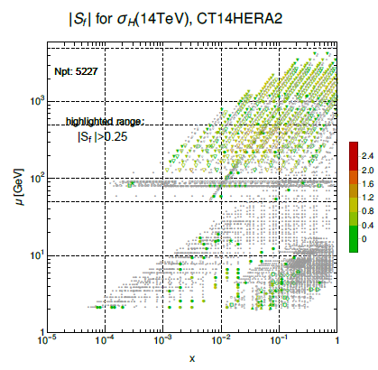
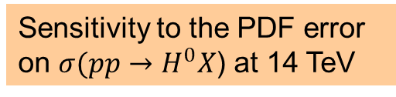
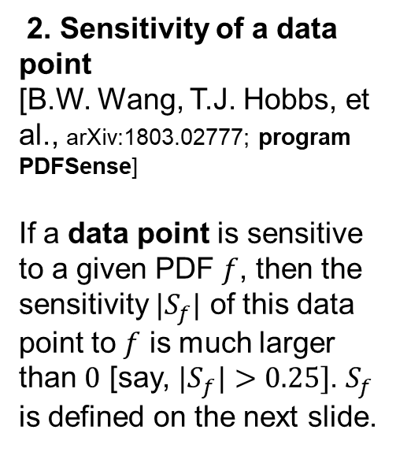
Statistical methods to identify the PDF dependence
Sensitivity to the PDF error on $σ(pp→H^{0}X$) at 14 TeV
2. Sensitivity of a data point
[B.W. Wang, T.J. Hobbs, et al., arXiv:1803.02777; program PDFSense]
If a data point is sensitive to a given PDF $f$, then the sensitivity $|S_{f}|$ of this data point to $f$ is much larger than $0$ [say, ${|S}_{f}|>0.25]$. $S_{f}$ is defined on the next slide.
Before the fit

Slide 21
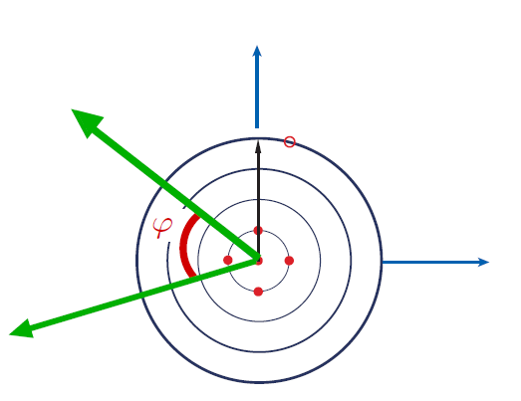
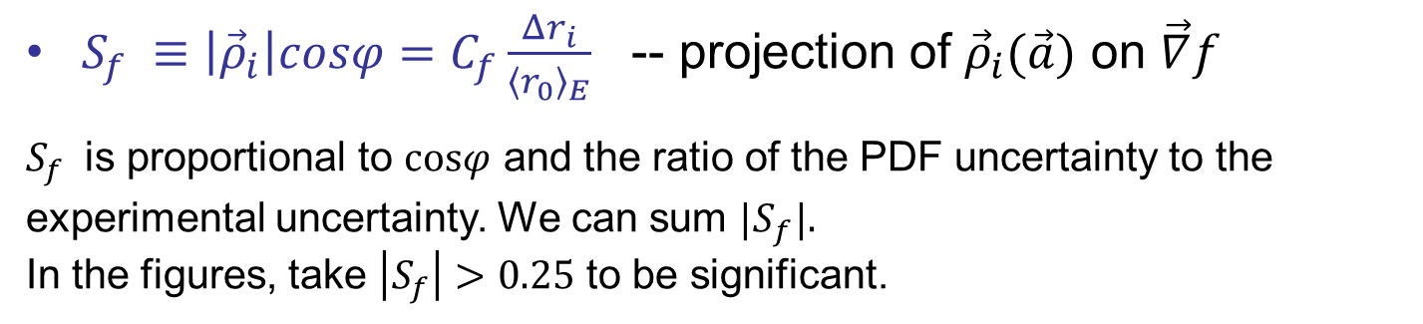
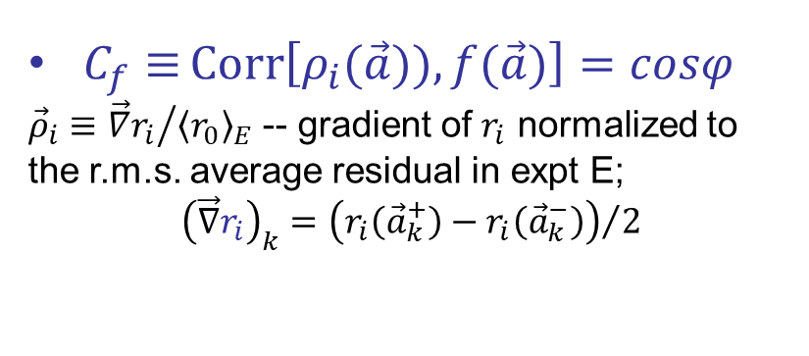


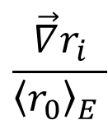
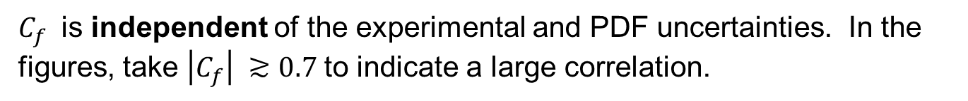

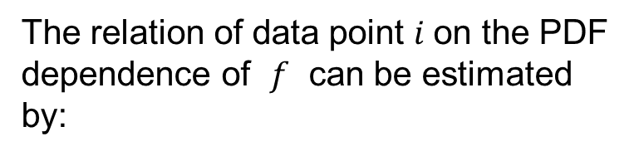
Correlation $C_{f}$ and sensitivity $S_{f}$
The relation of data point $i$on the PDF dependence of $f$ can be estimated by:
$$\frac{\vec{∇}r_{i}}{{〈r_{0}〉}_{E} }$$
$C_{f}≡{Corr\left[ρ_{i}(\vec{a})),f(\vec{a})\right]}=cosφ$
${\vec{ρ}}_{i}≡{\vec{∇}r_{i}}/{{〈r_{0}〉}_{E}}$ -- gradient of $r_{i}$ normalized to the r.m.s. average residual in expt E;
$${\left(\vec{∇}r_{i}\right)}_{k}={\left(r_{i}\left({\vec{a}}_{k}^{+}\right)−r_{i}\left({\vec{a}}_{k}^{−}\right)\right)}/2$$
$$\vec{∇}f$$
$$S_{f}$$
$C_{f}$ is independent of the experimental and PDF uncertainties. In the figures, take $\left|C_{f}\right| ≳0.7$to indicate a large correlation.
$S_{f} ≡\left|{\vec{ρ}}_{i}\right|cosφ=C_{f}\frac{Δr_{i}}{{〈r_{0}〉}_{E}}$ -- projection of ${\vec{ρ}}_{i}(\vec{a})$ on $\vec{∇}f$
$S_{f}$ is proportional to $cosφ$ and the ratio of the PDF uncertainty to the experimental uncertainty. We can sum ${|S}_{f}|.$
In the figures, take $\left|S_{f}\right|>0.25$ to be significant.

Slide 22
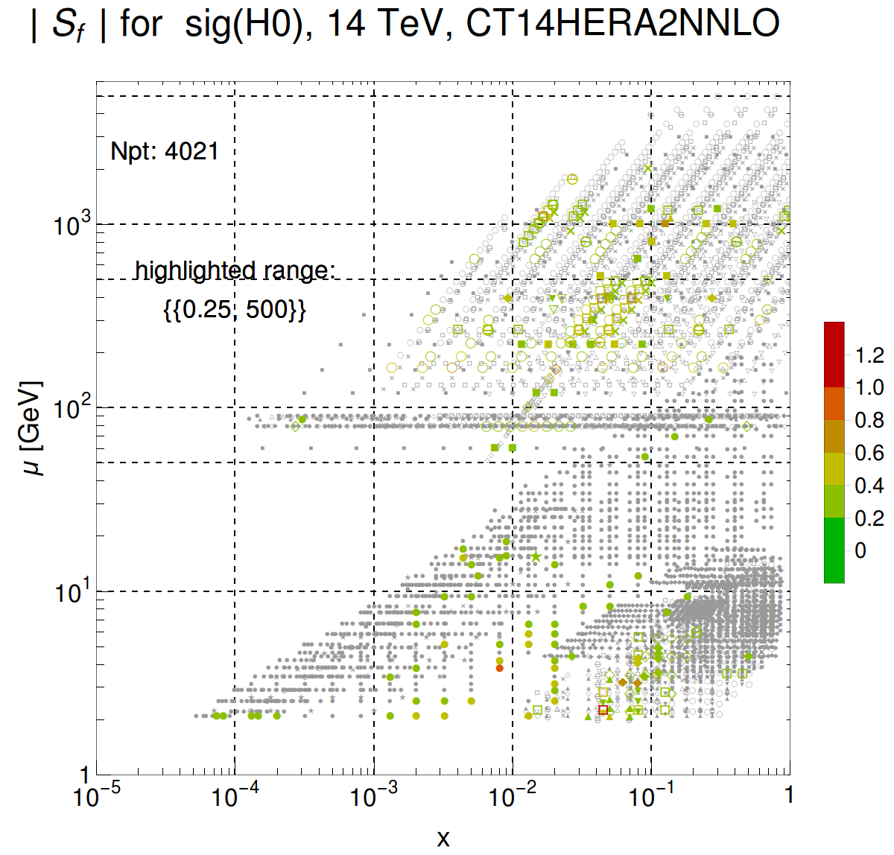
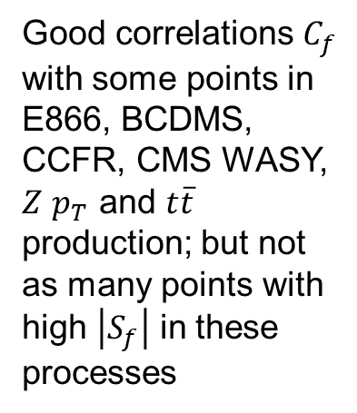


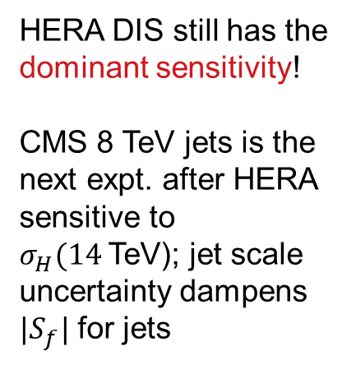
Higgs boson production
CMS, ATLAS jets
HERA DIS still has the dominant sensitivity!
CMS 8 TeV jets is the next expt. after HERA sensitive to $σ_{H}(14$TeV); jet scale uncertainty dampens ${|S}_{f}|$ for jets
$$\left|S_{f}\right|>0.25$$
$t\overline{t}$, $Z$ $p_{T}$
Good correlations $C_{f}$ with some points in E866, BCDMS, CCFR, CMS WASY, $Z$ $p_{T}$ and $t\overline{t}$ production; but not as many points with high $\left|S_{f}\right|$ in these processes
HERA
BCDMS, CCFR, E866, …

Slide 23
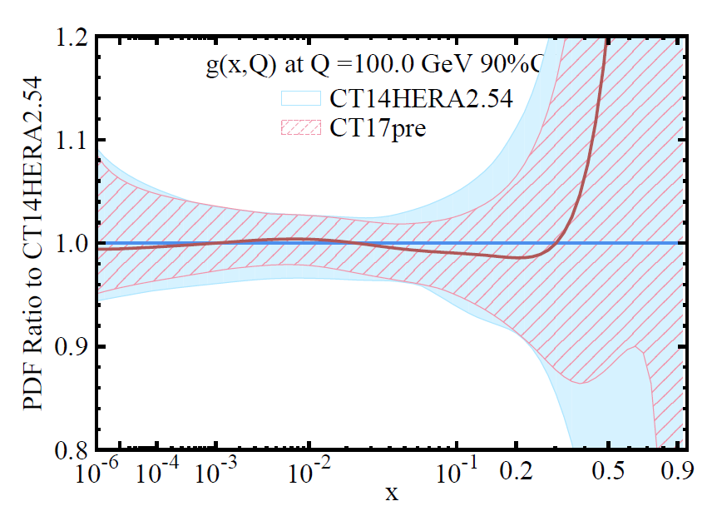
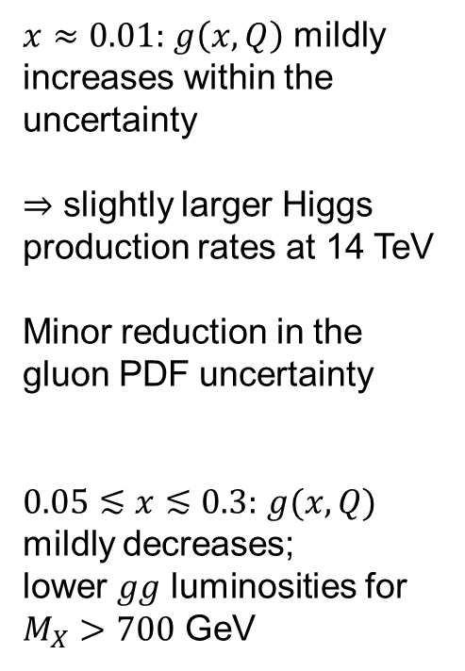
Gluon PDF before and after including the LHC data
[CT14HERA2 vs. CT17pre NNLO]
$x≈0.01:$ $g\left(x,Q\right)$ mildly increases within the uncertainty
$⇒$ slightly larger Higgs production rates at 14 TeV
Minor reduction in the gluon PDF uncertainty
$0.05≲x≲0.3:$ $g(x,Q)$ mildly decreases;
lower $gg$ luminosities for $M_{X}>700$ GeV
PRELIMINARY
After the fit

Slide 24
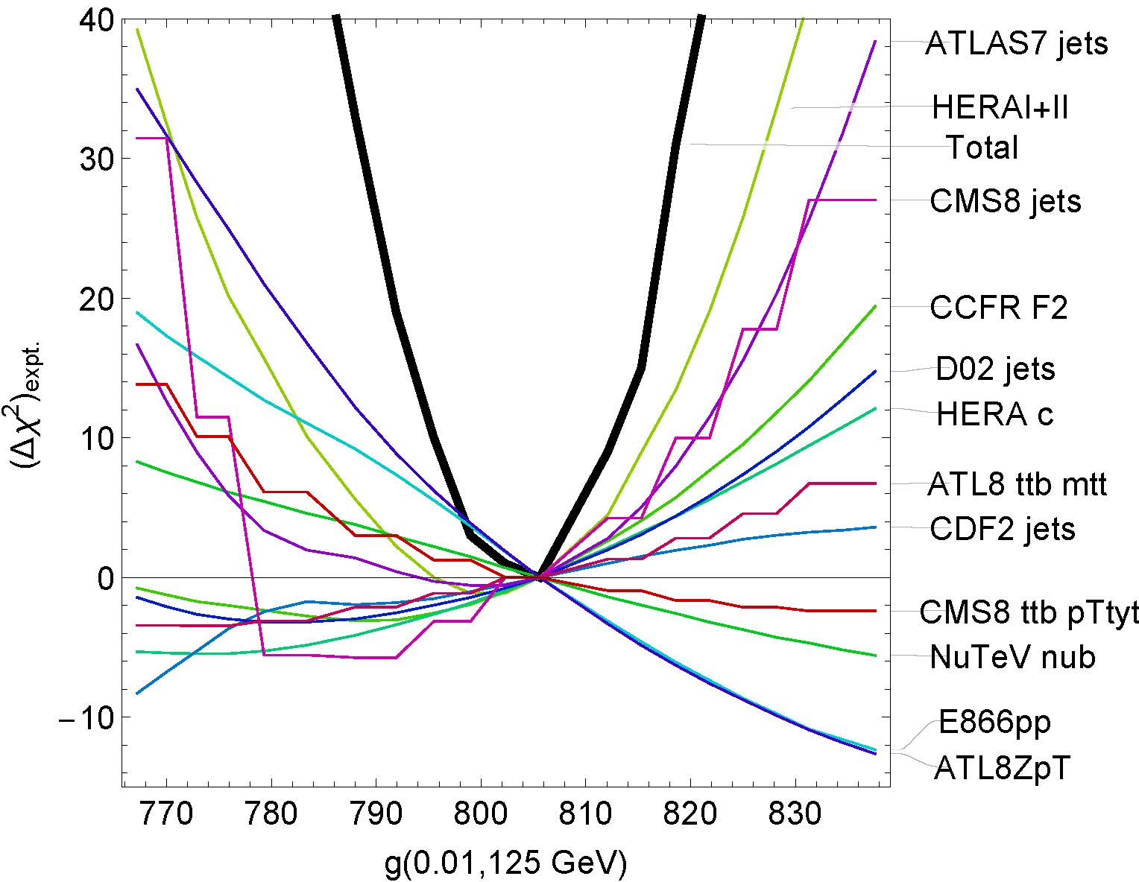
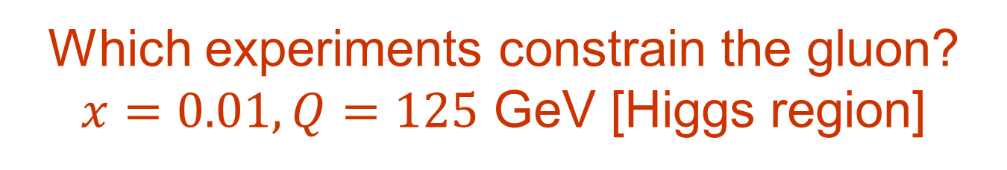
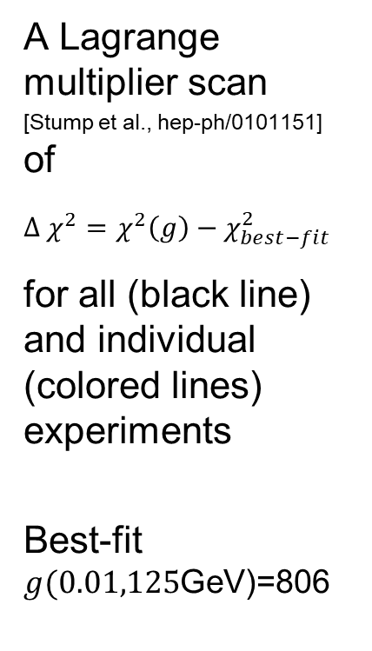
Which experiments constrain the gluon?
$x=0.01, Q=125$ GeV [Higgs region]
A Lagrange multiplier scan
[Stump et al., hep-ph/0101151] of
$Δ χ^{2}=χ^{2}\left(g\right)−χ_{best−fit}^{2}$
for all (black line) and individual (colored lines) experiments
Best-fit $g(0.01,125$GeV)=806
PRELIMINARY
After the fit

Slide 25

Which experiments constrain the gluon?
$x=0.01, Q=125$ GeV [Higgs region]
The LM scans broadly confirm $S_{f}$ estimates
HERAI+II, ATLAS7 jets, CMS8 jets impose the tightest constraints; are in agreement
E866, ATLAS 8 $Z$ $p_{T}$ prefer higher gluon
PRELIMINARY
After the fit

Slide 26



Which experiments constrain the gluon?
$x=0.3, Q=125$ GeV
ATLAS 7 and CMS 7 TeV jets, ATLAS 8 Z $p_{T}$ disagree with CMS8 jets
Weaker constraints from HERAI+II, E866, LHCb, Tevatron jets, CDHSW F2, $t\overline{t}$production
PRELIMINARY
After the fit

Slide 27

PRELIMINARY

Slide 28

PRELIMINARY

Slide 29





Inconsistent conclusions in literature about strangeness preferred by the LHC data
$$(s+\overline{s})/(\overline{u}+\overline{d})(x,μ_{f}^{2})$$
1612.03016
CMS-PAS-SMP-17-014
CT14 and MMHT14 NNLO PDFs profiled
using ATLAS 7 TeV (4.6 ${fb}^{−1}{) W}^{±},$Z xsecs prefer $s\left(x,1.9 GeV\right)∼1 @ x=0.023$
CMS W,Z, CMS W+c (13 TeV) prefer smaller $s(x,μ)$ than ATLAS for $x≳{10}^{−3}$

Slide 30



Effect of LHC data on strangeness: the actual CT17pre fit
Mild upward pool on $s\left(x,Q\right)$ compared to CT14 HERA2
Small to no reduction on the PDF error on $s(x,Q)$
PRELIMINARY
$R_{s}\left(CT17pre\right)=\frac{s+\overline{s}}{\overline{u}+\overline{d}}=0.53±0.16$ (90% c.l.) at $x=0.023$, $Q^{2}=1.9 {GeV}^{2}$

Slide 31


Effect of LHC data on strangeness: the actual CT17pre fit
Some tension between NuTeV, CCFR dimuon production, HERAI+II (preferring $R_{s}<0.6$);
and vector boson production at the LHC and Tevatron (preferring $R_{s}>0.6$)
However, still large uncertainties
PRELIMINARY

Slide 32

Is leading-power NNLO QCD theory sufficient for describing the CTEQ global data?
Can the higher-order/higher-twist corrections survive…
1. … at small $x$ in HERA DIS (“BFKL”; CT14HERA2)?
2. … for subleading flavor combinations (“intrinsic charm”; CT14IC)?

Slide 33


CT14:
only DIS data above the red line with $Q>2$ GeV, $W>3.5$ GeV are accepted to ensure stable NNLO predictions
Some higher-order corrections may survive in parts of phase space
+

Slide 34


CT14 PDFs with HERA1+2 (=HERA2) combination
Phys.Rev. D95 (2017) 034003
$e^{+}p$ data are fitted fine
$e^{−}p$ data are fitted poorly

Slide 35

CT14 PDFs with HERA1+2 (=HERA2) data
Points with excessive $χ^{2}$ are randomly scattered in the $\{x,Q\}$ plane

Slide 36



Stability of CT14 HERA2 fit
The fit quality does not change much when we vary lower cuts on $Q$ and $A_{gs}=x^{0.3}Q^{2}$, or increase statistical weight of the HERA2 data

Slide 37



CT14HERA2 vs. CT14 PDFs: central sets
All changes are within CT14 uncertainties

Slide 38



CT14HERA2 PDFs at small $x$
Figures: Bo Ting Wang
At $x<{10}^{−2}$, the CT14HERA2 NLO $N_{f}=3$ gluon is compatible with PROSA’15 PDFs fitted to 7 TeV LHCb heavy-flavor production data. Next rounds of LHCb measurements may help constrain the small-$x$ gluon.

Slide 39




A twist-4 contribution in HERA DIS charm production ($⊂$“intrinsic charm”)
[arXiv:1707.00065]
A ladder; must be resummed in $c\left(x,Q\right)$ in the $N_{f}=4$ scheme at $Q^{2}≫m_{c}^{2}$; e.g., in the ACOT scheme
+…
$Λ≲1$GeV

Slide 40

A twist-4 contribution in HERA DIS charm production ($⊂$“intrinsic charm”)
[arXiv:1707.00065]
A ladder; must be resummed in $c\left(x,Q\right)$ in the $N_{f}=4$ scheme at $Q^{2}≫m_{c}^{2}$; e.g., in the ACOT scheme
+…
$Λ≲1$GeV
Can be of order ~10% of the twist-2 $α_{s}^{2}$ term

Slide 41


A twist-4 contribution in HERA DIS charm production ($⊂$“intrinsic charm”)
[arXiv:1707.00065]
A ladder; must be resummed in $c\left(x,Q\right)$ in the $N_{f}=4$ scheme at $Q^{2}≫m_{c}^{2}$; e.g., in the ACOT scheme
The ladder subgraphs can be resummed as a part of $c\left(x,Q\right)$in the $N_{f}=4$ scheme at $Q^{2}≫m_{c}^{2}>Λ^{2}$;
contribute to the boundary condition for $c\left(x,Q_{0}\right)$ at $Q_{0}≈m_{c};$
obey twist-2 DGLAP
equations.
+…
$Λ≲1$GeV
Can be of order ~10% of the twist-2 $α_{s}^{2}$ term

Slide 42


CT14 IC study clarifies important questions
What are phenomenological constraints on the “intrinsic charm” from the global QCD data?
$⇒$ The CT14 charm PDFs allow a “nonperturbative” component carrying a total momentum fraction $〈x_{IC}〉=1−2\%$ in DIS at $Q≈m_{c}$ .
Can we estimate its impact on the LHC predictions?
Yes, based on the simplest approximation of the “nonperturbative” charm contribution. In most cases, the estimated impact is less than the net CT14 PDF uncertainty.
+…
[arXiv:1707.00065]
Note:
“intrinsic charm” $≠$“fitted charm”

Slide 43





PDF fits may include a ``fitted charm’’ PDF
``Fitted charm’’ = ``higher-twist charm’’
+ other (possibly not universal)
higher O($α_{s}$) / higher power terms
QCD factorization theorem for DIS structure function $F(x,Q)$ [Collins, 1998]:
All $α_{s}$orders:
The PDF fits implement this formula up to (N)NLO ($N_{ord}=1$ or 2):
PDF fits:
The perturbative charm PDF component cancels at $Q≈m_{c}$ up to a higher order
The ‘fitted charm component’ may approximate for missing terms of orders $α_{s}^{p}$ with $p>N_{ord}$, or $Λ^{2}/m_{c}^{2}$, or ${Λ^{2}}/{Q^{2}}$-- generally process-dependent

Slide 44




Dependence on the switching scale (no IC)
If the “fitted charm” is purely twist-2, we expect its effect to vanish for a sufficiently high $α_{s}$ order of the calculation.
This is analogous to the reduction in the dependence on the switching scale $μ_{c}$ from 3FS to 4FS, when the $α_{s}$ order increases for a fixed $Q_{0}$ and $m_{c}$, as demonstrated recently by the xFitter group
$$Δχ^{2}(μ_{c})≈25$$
$$Δχ^{2}(μ_{c})≈90$$
Bertone et al. (xFitter), arXiv:1707.05343

Slide 45



Dependence of $Δχ^{2}$ on the IC momentum fraction ${〈x〉}_{IC}$
In contrast, a twist-4 “IC” contribution will not decrease when going from $N^{k}LO$ to $N^{k+1}LO$.
Depending on its dynamical origin, the IC charm takes a variety of shapes, e.g., a “sea-like” (SEA) or “valence-like” form. The Brodsky-Hoyer-Peterson-Sakai form (BHPS) predicts a “valence-like” $c(x,Q_{0}$) peaked at $x∼0.2$. A sea-like form is monotonic in $x$.
BHPS1
BHPS2

Slide 46




ACOT-like factorization for twist-4 charm contributions (an example)
$α_{s}^{2}$:
$α_{s}^{3}$:
The IC terms can be factorized in the ACOT method into
- universal twist-4 nonperturbative functions $f_{gg}\left(ξ_{1},ξ_{2},Q\right),$ etc.
- process-dependent coefficient functions $c_{h,h}^{(k)}, C_{h,gg}^{(k)} ,$ etc.

Slide 47




Allowed $c+\overline{c}$momentum fractions
Sources of differences | CT14 IC | NNPDF3.x
$α_{s}$ order | NNLO only | NLO, NNLO
Settings | 90% c.l. from Lagrange multiplier scan $Q_{0}=m_{c}^{pole}=1.3 GeV$ | Symmetric. 68% c.l. from Monte-Carlo sampling, $Q_{0}=m_{c}^{pole}=1.51$ GeV
LHC 8 TeV $W,Z$ | Under validation; mild tension with HERA DIS data | Included; strong effect despite a smallish data sample
1983 EMC $F_{2c}$ data included? | Only as a cross check (unknown syst. effects in EMC data) | Optional, strong effect on the PDF error

Slide 48


Impact of IC on the PDF ratios
Common parametrizations of the IC may produce an unphysically large ratio
${\left(c\left(x,Q\right)+\overline{c}\left(x,Q\right)\right)}/{\left(\overline{u}\left(x,Q\right)+\overline{d}\left(x,Q\right)\right)}$at $x→1$ and low $Q∼m_{c}$. This is resolved in the BHPS3 parametrization, which solves the BHPS model numerically and introduces small valence-like components in $\overline{u}(x,Q_{0})$ and $\overline{d}\left(x,Q_{0}\right)$ to moderate their drop at $x→1$.

Slide 49

Outlook for CTEQ-TEA PDFs
Ongoing CTEQ-TEA PDF analysis
Detailed investigation of the LHC 7 and 8 TeV vector boson, jet, $t\overline{t}$ production data suggests mild changes in the central fits, PDF uncertainties, and precision EW observables, as compared to the CT14HERA2 NNLO data set. We notice the potential of the future ATLAS/CMS jet data, together with other LHC processes, for strengthening the constraints on the g, s, $\overline{u}$, and $\overline{d}$ PDFs with modest improvements in experimental systematics and full implementation of NNLO jet cross sections
CT14 PDFs with photon PDFs [1509.02905], intrinsic/fitted charm [1706.00657], and Monte-Carlo error PDFs [1607.06066]
NLO calculation for $c$, $b$production at LHCb, ATLAS in the S-ACOT-$χ$
scheme using MCFM/Applgrid [Campbell, P. N., Xie, in pre-publication]
Further development of programs for fast survey [PDFSense] and Hessian reweighting of the data [ePump]

Slide 50




Oekumene of the PDF universe
Tevatron
b
TMD’s
W asy, jets
DGLAP
resummed
Small-x
u,d,s
c
Low Q DY,
$νN$ DIS
HERA
combinations
QED
g
Lattice
$$α_{s}$$
Nuclear
LHC
DY, jets, W, Z, t
Tools
Incognita
(EIC, LHeC, FCC, …)
New lands for charting,
new tools for exploring

Slide 51


Workshop on
Parton distributions as a bridge from low to high energies
November 8 and 9, 2018
[before the CTEQ meeting]
Jefferson Laboratory, Newport News, VA
Multi-dimensional PDFs (TMDs and GPDs)
Collinear parton distributions at JLab 12, EIC, and LHeC
QCD and Nuclear PDFs in electron-nucleus and neutrino-nucleus scattering

Slide 52
Extra details

Slide 53

CT14: parametrization forms
CT14 relaxes restrictions on several PDF combinations that were enforced in CT10. [These combinations were not constrained by the pre-LHC data.]
  The assumptions $\frac{\overline{d}\left(x,Q_{0}\right)}{\overline{u}\left(x,Q_{0}\right)}→1$, $u_{v}\left(x,Q_{0}\right)∼d_{v}\left(x,Q_{0}\right)∝x^{A_{1v}}$ with $A_{1v}≈−\frac{1}{2}$ at $x<{10}^{−3}$ are relaxed once LHC $W/Z$ data are included
  CT14 parametrization for $s(x,Q)$ includes extra parameters
Candidate CT14 fits have 30-35 free parameters
In general, $f_{a} \left(x,Q_{0}\right)=Ax^{a_{1}}{\left(1−x\right)}^{a_{2}}P_{a}(x)$
CT10 assumed $P_{a}\left(x\right)=\exp\left(a_{0}+a_{3}\sqrt{x}+a_{4}x+a_{5} x^{2}\right)$
  exponential form conveniently enforces positive definite behavior
  but power law behaviors from a₁ and a₂ may not dominate
In CT14, $P_{a}\left(x\right)=G_{a}\left(x\right)F_{a}\left(z\right),$ where $G_{a}(x)$ is a smooth factor
  $z=1−1{\left(1−\sqrt{x}\right)}_{}^{a_{3}}$ preserves desired Regge-like behavior at low x and high x (with $a_{3}$>0)
Express $F_{a}(z)$ as a linear combination of Bernstein polynomials:
$$z^{4}, 4z^{3}\left(1−z\right), 6z^{2}{\left(1−z\right)}^{2} ,4z{\left(1−z\right)}^{3},{\left(1−z\right)}^{4}$$
  each basis polynomial has a single peak, with peaks at different values of z; reduces correlations among parameters

Slide 54

(N+1)-dim. perspective eliminates wrong N-dim. solutions

Slide 55


Slide 56




CJ15: DIS data for $Q^{2}>1.3 GeV^{2}$, $W^{2}>3 GeV^{2}$
Additional constraints on $d/u$

Slide 57
Flavor composition of PDFs

Slide 58


SU(2) and charge symmetry breaking
$\overline{d}\left(x\right)≠\overline{u}\left(x\right),$ $q(x)≠\overline{q}(x)$
May be caused by
DGLAP evolution
Fermi motion
Electromagnetic effects
Nonperturbative meson fluctuations
Chiral symmetry breaking
Instantons
…

Slide 59




Extrinsic and intrinsic sea PDFs
($\overline{q}=\overline{u},\overline{d}, \overline{s},\overline{c}, \overline{b})$
“Extrinsic” sea
(maps on disconnected diagrams of lattice QCD for both
heavy and light flavors?)
“Intrinsic” sea (excited Fock
nonpert. states, maps on connected
diagrams of lattice QCD?)
$$\overline{q}$$
$$\overline{q}(x)$$
p
Extrinsic
Total
Intrinsic
p
x
0.1
$$\overline{q}$$

Slide 60


Extrinsic and intrinsic sea PDFs
Smooth $\overline{u}+\overline{ d}$ parametrizations can hide existence of two components
Liu, Chang, Cheng, Peng, 1206.4339

Slide 61

(Dis)connected topologies in lattice QCD
Liu, Chang, Cheng, Peng, 1206.4339

