Slide 1



Dimuon Experiments and Parton Distribution Functions
Stephane Platchkov
Paris-Saclay University, CEA/IRFU, France
Mapping parton distribution amplitude and functions
ECT* Trento, 10 – 14 September 2018

Slide 2
“DY” - type experiments – a glorious historical background
Discovery of the J/𝜓
“1974: Ting, Richter
Discovery of the 𝛶
1977: Lederman
Discovery of the W,Z
1983: Rubbia, van der Meer
J/𝜓
𝜈_{µ}
W,Z

Slide 3
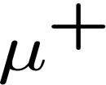



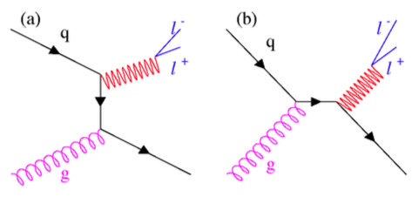
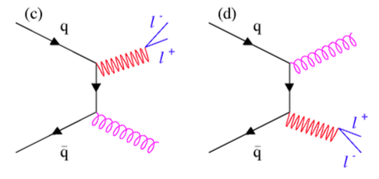
Drell-Yan cross section
QCD Compton
Gluon production
Drell-Yan is a well understood process
Convolution of beam and target PDFs
At order (α_{s}⁰) : a purely electromagnetic process
NLO (α_{s}¹) corrections are well known
NNLO (α_{s}²) corrections are also known

Slide 4
Outline
1. Meson PDFs – what do we (don’t) know about the lightest mesons
2. Nuclear PDFs – separate sea/valence, look for flavor-dependence
3. Partonic energy loss – what can we learn about it
4. Few words on the planned new DY + J/𝜓 experiment at CERN

Slide 5
Meson structure – present status of the meson PDFs

Slide 6
Hadron structure: the nucleon
Main laboratory for QCD studies
  About 4 decades of extensive investigations
  Parton distributions are (quite) well known
  Perturbative QCD works well
  Today: aim at a full multidimensional picture : GPDs, TMDs
Sharp contrast with the present knowledge on the pion and on the kaon

Slide 7
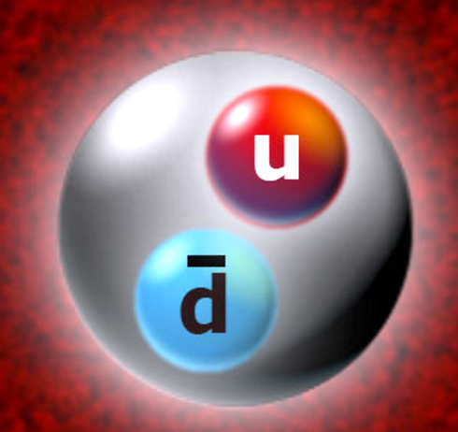
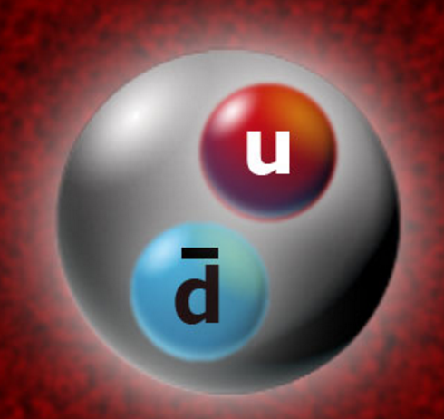
Meson structure
Double nature of the pion
  The lightest quark-antiquark pair
  Massless Nambu-Goldstone boson that acquires mass through DCSB
    Craig Roberts (in J. of Physics, 630 (2015) 012051):
    “Thus, enigmatically, the properties of the massless pion are the cleanest
    Expression of the mechanism that is responsible for almost all the visible
    mass in the universe.”
Open questions
  What is the behavior of the kaon and pion PDFs vs the PDFs in the nucleon?
  The s quark in the kaon is heavier: how is the total momentum shared?
  Are kaon and pion gluon distributions identical?
s

Slide 8
Meson structure
Progress in theory: non-perturbative QCD calculations
  Lattice QCD (LaMET), DSE, etc..
  Aim at describing the properties of the simplest hadrons
Advantages of meson beams
  There are no meson targets
  Nearly all information on the meson PDFs comes from dimuon experiments
  Mesons carry valence antiquarks
Present status
  No meson-induced dimuon data for nearly three decades !
s

Slide 9
Pion valence PDF
Data available today are three decades old !
  ~Fermilab and CERN : E331(1979), NA3(1983), NA10(1985), E537(1988), E615(1989)
Badier et al., Z.Phys. C18, 281 (1983).
Anassontzis et al., PRD38, 1377 (1988).
Conway et al., PRD 39, 92 (1989).
E = 200 GeV
E = 125 GeV
E615
Used to extract pion sea
NA3
NA10
NA3
E537
E615
The data determine only the pion valence PDF …

Slide 10
Pion valence PDF: Main “global” fits available
SMRS (NLO) 1992 GRV/S (NLO) 1992,1999
Sutton, Martin, Roberts and Stirling, PRD 45, 2349 (1992).
GRV: Z Phys C53, 651 (1992).
GRSh: Eur Phys J C10, 313 (1999).
  Mostly used pion PDF in Pythia: GRVPI 0/1
SMRS
GRV/S
Q²=20 GeV²
Global fits produce non-consistent results : 20% difference at x = 0.5 !

Slide 11

Pion valence PDF: reanalysis with NLL resummation (2010)
Aicher, Schäfer and Vogelsang, PRL 105, 252003 (2010).
New fit of E615 data
  NLO, NLL
  sea + gluons: from GRSh – 1999 ☹️
  take into account nuclear effects
  Valence PDF:
$$xvπ\left(x\right)=Nvxα(1−x)β(1+γxδ)$$
DSE
SMRS
ß=1.24
GRS
NLO + NLL
ß=2.34
  Slope at large x: Agreement with pQCD, DSE
NLL: makes the valence distribution softer at high x

Slide 12
Pion PDF at low x via DIS at HERA
Idea: scattering from the pion cloud (Sullivan, 1972):
  Pion cloud: the proton is a bare proton plus other states:
HERA (Zeus and H1)
  the proton fluctuates into a nπ⁺ state
  H1: study the process: ep → e′nX
  Detect leading neutrons
Tagged experiments at JLAB (... EIC)
☞ talk by Thia Keppel

Slide 13
Pion PDFs at low x via DIS at HERA
Main findings:
  the shape of the pion sea is quite similar
  to the one of the nucleon (solid curve)
  magnitude of the sea: ~about 1/3
  instead of expected 2/3.
  Large uncertainties on the estimate of the “pion flux”
Aaron et al., Eur. Phys. J. C68, 381 (2010)

Slide 14
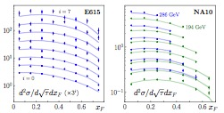
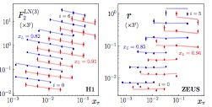
2018 global fit of pion PDFs
Method: use a MC approach
  Allows a determination of PDF uncertainties
Input data
  πA Drell-Yan data: E615 (E = 252 GeV), NA10 (E = 194 GeV) → large x
  HERA Leading neutron data → low x
Fit results
arXiv: 1804.01965
Note: NA10 data normalized by 0.816 and 0.758!

Slide 15
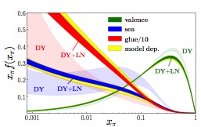
MC global fit of pion PDFs – results
arXiv: 1804.01965
Results
  Uncertainties are much reduced using DY+LN, as compared to DY alone
  Large-x behavior: ~ (1-x)¹, instead of (1-x)² as expected by QCD or DSE.
  Momentum fractions closer to SMRS-3: valence 48%, sea 17%, glue 35%.

Slide 16
Kaon structure : a single measurement from 1983
Results (NA3):
  The cross section ratio for K– and π– beams is proportional to:
  At large x, the kaon u(x) is smaller than the pion u(x)
  The heavier s quark carries a larger fraction of the kaon momentum
Badier et al, PL 93B, 355 1980.
π⁻ or K⁻ on a Pt target
NA3
NA3 data: 700 events. We need more.

Slide 17
Kaon and pion PDFs (DSE)
Chen et al., PRD 93, 074021 (2016).
DSE plot (courtesy C. Roberts)

Slide 18
Gluon PDF for kaons?
BS + DSE calculation
  Derive valence distributions, then
  incorporate sea and gluons. Evolve.
  Fit u(K)/u(π) ratio and adjust the
  gluon PDF.
Chen et al. (challenging ! ) conclusion:
  At the hadronic scale gluons carry only 5% of the momentum of the kaon BUT
  35% of the momentum of the pion !
10%
0%
5%
Chen et al., PRD 93, 074021 (2016).
Can we access the gluon distribution using J/𝜓 production?

Slide 19
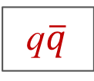
Main differences between DY and J/𝜓 production processes
Drell-Yan process
  Electromagnetic process “LO” (α_{s})⁰
  Used to extract valence and sea PDFs
  Low cross sections
  Well understood (up to NNLO)
J/𝜓 production
  Strong interaction
  Sensitive to valence and gluon PDFs
  Large cross sections (~x 30 !)
  Interpretation ?
q$\overline{q}$
gg

Slide 20


J/𝜓 production (proton beam)
Color Evaporation Model
NR-QCD
R. Vogt, Phys. Rev. C61, 035203 (2000)
gg
NRQCD
gg
CEM
q$\overline{q}$
q$\overline{q}$
Fixed targets: the production mechanism is not well understood

Slide 21
J/𝜓 – can we constrain the production models
J/𝜓 production cross section for K⁺ and K⁻
The cross section difference isolates solely the valence-valence term :
This experiment can only be done using kaon beams

Slide 22
Kaon-induced J/𝜓 production: compare K⁻ and K⁺
CEM calculations
identical val-sea and sea-sea contributions
qq
gg
gg
qq
identical gg contributions
The K⁻ − K⁺ cross section difference measures exclusively the quark valence-valence part of the J/psi production process. Only possible at CERN!

Slide 23
Nuclear effects and parton distribution functions

Slide 24
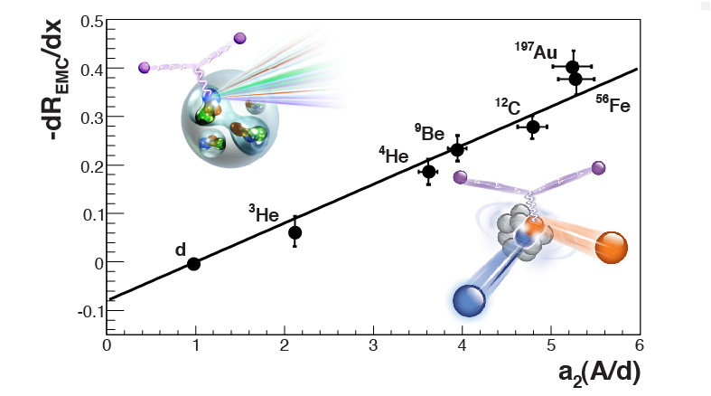
EMC effect: from 1983 to 2018
THE RATIO OF THE NUCLEON STRUCTURE FUNCTIONS F₂ FOR IRON AND DEUTERIUM
The European Muon Collaboration, Phys.Lett. 123B, 1983
Hen et al: “This implies that the EMC effect, like short range correlations, is a short-distance, high virtuality, and high density phenomenon.”
Aubert et al: “We are not aware of any published detailed prediction presently available which can explain the behavior of these data.”

Slide 25
Nuclear effects − studies using dimuon production
Separate valence and sea nuclear effects with DY (DIS doesn’t separate them)
  Pion beams : probe mainly valence quarks
  Proton beams probe mainly sea quarks
      Present data tell us something
Separate different flavors (DIS is not sensitive to the individual flavors)
  Pion (π⁻) beam : probes (preferentially) valence u quarks
  Pion (π⁺) beam : probes (preferentially) valence d quarks
  Can probe the flavor dependence of the nuclear mean field
      New experiment
Study the partonic energy loss effect
  Comparison between DY and J/psi
      Present data allow for some nice conclusions

Slide 26
Nuclear effects and parton distribution functions
- EMC effect -

Slide 27
Proton data: E772 results, 1990
Alde et al, PRL 64, 368 (1990)
Beam: protons
Targets: ²H (50 cm) C, Ca, Fe, W
Energy: 800 GeV
Statistics: total = 450 000 ev.
Goal:
    probe antiquark distribution in nuclei
C/D
Ca/D
Fe/D
”In summary, this experiment has shown almost no nuclear dependence in the production of continuum dimuon pairs....
This implies no modification of the antiquark sea in the range 0.1 – 0.3.“
W/D
x₂ region: ~0.10 – 0.30

Slide 28
Proton data: NA50 results, 2003
450 GeV/c protons
A-dependences
NA50, Alessandro et al., PLB 553, 167 (2003)
Drell-Yan
J/𝜓
𝜓’
−0.4 < ycm < 0.6
”...in our kinematical domain, the Drell–Yan cross-section scales with the number of nucleon–nucleon collisions.“

Slide 29
Proton data: E886 results, 1999
Vasiliev et al, PRL 83, 2304 (1999)
Beam: protons
Targets: Be, Fe, W (9.4% – 19% λ_{I})
Energy: 800 GeV
Statistics: total = 130 000 ev.
Goals:
    access the shadowing region
    measure parton energy loss
Fe/Be
W/Be
”Nuclear shadowing is found to be important in the small x₂ domain, where the shadowing observed in Drell-Yan has been demonstrated to be quantitatively similar to that in DIS.“
x₂ region: ~0.01 – 0.12

Slide 30
Pion data: NA10 results, 1987
Bordalo et al, PL B193, 368 (1987)
Beam: π⁻,
Targets: ²D, (120 cm), W
Energies: 140, 286 GeV
Statistics (²D): 7800 ev.
“The x₂ distribution indicates an effect (slope) quite similar in shape and magnitude to that reported by DIS experiments”
x₂ region: ~0.10 – 0.45

Slide 31
Nuclear effects from SeaQuest 2017 (preliminary!)
B. Dannowitz, PhD UIUC (2016)
Beam: protons Targets: D, C, Fe, W
Energy: 120 GeV Statistics: = 61 000 ev (~30%)
Preliminary data
x₂ region: ~0.10 – 0.50
B. Dannowitz: “This implies that perhaps the nuclear modification that leads to the DIS phenomenon known as the EMC effect is exclusively an effect of the valence quarks and does not originate from the quark sea.”

Slide 32
Summary from the available DY results
Pion data (NA3 and NA10) – probe valence quarks
  EMC region: onset of nuclear dependence observed by the two experiments. Better data are needed
Proton data (E772, E886, NA50) – probe sea quarks
  Shadowing region: DY data confirm the results of DIS (E866)
  Antishadowing: no nuclear effects observed both at Fermilab (E772) and CERN (NA50)
  EMC region: absence of nuclear effects is confirmed at high x₂ (E906)
Nuclear effects from DY - tentative summary
 | Shadowing | Antishadowing | EMC
Valence | --- | ??? | Yes
Sea | Yes | No | No

Slide 33
A-dependence studies – flavor dependence of EMC effect
Cloët, Benz and Thomas (2009):
  use nuclear matter within a covariant Nambu–Jona-Lasinio model
  look for flavour-dependence of the nuclear PDFs
    “...for N≠Z nuclei, the u and d quarks have distinct nuclear modifications. ”
Cloët, Bentz and Thomas, PRL 102, 252301 (2009)
Free nucleon PDFs: u₀, d₀
Medium modified PDFs: u_{A}, d_{A}
d_{A}/d₀
u_{A}/u₀
Standard DIS data are not sensitive to the flavour-dependence. Drell-Yan data are.

Slide 34
Flavor-dependent EMC effect – predictions for COMPASS++
Pion-induced Drell-Yan for E = 160 GeV.
Two options:
  .
  .
Dutta et al., Phys. Rev. C 83, 042201 (2011)
With flavour-dependence
Without flavour-dependence
Such measurements are part of a LoI for the CERN M2 QCD dacility

Slide 35
Nuclear effects and parton distribution functions
- Partonic energy loss -

Slide 36
Partonic energy loss in Cold Nuclear Matter
Energy loss
  Comes from the radiation of soft gluons during the scattering process
  Reduces the energy of the interacting parton: E → E - 𝜀
  Present in many hard processes
    Quarkonium production (and suppression) at all energies
    Hadron production in SIDIS
    Drell-Yan in pA and πA collisions
Drell-Yan
SIDIS

Slide 37
Partonic energy loss in Drell-Yan
Several advantages
  The Drell-Yan process is well understood
  No final-state effects
  Different beam energies = different energy losses
Experimental signatures
  Attenuation vs x_{F} (or vs x-Bjorken of the beam)
  Transverse-momentum (p_{T}) broadening
Study through the DY cross section ratio:

Slide 38
Partonic energy loss from various processes
G. Garvey and J.-C. Peng, PRL 90, 092302 (2003)
Large differences in the published values
The rate of energy loss in Cold Nuclear Matter is nearly unknown

Slide 39
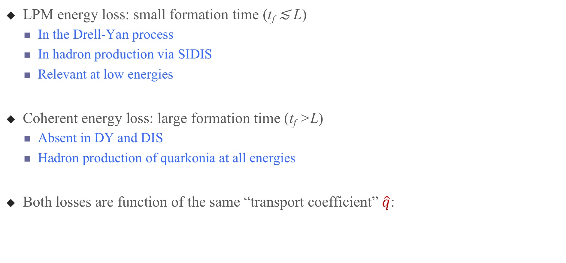
The (two) energy loss regimes
F. Arléo and S. Peigné, JHEP03, 122 (2013).
LPM energy loss: small formation time (t_{f} ≲ L)
  In the Drell-Yan process
  In hadron production via SIDIS
  Relevant at low energies
Coherent energy loss: large formation time (t_{f} >L)
  Absent in DY and DIS
  Hadron production of quarkonia at all energies
Both losses are function of the same “transport coefficient” $\hat{q}$:

Slide 40
Fitting the transport coefficient
F. Arléo and S. Peigné, JHEP03, 122 (2013).
Fit to fixed-target J/Psi production data of E866
Good agreement with NA3, NA60, HERA-B, E537
→ transport coefficient value : $\hat{q}$₀ = 0.075 GeV²/fm
E866, pA 800 GeV
NA3, πA 194 GeV
HERA-B, pA 920 GeV
fit

Slide 41
Proton data: SeaQuest, 2016 (preliminary!)
P.-J. Lin, PhD thesis, U. of Colorado (2017)
SeaQuest: hint for an energy loss effect
  E = 120 GeV
  Targets: C, Fe, W
  30% of the events
Fe/C
W/C
Preliminary data
Different x_{F}-slopes for Fe and W
Nice signal for possible energy loss effect

Slide 42

Calculation for the (preliminary!) Drell-Yan E906 data
Use transport coefficient $\hat{q}$₀ = 0.075 GeV²/fm (0.07 – 0.09)
Use CT14 proton PDF and EPPS16 nuclear PDFs
F. Arléo, C.-J. Naïm, SP, in preparation
Fe/C
W/C
Nuclear PDF only
Energy loss only
Preliminary data

Slide 43
Predictions for the forthcoming DY COMPASS data
F. Arléo, C.-J. Naïm, SP, in preparation
Pion-induced Drell-Yan at 190 GeV
R_{π}(W/NH₃)
R_{π}(W/NH₃)
x_{F}
x₂

Slide 44
Future prospects:
Meson PDFs
  New π-DY data: determine valence and sea distributions in the pion using π+ and π− beams
  New π-J/𝜓 data: study pion-induced production to infer pion valence and gluon distributions
  DY data with kaon beam: determine the kaon valence distribution
  J/𝜓 with kaon beam: study the J/𝜓 production mechanism + map-out the kaon valence distribution
Nuclear PDFs
  DY data are sensitive to the valence quark nPDFs in the target
  DY data can study the flavor dependence of the nuclear mean field
  DY data give allows for detailed studies of the partonic energy loss
  CERN M2 beamline with a COMPASS-like experiment is unique for such measurements
☞ talk by Vincent Andrieux (Wed)

Slide 45
  And… an advertisement
  for a new experiment

Slide 46
CERN accelerator complex
COMPASS
Notes:
COMPASS is located in the CERN “North area”, and uses as a primary beam the proton beam, as extracted from the SPS. Competition with the LHC. The primary proton beam is sent on a production target. Several secondary beams are available:

Slide 47
Why do dimuon experiments at CERN
CERN + “COMPASS”-like experiment: only place in the world with
  1) mesons beams (pions, kaons) ; also proton and antiproton beams
  2) positive or negative beam charge
  3) large and uniform acceptance (and there are planned improvements...)
  4) R&D for a new RF-separated beam line with unprecedented kaon/antiproton intensities
Only (in)-direct competition:
  J-PARC: up to 15 GeV
  SeaQuest at Fermilab: 120 GeV proton beam only (probe antiquarks)
  Panda: antiprotons with low energies
Unique features

Slide 48
A New QCD facility at the M2 beam line of the CERN SPS
A Letter of Intent with several ideas for new studies has been written. It is a contribution to the CERN-initiated “Physics Beyond Colliders” program
      New: The LoI was just released in as a DRAFT: arXiv: 1808.00848
  Dedicated web page: https://nqf-m2.web.cern.ch/
New ideas/contributions from people outside COMPASS more than appreciated
Looking ahead for new collaborators to take part in the preparation of the proposal, which is to be finalized for the fall 2019.

