Slide 1



T-Matrix Approach to QGP
Ralf Rapp
Cyclotron Institute +
Dept of Phys & Astro
Texas A&M University
College Station, TX, USA
ECT* Workshop on
Quark Gluon Plasma Characterization with Heavy-Flavor Probes
Trento (Italy) / hybrid, Nov. 15-18, 2021

Slide 2
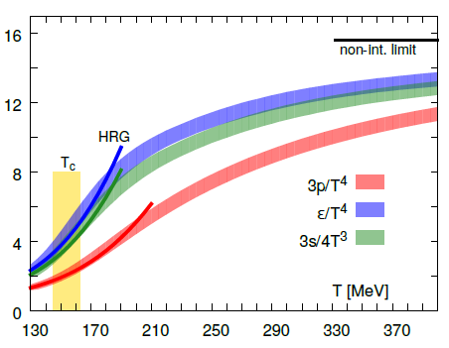
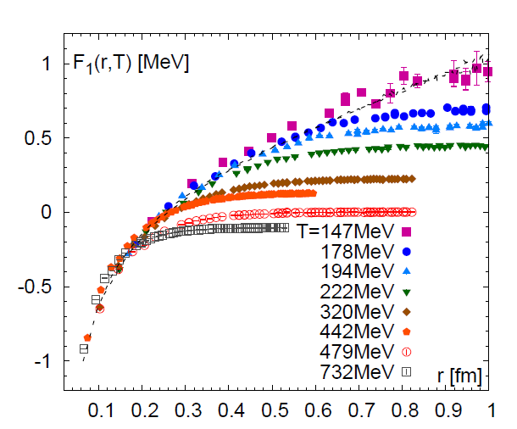
1.) QCD Matter and In-Medium Force
Equation of State Heavy-Quark Free Energy
μ_{Β} = 0
[GeV]
[Bazavov
et al ’13,’14]
F_{QQ} = U_{QQ} – T S_{QQ}
Non-perturbative above T_{c}
Change in dofs above T ~ 170MeV
- - -
Heavy-quark diffusion sensitive to long-range forces in medium,
probing the non-perturbative structure of the QGP

Slide 3
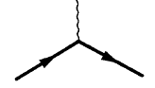
Heavy-Flavor Probe of the QGP
QGP: quantum liquid with transport coefficients
near conjectured lower bounds
Microscopic calculation of transport coefficients should
obey quantum-lower bounds
Description of bulk medium through which heavy quarks
propagate should encode strong-coupling properties
→ transports coefficients: (4p)h/s, D_{s}(2pT), s_{el}/T
Large scattering rates → large collisional widths
→ broad spectral functions → off-shell effects (quantum) effects
Q
QGP
Q

Slide 4
Outline
1.) Introduction
2.) T-Matrix Approach + Potential
● Dyson Schwinger Equations
● In-Medium Potential + Lattice QCD
3.) Bulk Medium + Heavy Flavor
● EoS + Spectral Functions
● Heavy- + Light-Flavor Transport
4.) Conclusions

Slide 5
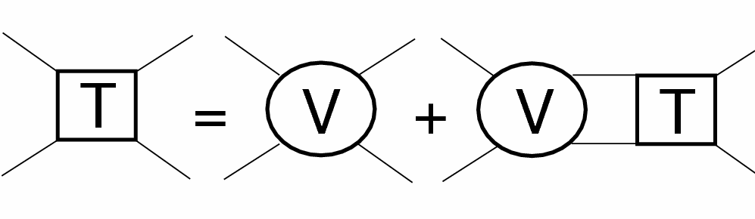
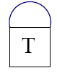
2.1 Thermodynamic T-Matrix in QGP
Scattering
equation
i=Q
j=Q,q,g
Born approximation (weak coupling): T_{ij} ≈ V_{ij}
Strong coupling → resummation: T_{ij} = V_{ij} + ∫ V_{ij} D_{i} D_{j} T_{ij}
Dyson equation: D_{i} = 1 / [ω – ω_{k} –Σ_{i}(ω,k)]
Parton self-energies → self-consistency:
Vacuum: Cornell potential → HQ spectroscopy
In-medium potential V?
j=q,g
Σ_{i}
=
ij
[van Hees, Mannarelli, Cabrera,
Riek, He, Liu,Tang+RR, since ’04]

Slide 6
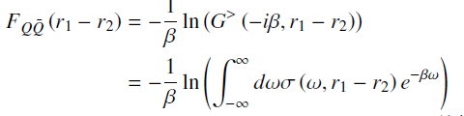


2.2 Potential Extraction from Lattice Data
Free energy ≠ potential: F_{QQ} = U_{QQ} – T S_{QQ}
−
Free energy from QQ spectral function:
In-Medium potential:
Self-consistently calculate self-energies to fit lattice-QCD data for F_{QQ}
For small Σ_{I} : F → V

Slide 7
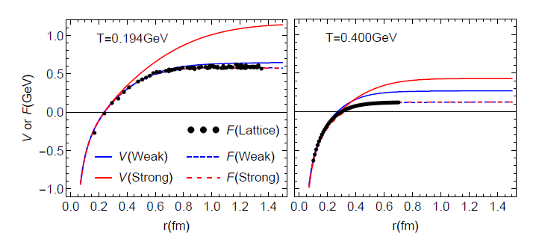
2.3 In-Medium Potential from Lattice Data
Two types of solutions:
weakly coupled scenario (WCS) vs. strongly coupled scenario (SCS)
WCS: potential close to free energy F, Γ_{Q} = 2Σ_{I} ~ 0.1 GeV
SCS: remnants of confining force, Γ_{Q} ~ 0.6 GeV
Quantum effects + self-consistency limit coupling strength

Slide 8


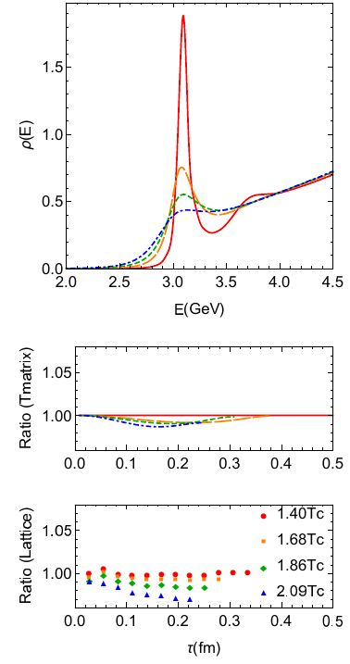
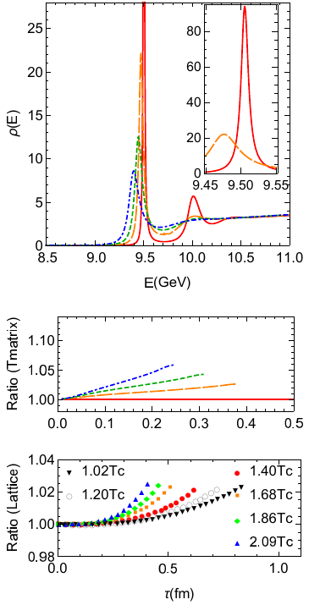
2.4 LQCD Constraints II: Euclidean Correlators
Charmonium Bottomonium
[Liu et al ’18]
[Aarts et al ’18]
J/y melts near T~ 300 MeV
ϒ(1S) survives until T > 400 MeV

Slide 9
Outline
1.) Introduction
2.) T-Matrix Approach + Potential
● Dyson Schwinger Equations
● In-Medium Potential + Lattice QCD
3.) Bulk Medium + Heavy Flavor
● EoS + Spectral Functions
● Heavy- + Light-Flavor Transport
4.) Conclusions

Slide 10
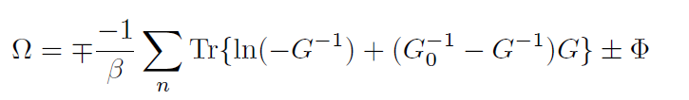
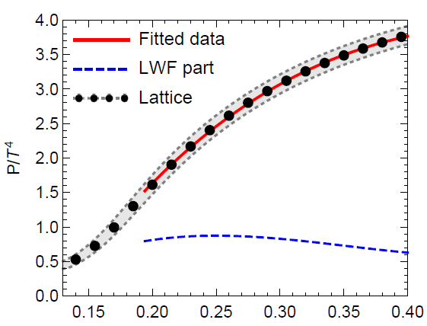
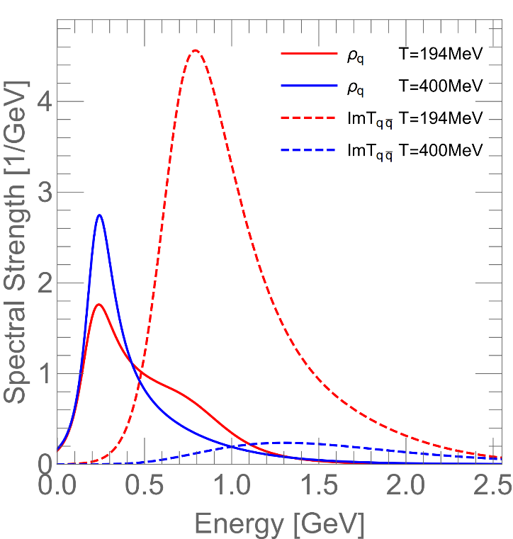
3.1 QGP Equation of State + Spectral Functions
Thermodynamic potential
with self-consistent SFs
EoS Quark + “Meson” SFs
Fit “bare” quark + gluon masses (m_{q,g} ~ 0.5, 1 GeV)
Near T_{c} quantum effects melt partons, broad hadronic states emerge
Embed heavy-quark/onium transport in strongly-coupled bulk
[S.Liu+RR ’16]

Slide 11
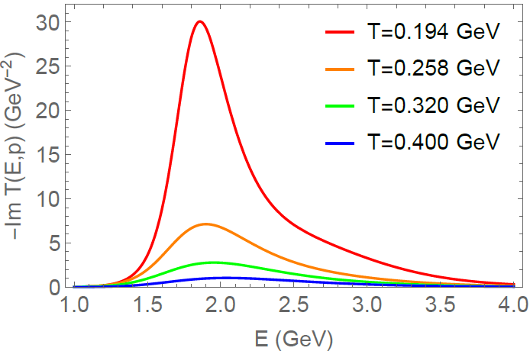
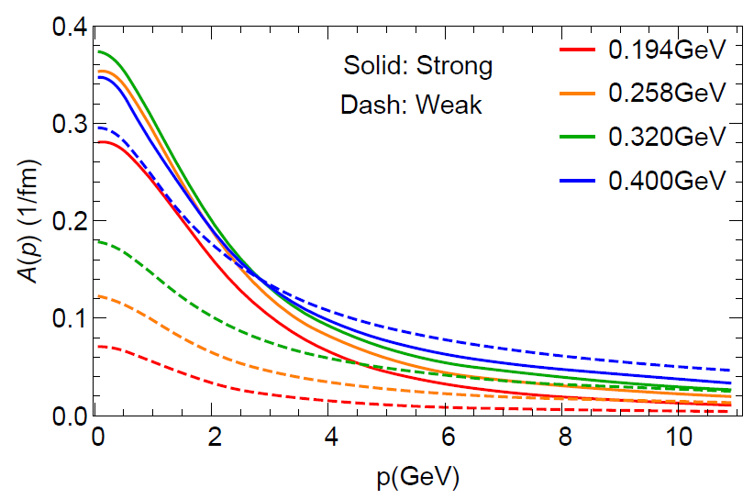
3.2 Charm-Quark Scattering in QGP
Charm-Light Quark T-Matrix Thermal Relaxation Rate
Broad D-mesons emerge near T_{pc} (~ vacuum mass)
Resonant interactions compensate decreasing parton density
Off-shell effects essential to access bound-state strength
q
QGP
q’
p
p’
A(p)
[Liu,He+RR ’19]

Slide 12
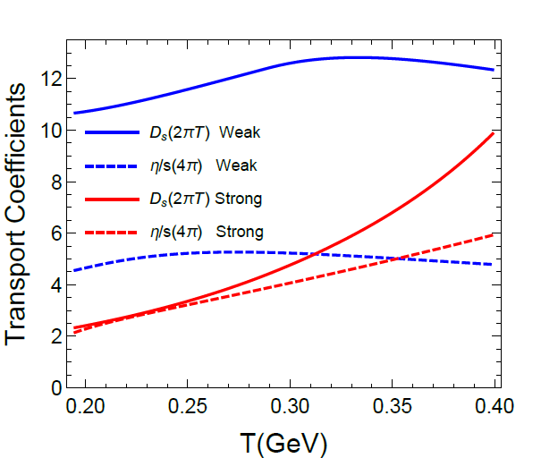
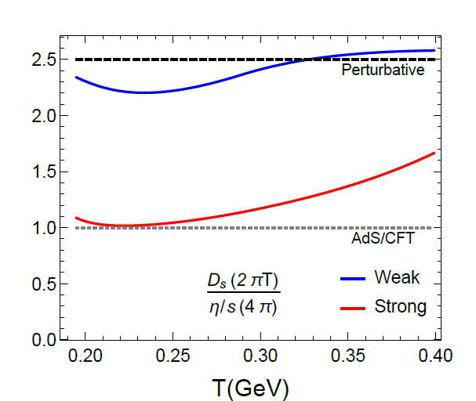
3.3 Heavy-Flavor vs. Bulk Transport
Heavy-Quark Diffusion vs. Shear Viscosity
Strongly coupled: (2πT) D_{s} ~ (4π) η/s
Perturbative: (2πT) D_{s} ~ 5/2 (4π) η/s
Transition as T increases
[Liu+RR ‘19]

Slide 13
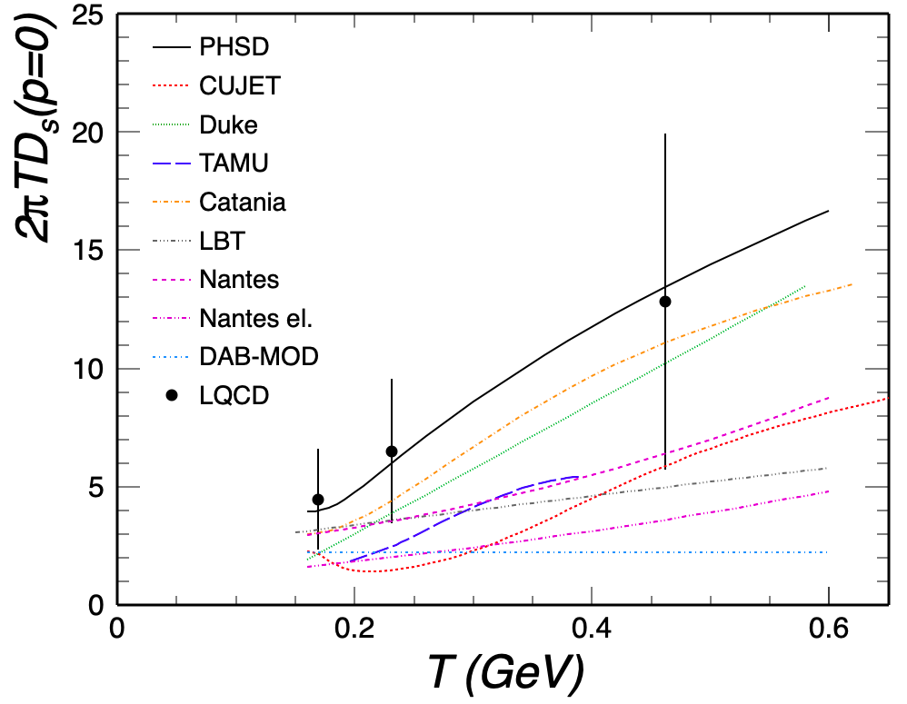
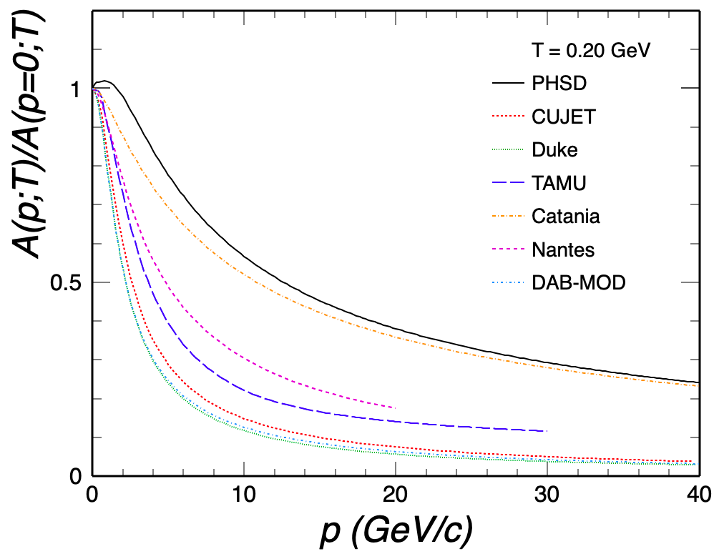
3.4 Momentum Dependence of Relaxation Rate
[ECT* HF workshop ’21 ]
correlation: large D_{s} ↔ weak p-dependence
need handle on momentum dependence

Slide 14
4.) Summary
Thermodynamic T-matrix approach to QGP rooted in lattice QCD
(HQ free energy, quarkonium correlation fcts., EoS)
Quantum effects through broad spectral fcts. (large coll. rates), manifest in:
-- Heavy quarkonia: large Γ_{coll} ↔ strong potential (self-consistency)
-- EoS: parton melting, transition to hadronic resonances
-- HQ transport: access strength in near-threshold resonances
Explicit connections between transport coefficients
→ ratio may quantify notion of “strongly coupled”

Slide 15

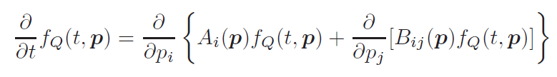
2.2 Transport Approaches
Boltzmann equation for HQ phase-space distribution f_{Q}
Collision term: semiclassical simulation of medium + HQ quasi-particles
Fokker-Planck equation
follows from Boltzmann with p² ~ m_{Q} T >> q² ~ T²
does not require quasi-particle medium
well suited for strongly coupled medium where E_{th} ~ Γ_{q,Q} < m_{Q}

Slide 16
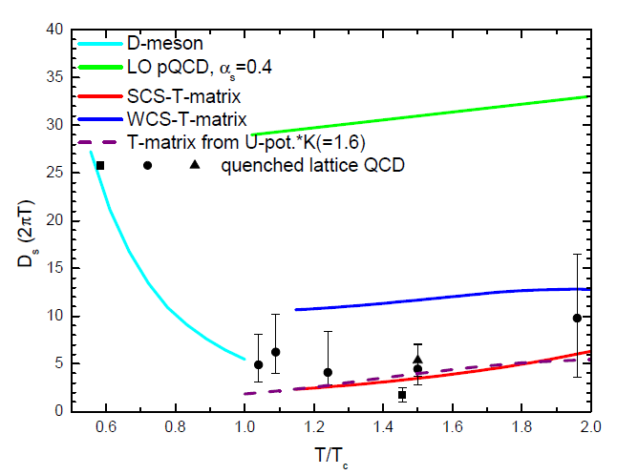
4.2.3 Spatial Charm-Quark Diffusion Coefficient
D_{s} =T / [m_{Q} Α(p=0)]
EMMI RRTF ‘18
Τ/Τ_{c}
suggests D_{s}(2πT) ~ 2-4 near T_{pc}
width: Γ_{c} ~ 3 / D_{s} ~ 1 GeV − no light quasi-particles!

Slide 17

2.3 Transport Coefficients
Fokker-
Planck
Q
thermalization rate momentum diffusion coefficient
g p = ∫ d³q w_{Q}(q,p) q
~ ∫ |T_{Qj}|² (1-cosq) f ^{j}
D_{p} = ∫ d³q w_{Q}(q,p) q²
thermal relaxation time: τ_{Q} = 1/γ
Einstein relation: T = D_{p} / γ m_{Q}
spatial diffusion constant: D_{s} = T / γ m_{Q}
Key ingredients: - heavy-light scattering amplitude T_{Qj}
- thermal-medium partons in f ^{j}

Slide 18
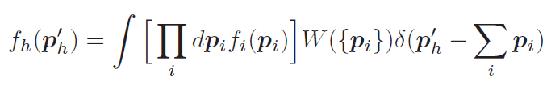

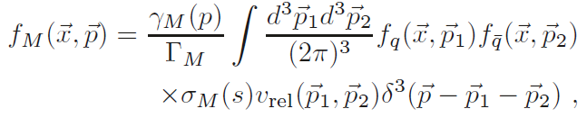
3.4 Heavy-Quark Recombination
Instantaneous Coalescence Models (ICMs)
projection on hadron WF, σ ~ radius parameter
- energy not conserved → challenge for chemical + thermal equilibrium
Resonance Recombination Model (RRM)
- derived from Boltzmann equation
σ_{Μ} (s) v_{rel} ~ |T_{Qj} |² : resonant heavy-light scattering amplitude
→ connects to T-matrix interactions in QGP near T_{c}
→ satisfies equilibrium limits (resonance masses)
[Hwa ‘80, Likhoded et al ‘83, …
Greco et al + Fries et al ‘03,…]
[Ravagli et al ‘07, He et al ‘12]

Slide 19
3.3 QGP Medium Models: Light Partons
→ essential for quantitative evaluation of transport coefficients, e.g.:
Massless quarks and gluons (over-estimates equation of state)
Perturbative quasiparticles (m_{q,g} ~ gT, over-estimates EoS for T < 1.5T_{c})
Effective quasiparticles (m_{q,g} ~ gT with g large near T_{c})
Dynamical quasiparticles (moderate widths Γ_{g,q} ~ 100-200 MeV)
T-matrix approach (large widths, no quasiparticles near T_{c})

Slide 20
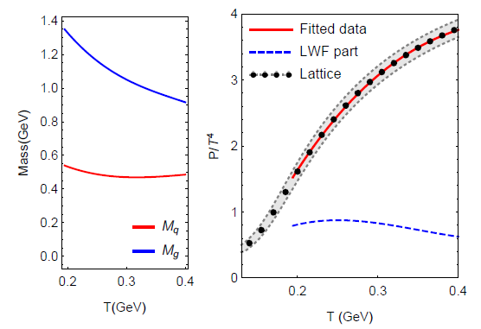
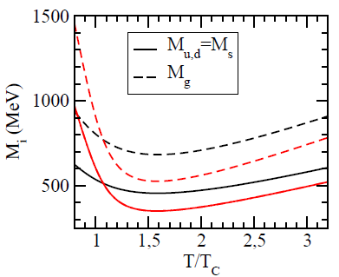
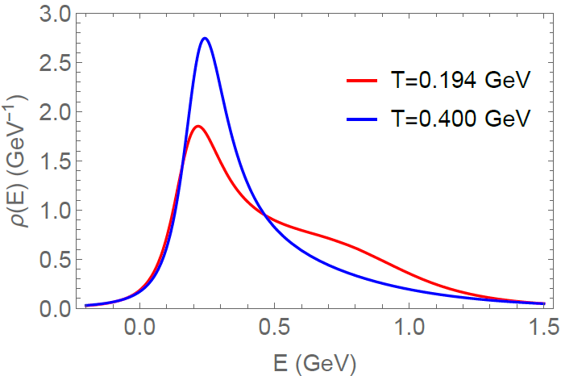
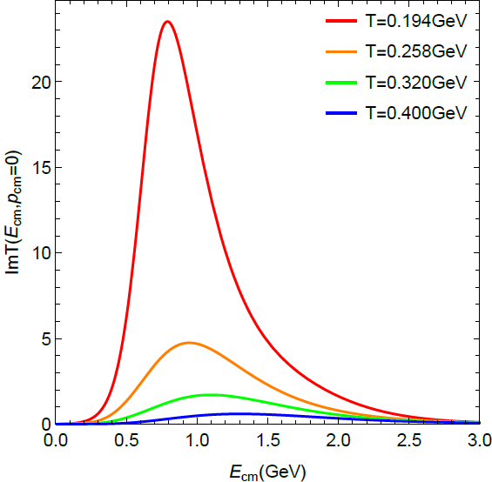
3.3.2 QGP Medium Properties: Light Partons
Effective Quasiparticle Model T-Matrix Approach
g(T)
[MeV]
Quark SF
Im T_{qq}
[Plumari
et al ‘11]
Large coupling / masses near T_{c}
Near T_{c}, partons “melt”,
hadronic bound states emerge

Slide 21



3.1 QGP Equation of State + Spectral Functions
Thermodynamic
Potential
Selfconsistent SFs
Lutttinger-Ward
Functional
G = G₀ + G₀S G
S = GT
T = V + VGGT
n,n
Full off-shell resummed Luttinger-Ward functional (!)
→ accounts for dynamically emerging hadronic resonances near T_{pc}
Fit “bare” quark + gluon masses (m_{q,g} ~ 0.5, 1 GeV)

Slide 22


4.) Hadronization of Heavy Quarks
Fragmentation
c → D, D*, D_{s}, Λ_{c}, …
determined by empirical fragmentation functions D_{c→Hc}(z) ;
universal in “vacuum”: e⁺e⁻ collisions or high p_{T}
Coalescence / Recombination
c + q (s) → D (D_{s}), D*,… ; c + q + q (s) → Λ_{c} (Ξ_{c}), …
depends on environment (phase space of surrounding anti-/quarks)
-- instantaneous coalescence (based on spatial wave functions)
-- resonance recombination (momentum space)

Slide 23
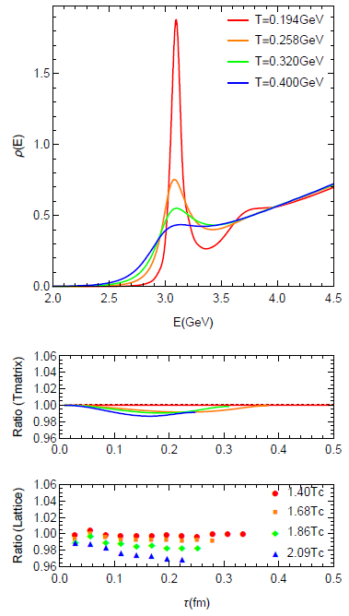
1.4 Quarkonia in Medium
potential V(r,T) → binding energy E_{B}(p,T)
Dissociation rate → width G(p,T,E_{B})
How do heavy quarks
within quarkonia interact
with the medium?
Quarkonium spectral functions
Constraints from lattice-QCD:
Euclidean-time correlators
QGP
Q
−
Q
→ Simpler problem: one heavy quark!

Slide 24
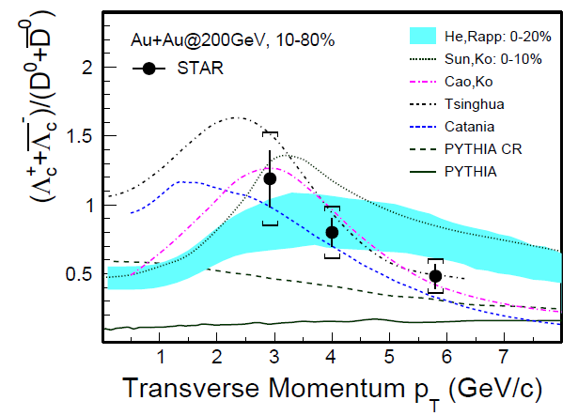
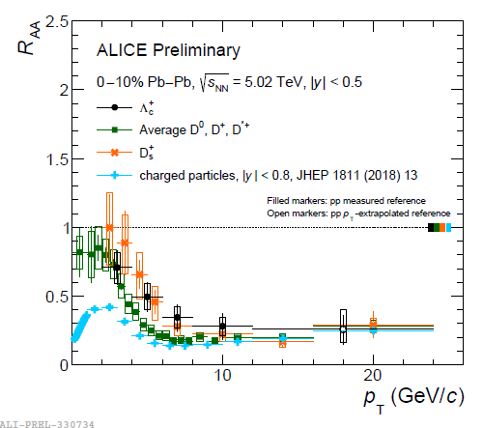
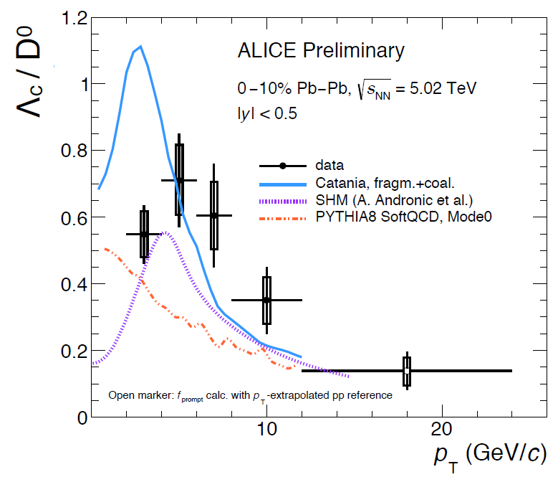
4.5 Heavy-Flavor Hadro-Chemistry
D, D_{s} and L_{c}
Distinct pattern up to p_{T} ~ 10 GeV
D_{s} strangeness-enhanced!?
Λ_{c} coalescence enhanced!?
Importance of low-p_{T} limit

Slide 25
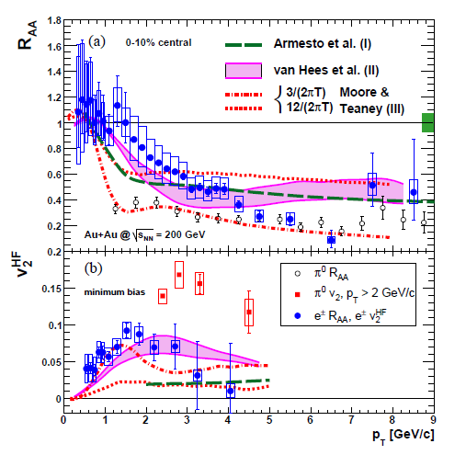
5.2 The v₂ – R_{AA} Correlation Story
Heavy-Flavor Electrons [PHENIX ’07]
Challenge: Large elliptic flow but not too large suppression in R_{AA}
→ better met by non-perturbative than perturbative interactions
[van Hees et al ’05] [Moore+Teaney ’05, Armesto et al ‘05]

Slide 26
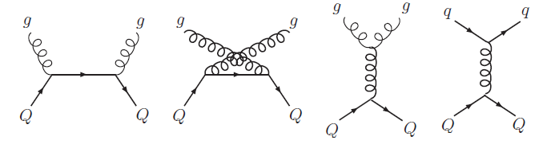

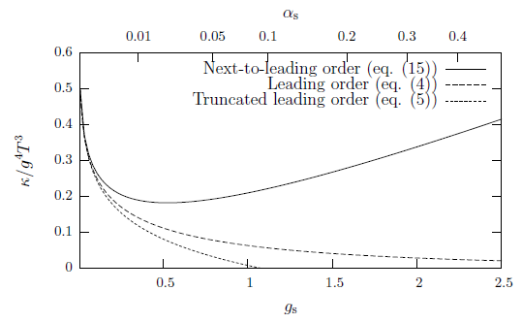
3.1 Perturbative QCD Approaches
Leading Order
screened 1-gluon exchange
2
dominated by forward scattering
long thermalization time: τ_{c} ≥ 20 fm/c (T≤ 300MeV, α_{s}=0.4)
[Svetitsky ’88, Mustafa et al ’98, Molnar et al ’04, Zhang et al ’04,
Teaney+Moore’04, Gossiaux et al ‘08, Greco et al, PHSD, …]
Next-to-Leading Order
bad convergence behavior
(even for α_{s} ~ 0.1)
genuine non-perturbative effects?
g m_{Q}/T²
[Caron-Huot+Moore ‘08]

Slide 27
2.1 Heavy-Flavor Transport in Heavy-Ion Collisions
0 0.5 5 10
| | | |
τ [fm/c]
D
c
initial cond.
(nPDFs, …),
pre-equil. fields
c-quark diffusion
in QGP liquid
c-quark
hadronization
D-meson
diffusion in
hadron liquid
no “discontinuities” in interaction
⇒ diffusion near T_{pc} ↔ hadronization
[Moore+Teaney ‘05, van Hees et al ‘05, Gossiaux et al ‘08, Vitev et al ‘08, Das et al ‘09, Uphoff et al ’10,
M.He et al ‘11, Beraudo et al ‘11, Cao et al ’13, Bratkovskaya et al ‘14, Liao et al ‘17, Katz et al ‘19,…]

